Slide 1
Nondestructive Evaluation of Fracture Properties in Irradiated Light Water Reactor Pressure Vessel Steels
James J. Wall, PhD (Joe)
Nuclear Nondestructive Evaluation (NDE)
Electric Power Research Institute
Elliot J. Long
Materials Reliability Program (MRP)
Electric Power Research Institute
Nuclear Science User Facilities (NSUF) Annual Program Review
May 11 – May 13, 2026

Slide 2
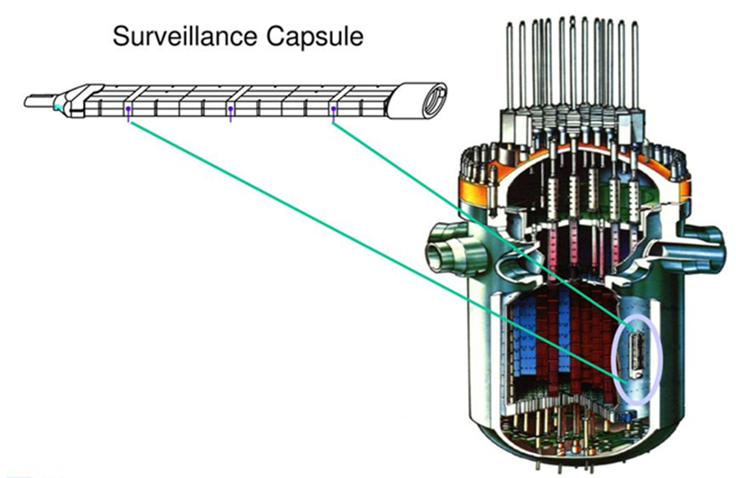
NDE Property Assessment in Surveillance Samples
Project Objective & Scope
The objective is to determine if nondestructive evaluation (NDE) methods can be used to assess fracture properties in RPV steels
  Destructive testing of RPV surveillance samples is costly samples are running out
  Surveillance samples at Westinghouse are being characterized using NDE
Completed and & Upcoming Work
DOE NSUF is funding access and technical support for the Westinghouse hot cell NDE experiments.
A DOE NEUP proposal for the GA Tech work (nonlinear ultrasonic testing) was not funded.
EPRI Obtained permission from Southern Co. and Constellation to assess Farley units 1 and 2 and Ginna forging surveillance samples, respectively.
Ultrasonic measurements (absorption, attenuation and velocity) were made in 2025.
Magnetic measurements (3MA) scheduled for 2026.
Deliverables and Collaboration
Technical Report
Conference Presentations
Support / Collaboration
  Internal EPRI collaboration between NDE and MRP groups
  Utility collaboration with Southern Co. and Constellation
  External collaboration with The Aerospace Corporation, Fraunhofer IZFP and Westinghouse (NSUF User Facility)
  NSUF Funding was allocated for the Westinghouse contribution

Slide 3
Experimental – Surveillance Samples of Interest

Slide 4
Ultrasonic Measurement Campaign (Absorption, Attenuation, Velocity)
- The ultrasonic measurements were performed at the Westinghouse hot cell laboratory
- The ultrasonic data is being analyzed currently, and the report is expected in Q2, 2026

Slide 5
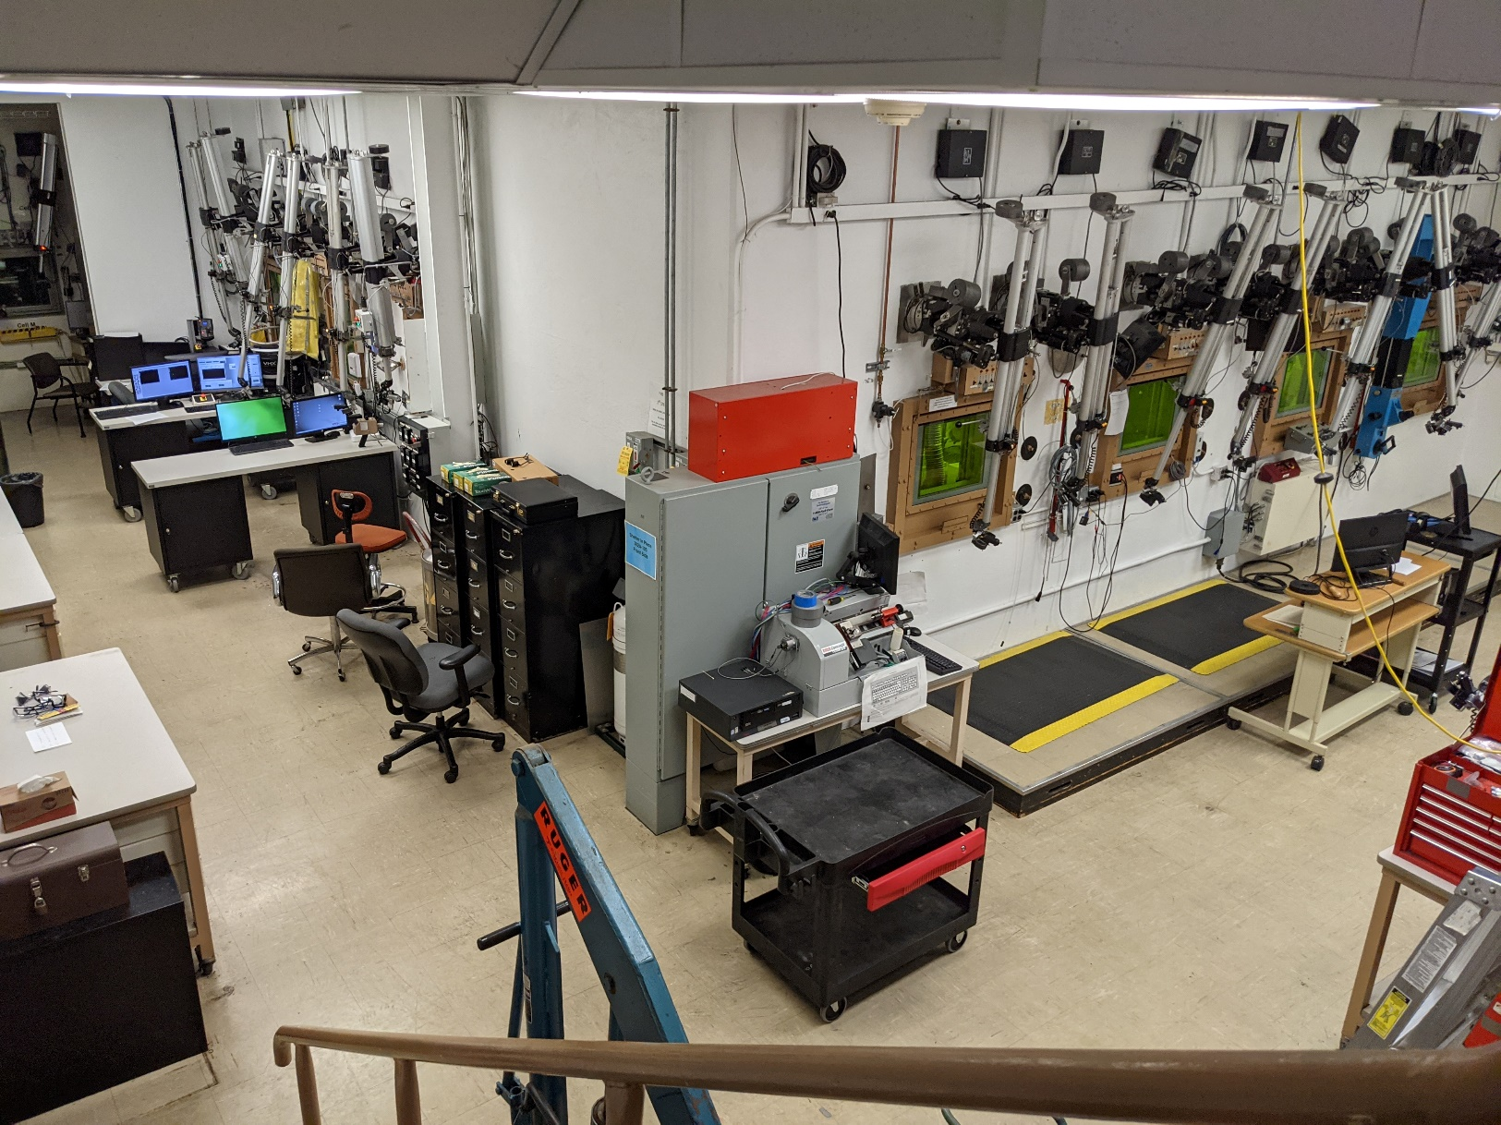
Hot Cell Work (Westinghouse Hot Cell Lab in Churchill, PA)
Remote manipulator arms used for work inside hot cell

Slide 6
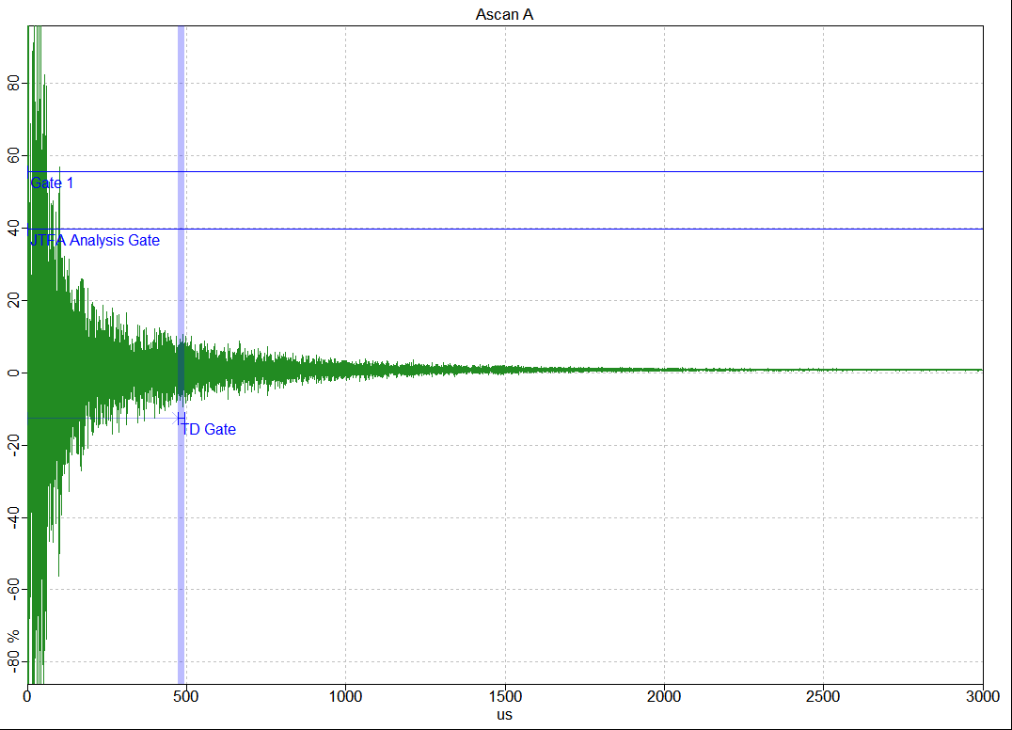
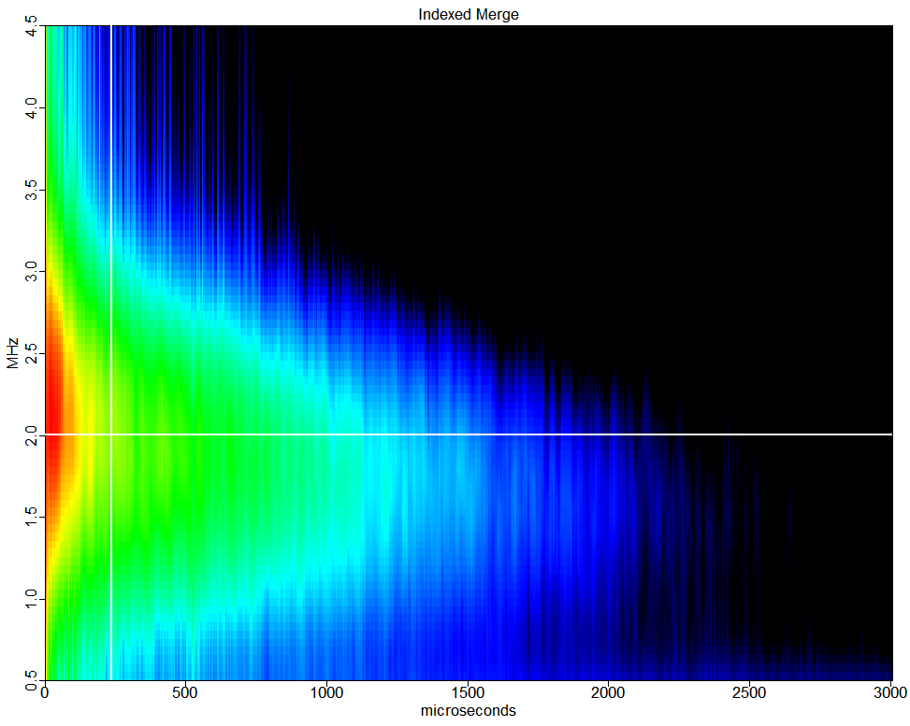

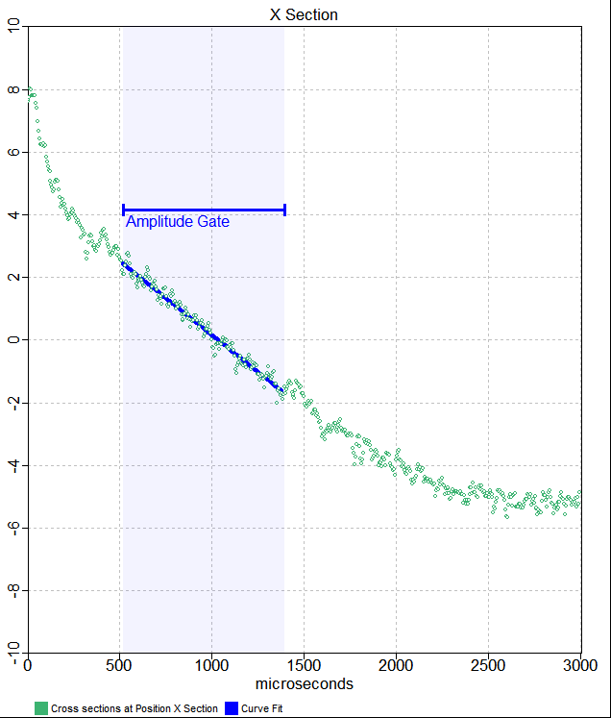
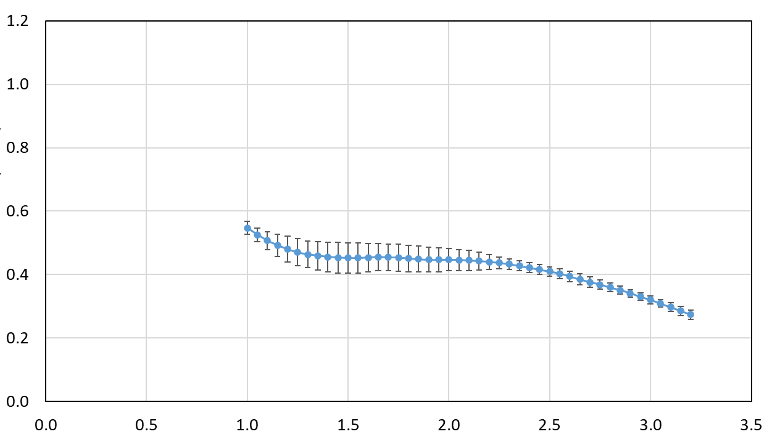



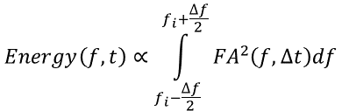

UT Diffuse Field Internal Friction Measurement and Analysis
RF Waveform
Joint time frequency analysis
$$Energy\left(f,t\right)∝\int_{f_{i}−\frac{∆f}{2}}^{f_{i}+\frac{∆f}{2}}{{FA}^{2}\left(f,∆t\right)df}$$
Voltage
f (MHz)
Δt
3 ms
Sensitivity (intrinsic properties)
Dislocation motion
Movement of atoms
Point defect motion
  Vacancies
  Interstitials
Magnetic transformation
Grain boundary relaxation
1 MHz
High
t (μs)
Low
Energy vs time (semi-log)
t (μs)
Internal friction vs. frequency
$$Energy(f_{i},t)=A_{i}e^{−σ\left(f_{i}\right)t}$$
$$Q^{−1}\left(f\right)=\frac{σ(f)}{2πf}$$
$$\ln\left(Energy(f_{i},t)\right)$$
$$Q^{−1}$$
t (μs)
f (MHz)
Notes:
316 Precision Data Side\JTFA Onsite 316-0-1_g60_av128_1.sdt

Slide 7
Ultrasonic absorption results: Fairly Unit 2 Plate B7212 Transverse – All Samples
Unirradiated (2 halves)
Unirradiated
Unirradiated

Slide 8
Ultrasonic absorption results: Fairly Unit 2 Plate B7212 Transverse – All Samples
Unirradiated (2 halves)
Unirradiated
Unirradiated

Slide 9
Ultrasonic absorption results: Fairly Unit 2 Plate B7212 Transverse – Percent Change from Unirradiated Sample
Unirradiated (2 halves)
Unirradiated
Unirradiated

Slide 10
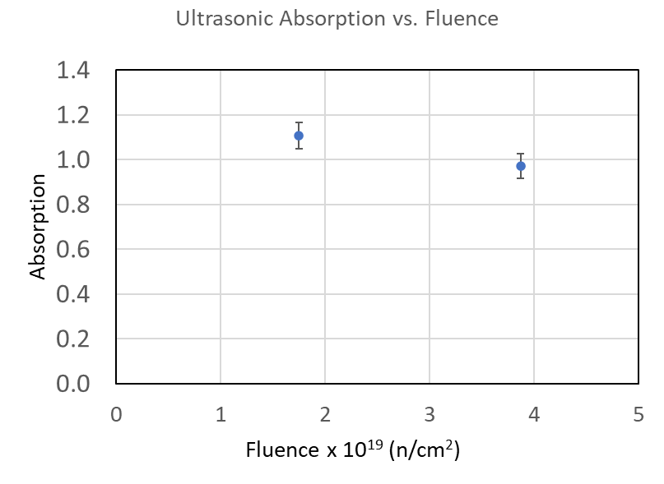
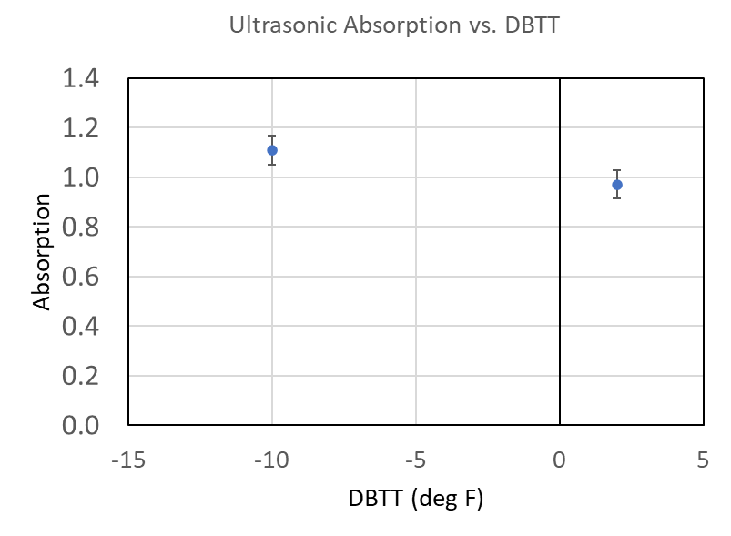
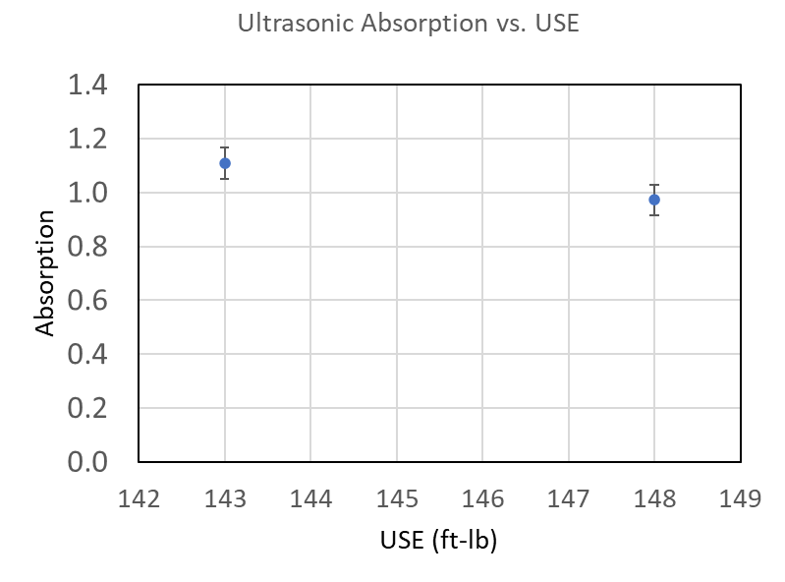
Ultrasonic Absorption Results: Ginna Unit 1 Forging 125P666 – Partial Sample Set

Slide 11
Magnetic Multiparameter Measurement Campaign (3MA)
- A contract with Fraunhofer IZFP (Germany) is being negotiated currently
A custom made probe with a 20 week lead time will be designed and fabricated
-The 3MA measurements will be performed at Westinghouse in Q4, 2026
- 3MA magnetic property data will be analyzed in Q4, 2026

Slide 12
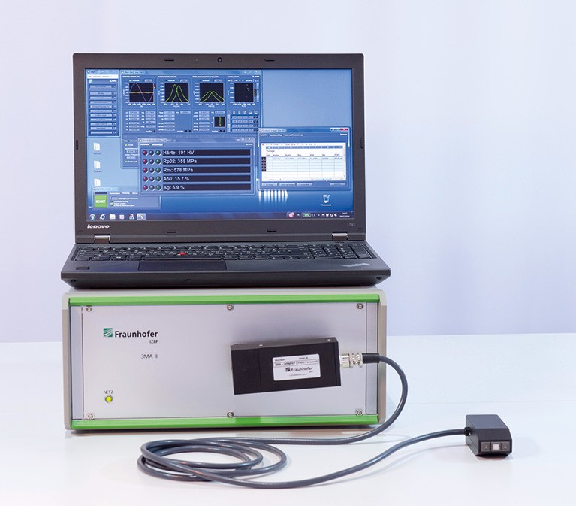
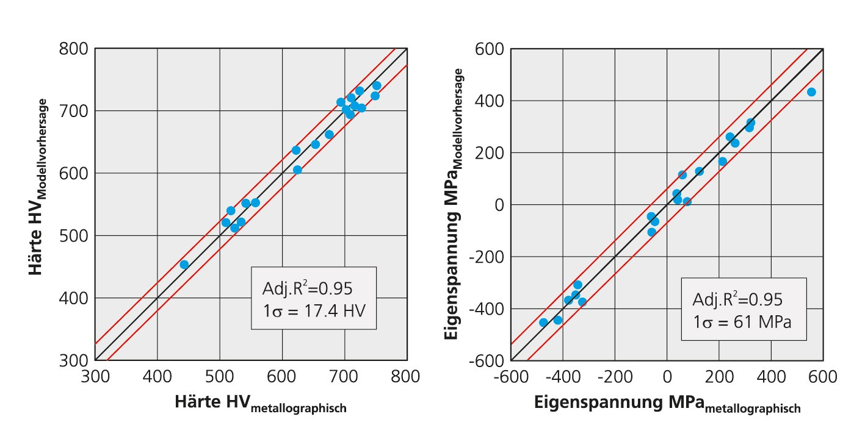
Experimental: 3MA Magnetic Testing – Hardness and Residual Stresses Examples
Image shows a 3MA magnetic NDE system. Left plot shows Vickers microhardness measured using 3MA (y-axis) and using a diamond indenter (x-axis). Right plot shows yield strength measured using 3MA (y-axis) and destructively measured (x-axis).

Slide 13
Ultrasonic Measurement Campaign (Absorption, Attenuation, Velocity)
-The UT absorption data has been partially analyzed.
-UT absorption data for surveillance samples from the Farley Unit 2 plate and one of the Ginna forgings was presented here.
The data from Farley Unit 2 plate and one of the Ginna forgings did not show a clear correlation of absorption as a function of fluence, DBTT or USE.
-Absorption data analysis is ongoing.
-The analyzed UT attenuation and velocity data will be available in Q2, 2026.
Magnetic Measurement Campaign (3MA)
-3MA is a multiparameter magnetic NDE method that has been shown to be sensitive to radiation damage in RPV steel.
-3MA was developed several years ago at Fraunhofer IZFP in Saarbrueken, Germany.
-3MA measurements on the samples will be conducted at the Westinghouse Churchill site hot cell laboratory in Q4, 2026.
-Joe Wall (NDE Lead) conducted a site visit at Fraunhofer IZFP in Q4 2025 to assess The 3MA method and discuss how to apply it in the Westinghouse hot cells.
-A contract between EPRI and Fraunhofer to perform 3MA testing is in progress.

