Slide 1
May 13, 2026
INL/CON-26-92424
Kevin Tsai
Nuclear Engineer
Temperature Effects of
Rhodium Self-Powered Neutron Detectors in a Gamma Field

Slide 2
Research Scope
Objectives:
Test self-powered neutron detectors (SPND) operating in high-temperature environments with demonstration through heated gamma irradiations
SPND Overview
1.5–2mm OD mineral insulated metal sheathed cable design
  Robust design compatible with high-temperature operation
“Self-powered” – passively generate electric current proportional to radiation field strength based on emitter choice.
Conceptual SPND design overview

Slide 3
Background—Self-Powered Neutron Detector
Two primary types of operation based on dominant emitter-neutron interaction
  Slow-response based on (n, β⁻)—Rh, V, Ag
  Prompt-response based on (n, γ, e_{ce}) and (n, γ, e_{pe})—Co, Hf, Pt(γ)
Interaction | # of Interactions | Time-response
(n, β⁻) | Single | Delayed
(n, e_{ic}) | Single | Delayed
(γ, e_{ce}) | Single | Prompt
(γ, e_{pe}) | Single | Prompt
(n, γ), (γ, e_{ce}) | Two | Prompt
(n, γ), (γ, e_{pe}) | Two | Prompt
Interaction in an SPND that results in an ejected electron
Cross-sectional view of an SPND
H. D. Warren, "Calculational Model for Self-Powered Neutron Detector," Nuclear Science and Engineering, vol. 48, no. 3, pp. 331-342, 2017, doi: 10.13182/nse72-a22491.

Slide 4
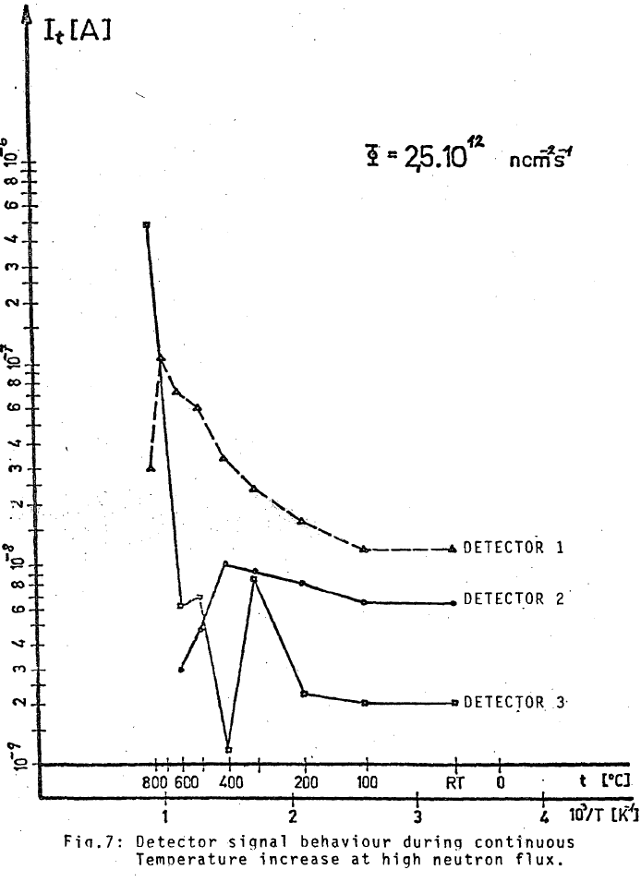
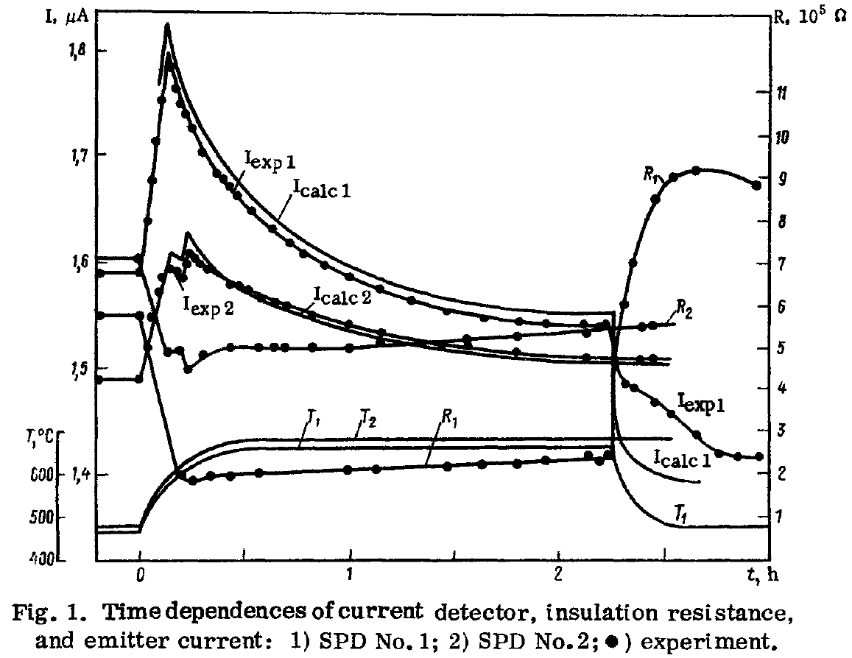
Background—Historical Experiments
Historical tests performed 1976 and 1980 identified “irregularities”
M. G. Mitel'man, A. A. Kononovich, V. M. Osipov, and N. D. Rozenblyum, "Effect of temperature on characteristic of self-powered detectors," Soviet Atomic Energy, vol. 48, no. 4, pp. 263-266, 1980/04/01 1980, doi: 10.1007/BF01146664.
J. Ziebermayr and H. Böck, "High Temperature Incore Tests of Selfpowered Neutron Detectors," in "4. European conference of TRIGA users," Vienna, Austria, INIS-AT--09N0002, 28-39 Sept 1976. [Online]. Available: https://inis.iaea.org/records/1mgfw-nac38.

Slide 5
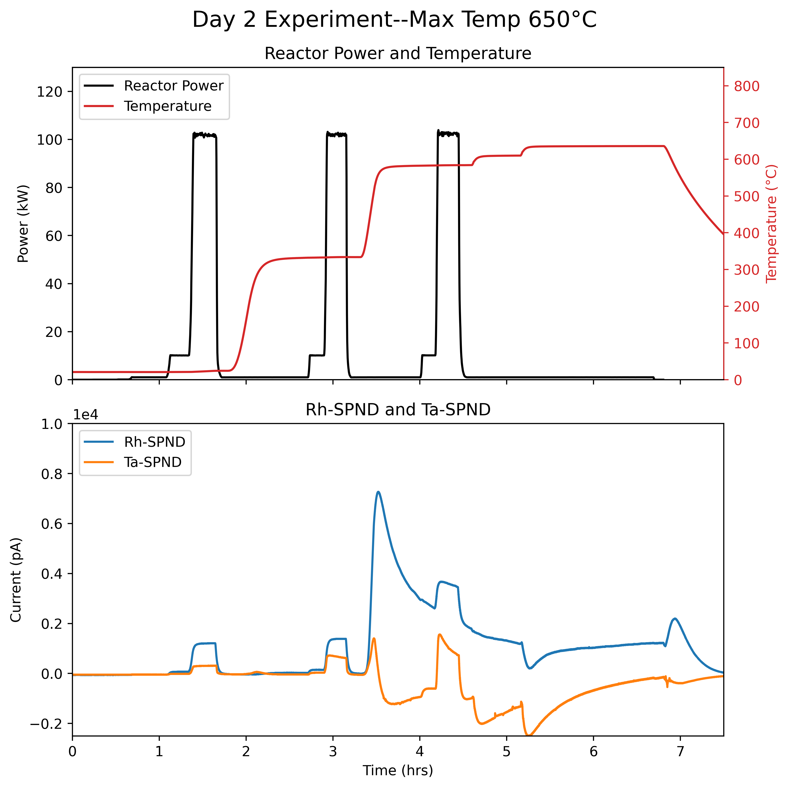
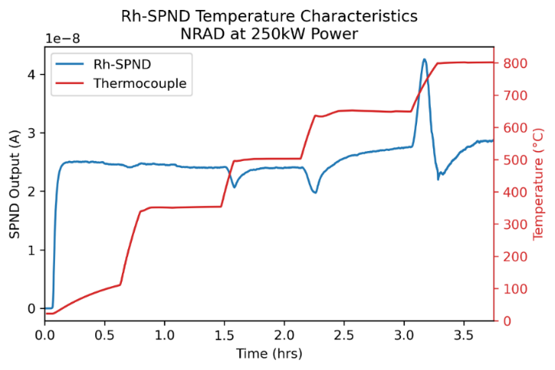
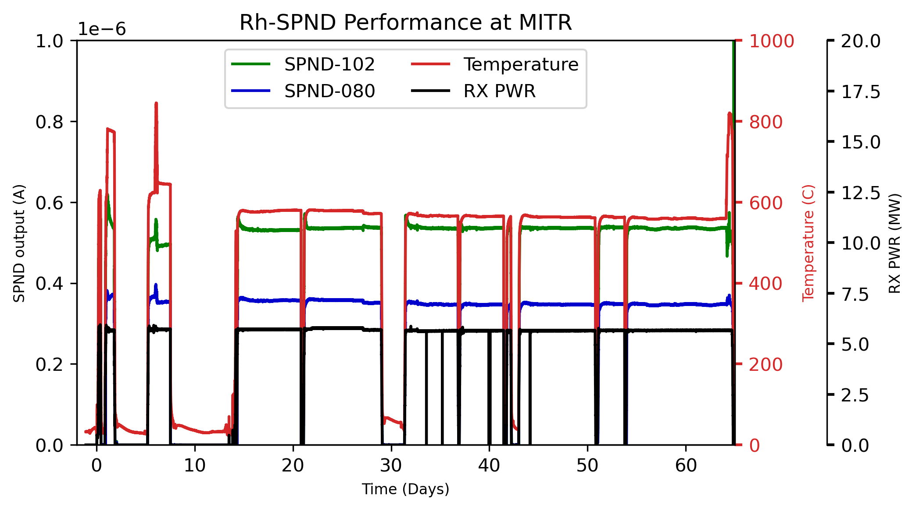
Background—Recent Experiments
High-temperature testing of Rh-SPNDs were performed in multiple reactors in past years.
Temperature effects first observed at NRAD (starting at 350°C)
Demonstrated capability to still track power at MITR (above 550°C)
First test with two different types of SPNDs at OSURR (up to 750°C)
  Gamma-induced electrons are most affected by temperature

Slide 6
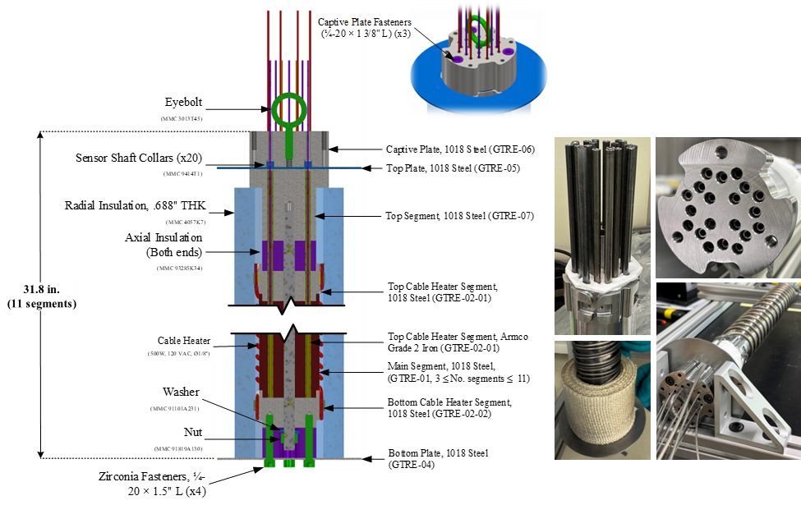
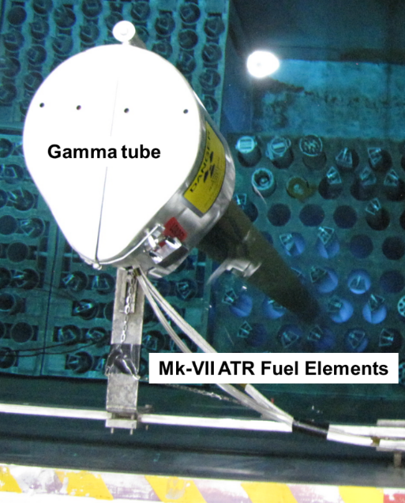
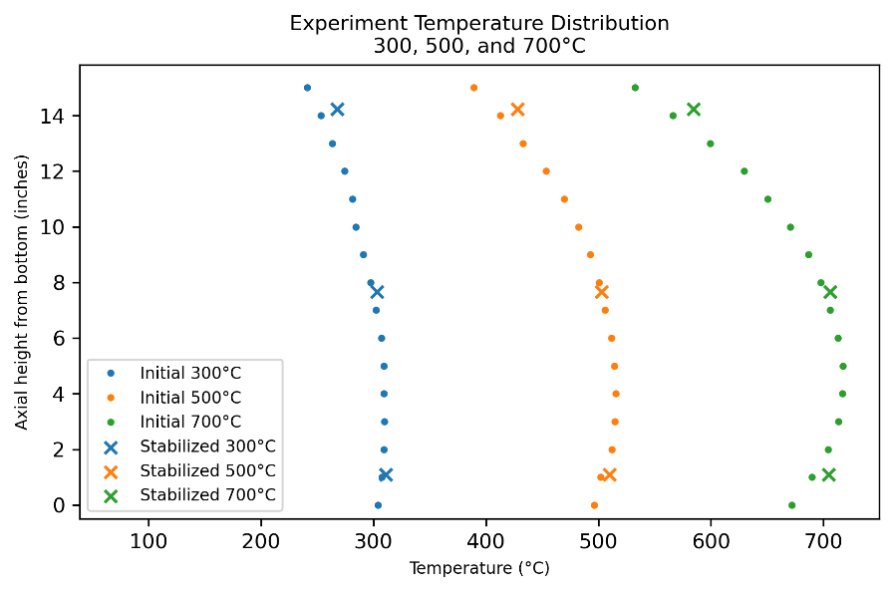
NSUF RTE—ATR Gamma Facility Test
Gamma Irradiation funded through NSUF Rapid Turnaround Experiment – ATR Canal (2 months)
Experiment uses a TQD design without the retractable sensor component
Rh-SPND and Dummy (MIC) placed at three different height positions.
  Al2O3 vs MgO insulation

Slide 7
NSUF RTE—ATR Gamma Facility Test
Test plan includes:
Multiple 100°C step increases up to 700°C
Single-step increases to target temperature, so that each target temperature increased by 50 ° C per test up to 750°C
Temperature changes near 500°C
  500–550°C
  400–600°C
Change heating rates to 600°C
  Ambient to 600°C
  400–600°C.

Slide 8
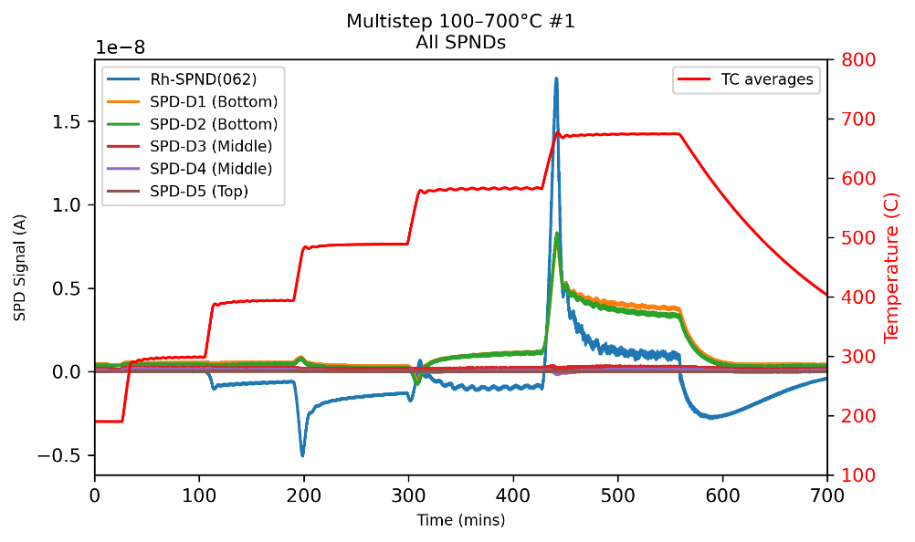
NSUF RTE—ATR Gamma Facility Test
Multiple 100°C step increases up to 700°C
  Repeatable across 4 days at the start of the test, the end of the test, and after removal
  Magnitude decreases at end and further decreases after removal

Slide 9
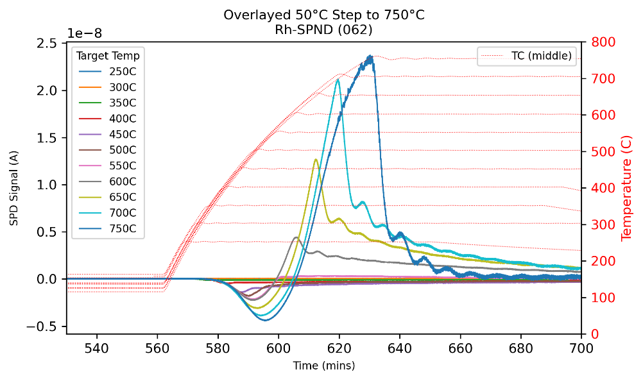
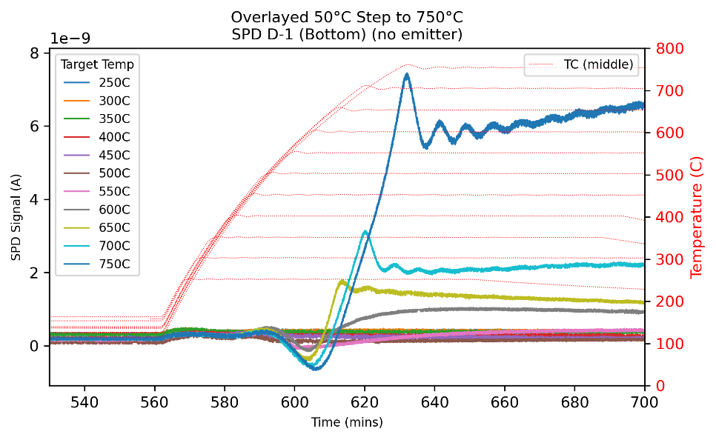
NSUF RTE—ATR Gamma Facility Test
Multiple 100°C step increases up to 700°C
  Different “displacement current” attributed to different insulation material
  Each displacement current’s peak is limited by a certain temperature

Slide 10
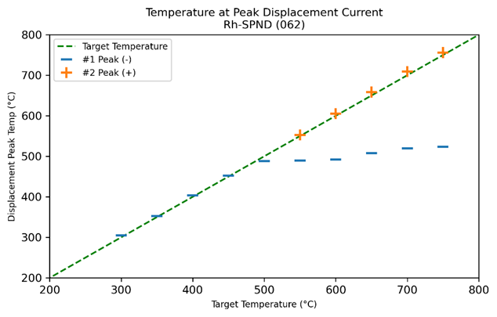
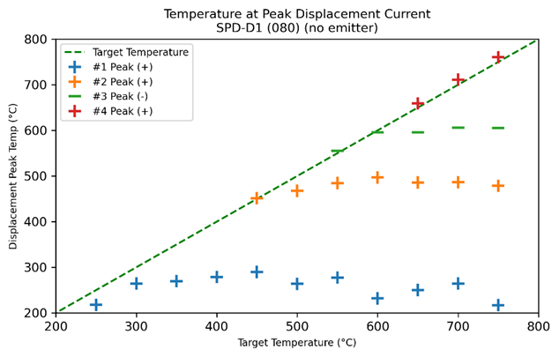
NSUF RTE—ATR Gamma Facility Test
Displacement peak maxima is dependent on insulation material.
  The cause of different polarities remain unknown
  Past theories assumes a shift in “space charge” with changing temperature
    trapped/release electron
    Multiple peaks is better described by thermoluminescence dosimetry type behavior
Rh-SPND with Al2O3
SPND Dummy with MgO

Slide 11
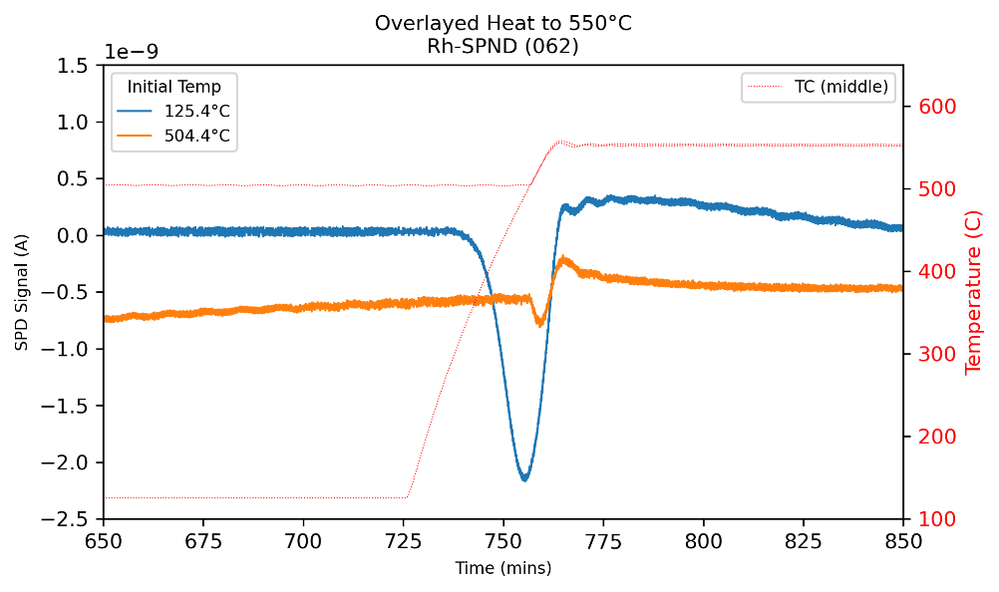
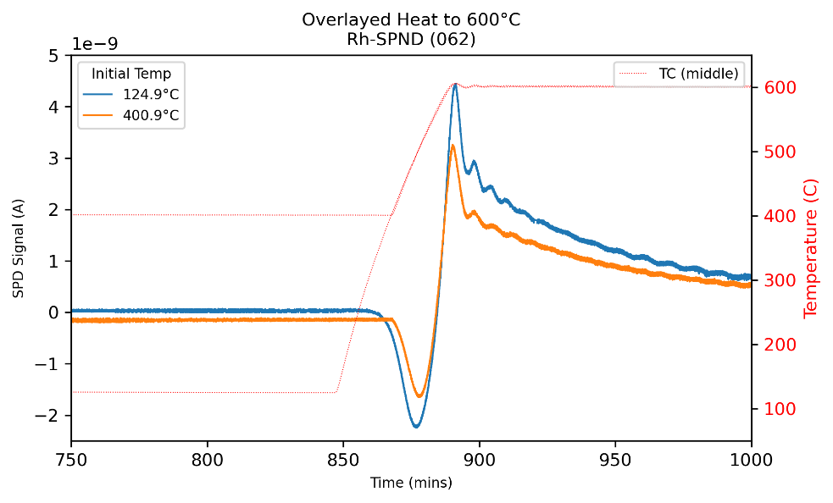
NSUF RTE—ATR Gamma Facility Test
Temperature changes near 500°C for the MgO Rh-SPND
  Temperature for peaks are still consistent regardless of starting and ending temperature

Slide 12
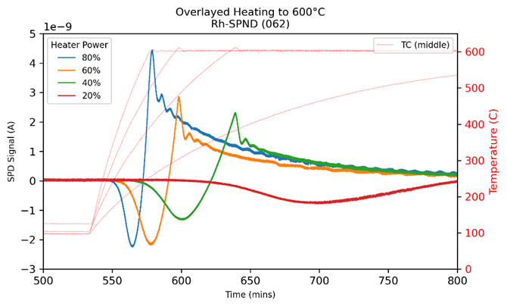
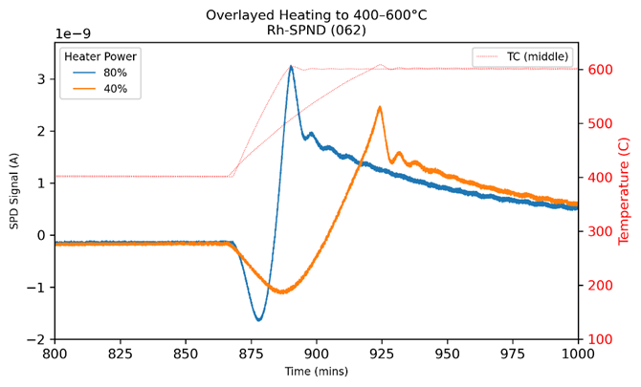
NSUF RTE—ATR Gamma Facility Test
Heating rates to 600°C with from ambient and from 400°C for MgO Rh-SPND
  Temperature for peaks are still consistent regardless of starting and ending temperature

Slide 13
Conclusion
In general, the behavior observed during the gamma irradiation is representative of reactor experiments.
  The individual displacement currents are material dependent. The preliminary estimated energy levels for each trapped peaks are approximately (based on temperature peak approximation):
    MgO: 1.7eV
    Al2O3: 1.1, 1.6, and 1.9eV
  Geometry can be a factor in magnitude, but will need further study
  Higher fidelity modeling is underway to better analyze the behavior

Slide 14
Acknowledgements
Thank you NSUF for the opportunity to perform this work
Experiment Team:
  Austin Fleming, Devin Imholte, Geran Call, and Matthew Arrowood
ATR Gamma Facility and Radiation Measurement Lab Personnel:
  Matthew Horkley, Kyle Ray, Joe Shaw, Michael Reichenberger, Dani Ottaway, and Kelly McCary for their coordination and escort into the facility.

