Slide 1
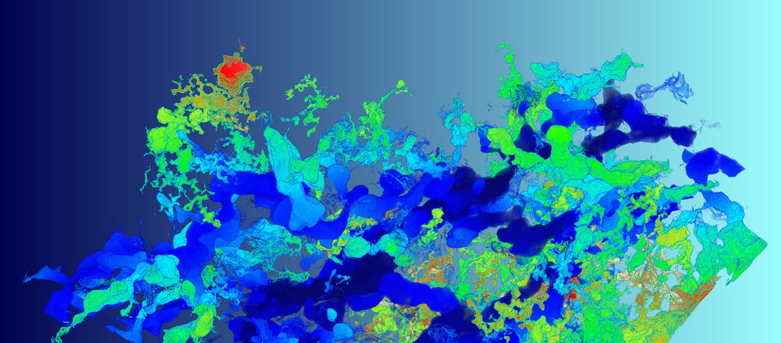

May 12, 2026
Cameron Howard
PIE Research Scientist
In Situ Irradiation of Spent Nuclear Fuels
Fuel and Cladding Materials

Slide 2
Outline
Background & Motivation
In-situ TEM Re-Irradiation
  Fission Product Evolution
  Grain Evolution
Conclusions
Publications

Slide 3
Background & Motivation

Slide 4
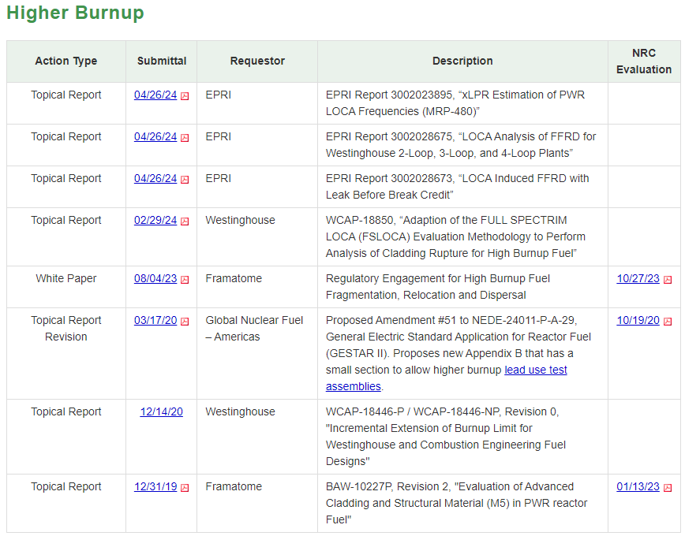
Motivation
Enhance scientific understanding of mechanisms leading to high burnup structure (HBS).
Develop experimentally validated computational capabilities to predict microstructural evolution.
Increase allowable burnup limit of UO₂ in commercial nuclear power plants.
62 GWd/MTU → 75-80 GWd/MTU
Longer reactor cycles/less refueling
Purchase fewer fuel assemblies
https://www.nrc.gov/reactors/power/atf/licensing-activities/licensing-actions.html#burnup
RIL 2021-13, “Interpretation of Research on Fuel Fragmentation, Relocation, and Dispersal (FFRD) at High Burnup.”

Slide 5
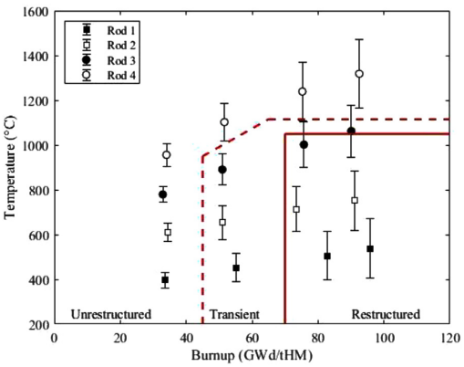
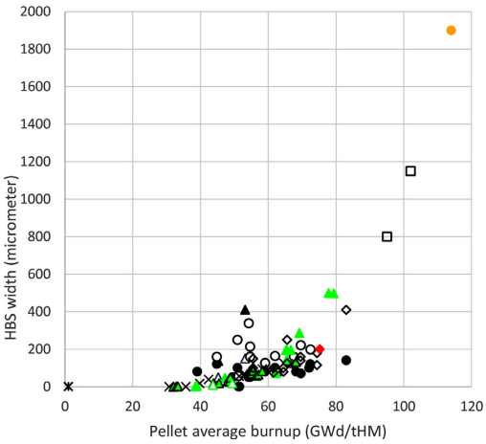
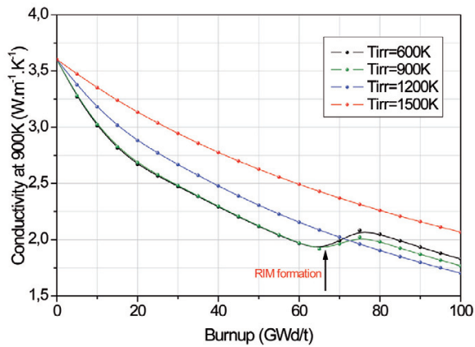
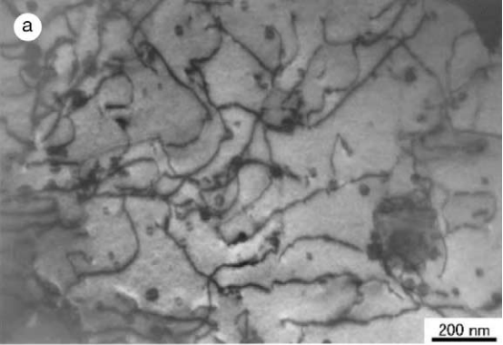
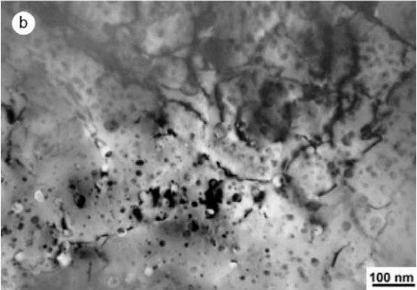
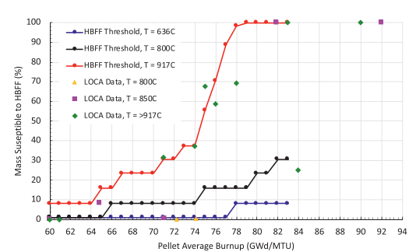
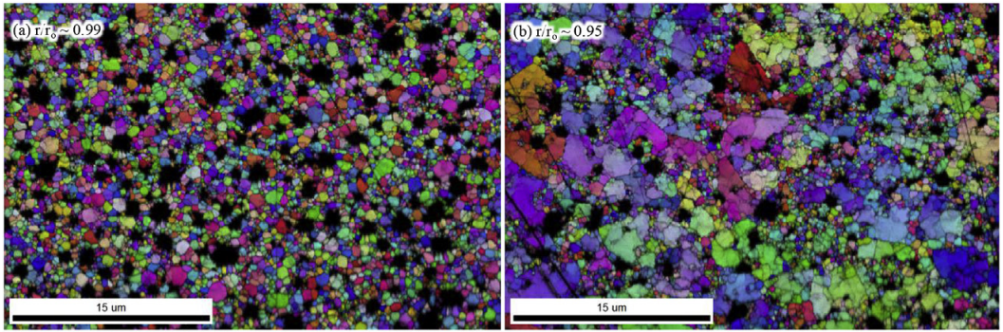
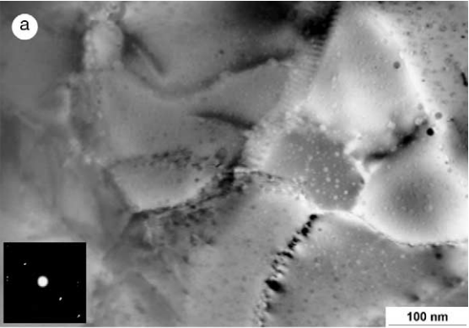
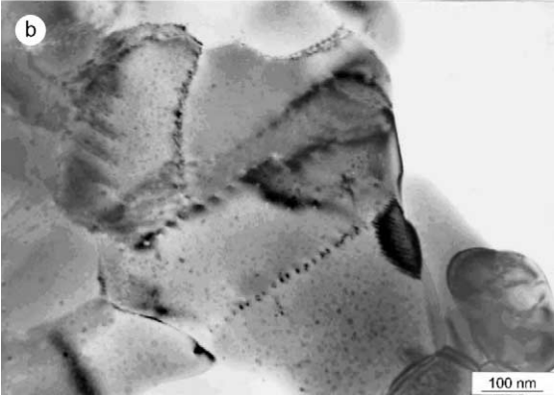
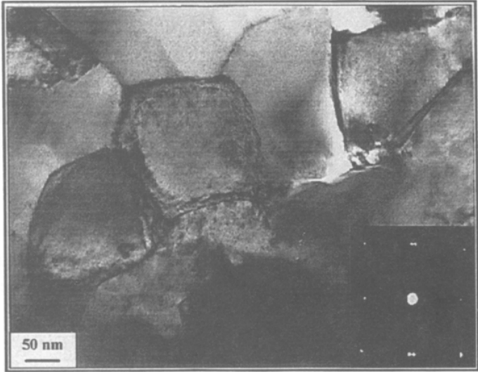
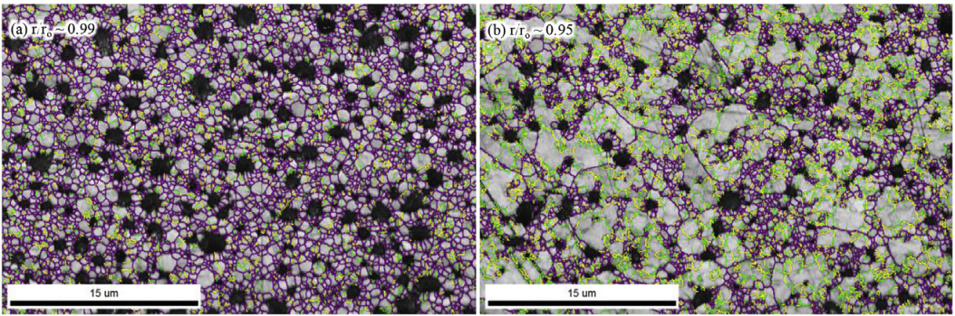
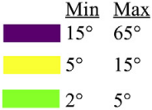
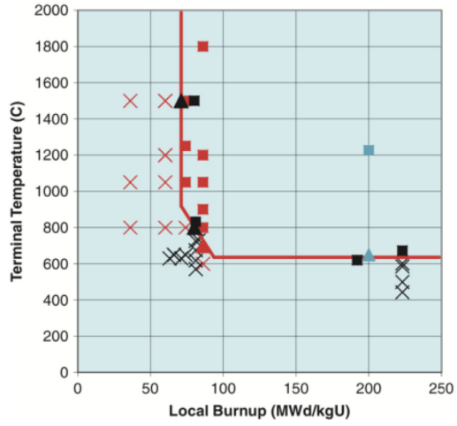
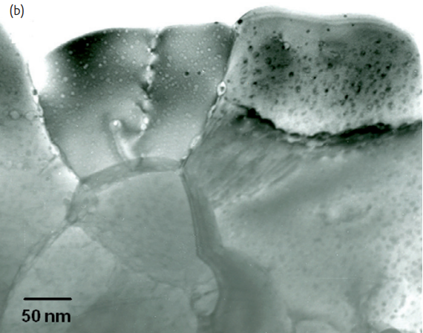
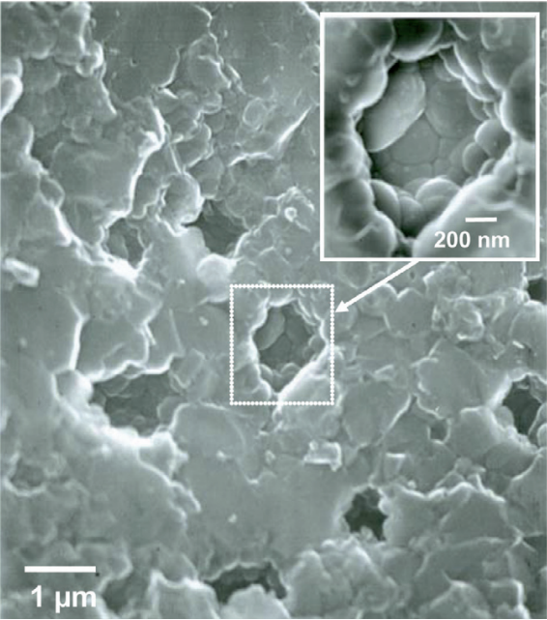
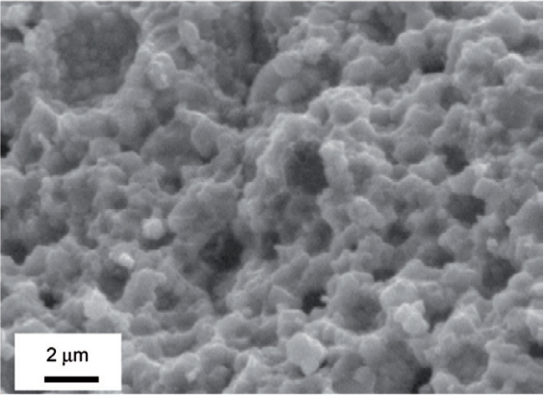
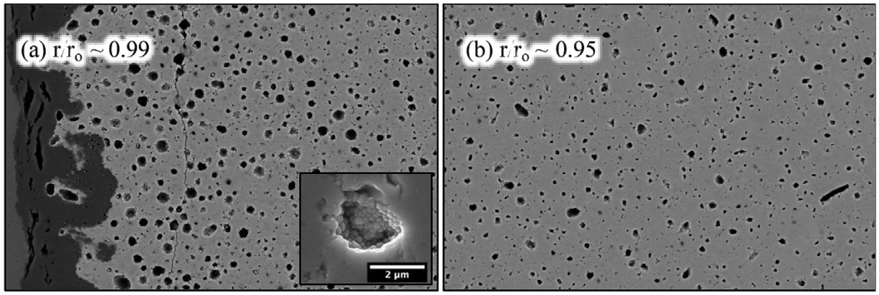
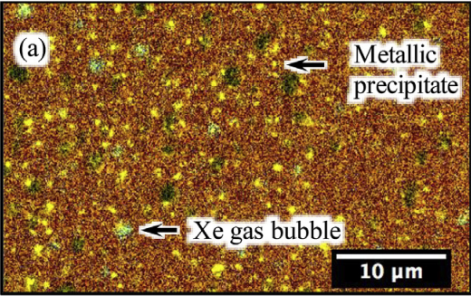
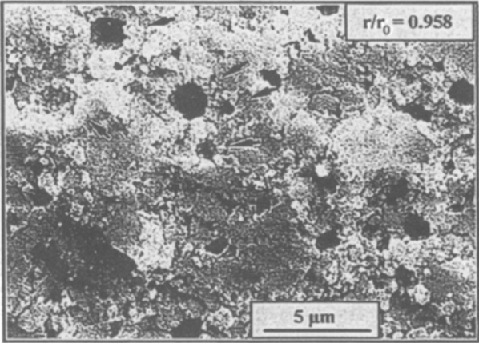
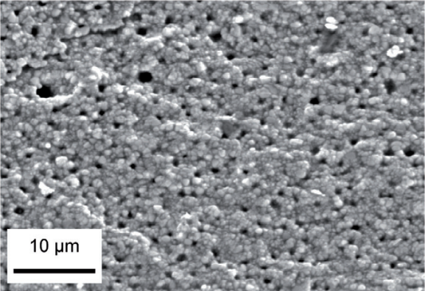
UO₂ High Burnup Structure
Critical burnup ~60-70 GWd/thM
Dislocations accumulate and create large networks.
Sonoda, T., et al. "Transmission electron microscopy observation on irradiation-induced microstructural evolution in high burn-up UO2 disk fuel." Nuclear Instruments and Methods in Physics Research Section B: Beam Interactions with Materials and Atoms 191.1-4 (2002): 622-628.
92 MWd/kgU @ 1300 °C
55 MWd/kgU @ 450 °C
New defect free sub-grains form.
HAGB
LAGB
75 MWd/kgU @ 1000 °C
74 GWd/tHM
72 MWd/kgU
Gerczak, Tyler J., et al. "Restructuring in high burnup UO2 studied using modern electron microscopy." Journal of Nuclear Materials 509 (2018): 245-259.
Spino, J. "Formation of the rim structure in high burnup fuel." Journal of Nuclear Materials 248 (1997): 170-179.
Rondinella, Vincenzo V., and Thierry Wiss. "The high burn-up structure in nuclear fuel." Materials today 13.12 (2010): 24-32.
Fragmentation threshold
82 GWd/tHM
Capps, Nathan, et al. "A critical review of high burnup fuel fragmentation, relocation, and dispersal under loss-of-coolant accident conditions." Journal of Nuclear Materials 546 (2021): 152750.
Intragranular fission gas concentration depletion.
160 GWd/thM
75 GWd/thM
72 MWd/kgU
66.6 GWd/thM
75 GWd/thM
Intergranular spherical fission gas bubbles.
Notes:
Historically referred to as “rim” structure
Grain subdivision also referred to as restructuring

Slide 6
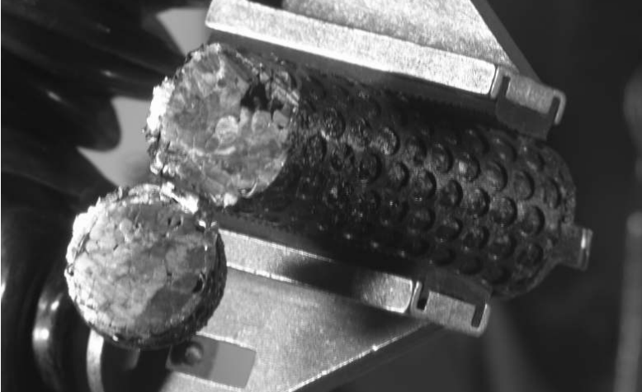
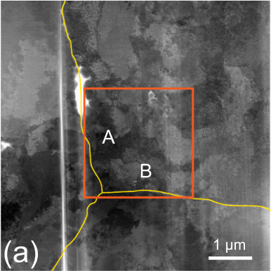
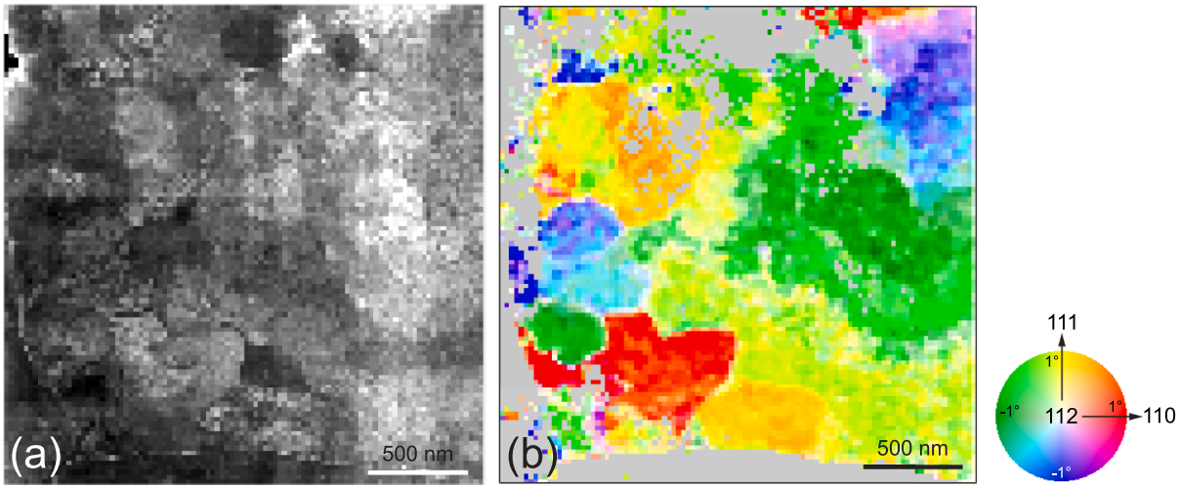
Legacy BR3 UO₂ Fuel
Well defined irradiation history & well studied
Intermediate rod averaged burnup: ~40 MWd/kgU
Some rim regions suggest early stage HBS formation
Original GBs
Electrolytic reduction for FP chemical analyses [i]
Drive BR3 UO₂ fuel to fully evolved HBS in-situ at temperature
Grain subdivision and HR sub-grain structure maps [ii]
What are the contributing mechanisms to HBS?
How can we simulate them and perform separate effects studies?
+ irradiation
IVEM in-situ TEM re-irradiation at ANL
+ stress
in-situ compression & creep testing at INL
[i] S. Herrmann, S. Li, M. Simpson, “Electrolytic reduction of spent light water reactor fuel - Bench-scale experiment results”, J. Nucl. Sci. Technol., 44 (2007) 361–367.
[ii] R. Yuan, J. Zhang, L. He, J. Zuo, “Training artificial neural networks for precision orientation and strain mapping using 4D electron diffraction datasets”, Ultramicroscopy, 231, 2021, 113256.
Notes:
What are the contributing mechanisms to HBS? How can we simulate them and perform separate effects studies?

Slide 7
In-Situ TEM Re-Irradiation

Slide 8
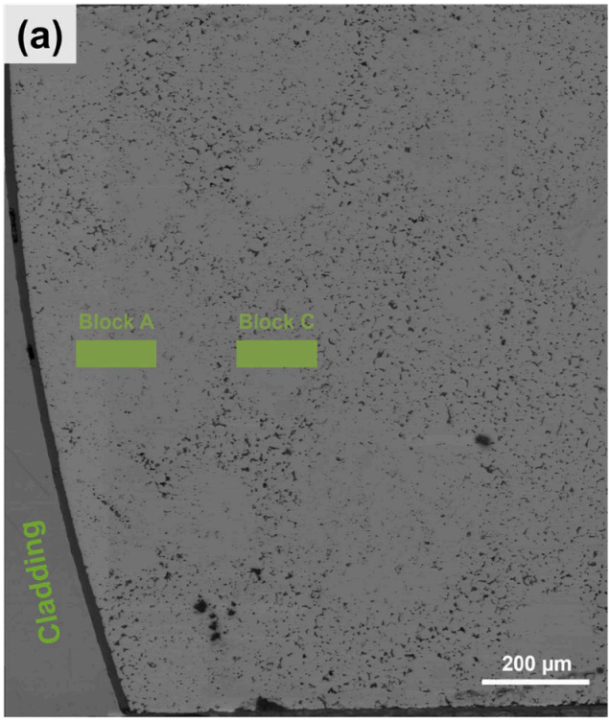
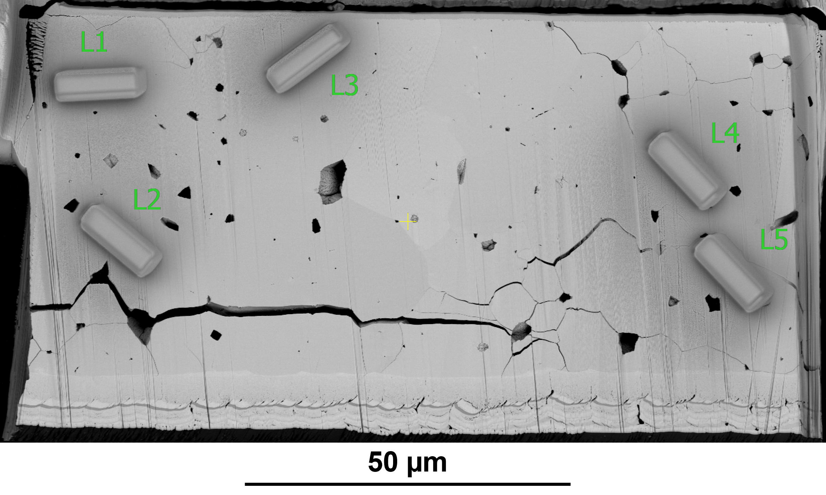
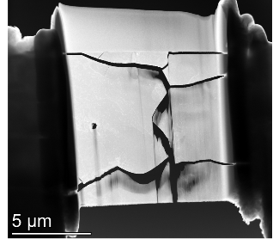
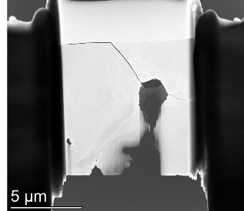
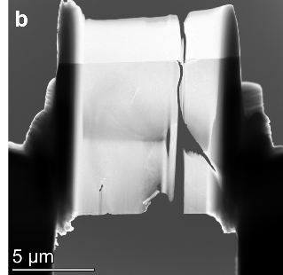
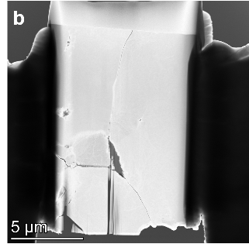
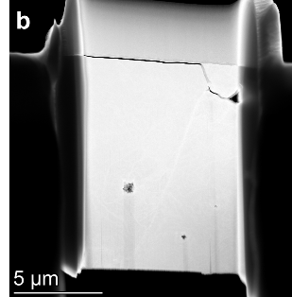
Sample Preparation
5 FIB lift outs taken from remaining volume of Block C after slice and view performed at regions where sub-grain structure observed in BSE image.
L1
L2
r/r₀ ≈ 0.99
r/r₀ ≈ 0.87
L3
L4
L5
Additional FIB lift outs taken from bulk at R ~ 0.9 adjacent
to cube lift out locations.

Slide 9
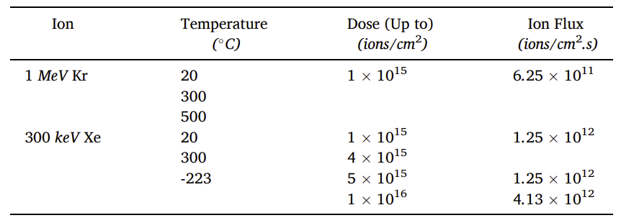
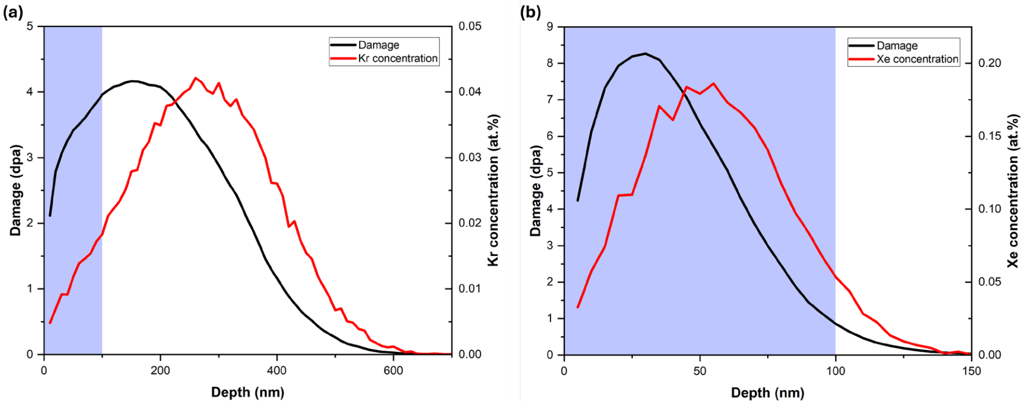
Irradiation Conditions
2+
+
+0.16% FIMA
+0.65% FIMA
Notes:
More Xe ion deposition in TEM lamellas compared to Kr ion deposition.

Slide 10
Fission Product Evolution

Slide 11
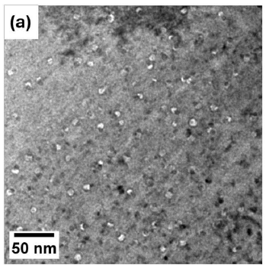
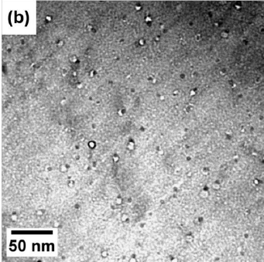
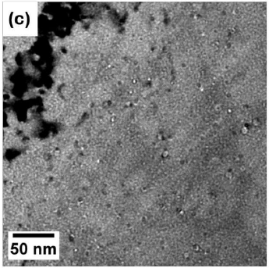
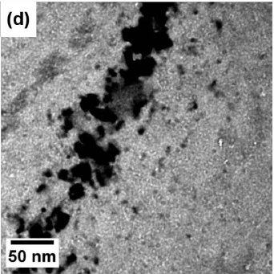
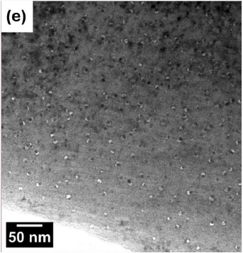
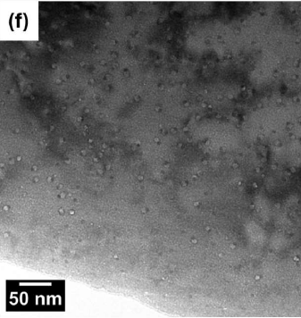
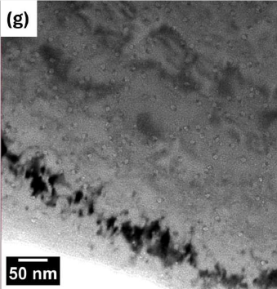
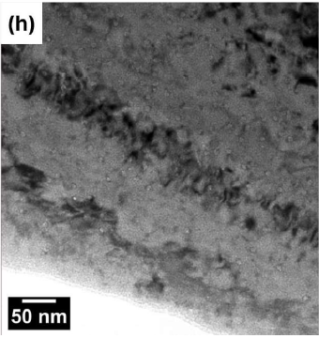
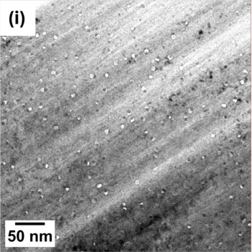
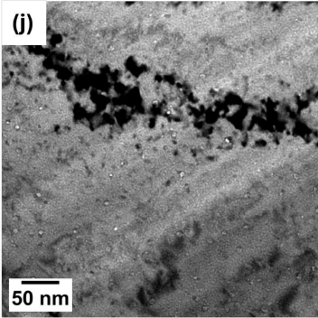
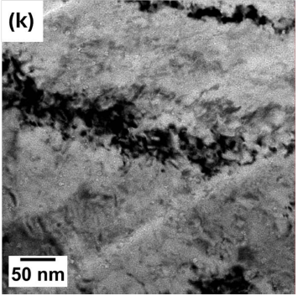
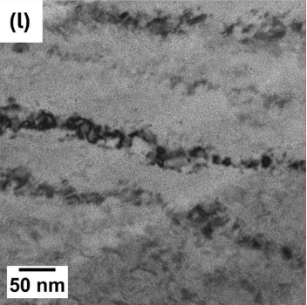
1 MeV Kr²⁺ Irradiation
Added Dose
0 dpa
0.32 dpa
1.62 dpa
3.24 dpa
RT
0 dpa
0.31 dpa
1.54 dpa
3.08 dpa
Temperature
300 °C
0 dpa
0.35 dpa
1.74 dpa
3.48 dpa
500°C
Notes:
-0.75 µm to -1.5 µm underfocus/overfocus for bubble/pair measurements

Slide 12
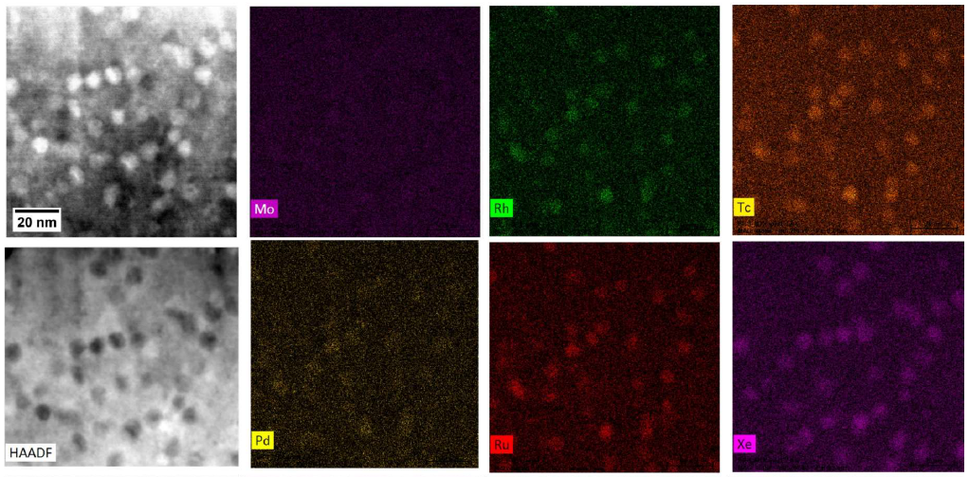
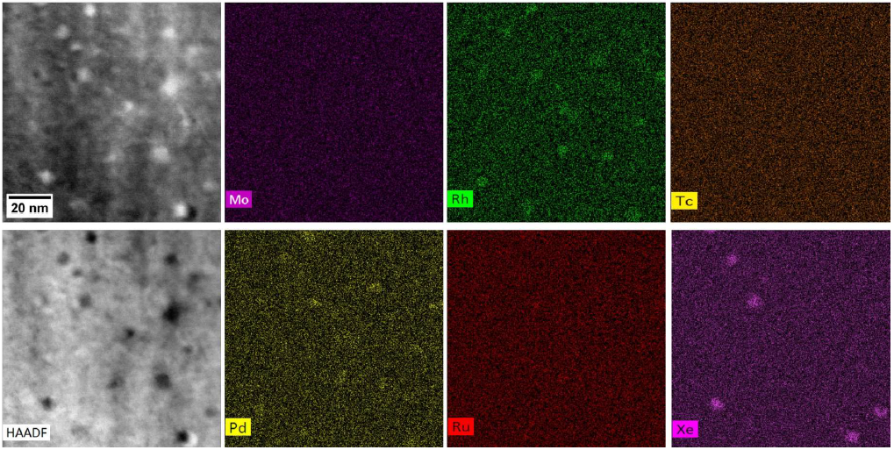
1 MeV Kr²⁺ EDS
Before Re-Irradiation
After Re-Irradiation @ 300 °C to 3.08 dpa
1. Faster diffusion rate of 5MPs compared to Xe
2. Less uniform distributions/spacings
3. Size reductions
4. Number density reductions
Notes:
Note: Mo grids used for robustness in HT irradiation set up, so Mo signal is obscured by Mo background signal from grid. Diamond TEM grids are a lot more expensive, would be useful for differentiating Mo.

Slide 13
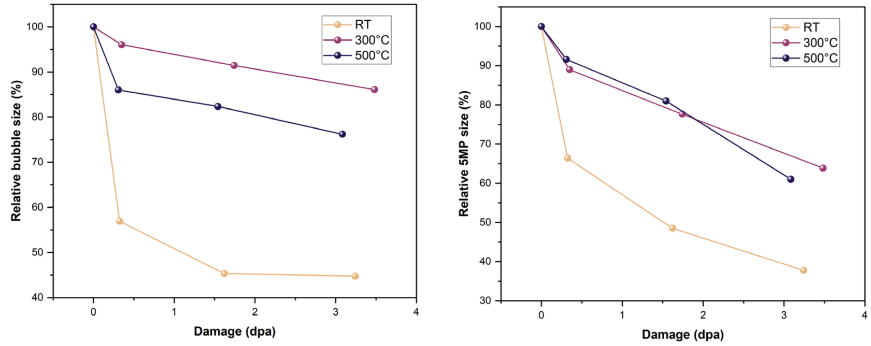
1 MeV Kr²⁺ Irradiation: Bubble and Pair Size Reductions

Slide 14
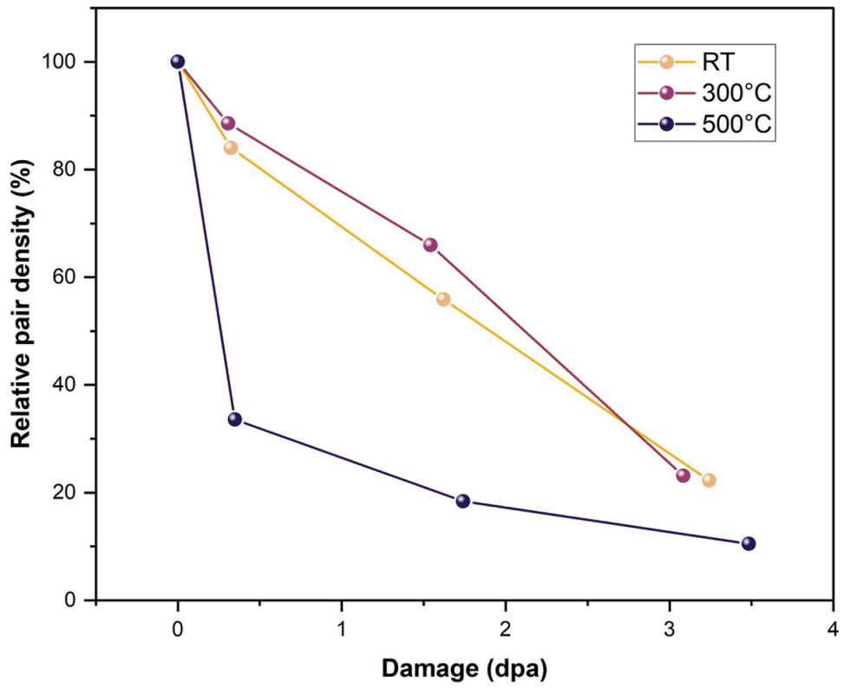
1 MeV Kr²⁺ Irradiation: Pair Density Depletion

Slide 15













300 keV Xe⁺ Irradiation
Added Dose
0 dpa
0.34 dpa
1.71 dpa
3.43 dpa
17.16 dpa
-223 °C
(high flux)
0 dpa
1.47 dpa
2.95 dpa
5.89 dpa
Temperature
RT
0 dpa
1.61 dpa
3.22 dpa
6.44 dpa
300 °C

Slide 16


300 keV Xe⁺ Irradiation: Bubble and Pair Size Reductions

Slide 17

300 keV Xe⁺ Irradiation: Pair Density Depletion

Slide 18




Metallic Precipitates Re-Precipitation
2.34 dpa
2.39 dpa
2.44 dpa
2.53 dpa
3.23 dpa
4.10 dpa
4.99 dpa
5.86 dpa

Slide 19

Pair Dissolution to 5MP Re-Precipitation Graphic
Starting microstructure
-Initial size reductions
-Xe ions:
1) Trapped in matrix V
2) Attach to pairs
3) Bind w/ detached Xe/Kr atom
Agrees w/ Nelson, Hudson, and Mazey (NHM) model
-Close spacing: Re-precipitation of 5MPs via backflow diffusion to existing clusters.
-Large spacing: Continuous dissolution
-Nucleation of new Xe/Kr gas bubbles from implanted ions.
-Detached Xe/Kr atoms:
1) Form bubbles
2) Dissolve into matrix
3) Annihilate at IG pores
4) Escape at free surface
-5MPs: Uniformly redistribute in matrix to supersaturation
point.

Slide 20
Grain Evolution

Slide 21

300 keV Xe⁺ Re-Irradiation at -223 °C
Added Dose
0 dpa
1.71 dpa
3.43 dpa
17.16 dpa
High Flux:
0 dpa
1.17 dpa
2.34 dpa
11.72 dpa
Low Flux:
Minimal grain evolution: little to no grain growth, ion sputtering opens pore

Slide 22

High Density of 5MPs near pore restricts GB Migration at -223 °C
After 11.72 dpa of added damage

Slide 23

300 keV Xe⁺ Re-Irradiation at RT
Added Dose
0 dpa
0.88 dpa
Most nanograins grow and merge into bigger adjacent grains
2.95 dpa
11.78 dpa
14.73 dpa

Slide 24

300 keV Xe⁺ Re-Irradiation at 300 °C
0 dpa
Arrows indicate nanograin growth and merger into larger grain.
6.44 dpa
16.1 dpa
Notes:
Rings become fainter and disappear transitioning to more distinct spots also indicating grain growth

Slide 25

Grain Size Evolution vs. Dose, Temperature and Initial Grain Size
Thermal activation required for growth
Grains < 30 nm: population decrease
Grains > 30 nm: population increase

Slide 26

Critical Transition Grain Size from Growth to Subdivision
200-900 nm
Notes:
Critical size suspected to be smaller for TEM lamellas compared to bulk irradiations due to increased free surface area to volume causing increased defect annihilation at the surfaces

Slide 27
Conclusions: Fission Product Evolution
  Over the complete range of temperatures (-223-500 °C) with both Kr²⁺ and Xe⁺ ions:
    Number density of fission gas bubble-5 metal precipitate pair structures decreases.
      Completely vanish at high dose: +9 dpa @ RT, +13 dpa @ 300 °C
    Sizes of pre-existing fission gas bubbles and metallic precipitates reduced.
      Faster diffusion rates of 5MPs vs. fission gases
    Increasing ion flux accelerates the reduction.
    Re-precipitation of metallic precipitates was also observed in real time video imaging.
    High dose implants new sub-nm Xe bubbles.
  Supports fission gas re-solution & precipitate re-precipitation/dissolution mechanisms (NHM model).
    Atomic diffusion coefficient has strong irradiation dependence but weak temperature dependence.
Notes:
TEM: fission gas re-solution & precipitate dissolution

Slide 28
Conclusions: Grain Evolution
Nanograin growth during ion irradiation in-situ in the TEM.
  Severe: 300 °C
  Moderate: RT
  Negligible: -223 °C
Thermal activation requirement to overcome GB pinning by fission gas bubbles, precipitates, and pores.
Largest grains (> 300 nm) do not grow or subdivide.
  Free surface defect annihilation contributions
  Limited 300 keV Xe⁺ ion electronic stopping power

Slide 29
Publications
Sakib, Sadman, Yunyuan Lu, Cameron B. Howard, Jatuporn Burns, Wei-Ying Chen, Linu Malakkal, Chao Jiang, Sudipta Biswas, Fabiola Cappia, and Lingfeng He. "In-situ ion irradiation of fission products in a spent UO2 fuel." Journal of Nuclear Materials 614 (2025): 155859.
Sakib, Sadman, Yunyuan Lu, Cameron B. Howard, Jatuporn Burns, Mario Matos, Wei-Ying Chen, Sudipta Biswas, Fabiola Cappia, and Lingfeng He. "In-situ ion irradiation induced nanograin growth in a spent UO2 fuel." Journal of Nuclear Materials (2025): 156394.

