Slide 1
NSUF Users Organization Overview
Stephen Taller, NSUF Users Org. Chair, FY26-FY27
Nuclear Science User Facilities (NSUF) Annual Program Review, May 12, 2026

Slide 2
What do we do?
The NSUF Users Organization aims to:
  Provide a formal and clear channel for the exchange of information and advice between the investigators who perform reactor-based nuclear technology experiments and the NSUF management.
  Serve as an advocacy group for the experimental activities at the NSUF.
  Provide a communication channel among users of the NSUF.
  Educate the public and decision-makers on the benefits of the use of nuclear energy for energy generation.
  Membership in the organization is open to all users and potential users of the various NSUF facilities and scientists and engineers engaged in the operation and development of these facilities. Potential members can join by self-nomination. For more information, please send an email to the executive committee (NsufUsersOrganization@gmail.com)
We are the user's voice!

Slide 3
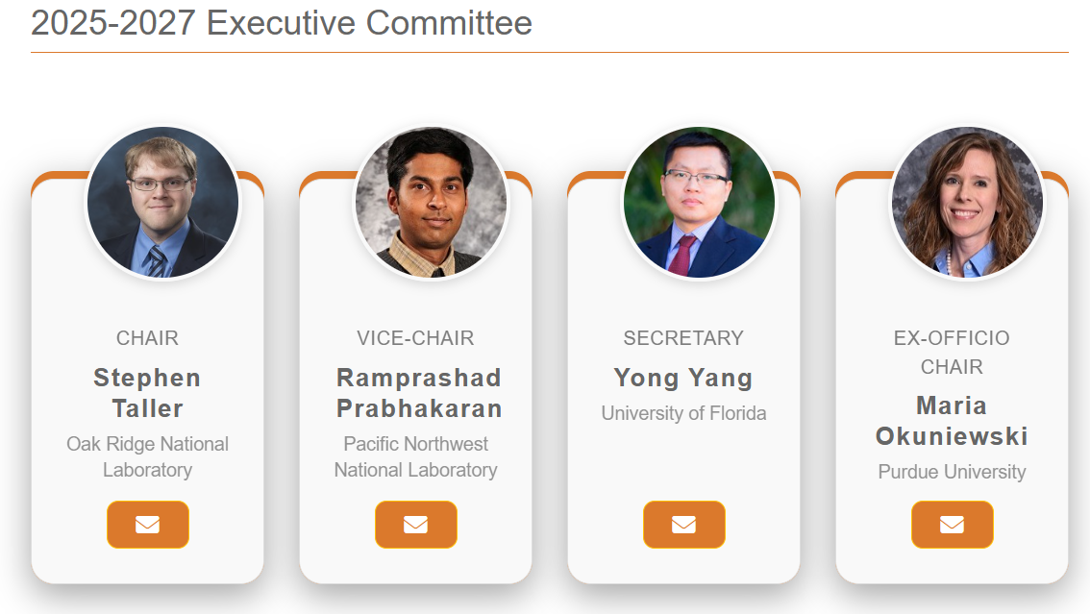
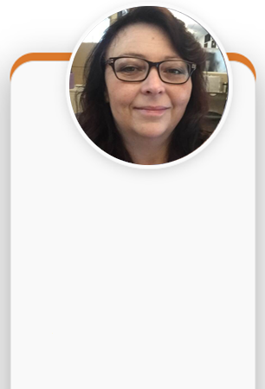
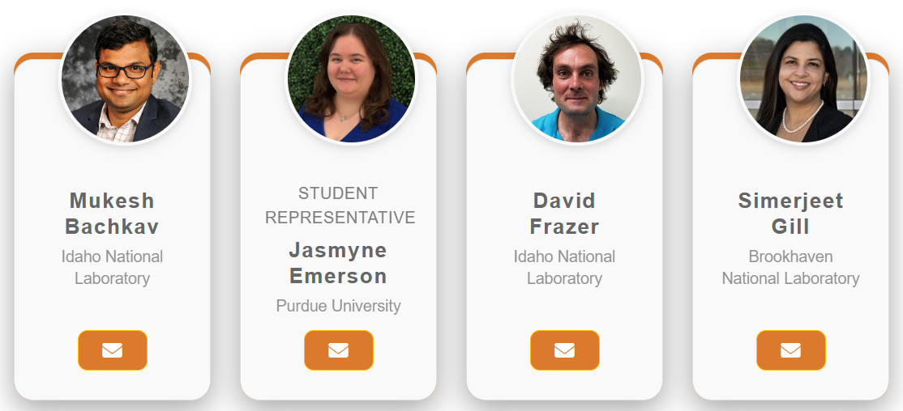
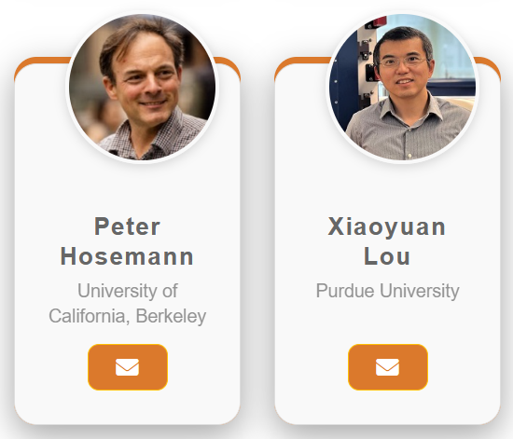
Meet your NSUF Users Organization Team
Person who makes everything happen
Renae Tripp
Idaho National Laboratory

Slide 4
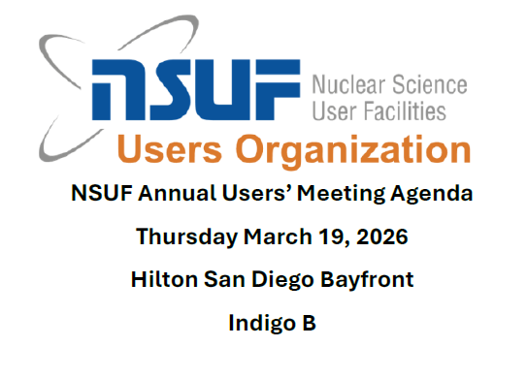
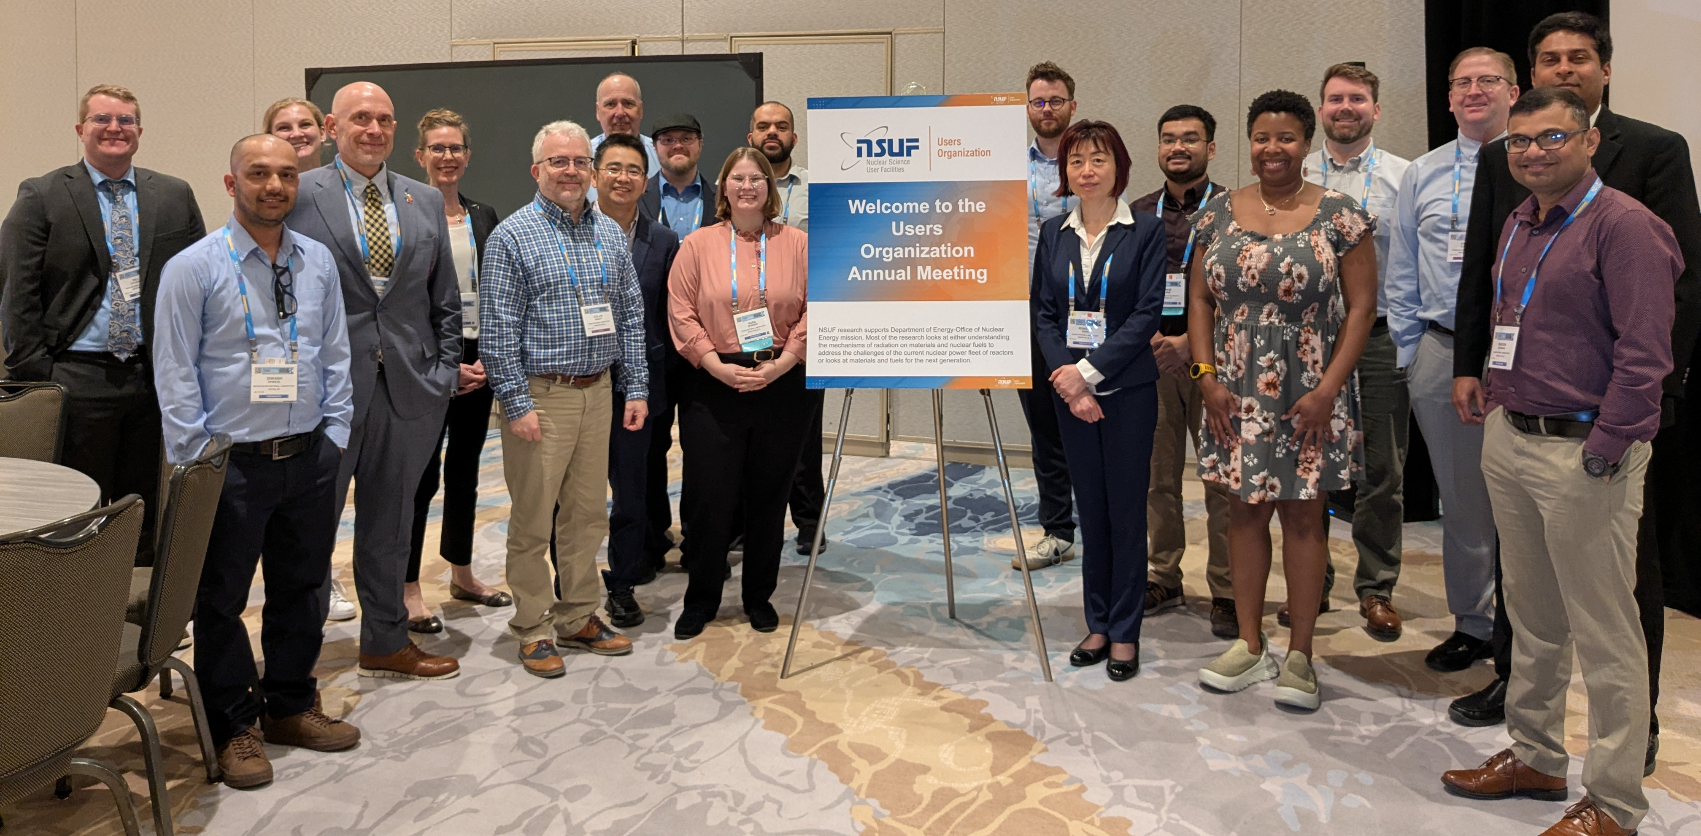
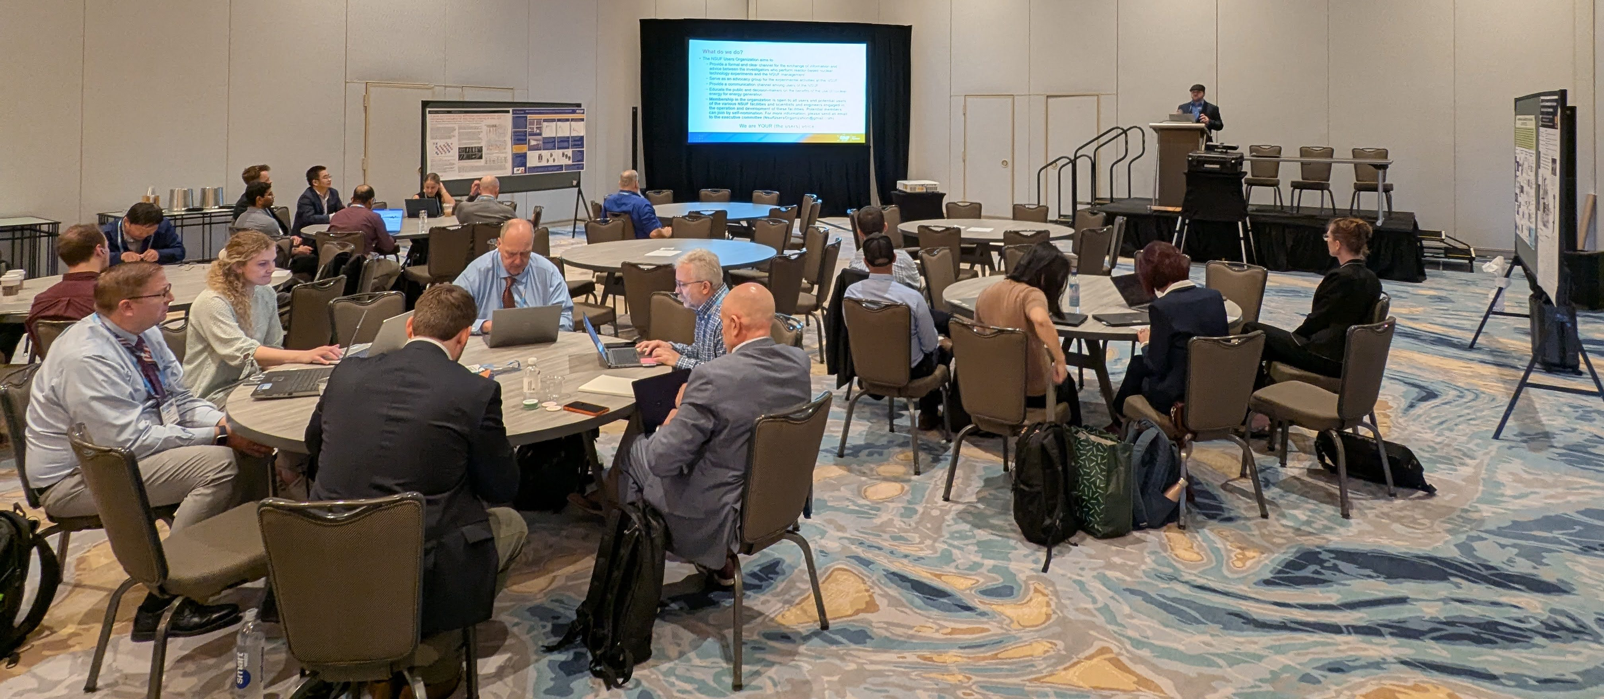
The NSUF Annual Users Meeting 2026 brought together NSUF leadership, instrument scientists, users and potential users
Estimated attendance: ~60-70 people, in person and remote

Slide 5
Engaging with NSUF Leadership
  Chris Barr (Program Manager, NSUF, DOE-NE) – DOE Perspectives of the NSUF
  Brenden Heidrich - Introduction to NSUF, Overview from NSUF Director, Upcoming opportunities and initiatives from NSUF
  A live demonstration of NRDS and discussion of the updates since the last NSUF Users meeting

Slide 6
Interactions with colleagues and NSUF leadership to enhance user experiences
Panel discussions for every step of the user experience.
  Panel 1. Working with NSUF partners. Hear from facility PIs and instrument scientists with commonly requested capabilities to know what has been developed, what is coming up, and how to work with instrument scientists for common characterization techniques.
  Panel 2. Jumpstarting Careers with NSUF. Hear from researchers at all stages of their careers who have gone through the NSUF RTE and CINR processes and how it helped kickstart and continue a career in nuclear materials.
  Panel 3. The NRDS and Data Management. Upcoming programmatic requirements will include uploading and sharing data with the Nuclear Research Data System (NRDS). This panel will discuss the requirements, data processing practices, and provide expert insight into data analysis with NSUF partners.
  Panel 4. Demystifying the Review Process. NSUF representatives and frequent reviewers provide insight on common pitfalls, tips to make a reviewer happy, identifying red flags and showstoppers from the program and PI perspectives.

Slide 7
Future Activities for the NSUF Users’ Organization

Slide 8

Next year is the 20th anniversary of NSUF

Slide 9
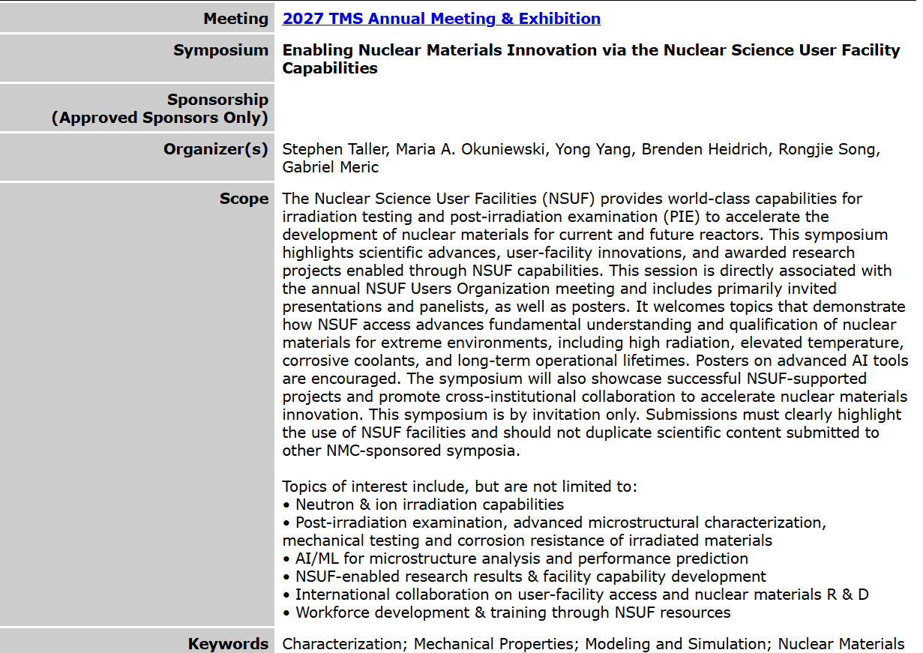
More formal integration into the TMS 2027 meeting through a dedicated NSUF symposium
Previous efforts acted as side meetings at the TMS Annual Meeting & Exhibition.
The challenge: How to engage people who aren’t already “in the know”?
Further integration helps with communication to a broader audience.

Slide 10
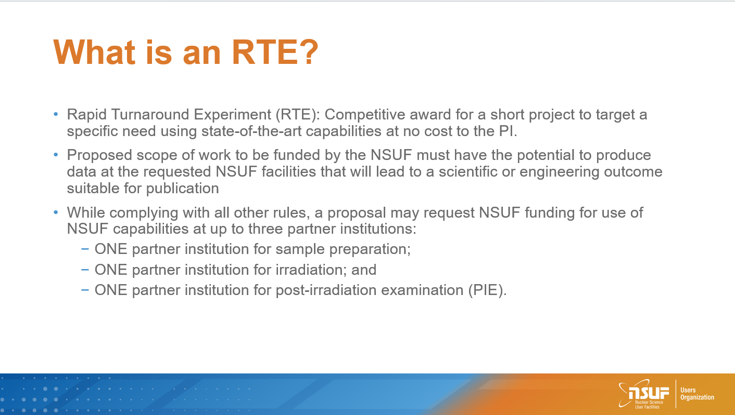
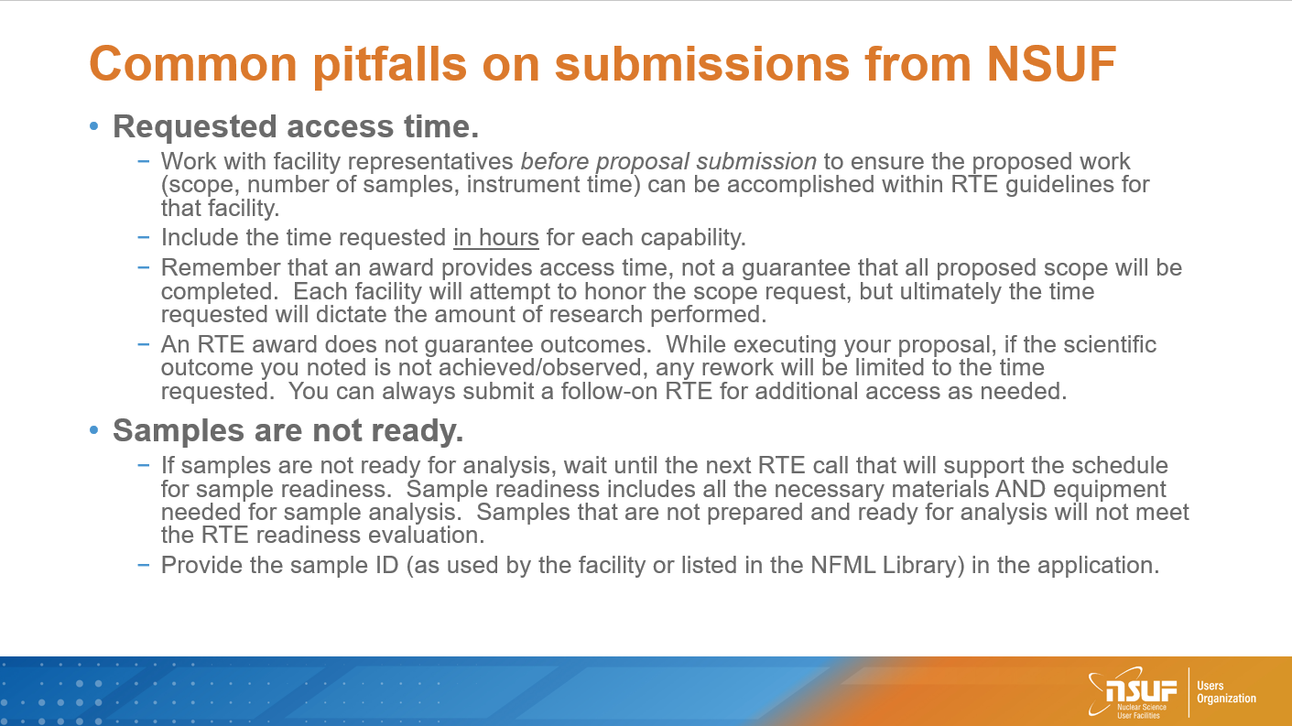
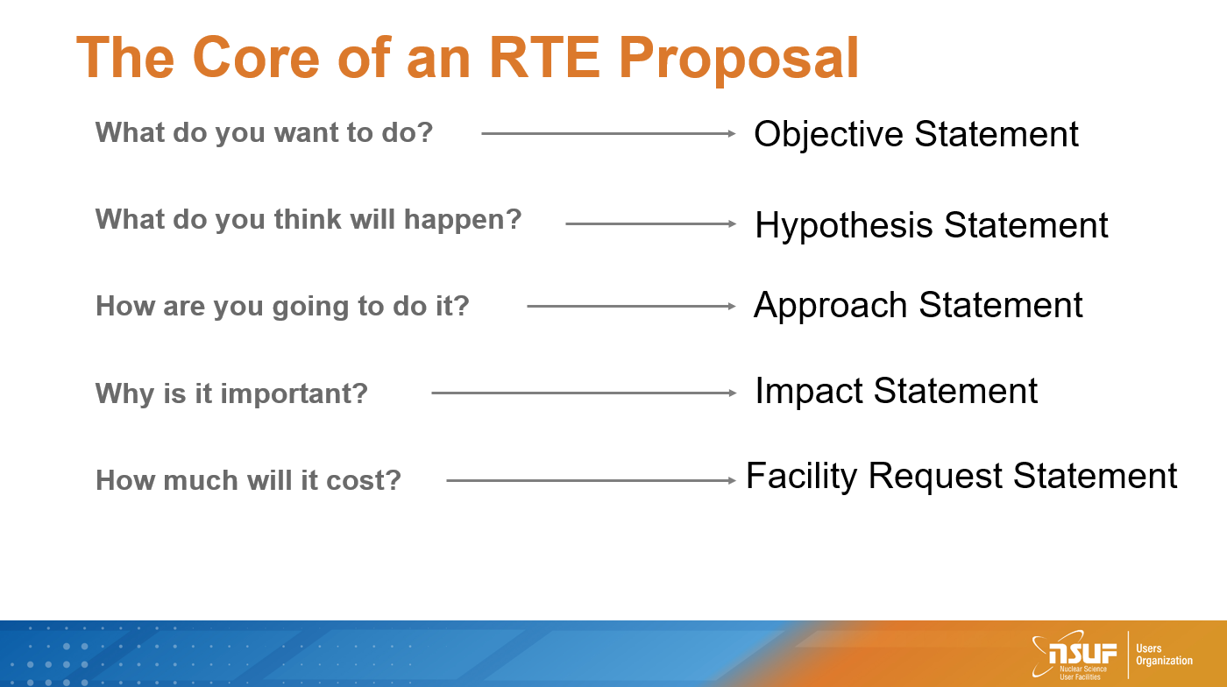
A Tips and Tricks Video and associated RTE proposal template will soon* be available via the Users Organization
With the Super RTE call open, the release may get expedited.
*Video and presentation made in 2024. An updated version will not be provided.

Slide 11
Special Issue in the Journal of Nuclear Materials to celebrate 20 years of NSUF supported research
Special issue: Nuclear Science User Facilities: 20 Years of Enabling Innovation in Nuclear Materials
Submission deadline: 01 October 2026
Guest editors: Mukesh Bachhav (INL, managing editor), Maria Okuniewski (Purdue University), Stephen Taller (ORNL)
Full papers are sought for NSUF supported research
Plan to invite specific individuals for retrospective articles
See the JNM call for papers for more information.

Slide 12
Summary
The NSUF Users Organization exists to provide a formal and clear channel for the exchange of information and advice between the investigators who perform reactor-based nuclear technology experiments and the NSUF management.
NSUF Annual Users Meeting 2026 was co-located with the TMS 2026 meeting.
  Full day of presentations and panels to help users learn more about NSUF and some of the behind-the-scenes details.
Future NSUF Users Organization activities include:
  Promotion of a Tips and Tricks guide video built from experience
  Formal integration of the Users Meeting into the TMS 2027 meeting to enhance visibility to the broader materials science community.
  Special Issue in the Journal of Nuclear Materials highlighting 20 years of innovation enabled by the NSUF.

Slide 13
Hope to see you all at the next NSUF Annual Users Meeting in Orlando Florida in 2027!

Slide 14
Year long ideas
While the annual meeting is the biggest event of the Users Organization, we want to keep the engagement with Users all year long.
Brainstormed ideas:
  Quarterly office hours
  Technique Chats
  Materials groups

Slide 15
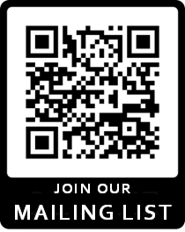
Sign up for the mailing list!
New major initiative! Our own mailing list!
This is a separate list from the mailing from the NSUF program list and requires people to opt-in to receive messages.
Only NSUF User Org officers have access.
Purpose:
  distribute information about user organized meetings,
  updates from the NSUF UO Executive Committee,
  facilitate feedback from users
  other topics relevant to the NSUF Users Organization.

