Slide 1
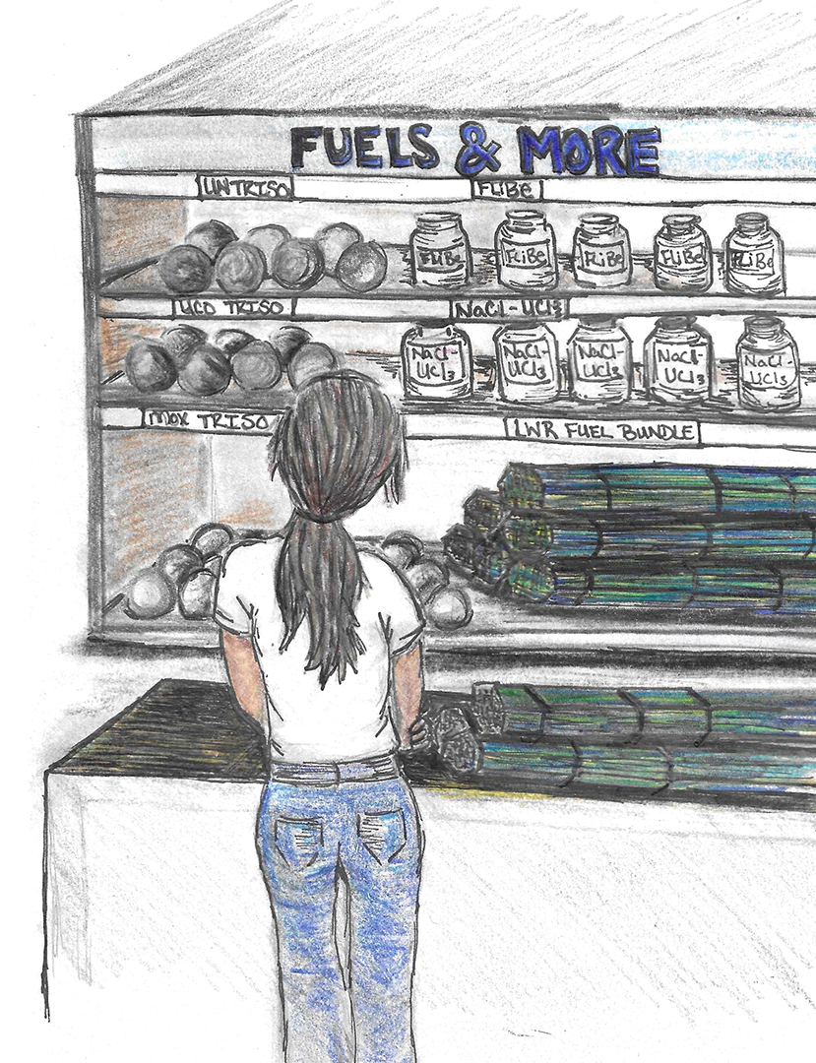
UN Multi-design Irradiation Campaign: a critical assessment of accelerated burnup and main correlations for mechanistic fuel performance modeling
May 12, 2026
Elizabeth S. Sooby
With contributions from:
D. Adorno-Lopes, A. Schrell, G. Helmreich, P.
Doyle, J. White, N. Capps, J. Harp, K. Linton

Slide 2
Motivation for High Uranium Density Fuel
High density fuels, particularly UN, has been identified as a long term accident tolerant fuel cladding
  While doped UO₂ and coated claddings are the current focus, fuel vendors and utilities looking for longer cycle lengths and improved performance have shown interest in a higher density fuel.
Further, there seems to be a new reactor design popping up every other day.
  These novel concepts often claim to leverage existing qualified materials.
As nuclear material scientists, we try to offer insight to the anticipated performance of these materials.
  However, we have data gaps in not only the irradiation performance
  But also, we lack the fundamental thermodynamic information to even predict equilibrium states
  The phenomena can span irradiation performance, oxidation, mechanical properties evolution, fuel clad chemical and mechanical interaction, etc.
So how do we as a community get to a place where we have multiple qualified, demonstrated materials for the reactor designer to choose from for their optimal design?
Elizabeth Sooby, Innovation News Network, Special Reports, August 2022.
2

Slide 3
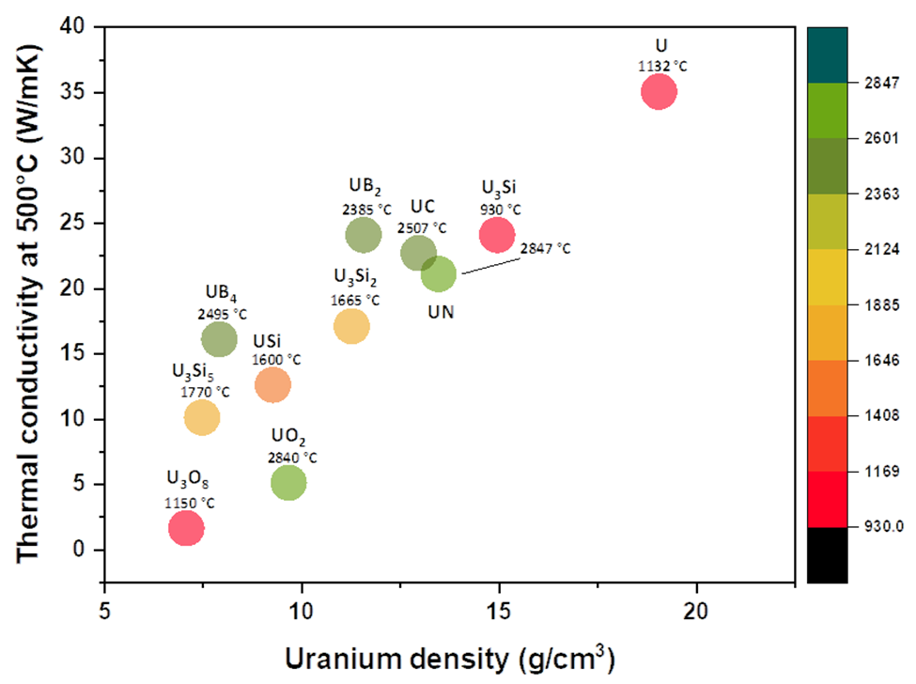
Advantageous Properties of Alternative Fuel Candidates
High uranium atom density
Low neutron absorption cross section for alloying/compound ion (isotopic separation necessary)
High melt point and structure stability to melt
High thermal conductivity
Inertness to the coolant (depends on the reactor)
Inertness to the cladding (depends on the fuel form)
Good mechanical strength
Stability under irradiation
Material Properties | UO₂ | U₃Si₂ | UB₂ | UN
Uranium density (g-U/cm³) | 9.7 | 11.3 | 11.7 | 13.5
Thermal conductivity (W/m∙K at 300°C) | 6.5 (95% TD) | 14.7 (98% TD) | 25.1 (95% TD) | 16.6 (95% TD)
Melting temperature (°C) | 2840 | 1665 | 2385 | 2847
J. Watkins, et al, Journal of Nuclear Materials, 2021.
3

Slide 4
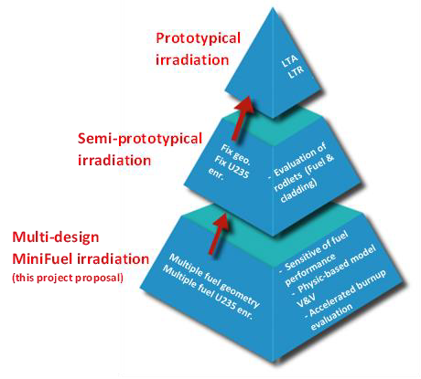
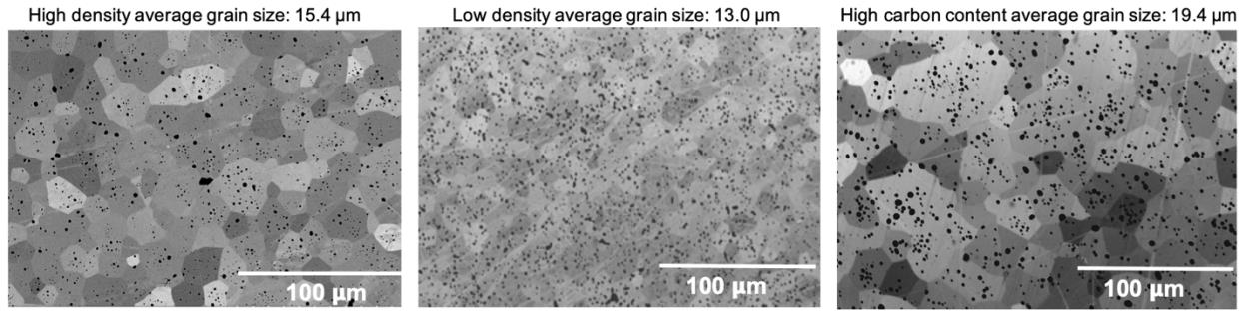
Addressing variability in performance as a function of sample quality
Oxygen and carbon are common fabrication impurities from the CTR-N process.
Further, sintered density variability can cause enhanced oxidation and potentially irradiation performance degradation.
Two new projects led by UTSA aim to assess the impact that impurities which arise at fabrication have on performance.
  International NEUP with UTSA, BSU, LANL and University of Manchester to assess impurities which arise at fabrication.
  These samples along with others fabricated at LANL are leveraged in an NSUF Irradiation.
The present NSUF irradiation in HFIR will expose samples with varied impurity concentration and varied density to a range of irradiation temperatures and levels of burn up.
4

Slide 5
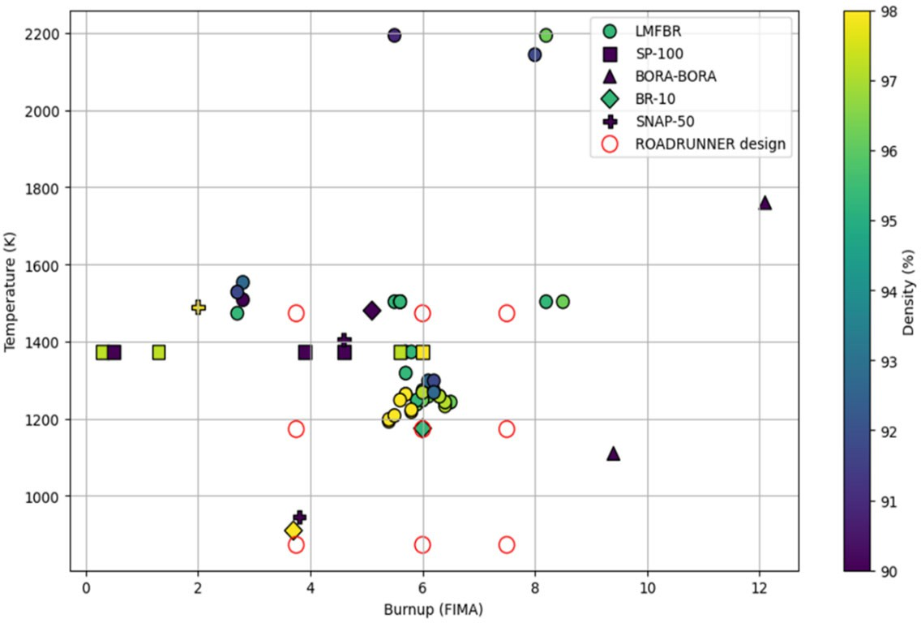
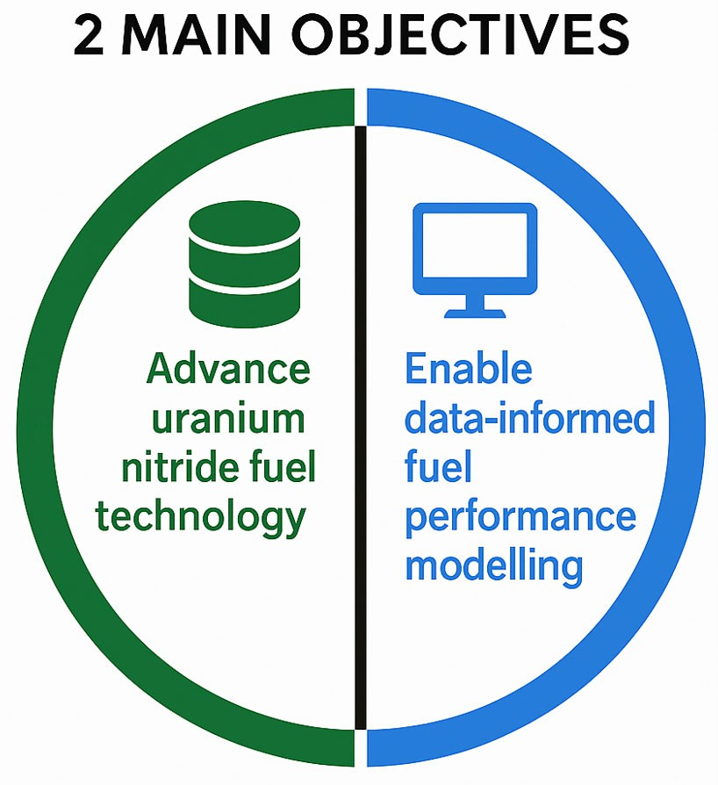




ROADRUNNER Irradiation
Research On ADvancing the peRformance of UraNium Nitrides in Extreme enviRonments
6-year project awarded under the Nuclear Science User Facilities program
Irradiation campaign to support UN fuel qualification assessing the effects of density and impurity variations across different irradiation temperatures and burnup levels.
D. Adorno Lopes et al., ROADRUNNER Uranium Nitride MiniFuel Accelerated Burnup Testing, 2026

Slide 6
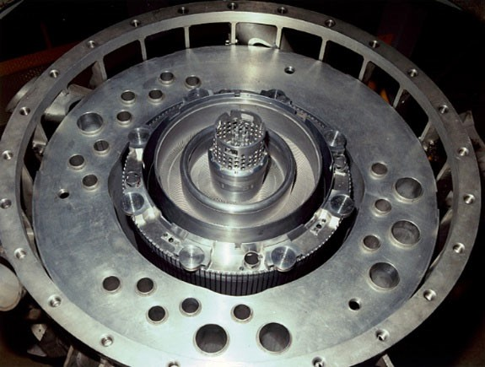

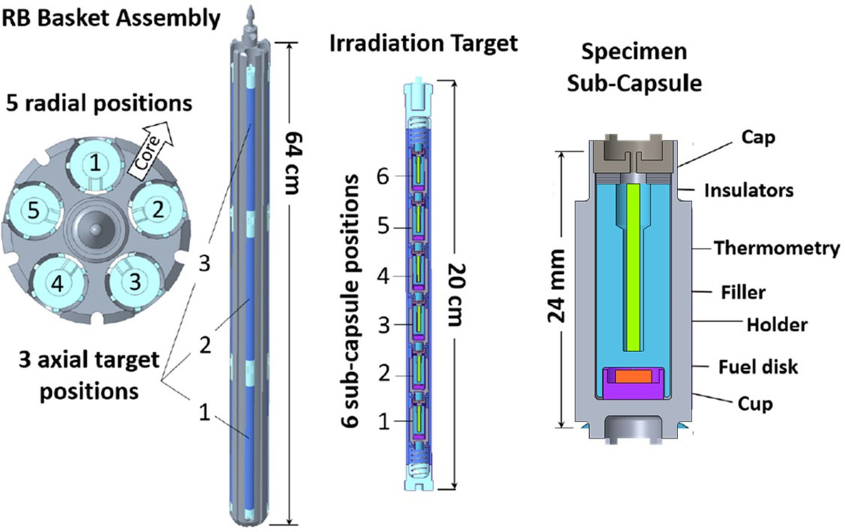


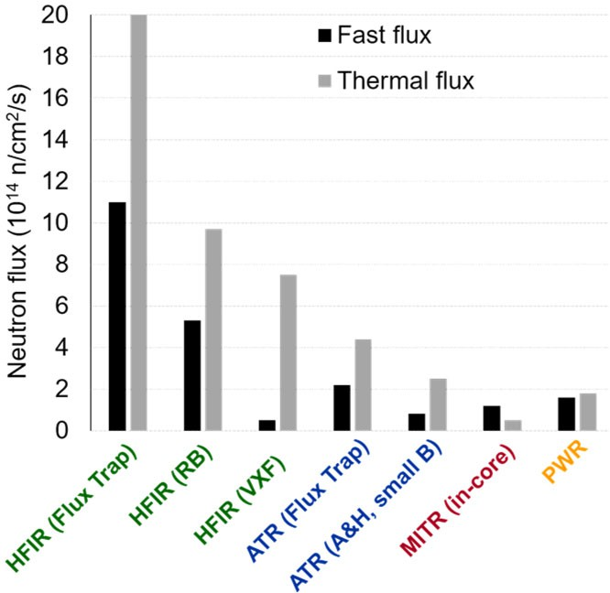
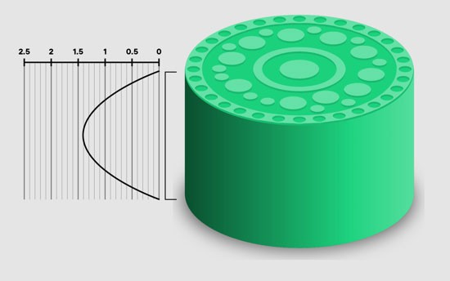
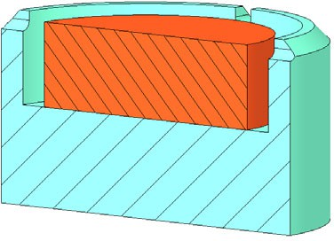
MiniFuel Experiment Design
RB
[R position]
HFIR
Normalized Axial Fast Flux Profile
[A position]
1.4
HFIR
85 MW
MiniFuel Experiment Design
A. Le Coq, et al, ORNL/TM-2024/3452
ø 3 mm × 1mm
Cross-sectional view of the cup containing the fuel disk (modification of existing design)
Courtesy of C. Petrie

Slide 7

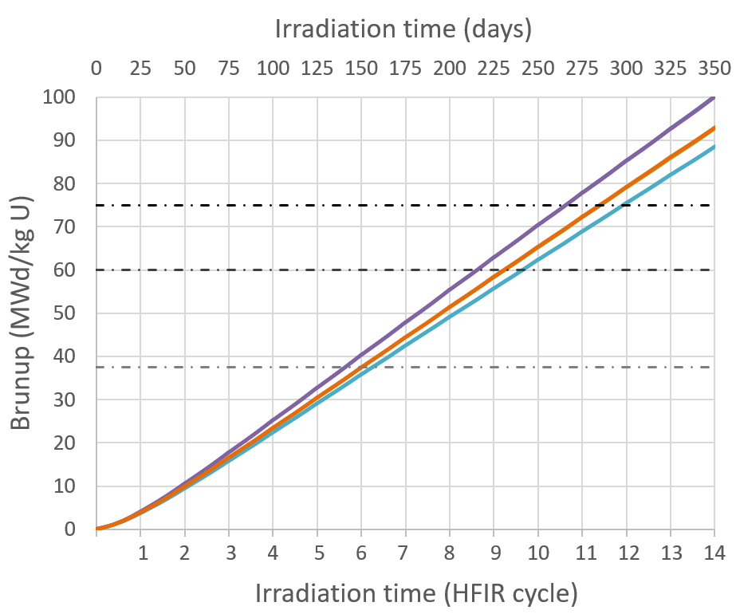
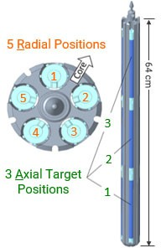
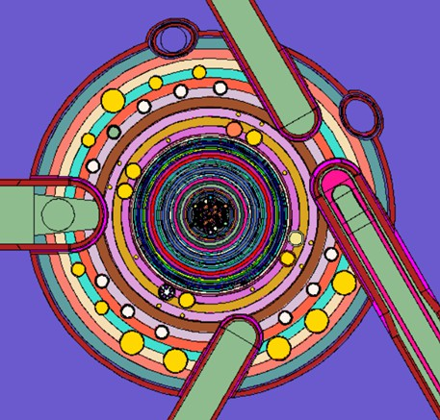
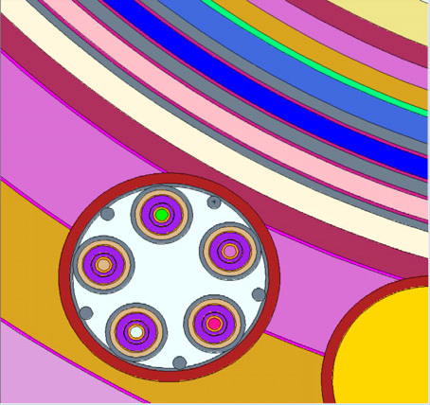



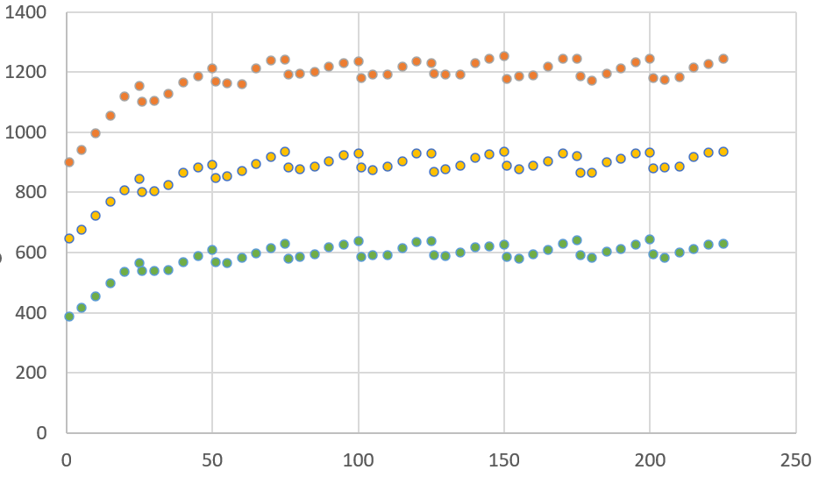
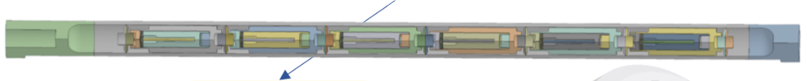

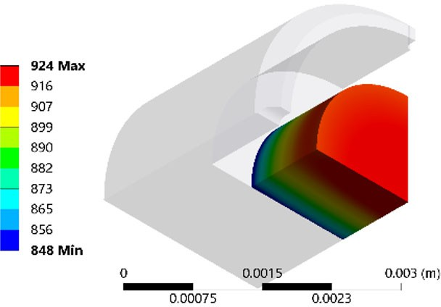
Irradiation Design
Burnup accumulation
Radial positions
1
5
2
4
3
Axial position
Neutron
ics analysis
HFIRCON model of HFIR
Heat generation rates
RAS: 223
Average fuel temperature (°C)
Thermal analysis
RAS: 221
RAS: 225
Experiment temperature
Irradiation time (days)

Slide 8



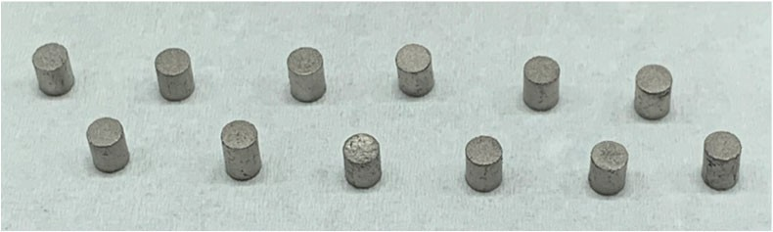
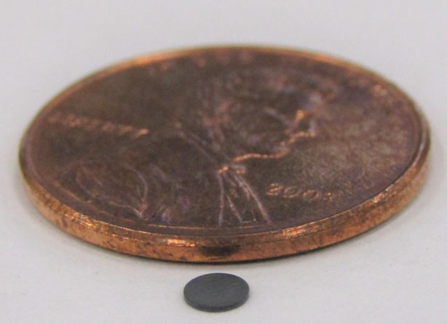
Specimens Fabrication and Characterization
Fabrication | ✓ | ✓
Impurity content | ✓
Dimensional/mass |  | ✓ | ✓
Density | ✓ | ✓ | ✓
SEM |  | ✓ | ✓
Grain size |  |  | ✓
Thermal diffusivity | ✓ |  | ✓
XCT |  |  | ✓
Raman analysis |  |  | ✓

Slide 9
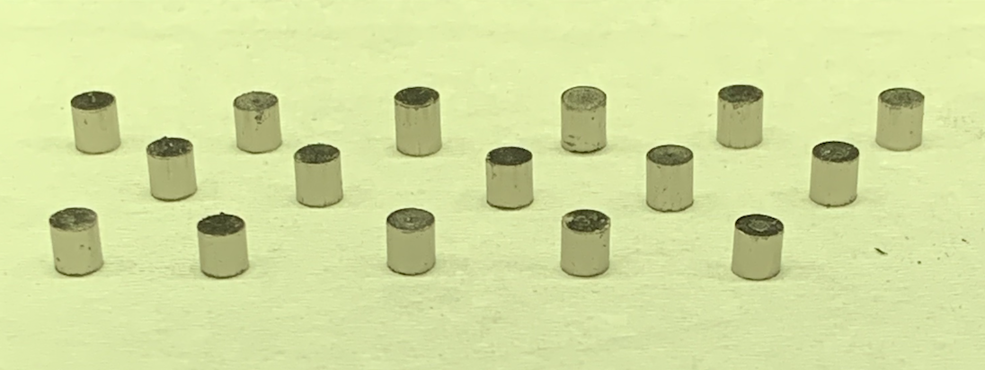
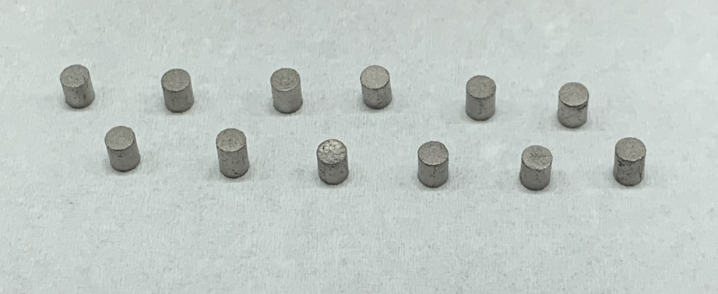
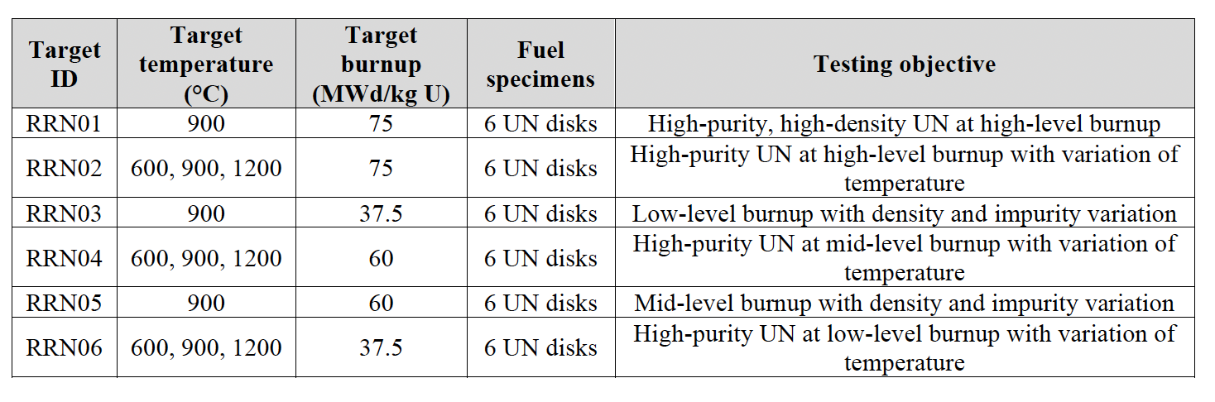
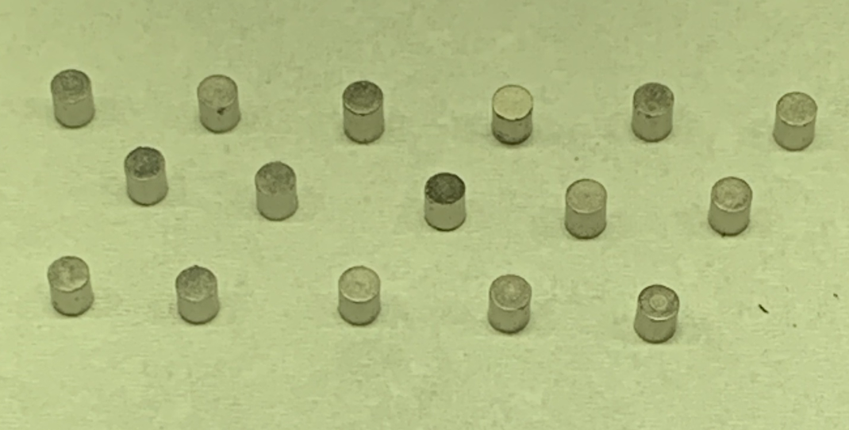
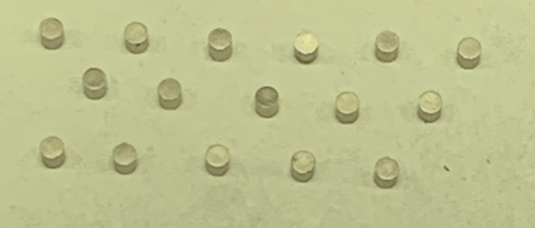
Bridging gaps in irradiation performance: NSUF Irradiation Only
First and foremost- we need a name!
  ROADRUNNER minifuel - Research On ADvancing the peRformance of UraNium Nitrides in Extreme enviRonments
Next, we need to identify samples and irradiation conditions.
  Targeted fabrication at LANL, aligned with NEUP, we have a range of impurities and densities
  UTSA will thin the samples to the 1 mm thickness
  Sample holders are designed around the final dimensions of these samples
    Final diameter ~2.9 mm
9

Slide 10
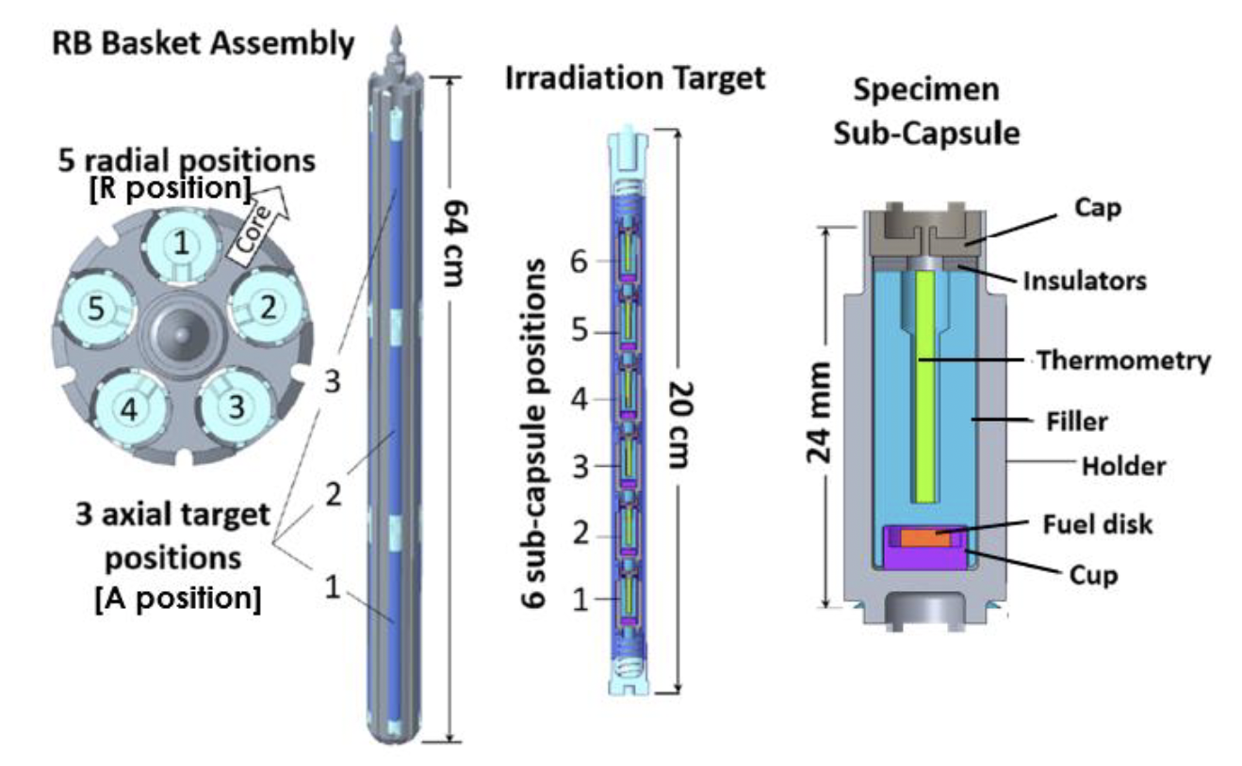
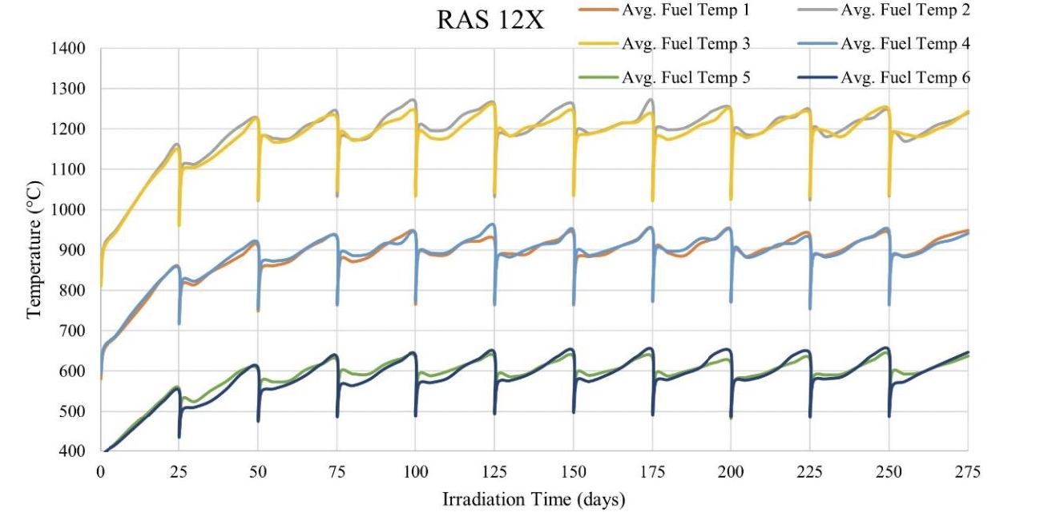
Mini-fuel Design and Evolution of Average Fuel Temperature
Leveraging the already very successful mini-fuel design at ORNL, we’ll expose these samples to varied burn-ups and temperatures
Temperatures vary from 600-1200 C, allowing us to provide data for a wide range of reactor types
Insertion is planned for the FY
  Potentially as early as this month for some samples
10

Slide 11
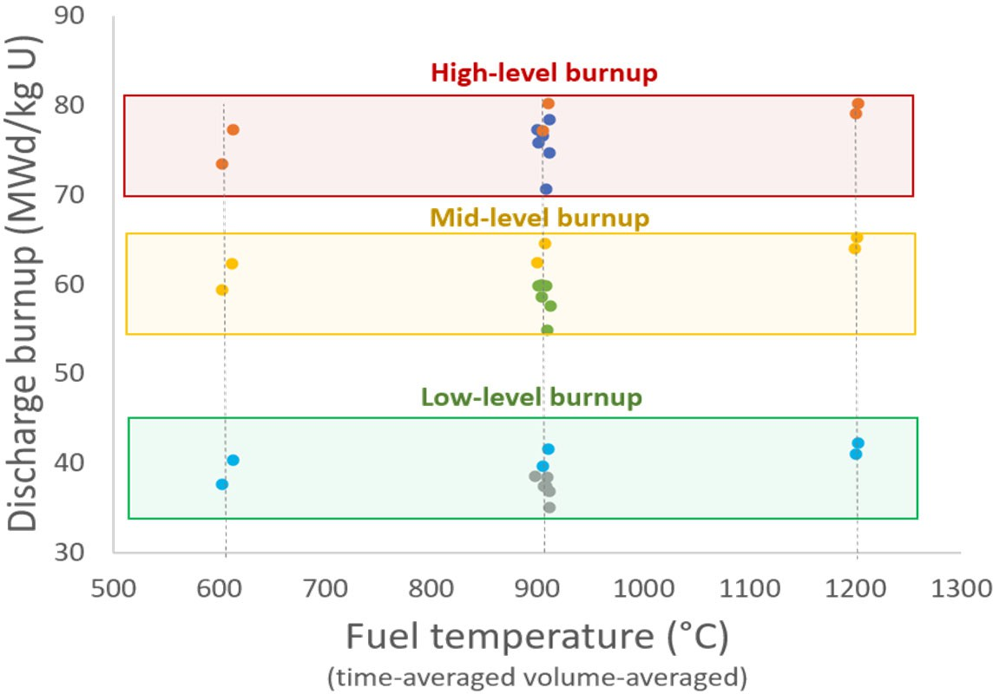
Experimental Test Matrix
Control, high-burnup
RRN01
Temperature variation
RRN02
RRN04 RRN06
Density/impurity variation
RRN03
RRN05

Slide 12
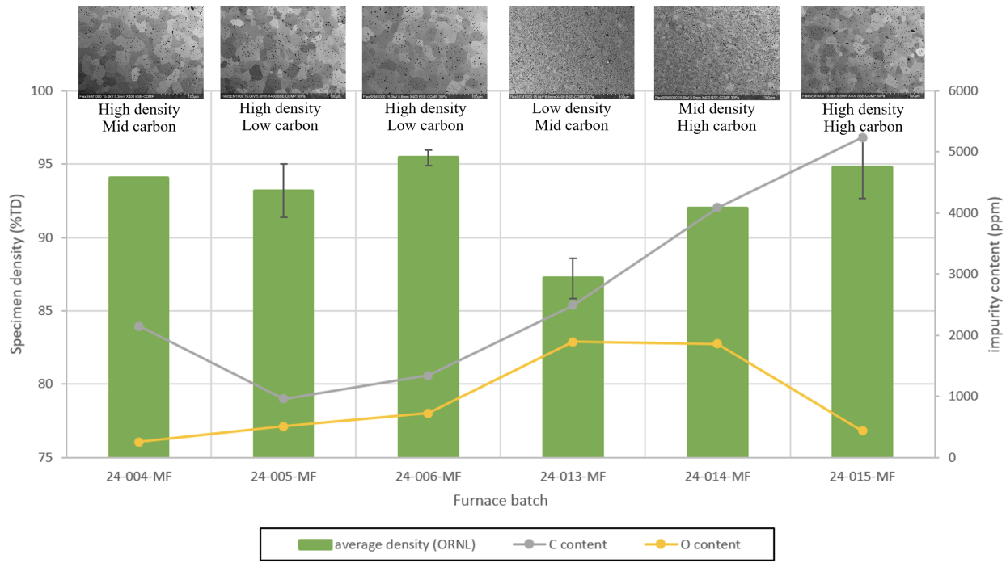
Varied Microstructures, Densities and Purity
Samples were fabricated at LANL
Shipped to UTSA for thinning and microstructural characterization
Then, 53 samples were shipped to ORNL for further characterization and loading into the irradiation capsules
The distinct differences in purity, density, and resulting microstructure will inform on the importance of fine tuning fabrication.
12

Slide 13
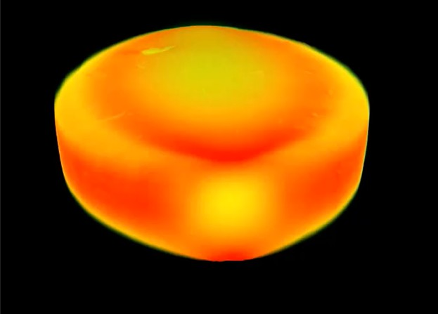
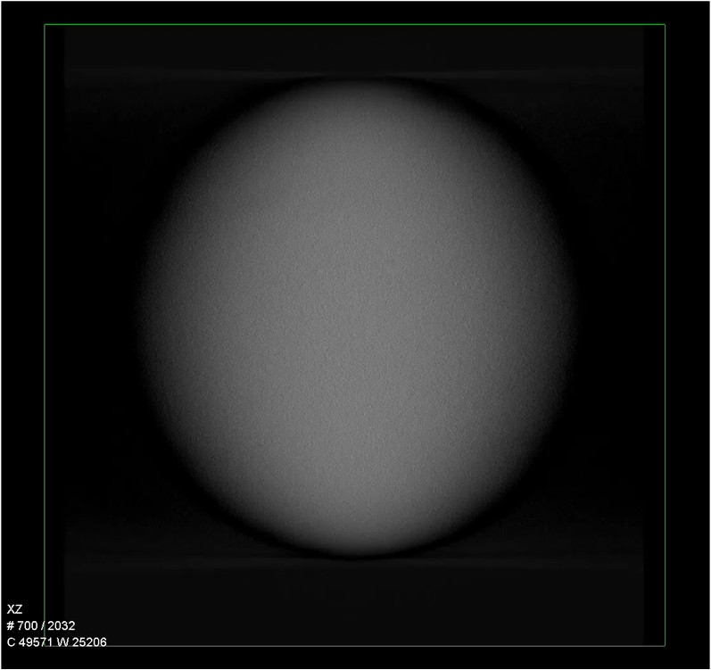
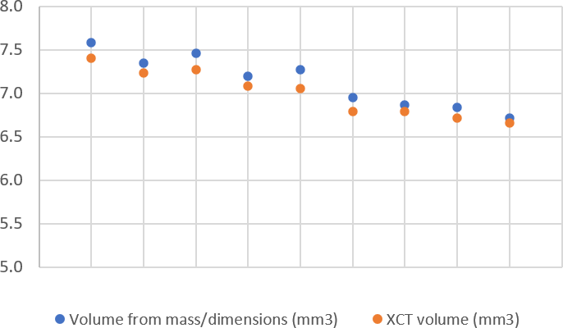
XCT Characterization
Technique to identify specimen defect
Volumes evaluated from the XCT within 2% of volumes estimated from dimensional measurements
3D image reconstruction of specimen 35-P-24-073
Specimen volume (mm³)
XZ plane image reconstruction of specimen 35-P-24-073
Selected specimens

Slide 14
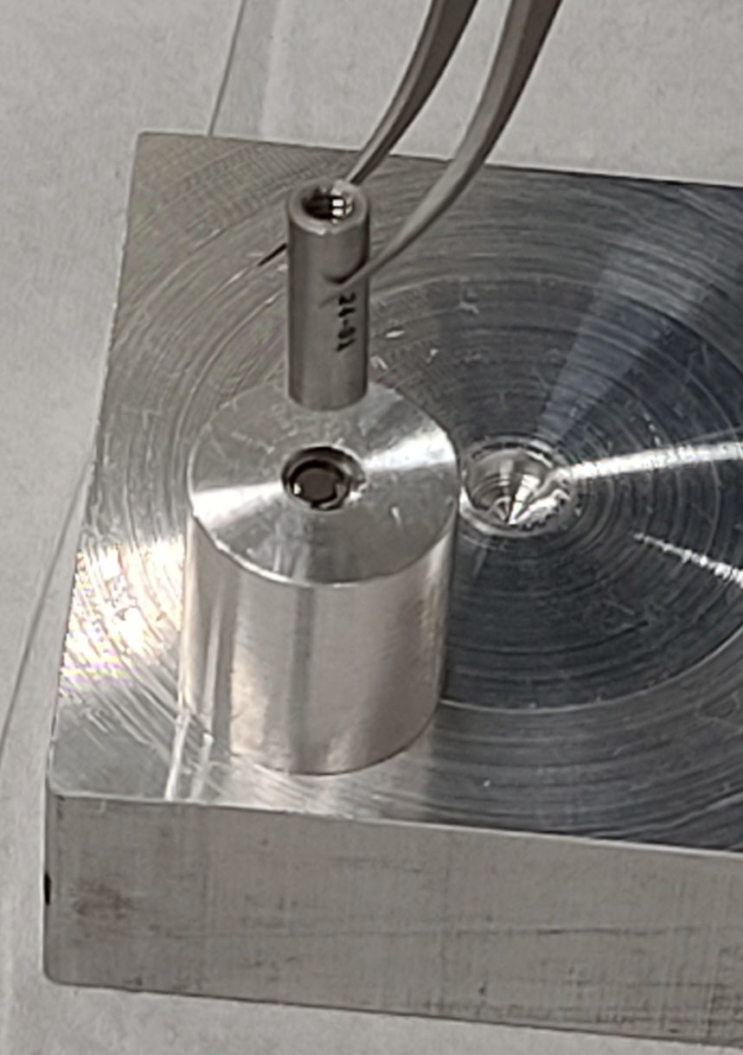
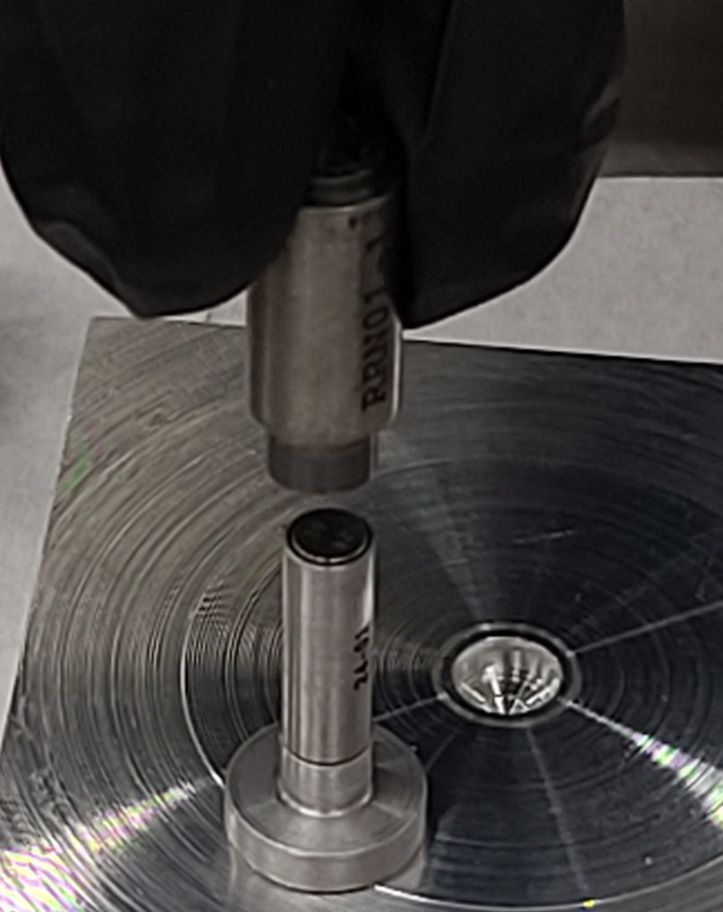
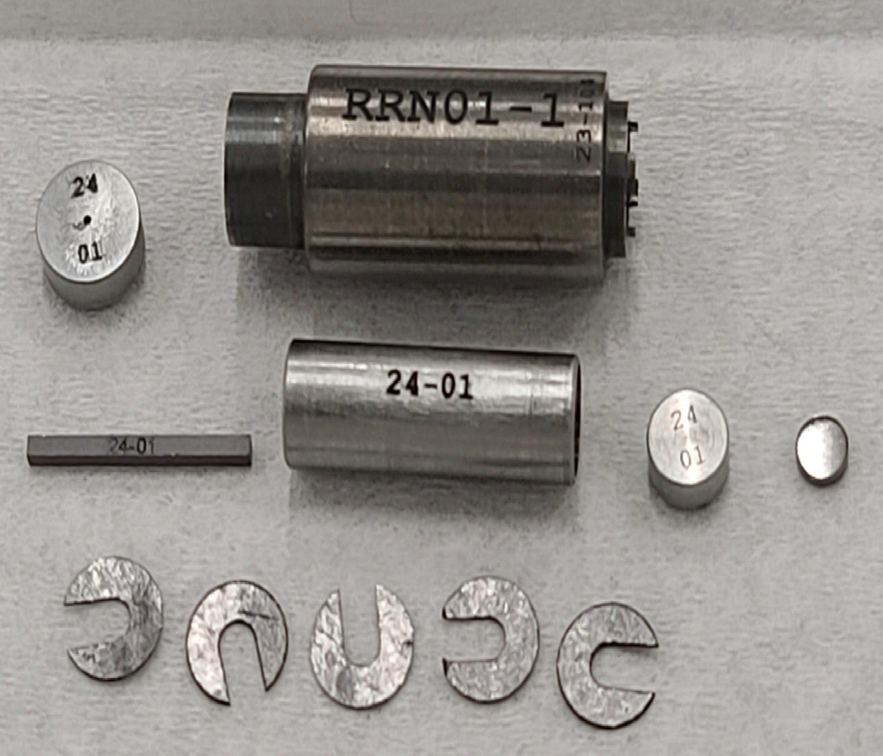
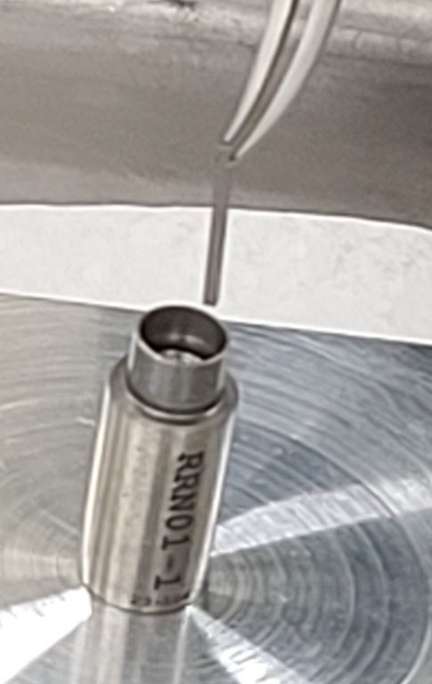
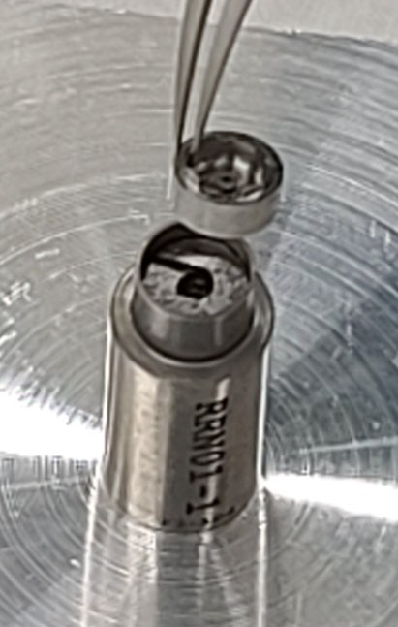
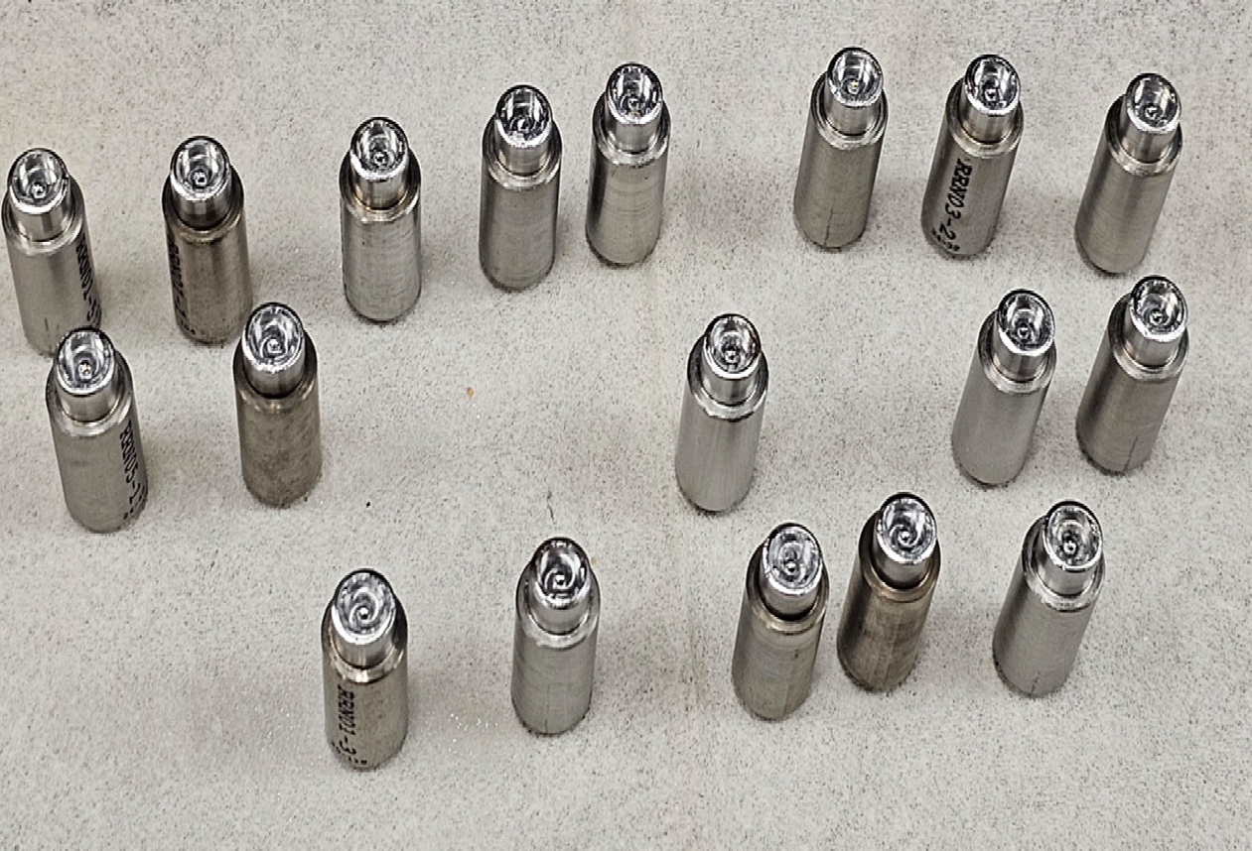
Experiment Assembly
Holder
End cap
Holder being inserted onto the tube
UN fuel specimen
Thermometry
Tube being inserted onto the fuel dish/fuel specimen
Tube
Fuel dish
Thermometry being loaded
End cap being placed
Grafoil disks

Slide 15
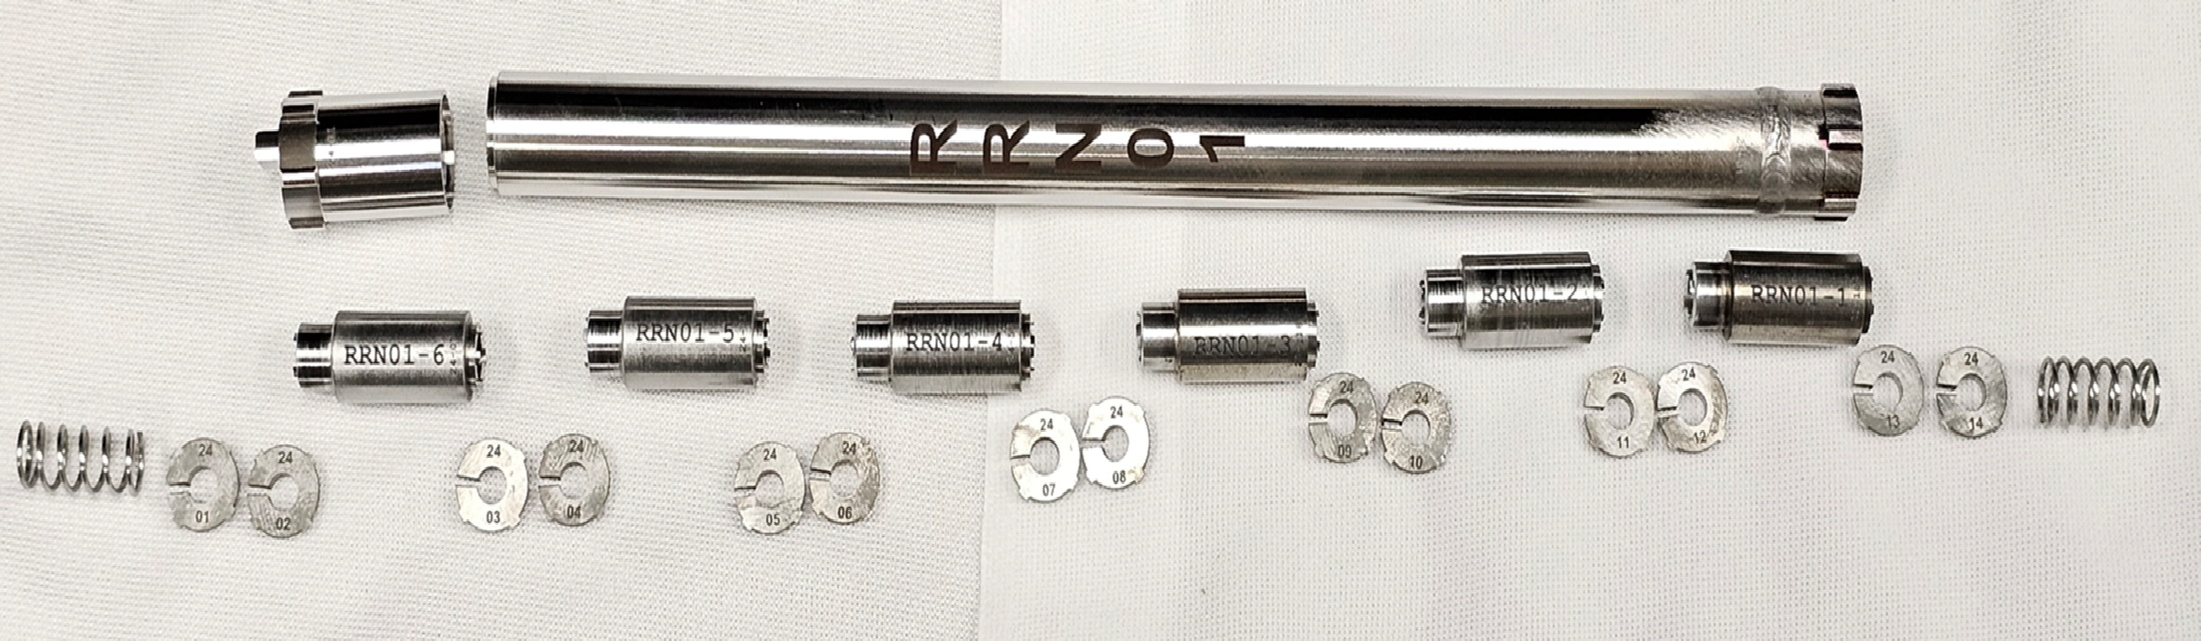
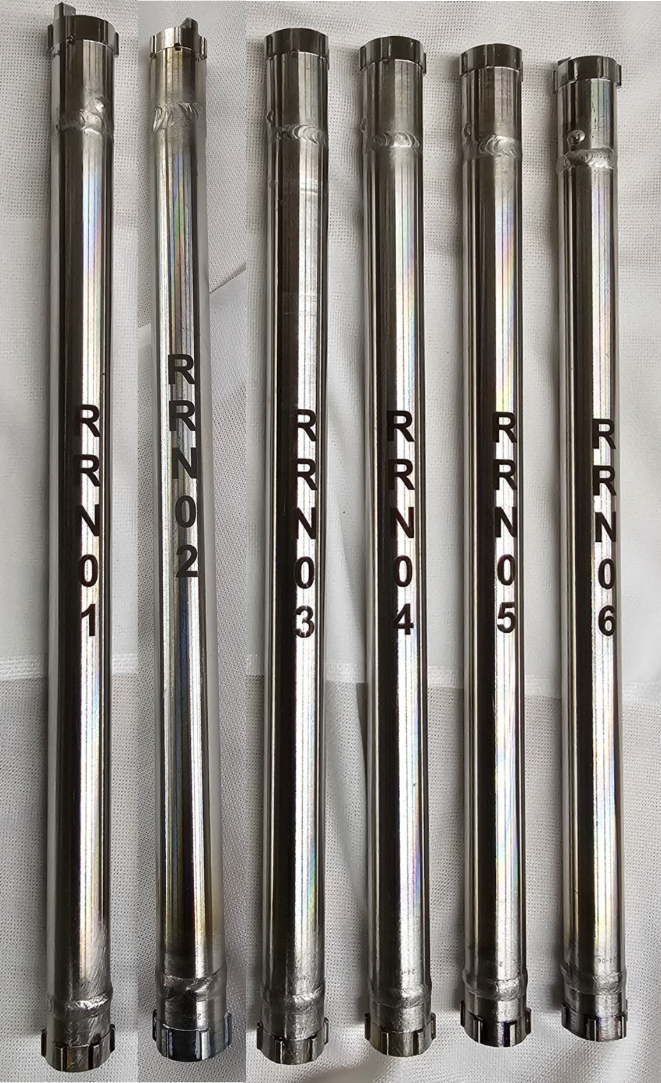
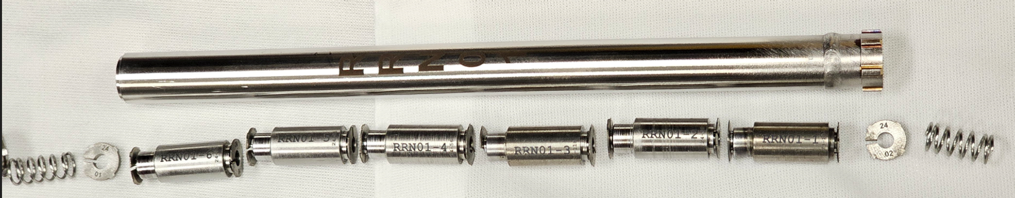
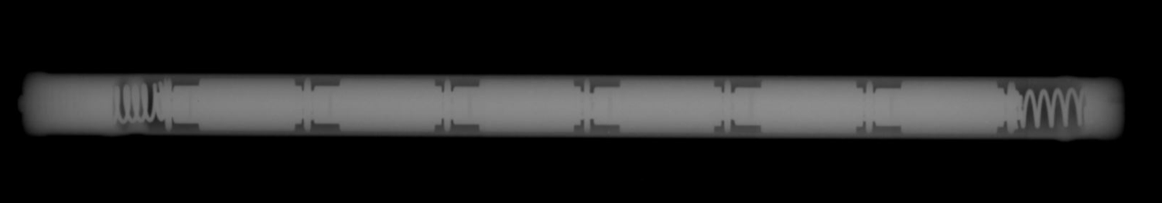
Experiment Assembly
Top end cap
Target tube
Bottom end cap
Subcapsules
Spring
Centering thimbles

Slide 16
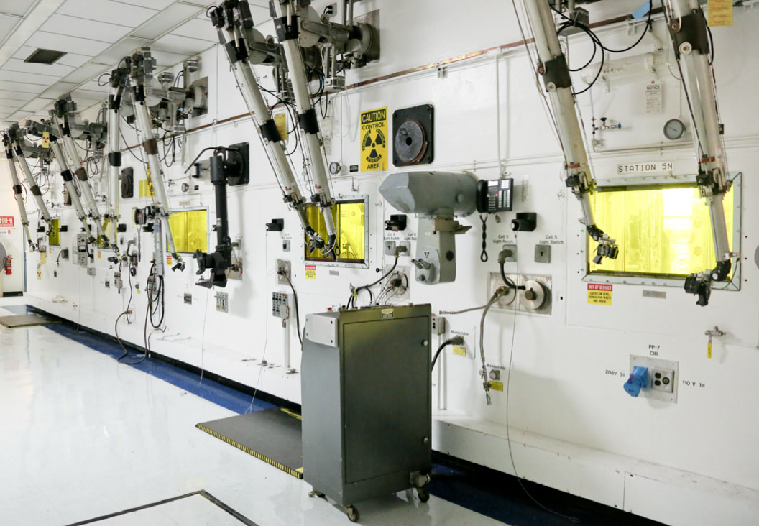
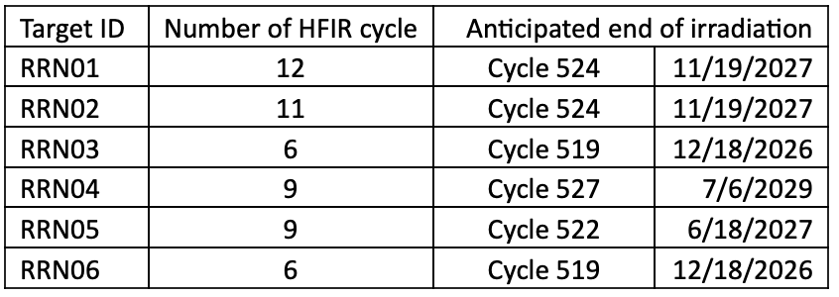
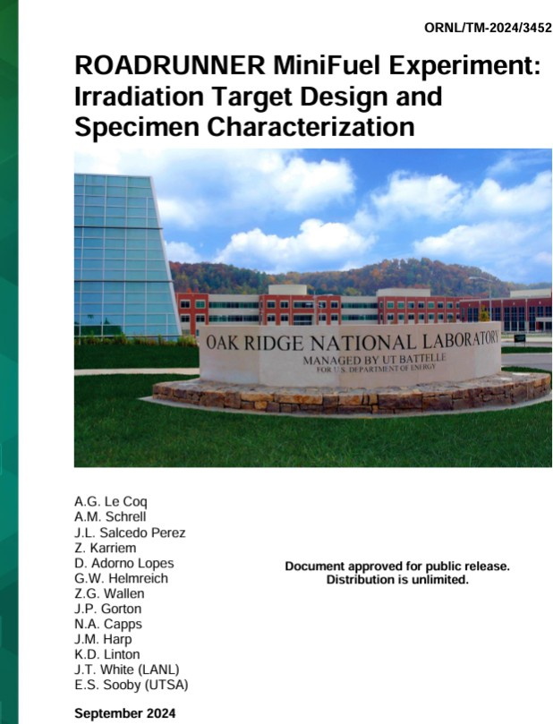
Timeline Status and Future Work
Publications:
  Report on Readiness as well as Status Reports
  Publications
    Recently accepted publication:
      Denise Adorno Lopes, Annabelle Le Coq, Adrian M Schrell, Julian Valdez, Peter Doyle, Ryan Heldt, Grant W Helmreich, Nathan Capps, Jason Harp, Kory Linton, Josh T White, Elizabeth Sooby, “ROADRUNNER uranium nitride MiniFuel: Experimental design, fabrication and pre-irradiation baseline characterization for accelerated burnup testing,” Nuclear Engineering and Design, 454, 2026.
PIE
  Targeted to begin early Q2-Q3 FY27

Slide 17





Thank you!
Principal Investigators and Collaborators
Denise Adorno Lopes
Annabelle Le Coq
Jason Harp
Nathan Capps Kory Linton
Joshua White Michael Cooper
Elizabeth Sooby
Antoine Claisse

