Slide 1
In situ Ion irradiation of U-10Mo alloy at sub-eutectoid temperatures
Nuclear Science User Facilities (NSUF) Annual Program Review
May 11-13th, 2026
Sukanya Majumder, M.A. Okuniewski
Materials Engineering, Purdue University, West Lafayette, IN 47907
05/12/2025

Slide 2
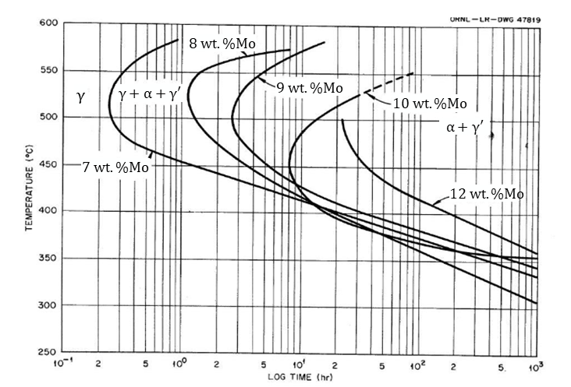
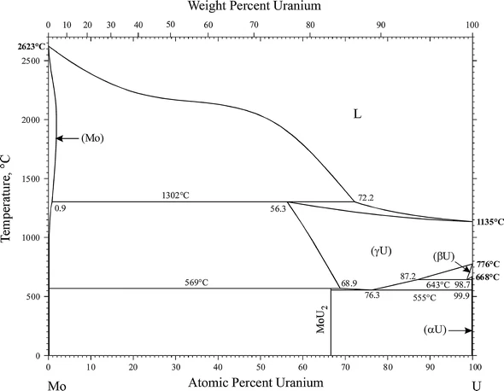
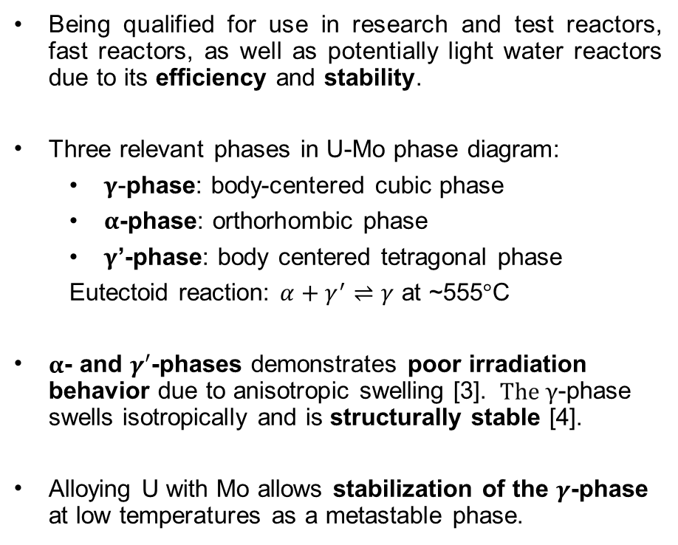

U-Mo as a nuclear fuel
Introduction
  Being qualified for use in research and test reactors, fast reactors, as well as potentially light water reactors due to its efficiency and stability.
Three relevant phases in U-Mo phase diagram:
  $γ$-phase: body-centered cubic phase
  $α$-phase: orthorhombic phase
  $γ$’-phase: body centered tetragonal phase
  Eutectoid reaction: $α+γ^{′}⇌γ$ at ~555$°$C
$α$- and $γ′$-phases demonstrates poor irradiation behavior due to anisotropic swelling [3]. $The γ$-phase swells isotropically and is structurally stable [4].
Alloying U with Mo allows stabilization of the $γ$-phase at low temperatures as a metastable phase.
U-10wt.%Mo
U-7wt.%Mo
High temperature (>555$°$C)
Research/test reactor and light water reactor temp. regime
TTT diagram of U-Mo alloys at different compositions [5]
Phase diagram of the U-Mo system [1,2]
[1] A. Berche, N. Dupin, C. Guéneau, C. Rado, B. Sundman, J.C. Dumas, Journal of Nuclear Materials 411 (2011) 131–143.
[2] H. Okamoto, J Phase Equilibria Diffus 33 (2012) 497.
[3] G.L. Hofman, Y.S. Kim, Nuclear Engineering and Technology 37 (2005) 299–308.
[4] R.W. Cahn, P. Haasen, E.J. Kramer, International Journal of Materials Research 84 (1993) 90–90.
[5] W.A. Bostrom, M.W. Burkart, E.K. Halteman, R.D. Leggett, R.K. McGeary, T.R. Padden, (1955).
Notes:
So lets begin! We know that Uranium molybdenum alloys are currently being qualified for use in research and test reactors because of their efficiency and stability under irradiation. There are 3 relevant phases in the phase diagram. First, the $γ$-phase, which is a BCC phase, that is stable at high temperatures. Then, there is the $α$-phase, which is orthorhombic, and the $γ$’ which is a body centered tetragonal intermetallic, and these are stable at lower temperatures, essentially that of research and test reactors and LWRs. As can be seen by the red arrow, there is a eutectoid reaction between the $γ$ and the $α+γ′$ phases at about 555$°$C. Since the stable $α$ and $γ′$ phases aren’t cubic crystals, they demonstrate anisotropic swelling and thus poor irradiation behavior. On the other hand, the gamma phase is cubic, swells isotropically, and is thus stable under irradiation. But, this is a high temperature phase, so the addition of Mo is needed to stabilize a metastable gamma phase.

Slide 3
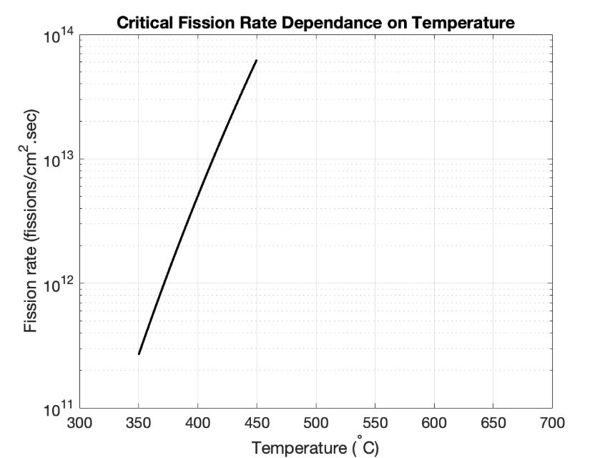
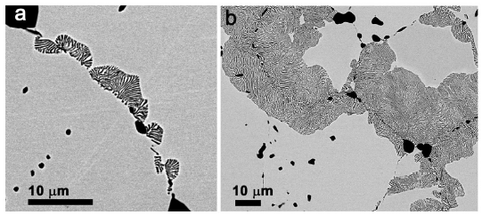
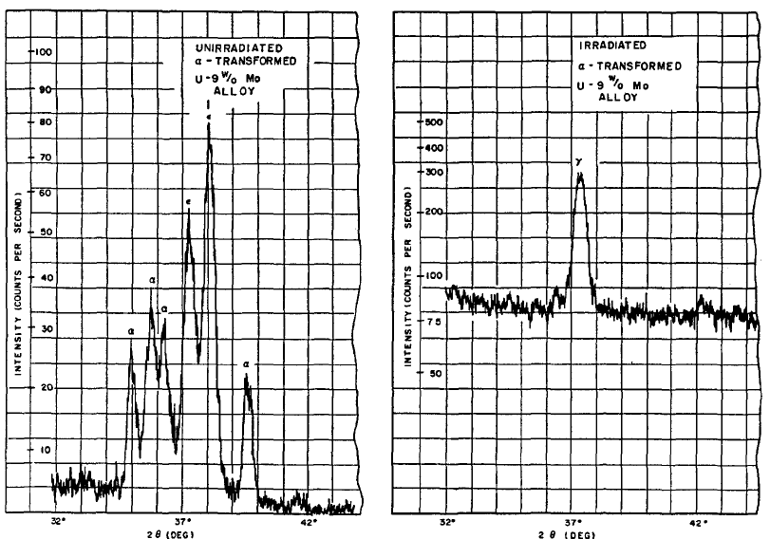


Phase evolution under Temperature vs. Irradiation:
Sub-eutectoid temperature range
Competing mechanisms:
Thermal annealing under the eutectoid temperature promotes $γ→α+γ′$ (phase decomposition)
  Via discontinuous and continuous precipitation reactions [1]
Exposure to irradiation promotes $α+γ′→γ$ (phase reversal)
  Via displacement spike mechanism [2]
Dominant mechanism depends on the fission rate of irradiation [3]
Temperature-dependent critical fission rate
  Depending on irradiation parameters, equivalent critical dose rate
γ
γ
Motivation
Literature: Phase reversal should dominate.
Hypothesis: Phase reversal does dominate, but eventually. A third dose-dependent mechanism exists and causes a transient phase decomposition.
Goals of this study:
To investigate the mechanisms of phase transformations in U-10Mo at subeutectoid temperatures
To possibly capture in-situ transient phase decomposition followed by reversal
Phase reversal
γ’+α
γ’+α
Phase decomposition
Phase decomposition of $γ$-phase after (a) 1 hr, (b) 10 hr of annealing at 500°C (Jana 2017 [1])
X-ray diffraction of unirradiated (left) and irradiated (right) U-9Mo specimens (Bleiberg 1956 [2])
Prior work [4]: Phase decomposition under neutron irradiation in U-10Mo at a dose rate higher than critical value, where reversal should dominate.
Dependence of critical fission rate in U-10wt.%Mo with temperature (redrawn from Willard et al. [3])
[1] S. Jana, A. Devaraj, L. Kovarik, B. Arey, L. Sweet, T. Varga, C. Lavender, V. Joshi, J Alloys Compd 723 (2017) 757–771.
[2] M.L. Bleiberg, L.J. Jones, B. Lustman, J Appl Phys 27 (1956) 1270.
[3] R.M. Willard, A.R. Schmitt, Irradiation Swelling, Phase Reversion, and Intergranular Cracking of U-10 Wt.% Mo Fuel Alloy, U.S. Atomic Energy Commission, 1965.
[4] S. Majumder, J.N. Emerson, M. Topsakal, G. Park, B. Beeler, M.A. Okuniewski, in: TMS Annual Meeting & Exhibition, Las Vegas, 2025.
Notes:
Let us look at the sub-eutectoid temperature range and the competing mechanisms that are known to affect the phase evolution in U-Mo. Thermal annealing promotes phase decomposition, which is the gamma phase decomposing into alpha and gamma prime. This occurs via discontinuous or continuous precipitation, depending on the temperature. Exposure to irradiation on the other hand promotes phase reversal, that is transformation of alpha and gamma prime back to gamma. I’s been conjectured to occur via the displacement spike mechanism. The fission rate of the irradiation determines which mechanism will dominate, That is, there is a temperature dependent critical fission rate, above which phase reversal dominates, and below which phase decomposition dominates.

Slide 4
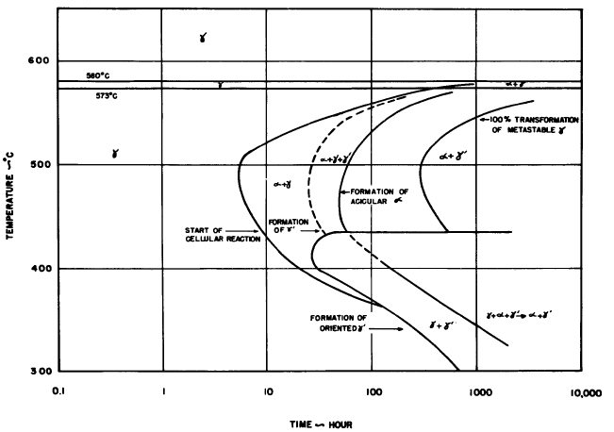

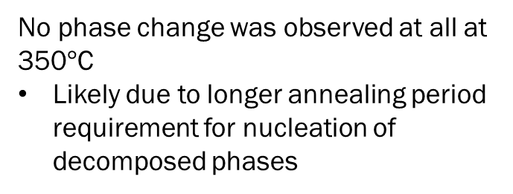
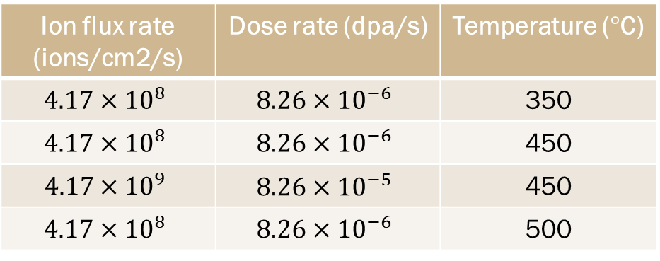
Methodology
No phase change was observed at all at 350$°$C
Likely due to longer annealing period requirement for nucleation of decomposed phases
In situ ion irradiation
Four DU-10Mo TEM disks ion irradiated at the IVEM Tandem Facility at Argonne National Laboratory
1 MeV Xe²⁺ ions
Ion flux rate (ions/cm2/s) | Dose rate (dpa/s) | Temperature ($°$C)
$$4.17×{10}^{8}$$ | $$8.26×{10}^{−6}$$ | 350
$$4.17×{10}^{8}$$ | $$8.26×{10}^{−6}$$ | 450
$$4.17×{10}^{9}$$ | $$8.26×{10}^{−5}$$ | 450
$$4.17×{10}^{8}$$ | $$8.26×{10}^{−6}$$ | 500
Prior work was investigated at 350$°$C
Dose rate effect
Temperature
effect
In situ TEM: ZONETEM II
  TEM micrographs (Bright field and dark field)
  Selected Area Electron Diffraction (SAED)
  Video of ion irradiation
Time-Temperature Transformation curve of U-10Mo [1]
[1] P.E. Repas, R.H. Goodenow, R.F. Hehemann, Vol: 57 (1964)..

Slide 5
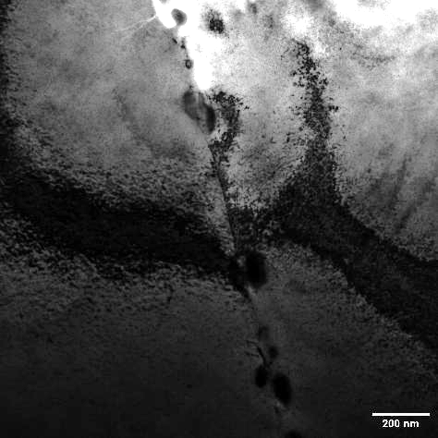
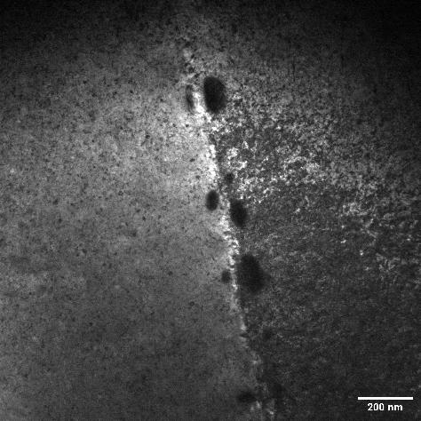
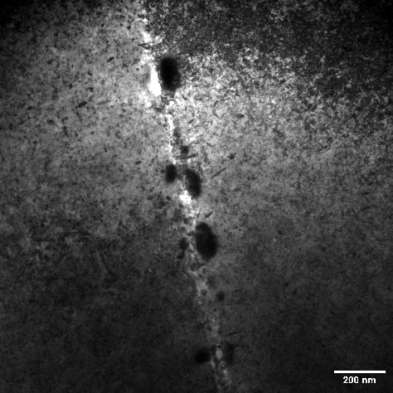
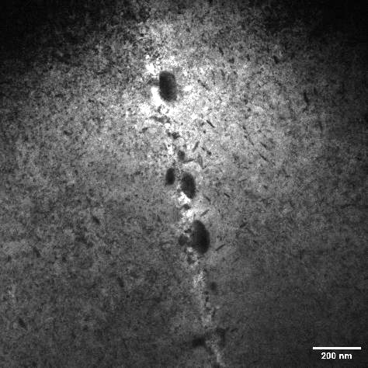
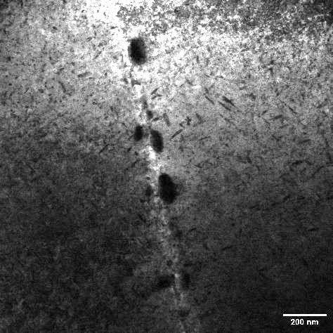
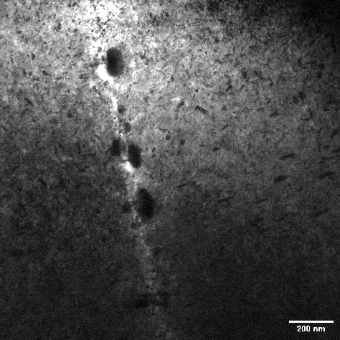
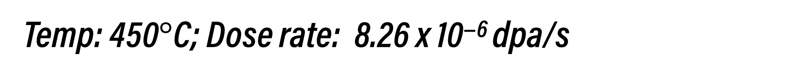
Temp: 450$°$C; Dose rate: 8.26 x 10⁻⁶ dpa/s
Unirradiated
0.030 dpa
0.055 dpa
0.072 dpa
0.121 dpa
0.237 dpa

Slide 6
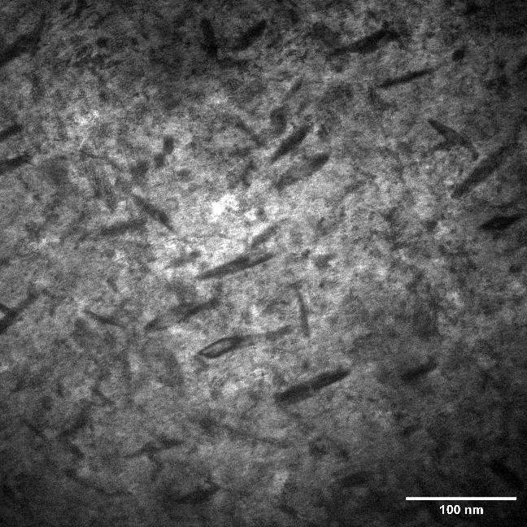
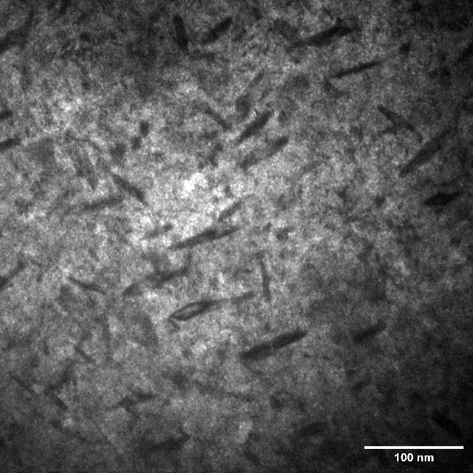
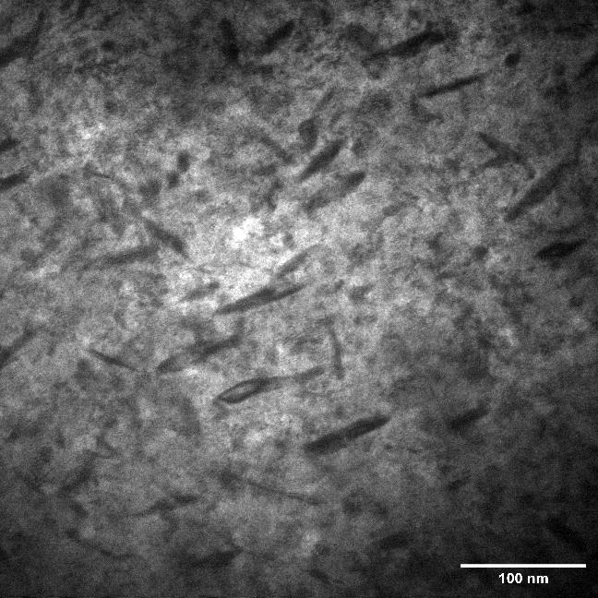


Temp: 450$°$C; Dose rate: 8.26 x 10⁻⁶ dpa/s
Precipitates and Fission Gas Bubbles (FGB)
0.121 dpa, Bright field
Overfocused (1 $μm$)
Underfocused (1 $μm$)
Precipitates are acicular and oriented primarily in three directions, a characteristic of continuous precipitation (CP)
Fission gas bubbles (FGBs) occur within the $γ$-phase matrix at doses > 0.055 dpa

Slide 7
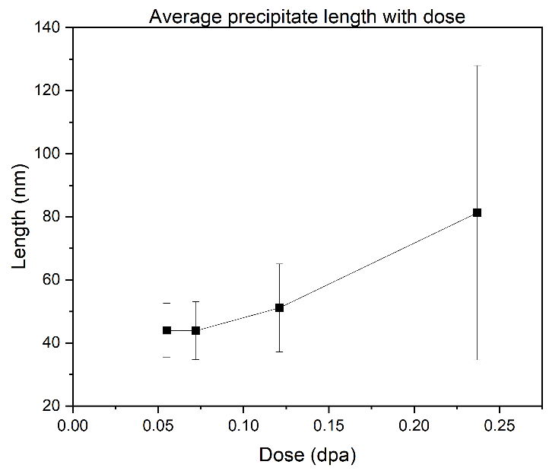
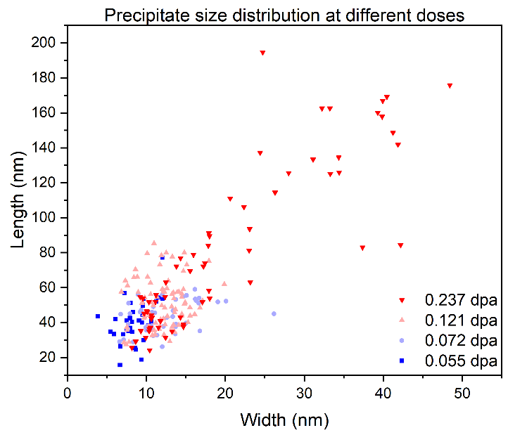
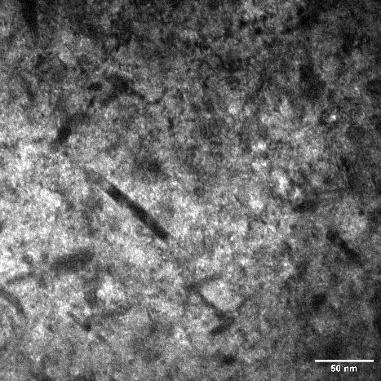
Temp: 450$°$C; Dose rate: 8.26 x 10⁻⁶ dpa/s
Precipitate length
(a)
(b)
Average precipitate length increases with increasing dose (Figure a)
Both length and width of individual precipitates increase with increasing dose (Figure b)
Both bigger and smaller precipitates are observed at high doses, indicating that nucleation is ongoing alongside growth

Slide 8
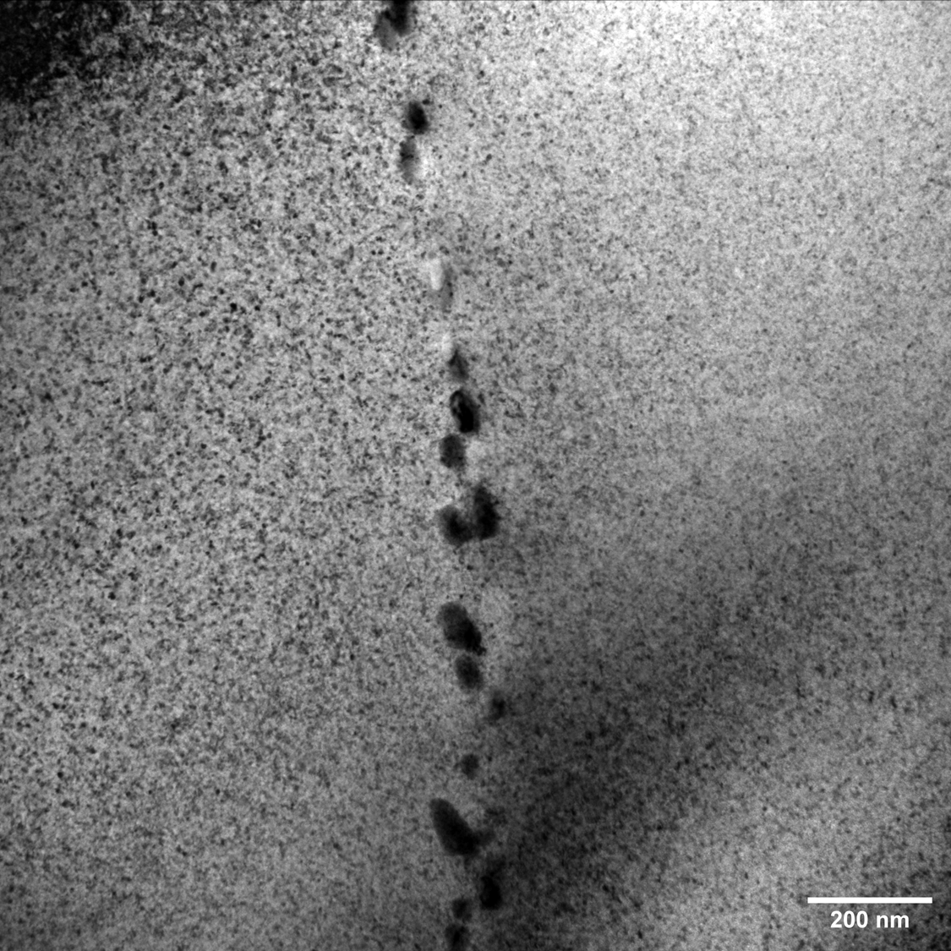
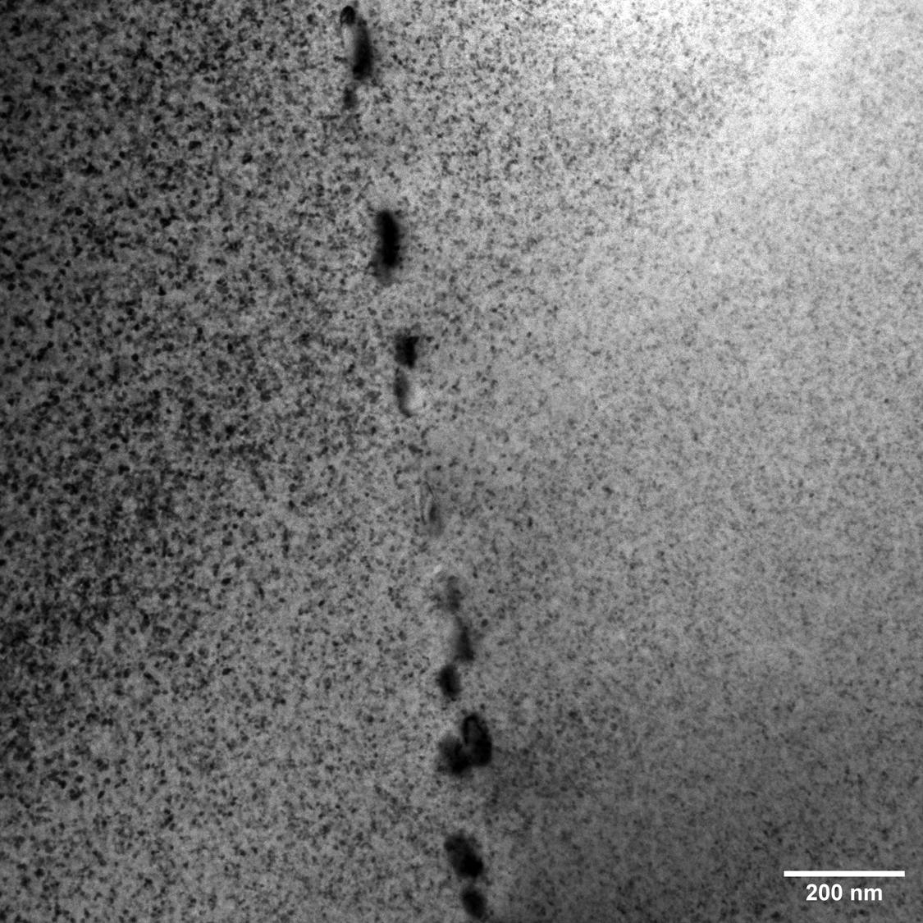
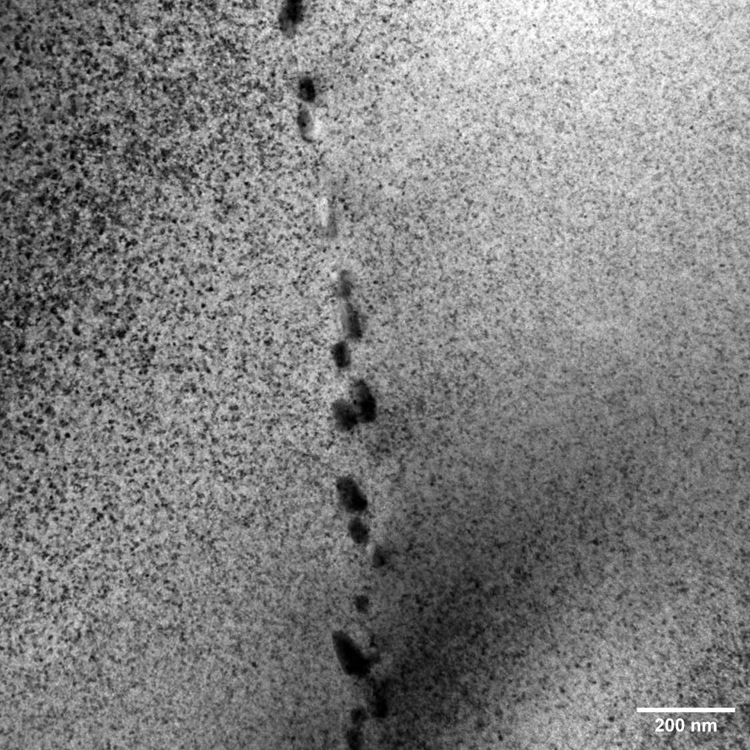
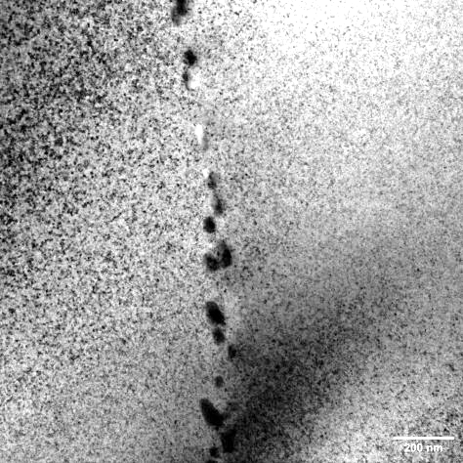
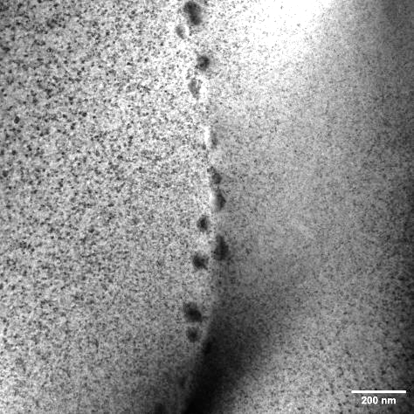
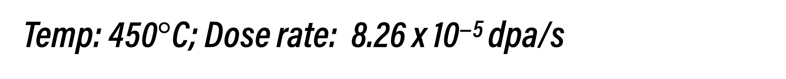
Temp: 450$°$C; Dose rate: 8.26 x 10⁻⁵ dpa/s
Unirradiated
0.058 dpa
0.096 dpa
0.212 dpa
0.500 dpa
0.910 dpa

Slide 9
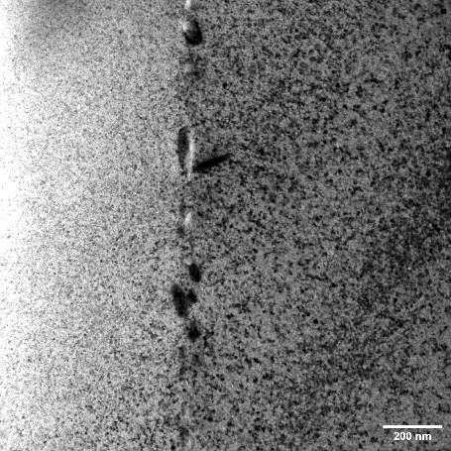
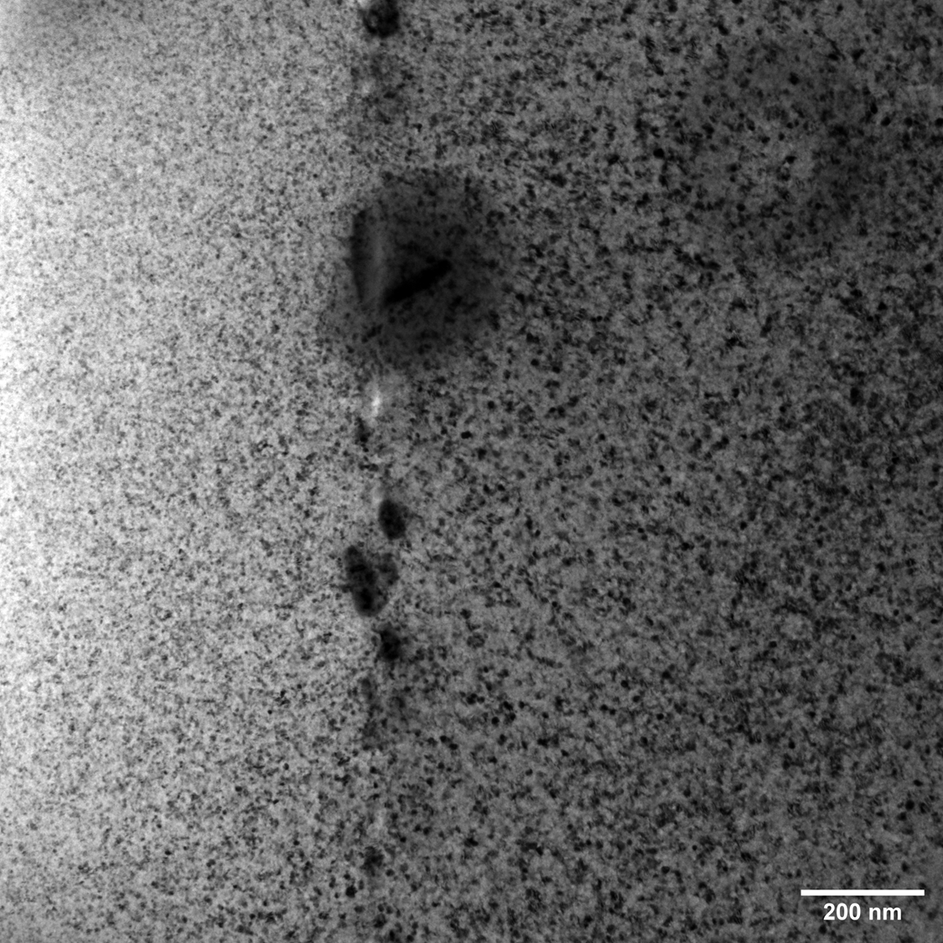
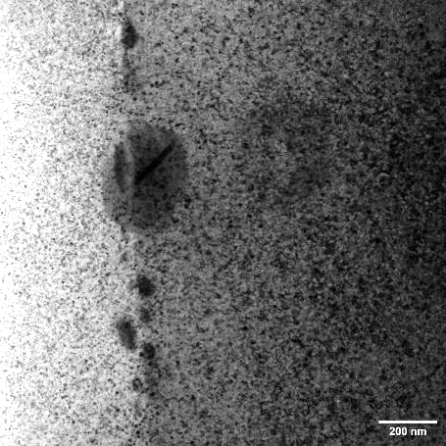
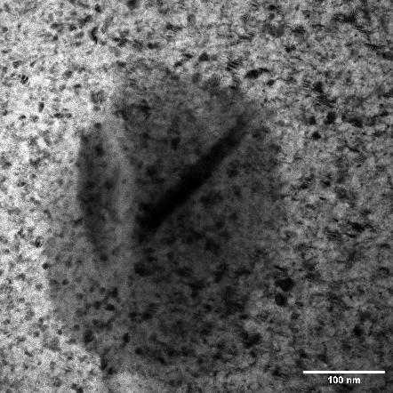
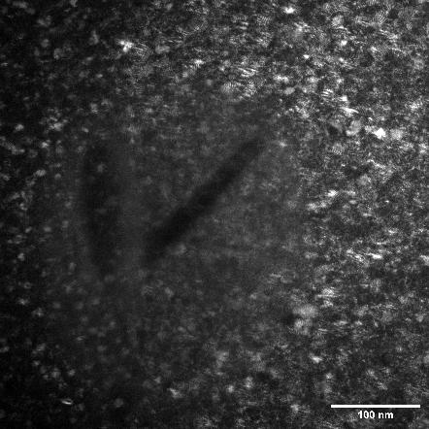
Temp: 450$°$C; Dose rate: 8.26 x 10⁻⁵ dpa/s
0.212 dpa
0.500 dpa
0.910 dpa
Bright Field
Dark Field
Formation of a singular large acicular precipitate
At 0.212 dpa, L = 143 nm
At 0.500 dpa, L = 128 nm
At 0.910 dpa, L = 198 nm

Slide 10
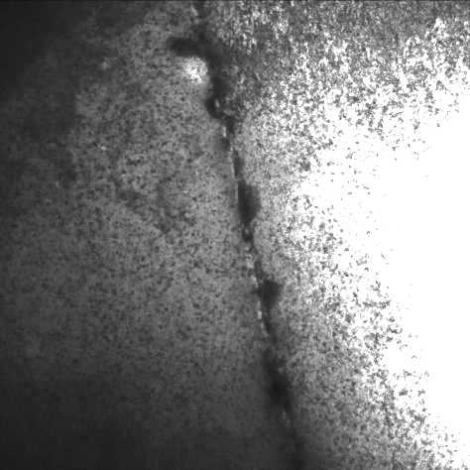
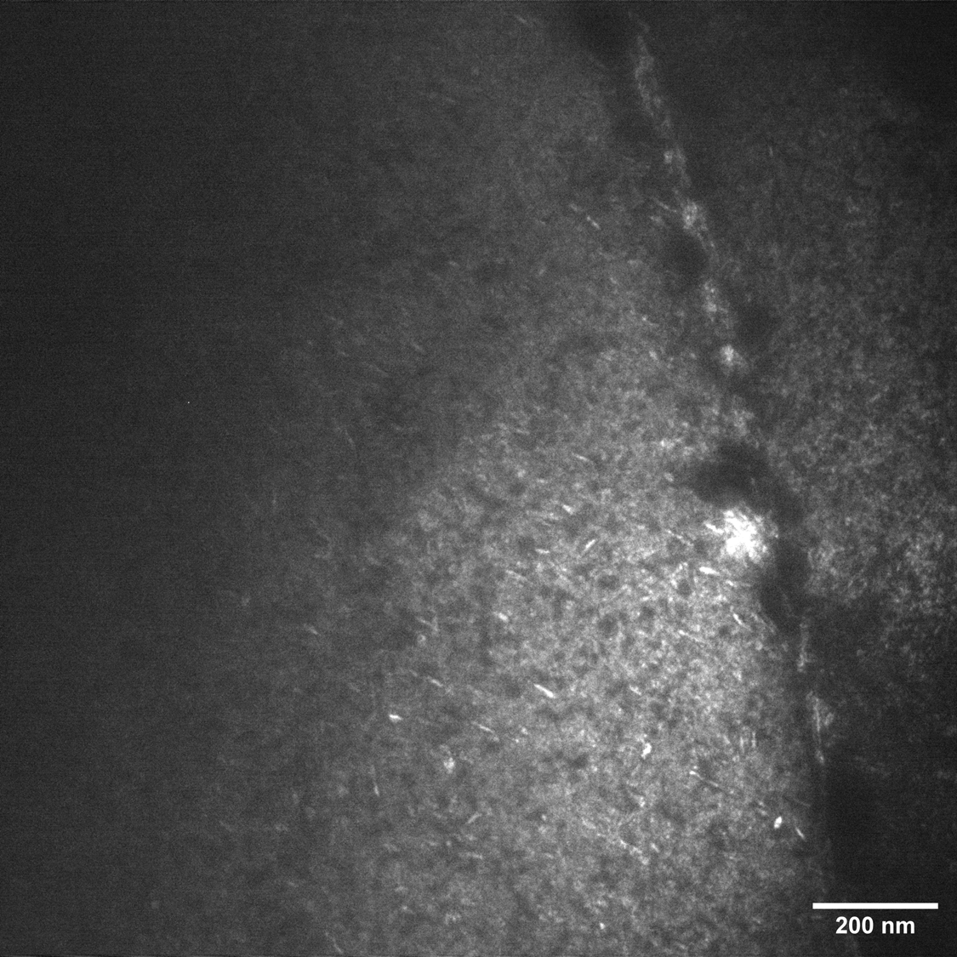
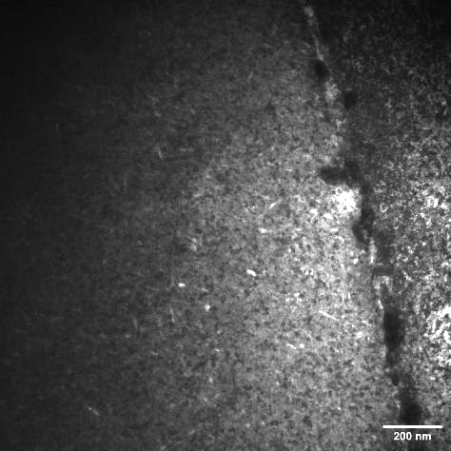
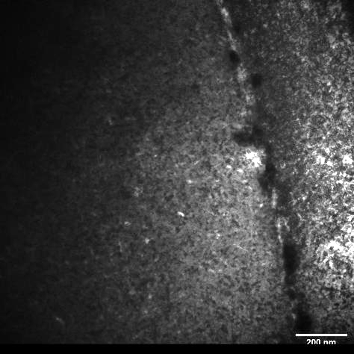
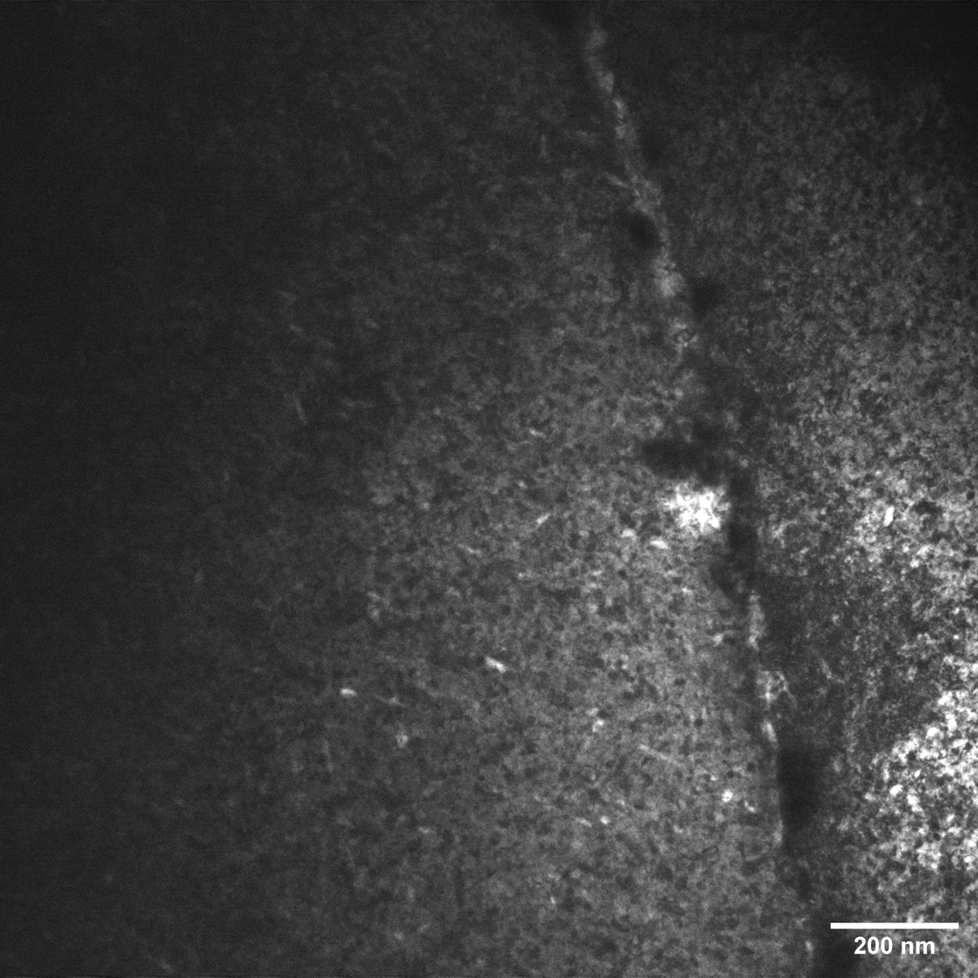
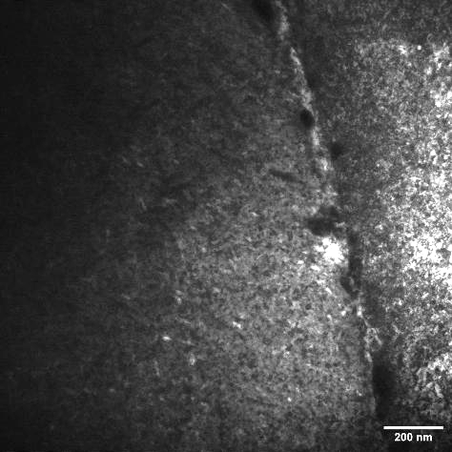
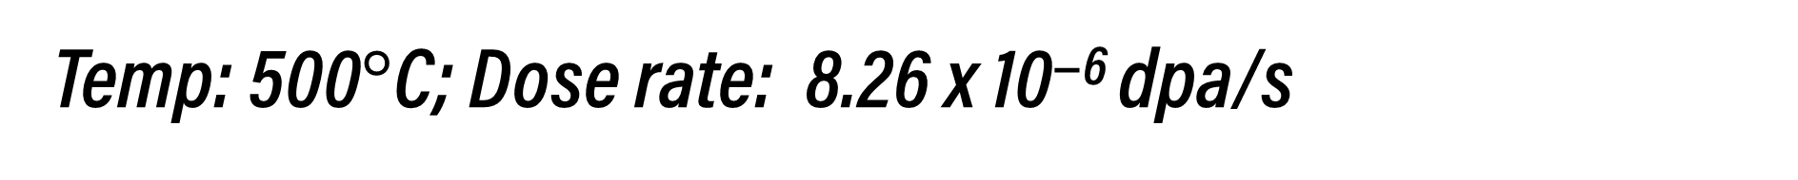
Temp: 500$°$C; Dose rate: 8.26 x 10⁻⁶ dpa/s
Unirradiated
0.030 dpa
0.056 dpa
0.073 dpa
0.100 dpa
0.179 dpa

Slide 11
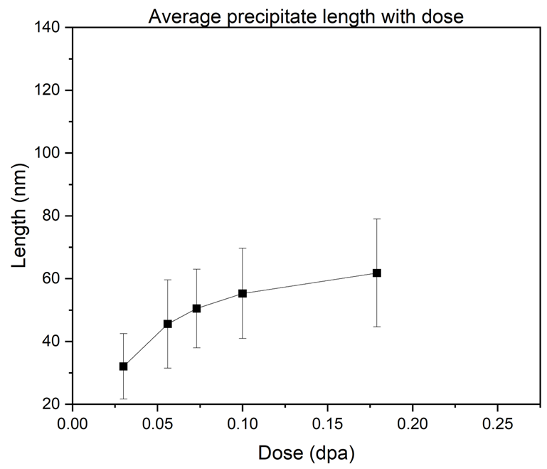
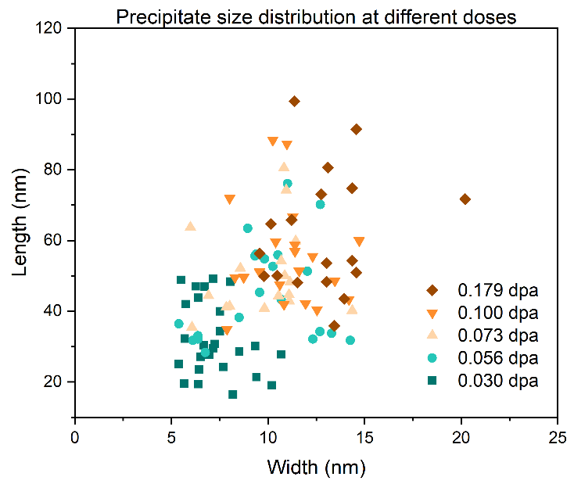
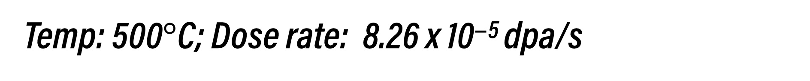
Temp: 500$°$C; Dose rate: 8.26 x 10⁻⁵ dpa/s
Precipitate length
(a)
(b)
Average precipitate length increases with increasing dose (Figure a)
Both length and width of individual precipitates increase with increasing dose (Figure b)

Slide 12
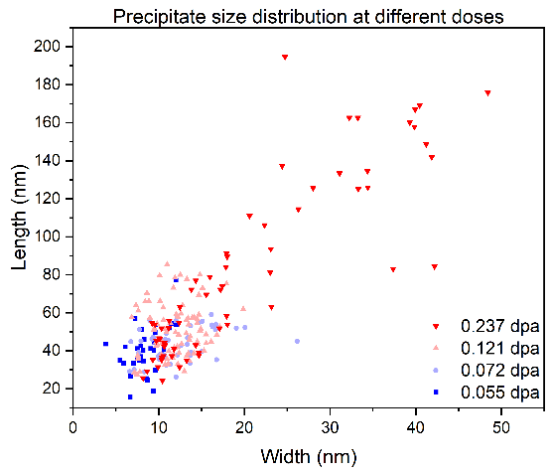
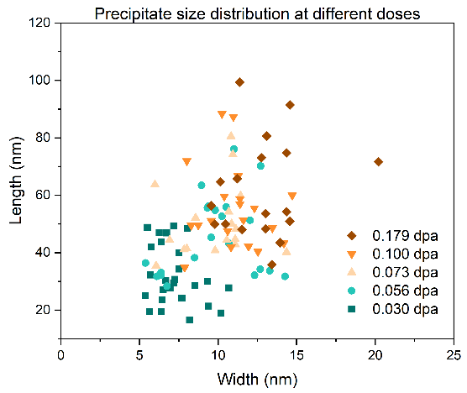
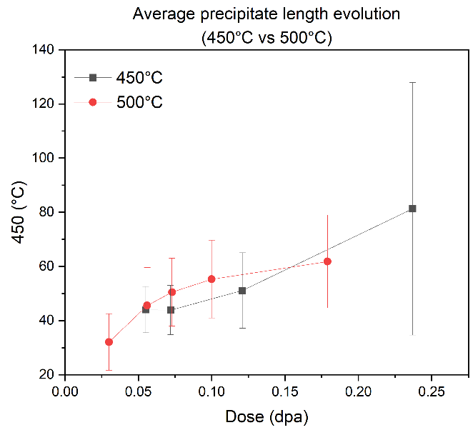


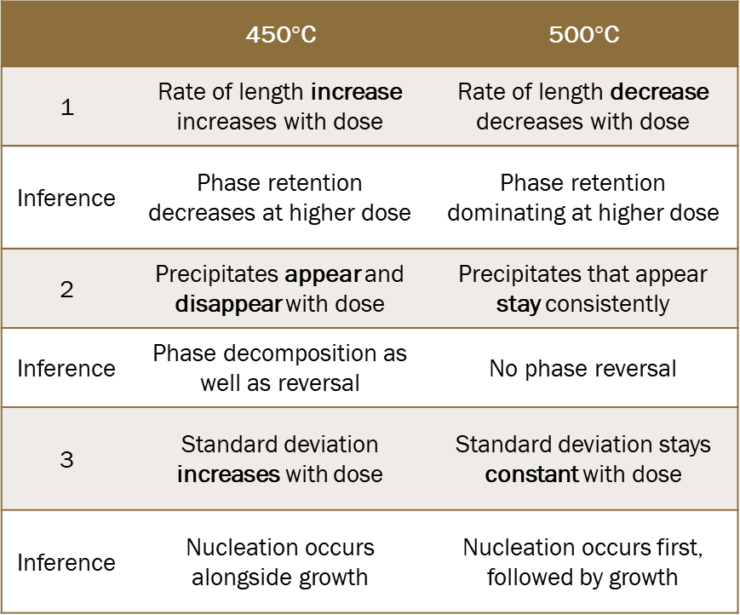
Temperature comparison
450$°$C
500$°$C
Dose rate: 8.26 x 10⁻⁶ dpa/s
 | 450$°$C | 500$°$C
1 | Rate of length increase increases with dose | Rate of length decrease decreases with dose
Inference | Phase retention decreases at higher dose | Phase retention dominating at higher dose
2 | Precipitates appear and disappear with dose | Precipitates that appear stay consistently
Inference | Phase decomposition as well as reversal | No phase reversal
3 | Standard deviation increases with dose | Standard deviation stays constant with dose
Inference | Nucleation occurs alongside growth | Nucleation occurs first, followed by growth

Slide 13



Phase transformations
No phase change (retention)
$$8.26×{10}^{−5}$$
Dose rate (dpa/s)
Acicular precipitates at doses > 0.05 dpa
Precipitates form and grow (decomposition) via CP as well as dissolve (reversal) with dose
Rate of decomposition increases with dose (lower retention)
Acicular precipitates form prior to irradiation and grow (decomposition) via CP and do not disappear (no reversal)
Rate of decomposition slows with dose (retention)
No phase change (retention)
$$8.26×{10}^{−6}$$
350
450
500
Temperature ($°$C)
Knee of U-10Mo TTT curve

Slide 14
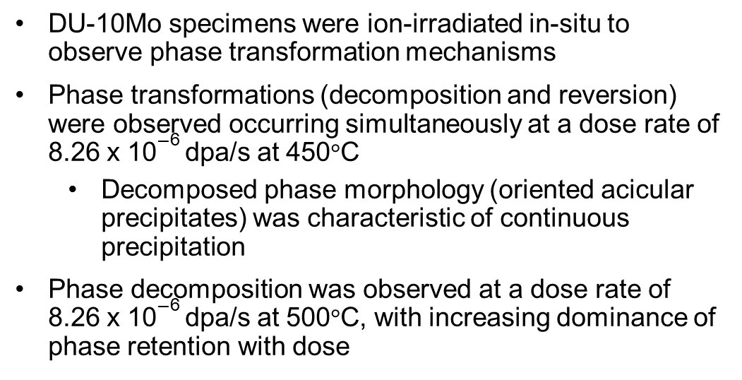
Conclusions and Future Work
Summary
DU-10Mo specimens were ion-irradiated in-situ to observe phase transformation mechanisms
Phase transformations (decomposition and reversion) were observed occurring simultaneously at a dose rate of 8.26 x 10⁻⁶ dpa/s at 450$°$C
  Decomposed phase morphology (oriented acicular precipitates) was characteristic of continuous precipitation
Phase decomposition was observed at a dose rate of 8.26 x 10⁻⁶ dpa/s at 500$°$C, with increasing dominance of phase retention with dose
Upcoming Work:
Phase identification of precipitate via synchrotron XRD of ion-irradiated specimens at APS
  Precipitates are very small, requiring noise-free XRD spectra

Slide 15

Acknowledgements
This work was supported by the U.S. Department of Energy, Office of Nuclear Energy under DOE Idaho Operations Office Contract DE-AC07-05ID14517 as part of Nuclear Science User Facilities award #24-4820
I would like to thank the IVEM staff (W.Y. Chen and D. Harbaruk) for their logistical and technical support during the experiment.
Notes:
This work is part of the USHPRR program, financially supported by Purdue university. We thank the Department of Energy for supporting this work via nuclear science user facilities. We would also like to thank Brookhaven National Lab and their personnel for synchrotron resources.

Slide 16

Thank You
Questions?
majumde1@purdue.edu
Add me on LinkedIn
Notes:
So that’s all I have today. Here is a talk by my colleague Nicole that I would suggest for everyone interested in metallic nuclear fuels. Thank you, and I will take questions now.

