Slide 1
May 11-13, 2026
  Anna Podgorney
    NFML Coordinator
    NSUF Program Administrator
Nuclear Fuels and Materials Library (NFML)
FY 2025 Annual Review
INL/MIS-26-92142

Slide 2
Agenda
NFML Overview
Access, Stewardship, and Acceptance
Growth and Utilization
FY 2025 Additions

Slide 3
NFML Overview

Slide 4

Overview of the Nuclear Fuels and Materials Library
U.S. Department of Energy (DOE) owned national resource
Curated by the Nuclear Science User Facilities (NSUF)
Access to irradiated and non-irradiated nuclear fuels/materials for research
Supports university, national laboratory, and industry users in advancing nuclear energy technology

Slide 5
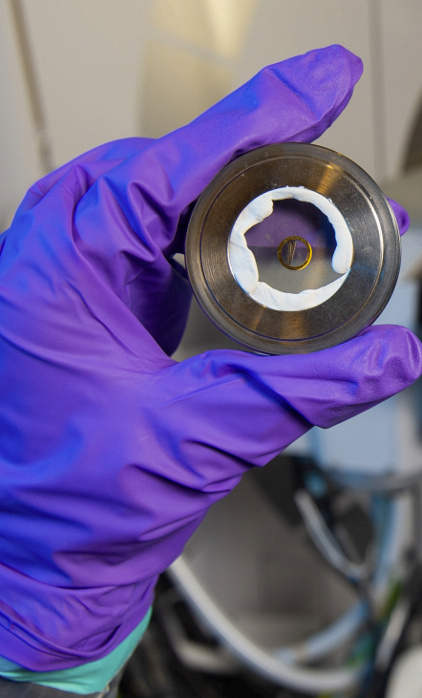
Purpose & Mission of the NFML
Enable
Enable broad, equitable access to high‑value materials that would otherwise be inaccessible
Support
Support cutting‑edge nuclear energy R&D, modeling, qualification, and PIE activities
Increase
Increase utilization of existing materials to reduce cost, duplication, and risk across the nuclear science community

Slide 6
NFML Contents and Sources
Samples resulting from NSUF-awarded projects
Legacy samples from the Experimental Breeder Reactor (EBR-II) shutdown in 1994
Samples from real-world components retrieved from decommissioned and operating power reactors
Donations from other sources
Technical information and publications associated with all NFML project samples
Irradiated fuels
Irradiated structural materials
Advanced alloy systems
Legacy or harvested specimens from prior test programs
Unirradiated reference materials for comparison

Slide 7
Access, Stewardship, and Acceptance

Slide 8
Sample Request Pathways
Solicitation Process: Request samples through CINR or RTE competitively awarded solicitations.
Proprietary Work: All NFML samples are intended for non-proprietary research.
(Proprietary requests are subject to additional review and specific conditions.)
Direct Request: Submit request to NSUF Director or Federal Program Manager for review and approval.
(Requestor may be responsible for retrieval, shipping and return costs.)

Slide 9
NFML Acknowledgement
All publications, reports, and presentations resulting from the use of NFML samples must acknowledge NSUF and NFML with:
Materials or samples employed in this study are from the Nuclear Fuels and Materials Library and were provided by the U.S. Department of Energy, Office of Nuclear Energy under DOE Idaho Operations Office Contract DE-AC07- 051D14517 as part of the Nuclear Science User Facilities.

Slide 10
Ownership & Transfer
All NFML samples are owned by DOE-NE. Materials must be formally transferred before curatorship:
DOE programs – documented agreement from the offering Federal Program Manager or DOE delegate
Third parties (industry, foreign entities, non-DOE agencies) – legal Agreement on Transfer of Title & Ownership
Upon transfer, the transferring party has no further authority over the samples.

Slide 11
NSUF Supported Project Samples
Materials irradiated under NSUF CINR projects automatically enter the NFML. Access follows a structured timeline:
Step 1: Irradiation phase complete. Samples transfer to PIE facility
Step 2: 3-year exclusive PIE access begins when materials arrive at PIE facility and are available for use.
Step 3: Samples opened to general research community via competitive proposals.
Subsequent proposers receive the original PI’s contact info as a courtesy. The original PI may collaborate but cannot deny access to awarded NFML requests.

Slide 12
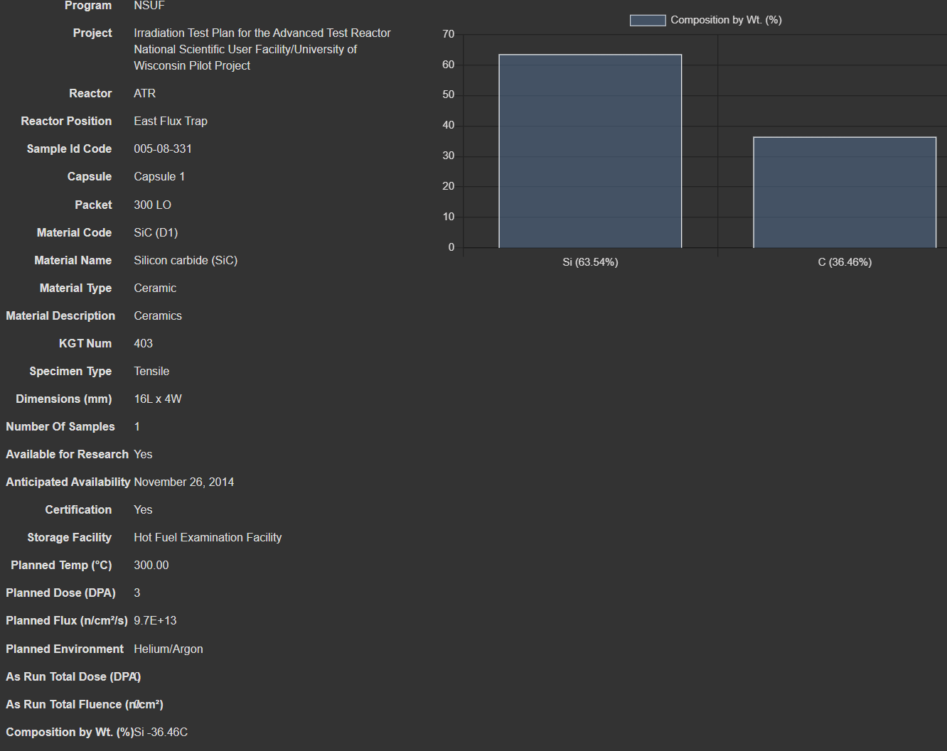
Sample Pedigree Requirements
Samples accepted into the NFML must include adequate pedigree documentation:
Material certifications, compositions & properties
Irradiation conditions (temperature, dose, flux, fluence, environment, duration)
Fabrication and/or manufacturing processes
Sample geometry and dimensions
Related reports and publications
Pedigree data is publicly available. (Proprietary portions may be excluded by arrangement.)

Slide 13
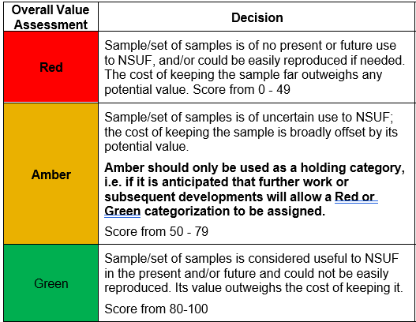
Value Assessment Process (VAP)
Step 1: Donor
  Provide relevant details regarding the potential donation
Step 2: NSUF Chief Scientists
  Determine the value of offered samples/materials.
Step 3: NSUF Management/Chief Scientists
  Decision to accept or reject samples

Slide 14
VAP Scoring Criteria
Is there supporting information/context for the sample/set of samples concerning provenance and baseline (unirradiated) material?
25 points
Does the sample/set of samples support a nuclear energy initiative or have any other known and ongoing purpose?
10 points
Is the sample/set of samples difficult to reproduce?
10 points
Is the sample/set of samples unique? Does it have unique characteristics/contain unique information?
20 points
Is the sample/set of samples in adequate condition for any ongoing purposes for which it is, or might be, required?
10 points
Can the sample/set of samples remain at its present location? What would be the cost or burden associated with keeping the sample/set of samples at its present location or must the samples be transferred to the INL?
10 points
Are there major issues involved in accessing, handling, transporting and/or storing the sample/set of samples?
15 points

Slide 15
Growth and Utilization

Slide 16
NFML Inventory Growth

Slide 17
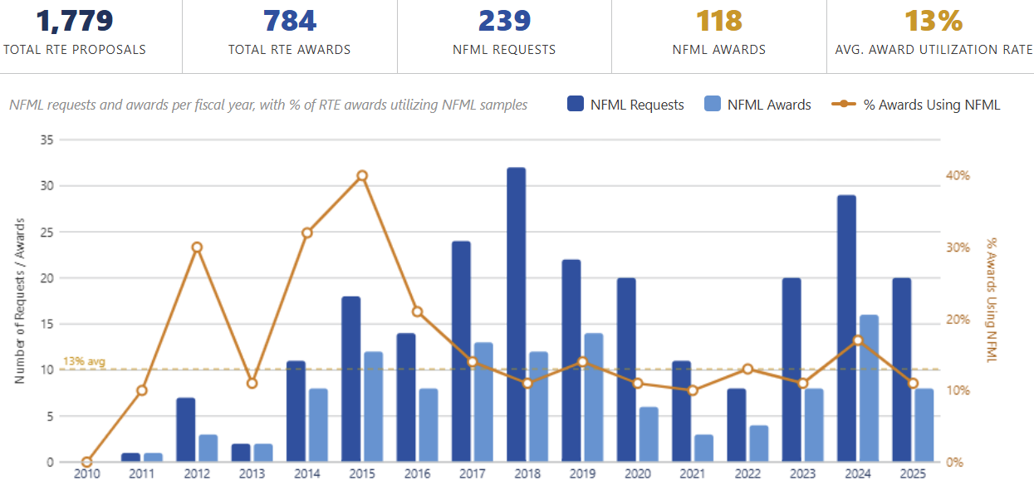
NFML Utilization via Rapid Turnaround Experiment (RTE) Program – FY2010-2025
Notes:
Current utilization. Looking for ways to improve utilization and just held an NFML Stakeholder workshop focused on ways to improve organization, useability and utilization.
Average % of proposals requesting NFML that were awarded = 56%
All time average % of proposals requesting NFML = 15%
All time average % of awards using NFML = 16%
Stabilized to 12-13% currently requesting and utilizing NFML

Slide 18
FY25 NFML Additions

Slide 19
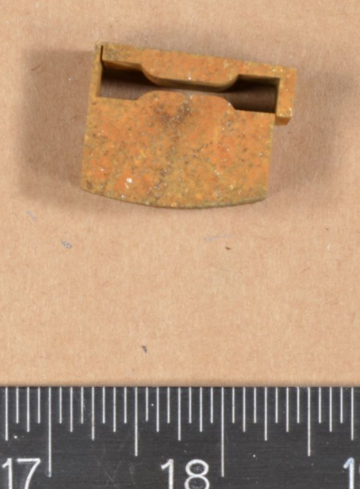
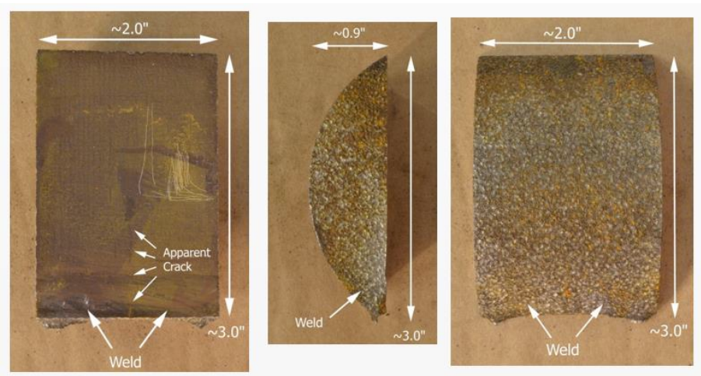
BWXT & Southern Nuclear Co. Addition: Harvested LWR Core Shroud Materials
(available)
304 SS core shroud samples (weld and base metal and Heat Affected Zones (HAZ) from a commercial LWR NPP
Legal transfer of Title and Ownership signed in FY 2022
Samples delivered in batches from BWXT to INL
Last shipment arrived March 2025

Slide 20
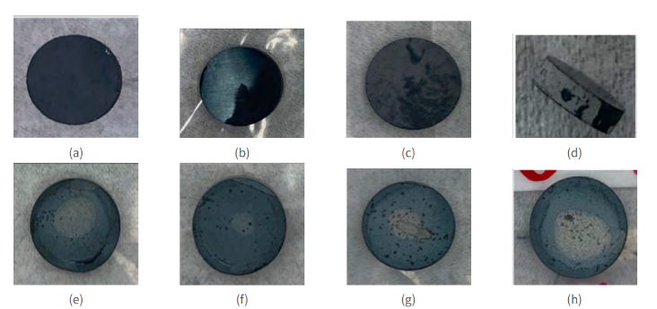
DOE-NE Microreactor Program Acquisition: Yttrium Hydride Samples
(available)
ATR-irradiated Yttrium-hydride experiments to advance technology readiness level of moderator material
Fabricated through innovative techniques
  powder metallurgy
  massive hydriding
Principle additions to the FY23 Version of the Advanced Moderator Material Handbook are the pre- and post-irradiation examination(s) of the irradiated YH
Examples of direct hydride samples
Examples of powder metallurgy samples

Slide 21
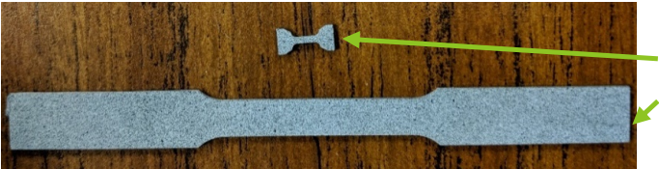
LDRD Acquisition: Tensile Testing Using the Standard Capsule (TTUSC)
(not currently available)
ATR-irradiated multi-principal element alloys (MPEAs)
16 material compositions
Tensile samples of five or more main components irradiated in the SAM-2 “standard capsule”
  “Standard” capsule with analysis basis to use any ATR position, reducing cost and time for new experiments
  Allows for large number of specimens to be irradiated
  Reduced specimen size to accommodate more specimens in reactor
Samples awarded for FY24 CINR: Radiation Effects of High Entropy Alloys
Miniature “MT2” Tensile specimen (16 x 5 mm)
  ASTM E8 Standard “Sub-sized Specimen”
  (50 mm x 12.5 mm)

Slide 22
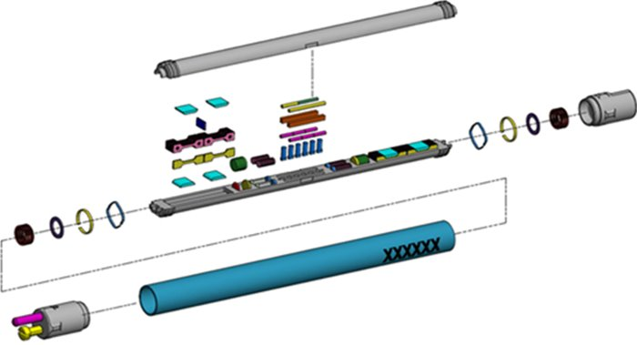
NSUF-Funded Project Addition: SAM-2 Neutron Transmutation Doping of High-Purity SiC
(not currently available):
ATR-irradiated high purity SiC samples using the standard capsule
Capsules A, B, and C were added to the library in FY-23​
Capsule D was included in the NFML in 2025​
Capsules E–H remain under irradiation
The full set of tensile and disc samples will become available following completion of PIE

Slide 23
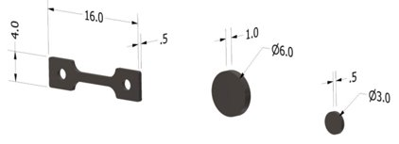
NSUF-Funded Project Addition: General Electric Research - Assessment of Irradiated Microstructure and Mechanical Properties​ of FeCrAl Alloy Fabrication Routes
(not currently available)
ATR-irradiated alloys using the NSUF standard capsule design
Produced through three different methods:​
  Conventional melting and forging​
  Additive manufacturing​
  Powder metallurgy
Post irradiation experiments will assess the irradiation effects on microstructure (e.g., irradiation-induced defect clusters​ and precipitation), as well as their corresponding impact on mechanical properties such as hardness and embrittlement​

Slide 24
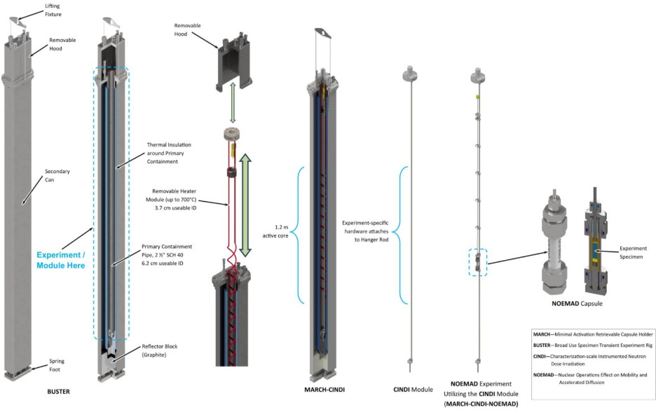
NSUF-Funded Project Addition: Ohio State University – NOEMAD Cladding Coating Study
(available)
Nuclear Operations Effect on Mobility and Accelerated Diffusion (NOEMAD)
TREAT-irradiated accident-tolerant fuel cladding
  Zircaloy coated with chromium
Determination of Zircaloy and Cr diffusion coefficients to understand ATF behavior under normal operating and accident conditions
Experiment Specimen
NOEMAD Capsule

