Slide 1
Extraction of Bulk-like Properties through Nanoindentation to Enhance Utilization of the NSUF Nuclear Fuels and Materials Library
May 12, 2026 | NSUF Program Review, Virtual
Stephen Taller¹, Caleb Massey¹, Wei-Ying Chen², Geeta Kumari^{1*}
1-Oak Ridge National Laboratory, 2-Argonne National Laboratory, *-Now at Eutectix, LLC
Notes:
Accessing Title Slide Options
The standard ORNL presentation template includes five branded title slide layouts:
Title | Standard. The preferred layout for lab-wide and general presentations. Features a default aerial photograph of the lab.
Title | Custom Image. Allows replacement of the default background with a custom full-slide image (16:9 or 4:3 landscape format).
Title | Custom Portrait Image. Supports inclusion of a custom 4:3 portrait image positioned next to the introductory text.
Title | Custom Landscape Image. Supports inclusion of a custom 16:9 landscape image positioned next to the introductory text.
Title | Text Only. Offers additional space for longer titles and multiple presenters.
Additional Lab-approved title slides specific to directorates and user facilities are available in PowerPoint under the following folders: Custom Title Slides and User Facility Templates, located in Electronic Presentation Templates.
Custom Title Slide Guidelines
Image Rights. Any custom images, graphics, or photography must be owned by ORNL or used with documented permission from the original creator or source.
Appropriate Image Use. Select images that work well with the layout. Ensure the focal point of the image is not obscured by the title text and white overlay box.
Relevance and Impact. Visuals are a key element of effective communication. Whenever possible, use imagery that enhances the message of your presentation and reflects ORNL’s mission and values.
Quality and Clarity. Use high-resolution images for clarity on large screens. Avoid overly complex or dark images that may conflict with the title text.
Text-Only Option. If no appropriate or approved imagery is available, or if imagery is not permitted for the subject matter, the Title | Text Only layout provides a clean, professional alternative.
Learn more about ORNL electronic presentations
https://ornl.sharepoint.com/sites/branding/SitePages/electronic-presentations.aspx

Slide 2

Acknowledgements
Funding Sources
People
U.S. Department of Energy
Ryan Duncan
Keith Carver
Chase Joslin
Tom Geer
Anthony Guajardo
Gavin Mattingly
Richard Howard
Erik Herbert
Mohammad Umar Farooq Khan
Jim Horenburg
Brian Long
Daniel Newberry
Sarah Graham
Kevin Hanson
David Collins
Stewart Marsh
Kory Linton
Annabelle Le Coq
Samples provided by:

Slide 3
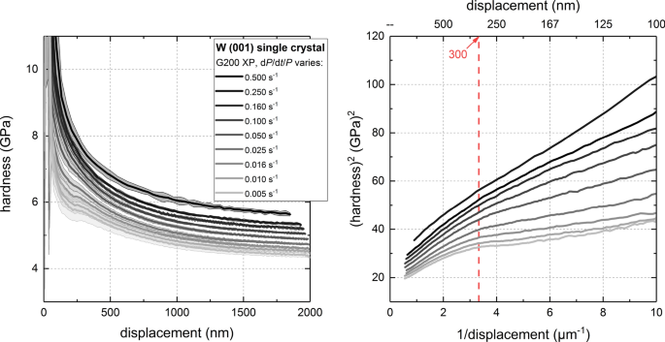
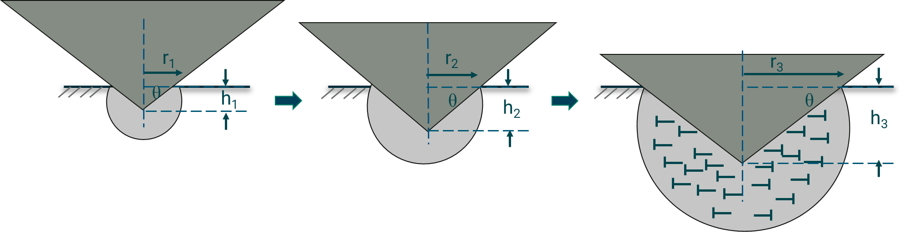
Instrumented indentation offers the ability to probe several material properties on small volumes
Near surface:
Information about local heterogeneity
Sensitive to surface finish and the tip defect
Pushing deeper
past h*~f(indenter, G (shear modulus), H₀)
10 x h* = critical length scale
H₀ = bulk equivalent hardness
“Bulk” Regime:
Result homogenized
Better for comparison
Sensitive to system compliance
At shallow depths, geometrically necessary dislocations are required to accommodate the strain gradient → leads to higher hardness
Notes:
h* is estimated by the indenter shape, shear modulus, and bulk hardness of the material near 450-500nm in this material.

Slide 4
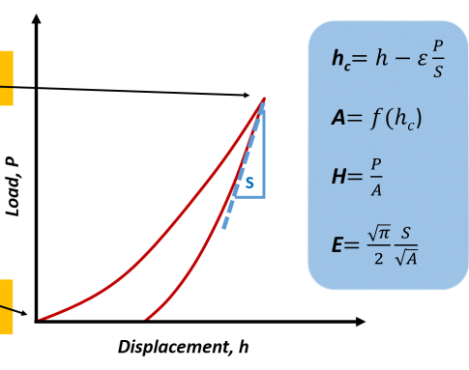
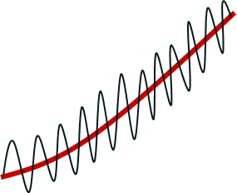





The continuous stiffness method allows us to get data-rich curves
Single Indent
Inputs:
ν, ${\dot{s}}^{−1}$
Max Load, Depth
$$H=\frac{P}{A}$$
Continuous Stiffness Method (CSM)
H(S), E(S)
Imposed harmonic oscillation with a known frequency (f) and amplitude (A)
Fixed amplitude
Depth
Signal/Noise
$$A=f\left(h_{c}\right)$$
A from calibration
Contact Point
W. C. Oliver and G. M. Pharr, J. of Mater. Res, vol. 7, 1992, doi: 10.1557/jmr.1992.1564.
Amplitude increases proportional to load
Procedure in non-mandatory appendix X4
800 to 1200 points per indent
Depth
Signal/Noise
J. Hay, P. Agee, and E. Herbert, Exp. Tech., 2010, doi: 10.1111/j.1747-1567.2010.00618.x.

Slide 5
Goals of the work is to get from small volumes to bulk-like mechanical properties
Objective: Develop the capability to extract a bulk-like, engineering-relevant mechanical property from small volumes of irradiated material using instrumented indentation techniques.
Approach:
Build the pipeline from nanoscale performance to a bulk-like property using 316 steel.
Extrapolate to irradiated materials to identify challenges with the methodology.
Throughout the approach, pursue automation.

Slide 6
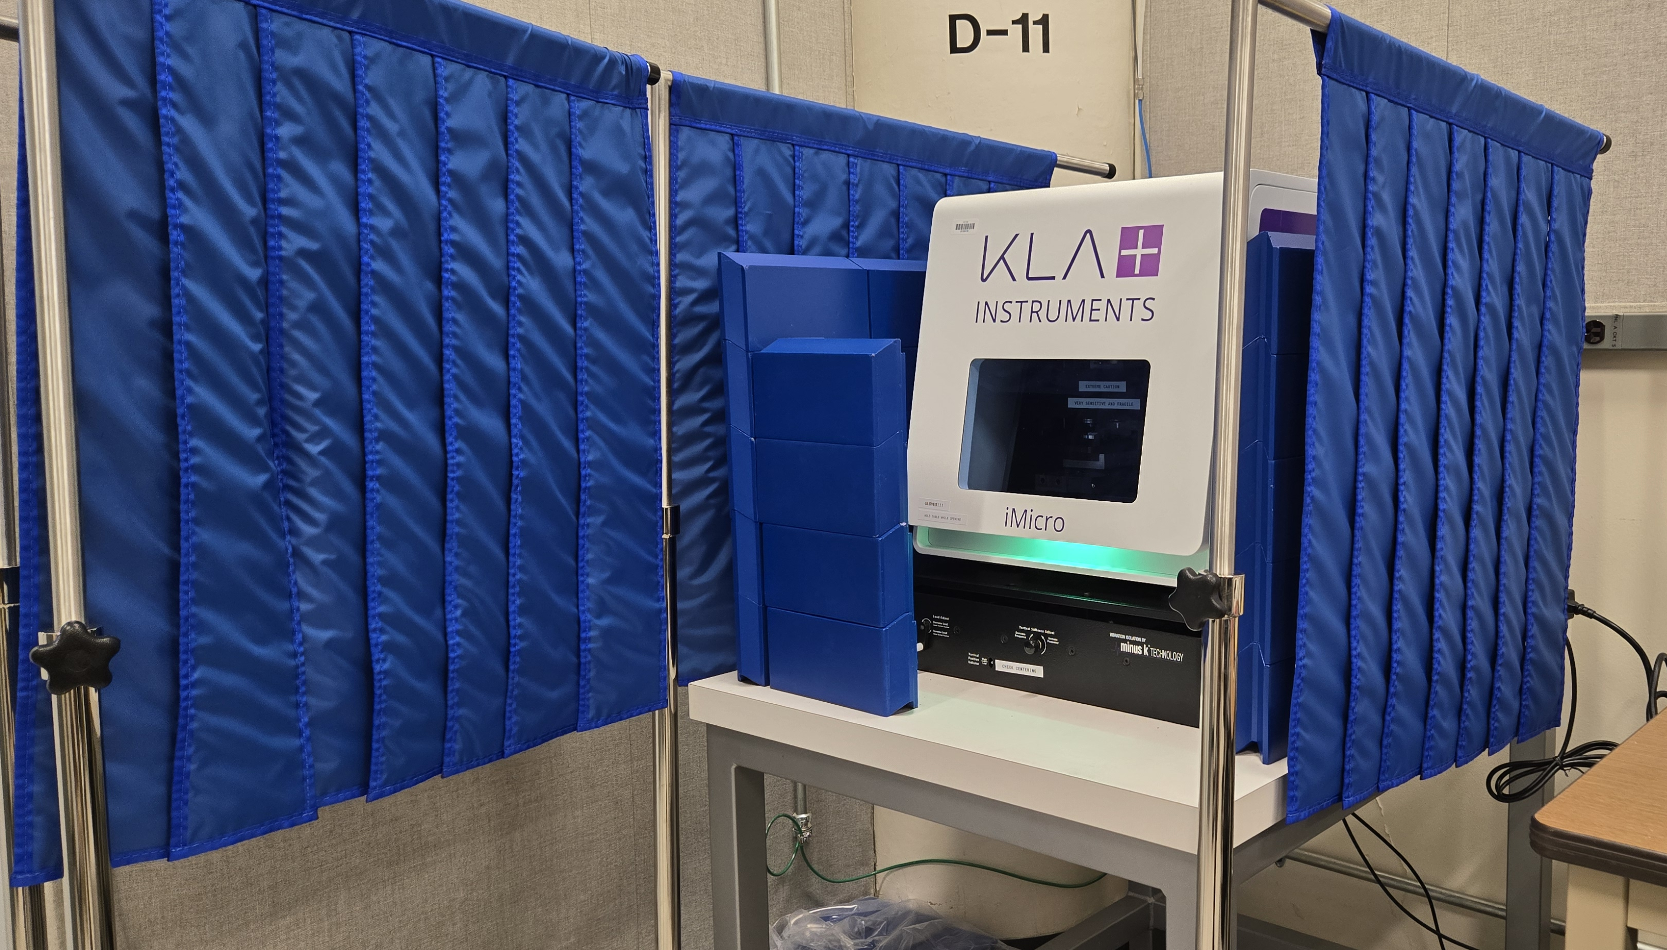
Indentations conducted on KLA iMicro at ORNL dedicated to nuclear fuels and materials
Parameters for all indents:
  50 mN actuator
  Berkovich tip
  Frequency: 110 Hz
  Amplitude: 10% of load
  Grid: Either 5 x 5 or 6 x 6
  Spacing: 50 μm in both horizontal and vertical directions
  Calibration using fused silica before and after each set of indents in case tip dulls during the run.
Photo of the KLA iMicro with Pb shielding surrounding the instrument
The instrument sits in a temperature controlled, acoustically damped room with an anti-vibration table to gather the best data we can.

Slide 7






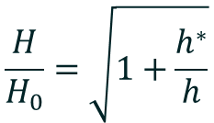




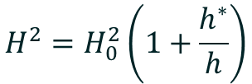

Software to process the data is a combination of vendor software and python-based scripts
Programming language
$$h_{c}=h−ε\frac{P}{S}$$
Import and manage datasets
$$A=f\left(h_{c}\right)$$
$$h_{c}, H\left(h_{c}\right), E\left(h_{c}\right),S(h_{c})$$
Math
$$H=\frac{P}{A}$$
$$\frac{H}{H_{0}}=\sqrt{1+\frac{h^{∗}}{h}}$$
Nix-Gao
$$S=β\frac{2}{\sqrt{π}}E_{eff}\sqrt{A}$$
$$H^{2}=H_{0}^{2}\left(1+\frac{h^{∗}}{h}\right)$$
$$\frac{1}{E_{eff}}=\frac{1−ν^{2}}{E}$$
Linear regression and error analysis
Make pretty figures systematically
Handled in the vendor software
W. D. Nix and H. Gao, Journal of the Mechanics and Physics of Solids, vol. 46, 1998, doi: 10.1016/s0022-5096(97)00086-0.

Slide 8
Start with a relatively simple material, 316 stainless steel
Why? Contains:
  Homogenous microstructure
  Very few dislocations
  Negligible density of precipitates
  No porosity
  Moderate amount of grain boundaries.

Slide 9
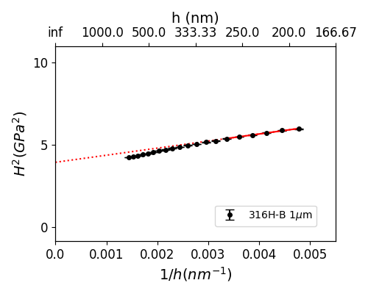
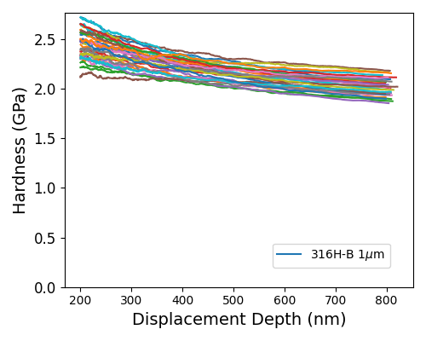

From here out, indentation results are presented according to the Nix-Gao formalism to extrapolate to the “bulk”
Nix-Gao
$$H^{2}=H_{0}^{2}\left(1+\frac{h^{∗}}{h}\right)$$

Slide 10
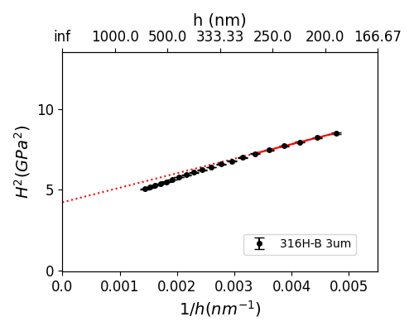

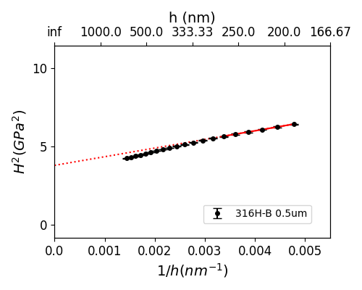

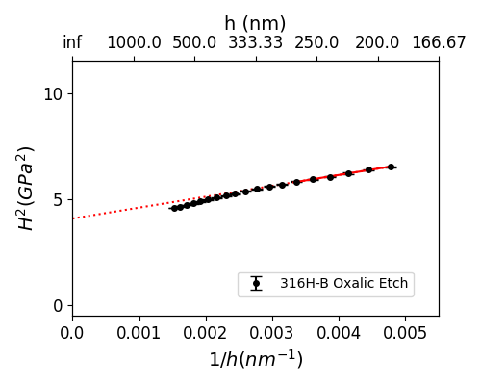
First step: Identify polishing conditions to provide reliable data
Material: Solution annealed 316H, Data from 0-200nm depth removed
H₀=2.05±0.17
H₀=1.98±0.26
H₀=1.95±0.15
H₀=2.01±0.25
H₀=2.02±0.23

Slide 11
Let’s increase the complexity by moving to Additively Manufactured Steels
Why? Contains:
  Homogenous microstructure
  Many dislocation networks
  Negligible density of precipitates
  Small amount of porosity
  Moderate amount of grain boundaries.

Slide 12
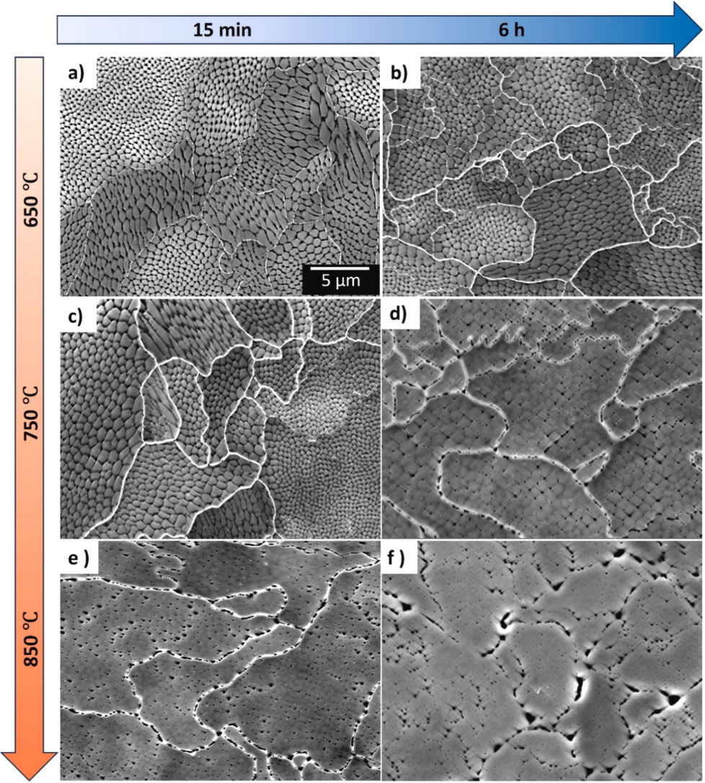
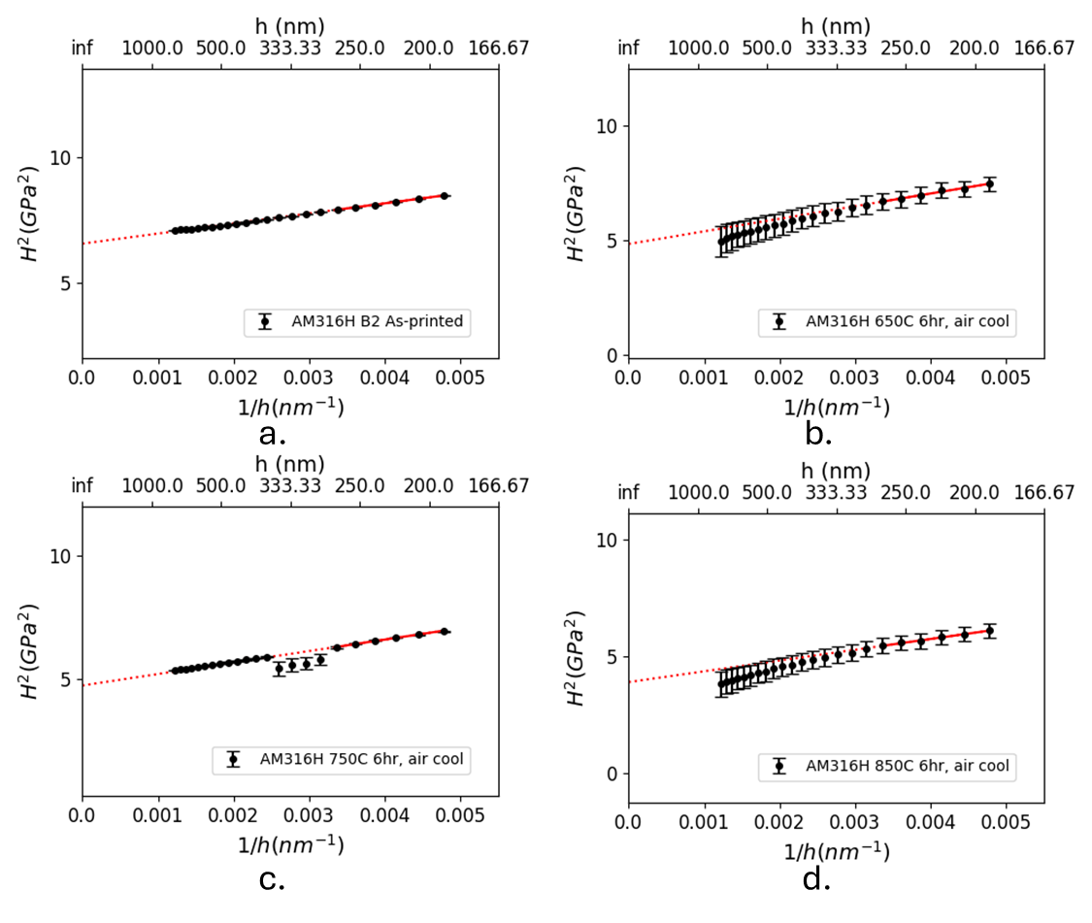
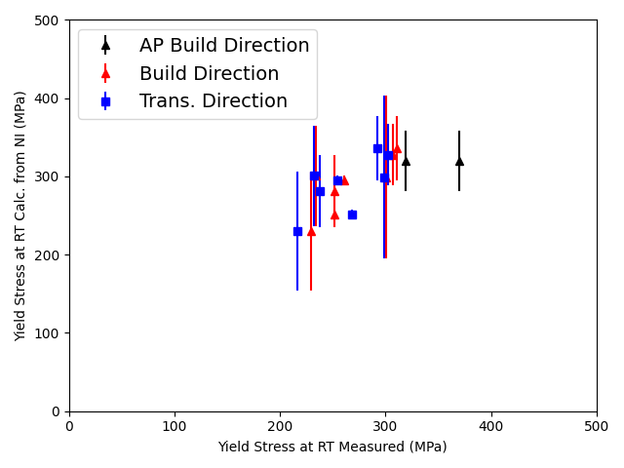
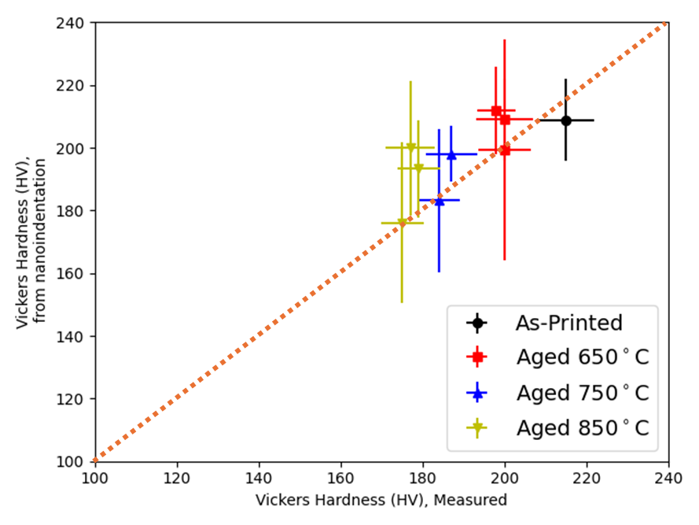
Correlations developed using 316SS with various dislocation densities bulk-equivalent hardness to Vickers Hardness to yield stress
LPBF 316H
However, LBPF 316SS has rather low yield stress. What about harder alloys?
Note: No work hardening included.
Dislocation cells and annealed microstructures serve to provide distinct hardness values

Slide 13
Irradiation of the same steels allows for continued examination of these relationships

Slide 14
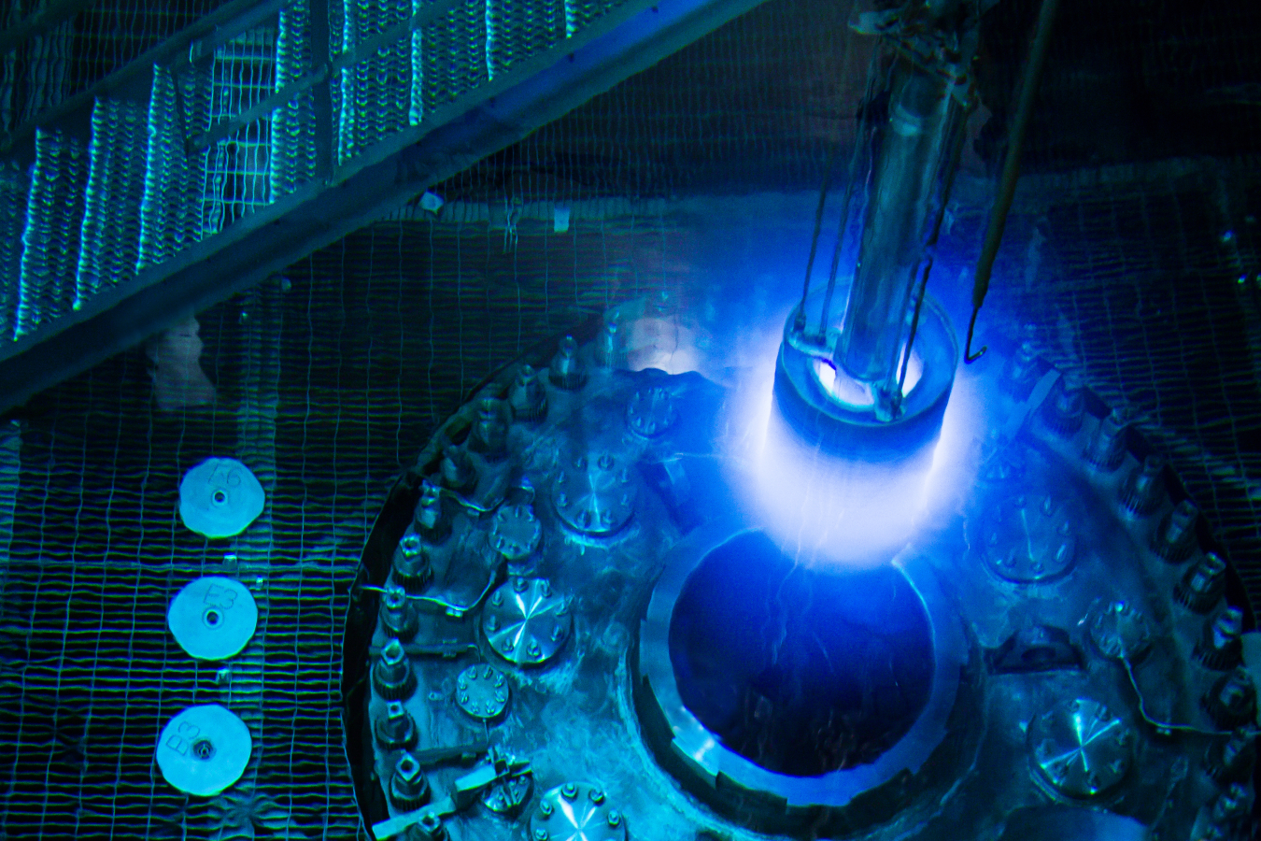
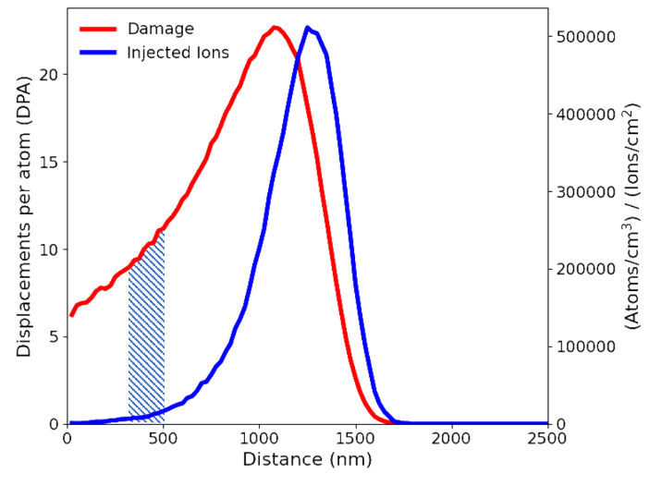
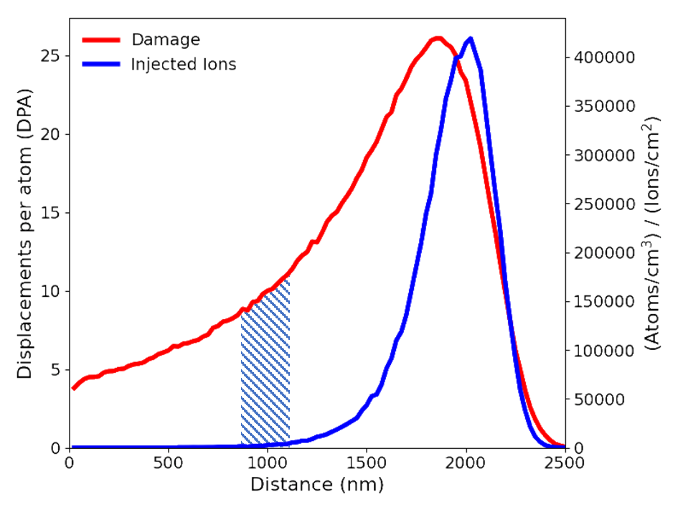
Irradiation of the same steels allows for continued examination of these relationships
As-Printed (AP), high sink strength
Solution Annealed (SA), low sink strength
Stress Relieved (SR), high sink strength
LPBF 316L
LPBF 316H
No helium
Environment:
HFIR
5 MeV Ni²⁺ at ANL
9 MeV Ni³⁺ at MIBL
Temperature:
Target from 400 - 600°C
300-600°C
300, 600°C
Damage Rate:
~10⁻⁶ dpa/s
~10⁻³ dpa/s
~5×10⁻⁴ dpa/s

Slide 15
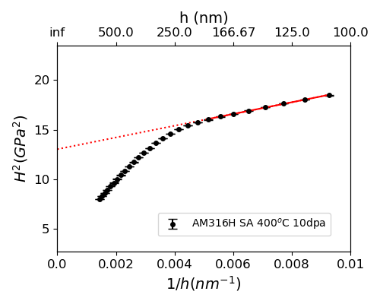
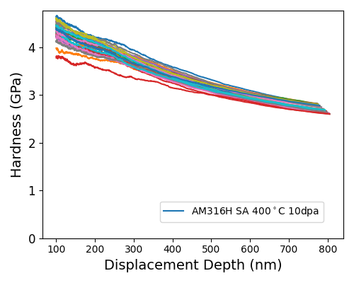
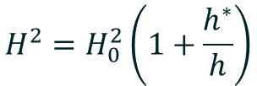
The depth dependence of the ion bombarded region requires being selective about data analysis.
Nix-Gao
$$H^{2}=H_{0}^{2}\left(1+\frac{h^{∗}}{h}\right)$$
Slope change corresponds to end of ion range
Small slope change corresponds to end of ion range
Fit from 100-200nm indentation depth to capture properties from roughly 500 - 1000nm in ion range

Slide 16
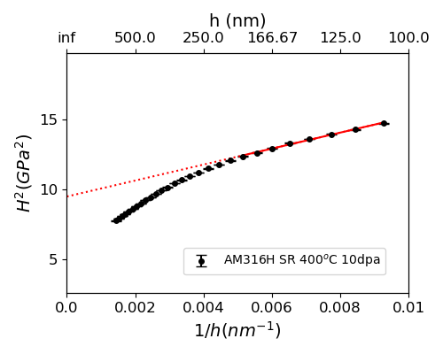
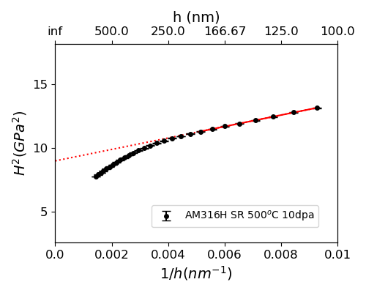
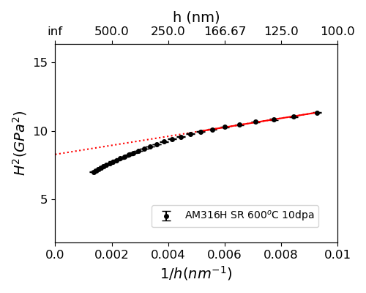
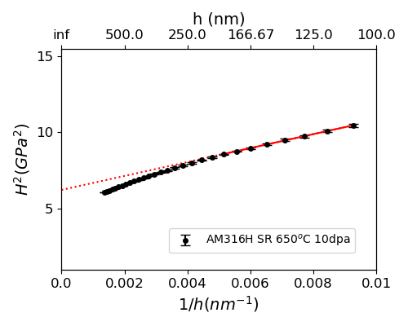
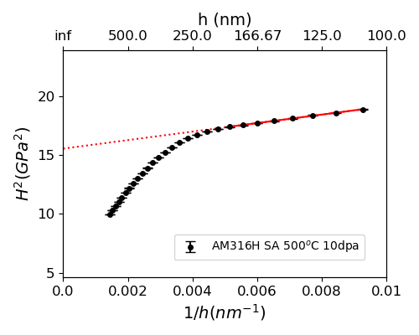
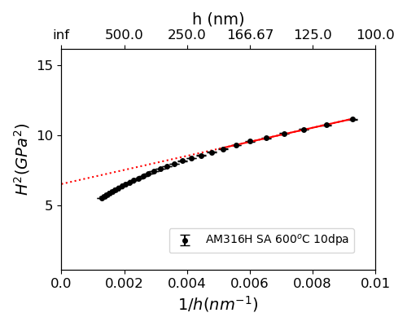

Limiting the examination depth allows for the extraction of properties from the ion irradiated region only
Stress-relived (SR) LBPF 316H, high initial sink strength
H₀=3.1±0.3 GPa
H₀=3.0±0.2 GPa
H₀=2.9±0.2 GPa
H₀=2.5±0.2 GPa
H₀=3.6±0.3 GPa
H₀=3.9±0.2 GPa
H₀=2.6±0.2 GPa
H₀=2.6±0.3 GPa
Solution Annealed (SA) 316H, low initial sink strength

Slide 17
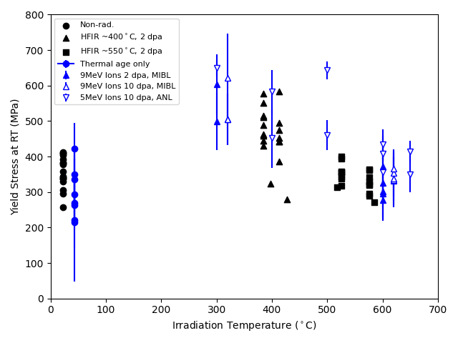
When all ion and neutron data are plotted together, the relationship looks near ideal for 316H
-Ion irradiation bulk hardness from NI converted to Vicker hardness and then yield stress using Tabor relationship (σ~3 HV)
-Yield stress provided from HFIR irradiated steels from the same AM build piece
No accounting for:
Differences in initial microstructure
Damage rate (ions~1000x neutrons)
Work hardening during indentation
However, this plot is misleading!
Some points displaced by 10°C for visibility

Slide 18
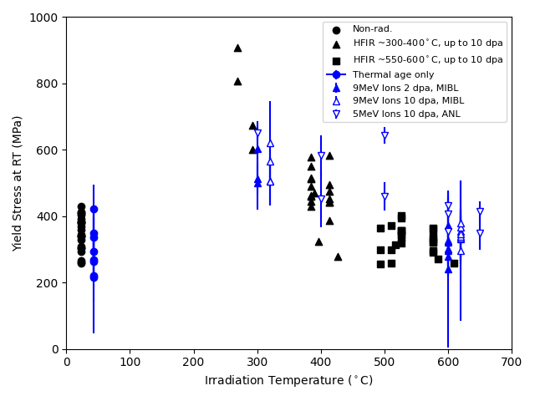
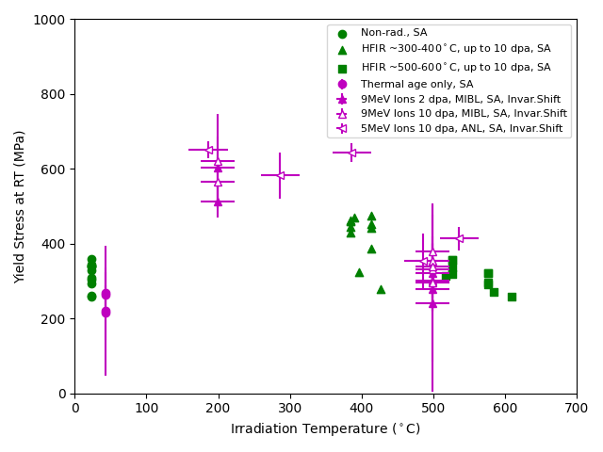
Bringing 316L and 316H together with invariance approach to account for damage rate produces reasonable trends
Stress-relived (SR) LBPF 316L and 316H
Solution Annealed (SA) LBPF 316L and 316H
10dpa SR 316L
1 pt each
This does not imply microstructure equivalence on its own!
Ion temperatures shifted via Mansur invariance relationships

Slide 19
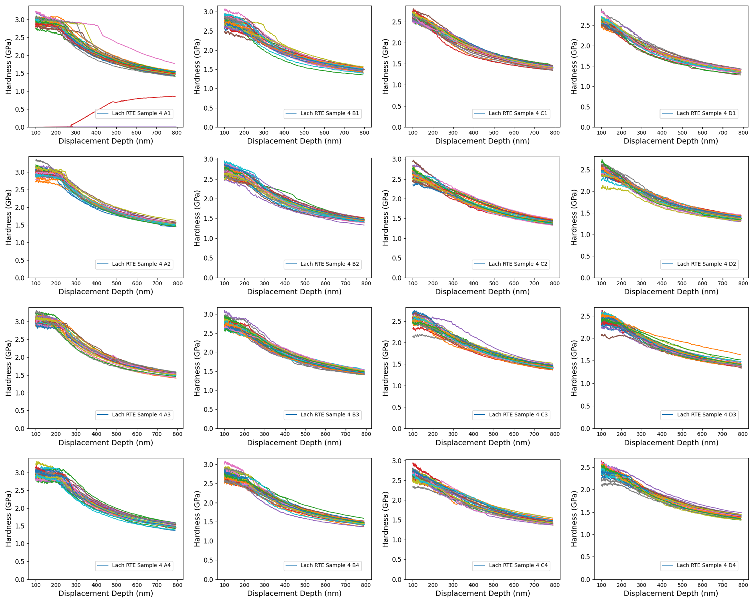
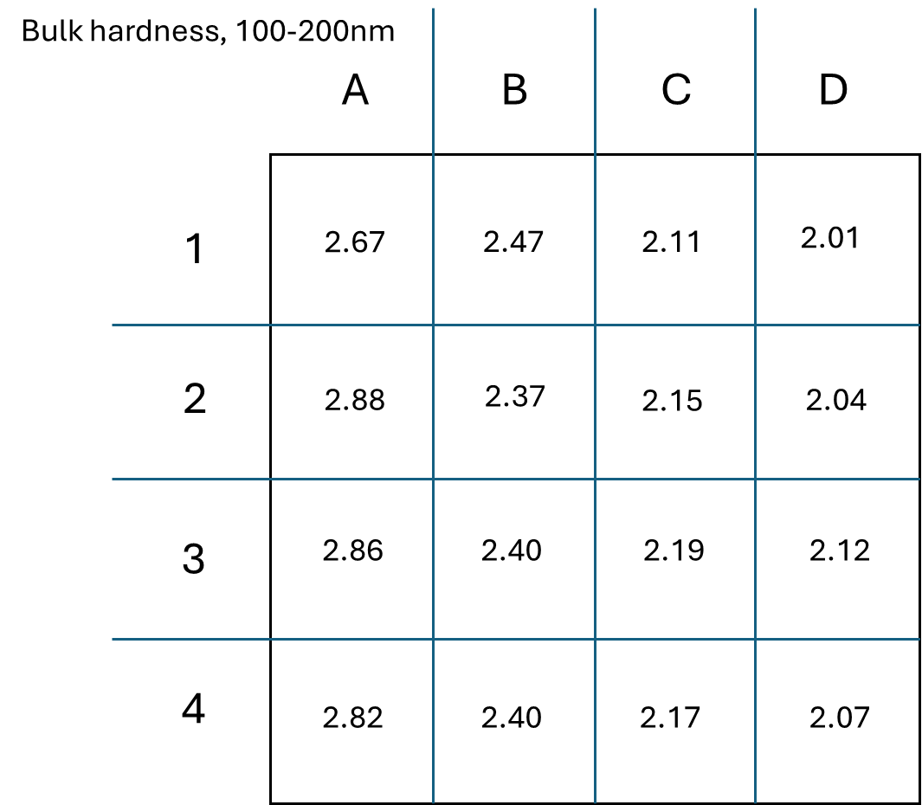

Example of Application to NSUF projects: Examining He and H gradients using triple ion irradiation, RTE 24-4880
Automated acquisition and processing
100 He/dpa
0 He
100 He/dpa
0 He
0 H
0 H
100 H/dpa
100 H/dpa

Slide 20
Within limitations, instrumented indentation may provide a technique to assess a bulk mechanical property.
High throughput instrumented indentation may allow for the determination of bulk-like tensile yield stress for materials with higher dislocation-obstacle densities.
  Strong note: Still consider this a blue-sky idea! Many assumptions in the models to validate or not.
Using Vickers hardness for the same alloy results in an acceptable empirical correlation between H₀ and tensile yield stress.
On-going work addresses gaps to arrive at a physically informed relationship between microstructure and instrumented indentation derived properties.
Future work (already planned) will compare to neutron irradiated samples to further validate methodology.

Slide 21
Back up slides

Slide 22
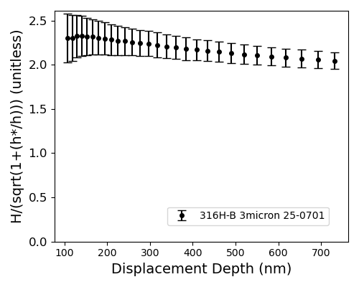
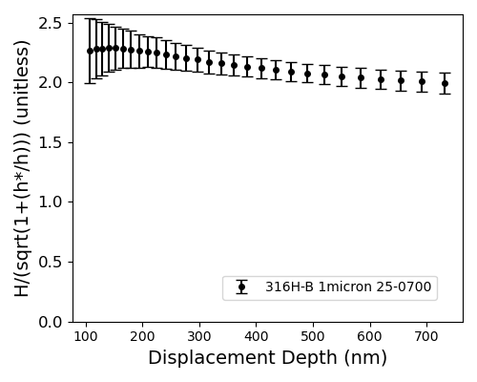
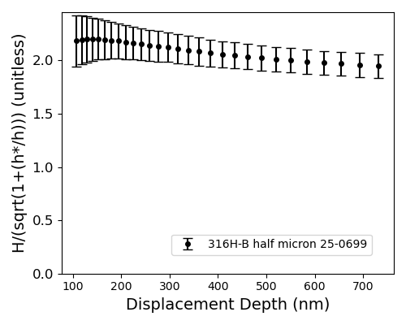
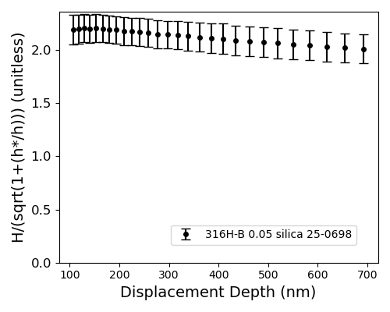
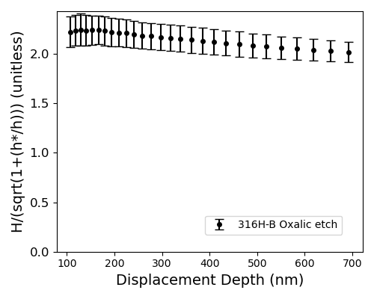
While the hardness is within error, there is a noticeable effect of polishing
H₀=2.05±0.17
H₀=1.98±0.26
H₀=1.95±0.15
H₀=2.01±0.25
H₀=2.02±0.23

Slide 23
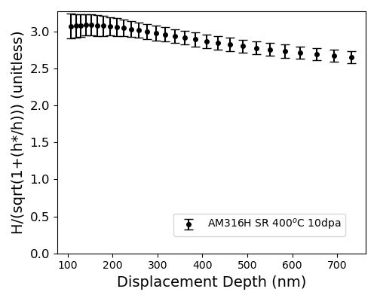
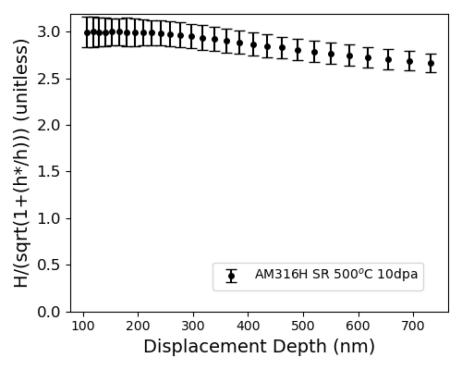
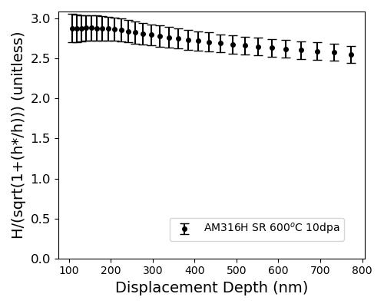
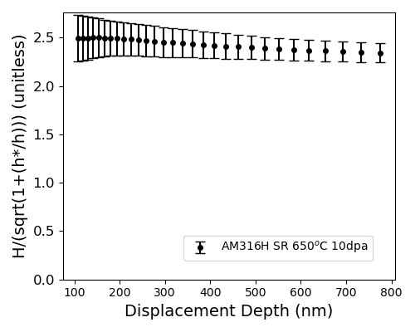
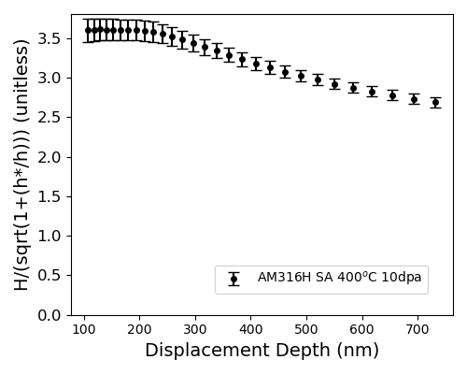
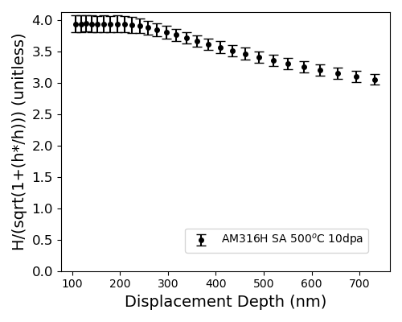


Normalized hardness is nearly uniform in ion-irradiated region
Stress-relived (SR) LBPF 316H
H₀=3.1±0.3 GPa
H₀=3.0±0.2 GPa
H₀=2.9±0.2 GPa
H₀=2.5±0.2 GPa
H₀=3.6±0.3 GPa
H₀=3.9±0.2 GPa
H₀=2.6±0.2 GPa
H₀=2.6±0.3 GPa
Solution Annealed (SA) 316H

Slide 24


HFIR Irradiation provides yield stress for comparisons
Stress-relived (SR) LBPF 316H
Solution Annealed (SA) 316H

Slide 25



Invariance theory provides a method to account for damage rate differences between ions and neutrons
For a high sink density ($C_{s}≫C_{v}$),
$N_{s}=fΔ$ (or $N_{s}=K_{0}$t)
These are independent of dose rate. Assuming that Δ is constant.
Let:
$${\left(N_{s}\right)}_{1}={\left(N_{s}\right)}_{2}$$
$$fΔ_{1}=fΔ_{2}$$
$$Δ_{1}=Δ_{2}$$
Therefore, no temperature shift is required to account for higher dose rate.
For a low sink density, derivations yield:
$N_{s}$ is the number of defects loss to sinks per unit volume up to time $τ$
f is fraction remaining after in-cascade recombination, Δ is damage level
$$T_{2}−T_{1}=\frac{\frac{kT_{1}^{2}}{2E_{v}^{f}+E_{v}^{m}}\ln{\frac{G_{2}}{G_{1}}}}{1−\frac{kT_{1}^{2}}{2E_{v}^{f}+E_{v}^{m}}\ln{\frac{G_{2}}{G_{1}}}}$$
where:
$G_{1}$ = Lower defect gen. rate (damage rate)
$T_{1}$ = Temperature at lower damage rate
$G_{2}$ = Higher defect gen. rate (damage rate)
$T_{2}$ = Temperature at higher damage rate
$E_{v}^{f}$ = vacancy formation energy
$E_{v}^{m}$ = vacancy migration energy
Note: Same derivation works for interstitial defects
L. K. Mansur, Journal of Nuclear Materials 1978 Vol. 78, Pages 156-160, DOI: 10.1016/0022-3115(78)90514-7
L. K. Mansur, Journal of Nuclear Materials 1993 Vol. 206, Pages 306-323, DOI: 10.1016/0022-3115(93)90130-Q

Slide 26


With an initially clean microstructure, recombination should be the dominant loss mechanism early in the irradiation
Temperature Shift assuming recombination dominant processes
No Temperature Shift
Recombination dominant is likely a valid assumption based on low sink density in SA initial microstructure

Slide 27



Adding work hardening will help remove reliance on empirical relationships
HFIR irradiation only, LPBF 316H
From true stress-true strain curves
$$n=\frac{d\left(\ln{σ}\right)}{d\left(\ln{ε}\right)}$$
For neutron irradiated specimens:
Increase in work hardening exponent with irradiation temperature (0.1 –> 0.55)
Possible dependence on the heat treatment
$$σ={\frac{H_{0}}{3}\left(0.1\right)}^{n}$$
Cahoon et al., Metallurgical Transactions 1971 Vol. 2 Issue 7 Pages 1979-1983, DOI: 10.1007/bf02913433

