Slide 1
Semantic Intelligence: A RAG-Based Knowledge Discovery Platform on HPC for NSUF
Nuclear Research Data Intelligence (NRDI)
Bradlee H. Jensen, Matthew W. Anderson, Tiankai Yao (Presenter)

Slide 2
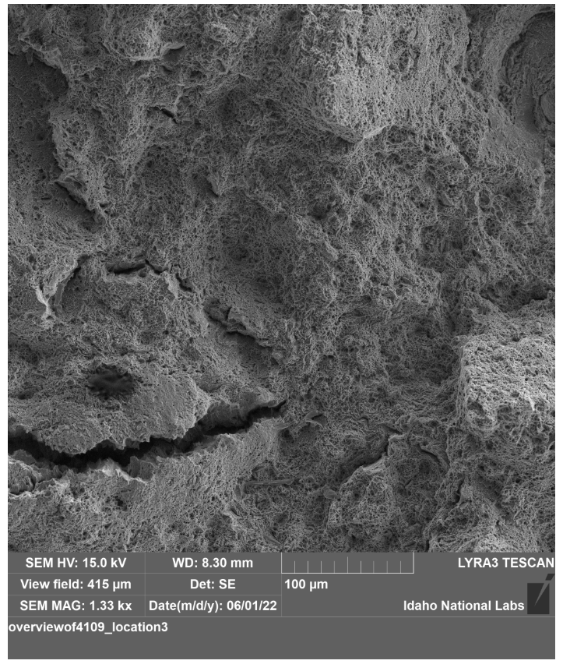
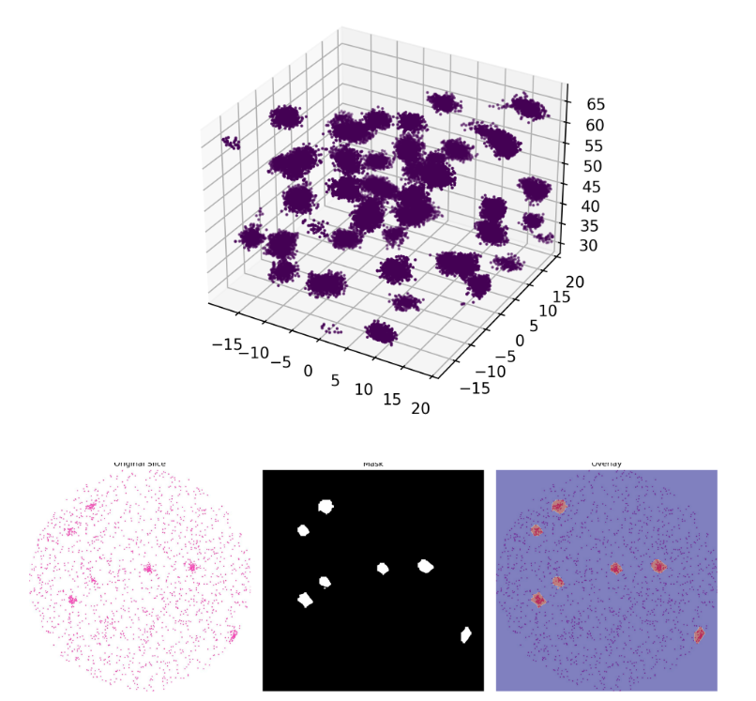
Unsearchable Data
Lots of collected data but unsearchable
  Non-text-based formats
  Too many files
  Details embedded in figures
  Handwritten documents
  Timeseries data
Way to make it so all data is searchable
Images taken from https://nrds.inl.gov/
Notes:
Many of these details are often embedded in figures, tables, handwritten notes, or scanned pages that contain very little machine-readable text. This forces researchers at the Idaho National Laboratory (INL) to rely heavily on slow, manual review

Slide 3
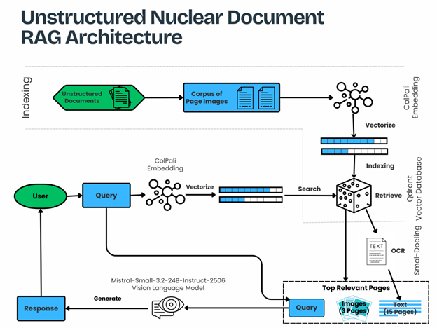
Retrieval-Augmented Generation (RAG)
Notes:
The resulting embeddings represent the semantic and structural content of the page. These embeddings are stored in a Qdrant vector database. Qdrant uses Hierarchical Navigable Small World (HNSW) indexing to support fast approximate nearest-neighbor search. Similarity between vectors is measured using cosine distance, which performs well for high-dimensional embeddings. query text is embedded using the same ColPali model. Using the same embedding model for both queries and document pages ensures that they share the same semantic space. The query embedding is used to retrieve the fifteen most relevant pages from the Qdrant index. Retrieving multiple pages improves recall because relevant information may appear in different sections of a report. the smol-docling OCR model extracts text from the selected pages. The extracted text is organized and combined with metadata such as page identifiers and document references. The system also selects the three highest-ranked page images to provide visual context for the language model.
The OCR text and selected page images are combined into a structured prompt and passed to the Mistral language model. The model analyzes the provided material and generates a response based on the retrieved pages. Page identifiers are included so the model can reference specific pages when presenting its answer.

Slide 4
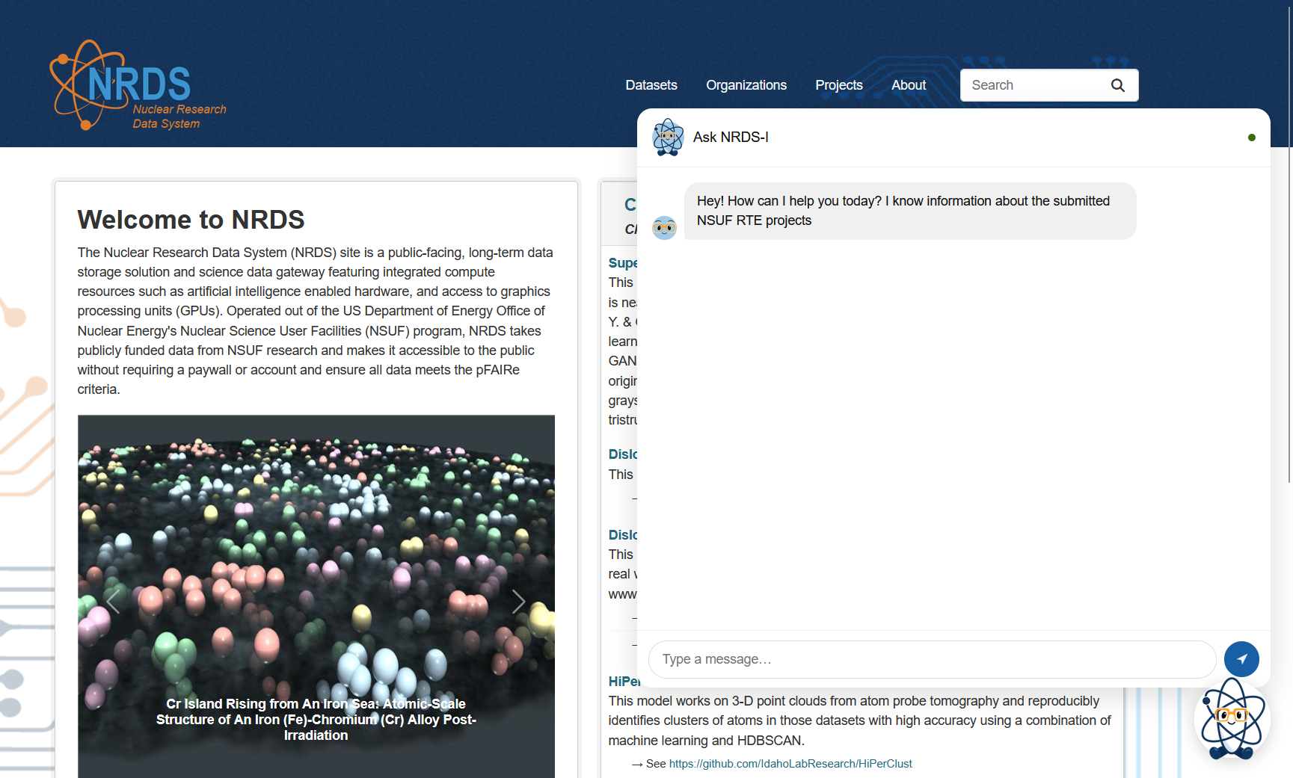
Nuclear Research Data Intelligence (NRDI)
Access to:
  RTE Publications
  Project Abstracts
Will soon have access to:
  All data and descriptions uploaded to NRDS

Slide 5
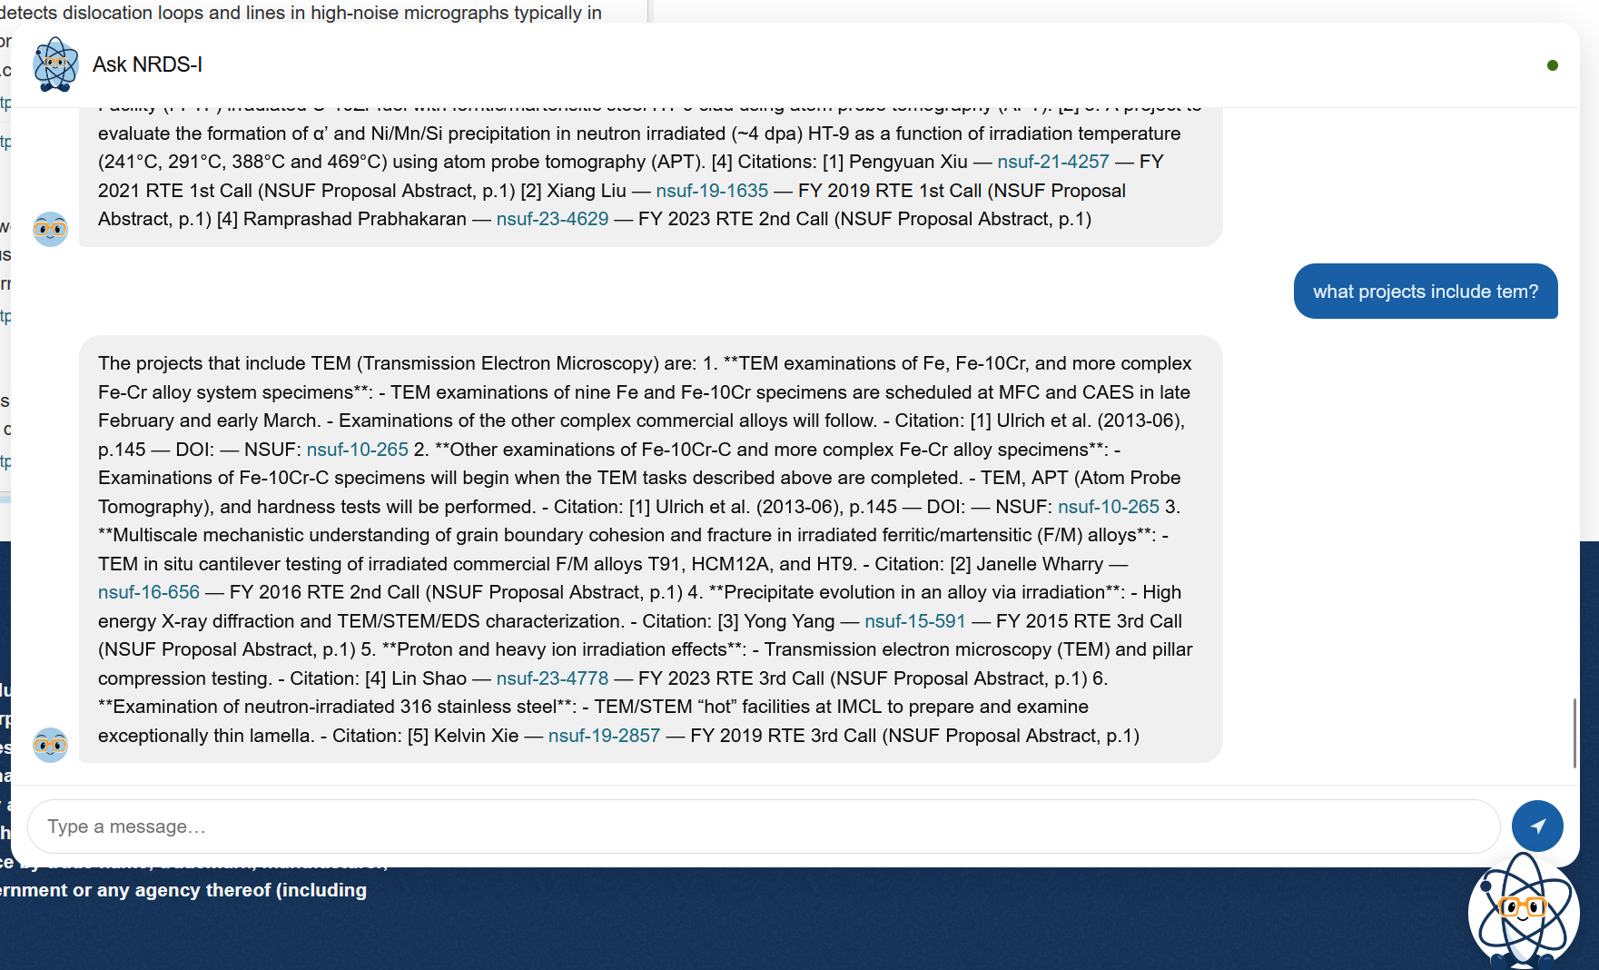
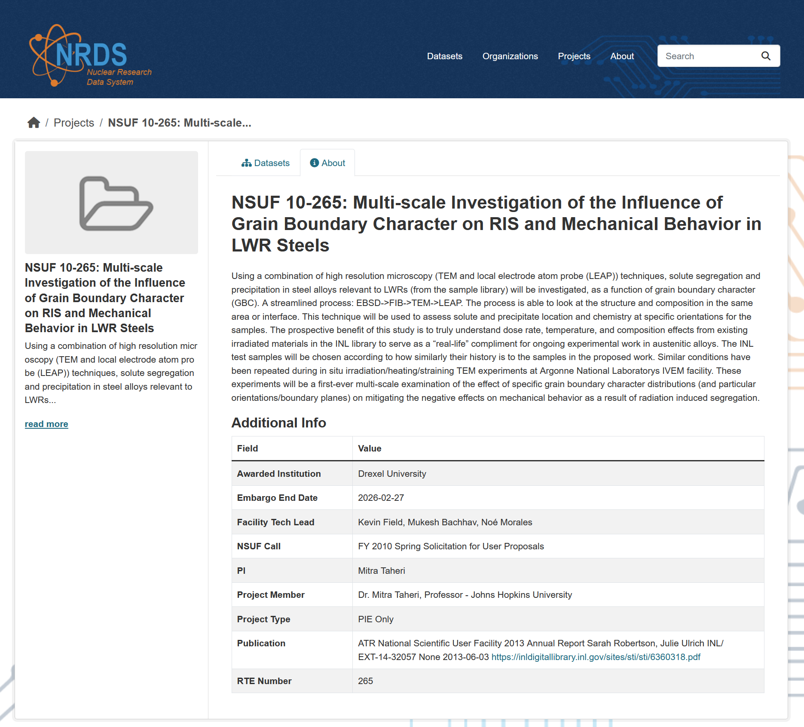
NRDI: What project include TEM?

Slide 6
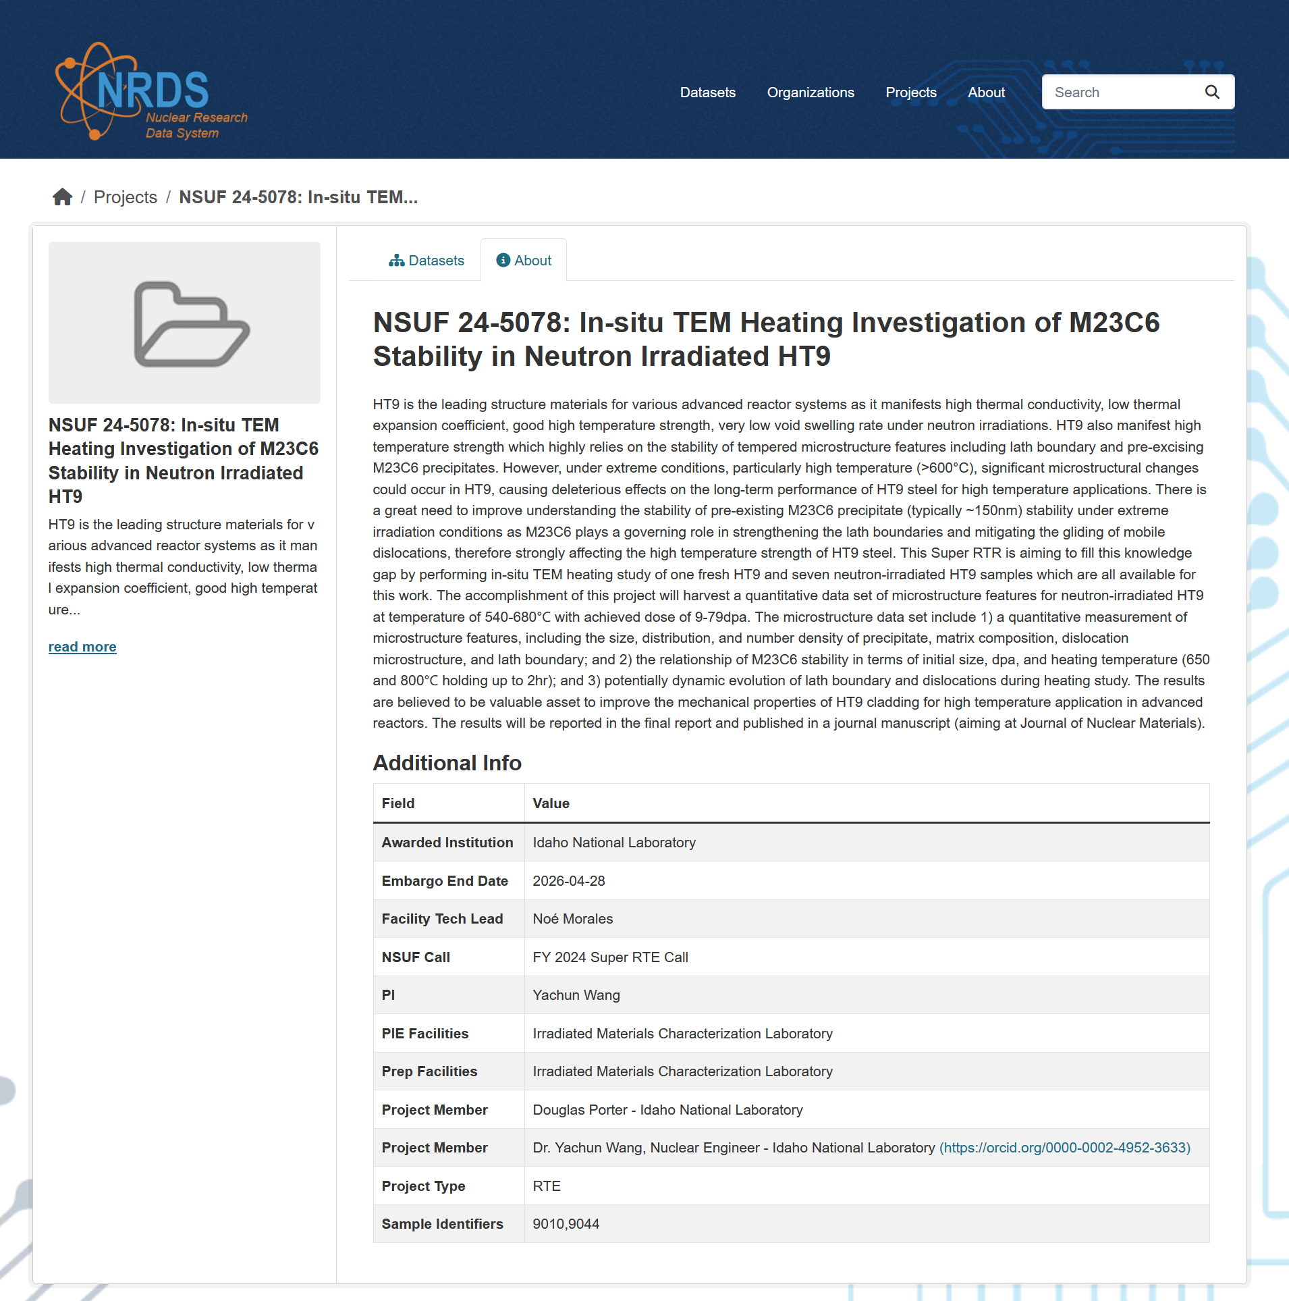
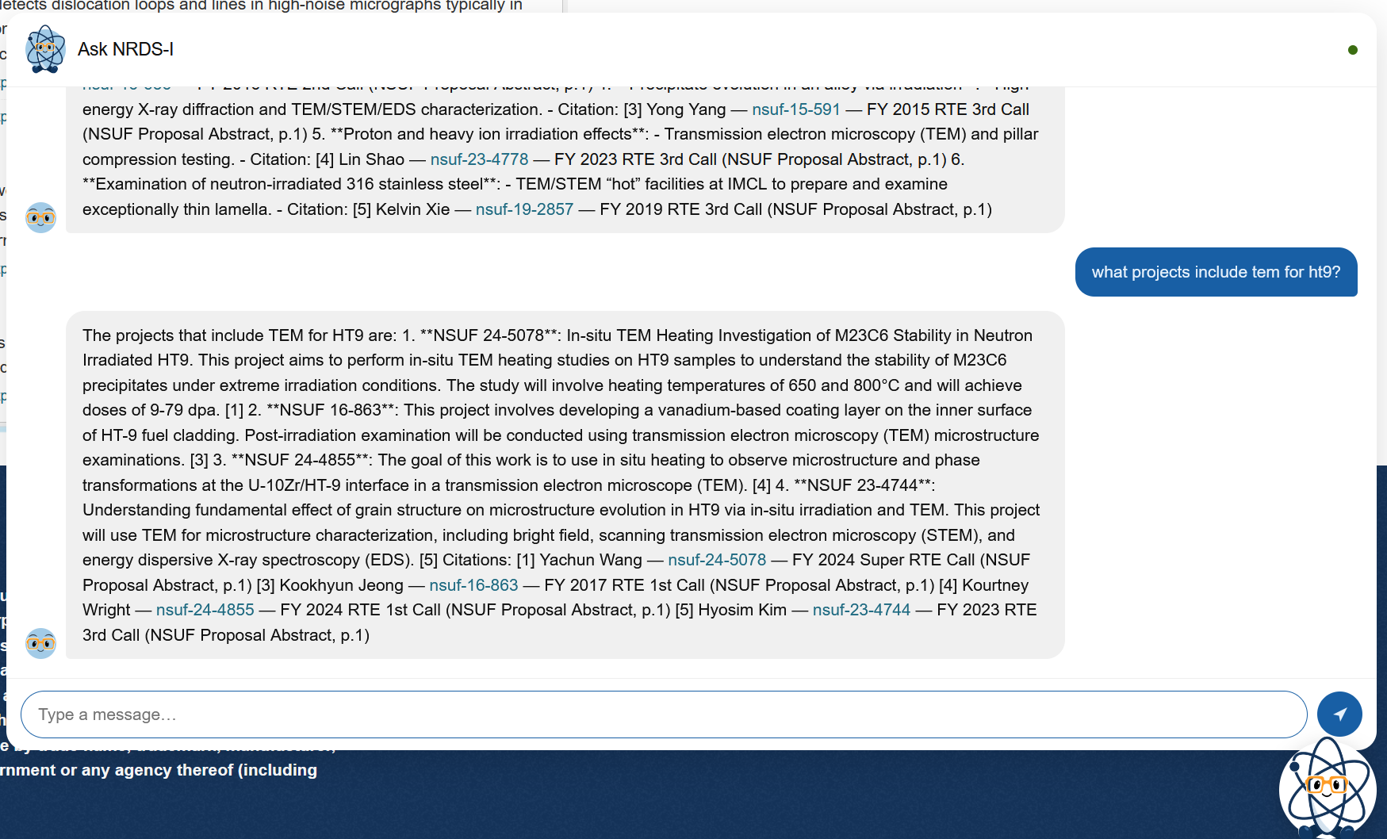
NRDI: What project include TEM for HT9?

Slide 7
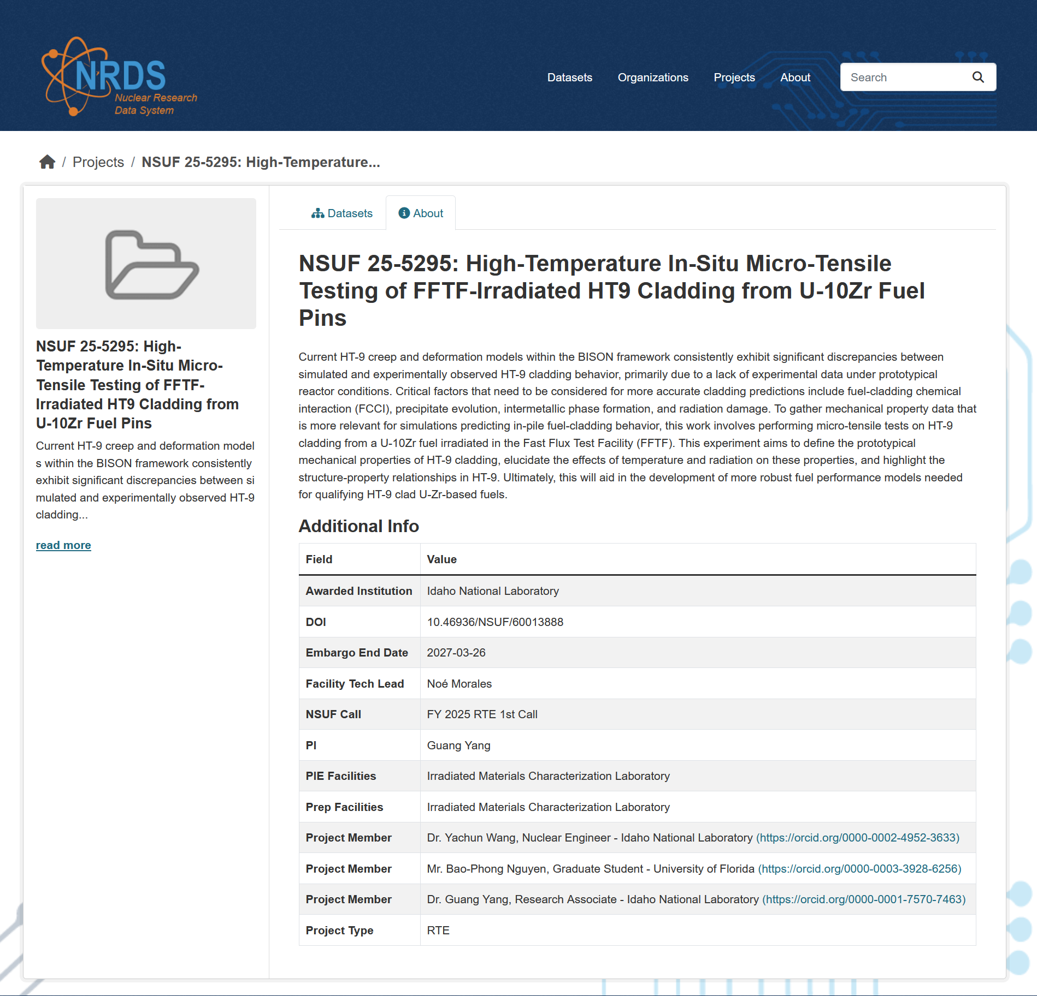
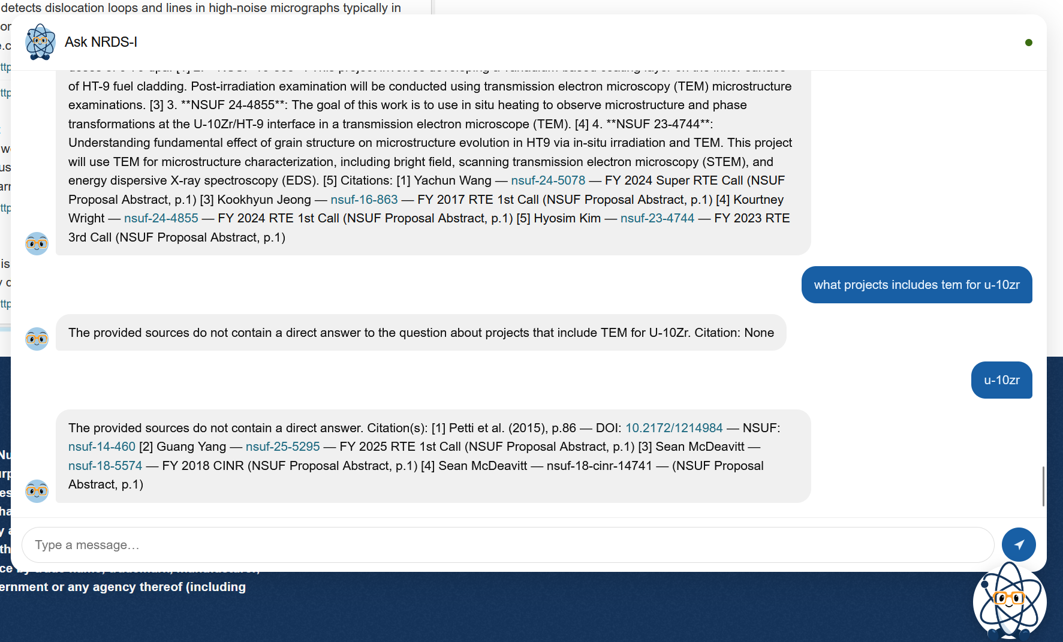
NRDI: What project include TEM for U-10Zr?

Slide 8
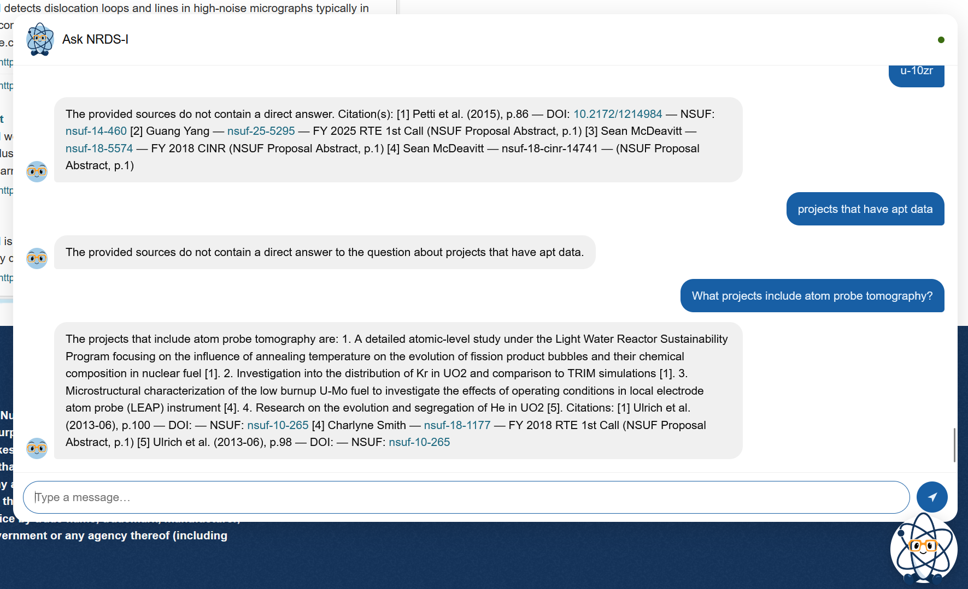
NRDI: What projects include apt vs atom probe tomography?

Slide 9
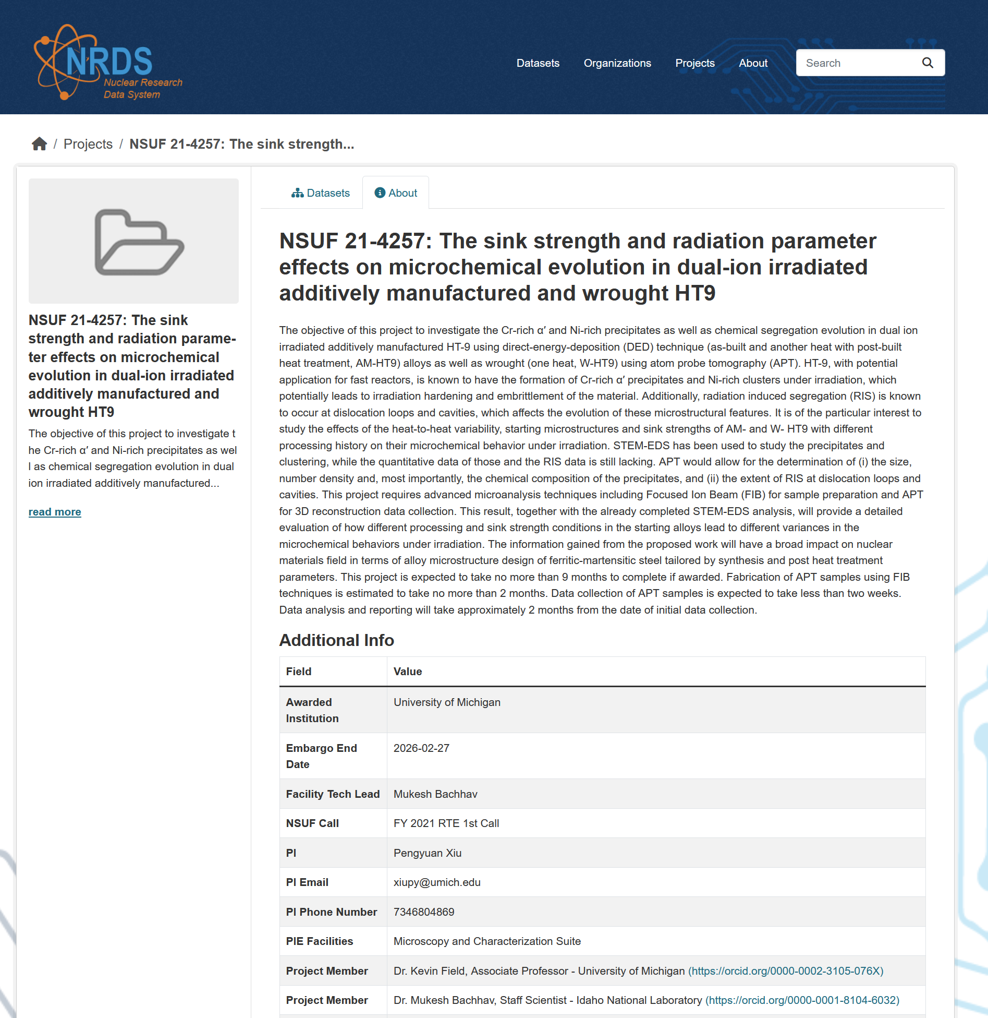
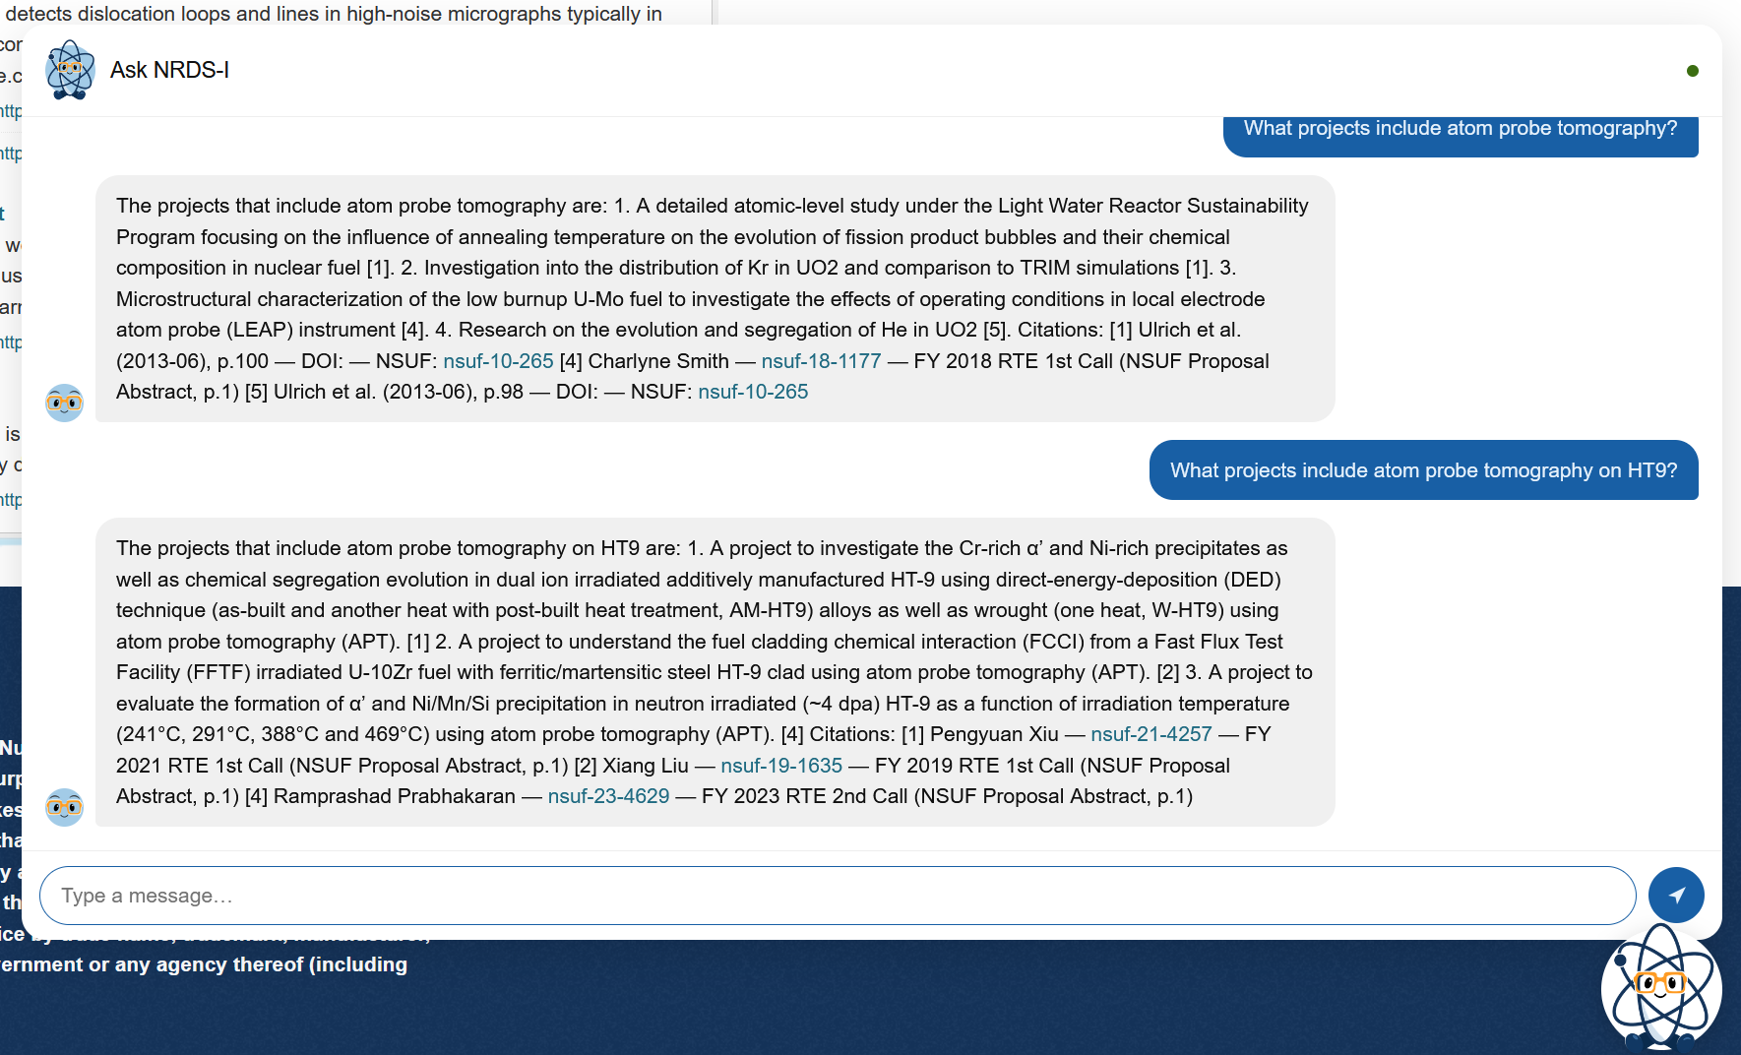
NRDI: What project include atom probe tomography on HT9

Slide 10
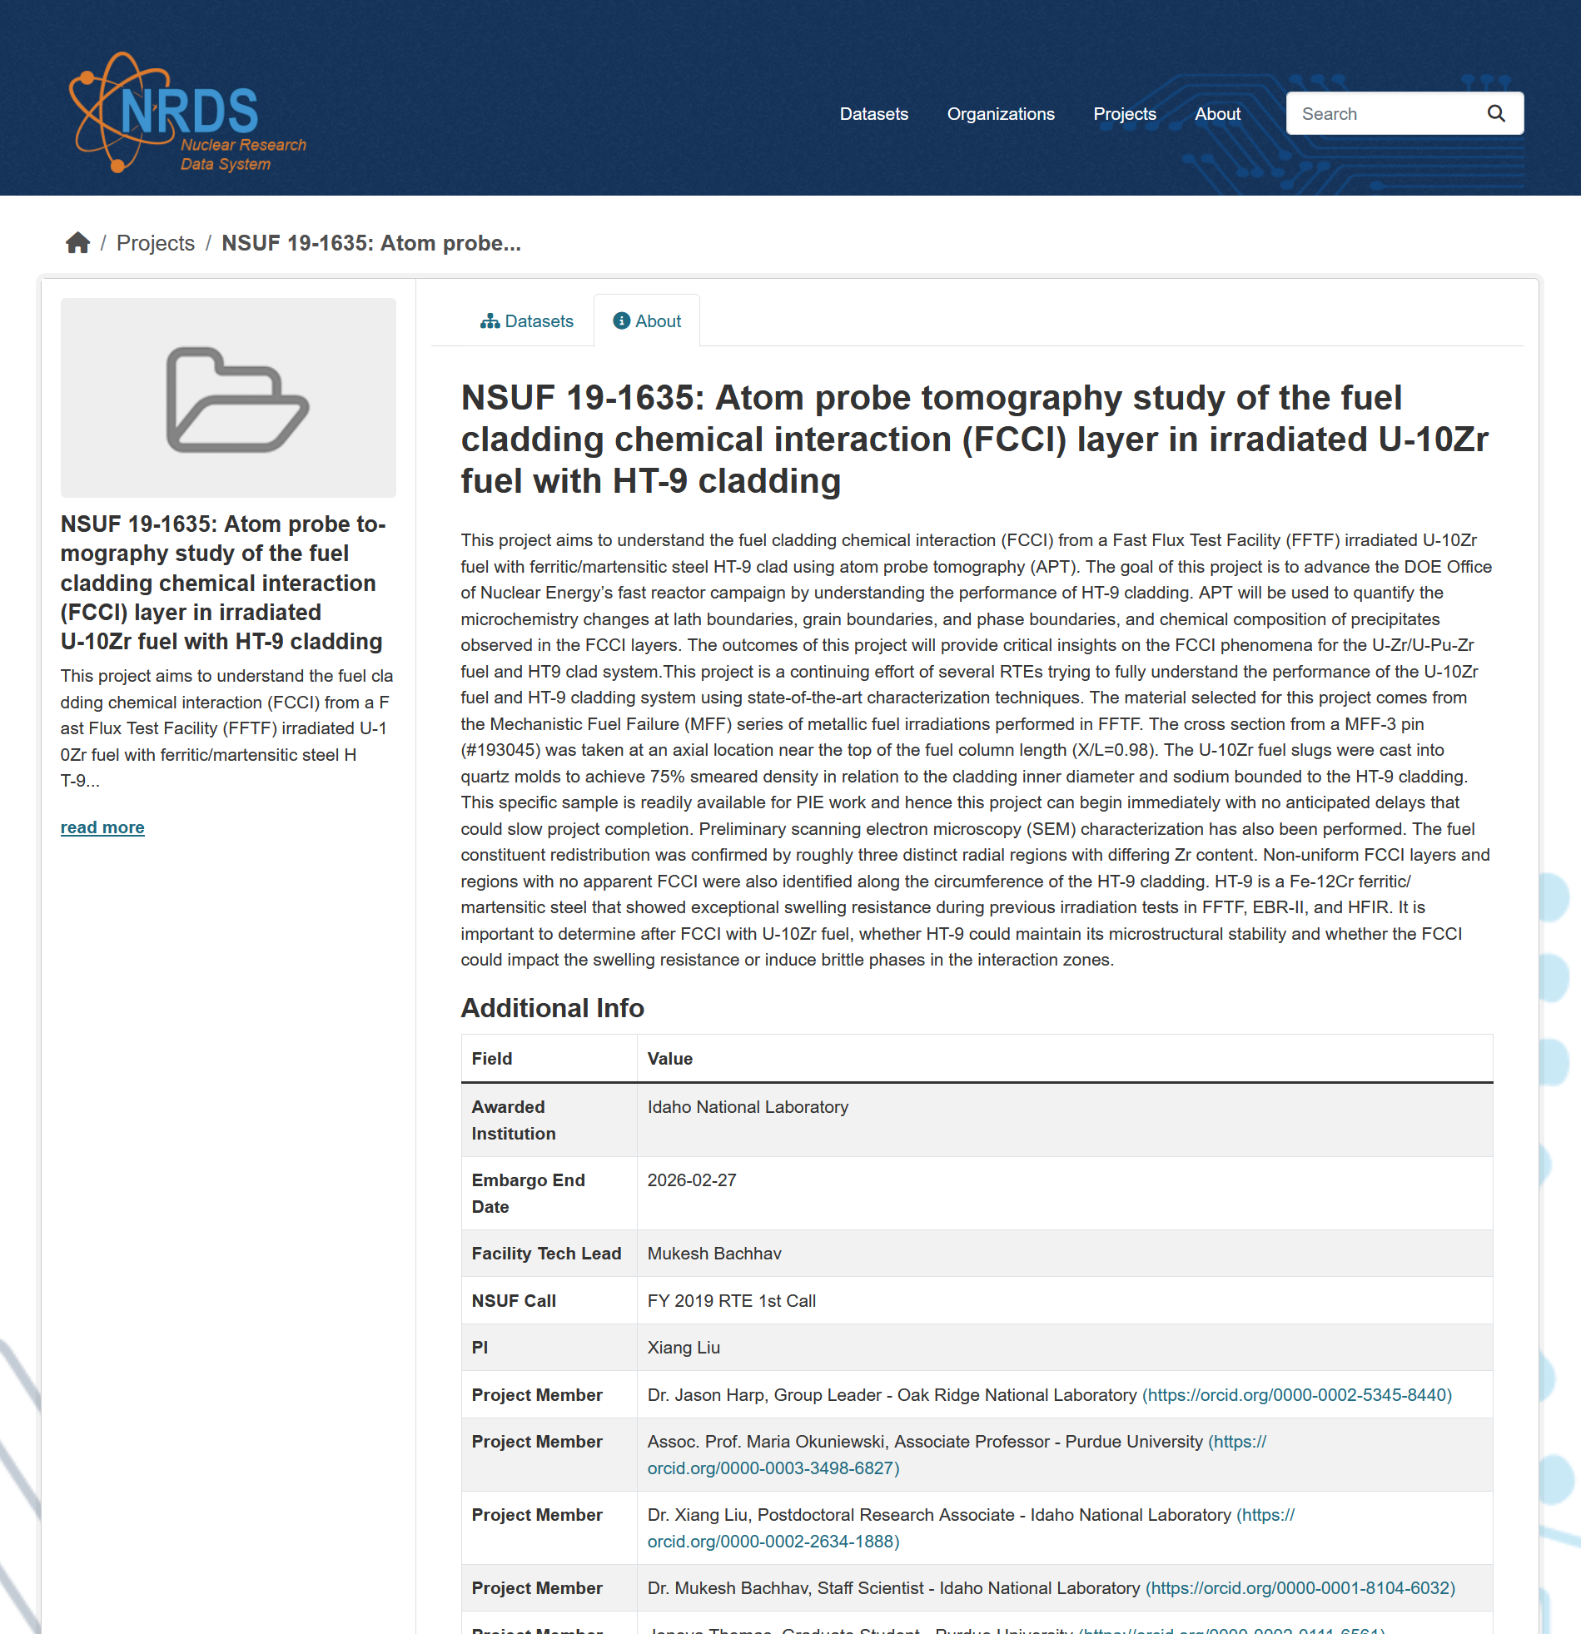
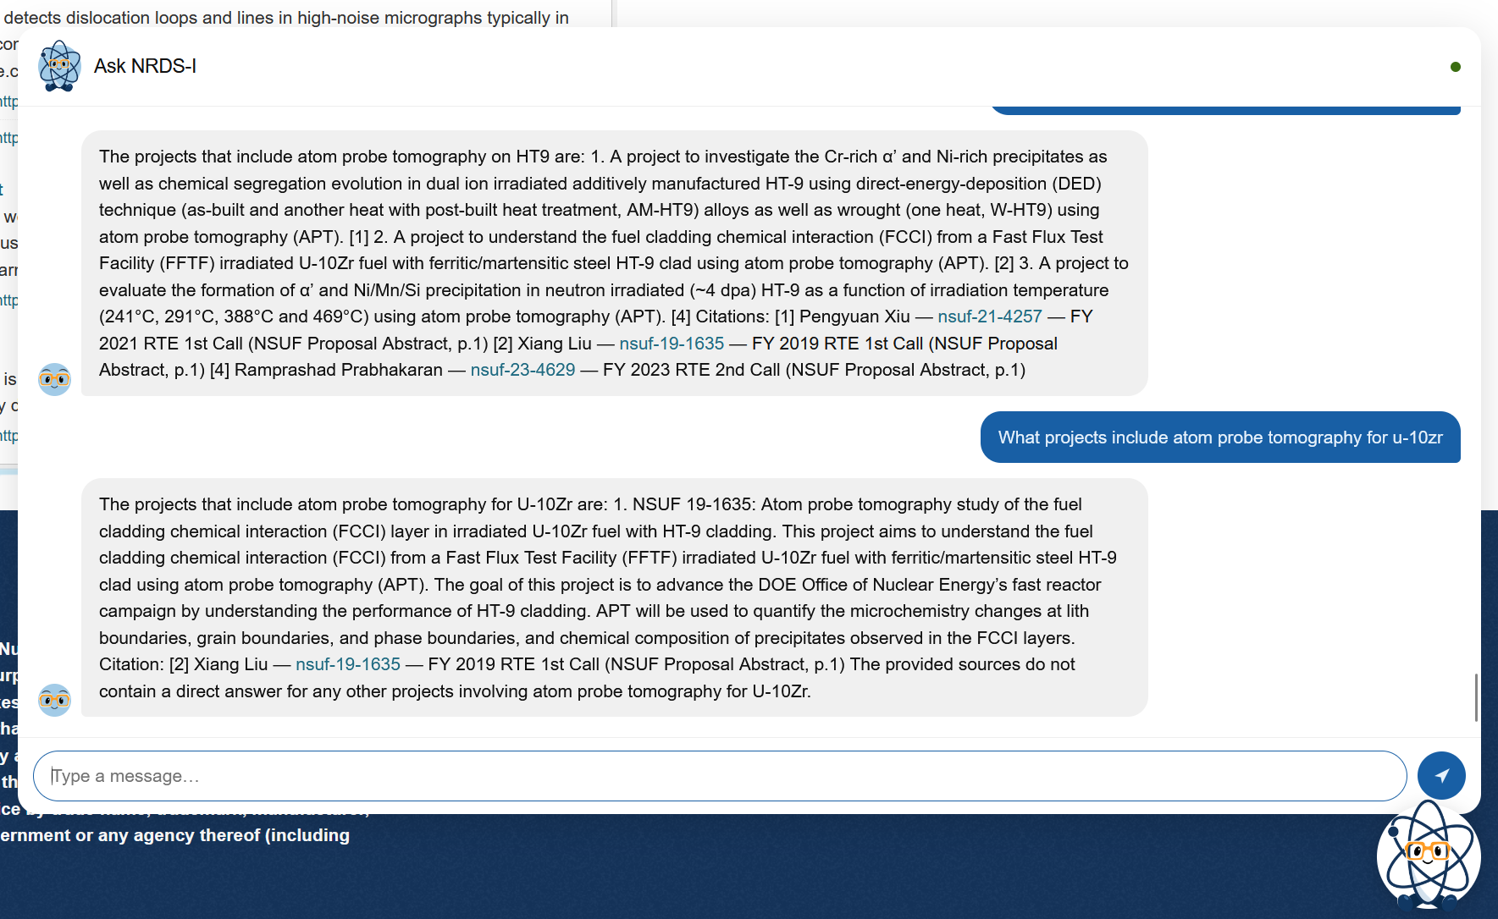
NRDI: What projects include atom probe tomography for U-10Zr

Slide 11
Near term plan
Quantify RAG performance
Improve the agentic workflow

