Slide 1
May 11, 2026 | NSUF Annual Program Review
  J. Derek Whipple
    CINR Administrator, NSUF
Nuclear Science User Facilities
  Consolidated Innovative Nuclear Research
INL/MIS-26-xxxxx
Notes:
Monday Morning 10:30/12/30

Slide 2
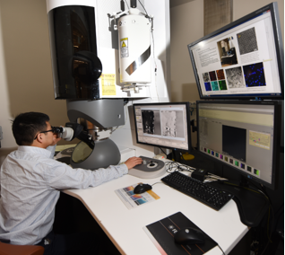
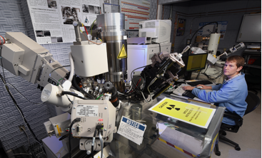
NSUF CINR Overview
In close coordination with the Nuclear Energy University Program, Nuclear Science User Facilities (NSUF) seeks proposals that will utilize NSUF irradiation, post-irradiation examination and beamline capabilities through the Consolidated Innovative Nuclear Research (CINR) Notice of Funding Opportunity (NOFO) formerly called the Funding Opportunity Announcement (FOA).
Through the NSUF CINR topic areas, NSUF provides no-cost access to world class capabilities to facilitate the advancement of nuclear science and technology. In addition to access to state-of-the-art facilities, NSUF provides technical assistance including the design and analysis of reactor experiments.

Slide 3
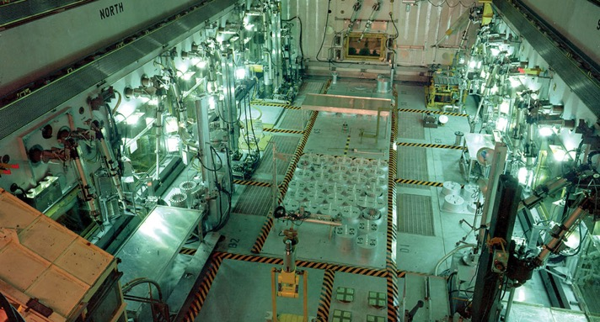
NSUF Funding Calls
Consolidated Innovative Nuclear Research (CINR) Notice of Funding Opportunity (NOFO)
  One call per year
  Proposals with NSUF access can include ion, neutron, and gamma irradiation, xray synchrotron beam or neutron beam interrogation, post-irradiation examination, advanced materials characterization, and high-performance computing.
  Can also receive user R&D funding on university topic areas
  Projects with test neutron irradiation and post-irradiation examination can extend to 7 years.
  Topic Areas for NSUF access projects:
    Fuel and Core Materials: irradiation performance and combined effects of irradiation and environment on fuels and materials; fundamental and applied aspects to fuel performance
    Structural Materials and Manufacturing Methods: advanced nuclear materials, novel or cost-effective manufacturing methods, and related topics
    Sensor Materials, Instrumentation, and Active Component Systems: development of advanced sensor materials, or advanced instrumentation or measurement systems
Notes:
Do not call out or speculate on the timeframe for the 25 or 26 opportunities
Only the 4MM$ is in the current NOFO, the rest are historical guidance

Slide 4
NSUF CINR Schedule
 |  | FY2024 |  | FY2025 |  | FY2026
Webinar |  | May 31, 2023 |  | May 9, 2024 |  | December 15, 2025
FOA/NOFO Issuance |  | June 22 |  | May 20 |  | December 15
Letters of Intent |  | July 12 |  | June 5 |  | January 5, 2025
Pre-Applications |  | July 26 |  | June 26 |  | February 3
Preliminary Statements of Work |  | August 31 |  | August 1 |  | February 24
Final Statements of Work |  | December 6 |  | October 10 |  | May 21
Full Applications |  | December 20 |  | November 13 |  | June 9

Slide 5
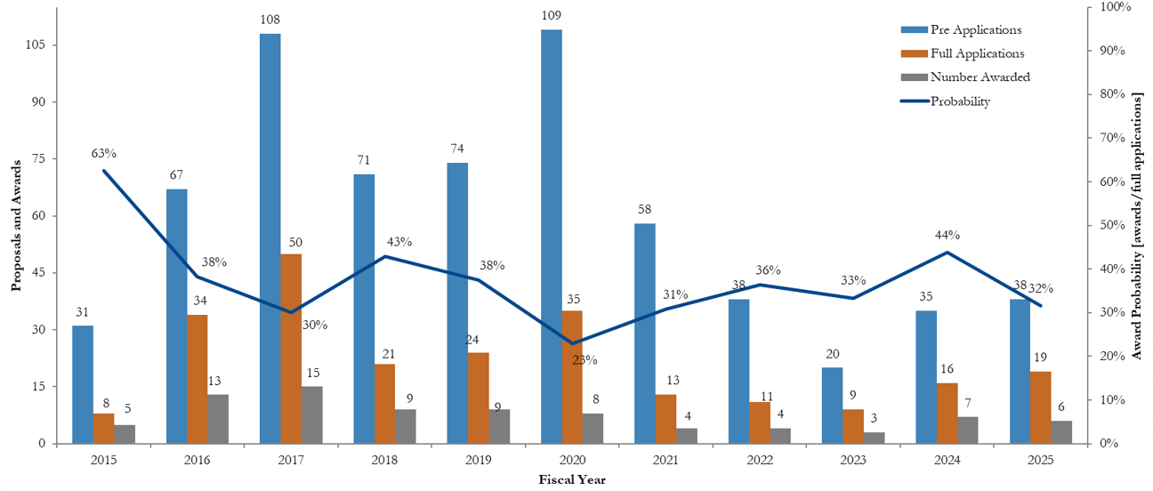
NSUF User Access Awards - CINR
Large Projects

Slide 6
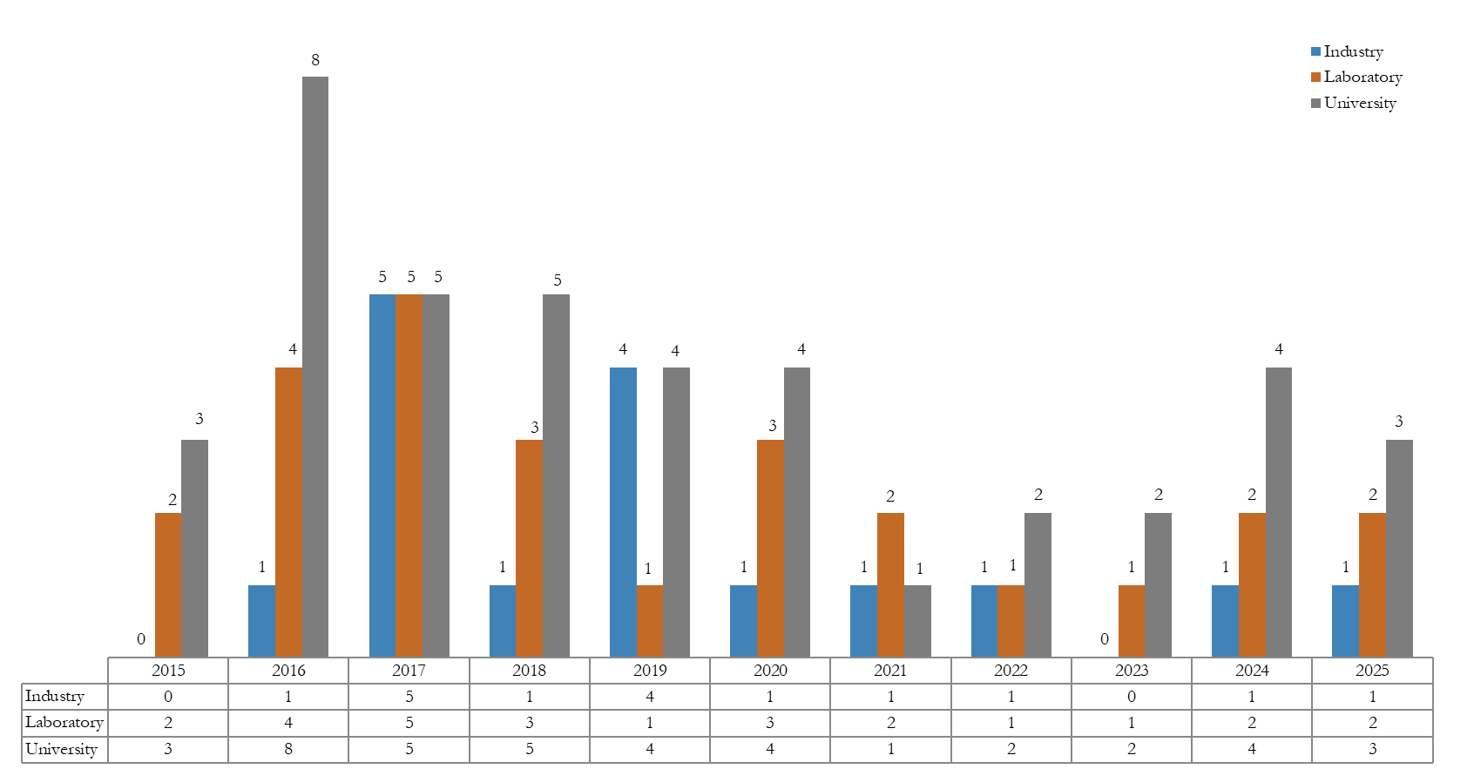
NSUF CINR Awards by Institution Type

Slide 7
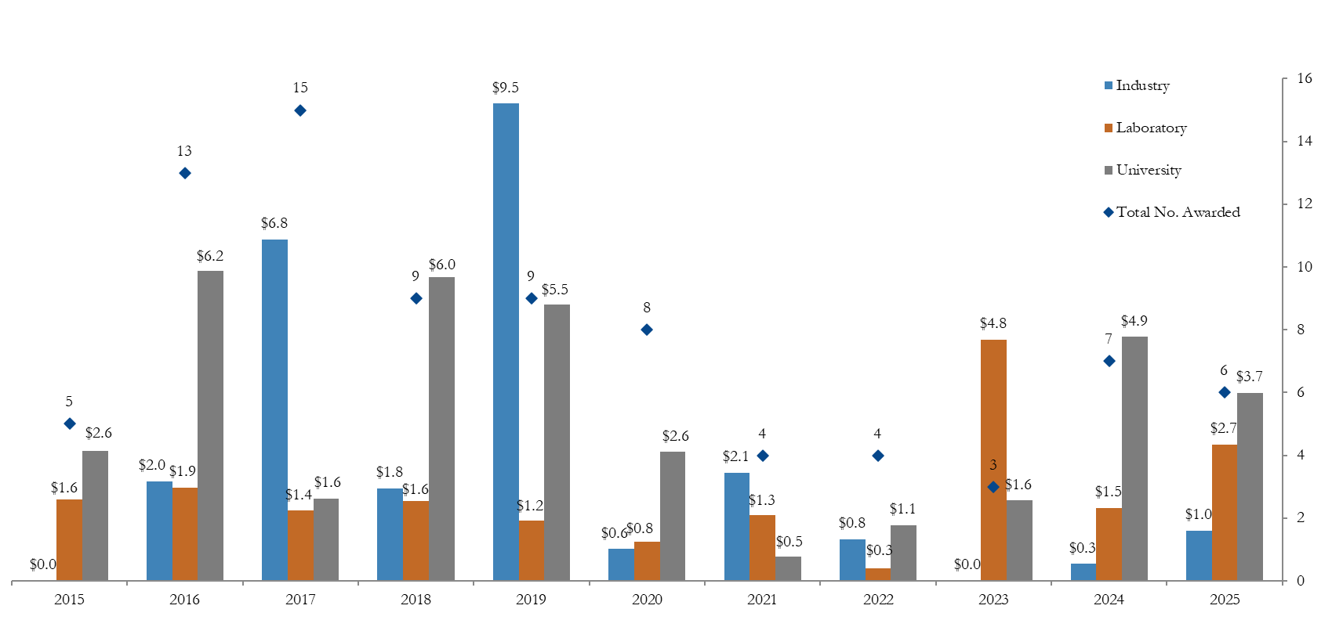
NSUF CINR Award Amounts by Institution

Slide 8
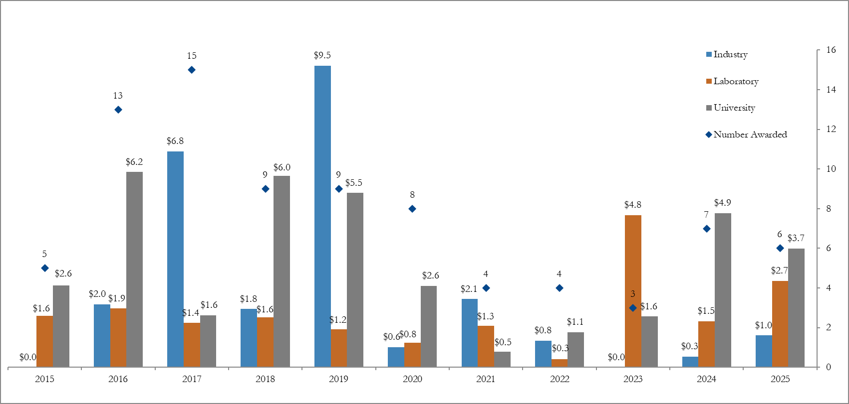
NSUF CINR Award Amounts by Institution

Slide 9
Summary of CINR work in various technical areas
Technical Areas | Number of CINR Awards | Award Years | Access Funding
Fundamentals for Reactor Materials | 38 | FY15, 16, 17, 18, 19, 20, 21, 22, 23, 24,25 | $30,698,949
Additive / Advanced Manufacturing | 12 | FY15, 16, 17, 18, 19, 21, 24, 25 | $18,204,147
Advanced Fuel Development | 13 | FY15, 16, 17, 19, 20, 23, 25 | $16,957,008
Sensor Development | 14 | FY15, 17, 18, 19, 20, 21, 24 | $9,030,941
Computational Model Development and Validation | 6 | FY17, 18 | $4,714,455
Welding & Joining Advanced Cladding | 3 | FY16, 17 | $1,656,984
Nuclear Materials Discovery & Qualification Initiative | 2 | FY20, 21 | $995,514

Slide 10
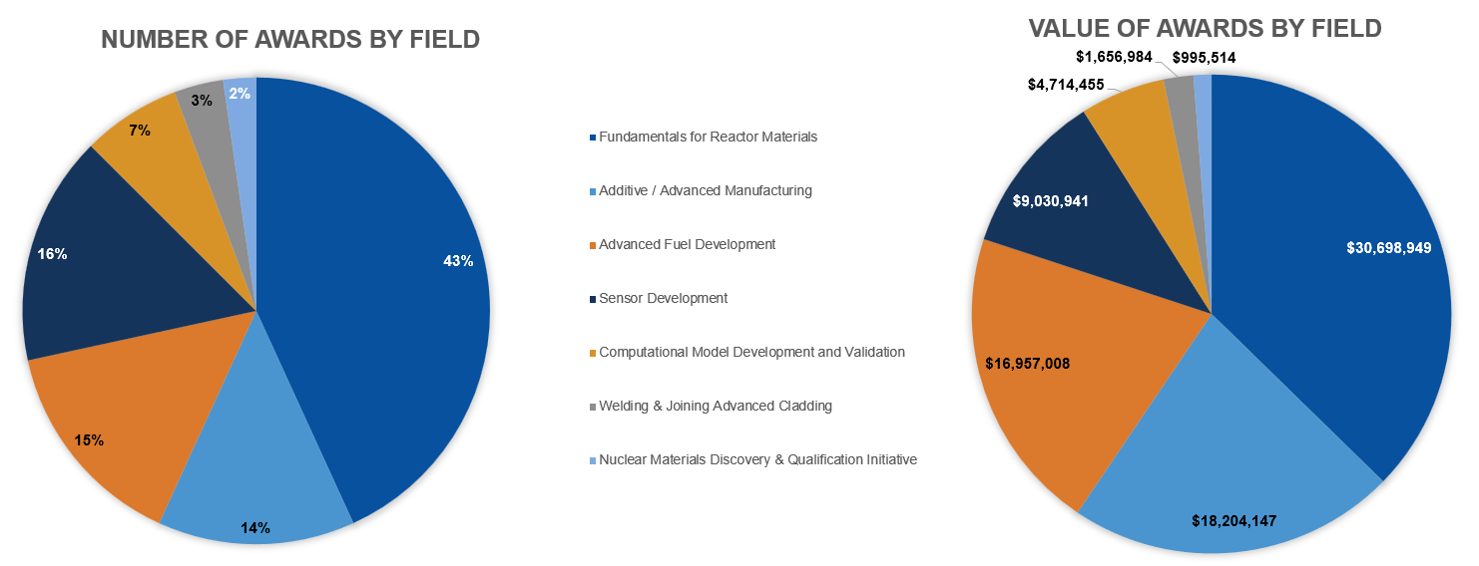
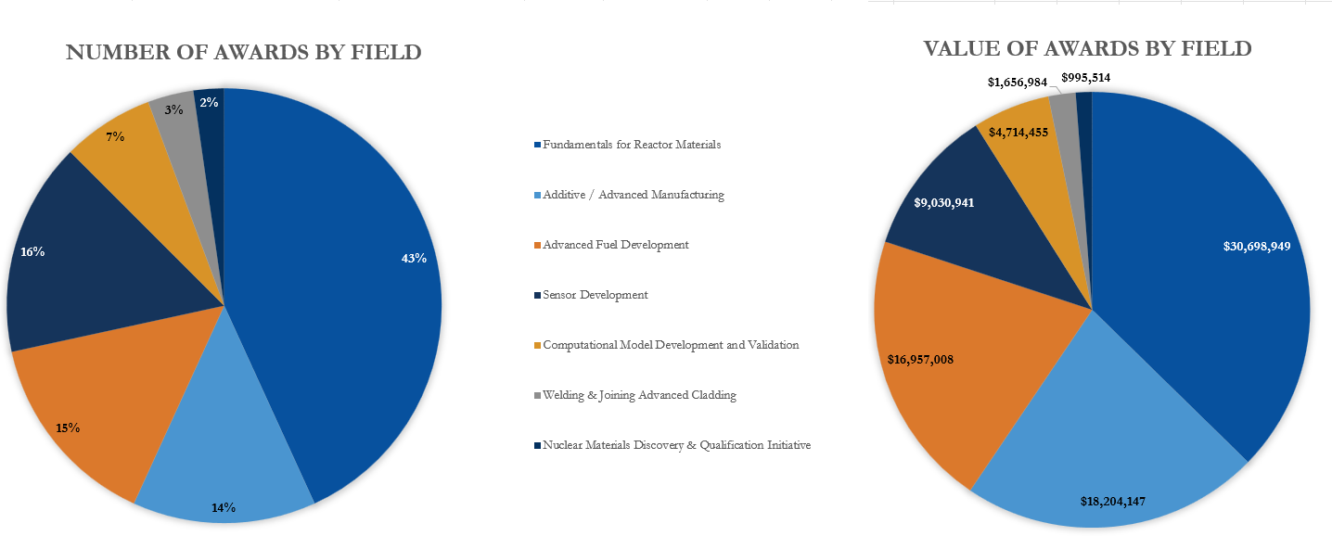
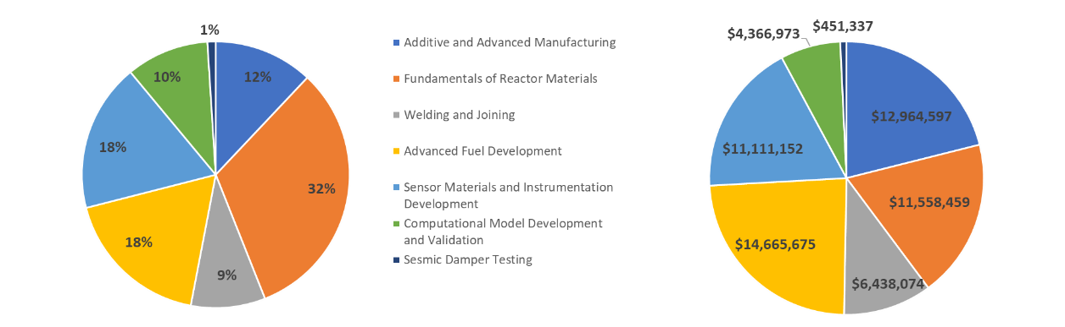
CINR awarded projects up to FY25 by research field
Number of awards by field
Value of awards by field

Slide 11
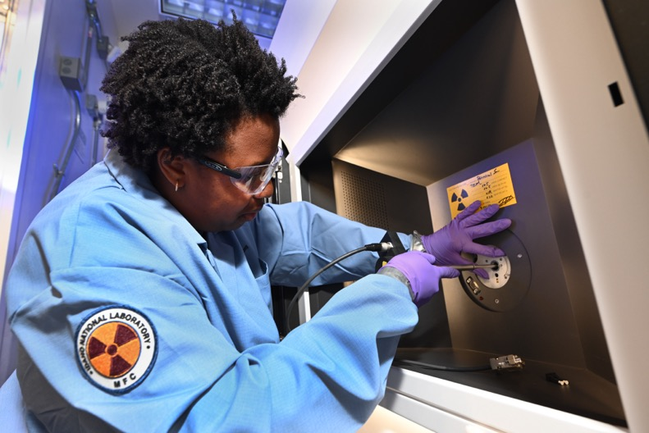
NSUF Access Award Projects Summary: FY07-FY25
Total NSUF Access Award Funding: $149.5M
900 total projects awarded
  78 CINR type projects executed
  36 CINR type projects currently ongoing
  672 RTEs executed
  145 RTEs ongoing
Awards distribution by institution type
  532 projects to 59 U.S. universities
  283 projects to 10 national laboratories
  42 projects to 16 industrial users*
  43 projects to 22 international researchers
  * All NSUF access awards support non-proprietary fundamental science and are intended for full public release
Notes:
Updated 3.2.2026 9-Mar-26 NEW TOTAL 149504658
Total projects awarded
900 46 CINR executed
37 CINR active
672 RTEs executed
145 RTEs Active
Awards by institution
532 projects 59 Universities
283 projects 10 labs
42 projects 16 industrial
43 projects 22 international
900

Slide 12
NSUF Access Awards
Award Year | Total | Completed | Ongoing
Pre-CINR | 31 | 30 | 1
FY2015 | 5 | 5 | 0
FY2016 | 13 | 11 | 2
FY2017 | 15 | 15 | 0
FY2018 | 9 | 6 | 3
FY2019 | 9 | 4 | 5
FY2020 | 8 | 6 | 2
FY2021 | 4 | 1 | 3
FY2022 | 4 | 0 | 4
FY2023 | 3 | 0 | 3
FY2024 | 7 | 0 | 7
FY2025 | 6 | 0 | 6
Total | 114 | 78 | 36

Slide 13
FY25 NSUF CINR Access Awards

Slide 14
FY25 CINR access awards
Lead Institution | PI | Value, $M | Duration |  | Title
University of Florida | Assel Aitkaliyeva | $1.7 | 3.5 Years |  | Mechanistic insights into the role Pu plays in properties of U-Pu-Zr fuels
Objective: Systematically assess microstructure and physical properties of fuel alloys with varying Pu content to capture phase-dependent thermo-mechanical behavior. Develop a mechanistic model for thermal and mechanical properties of U-Pu-Zr fuels, directly coupling to phase fractions from the constituent redistribution model in BISON. Demonstrate that increasing Pu content accelerates constituent redistribution, leading to substantial microstructural heterogeneity.
Collaborators: Dr. Michael Tonks, University of Florida Dr. Luca Capriotti, Idaho National Laboratory Dr. Tiankai Yao, Idaho National Laboratory Dr. Cynthia Adkins, Idaho National Laboratory Mr. Ryan Webster, Oklo Inc Mr. Patrick Everett, Oklo Inc Technical Lead: Dr. Bill Chuirazzi, Idaho National Laboratory |  |  |  | Capabilities: Idaho National Laboratory - Materials and Fuels Complex (MFC) Idaho National Laboratory - High Performance Computing
NSUF-1.1: Fuel and Core Materials

Slide 15
FY25 CINR access awards
Lead Institution | PI | Value, $M | Duration |  | Title
Idaho National Laboratory | J. Rory Kennedy | $2.0 | 3 Years |  | Relationship of Electrical, Thermal, and Mechanical Properties in Progressively Doped SiC via Chemical Vapor Deposited and Neutron Transmutation Doping
Objective: Systematically determine the intrinsic electronic, thermal, and mechanical properties of SiC doped with nitrogen via chemical vapor deposition and phosphorus via neutron transmutation doping. The goal is to increase SiC electrical conductivity through n-type doping via pre-irradiation fabrication and/or in-reactor nuclear transmutation, and test whether this increase in electrical transport leads to a corresponding increase in the electronic contribution to thermal conductivity.
Collaborators: Dr. Krzysztof Gofryk, Idaho National Laboratory Dr. Tsvetoslav Pavlov, Idaho National Laboratory Dr. Malwina Wilding, Idaho National Laboratory Dr. Fei Tang, Idaho National Laboratory Mr. Michael Heighes, Idaho National Laboratory Dr. Brian Newell, Idaho National Laboratory Dr. David Hurley, Idaho National Laboratory Dr. Mukesh Bachhav, Idaho National Laboratory Dr. Linu Malakkal, Idaho National Laboratory Dr. Yaqiao Wu, Kansas State University Technical Lead: Dr. J. Rory Kennedy, Idaho National Laboratory |  |  |  | Capabilities: Idaho National Laboratory - INL Research Center (IRC) Idaho National Laboratory - Materials and Fuels Complex (MFC) Idaho National Laboratory - Energy Innovation Laboratory Microscopy and Characterization Suite (MaCS) - Critical Materials and Energy Systems Innovation Center (Idaho Falls, ID)
NSUF-2.2: Advanced Materials and Manufacturing Technologies

Slide 16
FY25 CINR access awards
Lead Institution | PI | Value, $M | Duration |  | Title
Westinghouse Electric Co LLC | A. Parsi | $1.00 | 1.75 years |  | PIE of AM SS316 Thimble Plugging Device After Three Cycles in Byron Unit 1
Objective: Obtain empirical data on the effects of neutron irradiation on the microstructure of additively manufactured (AM) SS 316L fabricated via Laser Powder Bed Fusion (LPBF). High-resolution microstructural characterization will be performed on a thimble plugging device (TPD), partially built using LPBF, harvested after three operating cycles at Byron Station Unit 1. The TPD consists of a conventional 304SS base plate serving as a printing platform for the AM SS316L rodlets.
Collaborators: Dr. M. Grace Burke, Idaho National Laboratory Mr. Frank Gift, Electric Power Research Institute Ms. Catou Cmar, Westinghouse Churchill Hot Cell Facility Technical Leads: Dr. Bill Chuirazzi, Idaho National Laboratory |  |  |  | Capabilities: Idaho National Laboratory - Materials and Fuels Complex (MFC) Westinghouse Churchill Laboratory Services (WCLS)
NSUF-2.2: Advanced Materials and Manufacturing Technologies

Slide 17
FY25 CINR access awards
Lead Institution | PI | Value, $M | Duration |  | Title
Pacific Northwest National Laboratory | Ramprashad Prabhakaran | $0.67 | 3 Years |  | Effect of neutron irradiation on NF616 (Grade 92) at LWR and fast reactor relevant temperatures
Objective: Ferritic-martensitic (F-M) steels are candidate in-core structural materials for fast reactors and advanced LWRs due to their resistance to void swelling, microstructural stability, and irradiation creep. To comprehensively understand the radiation tolerance of NF616, this project will perform TEM, APT, and neutron scattering studies on NF616 samples neutron irradiated in the ATR across varying temperatures (240–470°C) and doses (3–8 dpa).
Collaborators: Dr. Stuart Maloy, Pacific Northwest National Laboratory Dr. Dan Edwards, Pacific Northwest National Laboratory Dr. Mychailo Toloczko, Pacific Northwest National Laboratory Dr. Kayla Yano, Pacific Northwest National Laboratory Dr. Kumar Sridharan, University of Wisconsin-Madison Dr. Don Brown, Los Alamos National Laboratory Dr. Yaqiao Wu, Boise State University Technical Leads: Dr. Mukesh Bachhav, Idaho National Laboratory |  |  |  | Capabilities: Pacific Northwest National Laboratory - Material Science Technology Laboratory (MSTL) Microscopy and Characterization Suite (MaCS) - Critical Materials and Energy Systems Innovation Center (Idaho Falls, ID) Los Alamos National Laboratory - Los Alamos Neutron Science Center (LANSCE)
NSUF-2.2: Advanced Materials and Manufacturing Technologies

Slide 18
FY25 CINR access awards
Lead Institution | PI | Value, $M | Duration |  | Title
Ohio State University | Marat Khafizov | $0.34 | 3 Years |  | Advanced post-irradiation examination of accelerated burnup Cr-doped UO2
Objective: Uncover outstanding questions in mechanistic understanding of oxide fuel behavior via advanced microscopy of fuels irradiated under accelerated burnup conditions. Goals include investigating accelerated irradiation impacts on UO2 microstructure evolution, targeting defect characterization affecting grain restructuring and high burnup structure formation, and characterizing fission gas bubbles and dislocations to uncover gas retention mechanisms in chromium-doped UO2 (Cr-UO2).
Collaborators: Dr. Denise Adorno Lopes, Oak Ridge National Laboratory Dr. Casey McKinney, Oak Ridge National Laboratory Dr. Jason Harp, Oak Ridge National Laboratory Dr. Nathaniel Capps,Oak Ridge National Laboratory Dr. Kyle Johnson, Westinghouse Electric Company Technical Leads: Mr. Kory Linton, Oak Ridge National Laboratory |  |  |  | Capabilities: Oak Ridge National Laboratory - Irradiated Fuels Examination Laboratory (IFEL) Oak Ridge National Laboratory - Radioactive Material Analytical Laboratory (RMAL) Oak Ridge National Laboratory - Low Activation Materials Development and Analysis facility (LAMDA)
NSUF-1.1: Fuel and Core Materials

Slide 19
FY25 CINR access awards
Lead Institution | PI | Value, $M | Duration |  |  | Title
Purdue University | Xiaoyuan Lou | $1.28 | 3 Years |  |  | Understanding neutron irradiation-assisted stress corrosion cracking mechanisms of 316L stainless steel made by laser additive manufacturing
Objective: The proposed project aims to study the impact of the neutron displacement damage to the yttrium hydrides. Neutron displacement damage can displace Study irradiation-assisted stress corrosion cracking (IASCC) mechanisms of neutron-irradiated 316L stainless steel fabricated via laser powder bed fusion and directed energy deposition additive manufacturing. Fundamental understanding will be developed through multiscale characterization and modeling, including synchrotron X-ray micro-computed tomography (μCT), grain-resolving high-energy X-ray diffraction microscopy (HEDM), advanced electron microscopy, and crystal plasticity modeling.
Collaborators: Dr. Janelle Wharry, University of Illinois Urbana-Champaign Dr. Wen Jiang, North Carolina State University Dr. Jun-Sang Park, Argonne National Laboratory Mr. Ramprashad Prabhakaran, Pacific Northwest National Laboratory Technical Leads: Mr. Noe Morales, Idaho National Laboratory Dr. Stuart Malloy, Pacific Northwest National Laboratory Dr. Yiren Chen, Argonne National Laboratory |  |  |  |  | Capabilities: Argonne National Laboratory - Irradiated Materials Laboratory Argonne National Laboratory - Activated Materials Laboratory at the Advanced Photon Source (APS) Pacific Northwest National Laboratory - Material Science Technology Laboratory (MSTL) Idaho National Laboratory - High Performance Computing
NSUF-1.2: Advanced Materials and Manufacturing Technologies

Slide 20
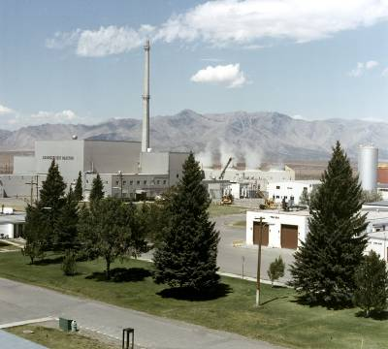
Contact Information
J. Derek Whipple
208-526-4662
j.whipple@inl.gov

Slide 21
Questions?
  J. Derek Whipple
    CINR Administrator, NSUF
    j.whipple@inl.gov

