Slide 1
Enabling specific heat measurements via the laser flash technique: Improving throughput and measurement accuracy
Tsvetoslav Pavlov
Idaho National Laboratory
May 12th, 2026

Slide 2
Acknowledgements
NSUF program and leadership
Geroge S. Evans
Michael C. Marshall
Laura Bonatti
FASB, IMCL operations and radiological control

Slide 3
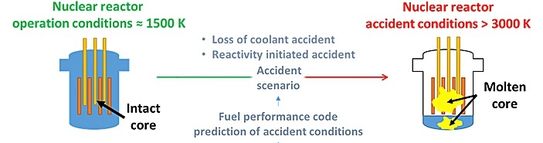

Project motivation
Specific heat is used to estimate thermal conductivity via the following equation : $k=αρC_{P}$
Specific heat is a critical input property for fuel performance/ safety codes to simulate accidents:
  Loss of Coolant Accidents
  Reactivity Initiated Accidents
Currently the Differential Scanning Calorimeter (DSC) is used for measuring this property which takes around 40 – 60 hours per sample
The Laser Flash Analyzer is proposed as an alternative technique for specific heat measurements that can reduce the time and cost by a factor of 2-3

Slide 4
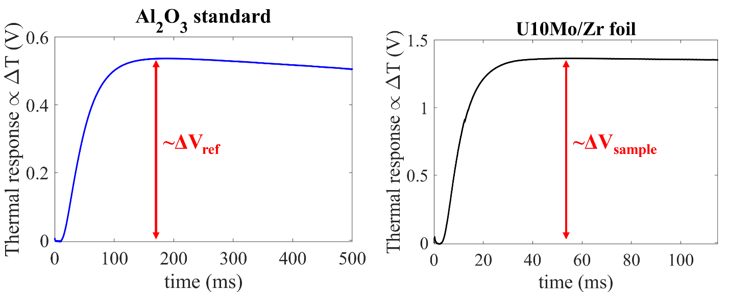

Methodology
The method leverages the following adiabatic energy balance:
$$ΔH_{ref}=ΔH_{sample}$$
$$m_{ref}∗ C_{p,ref}∗ {∆T}_{ref} = m_{sample}∗ C_{p, sample}∗ {∆T}_{sample}$$
$$C_{p, sample}=\frac{m_{ref}∗ C_{p,ref}∗ {∆T}_{ref}}{m_{sample}∗ {∆T}_{sample}}$$
$$C_{p, sample}=\frac{m_{ref}∗ C_{p,ref}∗ {∆V}_{ref}}{m_{sample}∗ {∆V}_{sample}}$$

Slide 5
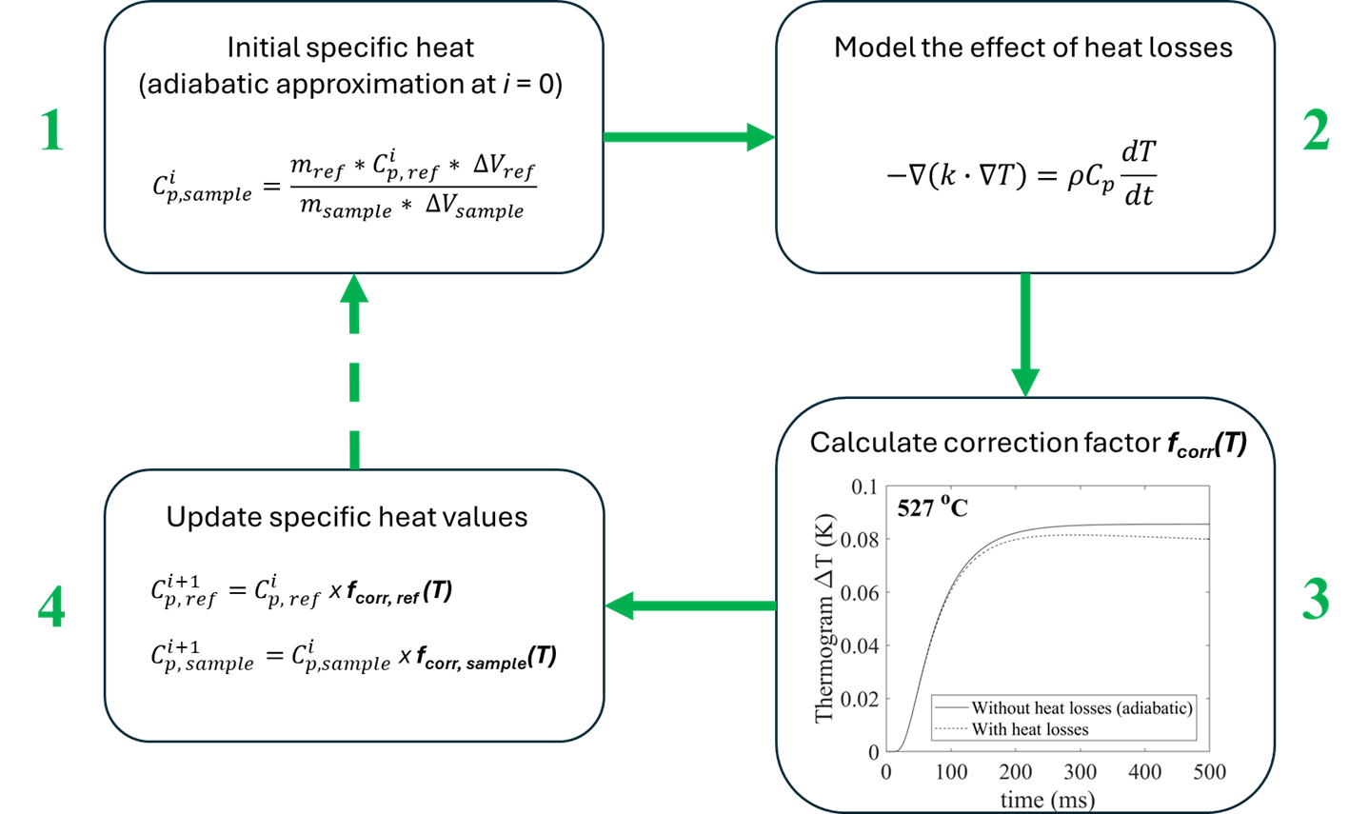
Methodology
Advanced tool development – based on finite element analysis and Gauss-seidel iterations
Correcting for heat loss effects which improves the accuracy of the measurement at elevated temperatures (>300℃)

Slide 6
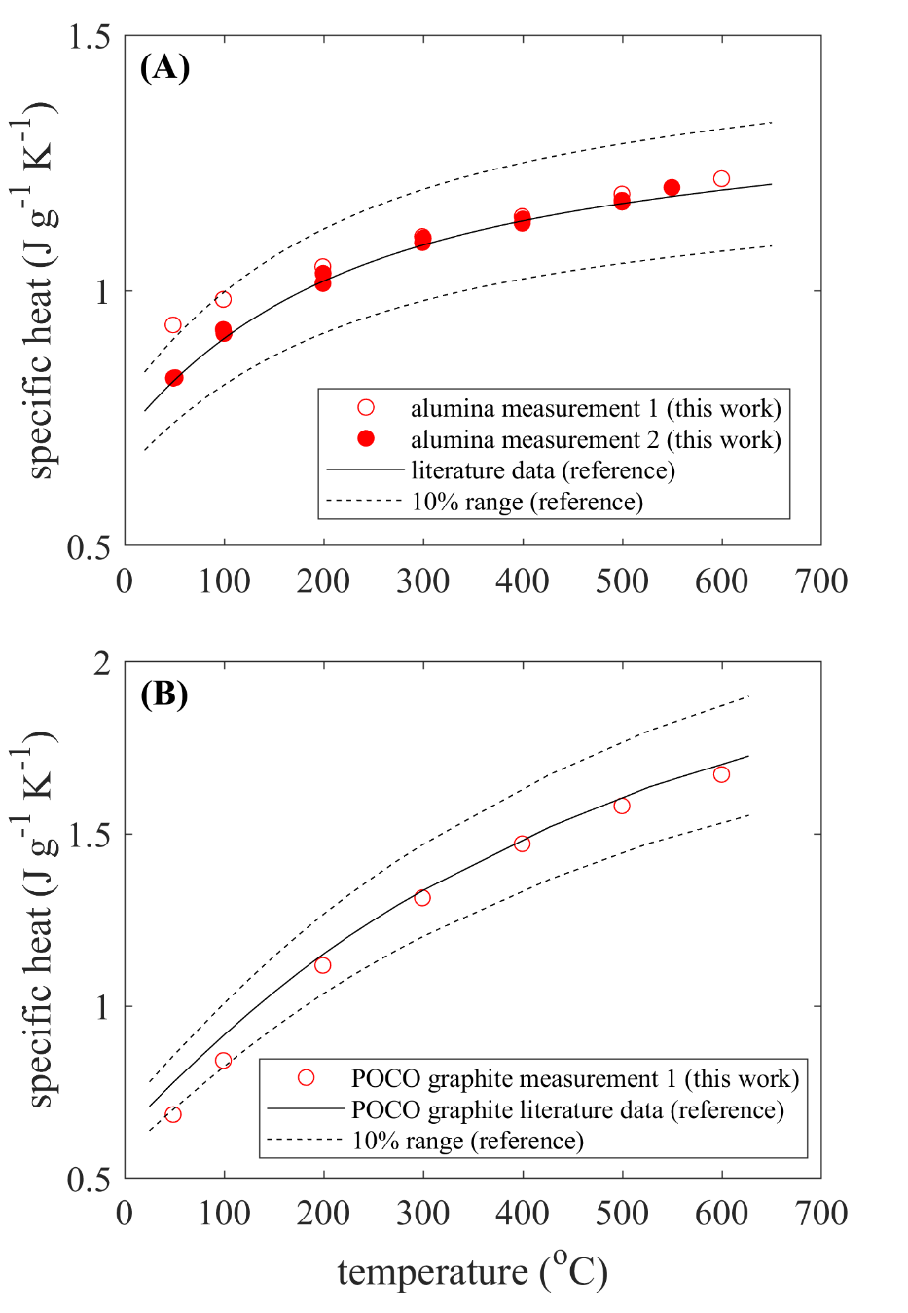
Results: Valiation
Standard reference materials validation:
  (A) alumina
  (B) POCO graphite
Excellent agreement with literature data
This method offers a factor of two greater throughput compared to DSC measurements (2 days instead of 4 days per sample)
No significant challenges – setting aside more time for further testing is the only

Slide 7
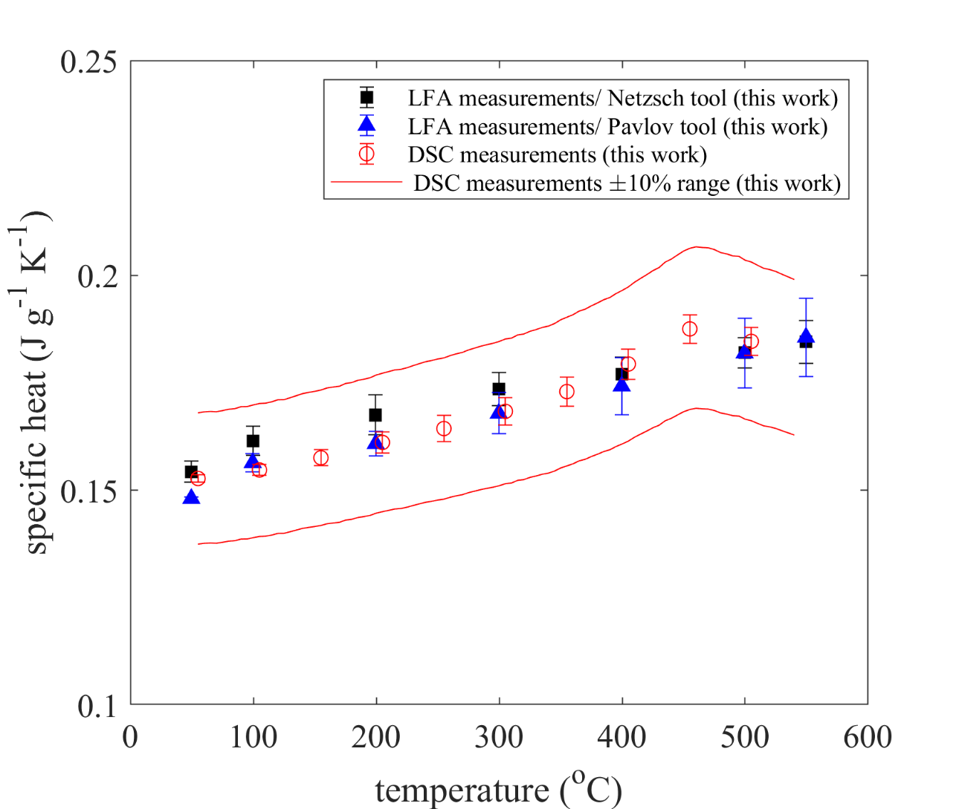
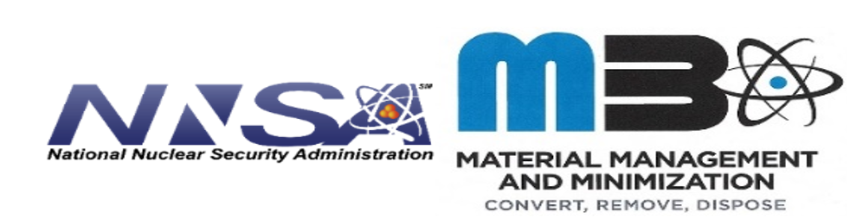
Results: Application to as-fabricated U-10Mo fuel
The new methodology was applied to U-10Mo/Zr fuel foils
The LFA results show excellent agreement with the DSC measurements
The time of LFA data collection was 2-3 times faster compared to the DSC and leveraged only 2 samples vs. the DSC averages were based on more than 5 samples

Slide 8
Summary
Developed a novel methodology for measuring specific heat capacity via Laser Flash Analysis
Demonstrated and validated method for measuring specific heat capacity via LFA at INL
Methodology offers improved accuracy and higher throughput (a factor of 2 or greater) compared to alternative techniques such as DSC
The methodology was successfully applied to as-fabricated U-10Mo and U-10Zr fuels as well as irradiated AGR TRISO compacts
Publications
Pavlov et al., A novel methodology for measuring specific heat via laser flash, draft, Journal of Thermal Sciences
Pavlov et al., Thermophysical properties of U-10Mo monolithic fuel from the MP-2 irradiation experiment, in preparation, JNM
Pavlov et al., Thermophysical properties of U-10Zr fuel before and after irradiation, draft, JNM
Hisle, E. J., Pavlov et al., Thermophysical properties of irradiated AGR-2 compacts, in preparation, JNM

Slide 9
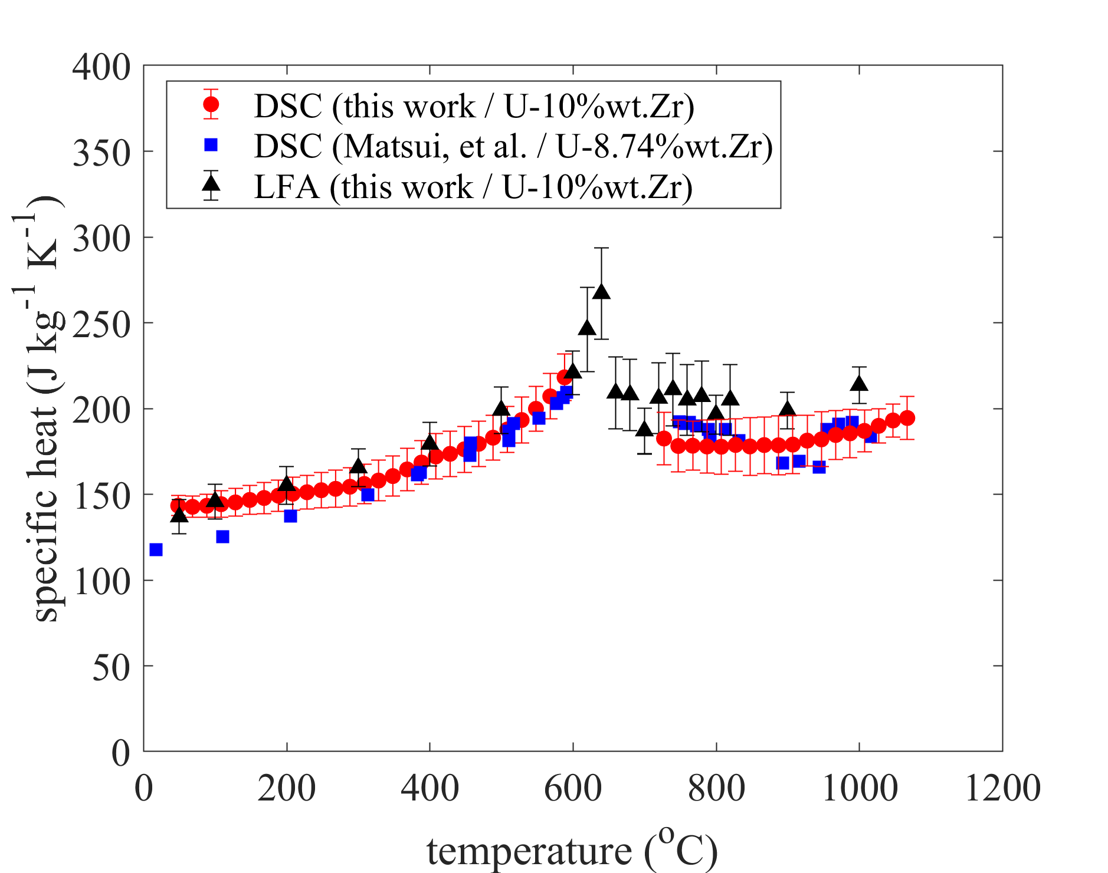

Results: Application to as-fabricated U-10Zr fuel
The new methodology was applied to as-fabricated U-10Zr fuel
Additional benefits of the new methodology include the ability to resolve specific heat in the solid-to-solid phase transition region (550℃ to 750℃) which is not possible via DSC in a scanning mode due to phase transition enthalpies masking the specific heat response of the sampl.

Slide 10
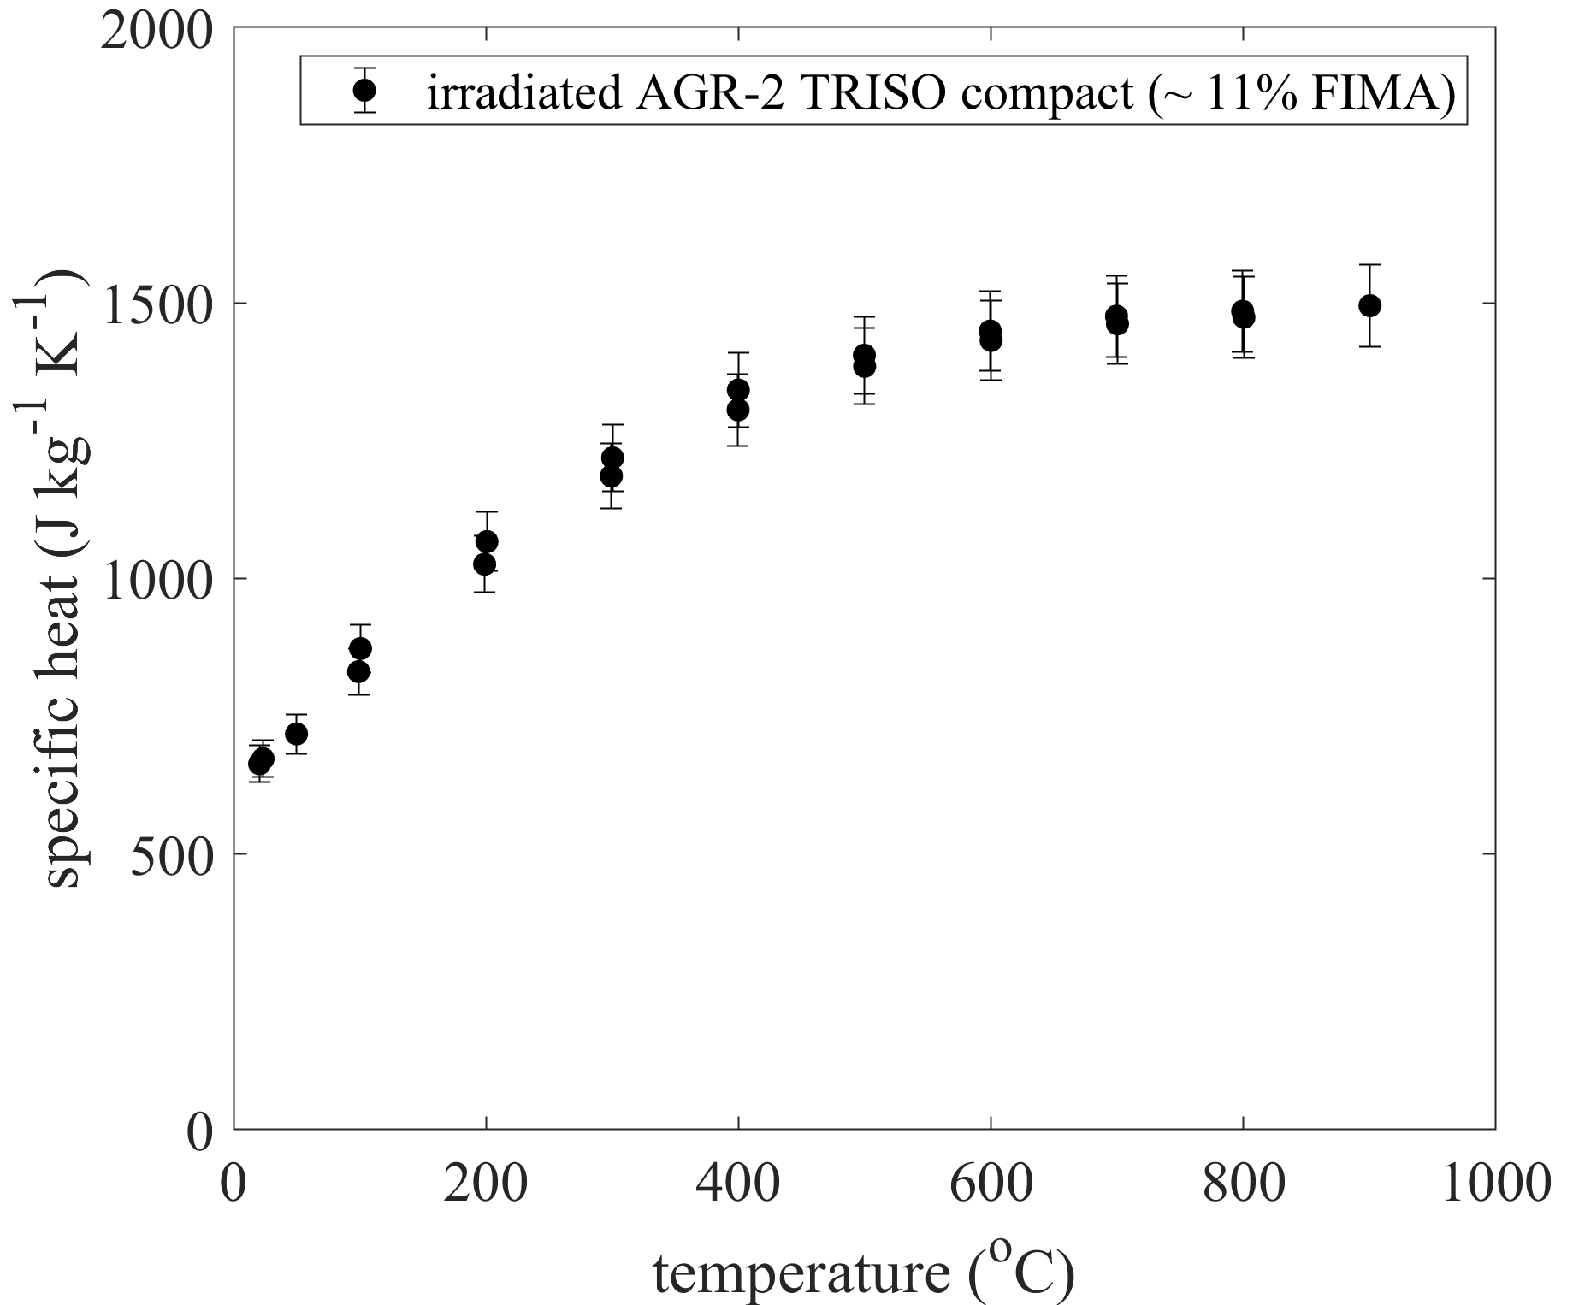
Results: Application to irradiated AGR-2 TRISO fuel compact
The new methodology was applied to irradiated AGR TRISO fuel
The LFA made accurate specific heat measurements on TRISO fuel possible which were not possible via the DSC after several attempts

