Slide 1
Brenden Heidrich NSUF Director
NSUF Annual Program Review Meeting
May 11, 2026
NSUF Program Overview and Update
INL/MIS-26-91517

Slide 2
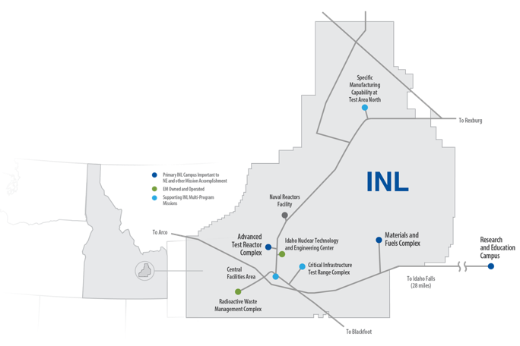
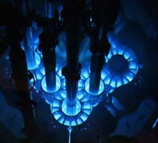
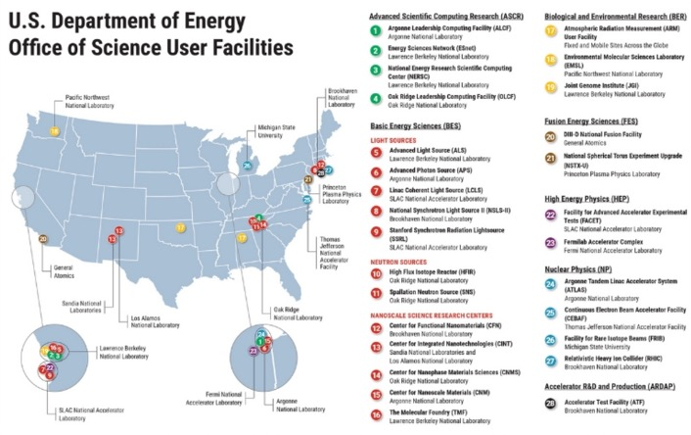
The Nuclear Science User Facilities Program
A User Facility to empower US Nuclear Energy
Established in 2007
  To be the U.S. Department of Energy Office of Nuclear Energy’s first dedicated user facility for nuclear energy
  To open the national laboratories to university researchers
Founded at Idaho National Laboratory (INL)
  INL remains the lead and primary institution
NSUF operates similarly to other user facilities in the United States
  Fundamental Research - basic and applied research in science and engineering, intended to be published and shared broadly with the scientific community
  Competitive proposal processes for access
  No cost to user for accessing capabilities
  No travel funding to users, etc.

Slide 3
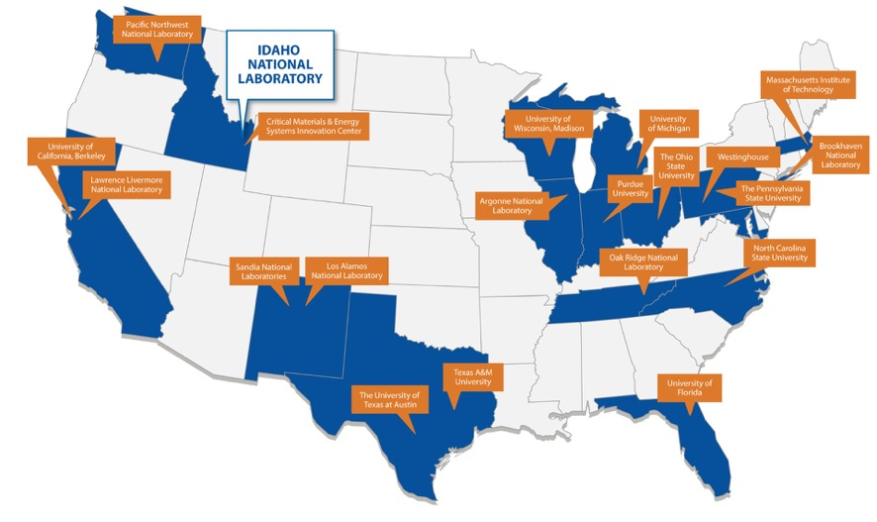
The Nuclear Science User Facilities (NSUF) Program
Unique aspects of NSUF
Consortium of facilities/capabilities
  21 institutions across the United States
  >50 major facilities and laboratories
  NSUF efficiently leverages existing investment in physical capabilities by utilizing excess capacity.
  Funding to partners covers only the costs for the awarded access project
NSUF offers multiple capabilities to a single scientific area
  Fundamental irradiation effects in nuclear fuels and materials important to US nuclear energy development
Large projects can last up to 7 years
  Full-scale projects can include engineering design, experiment fabrication, transport, neutron irradiation, post-irradiation examination, and final disposition.
  All projects are fully forward-funded at the time that they are awarded.
Notes:
The NSUF realized that the demand for nuclear energy material science capabilities far exceeded the capabilities provided by ATR and associated post-irradiation examination facilities at the Idaho National Laboratory (INL).
Between 2008 and 2025, NSUF added twenty institutions across the US as “partners.” The current list of NSUF partner institutions is available at https://nsuf.inl.gov/Home/PartnerInstitutions.
The distributed nature of the program adds a level of complexity in the interactions between the program office, located at the INL, and the partners and users, scattered across the US.

Slide 4


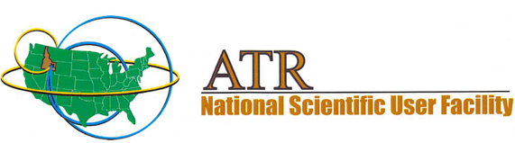
20th Anniversary of NSUF in 2027
Special 2026 Calendar to highlight Partners
Feature Articles in Nuclear News Magazine and Journal of Materials
Symposium and Users Organization meeting at Spring TMS conference.
Celebratory event at ANS 2027 Annual conference.
Special issue in Journal of Nuclear Materials for the research enabled by NSUF.

Slide 5
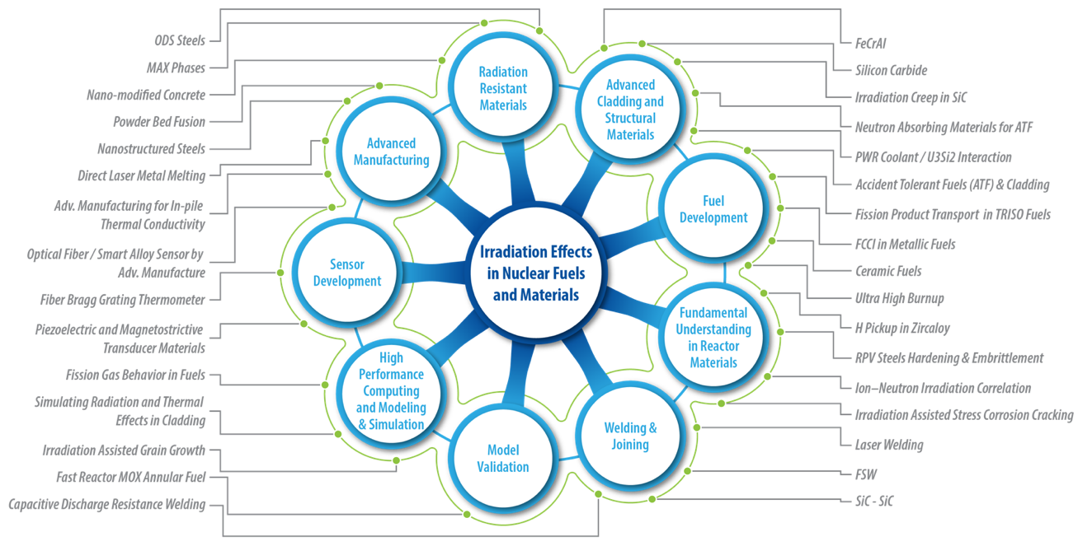
NSUF covers materials at all technical readiness levels

Slide 6
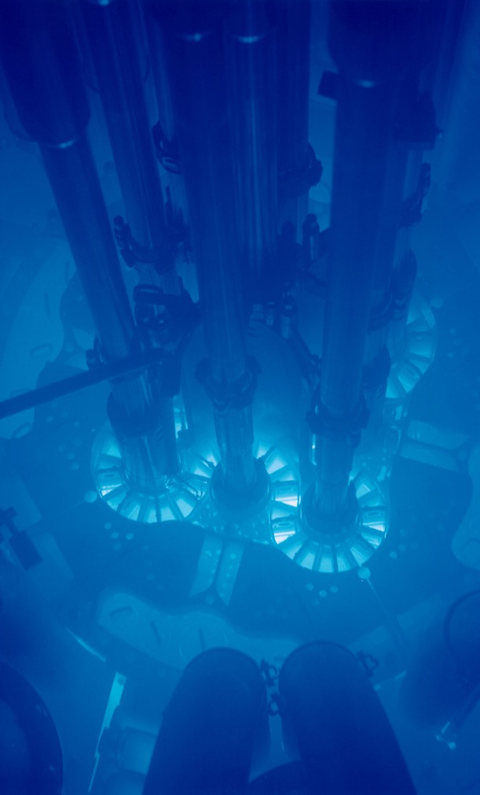
NSUF Capabilities

Slide 7
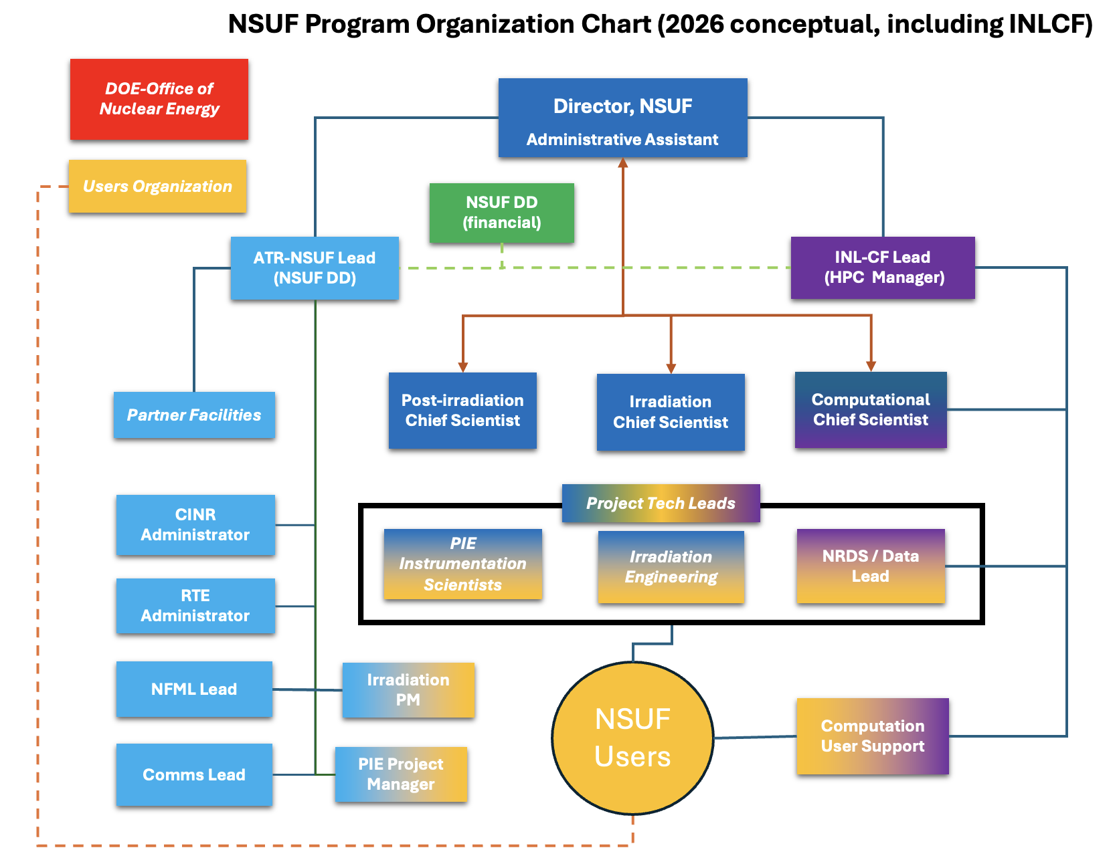
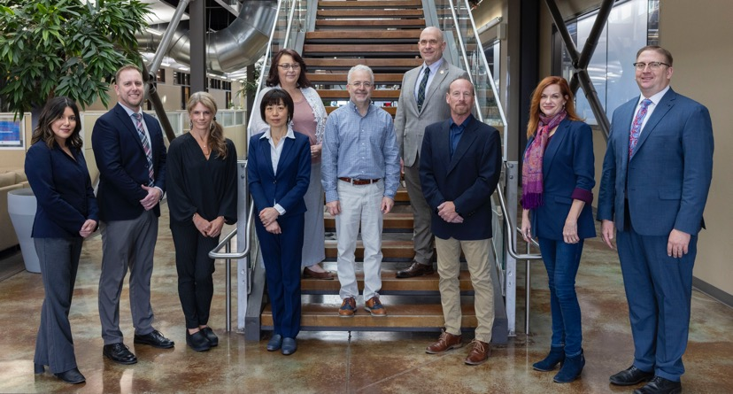
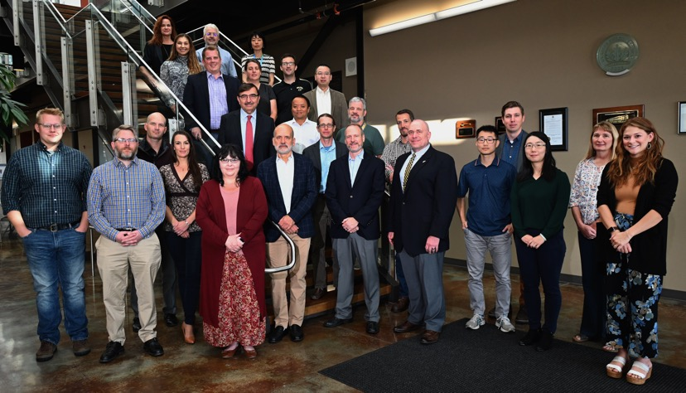

Slide 8

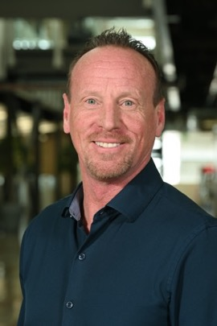
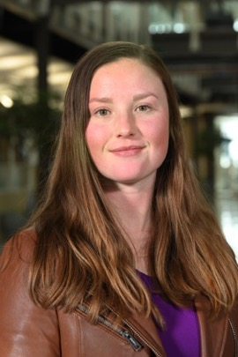
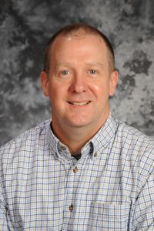
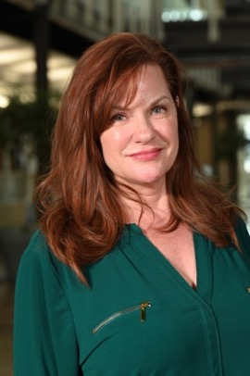

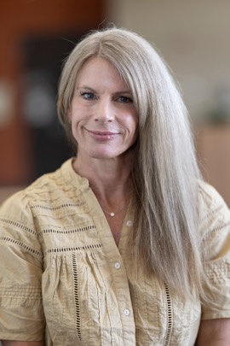

Staff Changes in the Program Office
Post-Irradiation Lead
  Alina Zackrone left INL in FY26
  Noe Morales is onboard
Irradiation Chief Scientist
  Keith Jewell retiring in FY26
  Allen Roach is onboard
NFML Lead and Agreements
  Kelly Cunningham retired in FY26
  Anna Podgorney is onboard
Communications Lead
  Alexis Starks transferred within INL
  Harshit Khatwani is onboard

Slide 9
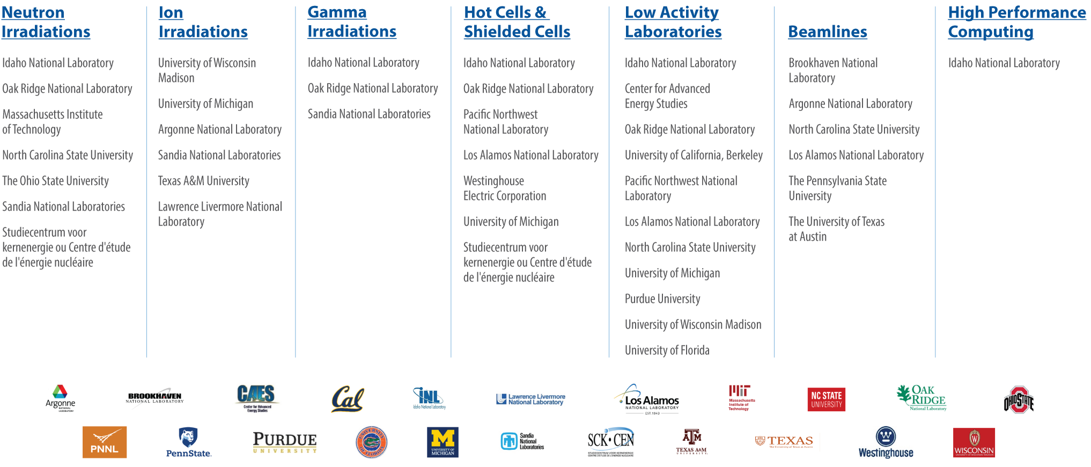
NSUF Capabilities Offer Unique Research Opportunities
Critical Materials and Energy Systems Innovation Center

Slide 10
Answering the need for a nuclear energy material
If you need a material for a nuclear energy system, start at the bottom and work upward to get the irradiation testing data. Note that higher up the pyramid is costlier and will take more time.
The material might already be in the marketplace. Search for ASME code cases and similar standards for qualified materials.
Perhaps there is not a code case, but there has been research. Do a search of the academic literature.
Maybe there has been research, but it doesn’t answer your questions, find the project data at NSUF’s Nuclear Research Data System and do your own analyses.
If you need to create your own data, find material specimens in the Nuclear Fuels and Materials Library.
Finally, if all else has failed, get your data from performing a new irradiation test.
5. Irradiation Testing
4. NFML + PIE
3. NRDS Data
2. Scientific Literature
1.Codes and Standards

Slide 11
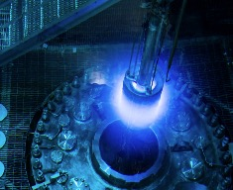
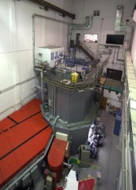
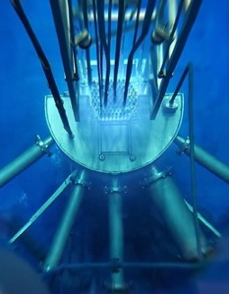
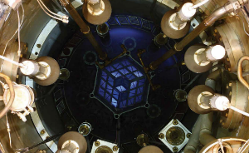
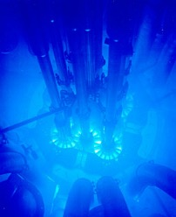
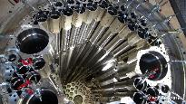
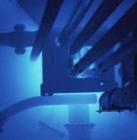
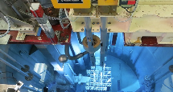
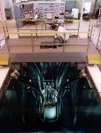
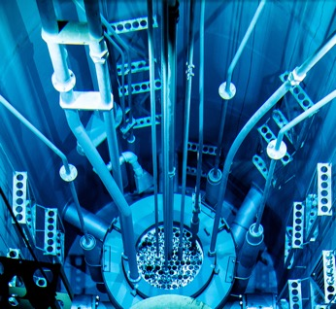
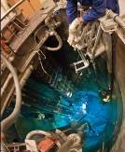
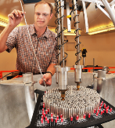
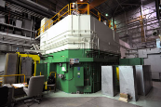
Simulated Reactor Environments: Neutron Irradiation

Slide 12



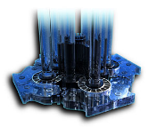
Testing Strategy for Novel Materials
Irradiation Testing Hierarchy
  Ion Beam Irradiation Facilities
    Allow immediate feedback of performance
    Ease of instrumentation
    Ease of environmental tuning
  Low-Power Research Reactors
    First 1% and 10% testing to inform future test reactor campaigns
    Instrumentation development (ease of access to the core)
    Neutron radiography and beam techniques
    Experiment modeling & validation capabilities
    URR advantages:
    Ease of use & lower cost
    Expertise in handling and shipping/receiving RAM
    Co-located with hot cell facilities (sample preparation)
    May have gamma irradiation and PIE facilities as well

Slide 13


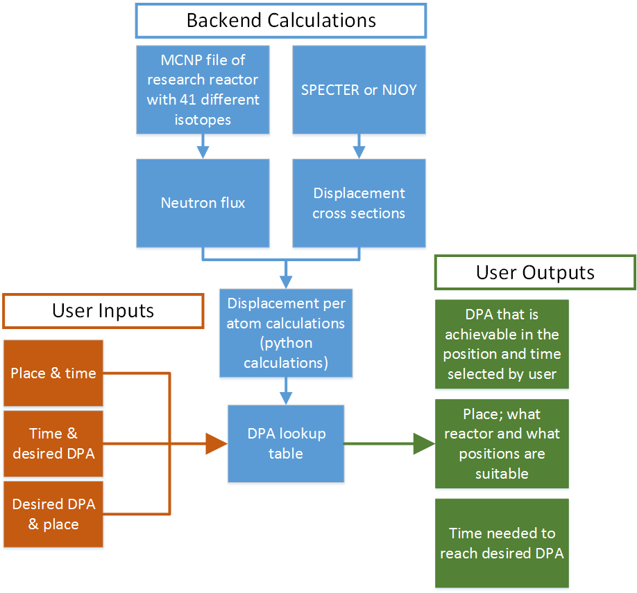
  NSUF RAD Calculator - Irradiation resource tool
RAD Calc is a tool that NSUF users can access during the conceptual design phase of the proposal to select the irradiation location which is the most appropriate for their project.
The tool has four main functions:
calculate displacements per atom (DPA) for multiple different materials,
calculate the time needed to reach the desired DPA,
inform users what position in what reactor will give them the desired radiation damage the most effectively.
Estimate residual radioactivity of the specimens following neutron irradiation.

Slide 14
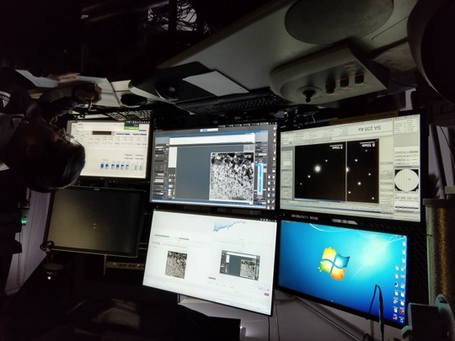
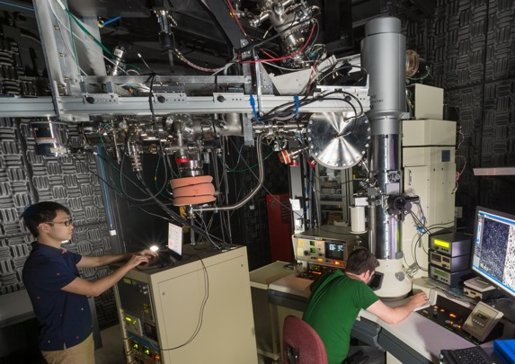
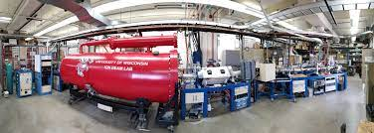
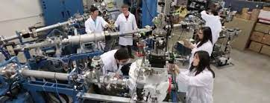
Simulated Reactor Environments: Ion Irradiation
IVEM
I³TEM
MIBL
In Situ TEM
In Situ TEM
In Situ TEM
WISC-IBL
TAMU-AL

Slide 15
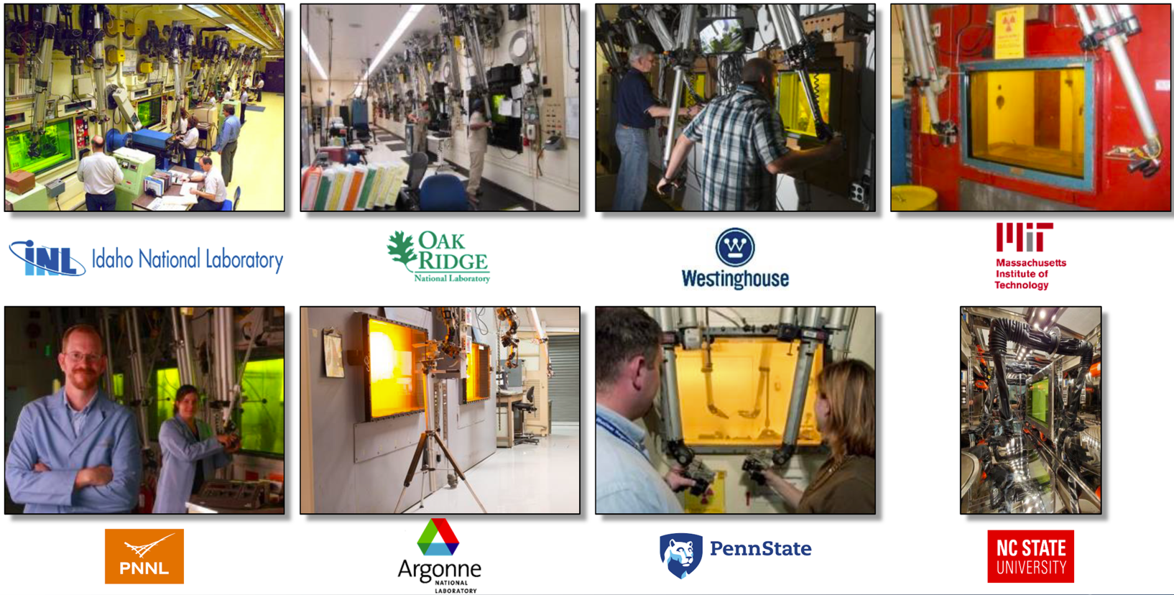
Hot Cells

Slide 16
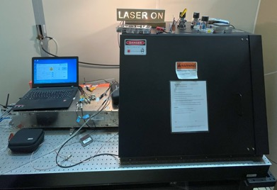
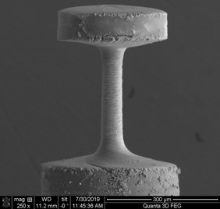
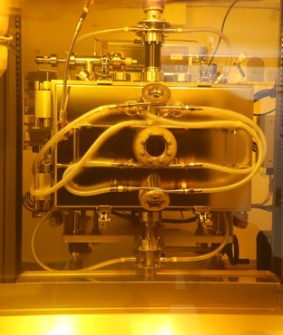
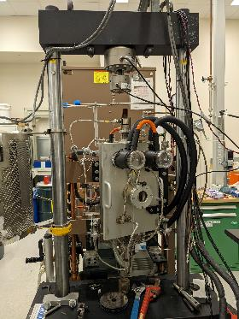
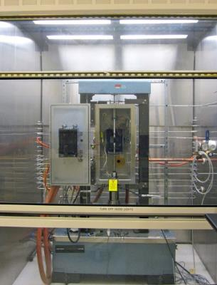
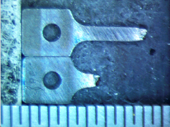
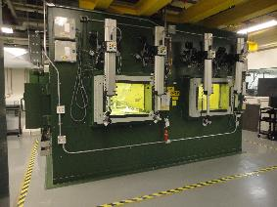
Simulated Reactor Environments: Mechanical Testing
  Hardness/ Bend test/ Tensile/ Creep/ Fatigue/ Compact tension/ Charpy impact (toughness)
High Temp Tensile Testing

Slide 17
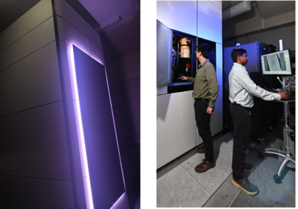
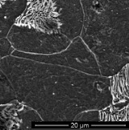
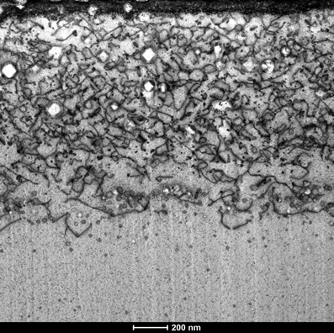
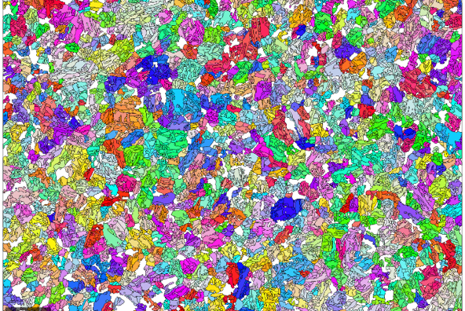
Advanced Microstructure Characterization Capabilities
Optical metallography
Scanning electron microscopy (SEM)
  BSE/EBSD/FIB
Transmission electron microscopy (TEM)
Spectra 300 STEM
STEM resolution 50 pm (125 pm at 30kV)
NF616
Ga₂O₃ Sensor

Slide 18
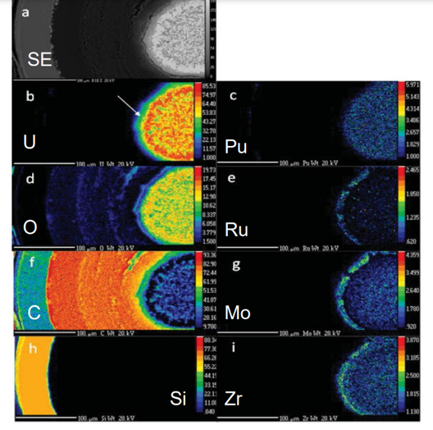


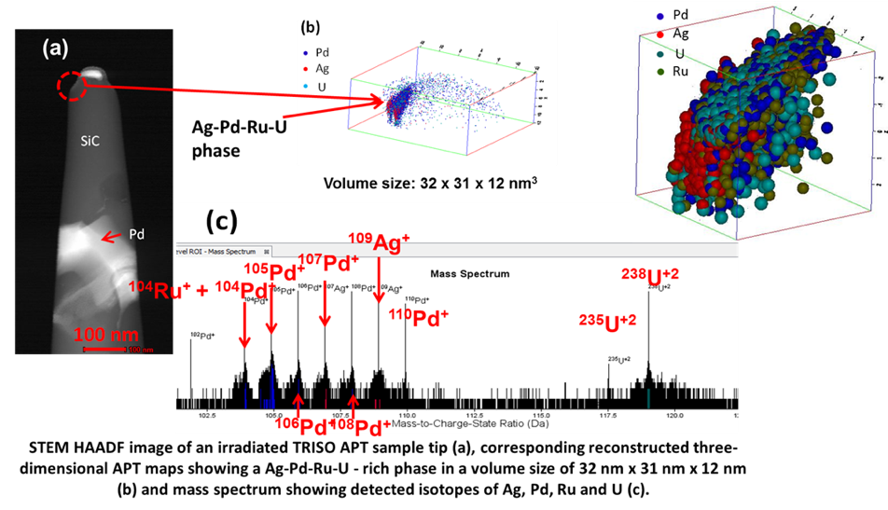
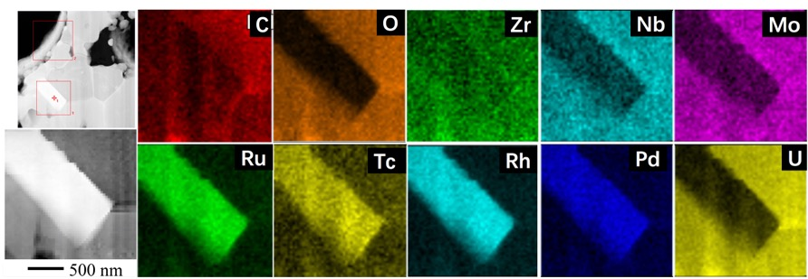
Advanced Microstructure Characterization Capabilities
  Atom probe tomography (APT)
  Electron Probe MicroAnalysis (EPMA)
  Energy Dispersive Spectroscopy (EDS)
  Electron Energy Loss Spectroscopy (EELS)
Combination of TEM + APT
WDS maps of a TRISO fuel particle
TEM images and EDS maps of irradiated fuel particle

Slide 19




High Performance Computing (HPC) resources
NSUF HPC systems support a wide range of users and programs
Teton (2026)
  15.6 Petaflops performance
  393,216 AMD 9965 Turin cores
  1024 nodes - 384 cores/node – 768GB/node memory
Windriver (2025)
  5.4 Petaflops performance
  94,416-core Dell CTS-2 system
  211 TB total memory
Bitterroot (2024)
  2 Petaflops performance
  43,008-core Dell CTS-2 system
  90 TB total memory
Hoodoo (2021)
  Machine Learning Cluster with 108 A100 GPUs
Sawtooth (2020)
  5.6 Petaflops performance (was #37 on Top 500 list in 2020)
  99,972 compute cores HPE SGI 8600 system
  395 TB total memory
Teton
Bitterroot & Windriver
Sawtooth
Notes:
Lemhi will be transferred to an Idaho university consortium this year, as was done with Falcon four years ago.

Slide 20


High Performance Computing (HPC)
New supercomputer Teton
  21,000 TFlops of performance
  393,216-core HPE Cray EX 4000 with each of its 1,024 nodes having 768 GB of RAM
  768 TB of total memory
  Ranked #85 on Top500 list
Delivered 1,930 million core hours in FY25
  926 million core hours more than in FY24
  over one billion core hours already in FY26
Creating a centralized Artificial Intelligence platform on HPC with Hoodoo (2021) and Arco (late 2026) GPU AI/ML development machines and the Nuclear Research Data System (NRDS) archive and portal.
Supporting user trainings on HPC resources and solving user problems.
Expanded storage by 1.8 petabytes to enhance performance

Slide 21




Nuclear Research Data System (NRDS)
Images from NRDS Portal

Slide 22
NSUF Instrument Scientists
Scientific Technique and Infrastructure Development
FY25 Fellows
FY26 Fellows
Scientist | Topic (Instrument)
Mukesh Bachhav (INL) | Atom Probe Tomography
Wei-Ying Chen (ANL) | TEM Pico Indenter
William Chuirazzi (INL) | X-ray Computed Tomography (µ-CT)
Ethan Hisle (INL) | Thermal Conductivity Microscope (TCM)
Trishelle Copeland-Johnson (INL) | Data Collection for 3-D Tomography
Tsvetoslav Pavlov (INL) | Specific Heat Using Laser Flash Diffusivity (LFD)
Stephen Taller (ORNL) | Bulk Material Property Through Nanoindentation
Tiankai Yao (INL) | Artificial Intelligence (AI) for Microstructure
Scientist | Topic (Instrument)
William Chuirazzi (INL) | X-ray CT development with enhanced visualization techniques
Soyoung Kang (ONRL) | In-situ annealing capabilities built on SEM-EBSD for irradiated materials
Jun Sang Park (ANL) | In-situ high energy X-ray characterization of nuclear materials
Tsvetoslav Pavlov (INL) | Thermo physical property development to advance instrumentation and modeling of irradiated fuels
Mehmet Topsakal (BNL) | Development of micro-heaters at NSLS-II for NSUF nuclear materials research
Malwina Wilding (INL) | SiC measurements and formalizing software to handle data within NSUF experimental work
Tiankai Yao (INL) | AI development to assist NSUF in streamlining proposals, reviews and work previously completed.
Notes:
Fy25: 8 selected from 28 applications
FY26: 7 selected from 34 applications

Slide 23

NSUF User Access Opportunities

Slide 24

NSUF Access Award Projects Summary: FY07-FY25
Total NSUF Access Award Funding: $149.5M
900 total projects awarded
  46 CINR type projects executed
  37 CINR type projects currently ongoing
  672 RTEs executed
  145 RTEs ongoing
Awards distribution by institution type
  532 projects to 59 U.S. universities
  283 projects to 10 national laboratories
  42 projects to 16 industrial users*
  43 projects to 22 international researchers
  * All NSUF access awards support non-proprietary fundamental science and are intended for full public release
Notes:
Updated 3.2.2026 9-Mar-26 NEW TOTAL 149504658
Total projects awarded
900 46 CINR executed
37 CINR active
672 RTEs executed
145 RTEs Active
Awards by institution
532 projects 59 Universities
283 projects 10 labs
42 projects 16 industrial
43 projects 22 international
900

Slide 25
Consolidated Innovative Nuclear Research (CINR) projects
Partnership with the Nuclear Energy University Programs (NEUP) to enable multi-year projects including NSUF access and funding for the research team.

Slide 26


NSUF Funding Calls
Consolidated Innovative Nuclear Research (CINR NOFO)
  One call per year
  Projects include design, analyses, fabrication, transport, irradiation, disassembly, PIE, disposition
  Possibility to also receive user R&D funding on university topic areas
  Projects with test reactor irradiation and post-irradiation examination can extend to 7 years and $4,000,000.
  Topic Areas for NSUF access projects:
    Fuel and Core Materials: irradiation performance and combined effects of irradiation and environment on fuels and materials; fundamental and applied aspects to fuel performance
    Structural Materials and Manufacturing Methods: advanced nuclear materials, novel or cost-effective manufacturing methods, and related topics
    Sensor Materials, Instrumentation, and Active Component Systems: development of advanced sensor materials, or advanced instrumentation or measurement systems

Slide 27

NSUF User Access Awards – CINR (Large Projects)

Slide 28



CINR awarded projects up through FY25 by research field
Number of awards by field
Value of awards by field

Slide 29
RTE and Super RTE
Streamlined opportunities to obtain NSUF access support for small and mid-sized projects to answer single questions on nuclear energy fuels and materials.

Slide 30

NSUF User Access Opportunities:
Rapid Turnaround Experiments
RTE Call Characteristics
  Projects are selected through open competitive proposal processes
  Proposals welcome from university, government laboratory, industry, and small business researchers
  Only non-proprietary projects accepted. All awarded projects are fully forward funded
Traditional RTEs (2 calls/year)
  Limited funding, executed within 9 months
Super RTEs (1 call/year)
  Twice the allowable access time at partner facilities
  Two NSUF partner institutions for PIE
  12-month project duration

Slide 31
NSUF Super RTE FY24 and FY25
Super RTEs offer a broader scope than a traditional RTE and allow for more time at NSUF facilities:
  Twice the allowable access time at NSUF partner facilities
  Two NSUF partner institutions for post-irradiation examination
  12-month project duration
  Support for shipping between multiple NSUF partner institutions
  Increased page limit for project narrative
Lessons Learned:
  More interest in Super RTE than anticipated (FY24: 49 proposals submitted; FY25 59 proposals submitted)
  Subsequent 3rd RTE call received many proposals that did not align with guidelines and were deemed infeasible, irrelevant, or disqualified
  Subsequent 3rd RTE call showed a reduction in overall technical review scores
Notes:
Project narrative for traditional RTE is 2-pages, compared to 3-pages for Super RTE.
Less than 15% of the proposals submitted to the 1st, 2nd, and Super RTE call were deemed infeasible, irrelevant, or disqualified, compared to 40% in the 3rd RTE call.
51% of Super RTEs were scored as 80 or higher for technical reviews, compared to 31% for the 3rd RTE call.

Slide 32
NSUF RTE Opportunities FY25 and FY26
FY25 Rapid Turnaround Experiments
1st call: Opened October 2024, 23 awards made in June 2025
2nd call: Opened June 2025, 29 awards made in December 2025
Super RTE call: Opened July 2025, 19 awards made in January 2026
FY26 Rapid Turnaround Experiments
1st call: Opened December 2025, proposals are currently under review
2nd call Super RTE call: Opened May 4, 2026 until June 1, 2026

Slide 33
FY25 Rapid Turnaround Experiments Metrics
Standard RTE
Super RTE
Awarded 52 of the 161 proposals (32%)
Metrics for the two FY25 RTE calls:
  27 awards (out of 103 submitted) to PIs from U.S. universities (26%)
  20 awards (out of 46 submitted) to PIs from U.S. national laboratories and government entities (44%)
  3 awards (out of 3 submitted) to PIs from U.S. industry (100%)
  2 awards (out of 9 submitted to PIs from international universities (22%)
Awarded 19 of 59 proposals (32%)
  Metrics for the single FY25 Super RTE :
  6 awards (out of 36 submitted) to PIs from U.S. universities (17%)
  8 awards (out of 16 submitted) to PIs from U.S. national laboratories and government entities (50%)
  3 awards (out of 5 submitted) to PIs from U.S. industry (60%)
  1 award (out of 1 submitted) to PI from nonprofit (100%)
  1 award (out of 1 submitted) to PI from international university (100%)

Slide 34

NSUF User Access Awards: Rapid Turnaround Experiments
Small projects

Slide 35

Distribution of Estimated cost for reviewed RTE proposals

Slide 36
Technical Reviewers
Thank you for supporting the RTE program!
We are receiving a lot of proposals and need to increase the pool of Technical Reviewers.
Please contact the RTE Administrator if you are interested in being a Technical Reviewer nsuf-proposals@inl.gov
New for Reviewers:
Please update the keywords in your profile so we can assign appropriately.
You will be asked to agree online to a Conflict of Interest/Non-Disclosure certificate when you first sign in.
Proposals and reviews are not public information. Reviewers should not upload content from proposals or reviews to AI tools. Sharing this information would violate the confidentiality and integrity principles of the technical review process.

Slide 37

Nuclear Fuels and Materials Library Inventory, Harvesting, and Donations

Slide 38


Nuclear Fuels and Materials Library (NFML)
What is the NFML? | Access & Policies | Recent Additions and Campaigns
DOE‑NE‑owned, NSUF‑curated archive of irradiated fuels and materials plus technical info and publications Tied to the Nuclear Research Data System (NRDS) for analysis and visualization using INL HPC. NFML includes NSUF‑project samples, EBR‑II legacy items, harvested power‑plant components, and donations. Online since 2016 (≈ 5,700 samples) → >10,000 samples by 2025. | Donations - Ownership & transfer: third‑party materials must transfer unrestricted title to DOE‑NE. NSUF Irradiations – s 3-year PI exclusivity for new samples created It starts when samples are delivered to the PIE facility Afterwards, the samples are open to the broader research community The original PI contact information is shared to enable collaboration Requests & guidance: NFML Request Page → https://nsuf.inl.gov/Page/nfml_request | Donations: ATR‑irradiated multi-principal element alloys (MPEA) tensile set Yttrium‑hydride moderator samples Additions: AM FeCrAl fabrication‑route assessment SiC neutron‑transmutation‑doped set Cladding coatings diffusion couples Directed Campaigns: DISECT UZr (2026-2027 irradiation at BR2) NIFT‑E US–UK cooperative ATR project (AFA SS and graphite) SAM‑3 multiple structural materials in six capsules (3–6 dpa, 320–700 °C) with ATR irradiation start FY27‑Q2.
Example of harvested reactor pressure vessel material specimens from the decommissioned Zion Nuclear Power Plant donated by the Light Water Reactor Sustainability Program (LWRS).

Slide 39

Overview
The Nuclear Fuels and Materials Library (NFML) is owned by the U.S. Department of Energy’s Office of Nuclear Energy (DOE-NE) and curated by the Nuclear Science User Facilities (NSUF). The NFML is comprised of:
Samples resulting from NSUF-awarded projects,
Legacy samples from the Experimental Breeder Reactor (EBR-II) shutdown in 1994,
Samples from real-world components retrieved from decommissioned and operating power reactors,
Donations from other sources, and
Technical information and publications associated with all NFML project samples.

Slide 40


Inventory Growth
The NFML inventory went online in 2016 with 5700 samples and has increased to over 10,000 samples in 2025. In addition to samples from NSUF-awarded irradiations, the inventory growth includes additions from:
Cooperative Research and Development Agreement (CRADA),
Laboratory Directed Research and Development (LDRD) project,
Material harvested from nuclear power plants, and
Other DOE programs.

Slide 41
NFML Utilization
1 RTE call
1 RTE call
3 RTE calls
3 RTE calls and 1 Super RTE call
2 RTE calls and 1 Super RTE call

Slide 42
NFML Guidance (updated) https://nsuf.inl.gov/Page/nfml_request
The majority of the updates involved further clarification of previous policy statements and semantic adjustments.
Materials or samples from third parties (industry, foreign entities, other non-DOE federal agencies, etc.) should MUST be transferred to the DOE-NE per a legal Agreement on Transfer of Title and Ownership.
NSUF Program Leadership (NSUF Director and Federal Program Manager) will make decisions regarding:
  Direct requests,
  Policy changes,
  Disputes involving the use of NFML samples, or the admittance of samples into the NFML.
Additional sample attributes were added to the list of pedigree information requested for samples offered and accepted into the NFML
  Material certifications, compositions, and properties
  Irradiation conditions (temperature, dose, flux, fluence, environment, duration)
  Fabrication and/or manufacturing processes
  Sample geometry and dimensions, and
  Related reports and publications.

Slide 43
NFML Guidance (updated)
Upon completion of the irradiation phase of an awarded experiment the samples are available for post-irradiation examination. The Principal Investigator (PI) will be given exclusive rights to the samples for a three-year period of post-irradiation examination unless other conditions are agreed upon.
  This three-year period starts once the materials are at the PIE facility and available for use by the PI.
  After the three-year period, the samples will be made available to the general research community for subsequent competitively awarded proposals.
  As a courtesy, subsequent proposers will be provided with the contact information of the original project PI to facilitate potential collaboration opportunities. The original PI may choose to collaborate but cannot deny access to the NFML sample requests included in an awarded proposal. (This statement has been added to the RTE proposal form with the original PI’s contact information.)

Slide 44


FY 2025 ACQUISITION: LDRD Donation/NSUF PIE
Tensile Testing Using the Standard Capsule (TTUSC)
ATR-irradiated multi-principal (high entropy) component alloys (MPEA)
16 material compositions
SSJ tensile samples of five or more main components irradiated in the SAM-2 “Standard capsule”
Reduces cost and time to get new experiments into ATR using highly available “A” positions.
Allows for large numbers of specimens to be irradiated.
Notes:
Acquisition process began in FY 2024. Samples added to the library in FY 2025.

Slide 45



FY 2025 ACQUISITION: Microreactor Program Donation
Yttrium-Hydride Samples
ATR-irradiated Yttrium-hydride experiments to advance technology readiness level of moderator material
Fabricated through innovative techniques (powder metallurgy and massive hydriding)
The principal additions to the FY23 Version of the Advanced Moderator Material Handbook are the pre- and post-irradiation examination(s) of the irradiated YH.
Examples of direct hydride samples
Examples of powder metallurgy samples
Notes:
Acquistion process began in FY 2023, continued through 2024, and added the library in FY 2025 when title transfer was signed.

Slide 46



FY 2025 ADDITION: Awarded NSUF Project – General Electric Research
Assessment of Irradiated Microstructure and Mechanical Properties
of FeCrAl Alloy Fabrication Routes
ATR-irradiated alloys using the NSUF standard capsule design
Produced through three different methods:
  Conventional melting and forging
  Additive manufacturing
  Powder metallurgy
Post irradiation experiments will assess the irradiation effects on microstructure (e.g., irradiation-induced defect clusters
and precipitation), as well as their corresponding impact on mechanical properties such as hardness and embrittlement
The irradiated samples were added to the NFML in FY-25, with a target availability date of 2028, or upon completion of PIE.

Slide 47

FY 2025 ADDITION: NSUF-Funded Project
SAM-2 Neutron Transmutation Doping of High-Purity SiC
ATR-irradiated high purity SiC samples using the standard capsule
The experiment aims to explore the complex relationship between the electronic structure and the thermal and mechanical properties of phosphorus-doped high-purity SiC. This is achieved by progressively increasing levels of neutron transmutation doping in the SiC through thermal neutron capture reactions over multiple irradiation cycles.
Capsules A, B, and C were added to the library in FY-23
Capsule D was included in the NFML in 2025
Capsules E–H remain under irradiation.
The full set of tensile and disc samples will become available following completion of PIE.

Slide 48






FY 2025 ADDITION: Awarded NSUF TREAT Irradiation – Ohio State University
NOEMAD Cladding Coating Study
Lifting Fixture
Removable Hood
Removable Hood
Experiment Specimen
Thermal insulation around Primary Containment
Experiment-specific hardware attached to Hanger Rod
Secondary Can
Removable Heater Module
Nuclear Operations Effect on Mobility and Accelerated Diffusion (NOEMAD) Capsule
Active Core
Experiment/ Module Here
Primary Containment Pipe
MARCH – Minimal Activation Retrievable Capsule Holder
BUSTER – Broad Use Specimen Transient Experiment Rig
CINDI – Characterization-scale Instrumented Neutron Dose Irradiation
NOEMAD Experiment
Utilizing the CINDI Module
(MARCH-CINDI-NOEMAD)
Reflector Block (Graphite)
CINDI Module
Spring Foot
BUSTER
MARCH-CINDI

Slide 49

Nuclear Fuels and Materials Library
Directed Irradiation Campaigns

Slide 50

Disc Irradiation for Separate Effects with Control of Temperature (DISECT)
DISECT Overview
  Contains 15 UZr fuel specimens
  Separate effects testing over a range of fission density, fission rate, and temperature.
  Highly instrumented, real-time temperature monitoring
Test Train Shipped to BR-2
  Completed on September 29, 2025 with turnover of the package to the third-party shipping agent.
  Received by SCK CEN on October 14, 2025.
The DISECT experiment capsule is shown as packaged and ready for shipment to the SCK CEN organization at the Belgian BR2 reactor. The instrumented leads and green tags are visible indicating the experiment is fully qualified for insertion into the reactor.

Slide 51




DISECT Experiment Design
  Each puck contains 1 (UZr) fuel foil
  Design temperatures 550°C – 750°C
  Samples span material phases in ⍺+𝛿, ⍺+𝛾, and pure 𝛾 phases.
Will enable the study of:
  Fuel Swelling
  Fuel-cladding mechanical interaction (FCMI)
  Gas release and porosity
  Fuel constituent redistribution
  Fuel-cladding chemical interaction (FCCI)
  Recrystallization/Polygonization
Puck Spacer
Insulator
Fueled Puck

Slide 52
NIFT-E
US/UK collaboration

Slide 53

NSUF-NNUF Cooperative ATR Project (NIFT-E)
NIFT-E "Neutron Irradiation as a Function of Temperature – Experiment"
Strategic Objectives
Explore sharing of nuclear facilities between US and UK
Further nuclear energy research collaboration
Technical Objectives
Capture effects of neutron irradiation as a function of temperature on dose on nuclear graphite and on alumina-forming austenitic (AFA) steels
Targets microstructure and mechanical property plus corrosion behavior
Stakeholders
US: NSUF plus INL, PNNL, Purdue University, Westinghouse
UK: NNUF plus UK NNL, Univ. of Manchester, Univ. of Oxford, Univ. of Sheffield,
UKAEA
Miscellaneous Material
Oxide-Coated F/M Steels 3µm Al2O3 coated
Oxide-Coated F/M Steels 1.5 µm FeCrAl 1.5 µm Al2O3 coated
Adv Mfg Grade 91
HEAs
Hetero Nano-composites
Alumina-Forming Alloys
GA05 SA
GA05 HT
GA05 20Ni SA
GA05 20Ni HT
AISI Type 304L SS 3 µm Al2O3 coated
AISI Type 304L SS 1.5 µm FeCrAl 1.5 µm Al2O3 coated
Graphite
IG110
2114
PCEA
HOPG
IPyC
Notes:
The objective of the irradiation campaign is to capture the effects of neutron irradiation as a function of temperature on dose on the Alumina-forming austenitic (AFA) material microstructure, mechanical properties, and corrosion behavior. No irradiation data appears to be available for this material.
AFA stainless steels have improved creep strength and oxidation resistance relative to 300-series stainless steels. The ability to form a passive alumina layer on the surface gives AFA excellent oxidation and corrosion resistance. AFA has been investigated for use in supercritical fluid and liquid lead environments and has seen limited commercialization in non-nuclear applications.
This irradiation campaign builds on previous testing campaigns performed on AFA steels in the US as funded by DOE and DOE-NE, and in the UK.
This experiment will also assist in removing the “trial and error” aspect from the design of future nuclear graphite grades.

Slide 54




NIFT-E Capsules & Specimens
Capsules for the NIFT-E joint irradiation project were designed at INL and fabricated and assembled at the UKAEA.
ATR Irradiation commenced in May 2025 with capsules being removed and replaced with new ones several times during the campaign.
Notes:
Graphite capsules being inspected

Slide 55




NIFT-E Capsules Complete Irradiation and Commence Disassembly
The first two NIFT-E capsules (AFA-1 and AFA-2) were shipped from the ATR to the Structural Properties Laboratory in April 2026.
Two more capsules (AFA-5 and C-1) will be shipped to SPL in June 2026.
Specimens will be cataloged and entered into the NFML and available to US and UK researchers in late 2026.

Slide 56


NIFT-E Project Timeline & Strategy
Activity | Finish Date
Final Design Complete | September 2023
Assembly Complete | September 2024
Commence Irradiation | May 2025
Notes:
Updated information

Slide 57


US-UK Collaboration Recognition
NSUF supports the US-UK Nuclear Research and Development Action Plan and leads the working group on cross-cutting technologies.
NSUF works with the UK National Nuclear User Facility (NNUF) and other UK organizations to share ideas and collaborate on common issues.
The Pioneering US-UK Breakthrough Award was presented by UKRI for "Training the Next Generation of Nuclear Scientists Across the Atlantic."
  NSUF resources included NFML specimens from a previous CINR and RTE awards.

Slide 58
SAM-III
NFML Irradiation Accelerator to populate the NFML with relevant materials without the need for individual irradiation projects.
SAM-III is both an irradiation project and a template for future cost-effective irradiations.

Slide 59
SAM-3 Project
Objectives
  Irradiate structural/cladding materials important to current and advanced civilian nuclear energy technologies
  Add high-value irradiated materials in the NSUF NFML
  Generate characterization data to accelerate materials development, qualification, and deployment.
Approach
Material Selection
Standardized Irradiation Capsule Design
Bounding Safety Analysis
Select high-priority nuclear structural/ cladding materials
Simplify fabrication and reduce cost
Ensure consistent thermal-mechanical conditions
Enable capsule qualification and test reactor approval
Notes:
Identify
Use
Utilize bounding neutronics/thermal safety envelopes

Slide 60



Materials Selected
Material Prioritization Criteria
National & Industry/
Regulatory Needs
Technical Readiness
Suitability for Testing
Expected Impact &
Knowledge Advancement
Conventional Alloys
A709 (Carson+PH, ATI+PH, ATI), 316H, A625, Haynes 244, TZM, Grade 92, Grade 92-modi, Ni-3Re
Advanced Manufacturing
AM 316H (SR & SA), AM 625, 316L SPS, 316L+ODS SPS
Refractory / HEAs
Ti2NbZrV0.5Mo0.2
Zr40Nb35Ti25
40Ti-20Zr-20Nb-4V-10Mo
Cladding + coating
TiN coated (HT-9, MA957, 14-YWT,)
Notes:
Meet, show, deliver

Slide 61


Experimental Irradiation Matrix
Drop In Materials Experiment
  6 capsules
B8 position
Insertion Cycle: 177A
Number of Cycles: 12
Capsule | DPA Target | Temperature
SAM-3-A | 3.0 ± 0.5 dpa | 320 ± 50°C
SAM-3-B | 3.0 ± 0.5 dpa | 500 ± 50°C
SAM-3-C | 6.0 ± 0.5 dpa | 500 ± 50°C
SAM-3-D | 6.0 ± 0.5 dpa | 700 ± 50°C
SAM-3-E | 6.0 ± 0.5 dpa | 320 ± 50°C
SAM-3-F | 3.0 ± 0.5 dpa | 700 ± 50°C
ATR irradiation test positions in or near the core

Slide 62



SAM-3 Specimens
Quantities and Sizes in one capsule
  (36) SSJ-3 – 16 x 4 x 0.75 mm
  (64) Ø3 x 0.5 mm
  (10) Ø6 x 1 mm
6-mm Disc
SSJ-3 Tensile Specimen
3-mm Disc

Slide 63

SAM-3 Capsule Assembly
Full Length - 6.180"
OD – 0.440"

Slide 64

Passive Instrumentation
2 Fluence Wires
  Ø.080 x .31”
  (1x) Al-Co, Ti, Nb with Cd cover
  (1x) Fe, Nb
3 Melt wires (4 shown)
  822782-1 Assy
  Ø.060 x .250”
  1 above Target Temp (+50°C)
  1 close to Target Temp
  1 below Target Temp (-50°C)
1 SiC monitor (Ø.059 x .354")

Slide 65
SAM-3 Progress
Final Design Review Kickoff Meeting Scheduled – 3/17/25
  Drawings technically checked
  Neutronics analysis technically checked
  Thermal analysis technically checked
  Structural analysis technically checked
Specimen fabrication has commenced
Hardware material procurement has commenced
Passive instrumentation has commenced
  Melt wires
  SiC temperature monitors
  INL fluence monitors

Slide 66
SAM-3 Timeline
ATR irradiation
Irradiation commences FY27-Q2
Materials selection
FY25 | FY26 | FY27 | FY28 | FY29
FY28 | FY29 | FY30 | FY31
Design and Analysis ​
Specimen Fabrication ​
Hardware Fabrication Assembly
Experiment Safety Analysis
NFML/PIE
(RTE and CINR)

Slide 67
Expected Impacts of the SAM-3 Campaign
Improved utilization of the NSUF NFML
Increased integration of NSUF with relevant DOE-NE programs
Scientific publications
Talent pipeline (graduate student training, recruitment)
The knowledge gained from the SAM-3 and resultant PIE studies will accelerate structural materials development/qualification/deployment for advanced nuclear reactor technologies in the US

Slide 68
Conclusion

Slide 69

Nuclear Science User Facilities Overview
NSUF provides the user with no cost access to specialized and unique capabilities.
NSUF fosters the development of novel ideas generated by external contributors from universities, national laboratories, and industry.
NSUF promotes collaborations between users and the expertise at the NSUF partners.
These collaborations:
  define the cutting edge of nuclear technology research in understanding the behavior of materials subjected to radiation environments,
  contribute to improved performance of current industry and future nuclear reactor systems, and
  stimulate cooperative research between users conducting research in nuclear energy systems.

Slide 70
Questions?
  Brenden Heidrich
    Director, NSUF
    Brenden.Heidrich@inl.gov
INL/MIS-26-91517

Slide 71

INL/MIS-26-91517

