Slide 1
May 11, 2026
Brenden Heidrich, Ph.D. PE
NSUF Director
Nuclear Science User Facilities (NSUF) Annual Program Review
Welcome and Introduction
INL/MIS-26-91517

Slide 2
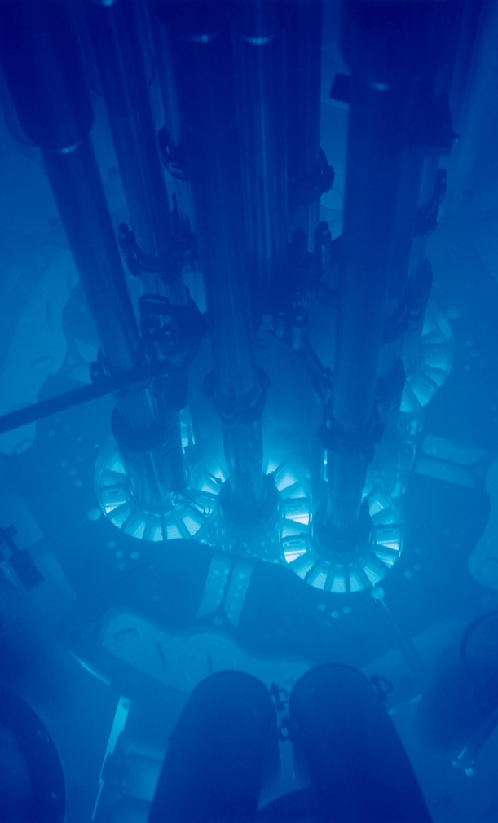
Nuclear Science User Facilities Overview
NSUF provides the user with no cost access to specialized and unique capabilities.
NSUF fosters the development of novel ideas generated by external contributors from universities, national laboratories, and industry.
NSUF promotes collaborations between users and the expertise at the NSUF partners.
These collaborations:
  define the cutting edge of nuclear technology research in understanding the behavior of materials subjected to radiation environments,
  contribute to improved performance of current industry and future nuclear reactor systems, and
  stimulate cooperative research between users conducting research in nuclear energy systems.

Slide 3
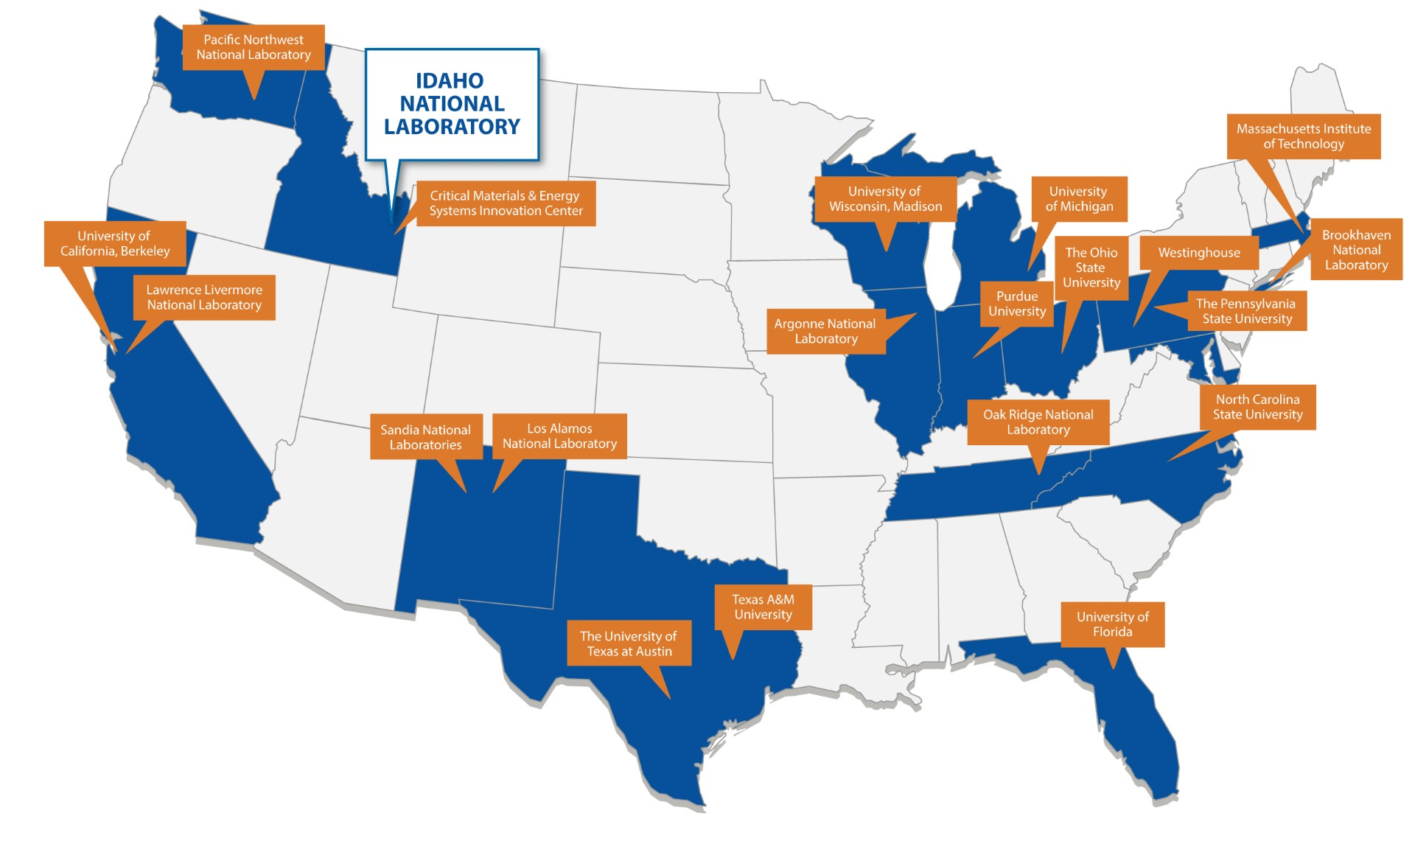
A Consortium of Materials Research Capabilities to Enable Advanced Nuclear Energy Development and Deployment
70+ unique nuclear energy R&D capabilities across 21 US institutions.
  8 national laboratories
  12 universities
  1 commercial partner
  HPC at INL
One integrated user facility program
  Small projects to solve individual questions
  Multi-year R&D campaigns to address larger challenges

Slide 4
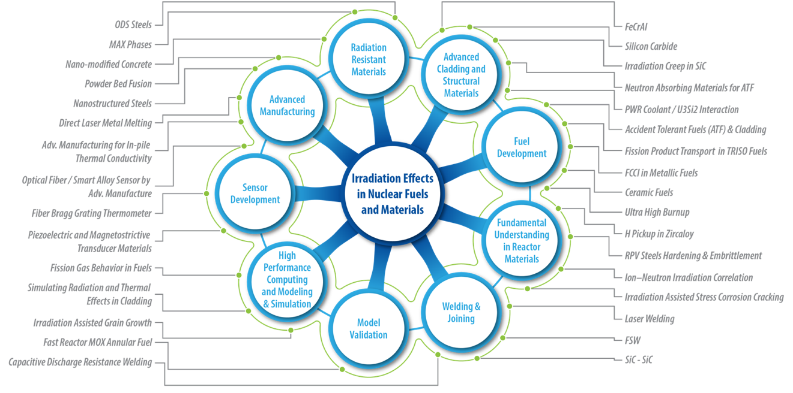
NSUF covers materials all technical readiness levels

Slide 5
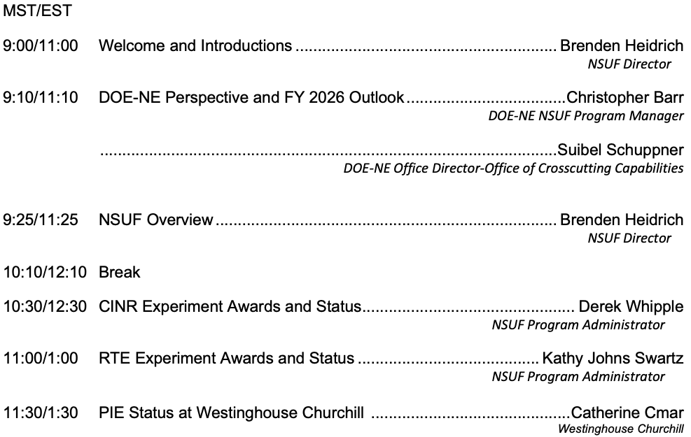
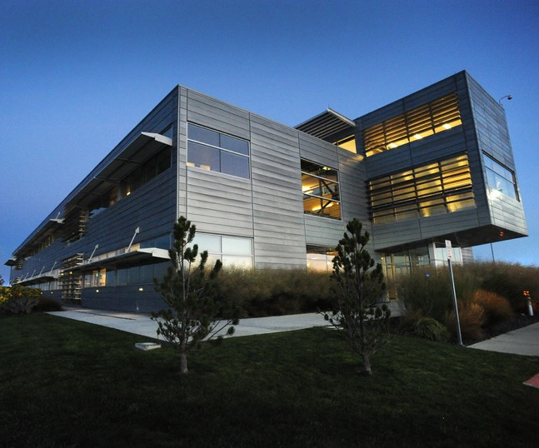
3-day meeting - Monday May 11 to Wednesday May 13, 2026
Monday May 11 Morning Session - Program Review
NSUF Program Offices and the Microscopy and Characterization Suite are located at the Critical Materials and Energy Systems Innovation Center in Idaho Falls, ID

Slide 6
Program Review Agenda
Monday May 11 | Tuesday May 12 | Wednesday May 13
Morning – 9:00-12:00 MT Program Review: Overview, NSUF Access Opportunities (CINR/RTE), Partner Capabilities | Morning – 9:00-12:00 MT Program Review: a) Users Org, NFML, Partners b) Program Capabilities and Instrument Scientists Chair – Dr. Jeff Giglio | Morning – 9:00-12:00 MT Program Review: High Performance Computing (Capabilities and Research)
Afternoon – 1:00-3:00pm MT NSUF User Access Awards: Structural Materials Chair – Dr. Rongjie Song | Afternoon – 1:00-3:00pm MT NSUF User Access Awards: Fuel and Cladding Materials Chair – Dr. Allen Roach | Afternoon – 1:00-3:00pm MT NSUF User Access Awards: Sensor Materials Chair – Dr. Allen Roach

Slide 7
May 12, 2026
Brenden Heidrich, Ph.D. PE
NSUF Director
Nuclear Science User Facilities (NSUF) Annual Program Review
Welcome and Introduction

Slide 8
Program Review Agenda
Monday May 11 | Tuesday May 12 | Wednesday May 13
Morning – 9:00-12:00 MT Program Review: Overview, NSUF Access Opportunities (CINR/RTE), Partner Capabilities | Morning – 9:00-12:00 MT Program Review: a) Users Org, NFML, Partners b) Program Capabilities and Instrument Scientists Chair – Dr. Jeff Giglio | Morning – 9:00-12:00 MT Program Review: High Performance Computing (Capabilities and Research)
Afternoon – 1:00-3:00pm MT NSUF User Access Awards: Structural Materials Chair – Dr. Rongjie Song | Afternoon – 1:00-3:00pm MT NSUF User Access Awards: Fuel and Cladding Materials Chair – Dr. Allen Roach | Afternoon – 1:00-3:00pm MT NSUF User Access Awards: Sensor Materials Chair – Dr. Allen Roach

Slide 9
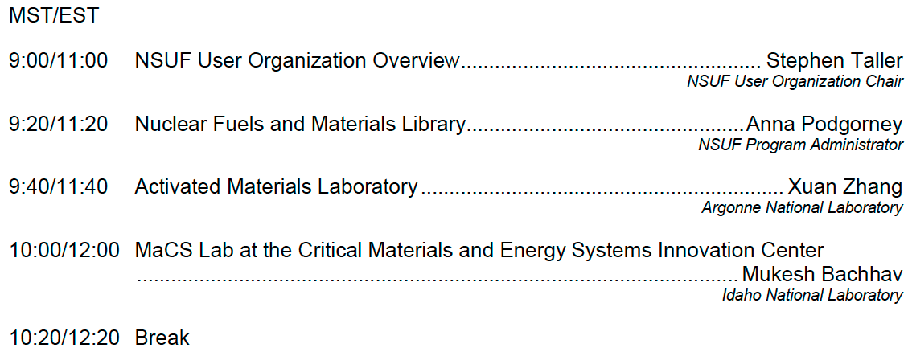
Tuesday May 12, 2026
Morning Session - Program Organization and Capabilities
NSUF Program Offices and the Microscopy and Characterization Suite are located at the Critical Materials and Energy Systems Innovation Center in Idaho Falls, ID

Slide 10
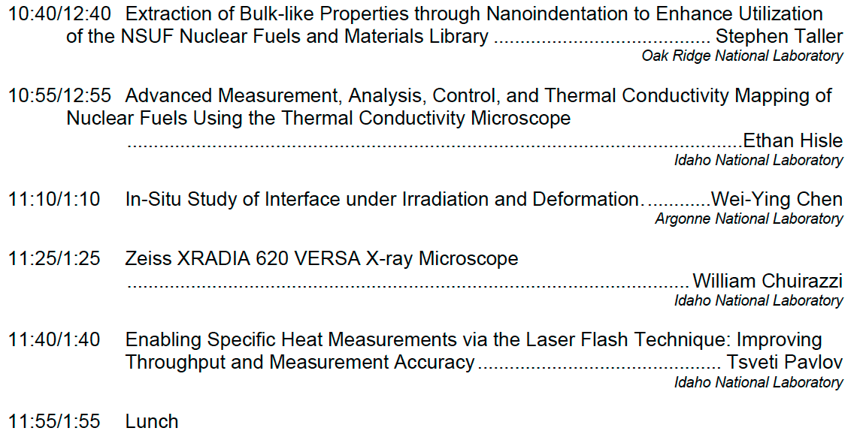
Tuesday May 12, 2026
Morning Session – Program Capabilities and Instrument Scientists
Session Chair – Dr. Jeff Giglio
NSUF Program Offices and the Microscopy and Characterization Suite are located at the Critical Materials and Energy Systems Innovation Center in Idaho Falls, ID

Slide 11
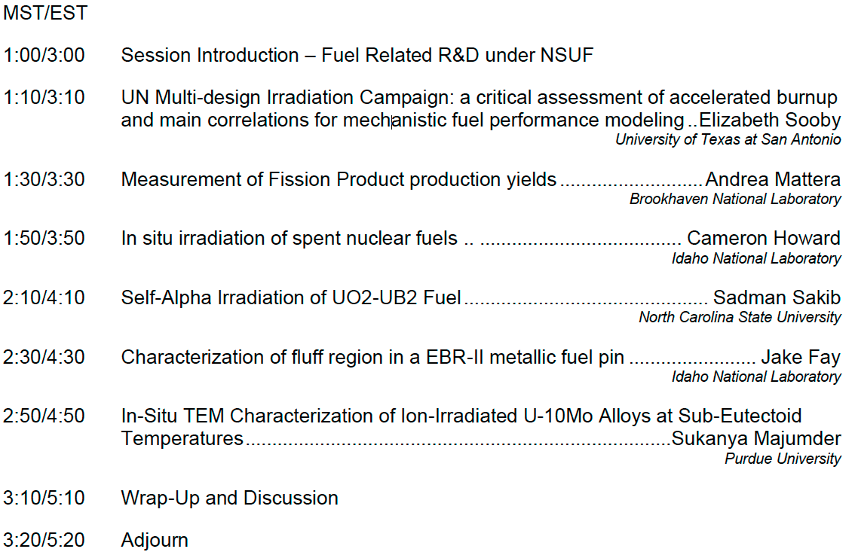
Tuesday May 12, 2026
Afternoon Session – NSUF User Access Awards: Fuel and Cladding Materials
Session Chair – Dr. Allen Roach
NSUF Program Offices and the Microscopy and Characterization Suite are located at the Critical Materials and Energy Systems Innovation Center in Idaho Falls, ID

Slide 12
May 13, 2026
Brenden Heidrich, Ph.D. PE
NSUF Director
Nuclear Science User Facilities (NSUF) Annual Program Review
Welcome and Introduction

Slide 13
Program Review Agenda
Monday May 11 | Tuesday May 12 | Wednesday May 13
Morning – 9:00-12:00 MT Program Review: Overview, NSUF Access Opportunities (CINR/RTE), Partner Capabilities | Morning – 9:00-12:00 MT Program Review: a) Users Org, NFML, Partners b) Program Capabilities and Instrument Scientists Chair – Dr. Jeff Giglio | Morning – 9:00-12:00 MT Program Review: High Performance Computing (Capabilities and Research)
Afternoon – 1:00-3:00pm MT NSUF User Access Awards: Structural Materials Chair – Dr. Rongjie Song | Afternoon – 1:00-3:00pm MT NSUF User Access Awards: Fuel and Cladding Materials Chair – Dr. Allen Roach | Afternoon – 1:00-3:00pm MT NSUF User Access Awards: Sensor Materials Chair – Dr. Allen Roach

Slide 14
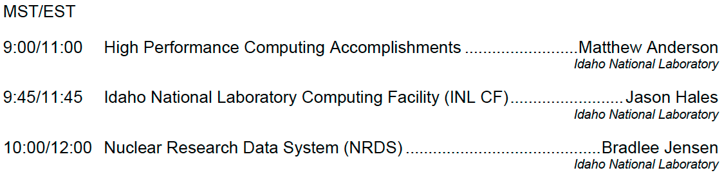
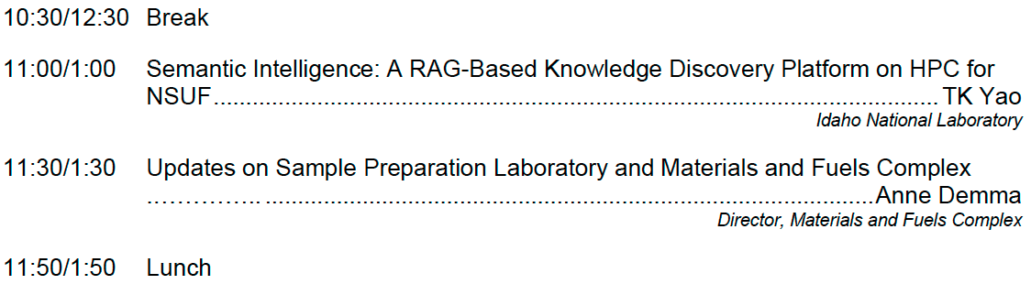
Wednesday May 13, 2026
Morning Session – High Performance Computing
NSUF Program Offices and the Microscopy and Characterization Suite are located at the Critical Materials and Energy Systems Innovation Center in Idaho Falls, ID

Slide 15
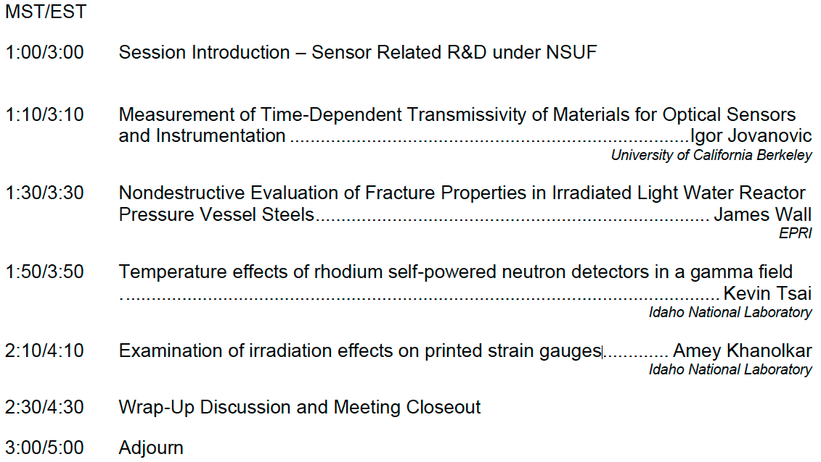
Wednesday May 1, 2026
Afternoon Session – NSUF User Access Awards, Sensor Materials
Session Chair – Dr. Allen Roach
NSUF Program Offices and the Microscopy and Characterization Suite are located at the Critical Materials and Energy Systems Innovation Center in Idaho Falls, ID

Slide 16
Questions?
  Brenden Heidrich
    Director, NSUF
    Brenden.Heidrich@inl.gov
INL/MIS-26-91517

