Slide 1



The Post Irradiation Examination Ion-bombarded High-entropy Carbide Ceramics
Todd Sherman ISU–NSUF 2026

Slide 2
Overview
Project background
NSUF – Post Irradiation Examinations
X-ray Diffraction (XRD)
Electron backscatter diffraction (EBSD)
Nanoindentation hardness testing
TEM
OVERVIEW
PROJECT BACKGROUND
NSUF-PIE
XRD
EDS
EBSD
NANOINDENTATION
TEM

Slide 3
Project Background
New series of high-entropy carbide ceramics
Synthesis parameters and material characterization
Mechanical and thermodynamic characterization
Analytical radiation shielding applicability
Heavy ion bombardment
Post Irradiation Examination (PIE)
OVERVIEW
PROJECT BACKGROUND
NSUF-PIE
XRD
EDS
EBSD
NANOINDENTATION
TEM

Slide 4
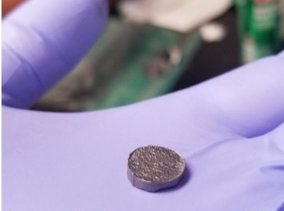
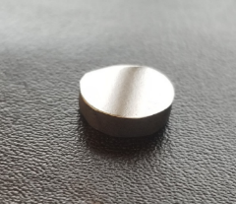
Synthesis
Six equimolar 5-principal element high entropy-based combinations from mono carbide powers
TiC, VC, ZrC, NbC, TaC & WC
  Material 1 - (Ti V Zr Ta W)C
  Material 2 - (Ti V Zr Nb W)C
  Material 3 - (Ti V Zr Nb Ta)C
  Material 4 - (Ti V Ta Nb W)C
  Material 5 - (Ti Zr Nb Ta W)C
  Material 6 - (V Zr Nb Ta W)C
High energy balling → Spark Plasma Sintering
OVERVIEW
PROJECT BACKGROUND
NSUF-PIE
XRD
EDS
EBSD
NANOINDENTATION
TEM

Slide 5
Material Characterization
Density
X-ray Diffraction (XRD)
Nanoindentation hardness testing
Thermal Diffusivity and Conductivity
OVERVIEW
PROJECT BACKGROUND
NSUF-PIE
XRD
EDS
EBSD
NANOINDENTATION
TEM

Slide 6
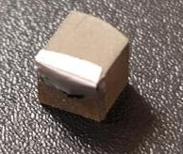
Radiation Shielding Analysis
& Heavy Ion Bombardment
Analytical radiation shielding evaluations for photon and neutron shielding applications
10 MeV Au-ion irradiation
Fluence 1 = 1.3 x 10¹⁶ ion/cm² → 43-47 dpa
Fluence 2 = 2.6 x 10¹⁶ ion/cm² → 85-95 dpa
OVERVIEW
PROJECT BACKGROUND
NSUF-PIE
XRD
EDS
EBSD
NANOINDENTATION
TEM
Polished surface
Shielded region

Slide 7
Post Irradiation Examinations
XRD
Comparison of X-ray Diffraction (XRD) plots of the unirradiated and the two irradiated surfaces
OVERVIEW
PROJECT BACKGROUND
NSUF-PIE
XRD
EDS
EBSD
NANOINDENTATION
TEM
Formation of an unknown phase at highest fluence

Slide 8
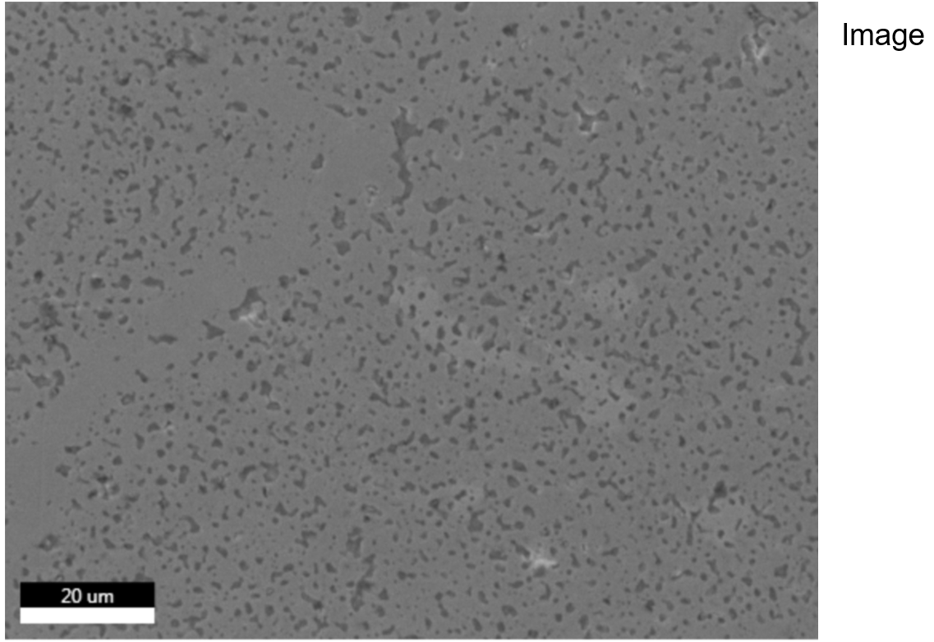
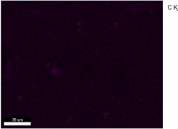
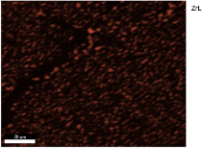
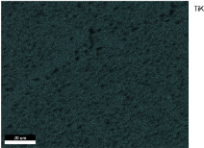
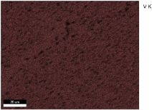
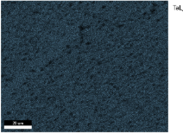
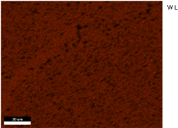
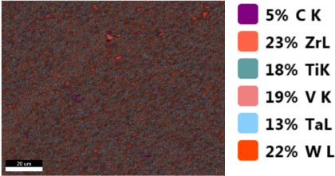
Post Irradiation Examinations
EDS
Energy Dispersive X-ray Spectroscopy (EDS)
Zr clustering
OVERVIEW
PROJECT BACKGROUND
NSUF-PIE
XRD
EDS
EBSD
NANOINDENTATION
TEM

Slide 9
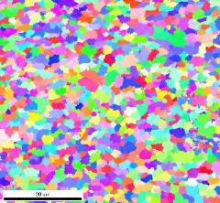
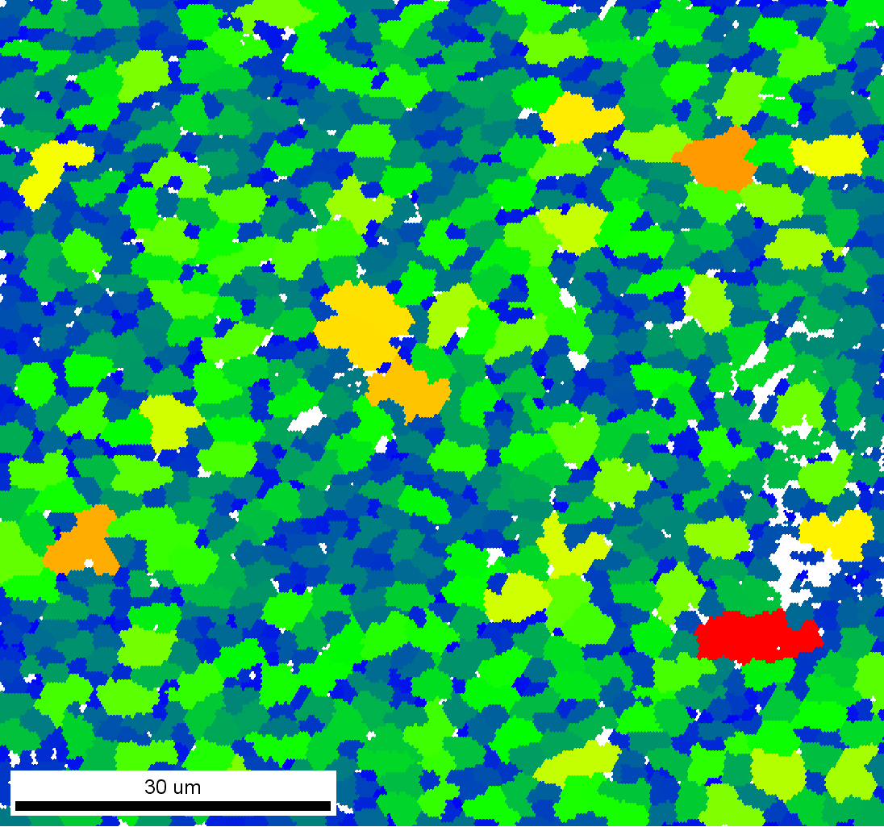
Post Irradiation Examinations
EBSD
Electron Backscatter Diffraction (EBSD)
OVERVIEW
PROJECT BACKGROUND
NSUF-PIE
XRD
EDS
EBSD
NANOINDENTATION
TEM

Slide 10
Post Irradiation Examinations
Nanoindentation
OVERVIEW
PROJECT BACKGROUND
NSUF-PIE
XRD
EDS
EBSD
NANOINDENTATION
TEM

Slide 11
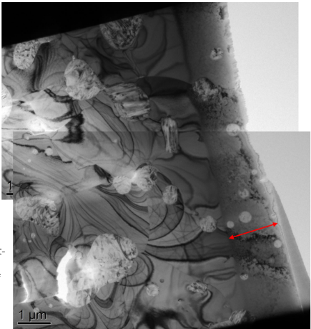
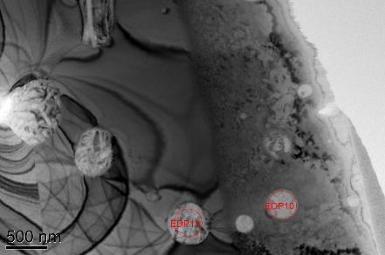
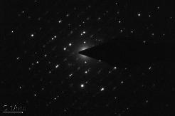
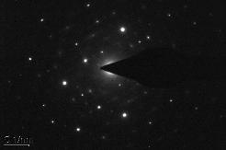
Post Irradiation Examinations
TEM
Transmission Electron Microscope (TEM)
OVERVIEW
PROJECT BACKGROUND
NSUF-PIE
XRD
EDS
EBSD
NANOINDENTATION
TEM

Slide 12
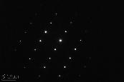
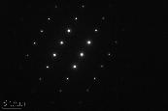
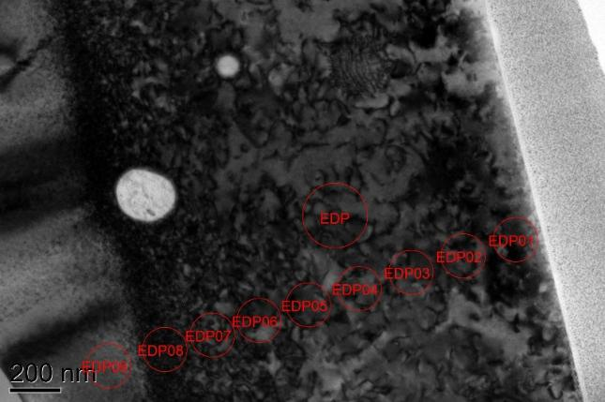
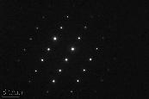
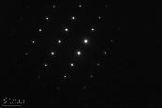
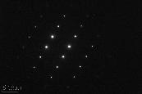
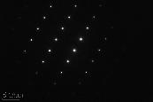
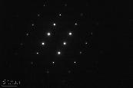
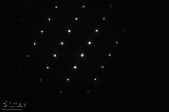
Post Irradiation Examinations
TEM
Amorphization vs irradiation depth
OVERVIEW
PROJECT BACKGROUND
NSUF-PIE
XRD
EDS
EBSD
NANOINDENTATION
TEM

Slide 13
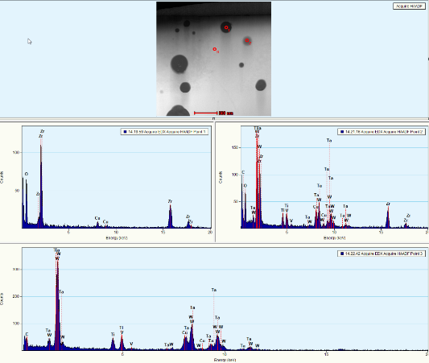
Post Irradiation Examinations
TEM
Secondary ZrO₂ phase identification
OVERVIEW
PROJECT BACKGROUND
NSUF-PIE
XRD
EDS
EBSD
NANOINDENTATION
TEM
Element Weight % Atomic % Uncert. %
------- -------- -------- ---------
O(K) 29.39 70.36 1.09
Zr(K) 70.60 29.63 1.72
Element Weight % Atomic % Uncert. %
------- -------- -------- ---------
Ti(K) 7.84 21.58 0.26
V(K) 6.43 16.64 0.25
Ta(L) 27.73 20.19 0.68
W(L) 57.98 41.56 0.96

Slide 14
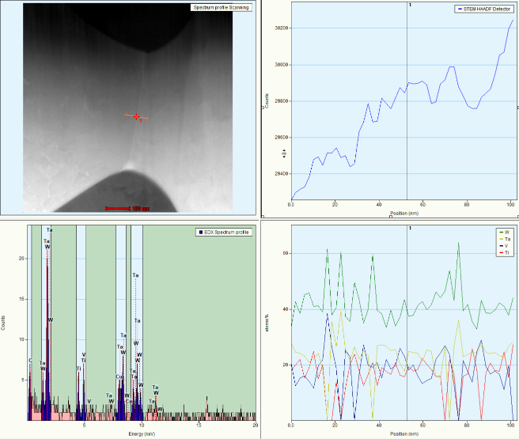
Post Irradiation Examinations
TEM
Grain Boundary Segregation
OVERVIEW
PROJECT BACKGROUND
NSUF-PIE
XRD
EDS
EBSD
NANOINDENTATION
TEM

Slide 15
Questions?
Todd Sherman
toddsherman@isu.edu
todd.sherman@inl.gov
OVERVIEW
PROJECT BACKGROUND
NSUF-PIE
XRD
EDS
EBSD
NANOINDENTATION
TEM

