Slide 1
May 12th, 2026
William Chuirazzi
X-ray Microscope Instrument Scientist
Diffraction and Imaging Group Lead
ZEISS Xradia 620 Versa X-ray Microscope

Slide 2
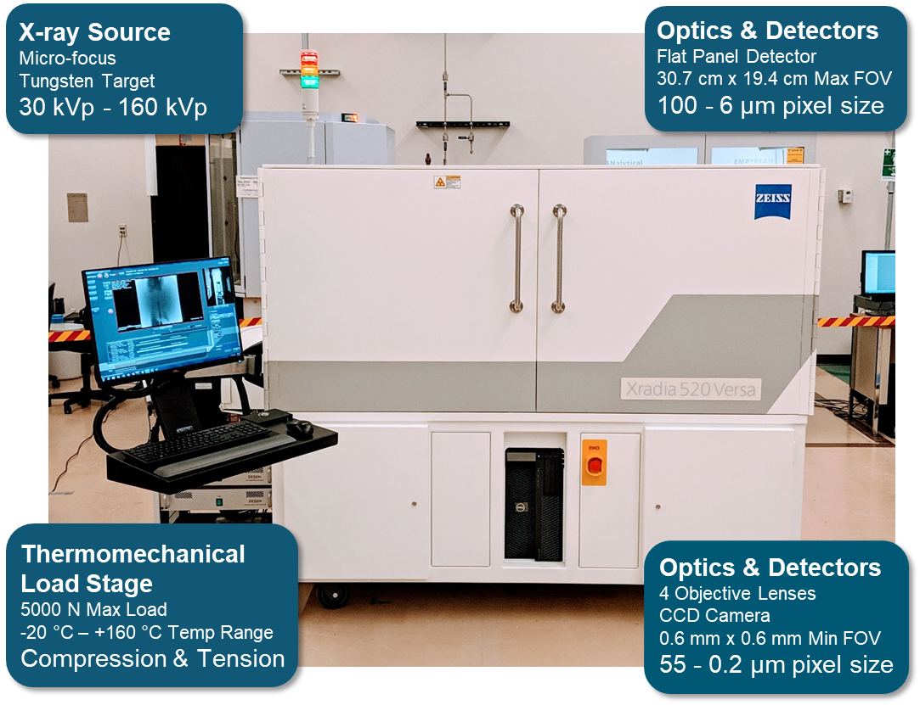
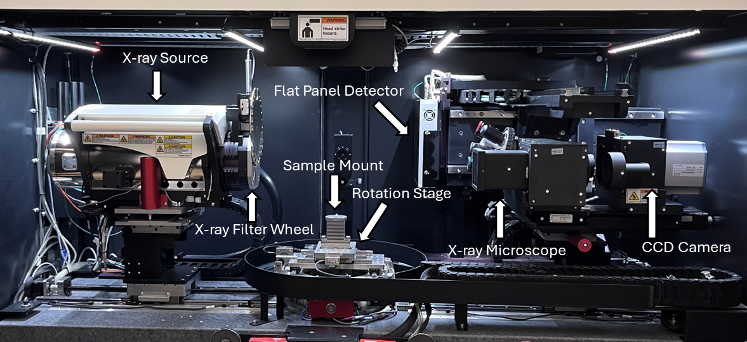
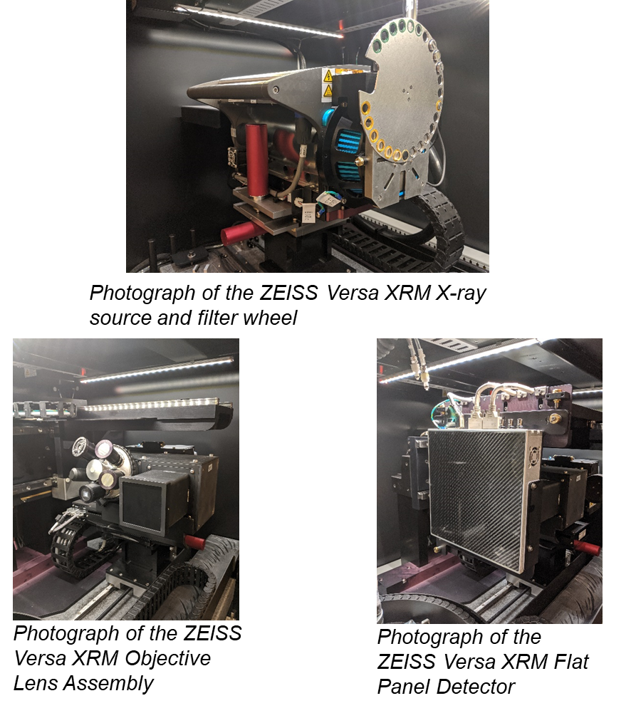
ZEISS Xradia 620 Versa at IMCL
Best spatial resolution: 500 nm/voxel
Hottest sample to date: >200 R/hr on contact
Instrument is maintained as radiologically clean

Slide 3
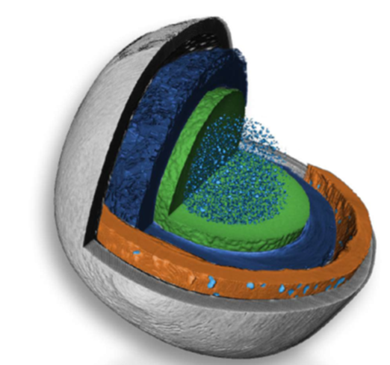
FY25 NSUF IS Supported Research Activities
  Machine learning-based image processing
    Reduce acquisition time and/or improve data quality for nuclear fuel samples
  Visualizing in-situ thermal expansion
    Use XCT to measure expansion and potentially calculate CTE
  Phase-contrast imaging
    Improve interface contrast in NSUF-relevant samples
  Support additional NSUF-relevant work
    Data analysis, reporting, and publication assistance

Slide 4
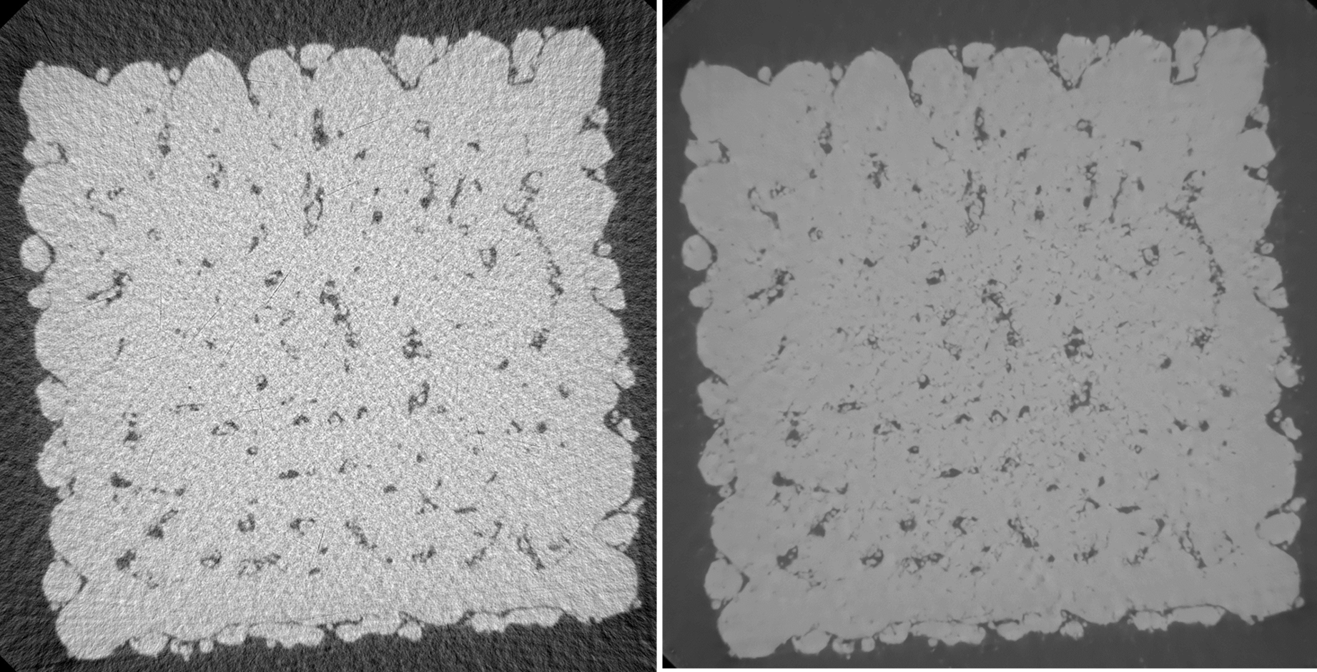
Task 1: Machine learning based image processing
Collaboration with Oak Ridge National Laboratory (ORNL) to train a machine learning algorithm (Simurgh), which performs data processing and image reconstruction with less 2D projections
  Increase throughput: data acquisition time has been reduced by ~90%
  Noise in images is also reduced
Previous collaboration focused on unirradiated advanced manufactured specimens (AMMT program)
Goal: Apply Simurgh to radioactive materials datasets, such as nuclear fuel
  Increase throughput
  Reduce radiation exposure (equipment and personnel)
  Reduced noise
(Left) A 2D cross-sectional slice of a SS316L sample reconstructed with traditional vendor software compared to (Right) the same cross-sectional slice reconstructed with ORNL’s Simurgh algorithm. Noise is reduced and porosity can be more easily distinguished.
ORNL Collaborators: Amir Ziabari (ziabariak@ornl.gov)
  Obaid Rahman (rahmano@ornl.gov)

Slide 5
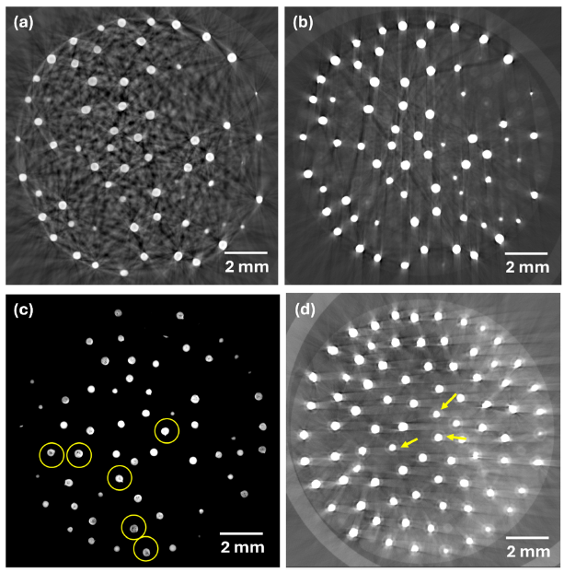
Task 1: Machine learning based image processing
Simurgh trained by ORNL on previous XCT data of irradiated AGR-3/4 compacts acquired by INL
  Full dataset: ~28-hour acquisition
  Reduce dataset: ~84-minute acquisition
  ~94% reduction in aquisition time
Simurgh applied to AGR-3/4 Compact 12-4
Simurgh won a 2025 R&D 100 Award
NSUF Instrument Scientist support used to expand collaboration with ORNL:
  Data curation and transfer
  Interpretation and analysis
  Manuscript writing and editing
Reconstructed 2D slices of an irradiated AGR compact: (a) Reconstructed image from 60 kVp scan, (b) Reconstructed image from 160 kVp scan. (c) Same as (b) with contrast changed to emphasize irregular shape of kernels and defects in kernels (yellow circles). (d) Same as (b) with contrast adjusted to emphasize the SiC layer around TRISO fuel kernels (yellow arrows).
Morankar, Swapnil, et al. "Post-irradiation examination of AGR-3/4 TRISO fuel compacts using three-dimensional X-ray computed tomography." Journal of Nuclear Materials (2025): 156341.

Slide 6
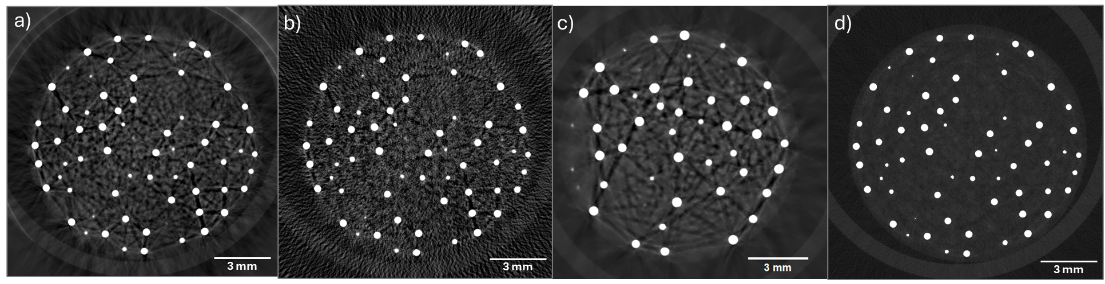
Task 1: Machine learning based image processing
Reconstructed 2D slices of an irradiated AGR compact generated with (a) standard commercial reconstruction, (28-hour data acquisition), (b) standard commercial reconstruction, expedited acquisition (84 minutes), (c) SIMURGH algorithm, untrained for TRISO (84 minutes), and (d) SIMURGH algorithm, trained for TRISO (84 minutes). Note a), b) and d) show the same slice, while c) is a different view.
Rahman, Obaid, et al. Metal artifact reduction in X-ray computed tomography of TRISO fuel compacts." Nondestructive Testing and Evaluation (2026). Under Review.

Slide 7
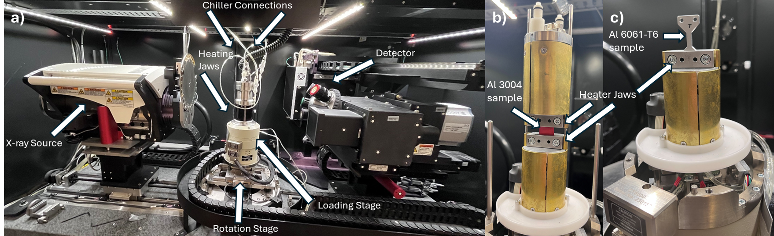
Task 2: Visualizing thermal expansion
Long-term goal: Measure unconstrained, anisotropic thermal expansion in irradiated nuclear fuels
  Noncontact measurement for thermal expansion by analyzing images
  Simultaneously observe thermal expansion of different materials (layers in a particle, FGM, etc.)
  No commercial equipment currently available to couple to XRM and reach temperatures of interest (800˚C -1200˚C)
Goal: Enable measurements of samples in XRM at temperature
The load testing stage configured for heating experiments.

Slide 8
Task 2: Visualizing thermal expansion
XRM currently has a load testing cell with a heated stage (Deben CT5000TEC)
  Maximum temperature 160˚C
  Serves as proof of concept
  Can measure thermal expansion through force displacement
Work control for heater operations implemented
Aluminum samples (3004 and 6061-T6) identified as best chance to visualize thermal expansion in images
  6061-T6 CTE is 25.2 µm/m-°C
Samples imaged before heating and after temperature stabilized
  15.5 µm/voxel spatial resolution
  Datasets were segmented and volumes compared to one another
Samples mounted in load stage.

Slide 9
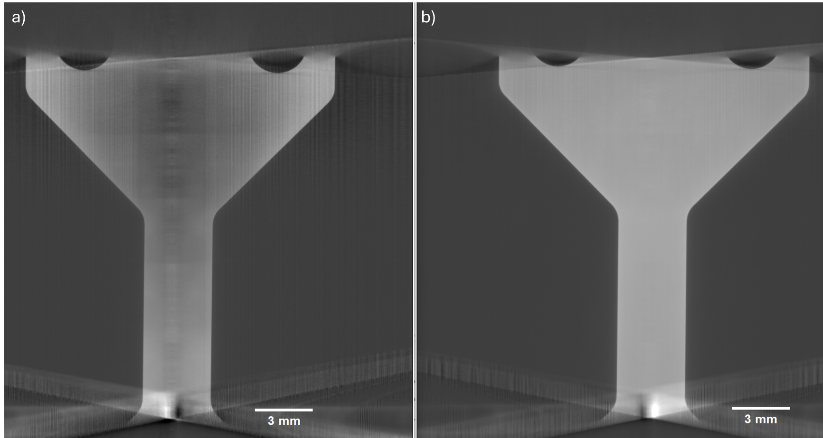
Task 2: Visualizing thermal expansion
Thermal expansion not directly observed (not unexpected)
  For 10 mm gauge length sample expected to expand vertically by ~40 µm at 160 °C
    < 3 pixels
Notable outcomes:
  Work control for heater experiments in XRM paves way for experiments for future users
  Methodology for segmentation and pre- and post-heating comparison developed and can be employed if suitable sample or hotter heater is used in future work.
Aluminum 6601-T6 dog-bone sample (a) before and (b) after heating.

Slide 10
Task 3: Phase Contrast Imaging
Phase-contrast X-ray imaging can increase contrast-to-noise ratio and enhance the detection of boundaries between different layers or interfaces
  XRM capable of propagation-based phase contrast imaging
Goal: Explore phase-contrast imaging for NSUF-relevant samples
  Analyze legacy data of surrogate TRISO particle with an Al₂O₃ kernel
  Collect relevant datasets
    NBG-25 graphite
    Irradiated U-Zr metallic fuel
    Irradiated AGR-2 compact chunks
Notable Outcomes:
Six new datasets collected
  Two scans had sample movement between scans, unsuitable for analysis
Two higher resolution scans showed promise:
  Surrogate TRISO particle
  FIB cube of U-10Zr
  Interfaces between different material (TRISO particle) and voids and high-Z material (U-10Zr fuel cube) appeared to be emphasized in the processed phase-contrast data.
Preliminary results lots of data collected and additional analysis needed

Slide 11
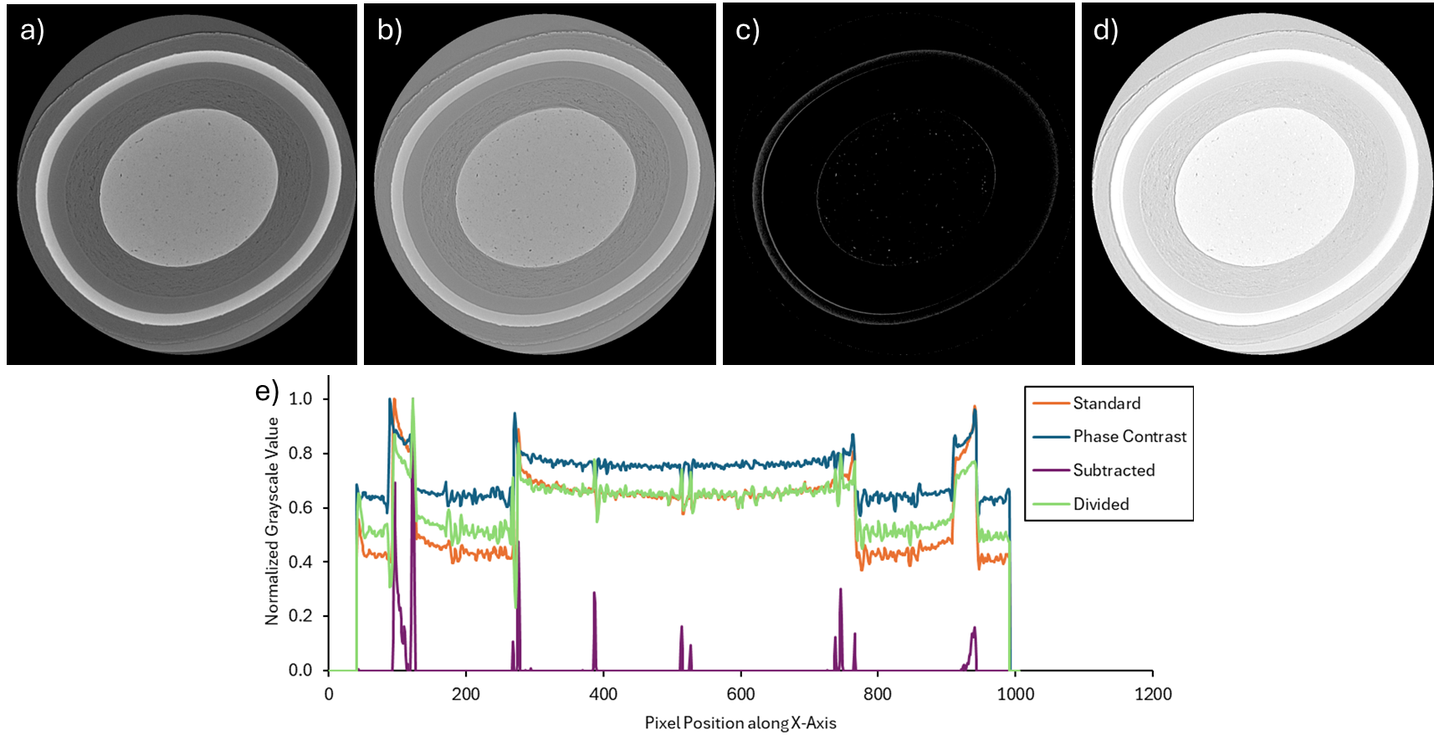
Task 3: Phase Contrast Imaging
2D cross section of the particle midplane: (a) a standard acquisition, (b) phase contrast acquisition, (c) standard acquisition minus phase contrast acquisition, and (d) standard acquisition divided by phase contrast acquisition. (e) Plots of a 10-pixel wide line profile showing grayscale value as a function of image position. Subtracted image appears to identify layer edges.

Slide 12
FY26 NSUF Researcher Supported Activities
Implement SyGlass Technology
  Support advanced segmentation as well as the creation of visualization renderings
  Reduce data processing time by employing commercially available artificial intelligence (AI) based segmentation algorithms
  Provide high quality renders, leading to better presentation/journal figures
3D Data Visualization
  Enables direct interaction with full 3D XCT datasets
3D Data Segmentation
  Integrates Python-based automated workflows and commercial AI/ML tools to reduce manual segmentation time by up to 94%
Additional Data Analysis
  Data curation and image analysis may be performed on additional INL-relevant datasets, as appropriate

Slide 13
NSUF Supported Outputs
FY25 Accomplishments:
5 Journal Publications (4 published/accepted, 1 under review):
  William Chuirazzi*, Rahul Reddy Kancharla, and Swapnil Morankar. "Laboratory-Based Micro-X-ray Computed Tomography of Energy Materials at Idaho National Laboratory." JOM 77.3 (2025): 1337-1353.
  Bor-Rong Chen*, Asa G. Monson, Pete L. Barnes, Corey M. Efaw, William C. Chuirazzi, Michael E. Woods, Harry W. Rollins, Jorgen F. Rufner, Arin S. Preston, Donna P. Guillen, and Eric J. Dufek., “3D Printed Porous LLZO Scaffolds for Li-Garnet Solid-State Batteries.” Cell Reports Physical Science. 6.11 (2025).
  Jake Fay*, William Chuirazzi, Luca Capriotti, Fidelma Di Lemma, Cameron Howard, Mario Matos, and Jie Lian. “3D Pore Structure Reconstruction of Fluff Region in Top of EBR-II Irradiated Fuel by X-Ray Micro-Computed Tomography.” Journal of Nuclear Materials (2025): 156167.
  William Chuirazzi*, Burkhard Schillinger, Steven Cool, Aaron Craft, Zoltan Kis, and Laszlo Szentmiklosi. “Boron-Based Neutron Scintillator Screen Characterization with X-rays and Neutrons.” Springer Nature - Springer Proceedings in Physics. Accepted.
  O. Rahman, W. Chuirazzi, R.Dehoff, and A. Ziabari. “Metal artifact reduction in X-ray computed tomography of TRISO fuel compacts.” Nondestructive Testing and Evaluation. Submitted.
1 Conference Presentation
  O. Rahman, W. Chuirazzi, R.Dehoff, and A. Ziabari. “Metal artifact reduction in X-ray computed tomography of TRISO fuel compacts.” July 8th, 2025. International Workshop on Electromagnetic Nondestructive Evaluation. Knoxville, TN, USA.
NSUF Presentations
  William Chuirazzi. “Data Acquisition and Analysis Techniques for X-ray Computed Tomography.” 2025. NSUF Annual Program Review. Idaho Falls, ID, USA.
  William Chuirazzi. “ZEISS Xradia 620 Versa X-ray Microscope at IMCL.” 2025. NSUF Mid-Year Review Meeting. Idaho Falls, ID, USA.

Slide 14
QUESTIONS?
Special thanks:
NSUF
Brenden Heidrich, NSUF Director
Collin Knight, NSUF Deputy Director
Jeff Giglio, NSUF Special Advisor
XCT
Swapnil Morankar, INL Staff- heating stage implementation
Obaid Rahman and Amir Ziabari, ORNL Staff- Simurgh collaboration

Slide 15
Why the need for X-ray Computed Tomography?
XCT is a nondestructive technique that provides volumetric data
Provides a first look at (irradiated samples)
  Targeted destructive analysis
  Meshing can provide direct inputs for modeling efforts
    Fuel performance, etc.
The ability to perform CT on highly irradiated samples can expedite the PIE process
  Less time spent waiting for decay
  Subsequent experiments/modeling can be planned/conducted

