Slide 1
Hybrid proton and heavy ion irradiation for void swelling testing
Benjamin E. Mejia Diaz
TAMU - NSUF 26

Slide 2

Overview
Project Background
Irradiation Scheme
Sample Details
Irradiation Experiment
Post-irradiation TEM Examination

Slide 3
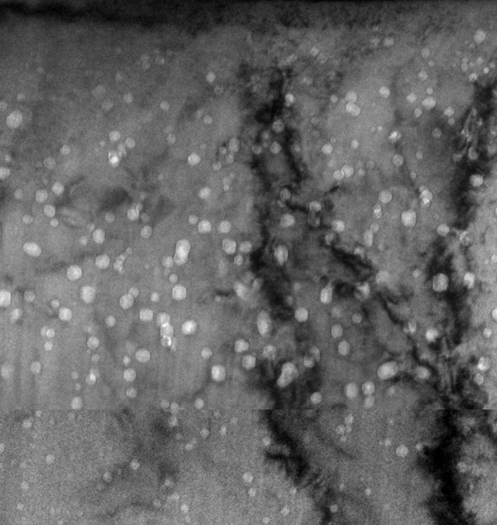
Project Background
5 MeV Fe ion irradiation
Heavy-ion irradiation introduces various irradiation artifacts, among which the injected-interstitial effect is one of the most severe problems.
Implanted ions act as excess interstitials, and even a small degree of interstitial enrichment can strongly suppress void nucleation and subsequently reduce void swelling.
Safe analysis zone
Reactor
Stainless steel in reactors. Cawthorne & Fulton, Nature, 216, p. 575 (1965).
Injected interstitial effect
Accelerator
Need to define the zone width

Slide 4
Project Background
The role of ion irradiation in structural nuclear materials testing
Ion irradiation has been widely used as a surrogate for neutron irradiation due to its high DPA (displacements per atom) rate.
Ion irradiation allows for high-throughput of irradiation materials testing.
Challenges of ion irradiation in structural materials
Among various atypical factors of neutron irradiation, the DPA rate effect still represents one of ion irradiation’s biggest
The currently used temperature-shifting model is limited to cases in which voids are already present in the material. At present, no temperature-shifting model exists for the void nucleation stage.
Our proposed solution:
Use of proton irradiation at low dpa rates to promote void nucleation, followed by heavy-ion irradiation at high dpa rates to emulate the void growth stage.
The hybrid proton + heavy-ion irradiation enables void nucleation under dpa-rate conditions much closer to reactor environments and expect to broaden the safe analysis zone.
The project provides a new methodology for accelerated swelling testing.
Reactor
316 stainless steel after reactor irradiation, J. Nuclear Materials, 216 (1994) 97.
Stainless steel in reactors. Cawthorne & Fulton, Nature, 216, p. 575 (1965).

Slide 5
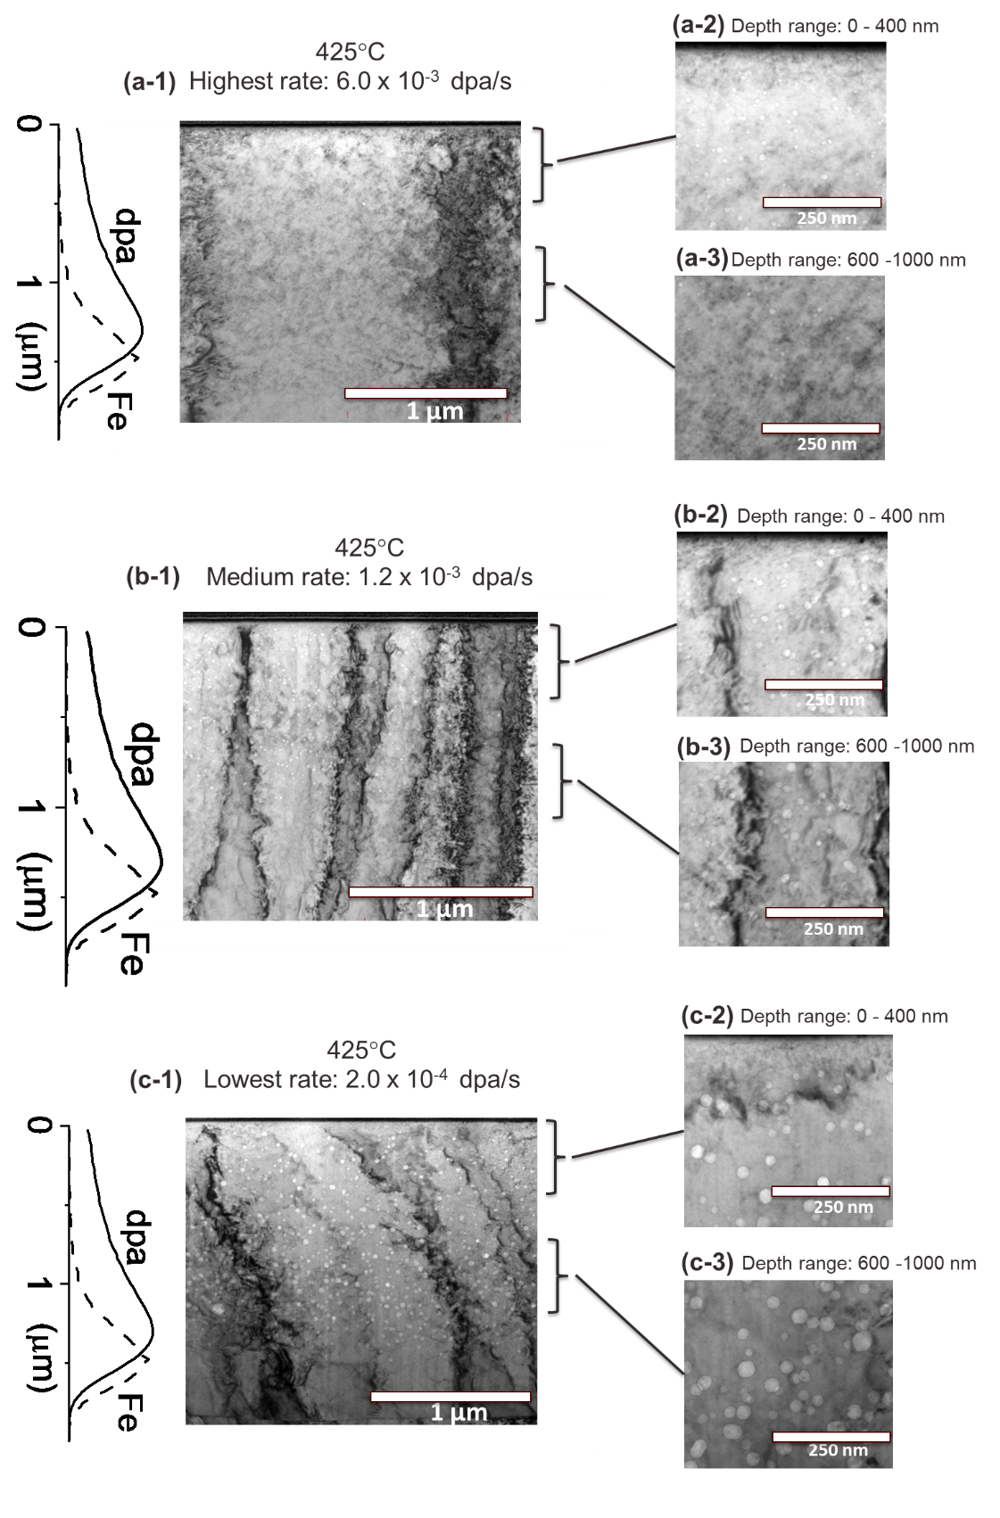
Project Background

Slide 6
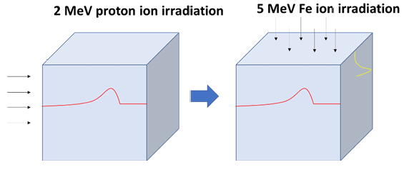
Irradiation Experiment
The ion irradiation includes two sequential steps.
Initial 1dpa at half-range of
2 MeV Proton Irradiation at 360°C.
Final 100 dpa at peak depth
5 MeV Iron Irradiation 600°C.
Proton + Fe Irradiated Region

Slide 7
Sample Preparation
Performing an irradiation on two faces of a samples is challenging because the irradiated region of interest is only 2um in depth.
One of the challenges to overcome during the experiment is the minimizing the curvature of the edge of the sample before the final iron irradiation.
TEM
Pre-iron irradiation surface prepared for TEM

Slide 8
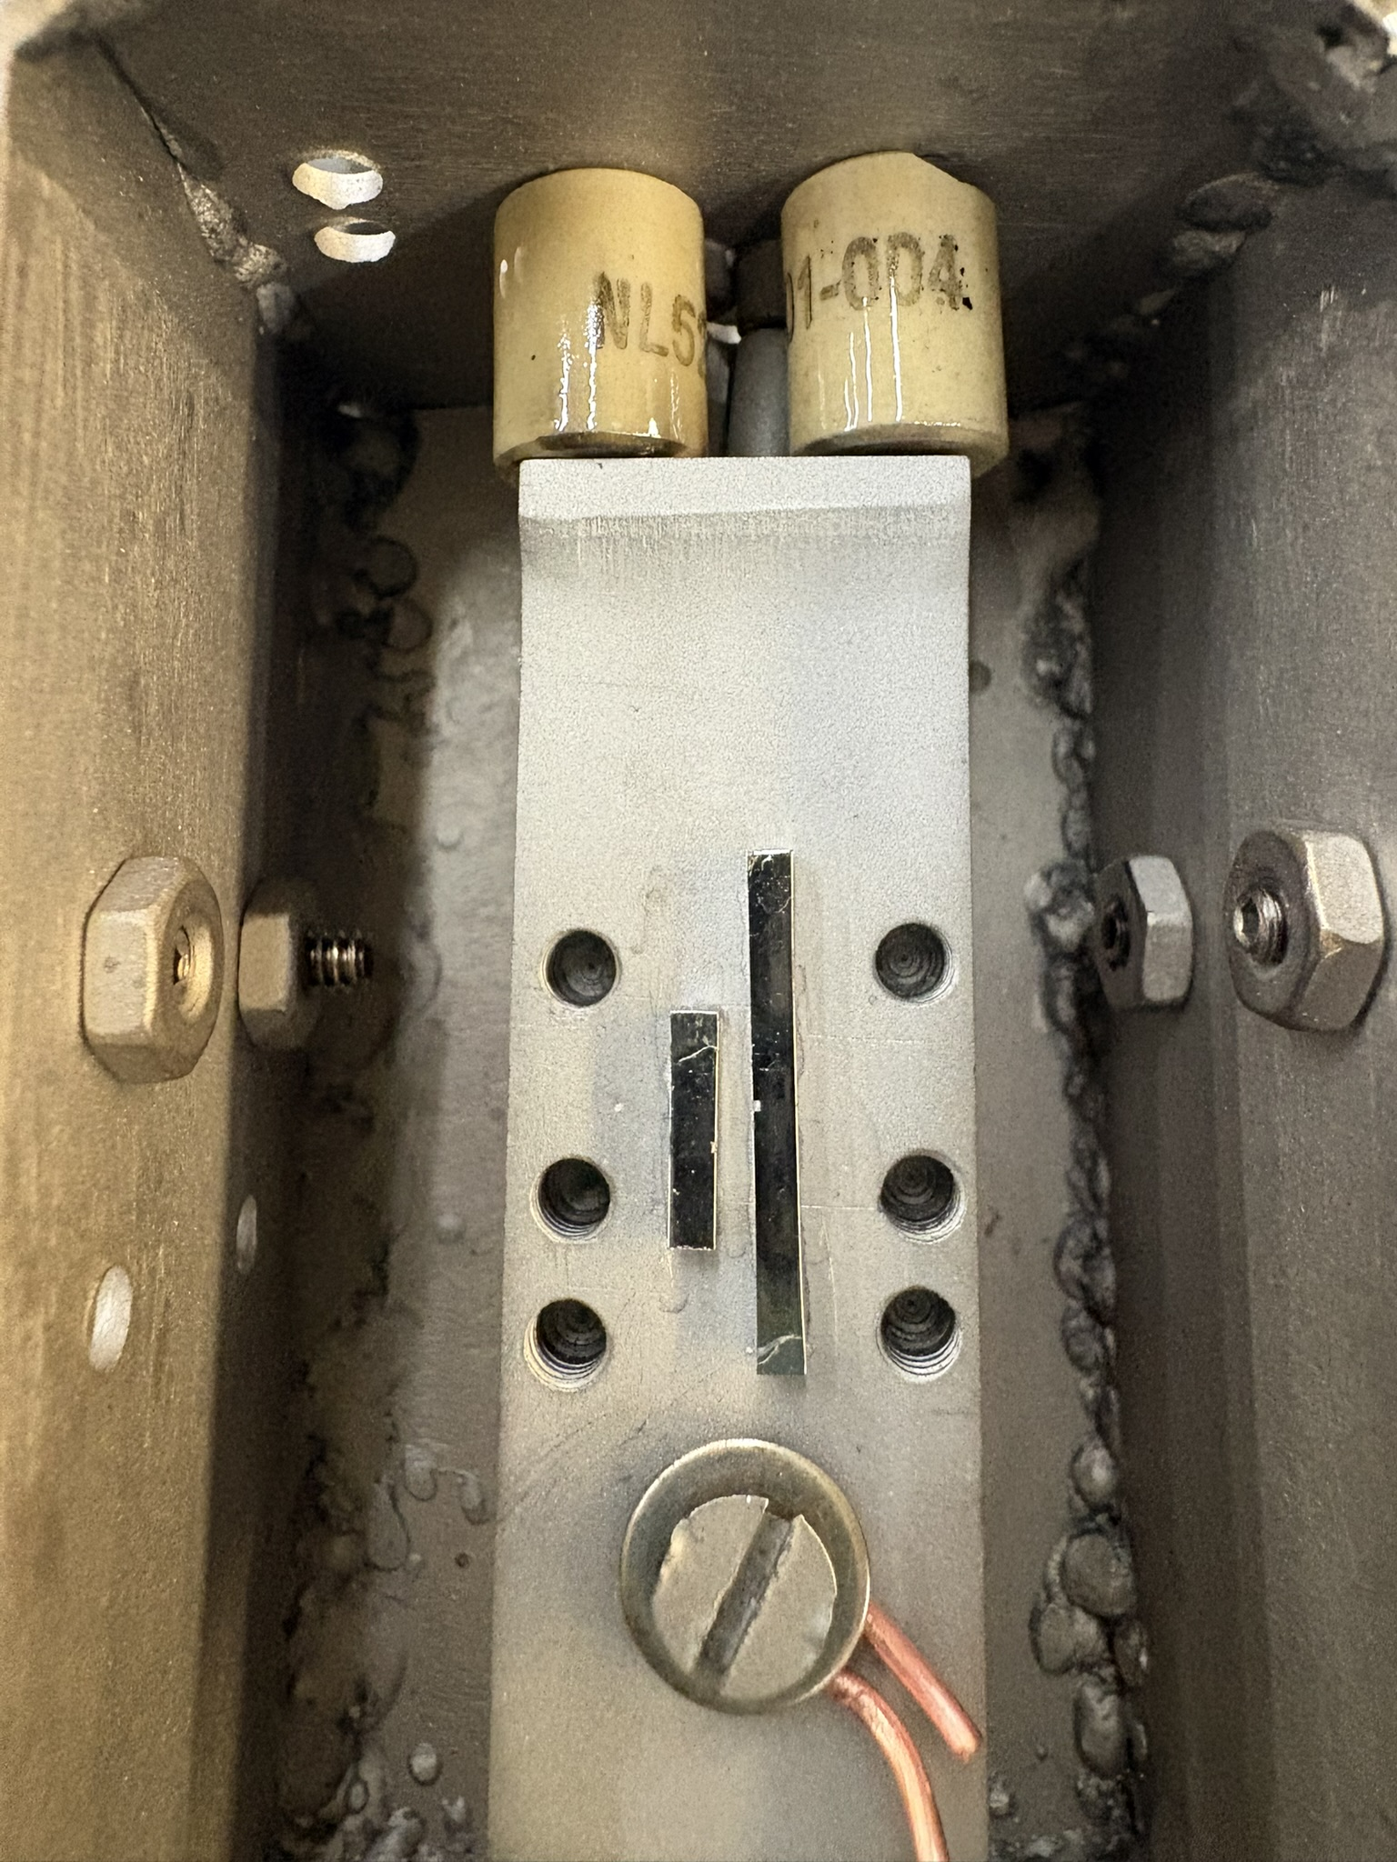

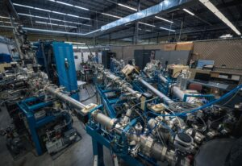
Irradiation Experiment
Irradiations were performed at Texas A&M using 3 MV NEC tandem Accelerator
Molybdenum Heating Stage
Irradiated Area
Samples after Iron Irradiation on Irradiation Stage
3 MV NEC tandem Accelerator at Texas A&M

Slide 9
Post-irradiation TEM Examination
Fe²⁺ injected direction
TEM Swelling Analysis done in four regions:
0.75 H⁺ dpa + 100 Fe⁺² dpa
0.92 H⁺ dpa + 100 Fe⁺² dpa
2 H⁺ dpa + 100 Fe⁺² dpa
0 H⁺ dpa + 100 Fe⁺² dpa
The TEM Swelling analysis consist of:
% Swelling
Void Density
Void Diameter
Void Diameter Distribution
Proton injected range
Iron Only Irradiated Area

Slide 10
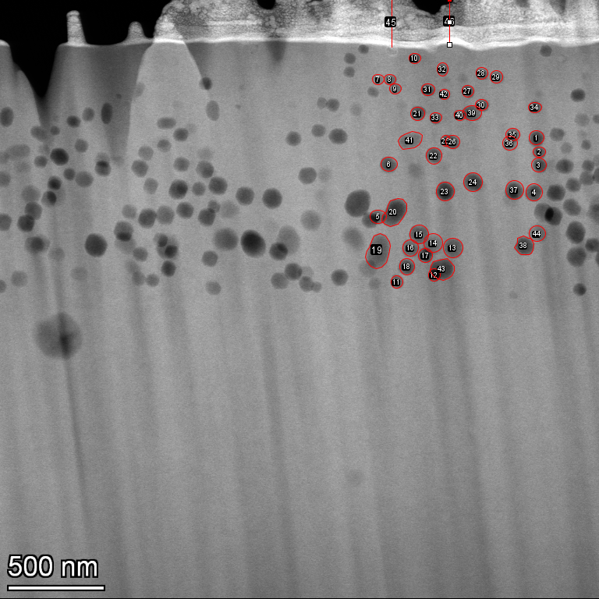
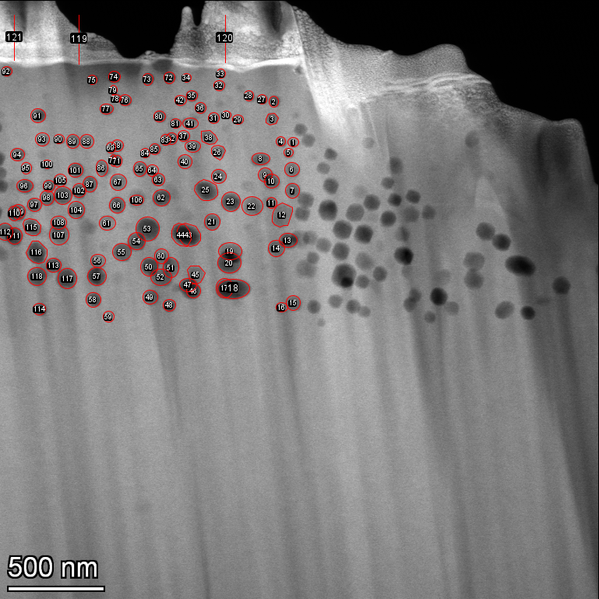
Post-irradiation TEM Examination
0.75 dpa is the average proton dpa between 4 um to 6.5um
Fe²⁺ injected direction
Iron Only Irradiated Area

Slide 11
Post-irradiation TEM Examination
0.75 dpa is the average proton dpa between 4 um to 6.5um
Fe²⁺ injected direction
Iron Only Irradiated Area

Slide 12
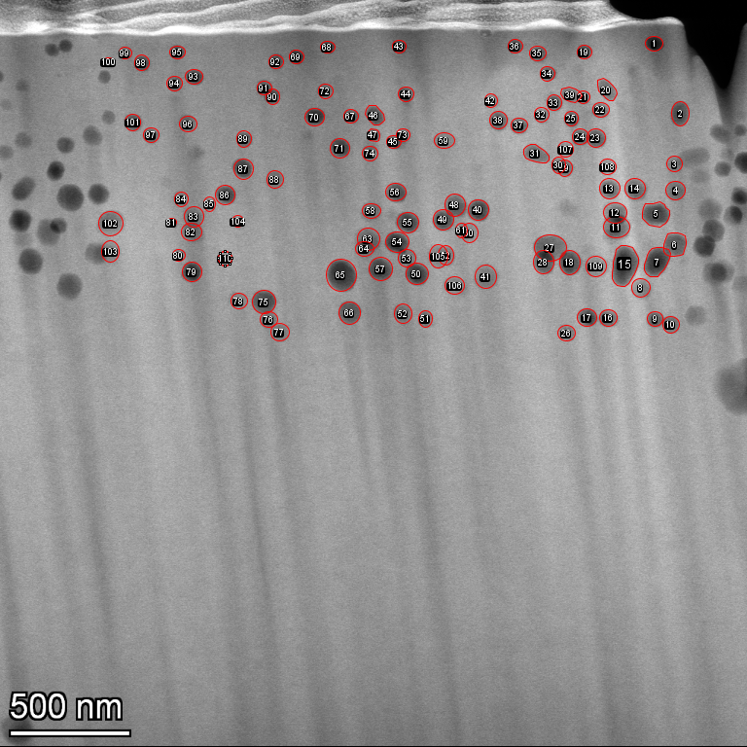
Post-irradiation TEM Examination
0.92 dpa is the average proton dpa between 8.5 um to 11um
Fe²⁺ injected direction
Iron Only Irradiated Area

Slide 13
Post-irradiation TEM Examination
0.92 dpa is the average proton dpa between 8.5 um to 11um
Fe²⁺ injected direction
Iron Only Irradiated Area

Slide 14
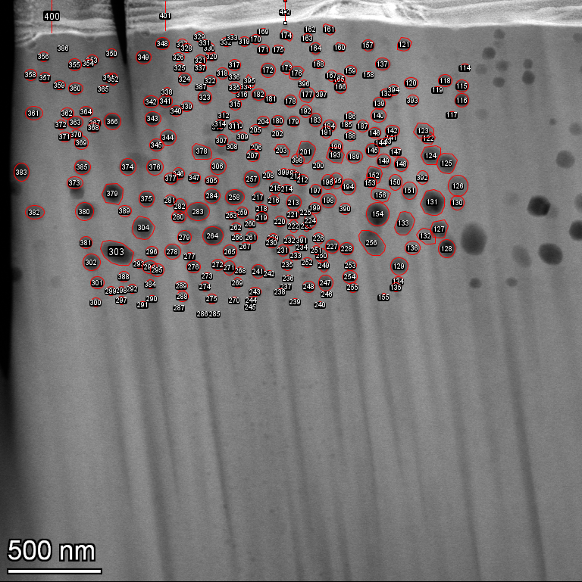
Post-irradiation TEM Examination
2 dpa is the average proton dpa between 14.5 um to 17um
Fe²⁺ injected direction
Iron Only Irradiated Area

Slide 15
Post-irradiation TEM Examination
2 dpa is the average proton dpa between 14.5 um to 17um
Fe²⁺ injected direction
Iron Only Irradiated Area

Slide 16
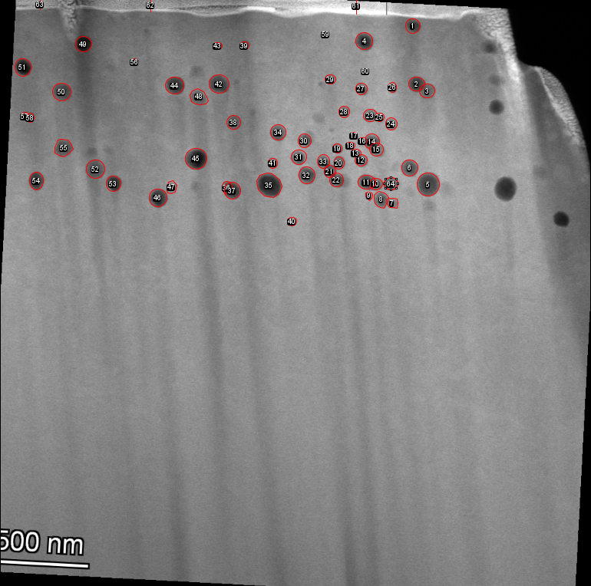
Post-irradiation TEM Examination
Fe²⁺ injected direction
Iron Only Irradiated Area

Slide 17
Post-irradiation TEM Examination
Fe²⁺ injected direction
Iron Only Irradiated Area

Slide 18
Post-irradiation TEM Examination

Slide 19
Post-irradiation TEM Examination

Slide 20
Conclusion
Proton + heavy-ion irradiation notably promotes void swelling.
The safe analysis zone in heavy-ion irradiation becomes significantly wider after proton preconditioning irradiation.
The hybrid irradiation approach shows strong promise as a new irradiation testing method.
One manuscript is currently under preparation.

