Slide 1
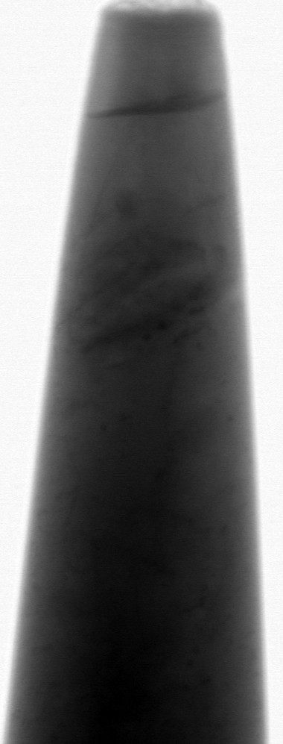
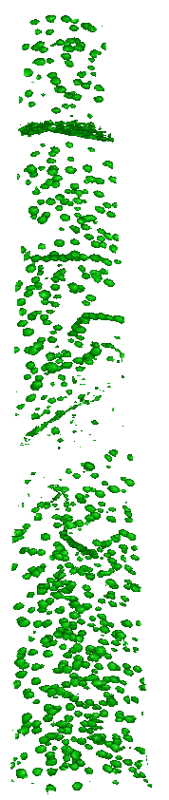
Mukesh Bachhav,
Distinguish Researcher and Laboratory Lead
Mukesh.Bachhav@inl.gov
Microscopy and Characterization Suite (MaCS) at Critical Materials and Energy Systems Innovation Center (CMESIC)

Slide 2
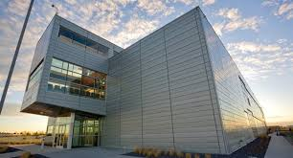
Microscopy and Characterization Suite (MaCS) at INL
MaCS is a user facility with the capabilities to characterize a wide range of materials, including alloys, semiconductors, oxides, ceramics, and minerals in bulk or powder forms. It can provide 2-D/3-D morphology, chemical information at nano/atomic scale, and mechanical testing data.
  Radiological and non-radiological materials

Slide 3
MaCS Transition (from 1st July 2025)
The operations of the Microscopy and Characterization Suite (MaCS) have transitioned to INL’s responsibility at CMESIC (formerly known as CAES)
Staffing structure
  Lab Lead: Mukesh Bachhav
  Scheduling – Jeremy Burgener
  Research associate – Jana Howard (FIB)
  Post-Doc - Sara Wonner (APT)
  Post-Doc - Lanh Trinh (TEM)
  Radiation Safety Officer-Kristi Moser-Mcintire, Idaho State University

Slide 4
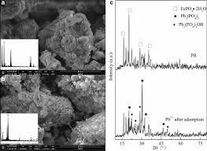
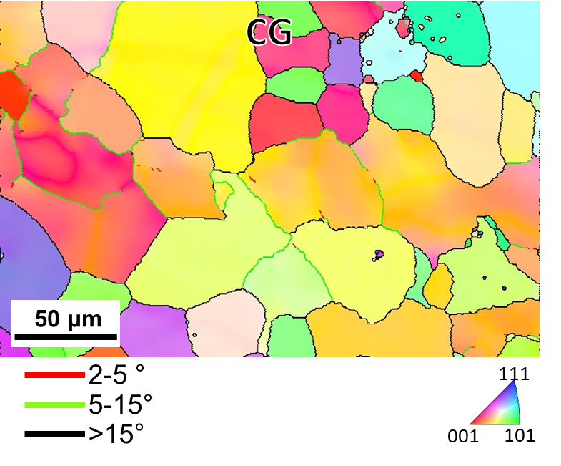
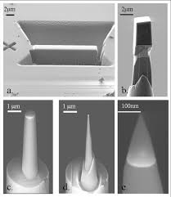
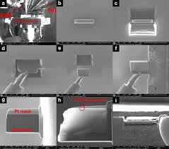
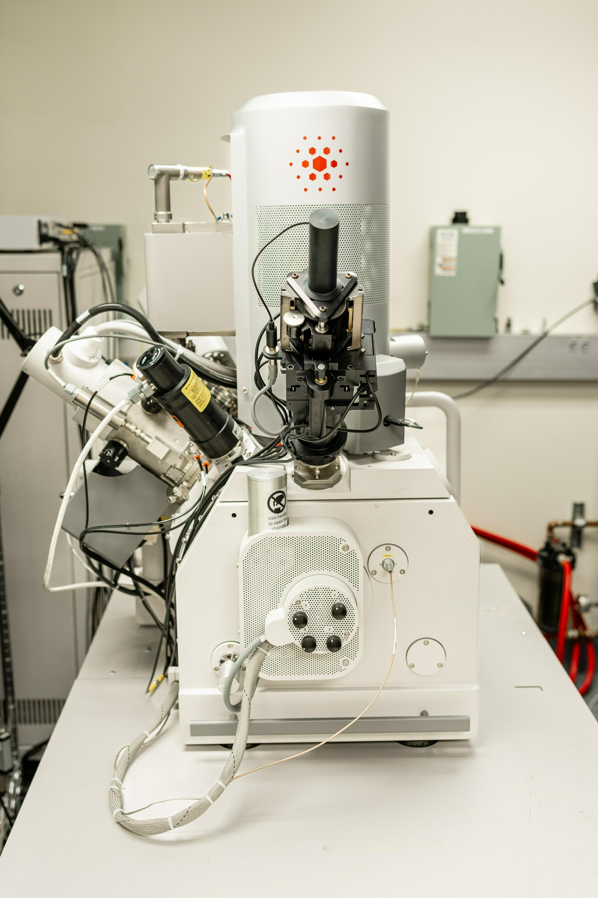
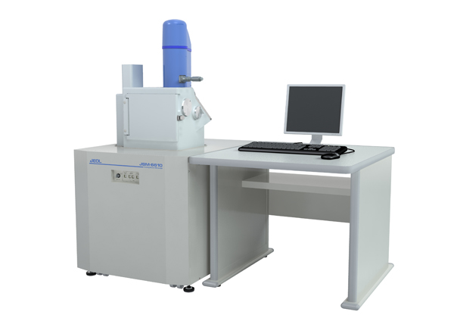
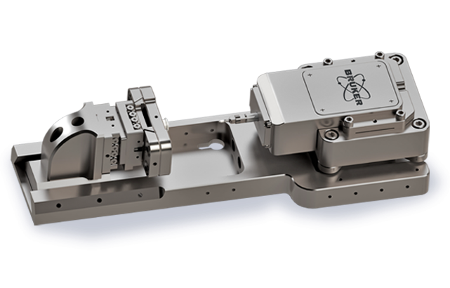
SEM/FIB at MaCS
EBSD
APT sample prep
TEM sample prep
PI- 88 in-situ nanomechanical testing
FEI QUANTA 3D FEG with EDS & EBSD
JEOL JSM 6610LV with EDS, EBSD, & CL
Dual Beam Focused Ion Beam Microscope (FIB))
Sample preparation for TEM, APT, EBSD, and PI-88 measurements
Scanning Electron Microscope (SEM)
Surface characterization, Chemical analysis
*Images taken from internet

Slide 5
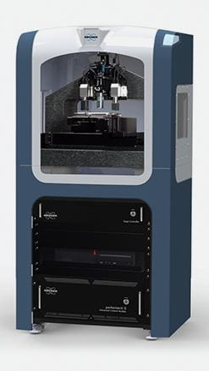
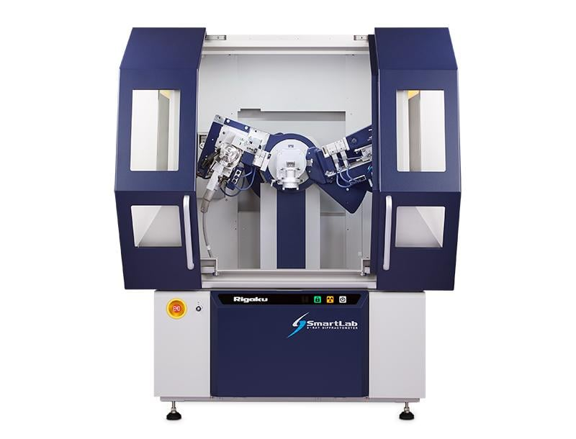
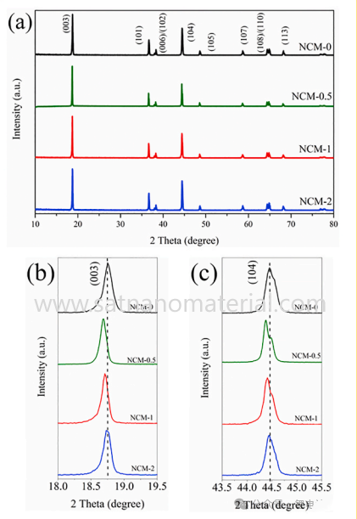
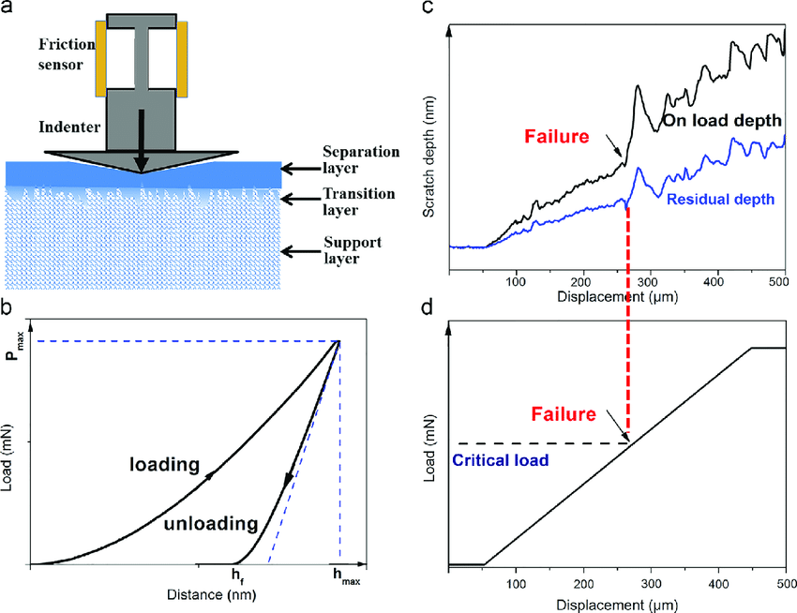
Nano Indenter at MaCS
XRD at MaCS
Rigaku SmartLab
Hysitron TI950 TriboIndenter
X-Ray Diffractometer (XRD)
Phase identification and quantification, percent (%) crystallinity, crystallite size and strain, lattice parameter refinement, Rietveld refinement, and molecular structure.
Nano Indenter Atomic Force Microscope
Nano-mechanical test instrument for measuring the hardness and elastic modulus of materials, and imaging surface morphology

Slide 6
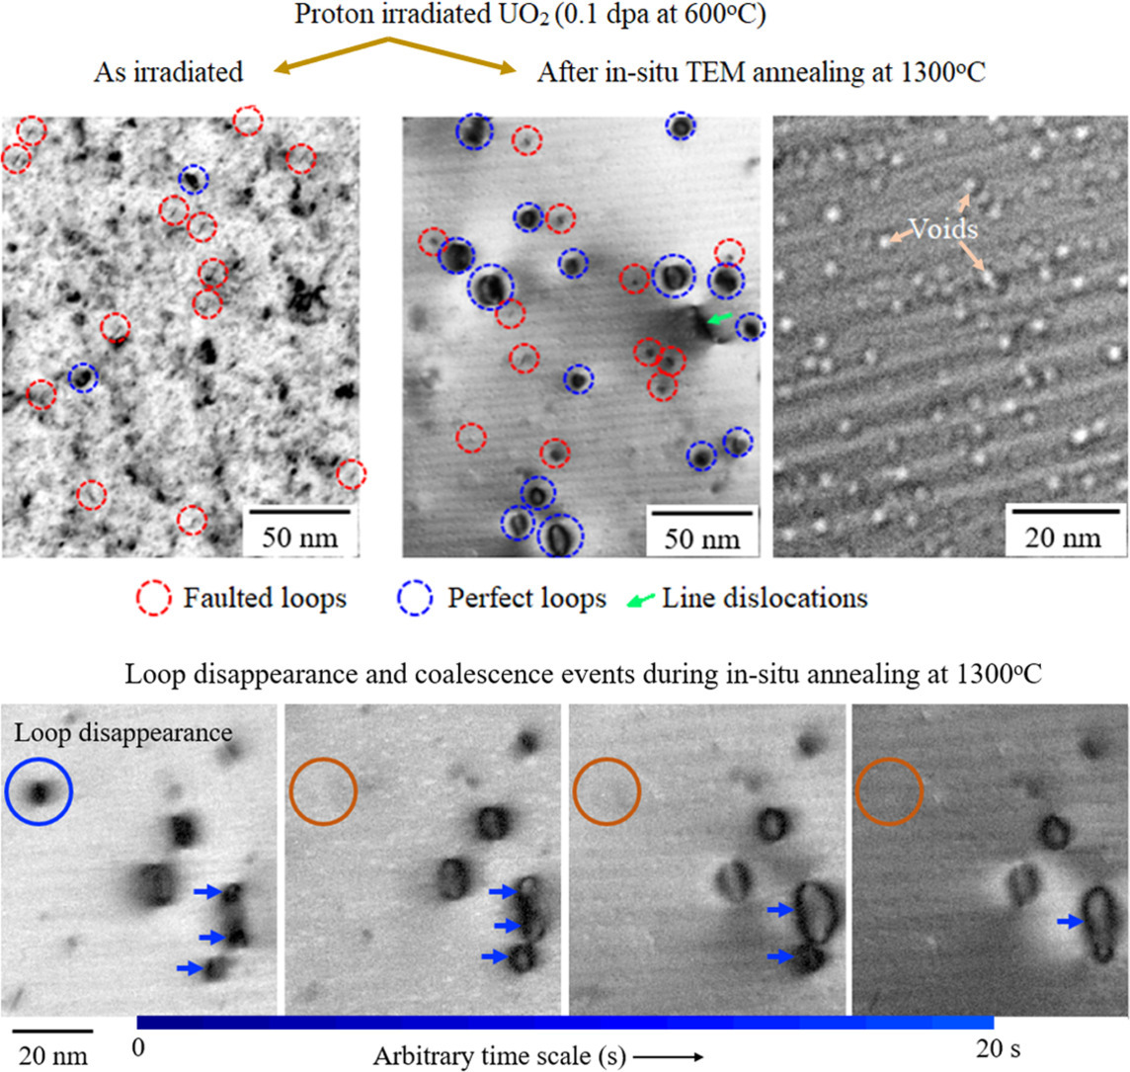
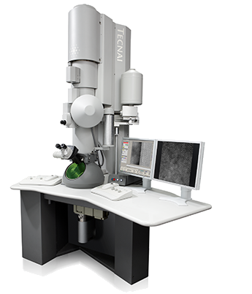
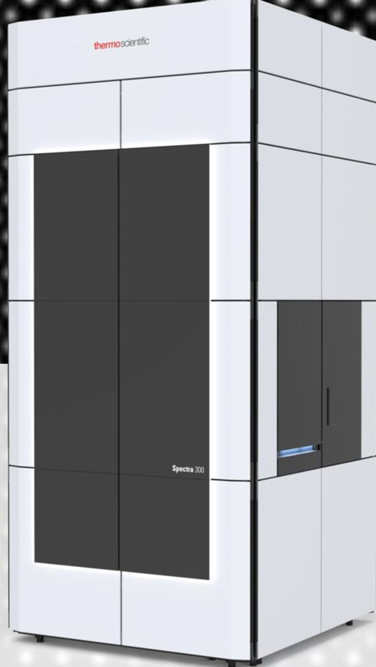
TEM at MaCS
FEI Technai TF30-FEG STwin
ThermoFisher Spectra 300
Transmission Electron Microscope (TEM)
Scanning Transmission Electron Microscope (STEM)
Imaging the microstructure and chemistry of materials at the atomic scale
Imaging the microstructure of materials at the atomic scale

Slide 7
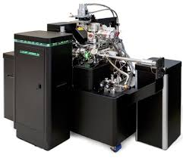
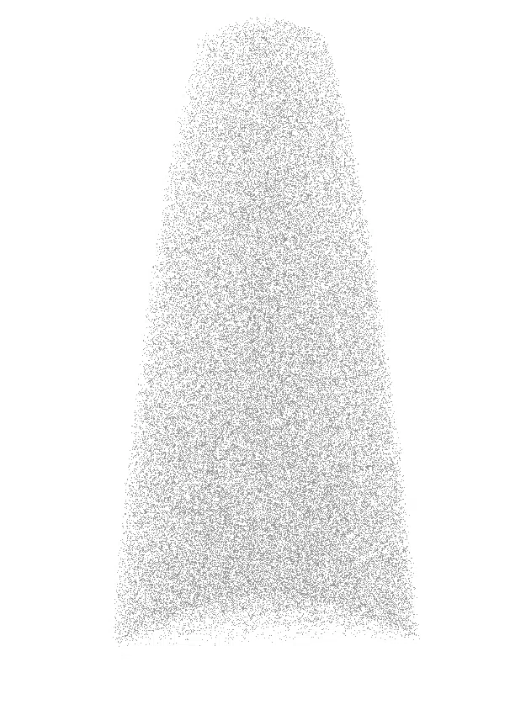
LEAP at MaCS
Microstructural analysis in RPV steel
Ni
Si
Mn
P
Cameca LEAP 4000X HR
Local Electrode Atom Probe (LEAP)
50 nm
Atom Probe Tomography (APT) is used for 3D atomic-scale characterization of materials, revealing their composition and nano scale microstructure
Correlative APT/TEM analysis

Slide 8
Other equipment at MaCS
Non-Rad Glovebox | Custom
Rad Glovebox | Custom
Linear Sectioning Machine, Non-Rad | Leco MSX-205MZ
Polisher / Grinder, Rad | Beuhler Minimet 1000
Polisher, Non-Rad | LECO Model: GPX-200
Ion Mill, Precision Ion Polishing System (PIPS) | Gatan PIPS II

Slide 9
Hosting collaborators at MaCS
MaCS is located inside CMESIC building (state building)
Easy access to MaCS lab
Sign off process for visitors on instrument relatively straightforward
After hours and weekend access to users for console ops
Workstation in MaCS allows data analysis

Slide 10
Shipping samples to/from MaCS
MaCS lab is under NRC license (ISU)
RSO Kristi Moser-McIntire (kristimosermcinti@isu.edu)
Coordinate with us for sample shipment and for receiving back samples
NSUF library materials

Slide 11
Working with us
….RTE, SuperRTE, CINR
Reach out to us for writing proposal (feasibility, scope, budget, timeline….)
Once proposal is awarded: “pre-job brief”
Closely working with our staff members to carry out scope
Data management, Data analysis and Data interpretation
Reports, Conferences, Manuscript…
Mukesh.Bachhav@inl.gov

Slide 12
NSUF celebrating 20th anniversary
Share your NSUF-enabled research | Journal of Nuclear Materials (JNM) special issue
The Journal of Nuclear Materials is accepting submissions for a special issue celebrating the 20th anniversary of the Nuclear Science User Facilities (NSUF).
This issue will highlight cutting-edge research enabled by NSUF capabilities across fuels, claddings, sensors and structural materials for both the current reactor fleet and advanced reactor technologies. Topics of interest include irradiation effects, microstructural characterization, mechanical and corrosion behavior, in situ experiments, modeling and simulation, AI-driven characterization, and additive manufacturing for extreme environments.
Manuscript submission deadline: Oct. 1
During submission select article type: VSI: NSUF Enabling innovation
Submit via Editorial Manager at the Journal of Nuclear Materials
For inquiries about the appropriateness of contribution topics, please contact guest editor Mukesh Bachhav, Stephen Taller, Maria Okuniewski

