Slide 1
May 13, 2026
3D Porosity Characterization of Fluff Region in an Irradiated EBR-II Fuel Rod
Jake Fay¹, William Chuirazzi¹, Cameron Howard¹, Christopher Bearcroft¹, Jie Lian²
¹Idaho National Lab,
²Rensselaer Polytechnic Institute

Slide 2
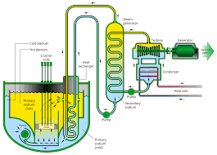
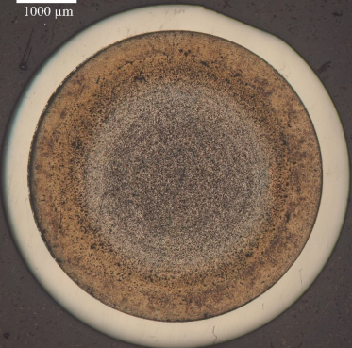
Metallic Fuels Background
Metallic fuels when combined with SFRs have numerous advantages over oxide fuels
  Improved thermal conductivity
  Higher uranium density
  Improved safety
Metallic fuel swelling properties
  Rapid swelling in early burnup (2 at. %)
  Fresh fuel slugs must be smaller than the inner cladding radius
  Sodium bond

Slide 3
Lift-Out of Cubes for 3D Characterization
New characterization performed on MNT38A
  U-19Pu-10Zr composition
  11% burnup
2 60x60x60µm cubes trenched from sample for characterization
Foam cube taken from center of distinct Foam section
Fuel cube taken from bottom of longitudinal mount

Slide 4
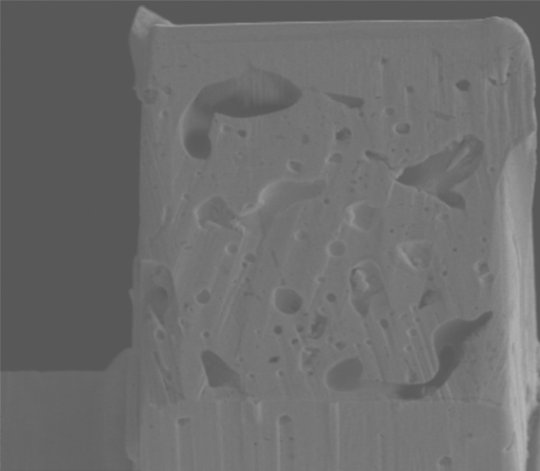
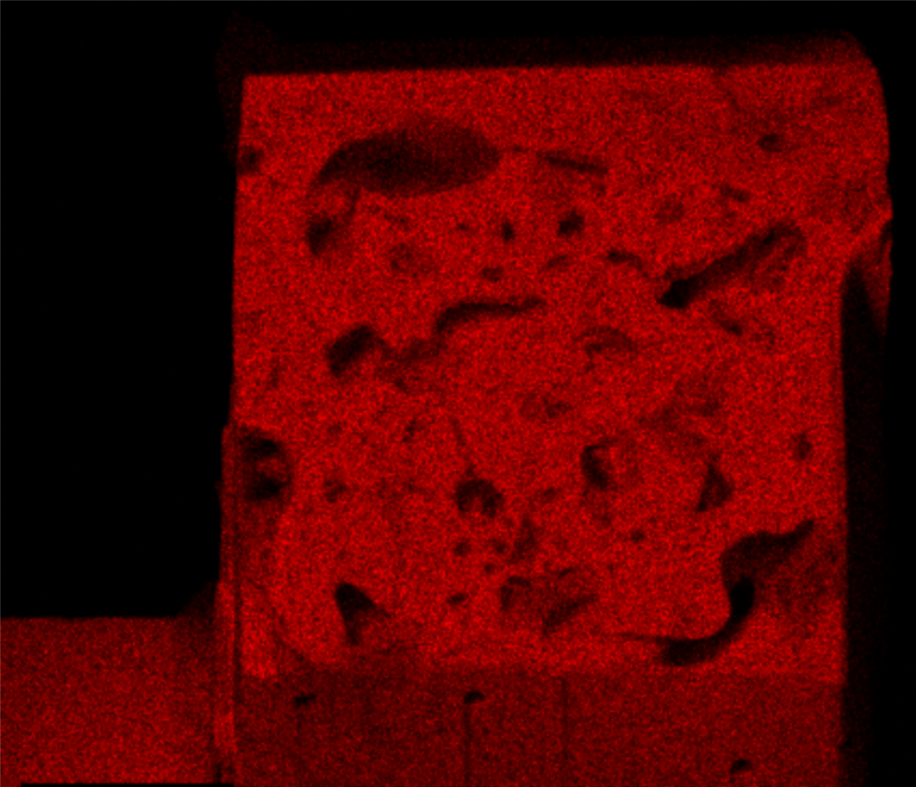
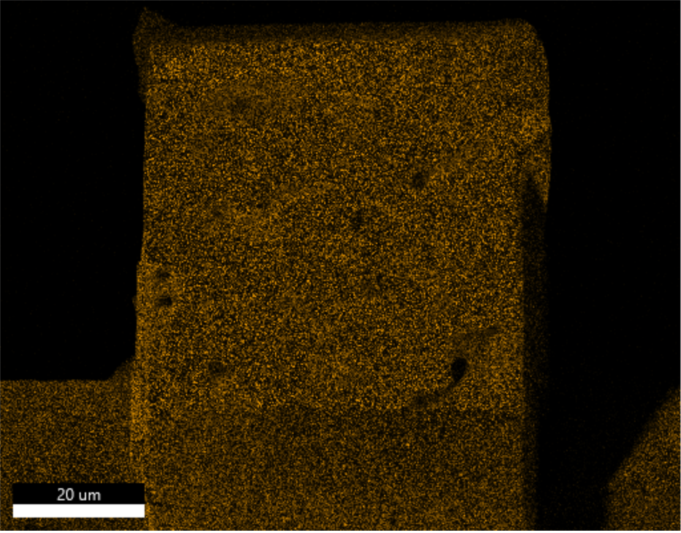
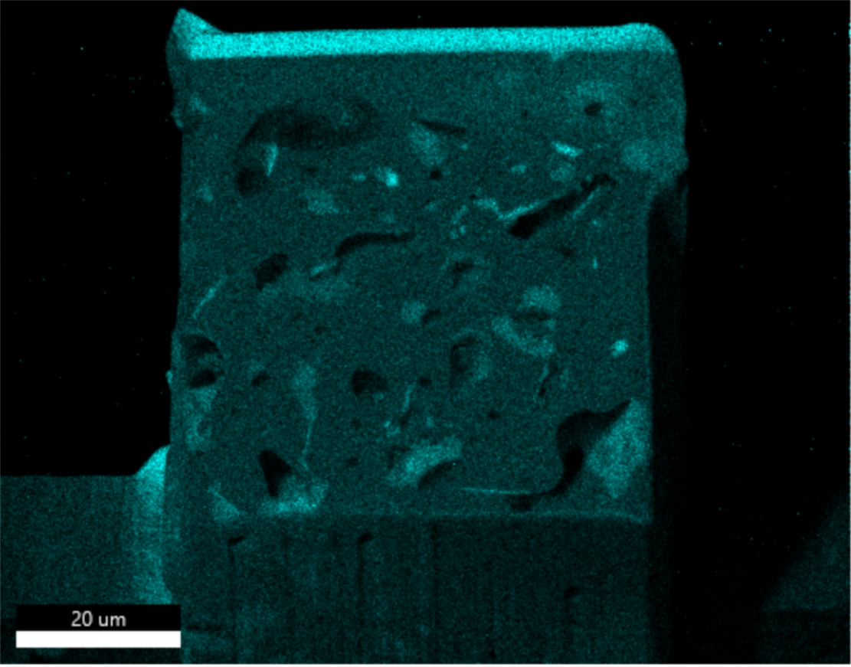
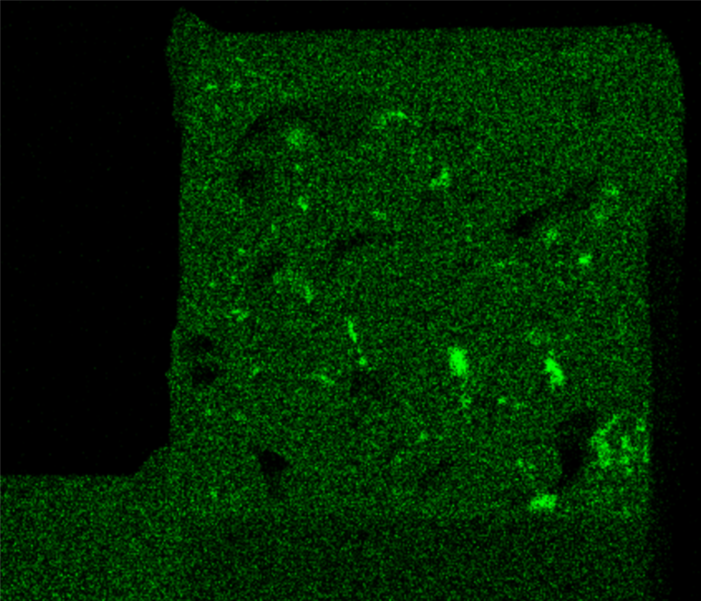
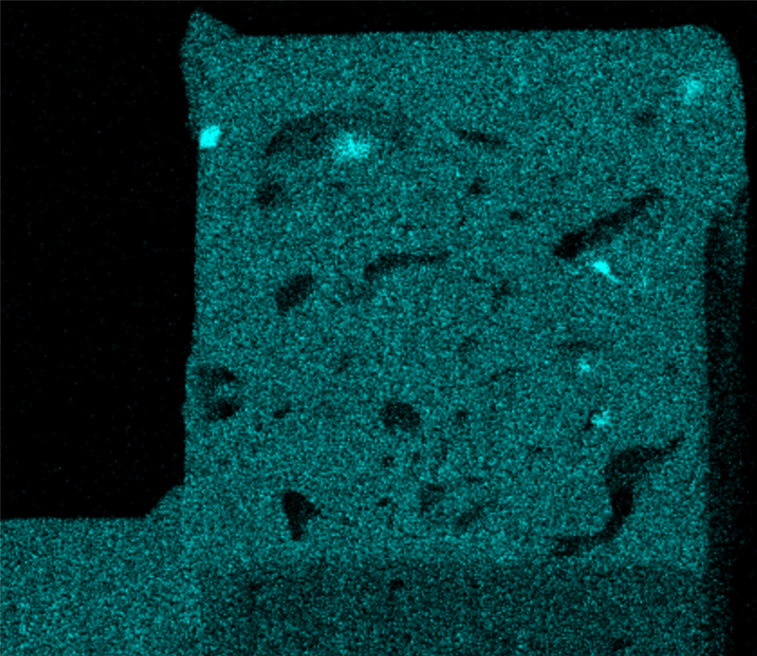
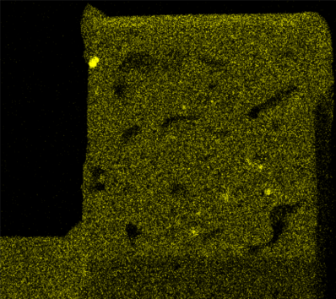
EDS Fuel Cube
U
Pu
 | Fuel Cube
Element | Spot 1 | Spot 2 | Spot 3 | Spot 4 | Spot 5 | Spot 6 | Spot 7
U | 22 | 62 | 62 | 63 | 19 | 17 | 40
Pu | 14 | 19 | 26 | 27 | 8 | 8 | 23
Zr | 10 | 18 | 12 | 10 | 13 | 5 | 33
Lanthanides | 3 | 1 | 0 | 0 | 59 | 70 | 3
Ba | 26 | 0 | 0 | 0 | 1 | 0 | 1
Te | 25 | 0 | 0 | 0 | 0 | 0 | 0
Spot 1
Spot 2
Spot 3
Spot 5
20µm
20µm
Spot 4
Zr
Nd
Spot 7
Zr
20µm
Te )
Ba )
20µm
20µm
20µm
20µm

Slide 5
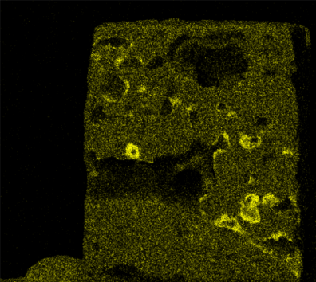
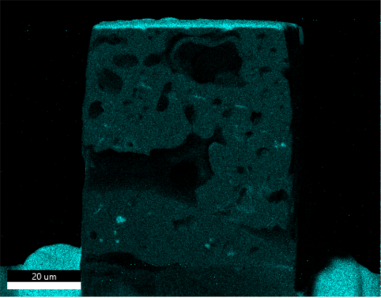
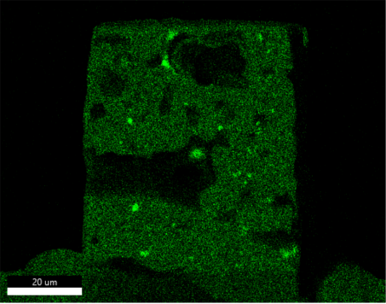
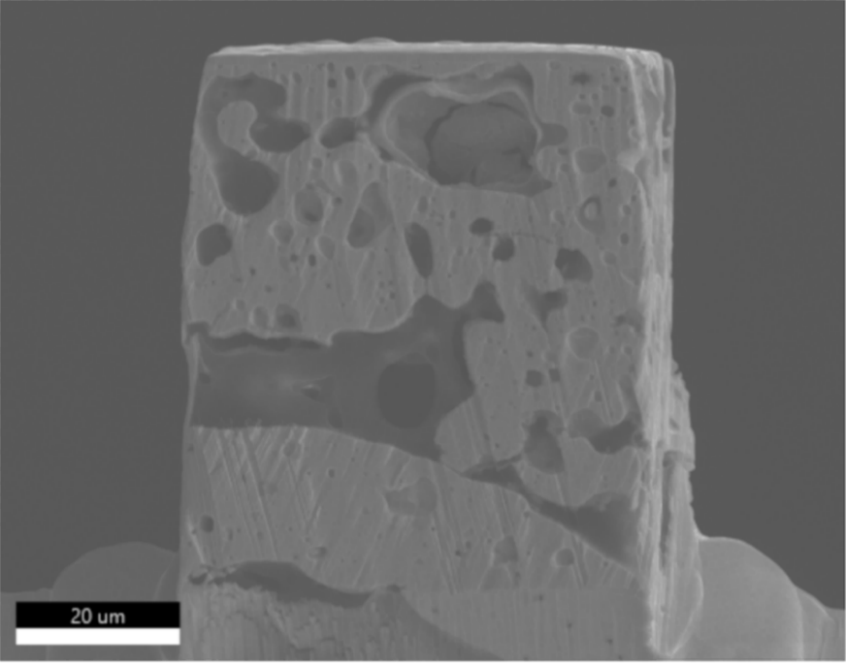
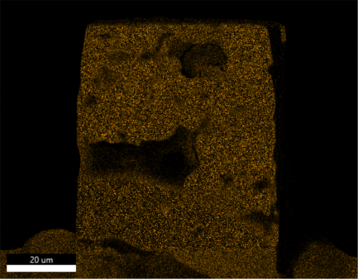
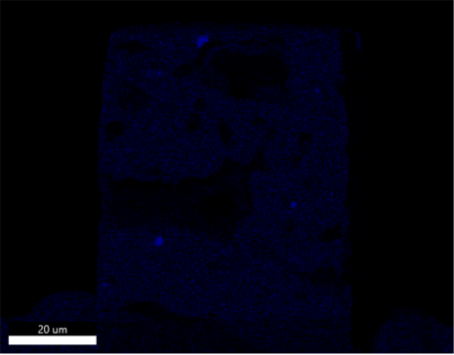
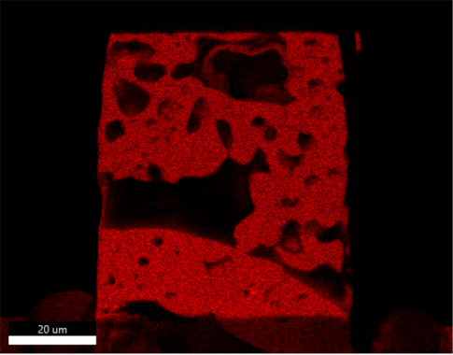
EDS Fluff Cube
 | Foam Cube
Element | Spot 1 | Spot 2 | Spot 3 | Spot 4 | Spot 5 | Spot 6 | Spot 7
U | 19 | 68 | 53 | 29 | 71 | 34 | 69
Pu | 8 | 23 | 18 | 12 | 23 | 11 | 23
Zr | 1 | 9 | 27 | 4 | 6 | 4 | 8
Lanthanides | 70 | 0 | 1 | 38 | 0 | 45 | 0
Cs | 2 | 0 | 1 | 0 | 0 | 3 | 0
Pd | 0 | 0 | 0 | 0 | 0 | 3 | 0
Te | 0 | 0 | 0 | 18 | 0 | 0 | 0
20µm
20µm
Spot 6
Spot 4
Ba
20µm
Spot 6
Ba
20µm
20µm
20µm
20µm

Slide 6
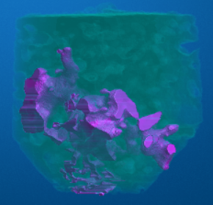
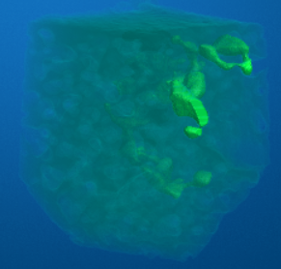
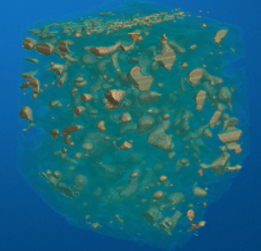
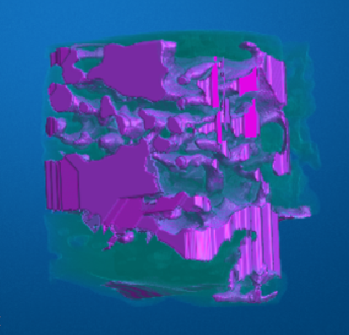
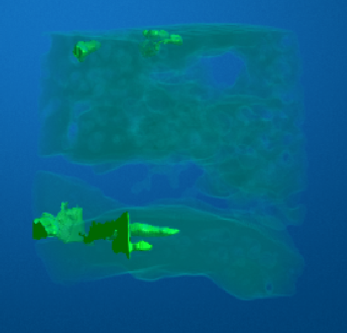
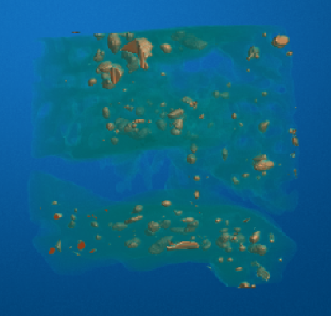
Micro-CT 3D Porosity
Binarization of image stacks
Pore identification with 3D object counter algorithms in Fiji
Foam cube had significantly higher porosity that concentrated into the largest large pore network
 | Fuel Cube | Foam Cube
Number of pores | 512 | 182
Total porosity | 15% | 36%
% Open porosity | 77% | 98%
% Closed porosity | 23% | 2%
% porosity in 5 largest pore networks | 69% | 97%
% porosity in largest network | 43% | 95%

Slide 7
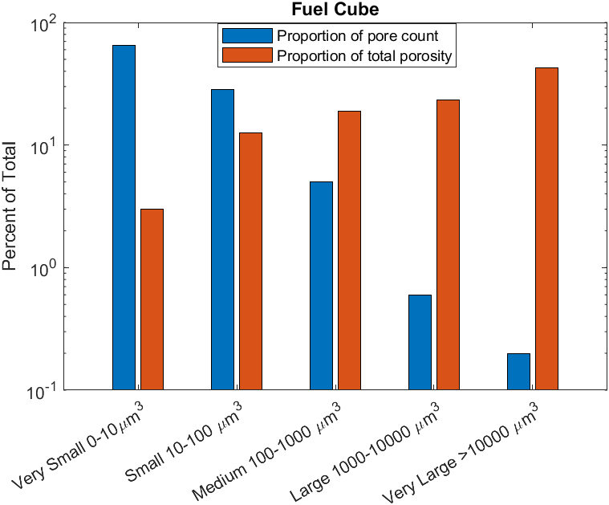
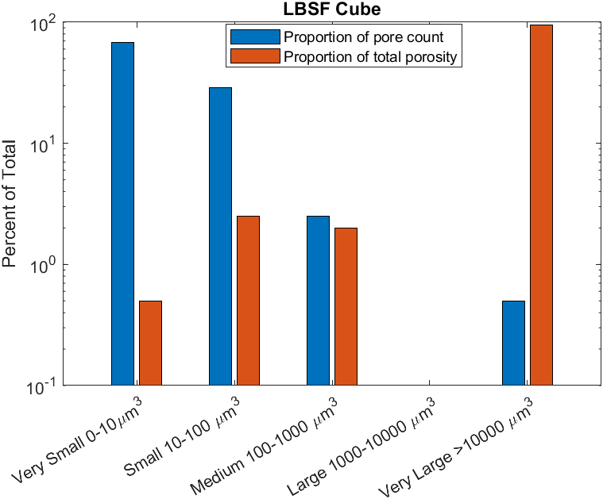
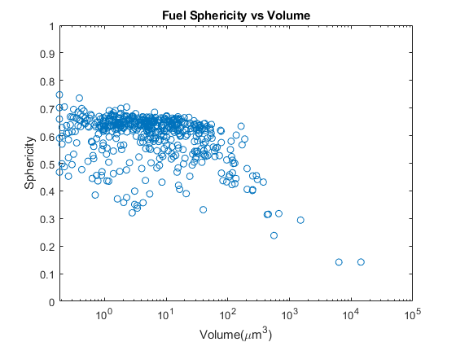
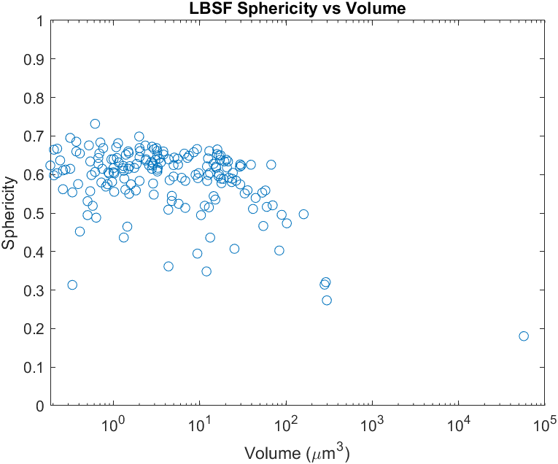
Pore Size Distribution
Differences in porosity distribution
  porosity in the Foam cube was concentrated in a single large pore
  porosity in the fuel cube was more evenly distributed
Sphericity distributions were very similar between Foam and Fuel
  Could indicate high presence of α-U during irradiation
Fuel Cube
Foam Cube
Fuel Cube
Foam Cube

Slide 8
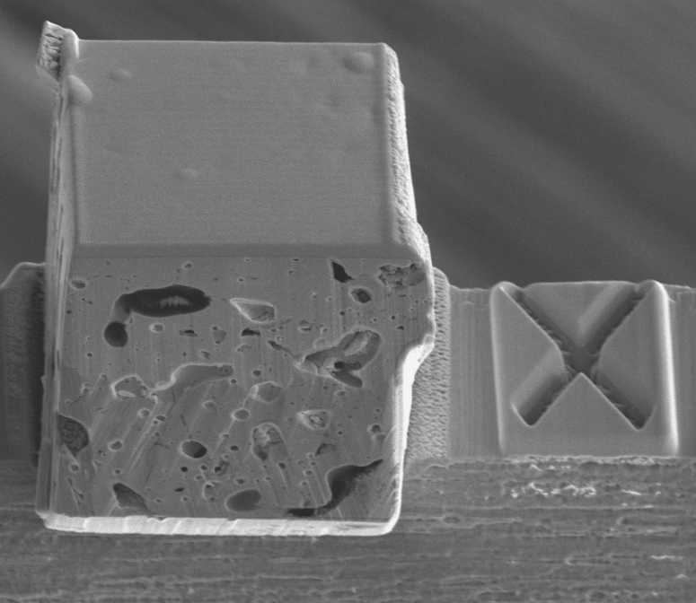
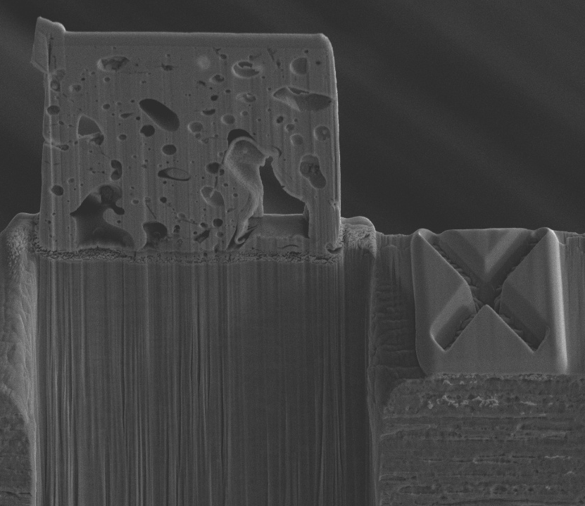
FIB Tomography of Foam and Fuel Cubes
Serial sectioning by focused ion-beam was performed on sub-volumes from the two cubes
higher resolution in the x and y planes compared to Micro-CT
Semi-manual segmentation method
Fiducial Marking
Fiducial Marking
Global Thresholding
Manual Removal of Shine Through Artifacts
Filling in Tearing Artifacts and Removing Stray Pixels
Final Cropping and Tilt Correction

Slide 9
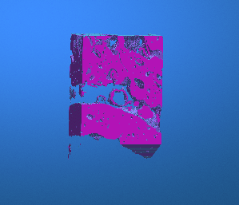
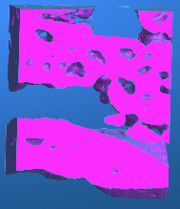
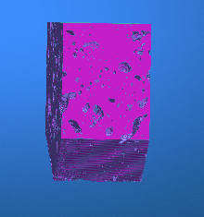
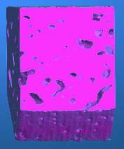
Comparison to Micro-CT (Qualitative)
 | Foam |  | Fuel
 | FIB Tomography | Micro-CT | FIB Tomography | Micro-CT
Number of pores | 4284 | 88 | 14468 | 453
Total porosity | 41 | 36 | 19 | 13
% Open porosity | 94 | 97.5 | 59 | 66
% Closed porosity | 6 | 2.5 | 41 | 34
% porosity in 5 largest pore networks | 93 | 97.5 | 54 | 60
% porosity in largest network | 92 | 96.5 | 34 | 44
Loss of fine detail and rounding of pore edges
New Features

Slide 10
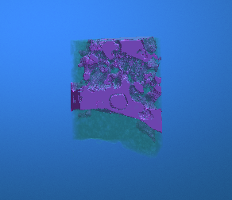
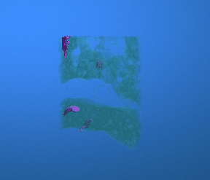
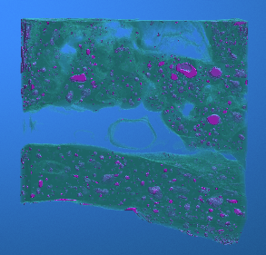
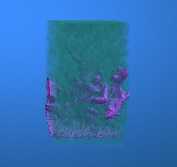
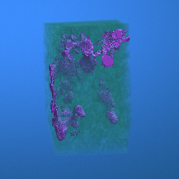
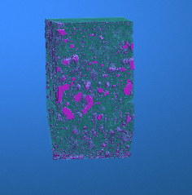
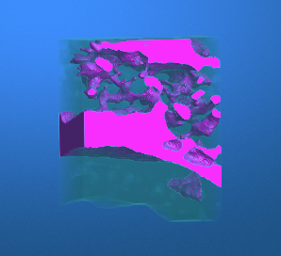
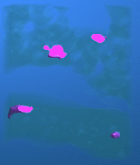
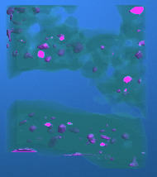
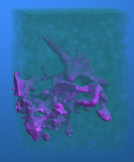
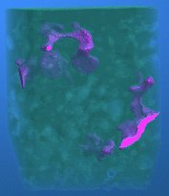
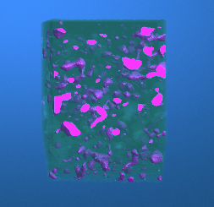
Comparison of Individual Pore Structures from Micro-CT and FIB Tomography
Fluff LALO
Fuel LALO
FIB Tomography
Only shared pore structure
Micro-CT

Slide 11
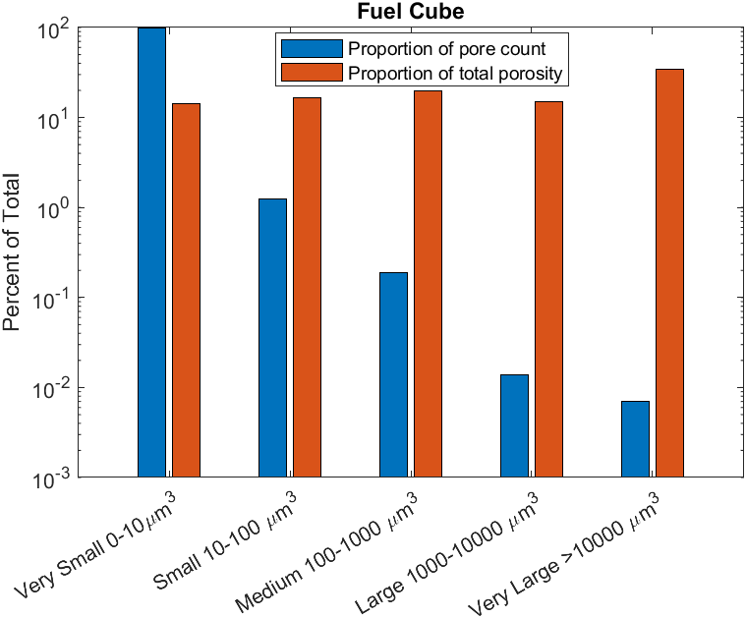
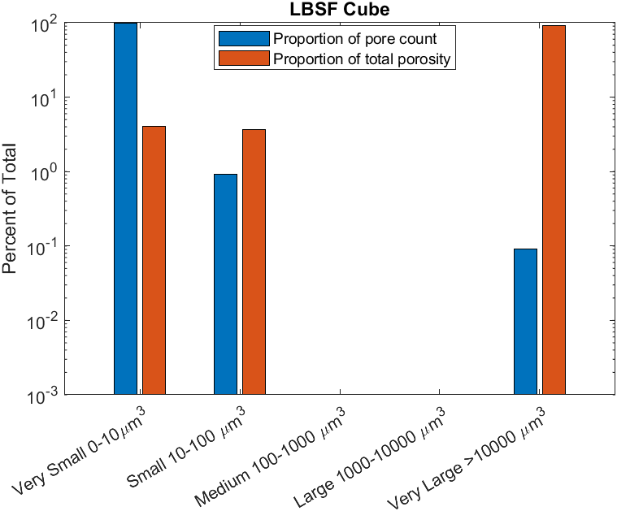
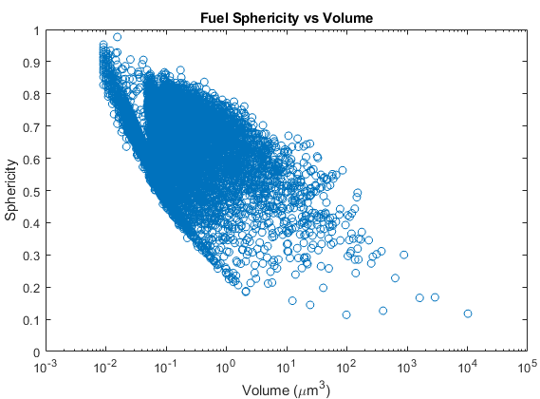
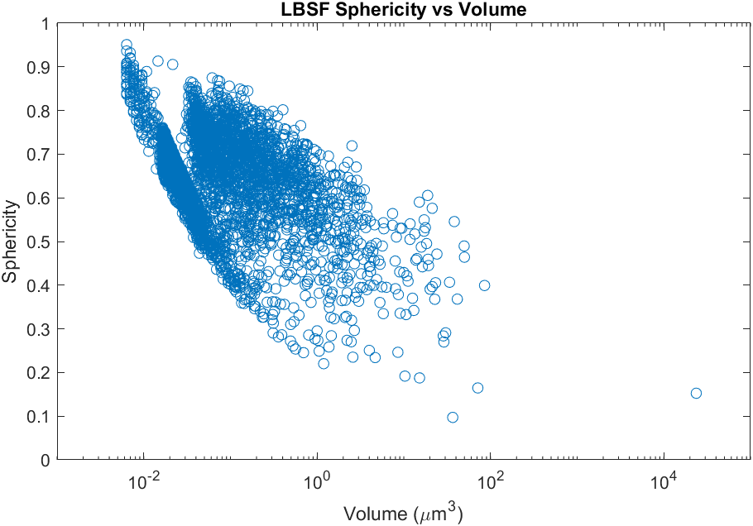
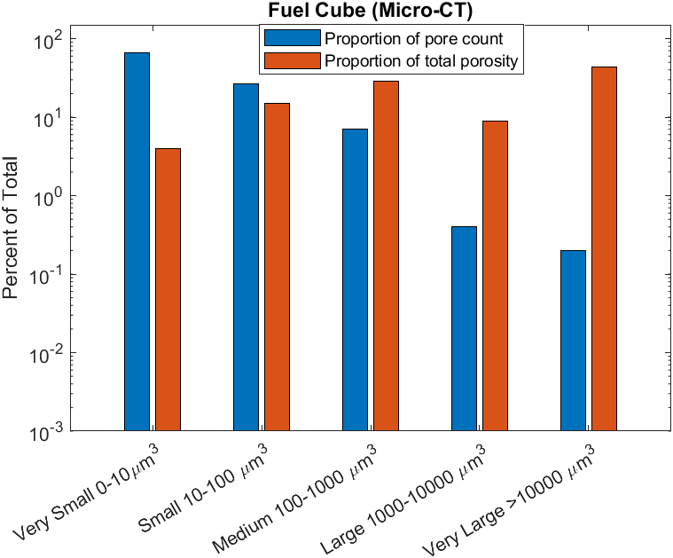
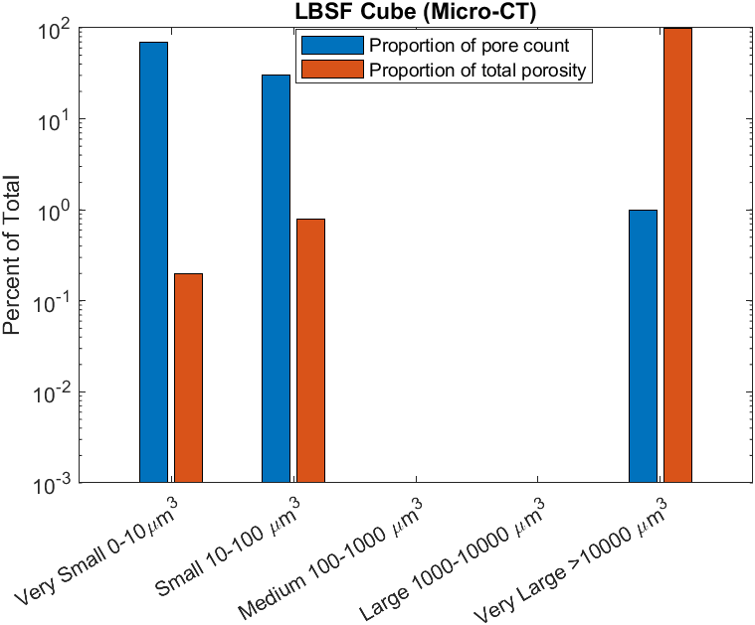


Comparison to Micro-CT Pore Distribution
Fuel Cube
Foam Cube
Fuel Cube
Foam Cube
Fuel Cube
Foam Cube
Fuel Cube
Foam Cube

Slide 12
























FIB tomography EDS of Foam
SEM Image
U Map
Pu Map
Zr Map
Nd Map
Ba Map
EDS maps collected at 10 slice intervals
There were small Zr rich precipitates distributed in the volume
Nd and lanthanides collected in large precipitates within the open porosity
Ba also collected on edges of open porosity
Slice 10
Slice 40
Slice 60
Slice 110

Slide 13




















FIB Tomography of Fuel Cube
SEM Image
U Map
Pu Map
Nd Map
Ba Map
Lanthanides and Ba collected on the edges of open porosity similar to the Foam cube
the size and quantity of precipitates however were smaller compared to Foam
  smaller amount of overall open porosity
  narrower passages within open porosity
Slice 30
Slice 100
Slice 150
Slice 230

