Slide 1
May 13, 2026
  Igor Jovanovic
    Professor, UC Berkeley
Measurement of Time-Dependent Transmissivity of Materials for Optical Sensors and Instrumentation

Slide 2
Project overview (2024–2027)
Goal and Objective:
Investigate the effect of radiation damage in optical materials on the operation and performance of optical sensors
Measure optical transmission in bulk samples during material irradiation with gamma rays and neutrons and concurrent heating
Extend in-situ characterization to shorter wavelengths, approaching the ultraviolet spectral region
Schedule:
Year 1: Prepare test materials; develop irradiation and characterization setup
Year 2: Conduct and interpret gamma irradiations
Year 3: Conduct and interpret neutron + gamma irradiations

Slide 3


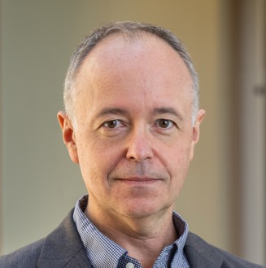

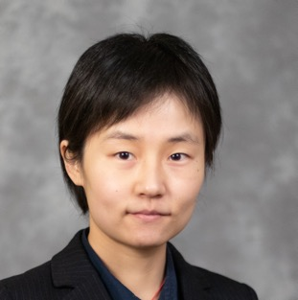
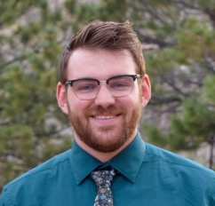

Research team and collaborations
Christian Petrie (ORNL)
Piyush Sabharwall (INL)
Igor Jovanovic (PI)
Yunping Zhang (postdoc)
Kyle Sperber
(PhD student)
Sylvain Gerard (Université Jean Monnet – Saint-Étienne)

Slide 4
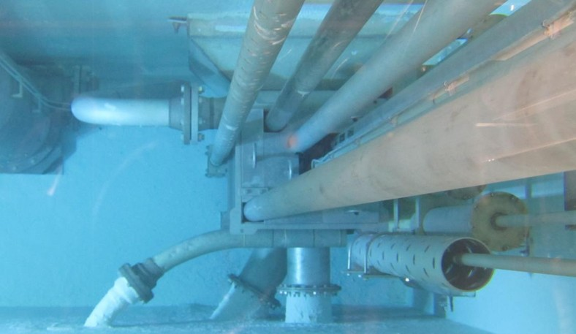


Irradiation facilities
Sample irradiation and thermal annealing at the OSU Nuclear Reactor Laboratory
Co-60 irradiator
OSURR
The Ohio State University Research Reactor

Slide 5
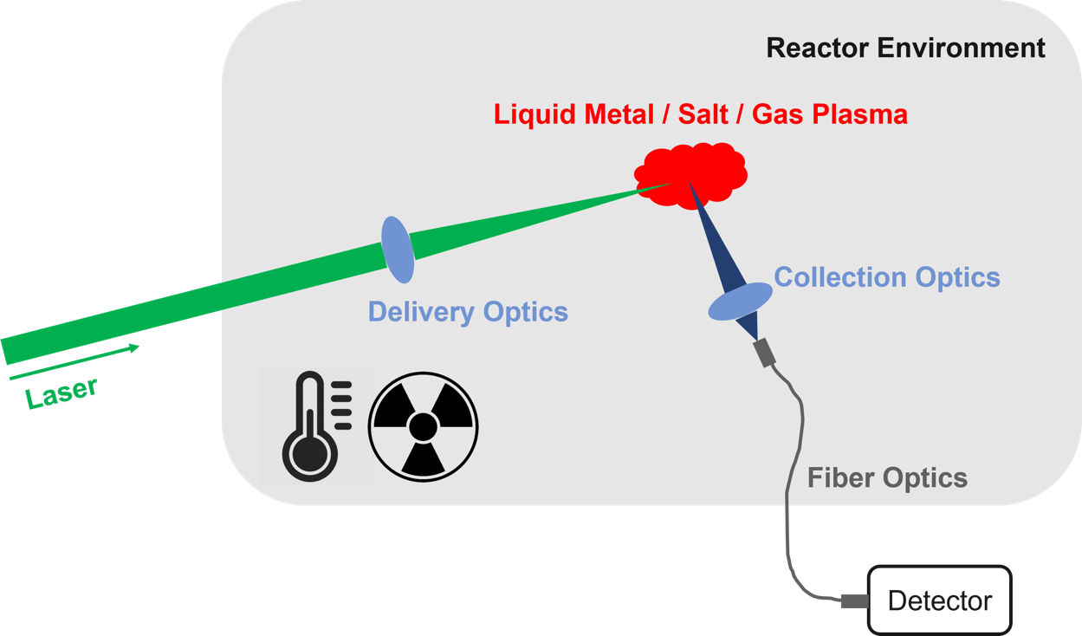
Technology impact: understanding in-operando optical sensor performance in nuclear power systems

Slide 6
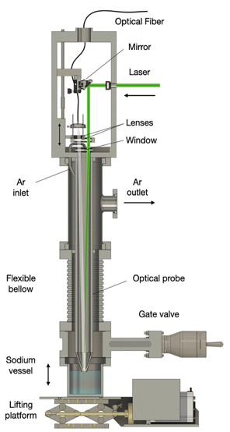
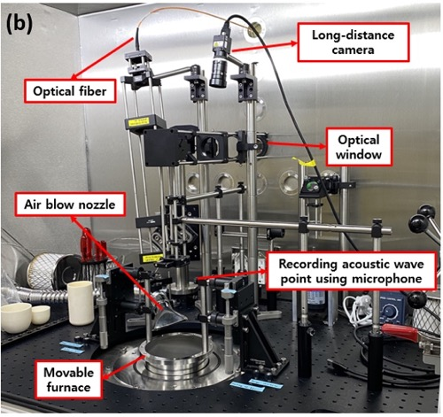
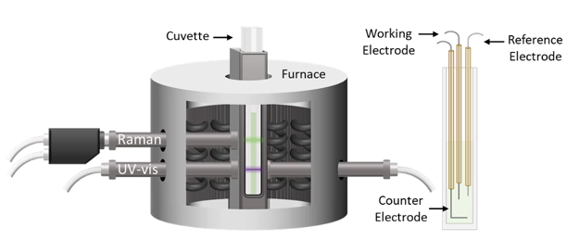
Technology impact: understanding in-operando optical sensor performance in nuclear power systems
Molten salt LIBS
Spectroelectrochemical measurement for MSRs
Liquid Na LIBS
A. Burak et al., Rev. Sci. Instrum. 96, 045108 (2025)
A. M. Lines et al., PNNL-31955 (2021)

Slide 7
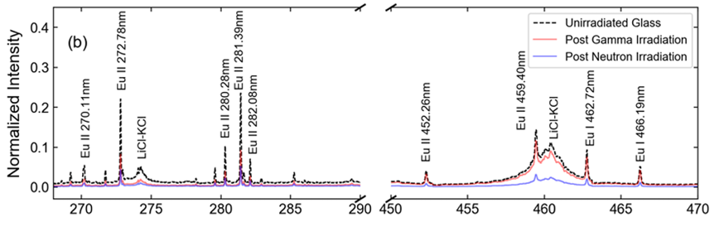
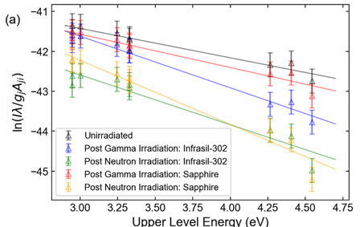
Measured spectra are affected by radiation-induced attenuation (RIA) in optical materials
L. J. Garrett et al., Sensors 23, 691 (2023)
Reduced measured line intensities
Spectrally nonuniform absorption
Especially prominent in UV spectral range

Slide 8
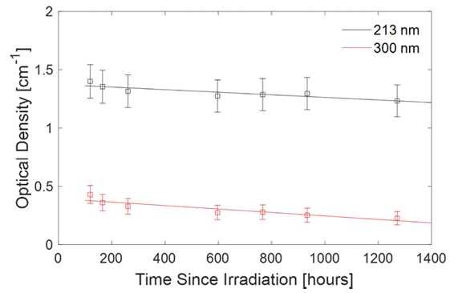
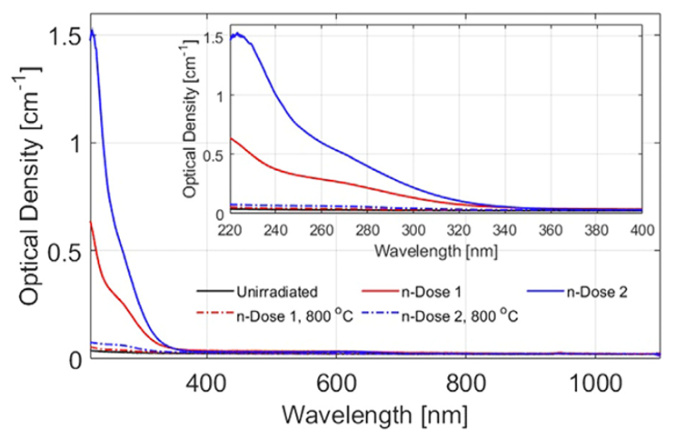
RIA varies with time and temperature during and after irradiation
Post-irradiation time evolution
Thermal annealing effects
B. W. Morgan et al., Opt. Mater. Express 12, 1188 (2022)
B. W. Morgan et al., J. Nucl. Mater. 570, 153945 (2022)
1.7x10¹⁷ n/cm²
(fast and thermal)

Slide 9
This work aims to bridge several gaps in the available experimental data
True real-time, in-situ measurement
Neutron and gamma irradiation
Concurrent-irradiation heating
Bulk optical sample
UV spectral range
Samples
Boron crown glass (borosilicate glass)
Boron crown glass (borosilicate glass)
Quartz glass (fused silica)
Quartz glass (fused silica)
Quartz glass (fused silica)
Sapphire
Molex Polymicro Optical Fiber
Molex Polymicro Deep UV Optical Fiber
Molex Polymicro Deep UV Optical Fiber
Molex Polymicro Deep UV Optical Fiber

Slide 10
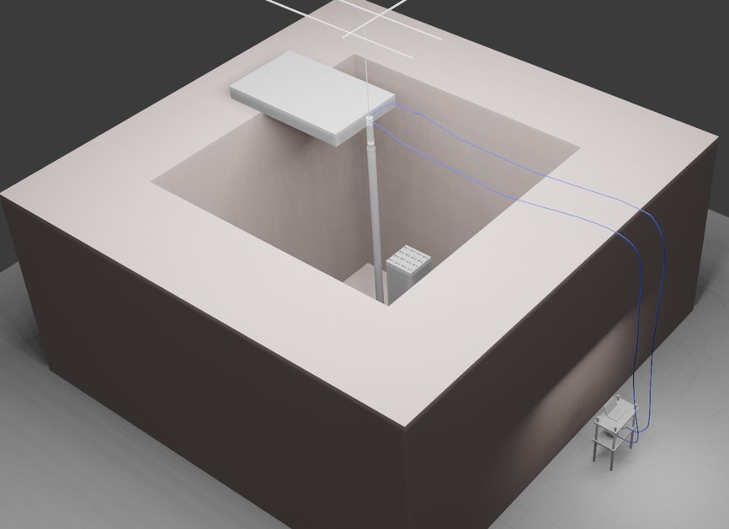
Our experiment is designed for deployment on the TRIGA reactor at Ohio State University
Furnace & rig
Reactor pool
Transport fibers
Notes:
Mechanical actuation
Crown Glass, Quartz Glass, Sapphire

Slide 11
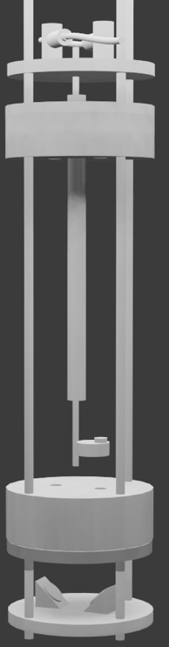
Our experiment is designed for deployment on the TRIGA reactor at Ohio State University
Reflective collimators
Insulation top cap (Φ6”)
Furnace & rig
Reactor pool
SiC heating element
Transport fibers
Sample holder
Window sample
Mirrors
Notes:
Mechanical actuation
Crown Glass, Quartz Glass, Sapphire

Slide 12
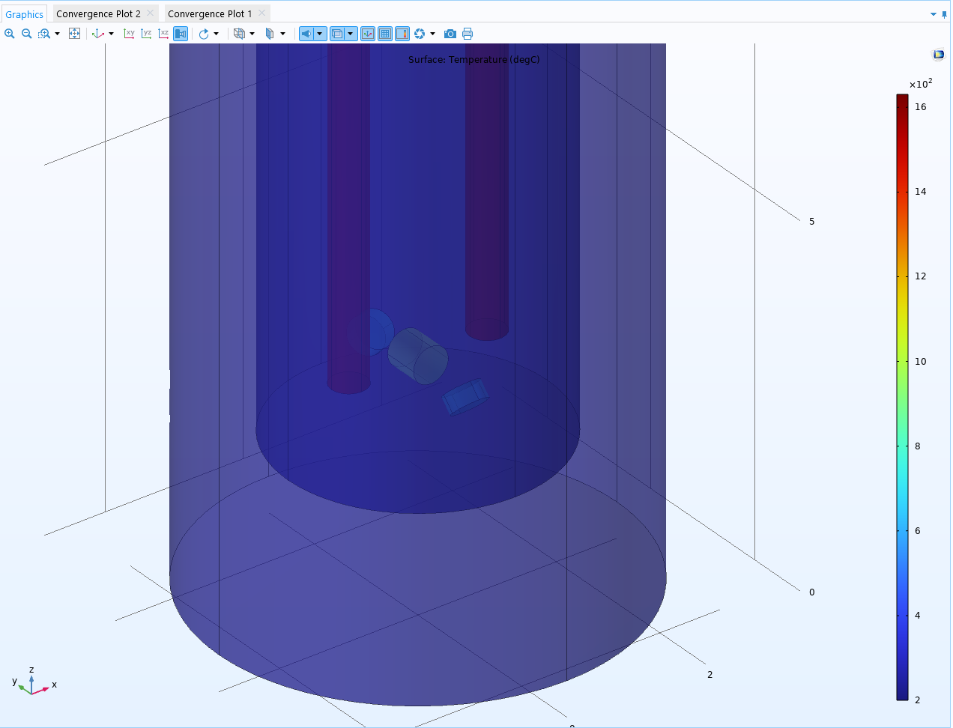
We simulated the heat transfer in custom furnace
Alumina insulation
SiC heating element
(at 1 W/cm²)
Quartz sample (884-932 ºC)
Notes:
Mechanical actuation
Crown Glass, Quartz Glass, Sapphire

Slide 13
We reduce transport fiber exposure to high T and radiation with reflective collimators
2 ft
Bottom of Furnace
Notes:
NRL High-Temperature SiC Furnace Rigs and Controllers for 6.5-in Tubes
Inside furnace near core estimated neutron fluxes: 1.7 × 10^12 n · cm^−2 · s^−1 total, 1.3 × 10^12 n · cm^−2 · s^−1 thermal (En < 0.5 eV) -(Bryanmo p72-)

Slide 14
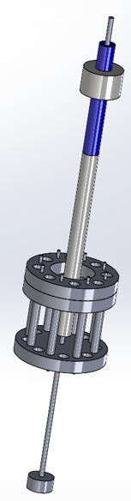
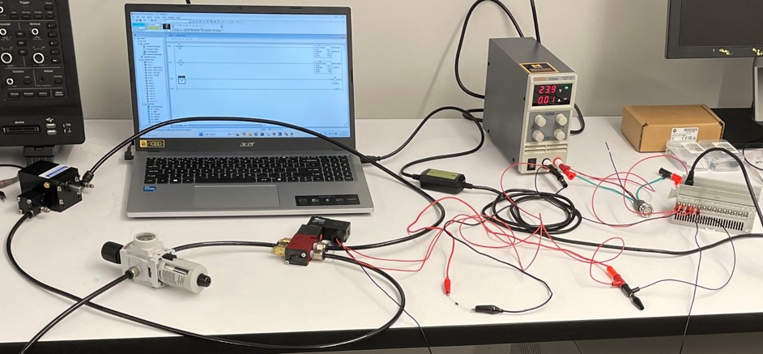
We use a rotating sample holder to irradiate multiple samples at once and periodically normalize transmission
Conceptual design of furnace interior
Heating element
Sample holder
Sample holder is rotated using a pneumatic rotary actuator controlled remotely by a programmable logic controller.
Bushing
Notes:
NRL High-Temperature SiC Furnace Rigs and Controllers for 6.5-in Tubes
Inside furnace near core estimated neutron fluxes: 1.7 × 10^12 n · cm^−2 · s^−1 total, 1.3 × 10^12 n · cm^−2 · s^−1 thermal (En < 0.5 eV) -(Bryanmo p72-)

Slide 15
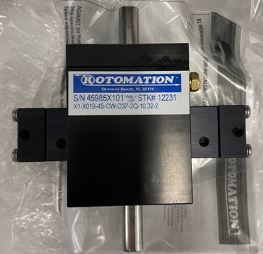
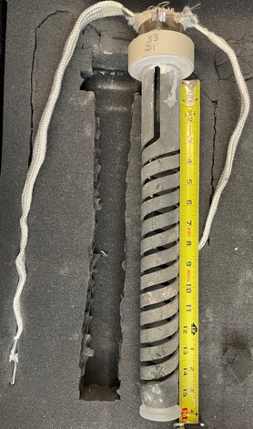
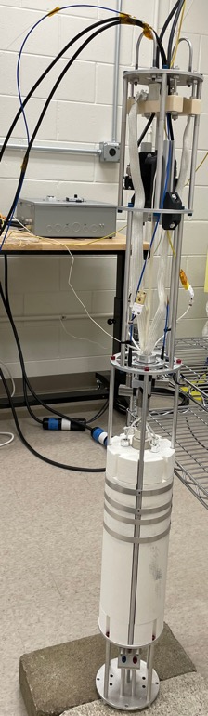
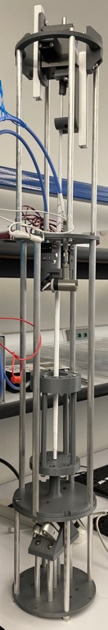
We conducted benchtop rotation and heated tests
Rotary actuator
Heating element
Thermocouple guide tube
Rotating shaft
Furnace insulation
Notes:
NRL High-Temperature SiC Furnace Rigs and Controllers for 6.5-in Tubes
Inside furnace near core estimated neutron fluxes: 1.7 × 10^12 n · cm^−2 · s^−1 total, 1.3 × 10^12 n · cm^−2 · s^−1 thermal (En < 0.5 eV) -(Bryanmo p72-)

Slide 16
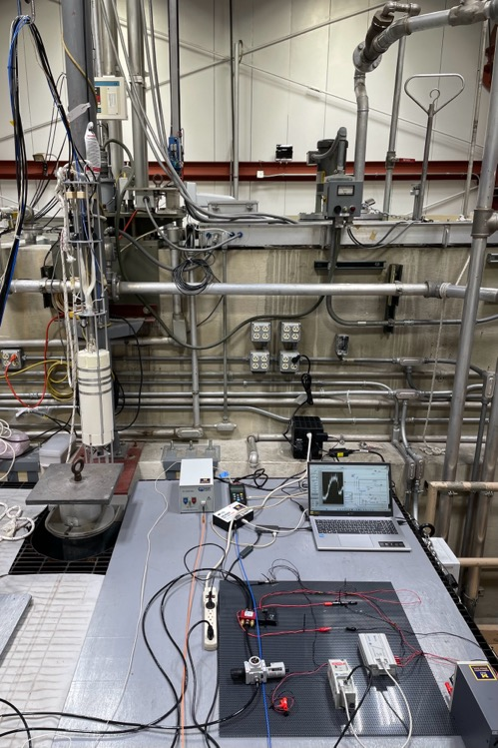
We deployed the optical characterization system at the OSU Co-60 irradiator
Deuterium lamp
Spectrometer
PLC
Notes:
NRL High-Temperature SiC Furnace Rigs and Controllers for 6.5-in Tubes
Inside furnace near core estimated neutron fluxes: 1.7 × 10^12 n · cm^−2 · s^−1 total, 1.3 × 10^12 n · cm^−2 · s^−1 thermal (En < 0.5 eV) -(Bryanmo p72-)

Slide 17
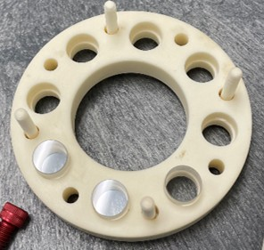

The sample holder carousel periodically rotates through 8 positions
Position 6 in
Position 5 in
Position 7 in
Position 4 in
Position 0 in
Position 3 in
Position 1 in
Position 2 in
Notes:
NRL High-Temperature SiC Furnace Rigs and Controllers for 6.5-in Tubes
Inside furnace near core estimated neutron fluxes: 1.7 × 10^12 n · cm^−2 · s^−1 total, 1.3 × 10^12 n · cm^−2 · s^−1 thermal (En < 0.5 eV) -(Bryanmo p72-)

Slide 18
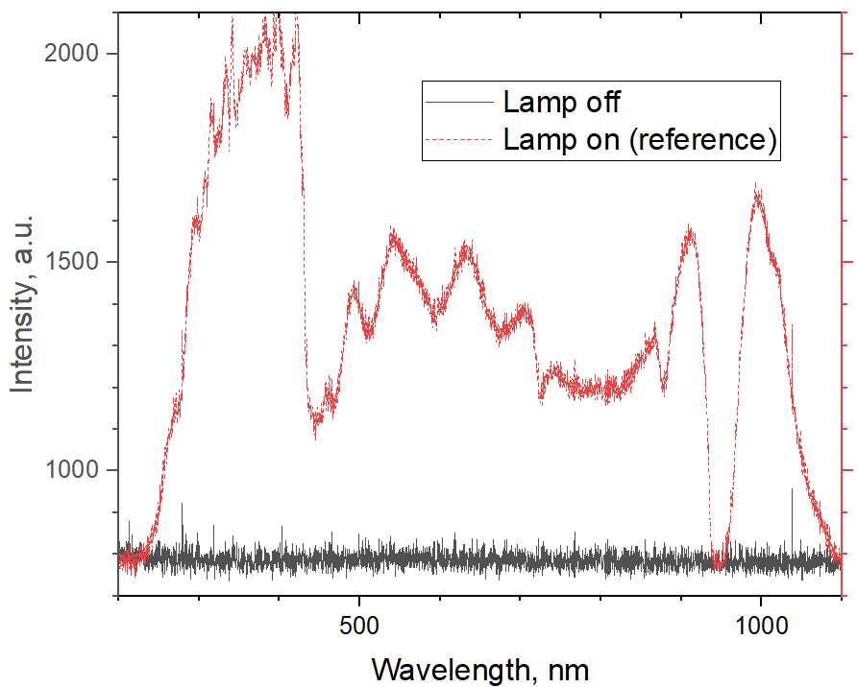
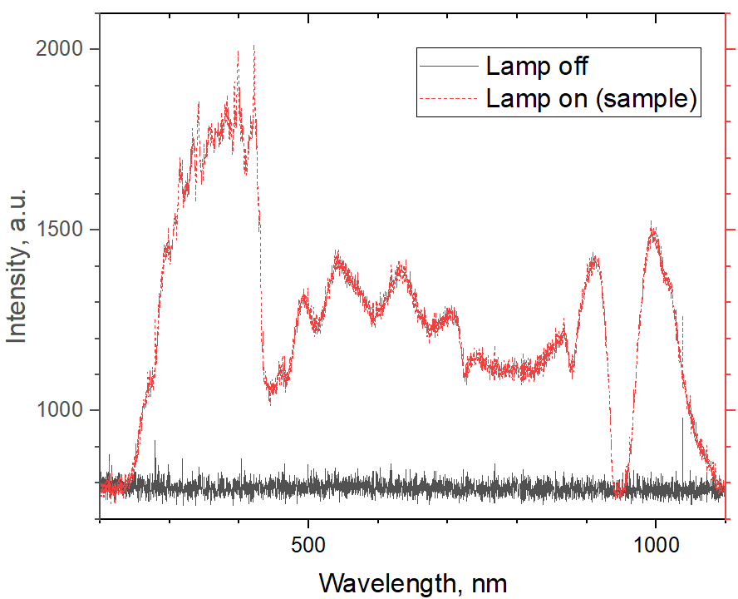
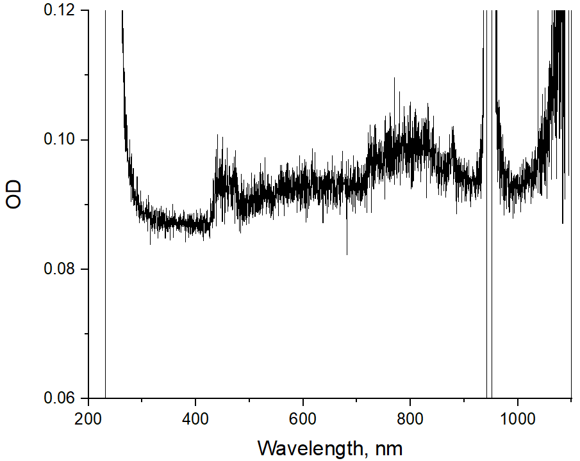
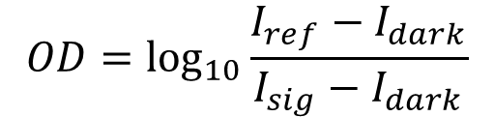
We are in the midst of first gamma irradiation campaign
Integration time: 200 ms
Scans to average (lamp off): 150
Scans to average (lamp on): 200
$$OD=\log_{10}{\frac{I_{ref}−I_{dark}}{I_{sig}−I_{dark}}}$$
Dark spectra (lamp off) taken at same positions as reference/sample spectra
Dark spectra is flat across the wavelength range at low temperatures

Slide 19
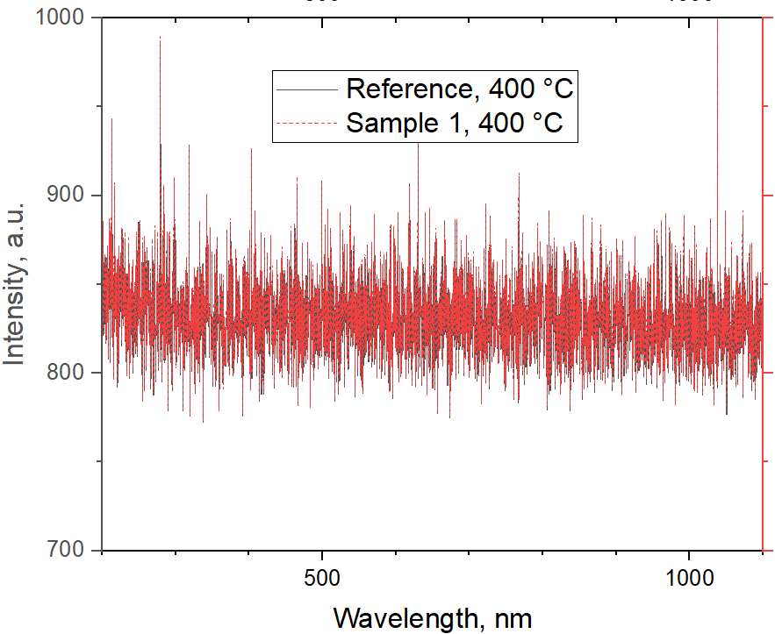
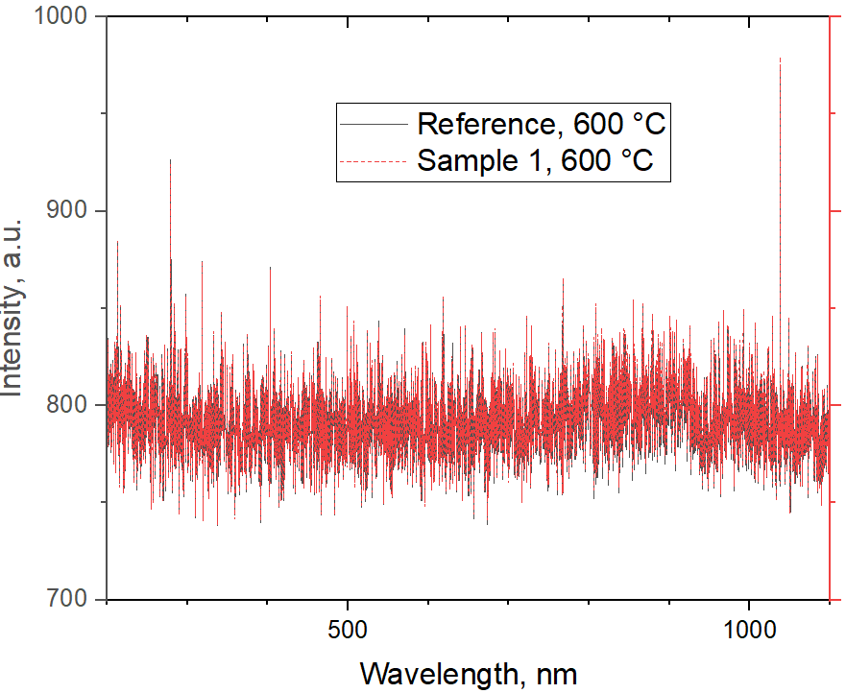
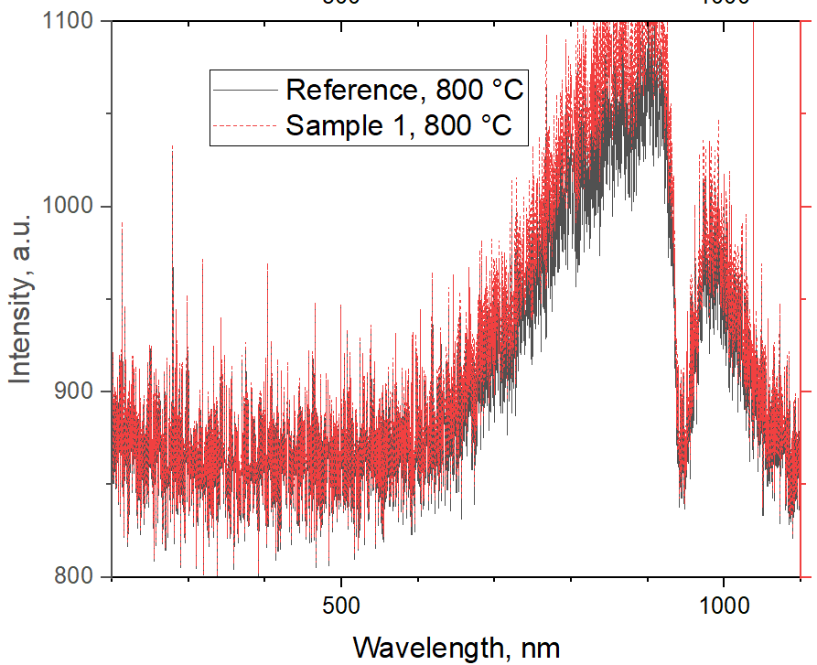
There is no evidence of significant radiation-induced emission
200 ms integration time, 200 scans average
Dark spectra (lamp off) at lower temperatures: sensor dark current
Dark spectra at high temperatures – sensor dark current + furnace glow

Slide 20
Publications to date
Y. Zhang, B. Sun, M. Burger, S. Girard, C. Petrie, P. Sabharwall, and I. Jovanovic, “Optical Characterization System Development for In-situ Real-time Measurement of Transmissivity of Irradiated Bulk Optical Materials,” Transactions of the American Nuclear Society 132(1), 424-426 (2025)
Y. Zhang, G. B. Sun, S. Girard, C. Petrie, P. Sabharwall, and I. Jovanovic, “Optical Characterization System Development for In-situ Real-time Irradiation at High Temperatures,” Transactions of the American Nuclear Society 133(1), 234-237 (2025)

Slide 21
Questions?
  Igor Jovanovic
    Professor, UC Berkeley
    ijov@berkeley.edu
LRS document ID#

