Slide 1
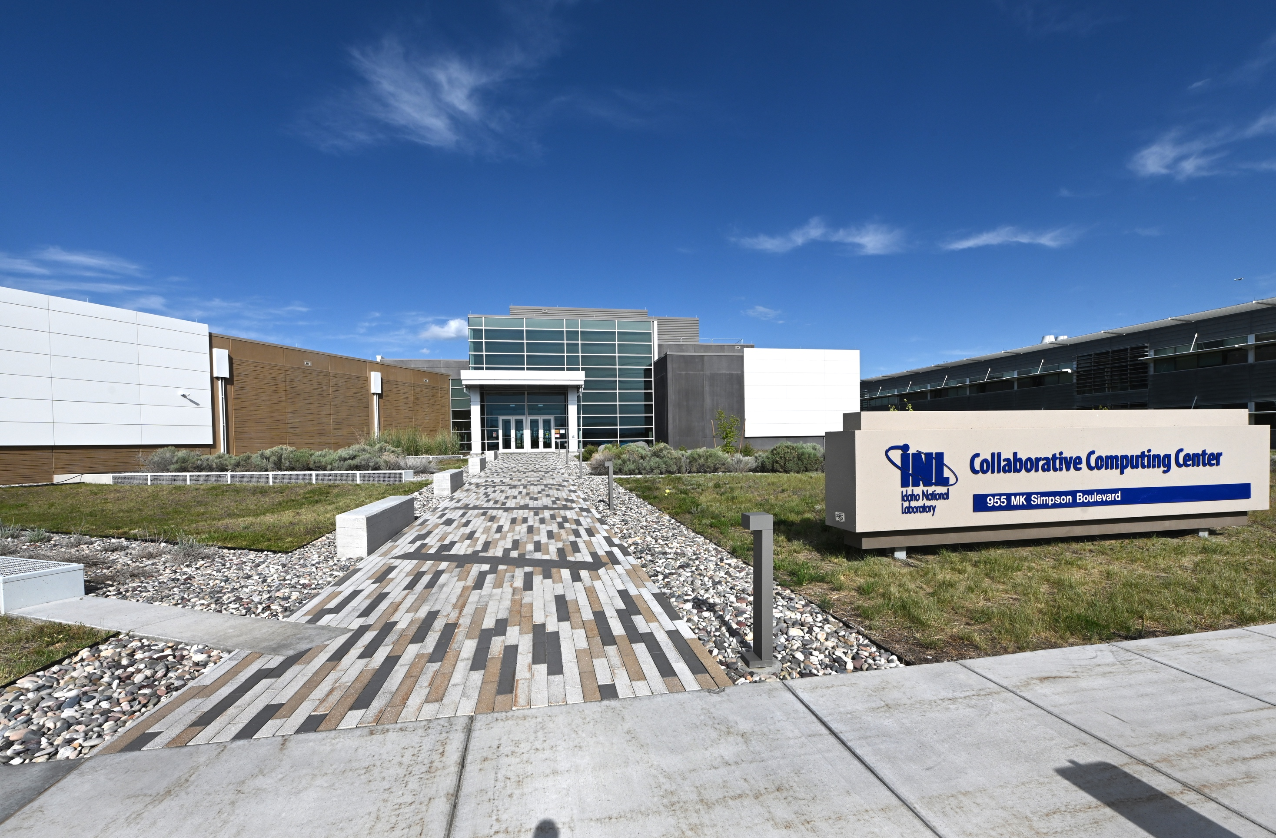
Designating INL HPC as a National User Facility
Idaho National Laboratory Computing Facility (INLCF)

Slide 2
The Need for Establishing INLCF
The U.S. nuclear sector is at a pivotal moment, driven by Executive Orders emphasizing energy independence and the deployment of advanced nuclear technologies.
Modeling, simulation, and AI are essential for reactor design, fuel development, regulatory analysis, and reactor deployment.
INL’s HPC capabilities are currently supporting over 1,000 researchers across national labs, academia, and industry.
Allowing HPC users from industry and academia without a user facility designation and appropriate agreements is out of compliance with DOE policies regarding
  Full cost recovery for use of government equipment, and
  Intellectual property rights.
Designating INLCF as a National User Facility will formalize access and ensure compliance with DOE policies.

Slide 3
Funding for INLCF
INLCF will operate under DOE-NE sponsorship from both the
  Nuclear Science User Facilities program (NSUF, which provides funding for HPC) and the
  Nuclear Energy Advanced Modeling and Simulation program (NEAMS, which provides funding for the Nuclear Computational Resource Center (NCRC)).
Existing funding mechanisms will continue with appropriate resources redirected for user agreement management.
Strategic coordination with DOE-NE will guide budget planning and resource acquisition.
Notes:
Estimates are 1-2 staff to help with agreements, $400k - $800k.

Slide 4
Will This Affect the Speed of Access for External Users?
Marginally.
  External users will need a user agreement.
  INLCF will utilize standard DOE user agreements (e.g., Class Waiver W(C)-2008-003).
  Non-proprietary users will benefit from reduced administrative burden and free use.
  Proprietary agreements will offer an option for industry use.
  Agreements will need to be approved.
    The approval process is still to be determined.
  INL’s current access portal and NCRC processes will remain in place with enhancements for user agreements, ensuring continuity and efficiency.

Slide 5
Risks and Mitigations
Administrative Overhead: Managing new external user agreements and hybrid models will require additional labor and will require coordination.
Mitigation: Leverage existing HPC/NCRC processes and NSUF user agreement expertise.
Funding Uncertainty: Sustained DOE-NE funding is essential; continuation of the specifically designated budget is ideal.
Mitigation: Coordination with DOE-NE and phased user agreement implementation.
User Expectations: External users will need to adjust to the requirements of the new agreements.
Mitigation: Clear agreement structures and user training.

Slide 6
INLCF as a User Facility
 | Nuclear-specific software and expertise | A secure environment for sensitive work | Integration with DOE-NE mission and regulatory support | Tailored focus and compliance framework needed for nuclear energy R&D
INLCF

Slide 7
Summary
John Wagner submitted the request to designate INLCF as a user facility
  This included a draft implementation plan
INLCF aligns with national priorities and DOE-NE mission.
The user facility designation will:
  Allow compliant HPC access including broad INL mission use
  Align with emphasis on nuclear energy innovation
  Preserve INL’s leadership in nuclear HPC

