Slide 1
  13 May 2026
    Idaho National Laboratory
High Performance Computing Accomplishments
Matthew Anderson
INL/MIS-26-92513

Slide 2
HPC: Expanding computational research capabilities:
Expanding and updating scientific computing and AI capacity
Expanding storage capabilities
Curating and deploying NSUF data with AI tools
Developing and validating innovative machine learning models for NSUF
Supporting data science gateways such as Open OnDemand and the Nuclear Research Data System (NRDS)
Supporting software container strategies and deployments
Expanding expertise in machine learning, artificial intelligence, advanced visualization, and large-scale data processing and analytics

Slide 3
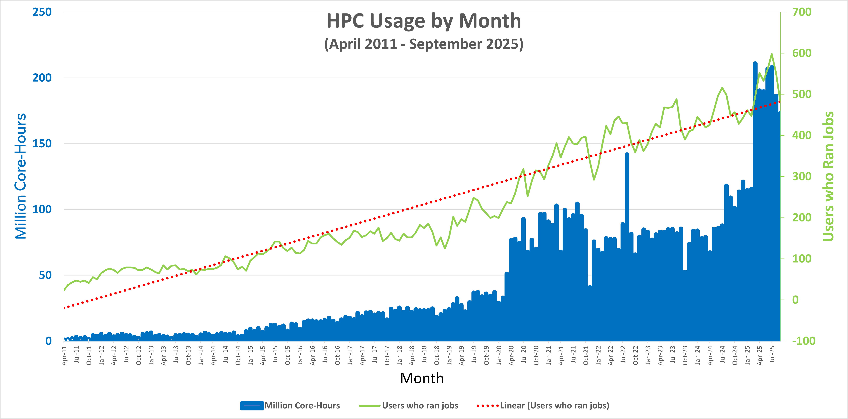
NSUF HPC Trajectory

Slide 4
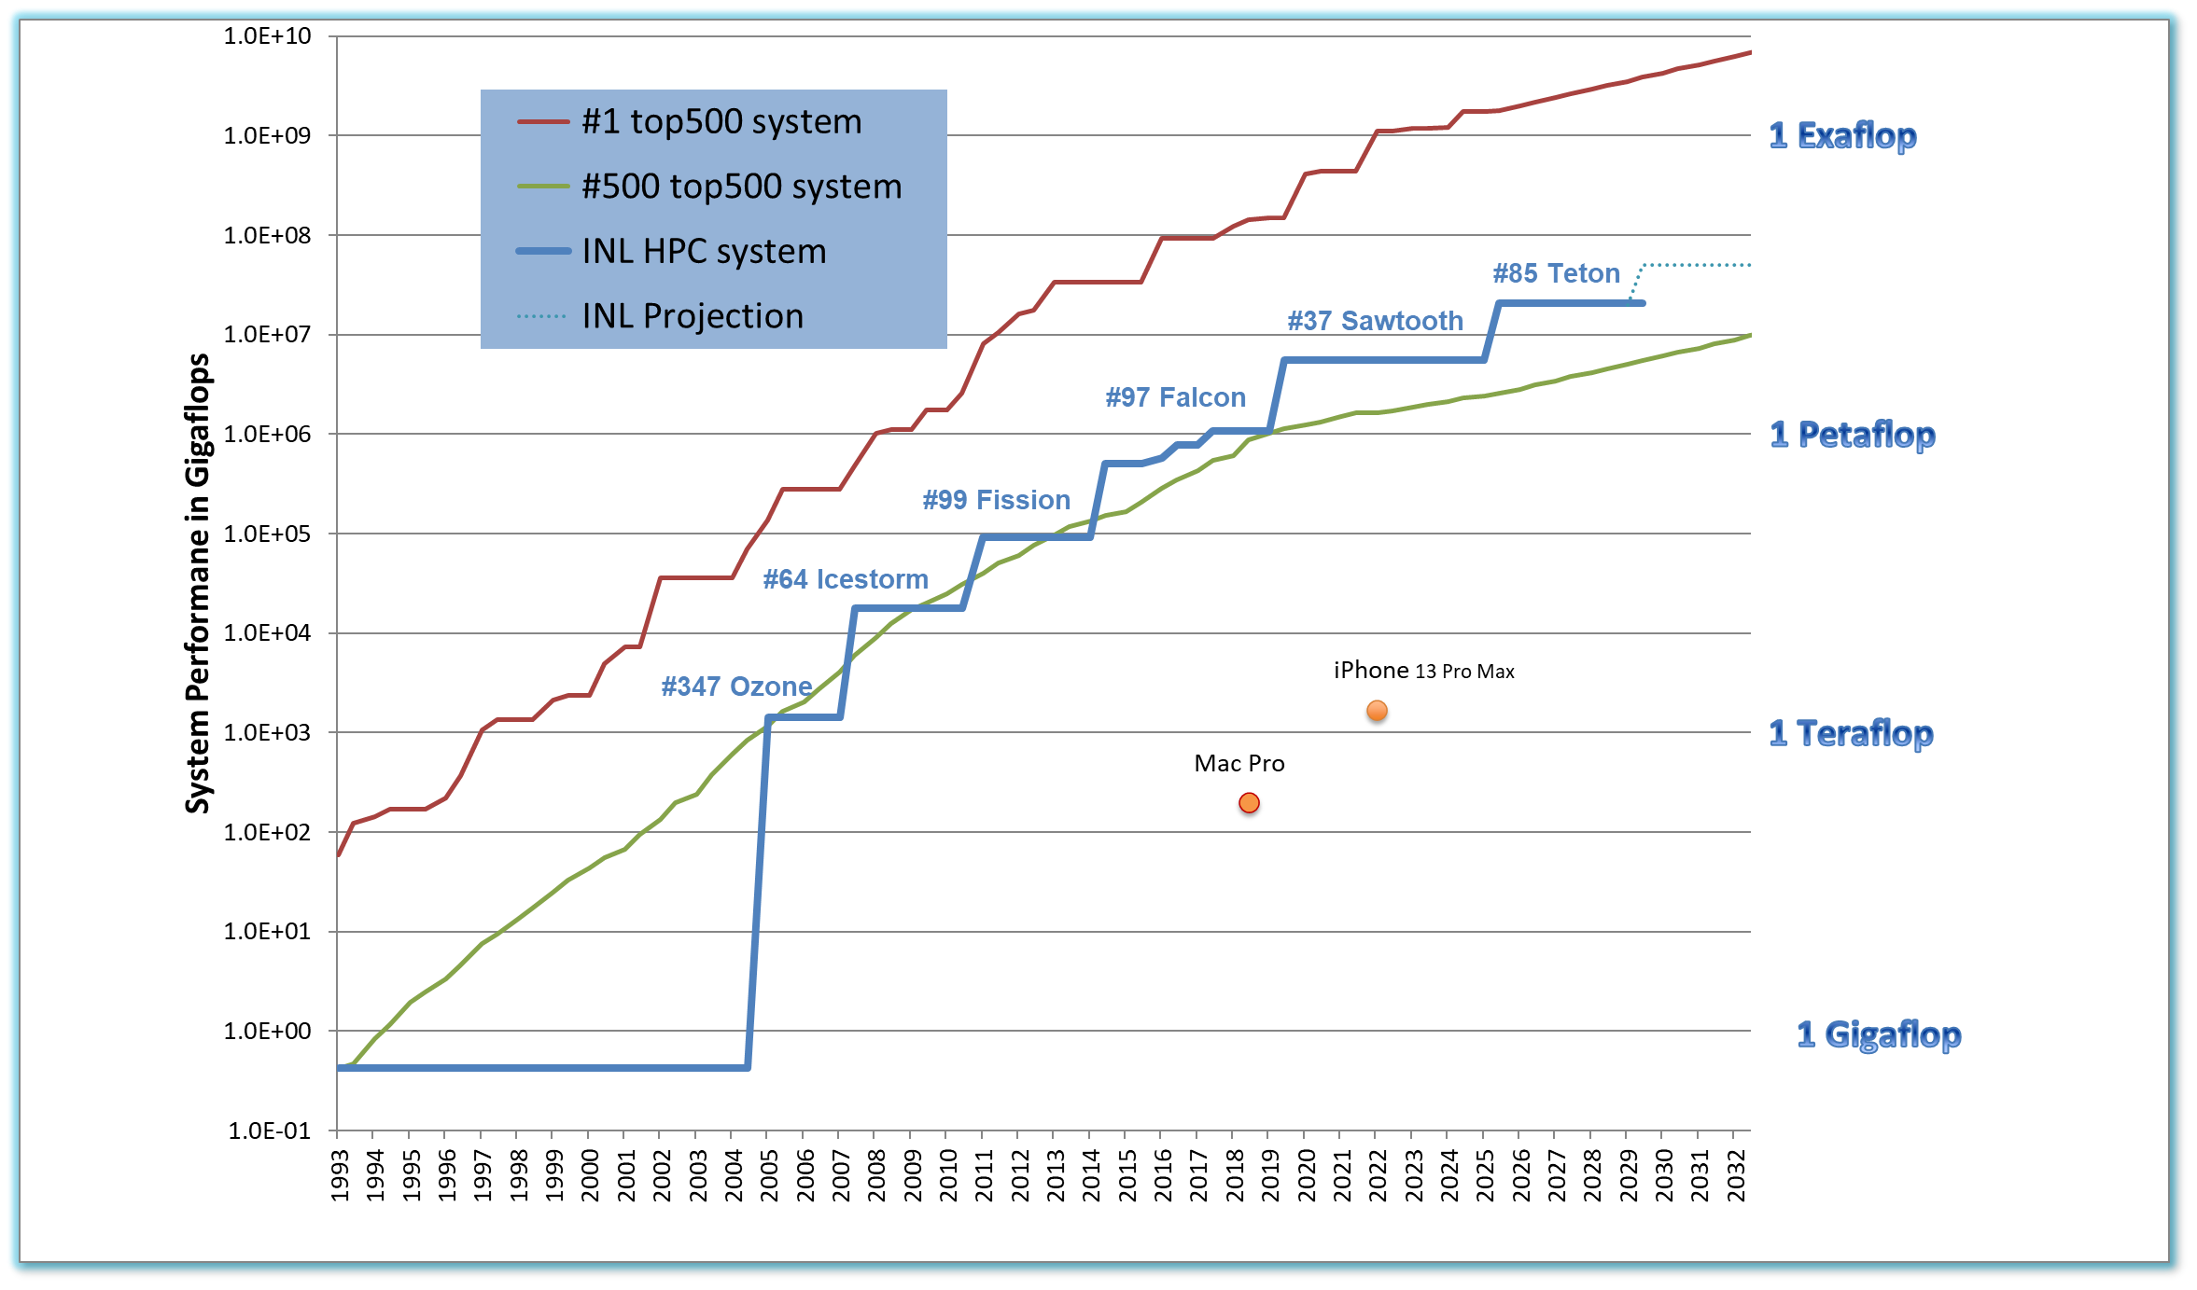
INL HPC Systems History
Other systems*:
2025-present WindRiver
2024-present Bitterroot
2021-present Viz
2020-present Hoodoo
2018-2025 Lemhi
201x Quark
201x Eos
201x Bechler
2005 Helios (Dell 6 racks)
2006 SGI 4700 Itanium 102 procs
2006 SGI 3700 FPGA
200x Orion, Merope, Mira, Wulf, Medusa, RELAP, HP, Lander
4

Slide 5
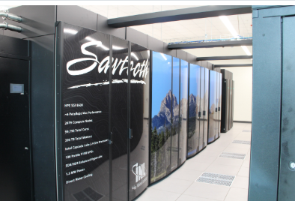
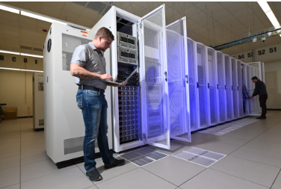
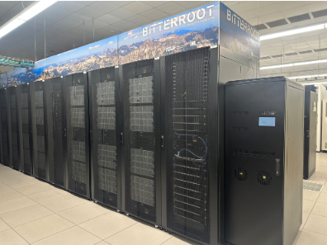
Systems in Production
SAWTOOTH
HOODOO
BITTERROOT
Highlights
Made public to users on March 17, 2020
99,792-core HPE SGI 8600
394.875 TB total memory
Infiniband EDR Enhanced Hypercube
Rocky Linux 8.10 (Green Obsidian) operating system
LINPACK: 5.60 Petaflops
Highlights
Made public to users on February 2, 2021
928-core Lambda Hyperplane A100
23.5 TB total memory
Infiniband HDR Fat-Tree
92 NVIDIA A100 40 GB GPUs
Rocky Linux 8.10 (Green Obsidian) operating system
LINPACK: 0.86 Petaflops
Highlights
Made public to users on June 17, 2024
43,008-core Dell CTS-2
90.0 TB total memory
OmniPath Fat-Tree
Rocky Linux 8.10 (Green Obsidian) operating system
LINPACK: 2.00 Petaflops
For More Details on Compute Clusters, go to:
https://hpcweb.hpc.inl.gov/hardware/ (internal)
https://hpcweb.hpcondemand.inl.gov/hardware/ (external)
INL/MIS-26-90817
Notes:
Presenter: Matt Anderson

Slide 6
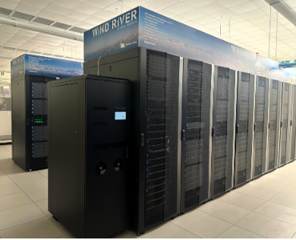
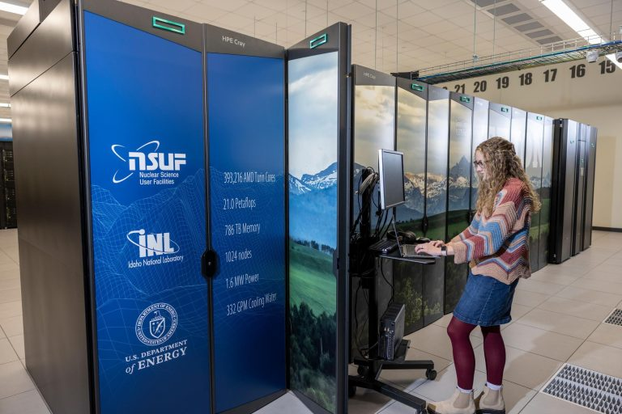
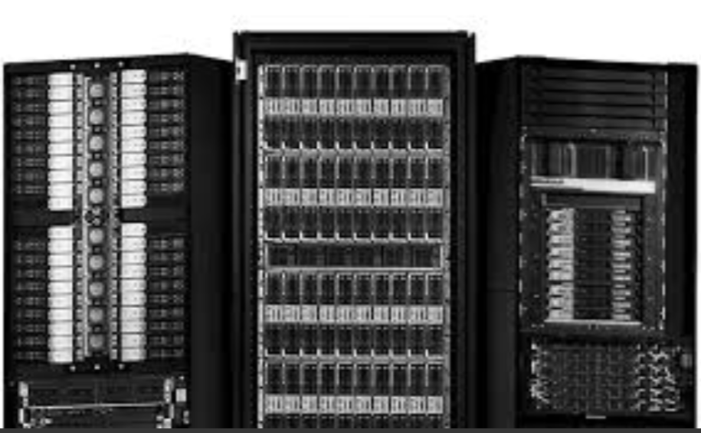
Systems in Production continued
WINDRIVER
TETON
GPU Cluster – ARCO
Highlights
Made public to users on
February 14, 2025
94,416-core Dell CTS-2
210.75 TB total memory
OmniPath Fat-Tree
Rocky Linux 8.10 (Green Obsidian) operating system
LINPACK: 6.00 Petaflops
Highlights
Made public to users on
February 16, 2026
393,216-core HPE Cray EX 4000
768.0 TB total memory
Slingshot Dragonfly
Red Hat Enterprise Linux 9.6 (Plow) operating system
LINPACK: 21.0 Petaflops
Highlights
Expected delivery July 2026
160 H200 GPUs; 20 nodes
400 Gbps Infiniband
1.5 TB/node memory
This system will serve as the replacement to Hoodoo
For More Details on Compute Clusters, go to:
https://hpcweb.hpc.inl.gov/hardware/ (internal)
https://hpcweb.hpcondemand.inl.gov/hardware/ (external)
Notes:
Presenter: Matt Anderson

Slide 7
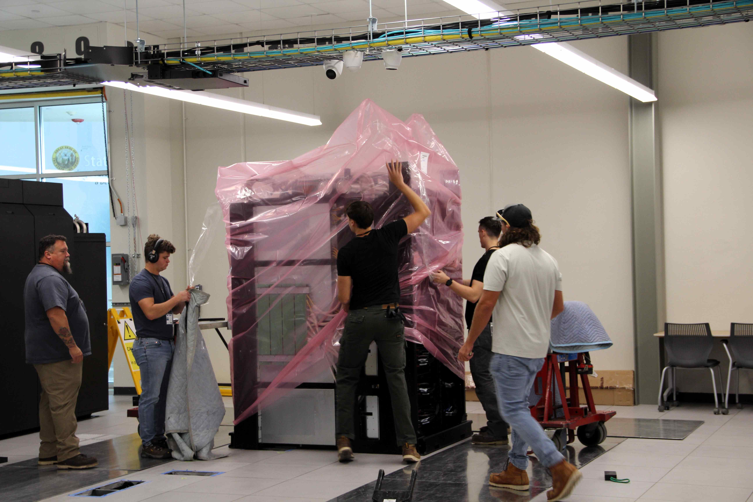
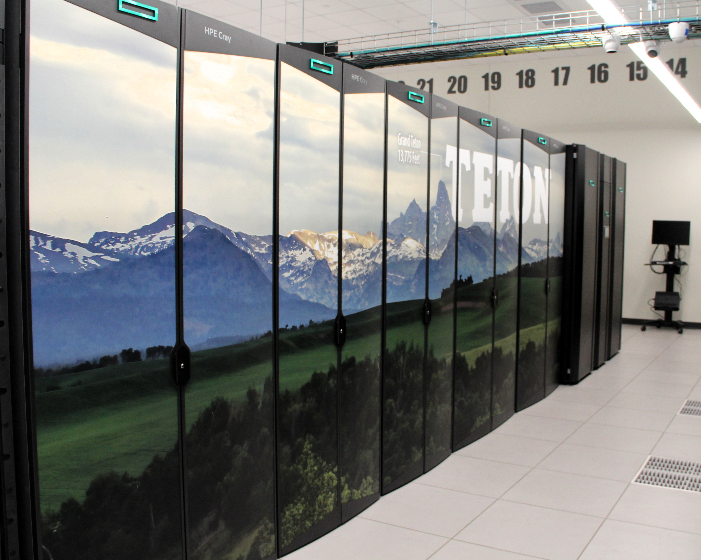
Teton – newest flagship system
393,216 AMD 9965 Turin cores
20.7 Petaflop/s performance
1024 nodes, 384 cores/node
768 GB/node, 2 GB/core
1.6 MW power
#85 in the Top500 List November 2025
200 Gb/s Slingshot 11 dragonfly network
800 Gb/s connection to INL storage systems
100% water cooled compute racks
Released to users in production on 16 Feb 2026
Since entering production (75 days of service), Teton has provided 533.8 million core-hours

Slide 8
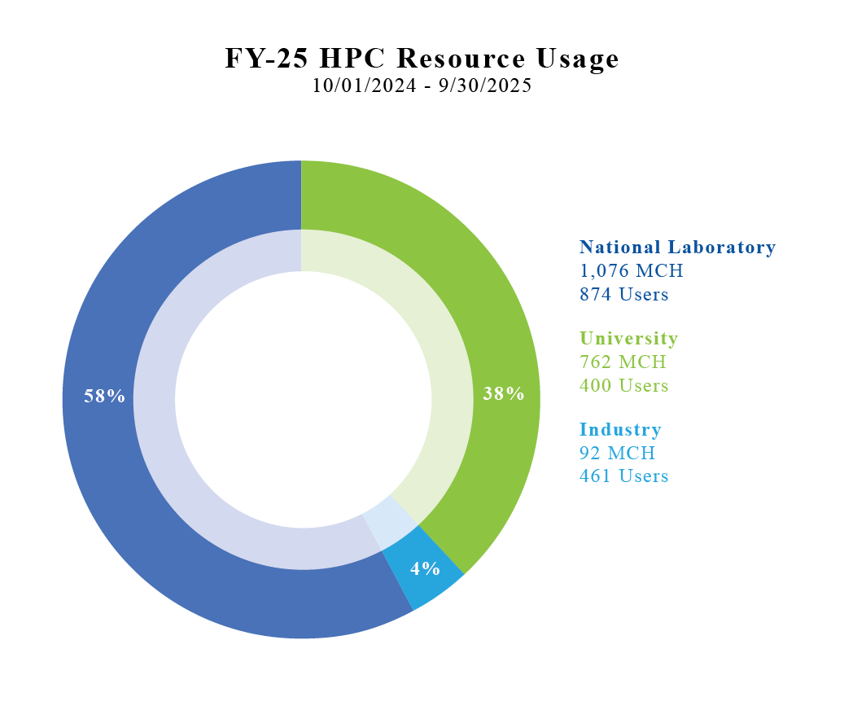
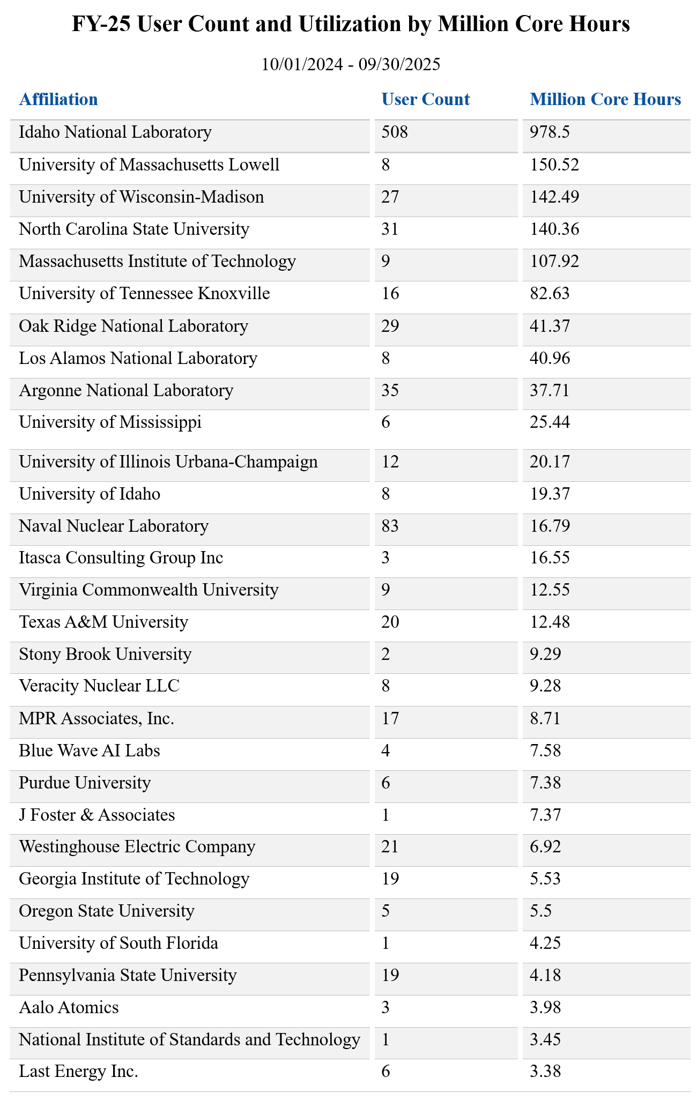
HPC User Statistics
In FY-25:
  Total number of users: 1,023
  Million Core-Hours Delivered: 1,930
Notes:
HPC delivered 939 million core hours and 3,732,911 computational jobs from 1,320 users with 86% of those jobs directly supporting nuclear energy research
First image (HPC Utilization for FY-23): The percentages shown are the distribution of core-hours used by each user group type.

Slide 9
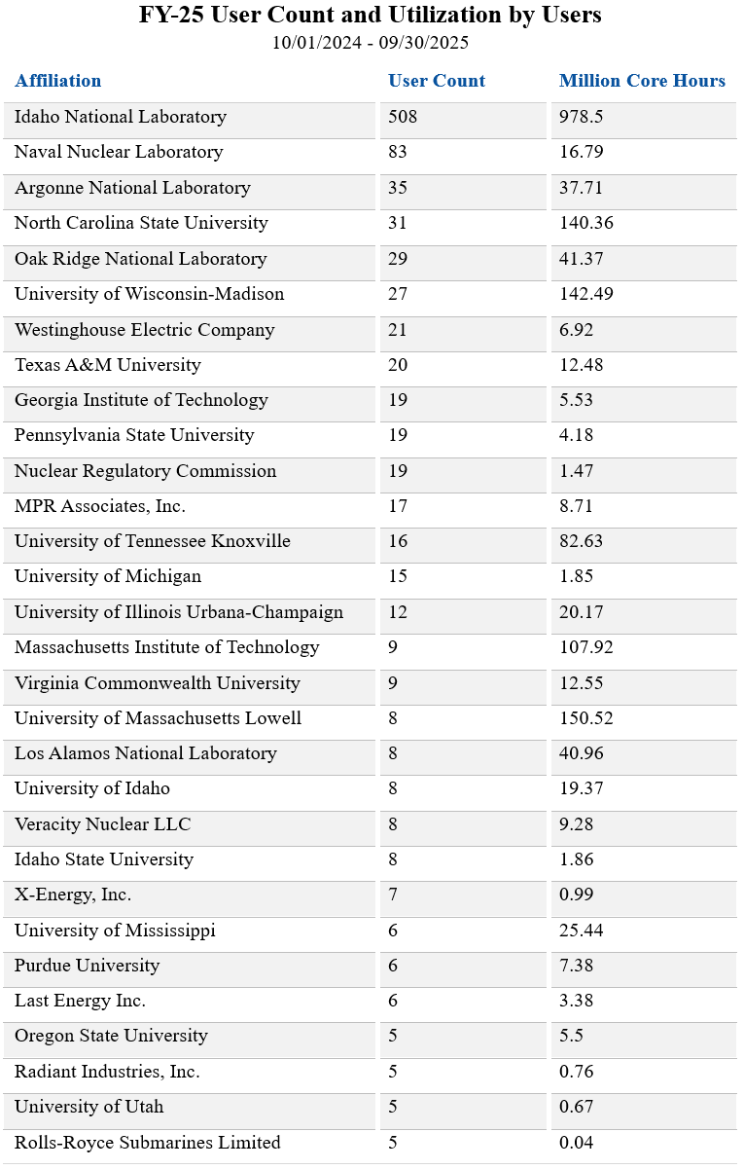
Institutions with largest number of users
HPC User Group Meetings: 4 per year
Scheduler trainings: 1 per year
Trainings supported:
Fiscal Year | # of Trainings
FY-23 | 4
FY-24 | 16
FY-25 | 11
FY-26 to-date | 8

Slide 10
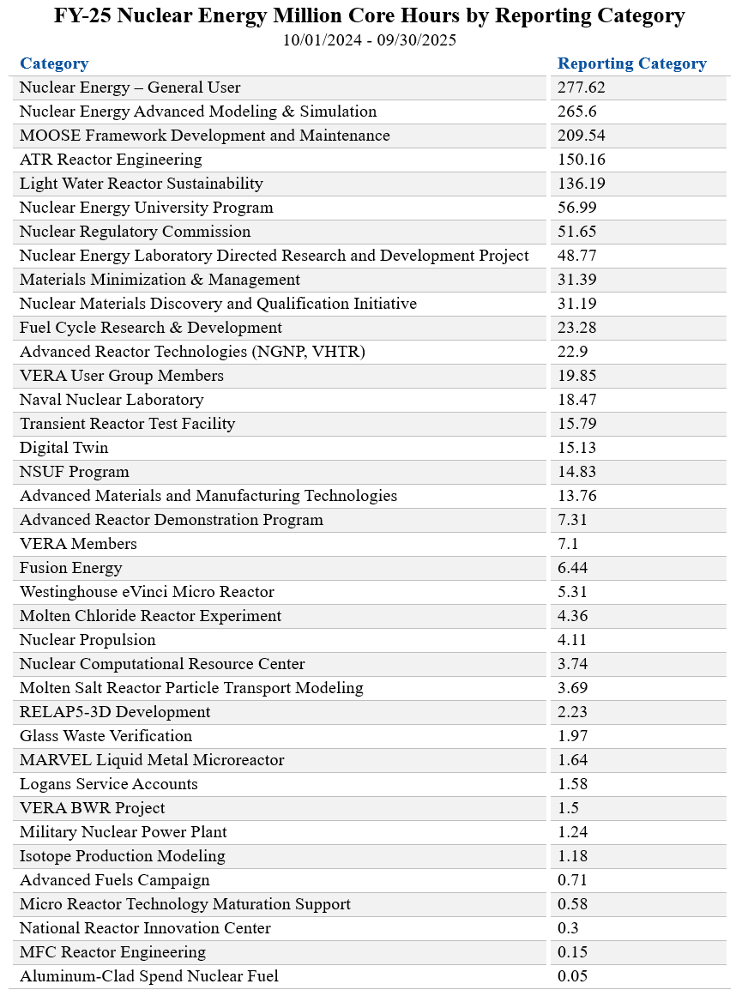
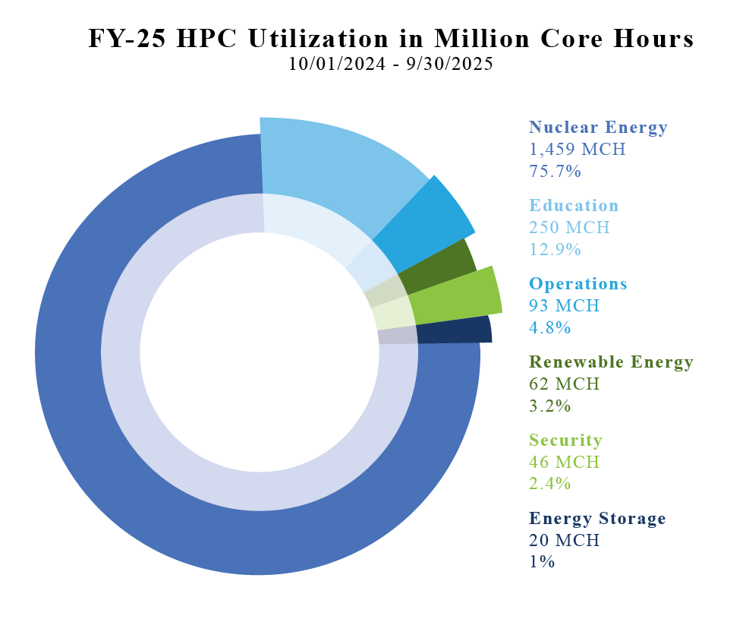
HPC Usage Breakdown

Slide 11
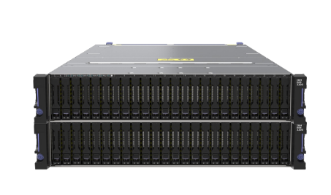
Storage Upgrade
New IBM Storage Scale System 6000 upgrade
This upgrade added ~2x throughput
Useable capacity ~600 TB
Placed in production 27 April 2026
System Features:
4U Enclosure
Up to 48 x 2.5” drives
Dual AMD EPYC Genoa 48 cores per controller
768 GB – 1.5 TB Memory
24 or 48 x NVMe / FCM (PCIe Gen 4 drives)
From 96 TB to 2.6 PBe Usable Capacity
Supports 24 or 48 NVMe SSDs
3.84 TB
7.68 TB
15.36 TB
30.74 TB
Notes:
Presenter: Shane Grover

Slide 12
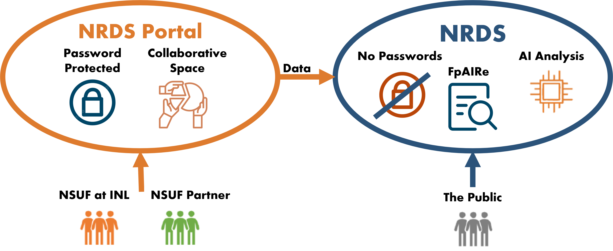
Nuclear Research Data System https://nrds.inl.gov https://nrds-portal.inl.gov
Uploads to NRDS-Portal (8 May 2026):
FY-24 RTEs: 84%
FY-25 RTEs: 11%

Slide 13
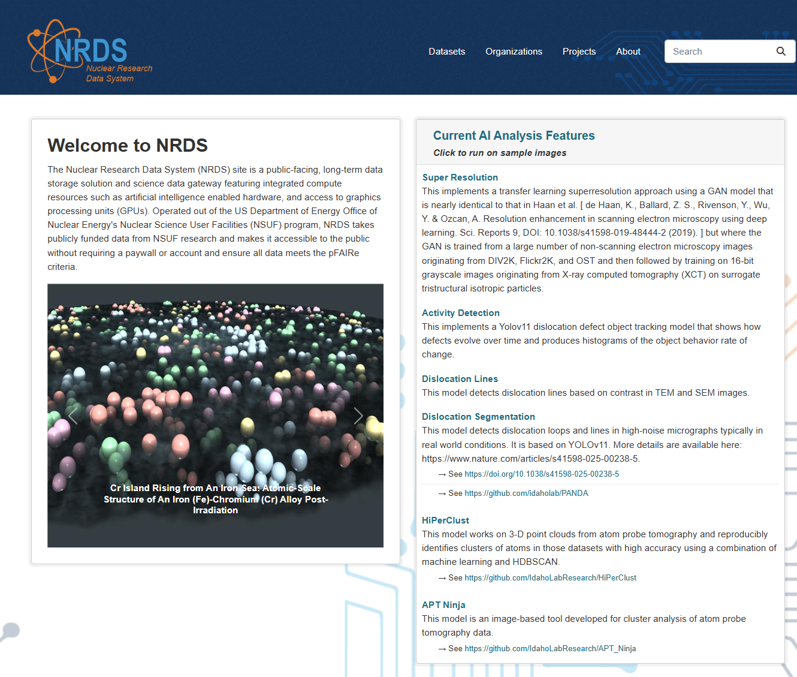
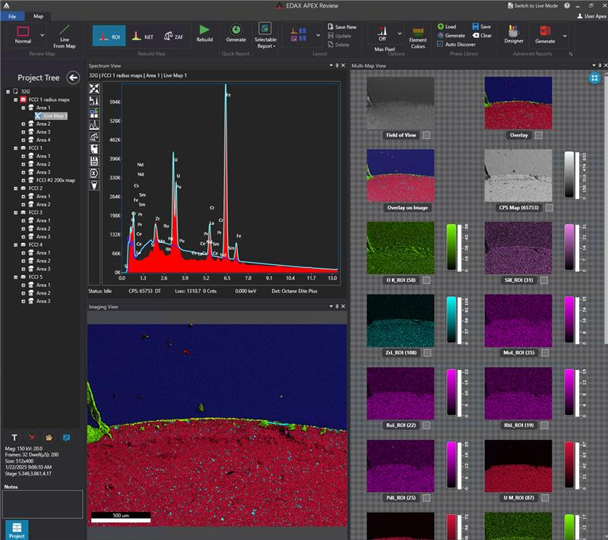
NRDS:

Slide 14
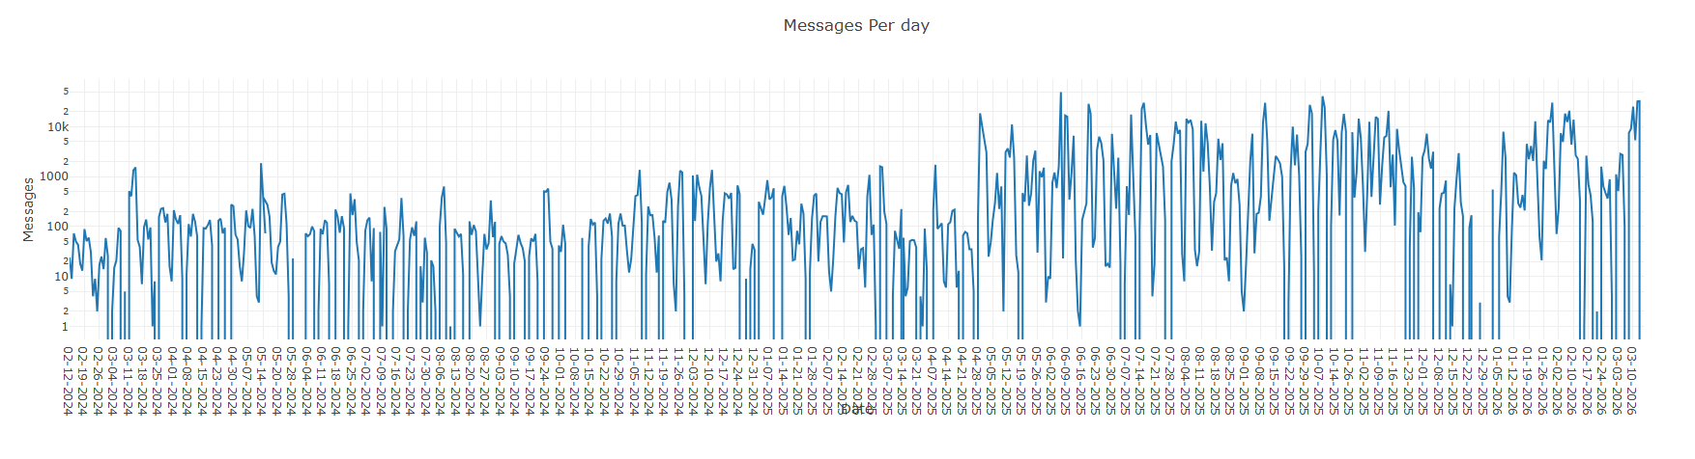
Over 30 On-Site Models Supported
Large Language Models (gemma-4-26B-A4B-it, Mistral)
Multimodal models
Reasoning models
Vision Language Models
OCR
Visual Retrievers

Slide 15

What is data gravity?
Data gravity = the tendency of large, complex, or sensitive datasets to attract compute, models, workflows, and other datasets to themselves.
Traditional High Performance Computing: move data to compute
Scientific AI: compute needs to be co-located with the data
AI doesn’t just consume data—it keeps coming back for more.
Why? AI increases reuse -> more reads than writes
Training favors locality
Autonomous labs require near-real-time loops

Slide 16
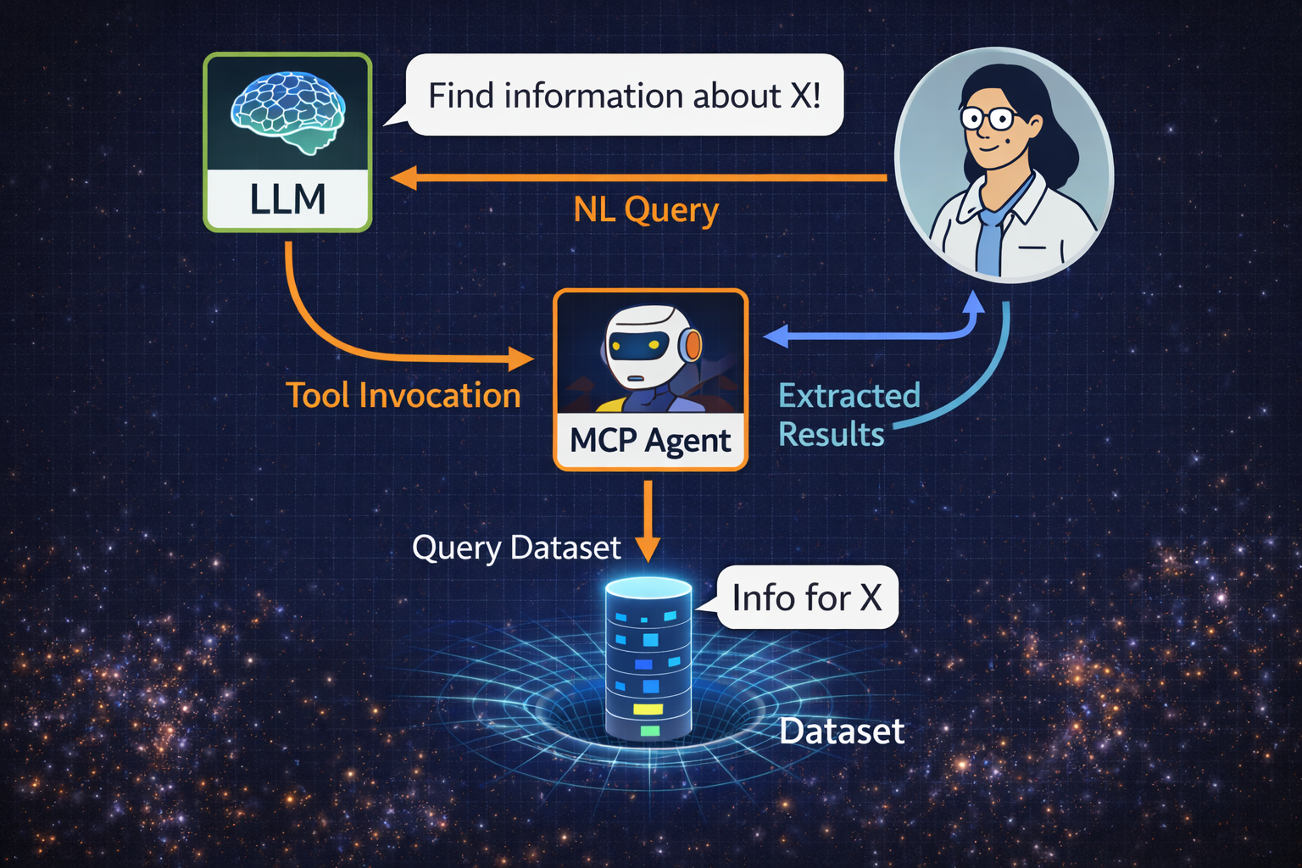
The LLM Reasons, the Agent Acts
Agents are the new infrastructure!
Agents limit hallucination by returning evidence
Fewer confident guesses and more supported statements

Slide 17
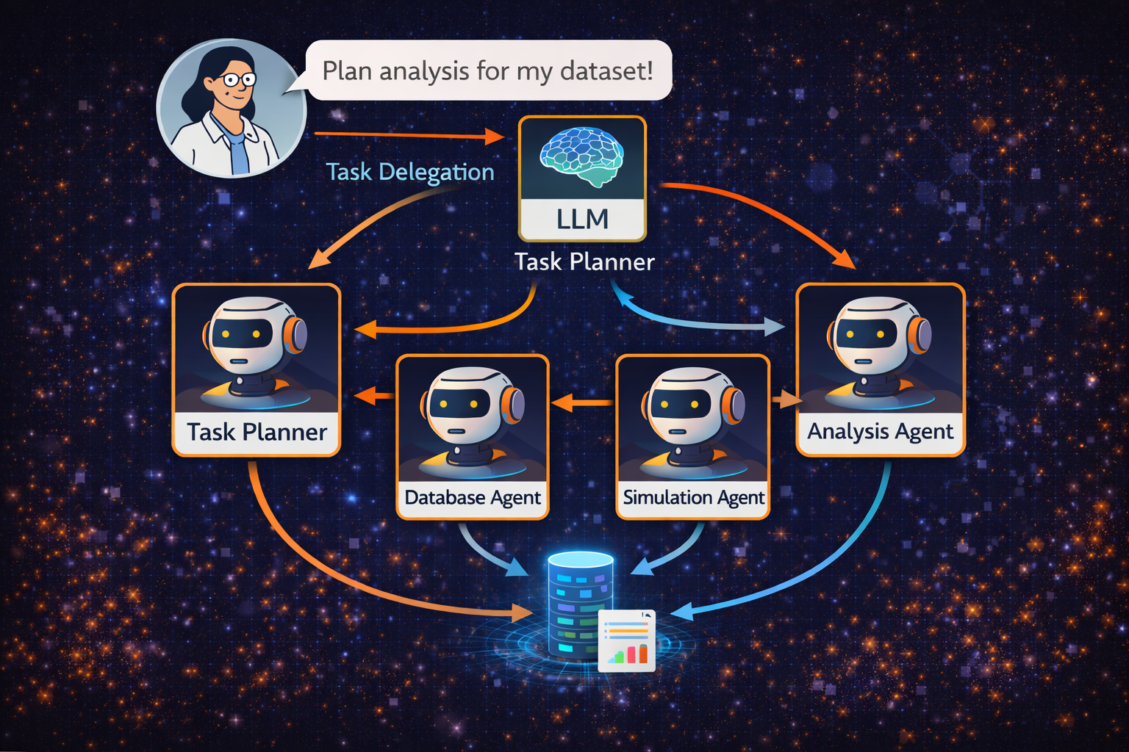
This is how we move intelligence, not terabytes.
The scientist expresses intent.
The LLM decomposes the task.
Agents execute near the data.
The LLM synthesizes the result.

Slide 18
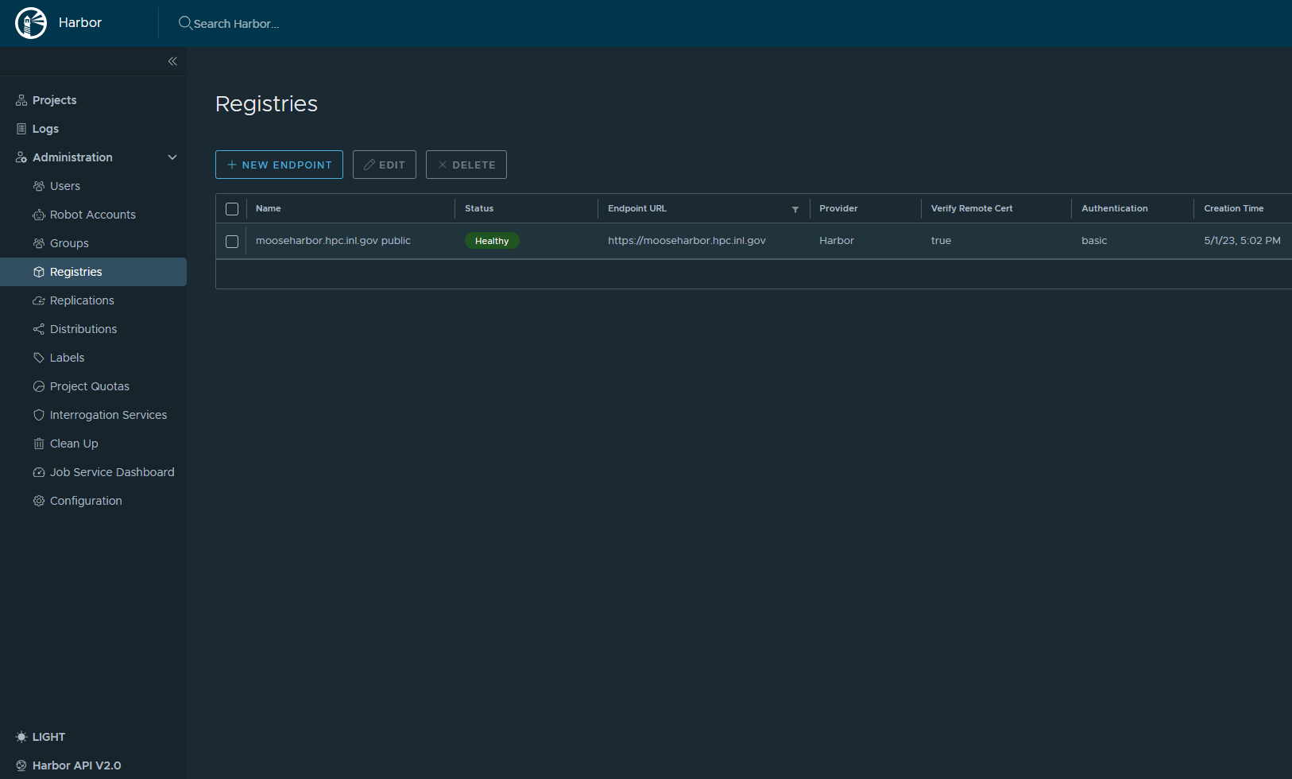
Container Registry: harbor.hpc.inl.gov

Slide 19
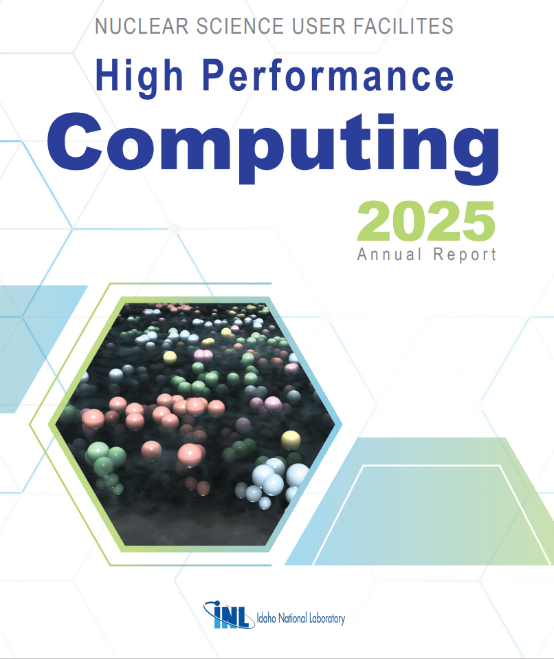
Annual User Report
https://hpcweb.hpc.inl.gov/home/about
Hundred’s of user report
Summary of major FY25 accomplishments
The figure shows the atomic-scale structure of an Iron (Fe)-Chromium (Cr) alloy post-irradiation. The image contrasts Fe atoms in the black cloud with Cr atoms represented as vibrant spheres, each hue indicating the specific cluster to which the Cr atom belongs. Captured through atom probe tomography (APT), this snapshot zooms into a 3-nanometer-thick slice from a sample measuring roughly 80 × 80 × 200 nanometers. The slice encompasses 447,418 atoms, among which approximately 54,000 are Cr atoms. The Fe-Cr alloy, irradiated to 1.8 displacements per atom (dpa) at 290 degrees Celsius at Idaho National Laboratory’s Advanced Test Reactor

Slide 20
Questions

