Slide 1

5-12-26
In-Situ study of interface under irradiation and deformation
Wei-Ying Chen, Jiaxuan Li, Sumit Bhattacharya , Argonne National Laboratory
This work was supported by the U.S. Department of Energy, Office of Nuclear Energy under DOE Idaho Operations Office Contract DE-AC07- 051D14517 as part of the Nuclear Science User Facilities.

Slide 2
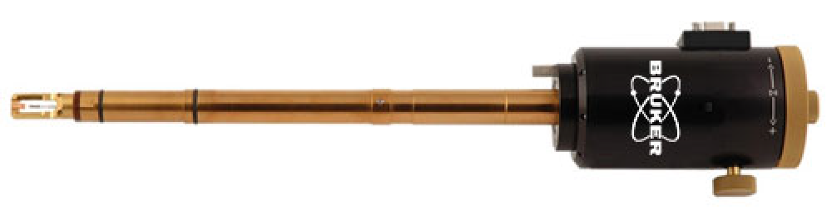
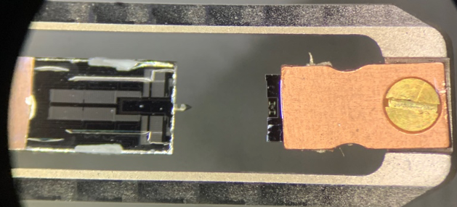
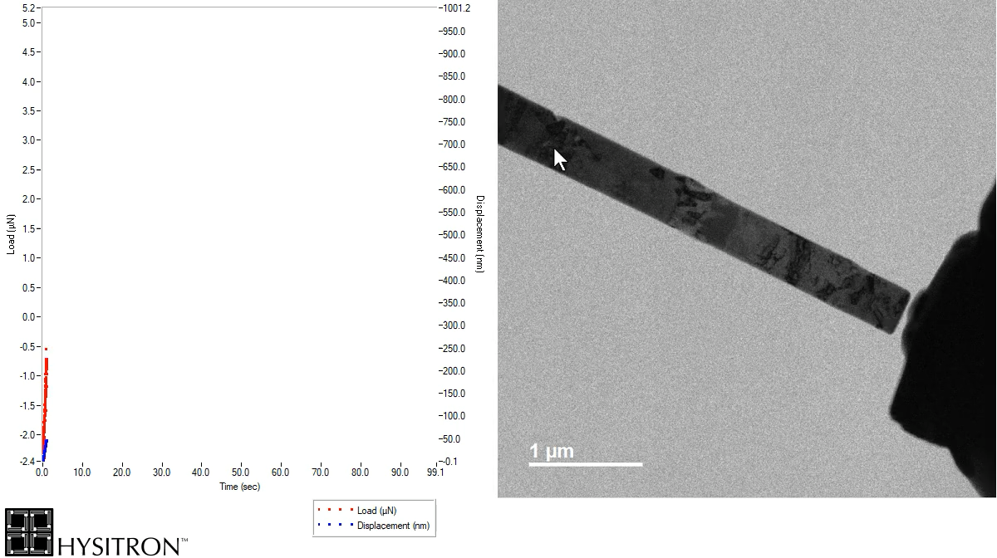
Project Description/Goals
Bruker PI95 holder
A specialized TEM holder designed for in-situ nanomechanical testing It allows for quantitative, direct-observation experiments such as compression, tension, and bending.
Motivation
How stress condition affects microstructural evolution under irradiation?
How “concurrent” irradiation affects the stress/strain behavior?
Scope
Establish the workflow for performing experiment using PI95 holders.
Cautions
Sample preparation
Sample loading
Experiments (with and without in-situ ion irradiation)
Sample unloading procedure
Notes:
Performed tasks up-to-date
Nanopillar experiments with multilayer materials and high entropy nanotwin materials with concurrent ion irradiation
Literature reviewed various types of viable experiments using PI95 holders
Drafted operation procedure for in-situ irradiation-deformation experiments
Drafted procedure for preparing nanopillar samples

Slide 3
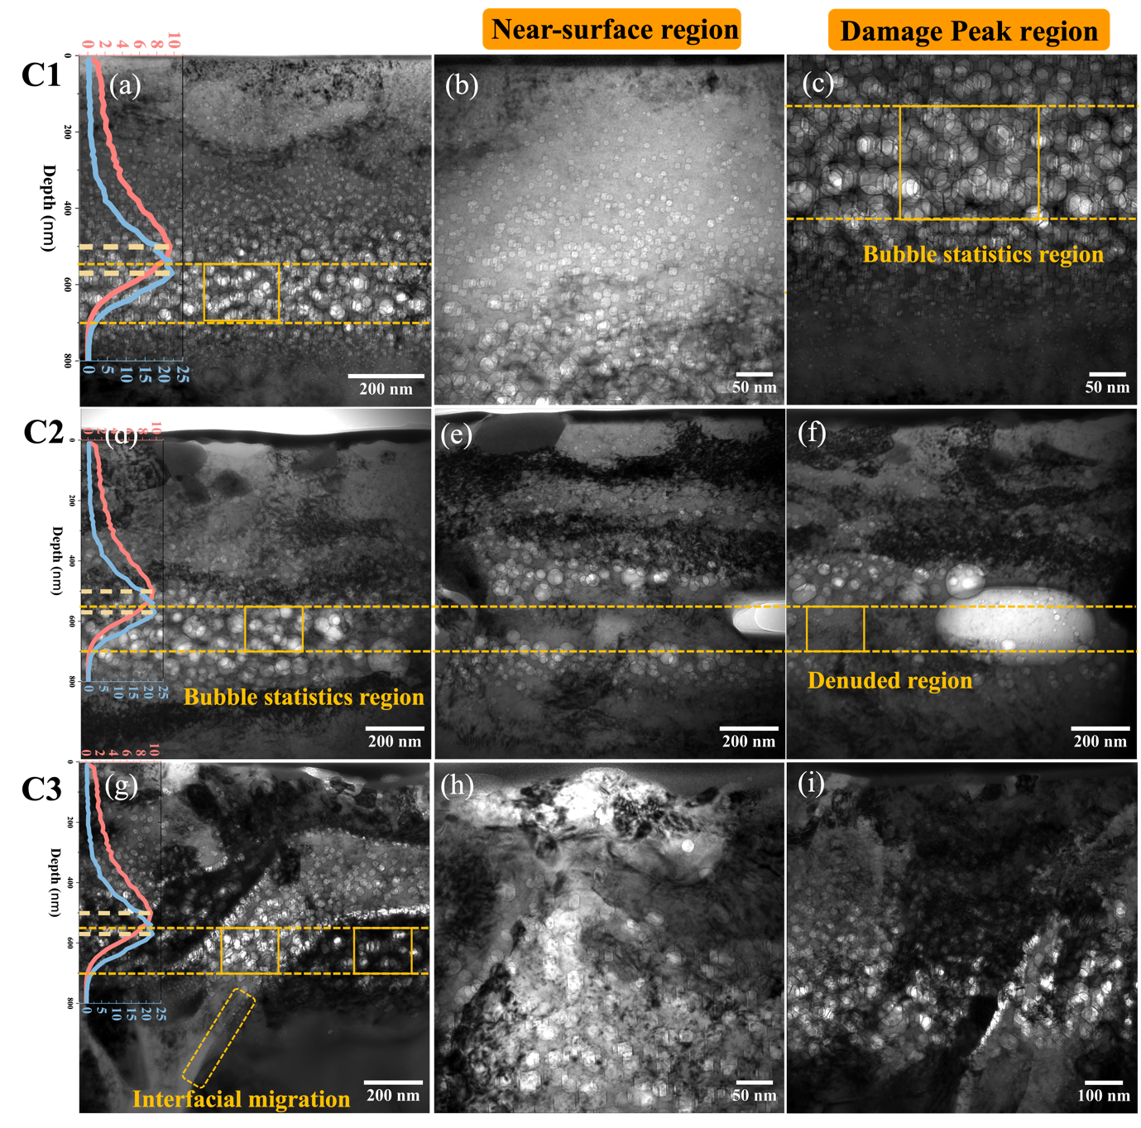
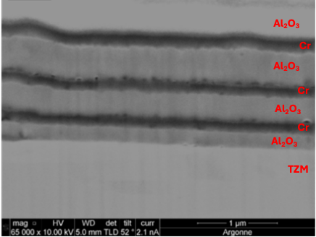
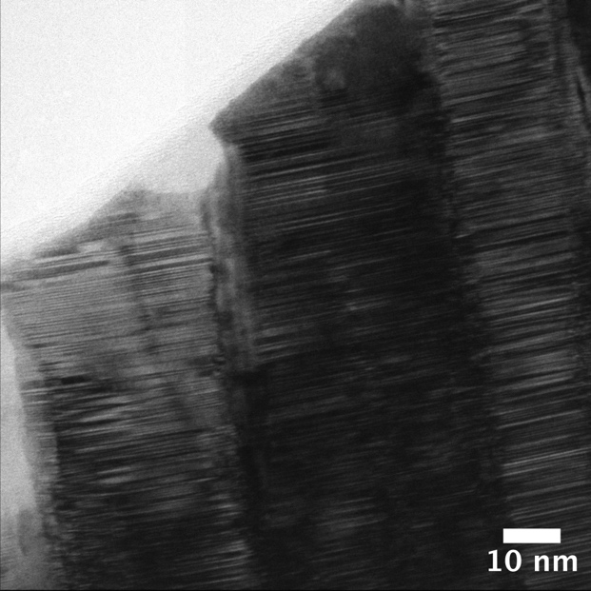
Experiments and Materials
He-implanted HEA
Al/Alumina multilayer coating
Additively manufactured HEA pre-irradiated with He ions
Nano-twined HEA
Multilayer coating
Nano-twined HEA

Slide 4
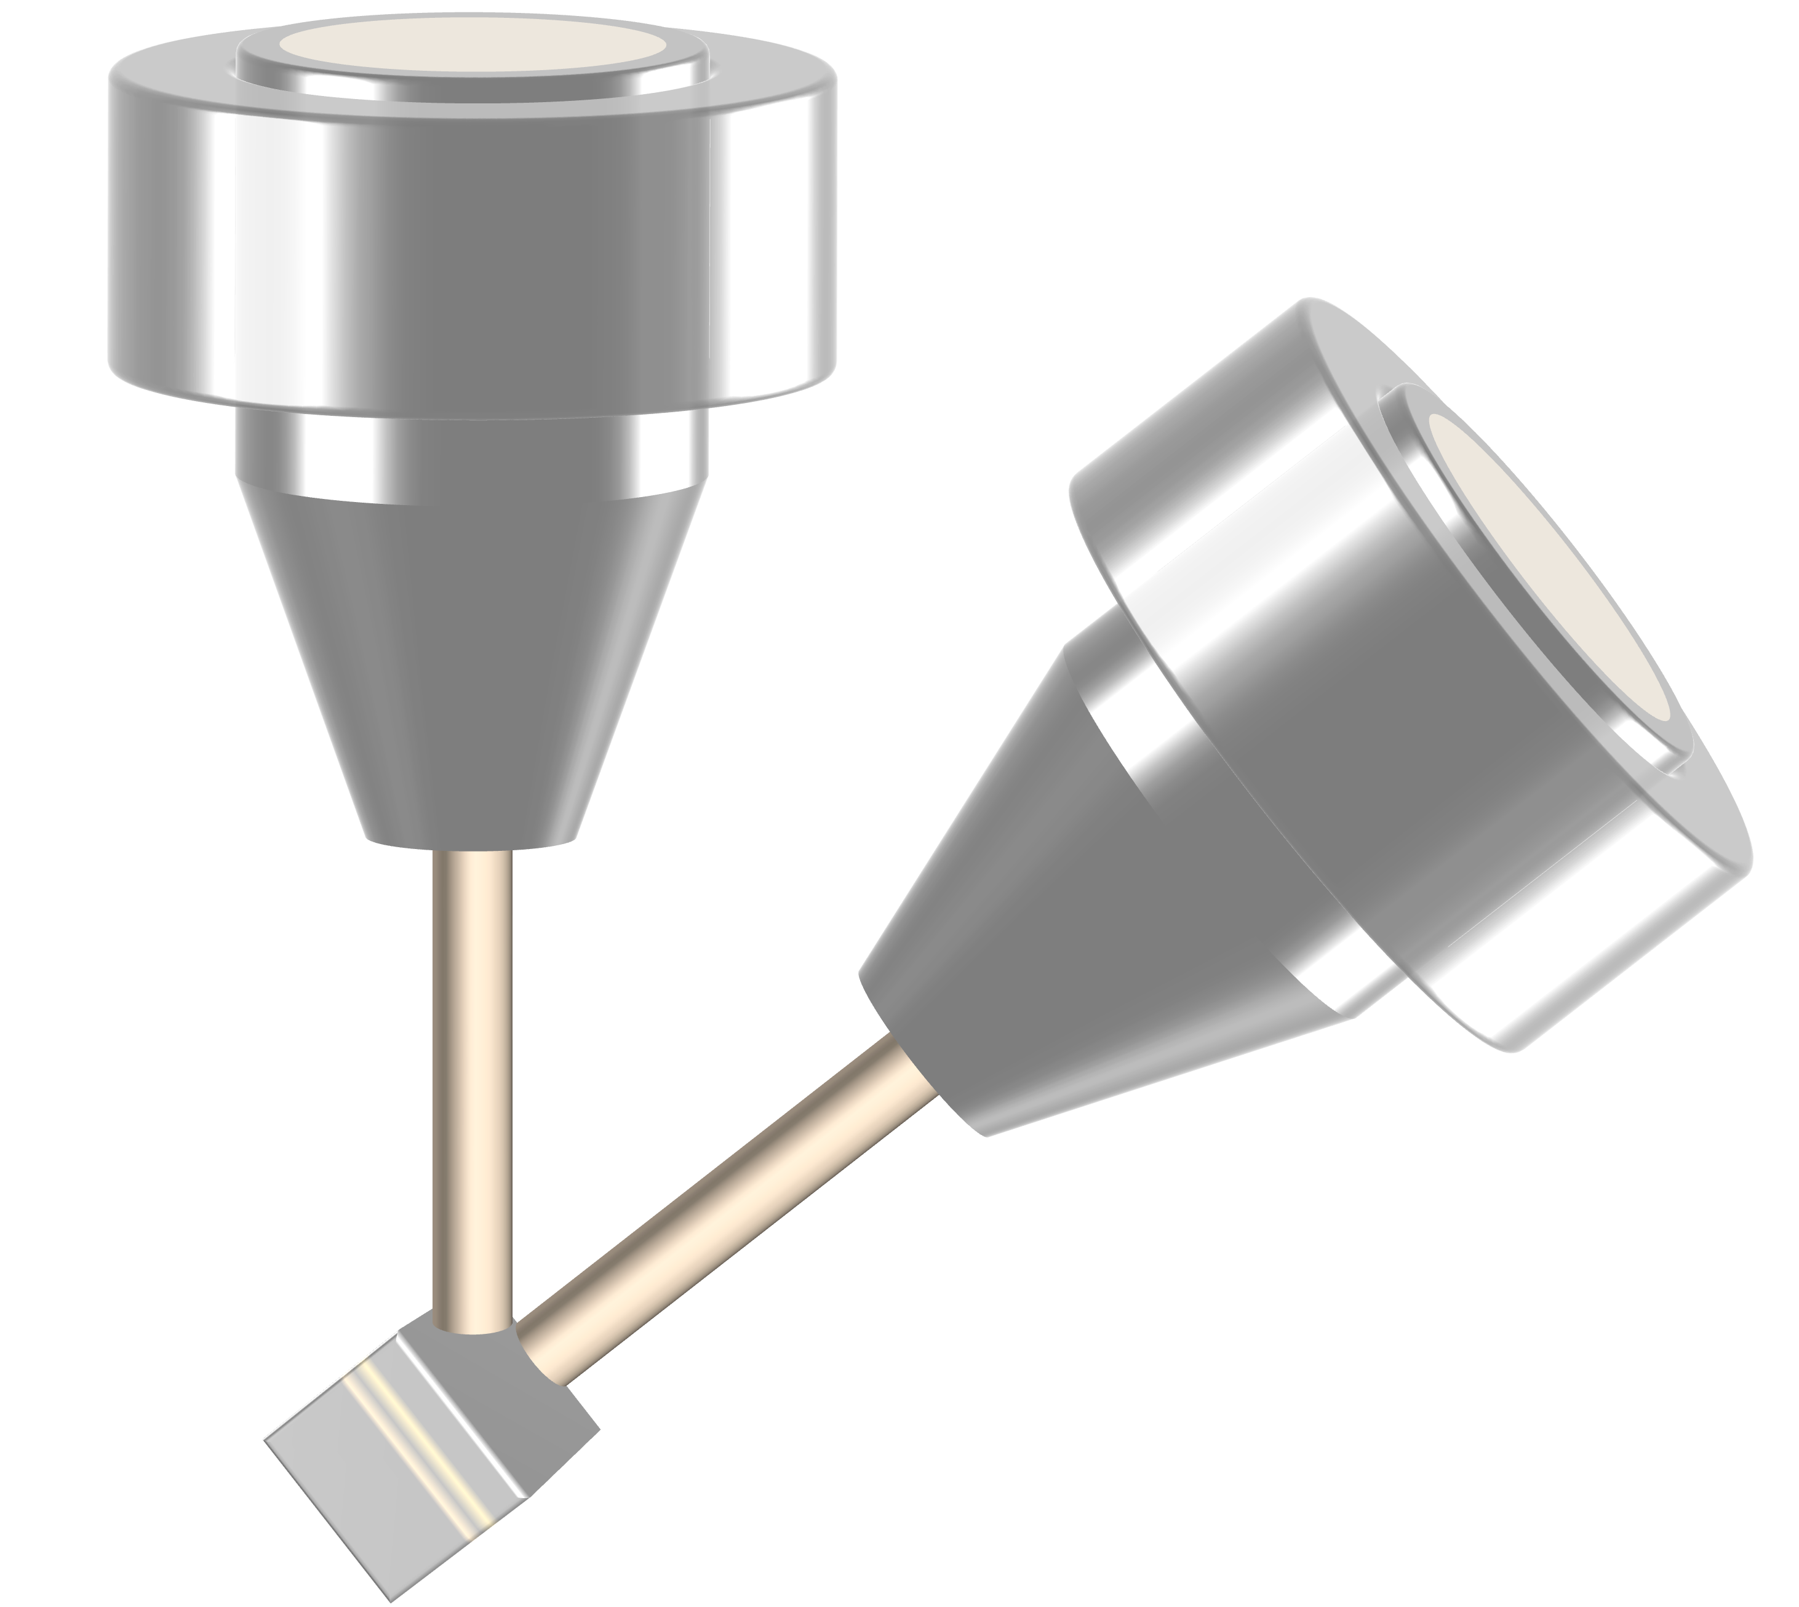
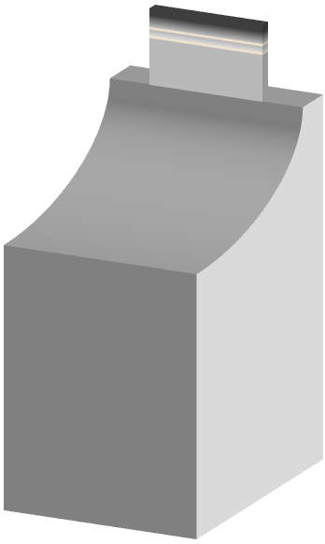
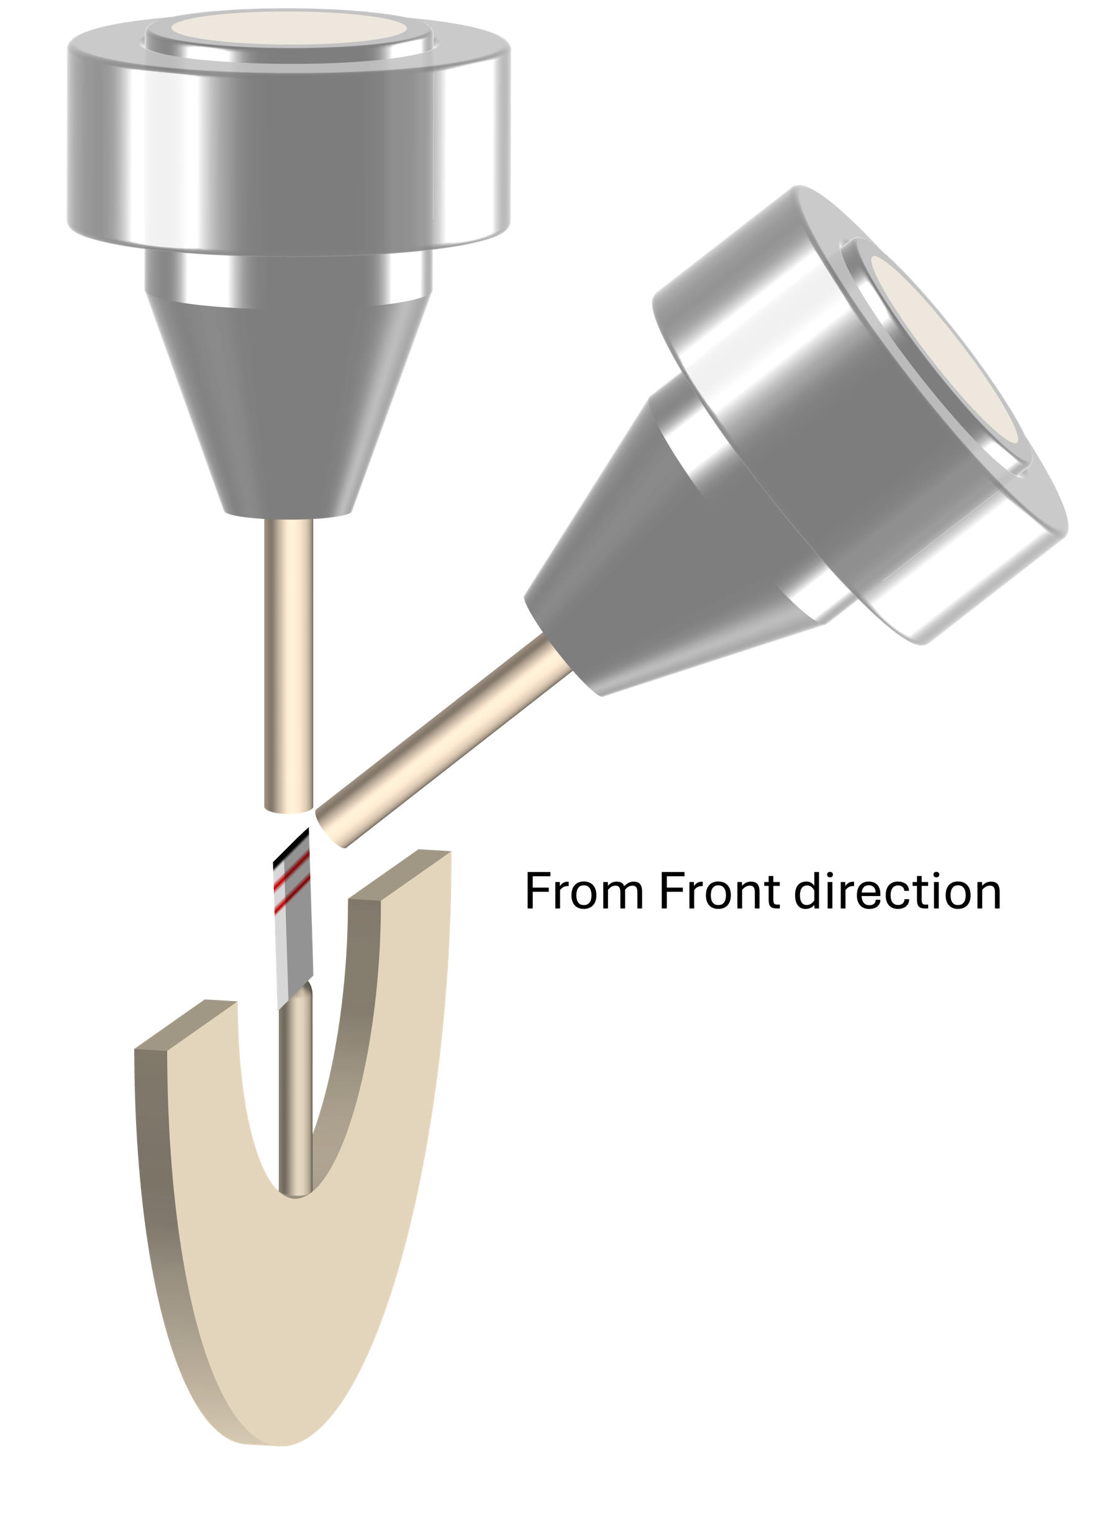
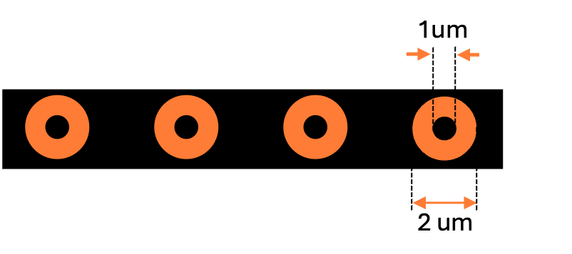
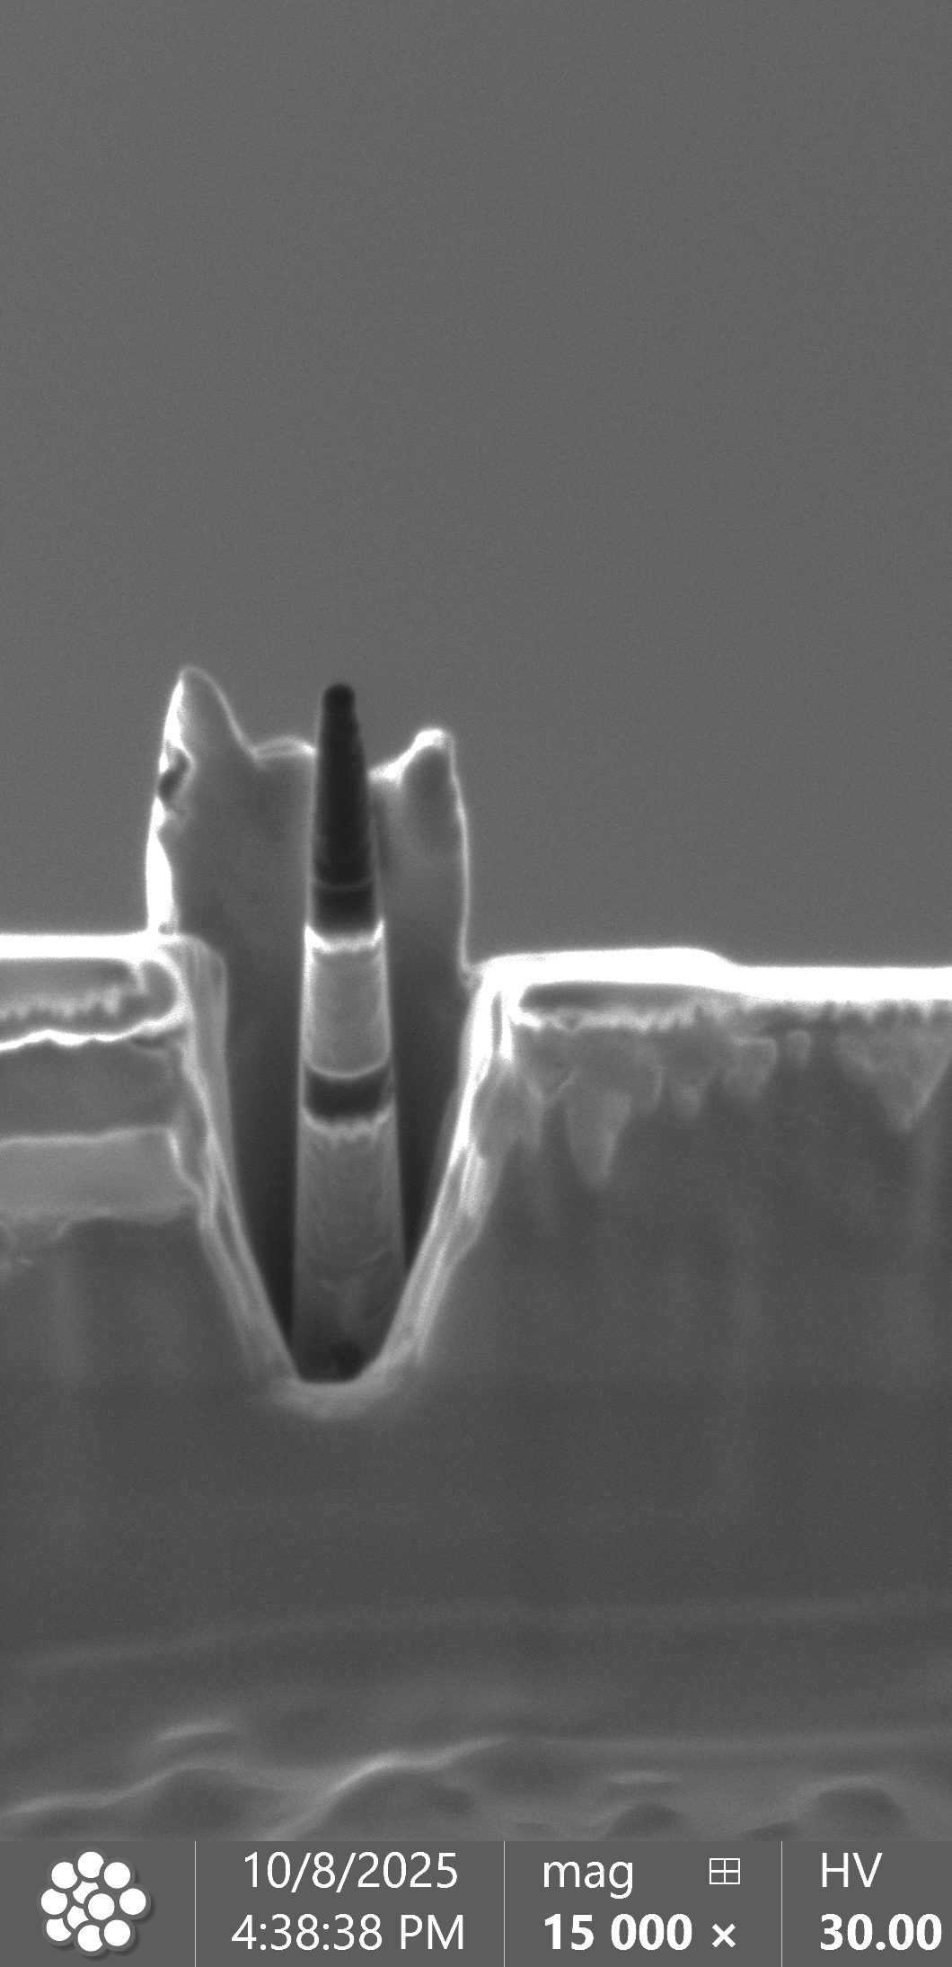
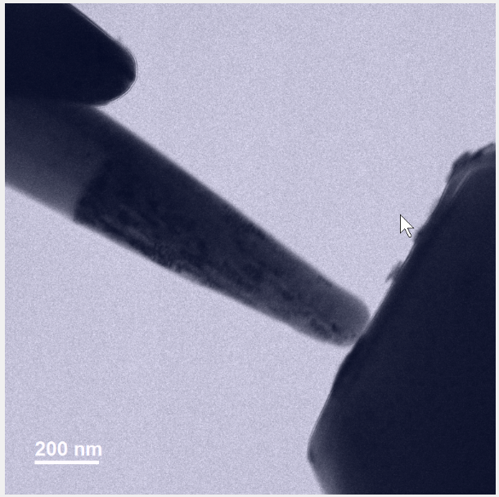
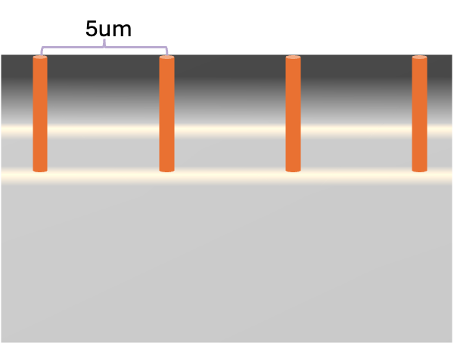
Experiments with Al/Alumina multilayer coating materials
The first step is to establish the FIB workflow to create nanopillar samples with desired orientation.
Prepare lamella
Al₂o₃
Cr
Side view

Slide 5
Experiments with Al/Alumina multilayer coating materials
After 5 dpa at RT
No irradiation
Samples dose not fracture at the interface for both irradiated and unirradiated conditions
Hardening is not significant
Size effect of brittle-to-ductile transition is likely observed
Concurrent irradiation during testing was performed but no significant effect was observed likely because the dose rate was too low.
The work was presented in “Engineering Y₂O₃/Cr Multilayer Barriers for FCCI Mitigation at High-Temperature Cladding Conditions in Fast Reactor Environment, Sumit Bhattacharya, Zhi-Gang Mei, Wei-Ying Chen, Abdellatif Yacout, MiNESconference, Cleveland, 2025.”

Slide 6
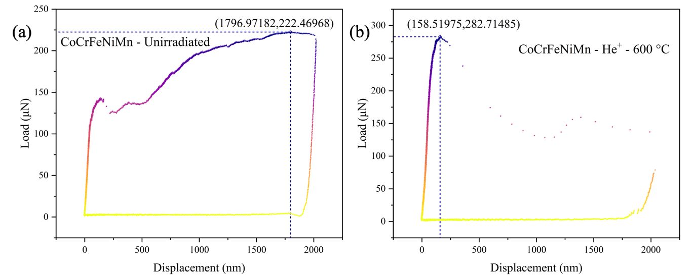
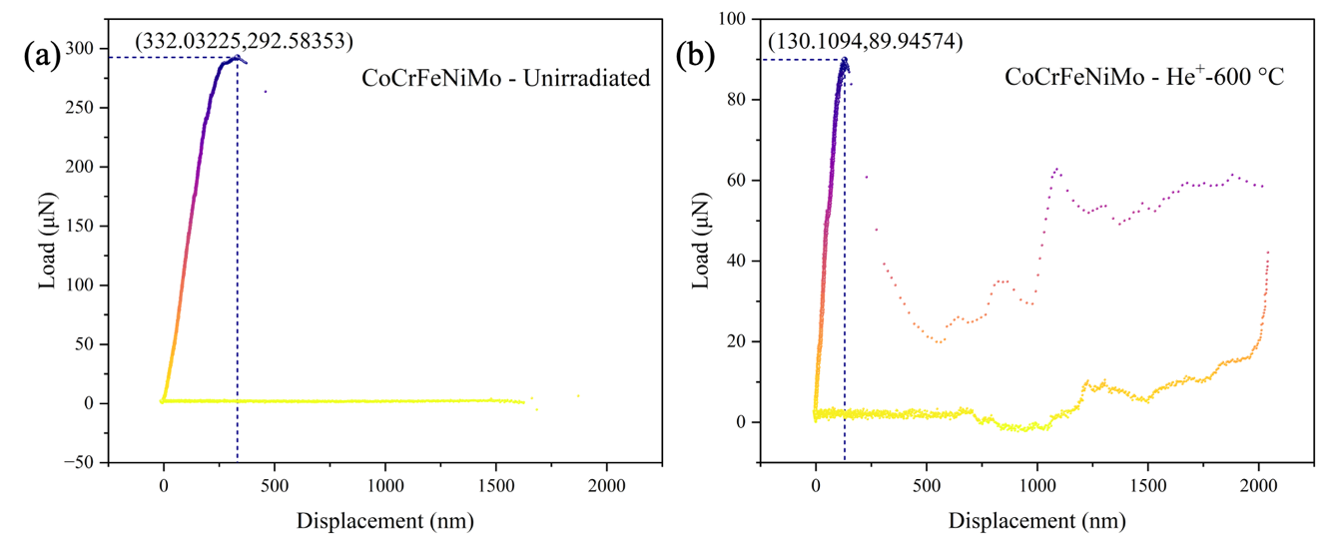
Experiments with He pre-injected HEA
Testing on pristine materials shows tensile property consistent with microstructure
Post irradiation testing indicates hardening and brittle behavior for all materials
Fracture did not occur at the depth with peak swelling
CoCrFeNi pre-irradiated with 200 keV He to 10 dpa at 600°C.
Single phase
Dual phase
Journal manuscript under preparation: “Helium bubble evolution and nanomechanical response in additively manufactured CoCrFeNi-based multi-principal element alloys under helium ion irradiation”

Slide 7
Experiments with Nano-twined HEA
No irradiation
Greater elongation during hold time is greater under concurrent ion irradiation
Potential removal of stacking-fault (nano-twin) under compression.
Concurrent irradiation shows softening effect.
Concurrent irradiation
Post irradiation

Slide 8
Conclusion
A workflow for using the PI95 holder in the IVEM has been established.
Preliminary investigations demonstrated the unique insights enabled by combining nanomechanical testing with in situ irradiation.
Current results indicate material softening under concurrent irradiation, providing knowledge that can be used to calibrate post-irradiation testing.

