Slide 2
Notes:
This study is part of an integrated research program. And we responsible for the ion irradiations and the TEM characterization of all kinds of microstructures and microchemics in alloy 800H. The ultimate goal is to emulate neutron-induced damage using ion irradiation, so that we can accelerate the licensing process for advanced nuclear reactors. The neutron samples were from the BOR-60 fast neutron reactor. And we conducted the dual ion irradiations in Michigan Ion Beam Lab. These experience were very impressive to me. Because it’s my first and second time to actually see and operate the entire irradiation in the beamlines.

Slide 3
Notes:
For the post-irradiation characterization, we did the studies on cavity, dislocation loop, precipitate, and segregation near grain boundary and cavity, from low dose to high dose. If these microstructures produced by ion irradiation are same as those produced by neutron, then we say that ion irradiation can simulate neutron irradiation. However, during the studies on cavities, we can simulate them at the beginning, but we couldn’t when the dose is high.

Slide 4
Notes:
We know that cavity formation contributes to swelling. Swelling is the ratio between the volume of cavities and the volume of original sample. By looking at the swelling plot on the right, the ion irradiation swelling matches neutrons up to 32 dpa, but it’s lower thereafter, when irradiated at high dose rate. So, what happened to the pre-existing cavities after 32 dpa?

Slide 5
Notes:
We know that the collision cascade could re-arrange all the atoms in its local region. What if the cascade hits around some pre-existing cavities? It would also re-arrange all the atoms, interstitials, and vacancies. So the vacancies could be dissolved and released back into the matrix, which would lead to the cavity shrinkage. However, given enough time before the next cascade hit, the vacancy being dissolved can get back into cavities. Therefore, there is a competition between the cascade-induced dissolution and vacancy back diffusion. With this idea, we conducted a low dose rate ion irradiation, which is the green curve in the swelling plot. And it follows the neutron swelling trends at high doses.

Slide 6
Notes:
So, to further validate this hypothesis, we wrote a NSUF RTE proposal. Using the in-situ ion irradiation capability in ANL, we can directly observe the cavity evolution. In this proposal, I served as a PI, with Dr. Xing Wang and Dr. Arthur Motta as co-PIs. And I really appreciate this opportunity to train myself from writing a proposal to real publications. And this research experience has become my favorite within all my PhD research.

Slide 7
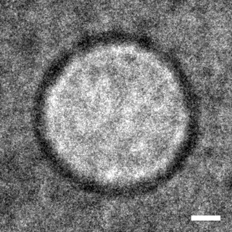
Notes:
As the ion irradiation damage is localized at the bulk sample surface, we only looked at the cavities within the yellow range, from 650 to 850 nm.
On the right shows an example of how the cavity evolve during the in-situ irradiation. And we tracked all the cavities shown in middle picture.

Slide 8
Notes:
This slide may be a little bit busy. Here shows all the micrographs that I took during the in-situ ion irradiations. We compared 8 samples prepared from the 32 dpa bulk sample and irradiated them to 1 additional dpa. Their dose rate varies from e-3 to e-5 dpa/s, and the temperature is at either 480C or room temperature.
The left group shows the 480C. At highest dose rate, no matter the cavities are small or large, they all shrink after 1 dpa. However, at lowest dose rate, no matter the cavities are small or large, their size remain unchanged.
The right group shows the room temperature. All the small and large cavities shrink at similar rate, either at highest dose rate or at lowest.
The micrographs here just show the most representative cavities. But actually, we measured all the cavities shown in the low-mag images.

Slide 9
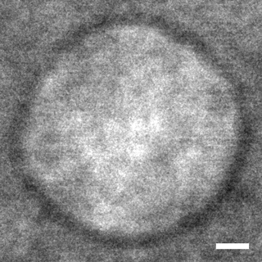
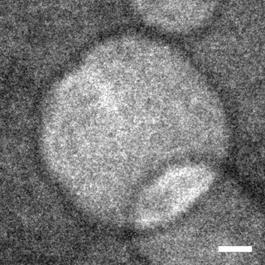
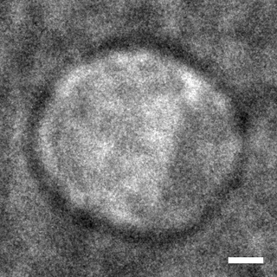
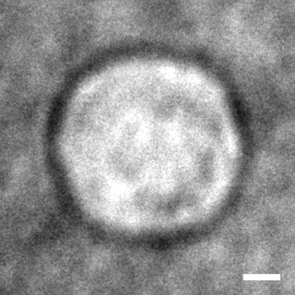
480ºC
1.5×10⁻³ dpa/s
480ºC
7.5×10⁻⁵ dpa/s
25ºC
1.5×10⁻³ dpa/s
25ºC
7.5×10⁻⁵ dpa/s
Notes:
Here I select some representative cavity per condition. Left two are highest and lowest dose rate at high temperature. Right two are highest and lowest dose rate at room temperature.
By simple eye testing, we can tell, cavities shrink in all conditions except the lowest dose rate at high temperature.

Slide 10
Notes:
Here shows the quantitative measurements of all cavities. The plots show the diameter change versus dose. Each individual cavity is drawn as a single line.
At high temperature, the red color group, the lines are gradually becoming horizontal with decreasing dose rate. High dose rate is on the left, low dose rate is on the right. However, at room temperature, the slope of each line is unchanged, when dose rate is decreased. This is as expected, because vacancies would not have enough mobility to move around and diffuse back in to cavities.

Slide 11
Notes:
Then we take the slope of each line in the previous plots as the shrinkage rate of each cavity, and draw the new plots here. The trends become more clear.
At 480C, the cavity shrinkage rate approach to zero at low dose rates, some of them have started to grow.
At room temperature, the cavity shrinkage rate remains unchanged.

Slide 12
Notes:
However, people are always questioning that the TEM foil surface could act as a strong defect sink for point defects during the in-situ ion irradiation. So, here we are trying to address it using the stereo-analysis. We took images of the same area at two different tilting angles. And by pairing the cavities, we can reconstruct the distribution along Z direction. As shown in the four plots on the left, the color scheme represents the shrinkage rate, if they share the same color, which means they have the same shrinkage rate. Y-axis is the Z direction. All four samples show no dependence of shrinkage rate on the distance to surface.
To further validate these results, we calculated the sink strength of all possible sinks. The sink strength can be interpreted as the point defect absorption rate. The calculation shows that the surface sink strength is an order of magnitude lower than the cavities. Therefore, the foil surface does not affect our conclusion.

Slide 13
Notes:
To rationalize our experiment findings, we worked with our colleagues to develop a simple rate theory model. And the modeling agrees very well with the trends we have seen in the previously slides, as shown in the two bottom plots.

