Slide 1
Welcome to the NSUF Annual Users Meeting 2026

Slide 2
Housekeeping
In-person participants:
  Please be respectful of those around you.
  Use a microphone when you have a comment or question.
Online participants:
  Please stay muted unless you are called upon.
  Put any questions or comments in the chat.
While there will be coffee available outside during breaks, DO NOT take any unless you’re a TMS conference attendee.

Slide 3
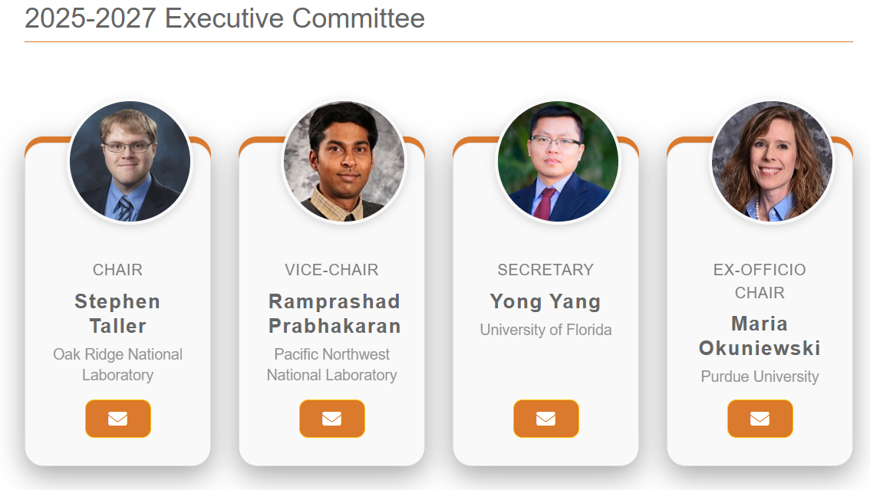
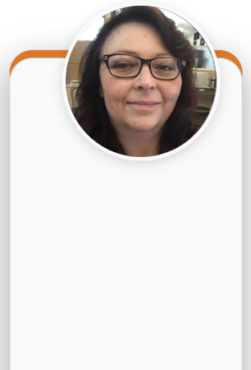
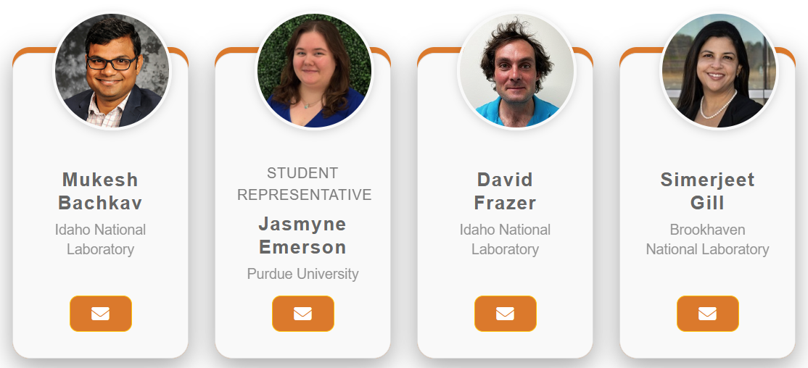
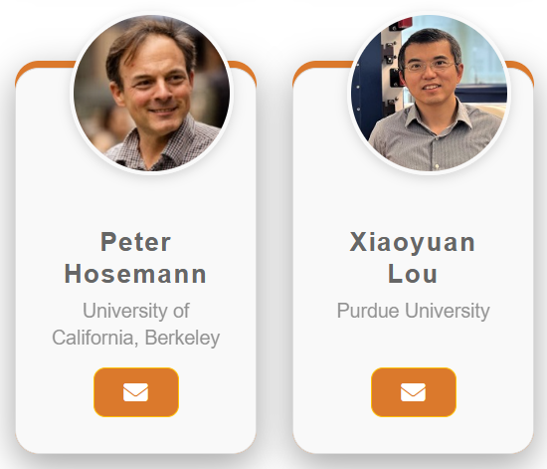
Meet your NSUF Users Organization Team
Person who makes these meetings happen
Renae Tripp
Idaho National Laboratory

Slide 4
What do we do?
The NSUF Users Organization aims to:
  Provide a formal and clear channel for the exchange of information and advice between the investigators who perform reactor-based nuclear technology experiments and the NSUF management.
  Serve as an advocacy group for the experimental activities at the NSUF.
  Provide a communication channel among users of the NSUF.
  Educate the public and decision-makers on the benefits of the use of nuclear energy for energy generation.
  Membership in the organization is open to all users and potential users of the various NSUF facilities and scientists and engineers engaged in the operation and development of these facilities. Potential members can join by self-nomination. For more information, please send an email to the executive committee (NsufUsersOrganization@gmail.com)
We are YOUR (the users) voice!

Slide 5
Today’s NSUF Annual Users Meeting has three simple themes.
Engage
Interact
Energize

Slide 6
Engaging with NSUF Leadership
Two Presentations
  8:50am – 9:10am – Chris Barr (Program Manager, NSUF, DOE-NE) – DOE Perspectives of the NSUF
  9:10am – 10:10am – Brenden Heidrich - Introduction to NSUF, Overview from NSUF Director

Slide 7
Interactions with colleagues and NSUF leadership to enhance user experiences
Panel discussions for every step of the user experience.
  Panel 1. Working with NSUF partners. Hear from facility PIs and instrument scientists with commonly requested capabilities to know what has been developed, what is coming up, and how to work with instrument scientists for common characterization techniques.
  Panel 2. Jumpstarting Careers with NSUF. Hear from researchers at all stages of their careers who have gone through the NSUF RTE and CINR processes and how it helped kickstart and continue a career in nuclear materials.
  Lunch
  Panel 3. The NRDS and Data Management. Upcoming programmatic requirements will include uploading and sharing data with the Nuclear Research Data System (NRDS). This panel will discuss the requirements, data processing practices, and provide expert insight into data analysis with NSUF partners.
  Panel 4. Demystifying the Review Process. NSUF representatives and frequent reviewers provide insight on common pitfalls, tips to make a reviewer happy, identifying red flags and showstoppers from the program and PI perspectives.

Slide 8
Energizing to build the future
For the Users
  Live Demonstration of NRDS
For the Users Organization
  Proposed NSUF UO Charter Amendments
  Future Engagement Opportunities with the NSUF Users’ Organization
  Plans for TMS 2027

Slide 9
Breaks and Lunch today correspond to the general TMS schedule
Break: 10:10 am – 10:30 am
Lunch (On your own): 12:00 pm – 1:00 pm
Break: 2:40 pm – 3:00 pm
There are posters in the back for break time conversations.

Slide 10
Future Engagement Opportunities with the NSUF Users’ Organization

Slide 11
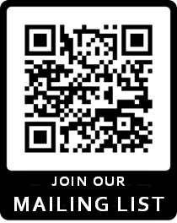
Sign up for the mailing list!
New major initiative! Our own mailing list!
This is a separate list from the mailing from the NSUF program list and requires people to opt-in to receive messages.
Only NSUF User Org officers have access.
Purpose:
  distribute information about user organized meetings,
  updates from the NSUF UO Executive Committee,
  facilitate feedback from users
  other topics relevant to the NSUF Users Organization.

Slide 12
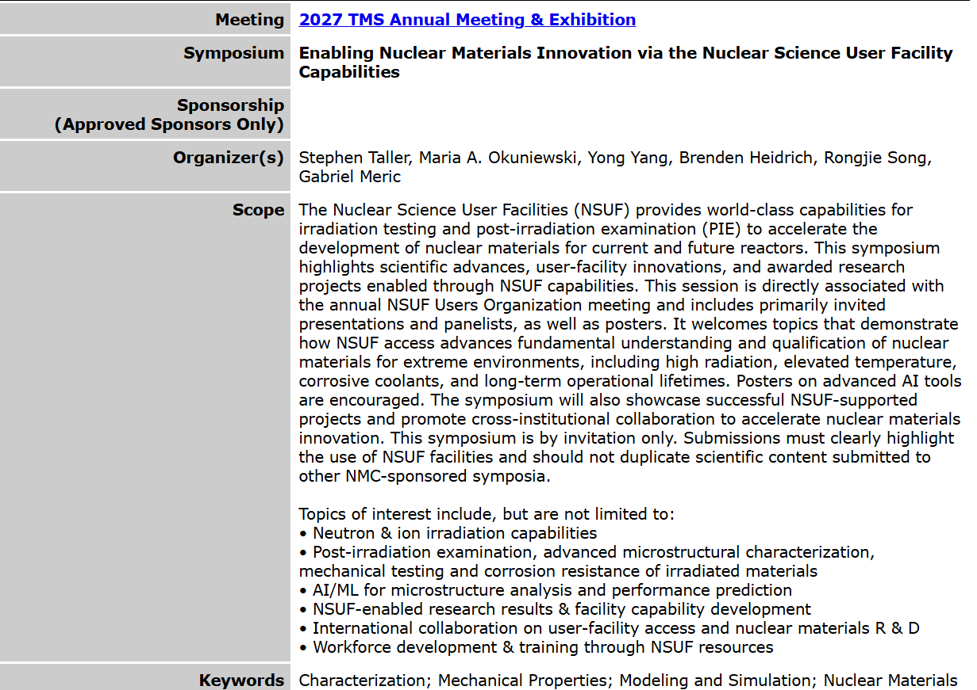
More formal integration into the TMS 2027 meeting through a dedicated symposium
Suggestions from the users for invited presentations and panels are welcome.
Must not duplicate presentations or posters submitted to other Nuclear Materials Committee symposia!

Slide 13
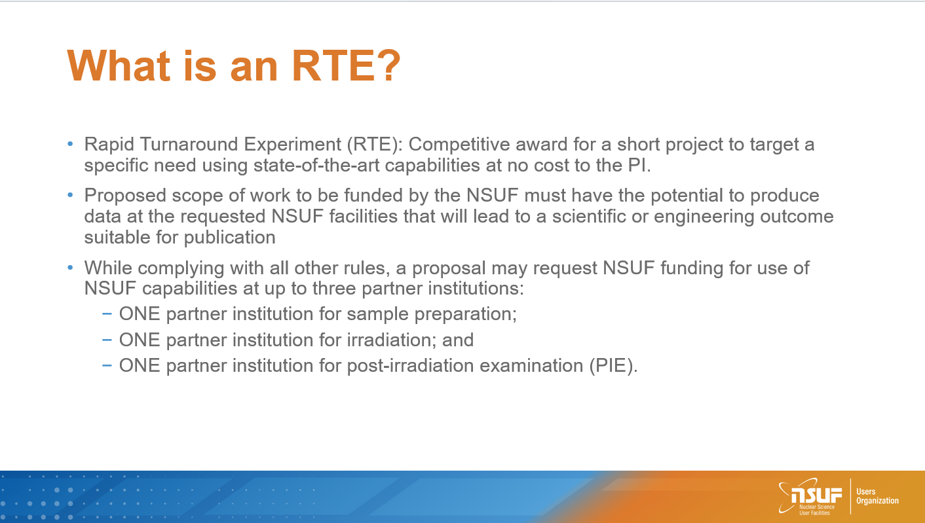
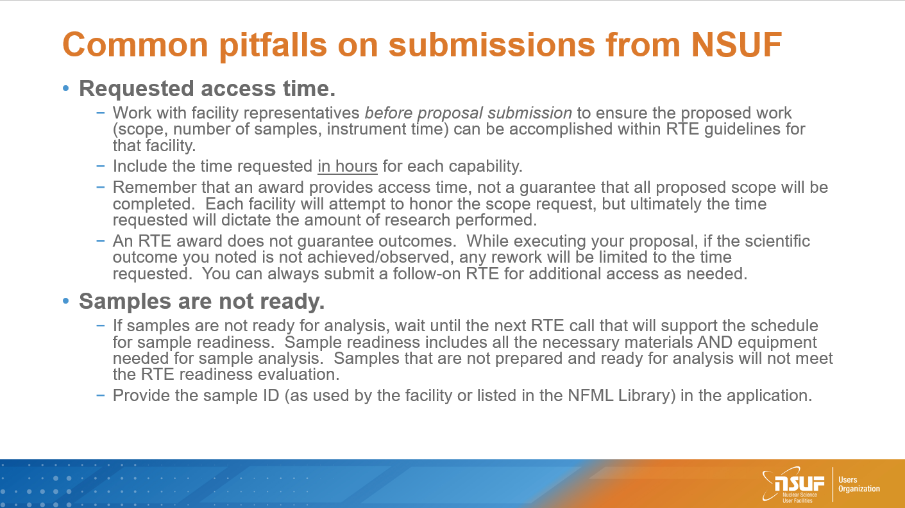
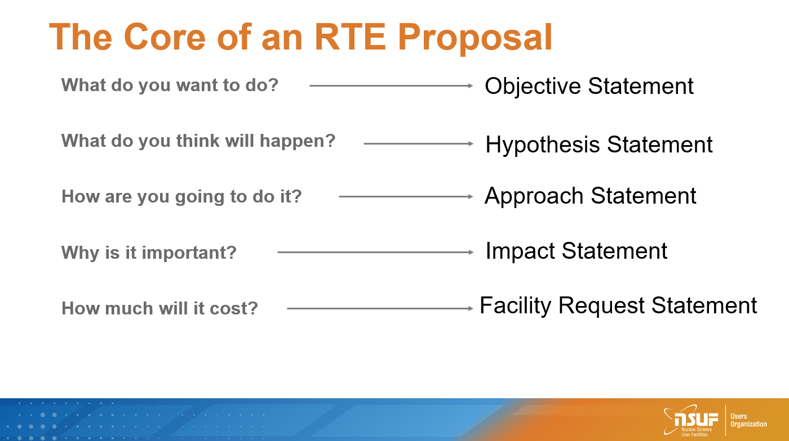
A Tips and Tricks Video and associated RTE proposal template will soon* be available
Stay tuned!
*Video and presentation made in 2024. An updated version will not be provided.

Slide 14




Next year is the 20th anniversary of NSUF
(maybe next year we can afford food and beverage at this meeting)

Slide 15
Special Issue in planning to celebrate 20 years of NSUF supported research in the Journal of Nuclear Materials
Special issue title (tentative): Nuclear Science User Facilities: 20 Years of Enabling Innovation in Nuclear Materials
Guest editors: Mukesh Bachhav (INL), Maria Okuniewski (Purdue University), Stephen Taller (ORNL)
Full papers are sought for NSUF supported research
Plan to invite specific individuals for retrospective articles
Tentative timeline: Papers submitted by August 1, 2026

Slide 16
Year long ideas
While the annual meeting is the biggest event of the Users Organization, we want your ideas to keep your voices heard.
Brainstormed ideas:
  Quarterly office hours
  Technique Chats
  Materials groups
  Send ideas to NSUFUsersOrganization@gmail.com

Slide 17
Hope to see you all in Orlando Florida in 2027.

