Slide 1
INL/MIS-25-85355
Katya Le Blanc
Nuclear Power Fundamentals

Slide 2
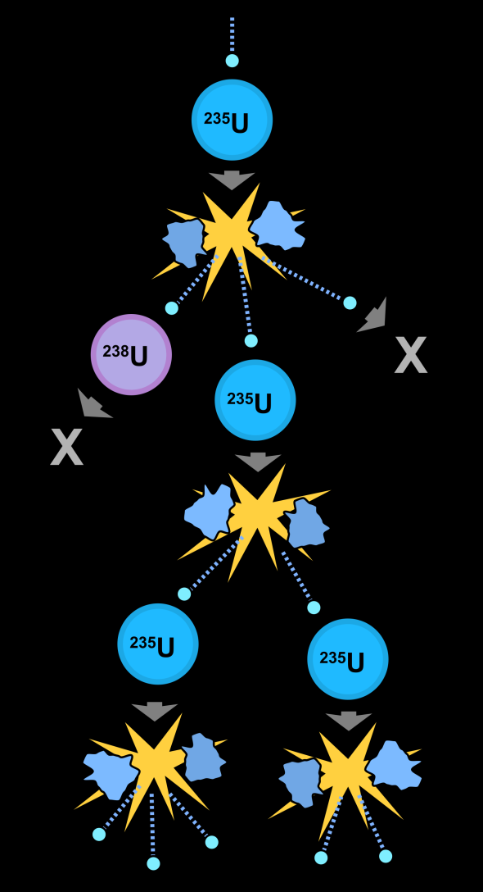
Fission
Notes:
Nuclear fission creates energy in the form of heat, it also releases neutrons, which under the right conditions drive a chain reaction. Nuclear power operations relies on careful control of the conditions to drive a chain reaction).

Slide 3
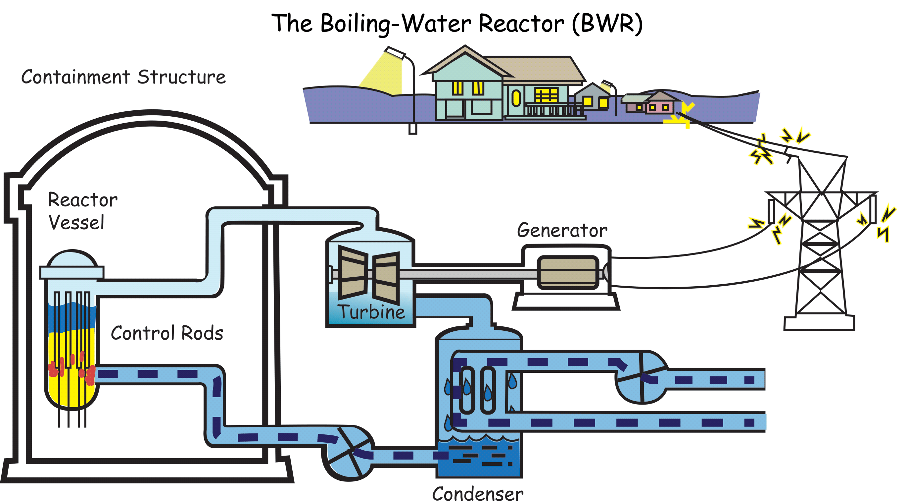
Boiling Water Reactor (BWR)

Slide 4
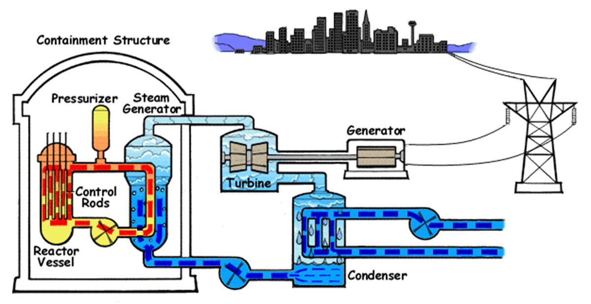
Pressurized Water Reactor (PWR)
Notes:
General overview of nuclear Power
Nuclear fission creates energy in the form of heat, it also releases neutrons, which under the right conditions drive a chain reaction. Control rods control how many neutrons are available to drive the chain reaction. They are made of a neutron absorbing material. A reactor trip or scram sends the control rods fully in and shuts down the chain reaction.
Water circulates through the reactor core to cool the reactor and to transfer the heat so we can use it to generate electricity. The reactor side (or primary side)is a closed system, and the radiation is contained there. It is under pressure to remain liquid at high temperatures.
Steam is generated in the secondary side in a separate circulating loop. In the steam generator fresh cooler water circulates. On one side the hot primary water and the heat transfers from there to the secondary side in the steam generator. The heated water turns to steam, turns the turbine, and generates electricity. It is then cooled and condensed and circulates to start the process again.

Slide 5
Some History:Three Mile Island

Slide 6
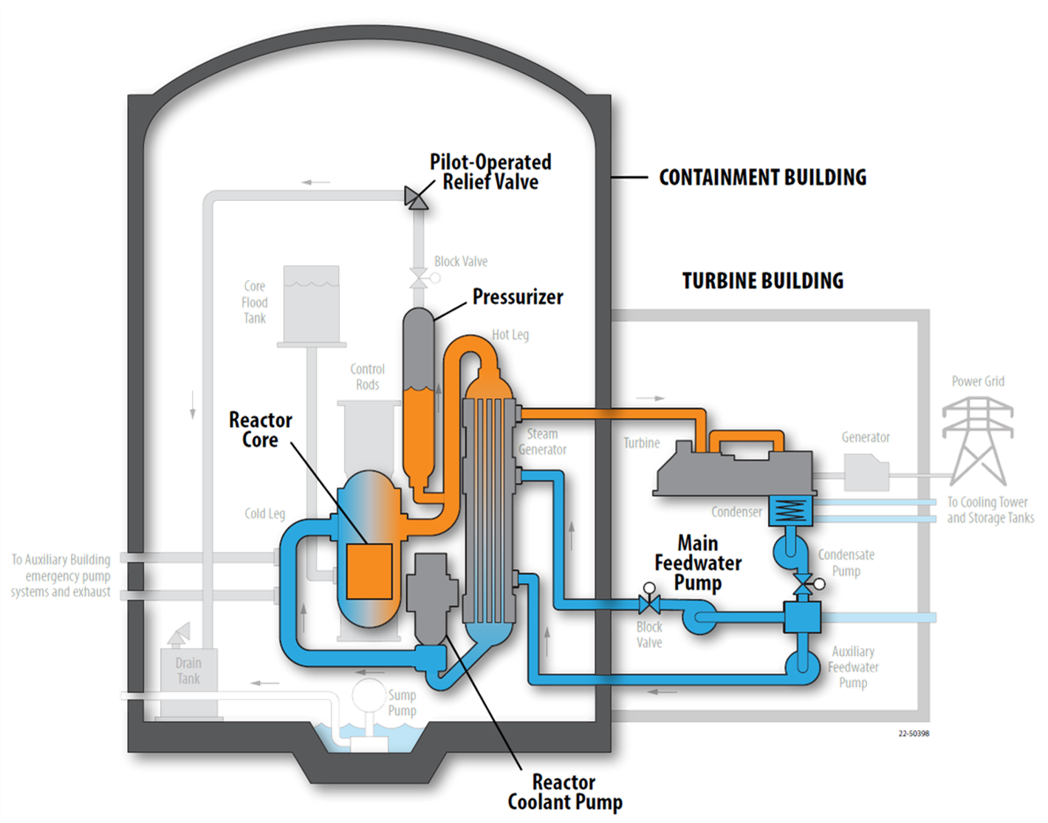
Notes:
Relevant systems in TMI
Once through steam generator, has a low volume of water, which reduces the time to respond in the event of a loss of feedwater
Pressurizer maintains pressure
PORV automatically opens to relieve pressure if the primary system pressure increases past a predefined threshold
Main feed water pump provides water to the steam generator, Auxiliary pumps are back up
Reactor coolant pumps are very large pumps that circulate water in the primary system

Slide 7
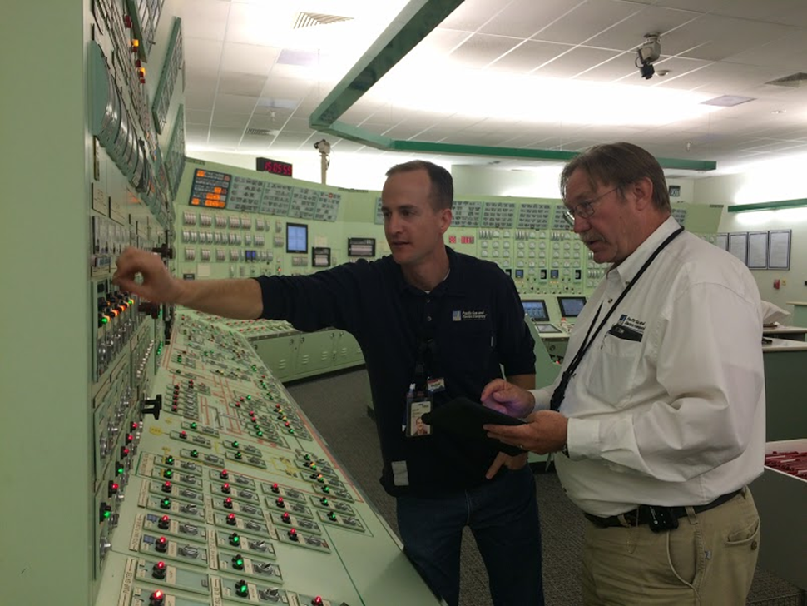
Setting the stage
Control rooms are a complex and noisy environment
It is 4 am
In an event, 100s of alarms are going off
Diablo Canyon Control Room

Slide 8
Setting the stage
Control rooms are a complex and noisy environment
It is 4 am
In an event, 100s of alarms are going off
There were many systems out of service the day of the event
Diablo Canyon Control Room

Slide 9
Organizational Culture
Maintenance Practices
Loss of Main Feedwater initiated the event

Slide 10
System Design
Steam Generator boils dry <2 Minutes

Slide 11
System Design
Primary System Pressure Increases, and PORV opens automatically to relieve pressure
Notes:
Because we are no longer removing heat, Water in the primary system heats up, expands , and the pressure increases. The PORV automatically opens in responses to increased pressure

Slide 12
System Design
Organizational Culture
Human System Interface
Training
Pressure is relieved, and automatic signal to close PORV is sent, however PORV is stuck OPEN
Indicator on Control Panel relies on electrical signal, and not actual valve position, so it indicates PORV is CLOSED, Operators believe it is closed

Slide 13
System Design
Organizational Culture
Human System Interface
Training
Stuck Open PORV initiates Loss of Coolant (LOCA)

Slide 14
System Design
Organizational Culture
Experience and Expectations
Procedures
Training
Level in Primary System increases
Pressure is dropping
High Pressure Injection (HPI) is automatically initiated (would normally indicate LOCA)
Operators have previously seen HPI actuation in non-LOCA conditions

Slide 15
Organizational Culture
Procedures
Experience and Expectations
Training
Human System Interface
Operators are trained to use pressurizer level indications for primary coolant inventory
Do not recognize that the system has reached saturation conditions
Water
Pressure
Steam
Temp
Primary system reaches saturation conditions
Primary coolant is boiling

Slide 16
Organizational Culture
Experience and Expectations
Procedures
Training
Level in Primary System is persistently high
Due to boiling of coolant
Countercurrent flooding
Operators continue to interpret pressurizer level as reliable indication of primary inventory per
Their training
Experience in the
There is no direct indication reactor coolant level
Notes:
Counter current flooding essentially suspends liquid at the pressurizer inlet because the steam is preventing it from circulating. It was a poorly understood thermal hydraulic phenomenon at the time. Operators and engineers would not have been trained to recognize it. It is the reason for the persistently high level and is misinterpreted as the reactor coolant system having too much water, when in fact, there is a LOCA.

Slide 17
Organizational Culture
Experience and Expectations
Procedures
Training
Level in primary System remains high
Pressure remains low
Human System Interface
Operators continue to think system is about to “go solid”, so they throttle the HPI pumps

Slide 18
Organizational Culture
Experience and Expectations
Procedures
Training
Level in Primary System increases
Pressure is dropping
Human System Interface
8 minutes in, a supervisor from UNIT 1, comes in and notices block valves are closed on aux feed pumps, operators open them
The closed block valves don’t directly affect the accident progression, but distract and confuse operators

Slide 19
Organizational Culture
Experience and Expectations
Procedures
Training
Cognitive Biases
Human System Interface
Level in Primary remains high
Pressure remains low
Operators interpret the low pressure as a primary-to-secondary leak due to thermal shock in the steam generator
Operators subsequently misinterpret many indications of a LOCA in this way
Notes:
Opening the auxiliary feedwater block valves calibrate the operator’s mental model to think that thermal shock from adding cool water from the auxiliary feed water system to the steam generator causing a break and hence a leak.

Slide 20
Organizational Culture
Experience and Expectations
Procedures
Training
Human System Interface
Still confused by the barrage of inconsistent indications and concerned about the primary system level and pump vibrations, operators turn off the reactor coolant pumps in accordance with pump operating limits
Reactor coolant pumps are vibrating due to low pressure

Slide 21
Cognitive Biases
Organizational Culture
Experience and Expectations
Procedures
Without coolant flow from the Reactor coolant pumps, the primary temperature increases leading to a core meltdown
Steam floods the containment building
  Increasing containment pressure, temperature, radiation
Training
Human System Interface
Operators continue to misinterpret indications that would point to a LOCA

Slide 22
Cognitive Biases
Temperature readings on relief valve discharge are high, indicating loss of coolant through valve
Operators dismiss this citing the chronic PORV leakage
Immediately prior to the event, an operator was performing boron dilution as a response to chronic leakage through PORV

Slide 23
Cognitive Biases
Operators misinterpret many indications as due to a primary to secondary leak
High containment pressure and temperature
Pressure difference between two steam generators
Reduced boron concentration
High radiation readings in primary system
Containment Sump level

Slide 24
Cognitive Biases
Experience and Expectations
A Shift supervisor comes in to relieve the previous one, and identifies the stuck open PORV valve and the operator close the the block valve, ending the LOCA
LOCA is resolved, it is many hours before operators can initiate coolant flow through the system to start to resolve the event

Slide 25
Some more context on operator mindset
According to Joyce, J. and Lapinsky, G. (1983),
When preconceived notions about plant behavior do not correspond to actual plant conditions, several things may happen.
  Operators may tend to repeat their original, inappropriate information-gathering strategy.
  In order to try to make actual conditions fit their preconceived notions, people often selectively disbelieve or disregard anomalous information.
When it becomes obvious that the situation does not fit their mental model, they regress to less effective forms of information gathering, for example, attending to all information regardless of its importance--looking for any clue at all that may be helpful.
  Information overload usually results, further degrading the reasoning process.
  Sub optional strategies such as information queuing, the dropping out of information, and cognitive fixation are the common under such conditions of stress and overload.

Slide 26
Summary of Human Factors in TMI
Organizational Culture
  Failure to learn from operational experience
      Davis Besse
      Beznau
      Oconee-3
    TMI-2
      PORV stuck open in a previous incident
Design
  Operational philosophy was to prioritize avoiding reactor trip by using PORV, which led to frequent PORV actuation
Maintenance
  Failure to correct known issues with condensate polishing system and leaky PORV
  Large number of systems out of service
Notes:
There were several precursor events. At Davis Besse, nearly an identical sequence of events occurred to TMI, except they recognized the stuck open PORV earlier and were able to avoid core damage. Mike Derivan, the shift supervisor at David Besse during the precursor event , describes his reaction and thoughts on TMI in https://www.ans.org/news/article-1556/tmi-operators-did-what-they-were-trained-to-do/. The insights from Davis Besse weren’t widely shared and would have likely prevented the accident at TMI.

Slide 27
Summary of Human Factors in TMI
Human System Interface
  Missing indications
  Misleading indications
  Obscured indications
Training
  Training focused on normal conditions, but failed to prepare operators for the conditions they encountered
    Training and procedures were valid for liquid, but not for saturation conditions
  Strong emphasis on avoiding letting the pressurizer go solid made operators fixate on wrong problem
    This came from the reactor designer, the site operations and training, and many of the operators’ Navy experience
Experience and Expectations
  Complacency associated with leaky PORV and actuation of HPI under “normal conditions”
  Cognitive biases associated with interpretation of indications
  Operators persisted in wrong interpretation despite contradictory evidence
    This isn’t their fault, it is how ALL humans work

Slide 28
What does this mean for the future?
Thankfully, we learned a lot from TMI
  Sharing of Operating Experience
  Improved Procedures
  Improved Training
    Including simulators
  Staffing improvements
    Shift Technical Advisor
  Improved indication
    Safety Parameter Displays
    Human factors evaluation
    Direct indication of reactor coolant level
We have implemented these lessons learned along with many more, and have an excellent safety record in the nuclear industry because of it

Slide 29
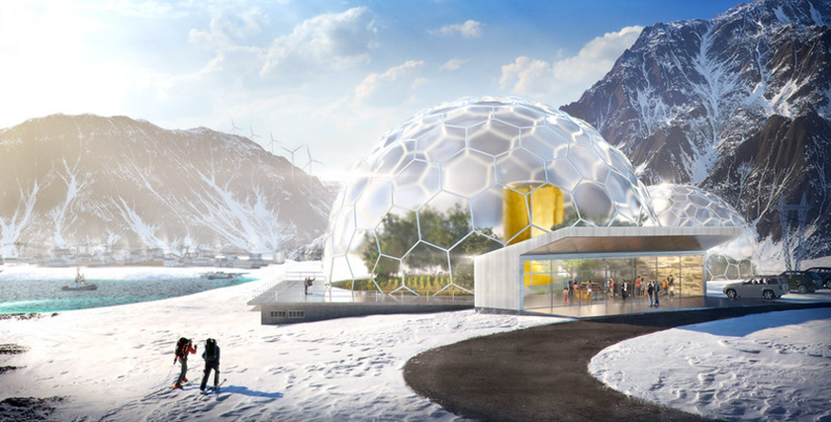
What does this mean for the future?
The nuclear industry is poised to build new systems based on some of the assumptions established by existing systems
We must remain vigilant in ensuring we understand the assumptions we are making, and that we do not violate them
https://www.flickr.com/photos/thirdwaythinktank/37875478862/in/album-72157665372889289/

Slide 30
Thank you!
Questions?
Katya.leblanc@inl.gov

Slide 31
References
The Davis Besse Nuclear Power Plant Three Mile Island Accident Precursor Event. Mike Derivan, 2014
Insights from the Three Mile Island accident—Part 1: The accident. William E. Burchill Nuclear News. 2019
Three Mile Island: A Report to the Commissioners and to the Public, M. Rogovin, director of Special Inquiry Group, U.S. Nuclear Regulatory Commission (Jan. 1980).
Joyce, J. and Lapinsky, G. (1983). A history and overview of the safety parameter display system concept. IEEE Transactions on Nuclear Science, NS-30(1).

