Slide 1
July 22, 2026
Jeff Benson
Lead, Research Excellence Programs
Research Excellence Programs
At Idaho National Laboratory

Slide 2
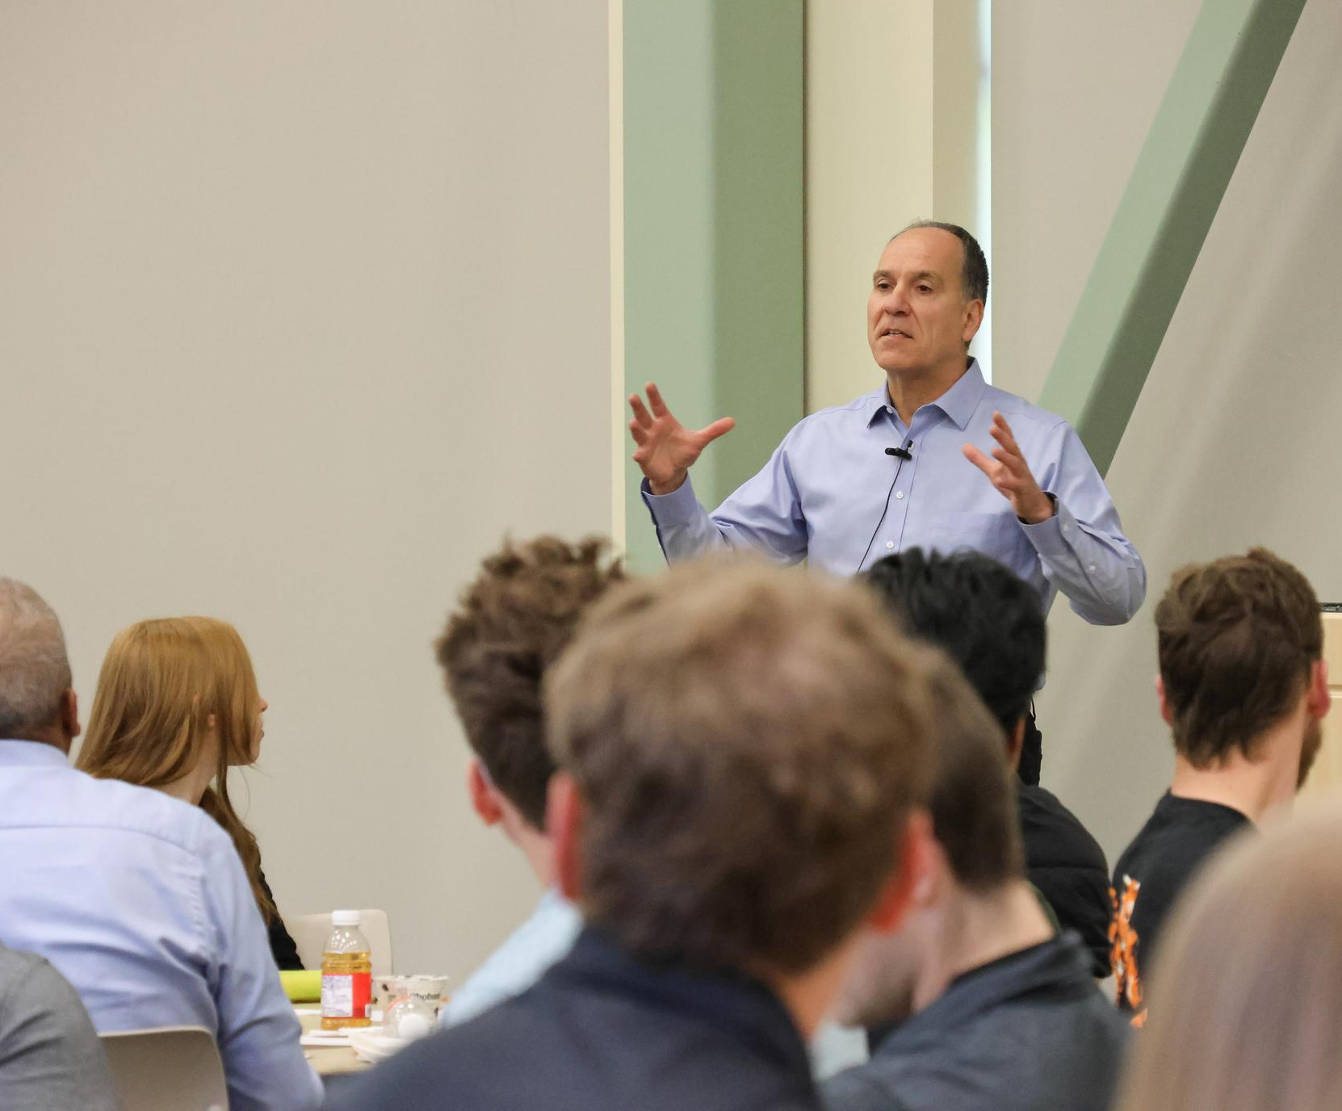
Internships
Lab wide intern program
  55% undergraduate
  45% graduate
550+ interns annually
Robust professional development program
Required deliverables
  Abstract
  Poster session
  Video or oral presentation
  Publication or prototype

Slide 3
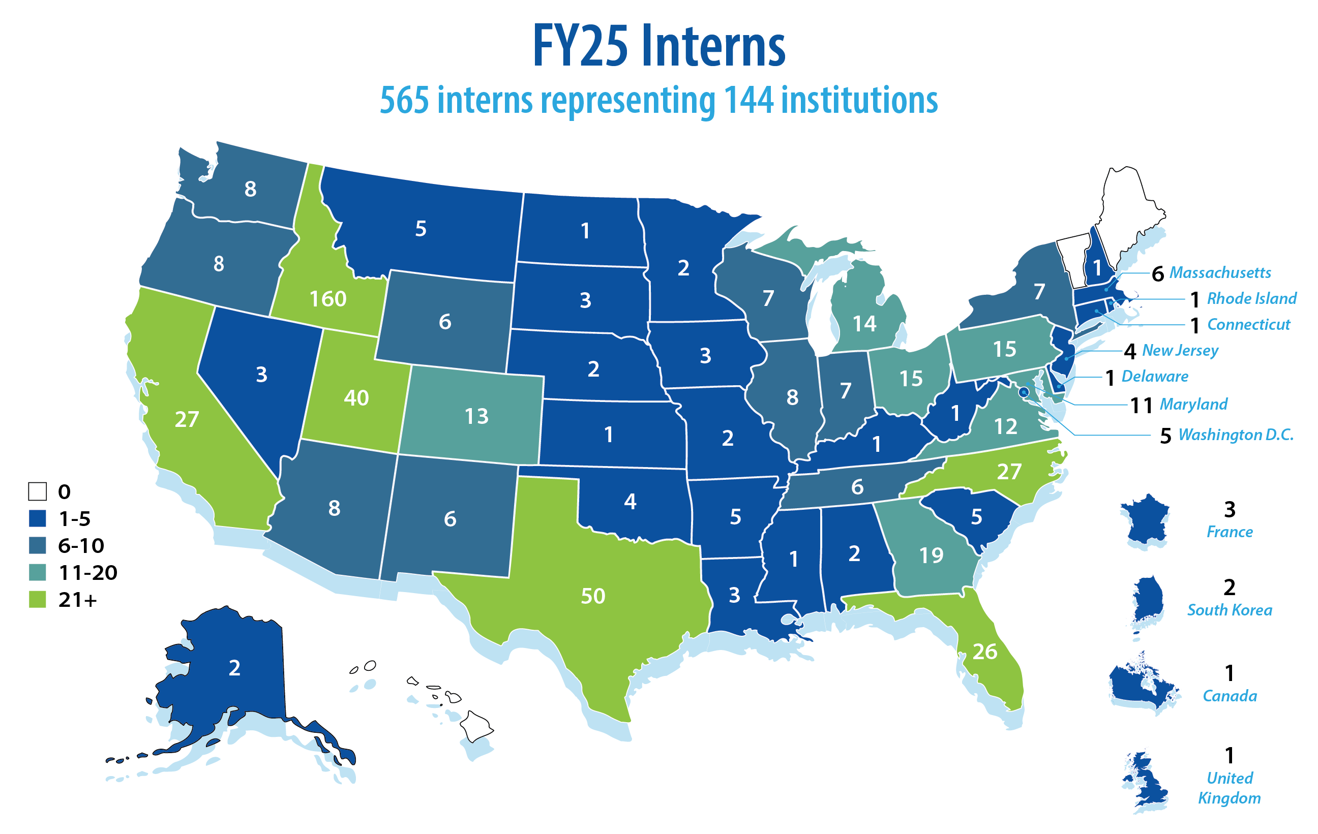

Slide 4
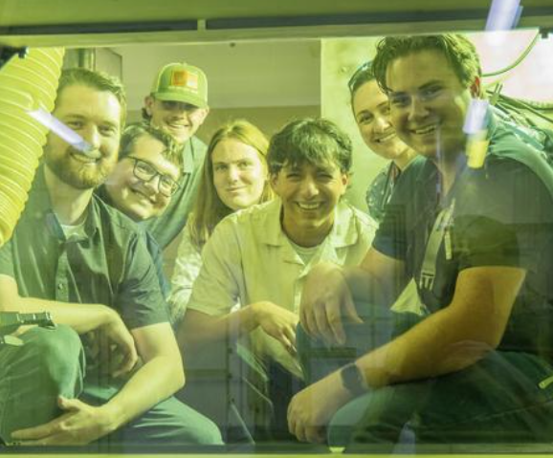
Intern Eligibility Requirement
  Eligibility Requirements
  Must be a full-time student attending an accredited university or college the semester before and after an internship award
  Have a minimum cumulative 3.0 GPA
  International students who attend an accredited U.S. college or university must have a current Curricular Practical Training Authorization
  Ability to pass a background check

Slide 5


Core competencies
A set of skills, behaviors and knowledge areas essential
for interns
Professional development curriculum aligned to competencies
Certificates provided to interns that met each of the core competencies through professional development activities
CORE COMPETENCIES
Professionalism
Communication
Teamwork
Critical thinking
Work ethic
Technical proficiency
Adaptability
Initiative
Artificial Intelligence
Learning mindset

Slide 6
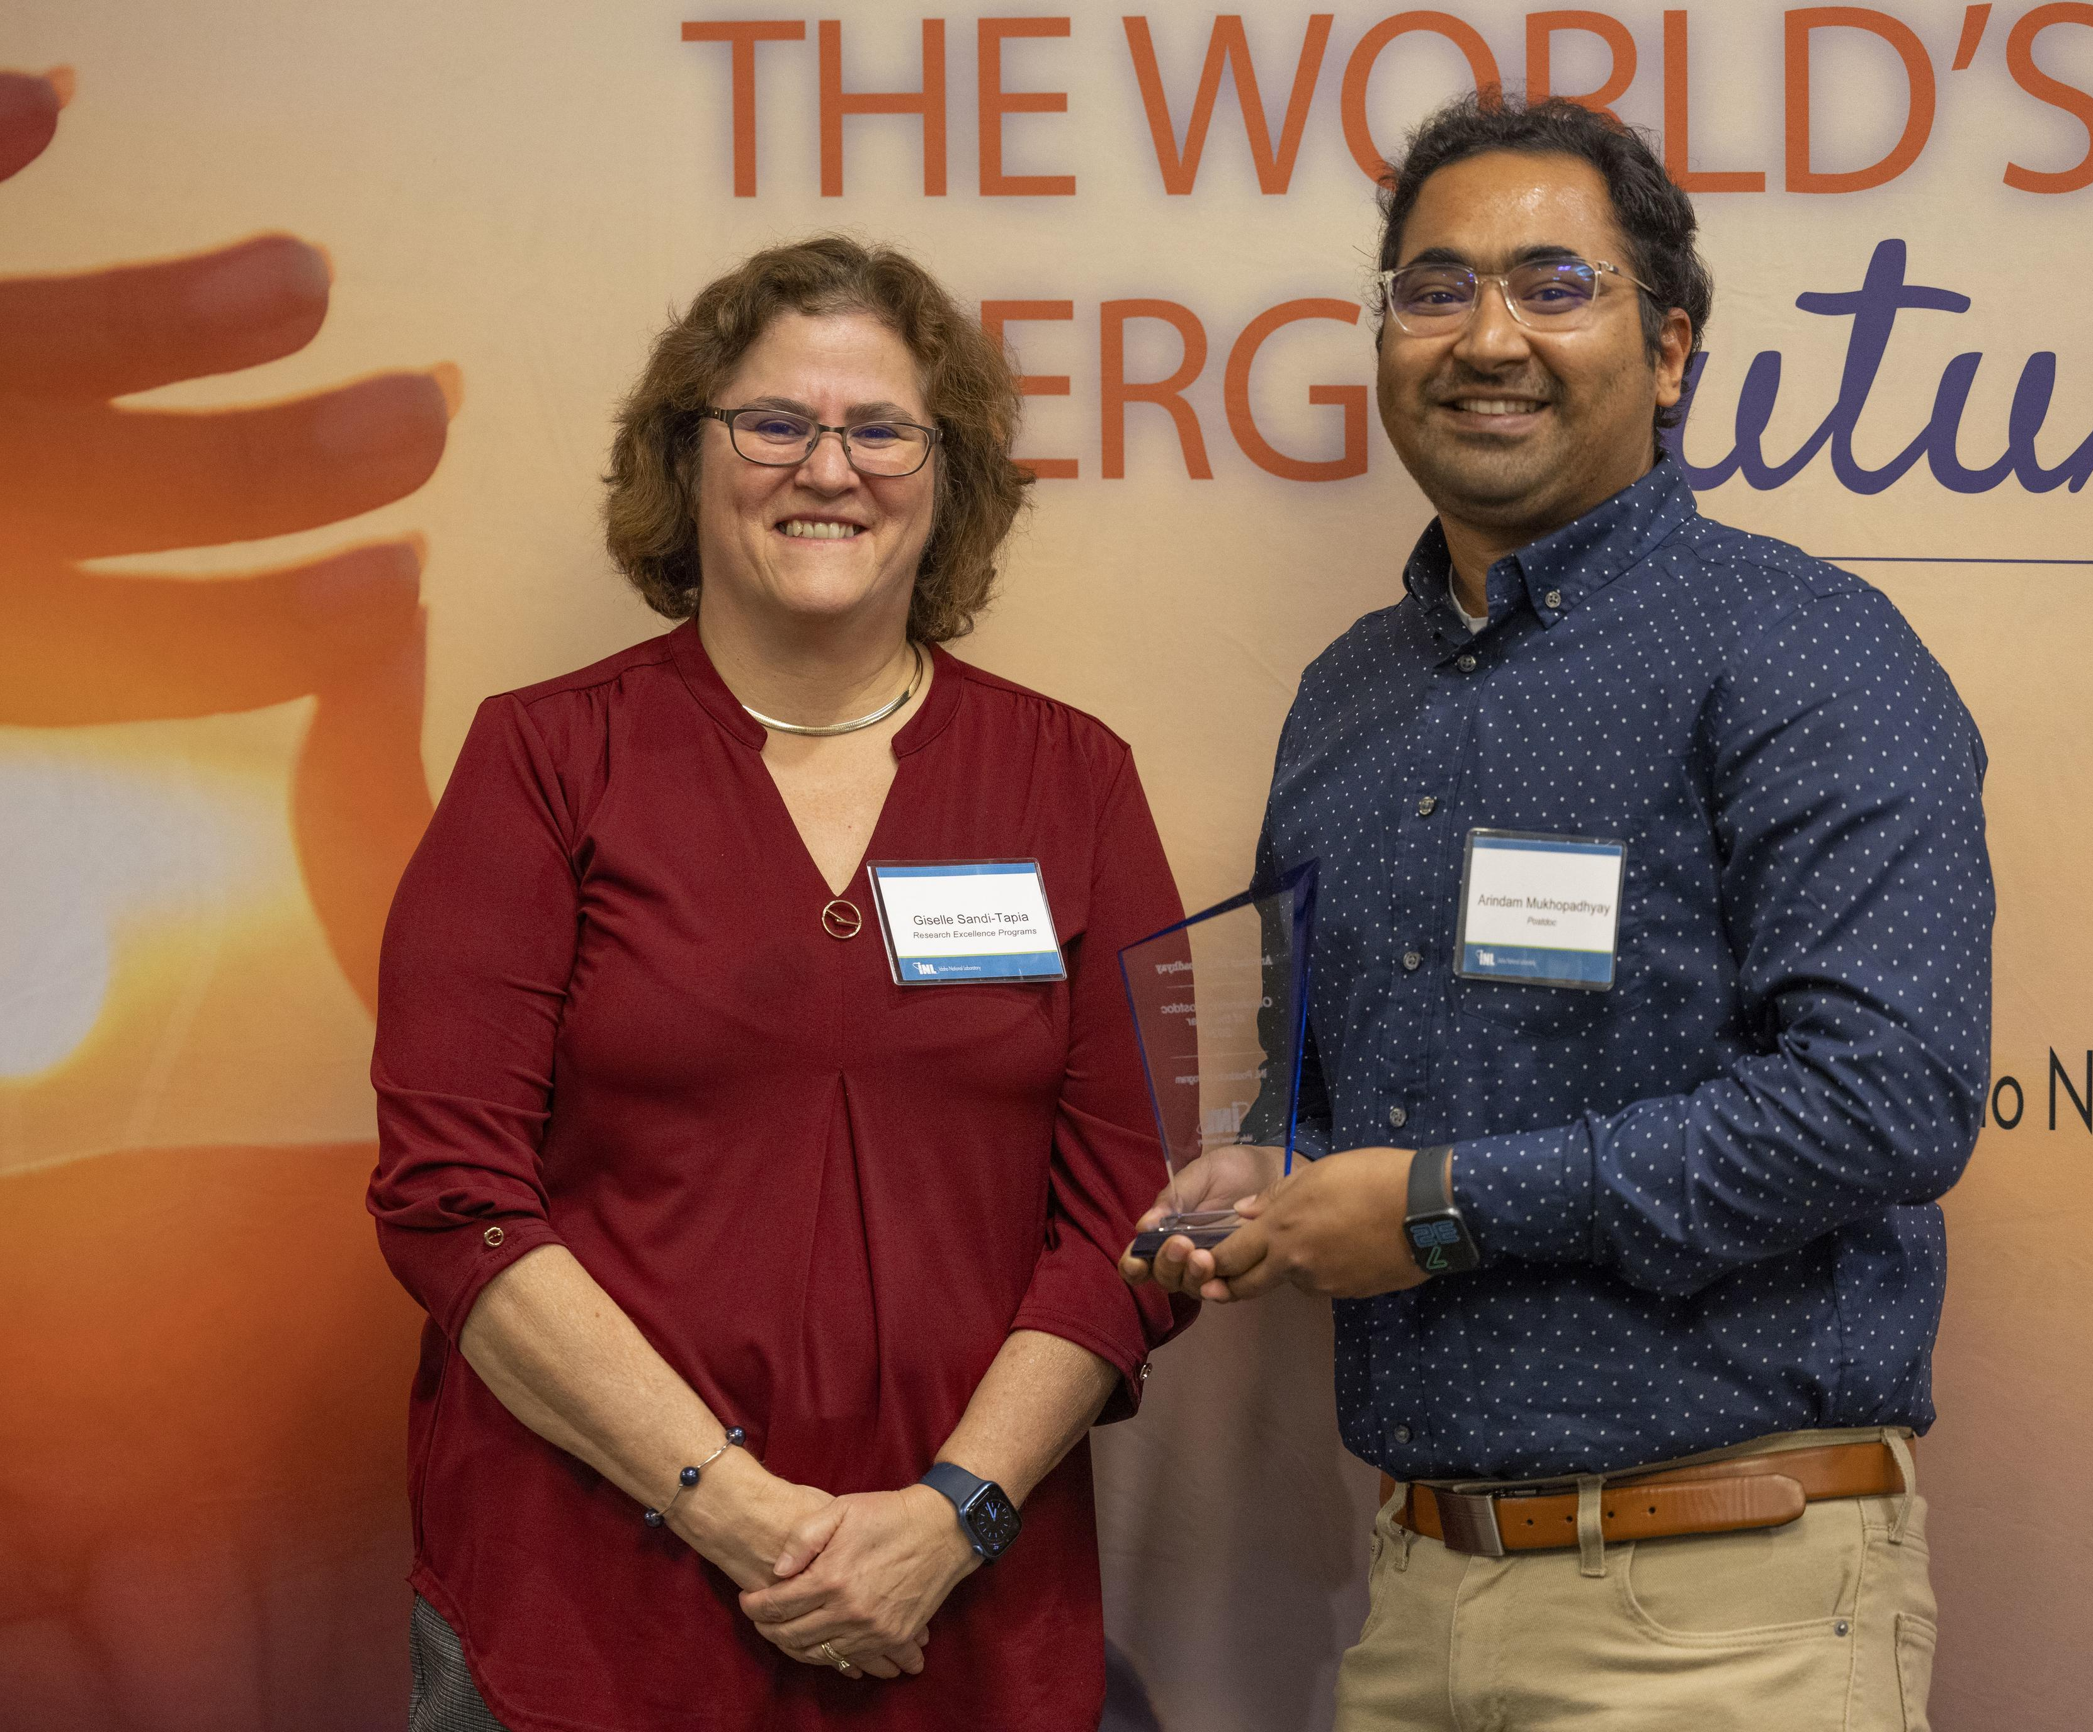
Education Programs: Postdocs
92 postdocs across all mission orgs
  Includes a small number of distinguished postdocs
1-3 years
All postdoc positions are posted
Ph.D. must be competed by start of the appointment and have been received within the previous five years
The Postdoctoral Association at INL
  A chapter of the National Postdoctoral Association

Slide 7
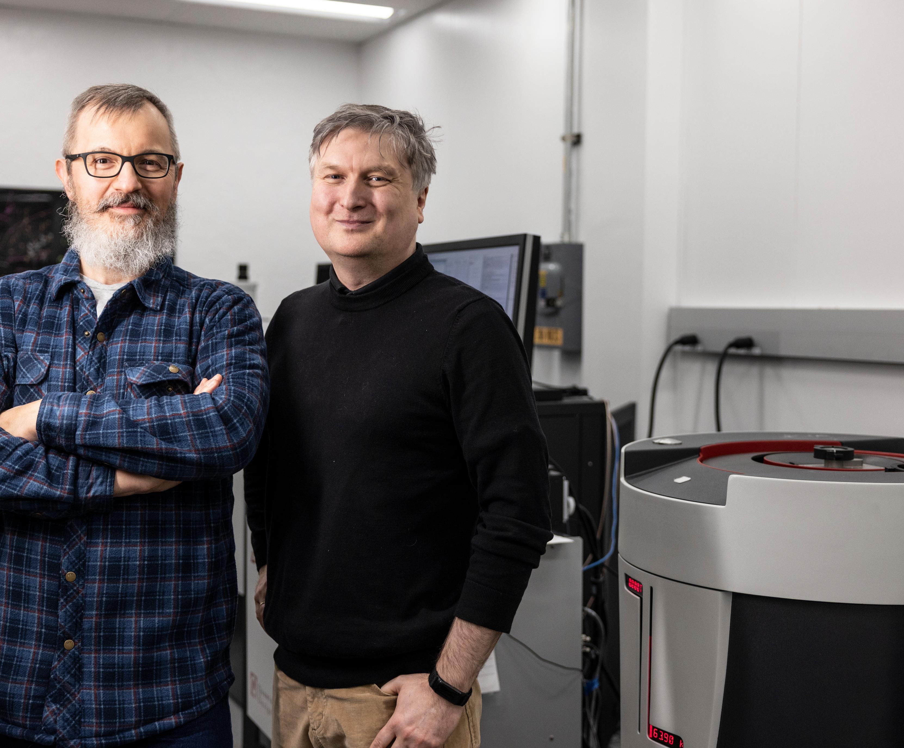
Faculty appointments and academic visitors
Joint Appointments
Joint appointment program: designed to enhance research collaborations between the laboratory and university staff
  Incoming and outgoing
Joint appointees conduct research at both INL and their host institutions
Other Faculty Programs
INL visiting faculty/researcher program
International researcher program

Slide 8
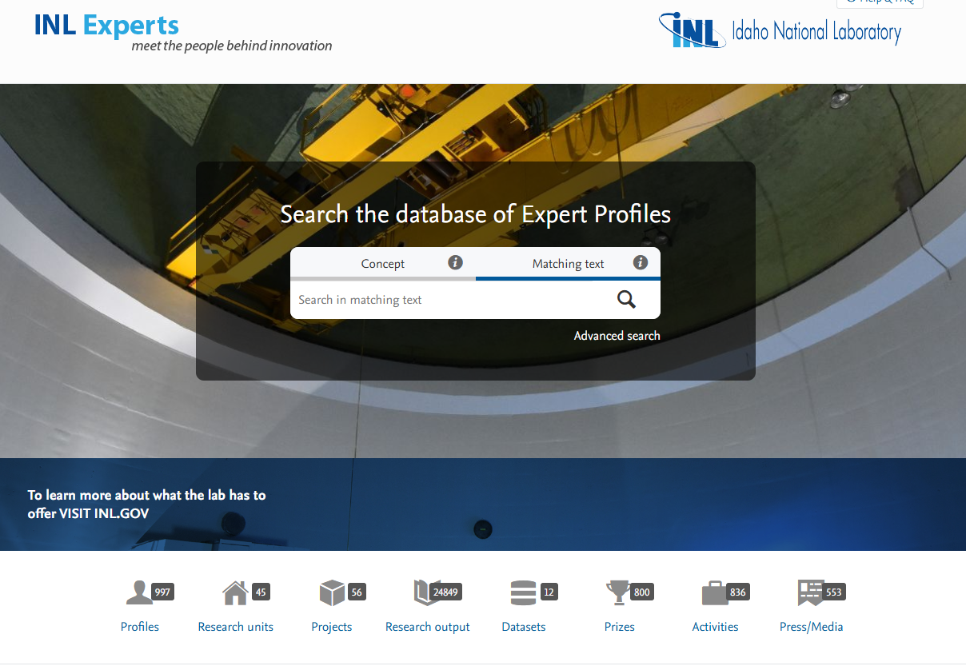
INL Experts
INL Experts
  External website to showcase researcher publications
  Public and searchable
  Features all INL researchers and postdocs
  https://inl.gov/experts/

