Slide 1
Fundamentals of Nuclear Fuel
N. Woolstenhulme
*Nicolas.Woolstenhulme@inl.gov
Jul 2026
INL/MIS-25-85854

Slide 2
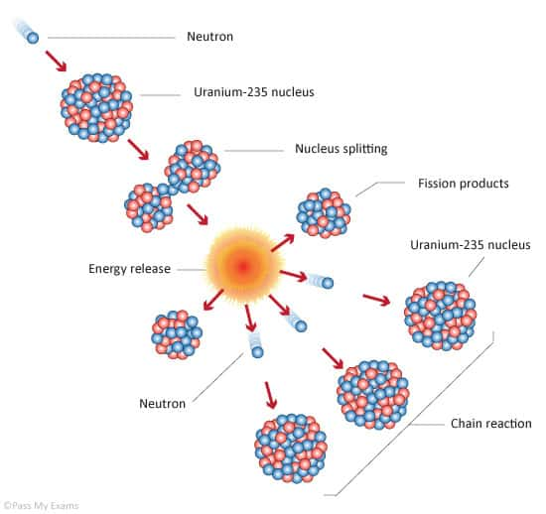
Nuclear Physics 101
Free neutrons are eventually either absorbed or scattered by atomic nuclei
  The probability of these reactions depends on both the target nuclide and the neutron energy
  Atoms which strongly absorb neutrons, fission, and release more neutron are called fissile isotopes or “fuel” (²³⁵U, ²³⁹Pu)
  Atoms which strongly absorb neutrons and transmute without releasing more neutrons are called poisons (B, Cd, Gd)
  Neutrons born of fission are considered “fast” neutron (~2 MeV)
  Fast neutrons are less likely to be absorbed, but more likely to knock atoms out of their crystal lattice (atom displacement)
  Fast neutrons can be scattered or “moderated”, usually by small nuclei (H, C, Be) to become lower energy “thermal” neutrons (~0.025 eV)
  Thermal neutrons are more likely to absorbed and cause transmutation
  Some actinide “fertile” isotopes will absorb neutrons and the turn into fissile isotope
A self-sustaining fission chain reaction is the whole point
  Releases heat, more neutrons, and leaves behind radioactive fission products

Slide 3
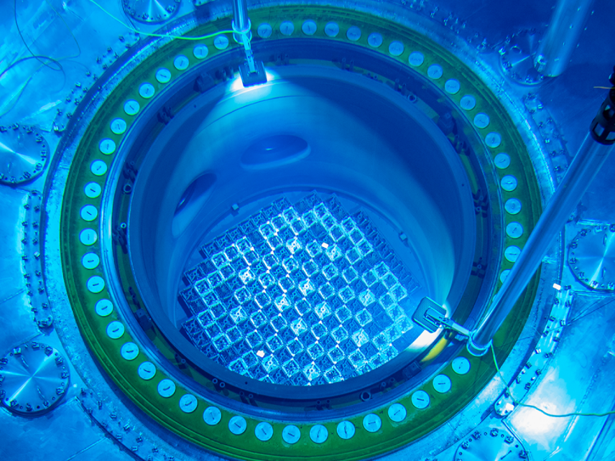
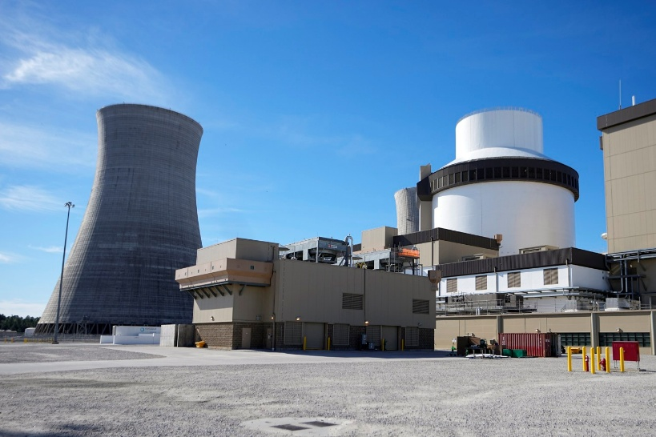
The Role of Nuclear Fuel
There are two useful products of nuclear fission/reactors:
  Release Energy: For electrical energy production, process heat, etc.
  Release Neutrons: To test nuclear materials, transmute isotopes, create neutron beamlines, etc.
Nuclear fuel must do three things well to support nuclear reactors
  Sustain Chain Reaction and Fuel Cycle
  Transfer Heat
  Retain Radioactive Fission Products
Operators, customers, & stakeholders care most about efficiency of these functions on an expected normal day
Regulators care most about failure probability and severity of these functions on a postulated bad day

Slide 4
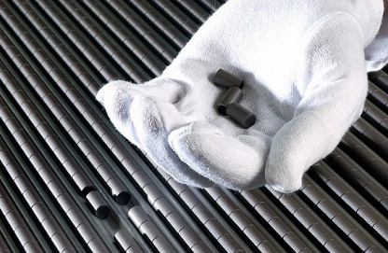
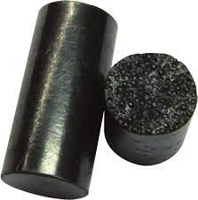
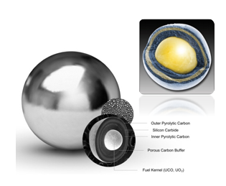
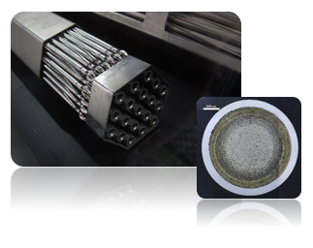
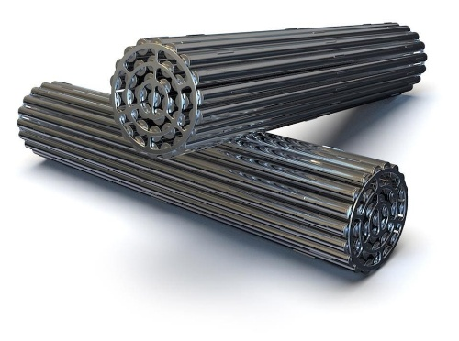
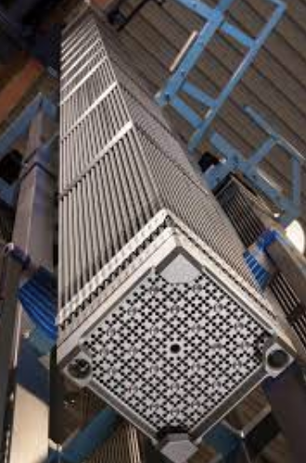
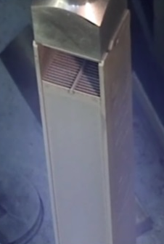
Some Vocabulary
Most fuel systems are a two-part system
The material bearing fissile, fissionable, and fertile actinides:
  Often categorized by material type: Ceramic (UO₂), Metallic (U-Zr), Intermetallic (U₃Si₂), Coated Particle (TRISO), or liquid (molten salt)
  Referred to as fuel material, fissile phase, and simply as “fuel”
The hermetic thing that contains radionuclides:
  Various designs/dialects includes “cladding” (MTR, SFR, LWR), “coatings” (TRISO), “canisters”, “sheaths” (Canadian word for cladding), or reactor vessel/piping (MSR)
  Most often metallic materials, but sometimes ceramics/composites
The fuel and cladding together create the “fuel system”
  Confusingly is also called “fuel”
  Less confusingly also included in description of assembly type:
    Fuel rods, fuel pins, fuel plates, fuel bundles, fuel assemblies, fuel elements, fuel pebbles, fuel compacts

Slide 5
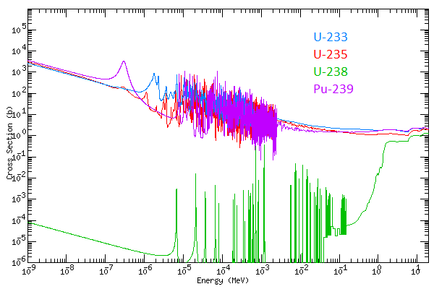
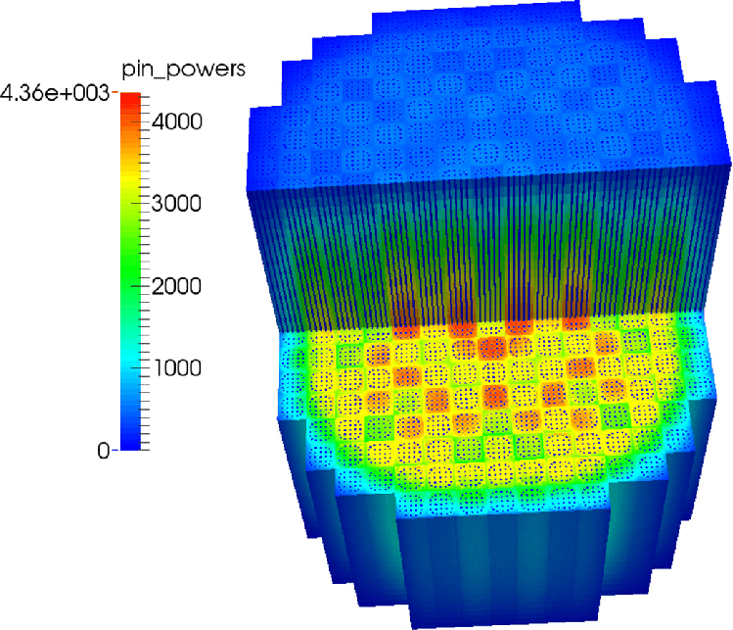
Fuel Performance for the Nuclear Physicist
Most neutrons are released immediately by fission as “prompt neutrons”
  If there were only prompt neutrons, then the only thing reactors could do would be an amusing but useless power pulse
Some neutrons (<1%) are released slightly later as “delayed neutrons”
  The rates at which neutrons are born (from fission) to those lost (by absorption and leakage) must be controlled within the delayed neutron fraction for a reactor to have stable power
  The composition and physical arrangement of fuel, moderator, and poison are crucial in getting it right
  Nuclear data cross sections describe probabilities of fission, capture, and scattering depending on isotope and neutron energy, and they are not simple
  Neutron transport codes rely on nuclear data
  Neutronic models of nuclear reactor must be validated against system scale physics experiments
Nuclear physicists’ favorite test reactors are “zero-power reactors” for well characterized criticality experiments

Slide 6
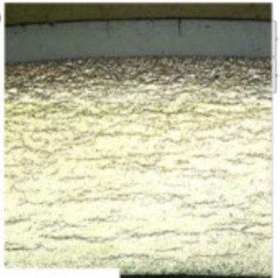
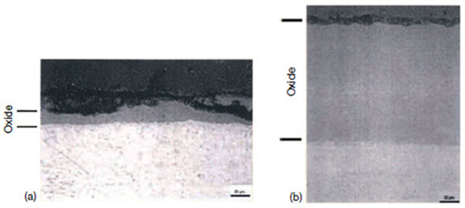
Fuel Performance for the Corrosion Scientist
Reactors usually have a fluid convection system to remove heat from core
  Cladding coolant interactions crucial considerations
  Corrosion consumes cladding thickness thus weakening mechanical function
  Build up of surface oxide and other deposits (e.g., CRUD) can impede heat transfer and cause fuel temperature to increase
  Diffusion of reaction products can embrittle cladding (e.g., hydrides)
A reactor dependent problem
  Light water reactor fuel development is a multidecadal story about getting zirconium alloys and pressurized hot water chemistry to cooperate
  With proper control of coolant contaminants, helium and sodium cooled reactors can have very benign corrosion behaviors
  Some other proposed reactor coolants (molten salt, lead-alloys, supercritical water) are expected to put corrosion centerstage for fuel performance
  Non-nuclear corrosion testing useful, but in-reactor phenomena (e.g., radiolysis) can dramatically affect behavior
Corrosion scientists’ favorite test reactors are material test reactors with independently controllable flowing coolant loops

Slide 7
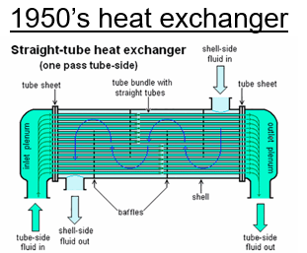
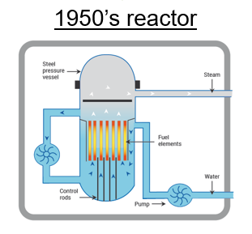
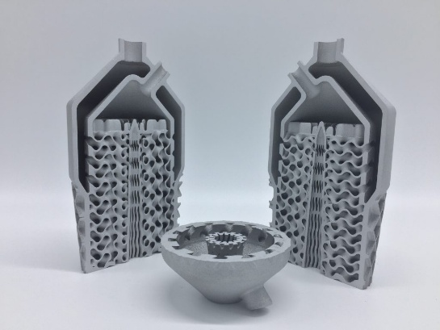
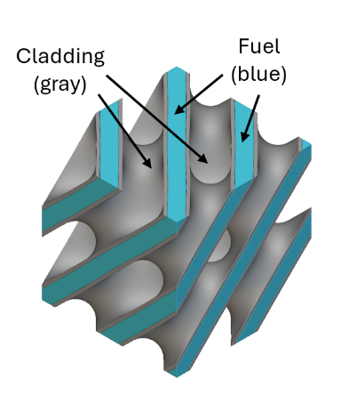
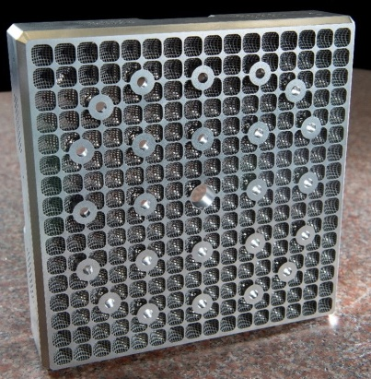
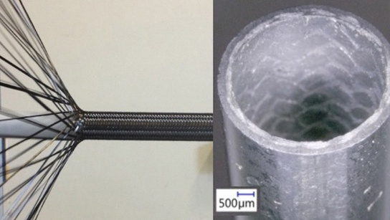
Fuel Performance for the Mechanical Engineer
Not surprisingly, mechanical engineers can also get excited about nuclear fuel
  Fuel manufacturing methods deeply intertwined with its behavior
  Cladding has key roles in retaining fission product swelling/pressure & maintaining fuel assembly structure
  Fuel assembly materials/geometry defines thermal hydraulics of core
  Complex multiphase thermal hydraulics behaviors in some coolant (especially water)
Mechanical engineers’ favorite test reactors are material test reactors and transient test reactors with all kinds of adaptable, versatile, and extreme condition test capabilities
Advanced AM heat exchangers
Concept being researched using AM for nature-inspired nuclear fuel
Advanced LWR Bundle Nozzle Made by AM
Ceramic fiber composite cladding being researched

Slide 8
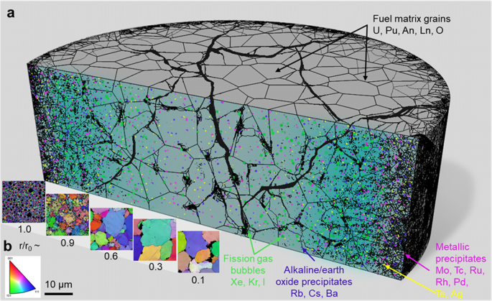
Nuclear Fuel Performance for the Material Scientist
Material science is probably the most represented discipline in nuclear fuel performance
Nuclear fuel is interesting stuff
  Not the atoms you started with: Fission products and transmutation nearly yield “one of everything” from periodic table
  High temperatures and thermal gradients to drive diffusion alongside dissimilar material interfaces to drive interactions
  Fast neutron damage and fission gas production constantly battering microstructures, causing volumetric swelling, and messing with creep rates
Material Scientists’ favorite test reactors are material test reactors
  They love material test reactors almost as much as microscopes!

Slide 9
The Basic of Fuel Material Performance
Nuclear fuel material performance usually falls into two battlegrounds*
  Fuel-cladding interaction
  Fission gas behavior
  * Setting aside radiation damage cladding behavior as it was well covered by preceding talks
Noble gases are boring (Xe, Kr), so why are they so interesting as a fission product?
  Cannot “tied up” in compounds, always a free non-condensable monoatomic gas
  If they stay in the fuel material, they cause it swell and push on the cladding
  If they get released from the fuel material, they apply internal pressure on cladding
  Hence, fission gas behavior is at the heart of fuel performance
Fuel-cladding interaction, dissimilar material interfaces
  Chemically aggressive fission product species corroding the cladding from the inside
  Complex thermo-mechanical stress and fuel swelling creep interactions, especially ceramic fuels in contact with metallic claddings

Slide 10
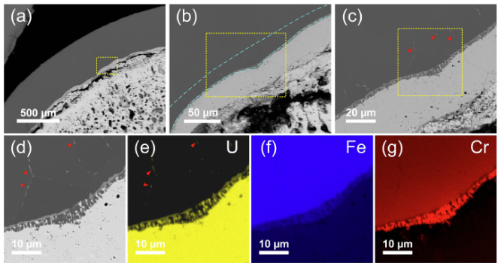
Fuel Cladding Chemical Interaction in Metallic Fuel
Uranium alloy metallic fuel preferred in sodium fast reactors for its high fissile density and thermal conductivity
Iron-based claddings needed for strength at temperature and resistance to fast neutron damage
Lanthanide fission products migrate through toward cladding and react, essentially corroding the cladding from the inside out
Understanding behavior crucial to determining temperature and burnup limits to ensure fuel performs reliably
FCCI Microscopy in U-10Zr metallic fuel https://doi.org/10.1016/j.jnucmat.2020.152588

Slide 11
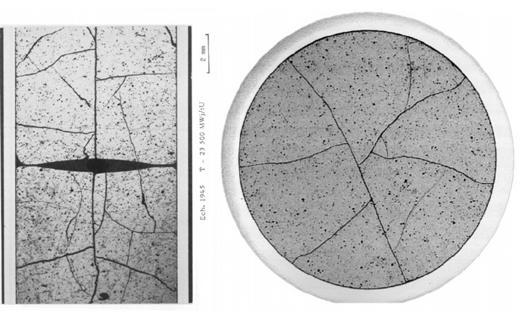
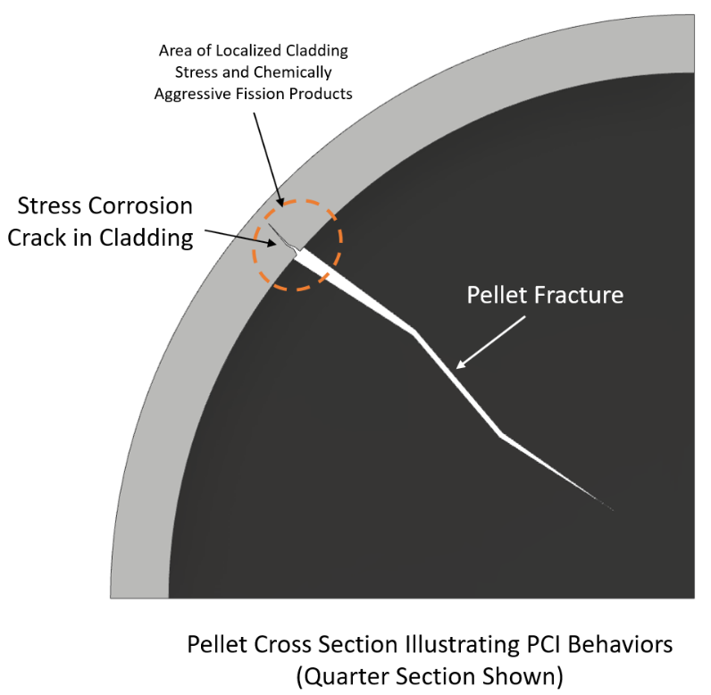
Summary of Pellet Cladding Interaction in LWRs
Thermal gradients causes radial fractures in UO₂ on first rise to power
External coolant pressure on Zr-alloy cladding “creep down” closes pellet-cladding gap by mid-life burnup
From this state, power ramps (planned power maneuvers) create a stress state susceptible to stress corrosion cracking
  Chemically aggressive fission products (e.g., iodine) concentrates phenomena near pellet fracture-cladding interfaces
  Can penetrate through cladding to create pin hole “leaker rod”
PCI ramp testing in material test reactors used to investigate behavior
  Irradiation at low power long enough for cladding creep down
  Followed by power ramp and hold, repeat until leak is detected
Fractured UO₂ LWR Fuel
Michel et al. Eng. Frac. Mech., 75, 3581 (2008)

Slide 12
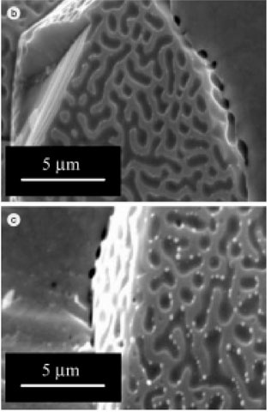
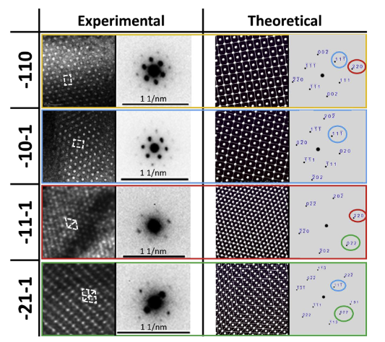
Let's talk about fission gas
Early life: Fission gas atoms recoil microns in fuel material and get “stuck”
As gas inventory grows, more gas atoms collect in nano bubbles, finding stable homes in the microstructure
  Ordering into beautiful patterns in fuels with ordered crystal structures (U-Mo at MTR temperatures, UO₂ at LWR temperatures)
  Or just chaotically “bubbling around” in glassy/amorphous microstructures (U₃Si₂ at MTR temperatures, U-Zr at SFR temperatures)
  Geometric swelling starts to manifest
As gas bubble pressure grows, so does the driving force for bubble growth and migration
  Bubbles often find each other and coalesce and drive toward a free surface to get released into the cladding
  Gas diffusion through the microstructure tends to follow thermal gradients, larger bubbles tend to collect at grain boundaries first
  Fractures in some fuel systems (e.g., pelletized ceramics) reduce gas diffusion length to a free surface
  In ductile fuel systems (e.g., metallic) bubbles interconnect and form “wormholes” to the surface
Intragranular fission gas bubbles in UO2
https://doi.org/10.3389/fenrg.2022.766865
Comparison of measurement and simulated fission gas lattice in U-Mo, https://doi.org/10.1016/j.jnucmat.2019.151947

Slide 13


Fission Gas Management Strategy
Resist, 0% release to cladding
Comply, 100% release to cladding
MTR
VHTR
LWR
SFR
MSR
Some things that increase FGR in solid fuels
  Burnup (or fission density) → more fission gas inventory
  Isotope (Pu-239, U-233 have different higher fission gas yields than U-235)
  Increasing temperature (gas micro-bubble pressure goes up, and diffusion rates increase as atoms in the fuel material “wiggle” more)
  Amorphous (gas atoms diffuse more easily through irregular “messy” non-crystalline microstructures)
  Time under irradiation (neutron atom displacement, fission, etc. are ”mixing” the microstructure, helping gas atoms move around)
In liquid fuels virtually all fission gas comes out and the piping/vessel system must deal with it

Slide 14
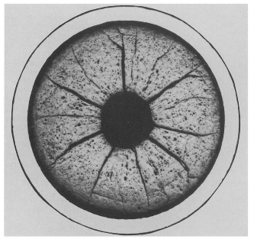
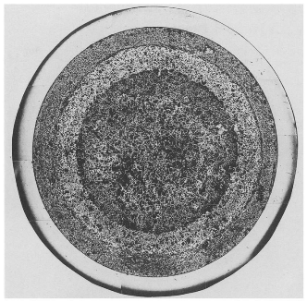
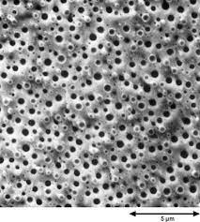
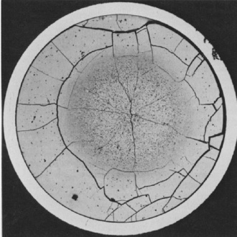
Fission Gas in Rod Type Fuel
LWR: Fresh state gap, plenum, pellet porosity (1-3%), initial plenum pressure, cladding properties/geometry all define the capacity for accommodating FGR
High temperature ceramic, well-order crystal structure, relatively low ²³⁵U density (5% enrichment) → Relatively low FGR (~10-20%)
Gas diffusion through microstructure to surfaces/fractures permits a slow-and-steady release to modestly-sized plenum
General idea is to maintain P_{outer} > P_{inner}
SFR: Higher fission rates and coolant temperatures
Extreme thermal gradients drive porosity migration to centerline in oxide systems (e.g., SFR-MOX), pathway for FGR to plenum
Fresh state 25% free volume designed into metallic systems, swells like bread until pores fully interconnect, then swelling ceases and FGR releases to plenum through “open-cell foam” microstructure
Larger FGR fractions (~80% in metallic fuel) require longer plenums (thankfully the cores are much shorter and fast spectrum neutronics allow cladding alloys to be stronger (Fe-based)
UO₂
Plenum
Plenum
Radial Gas Gap
SFR-MOX
SFR-Metallic Fuel

Slide 15
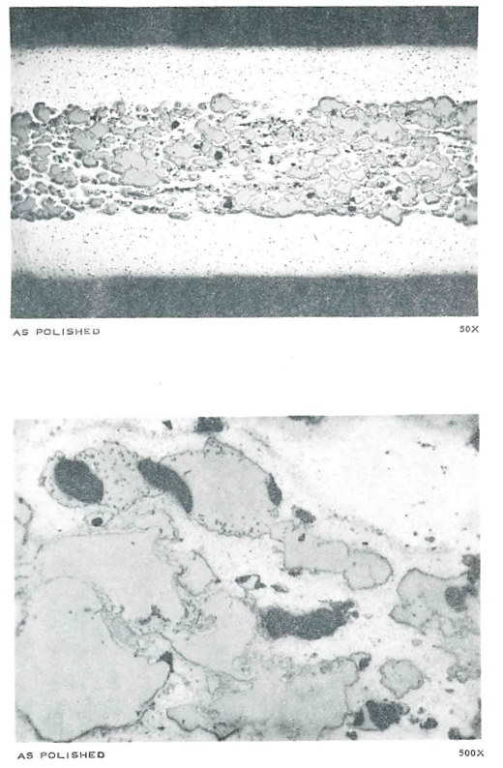
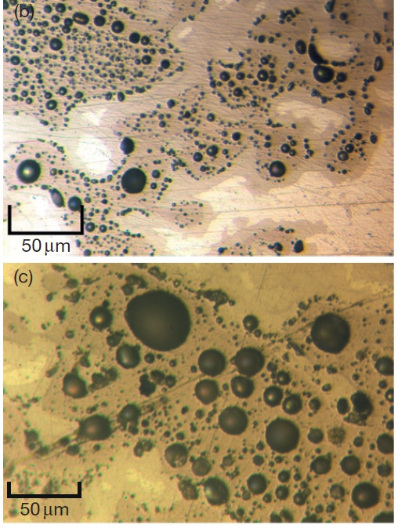
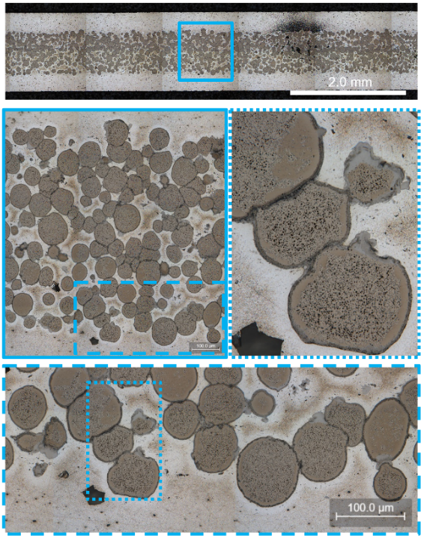
Fission Gas in MTR Plate-Type Fuel
0% FGR very difficult to achieve in useful burnup/temperature regimes
  Most fuel systems must have some free volume to accommodate gas
Rectangles make terrible pressure vessels, must retain nearly all fission gas in the microstructure (never grow up, stay an adolescent fuel forever)
  Composite architecture (“dispersion” fuel) helps provide some initial porosity (~10%) and holds composite together in a 3D web of metal
  But introduces new problem of managing particle matrix chemical interaction
UAlx in Al “aluminide” fuel (ATR fuel), a fuel system that succeeds by being mostly aluminum
U₃Si₂ in Al “silicide” fuel, an amorphous MTR fuel system that succeeds [barely] by managing fission rate and temperature
U-Mo in Al dispersion fuel, a high-density fuel system that succeeds by managing matrix chemical interaction

Slide 16
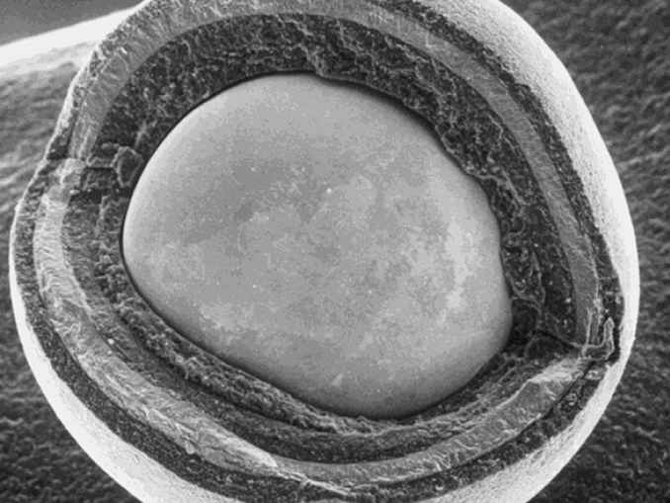
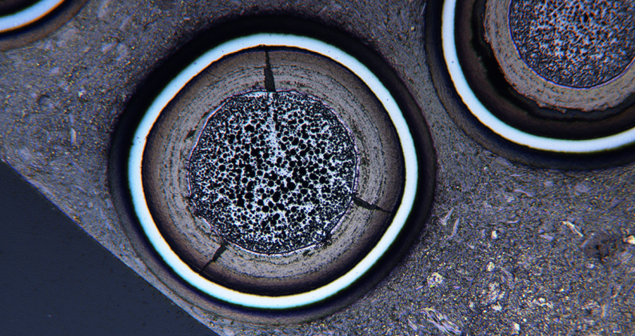
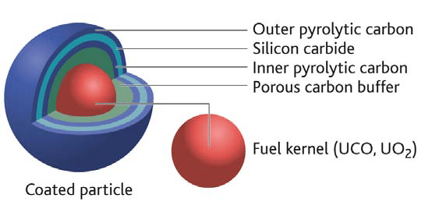
Fission Gas in Coated Particle TRISO Fuel
Uranium Oxide/Carbide ceramic kernels (UCO)
  Small kernel size (~500 μm) dispersed in high thermal conductivity matrix (graphite) reduces thermal gradients/cracking in fuel
  Despite LWR-like FGR microstructural behavior, increased enrichment (20%) and high burnups → Particles end up virtually decimated by fission gas in late life due to high fission density
  Innermost porous carbon buffer coating provides free volume
  SiC and pyrolytic carbon coatings function like cladding (tiny little spherical pressure vessels) to retain FGR

Slide 17
Conclusions
Nuclear fuels are the heart of a reactor, alongside coolant and spectra, constitute the most important decisions a reactor designer can make
Several disciplines and phenomena significant in fuel performance, test reactors make crucial contributions to developing nuclear fuels
  Oldest and most well-known fuel system (UO₂ in Zr-alloy) still being actively researched to unleash new gains
  Near future deployment of TRISO and U-Zr metallic fuels only possible because of DOE’s investment in understanding fuel behavior, now starting the journey toward their maximum potential
  Relatively little data for other fuel systems and innovative concepts, data will be key to unlocking their performance potential
Irradiation testing crucial to understand nuclear fuel performance, better optimize behavior, and maximize reactor performance

Slide 18
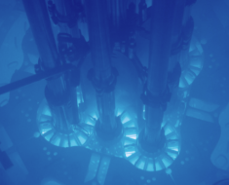

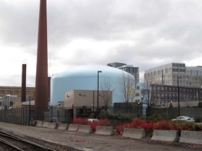
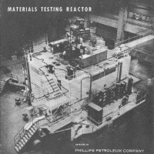
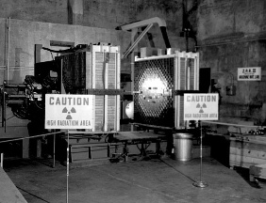
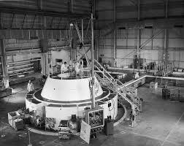
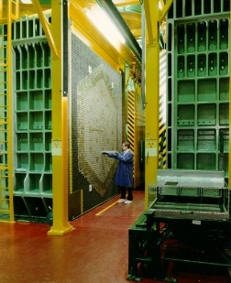
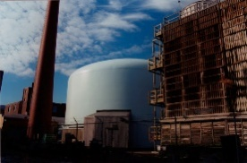
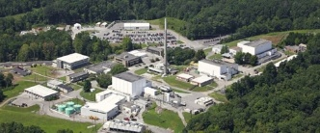
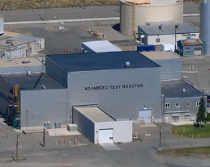
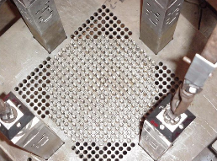
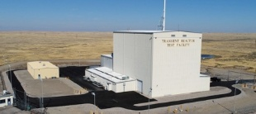
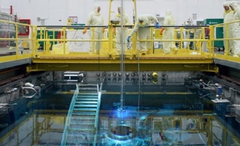
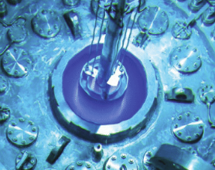
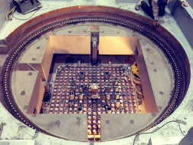









A Foreshadow to Tomorrow’s Session: Test Reactors
The Past
The Future
Thermal Spectrum
Critical Facilities
MTR
ZPR-3
ETR
ZPRR
ATR
-High flux, large volume
-Water loops for fuels testing
-Unique dynamic testing
MITR
MITR
-LWR-like flux
-Cladding corrosion testing in water loops
ATR
RCF
HFIR
-Very high flux on subsize tests
-Unique capabilities for accelerated testing
HFIR
TREAT
-Extreme power maneuvers
-Unique fuel safety testing abilities
TREAT
Transient
SPERT
SPARC
-Reactor scale critical tests
-Project recently initiated with near future timeline
Fast Spectrum
Fast Spectrum Test Reactor
-High fast flux
-Crucially needed, timeline TBD
EBR-II
PBF
FFTF
LOFT

