Slide 1
Foundations of Irradiation Testing Workshop:
Welcome and Introduction to the Nuclear Science User Facilities
Brenden Heidrich, PhD PE
NSUF Director
July 21, 2026

Slide 2
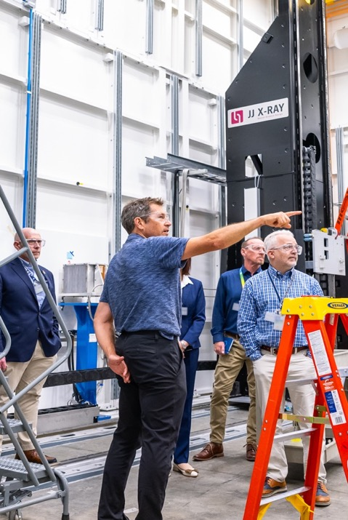
Foundations of Irradiation Testing Workshop

Slide 3
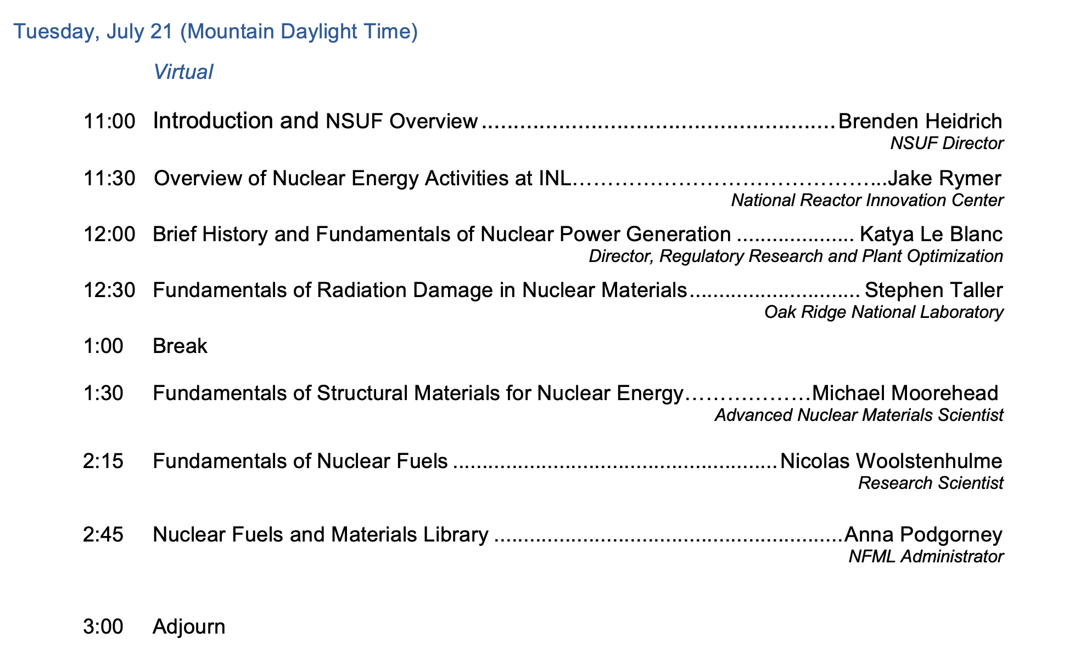
Foundations of Irradiation Testing:
A Workshop for Researchers (Day 1)

Slide 4
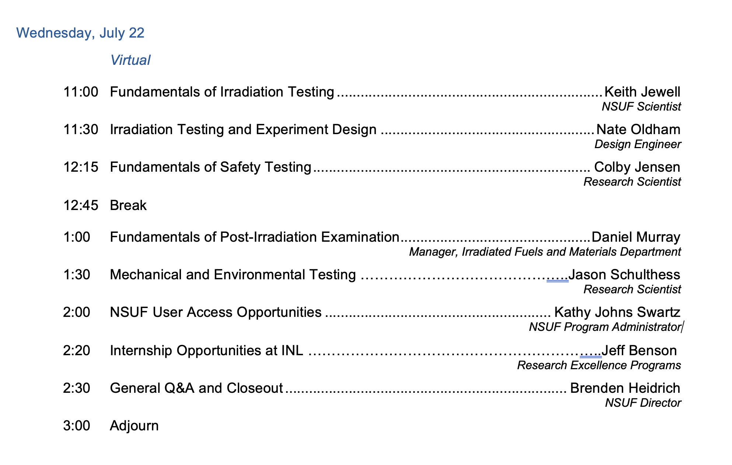
Foundations of Irradiation Testing:
A Workshop for Researchers (Day 2)

Slide 5
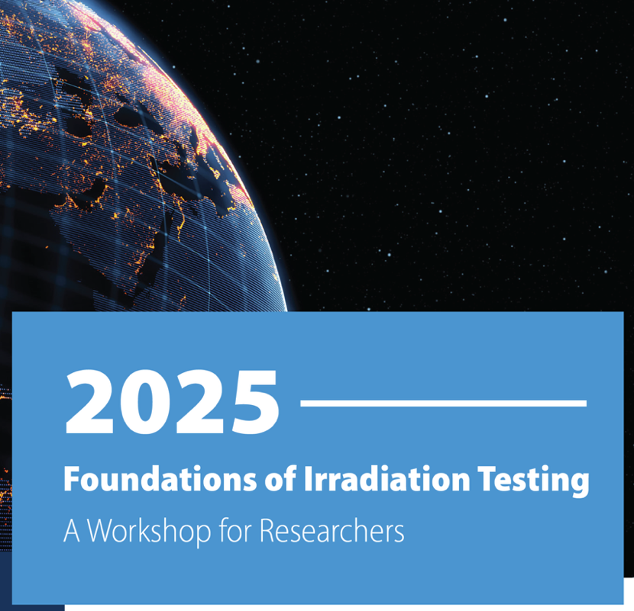
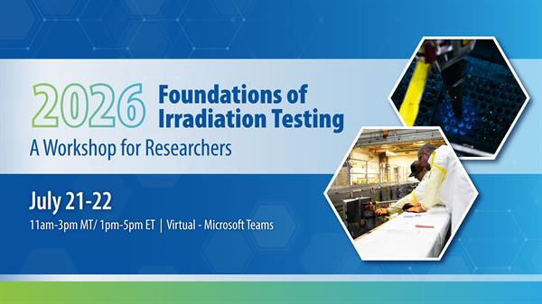
FIT Workshop Guidelines
Punctuality: Please join the meeting 5-10 minutes before the scheduled start time to ensure you are ready when the session begins.
Mute Your Microphone: To avoid background noise, keep your microphone muted when you are not speaking. You can unmute yourself when you need to ask a question or participate in discussions.
Use the Chat Function: Feel free to use the chat function to ask questions or make comments during the presentation. Our moderators will monitor the chat and address your queries at appropriate times.

Slide 6
FIT Workshop Guidelines
Camera Usage: While it is not mandatory, we encourage you to turn your camera on during interactive portions of the workshop, such as question-and-answer sessions, to foster engagement and collaboration. However, due to the high volume of registrations, we request that cameras remain off during presentations to ensure the quality and stability of the meeting.
No AI Bots: Please refrain from using automated bots or scripts to interact with the meeting. Any bots detected will be removed from the meeting to ensure a smooth and genuine experience for all participants.
Technical Issues: If you experience any technical difficulties, please notify us through the chat or contact our program office at nsuf@inl.gov.
Respect and Professionalism: Please be respectful and professional in your interactions with the presenters and fellow participants.

Slide 7
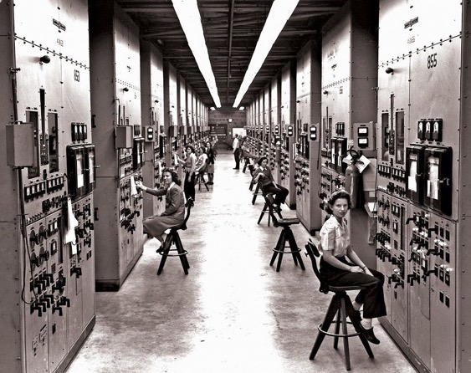
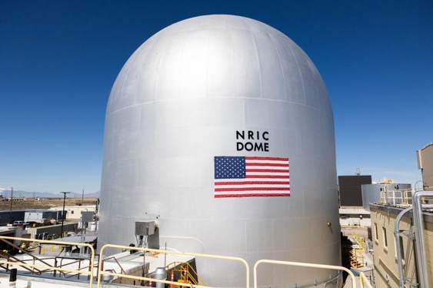
US Designated User Facilities
Origins: From the Manhattan Project to a National Scientific Infrastructure
Roots in WWII: the Manhattan Project created a vast R&D apparatus under the War Department, producing large, multi-purpose facilities such as Oak Ridge, Hanford, Los Alamos, and the Met Lab at Chicago (which became Argonne) that became the nation's first national laboratories.
Originally only temporary, the wartime labs were extended indefinitely by the newly created Atomic Energy Commission, which built out a permanent national laboratory system through the late 1940s and 1950s.
The founding rationale for "user facilities" was to provide a home for large, costly scientific instruments such as particle accelerators, reactors, light sources, that no single university could afford, but that the U.S. needed to maintain leadership in science.
The Department of Energy Organization Act of 1977 created the DOE and separated weapons labs from science labs. The Office of Energy Research (pre-Office of Science) took stewardship of the basic-research labs and their user facilities.
This Photo by Unknown Author is licensed under CC BY-SA
Photo credit: Idaho National Laboratory
Notes:
Reactor research at the University of Chicago's Metallurgical Laboratory led to Argonne National Laboratory; uranium separation built up Oak Ridge; plutonium production stood up Hanford; and the weapons design lab was established at Los Alamos under Robert Oppenheimer. These wartime labs were originally conceived as temporary.

Slide 8
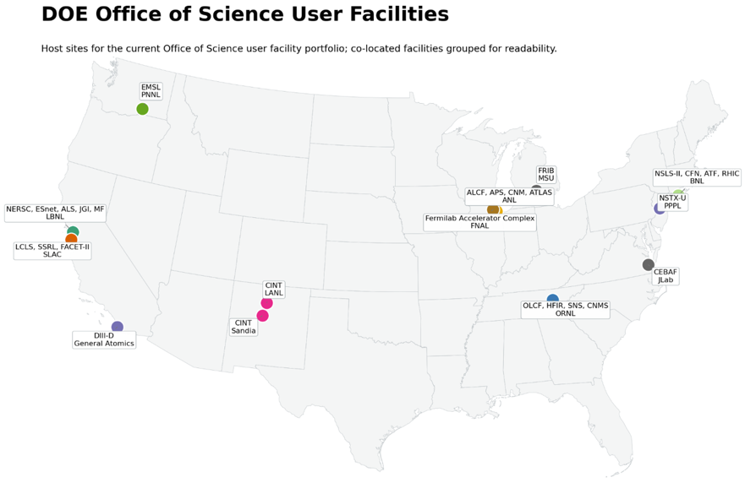
US Designated User Facilities
29 user facilities, distributed across the DOE national laboratory complex.
X-ray light sources (APS at Argonne, ALS at LBNL, LCLS at SLAC, NSLS-II at Brookhaven, SSRL at SLAC)
Neutron sources (SNS and HFIR at Oak Ridge)
Nanoscale science research centers (Argonne, Brookhaven, Oak Ridge, LBNL, and the joint Los Alamos/Sandia center)
Leadership-class scientific computing (ALCF at Argonne, OLCF at Oak Ridge, NERSC at LBNL, ESnet)
Particle and nuclear physics accelerators and colliders (RHIC at Brookhaven, CEBAF at Jefferson Lab, ATLAS at Argonne, FACET-II at SLAC, Fermilab accelerator complex)
Magnetic fusion (DIII-D at General Atomics, NSTX-U at PPPL)
Biological and environmental facilities (Joint Genome Institute, EMSL at PNNL, ARM atmospheric measurement)
Nuclear Energy material science and high-performance computing resources (NSUF in DOE-NE)
Image credit: ChatGTP using data from
https://www.energy.gov/science/office-science
Notes:
Reactor research at the University of Chicago's Metallurgical Laboratory led to Argonne National Laboratory; uranium separation built up Oak Ridge; plutonium production stood up Hanford; and the weapons design lab was established at Los Alamos under Robert Oppenheimer. These wartime labs were originally conceived as temporary.

Slide 9
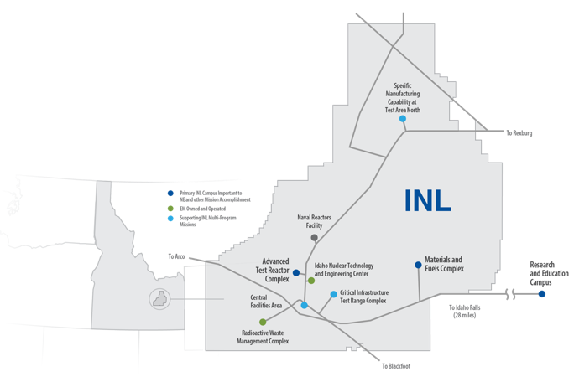
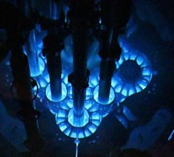
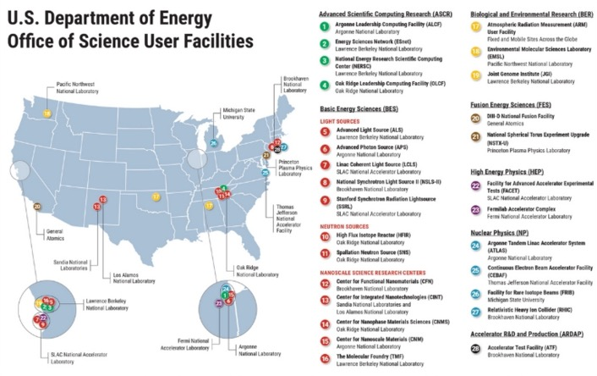
Nuclear Science User Facilities Program
A User Facility to empower US Nuclear Energy
Established in 2007 (along with Idaho National Laboratory in 2005)
  To be the U.S. Department of Energy Office of Nuclear Energy’s first dedicated user facility for nuclear energy
  Intended to open the national laboratories to university researchers
Founded at Idaho National Laboratory (INL)
  INL remains the lead and primary institution
  Seven other national laboratories are NSUF partners
NSUF operates similarly to other user facilities in the United States
  Fundamental Research - basic and applied research in science and engineering, intended to be published and shared broadly with the scientific community
  Competitive proposal processes for access
  No cost to user for accessing capabilities
  No travel funding to users, etc.

Slide 10
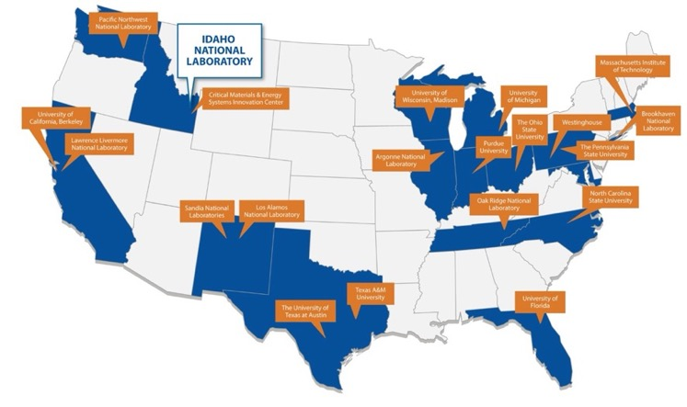
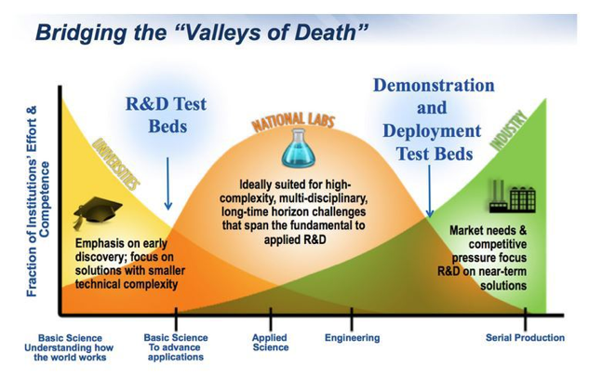
Nuclear Science User Facilities Program
The unique aspects of NSUF
  We are a consortium of facilities/capabilities
  21 institutions across the United States
  >50 major facilities and laboratories
  NSUF efficiently leverages existing investment in physical capabilities by utilizing excess capacity.
  Funding to partners covers only the costs for the awarded access project
  We can apply multiple capabilities to a single scientific area
  Fundamental irradiation effects in nuclear fuels and materials that are important to US nuclear energy development
  We support large projects that can last up to 7 years
  Full-scale projects can include engineering design, experiment fabrication, specimen transport, neutron irradiation, post-irradiation examination, and final disposition.
  All projects are fully forward-funded at the time of award. No worries about future budgets.
Notes:
The NSUF realized that the demand for nuclear energy material science capabilities far exceeded the capabilities provided by ATR and associated post-irradiation examination facilities at the Idaho National Laboratory (INL).
Between 2008 and 2025, NSUF added twenty institutions across the US as “partners.” The current list of NSUF partner institutions is available at https://nsuf.inl.gov/Home/PartnerInstitutions.
The distributed nature of the program adds a level of complexity in the interactions between the program office, located at the INL, and the partners and users, scattered across the US.

Slide 11
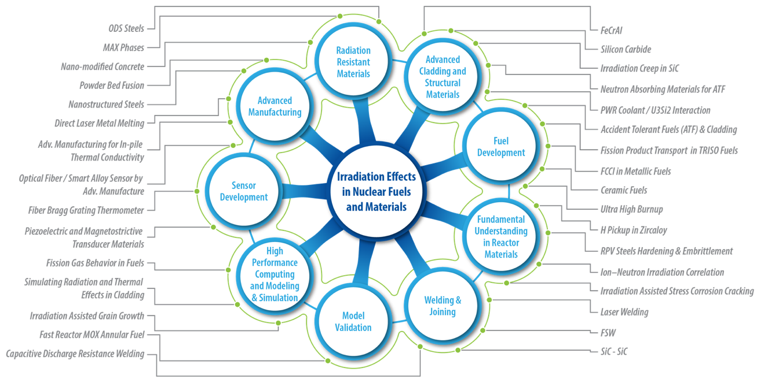
NSUF covers all aspects of nuclear energy materials R&D

Slide 12
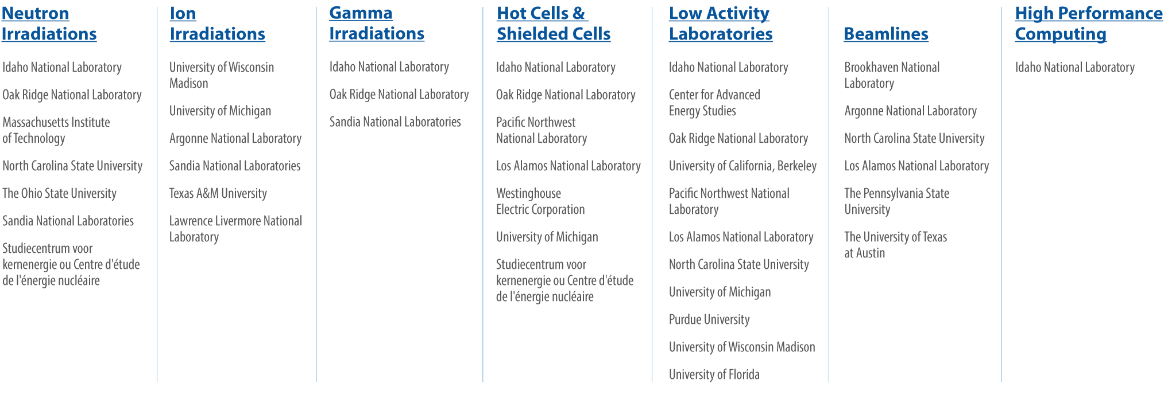
NSUF Provides Access to Enabling Capabilities

Slide 13
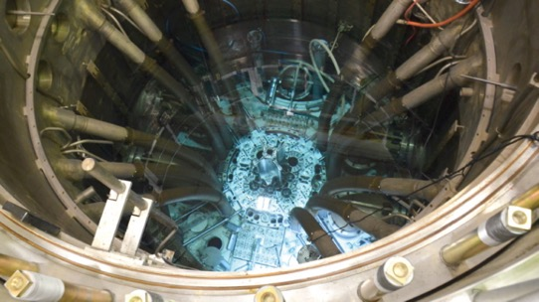
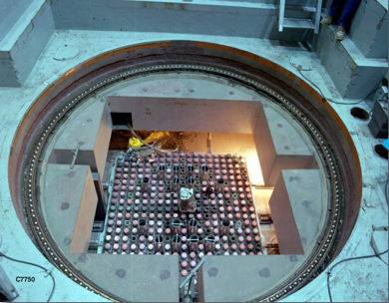
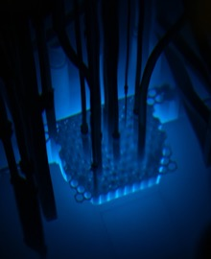
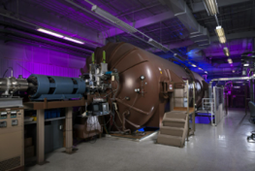
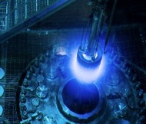
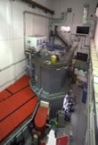
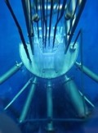
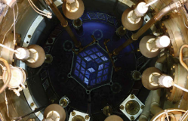
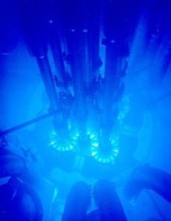
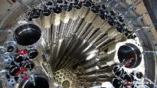


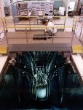
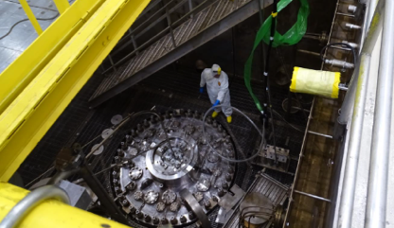
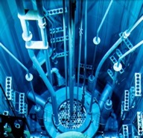
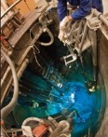
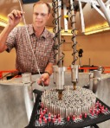
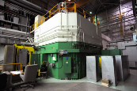
Ion and Neutron Irradiation Capabilities
PSBR 1MW TRIGA research reactor
(Credit: Penn State)
Irradiation Testing Hierarchy
  Ion Beam Irradiation Facilities
    Allow immediate feedback of performance
    Ease of instrumentation
    Ease of environmental tuning
  Low-Power Research Reactors
    First 1% and 10% testing to inform future test reactor campaigns
    Instrumentation development (ease of access to the core)
      Ease of use, faster access, and lower cost (NSUF RTE-eligible)
  Test Reactors
    Prototypic testing and materials qualification
    Utilize the NSUF RAD Calculator to estimate DPA and residence time at different reactors
10-MV tandem accelerator at the Center for Accelerator Mass Spectrometry (Credit: LLNL)
Materials Pathway
Sensor
Pathway
High Flux Isotope Reactor with NSUF
WIRE-21 experiment (Credit: ORNL)

Slide 14
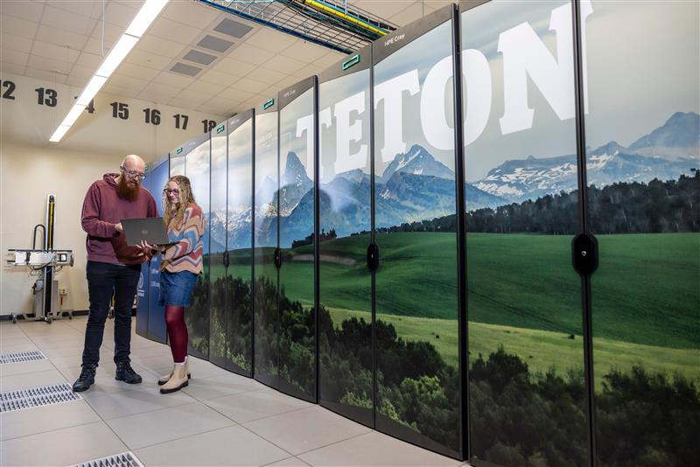
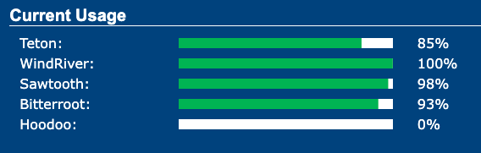
High-Performance Computing (HPC)
Teton (2026)
  15.6 Petaflops performance
  393,216 AMD 9965 Turin cores with 768 TB total memory
Wind River (2025)
  5.4 Petaflops performance
  94,416-core Dell CTS-2 system with 211 TB total memory
Bitterroot (2024)
  2 Petaflops performance
  43,008-core Dell CTS-2 system with 90 TB total memory
Sawtooth (2020)
  5.6 Petaflops performance (#37 on Top 500 list in 2020)
  99,972-core HPE SGI 8600 system with 395 TB memory
Delivered 1,930 million core hours to users in FY25
Creating a centralized Artificial Intelligence platform on HPC with Hoodoo (2021) and Caribou (late 2026) GPU AI/ML development machines and the Nuclear Research Data System (NRDS) archive and portal.
Supported user trainings and support activities.
Expanded storage by 1.8 petabytes to enhance HPC performance

Slide 15
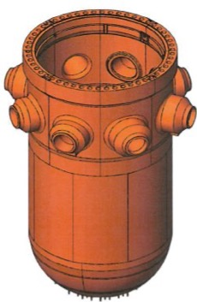
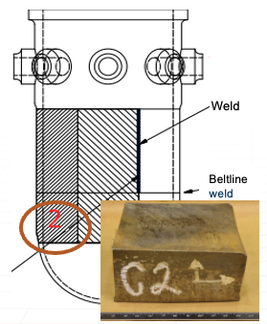
Nuclear Fuels and Materials Library (NFML)
What is the NFML? | Access & Policies | Recent Additions and Campaigns
DOE‑NE‑owned, NSUF‑curated archive of irradiated fuels and materials plus technical info and publications Tied to the Nuclear Research Data System (NRDS) for analysis and visualization using INL HPC. NFML includes NSUF‑project samples, EBR‑II legacy items, harvested power‑plant components, and donations. Currently >10,000 samples available to researchers | Donations - Ownership & transfer: third‑party materials must transfer unrestricted title to DOE‑NE. NSUF Irradiations – PIs have three years of exclusivity access for new samples created in their projects The time starts when samples are delivered to the PIE facility Afterwards, the samples are open to the broader research community in the NFML The original PI contact information is shared to enable collaboration Requests & guidance: NFML Request Page → https://nsuf.inl.gov/Page/nfml_request | Recent Donations: ATR‑irradiated multi-principal element alloys (MPEA) tensile set ATR‑irradiated Yttrium‑hydride moderator samples Additions: AM FeCrAl fabrication‑route assessment SiC neutron‑transmutation‑doped set Cladding coatings diffusion couples Directed Campaigns: NIFT‑E US–UK cooperative ATR project (AFA SS and graphite) DISECT UZr (2026-2027 irradiation at BR2) SAM‑3 multiple structural materials in six capsules (3–6 dpa, 320–700 °C) with ATR irradiation start FY27‑Q2.
Example of harvested reactor pressure vessel material specimens from the decommissioned Zion Nuclear Power Plant donated by the Light Water Reactor Sustainability Program (LWRS).

Slide 16
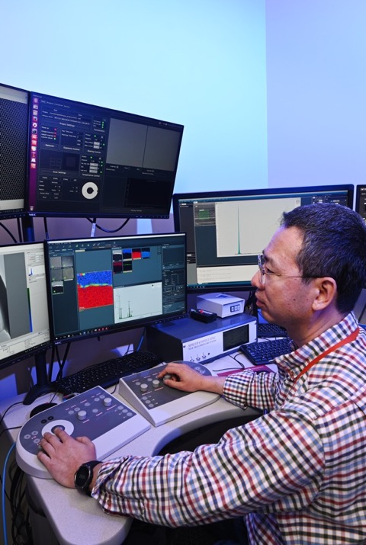
NSUF Competitive User Access Opportunities

Slide 17
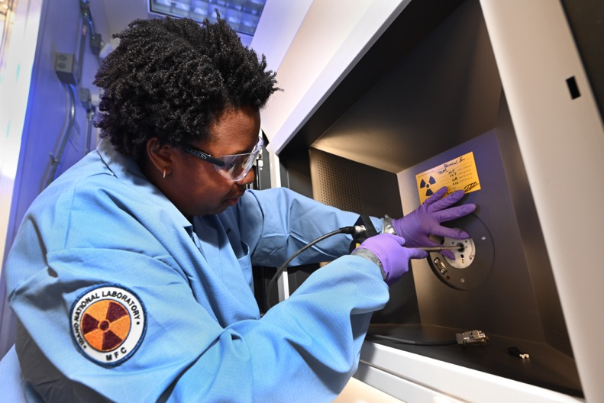
NSUF Access Award Projects Summary: FY07-FY25
Total NSUF Access Award Funding: $149.5M
900 total projects awarded
  46 CINR type projects executed
  37 CINR type projects currently ongoing
  672 RTEs executed
  145 RTEs ongoing
Awards distribution by institution type
  532 projects to 59 U.S. universities
  283 projects to 10 national laboratories
  42 projects to 16 industrial users*
  43 projects to 22 international researchers
  * All NSUF access awards support non-proprietary fundamental science and are intended for full public release
Notes:
Updated 3.2.2026 9-Mar-26 NEW TOTAL 149504658
Total projects awarded
900 46 CINR executed
37 CINR active
672 RTEs executed
145 RTEs Active
Awards by institution
532 projects 59 Universities
283 projects 10 labs
42 projects 16 industrial
43 projects 22 international
900

Slide 18



Consolidated Innovative Nuclear Research (CINR) projects
Partnership with the Nuclear Energy University Program (NEUP) to enable multi-year projects with NSUF access and funding for the research team and students.

Slide 19
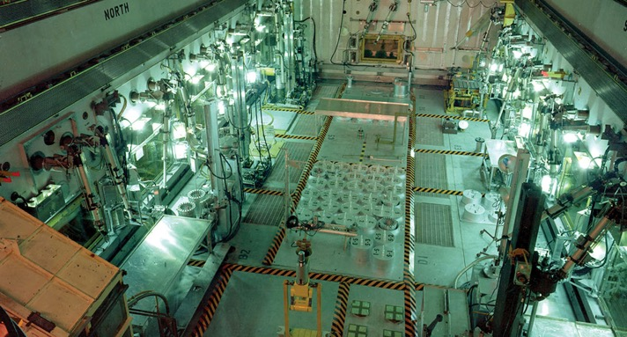
NSUF Consolidated Innovative Nuclear Research
Characteristics of the CINR NOFO
One call per year
Projects include design, analyses, fabrication, transport, irradiation, disassembly, PIE, disposition of materials
Possibility to receive user R&D funding on university-specific topic areas
Projects with test reactor irradiation and post-irradiation examination can extend to 7 years and up to $4,000,000.
Topic Areas (FY26)
Fuel and Core Materials: Projects in the areas of fuels irradiation performance and combined effects of irradiation and environment on fuels and core materials, such as fuel cladding.
Structural Materials and Manufacturing Methods: Projects in the areas of advanced structural materials for nuclear energy applications, novel or cost-effective manufacturing methods, and related topics that leverage NSUF irradiation and post-irradiation examination capabilities.
Sensor Materials, Instrumentation, and Active Component Systems: Projects that support the development of advanced sensor materials and advanced instrumentation to enhance the long-term viability and competitiveness of the existing fleet, and to develop an advanced reactor pipeline.

Slide 20
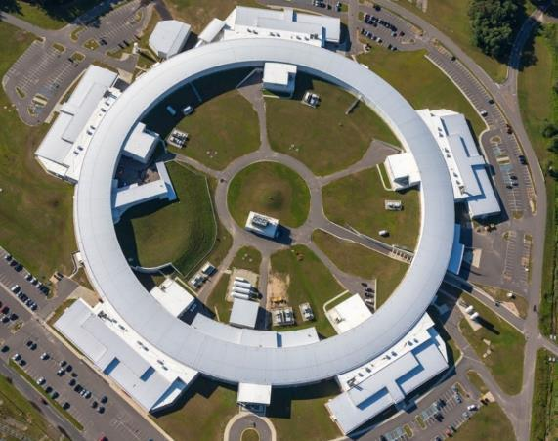
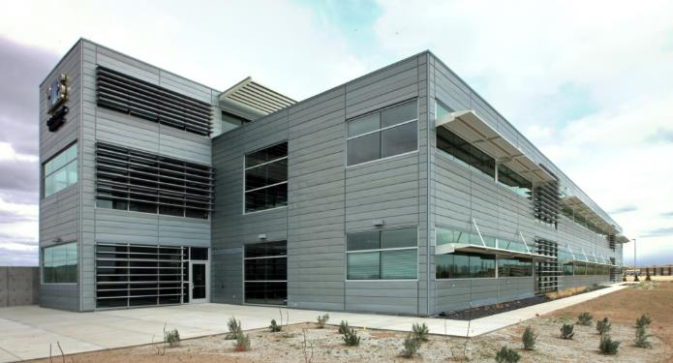
RTE and Super RTE
XPD Beamline at the National Synchrotron Light Source-II (NSLS-II), BNL
Streamlined opportunities to obtain NSUF access support for small and mid-sized projects to answer single questions on nuclear energy fuels and materials.
Microscopy and Characterization Suite at the Critical Materials and Energy Systems Innovation Center (INL)

Slide 21
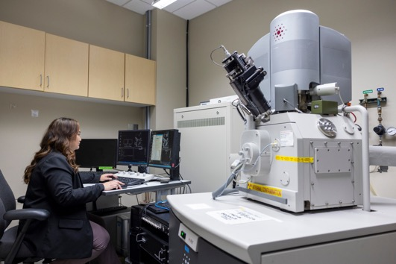
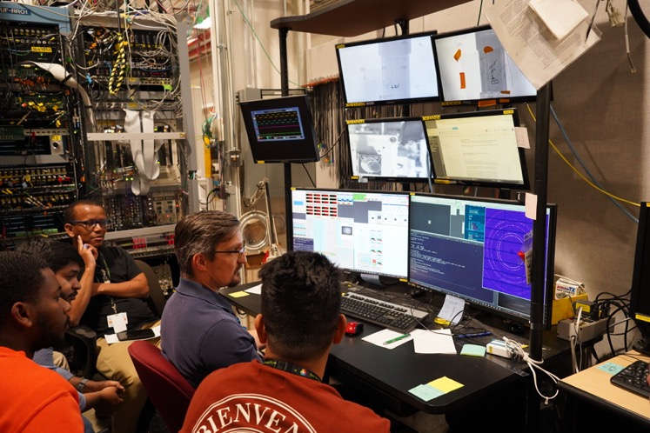
NSUF User Access Opportunities:
Rapid Turnaround Experiments
RTE Call Characteristics
Projects are selected through open competitive proposal processes
Proposals welcome from university, government laboratory, industry, and small business researchers
Only non-proprietary projects accepted. All awarded projects are fully forward funded
Traditional RTEs (1-2 calls/year)
Limited scope: ~2 weeks of characterization and executed within 9 months of the award
Super RTEs (1 call/year)
Twice the allowable access time at partner facilities
Two NSUF partner institutions for PIE
12-month project duration
Instrument scientist preparing a specimen for microscopy using the Focused Ion Beam at the Microscopy and Characterization Suite.
Scientists and students gathered to conduct X-ray measurements on radioactive samples at the Advanced Photon Source.

Slide 22
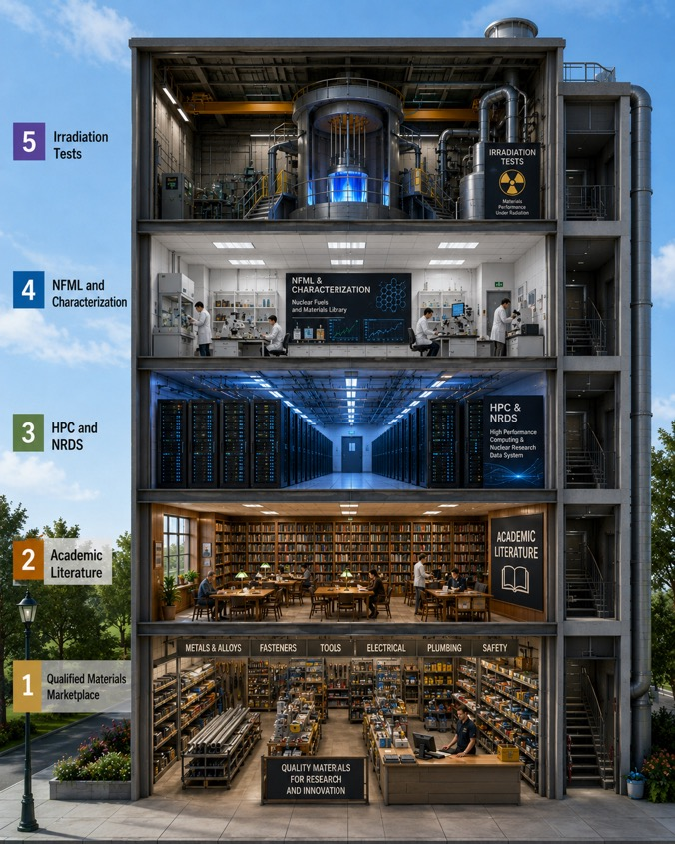
Answering the need for new nuclear energy materials
If you need a new material for a nuclear energy system, NSUF can help you create the irradiation testing data.
The higher that you go will add cost and time to your search.
The material might already be in the marketplace. Search for ASME code cases and similar standards for qualified materials.
Perhaps there is not a code case, but there has been research. Do a search of the academic literature.
Maybe there has been research, but the publications doesn’t address your specific questions, find the project data at NSUF’s Nuclear Research Data System and do your own analyses using INL HPC resources.
You may need to create your own data. You can find pre-irradiated specimens in the Nuclear Fuels and Materials Library and utilize NSUF’s advanced materials characterization capabilities.
Finally, if all else fails, NSUF has resources to perform a new irradiation test, using ions and neutrons.
Graphic created using ChatGPT

Slide 23

1st Floor: Qualified Materials Marketplace

Slide 24
NSUF Awards Related to Advanced Manufacturing
24 awarded projects on AM materials and techniques (through FY24)
  14 RTE and 10 CINR awards (starting in 2015) including multiple ATR and HFIR irradiations
Awards related to types of advanced manufacturing
  11 projects related to LPBF
  8 projects related to DED
  6 projects related to PM-HIP
  1 project related to electron beam welding
  2 projects related to cold spray
Awards related to AM materials
  ODS: FeAlCr
  Fe-based: T9, T91/Grade 91, SA508; HT9, 304, 304L, 309L, 316, 316L, 316H
  Ni-based: Haynes 230, Inconel Alloy 625, 690, 718
  Zircaloy
  Fiber sensor embedded titanium components
NIFT-E “Neutron Irradiation as a Function of Temperature – Experiment
  Alumina-forming austenitic (AFA) steels; GA05SA/HT; GA05 20Ni, SA/HT
  304L-3µm Al₂O₃ coated; 304L-1.5µm FeCrAl-1.5µm Al₂O₃ coated
  Oxide coated F/M steels-3µm Al₂O₃ coated; Oxide coated F/M steels-1.5µm FeCrAl-1.5µm Al₂O₃ coated
  AM Grade 91, HEAs, Hetero Nano-composites

Slide 25
2nd Floor: Library
Scholarly Publications and Technical Reports

Slide 26



NSUF Researcher Publications
NSUF-supported research produces around 180 peer-reviewed publications per year.
In total, NSUF (and INL HPC) have an estimated 1,107 peer-reviewed publications with 15,554 citations and an H-index of 53 according to data provided by Web of Science.
NSUF-supported research publications are available at no cost on OSTI.gov.
Lists of NSUF publications and presentations are tied to projects at NSUF.INL.gov.

Slide 27
3rd Floor: High Performance Computing and Nuclear Energy Materials Data

Slide 28
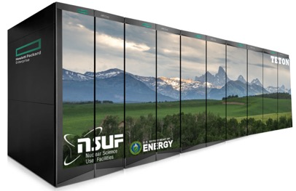
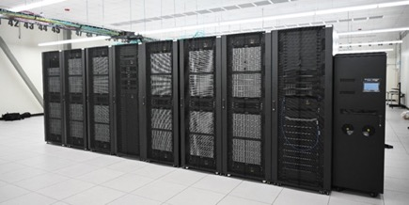
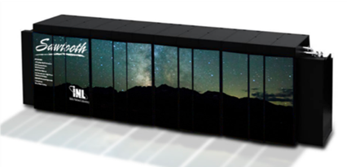
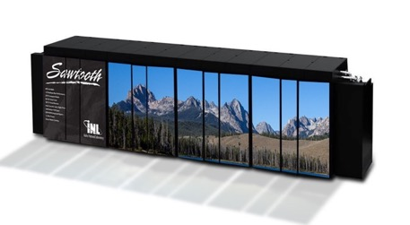
High Performance Computing (HPC) resources
NSUF CPU-based systems support a wide range of users and programs
Teton (2026)
  20.8 Petaflops performance (#85 on Top 500 list)
  393,216 AMD 9965 Turin cores
  1024 nodes - 384 cores/node – 768GB/node memory
Windriver (2025)
  5.4 Petaflops performance
  94,416-core Dell CTS-2 system
  211 TB total memory
Bitterroot (2024)
  2 Petaflops performance
  43,008-core Dell CTS-2 system
  90 TB total memory
Sawtooth (2020)
  5.6 Petaflops performance (was #37 on Top 500 list in 2020)
  99,972 compute cores HPE SGI 8600 system
  395 TB total memory
Teton
Bitterroot & Windriver
Sawtooth
Notes:
Lemhi will be transferred to an Idaho university consortium this year, as was done with Falcon four years ago.

Slide 29
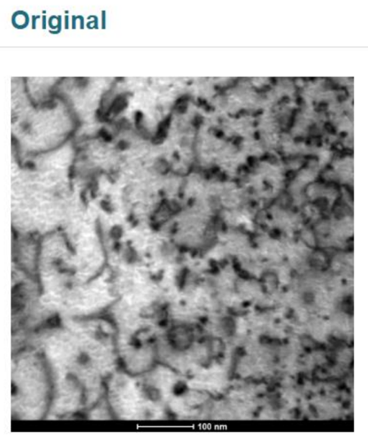
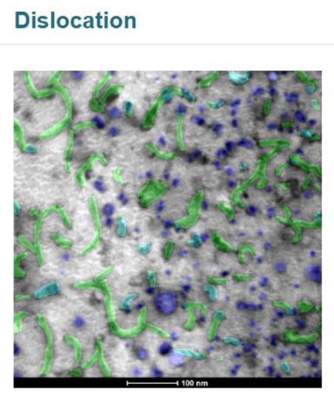
INL HPC supports AI/ML and Genesis Mission
NSUF is creating a centralized Artificial Intelligence platform on HPC with Hoodoo (2021) and Arco (late 2026) GPU AI/ML development machines and the Nuclear Research Data System (NRDS) archive and portal.
Arco (2026)
  AI development machine with 160 NVidia H200 GPUs
Hoodoo (2021)
  Machine Learning Cluster with 92 NVidia A100 GPUs
Teton (2026)
  Teton’s ~400,000 CPUs are being used to support agentic AI workflows.
  The agents currently running include Bison, Halden (data set), Relap5-3D, CUBIT, and MOOSE agents.
  Each agent includes tools such as time series data ingestion, Fortran code readers, mesh generators, plot generators, table readers, parameter optimization workflows, input evaluators, and HPC execution tools.
Images were produced by the NRDS Dislocation Segmentation tool
Notes:
Developed by Claude AI –
What is an agentic AI system?
A traditional AI answers a single question and stops. An agentic AI is different — it receives a goal, breaks it into subtasks, selects the right tools to accomplish each one, executes them in sequence (or in parallel), checks the results, and loops back if something needs adjusting. It acts more like a skilled research assistant than a search engine.
How it works on your supercomputer
When a scientist or engineer poses a task — say, "set up and run a neutronics sensitivity study and give me a ranked table of the most influential parameters" — the orchestrator agent takes that request and figures out a plan. It then delegates subtasks to specialist agents, each of which draws on a shared library of tools to get the job done.
Why this matters for DOE mission work
The practical effect is that scientists spend less time on the mechanics of running codes — job submission, debugging input files, post-processing output — and more time on the science itself. The agents handle the repetitive and error-prone parts of the workflow autonomously, with the human staying in the loop to review results and steer the analysis.

Slide 30
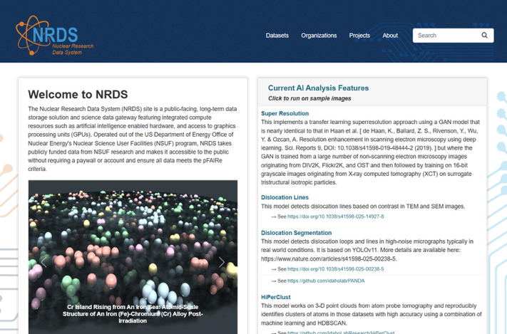



Nuclear Research Data System (NRDS)
Images from NRDS Portal
Notes:
Globus Endpoint is established to enable fast and secure data transfer to INL HPC and NRDS.

Slide 31
4th Floor: Nuclear Materials Archive and Characterization Capabilities

Slide 32

Hot Cells

Slide 33







Simulated Reactor Environments: Mechanical Testing
  Hardness/ Bend test/ Tensile/ Creep/ Fatigue/ Compact tension/ Charpy impact (toughness)
High Temp Tensile Testing

Slide 34




Advanced Microstructure Characterization Capabilities
Optical metallography
Scanning electron microscopy (SEM)
Transmission electron microscopy (TEM)
  Atom probe tomography (APT)
  Electron Probe MicroAnalysis (EPMA)
  Energy Dispersive Spectroscopy (EDS)
  Electron Energy Loss Spectroscopy (EELS)
Spectra 300 STEM
STEM resolution 50 pm
(125 pm at 30kV)
Combination of TEM + APT
Ga₂O₃ Sensor
WDS maps of a TRISO fuel particle
TEM images and EDS maps of irradiated fuel particle

Slide 35


Nuclear Fuels and Materials Library (NFML)
The Nuclear Fuels and Materials Library (NFML) is owned by the U.S. Department of Energy’s Office of Nuclear Energy (DOE-NE) and curated by the Nuclear Science User Facilities (NSUF).
The NFML is comprised of:
Samples resulting from NSUF-awarded projects,
Legacy samples from Experimental Breeder Reactor (EBR-II) and the Fast Flux Test Facility (FFTF)
Samples from real-world components retrieved from decommissioned and operating power reactors,
Donations from other sources, and
Specimens from directed irradiation campaigns
Technical information and publications associated with all NFML project samples.
Harvested LWR Core Shroud Materials donated by BWXT in FY24 and FY25

Slide 36


NFML Donations and Harvesting Activities
Materials that can be donated:
  Irradiated materials / specimens
  As-fabricated or processed materials
  Legacy / archived materials with unique history
Why Materials Donation is Important to NE R&D:
  Reduce cost and time to generate new samples
  Unlock existing high-value materials
  Enables broader community access and collaboration – R&D program coordination
  Donations convert existing assets into a shared, high-impact research resources
New Value Assessment Process was established to assess donations as well as current inventory.
Recent ATR irradiation donations:
High entropy alloys (INL LDRD)
Yttrium hydride moderators (Microreactors program)
AM FeCrAl from (NSUF project from GE Vernova)
Specimen readiness | Relevance to DOE-NE
Uniqueness | Potential Impact
General Electric CINR “Assessment of Irradiated Microstructure and Mechanical Properties of FeCrAl Alloy Fabrication Routes”
Notes:
Value Assessment Process
Assessed Criteria
Readiness
Availability of required documentation, traceability
Materials condition and usability
Transfer, handling, and storage feasibility
Relevance
Alignment with industry/ regulatory/ program needs
Addresses high-priority materials gap
Uniqueness
Rare composition, irradiation history, conditions
Impact Potential
Expected demand, enables high-impact research, supports modeling /AI / qualification

Slide 37
NSUF Directed Irradiation Campaigns to Support the NFML
NSUF has access to US test reactor capabilities at the Idaho National Laboratory (INL) and Oak Ridge National Laboratory (ORNL) and the associated engineering design and fabrication resources.
The program will utilize these capabilities to irradiate specific materials, in standard geometries, and incorporate them directly into the Nuclear Fuels and Materials Library (NFML) for access by NSUF researchers through the NSUF competitive access opportunities.
Standardized irradiation designs and analyses will be leveraged to maximize the effectiveness and efficiency of the campaign.
Based on the relative ease of reconfiguring the irradiation vehicle, many capsules may be constructed, over time, to accommodate a variety of materials.
Not all decisions need to be made at the beginning; additional capsules may be approved and constructed throughout the project.

Slide 38


Structural Material Standard Capsule (SMSC)
Materials and Irradiation Limits
  Materials: non-fuel, structural and cladding materials, materials should not be brittle.
  Maximum dpa: 6 dpa (in stainless steel)
  Temperature range: ~200-700 °C.
Experimental Overview
  Drop-in materials experiment with up to 6 capsules
  60 days ATR cycle
  B7 or B8 positions (near to the driver fuel, high fast flux)
  Concept maximizes the efficiency of the ATR, utilizing all three dimensions available.
  Capsules at lower doses are removed once completed and new capsules replace them in the reactor.
Notes:
This depends entirely on the position and material. For typical stainless steel structural materials, ATR runs a typical 60-day cycle. So, a large B position would take 1.5 years for 1 dpa, inner A position would be less than a cycle for 1 dpa. 2 dpa takes twice as long.
ATR's serpentine core

Slide 39
SAM-III - NFML Irradiation Accelerator
Conventional Alloys: A709 (Carson+PH, ATI+PH, ATI), 316H, A625, Haynes 244, TZM, Grade 92 & Grade 92-modi, and Ni-3Re
Adv. Manufacturing: AM 316H (SR & SA), AM 625, 316L SPS, and 316L+ODS SPS
Refractory / HEAs: Ti2NbZrV0.5Mo0.2, Zr40Nb35Ti25, and 40Ti-20Zr-20Nb-4V-10Mo
Cladding + coating: TiN coated (HT-9, MA957, 14-YWT)
Goal is to populate the NFML with relevant materials without the need for individual irradiation projects.
SAM-III is both an irradiation project and a template for future cost-effective irradiations. The knowledge gained from the SAM-3 and resultant PIE studies will accelerate structural materials development/qualification/deployment for advanced nuclear reactor technologies in the US.
Utilized a “specimen identification and prioritization” (SIP) working group of structural materials experts to solicitate input on materials of interest:
  The readiness of the materials for irradiation testing,
  the potential application of the materials in support of nuclear energy,
  the conditions for irradiation (temperature and fluence/dpa), and
  the importance to the development and deployment of US nuclear reactor technologies.

Slide 40



Experimental Irradiation Matrix for SAM-3
Drop-In Materials Experiment
B8 position with 6 capsules
Insertion Cycle: 177A
Number of Cycles: 12
Capsule | DPA Target | Temperature
SAM-3-A | 3.0 ± 0.5 dpa | 320 ± 50°C
SAM-3-B | 3.0 ± 0.5 dpa | 500 ± 50°C
SAM-3-C | 6.0 ± 0.5 dpa | 500 ± 50°C
SAM-3-D | 6.0 ± 0.5 dpa | 700 ± 50°C
SAM-3-E | 6.0 ± 0.5 dpa | 320 ± 50°C
SAM-3-F | 3.0 ± 0.5 dpa | 700 ± 50°C

Slide 41




US/UK Neutron Irradiation as a Function of Temperature
Graphite
IG110
2114
PCEA
HOPG
IPyC
AFA Capsule
Structural Materials
Oxide-Coated F/M Steels 3µm Al2O3 coated
Oxide-Coated F/M Steels 1.5 µm FeCrAl 1.5 µm Al2O3 coated
Adv Mfg Grade 91
HEAs
Hetero Nano-composites
Alumina-Forming Alloys
GA05 SA
GA05 HT
GA05 20Ni SA
GA05 20Ni HT
AISI Type 304L SS 3 µm Al2O3 coated
AISI Type 304L SS 1.5 µm FeCrAl 1.5 µm Al2O3 coated
Graphite Capsule
NIFT-E model keeps ATR position full of specimens for highest efficiency
Notes:
~500 specimens
Collaborators from AGC – Will Windes, Westinghouse, UKAEA, INL, ORNL, US and UK universities
Alumina-forming austenitic (AFA) stainless steels are leading candidates for lead fast reactor structural components and are also being considered as an alternative accident-tolerant fuel cladding for LWRs.
Graphite is one of the most versatile materials for numerous nuclear reactor designs, as it can be used as a reflector in LWRs and advanced reactors, as a moderator in molten salt and high-temperature gas reactors, as well as forming several of the coating layers of tri-structural isotropic (TRISO) particle fuels.

Slide 42
5th Floor:
Materials Irradiation Capabilities

Slide 43










Simulated Reactor Environments: Neutron Irradiation

Slide 44




Simulated Reactor Environments: Ion Irradiation
IVEM
I³TEM
MIBL
WISC-IBL
TAMU-AL

Slide 45


Past Successful Irradiation Collaborations
NSUF is a force multiplier for Nuclear Energy research and development
Nuclear Energy Advanced Modeling and Simulation
  Texas A&M University MARMOT Validation Project (TAMU-MVP) ATR NEAMS-2 in FY18 CINR
Advanced Sensors and Instrumentation
  Westinghouse Electric Company Integral Fuel Rod Real-Time Wireless Sensor (WIRE-21) sensor irradiation HFIR NSUF-2 in FY18 CINR
  Idaho National Laboratory Testing of Sapphire Optical Fiber Distributed Temperature Sensors MITR NSUF-1.1 in FY19 CINR
  University of Pittsburgh Optical Fiber Sensor Fused Smart Alloy Parts with Graded Alloy Composition MITR NSUF-1.2B in FY17 CINR
  Idaho National Laboratory Demonstration of Self Powered Neutron Detectors MITR NSUF-2.3 in FY20 CINR
Advanced Fuels Campaign
  Ohio State University Diffusion of Zr and Cr for Accurate Lifetime Prediction of ATF (NOEMAD) TREAT - FC-2.5 in FY19 CINR
  University of Pittsburgh Thermal Conductivity Measurement of Irradiated Metallic Fuel Using TREAT (EPIC THOR) TREAT - FC-2.5 in FY19 CINR
  University of Wisconsin Degradation Mechanisms of Cr-coated Zirconium Alloy Cladding in Reactivity Initiated Accidents (CCZ-RIA) TREAT FC-2.5 in FY20 CINR
Graphite Qualification
  SAM-1 – INL/AGC - Graphite and the University of Houston - Fiber Optics (ATR-HSIS directed irradiation and RTEs for PIE)
  NIFT-E – NSUF(US)/NNUF(UK) – advanced graphite materials for reactor applications
EPIC THOR instrumentation assembly for TREAT (credit INL)
Assembled PFOX2 capsule train ready for MITR (credit MIT)
Notes:
All NSUF irradiations are relevant to NE, therefore relevant to some R&D program within NE.

Slide 46

Additional References

Slide 47
Department of Energy Technical Standards and Handbooks
https://www.standards.doe.gov/
Reactor Physics 1: https://www.standards.doe.gov/standards-documents/1000/1019-bhdbk-1993-v1
Reactor Physics 2: https://www.standards.doe.gov/standards-documents/1000/1019-bhdbk-1993-v2
Material Science 1: https://www.standards.doe.gov/standards-documents/1000/1017-BHdbk-1993-v1
Material Science 2: https://www.standards.doe.gov/standards-documents/1000/1017-BHdbk-1993-V2
Mechanical Science 1: https://www.standards.doe.gov/standards-documents/1000/1018-bhdbk-1993-v1
Mechanical Science 2: https://www.standards.doe.gov/standards-documents/1000/1018-bhdbk-1993-v2
Chemistry 1: https://www.standards.doe.gov/standards-documents/1000/1015-bhdbk-1993-v1
Chemistry 2: https://www.standards.doe.gov/standards-documents/1000/1015-bhdbk-1993-v2
Thermal Hydraulics 1: https://www.standards.doe.gov/standards-documents/1000/1012-BHdbk-1992-V1
Thermal Hydraulics 2: https://www.standards.doe.gov/standards-documents/1000/1012-bhdbk-1992-v2
Thermal Hydraulics 3: https://www.standards.doe.gov/standards-documents/1000/1012-bhdbk-1992-v3
Notes:
The first four are the most useful for NSUF projects.

Slide 48
Nuclear Energy Education Resources
  https://www.energy.gov/ne/office-nuclear-energy
  https://www.energy.gov/ne/stem-resources
  https://inl.gov/nuclear-energy/
  https://www.nrc.gov/reading-rm/basic-ref/students/elearning.html
  https://www.ans.org/nuclear/energy/
  https://www.ans.org/nuclear/science/
  https://hps.org/publicinformation/

Slide 49
Nuclear Reactors and Nuclear Energy References
  https://www.energy.gov/ne/articles/nuclear-101-how-does-nuclear-reactor-work
  https://www.energy.gov/ne/light-water-reactor-sustainability-lwrs-program
  https://www.energy.gov/ne/articles/7-moments-december-changed-nuclear-energy-history
  https://www.energy.gov/ne/enhanced-safety-advanced-reactors
  https://www.energy.gov/ne/advanced-reactor-technologies
  https://www.energy.gov/ne/nuclear-fuel-cycle
  https://www.energy.gov/ne/fuel-cycle-technologies
  https://www.energy.gov/ne/office-spent-fuel-and-high-level-waste-disposition
  https://inl.gov/proving-the-principle/
  https://inl.gov/52-reactors/
  https://www.energy.gov/ne/articles/history-nuclear-energy
  https://www.eia.gov/energyexplained/nuclear/us-nuclear-industry.php
  https://www.epa.gov/radtown/nuclear-power-plants
  https://www.nrc.gov/about-nrc/history.html

Slide 50
Learning Resources
Short courses and Summer schools
  https://www.mevschool.net/
  https://www.anl.gov/education/national-xray-school
  https://neutrons.ornl.gov/nxs
  https://www.nist.gov/ncnr/chrns/education-and-outreach/chrns-summer-school-neutron-scattering
User Facilities and Research Tools
  https://nsuf.inl.gov/
  http://science.energy.gov/user-facilities/ (DOE-supported)
  https://www.nsf.gov/focus-areas/infrastructure (NSF-supported)
  https://ssurf.org/

Slide 51
Learning Resources
Radiation Effects on Materials
Materials for Nuclear Power Systems
  https://www.ansys.com/content/dam/amp/2021/august/webpage-requests/education-resources-dam-upload-batch-3/materials-for-nuclear-power-systems-PAPNPSEN21.pdf
Impact of Irradiation on Material Performance
  https://www.antinternational.com/docs/samples/FM/11/Zirat10_Str_Impact_Of_Irradiation_Sample.pdf

Slide 52

American Nuclear Society: “Nuclear-101” Course
Learn the essentials of nuclear energy and technology from the field’s leading experts and instructors during this comprehensive 32-hour course.
Who Should Participate New to nuclear? If you’re just getting started in the nuclear field, Nuclear 101 can quickly get you up-to-speed and provide foundational knowledge to help you succeed. Looking to expand your technical knowledge? If you already work in nuclear without a technical background, Nuclear 101 can strengthen your expertise and help advance your career! Want to build up your professional qualifications? Differentiate yourself and showcase your knowledge by earning the Nuclear 101 Certificate from the industry's leading professional organization. Employers! Nuclear 101 is the perfect way to augment your training and onboarding, allowing your team to learn from seasoned industry experts. | What You'll Learn History and Legacy of Nuclear Nuclear Fundamentals Introduction to Nuclear Fuel Cycle Nuclear Reactors and Power Generation Licensing and Regulatory Concepts Radiation Detection and Measurement Health Physics and Radiation Safety Non-Power Applications of Nuclear Energy Nuclear Safety Culture Advanced Reactor Technologies
The next in-person course is taking place November 15-19 in Phoenix.
Registration will open this summer.
Information and images on this slide are courtesy of the American Nuclear Society https://www.ans.org/nuclear101/
https://www.ans.org/nuclear/professionalcourses/

Slide 53

Questions?
  Brenden Heidrich
    Director, NSUF
    Brenden.Heidrich@inl.gov
INL/MIS-26-91517

