Slide 1
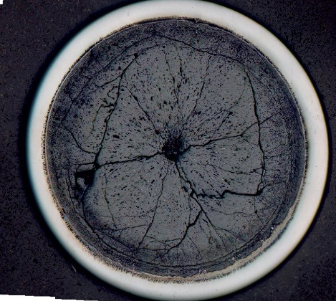
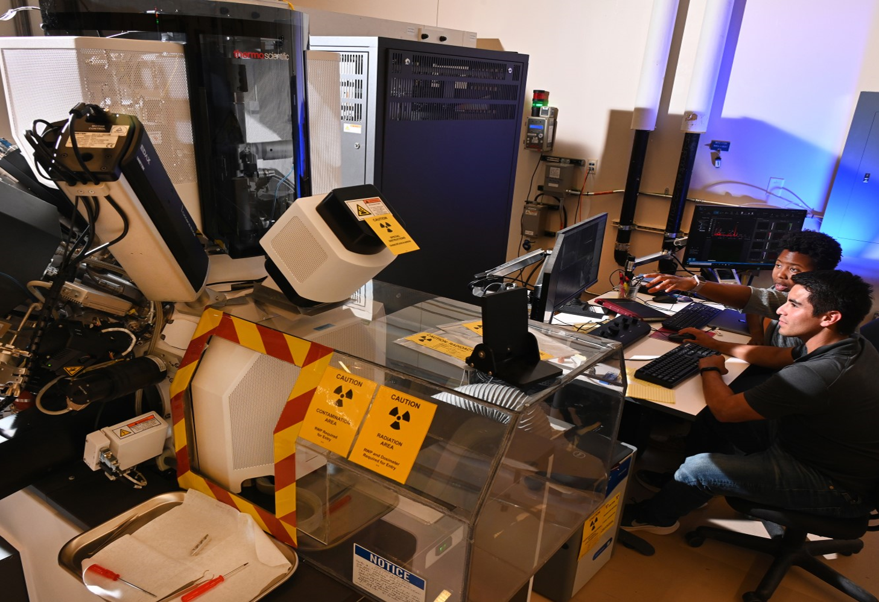
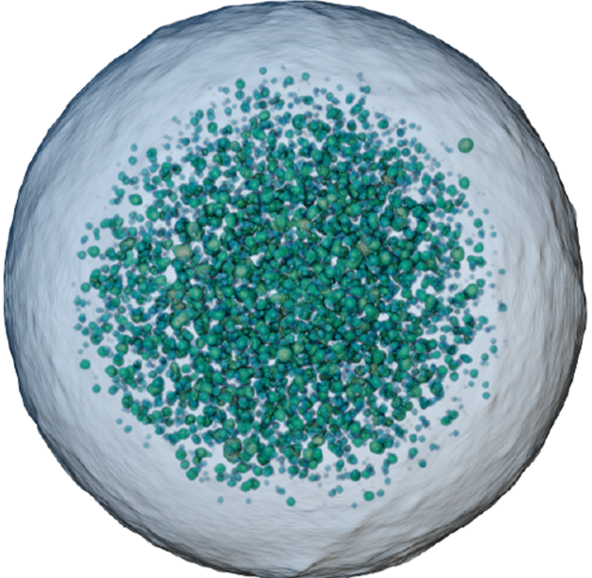
Daniel Murray
Sr. Manager
Irradiated Fuels and Materials
Fundamentals of Post-Irradiation Examination
INL/MIS-26-93307

Slide 2
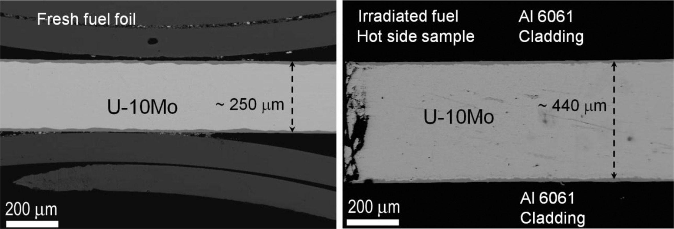
What is Post-Irradiation Examination (PIE)?
Examinations conducted on irradiated material to understand physio-chemical changes that can be related back to in-reactor performance

Slide 3
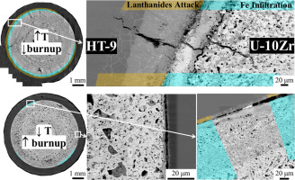
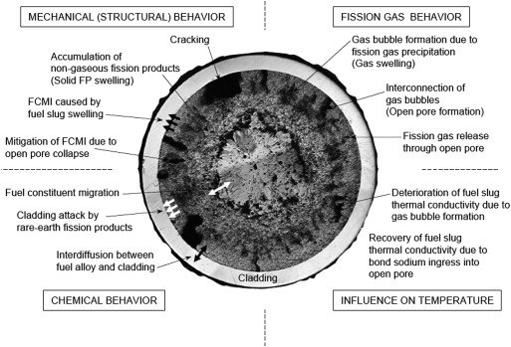
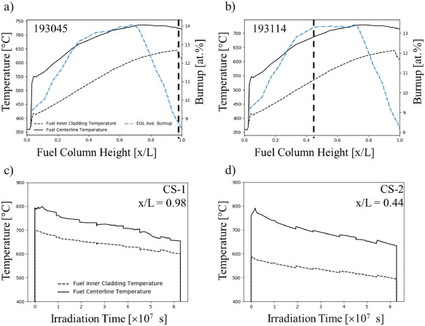
Nuclear fuel performance
Experimental
Modelling
T. Sofu, Nuclear Engineering and Technology (2015), doi:10.1016/ j.net.2015.03.004
D. Salvato et al., Journal of Nuclear Materials (2024),
doi:10.1016/j.jnucmat.2024.154928.

Slide 4
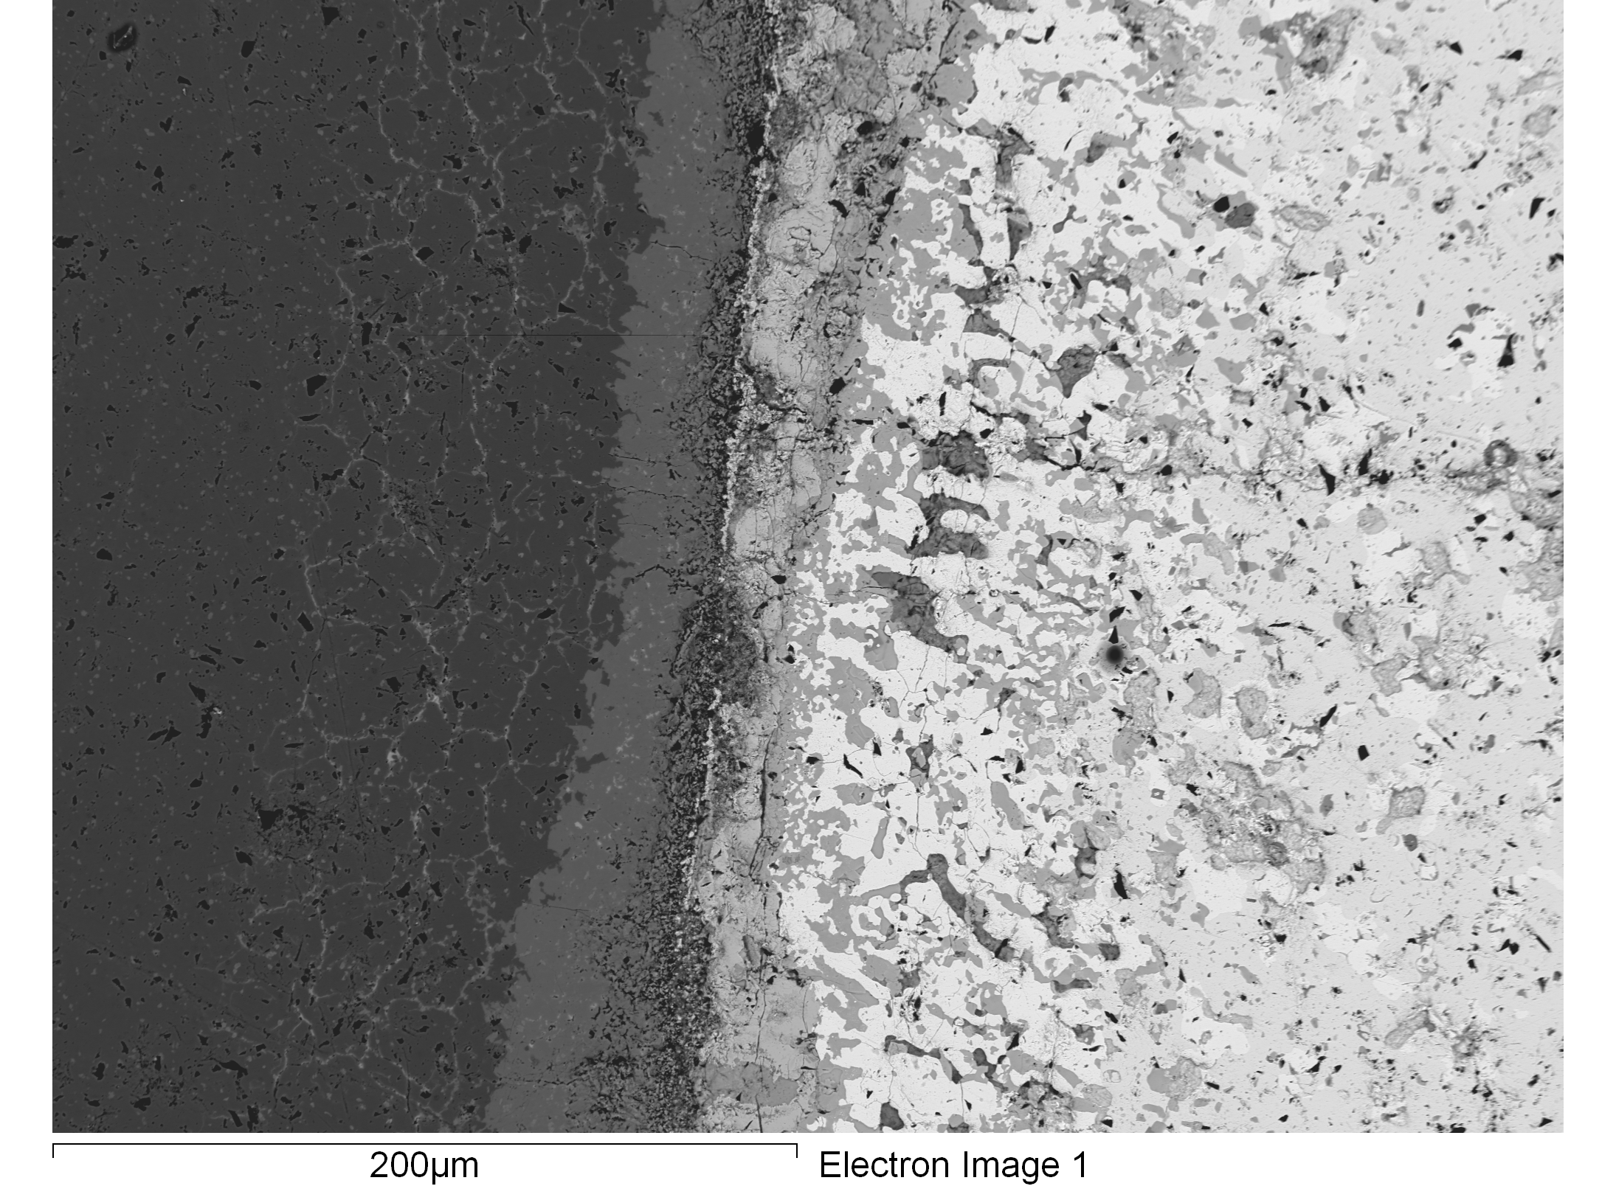
Why is PIE Important?
PIE provides feedback to the fuel/materials designers, fabricators, reactor operators and fuel model developers on the performance of fuel and structural components.
Fuel Cladding Chemical Interaction between HT-9 and U-Zr fuel

Slide 5
Approaches to PIE
Question (what are you studying and why)
irradiation
Preirradiated material
Starts with scientific question (like any research)

Slide 6
Process Flow
Poolside Examinations
Non-destructive Examinations
Destructive Examinations
Only if performing an irradiation
Traditional and Advanced

Slide 7
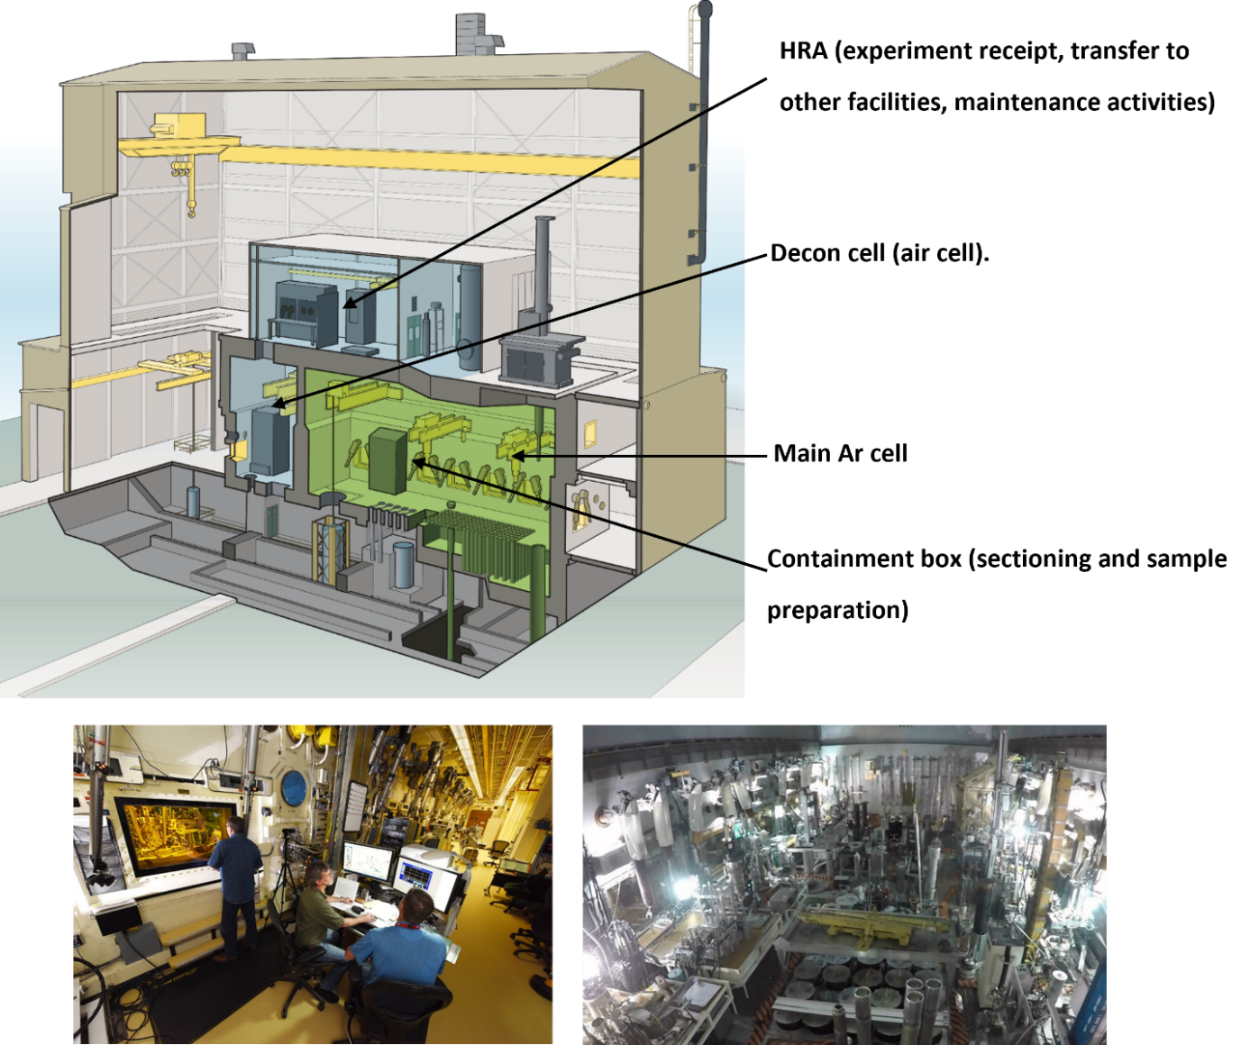
PIE Facilities
Facilities must be designed to handle radioactive materials (and contamination)
Remote handled
  Hot-Cells
  Shielded enclosures
Contact handled
  Glove boxes
  Fume hoods
  Long reach tools

Slide 8
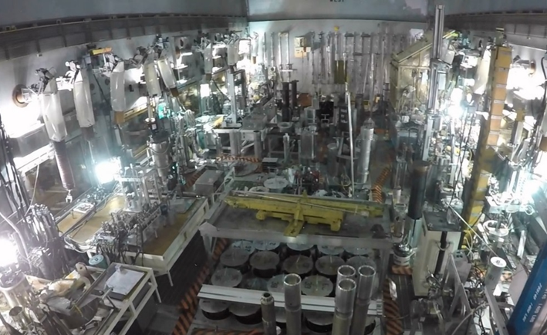
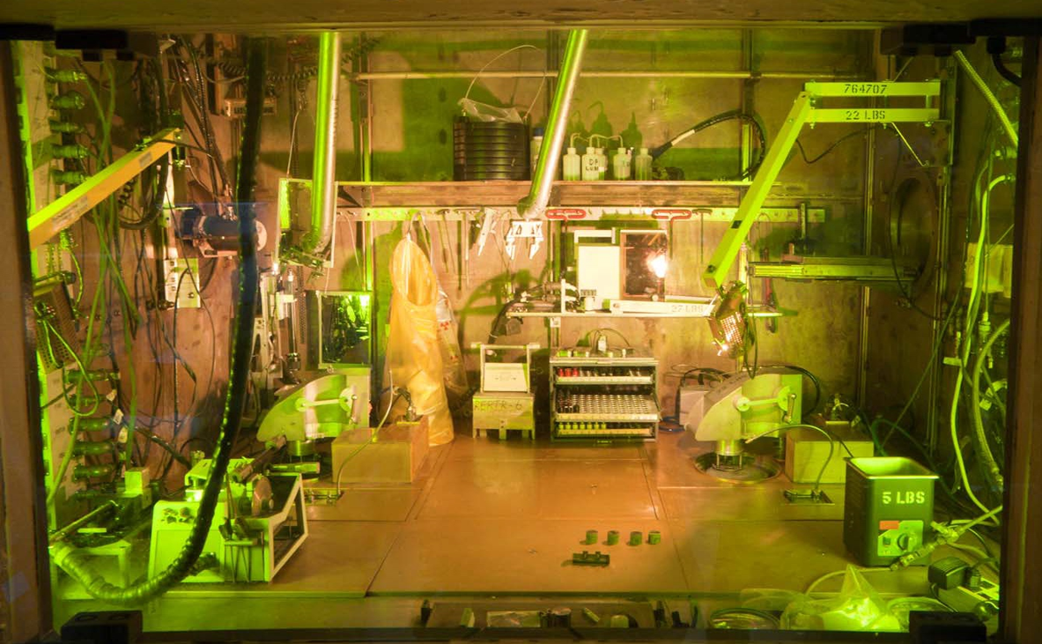
Hotcells
Thick concrete walls
Lead glass windows for shielding and visual
Use manipulators to handle materials (up to 3 meters away from actual samples)
  Limited feel feedback
  Dexterity
  Challenges with view potentially
Inert vs Air Environments
Increased training time to become proficient

Slide 9
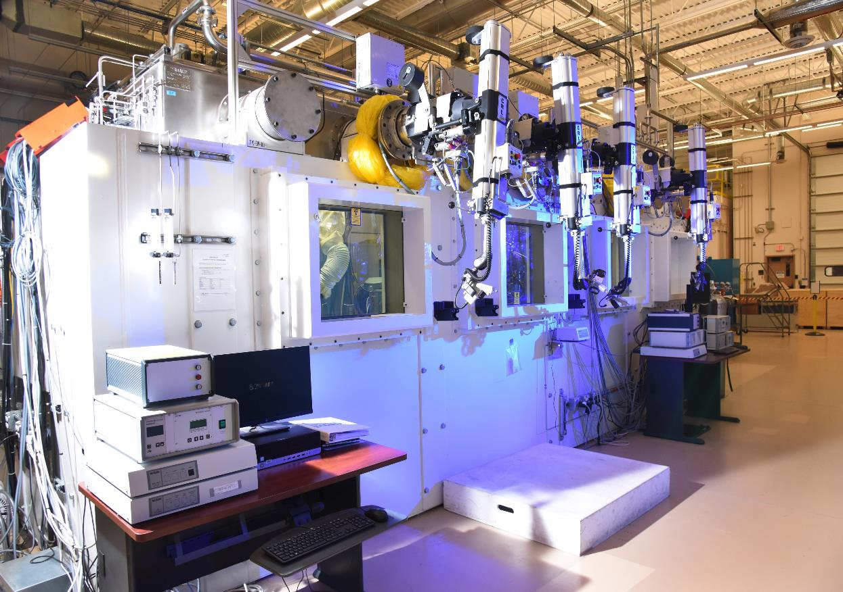
Shielded Enclosures

Slide 10
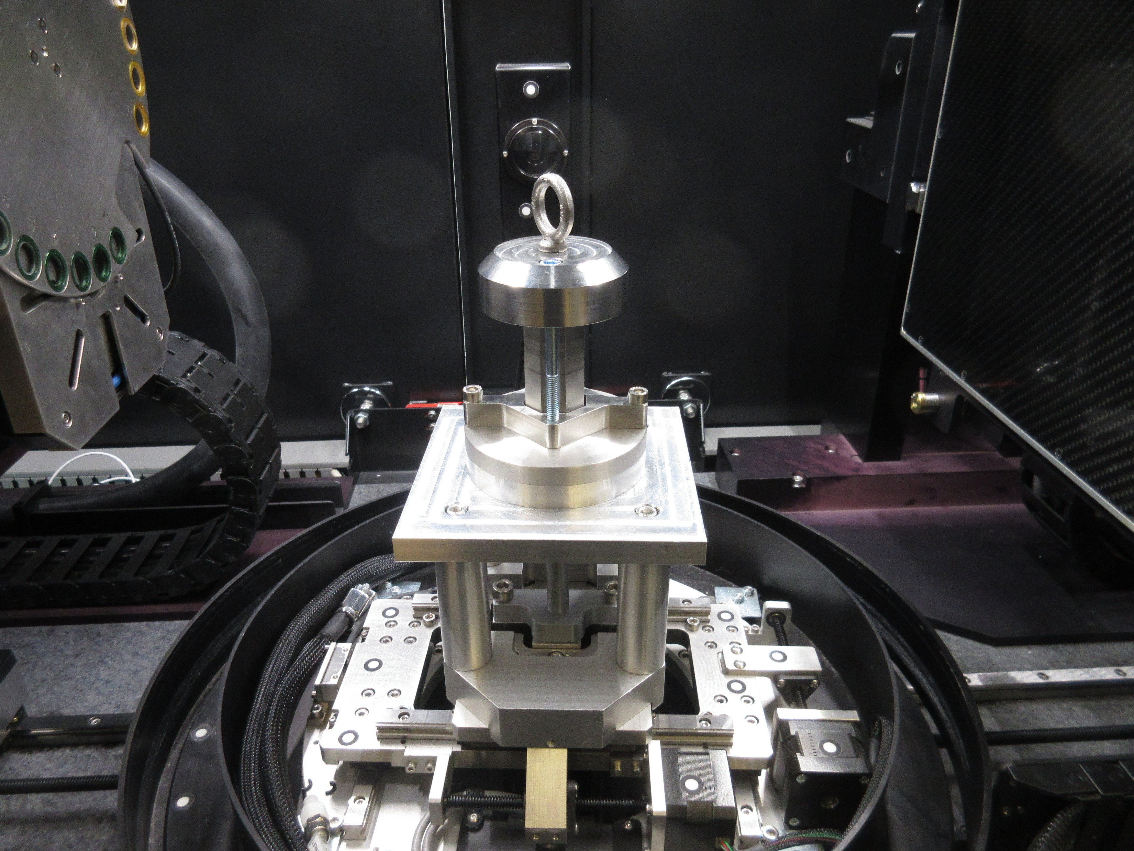
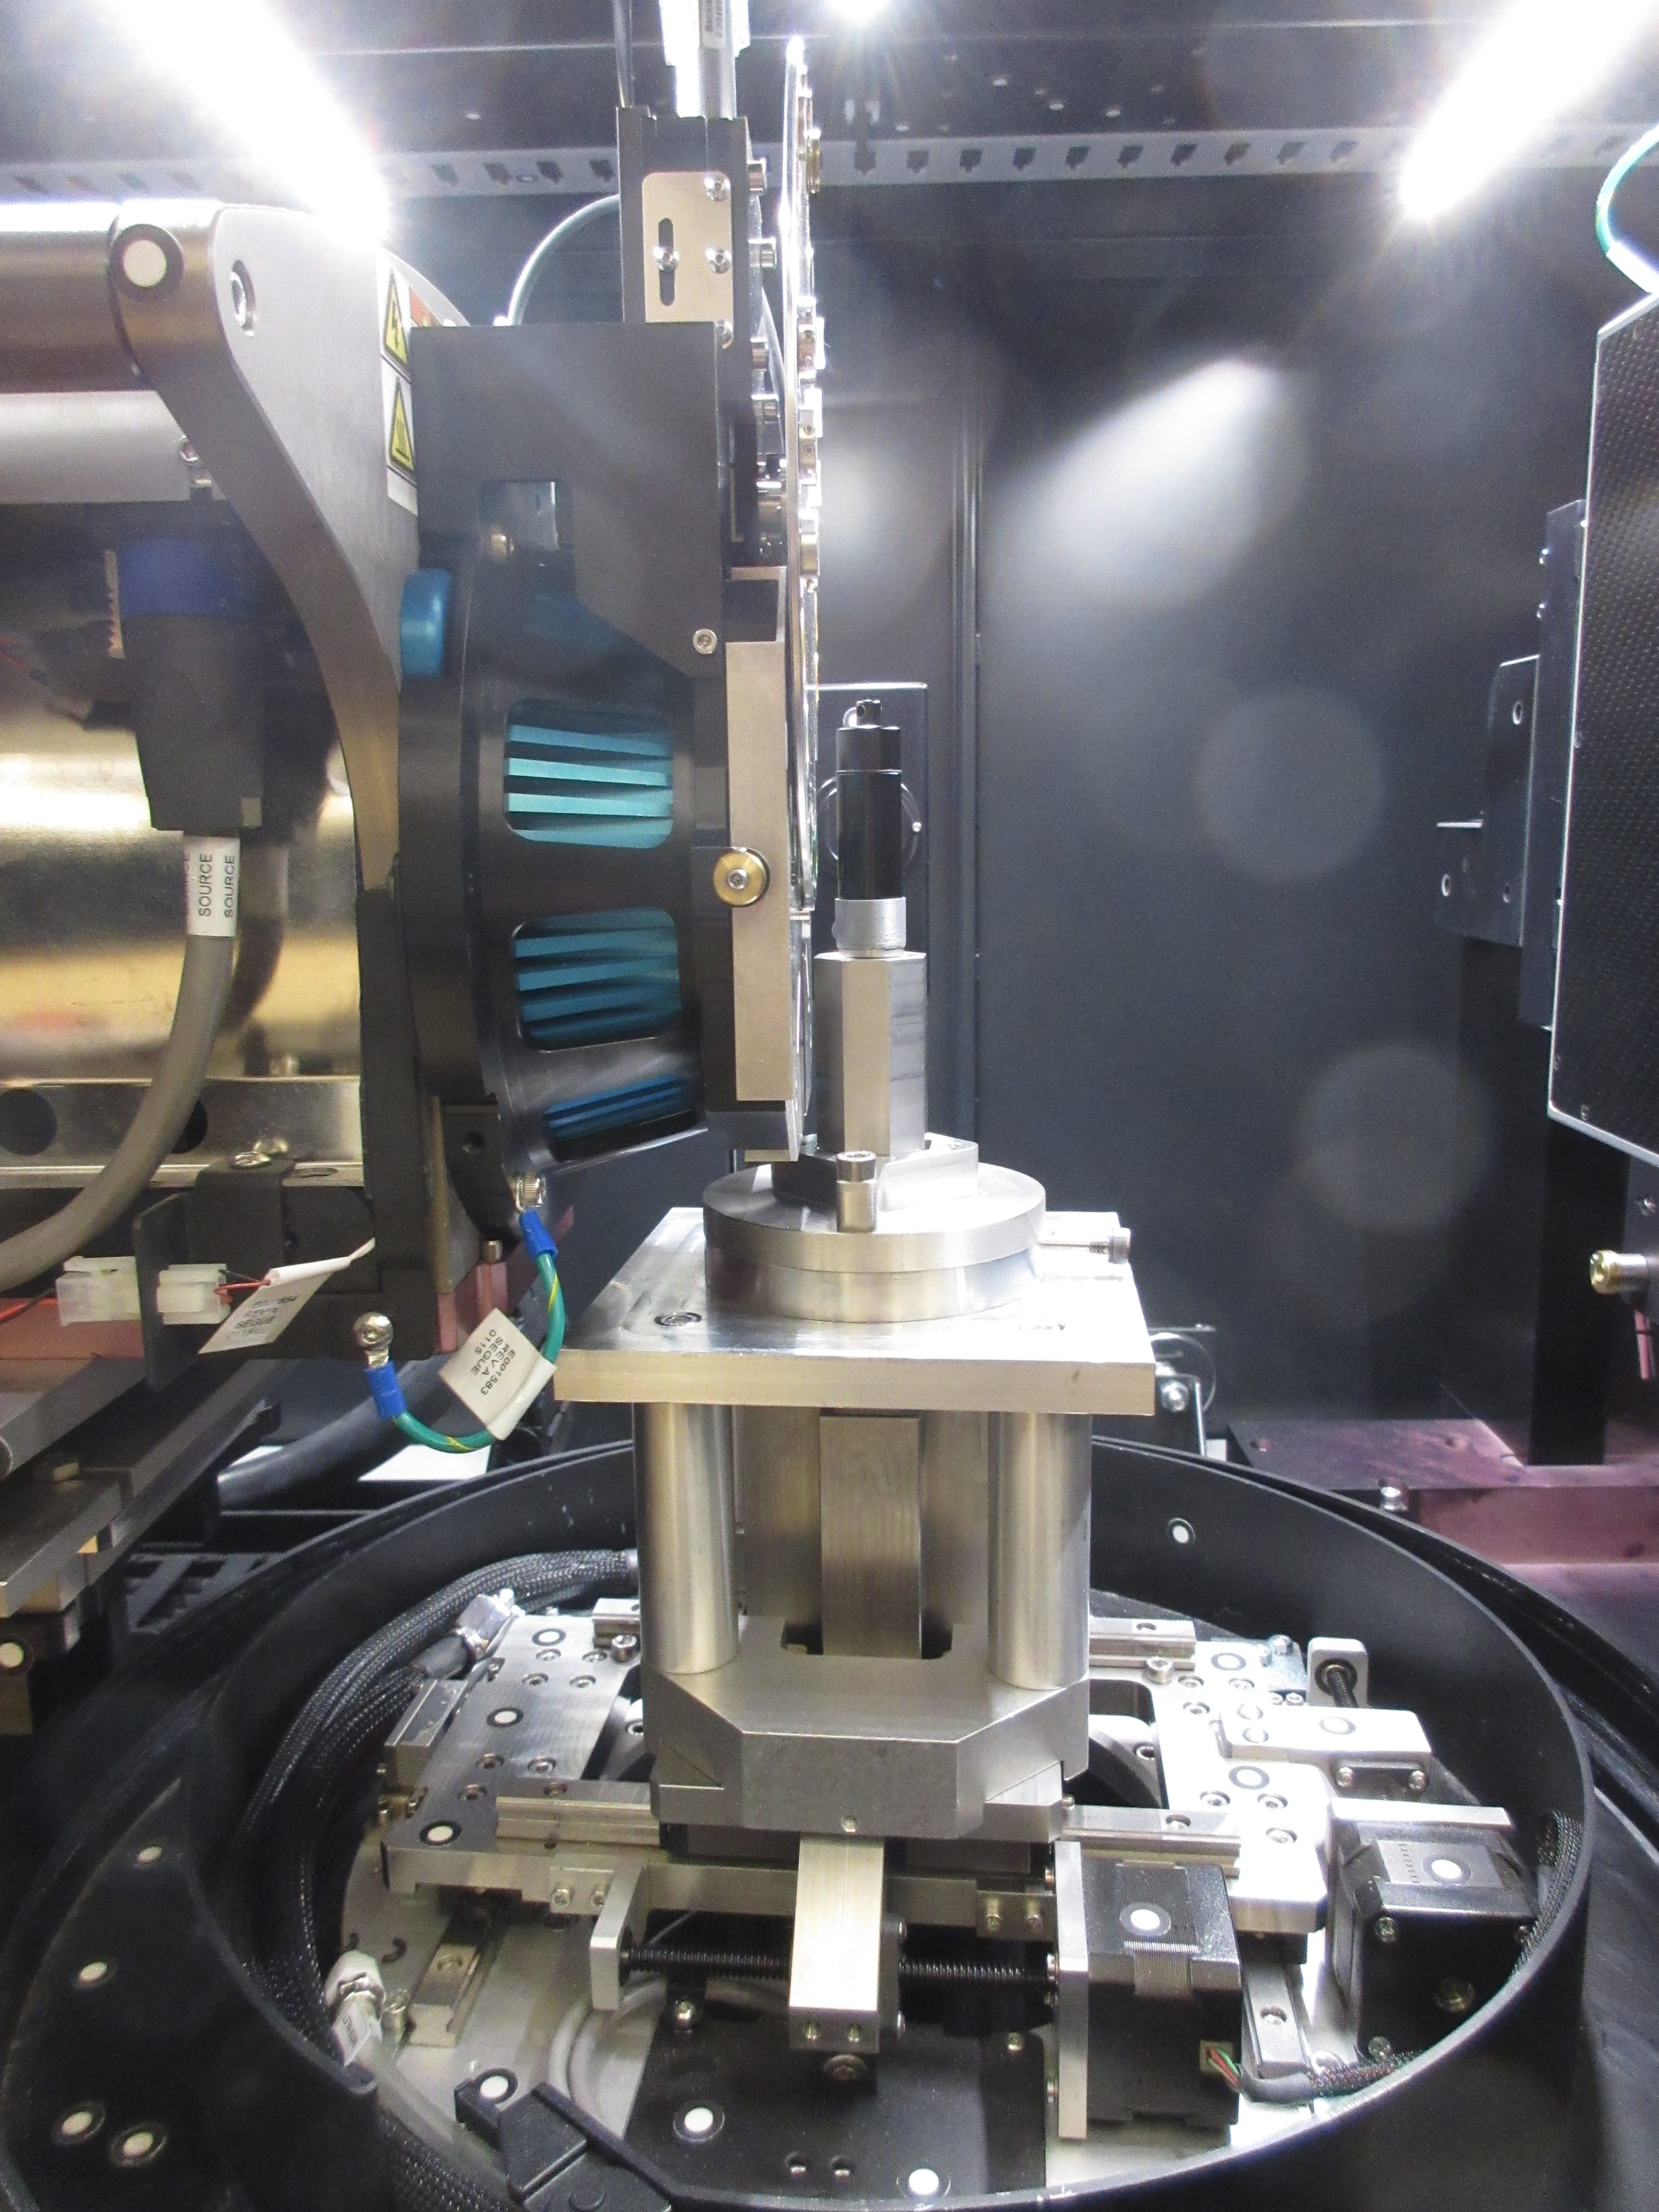
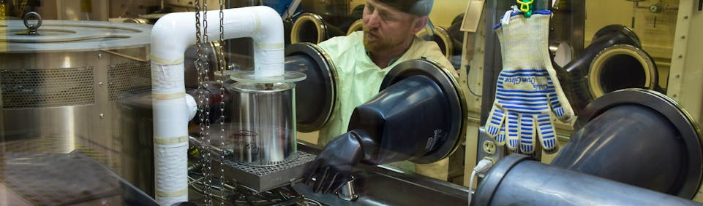
Gloveboxes/Hoods
Glovebox
  Full contamination control with potential for some radiation shielding
  Limited dose rates for contact handling
  Limited dexterity and feel
  Use of shielding items to handle samples
Hoods
  Limited contamination and radiation protection
  Samples of sample dose rates as gloveboxes
  Better dexterity and feel
  Increased contamination
Push pop shielding for X-ray microscope testing

Slide 11
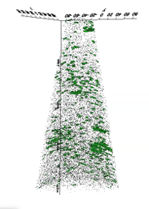
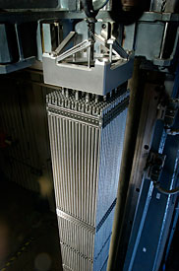
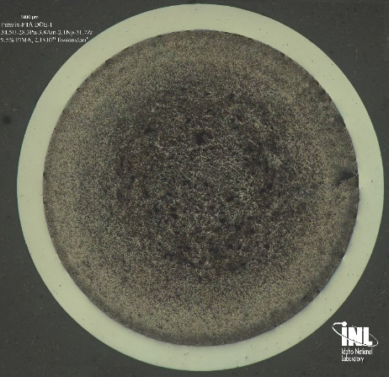
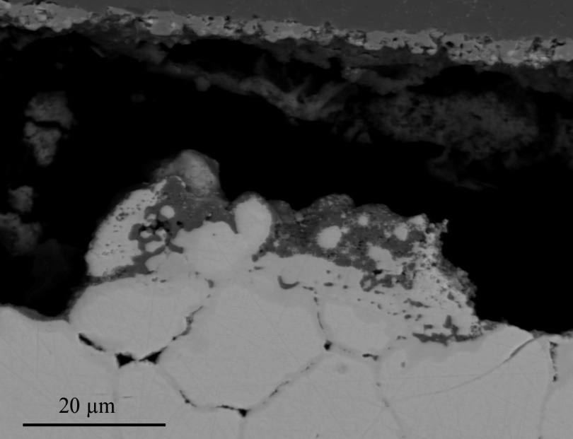
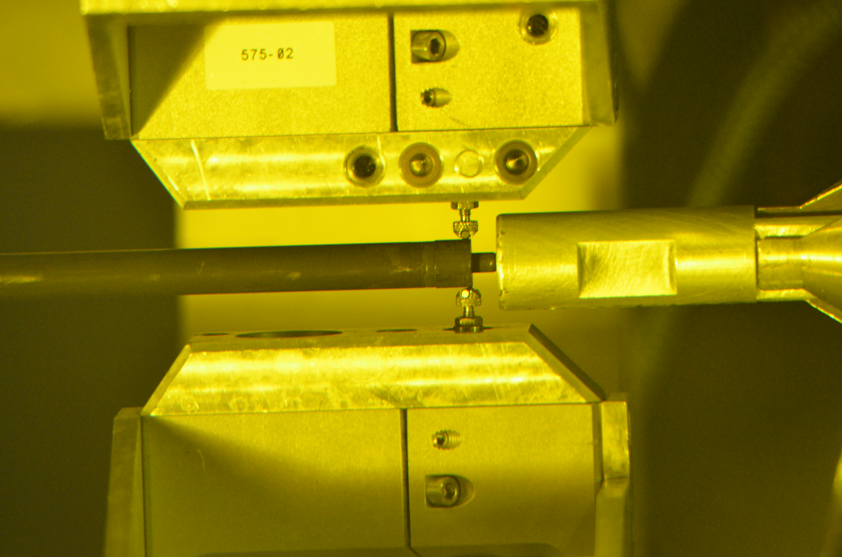
PIE strategy
Scale of Exam
Macro
<1 µm
TOOLS
Neutron Radiography
Dimensional Exams
Gamma Spectrometry
Fission Gas Release
Optical Microscopy
Chemistry Analysis
Electron Microscopy
SEM, TEM, EPMA
Focused Ion Beam
Atom Probe
Visual Exams
Fuel Performance
Did it Fail
Catastrophically
How much did the geometry change
Fission Product Migration
Microstructure, Restructuring, FCCI
Burnup, Actinide Balance
Elemental distribution
3D microstructure
Engineering Scale
Microstructural
Number of Samples
A few pins
The historic approach
Section pins
Select samples to EM
FIB Sample Preparation
PIE capabilities span 10 orders of magnitude

Slide 12
Multi-scale Approach to PIE

Slide 13
Non-Destructive examination
First step in the process
  Visual examination
  Thickness, diameter and oxide thickness measurements
  Neutron radiography
  Gamma scanning
  Density
  Fission gas analysis
  X-Ray Micro-CT*
INL EXT-20-59619

Slide 14
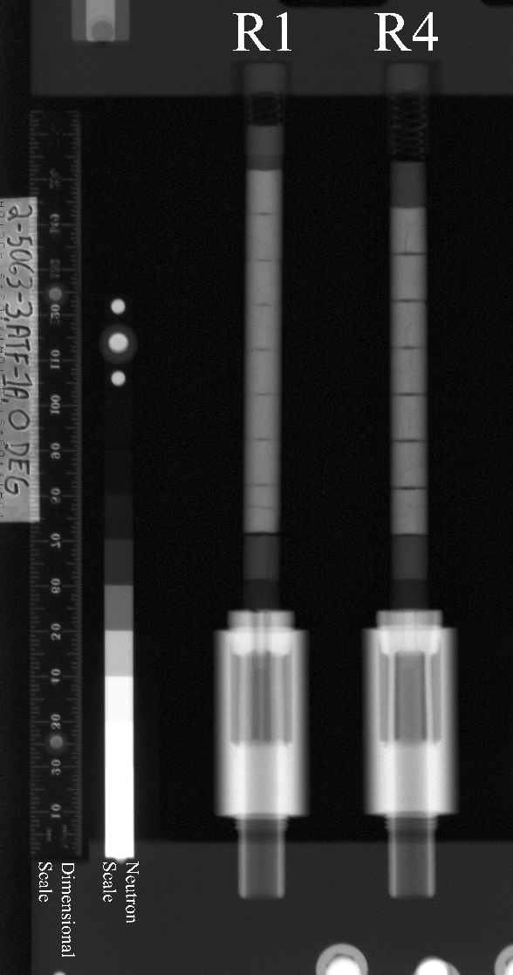
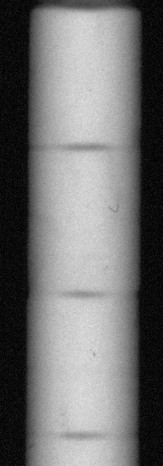
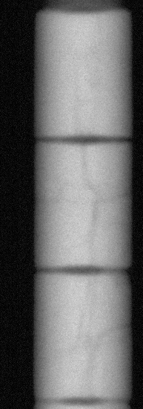
Non-Destructive examination
INL EXT-20-59619

Slide 15
Destructive Examinations
NDE data must be examined before DE can start
NDE data is used to determine sampling locations

Slide 16
Destructive Examinations
Sampling and sample preparation
Optical metallography
Scanning electron microscopy
Electron probe microanalysis
Transmission electron microscopy
X-ray diffraction
Radiochemical burnup determination
Thermophysical properties measurements
Secondary ion mass spectrometry
Neutron diffraction
Atom probe tomography
X-Ray Micro-CT*
Main hot cell DE capabilities:
  Fission Gas Release
  Sample preparation
  Pycnometry
  Microscopy
  Microhardness testing
  Mechanical testing
  Burnup analyses
  H content measurement

Slide 17
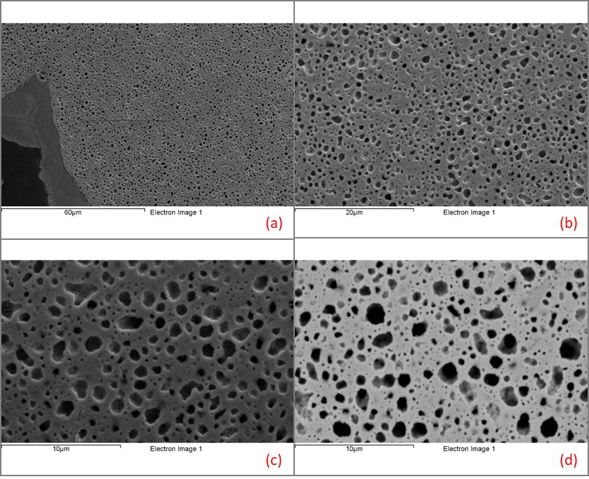

Sample Preparation
High quality prep challenging with non-radioactive samples
Provides accurate and reliable results for advanced characterization results
  Best practices provide the best results
Compounded significantly with radiation and contamination fields added in with radiological samples
Porosity of U-Mo fuel

Slide 18
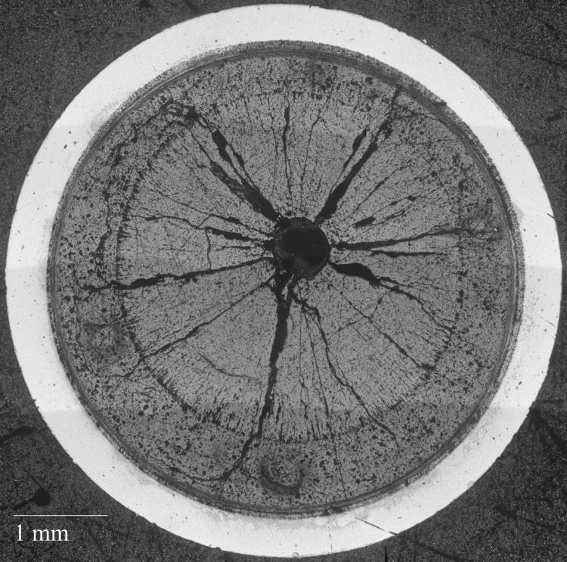
Example: U-Zr Based Fuel Cross-Section
Phase changes radially
U-Zr based fuel in a HT-9 cladding
Multi-phases in fuel
  Polish different rates (rounding)
  Holds liquid and could lead to residues
  Increased polish times of different phases
Porosity
  Buildup of polishing debris in pores which lead to scratching later
Residue staining in areas from cleaning
Removal of Cs-bearing precipitates due to use of water
Radiolysis of the epoxy due to radiation fields
Decontamination of the material leads to increased handling
Oxidation of the surface if perform in air vs inert
Many more!
Residue
Scratches

Slide 19
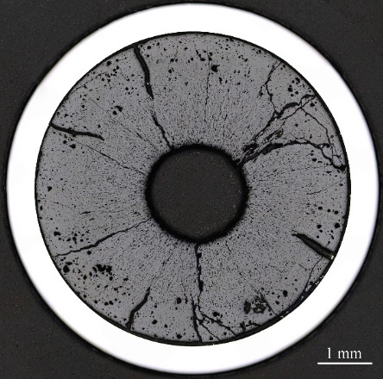
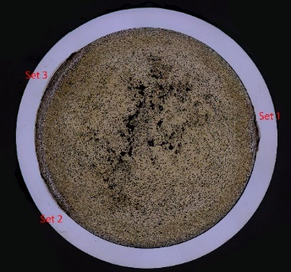
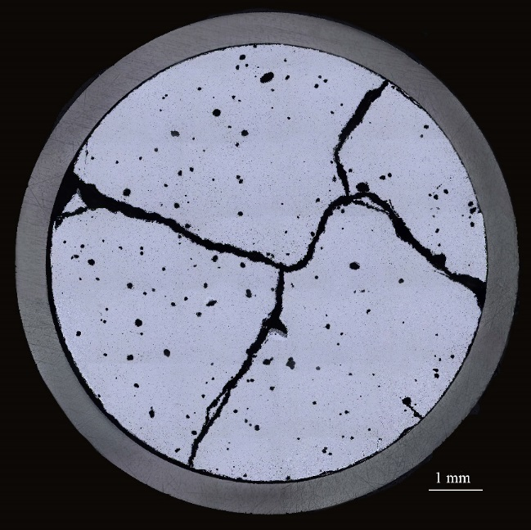
Examples of metallography and hardness testing
U-5Mo-4.3Ti-0.7Zr fuel

Slide 20
Focused Ion Beam Microscopy
Site Specific TEM and APT sample prep
Utilize FIB to remove defects on the surface of the material
  Mechanical damage from polishing
  Oxidation
  Can get electron backscatter diffraction quality samples with some materials
Drawbacks
  Curtaining effects
  Sputtering of radioactive materials into the instrument
Cross section of (U,Pu)O₂ Fuel

Slide 21
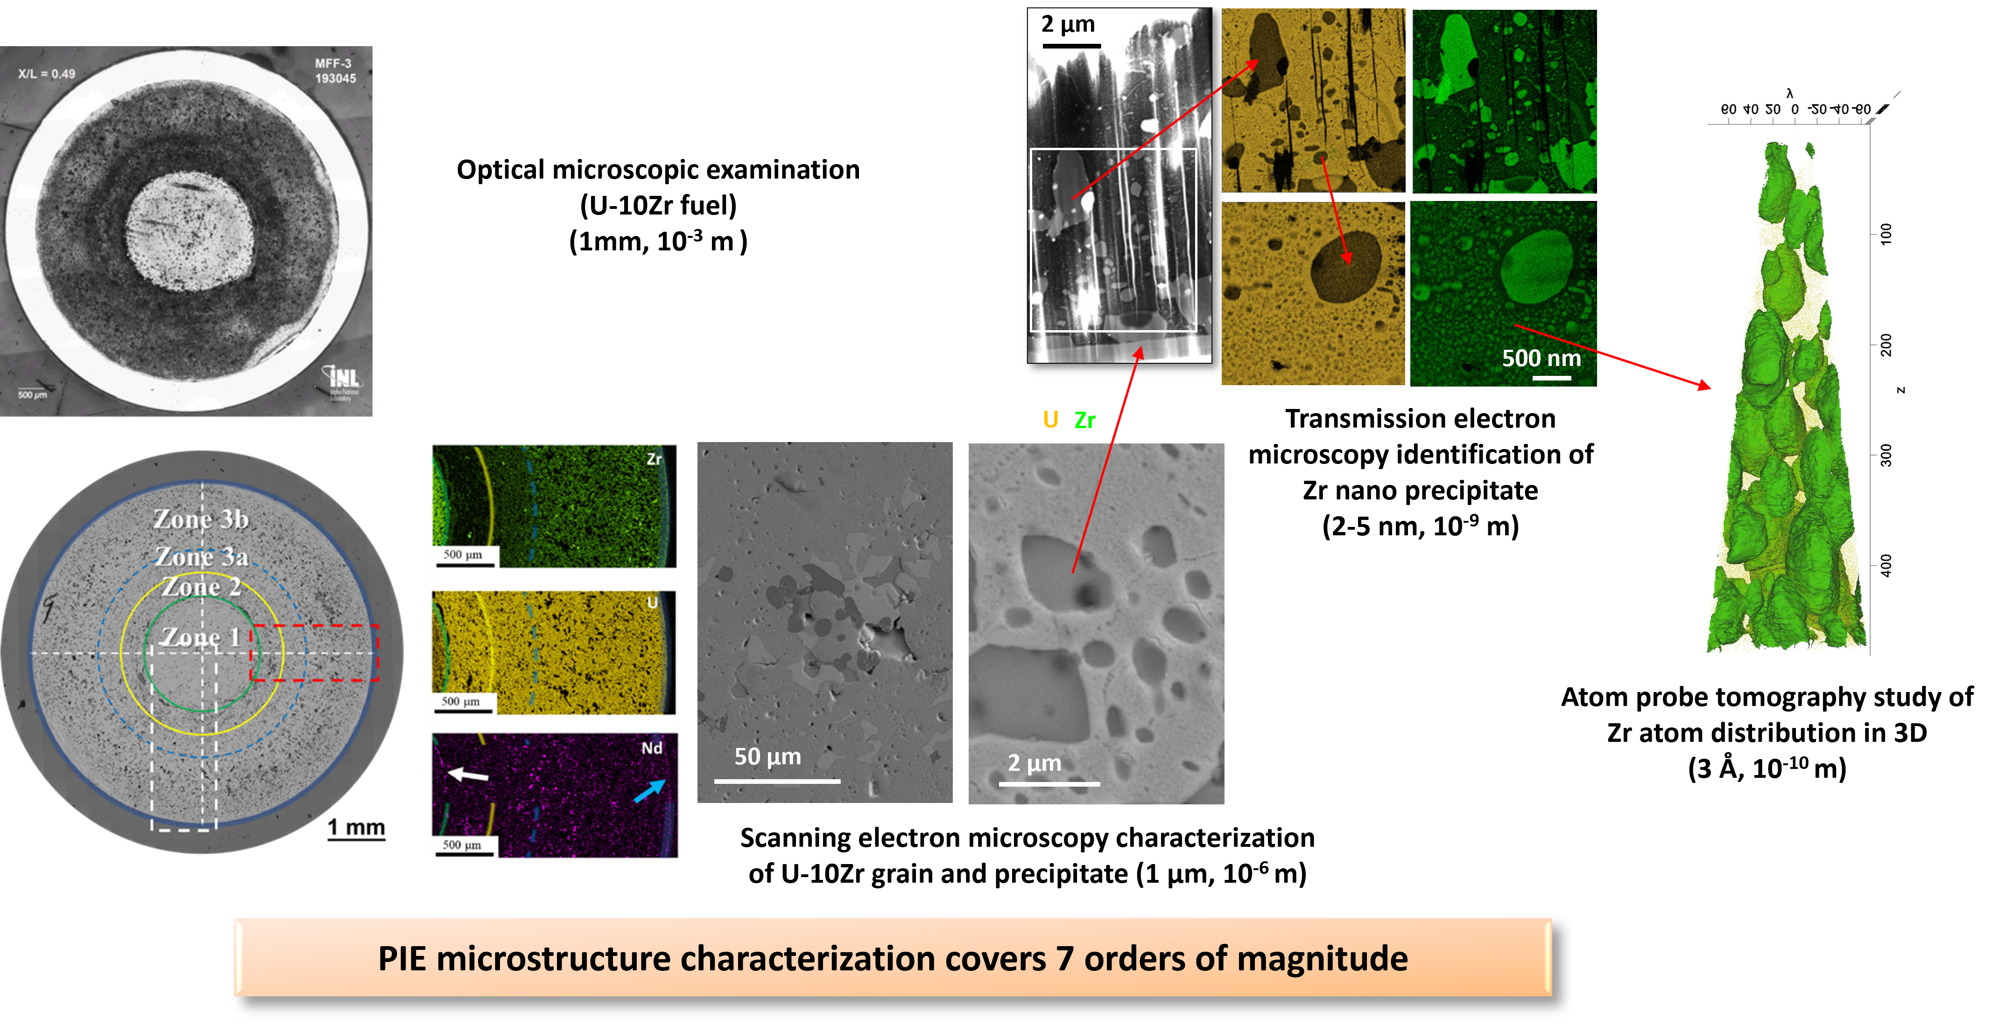
PIE Example Workflow

Slide 22
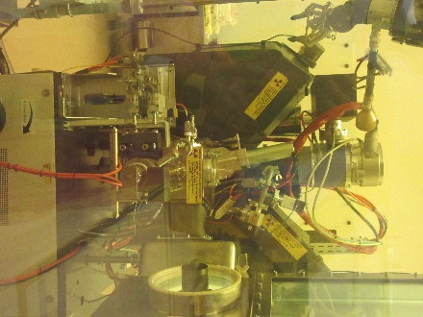
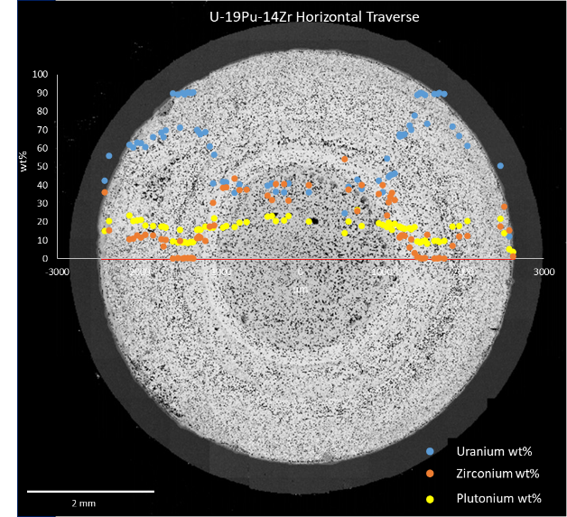
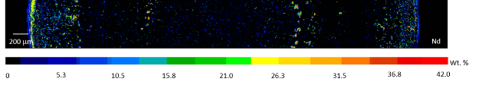
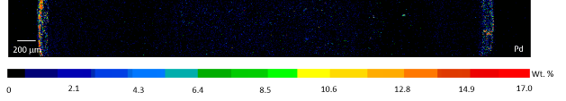
Electron Probe Microanalyzer (EPMA)
Shielded to 3 curies of Cs-137 radiation energy allowing analysis of irradiated fuel pin cross sections
Capable of quantitative analysis of solid specimens on a micrometer spatial scale
Can detect elements from B-Cm+ (including gasses trapped in bubbles)
Quantitative X-ray maps of irradiated U-19Pu-14Zr
Enhanced center pin Zr concentration
Depleted center pin U concentration
Rare earth element phases near center
Asymmetrical fuel-cladding chemical interaction
Quantitative analytical diameter traverse of mapped diameter region of U-19Pu-14Zr
U
Pu
Zr
Nd
Pd
Contact: Karen.Wright@inl.gov

Slide 23
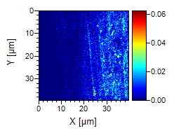
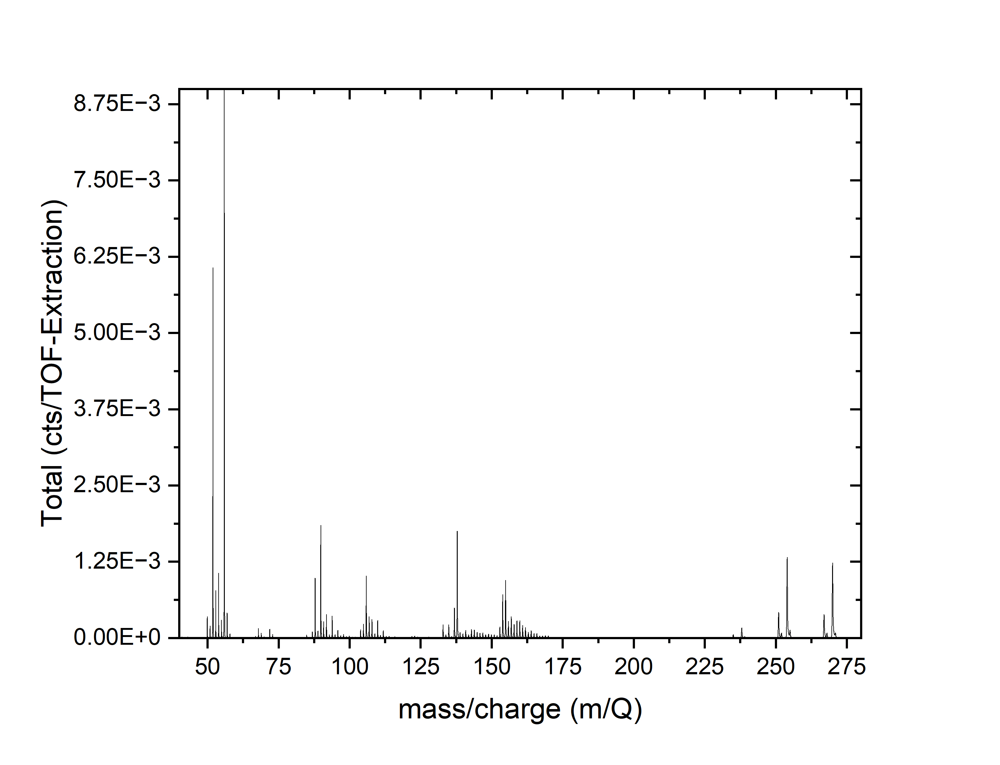
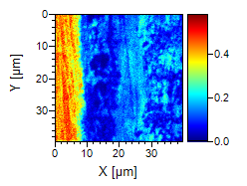
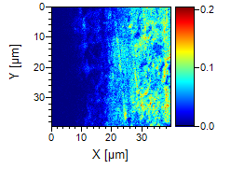
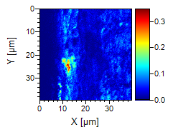
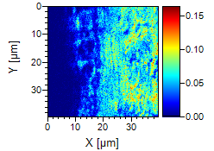
Secondary Ion Mass Spectrometry
U²³⁸
Mass spectrum
Fe⁵⁶
FCCI cube
Fe
UO
30 μm
Zr⁹⁰
Zr
Ln-FPs
U, UO, UO₂
UO₂

Slide 24
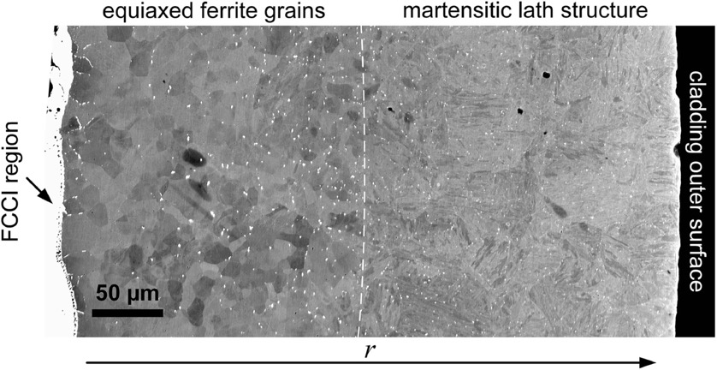
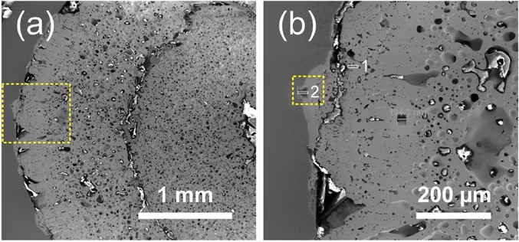
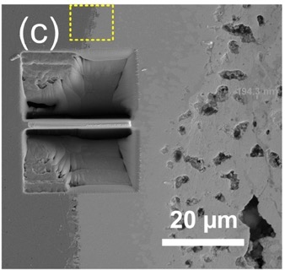
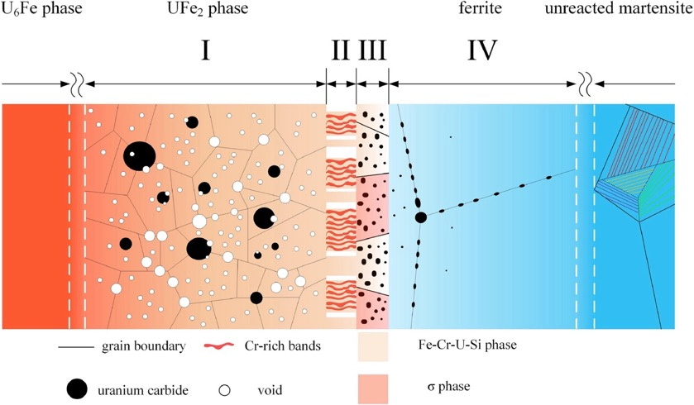
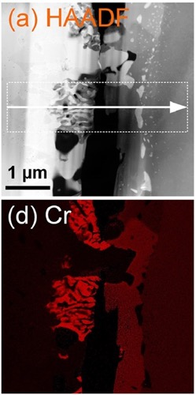
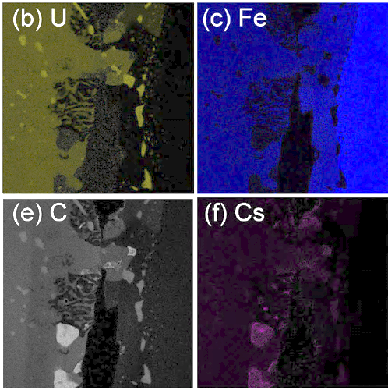
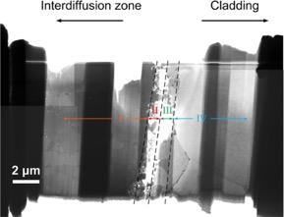
TEM analysis
24

Slide 25
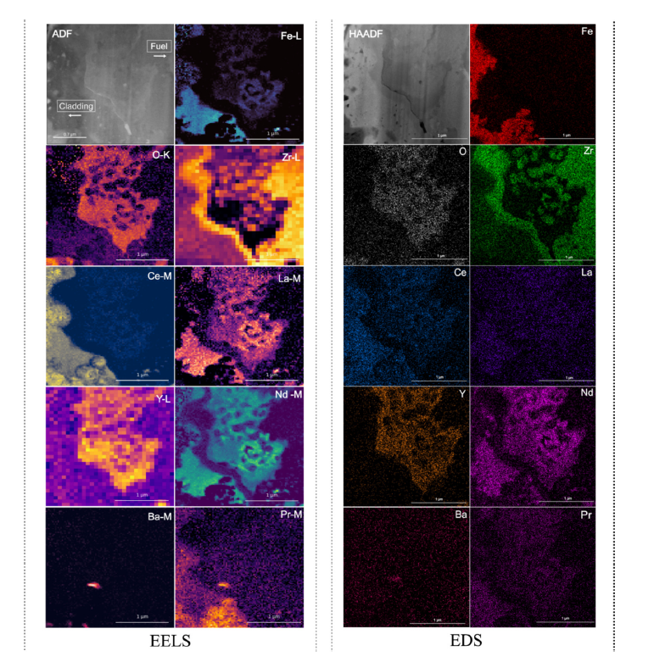
EELS and EDS
Fig. 5. Elemental maps of a FCCI region from a high burnup fuel (13.2 at%) along with their microstructure image through STEM-EELS (left) and EDS (right) (Pradhan et. al).
A. Pradhan, F. Xu, D. Salvato, I. Charit, C. Judge, L. Capriotti, T. Yao, Characterization of Fuel Cladding Chemical Interaction on a High Burnup U-10Zr Metallic Fuel via Electron Energy Loss Spectroscopy Enhanced by Machine Learning, Materials Characterization 218 (2024) 114524.

Slide 26
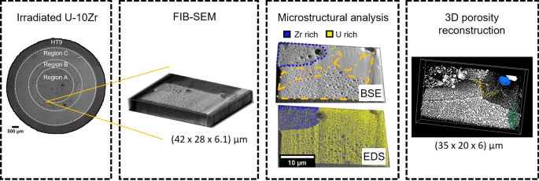
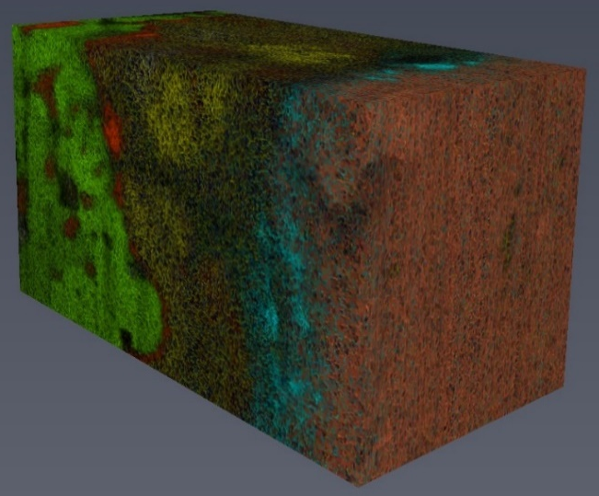
3D FIB/SEM reconstructions

Slide 27
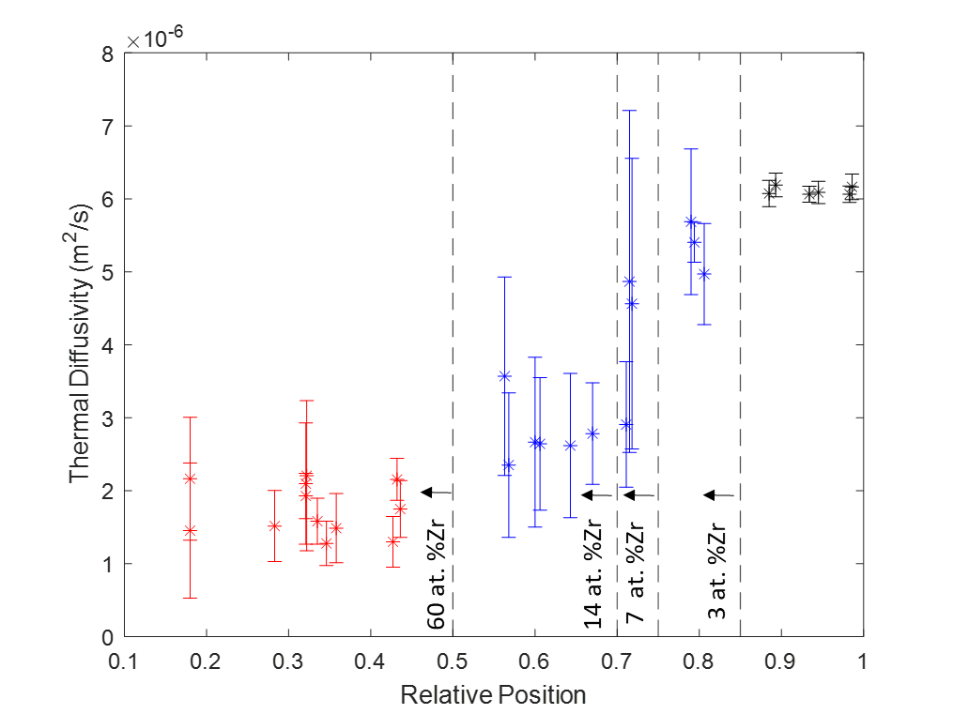

Thermal diffusivity measurements
Figure 2 Thermal diffusivity values from TCM measurements of the inner fuel region (red), annular fuel region (blue), and cladding region (black).

