Slide 1
Fundamentals of Radiation Damage in Nuclear Materials
NSUF Foundations of Irradiation Testing Workshop, July 2026
Presented by
Stephen Taller
Oak Ridge National Laboratory
Notes:
Image - provided by Liz McCrory
Cool S&T Photo - Low Activation Materials Development and Analysis, LAMDA Microscopy research lab, July 25 , 2024. Alec Pfundheller, a graduate student intern from Texas A&M University, and his mentor, Dr. Stephen Taller from the Nuclear Energy and Fuel Cycle Division, perform transmission electron microscopy to investigate radiation damage in additively manufactured type 316 stainless steels. The images depict different patterns produced by the electrons as they scatter off the face centered cubic structure of the steel. These investigations are routinely performed at ORNL’s Low Activation Materials Development and Analysis (LAMDA) laboratory on irradiated materials. This image has been reviewed by an ORNL Releasing Official and is approved for public release, July 2024.

Slide 2
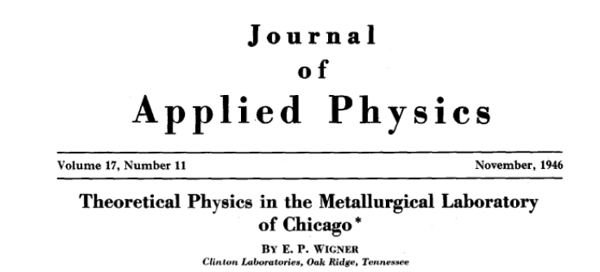
Radiation Damage has been part of the Nuclear Engineering discipline since the beginning
Excerpts from Section 3.
“The radiation densities, both γ and neutron, are higher in a plutonium producing pile than can be maintained outside the pile for extended periods of time.”
“The effect of these radiations on the structure of materials was one of our early concerns from the theoretical point of view.”
“Clearly, the collision of neutrons with the atoms of any substance placed into the pile will cause displacements of these atoms.”
“The matter has great scientific interest because pile irradiation should permit the artificial formation of displacements in definite numbers and a study of the effect of these on thermal and electrical conductivity, tensile strength, ductility, etc.”

Slide 3
Radiation damage is one piece in a complex puzzle
Coolant
Corrosion
Stress Corrosion Cracking
IASCC
Fracture Mechanics
Thermal Creep
Stress
Radiation
Radiolysis (Charge Movement)
Radiation Corrosion
Radiation Creep
Microstructure Evolution
Adapted from: Vankeerberghen M. IASCC Modelling: phenomenological approach. Symposium on Irradiation
Effects in Structural Materials for Nuclear Reactors, pages STR–6.1–1–STR–6.1–5, 2012.
Material

Slide 4
Our Discussion Today Is in 3 Parts
What is radiation damage?
What does it do to materials, broadly?
What are some open questions?

Slide 5
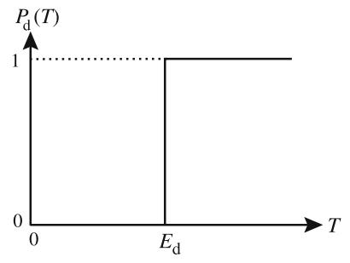
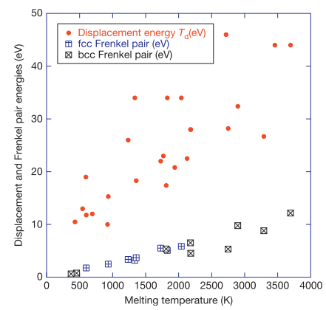
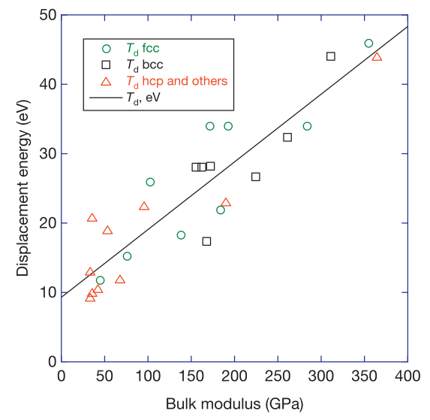
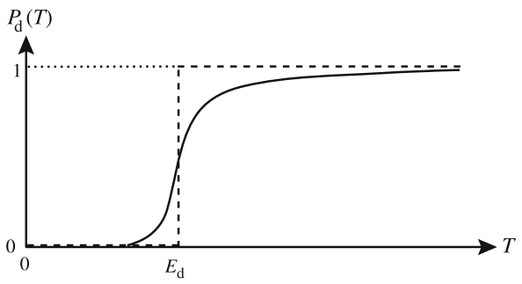
Radiation damage is a disruption of the crystal lattice and production of defects in the crystal
Displacements happen when enough energy is transferred to displace an atom
In reality, the threshold is blurred due to atomic vibrations, impurity atoms, scattering angle, etc.
Wolfer, Comprehensive Nucl. Mat. (2020)
Adapted from G. S. Was, Fund. of Rad. Mat. Sci., 2nd ed., 2017.

Slide 6
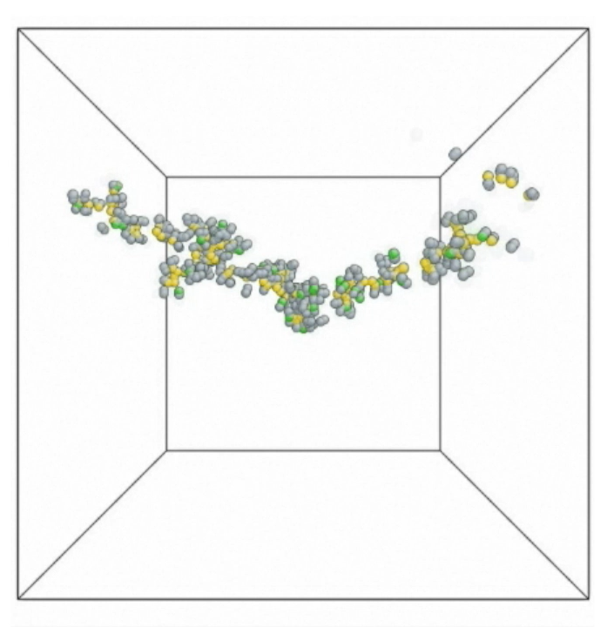
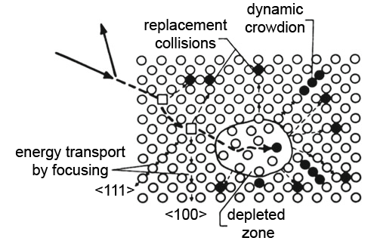
Damage cascades and generates subcascades until all atoms are below a threshold energy
Adapted from G. S. Was, Fund. of Rad. Mat. Sci., 2nd ed., 2017.
Courtesy, B. D. Wirth

Slide 7
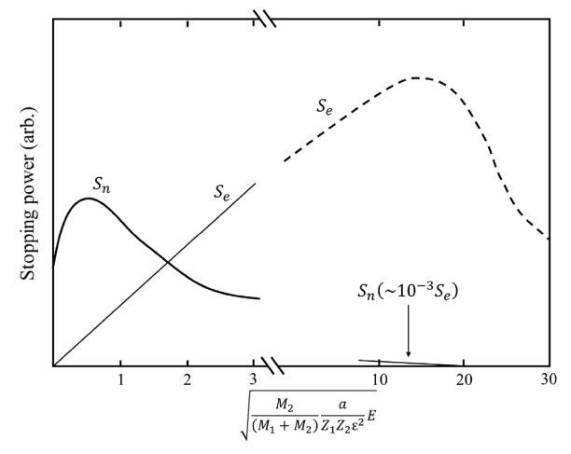
Differences in PKA and cascades occur via nuclear and electronic energy losses
Nuclear Stopping Power (S_{n})
  Primarily responsible for displacements
Electronic Stopping Power (S_{e})
  Responsible for:
    Phonon transport (heat)
    Electron motion (chemical activity)
Adapted from G. S. Was, Fund. of Rad. Mat. Sci., 2nd ed., 2017.

Slide 8
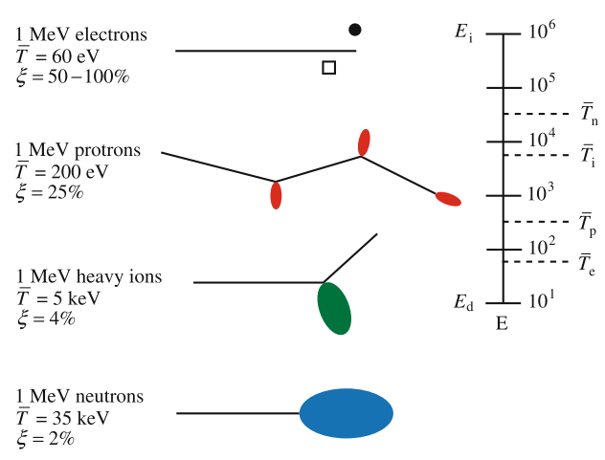
Radiation damage cascades are particle dependent
Adapted from G. S. Was, Fund. of Rad. Mat. Sci., 2nd ed., 2017.

Slide 9
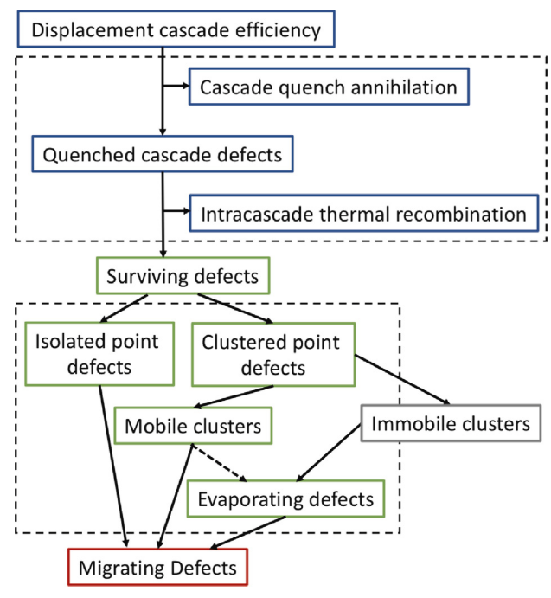
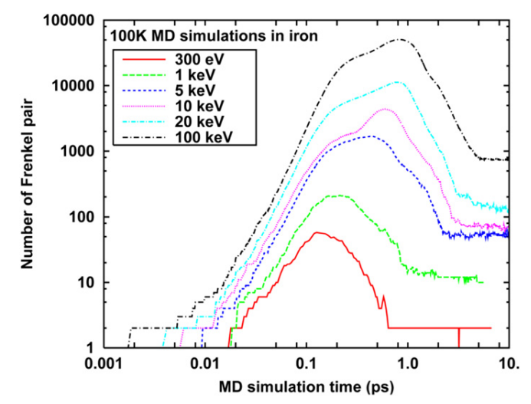
Displacements are only one part of the process
R. Stoller and E. Zarkadoula, Comp. Nuc. Mat. 2020
Adapted from G. S. Was, Fund. of Rad. Mat. Sci., 2nd ed., 2017.
What metric can define this process?

Slide 10
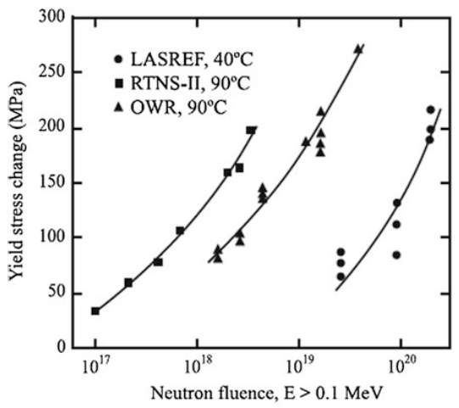
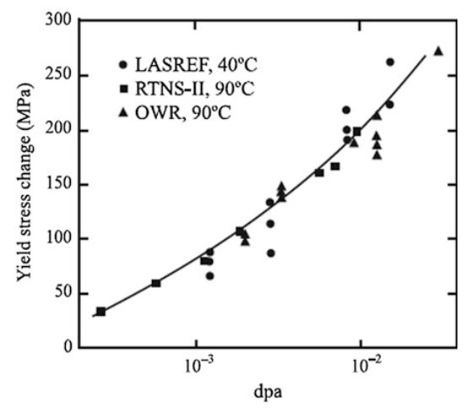
The metric of displacements per atom (DPA) is used to compare across environments
L. R. Greenwood, JNM 216, p. 29-44, (1994)

Slide 11
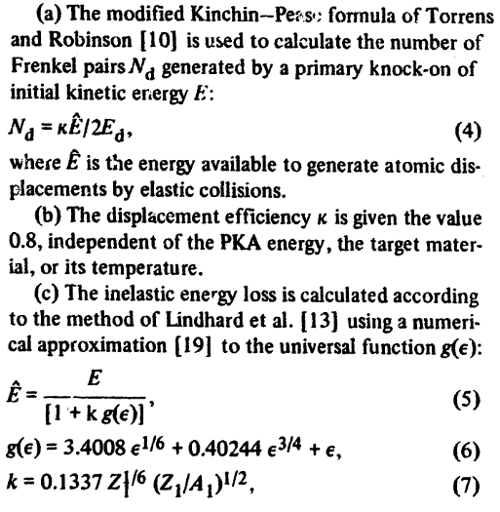
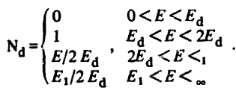
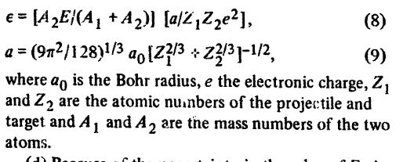
The international standard is the Norgett-Robinson-Torrens model of displacements (NRT-dpa)
Kinchin-Pease model (1955)
Hard barrier for displacements
Linear rate of production at higher energies
Hard barrier for displacements
Non-linear rate of displacements based on additional factors
Norgett et al, Nuc. Eng. and Design 33 (1975)

Slide 12
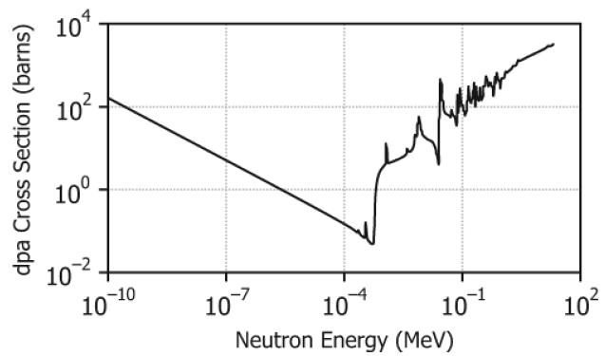
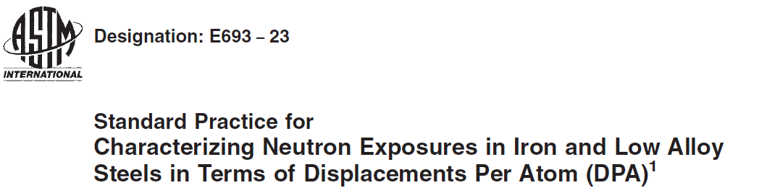
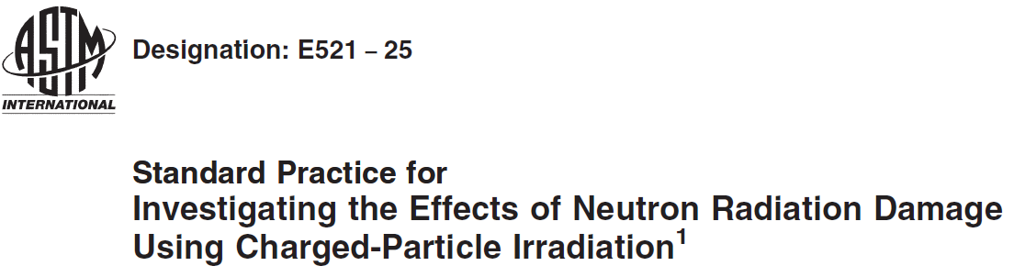
In practice, standardized methodologies are available to calculate displacements consistently across environments
ENDF/B-VI-based Iron Displacement Cross Section
Several code packages exist to calculate displacements from cross section data using ASTM methods

Slide 13
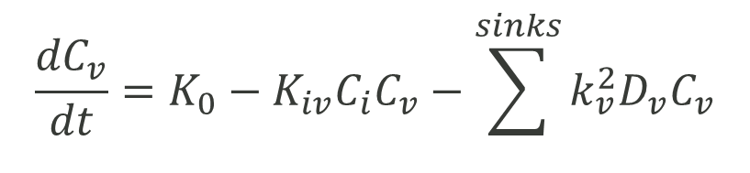
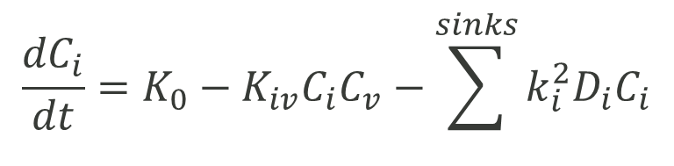
Fundamentally, rate theory equations provide a conceptual framework for understanding microstructure evolution
$$\frac{{dC}_{i}}{dt}=K_{0}−K_{iv}C_{i}C_{v}−\sum^{sinks}{k_{i}^{2}{D_{i}C}_{i}}$$
Rate of defect concentration change
Mutual annihilation
Loss to microstructure sinks
Production from cascades
$$\frac{{dC}_{v}}{dt}=K_{0}−K_{iv}C_{i}C_{v}−\sum^{sinks}{k_{v}^{2}{D_{v}C}_{v}}$$
While microstructure evolution of an individual feature is more complex, they’re all interconnected.

Slide 14
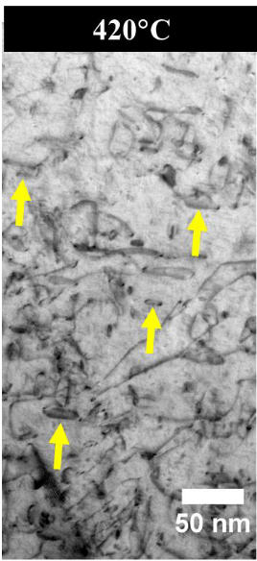
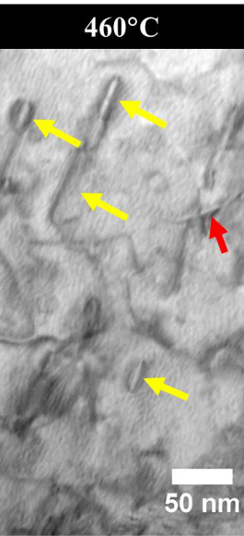
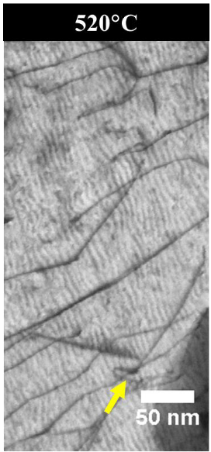
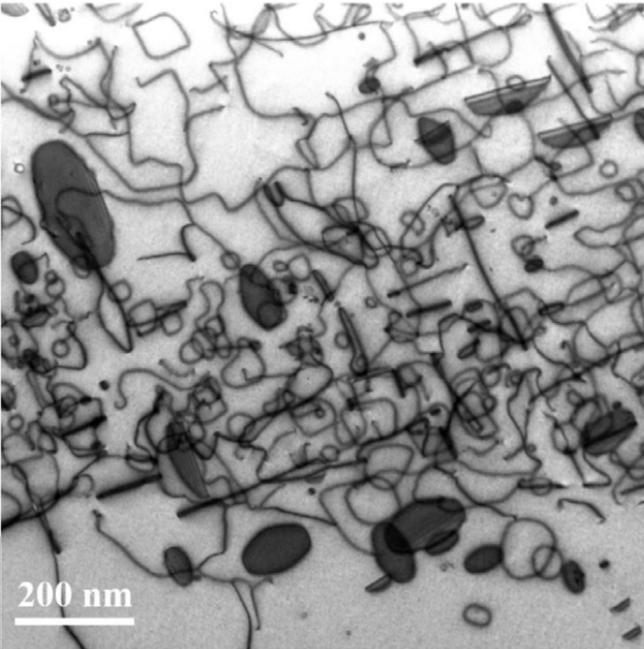
Defects agglomerate into dislocation loops and lines depending on crystal structure, temperature, composition…
Ion irradiated T91 steel, 17 dpa
Ion irradiated Ni₄₀Fe₄₀Cr₂₀, 7.2 dpa, 500°C
S. Taller, Dissertation, University of Michigan 2020
P. Xiu et al, JNM 544 (2021)

Slide 15
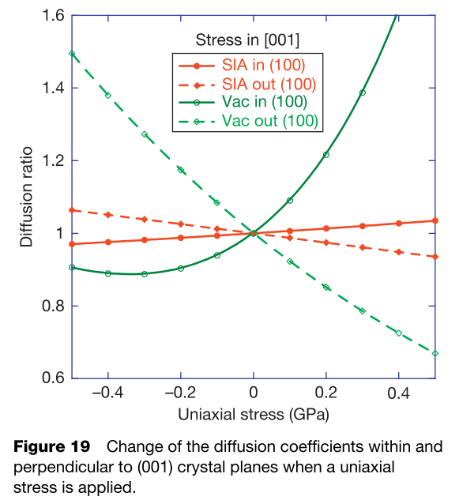
Dislocations generate local stress fields that impact defect migration and clustering
Kohnert, Capolungo J. Mech. Phys. Solids 122 (2019)
Wolfer, Comprehensive Nucl. Mat. (2020)

Slide 16
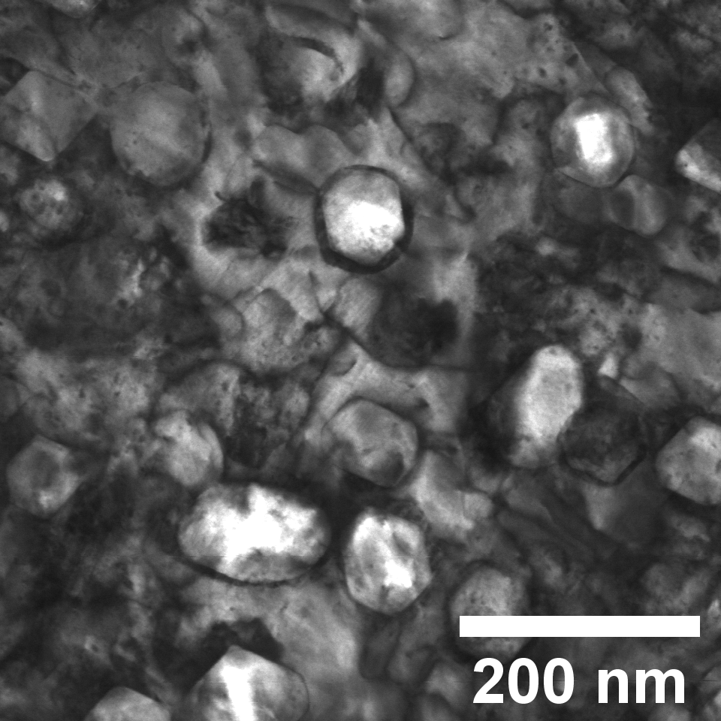
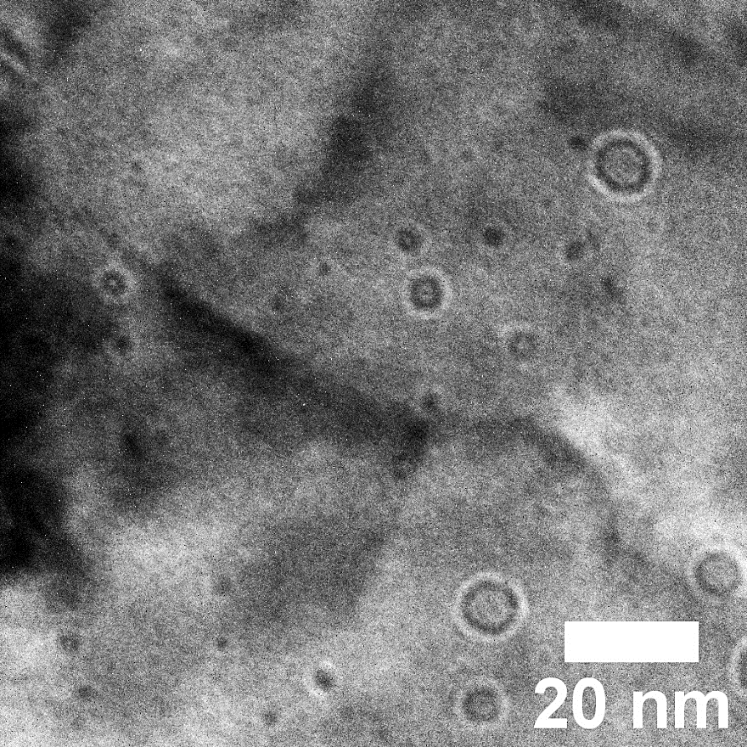
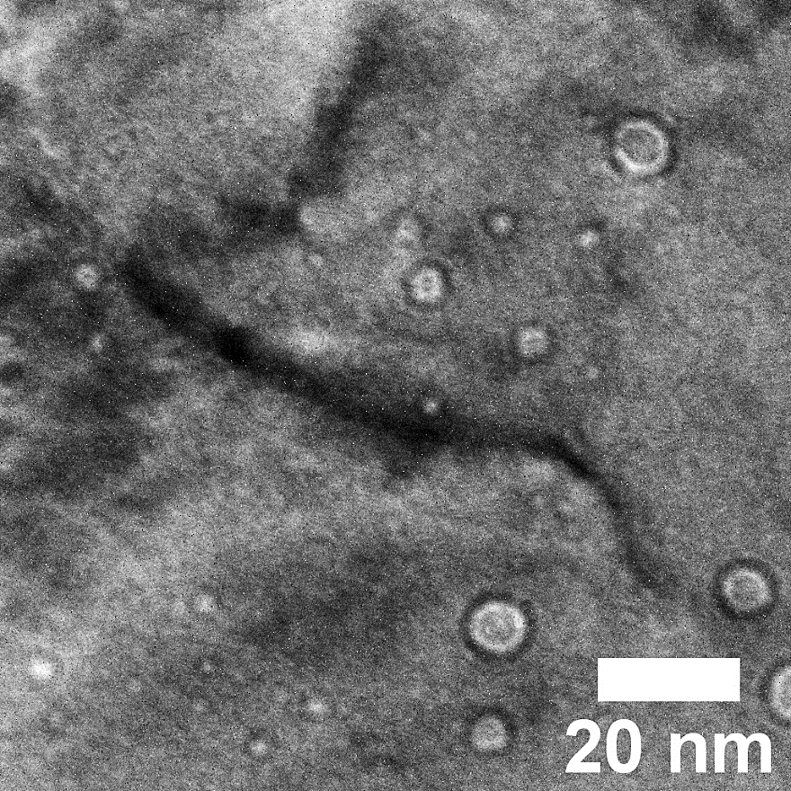
In the range of 0.3 < T_{m} < 0.6, cavities form from vacancy rich clusters
Stainless Steel 316 ion irradiated to 10 dpa near 600°C
T91 Steel ion irradiated to ~17 dpa near 445°C
CTEM overfocus (+2μm)
CTEM underfocus (-2μm)
STEM BF
Stephen Taller, unpublished

Slide 17
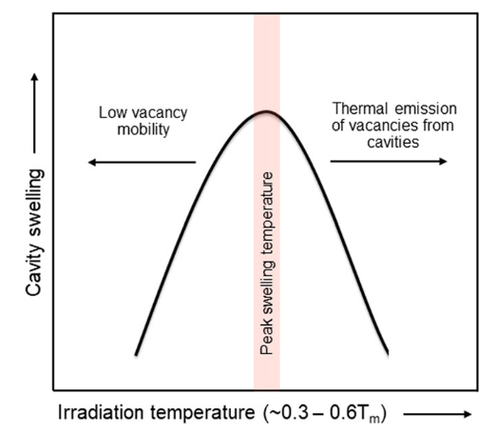
The cavity growth rate equation provides a framework to examine cavity formation
Growth rate of cavity
Pressure of He gas from Eq. of State
$$\frac{dr}{dt}=\frac{Ω}{r}\left[D_{v}C_{v}−D_{i}C_{i}−{D_{v}C}_{v,T}exp\left(\frac{2γ}{r}−p_{g}\right)\right]$$
+
Arrival of vacancies
Thermal emission
of vacancies
Arrival of interstitials
$$\frac{dr}{dt}$$
0
$$r$$
Critical points for stability!
Bhattacharya and Zinkle, Comprehensive Nuclear Materials, 2020
-
Cavities have a dependence on temperature through diffusion, helium rate through the gas pressure, p_{g} and damage rate through the concentration of defects, C_{v} and C_{i} and their own size, r.

Slide 18
Helium from transmutation is a (nearly) uniquely nuclear problem and “flows” between sinks and traps in the microstructure
Dislocation Loops (strong sink)
Dislocation Lines (weak trap)
He
He
He
He
He
He
He
He
He
He
Time dependence:
1. Helium diffuses to sinks and traps in proportion to sink strength.
2. Helium releases from a weaker trap and diffuses.
3. Helium accumulates at the strongest trap.
Cavities (strongest trap)

Slide 19
The role of helium is to increase cavity nucleation (primarily)
T_{neutron} = 400-500°C
T_{dual ion}=360-600°C
Reactor Irradiation Literature
J.M. Vitek, R.L. Klueh, JNM. 122–123 (1984)
N. Hashimoto, R.. Klueh, JNM. 305 (2002)
E. Wakai, et al, JNM. 283–287 (2000)
E. Wakai, et al, JNM. 307–311 (2002)
J.J. Kai, R.L. Klueh, JNM. 230 (1996)
A. Kimura, et al JNM. 191–194 (1992)
B.H. Sencer, et al, JNM. 414 (2011)
D.S. Gelles, JNM. 237 (1996)
J. Van Den Bosch, et al, JNM. 440 (2013)
Dual Ion Irradiation Literature
K. Asano, et al, JNM. 157 (1988)
Y.E. Kupriiyanova, et al, JNM. 468 (2015)
H. Ogiwara, et al, JNM. 307–311 (2002)
E. Wakai, et al, JNM. 318 (2003)
S. Hiwatashi, et al, JNM. 179–181 (1991)
T. Yamamoto, et al, JNM. 449 (2014)
A. Bhattacharya, et al, Acta Mater. 108 (2016)
D. Brimbal, et al, Acta Mater. 61 (2013)
S. Taller, Dissertation, University of Michigan, 2020
Cavity density increases with He/dpa.
Overall, average cavity diameter decreases with appm He/dpa. However, without the cavity size distributions, it is unclear what cavities are bubbles, stabilized by helium, or how they grow to larger sizes.

Slide 20
So far we’ve seen the basic defect clusters based on interstitials and vacancies (and some helium).
What happens when individual elements are considered?

Slide 21
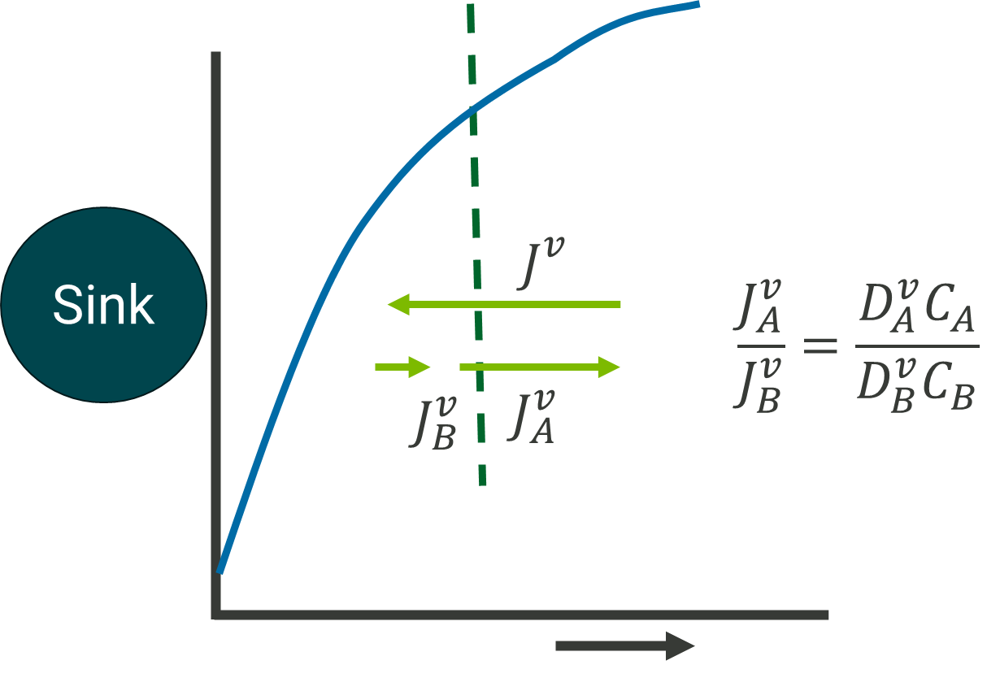
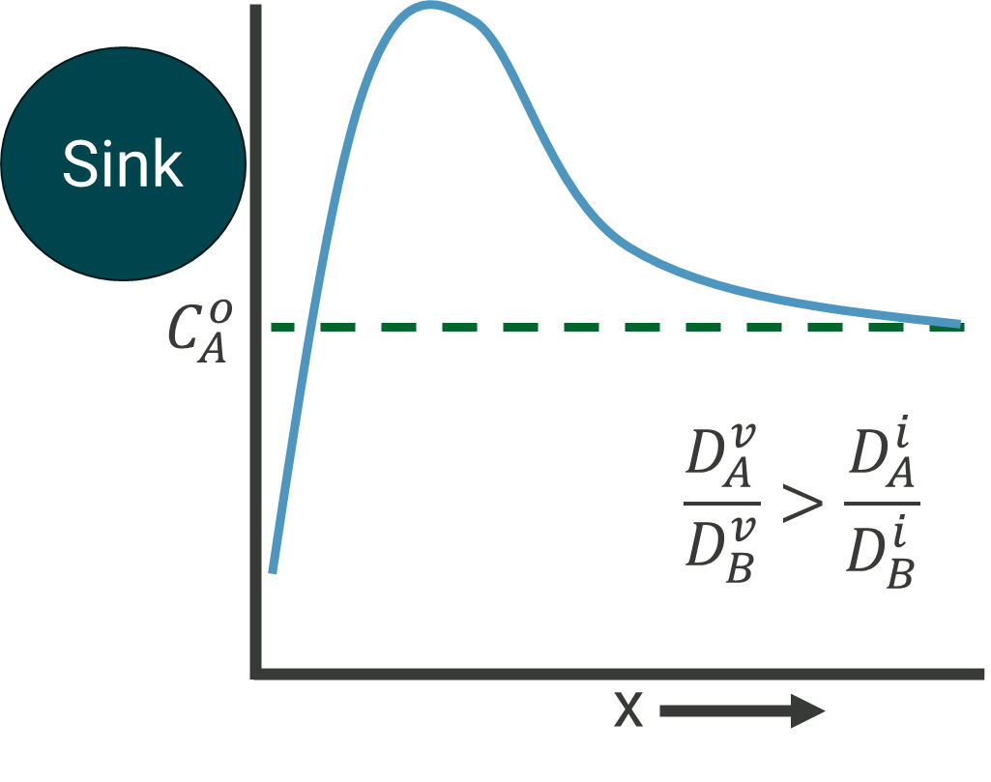
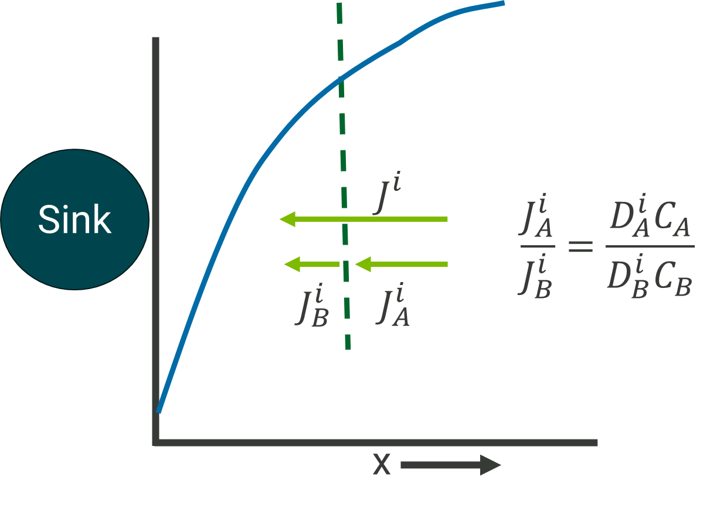
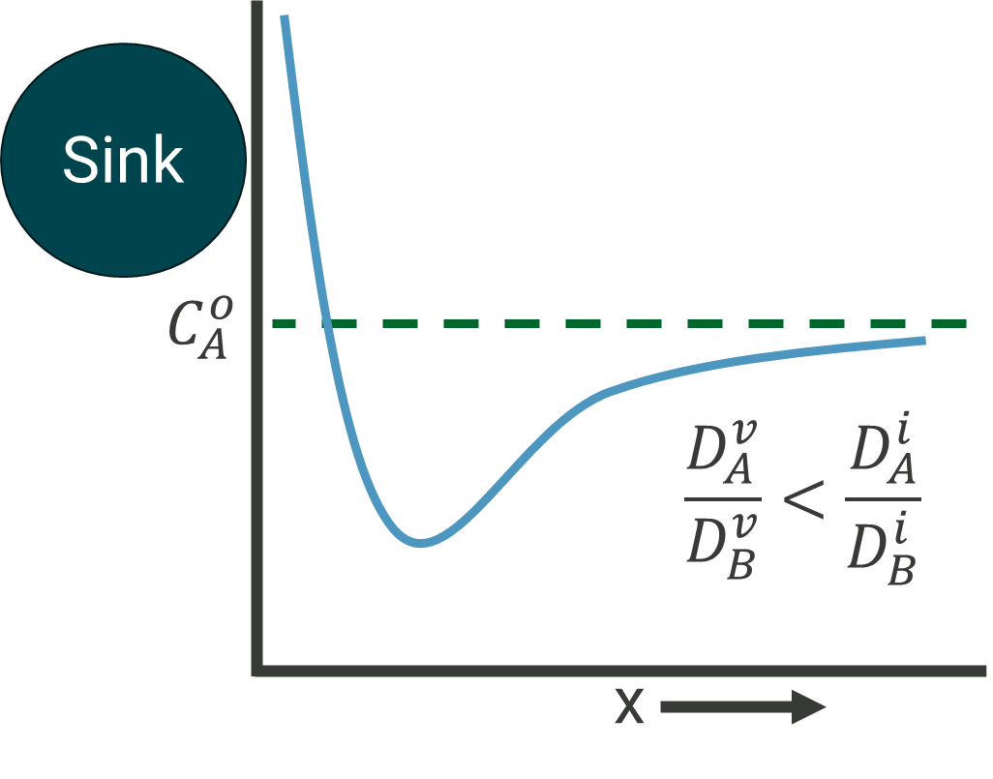


Differences in atomic diffusivity with enhanced point defect concentrations leads to radiation induced segregation
Sink
$$C_{A}^{o}$$
$$\frac{D_{A}^{v}}{D_{B}^{v}}<\frac{D_{A}^{i}}{D_{B}^{i}}$$
x
Adapted from P. R. Okamoto and L. E. Rehn, JNM 83 (1979)

Slide 22
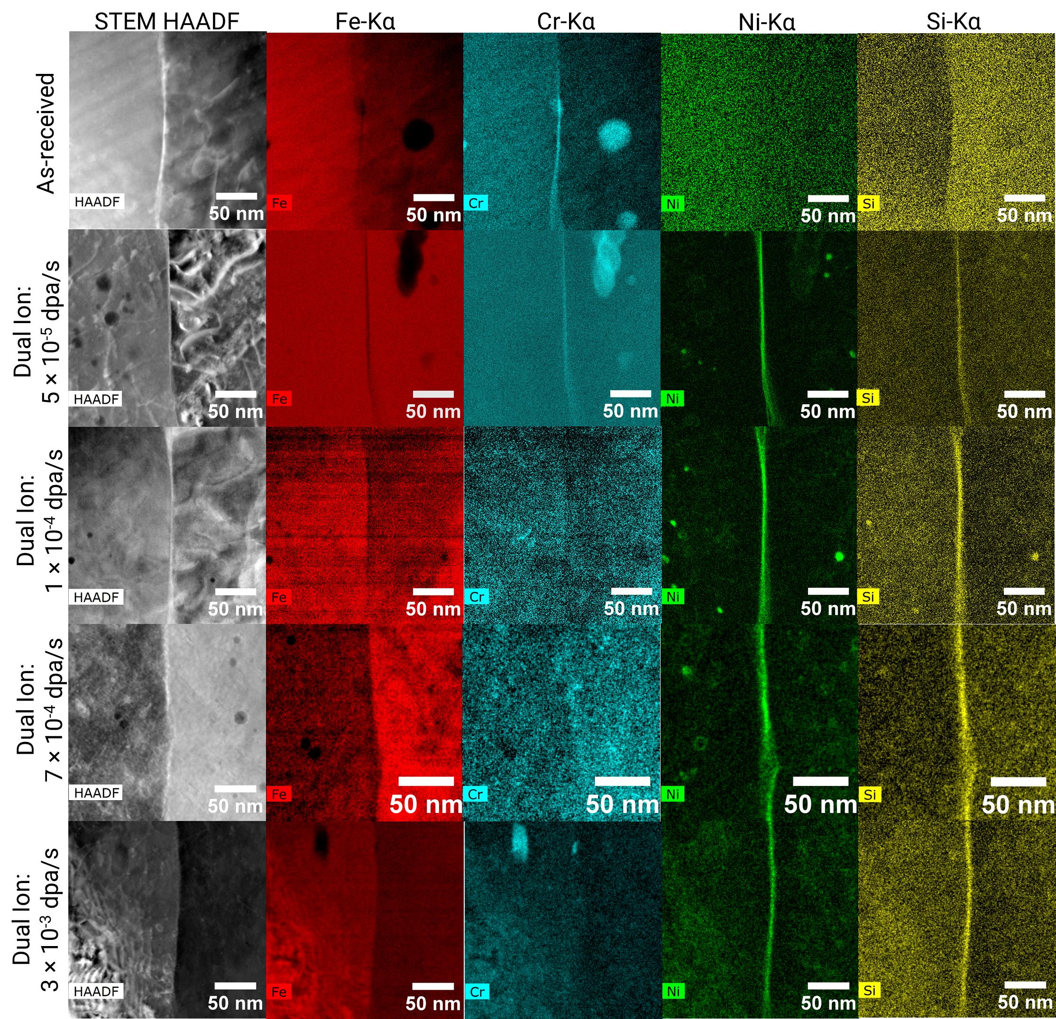
Radiation induced segregation is temperature and dose rate dependent
T91 Steel, 445°C, ~17 dpa
Nastar, Soisson, Comp. Nuc. Mat. (2012)
Adapted from S. Taller et al, JNM 563 (2022)

Slide 23
Precipitation is a complex mix of thermodynamics and kinetics
Radiation Induced Precipitation
Radiation Enhanced Precipitation
New phases form that otherwise are prohibited
Enhanced point defect concentrations and mobility increase kinetics
Phase Stability
Radiation Ordering/Disordering
Recoil Dissolution
Loss of long range order (LRO) or formation of short range order (SRO) due to irradiation
Damage cascades ballistically release solutes to the surrounding lattice

Slide 24
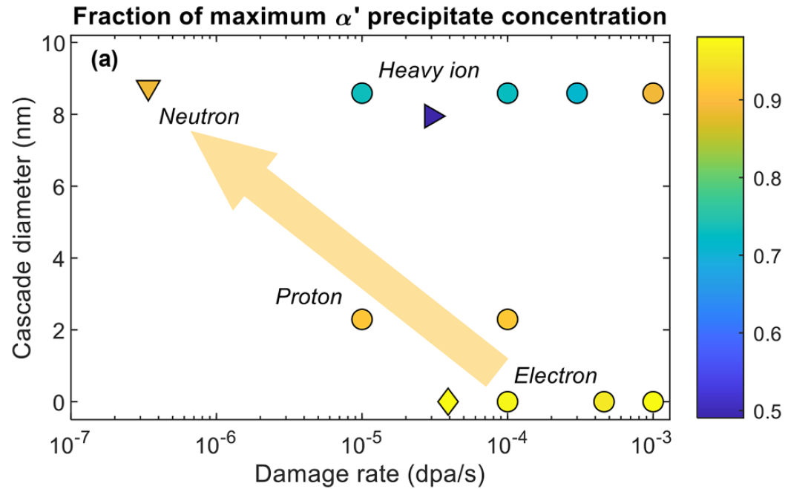
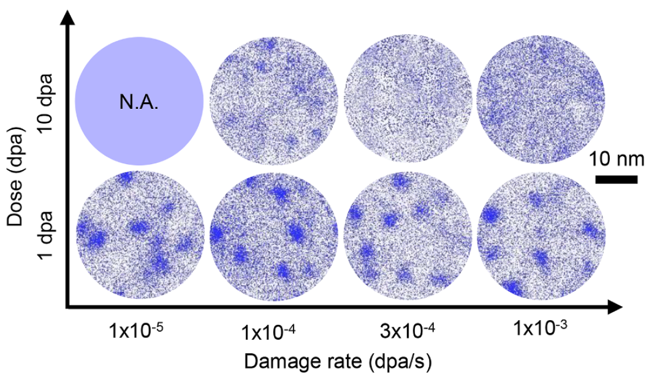
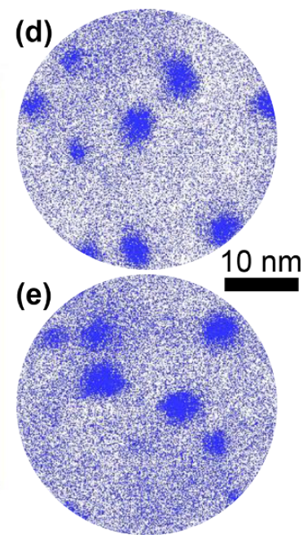
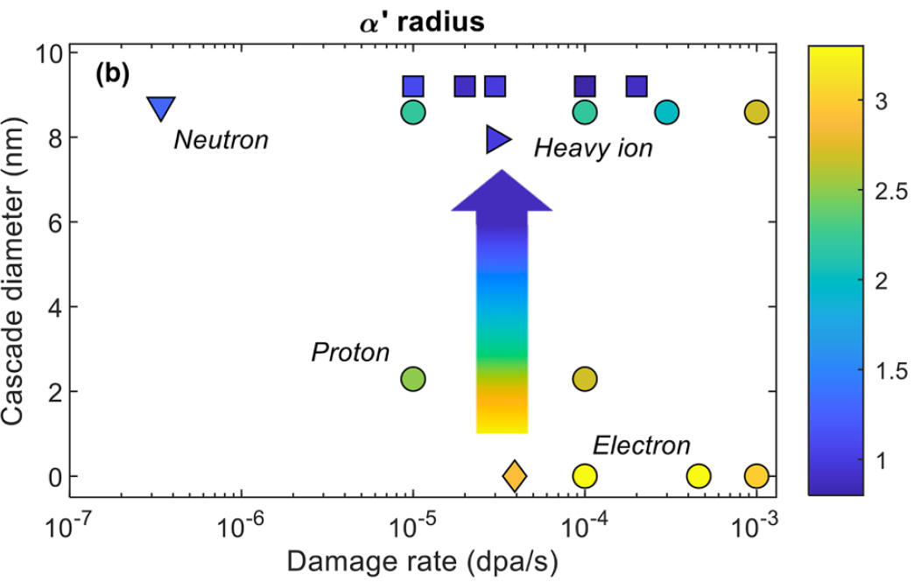

Case Study: α’ precipitates in Fe-Cr binary alloys
Initial conditions
Cr-rich precipitates present
Heavy ion irradiation at 400°C
K. Thomas and G. S. Was, JNM 585 (2023)

Slide 25
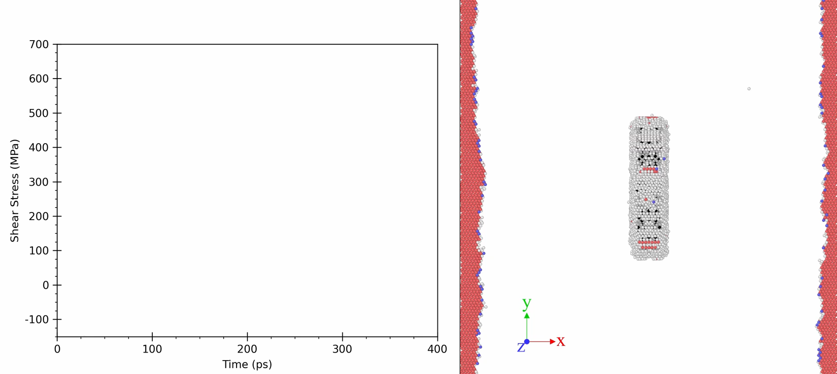
Precipitates and defect clusters act as barriers to dislocation motion
γʺ precipitate in Nickel
Visualization of edge dislocation structure mobility and shear stress behavior during dislocation MD simulation for X-oriented, 10nm, 300K simulation
Provided by L. Metzger, Virginia Tech

Slide 26
Microstructure evolution is holistic!
Dislocations
Strain/Bias leads to
Cavities
Act as barrier to motion
Act as nucleation sites for
Helium
Coatings reduce nucleation barrier
Can provide variable bias
Act as barrier to motion
Precipitates
Segregation
Provides solutes for

Slide 27
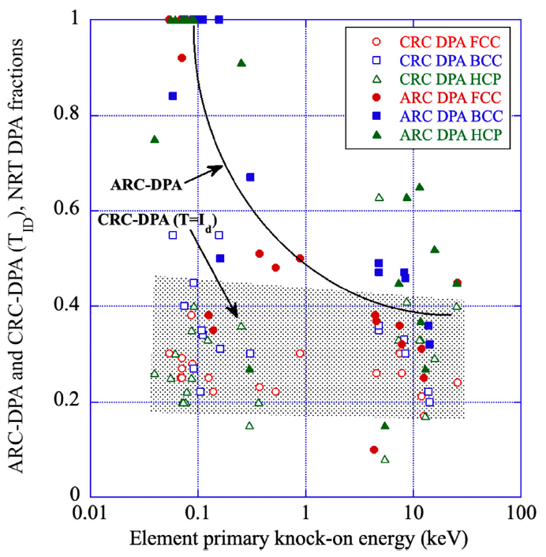
Which DPA measure is the right one?
Recall NRT-dpa is primarily about the damage event, NOT the outcome of the damage.
Two additional metrics are proposed:
ARC-dpa (athermal recombination correlated)
CRC-dpa (correlated recombination- corrected dpa, “core-dpa”)
S. Zinkle and R. Stoller, JNM 577 (2023)

Slide 28
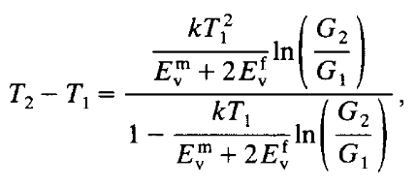
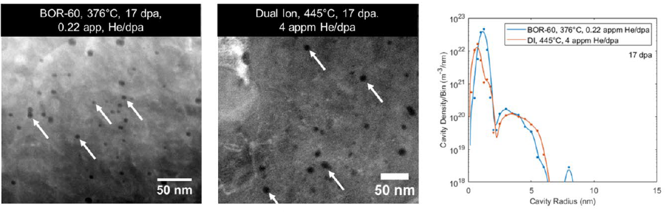
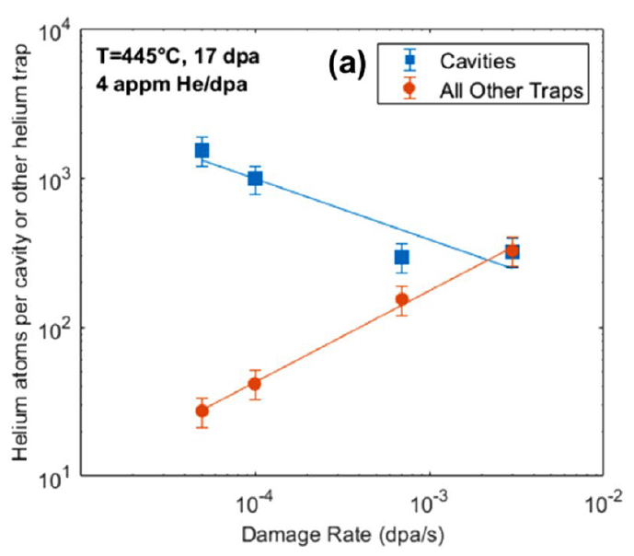
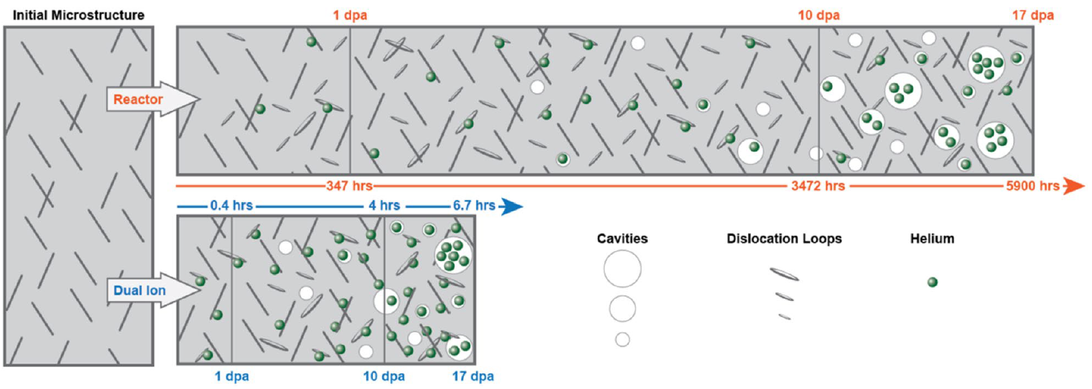
How can we simulate one environment with another?
Mansur, JNM 206 (1993)
ΔT~60-70°C across ~10³ in dpa rate
S. Taller et al, Scientific Reports, 11 (2021)
Short answer: It depends and it’s complicated.

Slide 29
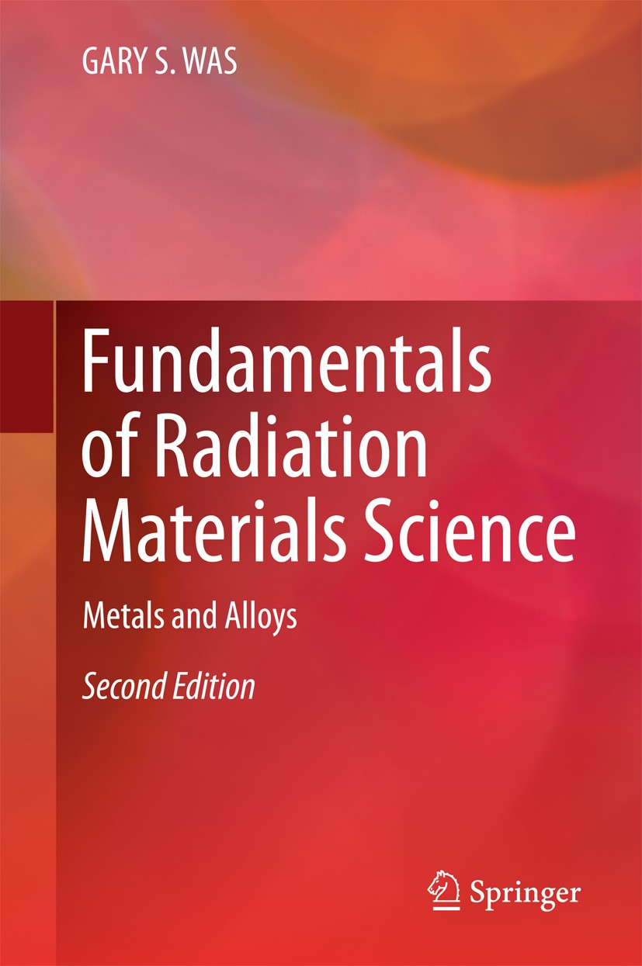
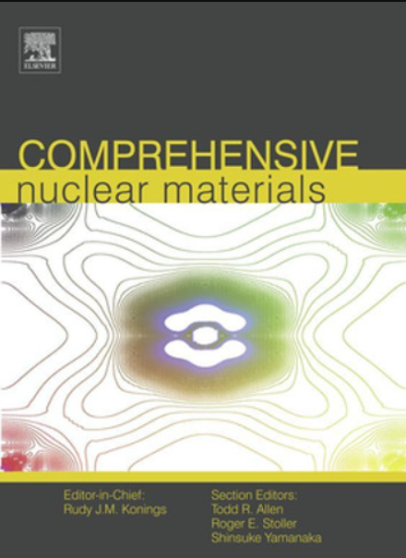
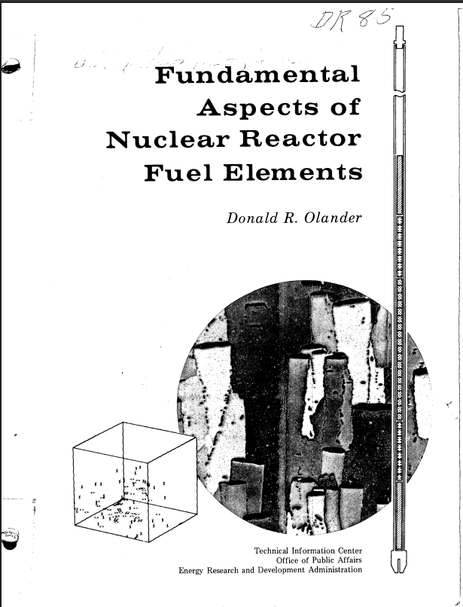
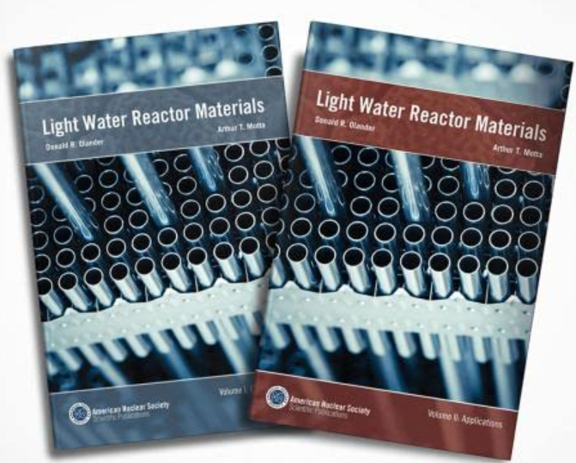
For more information there’s great reference materials
For more fuels related items:
Also free on OSTI
For theory and equations:
For material specific reviews:
Focused on LWR materials:
https://doi.org/10.2172/7343826

Slide 30
Summary
Radiation damage is a complex set of interconnected phenomena (and that’s why its fun to research!)
Picosecond (timescale) events influence large length scale properties!
There are many independent and synergistic effects to consider when planning or designing irradiation test campaigns.
NSUF scientists are available to help plan out experiments across the 20+ facilities.

