Slide 1
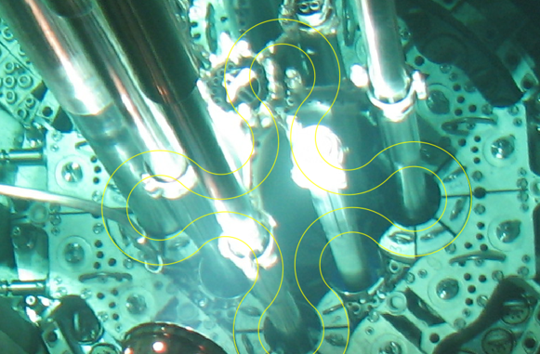
July 22, 2026
Nate Oldham
Experiment Design Engineering Manager
Irradiation Testing and Experiment Design
ATR capsules and loops | TREAT transient testing

Slide 2
Table of Contents
ACT | SLIDES | PURPOSE
1 | 1–5 | TYPES OF IRRADIATION TESTS + DESIGN DECISION LOGIC
2 | 6–9 | FACILITY + ARCHITECTURE | ATR and TREAT
3 | 10–18 | CAPSULES | Type of Irradiation Vehicle
4 | 17-18 | INSTRUMENTATION LEADOUT | Type of Irradiation Vehicle.
5 | 19–23 | PRESSURIZED-WATER LOOP | Type of Irradiation Vehicle.
6 | 24–26 | TREAT TRANSIENT TESTING | Type of Irradiation Vehicle.
7 | 27 | CLOSE + QUESTIONS

Slide 3
Think in test campaigns, not single irradiations
Each facility answers a different part of the technical question.
ATR DROP-IN CAPSULE
ATR INSTRUMENTED / LOOP
TREAT TRANSIENT
Screen concepts
Accumulate dose or burnup
Compare materials and specimens
Control key conditions
Measure selected responses
Increase environmental fidelity
Apply controlled rapid energy input
Capture time-resolved response
Explore thresholds and progression
PIE + models + fabrication records + facility history = the defensible dataset

Slide 4
Start with the decision, not the hardware
A good experiment concept is a traceable chain from the decision to the data product.
1 Research question
2 Measured response
3 Success criterion
What decision will the test support?
What observable changes that decision?
What result is sufficient or unacceptable?
4 Environment + history
5 Architecture + controls
6 PIE + data pedigree
Spectrum, dose, temperature, chemistry and time.
Capsule, lead, loop or transient vehicle.
How will evidence be recovered and defended?
If one link is vague, the hardware will not make the result defensible.

Slide 5
ATR and TREAT answer different parts of the LWR question
Connect histories
ATR | STEADY-STATE IRRADIATION
TREAT | TRANSIENT IRRADIATION
Dose, burnup, and microstructure evolution
Temperature and environment over time
Capsule, instrumented, and water loop configurations
Rapid power or energy deposition
Time-resolved response and diagnostics
Transient vehicle, confinement, and recovery

Slide 6
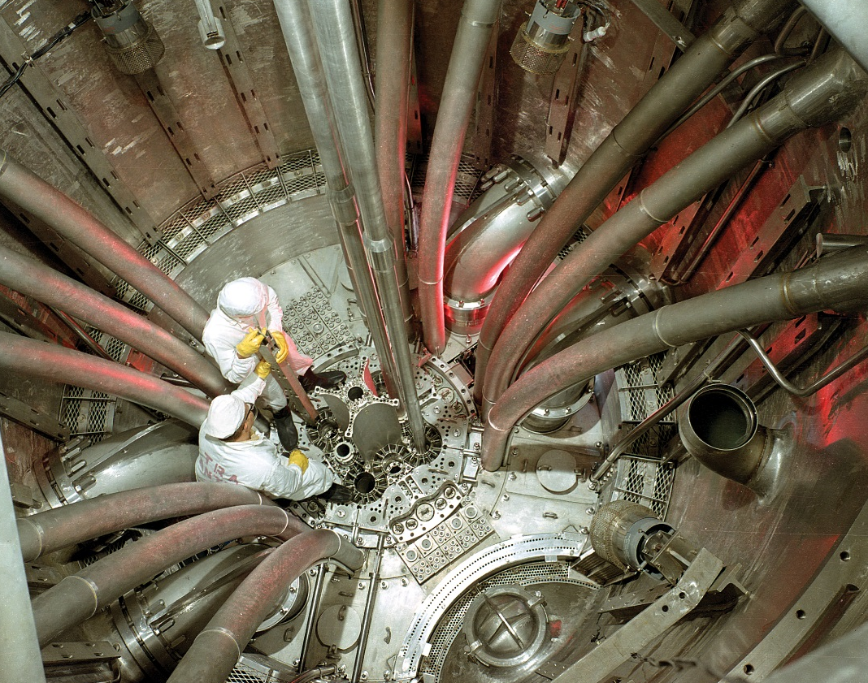
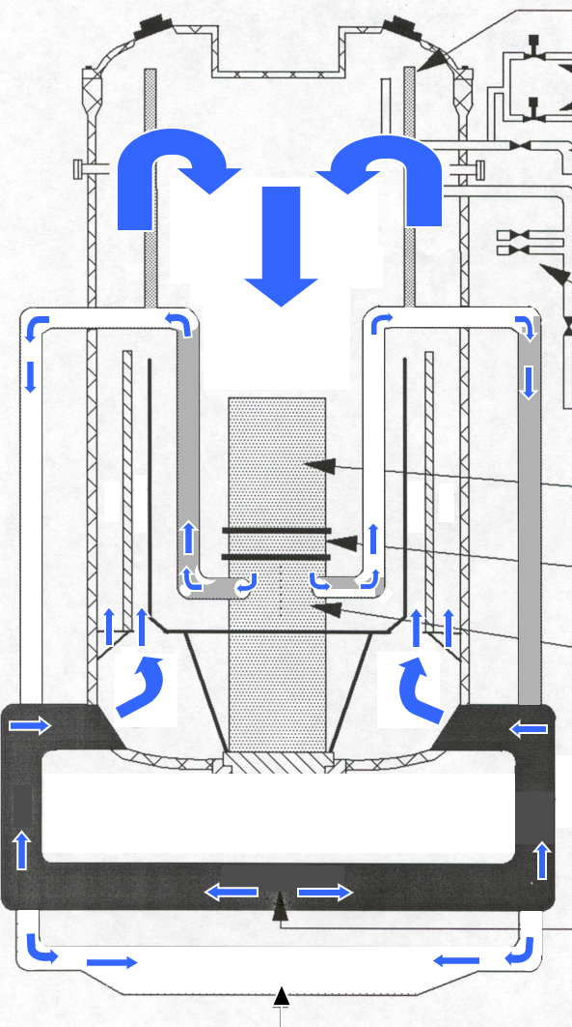
ATR at a glance
Materials and fuels test reactor with multiple experiment positions
Pressurized light-water primary coolant and downflow through the core
Cloverleaf core supports different flux conditions in the same cycle
Position selection affects spectrum, heating, space and interfaces
Cycle history and control configuration become part of the test record

Slide 7
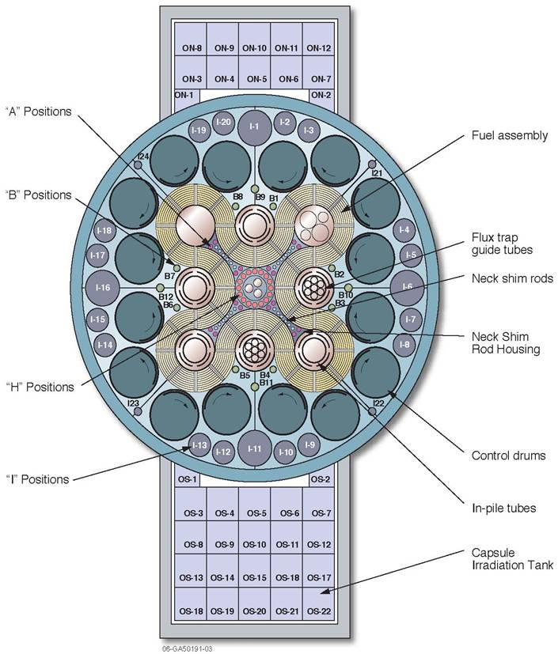
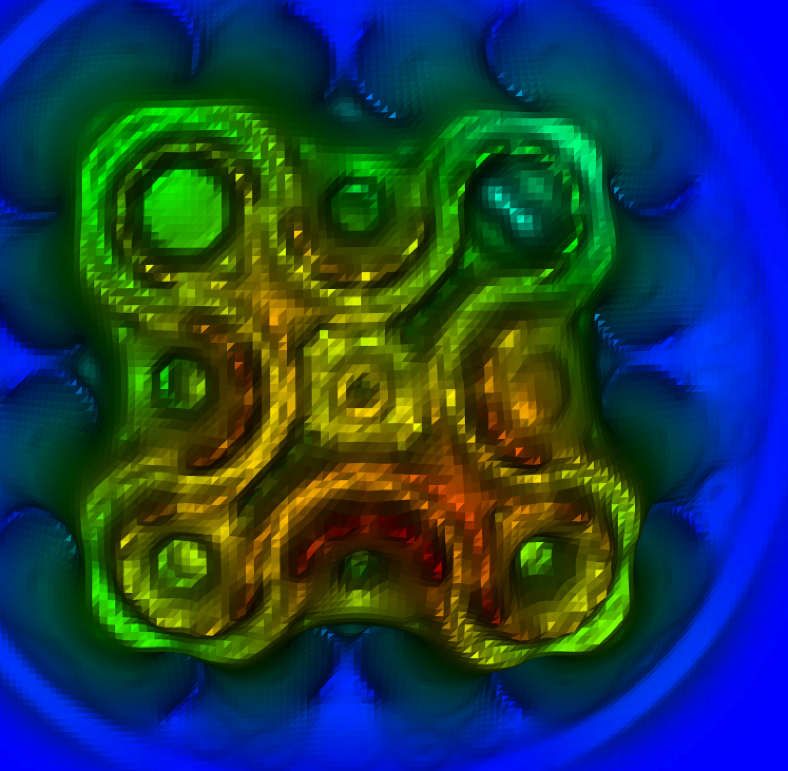
ATR position and experiment types
DROP-IN CAPSULE
Passive hardware in an available reactor position; containment and thermal gaps do most of the work.
INSTRUMENTED LEAD
Leadouts connect sensors and sweep-gas controls to external systems.
Diameter + flux + spectrum + heating + handling + interfaces
PRESSURIZED WATER LOOP
An independent coolant system provides pressure, temperature, flow, and chemistry control.

Slide 8
TREAT at a glance
Uranium-fueled, graphite-moderated, once-through air-cooled thermal-spectrum test reactor
Fast-acting rods produce natural bursts or shaped power histories
Strong negative temperature feedback makes excursions self-limiting
Central test positions support pins, clusters and specialized experiment vehicles
Open-core access enables time-resolved diagnostics, including the fast-neutron hodoscope
PEAK TRANSIENT POWER
TYPICAL TRANSIENT DURATION
up to ~18 GW
tens of msec to a few sec
core dependent
some shaped cases last minutes

Slide 9
Choose the simplest architecture that meets the objective
Decision factor | Drop-in capsule | Instrumented lead | Pressurized loop | Instrumented TREAT vehicle
Best fit | Screening / accumulation | Controlled exposure | Qualification-oriented evidence | Transient thresholds / progression
Environment | ATR primary boundary outside capsule | ATR position + local gas control | Independent PWR-like coolant | Vehicle-defined capsule or loop boundary
Real-time data | Usually none | Selected sensors | Sensors + loop-system data | Many high-speed sensors + facility diagnostics
Control strategy | Passive geometry / gas gap | Sweep gas + feedback | Coolant system + local design | Dedicated experiment controls / DAQ synchronized with reactor transient
Integration effort | Lowest | Intermediate | Highest | High; fast timing + recovery interfaces
Use when... | The decision tolerates lower fidelity | Real-time control changes the answer | Coolant fidelity changes the answer | Time-resolved response changes the answer
Architecture is a trade space: choose by decision, fidelity, control strategy and time scale.

Slide 10
Drop-in capsule testing
ATF-1 illustrates how modular containment supports early LWR fuel screening.
CONTAIN
POSITION
CONTROL TEMPERATURE

Slide 11
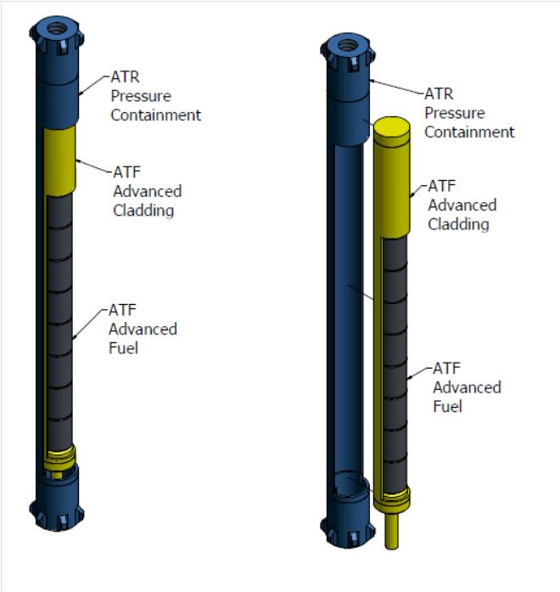
ATF-1: screen LWR fuel concepts efficiently
Fuel and cladding concepts are enclosed in individual capsules
Steady-state irradiation is followed by post-irradiation examination
A common facility position supports comparative evidence
Containment enables early concepts to be tested with defined boundaries
The decision is which concepts merit more prototypic testing
Concept
Capsule
ATR exposure
PIE
Down-select

Slide 12
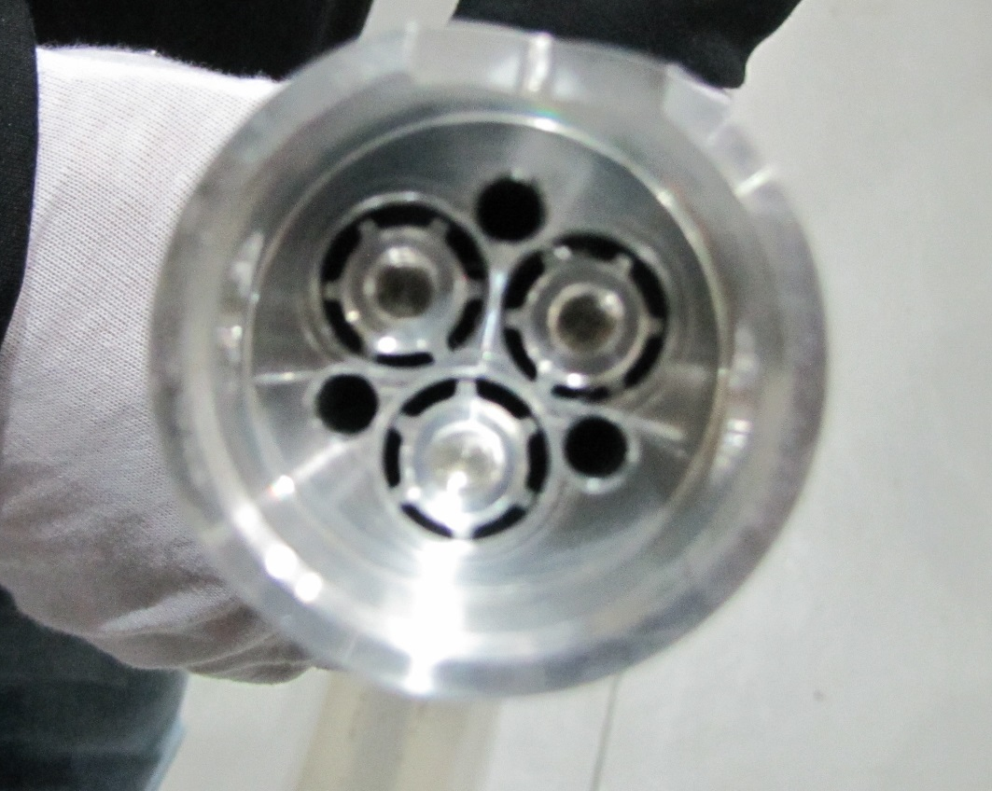
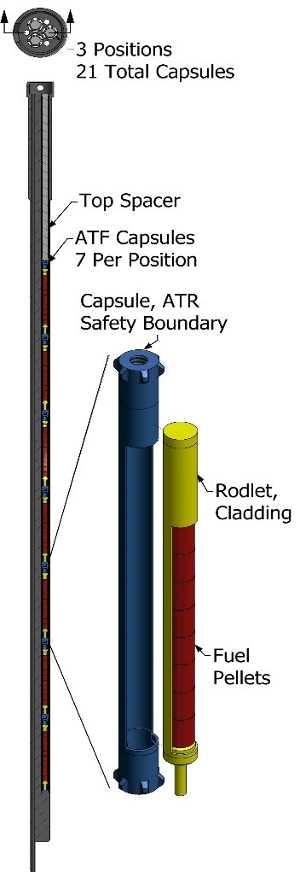
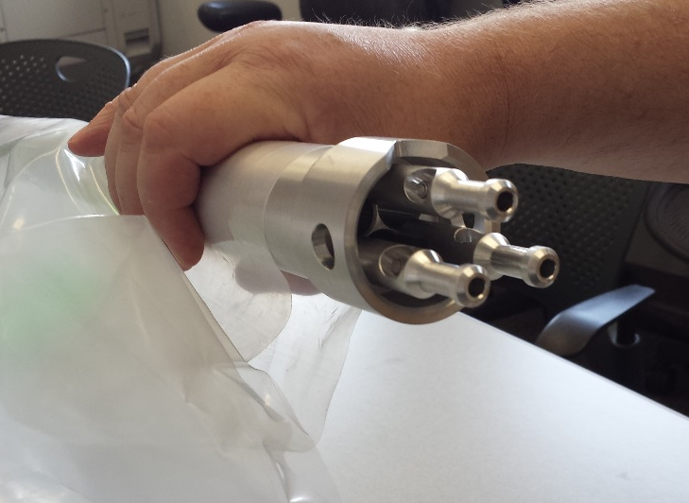
The small-I basket makes capsule testing modular
HISTORICAL CONFIGURATION
DESIGN IMPLICATION
4 locations x 3 channels x 7 axial locations = 84 capsule positions
Specimen identity, axial location, flux monitoring, handling and PIE retrieval must remain traceable.

Slide 13
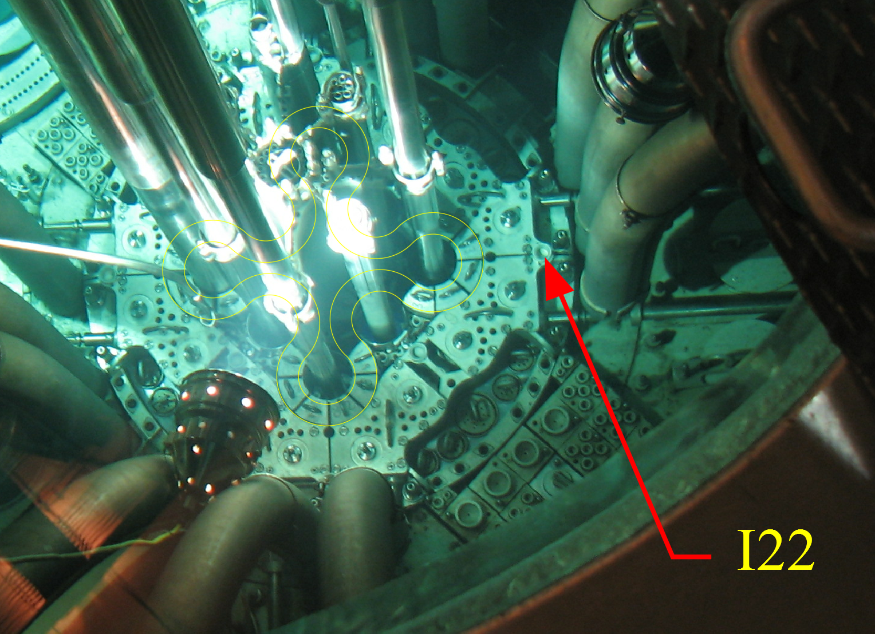
Capsule anatomy controls containment and specimen temperature
Capsule boundary separates the specimen from ATR primary coolant
Holder geometry locates the rodlet and maintains handling features
The gas gap creates thermal resistance and elevates cladding temperature
Materials, dimensions and tolerances set the heat-transfer path
Closures, inspection and PIE access are part of the same design
  ATR Top View

Slide 14
Drop-in capsules are powerful when their limits match the decision
STRENGTHS
LIMITS
Modular and reconfigurable
High position capacity
Established fabrication methods
Individual containment boundaries
Good first in-reactor test for new concepts
Lower environmental fidelity
Usually no real-time instrumentation
Passive temperature control
Local flux and heating constraints
High-heat concepts can be difficult to keep in range
Use a capsule when screening value exceeds the value of added fidelity and instrumentation.

Slide 15
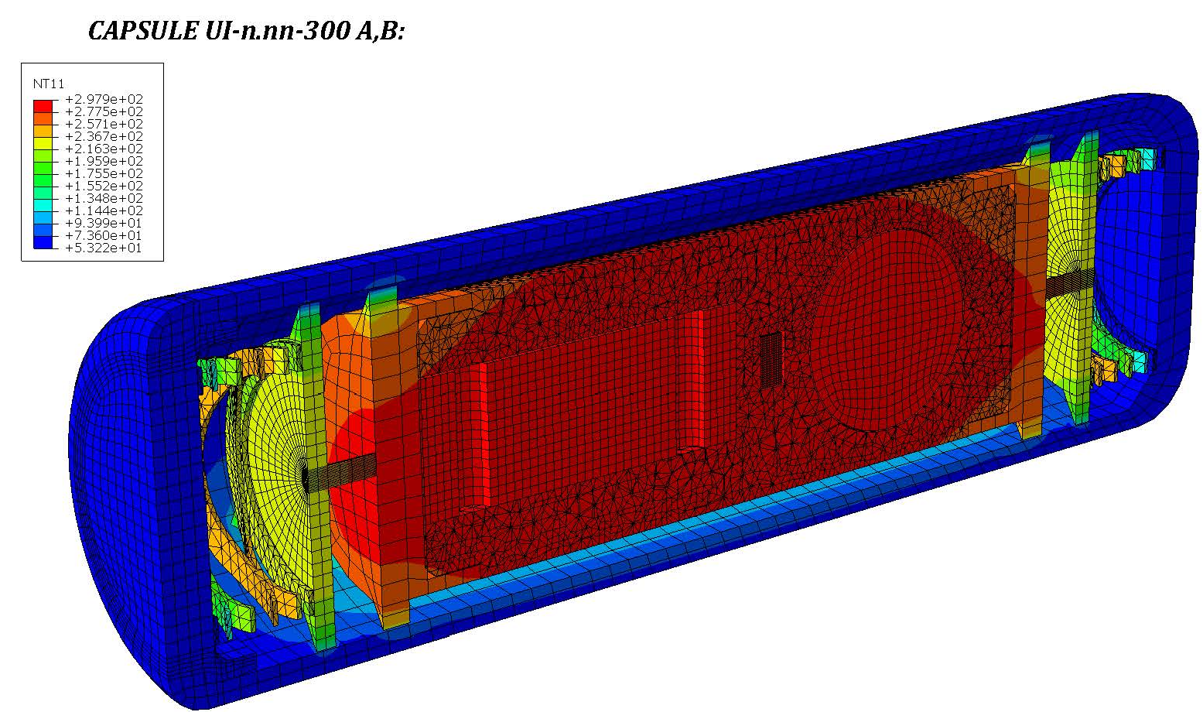
Thermal design connects nuclear heating to specimen temperature
Neutronics predicts local heat generation and uncertainty
Geometry and materials establish conduction paths
Gas composition and gap size establish thermal resistance
Radiation, contact and surface conditions can matter
Coolant boundary conditions close the thermal model
UNCERTAINTY BUDGET
Heat-rate uncertainty, power variation, gap tolerances, properties and model assumptions can all move the result.

Slide 16
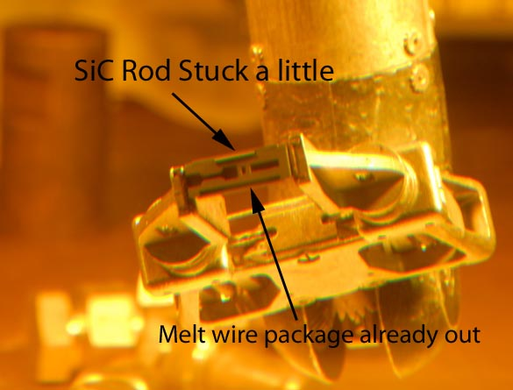
Select temperature evidence that matches the decision
Method | What it tells you | Design question
Melt wire | Peak threshold exceeded | Is one threshold sufficient?
SiC indicator | Post-irradiation inference | Is the method calibrated for the range?
Thermocouple | Real-time temperature history | Will routing, drift and survival be acceptable?
Post-irradiation access and chain of custody are part of the measurement system.

Slide 17
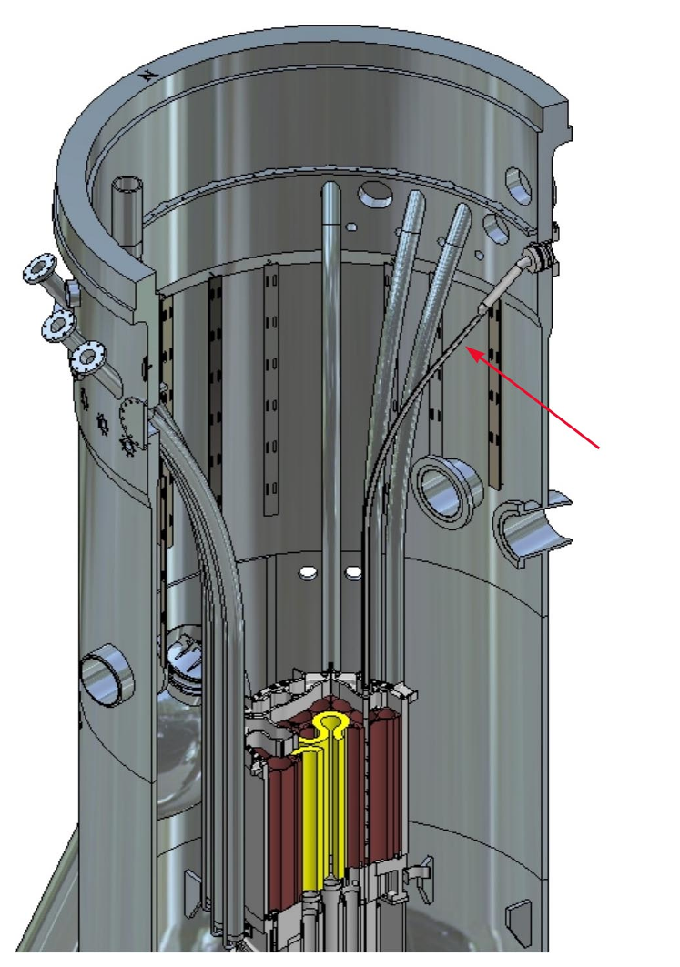
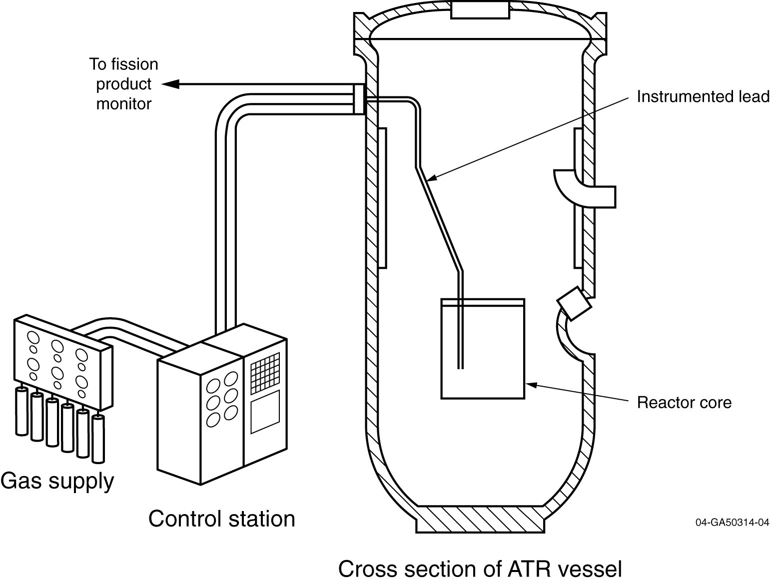
Instrumented capsules add control and real-time evidence
Leadouts connect in-core sensors and sweep-gas lines to external systems
Gas mixing can adjust conductance and specimen temperature
Selected thermocouples provide control feedback and operating history
Exhaust monitoring can add experiment-performance information
Every line creates routing, sealing, calibration and survivability requirements
Use instrumentation when the information gained justifies the added failure modes and integration work.

Slide 18
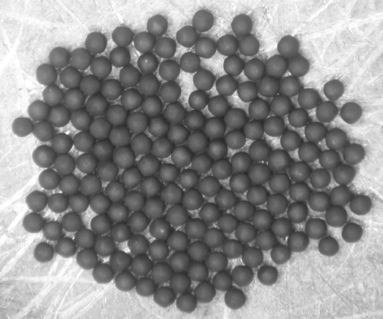
AGR shows how requirements become a complete test train
The research objective drives capsule zoning, specimen placement and instrumentation
Individual capsule functions must integrate with the full test-train structure
Lead routing, handling, assembly and qualification are system-level decisions
The final dataset connects in-reactor history to post-irradiation fuel performance
TRISO fuel form
Particle cross sections

Slide 19
Pressurized-water loop testing
ATF-2 illustrates prototypic coolant conditions and tighter facility integration.
PRESSURE + TEMPERATURE
FLOW + CHEMISTRY
TEST-TRAIN INTEGRATION

Slide 20
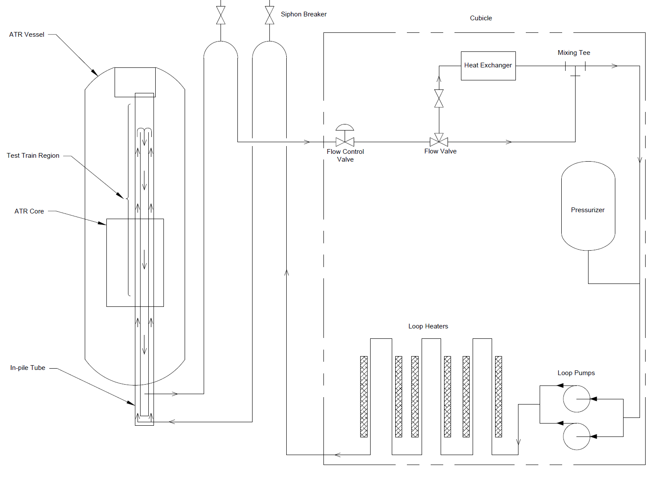
The loop and test train form one experiment system
Loop coolant is isolated from ATR primary coolant
Dedicated systems control pressure, temperature, flow and chemistry
The in-pile tube, test train and external plant share interfaces
Facility transients and operating procedures enter the design basis
Use a loop when coolant fidelity changes the technical decision
SOURCE EXAMPLE: ~15 MPa | ~300 C

Slide 21
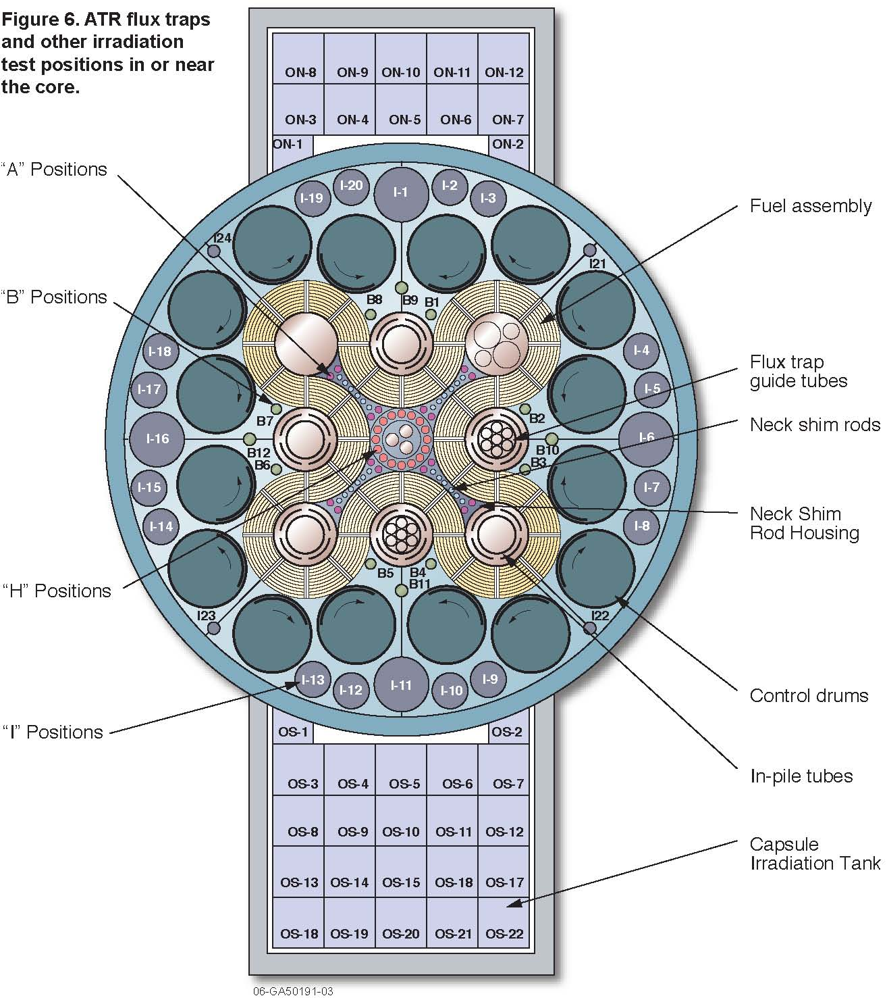
ATF-2 moves mature LWR concepts into PWR-like conditions
The test train occupies the center flux-trap loop position
Fuel pins contact the independent loop coolant directly
Pressure, temperature, flow and chemistry are controlled as a system
Local power depends on core position and control configuration
The loop supports evidence closer to qualification needs
DESIGN CONSEQUENCE
Core-physics variability must be carried into tier design, power history and uncertainty.

Slide 22
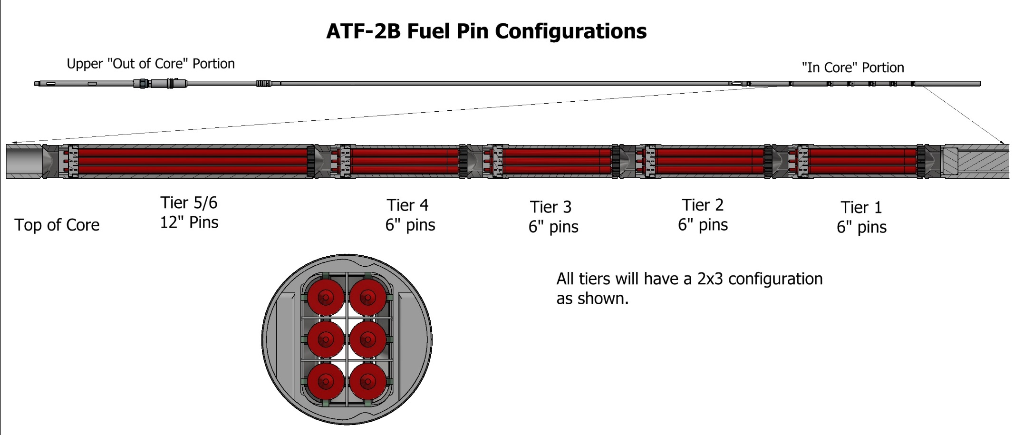
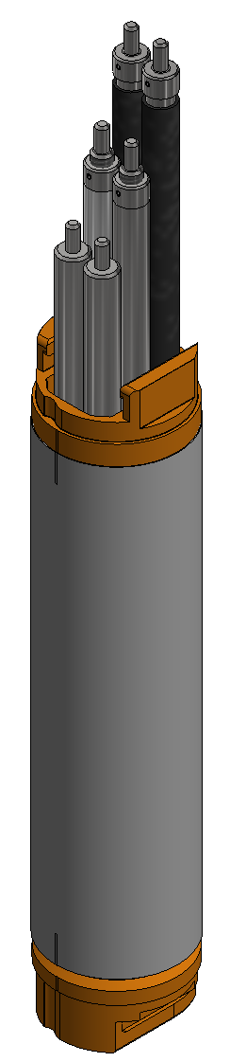
Five tiers turn irradiation requirements into a test train
TIERING
SHROUDING
HOLDERS
Five axial tiers place specimens at different locations in the flux profile.
Local material and geometry tailor power to the target condition.
Each holder locates six rodlets and supports vertical reconfiguration.

Slide 23
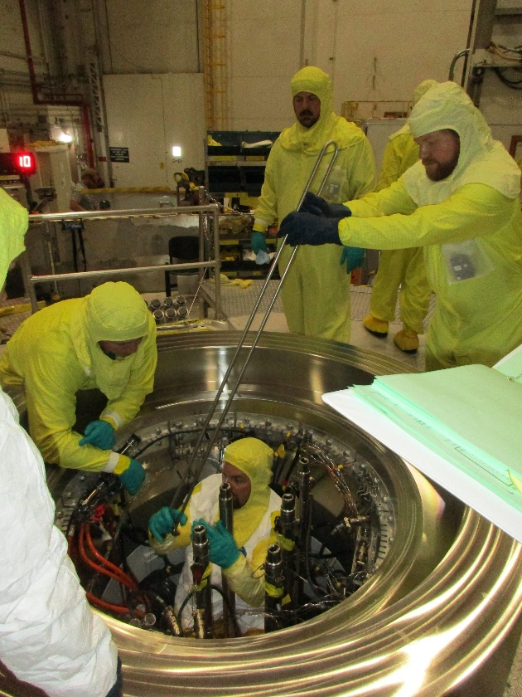
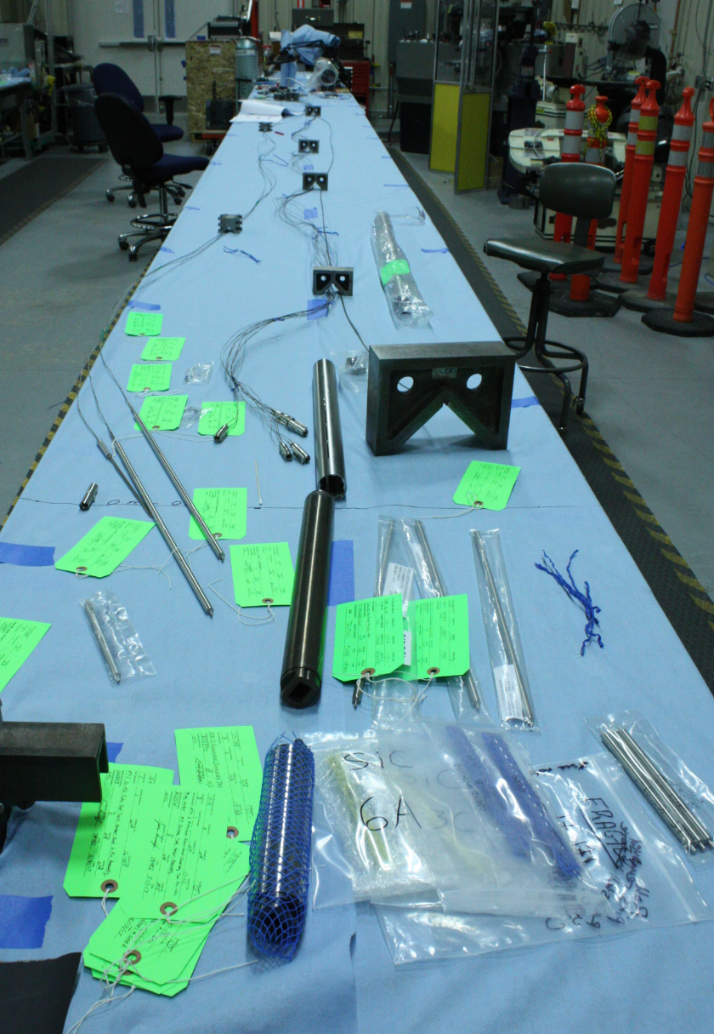
Instrumentation multiplies the integration interfaces
Thermocouples measure selected fuel or holder temperatures
Displacement sensors add routing, calibration, and range requirements
Each connector and feedthrough must survive fabrication and operation
Non-fueled testing can qualify the integrated measurement chain
Test-train wiring must coexist with reactor-top handling and operations
REACTOR-TOP INTERFACE
Connector access, routing, strain relief, handling, and configuration control.
Qualification is for the complete measurement path, not only the sensor.

Slide 24
Transient testing in TREAT
The design emphasis shifts from accumulated exposure to energy deposition, time response and recoverable evidence.
DEFINE THE TRANSIENT
CAPTURE THE RESPONSE
RECOVER THE EVIDENCE

Slide 25
Transient tests change the dominant design questions
INPUT
DIAGNOSTICS
What transient shape, timing and deposited energy represent the event of interest?
Which signals require high time resolution, calibration and protection from the event?
VEHICLE
RECOVERY
What geometry, thermal boundary and confinement preserve the intended response?
What must remain identifiable and examinable after the transient?
The experiment vehicle must preserve both the physics and the evidence.

Slide 26
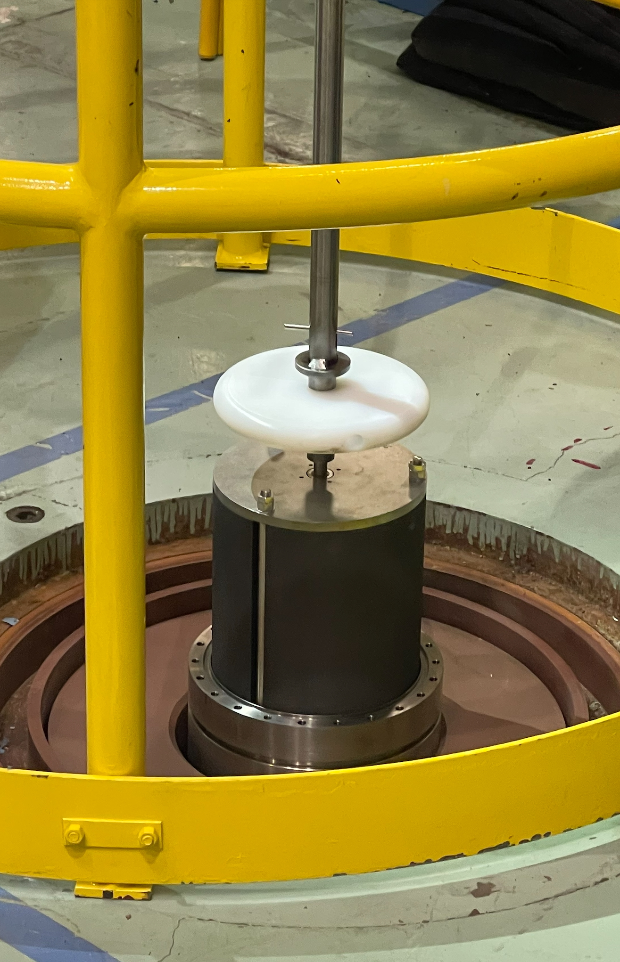
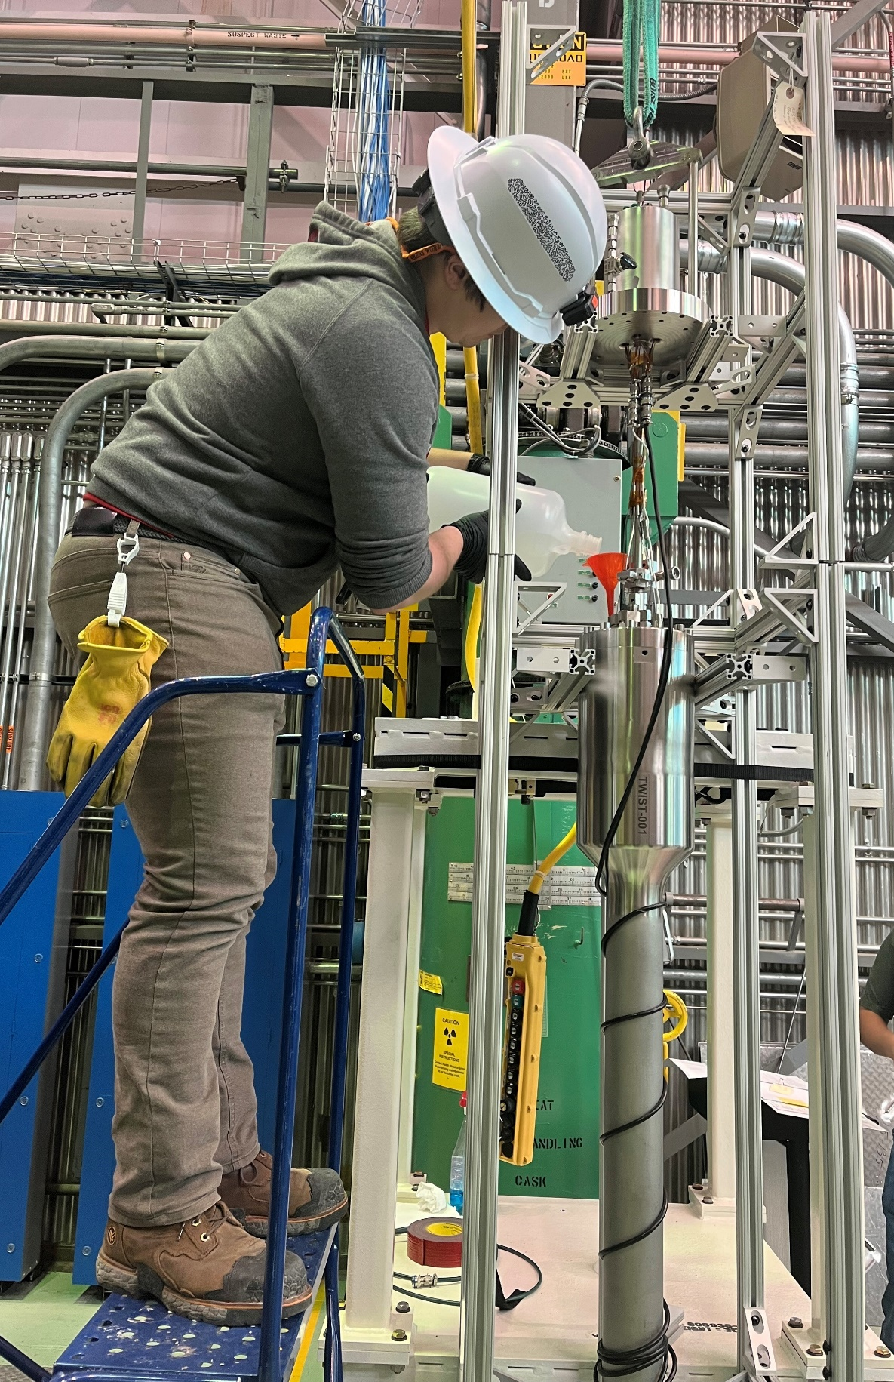
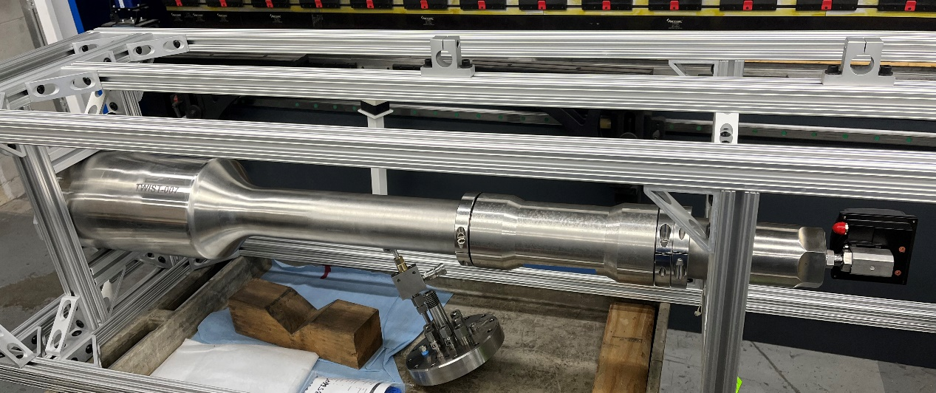
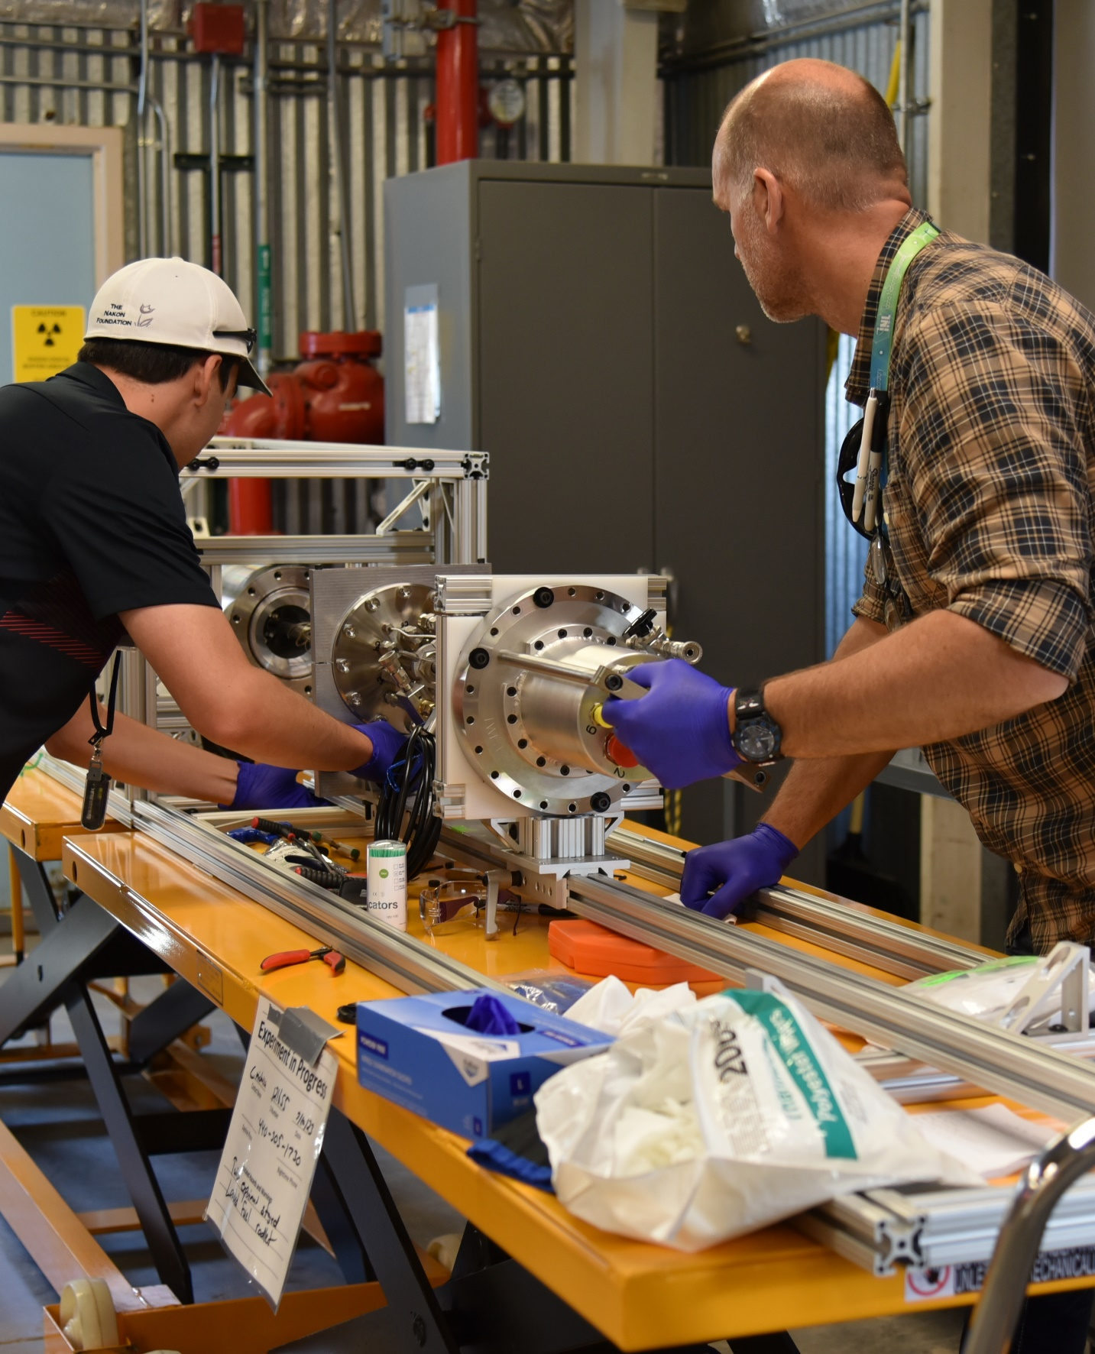
TWIST Device
Most components remain unchanged from previous TWIST experiments
  Capsule will be configured with an external borated steel flux collar like previous RIA tests
Only changes are modifications to the rodlet holder and the addition of heaters to get to the desired pre-transient conditions
Borated stainless steel Flux Collar on TWIST capsules used for RIA testing

