Slide 1
National Reactor Innovation Center
Partnering with industry to deploy advanced nuclear at the speed of a startup
June 2026
Jake Rymer
Technical Program Manager
National Reactor Innovation Center
jacob.rymer@inl.gov
MIS-25-85413

Slide 2
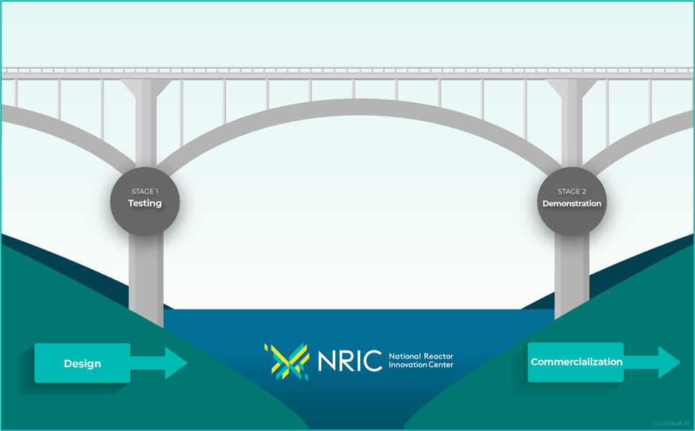
The National Reactor Innovation Center (NRIC) is a DOE program launched in October 2019
NRIC Enables Nuclear Reactor Tests & Demonstrations
Authorized by the Nuclear Energy
Innovation Capabilities Act (NEICA)
  Department of Energy (DOE)-Office of Nuclear Energy
  Headquartered at Idaho National Laboratory (INL) and part of Nuclear Science & Technology Directorate
Partner with industry to bridge the gap between research and commercial deployment
Leverage national lab expertise and infrastructure

Slide 3

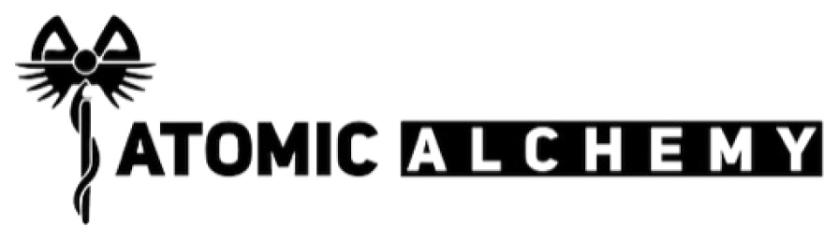



















Select DOE Pilot Programs
Launch Pad
Other Early Engagement
NS&T
MFC
ATR
CFA
& Other
National Labs
Advanced Reactor Demonstration Program
26-50349
Natrium Reactor Sodium-cooled reactor + molten salt energy storage system (TERRAPOWER)
XE-100 High-temperature gas reactor (X-ENERGY)
BWXT Advanced Nuclear Reactor (BANR) High-temperature gas-cooled microreactor
(BWX TECHNOLOGIES)
NRIC serves as a hub, bringing the best of the National Laboratories to bear for successful deployment of private industry-developed advanced nuclear technology.
Notes:
For Graphics Use: 26-50349

Slide 4
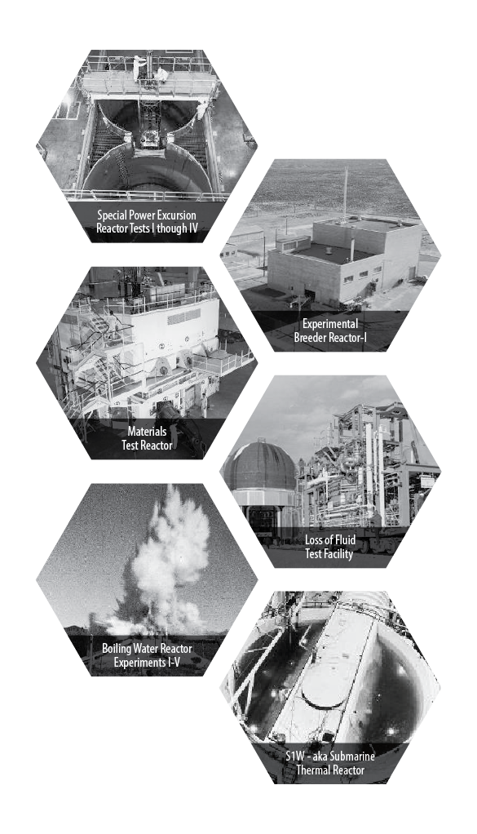
Our Heritage: The National Reactor
Testing Station drove nuclear innovation in the U.S. and around the world
1st
Nuclear power plant
U.S. city to be powered by nuclear energy
Submarine reactor tested; training of nearly 40,000 reactor operators until mid-1990s
Mobile nuclear power plant for the army
Demonstration of self-sustaining fuel cycle
Basis for LWR reactor safety
Aircraft and aerospace reactor testing
Materials testing reactors

Slide 5
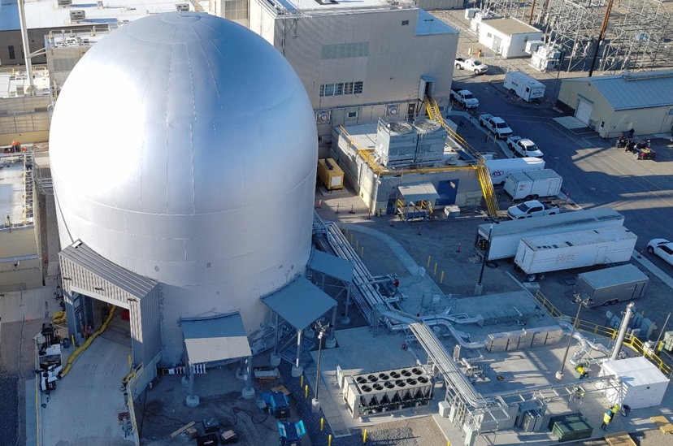
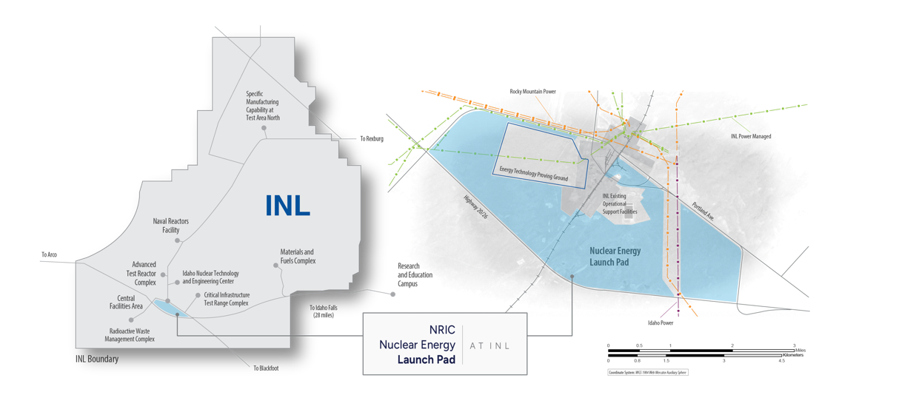
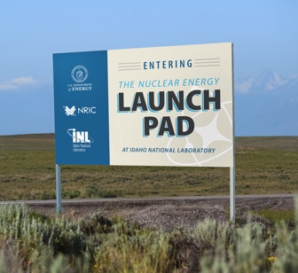
Portfolio Empowering Developers
NRIC’s portfolio of facilities, capabilities and expertise is bridging the gaps identified by industry.
DOME ecosystem
Accelerating Nuclear Testing
Advanced reactor test beds
National Lab/Developer Partnerships
Nuclear Energy Launch Pad
Experimental infrastructure
Addressing Costs & Markets
Advanced Construction Technology Initiative
Digital Engineering for Nuclear
Virtual Test Bed
Maritime applications

Slide 6
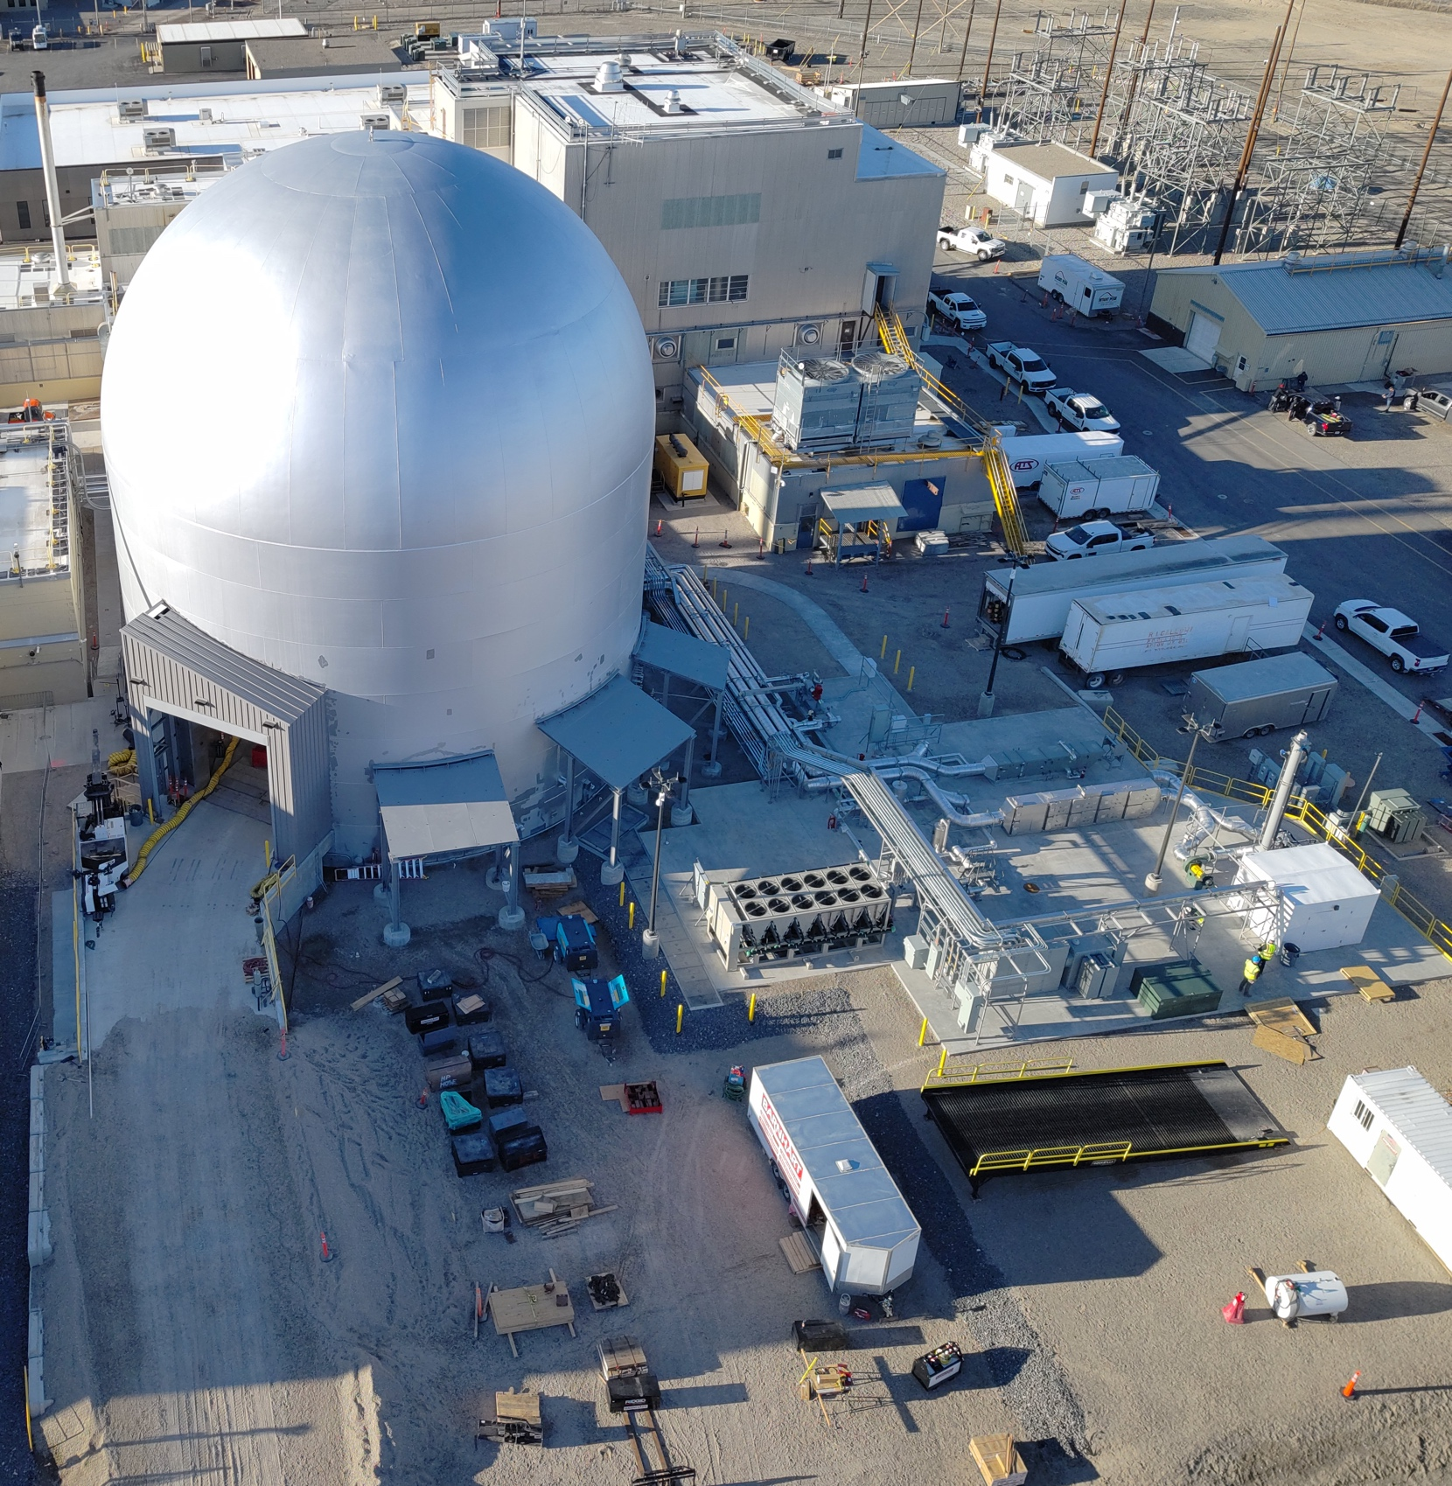
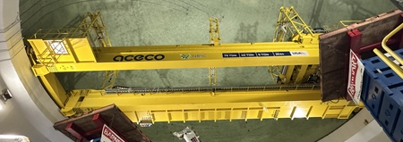
DOME Physical Systems
DOME Testbed
DOME
Polar
Crane
Built for Advanced Microreactors up to 20MWth
Accommodates up to High-Assay Low-Enriched Uranium ((HALEU) enrichment < 20%)
Containment up to 10 psi
Supports ISO 668 High-Cube Shipping Containers up to 40ft long
480V / 400Amp
electrical service
≈ 78 ft diameter floor space with an 80ft ceiling
300kW of environmental cooling
Planned Reactor cooldown pad at the Radioactive Scrap and Waste Facility (RSWF)
75-ton NOG-1 polar crane

Slide 7
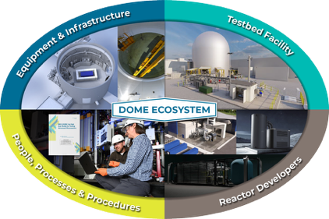
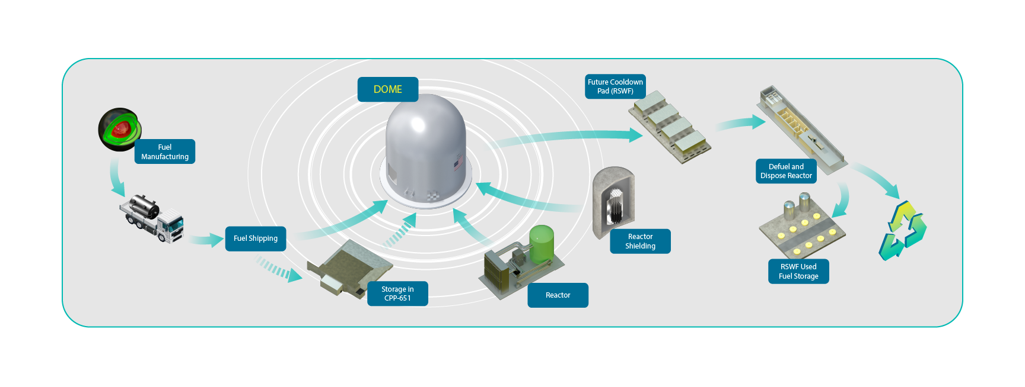
DOME Ecosystem
Performing reactor experiments takes more than just the DOME facility. It requires integration of additional infrastructure, partners, procedures, and processes.

Slide 8
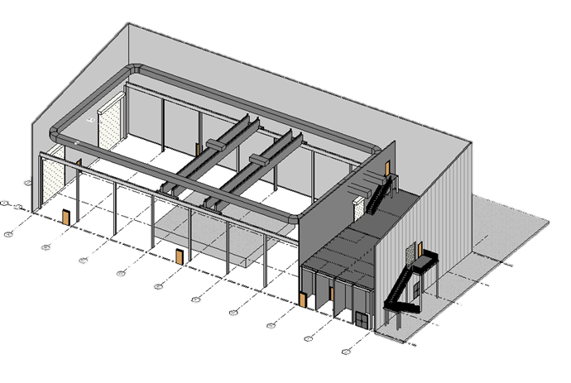
NRIC-LOTUS Test Bed
Laboratory for Operations & Testing in the US (LOTUS)
STATUS
FEATURES
Original scope intended to repurpose Zero Power Physics Reactor structure
Pivoted to new building due to increased costs of original project scope
New facility design/build request for proposals – Mid-2026
Targeting construction completion - 2028
Designed for >20% enriched high security fuels
Performance based security posture
7,000 ft² experiment area with 4,000 psf floor bearing capacity
(2) 20 ft-wide by 20 ft-high doors
Overhead crane; 30 ft to bottom of crane hook
Ventilation system with radiological monitoring
Instrument air system available
Available uninterruptable power supply, standby power – diesel generator

Slide 9
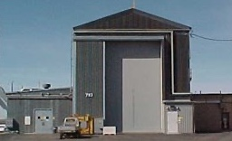
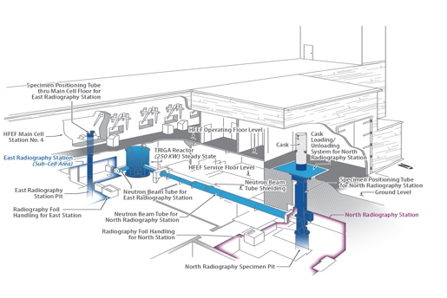
Additional Test Beds
RACE and NRAD NRS – Developer Funded
RACE Test Bed
Reactor And Critical Experiments
(RACE) Facility
NRAD NRS (3N) Test Bed
Neutron Radiography (NRAD) Reactor North Radiography (NRS)
Station Test Bed
Overview
Originally housed ML-1 reactor in ​1960s
Currently supports MFC sodium waste management activities
​Features
32’ tall × 20’ wide rollup door
30-ton crane; 32 ft hook height
10’ wide x 15’ long x
20’ deep pit
Status
Upgraded to Hazard Cat 2 nuclear facility
Initial construction completion mid 2026
Final construction completion in 2027
Overview
Located below MFC’s Hot Fuel Examination Facility (HFEF)
Features
Personnel entry to NRS via 11.5-ton shield door
18’ tall × 14’ wide rollup door
30” diameter “pit” that extends below the
shielded cell 34’
HAZCAT 2 CAT B
Reactor Facility
Radiation shielding,
6’ thick concrete walls
5-ton bridge crane
Configuration funded by Deployable

Slide 10
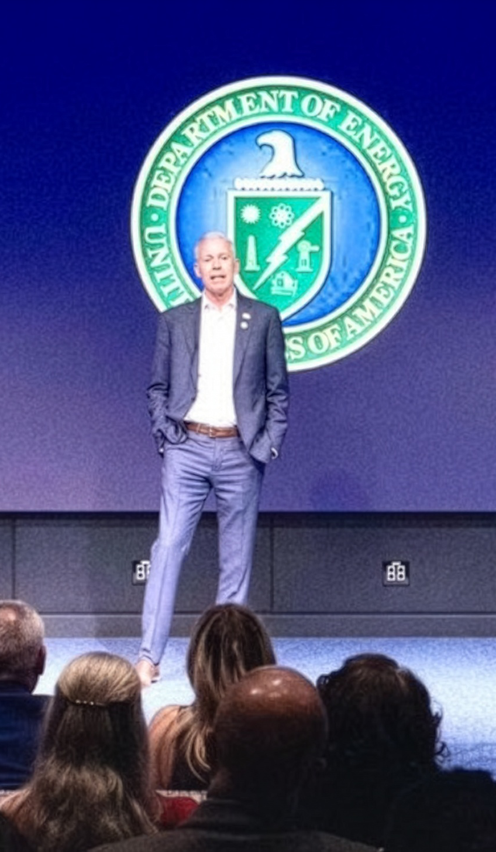
Unleashing the golden era of American energy dominance
Advance energy addition, not
subtraction
Unleash American energy innovation
Return to regular order on LNG exports
Promote affordability and consumer
choice in home appliances
Refill the strategic petroleum reserve
(SPR)
Modernize America’s nuclear stockpile
Unleash commercial nuclear power
in the United States
Strengthen grid reliability and security
Streamline permitting and identify
undue burdens on American energy
“The long-awaited American nuclear renaissance must launch during President Trump’s administration. As global energy demand continues to grow, America must lead the commercialization of affordable and abundant nuclear energy.”
Secretary of Energy
Chris Wright

Slide 11
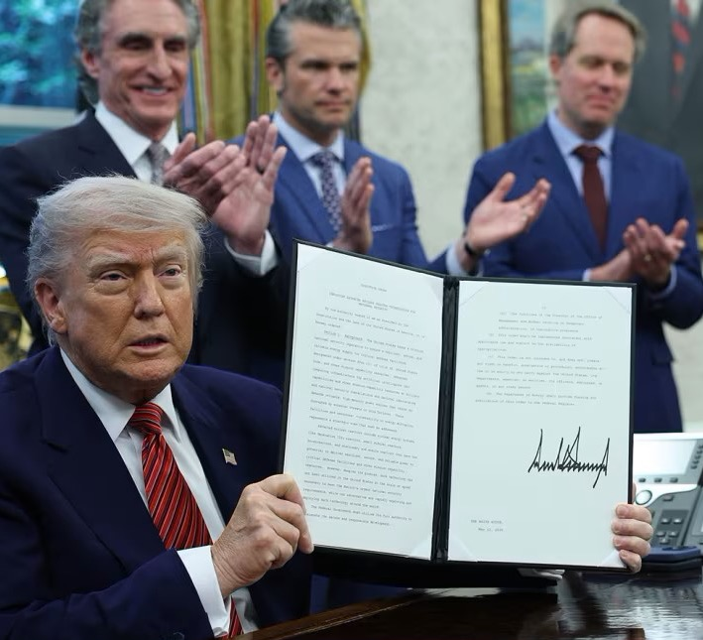
Nuclear Energy
Executive Orders
Reinvigorate the Nuclear Industrial Base
Reform Nuclear Reactor Testing at DOE
Deploy Advanced Nuclear Reactor Technologies for National Security
Reform the Nuclear Regulatory Commission
President Donald Trump holds up a signed executive order in the
Oval Office of the White House May 23, 2025 in Washington, DC.
Win McNamee/Getty Images

Slide 12
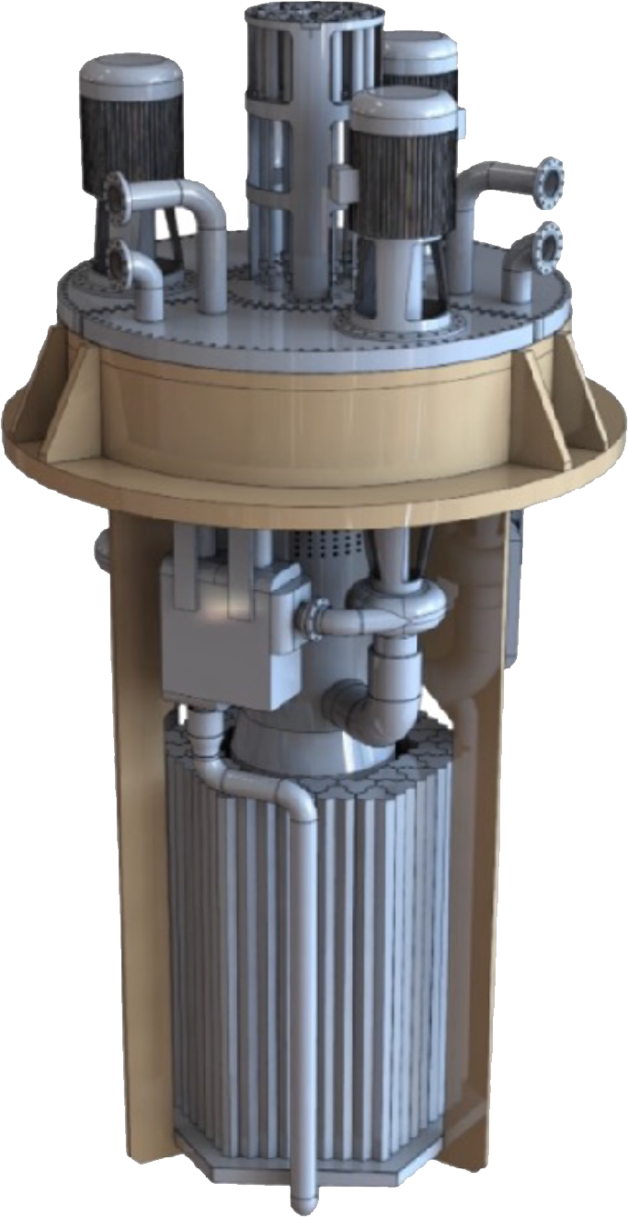
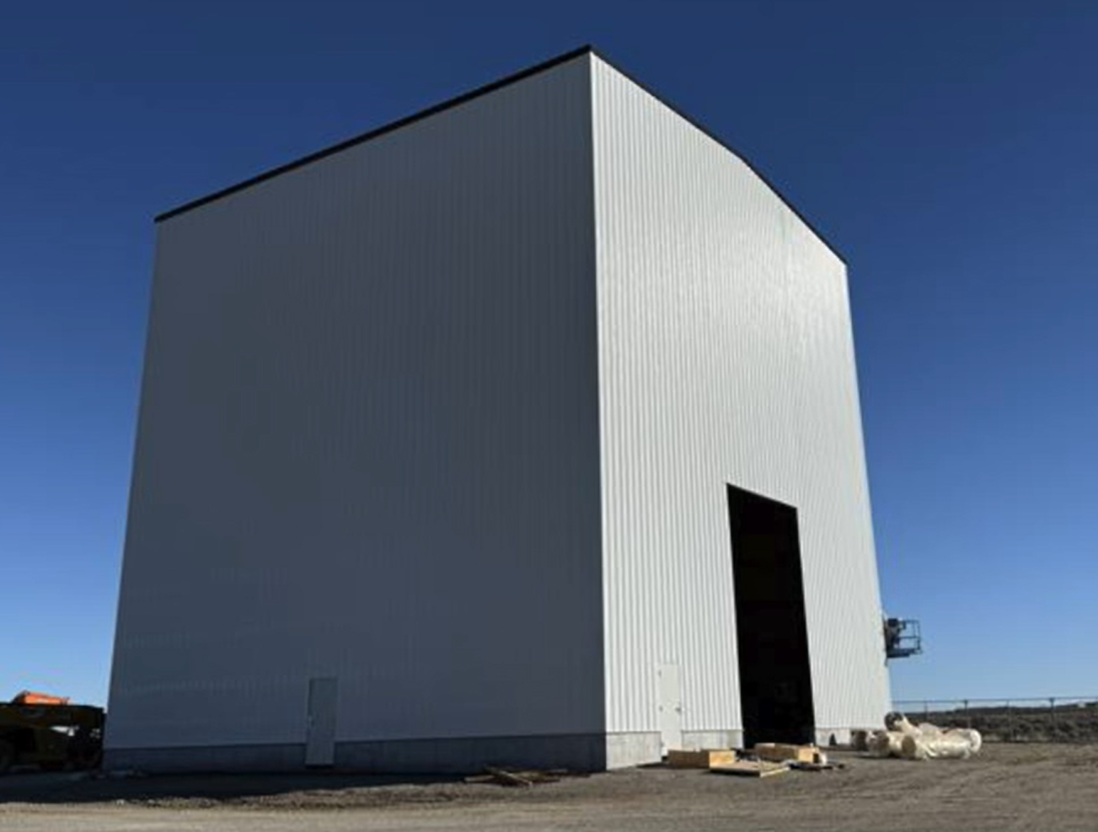
Aalo-X Reactor
Aalo Atomics
  Selected for DOE Reactor Pilot Program
  Signed Other Transaction Authority (OTA) agreement with DOE
  Planned as DOE authorized test
Aalo-X Reactor
  Liquid Metal Reactor, Sodium Cooled Thermal Reactor
  UO2 fuel pins and graphite moderated core
    Final design under development
  30 MWth
5% enriched UO2
  Aalo signed agreement with Urenco to supply fuel
Groundbreaking held August 28 after receiving the Environmental Compliance Permit
Aalo’s goal is to have a dry criticality experiment by July 4, 2026 COMPLETE
Critical Assembly Facility
Home of the Zero Power Dry Criticality Experiment

Slide 13
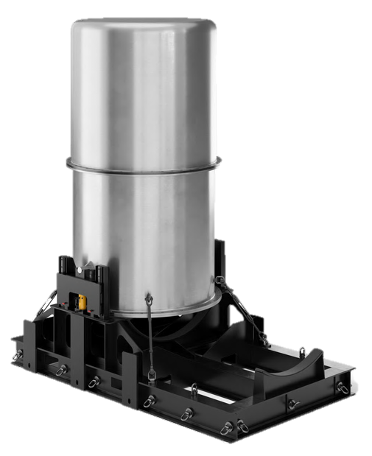
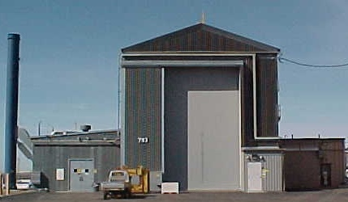
Antares R1 Demonstration
Antares
  Selected for DOE Reactor Pilot Program
  DOE Other Transaction Authority (OTA) agreement – Sept 2025
  Planned as DOE authorized test
Antares R1 Reactor
  Sodium Cooled Heat Pipe Reactor
  Graphite moderated core
  TRISO fuel compacts
  1-3 MWth, scalable to higher power levels
TRISO Fuel: 19.75% enriched U-235
  Contract with BWXT to manufacture fuel
INL is cleaning/modifying MFC-793 to establish the Reactor and Critical Experiment (RACE) Facility
Mark-0 Test: Dry criticality experiment COMPLETE
Mark-1 Test: Full R1 reactor test - 2028
Antares R1 Reactor
MFC 793

Slide 14
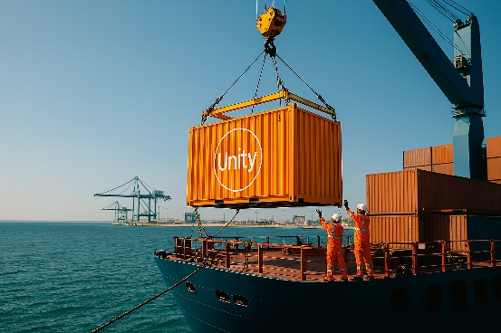
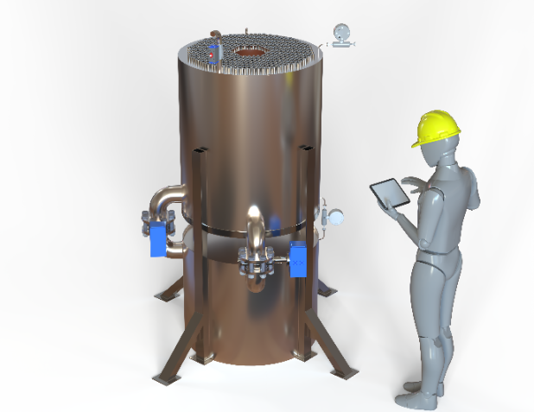
Deployable Energy Unity Nuclear Battery
Deployable Energy
  SPP and PTS approved and active Jan 2026
  Contract covers development of Water Tank Zero Power Criticality Experiment
  Plan is to execute test under SPP
Unity Nuclear Battery
  Light-Water Moderated – Helium Cooled
  4.95%% LEU UO2 fuel
    Contract with Westinghouse to deliver fuel by April 2026.
  3 MWth – 1 MWe
Goal is to conduct criticality experiment by July 4, 2026 COMPLETE
This test will validate neutronics modeling and confirm the Unity core design using LEU fuel and water moderation.
After this test Deployable intends to continue to work with INL for additional criticality experiments and eventually a First of a Kind (FOAK) reactor demonstration.
Water Tank Zero Power Criticality Experiment

Slide 15
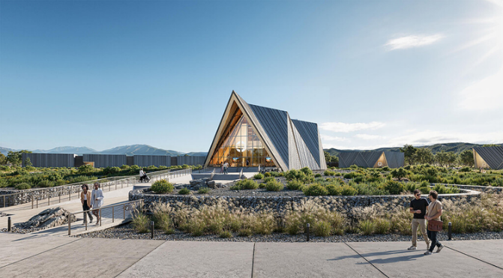
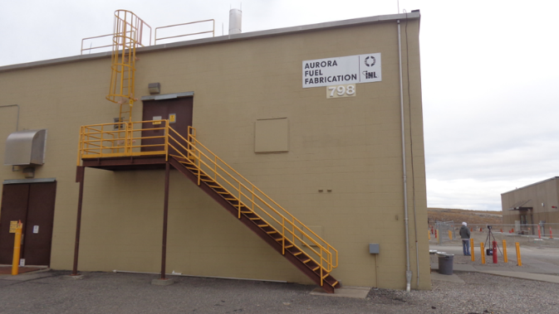
Oklo Aurora Reactor &
Fuel Fabrication Facility
Sodium-cooled fast reactor based on proven technologies developed at INL (e.g., EBR-I, EBR-II)
Aurora Reactor
  DOE Authorization through Pilot Program
  75 MWe
  Groundbreaking Sept 22, 2025
  Goal to begin operation in 2028
DOE competitively awarded Oklo with 5 MT of HALEU material recovered from EBR-II driver fuel
  Fuel fab facility to be constructed at MFC
    DOE authorized
    PDSA approved by DOE – Dec 8, 2025

Slide 16
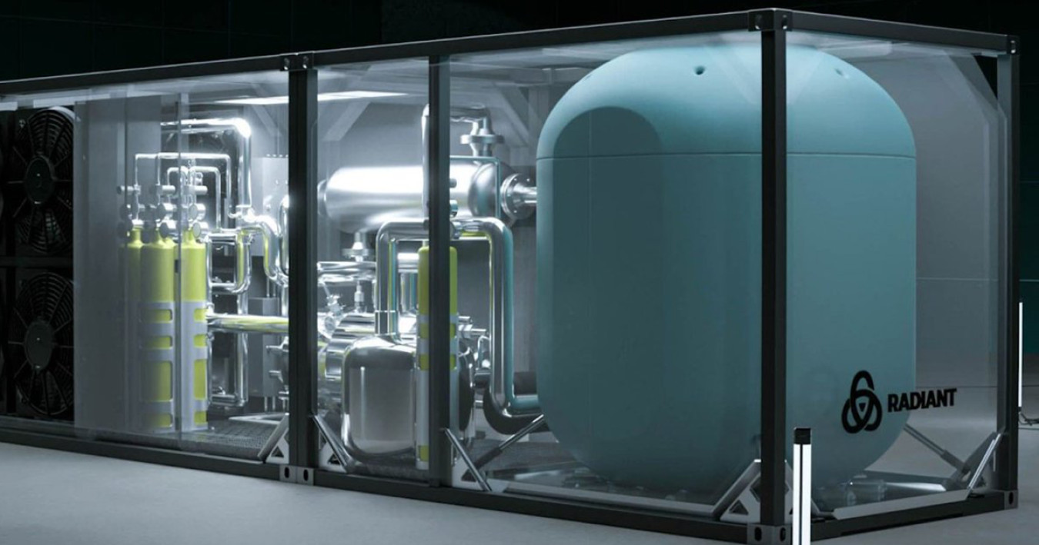
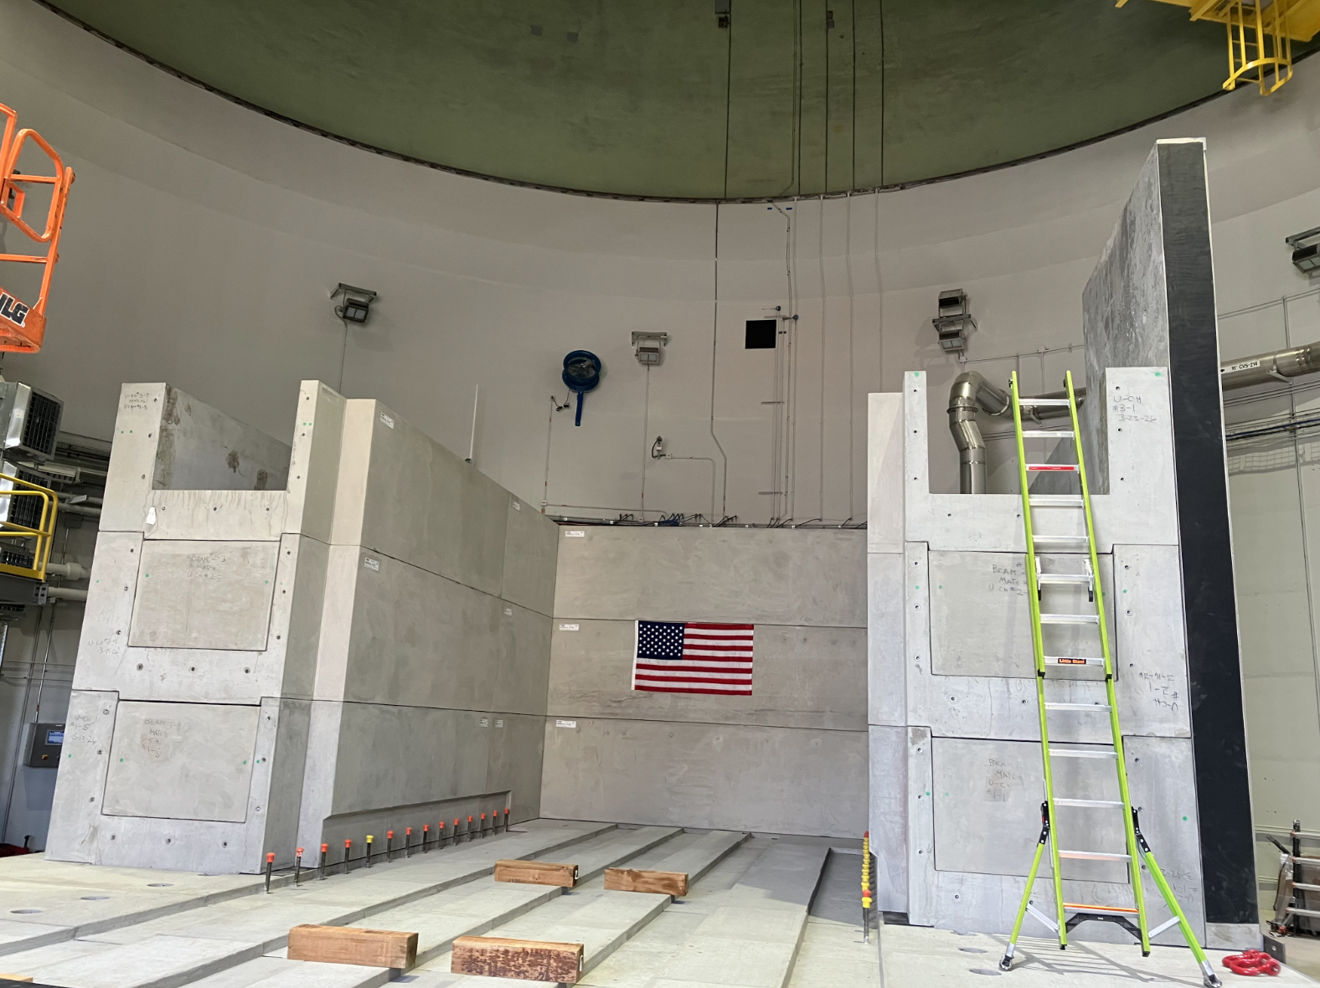
Radiant Kaleidos Reactor
Radiant Industries
  Selected as first DOME microreactor experiment
  DOE Authorization pathway for full-power test
  DARK/PDSA approved by DOE – Feb 2026
Kaleidos Demonstration Unit
  Gas-cooled, HALEU TRISO-fueled microreactor
  HALEU TRISO fuel
  3.5 MWth test at NRIC DOME
  Target operation/startup: Summer 2026
DOME Integration
  All pre-reactor shielding installed in DOME
Radiant’s Kaleidos test will demonstrate operation of a commercial prototype for 150+ hours of full power operation.

Slide 17
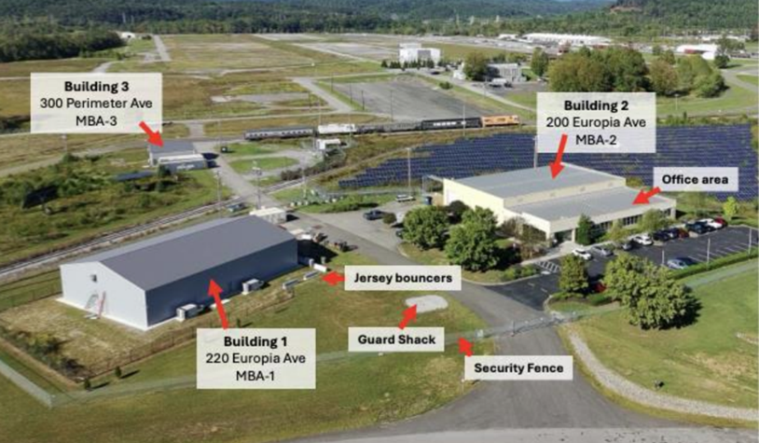
Standard Nuclear Fuel Fabrication
Standard Nuclear is building advanced nuclear fuel production facilities focused on TRISO fuel for next-generation reactors.
Current facility located in Oak Ridge, TN producing 350kgU per year
Two more planned facilities (one at Oak Ridge, one at INL), both planned to produce 1000kgU per year
DOE authorization for all facilities
INL supporting development of Standard Nuclear facility
programs and submittals for DOE authorization
Status:
Signed OTA with DOE – September 2025
Received DOE Authorization for SN-0 – January 2026
Commenced fabrication of Radiant KDU fuel – January 2026
Idaho facility construction start – March 23, 2026
Idaho facility operations commence – July 2026

Slide 18

Nuclear Energy Launch Pad
Established March 5, 2026
Replaces/Expands Pilot Program
  Fast-track the testing of advanced nuclear technologies
  Strengthen domestic nuclear infrastructure
TWO PATHS
1. Launch Pad – INL
Land set aside for testing with coordinated site characterization, shared utilities and infrastructure
Open to DOE-Authorization
2. Launch Pad – USA
Location proposed by Applicant
Open to DOE Authorization
Requests for Application (RFA)
Issued: April 29
Industry Day: May 19
Due: July 8
Includes both pathways
Process similar enough to pilot program that current pilot program applicants
can easily apply
Establish contracts with participants for siting
OTAs with DOE
SPPs with INL
or other National Labs
as appropriate
Provides a solution to backlog of pilot program applicants
4 selectees transferred
3 applications transferred
MIS-26-90225

Slide 19
Launch Pad Pathway Comparison
Features
LAUNCH PAD INL
LAUNCH PAD USA
Primary Purpose
Siting Location
Land Availability
Site Characterization
Infrastructure & Services
Access to INL Expertise
DOE Authorization
NRC Licensing
Flexibility
Ideal Use Cases
Centralized demonstration site at Idaho National Laboratory
Idaho National Laboratory
Dedicated land reserved for technology siting
Well-characterized sites with existing environmental and safety data
Shared infrastructure, facilities, and services through co-location
Direct, on-site access to INL staff and facilities
Prioritized access to DOE authorization processes
Enables pathway to NRC licensing of projects
Standardized, controlled environment
First-of-a-kind demonstrations, multi-project co-location with shared services, rapid access to infrastructure
Distributed demonstration sites across the United States
Any suitable U.S. location outside INL
Developer-identified or partner-provided sites
Site characterization dependent on selected location
Infrastructure varies by site; not shared through INL
Remote or project-specific access to INL expertise
Prioritized access to DOE authorization processes
Enables pathway to NRC licensing of projects
High flexibility to leverage unique regional or project-specific advantages
Projects requiring unique siting conditions, partnerships, or regional advantages
Notes:
For Graphics Use
26-50091_Hansen

Slide 20
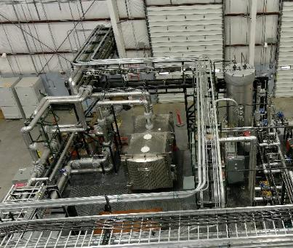
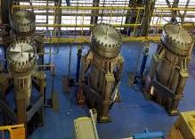
NRIC Experimental Infrastructure
Mechanisms Engineering Test Lab (METL) [Operating since 2018]
Helium Component Test Facility [2022]
In-HotCell Thermal Creep Frame [2025]
Molten Salt Thermophysical Examination Capabilities (MSTEC) [2025]

