Slide 1
Nuclear Science User Facilities (NSUF) Annual Program Review, April 15-17, 2025
Tanner Mauseth
Post-Irradiation Examination (PIE) Research Scientist
Correlative Atom Probe Tomography of the Buffer-IPyC Interlayer Region of TRISO-coated Particles

Slide 2
Acknowledgements
Mary Lou Dunzik-Gougar - Idaho State University
Fei Teng - Idaho National Laboratory
Sohail Shah – Idaho National Laboratory
Kaustubh Bawane – Idaho National Laboratory
Arnold Pradhan – Idaho National Laboratory
Lu Cai - Idaho National Laboratory
Mukesh Bachhav - Idaho National Laboratory
John Stempien - Idaho National Laboratory
U.S. DOE AGR Program
Nuclear Science User Facilities (NSUF)
Irradiated Materials Characterization Laboratory (IMCL) Staff Members
The slide contents were previously presented at NuMat 2024 and SMINS-7
2

Slide 3
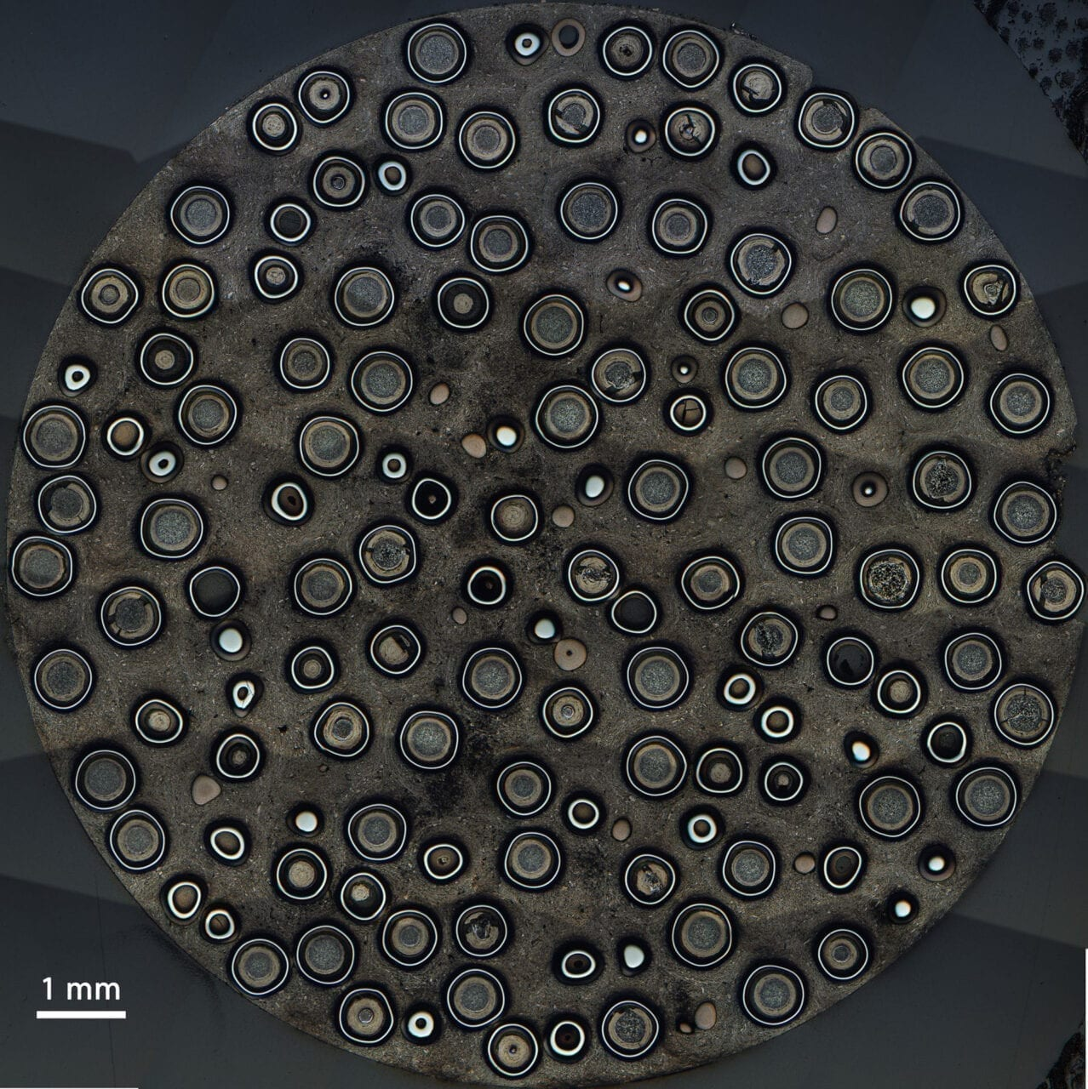
Experimental Motivation
Mechanical and structural properties of TRISO particle layers needed for more detailed modeling of failure probability and licensing.
Through the work done by Mauseth (2023), a capability that enables micrometer scale tensile strength characterization of the buffer, IPyC, and buffer-IPyC interface of TRISO particles was developed.
Atom probe tomography (APT), transmission electron microscopy (TEM), and micro-tensile testing were utilized for the microstructural characterization of AGR-2 TRISO particle layers irradiated in the Advanced Test Reactor (ATR) at Idaho National Laboratory (INL).
3

Slide 4
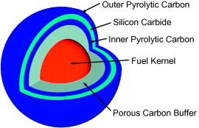
TRISO Particles
TRISO fuel particles are under development for advanced nuclear reactor designs.
TRISO particles are ~1 mm in diameter and consists of a fuel kernel surrounded by layers of various materials.
Layers allow exposure to higher temperatures and neutron fluences.
4

Slide 5
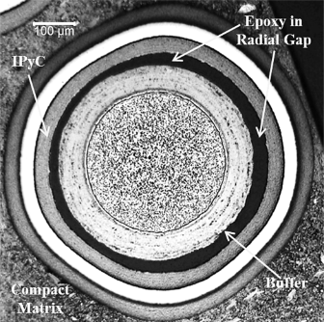
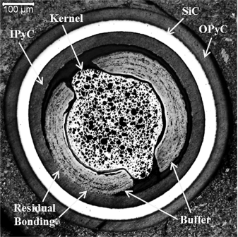
TRISO Particle Layer Degradation
While TRISO particle failure is rare, when it does occur it is typically due to degradation of the silicon carbide (SiC) layer caused by incomplete delamination of the internal buffer and inner pyrolitic carbon (IPyC) layers during irradiation.
Gordon R. Bower, Scott A. Ploger, Paul A. Demkowicz, John D. Hunn, Measurement of kernel swelling and buffer densification in irradiated UCO-TRISO particles, Journal of Nuclear Materials, Volume 486, 2017, Pages 339-349, ISSN 0022-3115, https://doi.org/10.1016/j.jnucmat.2017.01.006. (https://www.sciencedirect.com/science/article/pii/S0022311516310625)
5

Slide 6
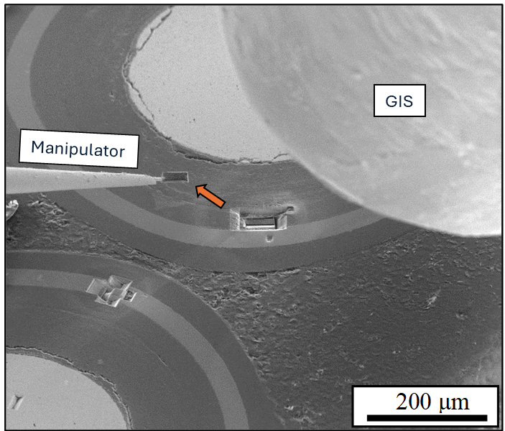
Micro-tensile Sample Fabrication Using IMCL FIB
Trenched Block
Lifted-Out Block
6

Slide 7
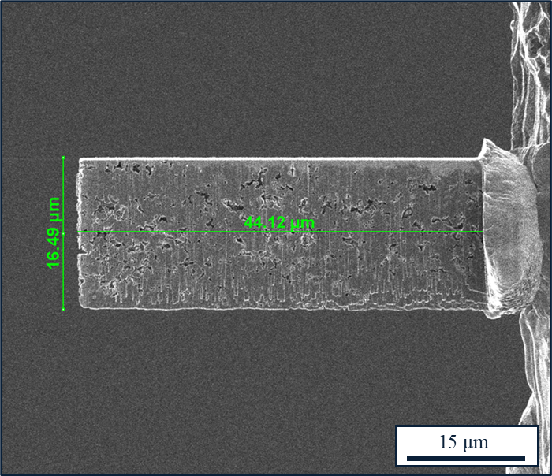
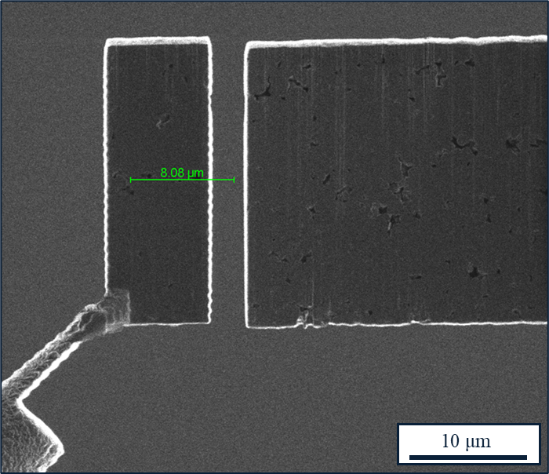
Micro-tensile Sample Fabrication (cont.)
Thinned Block
Individual Lamella
7

Slide 8
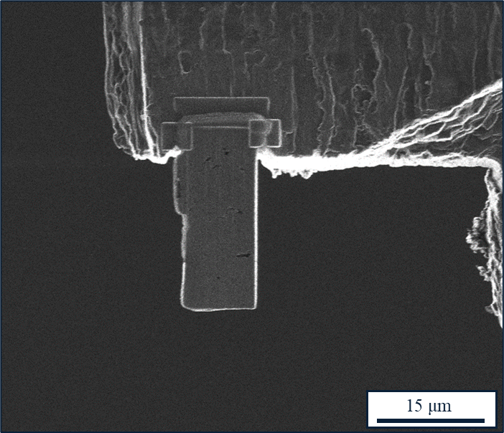
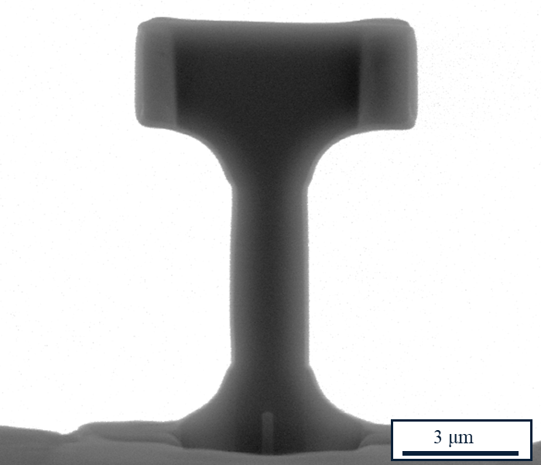
Micro-tensile Sample Fabrication (cont.)
Mounted Lamella
Final Microtensile Sample
8

Slide 9

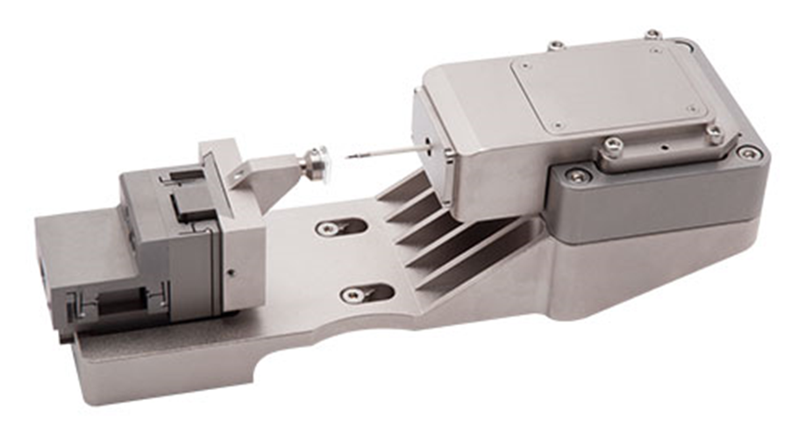



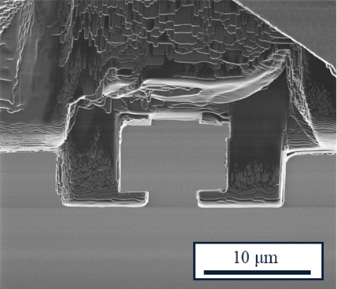
Micromechanical Load Cell
Bruker Hysitron PI 88 SEM PicoIndenter was used to perform micro-tensile test in conjunction with SEM.
The PI 88 is typically used to conduct nanoindentation, was retrofitted with a diamond gripper to enable micro-tensile testing.
9

Slide 10
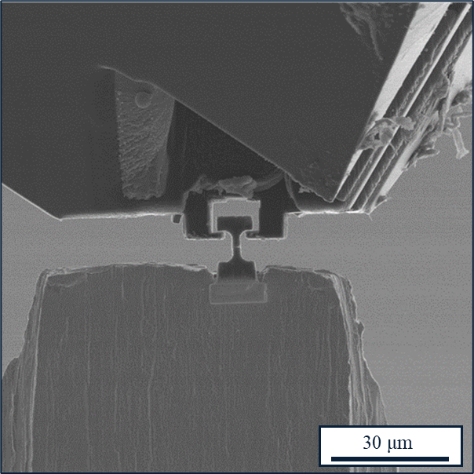
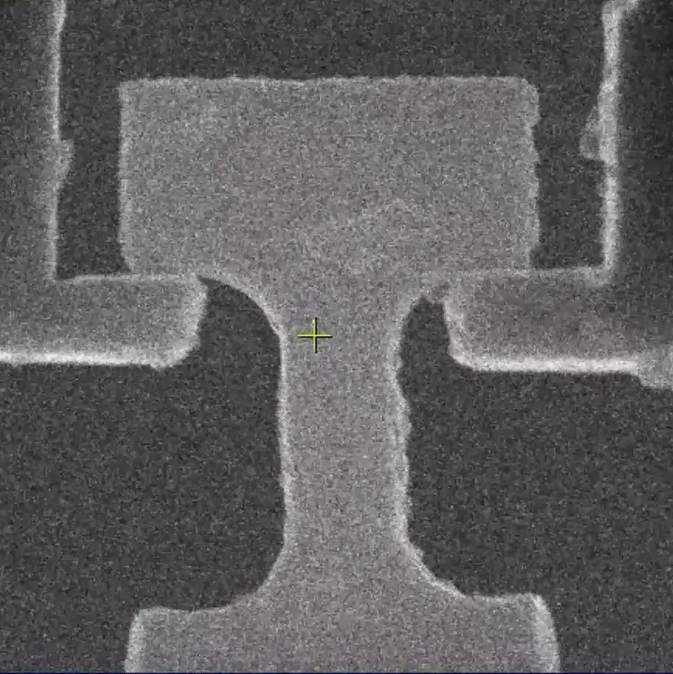
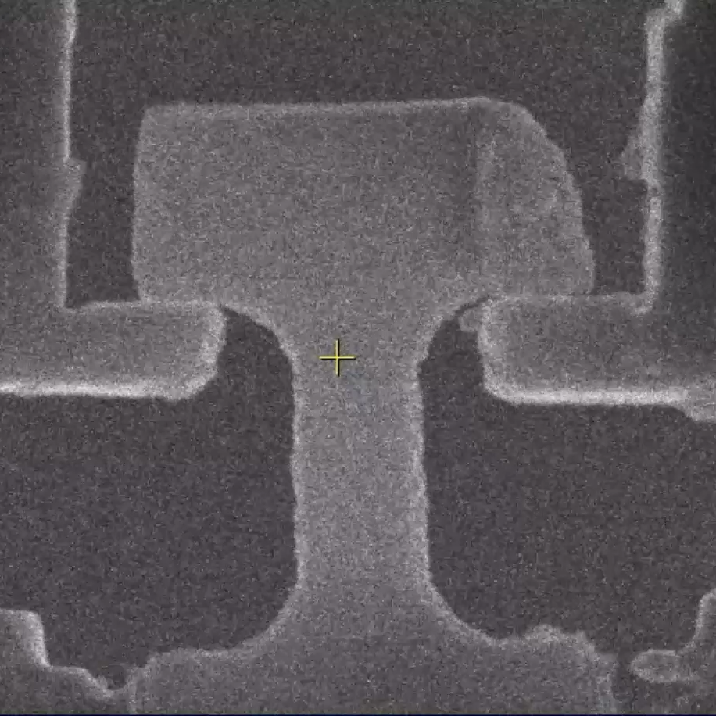
PI 88 Micro-tensile Testing
Testing Overview
Brittle and Steady
(Buffer, Fractured Buffer, Buffer-IPyC)
Brittle and Abrupt
(IPyC, SiC, Buffer-IPyC)
10

Slide 11
Results
APT, TEM, and micro-tensile analysis were applied to the buffer, IPyC, and buffer-IPyC layers and interlayers of fresh-fueled and one irradiated AGR-2 TRISO particle.
While APT and TEM data were collected, they were collected separately and not correlatively as originally planned. APT and TEM data are paired with micro-tensile data from the same regions.
Micro-tensile analysis of the buffer, IPyC, buffer-IPyC, SiC, and SiC-IPyC layers and interlayers was applied to TRISO particles with a greater range of irradiation conditions.
Due to the focus of this presentation, only the buffer, IPyC, and buffer-IPyC layers and interlayers will be discussed in detail.
11

Slide 12
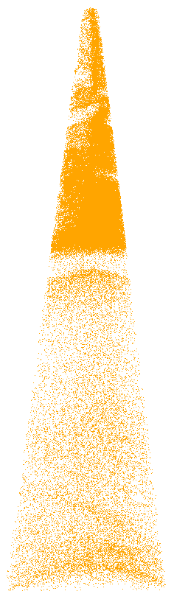
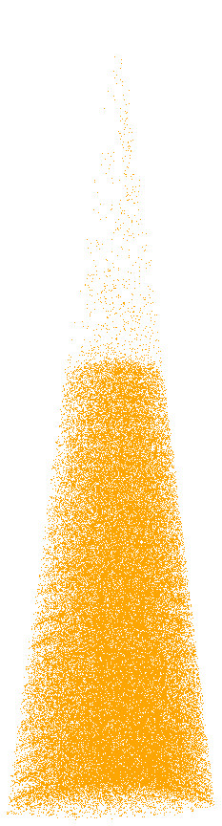
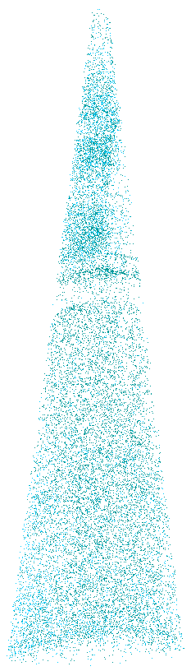
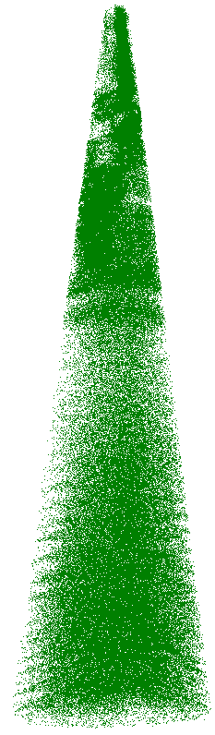
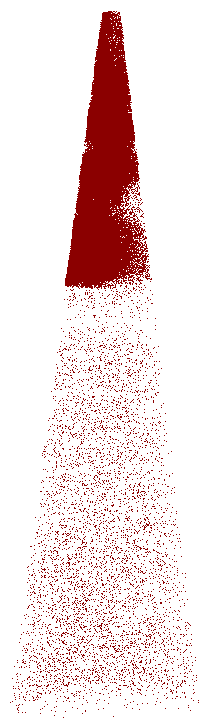
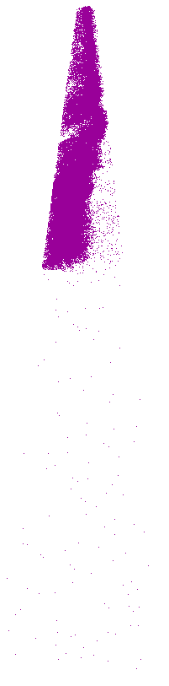
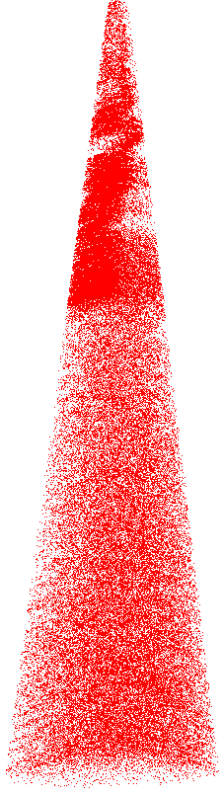
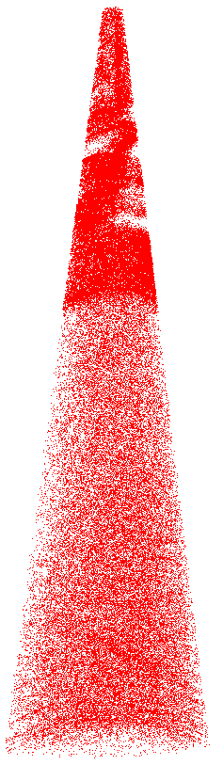
Irradiated Fuel Kernel APT
UO
UO₂
O
UC
C
U
Gd
Tb
12
100 nm

Slide 13
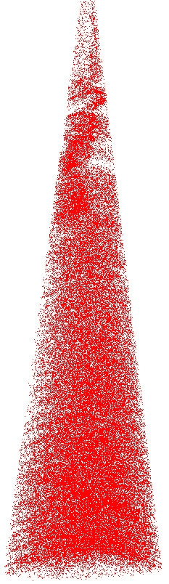
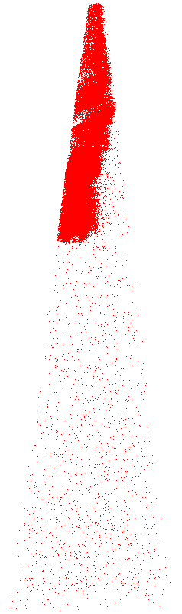

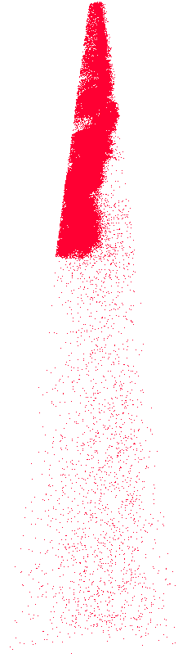
Irradiated Fuel Kernel APT (cont.)
Atom Type | Ranged
O | 59.15%
U | 33.76%
C | 3.03%
Mo | 1.50%
Gd | 1.10%
Dy | 0.58%
Tb | 0.27%
Cd | 0.19%
Ru | 0.19%
Sn | 0.12%
Ag | 0.09%
Nb | 0.02%
Dy
Cd
Ru
Mo
13

Slide 14
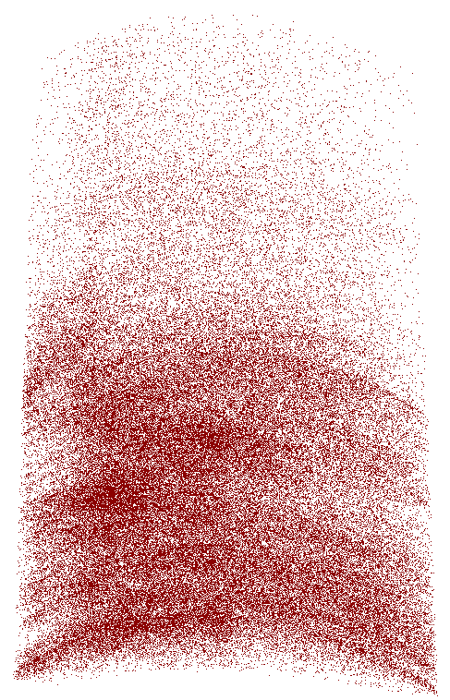


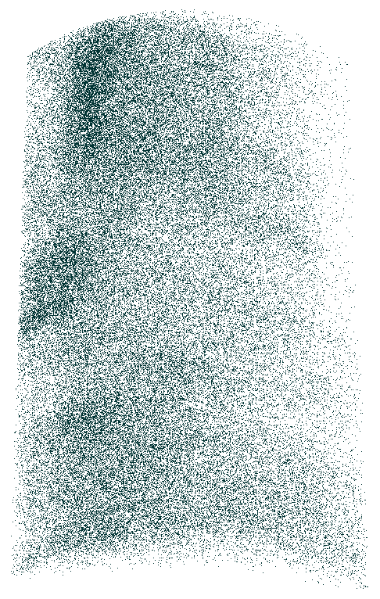
Irradiated Buffer-IPyC APT
Atom Type | Ranged
C | 61.6%
O | 21.6%
Other fission products: Ag, Cd, Te, Cs, Bi, Rh, Ru
C
CO
O
FP
10 nm
14

Slide 15
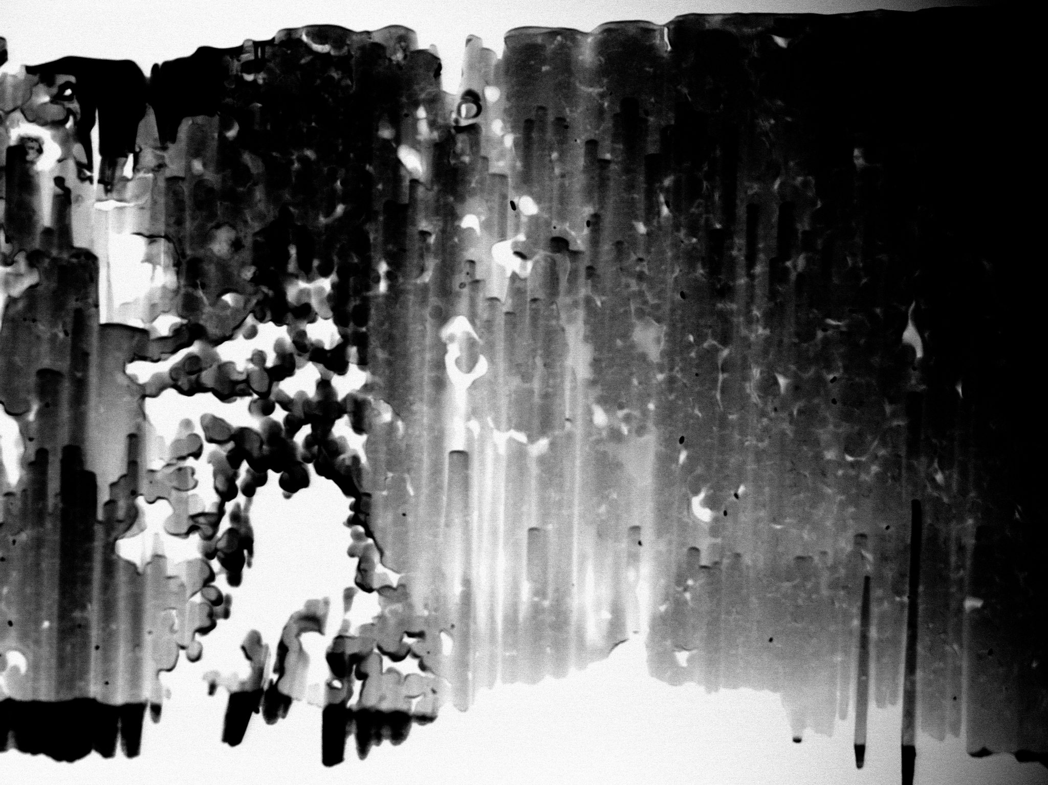
Buffer-IPyC TEM
Fresh Fueled
Irradiated
Neutron Fluence
2.14 x 10²⁵ n/m²
Buffer
IPyC
Buffer
IPyC
TAVA 1060°C
4 µm
4 µm
Increased porosity/pore segregation
15

Slide 16
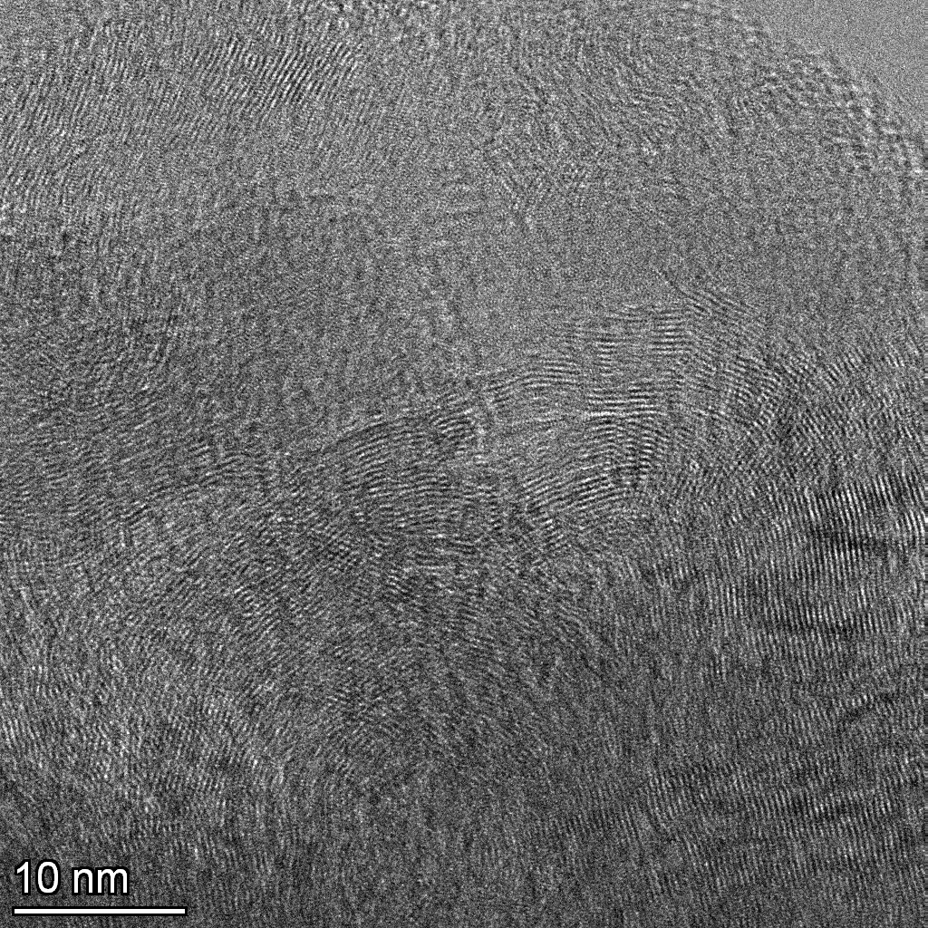
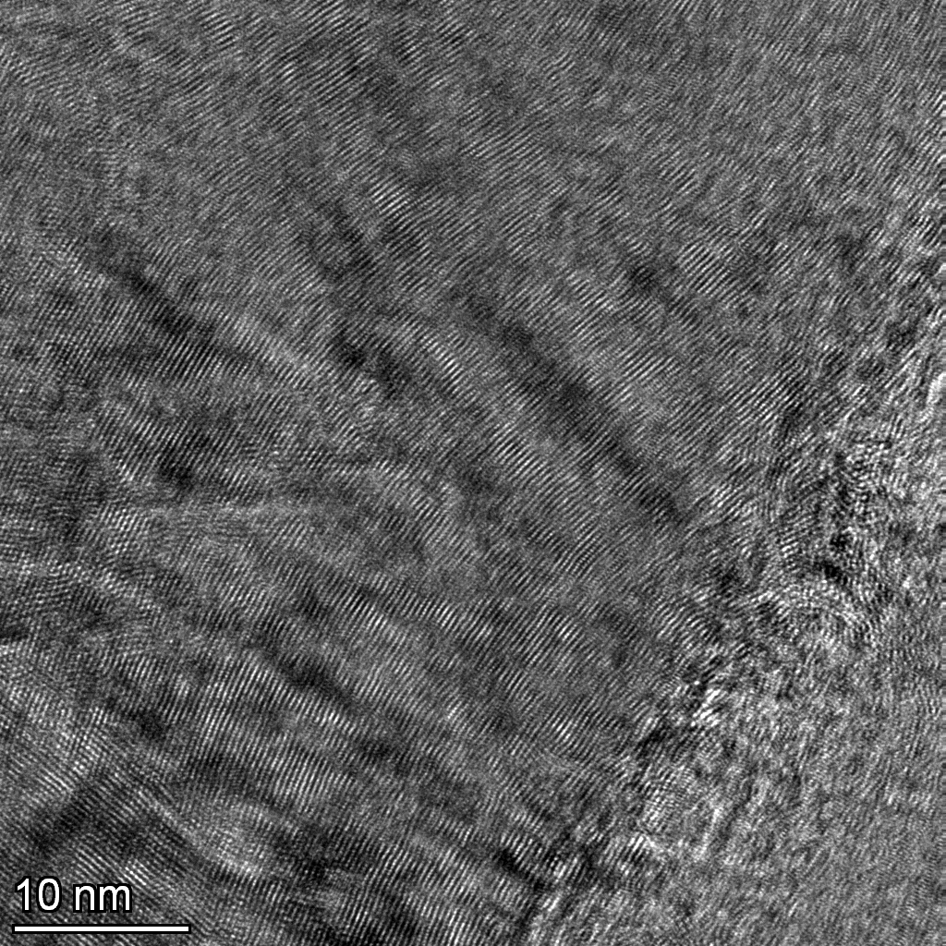
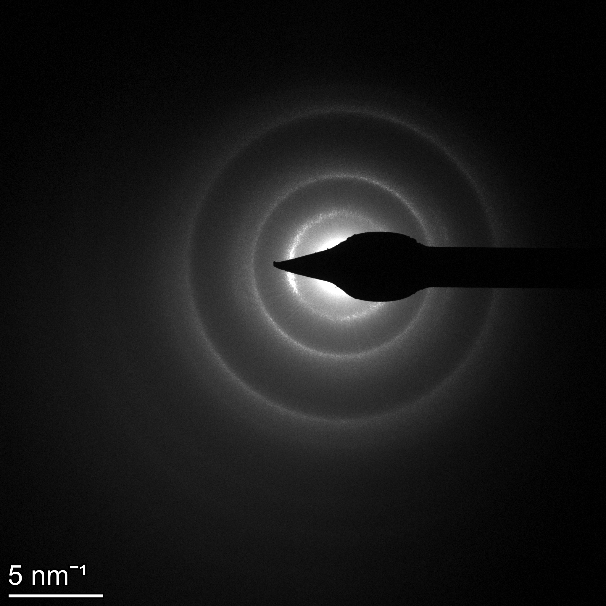
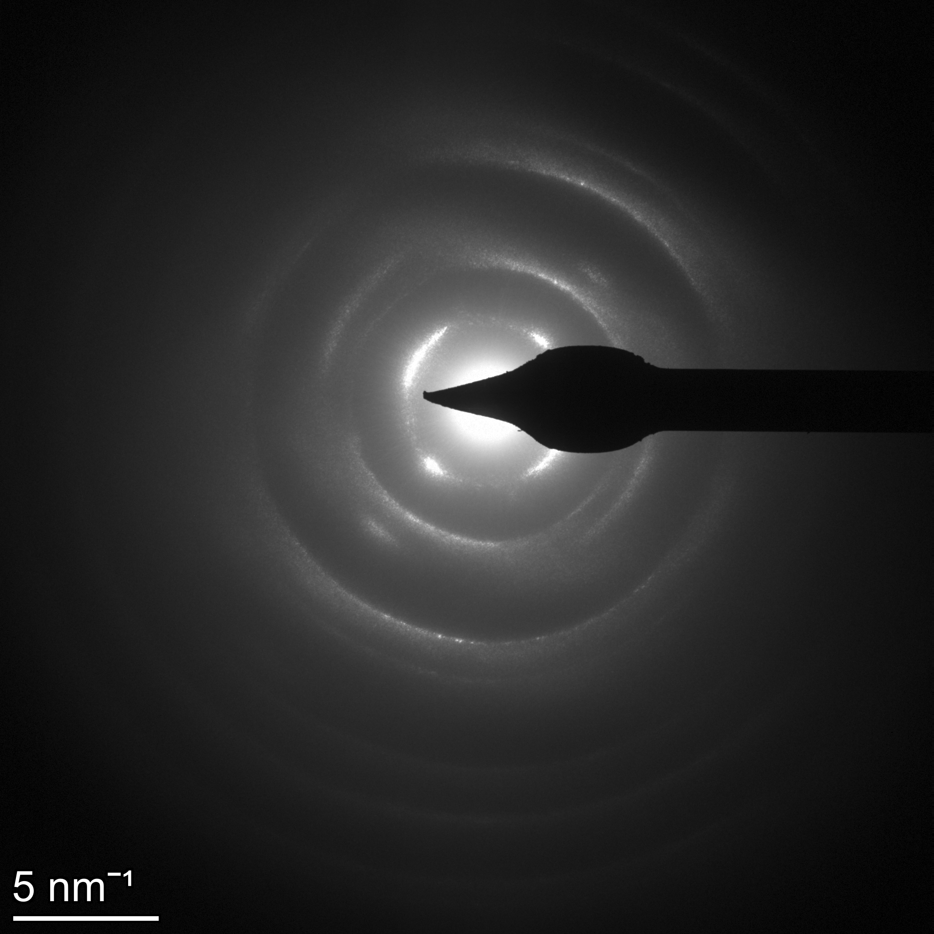
Buffer-IPyC TEM (cont.)
Fresh Fueled
Irradiated
Appearance of increased texturing
Neutron Fluence
2.14 x 10²⁵ n/m²
Possible increased anisotropy
TAVA 1060°C
Nanocrystalline material, possible grain growth
16

Slide 17
Micro-tensile Sample Locations
Compact Overview
Standard Particle
Fractured Particle
17

Slide 18
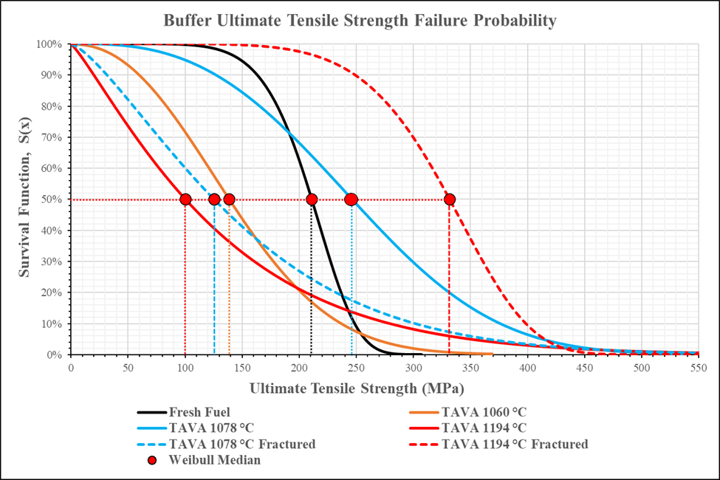
Buffer Comparison
Mechanical Values | Fresh Fuel | Compact 6-3-3 | Compact 5-1-3 | Compact 2-1-3 | Compact 5-1-3 Fractured | Compact 2-1-3 Fractured
Number of samples | 4 | 5 | 5 | 4 | 5 | 4
Neutron Fluence (x10²⁵ n/m²) | None | 2.14 | 3.03 | 2.88 | 3.03 | 2.88
TAVA (°C) | None | 1060 | 1078 | 1194 | 1078 | 1194
Weibull Median (MPa) | 210.74 | 138.57 | 246.00 | 100.37 | 125.36 | 331.57
Modulus (GPa) | 19.35 | 22.83 | 14.55 | 13.65 | 8.46 | 27.43
R² | 0.92 | 0.98 | 0.90 | 0.94 | 0.94 | 0.91
18

Slide 19
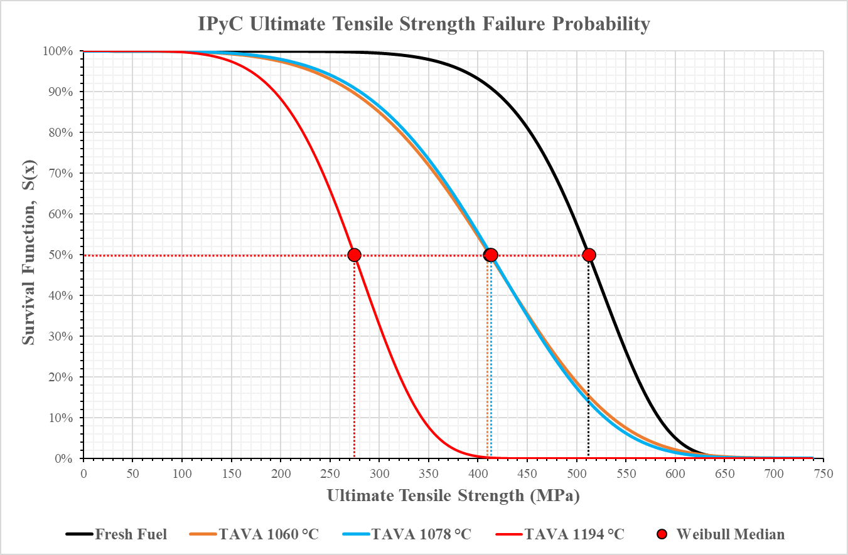
IPyC Comparison
Mechanical Values | Fresh Fuel | Compact 6-3-3 | Compact 5-1-3 | Compact 2-1-3
Number of samples | 4 | 4 | 7 | 9
Neutron Fluence (x10²⁵ n/m²) | None | 2.14 | 3.03 | 2.88
TAVA (°C) | None | 1060 | 1078 | 1194
Weibull Median (MPa) | 512.12 | 411.94 | 413.17 | 274.62
Modulus (GPa) | 31.69 | 27.11 | 27.21 | 30.81
R² | 0.89 | 0.94 | 0.99 | 0.93
19

Slide 20
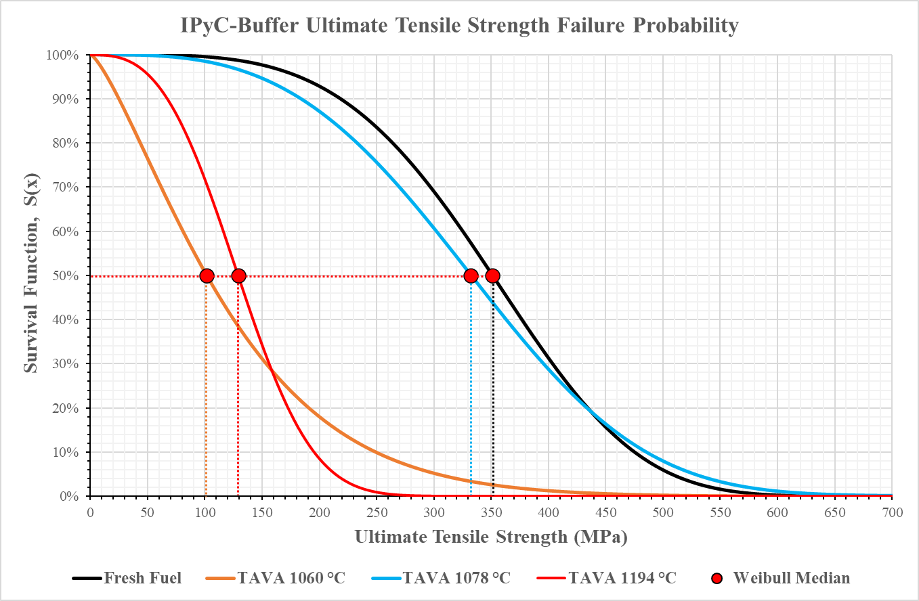
Buffer-IPyC Comparison
Mechanical Values | Fresh Fuel | Compact 6-3-3 | Compact 5-1-3 | Compact 2-1-3
Number of samples | 12 | 9 | 4 | 5
Neutron Fluence (x10²⁵ n/m²) | None | 2.14 | 3.03 | 2.88
TAVA (°C) | None | 1060 | 1078 | 1194
Weibull Median (MPa) | 351.33 | 101.60 | 332.39 | 129.25
Modulus (GPa) | 14.38 | 5.30 | 21.32 | 11.12
R² | 0.96 | 0.83 | 0.81 | 0.88
20

Slide 21
Conclusion
APT, TEM, and micro-tensile characterization were applied to the buffer, IPyC, and buffer-IPyC layers and interlayers of unirradiated and irradiated AGR-2 TRISO particles.
Each layer/interlayer region demonstrated unique material properties:
  Buffer/Fractured Buffer Layers:
    TEM results indicated increased porosity and pore segregation in the buffer layer with increased irradiation. Highest TAVA samples showed both the highest and lowest strength values, suggesting strength variations were driven by porosity and microstructural features caused by irradiation and temperature.
    IPyC Layer:
      TEM results suggested the appearance of increased texturing, possible increased anisotropy, and potential nanocrystalline grain growth with increased irradiation. Strength decreases as TAVA increases. PARFUME metrics align well with experimental results, including a reference PyC Weibull modulus of 9.5 with a density of 1.9 g/cm³, and reference PyC elastic moduli ranging from 26 to 62 GPa. Comparatively, the fresh fueled IPyC Weibull modulus was 9.26 with a density of 1.85-1.95 g/cm³, and experimental IPyC elastic moduli range from 27.11 to 31.69 GPa.
    Buffer-IPyC Interlayer:
      APT results suggested diffuse amounts of fission products with no major/large precipitates in the buffer-IPyC region. No clear direct relationship between TAVA and sample strength, but general trends suggest buffer layer strength significantly influences buffer-IPyC debonding strength.
21

Slide 22
Future Work
Samples tested thus far paint a general picture, more testing needed to clarify properties of select layers:
  Testing TRISO particles under real-time heat stress would help clarify correlated strength trends.
    800 ºC in situ high temperature micro-tensile testing of buffer, IPyC, and SiC samples planned for FY2025.
  Testing different-sized micro-tensile samples in various orientations in the buffer, IPyC, and SiC layers would help clarify any porosity-based and grain-related size effects.
    Anisotropic and size effect studies on buffer, IPyC, and SiC samples planned for FY2025.
  Other layers and layer interfaces (Kernel, Buffer-Kernel, OPyC-SiC, OPyC, Matrix-OPyC, etc.) have yet to be investigated.
    Super RTE investigating Pd effects on micro-tensile properties of OPyC-SiC and SiC-IPyC layers and interfaces was recently awarded.
  Pursuing XRD analysis of the PyC layers may help quantify any possible nanocrystalline grain growth.
22

Slide 23
References
Bower, G. R., Demkowicz, P. A., Ploger, S. A., & Hunn, J. D. (2017). Measurement of kernel swelling and buffer densification in irradiated UCO-TRISO particles. http://www.inl.gov
Hales, J. D., Williamson, R. L., Novascone, S. R., Perez, D. M., Spencer, B. W., & Pastore, G. (2013). Multidimensional multiphysics simulation of TRISO particle fuel. Journal of Nuclear Materials, 443(1–3), 531–543. https://doi.org/10.1016/j.jnucmat.2013.07.070
Kiener, D., & Minor, A. M. (2011). Source truncation and exhaustion: Insights from quantitative in situ TEM tensile testing. Nano Letters, 11(9), 3816–3820. https://doi.org/10.1021/nl201890s
Mauseth, T. (2021). Development of a Sample Preparation Technique for Determining the Tensile Strength of Select Layers and Layer Interfaces of TRISO Particles.
Mauseth, T. (2023). Micro-tensile Characterization of Select TRISO-coated Particle Layers and Interlayer Regions. Idaho State University.
Mauseth, T., Dunzik-Gougar, M. L., Meher, S., & van Rooyen, I. J. (2023). Determining the Tensile Strength of Fuel Surrogate TRISO-coated Particle Buffer, IPyC, and Buffer-IPyC Interlayer Regions. Journal of Nuclear Materials, 154540. https://doi.org/10.1016/J.JNUCMAT.2023.154540
Mauseth, T., Dunzik-Gougar, M. L., & Teng, F. (Preprint, 2025). Micro-Tensile Characteristics of As-Fabricated and Irradiated AGR-2 TRISO Fuel Particle Buffer, IPyC, and Buffer-IPyC Interlayer Regions.
PI 88 SEM PicoIndenter ®. (2020). https://airtable.com/shrrfypV1Wg7J9ULa
Wolff, A. (2020). Focused ion beams: An overview of the technology and its capabilities - 2020 - Wiley Analytical Science. https://analyticalscience.wiley.com/do/10.1002/was.00070009

Slide 24
Thank you for attending. Any questions?
Tanner Mauseth, Ph.D. (he/him/his)
Post-Irradiation Examination (PIE) Research Scientist | Characterization, Materials & Fuels Complex
Tanner.Mauseth@inl.gov | 208-533-9396 | 208-530-2953
Idaho National Laboratory | PO Box 1625, MS 6000 | Idaho Falls, ID | 83415

