Slide 1
Investigation of intergranular cracking of highly irradiated austenitic stainless steels in ambient conditions
M. Gussev (Oak Ridge National Laboratory)
C. Cmar (Westinghouse Electric Company)
S. Raiman (University of Michigan)
G. Was (University of Michigan)
NSUF annual program review meeting, April 15-17, 2025

Slide 2
Materials Research Pathway of Light Water Sustainability Program.
The idea of the present project crystallized as part of the research activities under the Materials Research Pathway (MRP) of the Light Water Reactor Sustainability (LWRS) program (LWRS MRP lead: Dr. X. Chen [ORNL]).
LWRS MRP investigates radiation-induced material degradation mechanisms, effects of long-term in-service irradiation, and material science-related aspects of reactor lifetime extension.
The goal of the LWRS MRP is to inform relicensing decisions and aging management programs.
Several key tasks within the MRP focus on (1) reactor pressure vessel aging and degradation, (2) concrete aging, (3) cable aging, and (4) degradation mechanisms of in-core components.
LWRS MRP conducts multiple harvesting and post-irradiation evaluation projects (e.g., RPV sections harvested from Zion Unit 1, baffle bolt harvesting, etc.).
Often, promising tasks are postponed due to labor and funding limitations. In such cases, NSUF provides valuable opportunities to continue impactful scientific research.

Slide 3
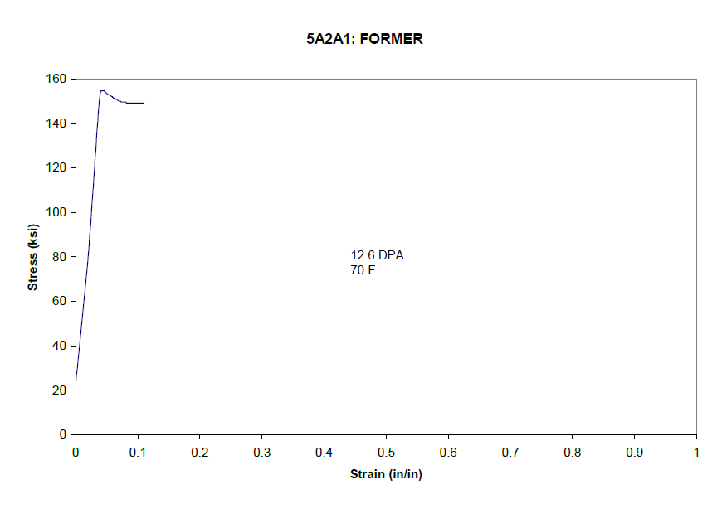
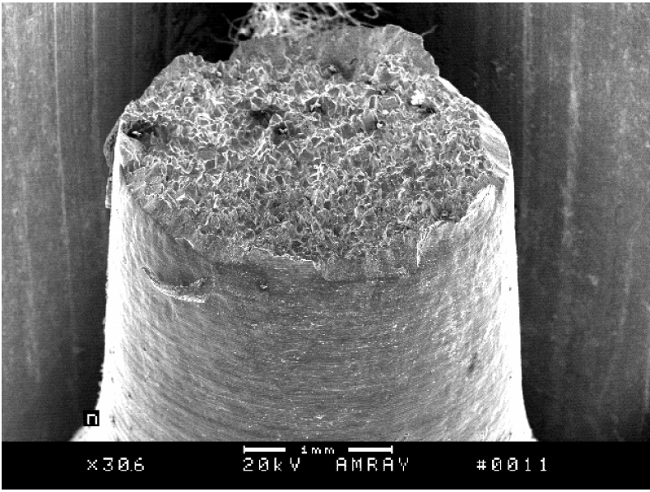
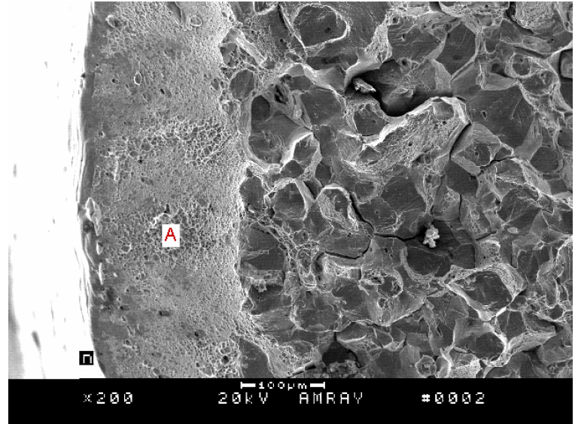
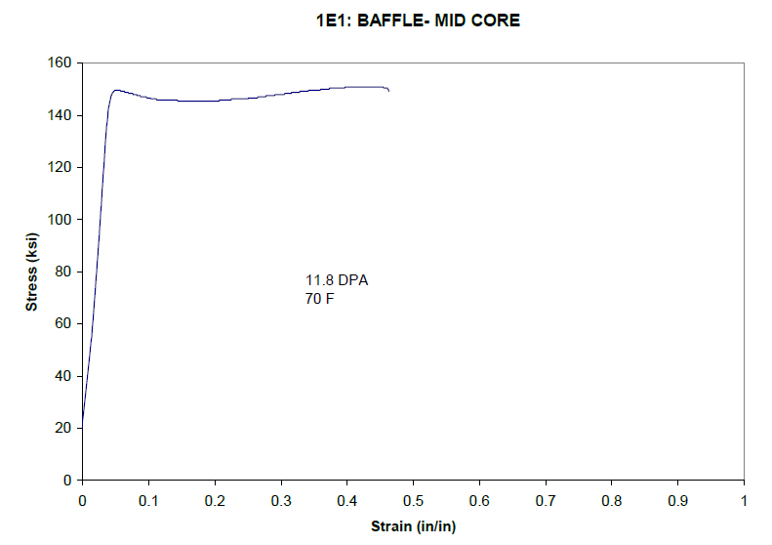
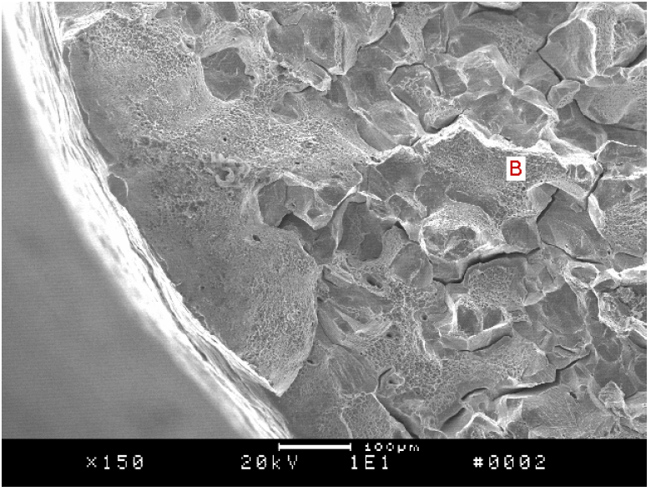
Brittle fracture phenomenon: the first evidence
Model experiments and irradiation campaigns in fast reactors created a common perception that once saturation in radiation hardening occurred, (roughly, at ~5-8 dpa), austenitic stainless steel will keep satisfactory performance as long as swelling is not an issue.
However, investigation of in-service irradiated 304L steel (material of baffle plate and baffle former) performed by EPRI early in 2000 revealed case of brittle fracture developing at ambient temperature.
Tensile curves showed limited necking or even sudden fracture without necking, unusual at such a small damage dose.
Fractography analysis revealed brittle fracture with pronounced secondary cracking. Brittle fracture during RT testing, outside of the corrosion environment, is unusual and unexpected.
This case was mostly dismissed by community (likely because “formally, material still has some ductility”).
Former plate 5A2A1
12.6 dpa
70°F
No necking
Baffle plate 1E1
11.8 dpa,
70°F
Weak to no necking
EPRI report, “Materials Reliability Program Characterization of Decommissioned PWR Vessel Internals Material Samples—Tensile and SSRT Testing (MRP-129),” 1008205.

Slide 4
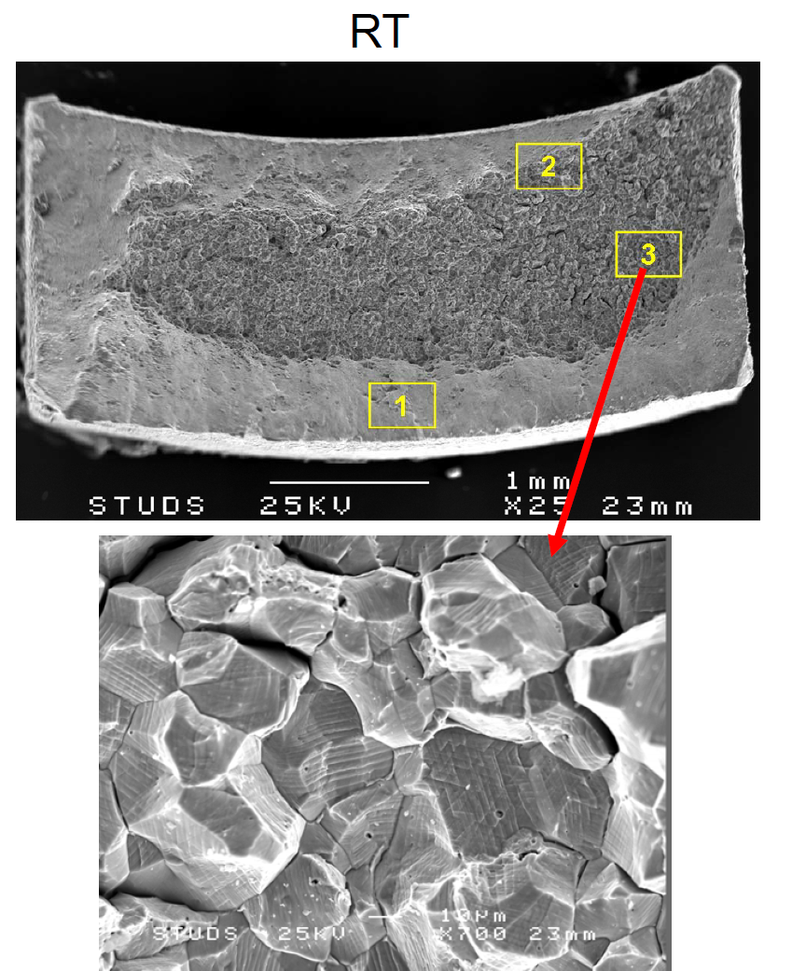
Brittle fracture phenomenon: in-service irradiated instrument tubes
Jenseen (Studsvik Nuclear AB) et al. investigated several internals from BWR (boiling water reactor) and PWR. The results were presented at Fontevraud 7 conference in 2010.
Their overall conclusion was reasonably positive with respect to mechanical properties (materials retained some ductility).
However, fractography analysis demonstrated appearance of brittle fracture mode when some specimens were tested at ambient conditions (RT).
Additionally, cracks were observed after occasional deformation of flux thimble tubes during handling in the fuel pool (at ~35-40°C).
Jenseen (Studsvik Nuclear AB) et al. Examination of highly irradiated SS from BWR and PWR RPV internals // Fontevraud 7, 2010

Slide 5
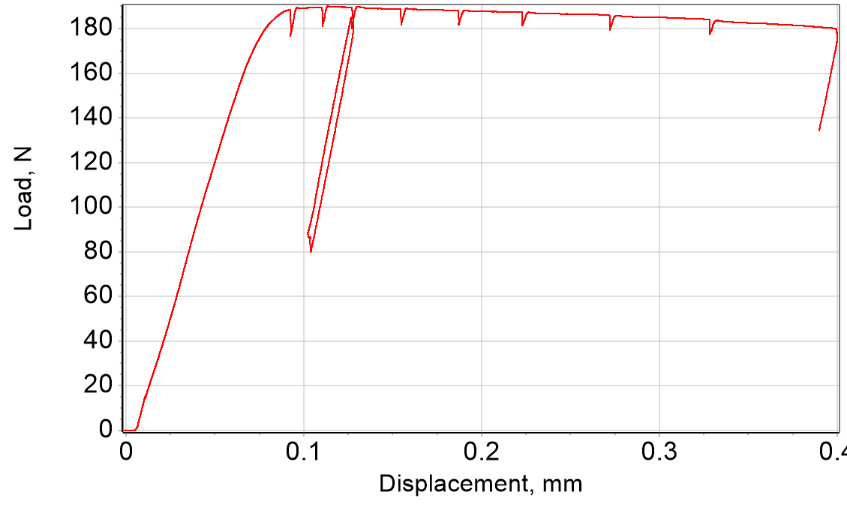
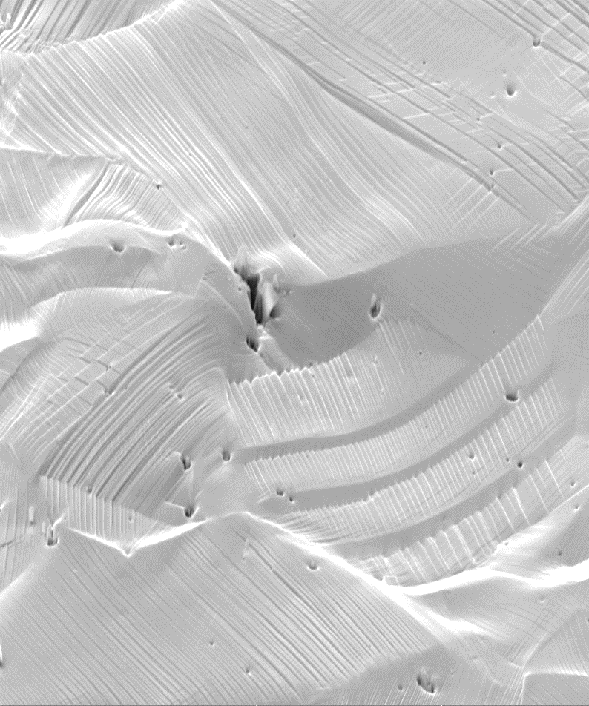
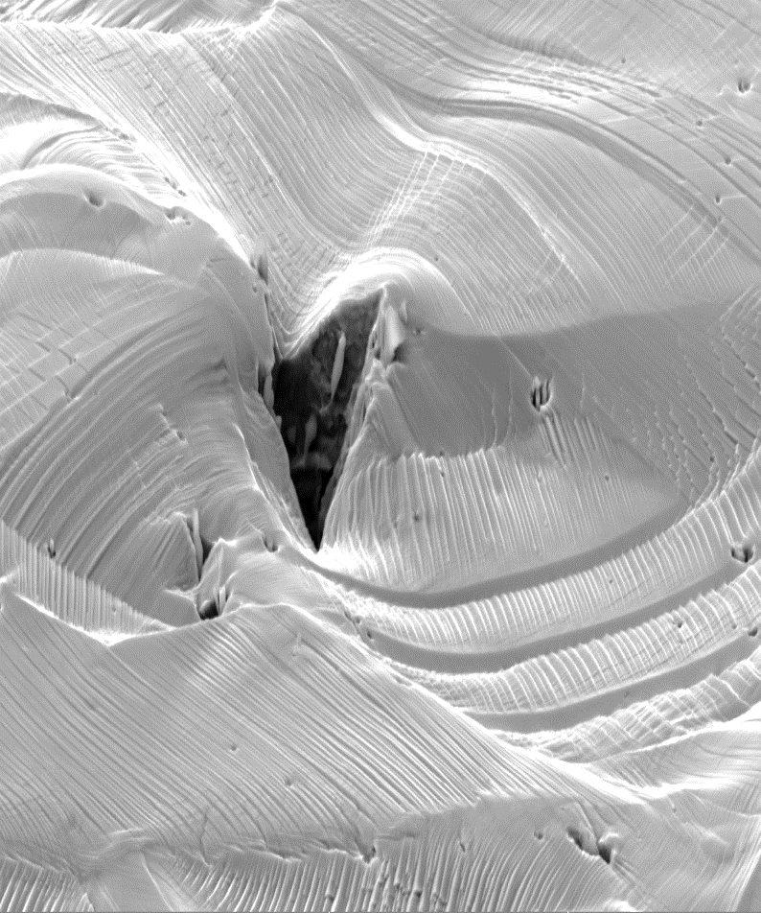
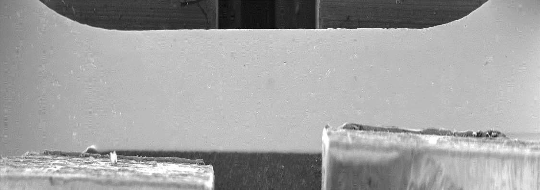
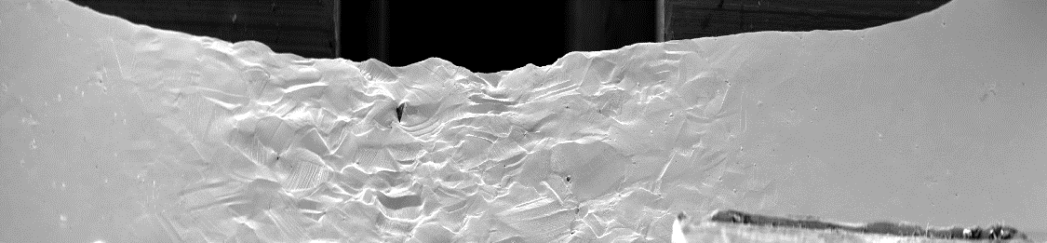
Revisiting LWRS results on baffle former bolts: first signs of emerging brittle fracture phenomenon?
[S02]
[S09]
[S01]
[S04]
[S05]
[S06]
[S07]
[S08]
[S07]
[S09]
[S03]
(partial unloading)
4416-BS-2
[S00], Reference
50 µm
50 µm
[S00]
Localized fracture and its evolution at different steps. Note the appearance of “needle-” or “rod”-like inclusions in the crack interior.
Baffle bolt specimen (316L steel, ~20 dpa) demonstrated multiple microfracture events during tension. At that time, it was considered just a curious observation. It was assumed that the events were associated with non-metallic inclusions (one may see some specific objects in the crack interior).
However, this particular result may be an initial stage of the brittle fracture phenomenon.
[S09]
0.5 mm
Low-magnification images recorded at different strain steps. Bold arrows point to a notable fracture events. 4416-BS-2.

Slide 6
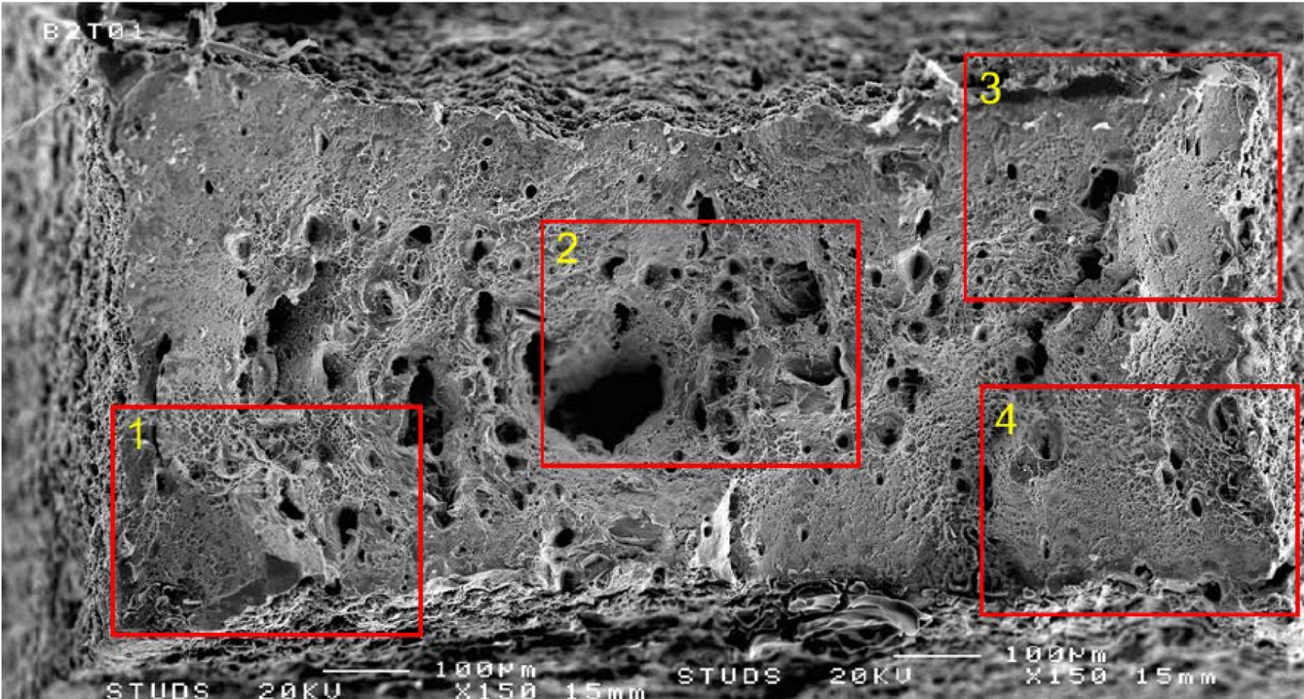
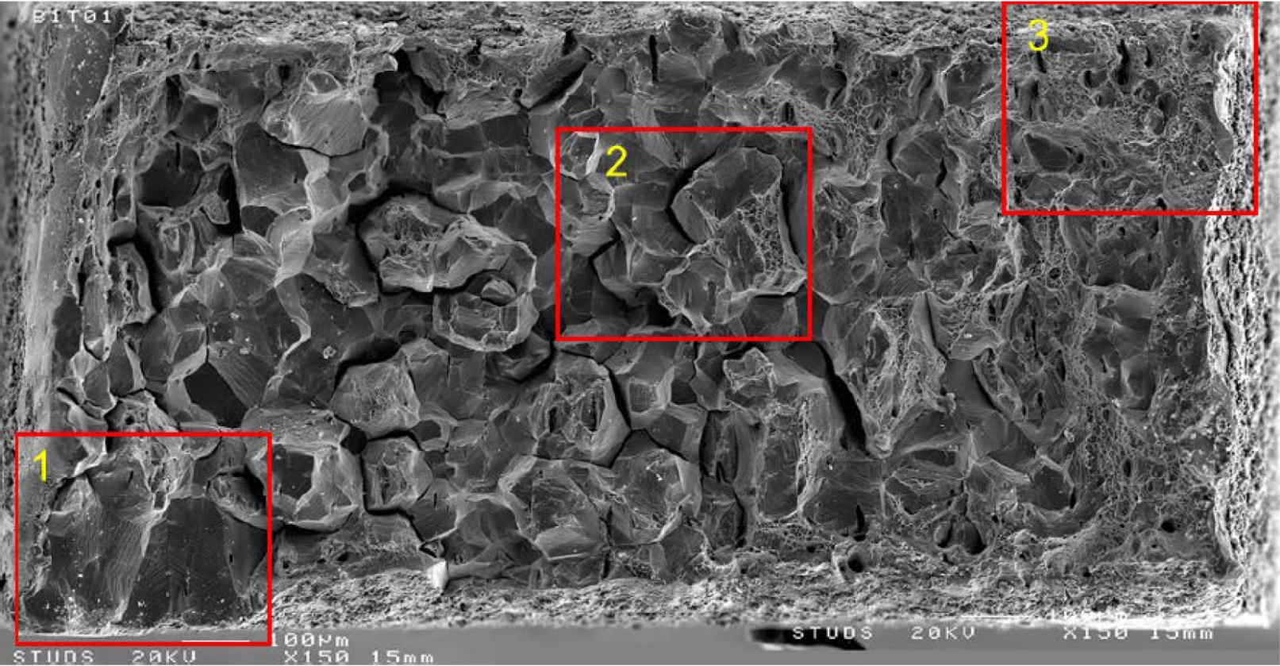
Brittle fracture phenomenon: compelling evidence from ZORITA
Additional evidence appeared just recently. Baffle plate specimens from decommissioned ZORITA NPP (Spain) also showed brittle fracture at room temperature.
The second observation (ZORITA BP) does not allow us to dismiss the case.
Altogether, available evidence raises severe questions:
The key question is how many NPPs are close to or have already approached this stage?
How does this phenomenon develop with dose?
Does it create a risk of unstable fracture?
Any possibility to mitigate the phenomenon?
25 dpa: ductile fracture dominating.
50 dpa: brittle fracture dominating.
SEM fractography of fracture surfaces from RT tensile tests at 25 dpa (top) and 50 dpa (bottom). Adopted from: NRC TECHNICAL ASSESSMENT OF ZORITA MATERIALS TESTING RESULTS, M. Hiser, P. Purtscher R. Tregoning // May 2022, RIL 2022-05.

Slide 7
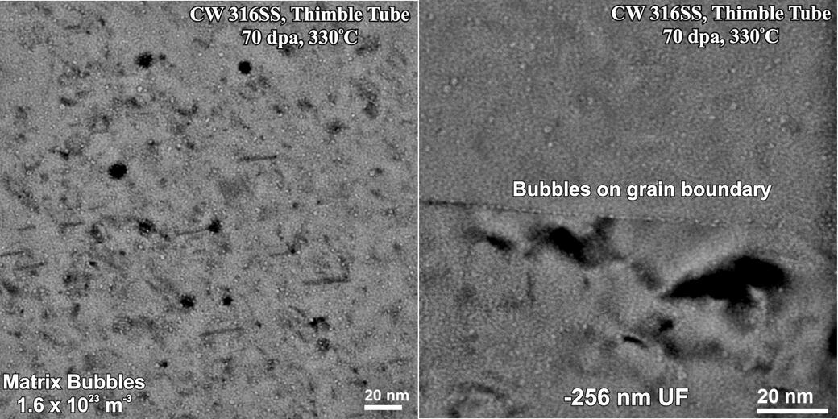
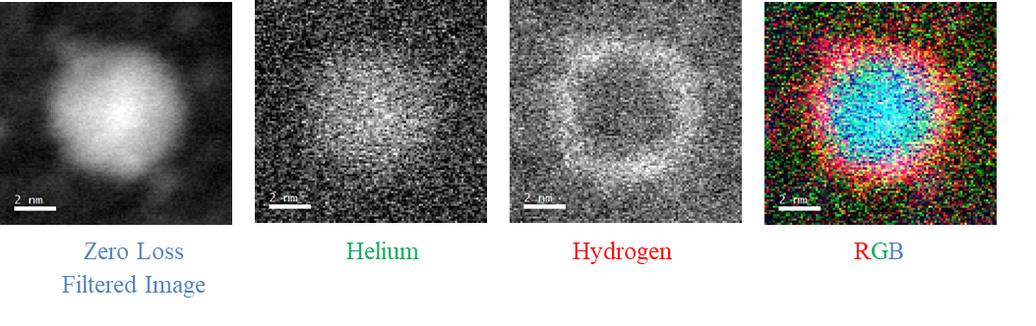
Working hypotheses
The project considers several possible mechanisms to explain the RT-brittle fracture:
Helium (or helium/hydrogen) bubble formation at grain boundaries.
Hydrogen trapping/some mechanism related to hydrogen embrittlement.
Martensitic instability caused by irradiation.
Some synergism between mechanisms mentioned above.
Nano-cavities in a PWR Flux Thimble Tube at 70 dpa // Edwards, Garner, Bruemmer, Efsing, 2009
Transmutant He is inside the cavity with H coating the surface //
Judge, C. D., H. Rajakumar, A. Korinek, G. A. Bickel,19th Intern. Env. Deg. 2019.

Slide 8
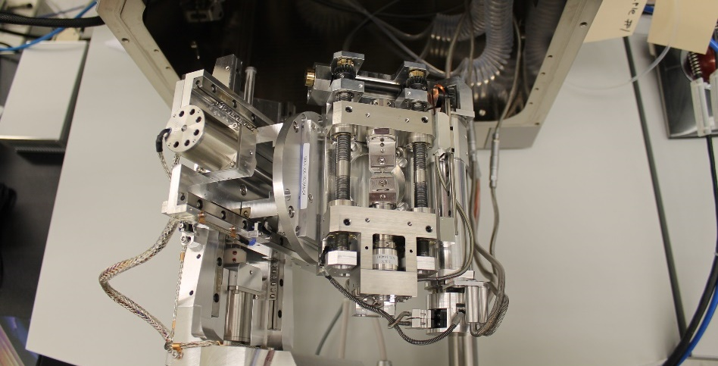
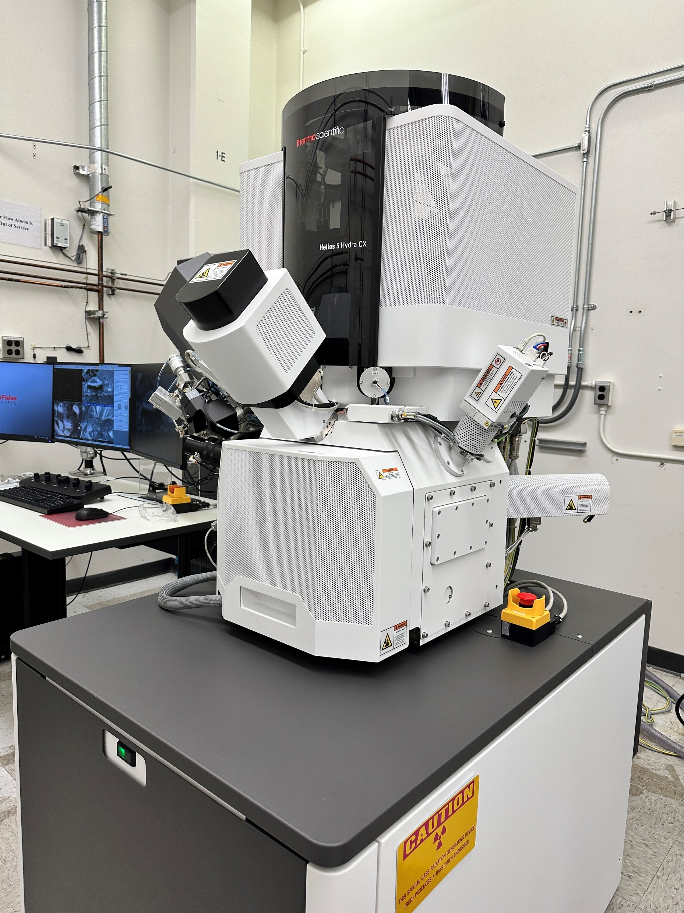
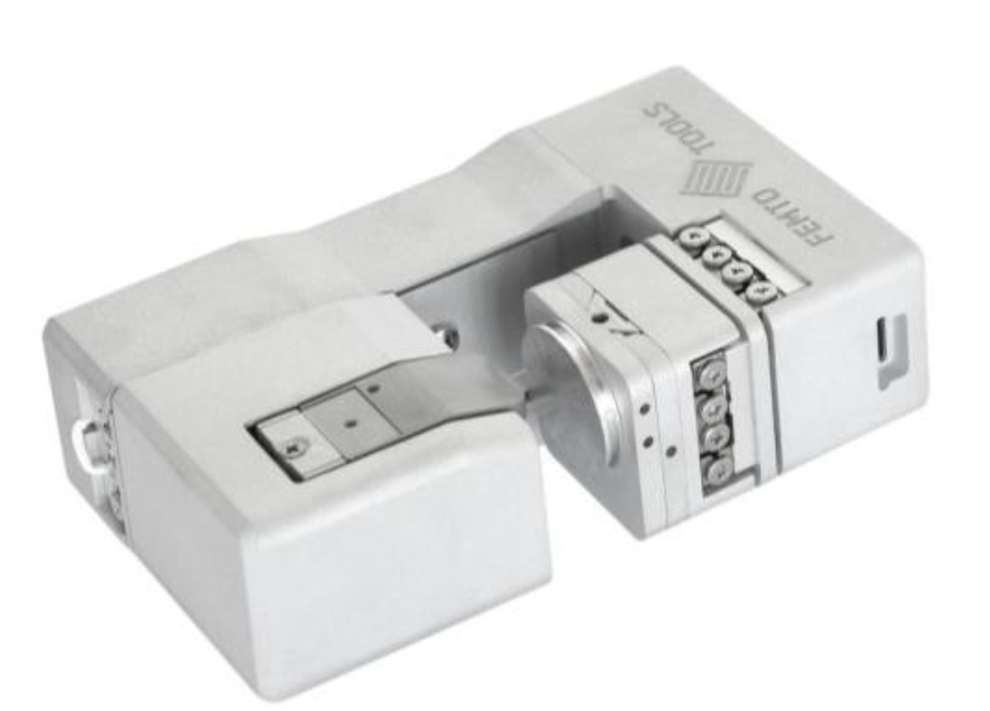
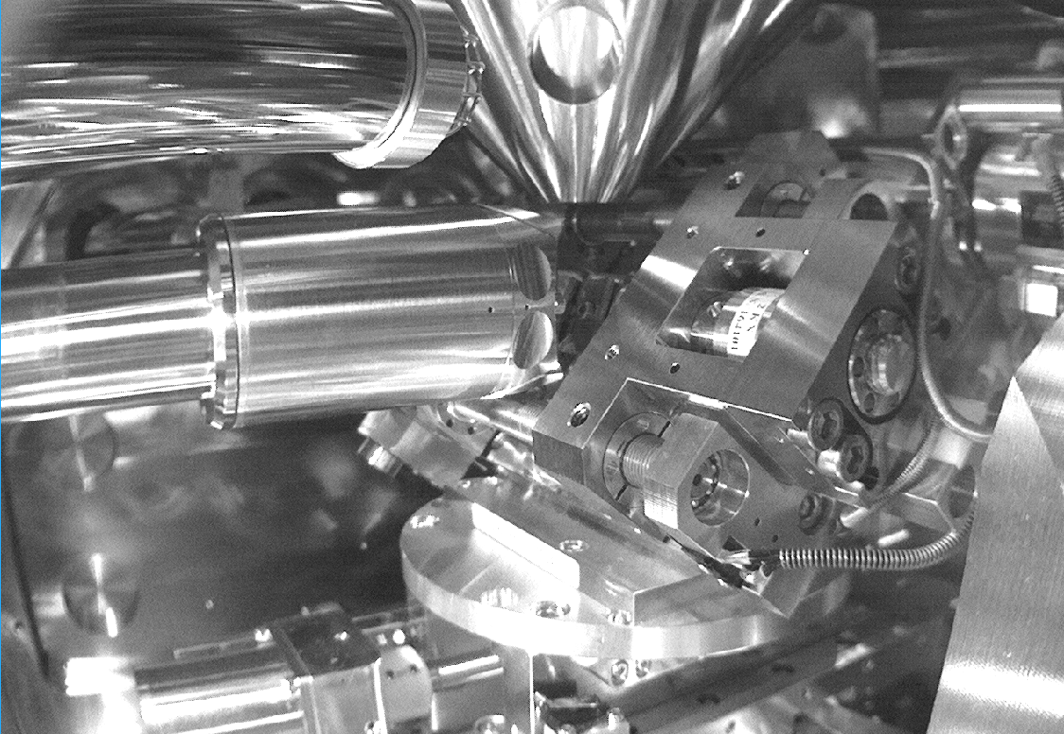
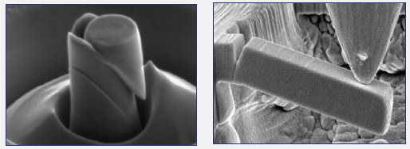

Key capabilities for advanced mechanical testing
ThermoFisher Scientific Helios 5 CX Hydra plasma focused ion beam // image courtesy:
Dr. C. Parish (ORNL).
SEM/ESBD in situ testing: TESCAN Mira3 SEM/ Oxford Symmetry high speed EBSD detector/ miniature 5 kN tensile stage for in-situ testing.
FEMTO Tools nanoindenter for micro-mechanical testing (in-depth assessment of deformation and fracture mechanisms (e.g., grain boundary embrittlement) [being installed]
SEM Chamber interior
SEM pole piece
High-speed
EBSD camera
Specimen
Tensile stage
Pre-tilted holder

Slide 9
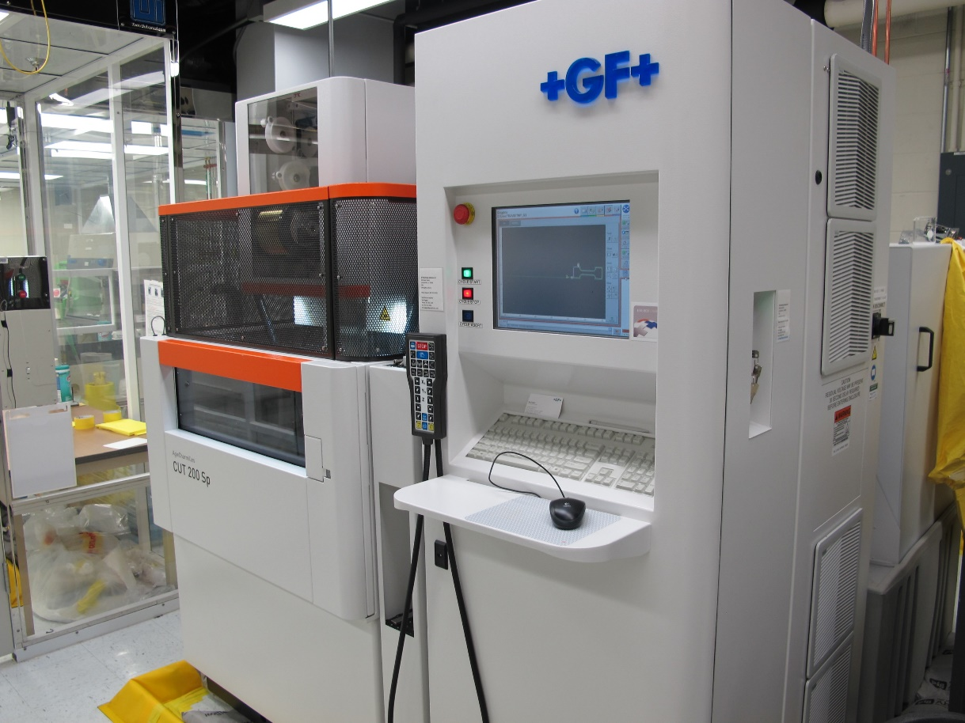
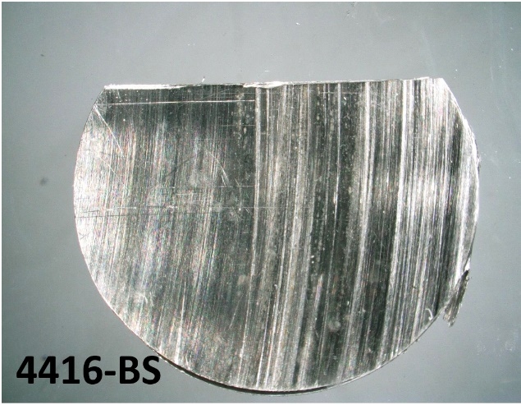
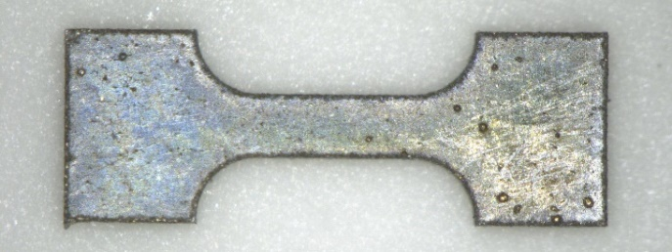
Electric Discharge Machine
Ultraminiature specimen manufacturing: Electric discharge machine (EDM) installed in LAMDA.
Commercial industrial scale EDM system served in LAMDA for ~7 years with more than 2k specimens cut.
This EDM experienced sudden complex failure early in FY 2025.
Repairing efforts are in progress since EDM is the best and safest option (minimal risk to damage the specimen). Service engineers from the vendor work on site for the last 3 weeks replacing damaging components.
The key issue is electronic or mechanical components or parts cannot be sent to the vendor for diagnostics and repairing because of radioactive contamination.
Several alternate options are being explored, considering required accuracy/precision levels as the main criteria CNC machining should be able to provide the necessary number of tensile and bend specimens.
EDM-cut miniature tensile specimen blank. Gauge dimensions: 1.5×0.6×0.6 mm.
Slice from irradiated baffle bolt (316L steel)

Slide 10
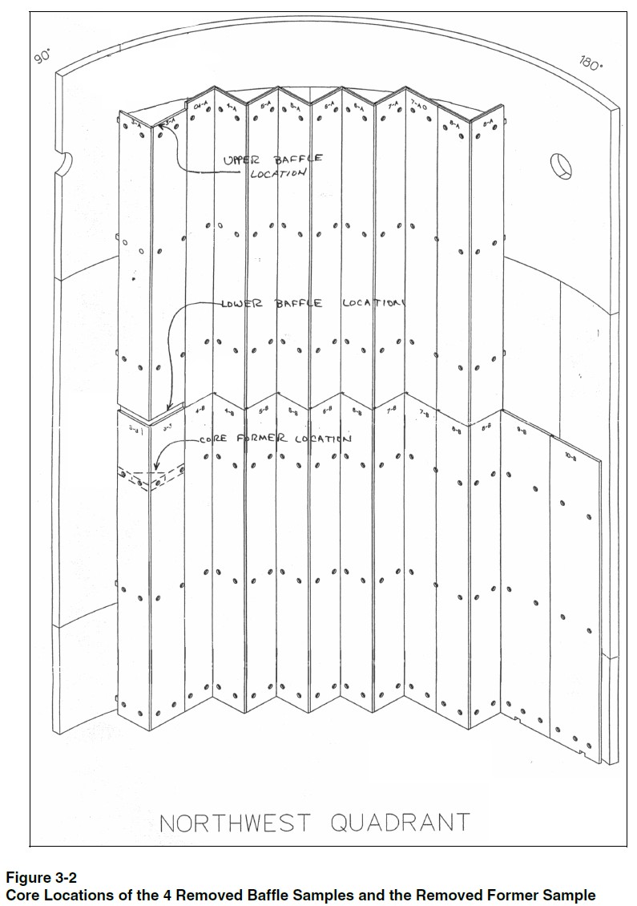
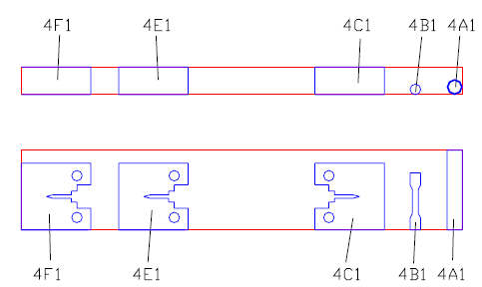
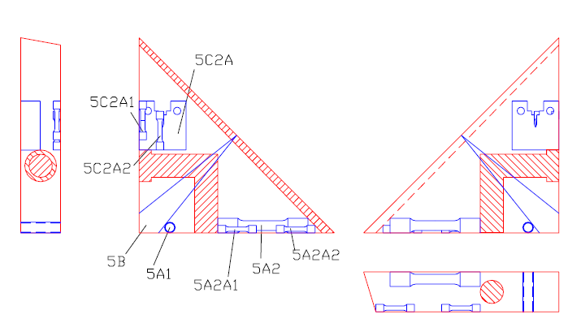
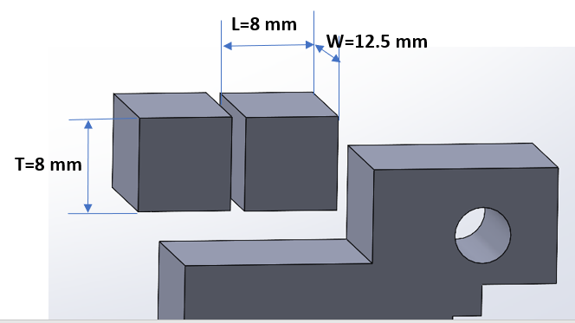
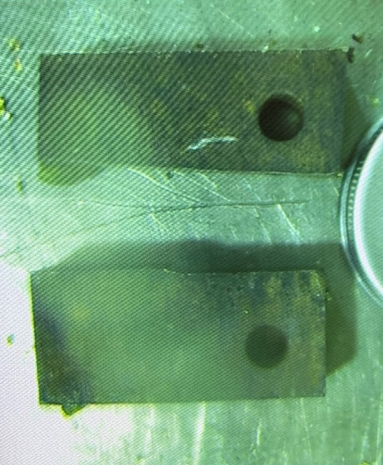
Harvesting materials
Samples of baffle plate and baffle former, as well as flux thimble tube samples irradiated while in-service were successfully harvested and delivered to LAMDA with support from NSUF project.
Baffle plate sample origin from ~middle of the core, and specimen manufacturing scheme (EPRI report, Materials Reliability Program
Characterization of Decommissioned PWR
Vessel Internals Material Samples - Material
Certification, Fluence, and Temperature
(MRP-128, 1008205)).
Left: Baffle plate samples (304L steel, 19.1 dpa; image courtesy: C. Cmar, Westinghouse Electric Company). Right: cutting scheme to produce objects (small “cubes”) suitable for ORNL’s LAMDA facility.

Slide 11
List of harvested specimens
Specimen ID | Description of specimen origin | Damage dose (dpa) | Dose rate (mR/h/ft), Westinghouse in-hot-cell measurements
Baffle plate and baffle former samples
1D1-1 | Baffle plate | 13.2 | 116
1D1-2 | Baffle plate | 13.2 | 115
1G1 | Baffle plate | 5.9 | 52
5C2A | Baffle former | 9.62 | 90
5C2A-2 | Baffle former | 9.62 | 86
4E-1 | Baffle plate | 19.1 | 83
4E-2 | Baffle plate | 19.1 | 80
2C1 | Baffle plate | 0.065 | 5
FTT samples
2A1 | FTT | 75 | 33
2A2 | FTT | 75 | 33
2A3 | FTT | 75 | 33
2A4 | FTT | 75 | 33
2A5 | FTT | 75 | 32
2A6 | FTT | 75 | 32
4A1 | FTT | 50 | 23
4A2 | FTT | 50 | 23
1F1 | FTT | 12 | 29
1F2 | FTT | 12 | 29
Selected specimens of 304L steel include nominally “reference” specimen (~0.065 dpa), specimen with limited to no embrittlement (~6 dpa), and high-dose brittle specimens.
316L specimens include objects with different levels of embrittlement.

Slide 12
Specimen survey
Specimens are being evaluated to survey the surface conditions.
Back // machining
Top
Left // corrosion
Right // corrosion
Top // machining
Front
Front machining
General view of the as-received 1G1 specimen loaded into SEM. “Top”, “Front”: provisional names for the visible sides of the “cuboid.” 5 sides of 6 are visible and may be analyzed, if tilt/rotation are used.

Slide 13
In-service corrosion damage at the baffle plate surface
1G1.
b) “Right” side, high magnification
d) “Left” side, high magnification
An interesting observation: corrosion layer formed in service partially survived and, unexpectedly, revealed corrosion pits. In-service oxidation may be different compared to model experiments in autoclave. The presence of oxide layer opens important additional opportunities.

Slide 14
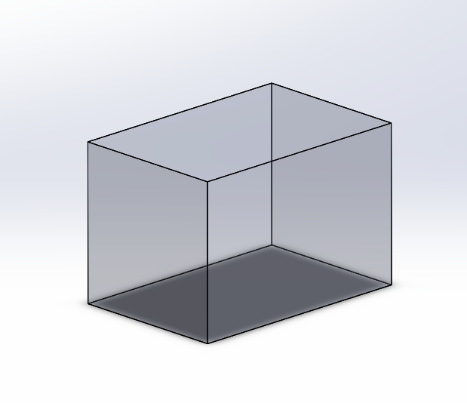
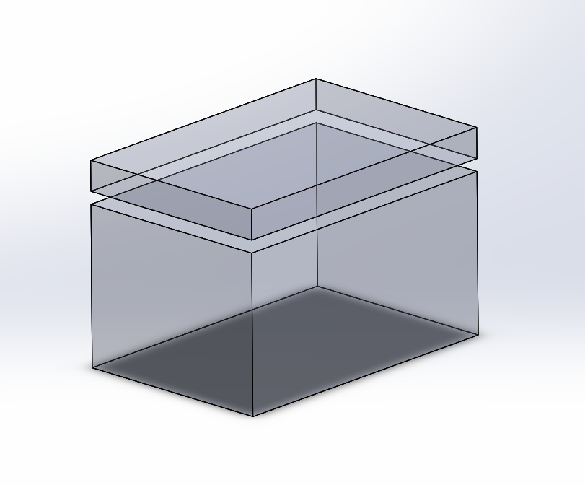
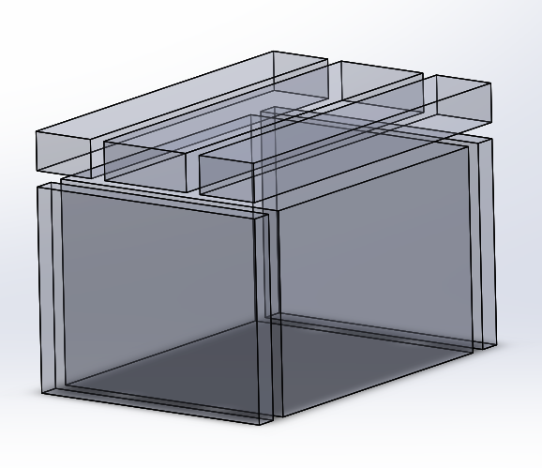
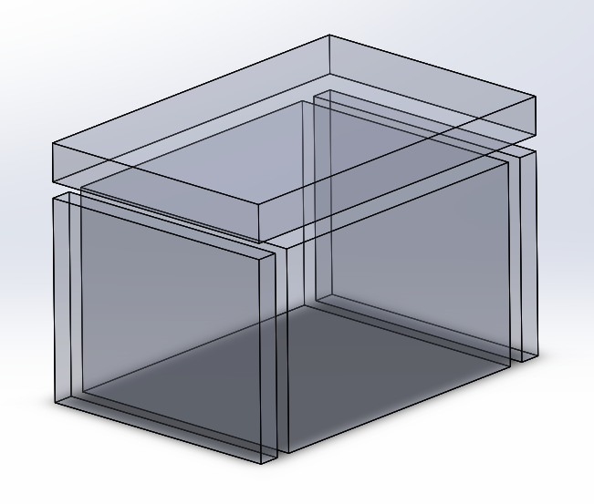
Baffle plate specimen cutting plan (1)
1G1A
Top surface
Int.
Ext.
General metallography specimen
1G1
Vertical direction / Tensile axis direction
Hydrogen measurements
Helium measurements
1G1A1
Int.
1G1A2
1G1A
Ext.
1G1A3
1G1C
1G1B
1G1B
1G1C
In-service corrosion

Slide 15
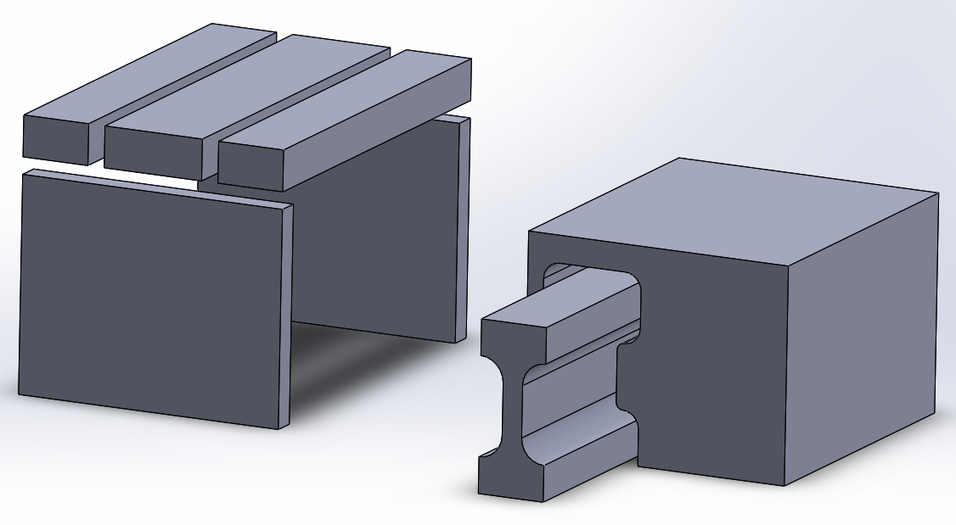
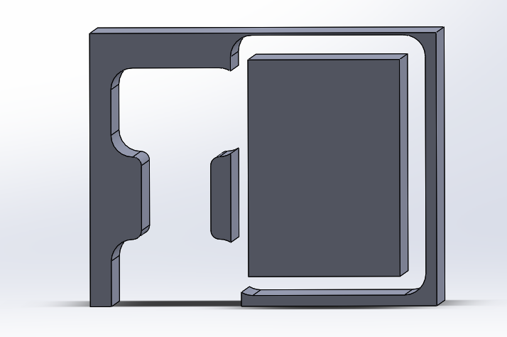
Specimen cutting plan (2)
1G1A1
1G1A2
1G1A3
1G1
Blank for tensile specimen manufacturing
1G1C
1G1B
1G1D
1G1 (remaining portion)
1G1E
Blank for
bend specimen
manufacturing
Debris

Slide 16
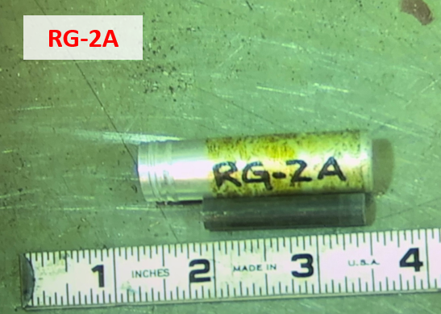
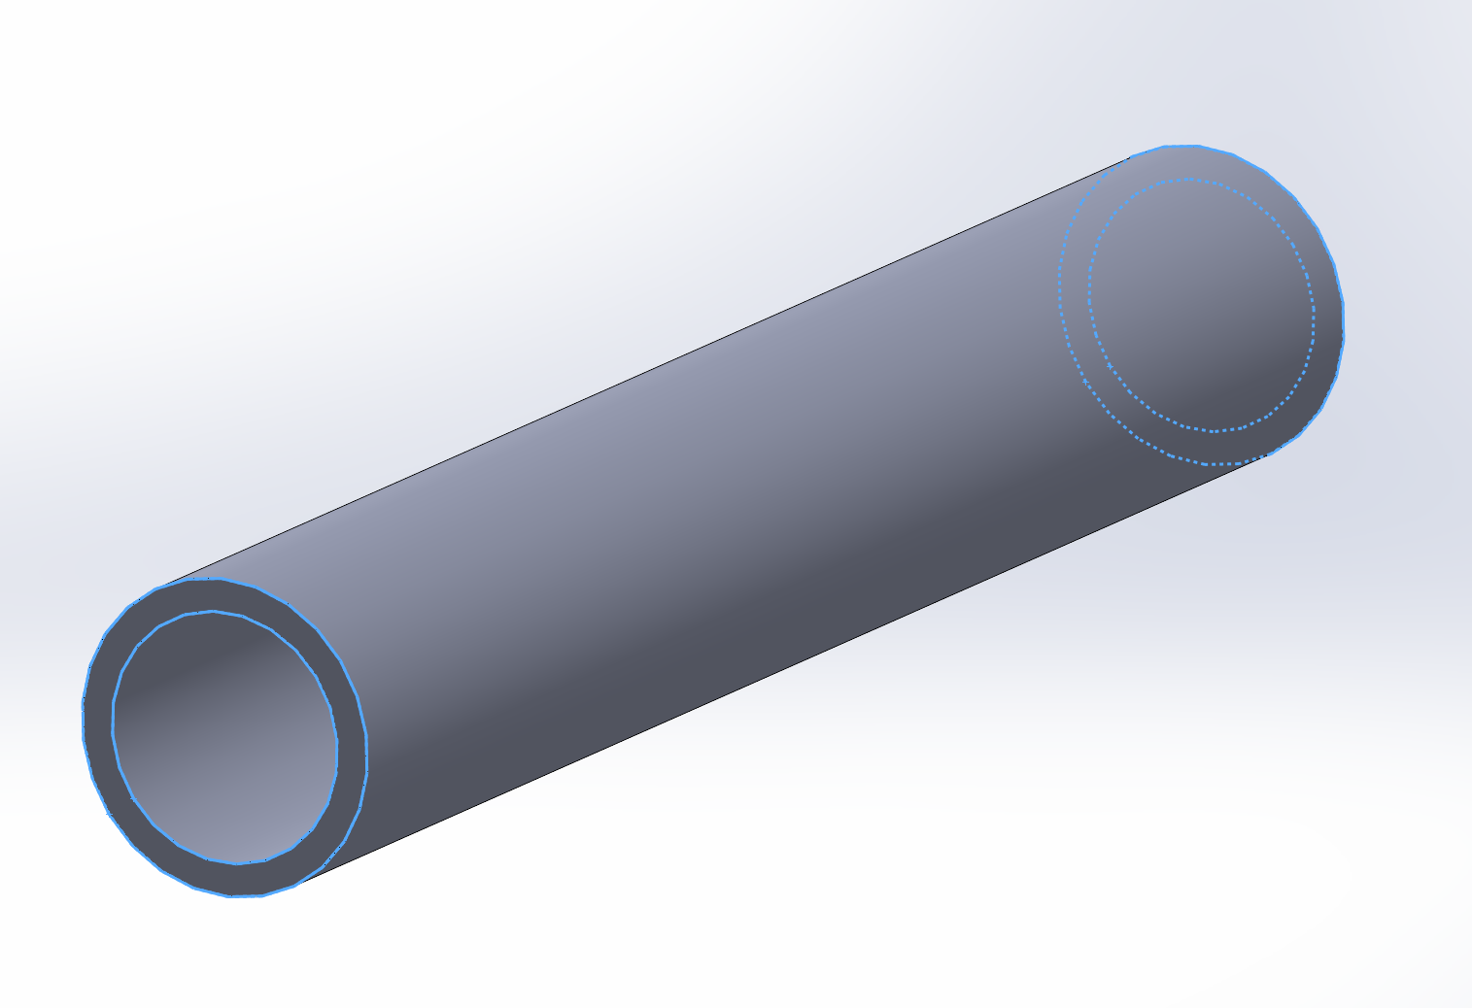
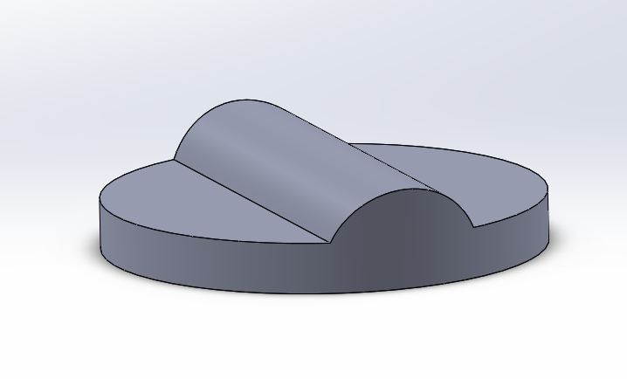
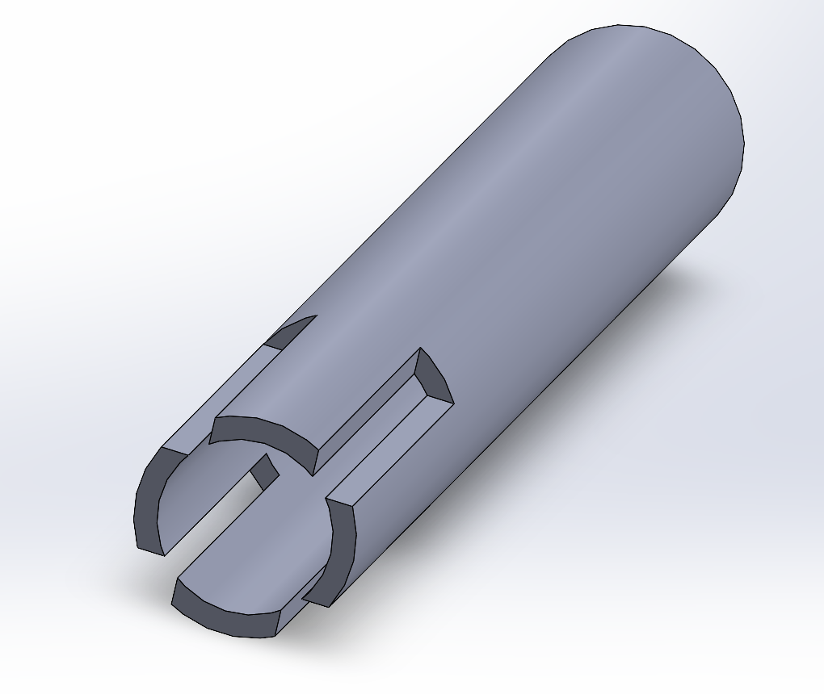
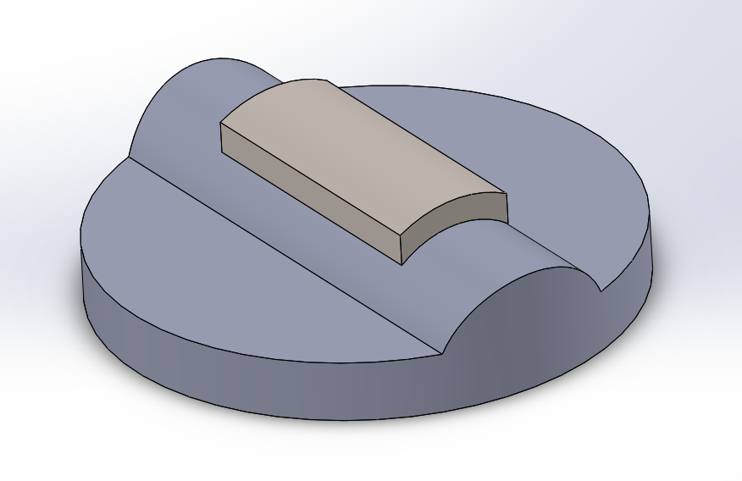
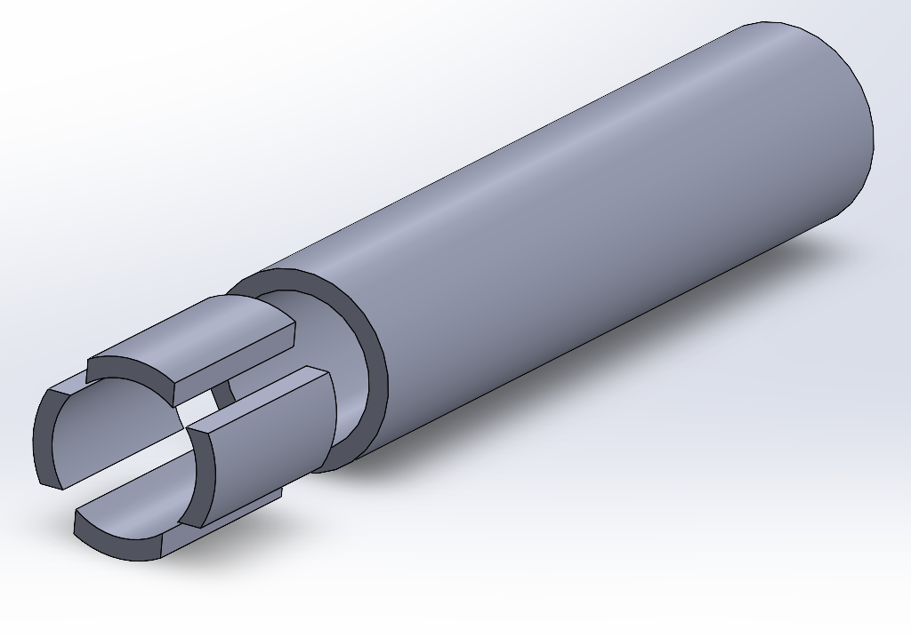
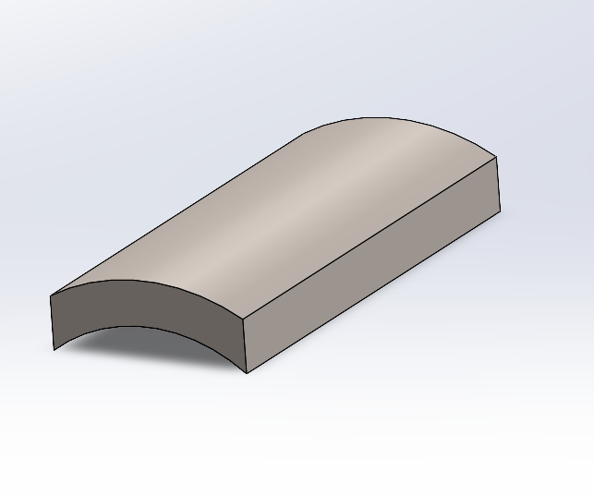
Flux thimble tube specimen manufacturing
Custom holder
Mounted FTT “chip”
Small “chips” for tensile specimen manufacturing
Planned at ORNL
Performed at Westinghouse (C. Cmar)

Slide 17
Conclusions
The first stage—harvesting irradiated materials—was completed successfully.
The second stage—specimen manufacturing—is experiencing delays due to severe equipment failure. Alternative options, such as CNC machining or a combination of CNC machining and low-speed saw cutting, are being considered if EDM repair proves impossible.
A specimen survey is currently in progress to evaluate material and specimen conditions. In-service irradiated components frequently reveal new, previously unrecognized phenomena. For example, specific corrosion patterns, such as localized "pitting-like" features within oxide layers formed during service, were observed on baffle plate samples. These features warrant further detailed investigation. Consequently, the cutting plan was adjusted to preserve sufficient material for this future work.

Slide 18
Acknowledgements
The authors would like to thank K. Everett, M. Terry, and P. Tedder (ORNL’s Low Activation Materials Development and Analysis laboratory) for valuable help with receiving, inventorying, and cutting irradiated samples; A. Moore and B. Kennedy (ORNL’s Radiation Protection Operations Group) for help with planning the work, receiving and surveying the samples; K. Linton (ORNL/NSUF) for help and support at all stages of the project.
Help, advice, and scientific and technical insights from Dr. X. Chen (ORNL, Materials Research Pathway of the Light Water Sustainability Program) are appreciated.
Technical and scientific insights and discussions with Dr. F. Garner (Radiation Effects Consulting) are acknowledged and greatly appreciated. The author would also like to thank P. Hamilton (ORNL) for help with document preparation.

