Slide 1
Advanced Characterization Techniques on Nuclear Fuels and Materials
Donna Post Guillen, PhD, PE
Group Lead and Distinguished Researcher, Materials Performance and Modeling Group
Material Science and Manufacturing Department, Energy and Environment Science & Technology Directorate
Nuclear Science User Facilities (NSUF) Annual Program Review
Idaho Falls, Idaho
April 15-17, 2025

Slide 2
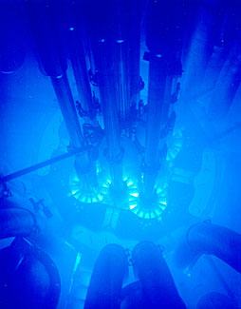
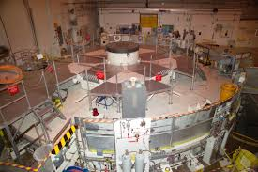
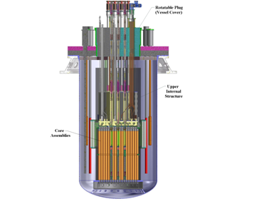
Motivation
Establish a domestic high intensity fast-flux irradiation test capability for nuclear fuels and materials for advanced concept nuclear reactors
Provide an interim fast-flux test capability to test nuclear fuels and materials
  Could be brought on-line in 5-6 yrs.
  Much sooner than building a new fast-flux test reactor
Use existing irradiation facility with irradiation volume large enough to irradiate meaningful numbers of test specimens

Slide 3
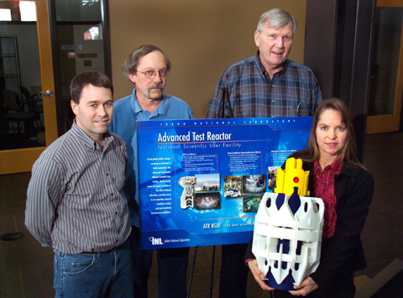
Genesis of Absorber Block Concept
Gas Test Loop project
  Mission need established 2004 by DOE
  CD1-A in 2005 authorized resolution of key feasibility issues
Original Gas Test Loop Conceptual Design estimated cost was $80M to $100M depending on contingency
Challenge - Find a way to make the Gas Test Loop less expensive by using a different cooling approach than pressurized helium
Boosted Fast Flux Loop (BFFL) concept explored
Experiments conducted in INL’s Advanced
Test Reactor (ATR)
Methods for Absorbing Neutrons, US 8,229,054, July 24, 2012
Neutron Absorbers and Methods of Forming at Least a Portion of a Neutron Absorber, US 8,903,035, Dec. 2014

Slide 4
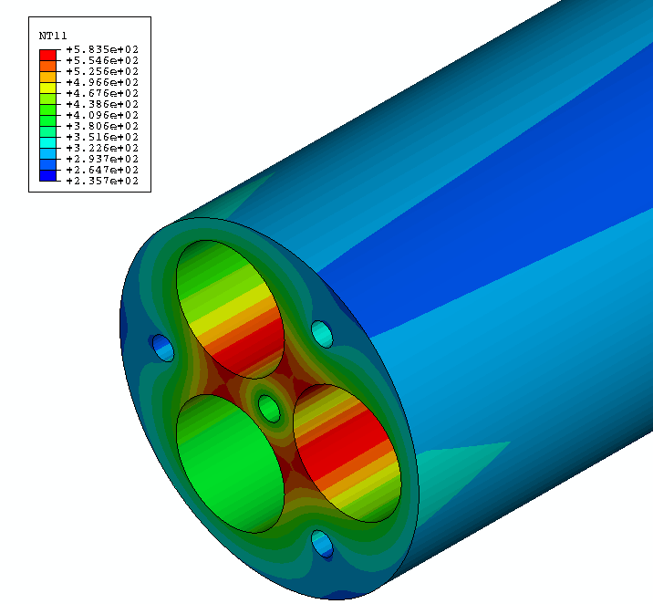
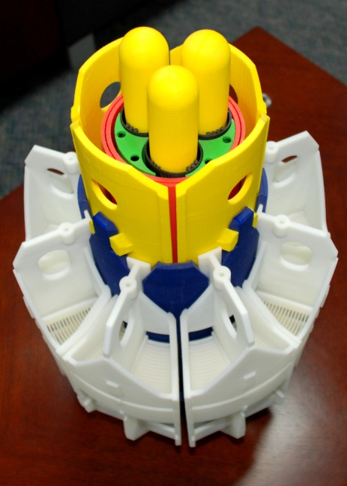
Absorber Block Design
Concept developed to filter out a large portion of the thermal flux component by using a thermally conductive neutron absorber block
Use Hf-Al alloy (Al₃Hf-Al) to conduct heat away from the experiments
Serves a dual role
  High thermal conductivity of Al
  Thermal neutron absorption of Hf
Limit amt. of pressurized water for cooling
  Pressurized water systems already exist in ATR
  If water is not close to experiments, thermalization may be manageable
Use booster fuel to augment neutron flux
Thermal Evaluation of Uranium Silicide Miniplates Irradiated at High Heat Flux, Nuclear Engineering and Design 250, September 2012, p. 237– 246
Thermal Analysis of a Uranium Silicide Miniplate Experiment, Proceedings of the 13th International Nuclear Thermal Hydraulics Meeting (NURETH-13), Kanazawa, Japan, September 29-October 1, 2009

Slide 5
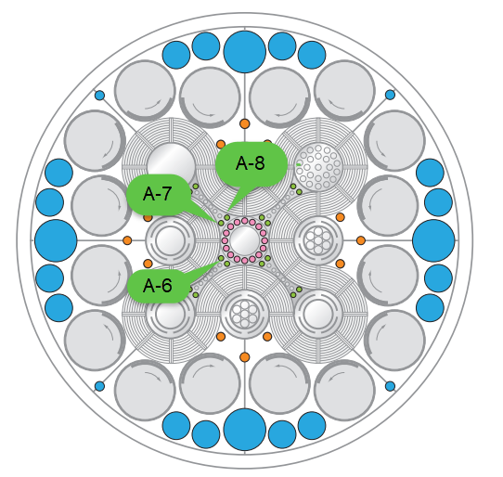
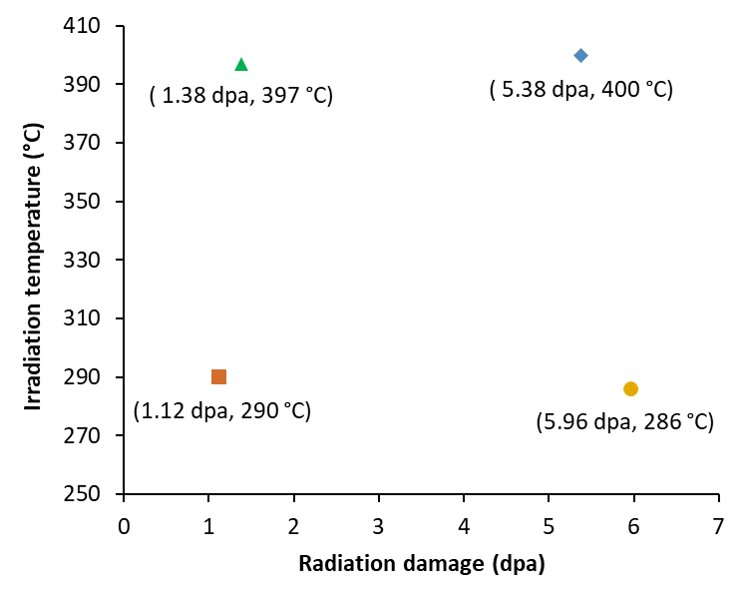
ATR Irradiations
Original neutron irradiation via NSUF project 09-157
Neutron irradiation performed via NSUF project 15-8242
Post-irradiation examination performed through NSUF Rapid Turnaround Experiment 21-4280
Capsule Designation | Target Irradiation Conditions | ATR Position | Cycles | EFPD
1 DPA | 1 ± 0.2 dpa 300 ± 50 °C and 400 ± 50 °C | A-7 A-8 | 164A | 54.9
3 DPA | 3 ± 0.2 DPA 300 ± 50 °C and 400 ± 50 °C | A-6 A-7 A-8 | 164A 164B 166A | 187.8
Guillen, D. P., Greenwood, L. R., & Parry, J. R. (2014). High conduction neutron absorber to simulate fast reactor environment in an existing test reactor. Journal of Radioanalytical and Nuclear Chemistry, 302(1), 413-424.
Guillen, D. P., Wharry, J. P., Housley, G. K., Hale, C. D., Brookman, J. V., & Gandy, D. W. (2022). Experiment design for the neutron irradiation of PM-HIP alloys for nuclear reactors. Nuclear Engineering and Design, 402, 112114.
Notes:
Piggybacked on 15-8242 irradiation

Slide 6
Transfer Learning Approach
Transfer learning process for quantifying dislocation defects
  The YOLO11 object detection model was initially trained on crops and a synthetic cavity dataset
  The resulting weights were then fine-tuned using MA956 ODS alloy images to obtain the final model weights

Slide 7
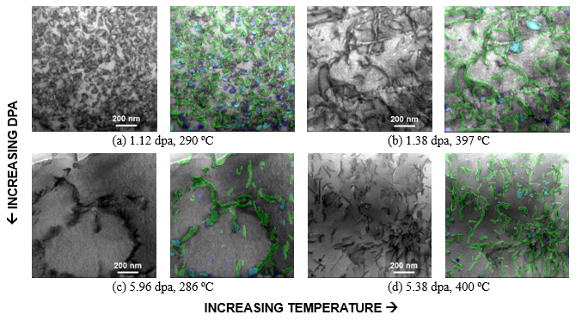
Dislocation Defect Detection and Quantification
On zone axis BF-STEM images in the Al₃Hf showing dislocation lines and loops under various irradiation dpa and temperatures.
For each pair of images, the left image is the original BF-STEM image, and the right image shows the YOLO11 detected lines and loops overlaid
green mask → dislocation lines
blue mask → loops
teal mask → overlap between lines and loops
Dpa | Temperature (ºC) | Zone Axis | Lamellae Thickness (nm) | Dislocation Lines (Number) | Dislocation Loops (Number) | Line Number Density (m⁻³) | Loop Number Density (m⁻³)
1.12 | 290 | [001] | 68.35 | 666 | 194 | 6.72 × 10²¹ | 1.96 × 10²¹
1.38 | 397 | [041] | 125.88 | 526 | 35 | 2.86 × 10²¹ | 1.91 × 10²⁰
5.96 | 286 | [221] | 88.82 | 315 | 24 | 2.43 × 10²¹ | 1.85 × 10²⁰
5.38 | 400 | [221] | 106.34 | 149 | 46 | 9.87 × 10²⁰ | 3.05 × 10²⁰
Guillen, D. P., Wharry, J., Lu, Y., Wu, M., Sharapov, J., & Anderson, M. (2025). Microstructure of Neutron-Irradiated Al3Hf-Al Thermal Neutron Absorber Materials. Materials, 18(4), 833.

Slide 8
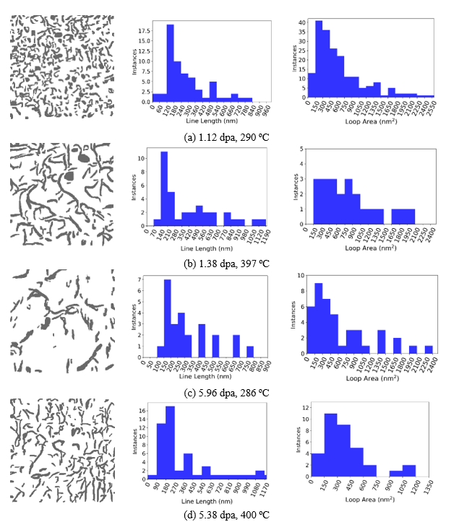
Histograms of Line Lengths and Loop Areas
The on-zone axis BF-STEM images show dislocation loop and line networks in the Al matrix that vary in relative population, size, and number density across irradiation conditions
At the lowest dpa and temperature, the network is comprised almost exclusively of dislocation loops
With increasing irradiation temperature, 1.38 dpa at 397 ºC, a few large dislocation loops remain (~50-150 nm in diameter), amongst a relatively high density of dislocation lines formed by loops growing too large and subsequently unfaulting
With increasing dpa, nearly all dislocation loops have completely unfaulted into dislocation lines, and dislocation line recovery has occurred
At the highest dpa and temperature, 5.38 dpa at 400 ºC, the dislocation loops have almost completely unfaulted into dislocation lines, and dislocation line recovery has occurred

Slide 9
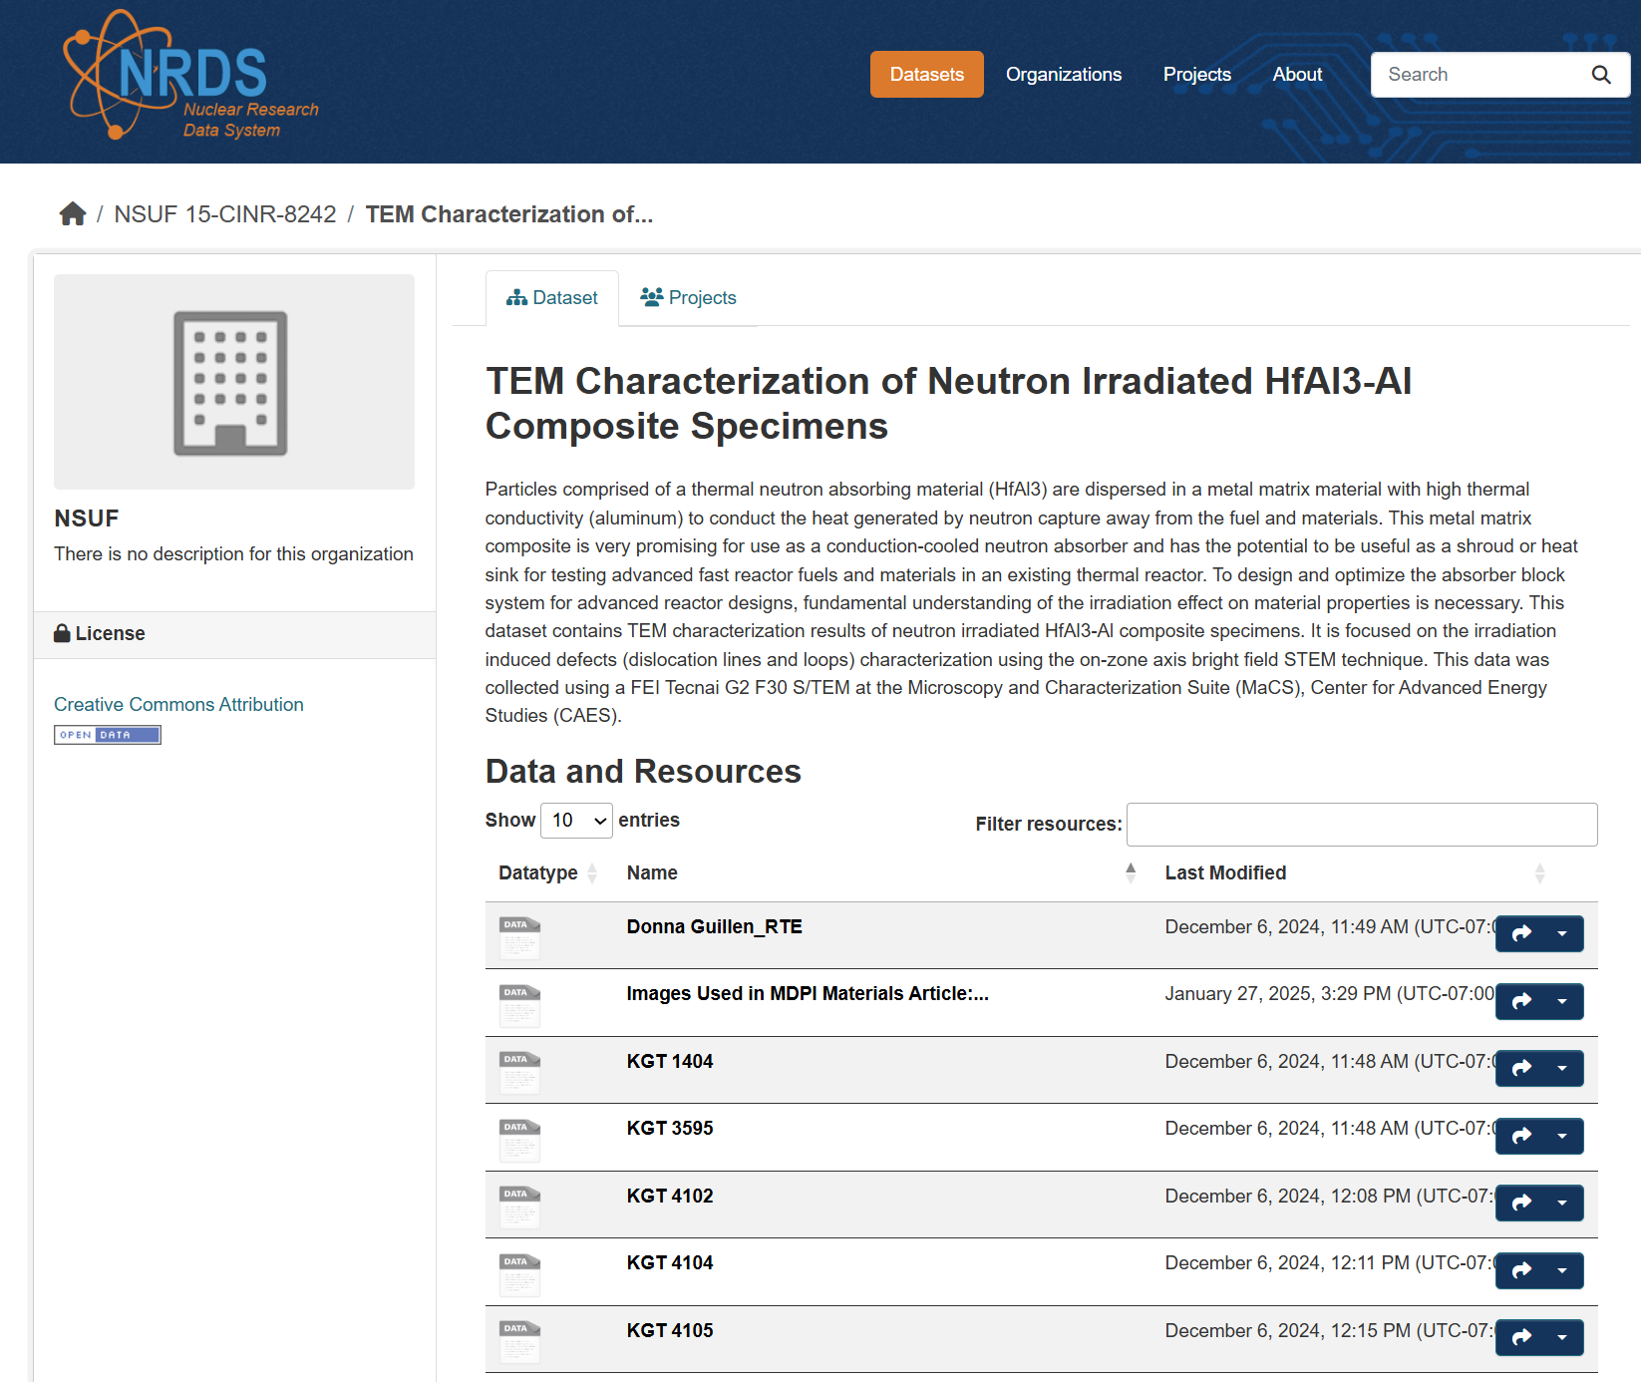
NRDS Data Availability
The data supporting the findings of this study are openly available via the Nuclear Science User Facilities’ Nuclear Research Data System, TEM Characterization of Neutron Irradiated Al₃Hf-Al Composite Specimens: https://doi.org/10.48806/2478162 (2024). The code and models, along with the training, test, and validation datasets, are available at: https://github.com/idaholab/PANDA. The MA956 ODS images used for training are available at: https://doi.org/10.48806/2468645

Slide 10
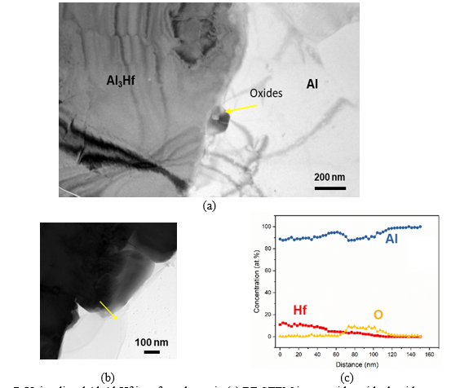
Particle-Matrix Interface in Unirradiated Specimen
Unirradiated Al₃Hf-Al specimen shows ~30 nm oxide thickness
High resolution TEM characterization was performed with a FEI Tecnai G2 F30 Scanning TEM (STEM) (Thermo Fisher Scientific, Waltham, MA)
Bright field (BF) STEM images were acquired to visualize the coherency of the interface between the particles and the matrix
Energy dispersive X-ray spectroscopy (EDS) was applied to study the chemical composition evolution across the interface
BF-STEM image with residual oxide along interface
Higher magnification image with EDS linescan

Slide 11
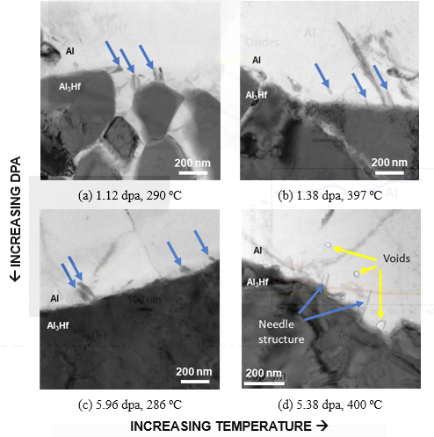
Particle-Matrix Interface in Irradiated Specimens
BF-STEM imaging shows needle-like structures have formed within the Al matrix along the particle-matrix boundary
  The aspect ratios of the needles appear larger (i.e., longer and thinner) in the ~400 ºC irradiation conditions than in the ~300 ºC irradiation conditions, possibly due to the accelerated kinetics at the higher temperature
  The needles do not appear to exhibit significant evolution as a function of dpa
Voids are observed only in Al₃Hf-Al irradiated under the highest dpa-temperature condition
  The voids primarily appear in the vicinity of the Al₃Hf- Al interface, suggesting that void formation induced by irradiation may compromise the material’s integrity at this interface
  The voids may affect thermal conductivity, which in turn impacts the material's function as a thermal neutron absorber

Slide 12
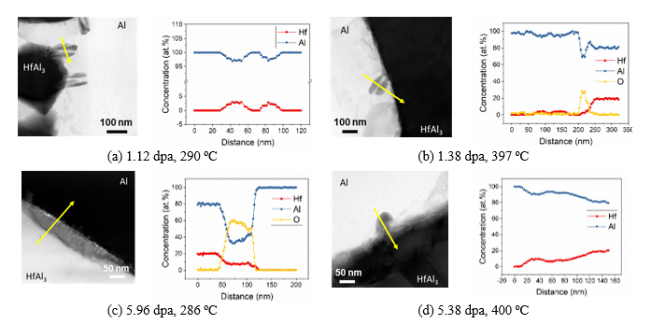
TEM EDS Line Scans
Irradiated Al₃Hf-Al
Hf, Al, and O composition profiles across irradiation-induced needle-like structures in Al matrix at conditions
  Needle-like structures are Hf-rich and there remains oxide present at the interface
  In the 5.96 dpa, 268 ºC condition, an EDS line scan is taken across the particle-matrix interface rather than across the needles, (Figure c) revealing a thicker oxide layer than prior to irradiation

Slide 13
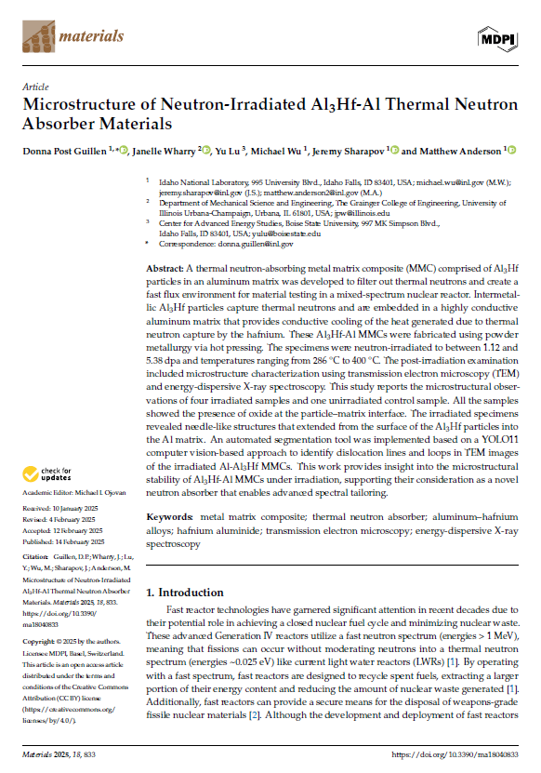
Summary and Conclusions
This NSUF RTE study provides insights into the microstructural stability of the Al3Hf-Al MMCs under irradiation, supporting their potential as novel neutron absorbers for advanced spectral tailoring in LWRs, and playing a crucial role in the qualification of fast reactor fuels and materials, enhancing the development of fast flux irradiation testing facilities
An open-source object segmentation method was developed to automate the detection and quantification of dislocation defects. Since developing a database of manually annotated images is quite time-consuming, the application of transfer learning can facilitate high throughput analysis of TEM images.
TEM EDS showed:
  Oxygen at the particle-matrix interface in all samples
  Needle-like structures extending from the Al₃Hf particles into the Al matrix in the irradiated samples (but not the unirradiated samples)
  Voids within the Al matrix of the high temperature/high dpa specimen
Notes:
Acknowledge co-authors

Slide 14
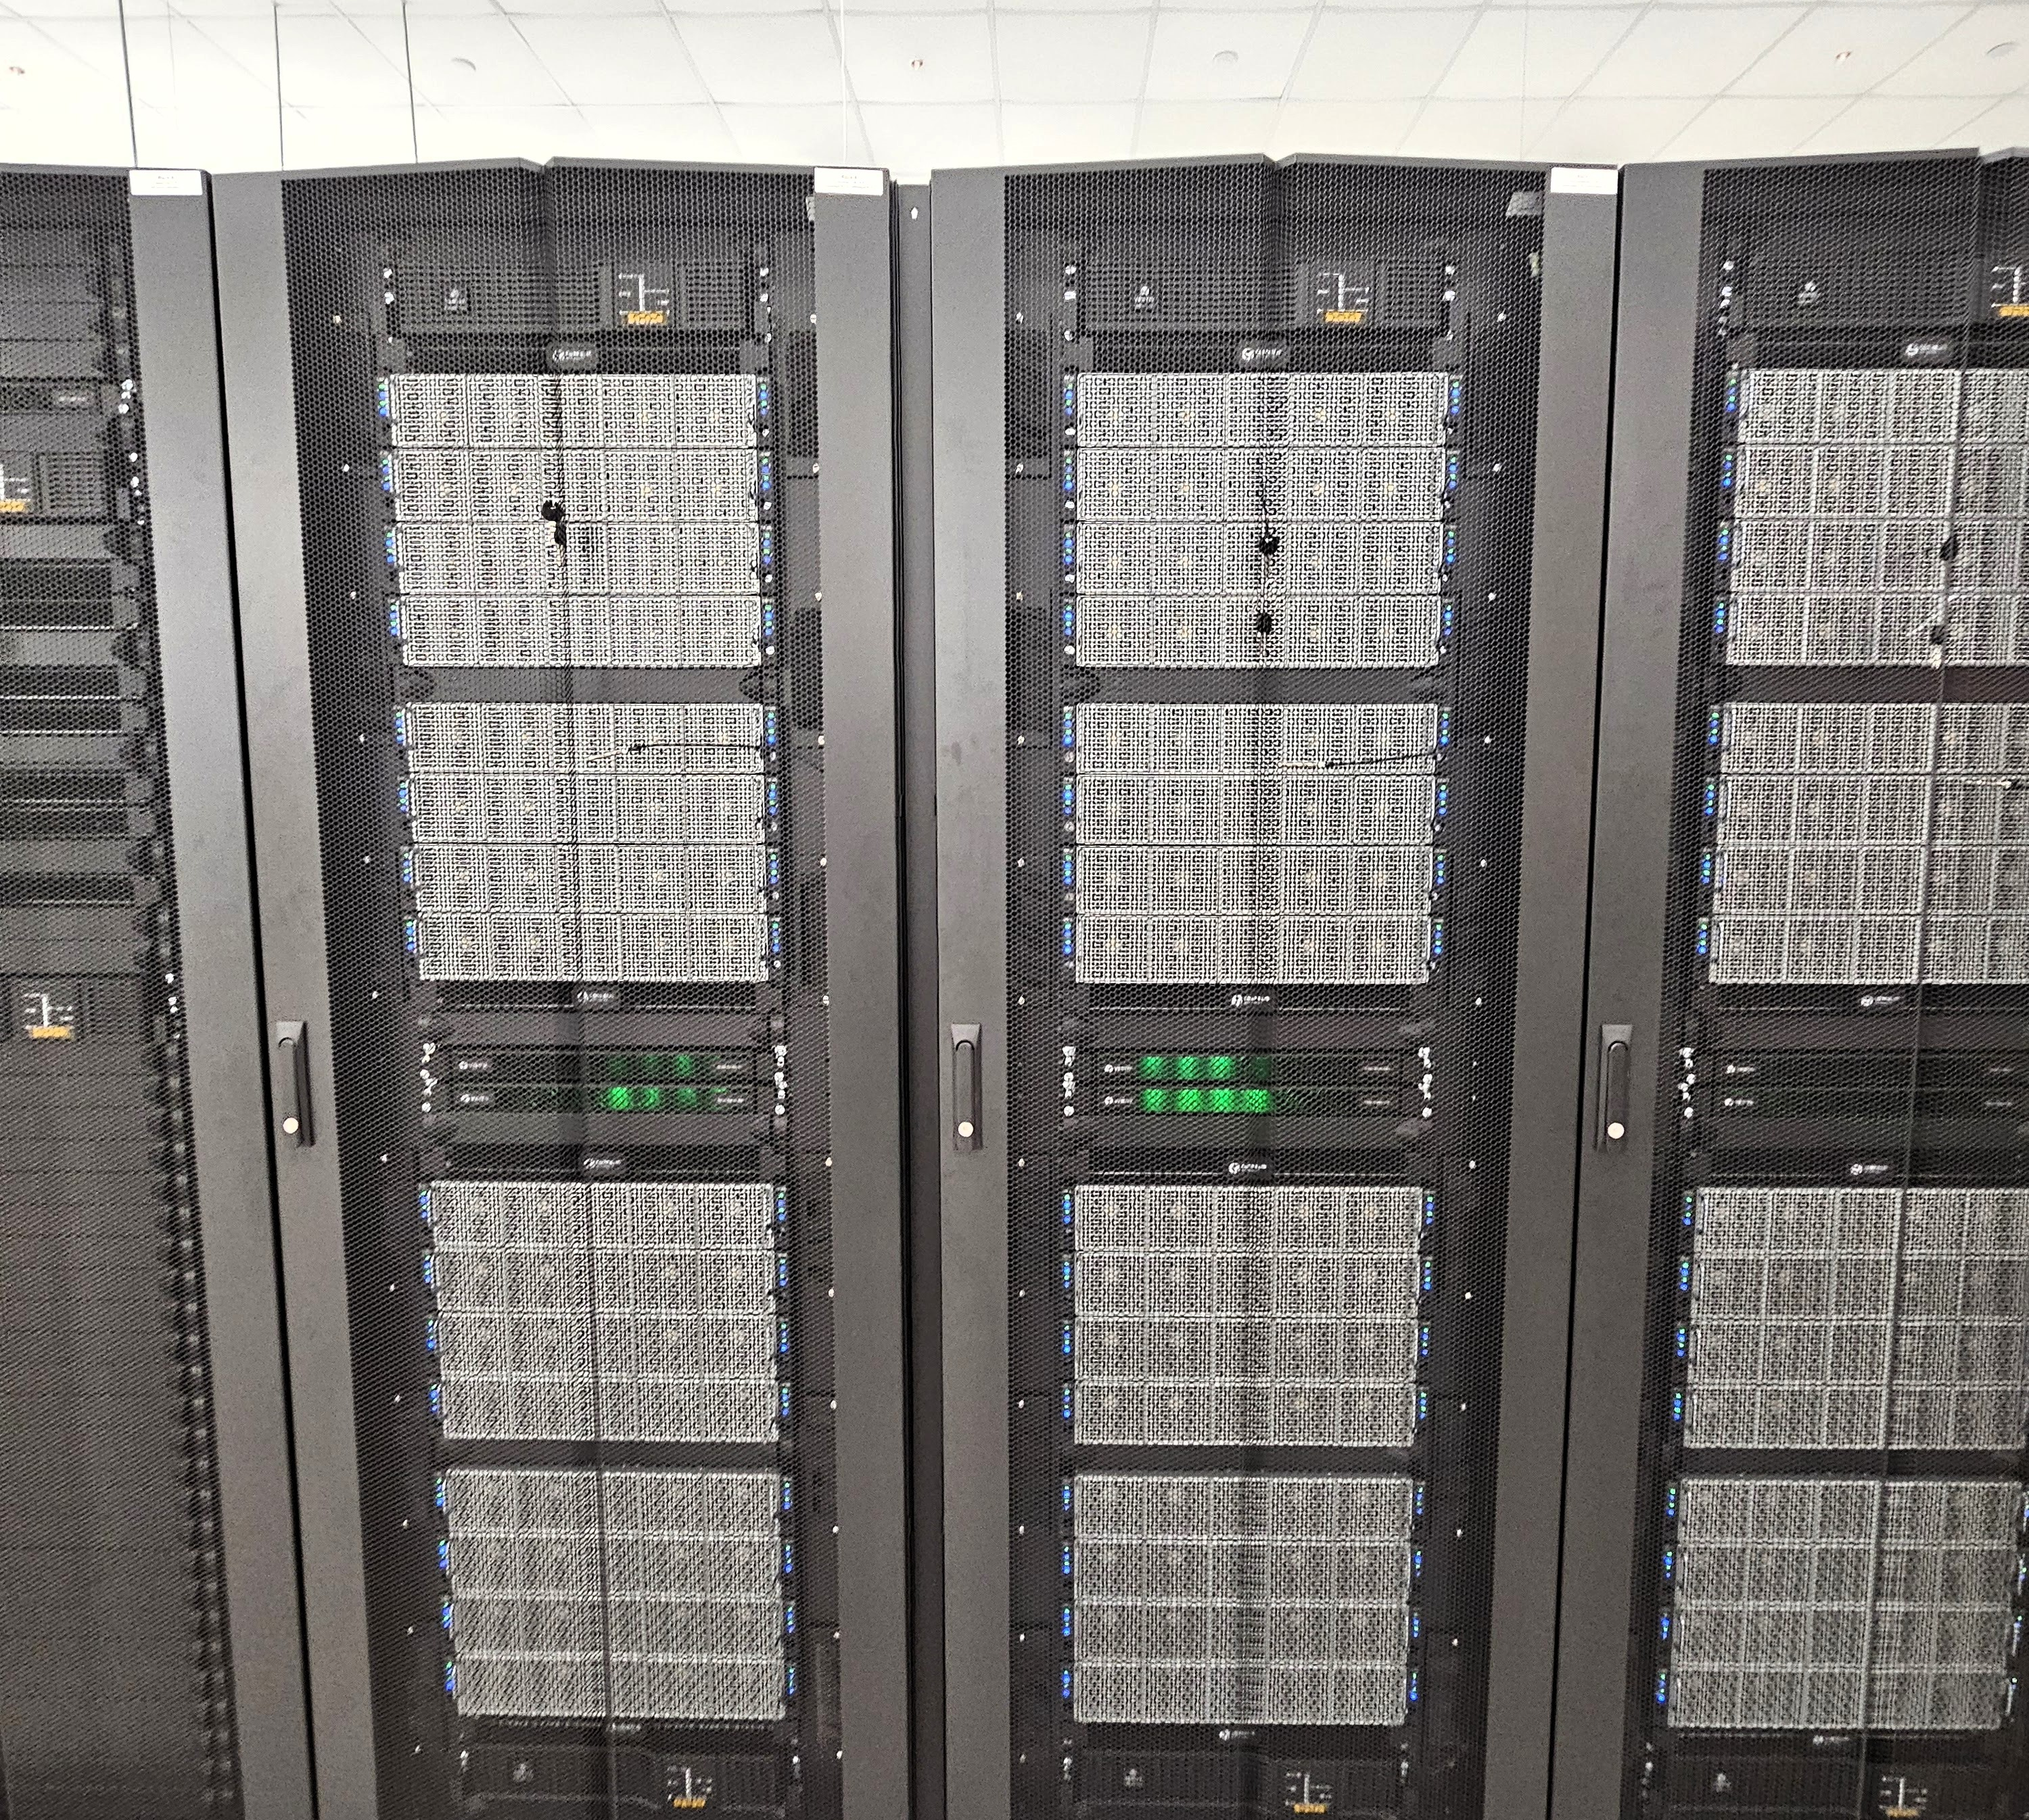
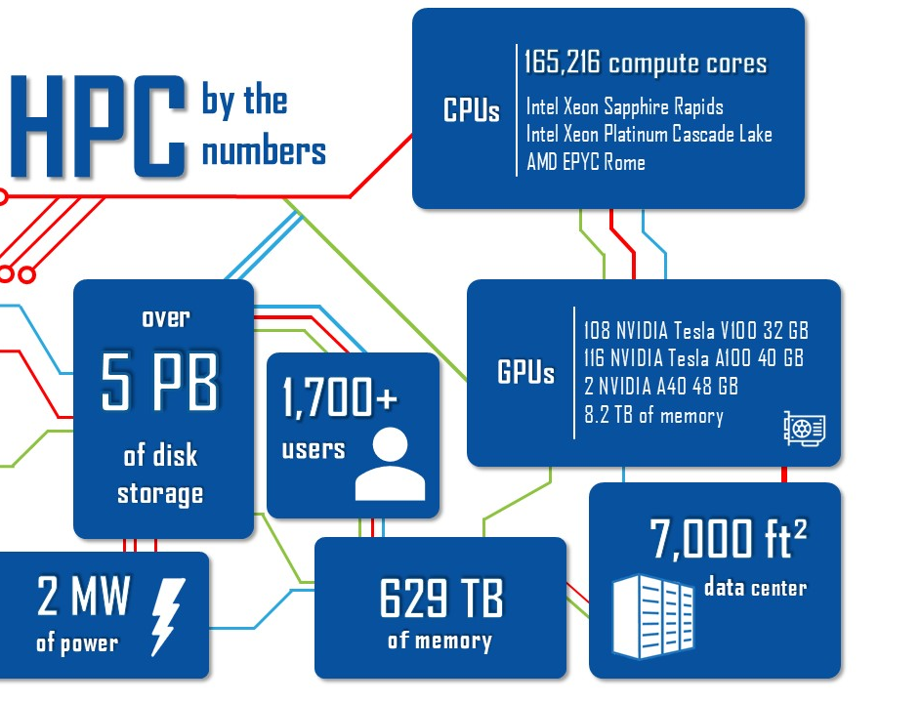
Acknowledgements
This work was performed by Battelle Energy Alliance, LLC under the DOE Idaho Operations Contract DE-AC07-05ID14517. This research made use of INL's High Performance Computing systems located at the Collaborative Computing Center and supported by the Office of Nuclear Energy of the U.S. Department of Energy and the Nuclear Science User Facilities under Contract No. DE-AC07-05ID14517. Neutron irradiation in the ATR was conducted through DOE Office of Nuclear Energy, NSUF project 15-8242. Post-irradiation examination was performed through NSUF Rapid Turnaround Experiment 21-4280 at the Microscopy and Characterization Suite (MaCS), Center for Advanced Energy Studies (CAES).
Notes:
Finally, I’d like to acknowledge our funding sponsors

Slide 15


