Slide 1
Automated Regions of Interest (ROI) Detection in Irradiated U-Zr Metallic Fuel Using Deep Learning Method
By Tiankai Yao
Prepared for NSUF Annual Program Review
04/17/2025

Slide 2
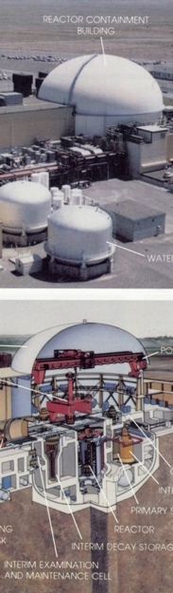
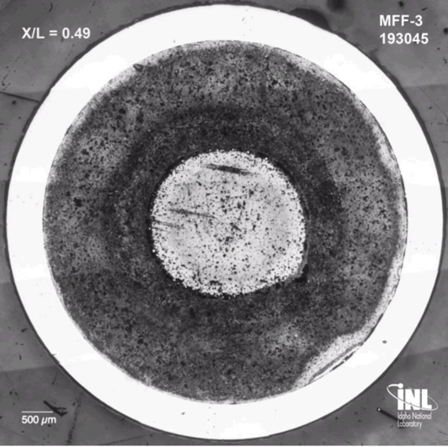
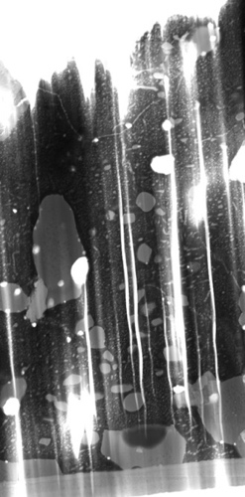
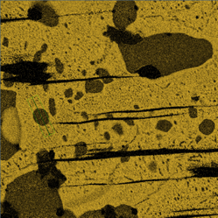
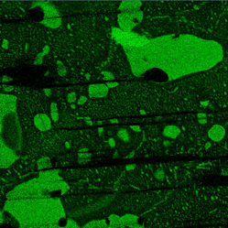
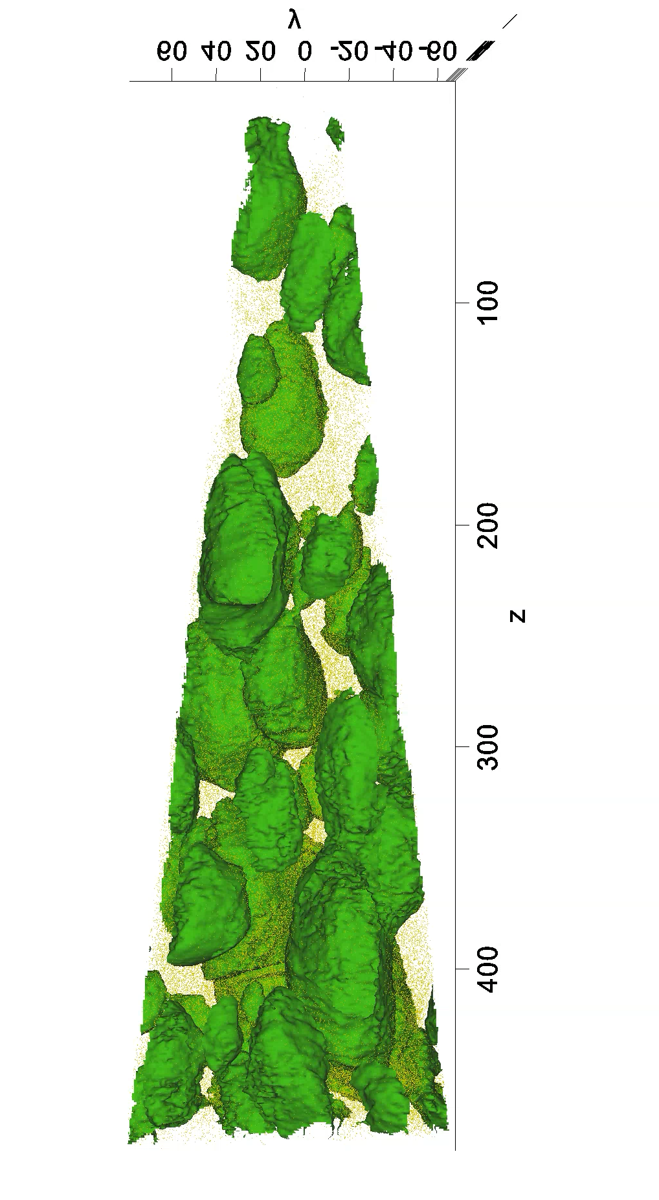
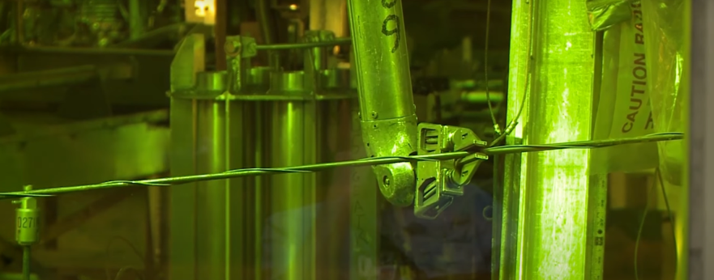
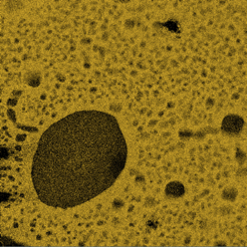
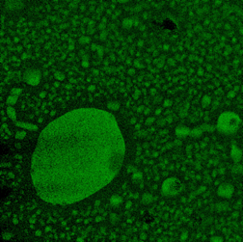
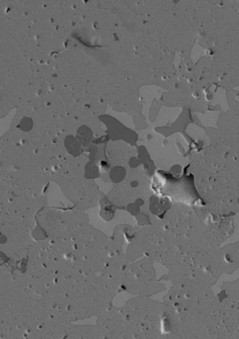
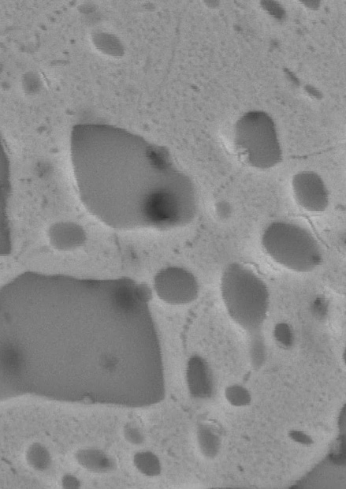
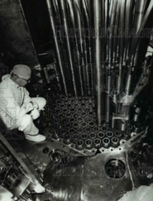
Nuclear Fuel Post Irradiation Examination
U
Zr
2 µm
500 nm
Transmission electron microscopy identification of Zr nano precipitate
(2-5 nm, 10⁻⁹ m)
OM examination (U-10Zr fuel)
(1mm, 10⁻³ m )
Photo observation of U-10Zr fuel pins irradiated in Fast Flux Test Facility (~1 m)
50 µm
2 µm
Atom probe tomography study of Zr atom distribution in 3D
(3 Å, 10⁻¹⁰ m)
Scanning electron microscopy characterization
of U-10Zr grain and precipitate (1 μm, 10⁻⁶ m)
INL PIE capabilities span 10 orders of magnitude

Slide 3
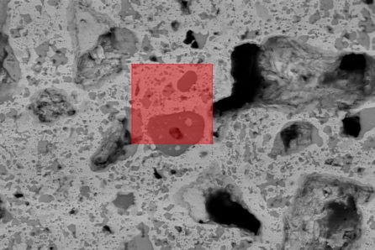
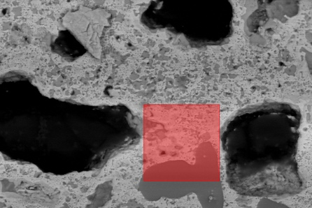
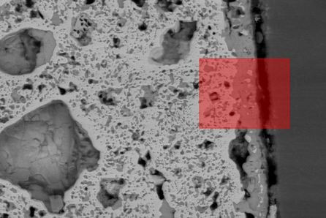
ROI is the starting point of materials characterization

Slide 4
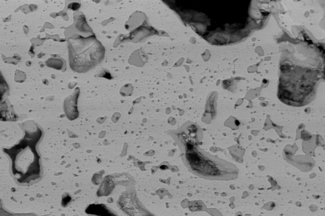
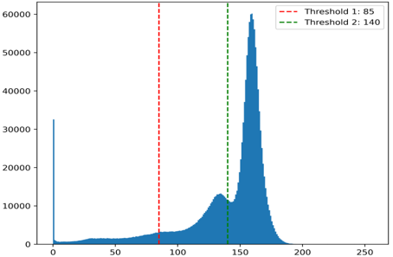
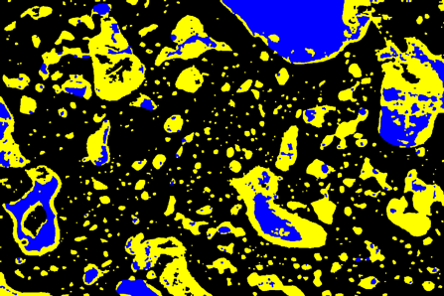
ROI and Image Analysis
Is the ROI selected representative of irradiated fuel
If Yes, proof?
If not, how to make sure it is representative
Automation
Efficiency
Cost

Slide 5
10, 000 images stitched to cover the whole area

Slide 6
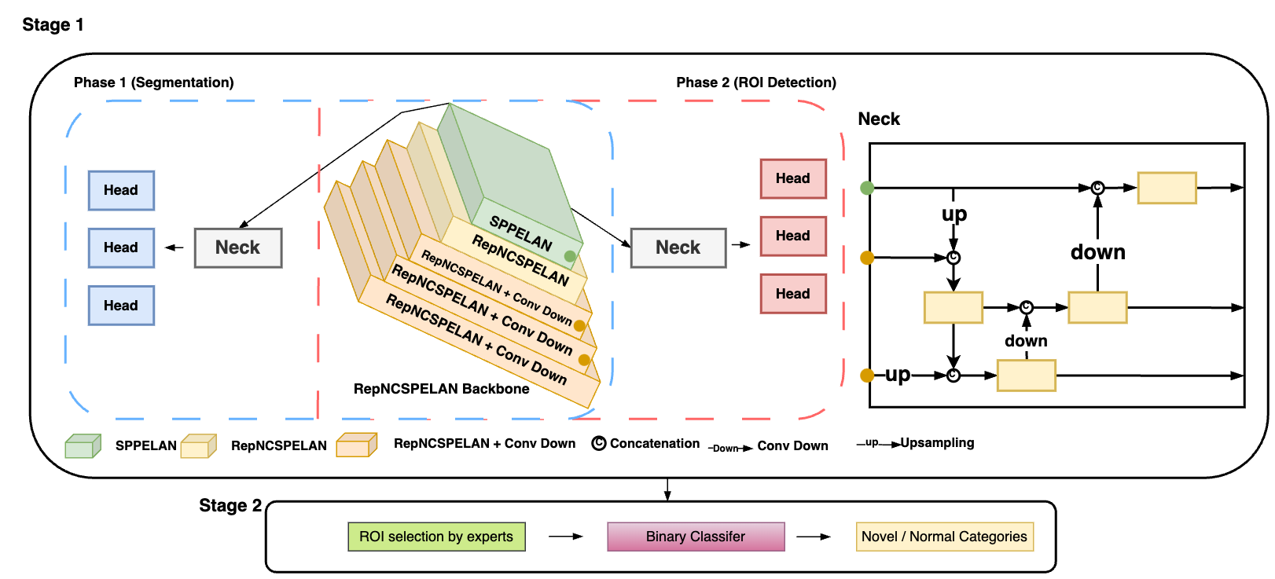
Deep learning

Slide 7
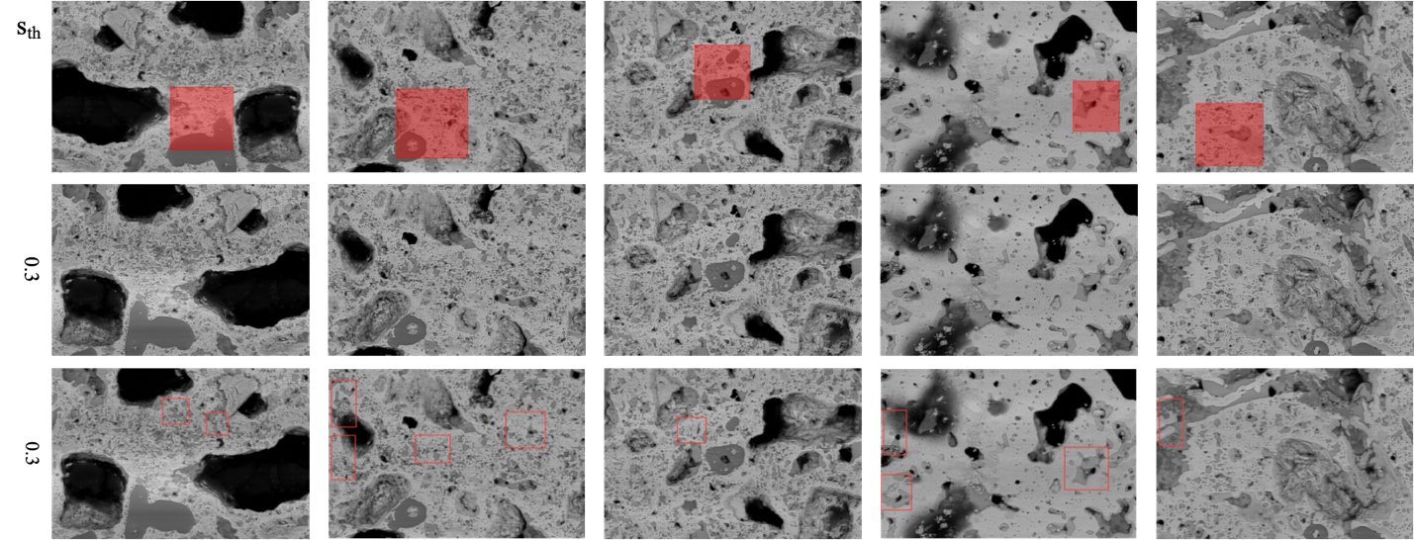
Singe-phase vs two-phase
Comparison of single-phase and two-phase training. The top row shows annotated ROIs, serving as ground truth. The middle row shows ROI proposals inferred using the single-phase model, while the bottom row shows ROI proposals generated by the two-phase model, highlighting its performance. S_{th} represents the prediction threshold score.

Slide 8
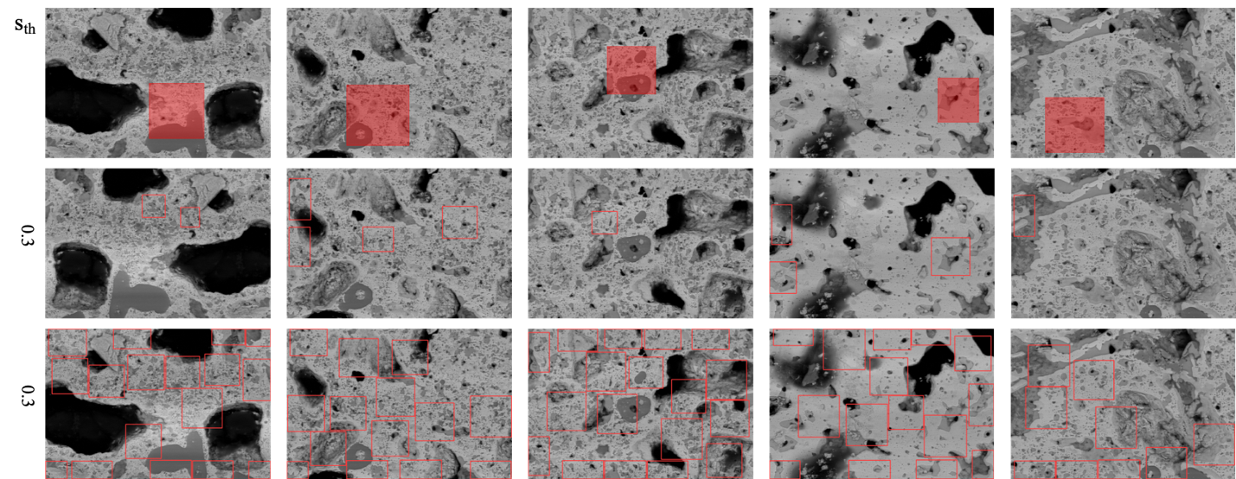
2nd phase with modified weight loss function
The top row shows annotated ROIs. The middle row shows ROI proposals inferred using the two-phase model utilizing original loss functions, while the bottom row shows ROI proposals generated by the two-phase model with modified weighted loss functions. S_{th} represents the prediction threshold score.

Slide 9
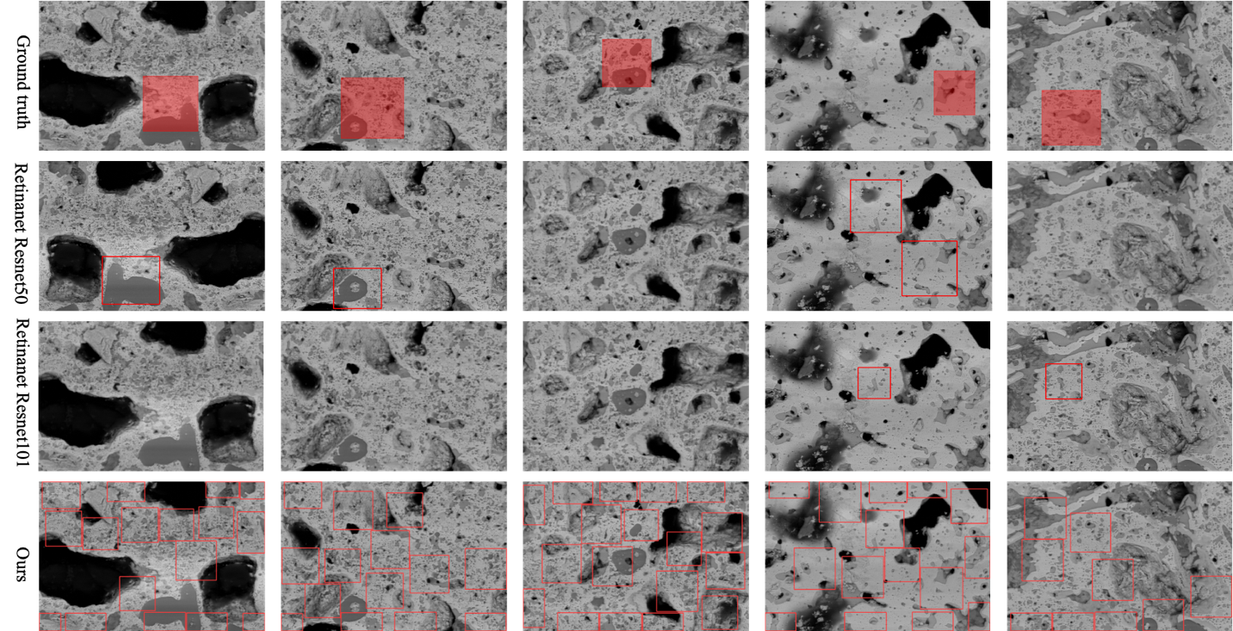
Compared with other methods in literature
Visual comparison of ROI proposals generated by two variations of RetinaNet and our Proposed Method.

Slide 10
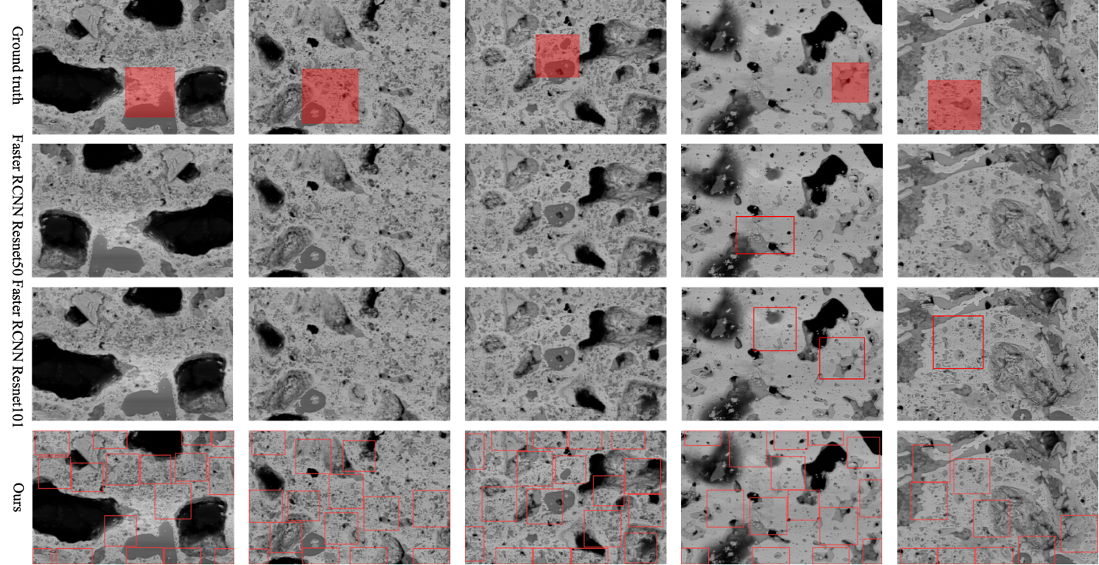
Compared with Faster RCNN method

Slide 11
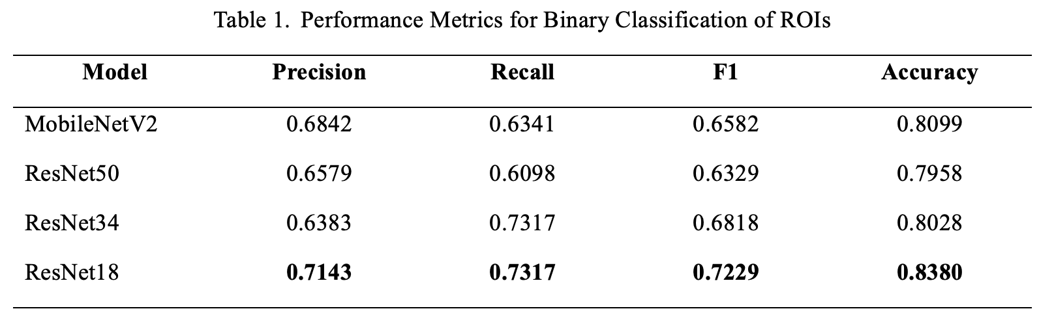
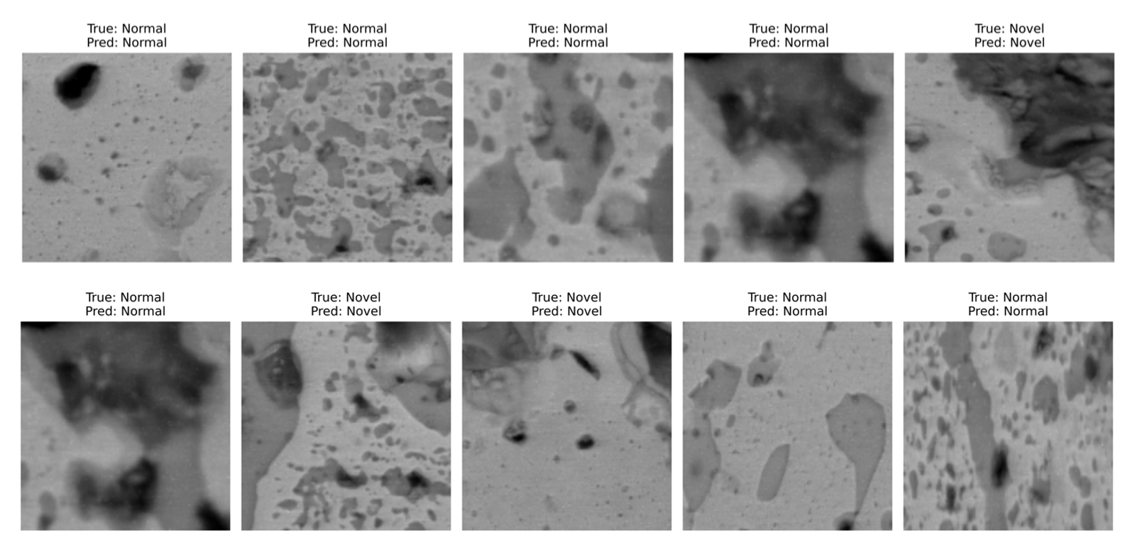
Model Performance by Numbers

Slide 12
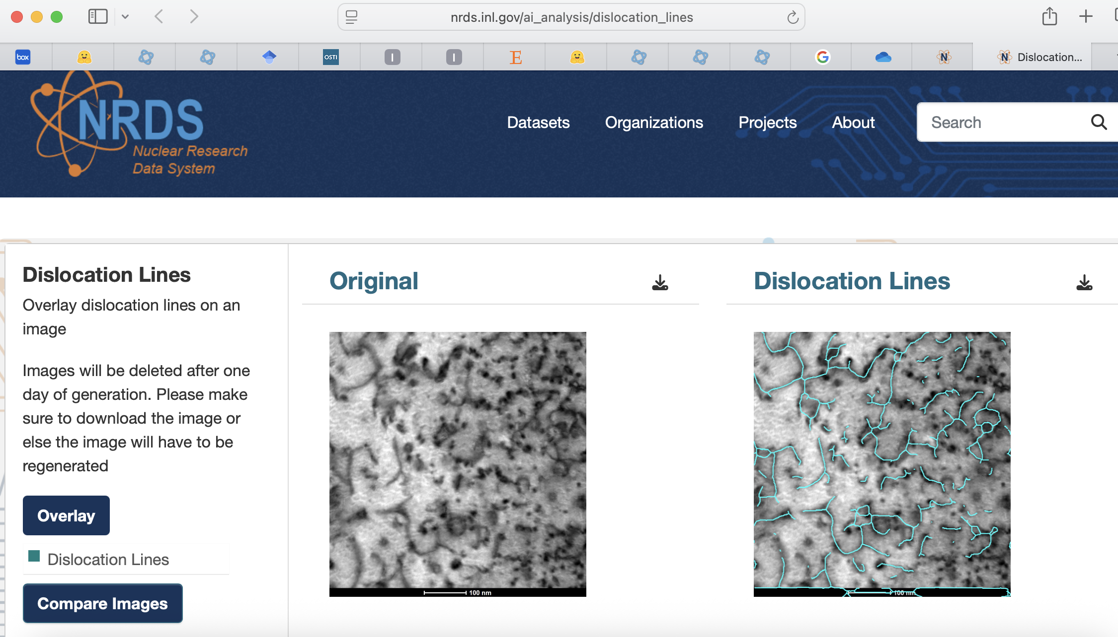
Other AI models developed and deployed on NSUF NRDS site

Slide 13
Other AI models developed and deployed on NSUF NRDS site
Accurate Segmentation of Localized Corrosion in Structural Alloys via Deep Learning

Slide 14
Performance comparison
Without (c) and with (d) texture refinement

Slide 15

Thank you

