Slide 1

Thermal Conductivity Measurements of Irradiated Annular Low Burn-Up U-10Zr Fuel
Mary Sevart¹, Daniele Salvato², Tiankai Yao², Cynthia Adkins², Luca Capriotti², Assel Aitkaliyeva¹
¹Department of Materials Science and Engineering, University of Florida
²Idaho National Laboratory

Slide 2





Why U-Zr Fuels?
Uranium-zirconium (U-Zr) fuels have several advantages over traditional oxide fuels.
High fissile and fertile densities
High thermal conductivities
Ability to reach up to 20 at% burn-ups
Compatibility with sodium coolant and HT-9 cladding
Inherent safety mechanisms

Slide 3
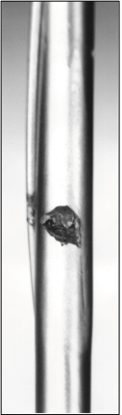
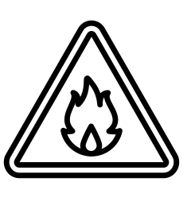
To Achieve DOE-NE Goals of Reducing Nuclear Operation Costs, Improvements to U-Zr Fuels are Necessary
However, solid U-Zr fuels cannot reach ultra-high burn-ups (~30 – 40 at%) safely
Initial pin designs breached near 10 at% burn-up
Breaches attributed to extreme cladding strain and significant FCCI
Experiment operated at high temperatures, contributing to FCCI
Sodium bond between fuel and cladding creates disposal concerns from reactive and pyrophoric nature of sodium
[1] W. J. Carmack, Temperature and burnup correlated FCCI in U-10Zr metallic fuel, Tech. Rep. INL/EXT-12-25550, Idaho National Laboratory (2012). DOI:https://doi.org/10.2172/1055966.
[2] S.L. Hayes, J.M. Harp, H.J.M. Chichester, R.S. Fielding, R.D. Mariani, W.J. Carmack, Advances in Metallic Fuels for High Burnup and Actinide Transmutation, in: 14th Inf. Exch. Meet. Actin. Fission Prod. Partitioning Transmutat., San Diego, CA, USA, 2016. doi:https://www.osti.gov/servlets/purl/1358285.

Slide 4

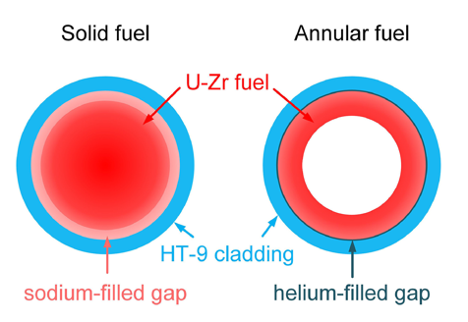
Annular U-Zr Fuels Can Increase Safety and Economic Viability over Solid Designs
New annular U-Zr geometry aims to safely allow for ultra-high burn-ups
Capacity to reach burn-ups up to 30 – 40 at% safely without risk of cladding breach
  Can improve economic viability of U-Zr fuels by reducing waste and extending fuel rod lifetimes
  Doubling fuel burn-ups can reduce fuel cycle costs by nearly half
Fuel swells inward to fill annulus rather than outward to press on the cladding
Smaller fuel-cladding gap filled with helium to mitigate disposal concerns
Kittel, J. H., et al. "History of fast reactor fuel development." Journal of nuclear materials 204 (1993): 1-13.

Slide 5
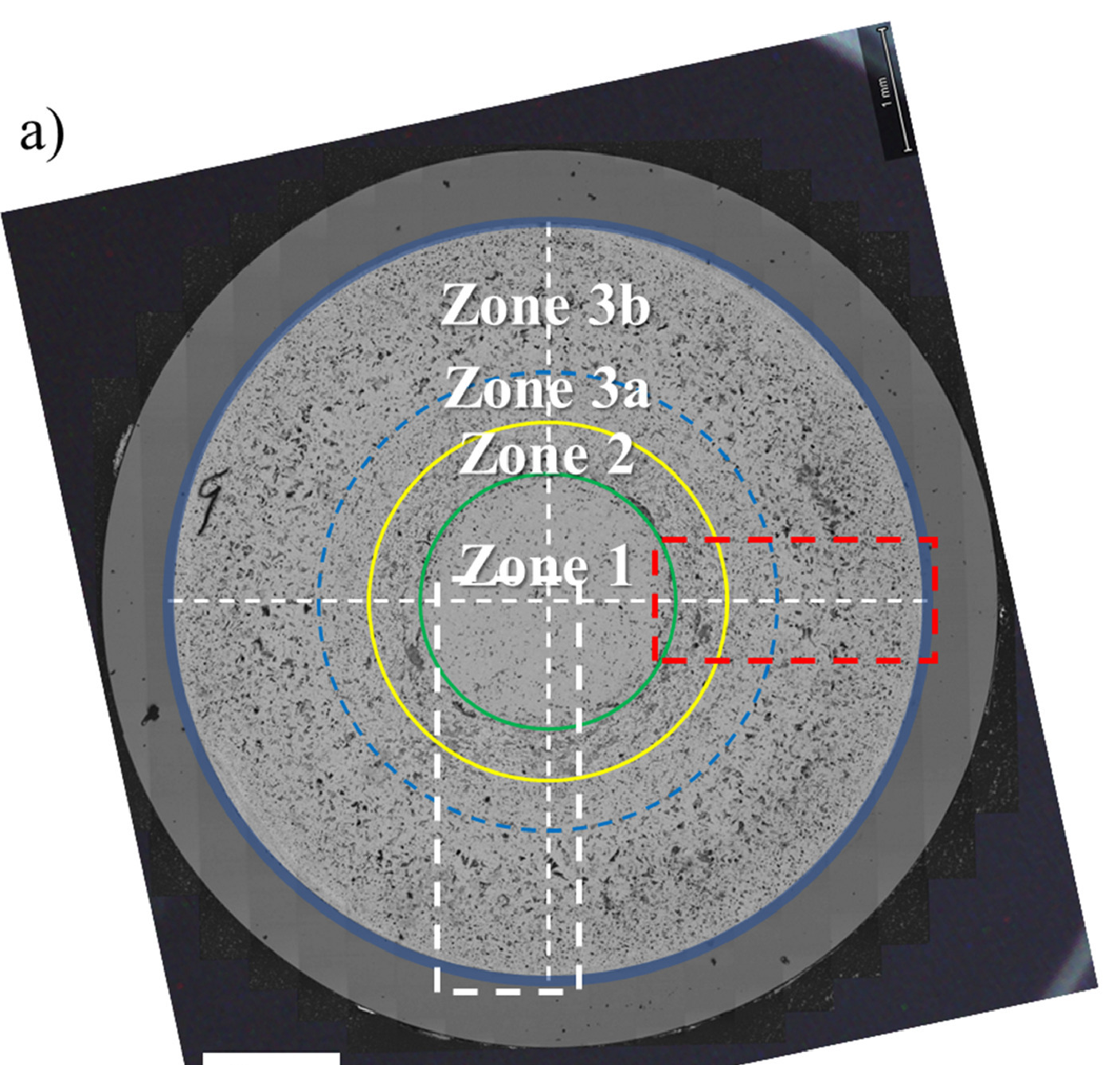
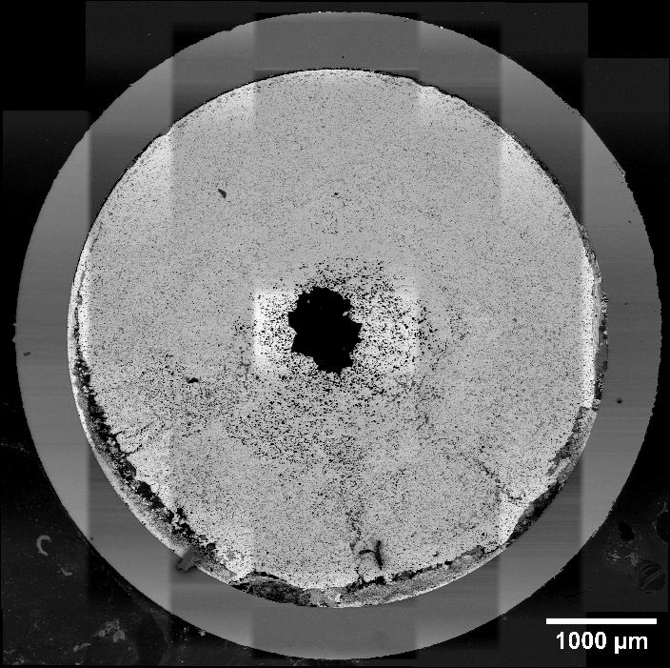
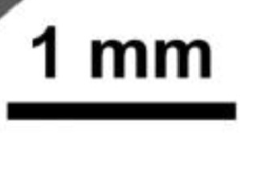
Annular and Solid U-Zr Fuels Exhibit Different Irradiation Behaviors
However, the differences in irradiation behavior between solid and annular designs are not well understood because of a lack of data for annular fuels
Zone 2
Zone 2
Zone 1
Solid U-Zr fuel
Annular U-Zr fuel
J. Nucl. Mat. 570 (2022) 153963.
Burn-up: 12 at%
Burn-up: 13.1 at%

Slide 6
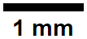
Use Advanced Characterization to Understand Linkages Between Fuel Irradiation Behaviors
Annular, U-10wt%Zr Fuel Rod
Burn-up: 12 at%
Peak inner cladding temperature (PICT): 515 °C
Cladding material: HT-9
Thermal bond material: Helium
Smeared density: 55%
Irradiation location: Advanced Test Reactor (ATR)
Casting method: cast as solid fuel with quartz tube and annulus machined out

Slide 7
What previous work has been completed on this fuel rod?

Slide 8
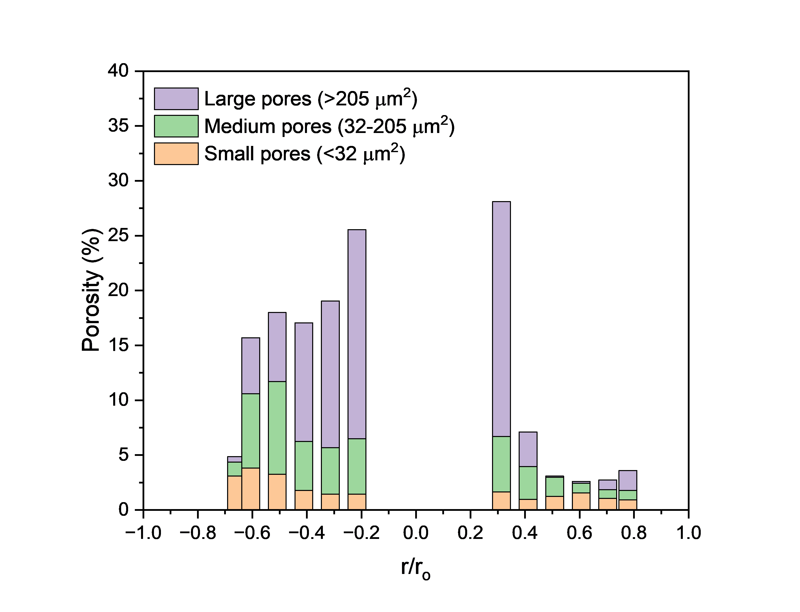
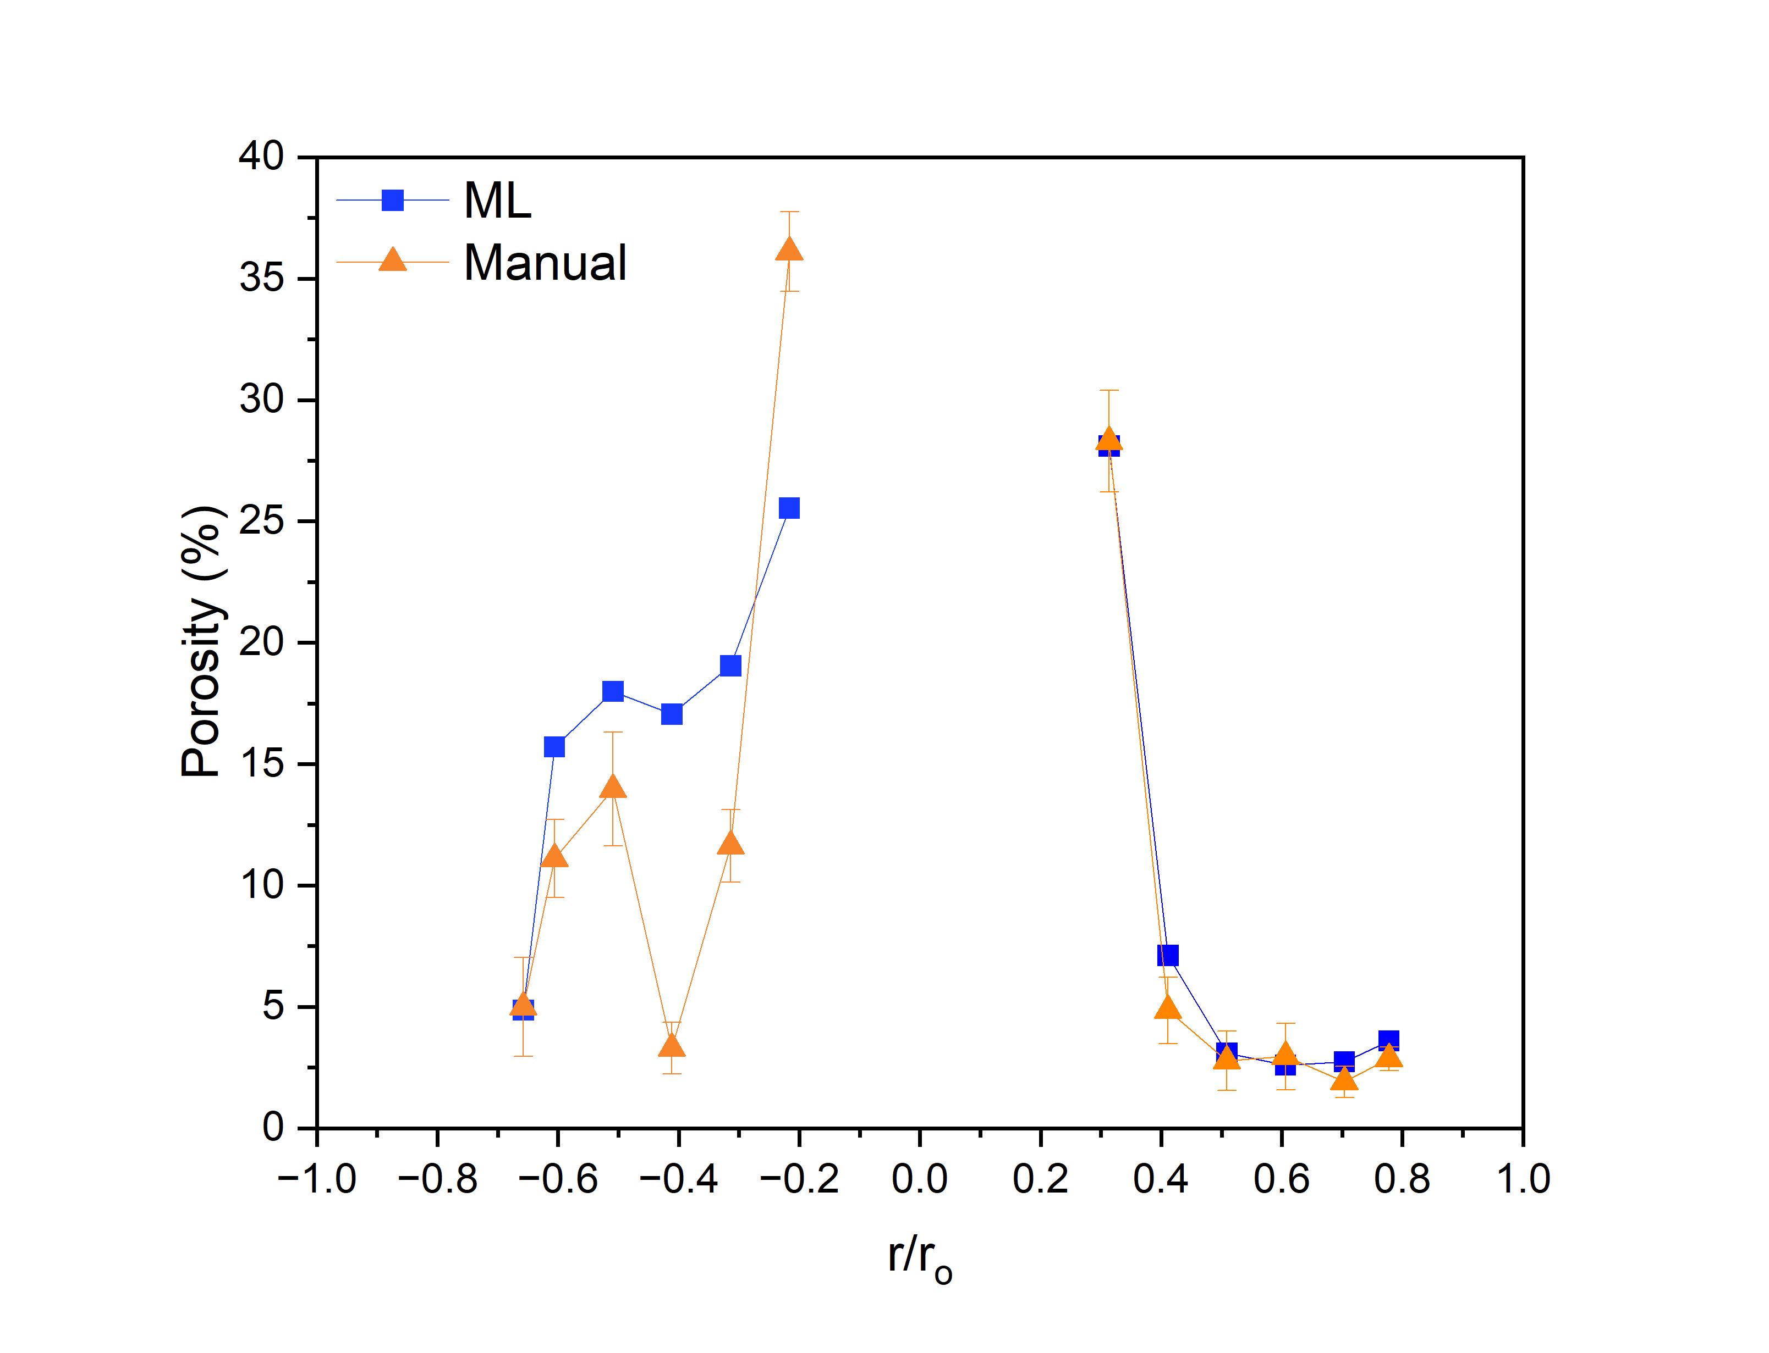
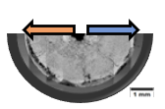
Porosity is Highest in the Fuel Center and Decreases Radially to Cladding
For most data points, manual and ML analyses match very well
More large pores in central zone than in peripheral zone
Asymmetric porosity around central annulus
  Gap between fuel and cladding on left-hand side may have changed fuel temperature gradient, leading to higher fuel temperatures and increased porosity

Slide 9

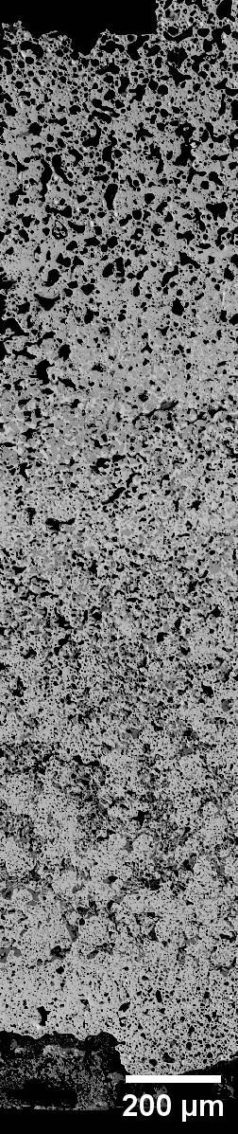
Fuel Rod Splits into 2 Constituent Redistribution Zones
RTE #24-5135
U wt. %
Zr wt. %
Nd wt. %
La wt. %
Fuel center
85.0
50.0
18.0
74.4
43.8
15.8
63.8
37.5
13.5
53.1
31.3
11.3
42.5
25.0
9.0
31.9
18.8
6.8
21.3
12.5
4.5
10.6
6.3
2.3
Cladding
0.0
0.0
0.0

Slide 10
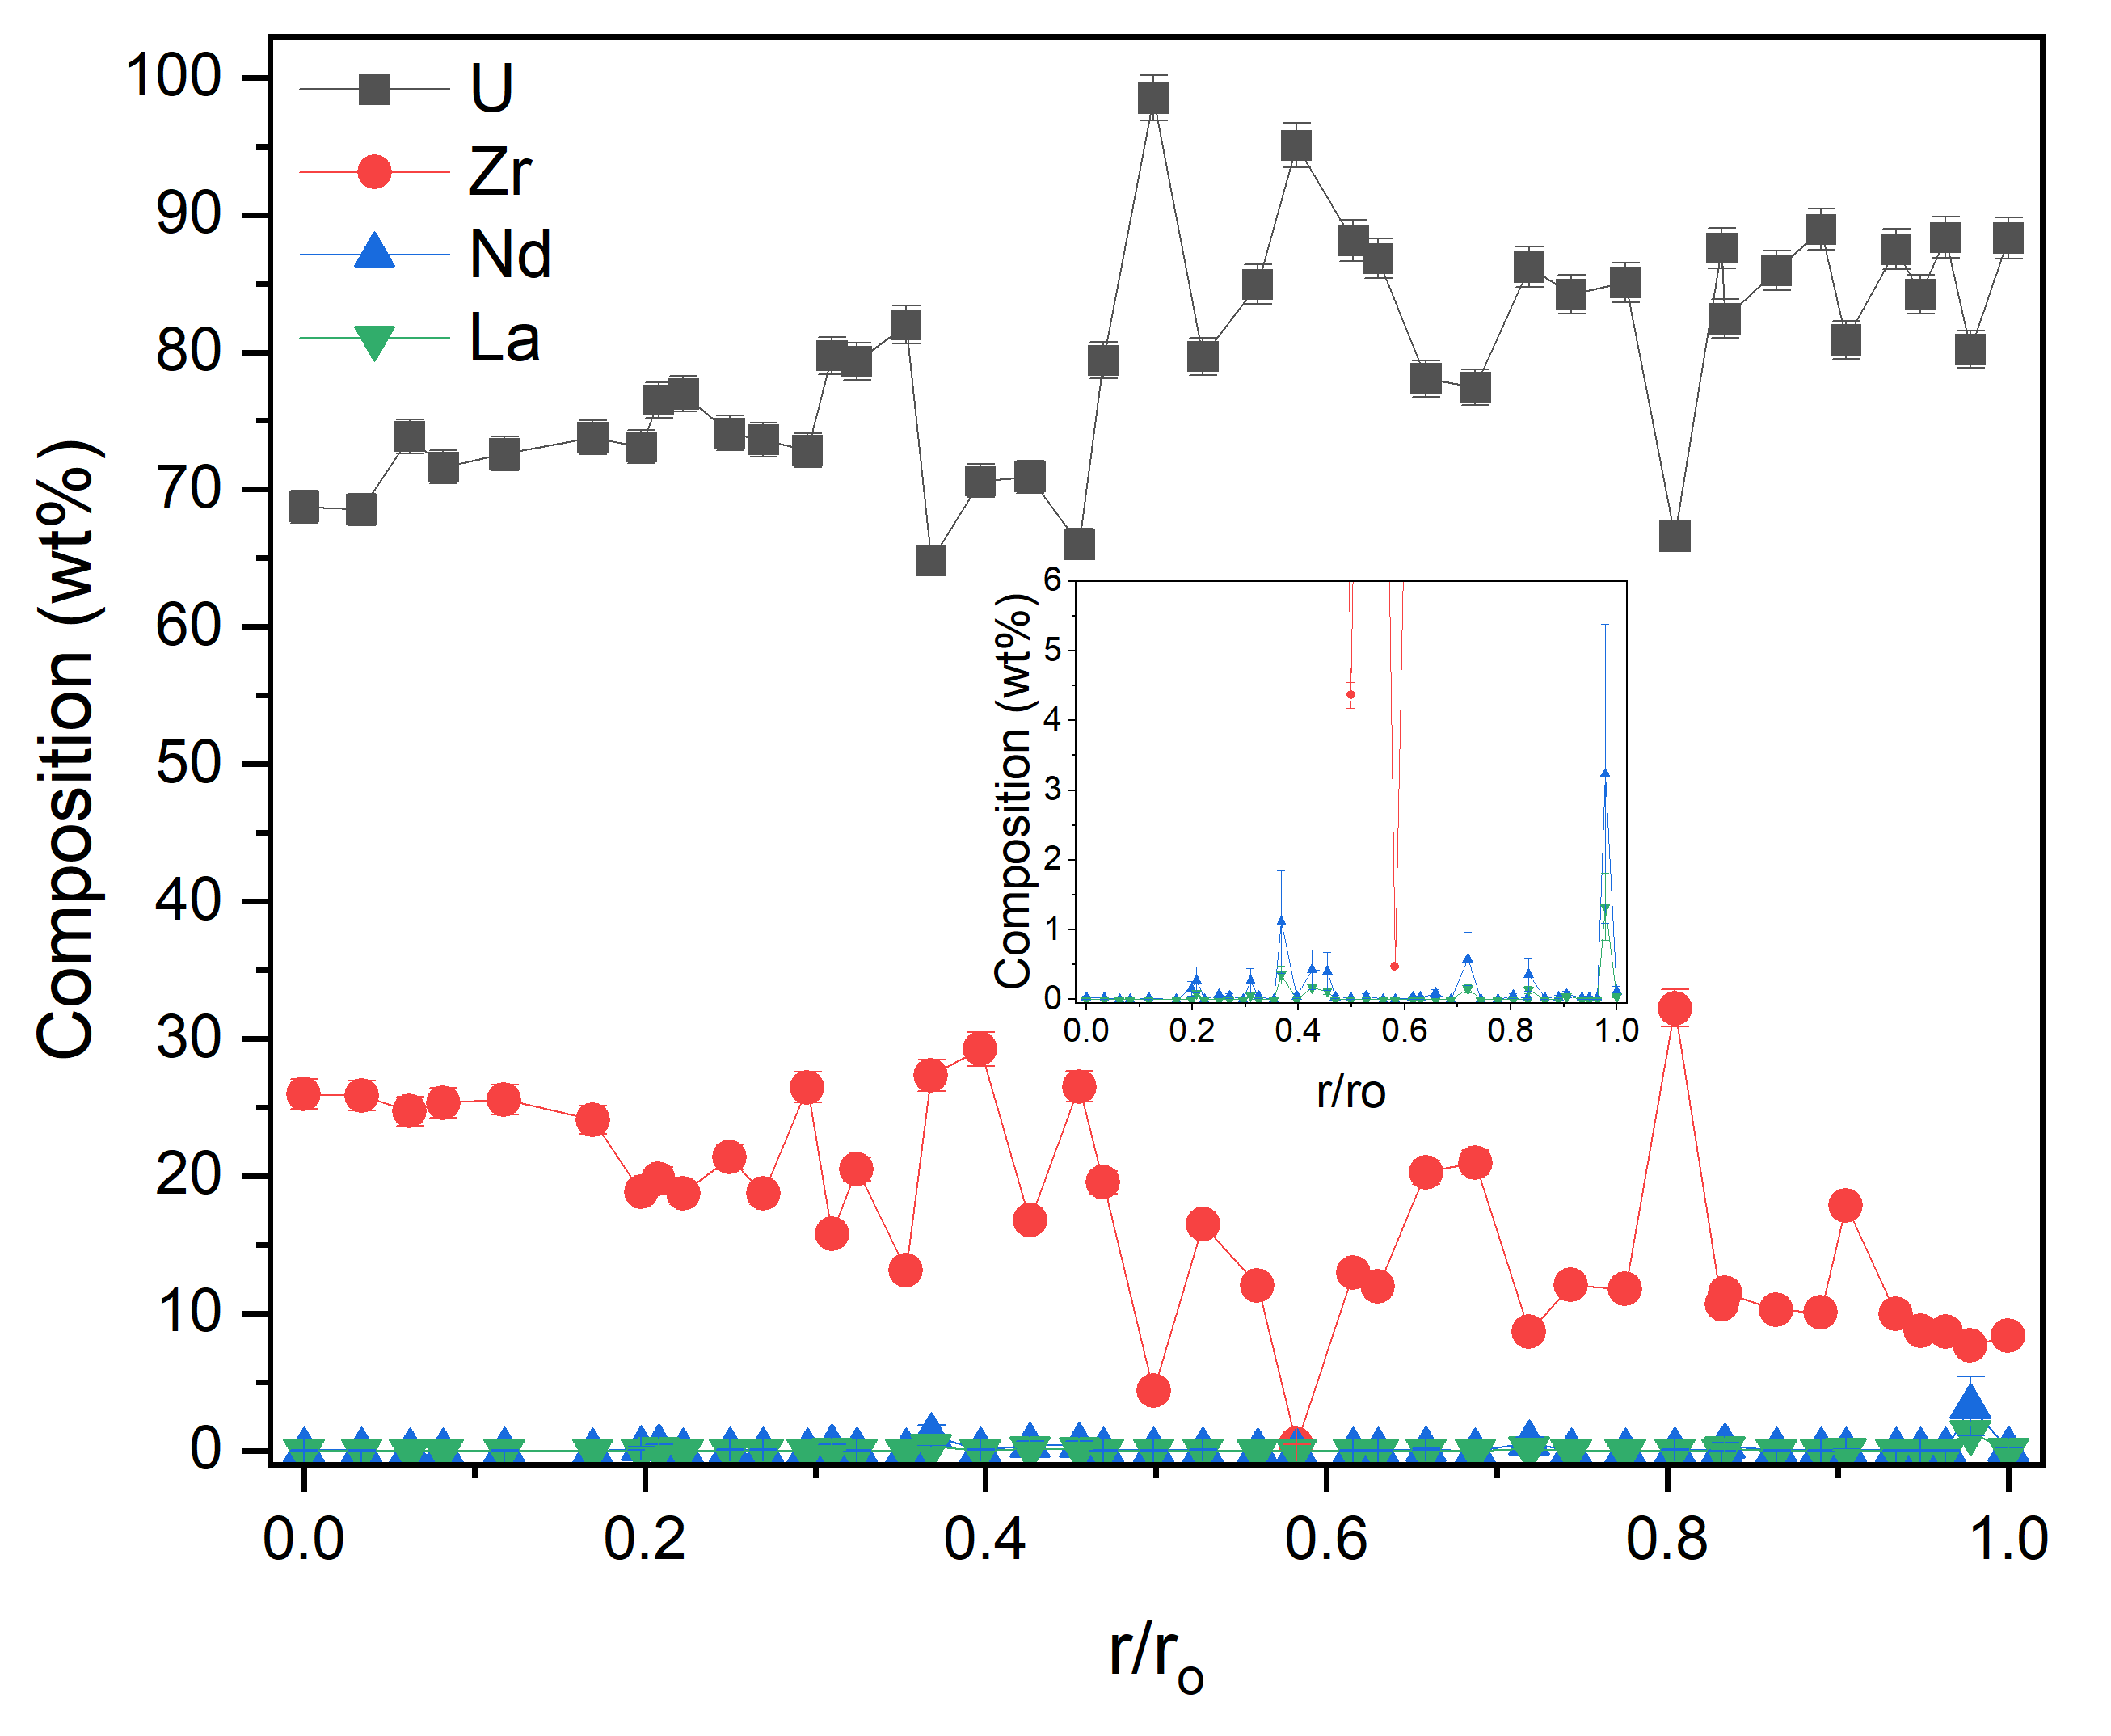
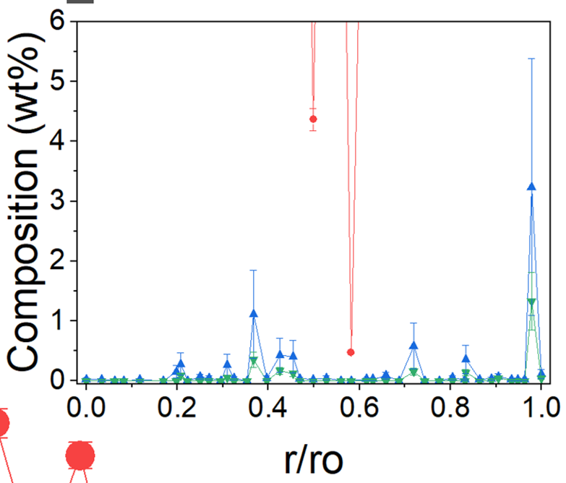
Outer Zone of Fuel Has Large Number of Lanthanide Precipitates
RTE #24-5135

Slide 11
How do these behaviors impact thermal conductivity and fuel efficiencies?

Slide 12
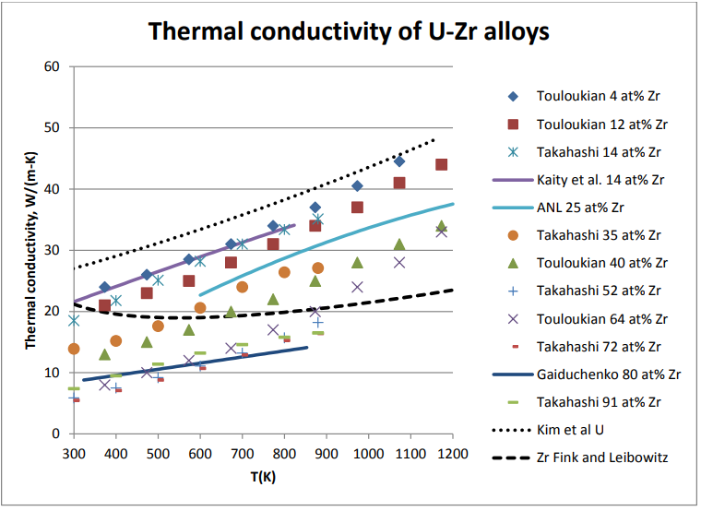
Thermal Conductivity is Affected by Porosity and Constituent Redistribution
High k(T); low Zr
α-U
U-Zr
Heat transfer to coolant
Low k(T); high Zr
Porosity
Thermal conductivity
Dawn E. Janney. Metallic fuels handbook, part 1. Technical Report INL/EXT-15-36520,Idaho National Laboratory, 2018.

Slide 13
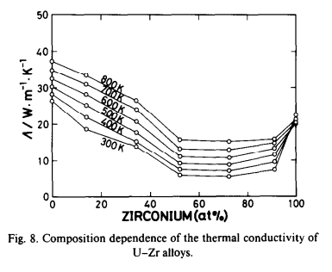
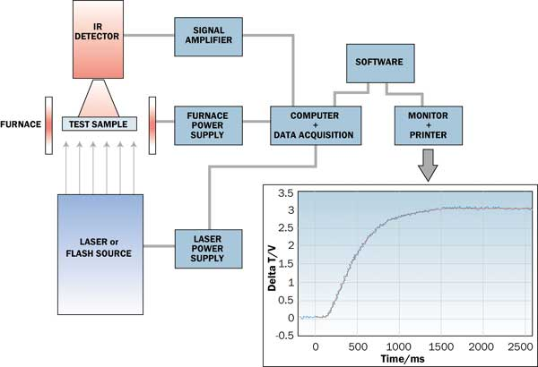
Historical Thermal Conductivity Work Has Focused on Bulk Properties
Data is scarce on irradiated U-Zr fuels
  Majority of studies focused on bulk characterization of fresh U-Zr alloys
Available data on irradiated U-Zr alloys is bulk measurement using laser flash analysis
  Unable to measure thermal properties of individual phases, necessary for modeling efforts
  Difficult to distinguish between impacts of porosity and constituent redistribution on thermal conductivity
https://www.electronics-cooling.com/2002/05/flash-diffusivity-method-a-survey-of-capabilities/
Yoichi Takahashi, Michio Yamawaki, Kazutaka Yamamoto, Thermophysical properties of uranium-zirconium alloys, Journal of Nuclear Materials, Volume 154, Issue 1, 1988, Pages 141-144, ISSN 0022-3115, https://doi.org/10.1016/0022-3115(88)90127-4.

Slide 14
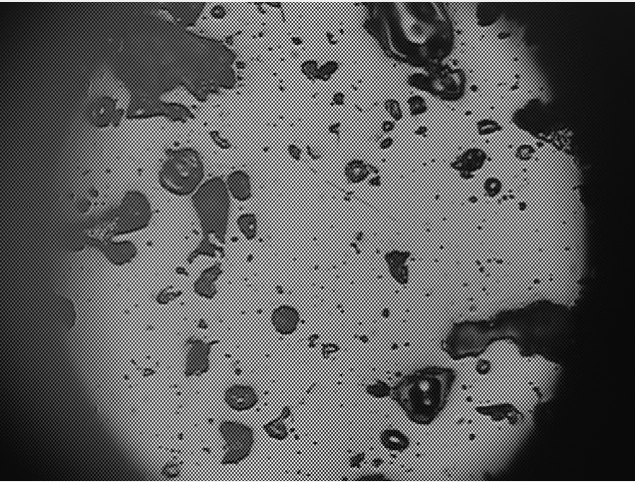
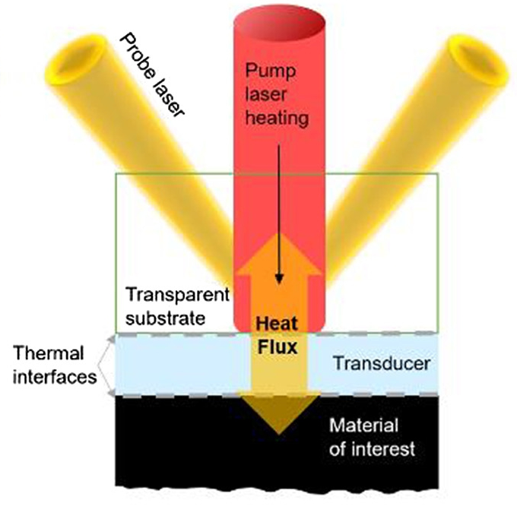
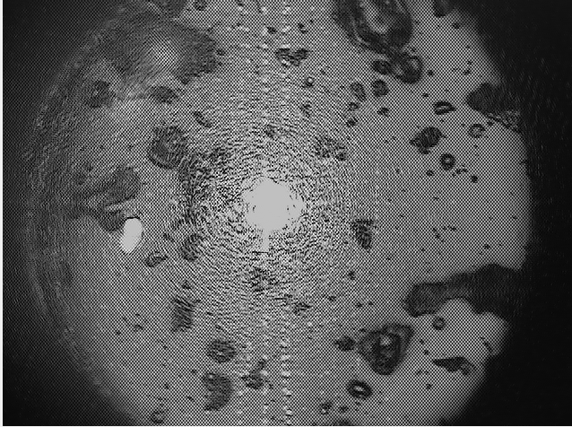
Local Thermal Property Measurements Can Enhance Model Accuracy
RTE #24-4956
Spot size of probe laser ~ 2 µm
  Allows for measurement of individual phases
  Can aim laser around pores, minimizing effects of porosity on thermal property values
Non-destructive technique
Can correlate thermal properties with EPMA and TEM results
Instrument gathers thermal diffusivity values
  Use Kopp-Neumann rule to calculate thermal conductivity
Fladischer, Katrin, Leitgeb, Verena, Fernbach, Simon and Mitterhuber, Lisa. "Measuring thermal properties of thin layers with rough surfaces by using the bidirectional heat flow approach" tm - Technisches Messen, vol. 89, no. 5, 2022, pp. 343-351. https://doi.org/10.1515/teme-2021-0118

Slide 15
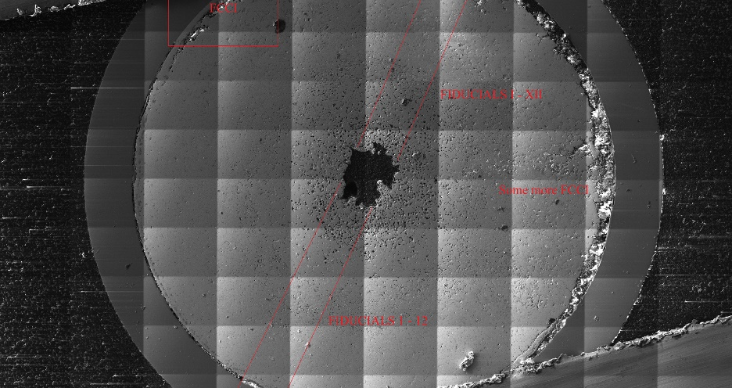
Thermal Conductivity Experimental Set-up
Error bars are from the average of angles recorded at one location (0, 45, 90, and 135 degrees) and standard deviation taken as error
Fiducial markings were used to ensure relatively even spacing between sample points
  Additionally, can couple this to EPMA and TEM liftouts to correlate to phases

Slide 16
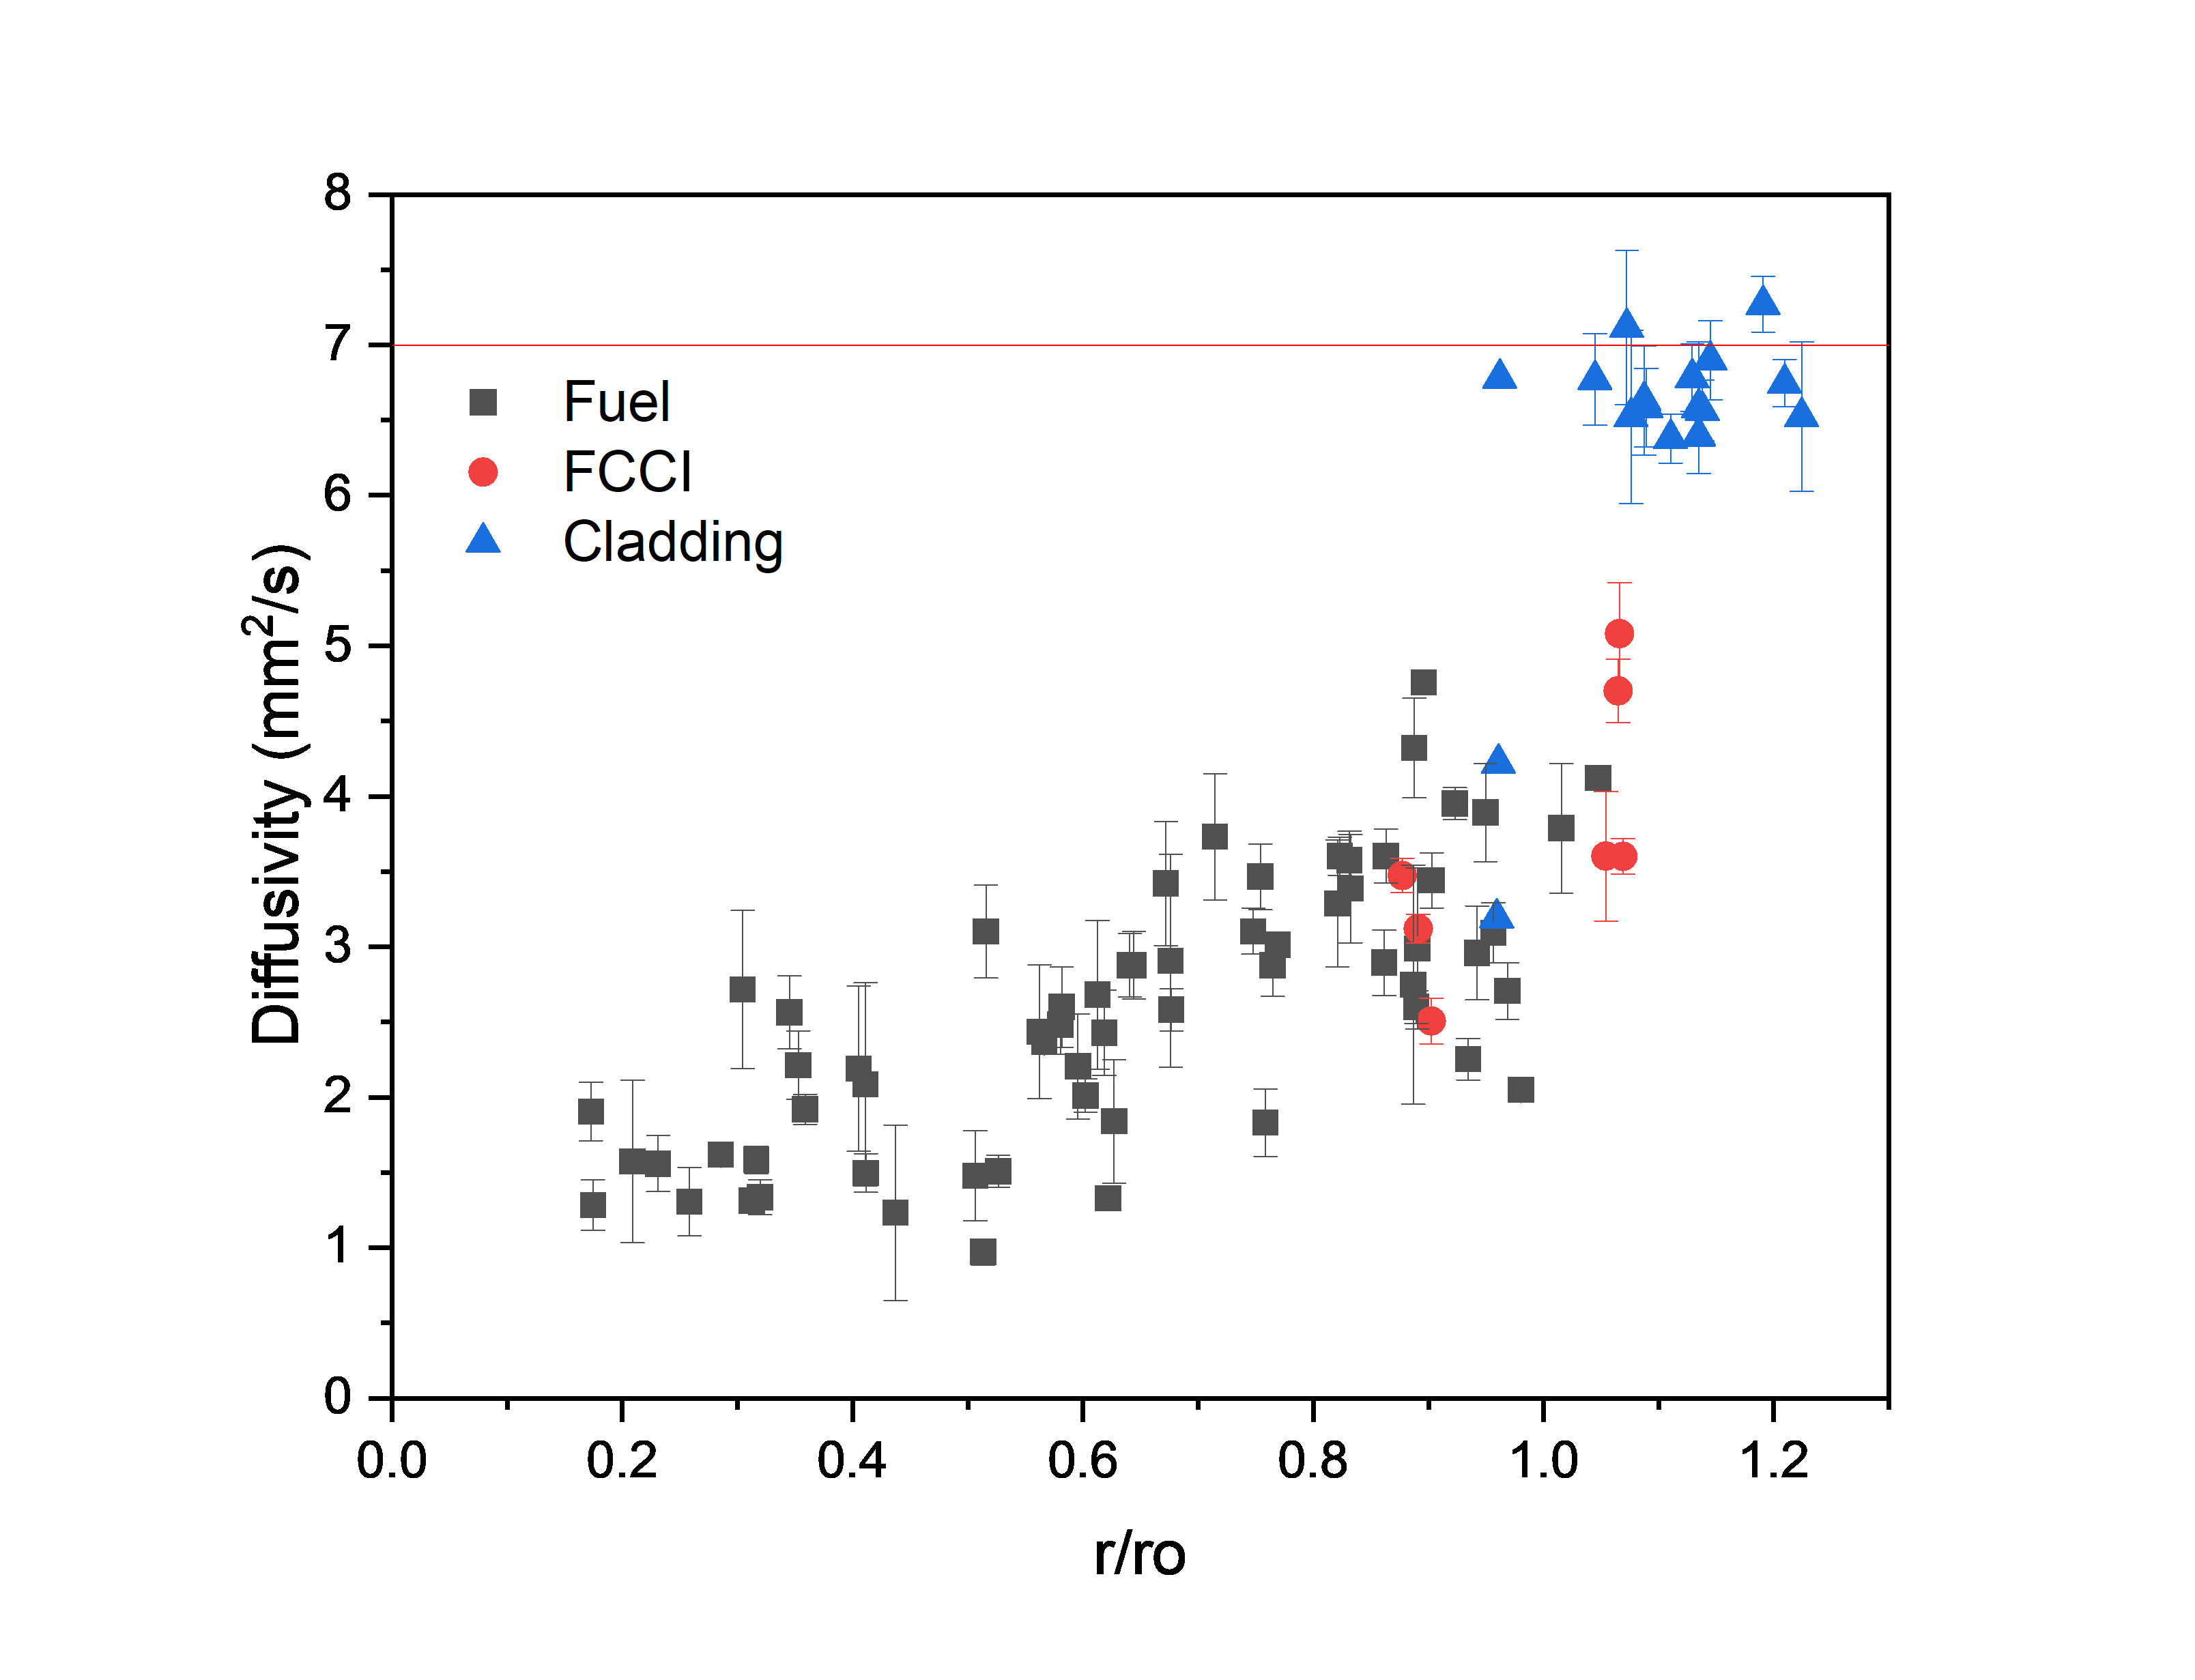

Local Thermal Conductivity is Lowest in Porous Fuel Center
Thermal diffusivity lowest in Zr-enriched fuel center (likely γ- or δ-UZr₂) and highest in dual phase peripheral region—U-rich phase (likely α-U) and Zr-rich phase (likely δ-UZr₂)
α-U
U-Zr
Dawn E. Janney. Metallic fuels handbook, part 1. Technical Report INL/EXT-15-36520,Idaho National Laboratory, 2018.

Slide 17
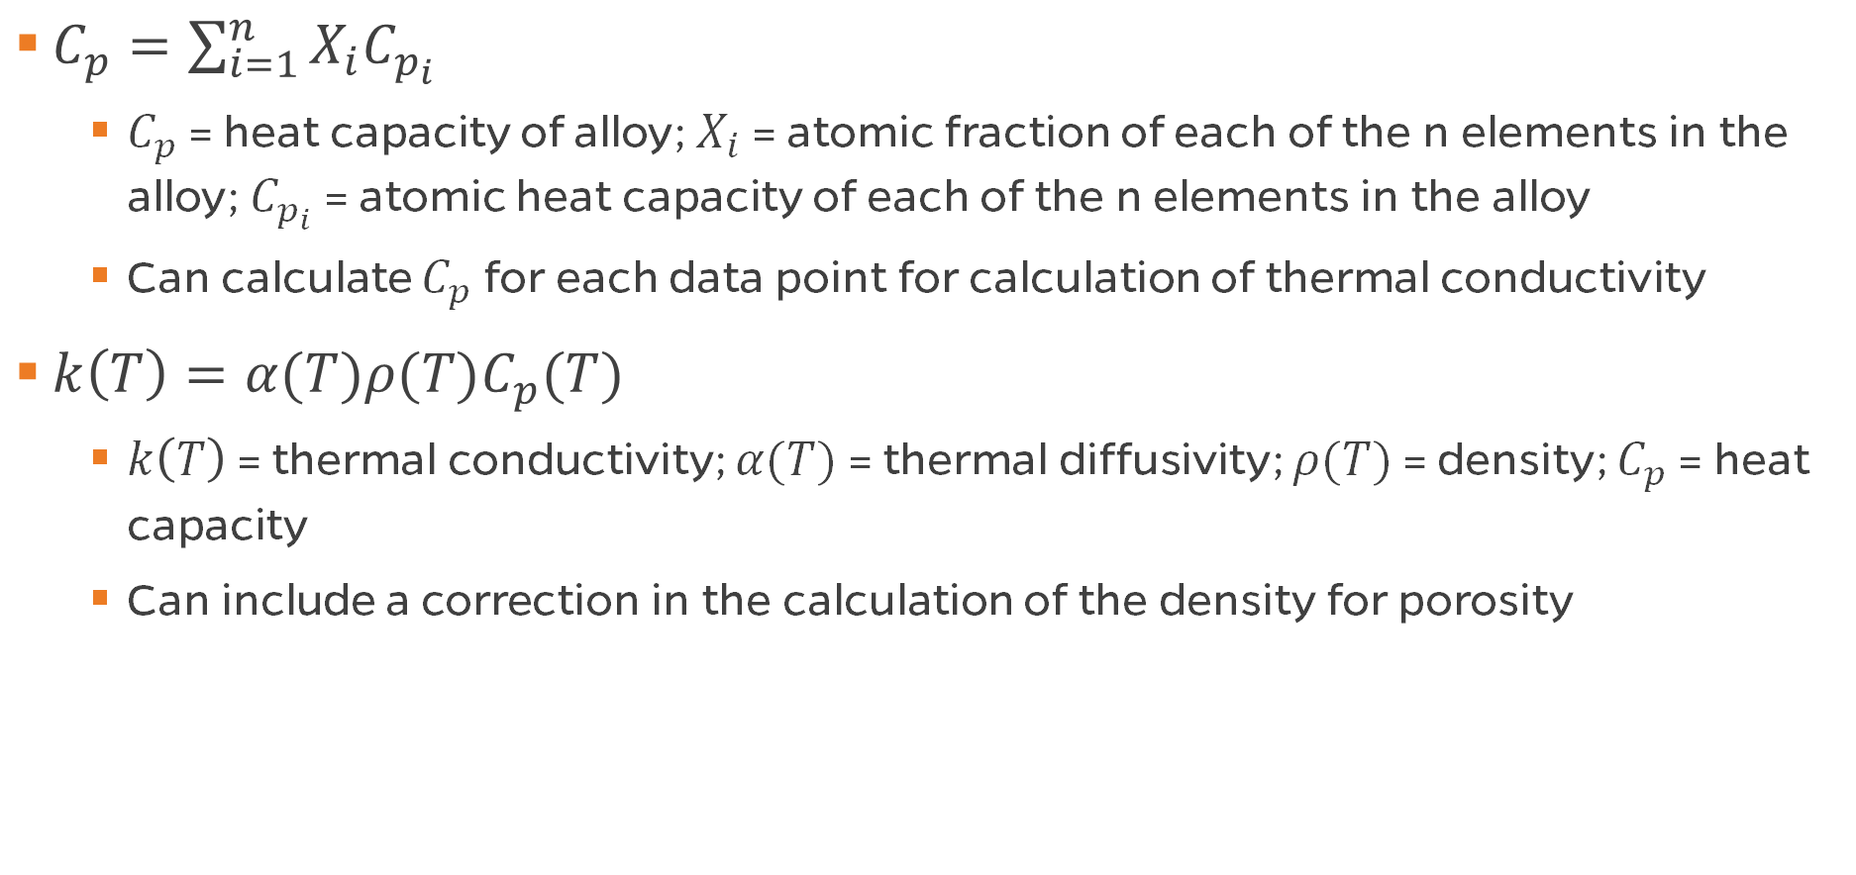
Next Steps: Kopp-Neumann Rule and Thermal Conductivity Calculations
$C_{p}=\sum_{i=1}^{n}{X_{i}C_{p_{i}}}$
  $C_{p}$ = heat capacity of alloy; $X_{i}$ = atomic fraction of each of the n elements in the alloy; $C_{p_{i}}$ = atomic heat capacity of each of the n elements in the alloy
  Can calculate $C_{p}$ for each data point for calculation of thermal conductivity
$k\left(T\right)=α(T)ρ(T)C_{p}(T)$
  $k\left(T\right)$ = thermal conductivity; $α(T)$ = thermal diffusivity; $ρ(T)$ = density; $C_{p}$ = heat capacity
  Can include a correction in the calculation of the density for porosity
J. Leitner, P. Voňka, D. Sedmidubský, P. Svoboda, Application of Neumann–Kopp rule for the estimation of heat capacity of mixed oxides, Thermochimica Acta, Volume 497, Issues 1–2, 2010, Pages 7-13, ISSN 0040-6031, https://doi.org/10.1016/j.tca.2009.08.002.

Slide 18

Summary of Annular U-Zr Behavior
RTE #24-5135
RTE #24-4956
Porosity is highest and thermal diffusivity is lowest in (U, Zr) central region. Whole fuel rod demonstrates thermal property degradation (decreasing fuel efficiency) as compared to as-cast diffusivity.

Slide 19
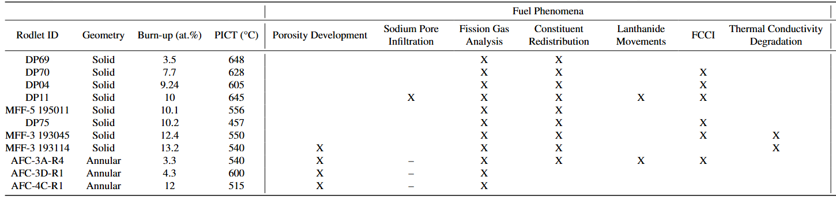

NSUF Has Played Critical Role in Annular U-Zr Characterization

