Slide 1




Stability of TaC, TaN, and VN MX-type Precipitates in Neutron Irradiated Model Ferritic Alloys
Emily Proehl¹, Weicheng Zhong², Steven Zinkle^{1,2}
¹University of Tennessee-Knoxville; ²Oak Ridge National Laboratory

Slide 2
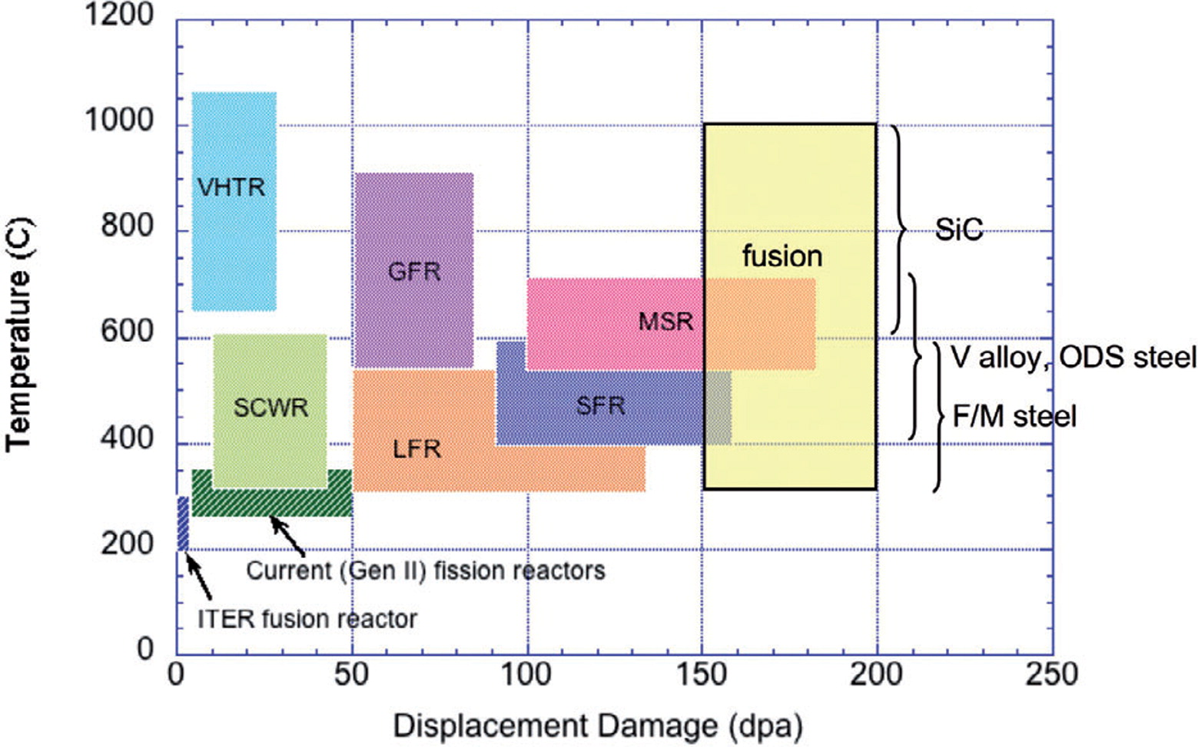
Motivation: Ferritic martensitic (FM) steels are promising nuclear structural materials
High thermal conductivity
Low thermal expansion coefficient
Thermal fatigue properties
Low void swelling
Established supply chain
Material fabrication and joining ability
x
x
Thermal creep resistance
Irradiation hardening, embrittlement, and loss of ductility
F/M steel challenges:
Insufficient creep strength
~600°C
FM steel operating temperature range
~330°C
Irradiation hardening & embrittlement
S. J. Zinkle and J. T. Busby, Materials Today, vol. 12, no. 11, 2009.

Slide 3
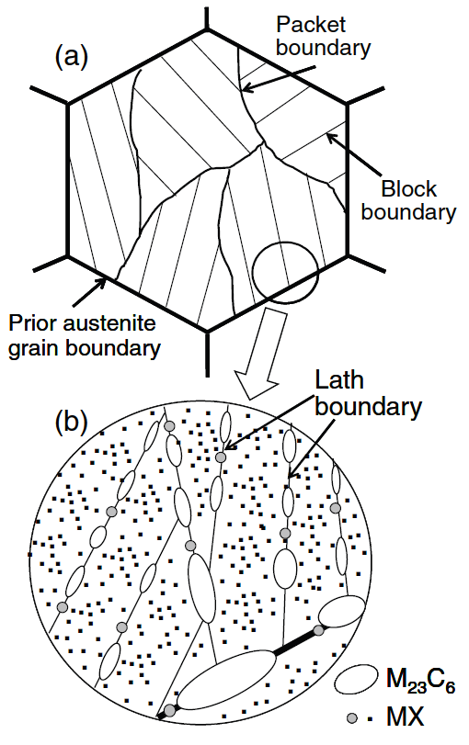
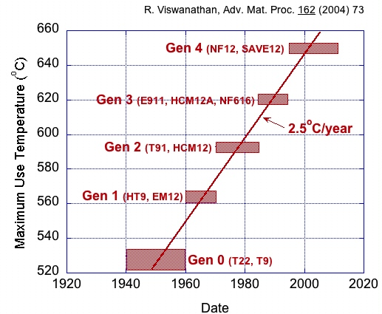
Engineering precipitate microstructure has led to dramatic increases in creep rupture strength in FM steels
F. Abe, Sci Technol Adv Mater, vol. 9, no. 1, 2008.
Creep strengthening features in FM steel:
  Solute strengthening
  Dislocation hardening
  Boundary or sub-boundary hardening
  Precipitation or dispersion hardening
M₂₃C₆ → M: Cr, Fe
MX → M: Nb, Ta, V; X: C, N
+Nb, V alloying addition
S. J. Zinkle and J. T. Busby, Materials Today, vol. 12, no. 11, 2009.

Slide 4
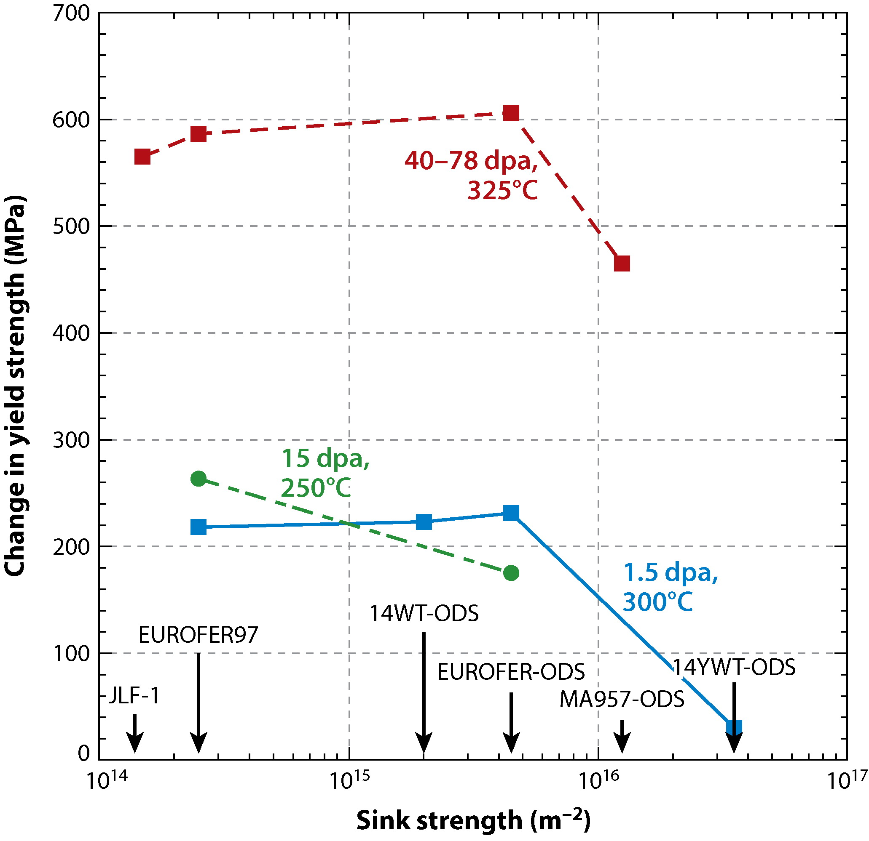
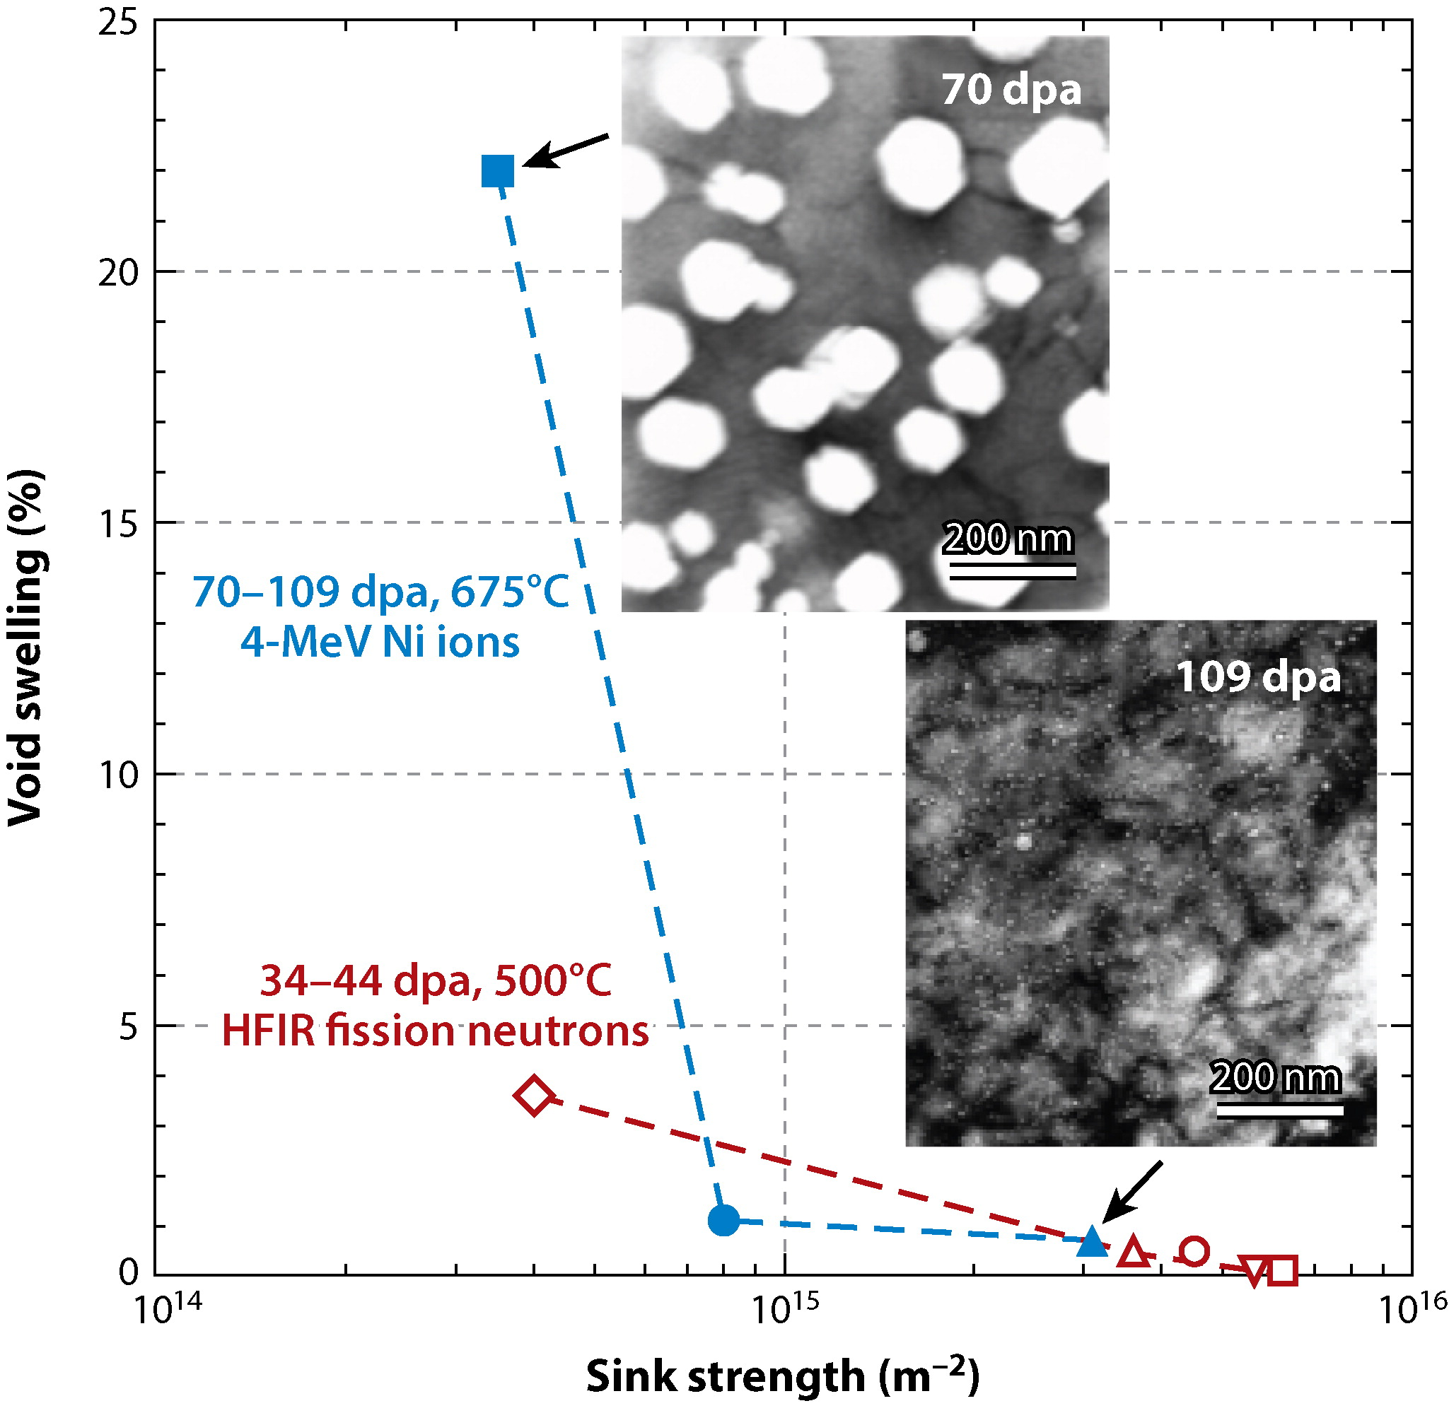
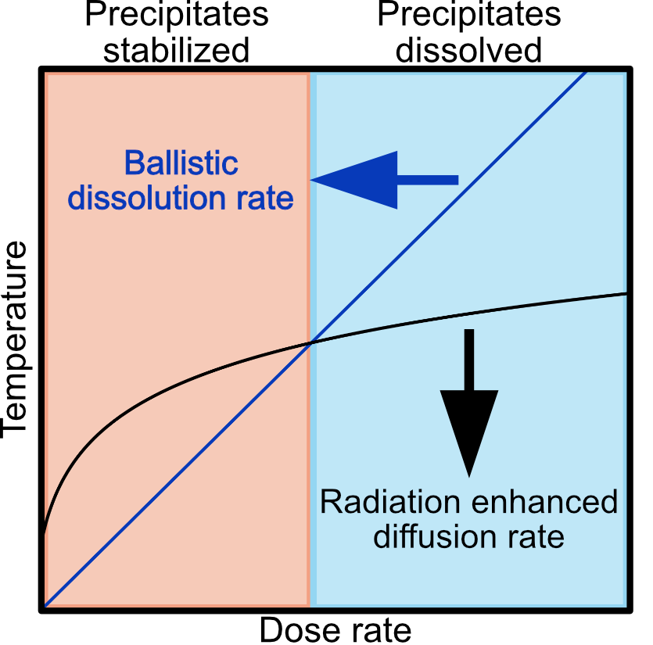

Advantageously, radiation resistance can also be engineered by a high number density of nanoscale precipitates
S = 10¹⁶ m⁻²
S = 10¹⁵ m⁻²
Radiation resistance engineered with ↑sink strength
Sink strength for spherical precipitates:
$$S=4πNR$$
$N$: ppt. # density, $R$: ppt. radius
Maximized at ↑$N$ and ↓$R$
S. J. Zinkle and L. L. Snead, Annual Review of Matls Research, vol. 44, no. 1, 2014.
Precipitate stability crucial to maintaining radiation tolerance
  Competition between:
    Ballistic dissolution
    Radiation-enhanced diffusion
Y. Zhao, et, al., Acta Materialia, vol. 231, 2022.

Slide 5
Objective: Analyze MX precipitate evolution after neutron irradiation in terms of size, number density, morphology, and sink strength
Three model Fe alloys fabricated, each containing different MX composition (wt%):
MX | C | N | Cr | Ta | V | W | Mn+Si | Fe
TaC | 0.0180 | <0.001 | <0.01 | 0.30 | - | 1.45 | 0.20 | Bal.
TaN | 0.0019 | 0.021 | 0.51 | 0.25 | - | 1.43 | 0.19 | Bal.
VN | 0.0019 | 0.024 | 1.03 | - | 0.20 | 1.44 | 0.18 | Bal.
Vacuum induction melting
Annealing 1100°C/30 min
Hot forging + rolling
Tempering 750°C/1 hr
Air cool
Previous results indicated TaC had greatest stability
Thermal aging for 5000 hr, creep at 70% σ_{YS} at 600°C, 5 MeV Fe²⁺ irradiation at 500°C up to 49 dpa (1.2 – 7.6 × 10⁻⁴ dpa/s) [1], [2]
Characterization gap: MX stability after neutron irradiation at High Flux Isotope Reactor (HFIR) at ORNL to 7.4 dpa (5x10⁻⁷ dpa/s) at ~490°C
[1] L. Tan, et al., Acta Materialia, vol 71, 2014. [2] L. Tan, et al., JNM, vol. 445, 2014.

Slide 6
All MX precipitates were enriched in Cr or W and maintained habit plane; only TaN exhibited significant morphology change
Composition:
TaC enriched in W
TaN and VN enriched in Cr
  Potential TaN → Z-phase formation
Morphology:
TaC and VN maintained morphology
TaN elongated into thin platelets
Orientation:
All on {110}, {112}, and {200} habit planes
TaN
TaC
VN

Slide 7
TaC MX precipitates exhibited greatest stability over TaN, VN as determined by size and number density
Maintained size and # density
Major ↓ in width; ↑ in # density
Slight ↓ in length; ↑ in density

Slide 8

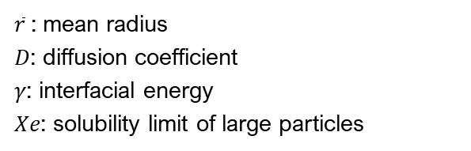
Both ballistic dissolution and radiation enhanced diffusion parameters influence MX-type precipitate stability
Max. energy transfer in elastic collision: $Q_{max}=T\left[\frac{4mM}{{\left(m+M\right)}^{2}}\right]=TΛ$
  $⇒$ more localized damage in (Ta, Cr)N & (V, Cr)N than (Ta, W)C
Particle coarsening rate: $\frac{d\overline{r}}{dt}∝\frac{D{γX}_{e}}{{\overline{r}}^{3}}$
𝑇: kinetic energy
𝑚: neutron mass
𝑀: target particle mass
$\overline{r}$: mean radius
𝐷: diffusion coefficient
𝛾: interfacial energy
𝑋𝑒: solubility limit of large particles
(spherical precipitates)
[1] A. W. Bowen and G. M. Leak, Metal. Tran., vol. 1, 1970. [2] S. Huang et al., Acta Materialia, vol. 58, 2010. [3] J. R. G. d. Silva and R. B. McLellan, Matls. Sci. and Eng., vol. 26, 1976. [4] Y. Abe et al., Philosoph. Mag., vol. 102. [5] X. Tang et al., Phys. Rev. Mater., vol. 4, 2020.

Slide 9

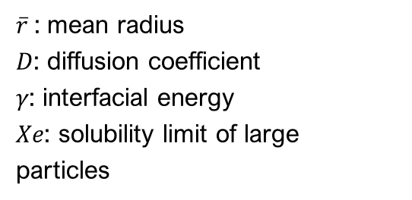
TaN has largest magnitude negative coherent interfacial energy, indicating increased tendency to spread to a single layer
$\overline{r}$: mean radius
𝐷: diffusion coefficient
𝛾: interfacial energy
𝑋𝑒: solubility limit of large particles
Particle coarsening rate: $\frac{d\overline{r}}{dt}∝\frac{D{γX}_{e}}{{\overline{r}}^{3}}$
Negative coherent interfacial energies → ↑tendency of spreading to single layer to maximize interface area
(spherical precipitates)
[1] J. Hartford, Phys Rev B, vol. 61, no. 3, pp. 2221-2229, 2000. [2] D. H. R. Fors and G. Wahnström, Phys Rev B, vol. 82, no. 19, 2010. [3] W.-S. Jung et al., Modell and Sim in Mat Sci and Eng, vol. 14, 2006. [4] S.-H. Chung et al., ISIJ International, vol. 46, 2006.

Slide 10
Preliminary strain mapping indicates significant differences in
precipitate strain fields before and after irradiation
Atomic resolution STEM imaging on Cs-corrected JEOL-2200FS
Geometric phase analysis (GPA) on Strain++ software after HR image filter
  Thin platelet feature in irradiated sample indicative of chemical segregation/ precipitation around dislocation loop
TaN
Modeled diffusion path of vacancy around 2 nm interstitial <100> loop [1].
[1] Z. Yu and H. Xu, Communications Materials, vol. 4, no. 1, 2023.

Slide 11
Conclusions: TaC exhibited greater stability than TaN and VN MX precipitates after neutron irradiation to 7.4 dpa at ~500°C
Preliminary GPA analysis detected irradiation-induced strain field
Possible dislocation loop impacting chemical segregation
Future work: Atom probe tomography (APT) for morphology and composition
4D-STEM, and/or GPA strain mapping on TaN and TaC
TaC exhibited greatest MX ppt stability
Irradiation-induced evolution of strain field around TaN precipitate
Irradiated TaN

Slide 12


Acknowledgements
Thank you!
Funding: This work was supported by the U.S. Department of Energy, Office of Nuclear Energy under DOE Idaho Operations Office Contract DE-AC07- 051D14517 as part of a Nuclear Science User Facilities experiment. This work was supported by the U.S. Department of Energy, Office of Science, Fusion Materials Science Program, under Contract no. DEAC05- 00OR22725 with UT-Battelle, LLC.
This material is based upon work supported under a Department of Energy, Office of Nuclear Energy University Nuclear Leadership Program Graduate Fellowship (EP). Any opinions, findings, conclusions, or recommendations expressed in this publication are those of the author(s) and do not necessarily reflect the views of the Department of Energy Office of Nuclear Energy.
Facilities: The Low Activation Materials Development and Analysis (LAMDA) laboratory and the Materials Characterization Core (MCC) at Oak Ridge National Laboratory (ORNL) and the Electron Microscopy Center at the Institute for Advanced Materials and Manufacturing (IAMM) at the University of Tennessee – Knoxville (UTK).
Collaborators: Drs. Yan-Ru Lin, Lizhen Tan, & Ying Yang

