Slide 1
NSUF Users Organization Overview
Maria Okuniewski
Purdue University, School of Materials Engineering
NSUF UO Chair
NSUF Annual Review Meeting
April 16, 2025, Idaho Falls, ID

Slide 2
Our Purpose
The purpose of the UO is to promote the advancement of nuclear energy science and technology to meet needs as defined by the U.S. Department of Energy Office of Nuclear Energy and executed through the Nuclear Science User Facilities program through:
1. Providing a formal and clear channel for the exchange of information, advice and best practices between the investigators who perform nuclear technology-driven experiments and the NSUF Management.
2 Serve as an advocacy group for the activities at the NSUF.
3. Educating and informing all stakeholders regarding experimental activities at the NSUF.
4. Facilitating communications among users of the NSUF.
NSUF UO Charter and Bylaws - Rev. 2024
Notes:
Recently expanded in 2024 under bullet point 2.2 – codified within charter

Slide 3
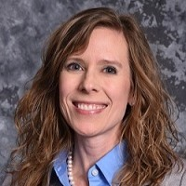
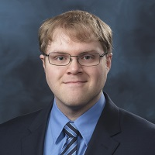
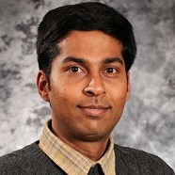
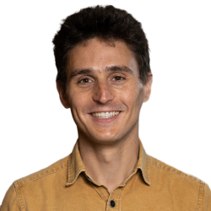
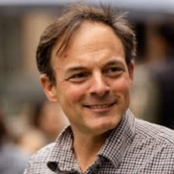
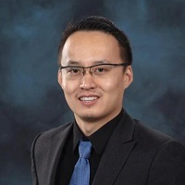
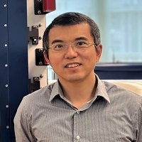
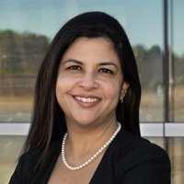
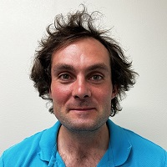
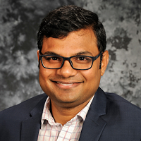
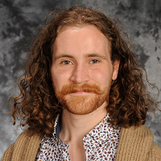
Meet the Team
Maria Okuniewski, Purdue University, Chair
Stephen Taller, Oak Ridge National Laboratory, Vice Chair
Ramprashad Prabhakaran, Pacific Northwest National Laboratory Secretary
Gabriel Meric de Bellefon, Kairos Power, Chair Ex-Officio
Peter Hosemann
University of California, Berkeley, Representative Member / Ex-Chair
Keyou Mao
Florida A & M, Representative Member
Xiaoyuan Lou
Purdue University, Representative Member
Simerjeet Gill, Brookhaven National Laboratory, Representative Member
David Frazer, General Atomics, Representative Member
Mukesh Bachav,, Idaho National Laboratory, Representative Member
Malachi Nelson, UCB Representative Member, Emerging Professional

Slide 4
Can I join?
YES - Membership in the organization is open to all users and potential users of the various NSUF facilities and scientists and engineers engaged in the operation and development of these facilities. Potential members can join by self-nomination.
www.nsuf.inl.gov
  My Research → Create an Account

Slide 5
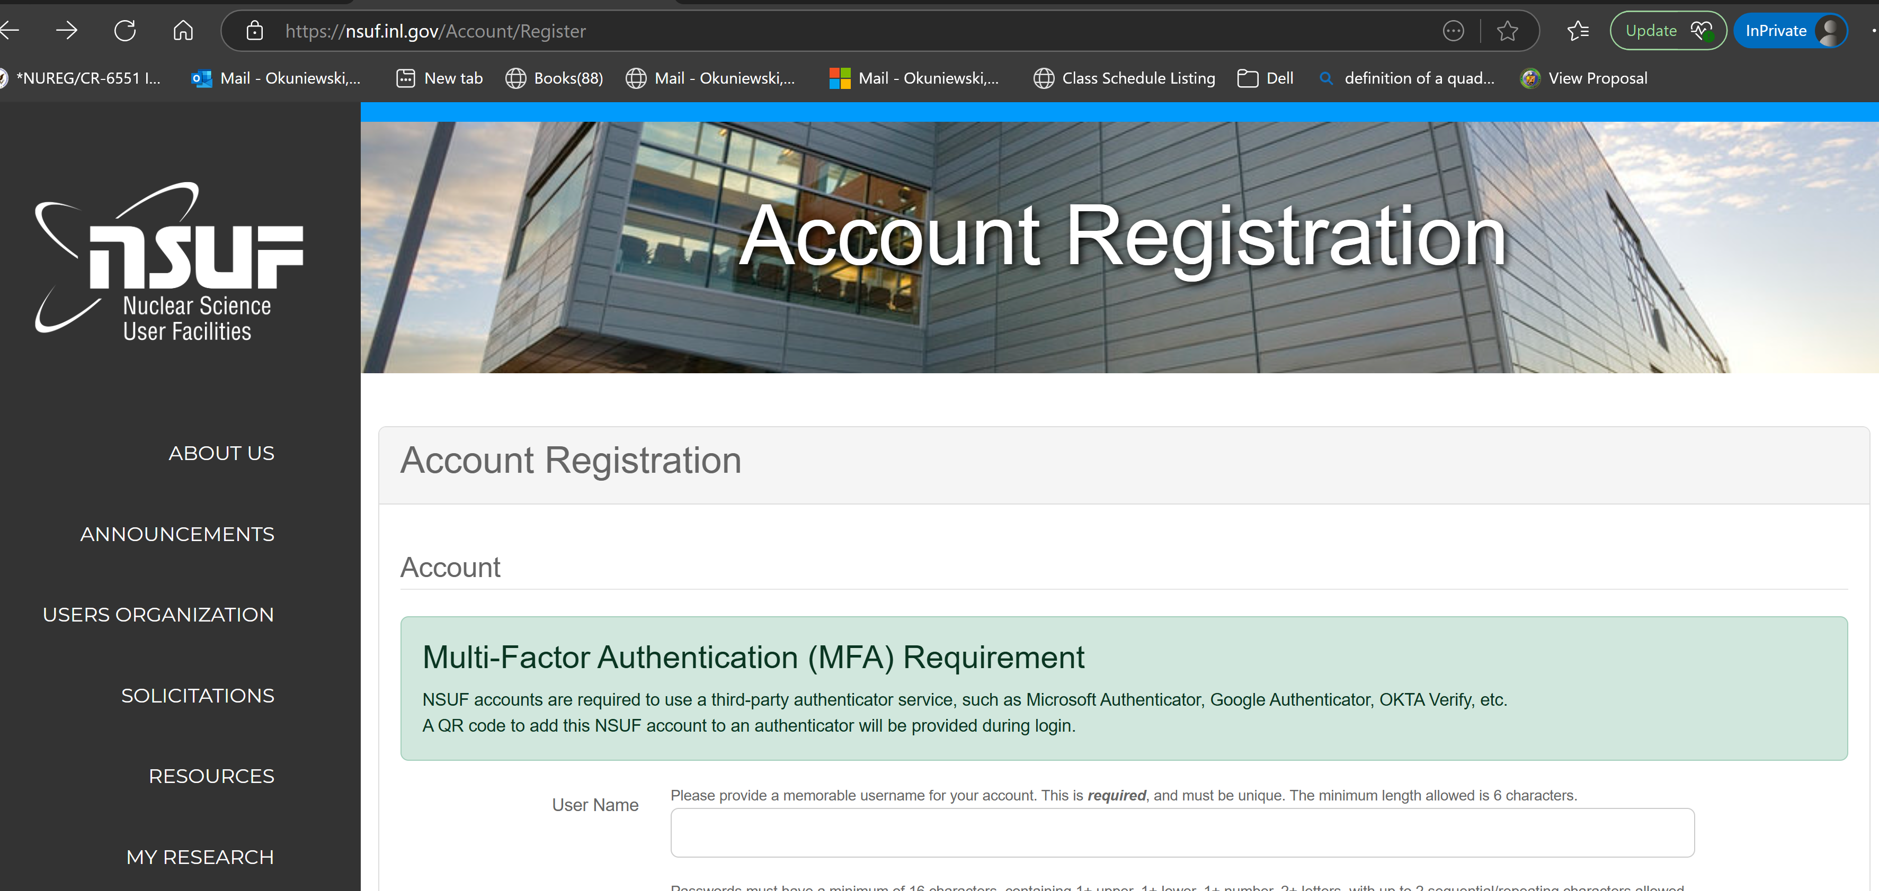
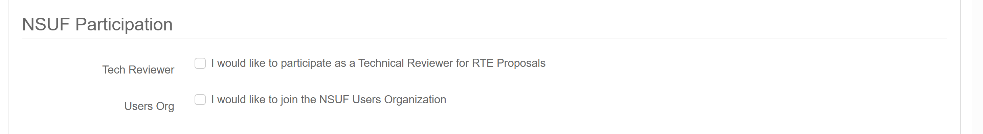

Slide 6
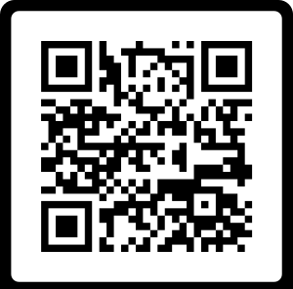
Sign up for the NSUF UO Mailing List (independent of INL)

Slide 7
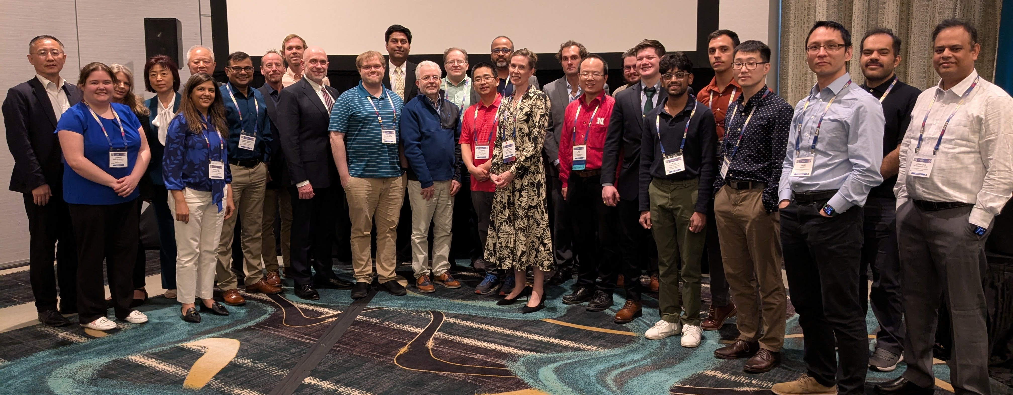
Annual NSUF Users Org. Meeting
Date: Thursday, March 27, 2025; during TMS Meeting 2025 in Las Vegas, NV
Participation:
  In person (63) / Virtual (24): 87
  New Users: 4

Slide 8
Annual NSUF Users Org. Meeting
Objectives:
  Share with current and potential users what is new within NSUF
    FY24 Summary, project award updates, completion report template, website updates, NRDS
  Highlight new capabilities / research / instrument scientist investments
  Share research & capabilities – presentations / posters
  Topical Focus: Harnessing artificial intelligence, machine learning, automation/robotics, and additive manufacturing for accelerating nuclear research, development, & deployment
  Users: Dialogue with NSUF leadership and staff & amongst each other to foster new proposal ideas / collaboration

Slide 9
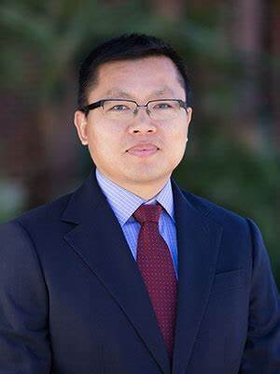
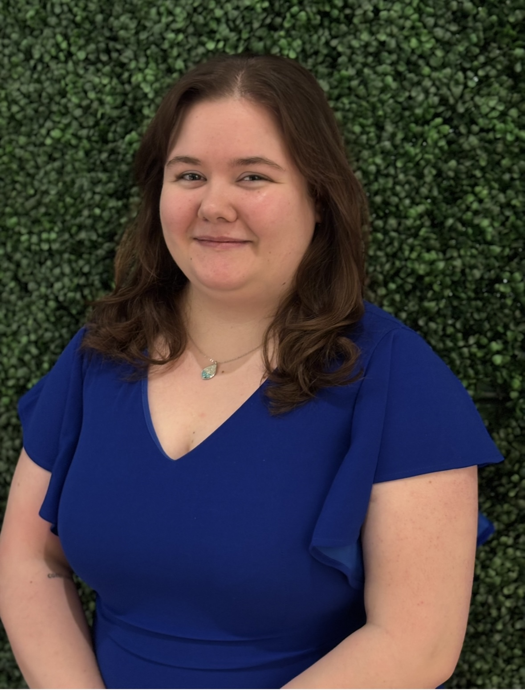
Elections
Two new positions start Oct 1, 2025: Secretary and Emerging Professional Member
Secretary: Eight year-term - the first two years as a Secretary, transitions to Vice-Chair (two years), then Chair (two years) and finally as a Chair Ex-Officio (final two years).
Emerging professional member: (graduate student or postdoctoral fellow) for a two-year term.
Emerging Professional:
Ms. Jasmyne Emerson, Purdue University
Secretary: Prof. Yong Yang, University of Florida

Slide 10
Upcoming Activities
Lowering the Barrier for New NSUF Users
  Online Video: My First RTE: Tips and Tricks for Success
    Stephen Taller, ORNL, NSUF UO Vice-Chair
    Anna Podgorney, INL, RTE Administrator
Surveying Community for:
  Annual NSUF User Meeting: Feedback, ideas
  NSUF needs: Library, working groups, SAM-like experiments
  Community wants: Specific user needs
  Community input: Nuclear Research Data System (NRDS) best practices, data embargo

Slide 11
Thank you for your attention!
Questions/Ideas/Concerns?
Maria Okuniewski mokuniew@purdue.edu

Slide 12
Agenda
9:00 – 9:10 – Maria Okuniewski (Chair NSUF Users’ Organization, Purdue University) – Welcome and Introduction
9:10 - 9:30 – Chris Barr (Program Manager, NSUF, DOE-NE) – Nuclear Science User Facilities
Machine Learning, Artificial Intelligence, and Automation
9:30 – 9:45 Kevin Field (University of Michigan) – Accelerating NSUF studies with Artificial Intelligence and Machine Learning at Partner Facilities
9:45-10:00 Adrien Couet (University of Wisconsin at Madison) – High-throughput irradiation and characterization capabilities at UW Ion Beam Laboratory to support data-driven modeling and nuclear materials design
10:00-10:15 James Haley (Oak Ridge National Laboratory) – Simulation and Sensing Driven Automation in Additive Manufacturing for Adaptive Materials Research
10:15 – 10:35 Break and Poster Viewing

Slide 13
Agenda
NSUF User Data Storage, Sharing, Data Embargo, Demonstration, and Discussion
10:35 -10:55 Anna Podgorney & Bradlee Jensen (Idaho National Laboratory) – Nuclear Research Data Search (NRDS)
10:55-11:15 All Participants - Discussion
Expansion of Capabilities Supported by NSUF Instrument Scientist Awards
11:15-11:30 Sven Vogel (Los Alamos National Laboratory) – HIPPO Meets ERNI & BERT - Combining Diffraction and Imaging for Characterization of Nuclear Materials
11:30-11:45 T.S. Byun (Oak Ridge National Laboratory) – Miniaturized Fracture Toughness Testing Technology for Irradiated Materials
11:45-1:15 Lunch (On your own) & Poster Viewing

Slide 14
Agenda
New Developments within NSUF
1:15 – 1:35 Brenden Heidrich (Director, NSUF, Idaho National Laboratory) – State of the NSUF
1:35 – 2:00 All Participants - NSUF Users Feedback
Election for NSUF User’s Organization Executive Committee Members
2:00 – 2:30 All Users
2:30 – 3:00 Break and Poster Viewing
New NSUF Capabilities
3:00– 3:15 – Mehmet Topsakal (Brookhaven National Laboratory, NSLS-II) - Capability upgrades and future plans for nuclear materials research at NSLS-II
3:15-3:30 – Weiying Chen (Argonne National Laboratory, IVEM) - Capability updates for IVEM-Tandem facility

Slide 15
Agenda
Super Rapid Turn-around Experiment
3:30-3:45 – David Frazer (General Atomics) -Performance of SiC-SiC Cladding and Endplug Joints Under Neutron Irradiation
Additive Manufacturing in Nuclear
3:45 – 4:00 - Bai Cui (University of Nebraska-Lincoln) – Compositionally Complex Carbides for Extreme Environments
Closing Remarks
4:00 – 4:15 - Maria Okuniewski (Chair NSUF Users’ Organization, Purdue University)

Slide 16
Poster Presentations
Academic Facilities
Name | Affiliation | Title
Rashed Almasri | North Carolina State University | In-situ TEM Analysis of Xe-Irradiation-Induced Bubble Dynamics and Swelling in Zirconium Carbide (ZrC) and Nitride (ZrN) at 800°C
Nathan Curtis | University of Wisconsin-Madison | Local chemical ordering in a CrFeMnNi compositionally complex alloy under neutron irradiation
Artur Santos Paixao | Texas A & M University | Combination of ion irradiation testing and finite element analysis for risk assessment of Cr-coated fuel cladding over a fuel cycle
Valentin Pauly | University of Michigan | Prediction of Neutron-Irradiated Cavity Microstructures via Dual-Ion Irradiation up to 184 dpa in T91 Steel
Name | Affiliation | Title
Keith Jewell | Idaho National Laboratory | The Advanced Test Reactor
Kenneth Cooper | Oak Ridge National Laboratory | Flexible Irradiations for Accelerated Development of Advanced Nuclear Fuels and Materials
Raymond Cao | Ohio State University | Research Capabilities at The Ohio State University Nuclear Reactor Laboratory: Supporting Sensor and Sensor Materials Irradiation Testing
Ramprashad Prabhakaran | Pacific Northwest National Laboratory | Nuclear materials PIE capability at PNNL
Brandon Bohanon | University of Florida | Nuclear Fuels and Materials Characterization Facility (NFMC) at the University of Florida

Slide 17
Organizational Structure for Executive Committee
Chair
Chair Ex-Officio
Officers
2 year term
in each position
Vice Chair
Benefits:
Continuity of Knowledge
Consistent presence at NSUF meetings
Familiar voices for user advocacy
Secretary
4 year term
2 year term
Representative Member
Representative Member
Representative Member
Representative Member
Representative Member
Representative Member
Restrictions imposed:
Exec committee strives to have scientific and institutional diversity reflected and avoid multiple members representing similar interests.
Neither the Chair, Vice-Chair nor Secretary shall be an employee of the organization contracted for the management or operation of Idaho National Laboratory.
Up to 2 positions reserved for emerging professionals
(graduate students, postdocs)

Slide 18
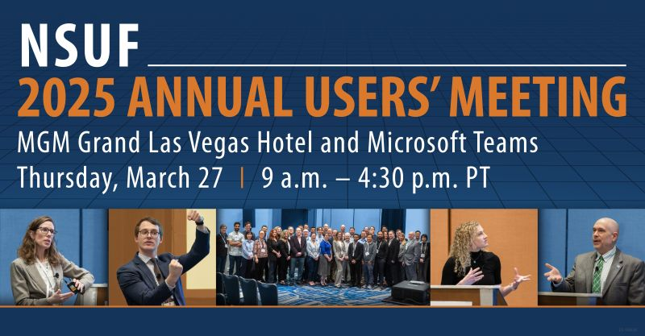
Prof. Maria Okuniewski, Purdue University, NSUF UO Chair

