Slide 1


Advanced Mechanical Testing of Highly Irradiated Materials
By:
Sriram “Praneeth” Isanaka
Assistant Research Professor
Dept of Mechanical and Aerospace Engineering
Missouri University of Science and Technology
Rolla, MO
04/12/2025

Slide 2
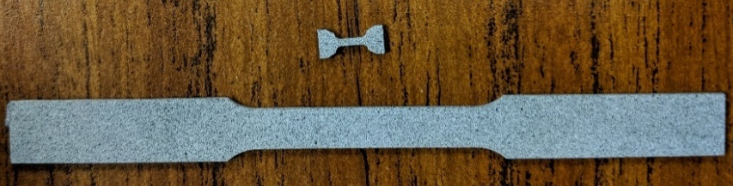
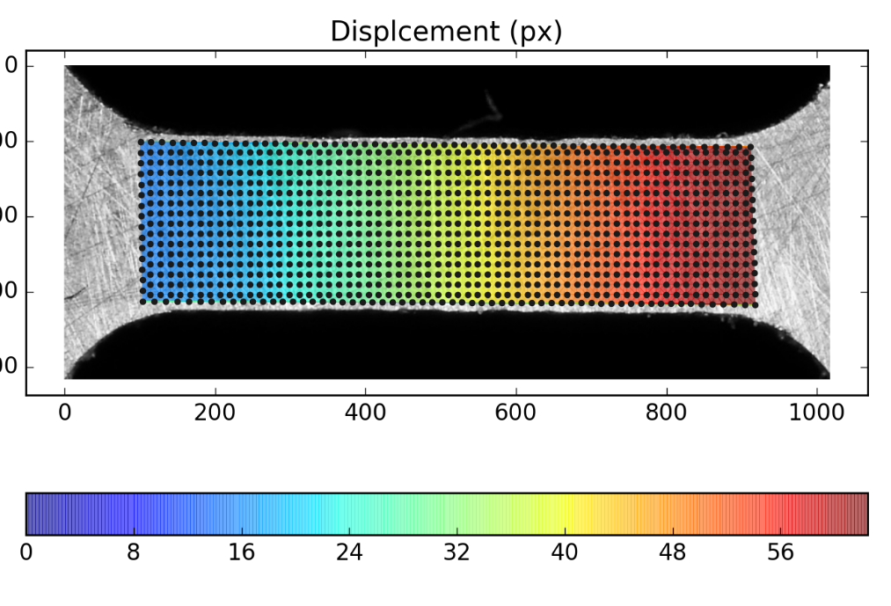
Miniature tensile specimen
Material characterization
Chemistry variation
Spatial variation
Process variation
Benchmarking
DIC analysis
ASTM sub-size “dog bone” specimen
  102 mm long with a gage length of 25.4 mm
Miniature specimen
  9.65mm long with a three mm gage length
2

Slide 3
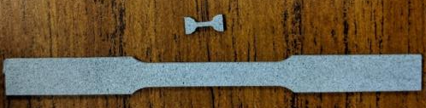
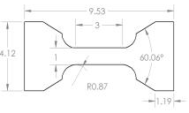
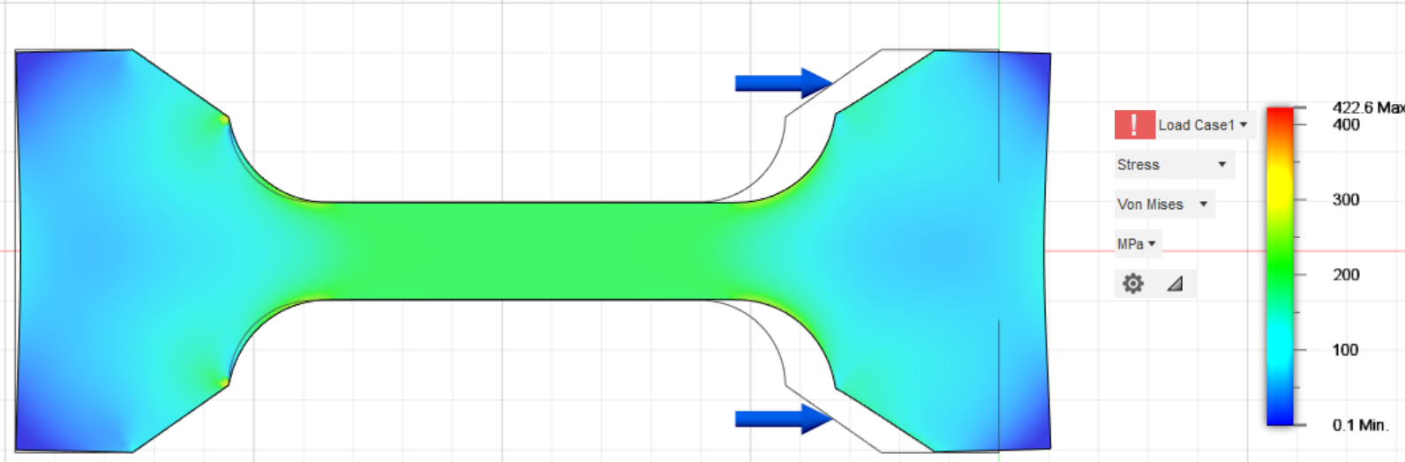
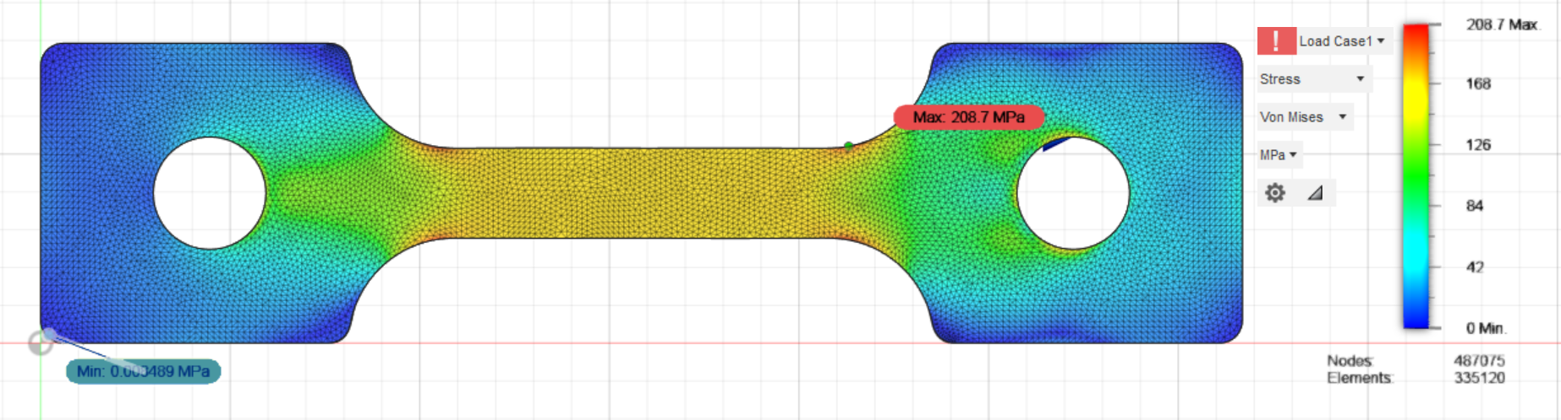
Some advantages of our specimen design
What we call “waist loading” to minimize complexity of miniature specimen
  Minimizing manufacturing complexity for tough and/or brittle materials
  Minimizing testing complexity due to the load applications without the need for clamping, pin loading and other loading mechanisms
Waist loading
Shoulder loading
Shoulder loading

Slide 4
Specimen preparation
Miniature specimen come with manufacturing and specimen preparation challenges
EDM Manufacturing process chosen to minimize work hardening
Lapping process included to remove scale, oxide layer and other artifacts like burr, formed during specimen manufacture

Slide 5
Verification of specimen preparation
Independent validation of lack of oxide layer and any potential plastic deformation or heat affected zones
Cp-Ti specimen etched with Krolls agent, 4140 Steel etched with Nital
Specimen prepared by Missouri S&T and sent to Rio Tinto, Canada, for evaluation
No plastic deformation at the edges of the gage
Minimal oxide layer presence that could affect tensile data
Confirmed for multiple specimen of 4140 Steel and Cp-Ti

Slide 6
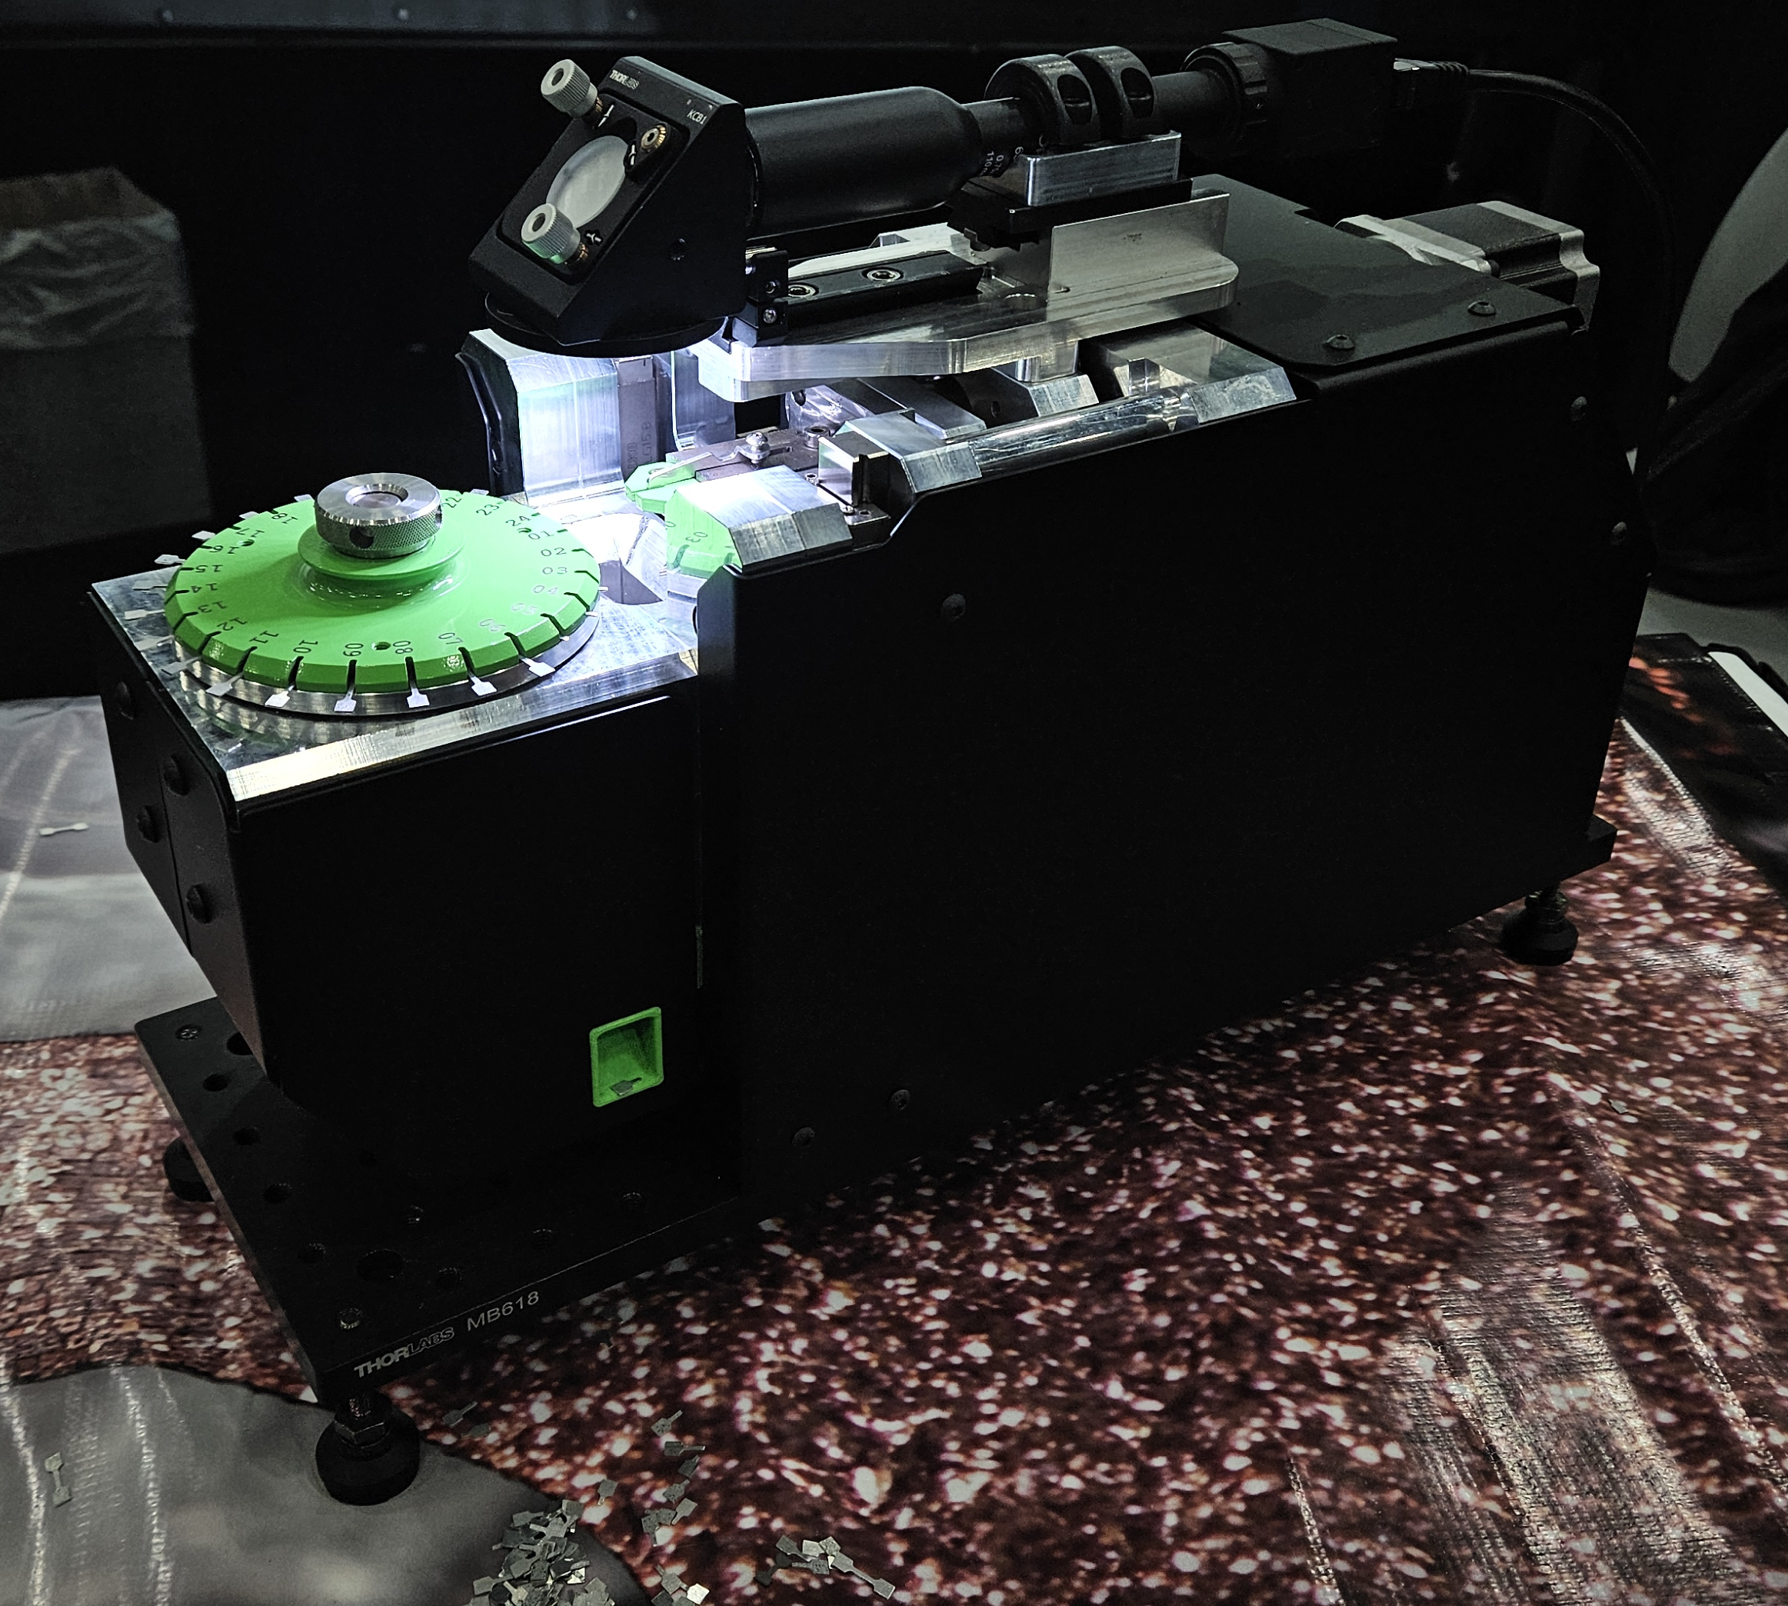
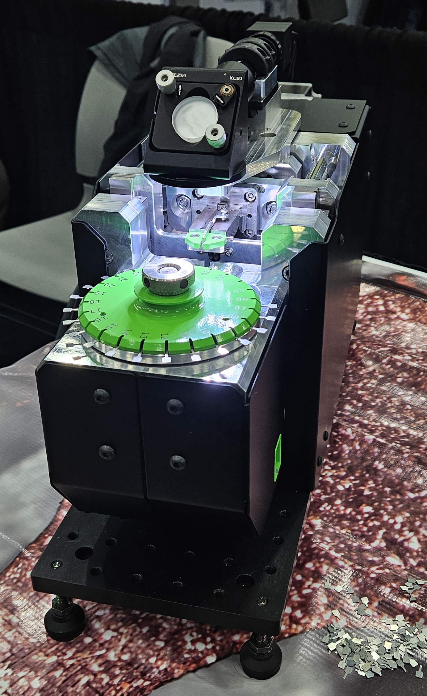
Advanced Mechanical Test System (AMTS)
Cartridge design to house 24 specimen
Rotational indexing to position specimen, apply preload, and test

Slide 7
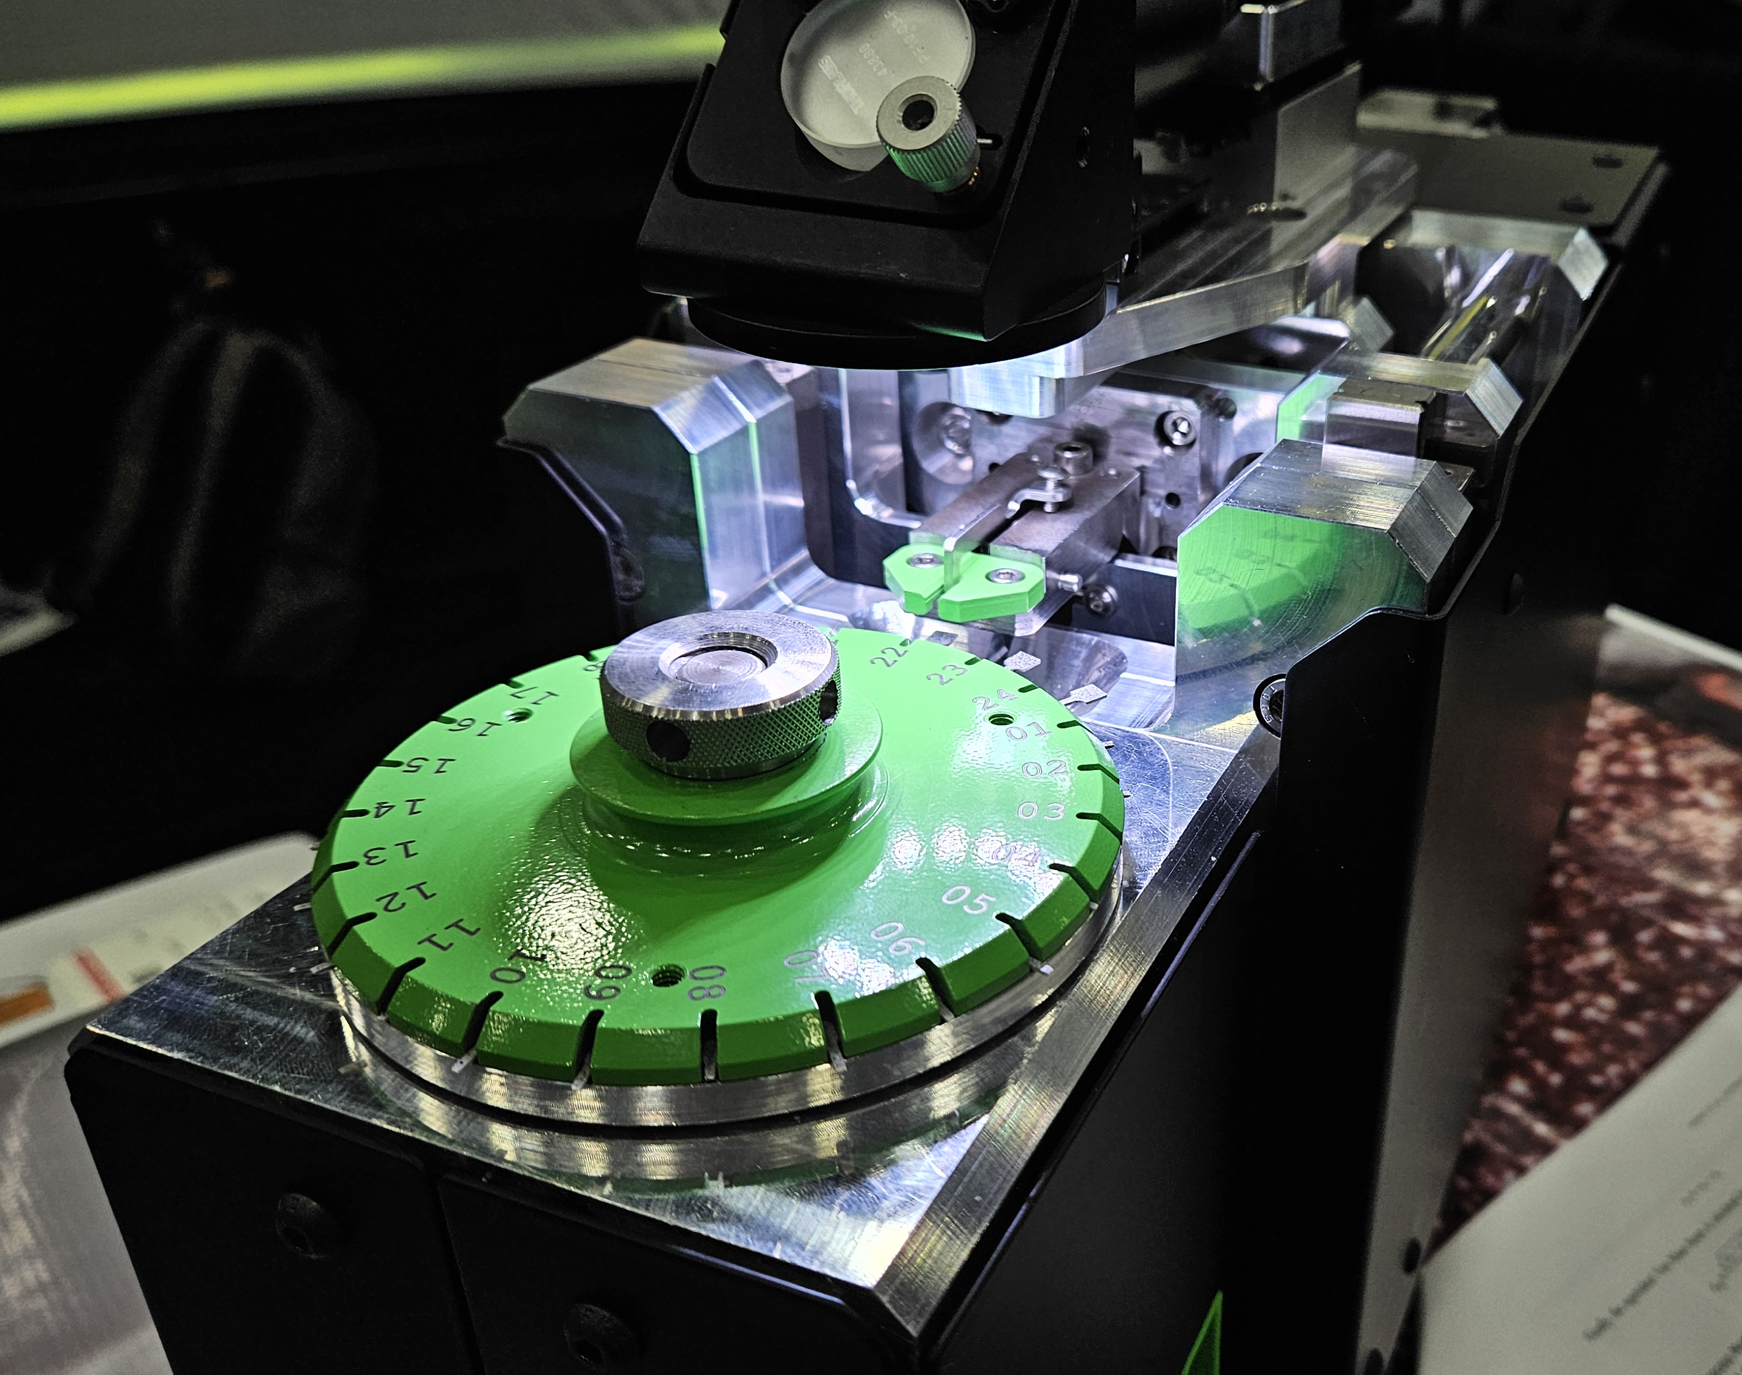
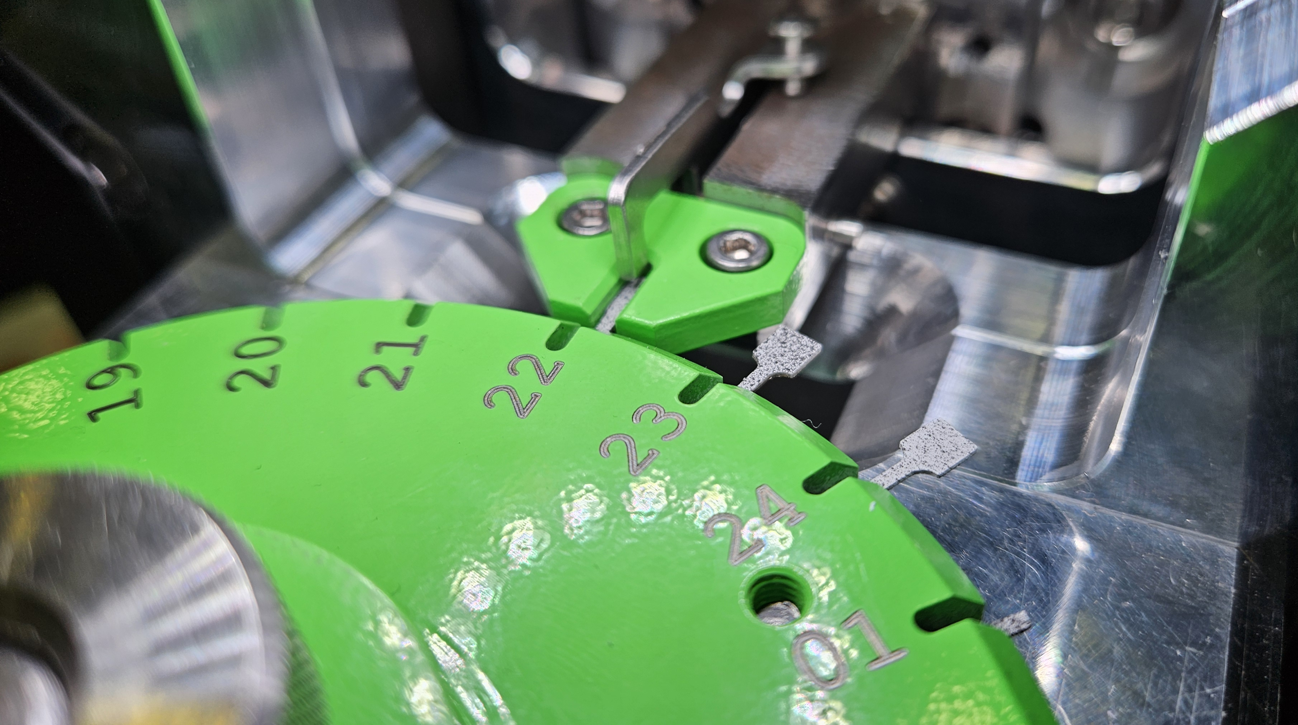
Advanced Mechanical Test System (AMTS)
Close ups of AMTS performing tests
SSJ Specimen
Speckle pattern applied

Slide 8
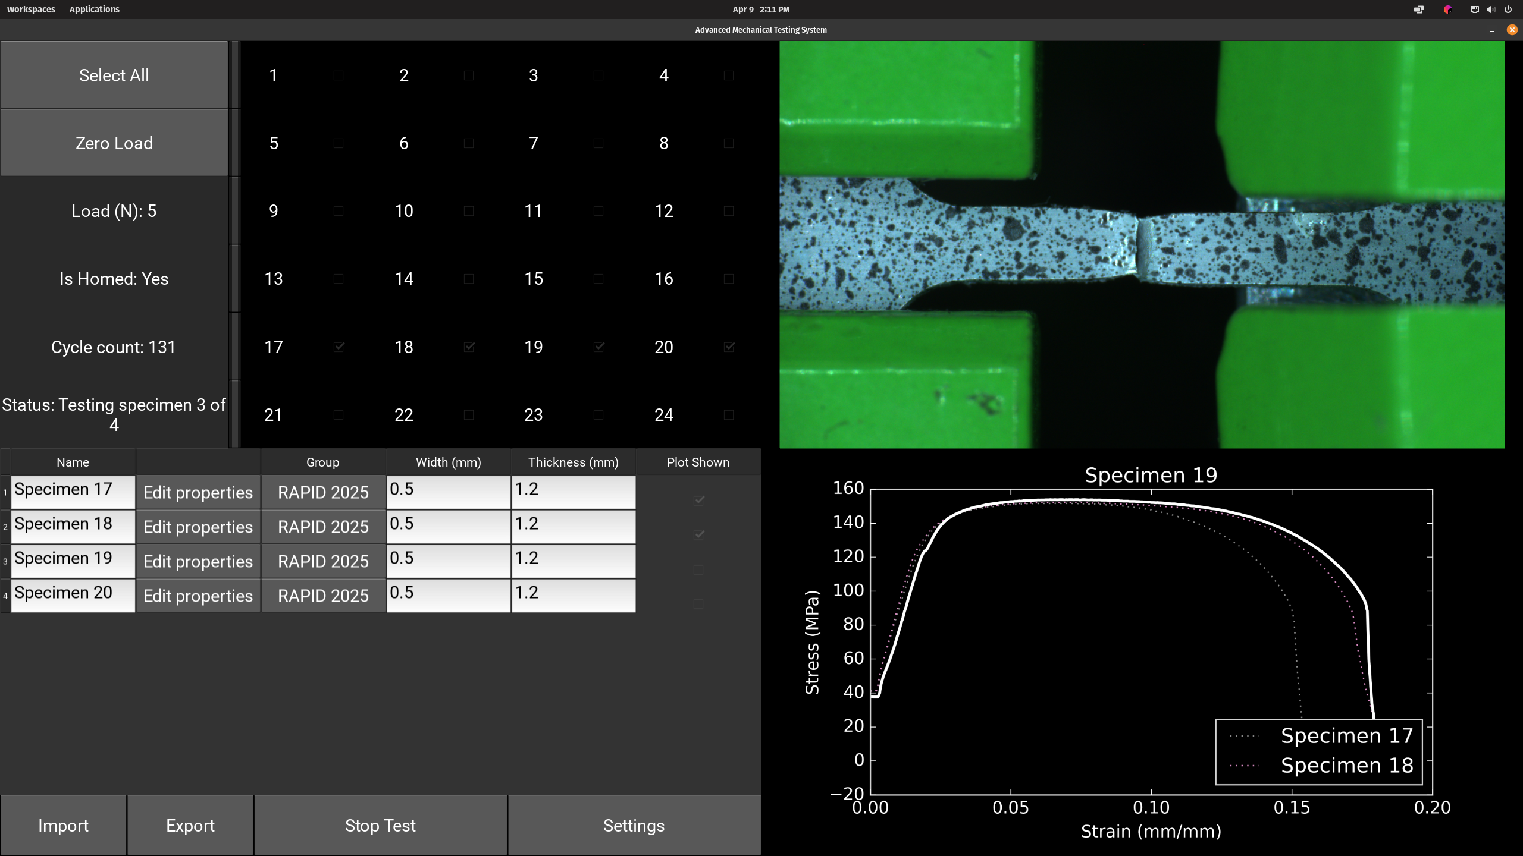
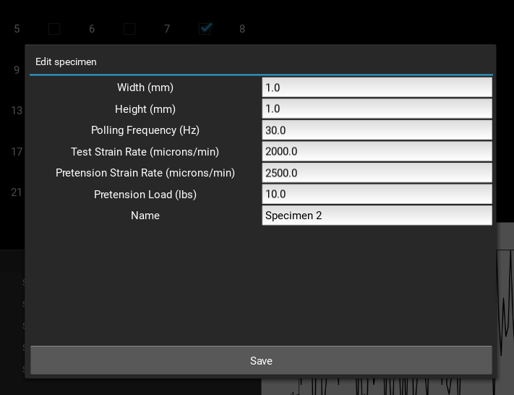
In-house developed software
Live view section
Specimen selection and status update section
Test parameter edit section
Specimen geometry and test parameters edit section
aa
Live plot section for stress strain curves

Slide 9
AMTS in action
Upon test completion 3 files saved for every test. Raw data in .csv, video file to be used for post processing. Separate .pdf compiled report saved as well.

Slide 10
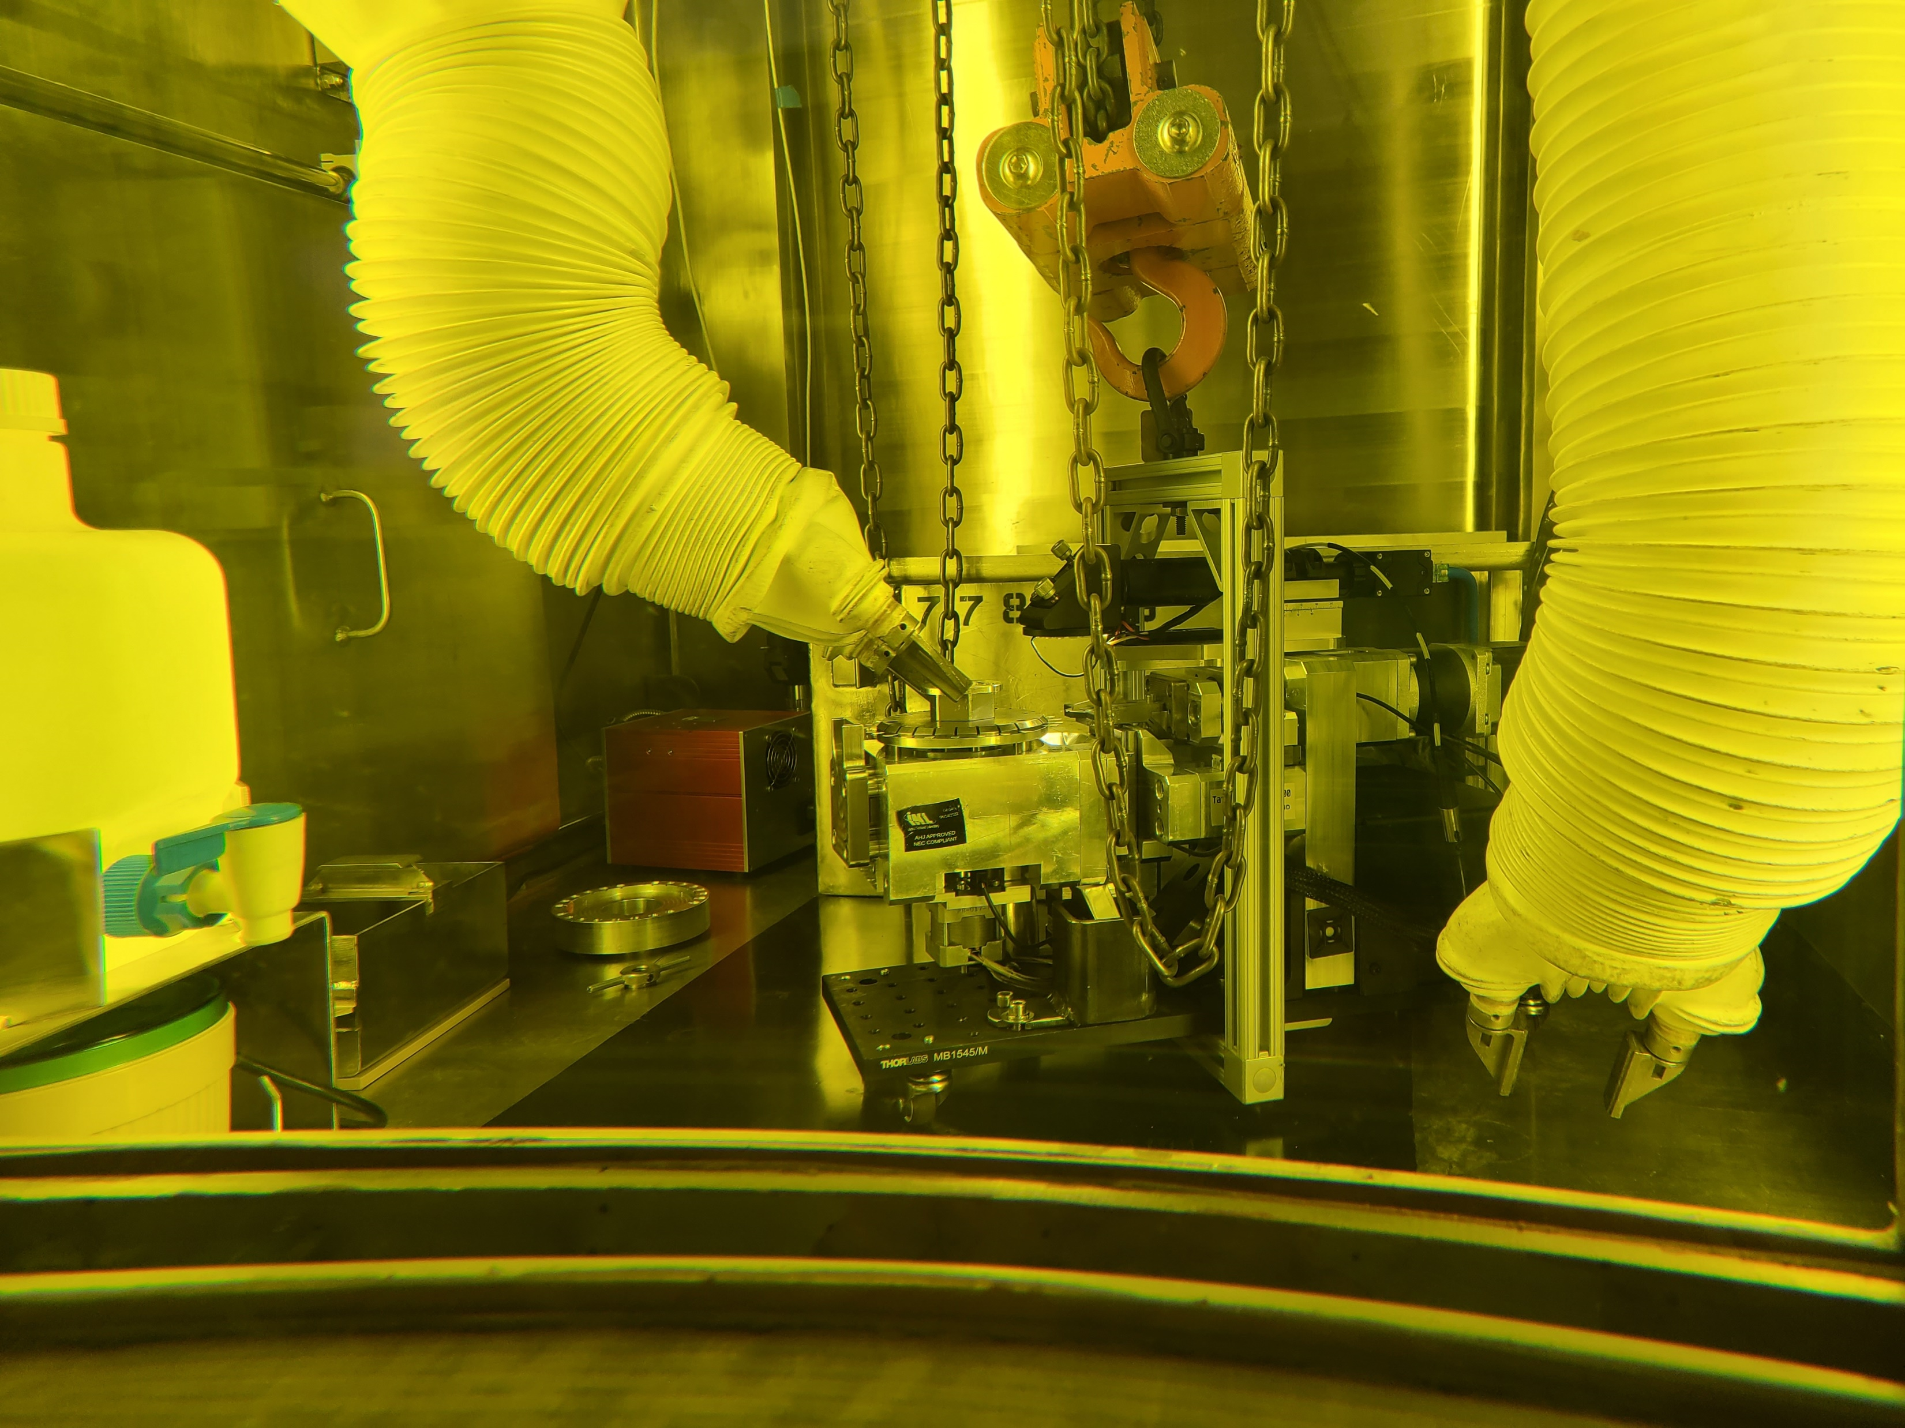
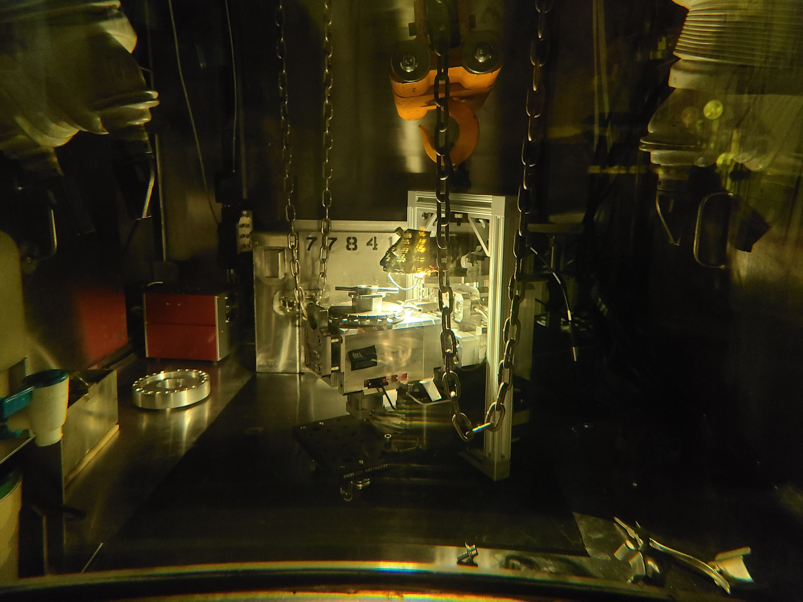
Advanced mechanical test system installed in hot cell facility at INL
Applying for a trademark called “MiniTensile”
Frame for lifting, Cartridge modifications for ease of loading
Calibration fixture to periodically test and correct load cell
Pics approved for public release by INL

Slide 11
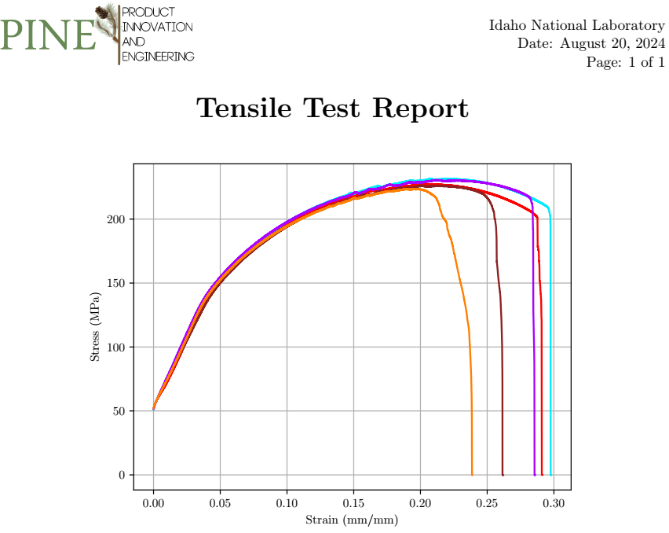
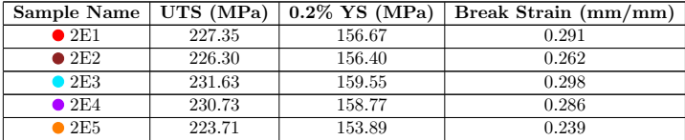
Data generated
Reports compiled for individual tests and groups with important metrics

Slide 12
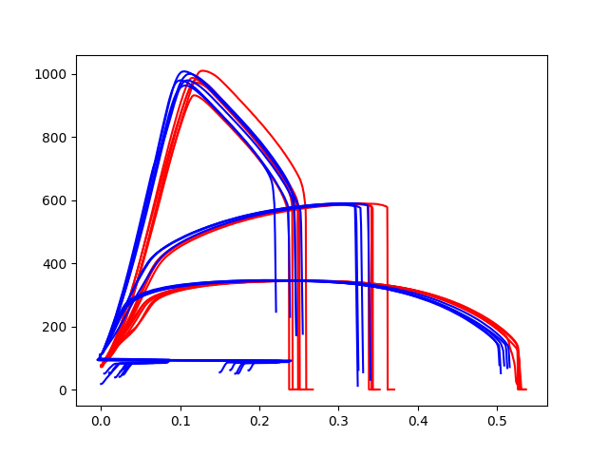
Comparison with existing test frames
Comparative test between Tinius Olsen 25 kN frame and AMTS
3 materials
  17-4 PH steel
  Al 7075-T6
  C1008 steel
5 specimen per material each tested on the TO and the AMTS
TO data in blue, AMTS data in red
Stress (MPa)
Strain (mm/mm)

Slide 13
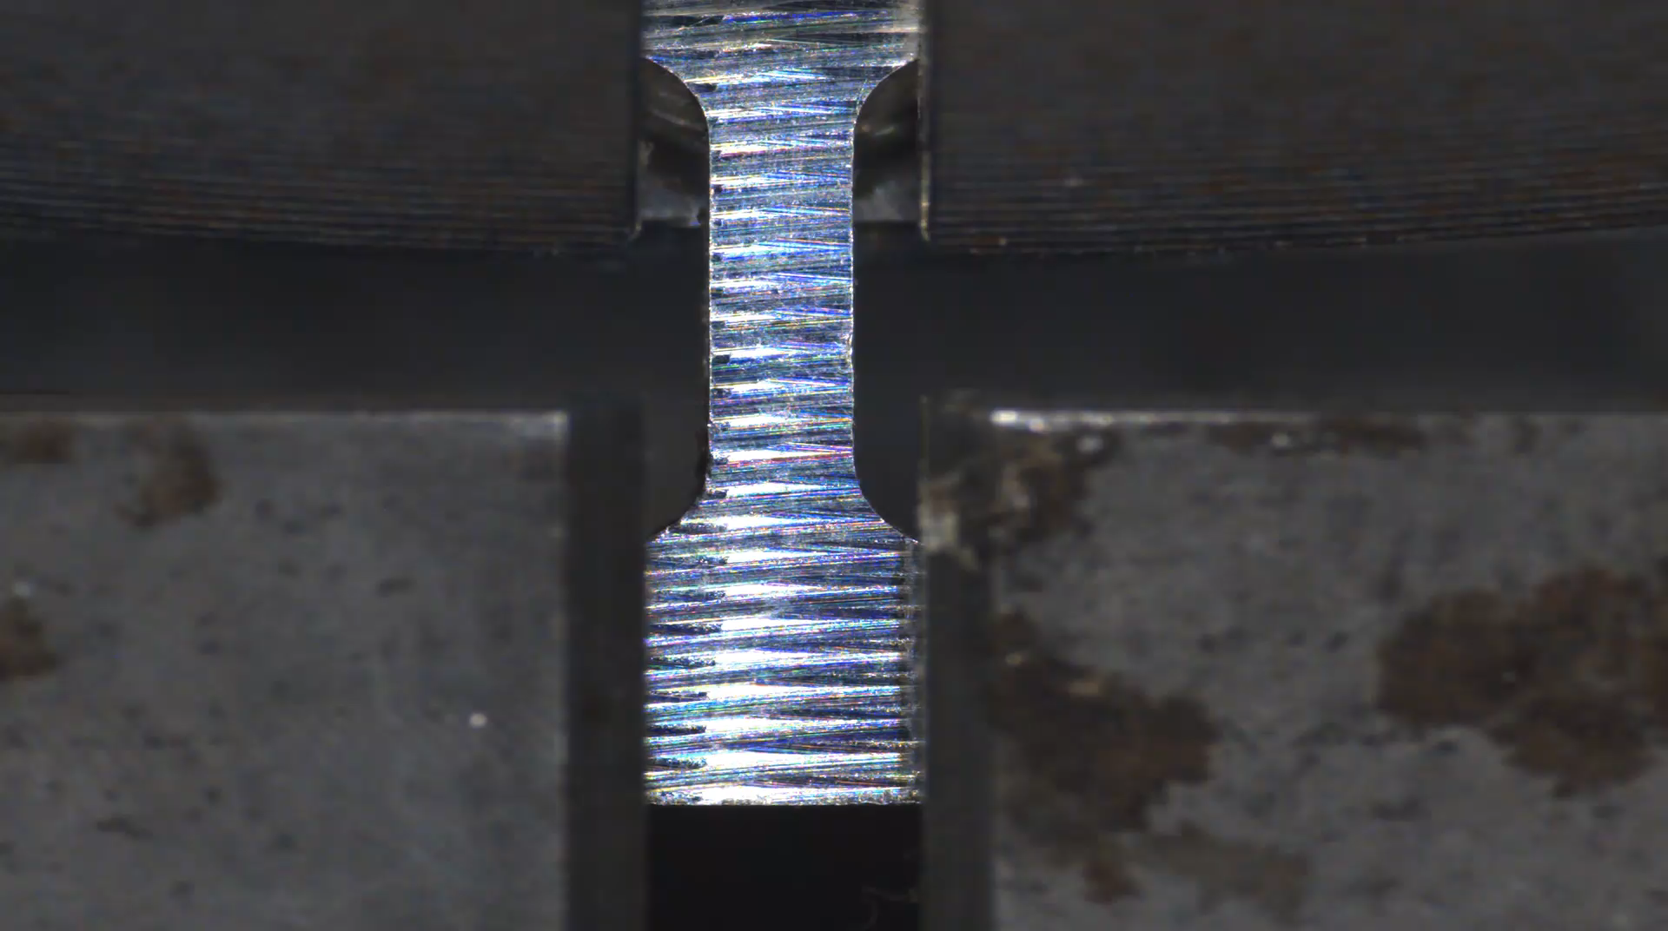
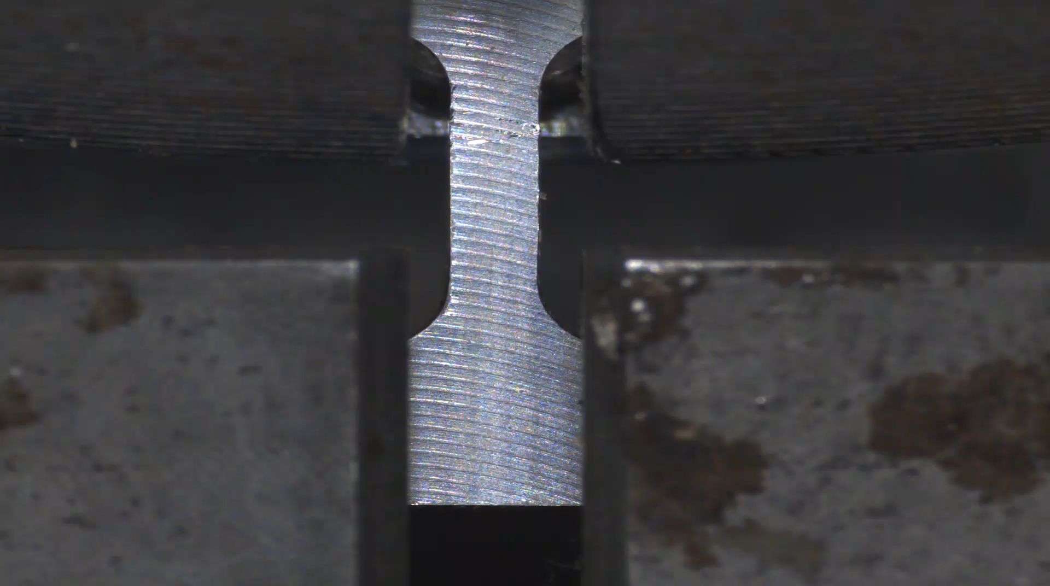
Effects of manufacturing process
CNC machining tends to work harden material
Leading to zones that affect the neck formation and material elongation behavior

Slide 14
Contact
Missouri S&T:
Sriram Praneeth Isanaka
Missouri University of Science and Technology, Rolla, MO – 65409
sihyd@mst.edu
PINE:
Braden McLain
Product Innovation and Engineering, LLC., St.James MO – 65409
team@mopine.com
INL:
Jason Schulthess
Idaho National Laboratory, Idaho Falls, ID – 83415
jason.schulthess@inl.gov

Slide 15
Thank you for your time.

Slide 16
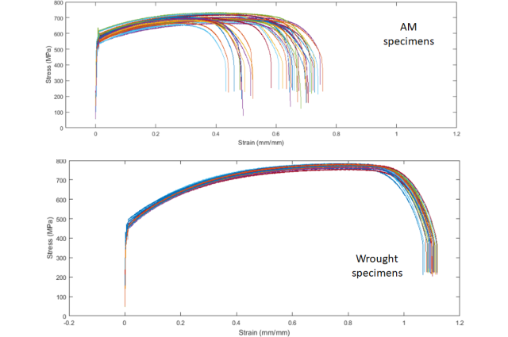
Some initial data
Wrought materials by virtue of temperatures and pressures involved produce fine grained microstructures with minimal defects
Mechanical performance consistency is anticipated
AM materials due to their cooling rates produce meta-stable structures with inclusions and other defect mechanisms that exhibit inconsistent performance

Slide 17
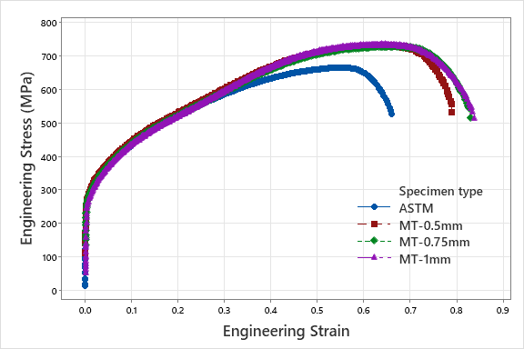
Representativeness comparison to ASTM E8
Within the elastic region, curves matched closely
Even in the plastic regime, mechanical performance matched between the ASTM and miniature SS304 long after the yield
Differences here were observed and noted and attributed to varying defect/inclusion populations

Slide 18
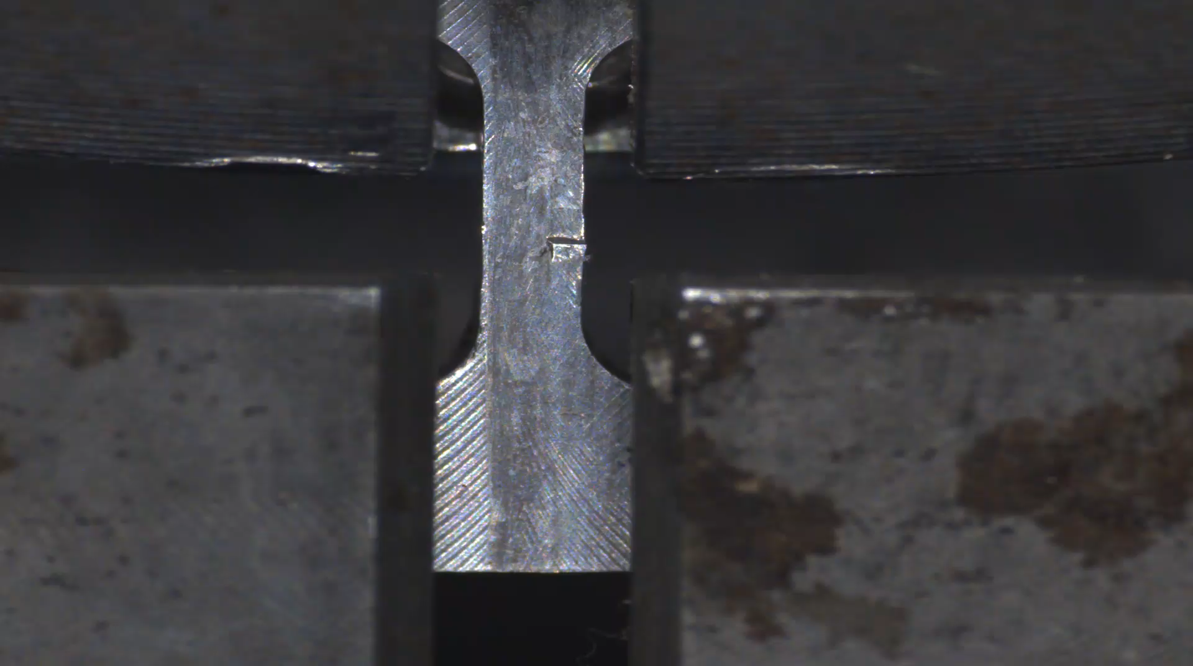
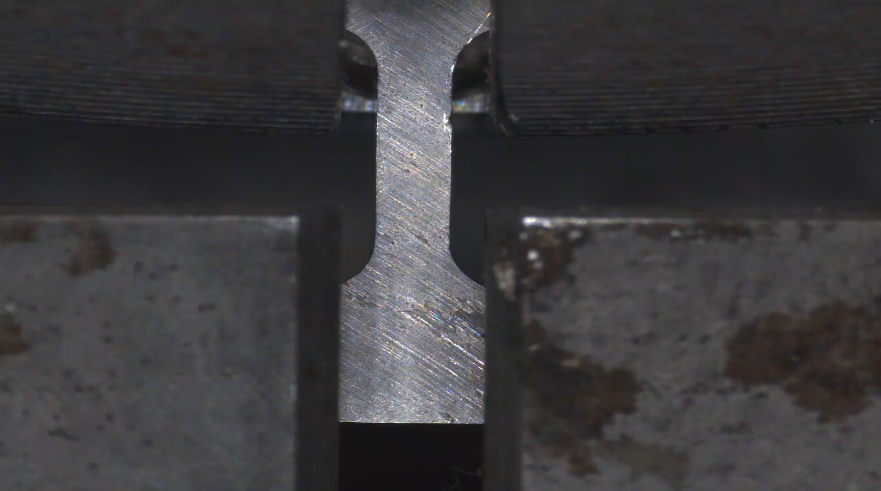
Effects of poor specimen preparation
Effect of defects on the gage length due to poor manufacturing
Neck formation and failure follow the presence of defects

Slide 19
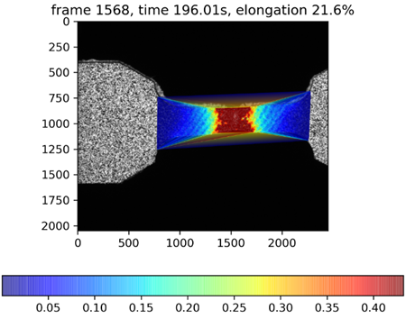
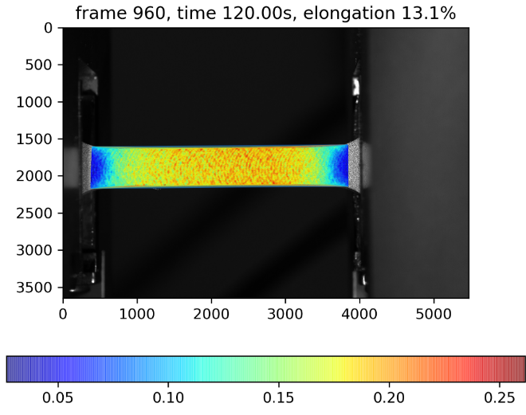
Effects of work hardening
Strain field development in SS 304L
Strain field development in Cp-Ti
Our own analyses confirms this. Work hardening was mapped to increase strength and minimize elongation which is indicative of an inaccurate test.

