Slide 1
April 15-17, 2025
Nuclear Science User Facilities (NSUF) Program Review Meeting:
Agenda

Slide 2
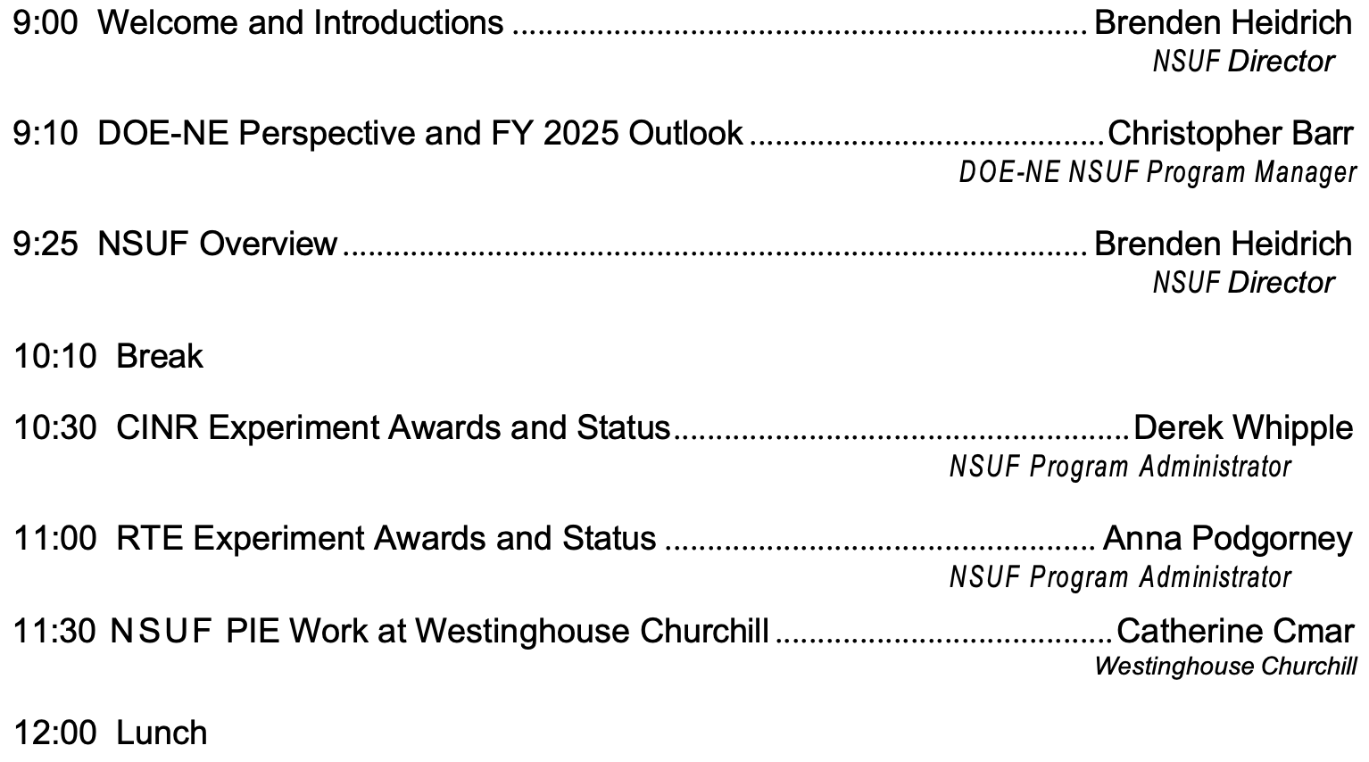
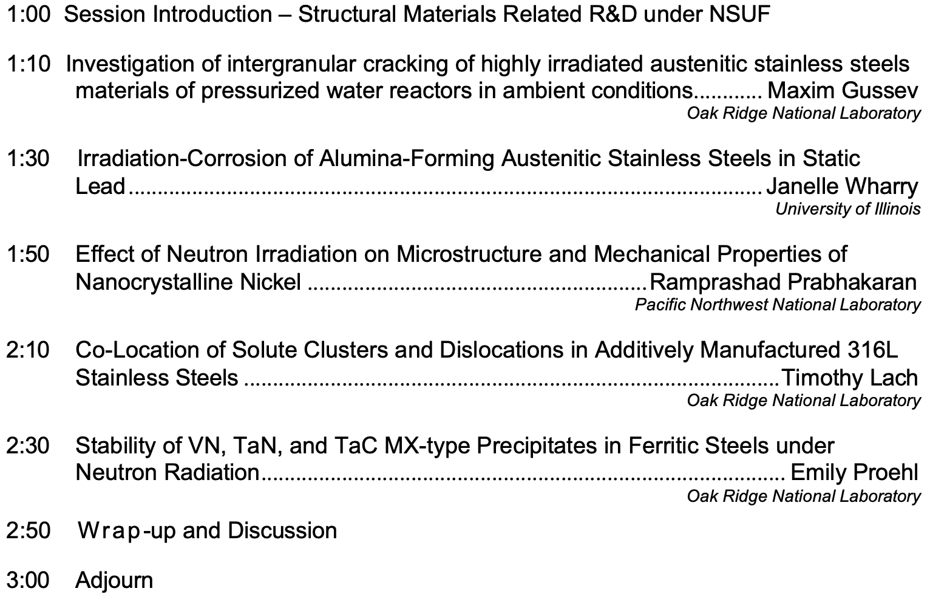
Tuesday – April 15, 2025
Program Overview
NSUF User Access Awards: Structural Materials

Slide 3
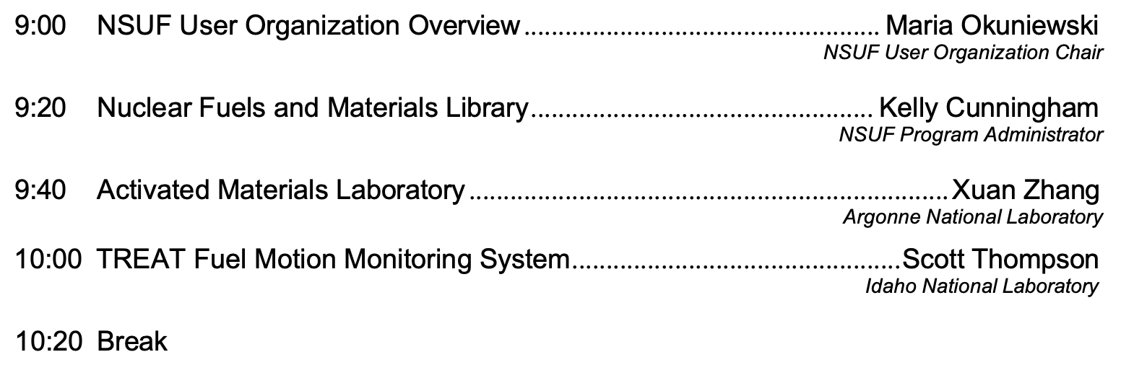
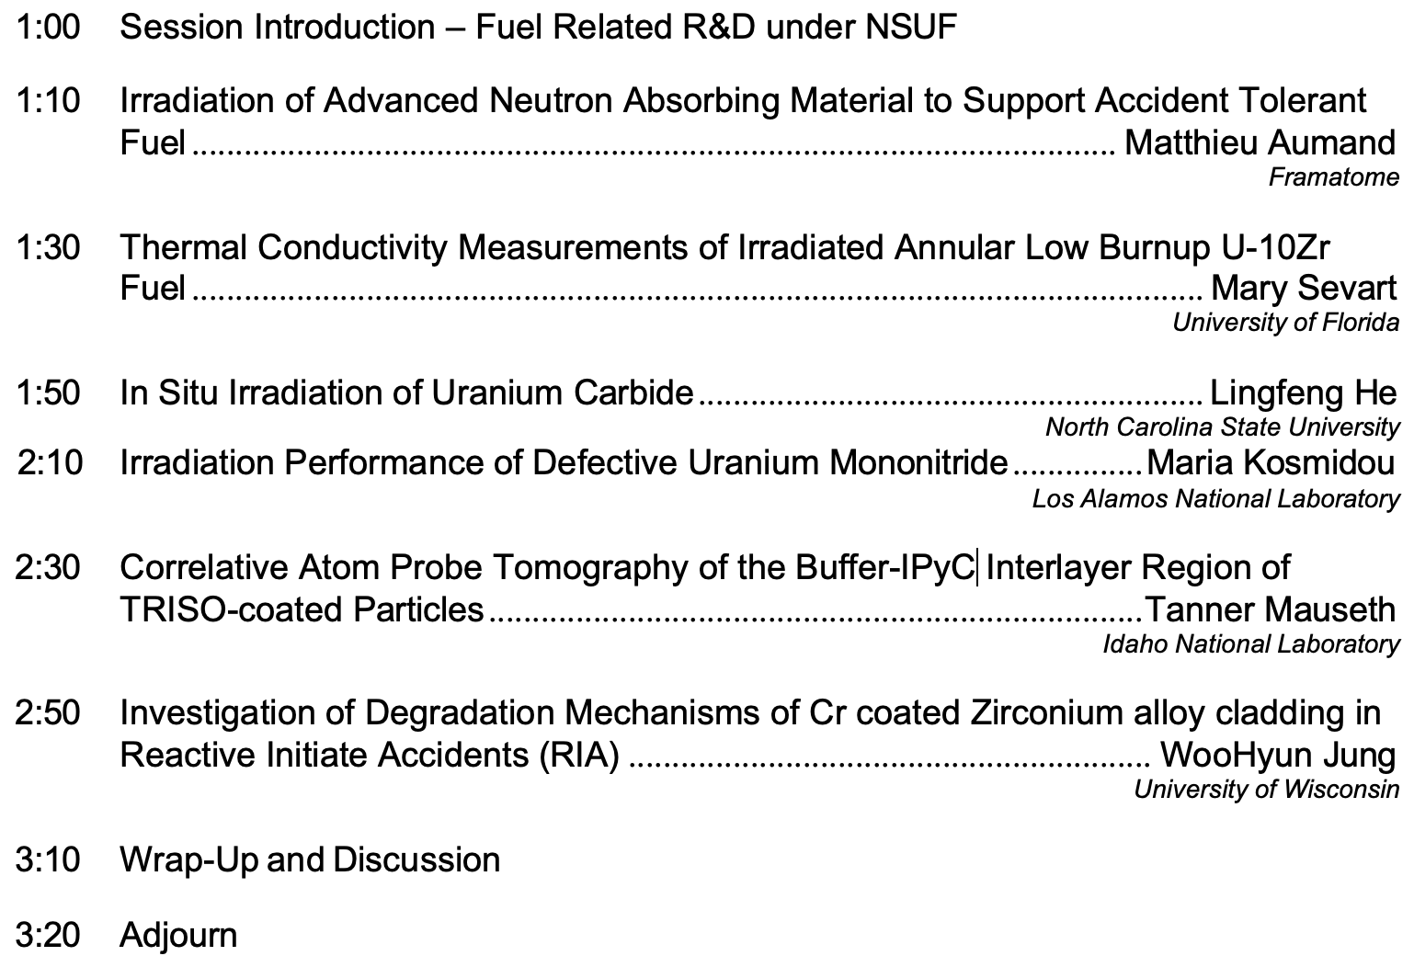
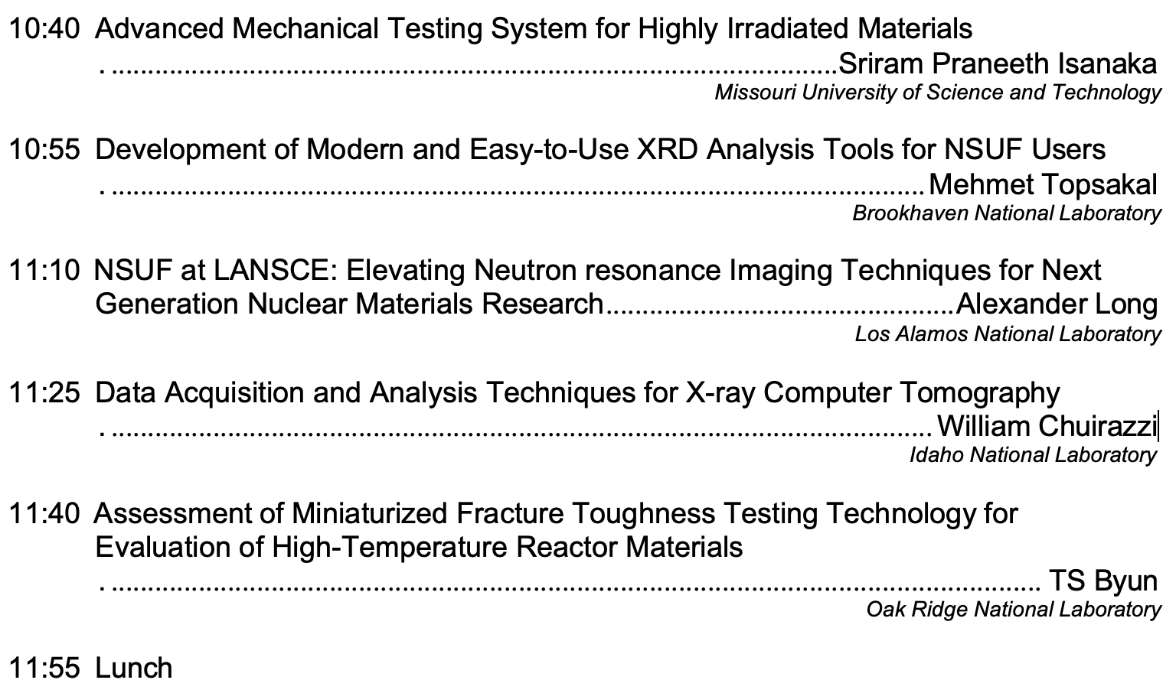
Wednesday – April 16, 2025
Users and Capabilities
NSUF User Access Awards: Fuel and Cladding Materials

Slide 4
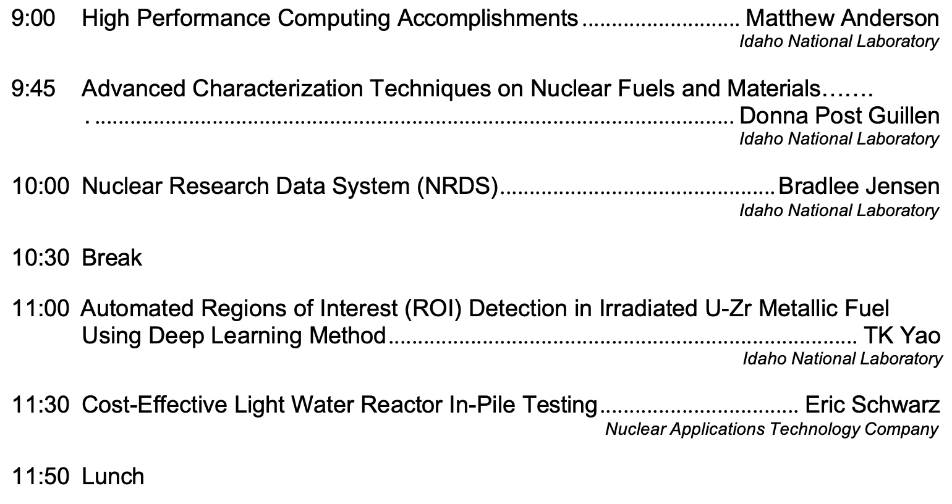
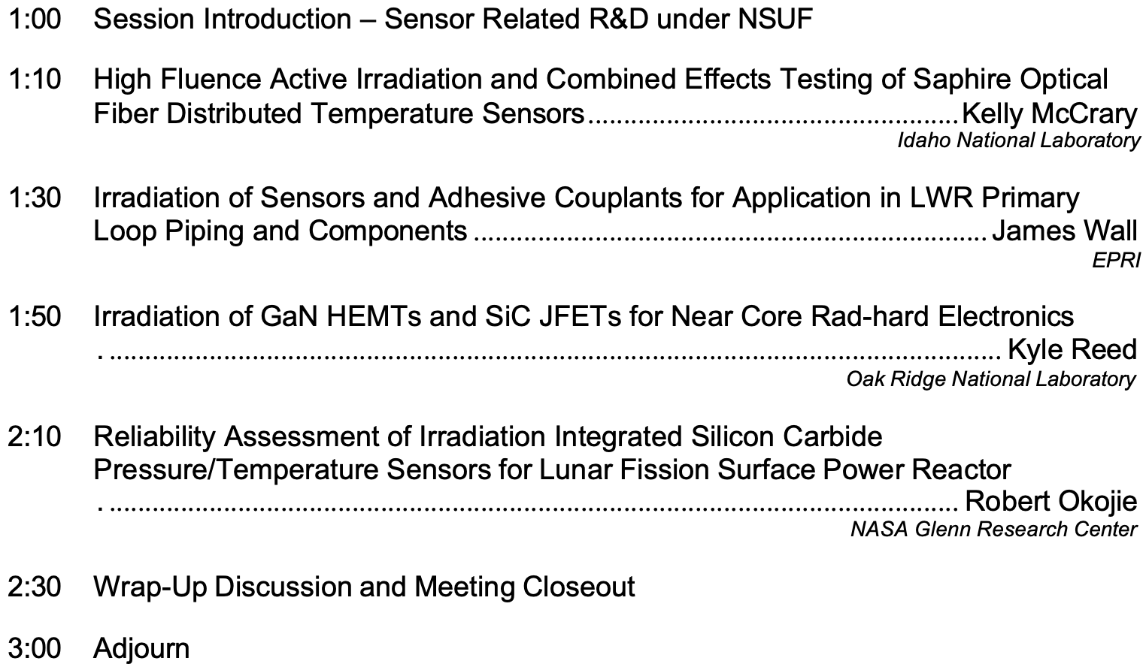
Thursday – April 17, 2025
High Performance Computing
NSUF User Access Awards: Sensor Materials

