Slide 1
April 14-17, 2025
  Kelly Cunningham
    Nuclear Fuels and Materials Administrator, NSUF
Nuclear Science User Facilities
  The Nuclear Fuels and Materials Library

Slide 2

Overview
The Nuclear Fuels and Materials Library (NFML) is owned by the U.S. Department of Energy’s Office of Nuclear Energy (DOE-NE) and curated by the Nuclear Science User Facilities (NSUF). The NFML is comprised of:
Samples resulting from NSUF-awarded projects,
Legacy samples from the Experimental Breeder Reactor (EBR-II) shutdown in 1994,
Samples from real-world components retrieved from decommissioned and operating power reactors,
Donations from other sources, and
Technical information and publications associated with all NFML project samples.

Slide 3
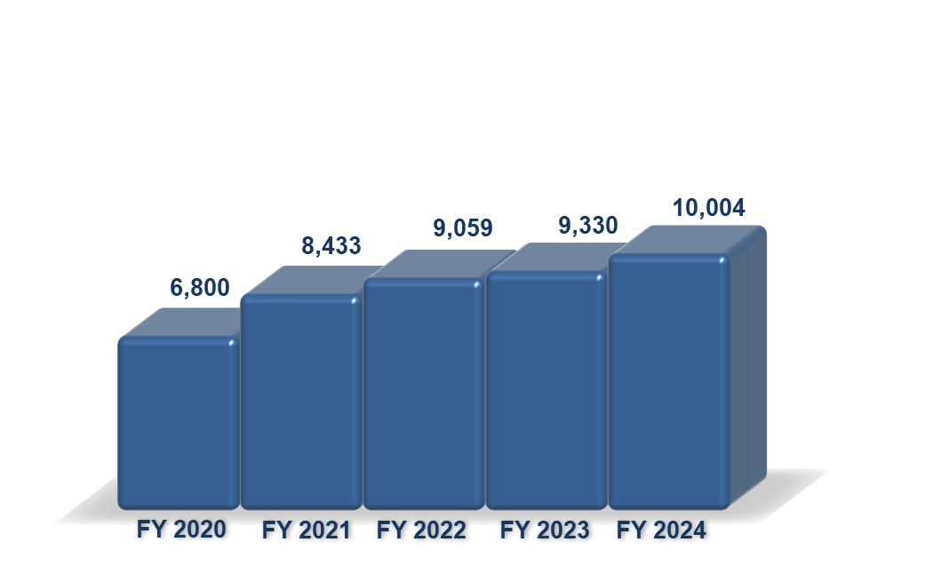
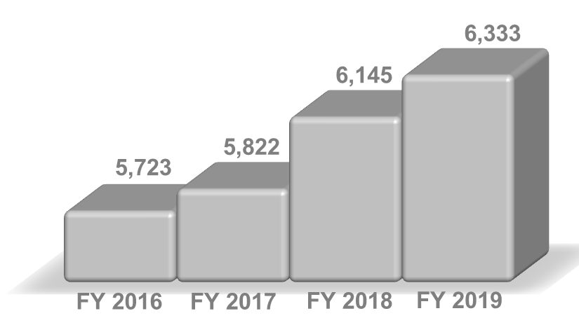
Inventory Growth
The NFML inventory went online in 2016 with 5700 samples and has increased to over 10,000 samples in 2025. In addition to samples from NSUF-awarded irradiations, the inventory growth includes additions from:
Cooperative Research and Development Agreement (CRADA),
Laboratory Directed Research and Development (LDRD) project,
Material harvested from nuclear power plants, and
Other DOE programs.

Slide 4
NFML Guidance (updated) https://nsuf.inl.gov/Page/nfml_request
Most of the updates provide further clarification of existing guidance and semantic adjustments.
Materials or samples from third parties (industry, foreign entities, other non-DOE federal agencies, etc.) should MUST be transferred to the DOE-NE per a legal Agreement on Transfer of Title and Ownership.
NSUF Program Leadership (NSUF Director and Federal Program Manager) will make decisions regarding:
  Direct requests,
  Guidance changes,
  Disputes involving the use of NFML samples, or the admittance of samples into the NFML.
Additional sample attributes were added to the list of pedigree information requested for samples offered and accepted into the NFML
  Material certifications, compositions, and properties
  Irradiation conditions (temperature, dose, flux, fluence, environment, duration)
  Fabrication and/or manufacturing processes
  Sample geometry and dimensions, and
  Related reports and publications.

Slide 5
NFML Guidance (updated) continued
Upon completion of the irradiation phase of an awarded experiment the samples are available for post-irradiation examination. The Principal Investigator (PI) will be given exclusive rights to the samples for a three-year period of post-irradiation examination unless other conditions are agreed upon. This three-year period starts once the materials are at the PIE facility and available for use by the PI. After the three-year period, the samples will be made available to the general research community for subsequent competitively awarded proposals.
  As a courtesy, subsequent proposers will be provided with the contact information of the original project PI to facilitate potential collaboration opportunities. The original PI may choose to collaborate but cannot deny access to the NFML sample requests included in an awarded proposal. (This statement has been added to the RTE proposal form with the original PI’s contact information.)

Slide 6
NFML Utilization
The NFML was available online for the first time in 2016 for the 3rd RTE Call.
2016 | 75 |  | 13 |  | 17%
2017 | 180 |  | 23 |  | 13%
2018 | 280 |  | 33 |  | 12%
2019 | 185 |  | 22 |  | 12%
2021 had 1 RTE call
2022 had 1 RTE call
2024 had 3 RTE calls and 1 Super RTE call

Slide 7
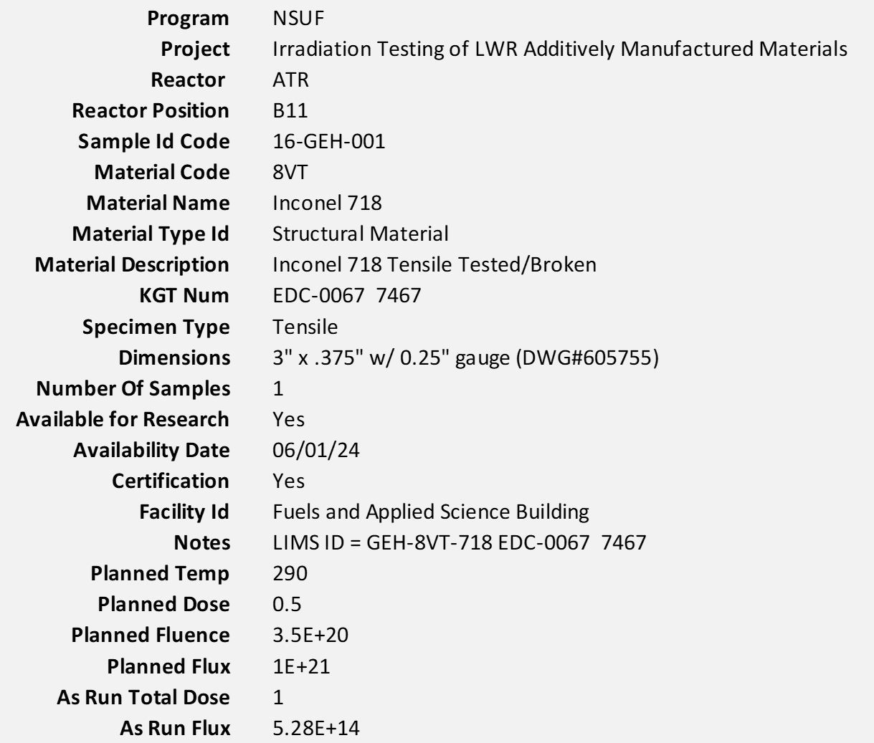
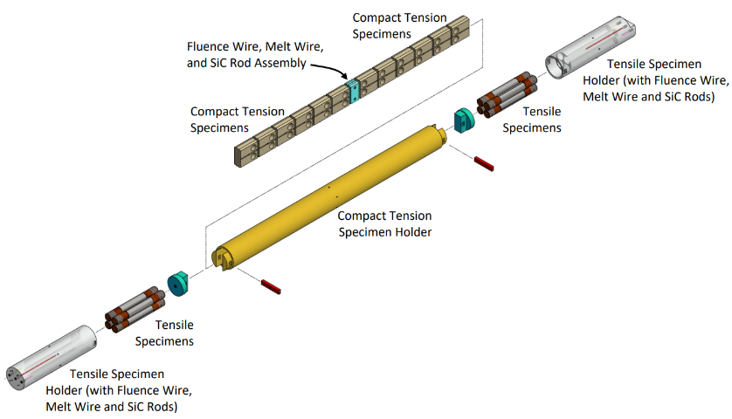
FY 2024 Sample AVAILABILITY: Awarded NSUF Project – GE Hitachi
Irradiation Testing of LWR Additively Manufactured Materials
Additively Manufactured - Laser-Powder Bed Fusion
Compact tension and tensile specimens
Inconel 718 Nickel-base alloy
316L Stainless Steel
Unirradiated (baseline) specimens

Slide 8
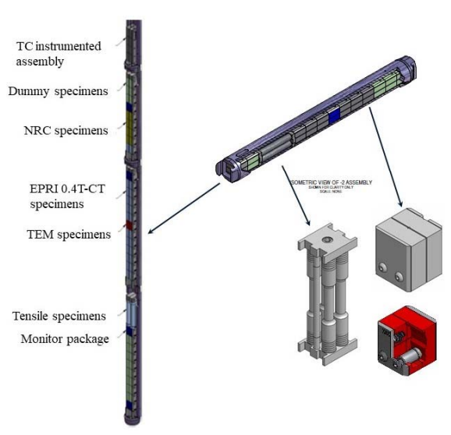
FY 2024 Sample ADDITION: Cooperative Research and Development Agreement
Electric Power Research Institute/NSUF CRADA Pilot Project
Cooperative Research & Development Agreement (CRADA) between DOE NSUF and EPRI made ATR’s capabilities available to universities and the commercial nuclear industry.*
Research on the X-750 samples provided a chance to gather data needed for reactor licenses to be extended 40, 60, and 80 years.
The research showed X-750 and XM-19 retain a high level of integrity even at the highest fluence, synonymous with beyond end-of-life components that utilize these materials.*
Valuable experience was gained in testing protocol and processes, and paved the path for future NSUF experiments on structural materials involving Irradiation Assisted Stress Corrosion Cracking.
Experiment capsules and specimen stack-up
*https://nsuf.inl.gov/Home/Article/75

Slide 9
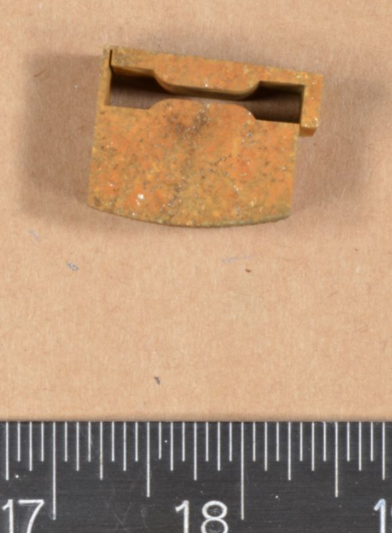
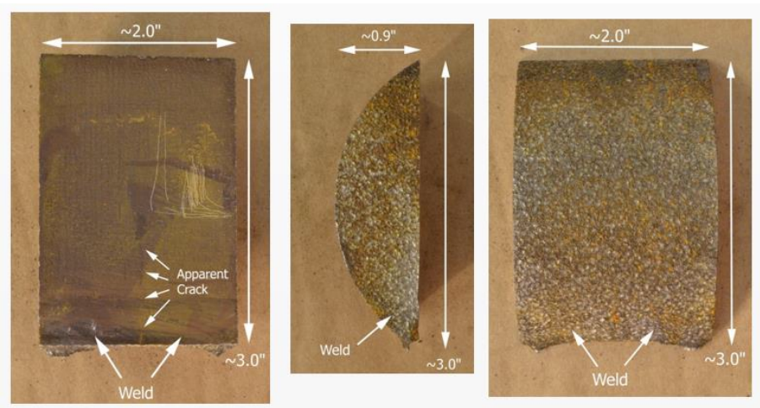
FY 2024 Sample ADDITION: Deliveries from BWXT Nuclear Operations Group
Harvested LWR Core Shroud Material
Donors: EPRI/Southern Nuclear/BWXT
304 SS core shroud samples (weld and base metal and Heat Affected Zones (HAZ) from a commercial LWR NPP
Legal transfer of Title and Ownership signed in FY 2022
Samples delivered in batches from BWXT to INL
Last shipment arrived March 2025

Slide 10
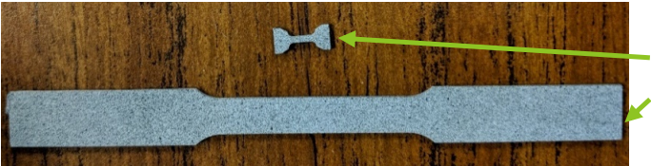
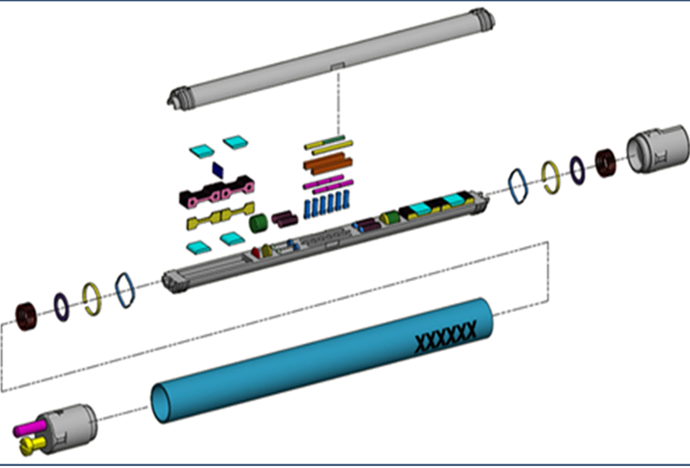
FY 2024 Sample ACQUISITION: LDRD Donation/NSUF PIE
Tensile Testing Using the Standard Capsule (TTUSC)
ATR-irradiated multi-principal (high entropy) component alloys (MPEA)
16 material compositions
SSJ tensile samples of five or more main components irradiated in the SAM-2 standard capsule
“Standard” capsule with analysis basis to use ATR “A” positions.
Allows for large number of specimens to be irradiated
Reduced specimen size to accommodate more specimens in reactor
Samples awarded for FY24 CINR: Radiation Effects of High Entropy Alloys
Miniature “MT2” Tensile specimen (16 x 5 mm)
ASTM E8 Standard “Sub-sized Specimen”
(50 mm x 12.5 mm)

Slide 11
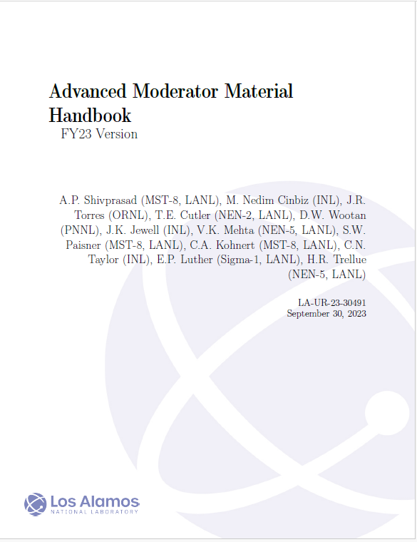
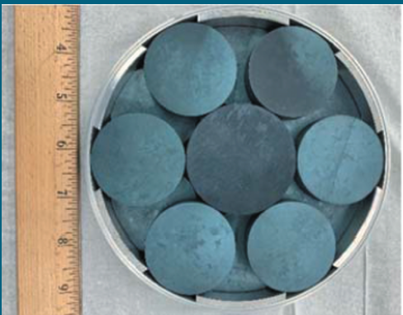

FY 2024 Sample ACQUISITION: Microreactor Program Donation
Yttrium-Hydride Samples
ATR-irradiated Yttrium-hydride experiments to advance technology readiness level of moderator material
Fabricated through innovative techniques (powder metallurgy and massive hydriding)
The principal additions to the FY23 Version of the Advanced Moderator Material Handbook are the pre- and post-irradiation examination(s) of the irradiated YH.

Slide 12
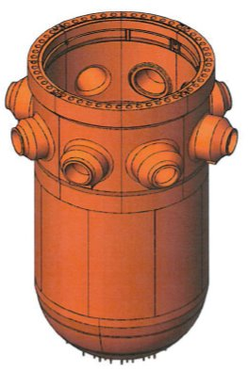
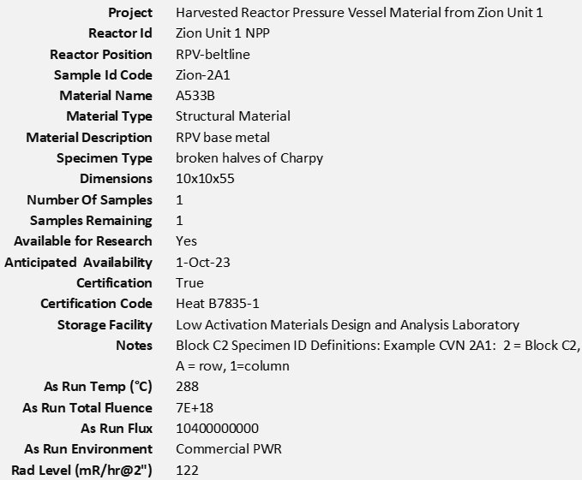
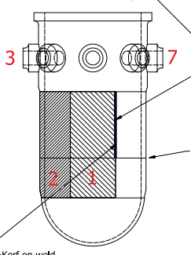
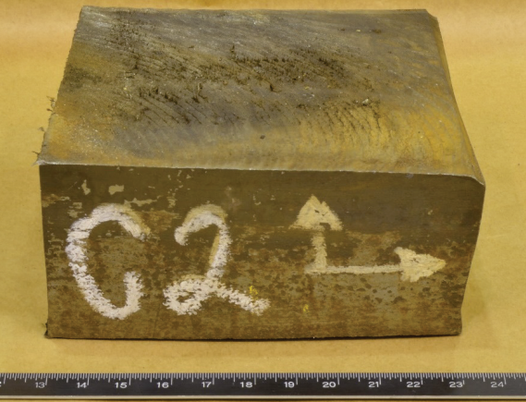
FY 2024 Sample ACQUISITION: Light Water Reactor Sustainability Program
Zion Nuclear Power Plant Reactor Pressure Vessel Material
Weld
Beltline weld

Slide 13
Value Assessment Process
Step 1: Donor
Provide relevant details regarding the potential donation
Sample geometry and dimensions, weight
Materials certification
Composition (chemical and radioactive)
Irradiation condition (temperature, dose, flux, fluence, environment, duration)
Fabrication (methodology, processing parameters)
Provenance/history
    Harvested
    Experiment name/cycle(s)/logical designation
Properties (mechanical, physical, etc.)
Current condition (contaminated, degraded, time-critical etc.)
Burnup/irradiation history (for fuel samples) if available
Related reports and publications
Step 2: NSUF Chief Scientists
Determine the value of offered samples/materials.
Provide Justification for score (include references to evidence or further information, if applicable) Include sufficient detail to document relevant issues/concerns.
Is there supporting information/context for the sample/set of samples concerning provenance and baseline (unirradiated) material? 0 – 25points
Does the sample/set of samples support a nuclear energy initiative or have any other known and ongoing purpose? 0 – 10 points
Is the sample/set of samples difficult to reproduce? 0 – 10 points
Is the sample/set of samples unique? Does it have unique characteristics/contain unique information? 0 – 20 points
Is the sample/set of samples in adequate condition for any ongoing purposes for which it is, or might be, required? 0 – 10 points
Can the sample/set of samples remain at its present location? What would be the cost or burden associated with keeping the sample/set of samples at its present location or must the samples be transferred to the INL? 0 – 10 points
Are there major issues involved in accessing, handling, transporting and/or storing the sample/set of samples? 0 – 15 points

Slide 14
Value Assessment Process
Step 3: NSUF Management and Chief Scientists
Overall Value Assessment | Decision
Red | Sample/set of samples is of no present or future use to NSUF, and/or could be easily reproduced if needed. The cost of keeping the sample far outweighs any potential value. (0 – 49)
Amber | Uncertain value, needs further consideration (50 – 79) Amber should only be used as a holding category, i.e. if it is anticipated that further work or subsequent developments will allow a Red or Green categorization to be assigned.
Green | High value, sample accepted (80 – 100) Sample/set of samples is considered useful to NSUF in the present and/or future and could not be easily reproduced. Its value outweighs the cost of keeping it.
Value Assessment:
Decision to accept, transfer to NSUF facility, reject:
Outcome of Value Assessment (overall Numerical score) | Reject – score Accept – score Uncertain – score
Outcome (endpoint reached, i.e. Accept, retain at current location, transfer to NSUF facility, or Reject

