Slide 1


In-situ Irradiation of Uranium Carbide and Zirconium Carbide
The 2025 NSUF Annual Program Review
Rashed Almasri¹; Adrian Wagner²; Laura Hawkins²; Wei-Ying Chen³; Yuhan Li⁴; Jian Gan² ; Lingfeng He¹
¹North Carolina State University
²Idaho National Laboratory
³Argonne National Laboratory
⁴University of Michigan
4-16-2025

Slide 2
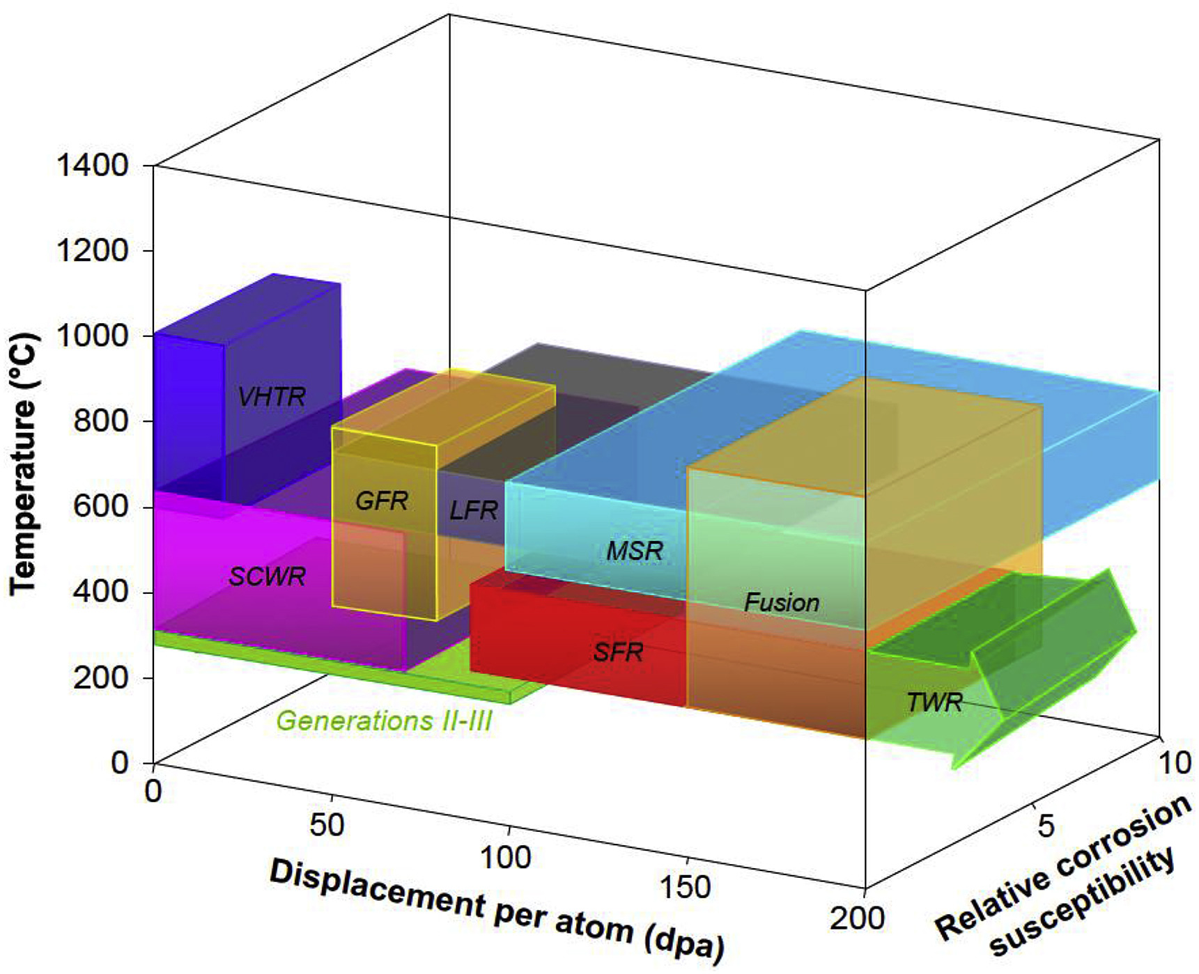
Introduction
UC as a Promising Nuclear Fuel
Historical Context:
Developed in mid-20th century for NASA’s NERVA program; valued for high thermal conductivity and uranium density. Later explored for molten salt/sodium-cooled fast reactors.
Shift to UO₂:
UO₂ became industry standard due to stability and compatibility with light water reactors (LWRs).
Resurgence in Advanced Reactors:
UC regains attention for Generation IV systems (e.g., gas-cooled fast reactors, VHTRs) and TRISO fuels (e.g., UCO kernels).
Placement of various advanced reactor concepts on scales describing the ranges of values of components of the environment for core materials¹
¹G. Was, et al. 2019

Slide 3
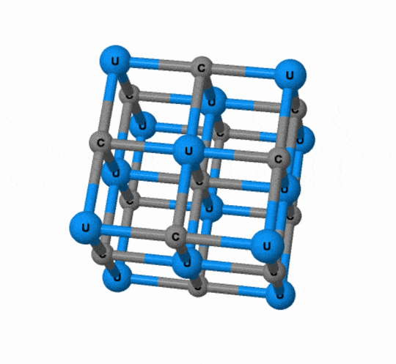
Introduction
Advantages of UC over UO₂
Superior Properties:
Higher uranium density (12.9 vs. 9.7 g/cm³) and thermal conductivity (22 vs. 3 W/m·K at 1200 K).
Design Benefits:
Enables compact cores, reduces thermal gradients, and mitigates melting risks.
Material Compatibility:
Stable with SiC/ZrC cladding (e.g., proposed in General Atomics’ EM2 reactor).
The crystal structure of UC¹
¹University of Liverpool. (2024). ChemTube3D.

Slide 4
Introduction
Knowledge Gap & Study Focus
Irradiation Performance:
Limited data on UC’s response to radiation (swelling, defect formation).
Research Approach:
In situ TEM analysis of radiation-induced defects (Xe/Kr ion irradiation) and swelling.
Comparison with UO₂:
Contrasts UC’s dynamic microstructural evolution with well-documented UO₂ behavior.

Slide 5
Introduction
Zirconium Carbide (ZrC)
High Melting Temperature: 3420 ºC, part of UHTCs (ultra-high temperature ceramics)¹.
Thermal & Electrical Conductivities: Higher than other materials.
Mechanical Properties: Excellent strength and durability.
Resistance & Absorption: Resistant to fission products and low neutron absorption cross-section.
It can be used as:
  Inert fuel matrix for GFRs²
  Oxygen-getter for microencapsulated fuels³
  Cladding alternative for advanced reactors⁴
  Fission product barrier in TRISO fuel particles⁵
¹I. L. Shabalin, 2019.
²G. Vasudevamurthy et al., 2008.
³D. Wongsawaeng, 2010.
⁴K. A. Terrani, 2018.
⁵I. E. Porter, et al., 2018.

Slide 6
Experimental
Sample Preparation
Synthesis:
  Single-phase UC synthesized and sintered at Idaho National Laboratory (INL).
Purity Validation:
  XRD analysis confirms high-purity UC.
Microstructure Characterization:
  Optical microscopy reveals a high-density as-sintered pellet with equiaxed grains (10s to >100 µm in size).
TEM Sample Preparation:
  TEM lamellas prepared via the Focused Ion Beam (FIB) technique (FEI Quanta 3D FIB).
  Mounted on molybdenum (Mo) grids at INL’s Irradiated Materials Characterization Laboratory (IMCL).

Slide 7
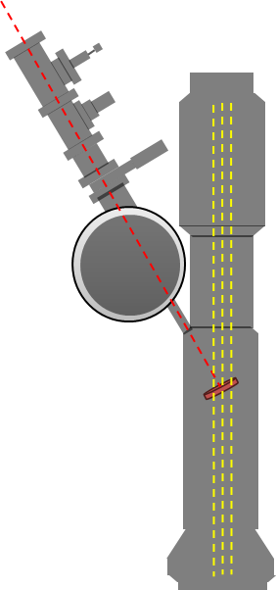
Experimental
In-Situ Ion Irradiation:
  Conducted using the Intermediate Voltage Electron Microscope (IVEM) at Argonne National Laboratory (ANL)
Microstructural Evolution Analysis:
  In-situ TEM images captured at multiple irradiation doses.
  Manual quantification of dislocation loops and Xe bubbles:
    Diameters measured individually.
    Densities calculated using ImageJ software¹.
Kr⁺⁺/Xe⁺
e⁻ beam
Ion | Temperature °C | Final Dose ions/cm²
1 MeV Kr²⁺ | 300 | 9.38 × 10¹⁴
 | 600
300 keV Xe⁺ | 300 | 2.5 × 10¹⁵
 | 600
 | 900
¹M.D. Abràmoff, et al., 2004.

Slide 8
Experimental
Sample Thickness Measurement:
  Electron Energy Loss Spectroscopy (EELS) applied to determine sample thickness¹.
Advanced Characterization:
  Elemental distribution analyzed via 200 kV FEI Titan TEM equipped with ChemiSTEM™ technology.
SRIM Simulations:
  Simulated depth profiles and atomic displacements using Kinchin-Pease mode:
Kr⁺⁺
Xe⁺
¹T. Malis, et al., 1988

Slide 9
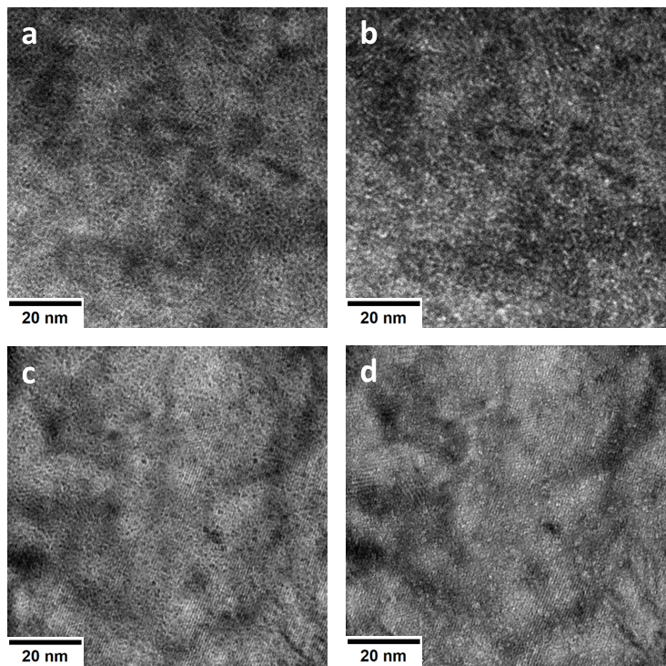
Results
Dose (dpa) | Temp (°C) | Swell (%) | Average Size (nm)
9.3 | 600 | 0.36 | 1.14±0.26
9.3 | 900 | 0.6 | 1.34±0.39
While there is expected to be an increase in bubble sizes and swelling at higher temperatures, our samples showed only marginal changes.
Xe bubble formation at a) 600 ºC under-focus and b) over-focus and at c) 900 ºC under-focus and d) overfocus, all by 1 micron.

Slide 10
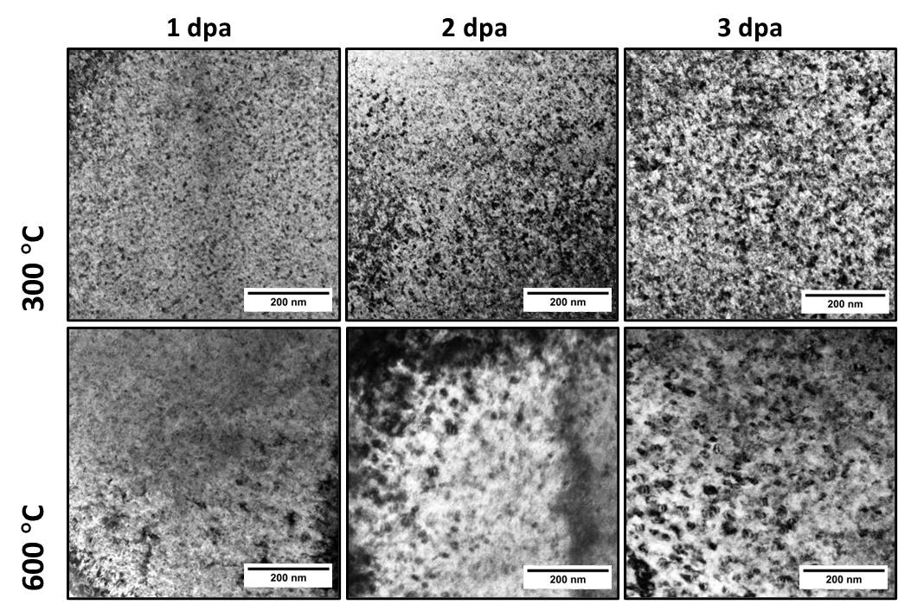
Results
TEM BF images in the two-beam condition showing the formation and evolution of dislocation loops about irradiation temperature and dose in the Kr irradiated samples.

Slide 11
Results
Dislocation loop density concerning irradiation dose
Dislocation loop size evolution with the irradiation dose

Slide 12
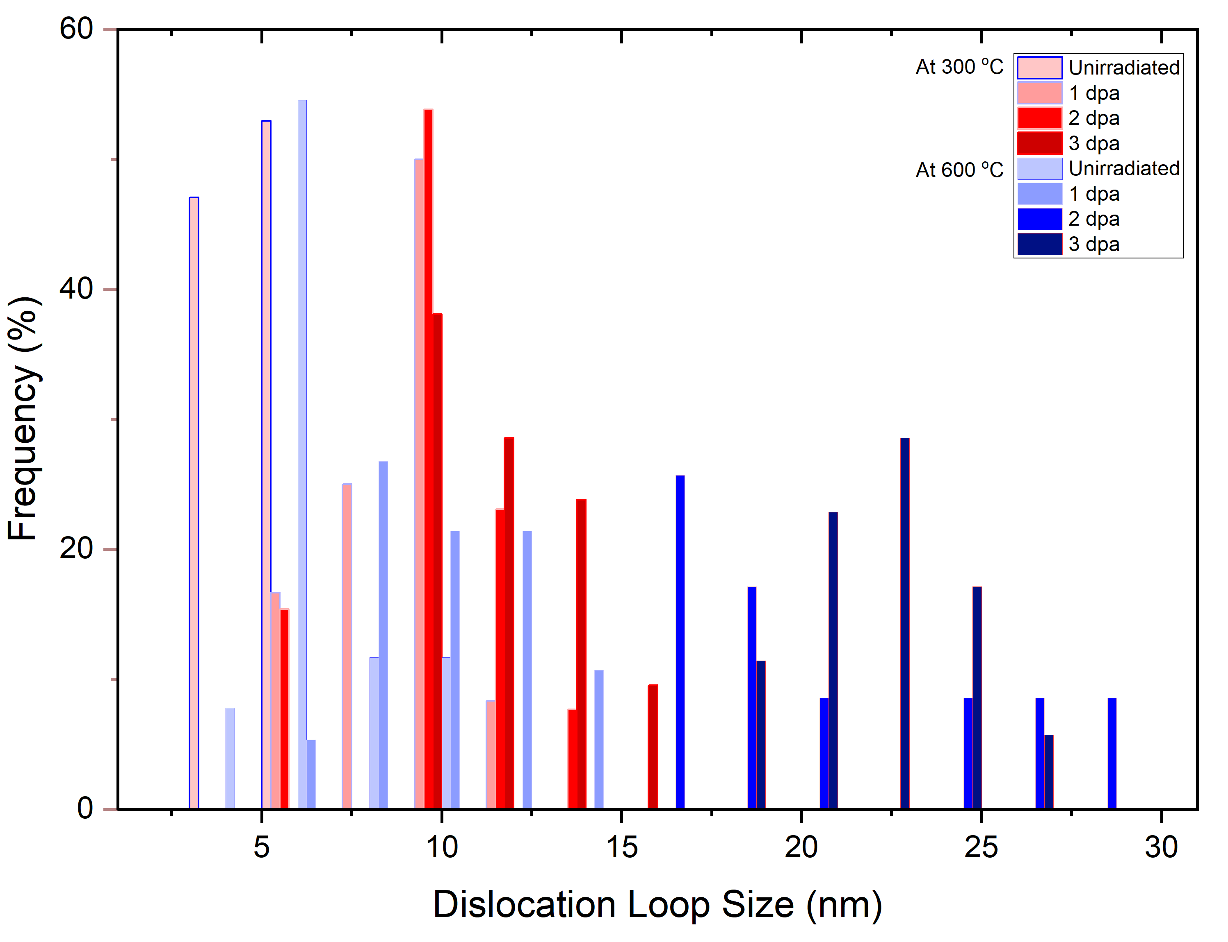
Results
Dislocation loop size frequency depending on the dose at 300 ºC and 600 ºC.

Slide 13
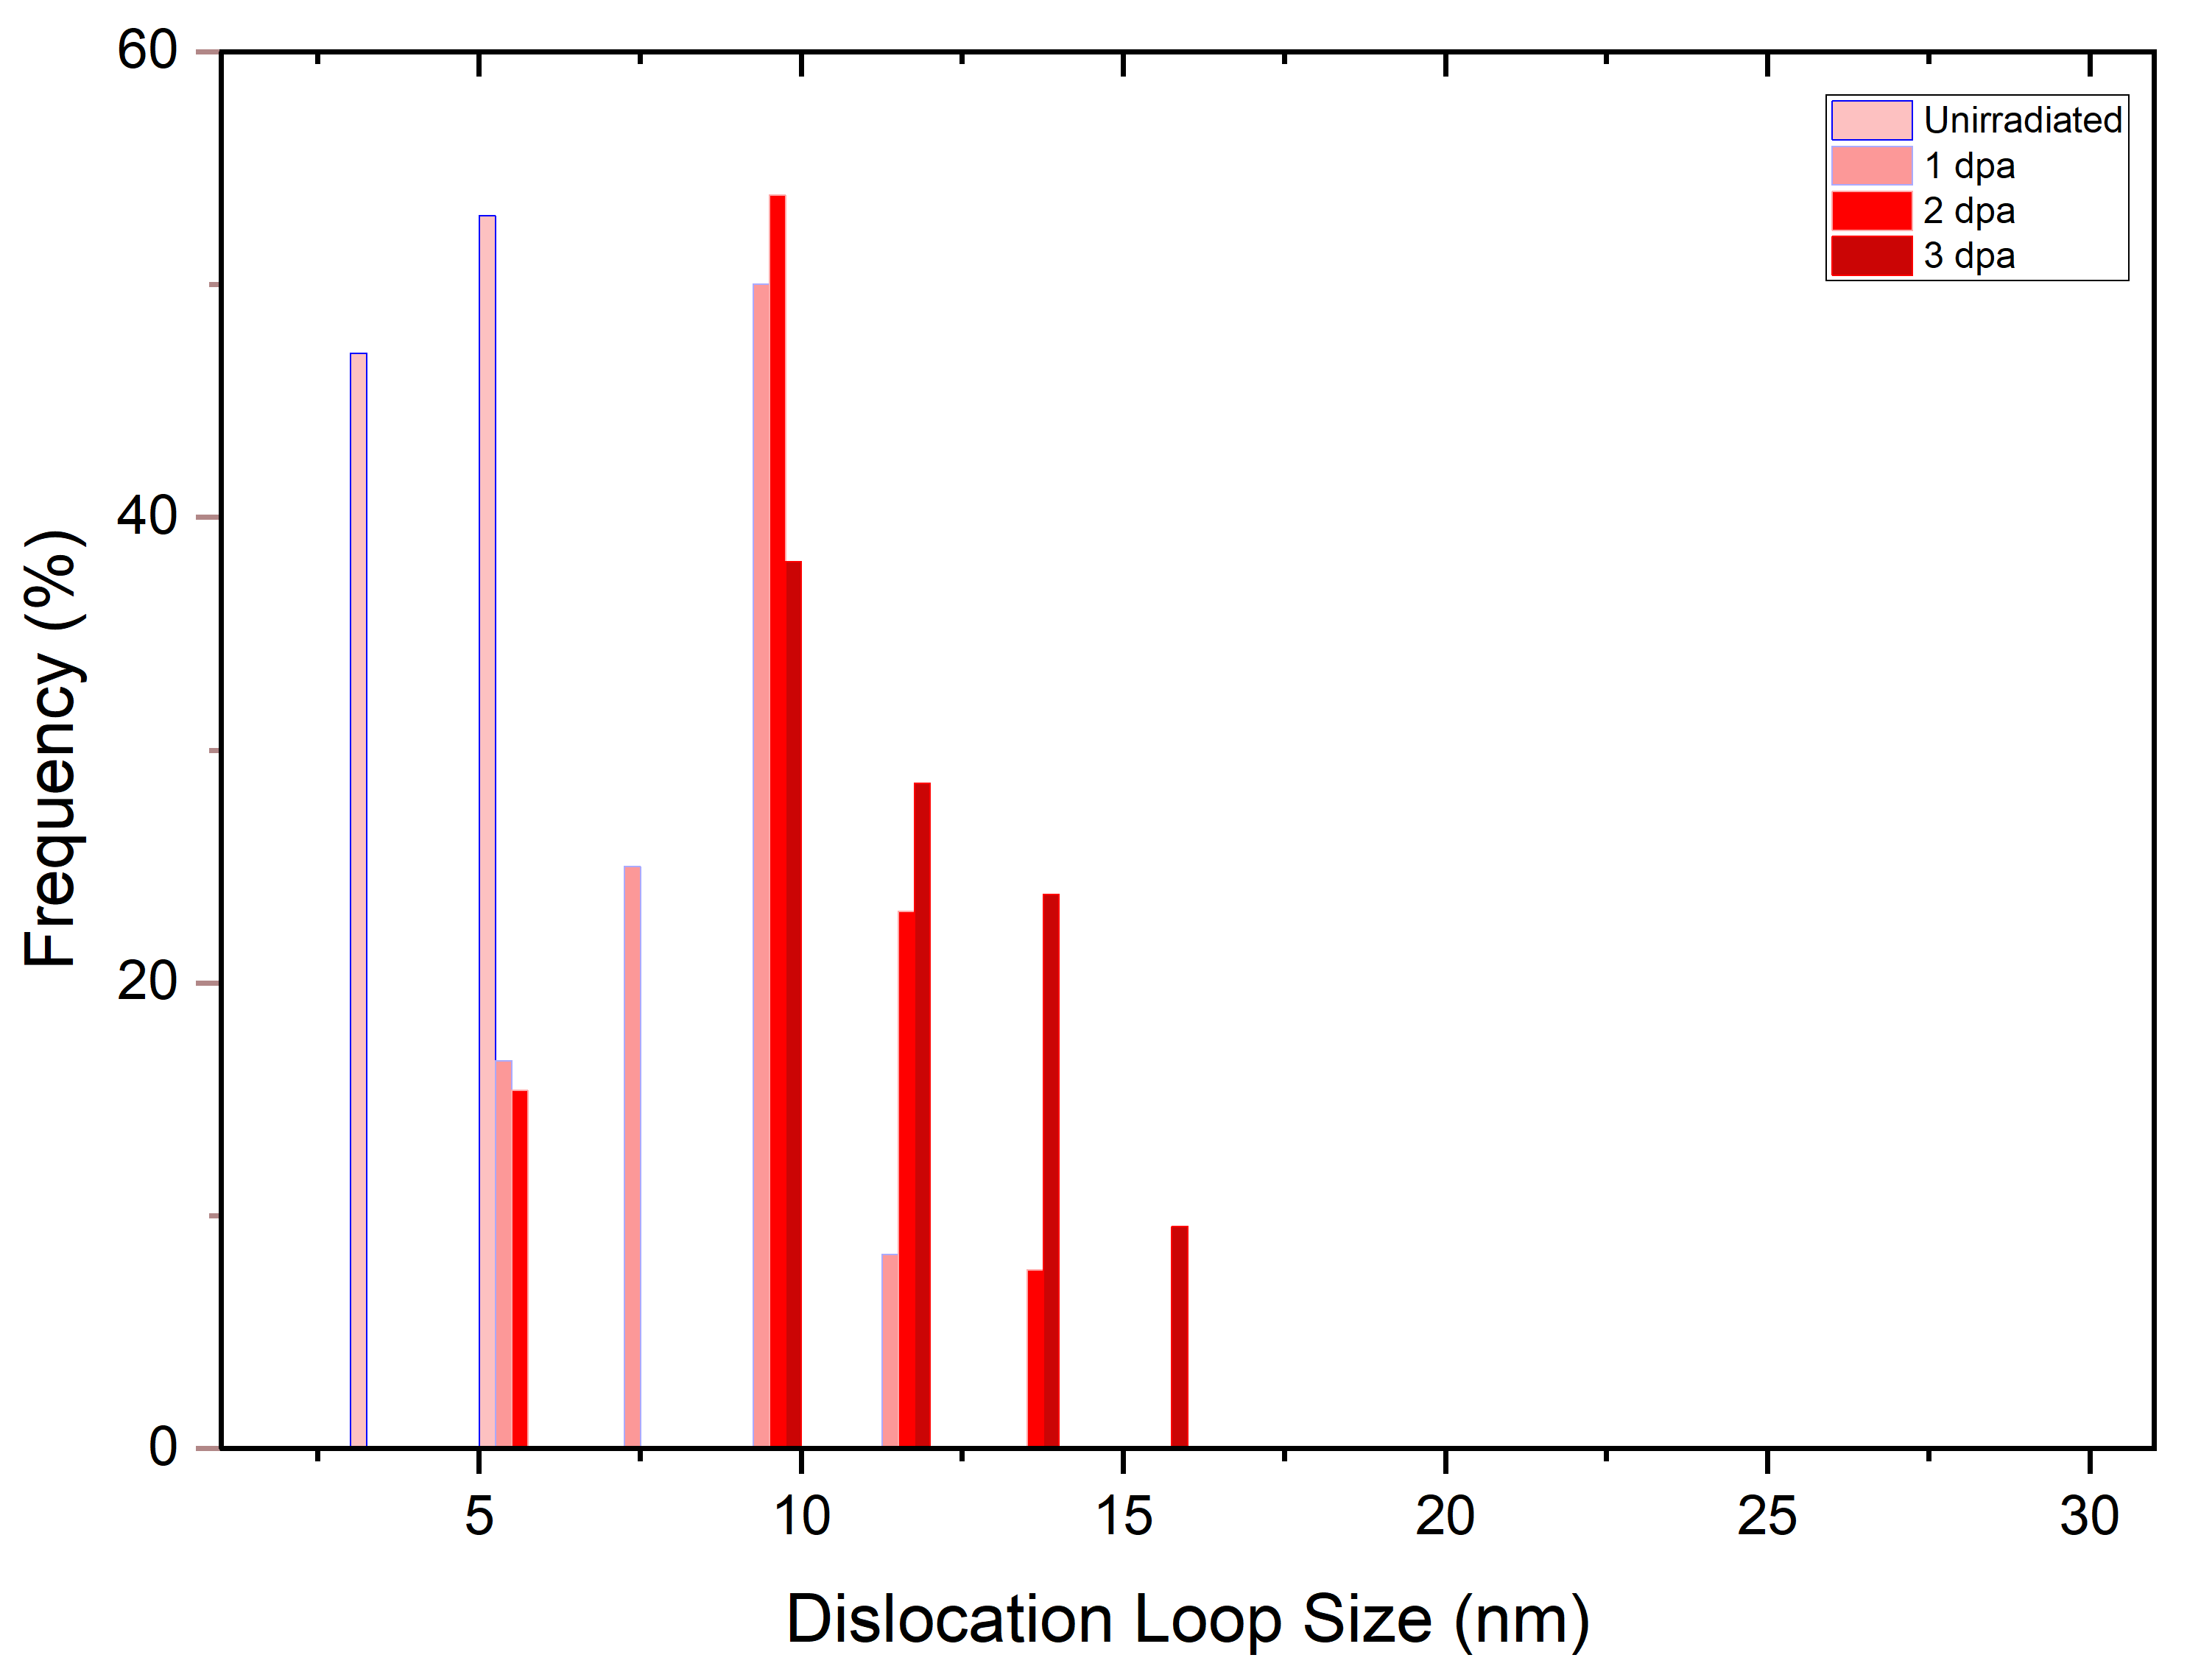
Results
Dislocation loop size frequency depending on the dose at 300 ºC and 600 ºC.

Slide 14
Results
Dislocation loop size frequency depending on the dose at 300 ºC and 600 ºC.

Slide 15
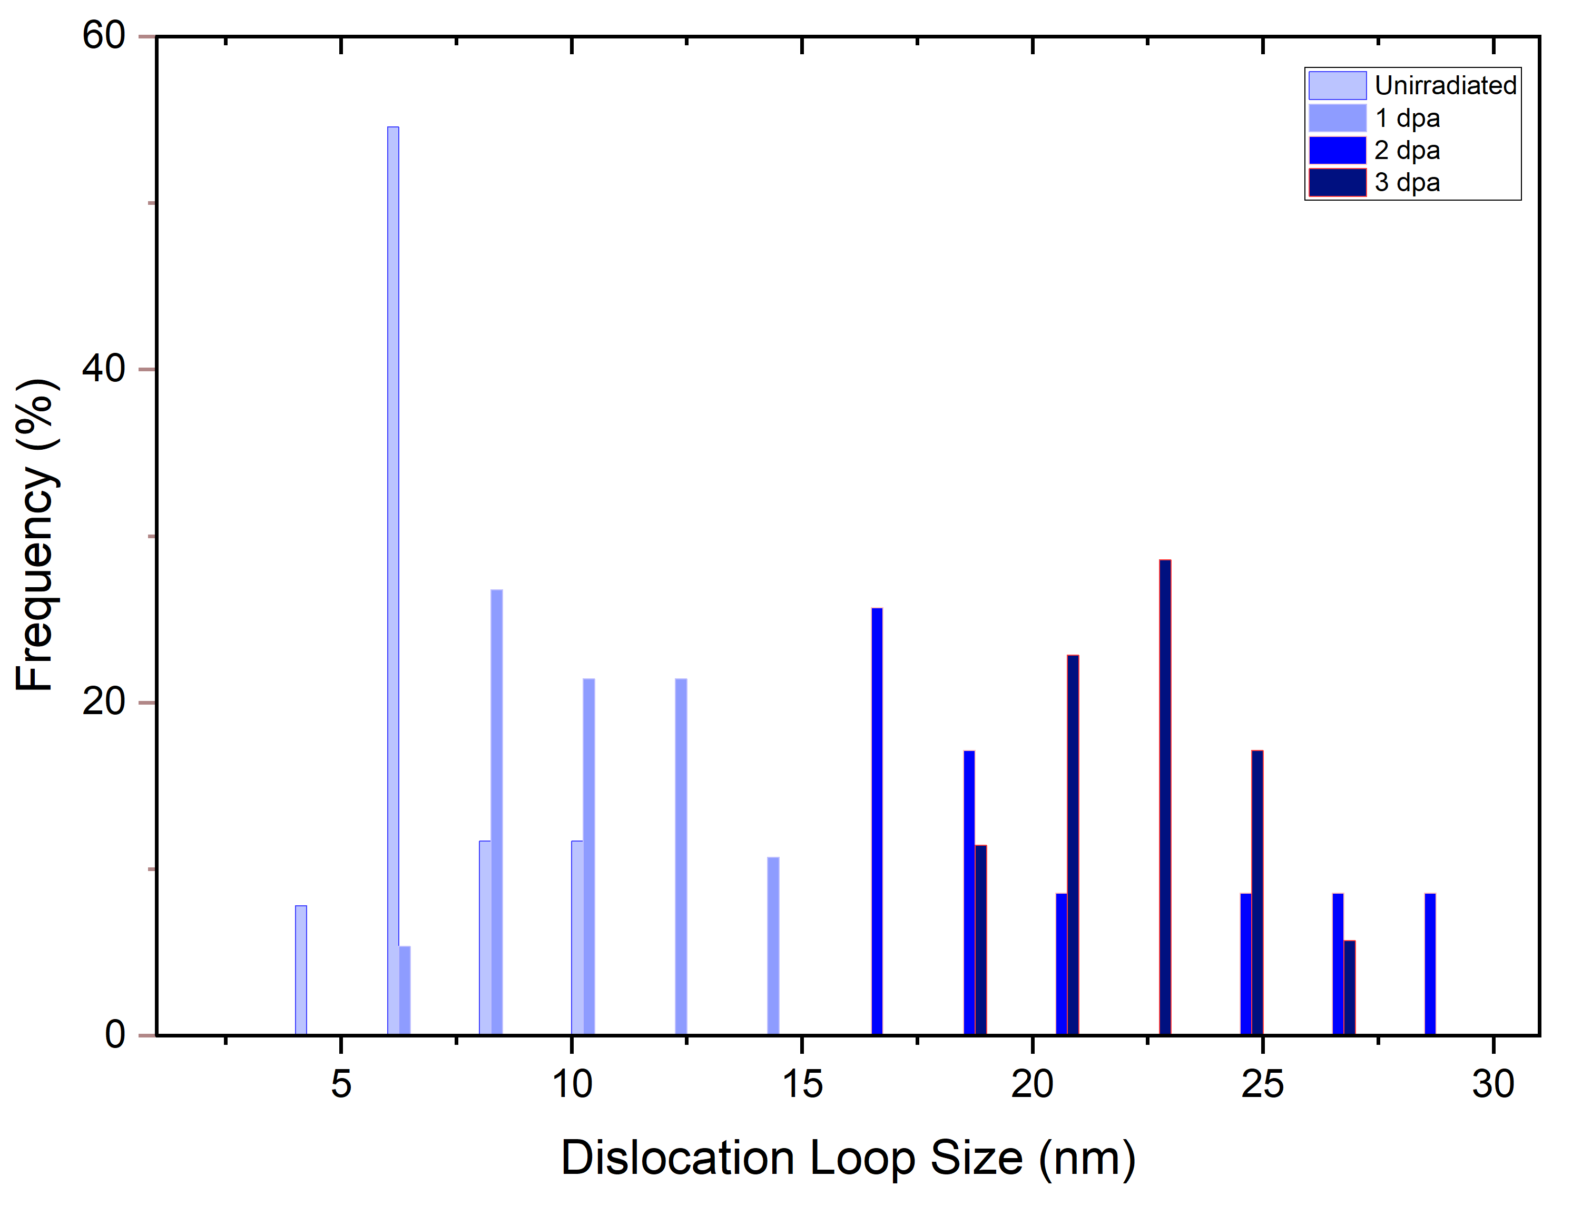
Results
Dislocation loop size frequency depending on the dose at 300 ºC and 600 ºC.

Slide 16
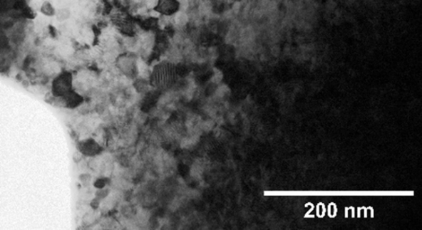
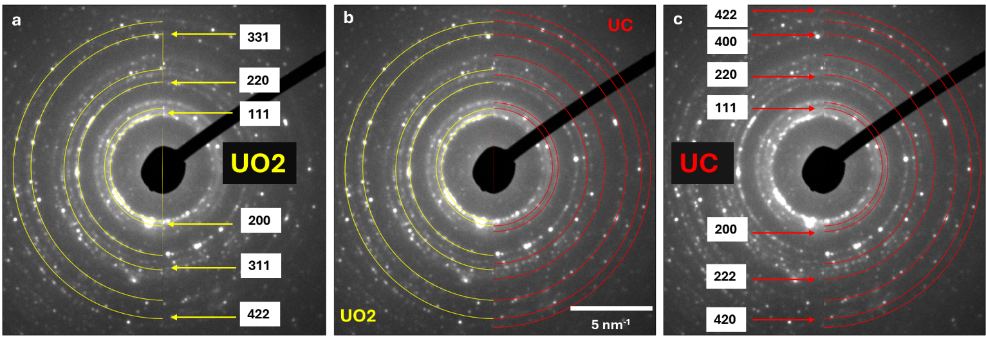
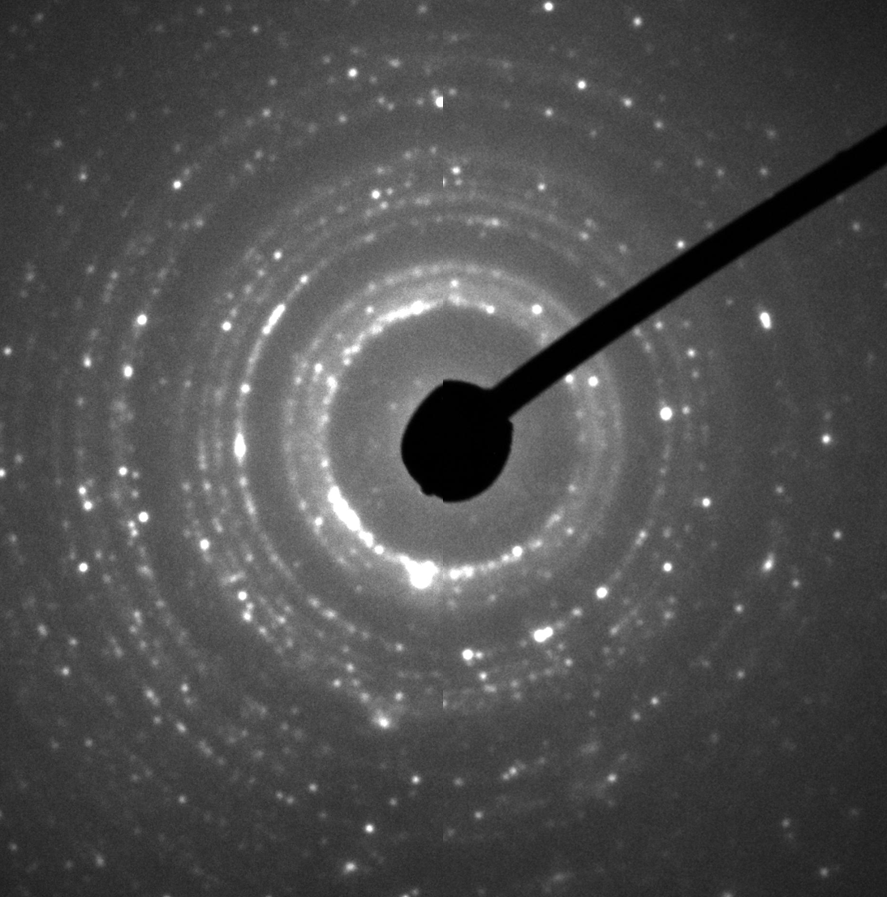
Results
Nanograin-like structure appears at thin regions after irradiation.

Slide 17
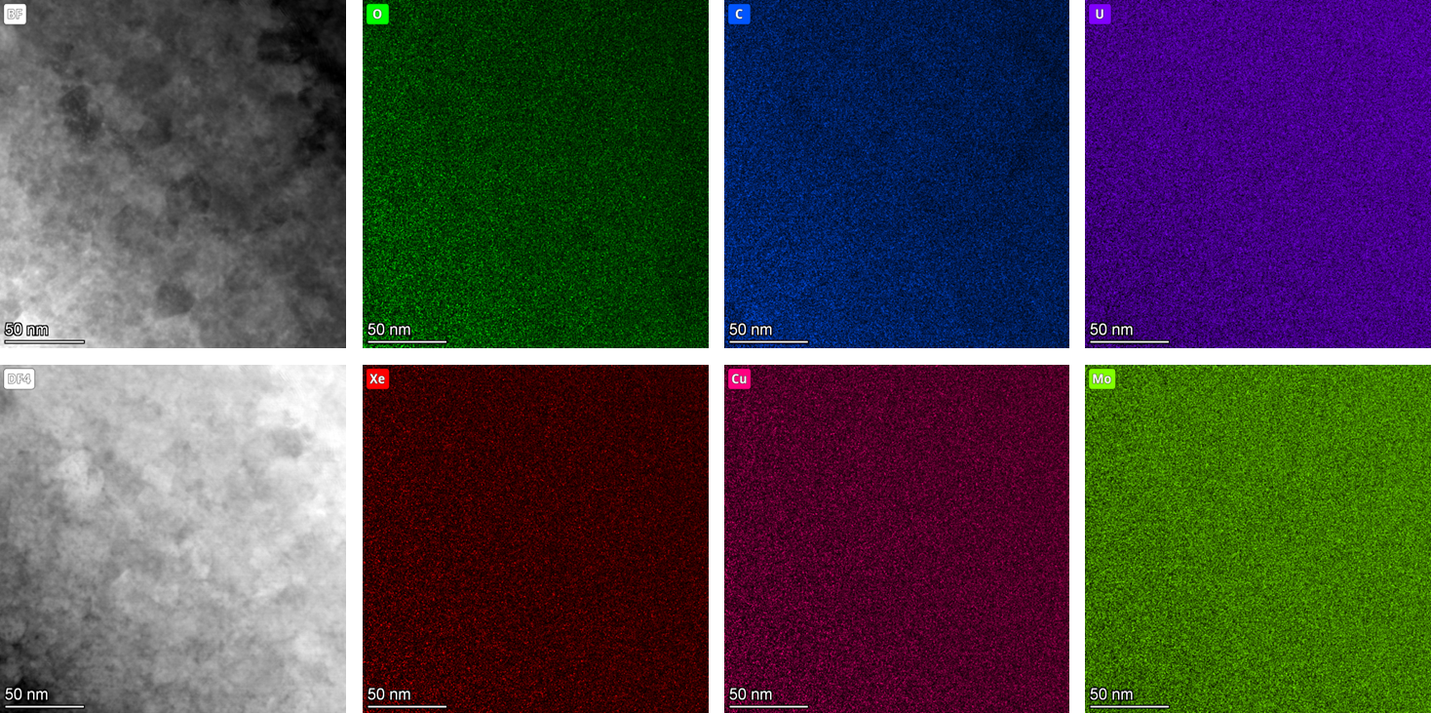
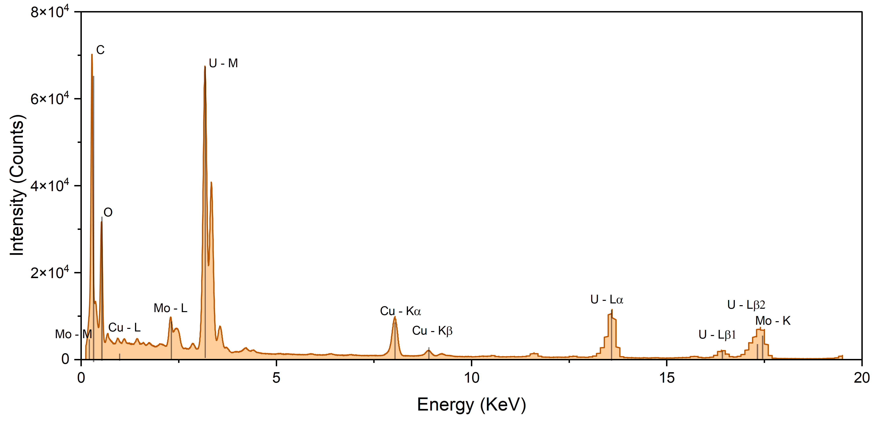
Results
EDS maps and spectrum for the nano-grained microstructure observed in UC irradiated at 600 oC
U - K

Slide 18
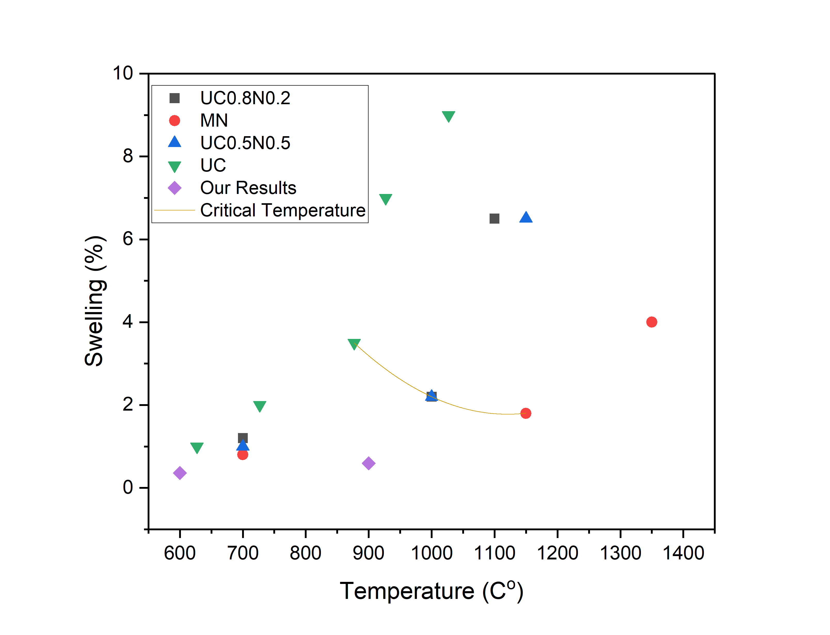
Discussion
Xe Bubble Formation & Swelling Behavior in Fuels
Bubble Size vs. Temperature:
  300 ºC: Bubbles too small for TEM detection.
  600 ºC & 900 ºC: Smaller bubbles vs. oxide fuels⁴.
Swelling Measurements Comparison:
  Carbide/nitride fuels: Early TEM (nano-bubbles) + optical imaging (larger bubbles).
  Swelling values slightly higher in literature but show slow rise until critical temperature (900–1150°C), then sharp increase.
Critical Temperature:
  Matches onset of extensive grain growth.
  Carbide fuels: Lower bubble concentration due to higher carbon self-diffusivity⁵.
Swelling data from other studies ^{1,2,3} compared to this work
¹C. Ronchi, et al., 1978.
²C. Ronchi, et al., 1975.
³H. Blank, et al., 1975.
⁴K. L. He, et al., 2015.
⁵H. Matzke, et al., 1977.

Slide 19
Discussion
Dislocation loop size comparison with UO2¹
Dislocation loop size comparison UN²
¹M. Kosmidou et al., 2025.
²L. F. He et al., 2013.

Slide 20
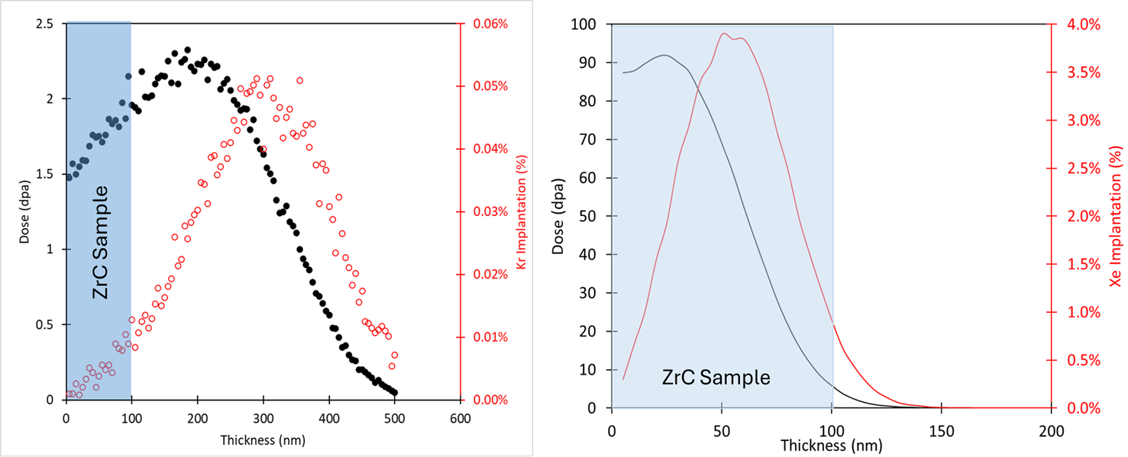
Zirconium Carbide
Damage profiles and ion implantation modeled using the Kinchin-Pease model in SRIM.
Final Kr-irradiation dose: 1.8 dpa with 0.0052% Kr implantation in ZrC.
Final Xe-irradiation dose: 57 dpa with 2.4% Xe implantation in ZrC.
Kr⁺⁺
Xe⁺

Slide 21
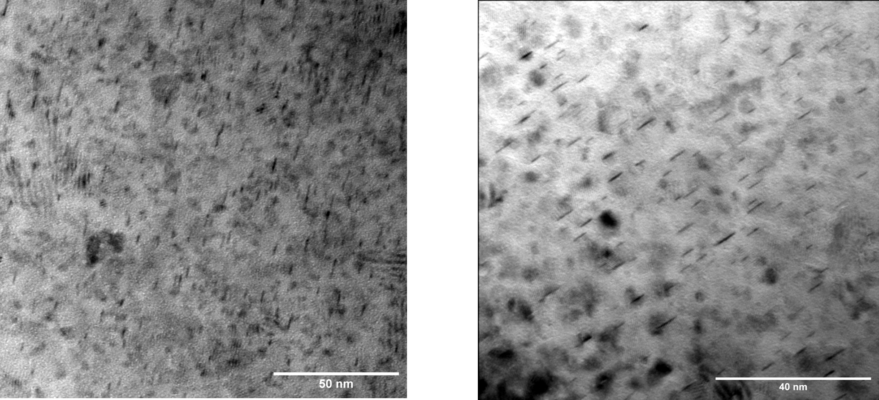
Zirconium Carbide
Dislocation loops in ZrC at 800ºC (left) and 1000ºC (right) at 1.8 dpa.

Slide 22
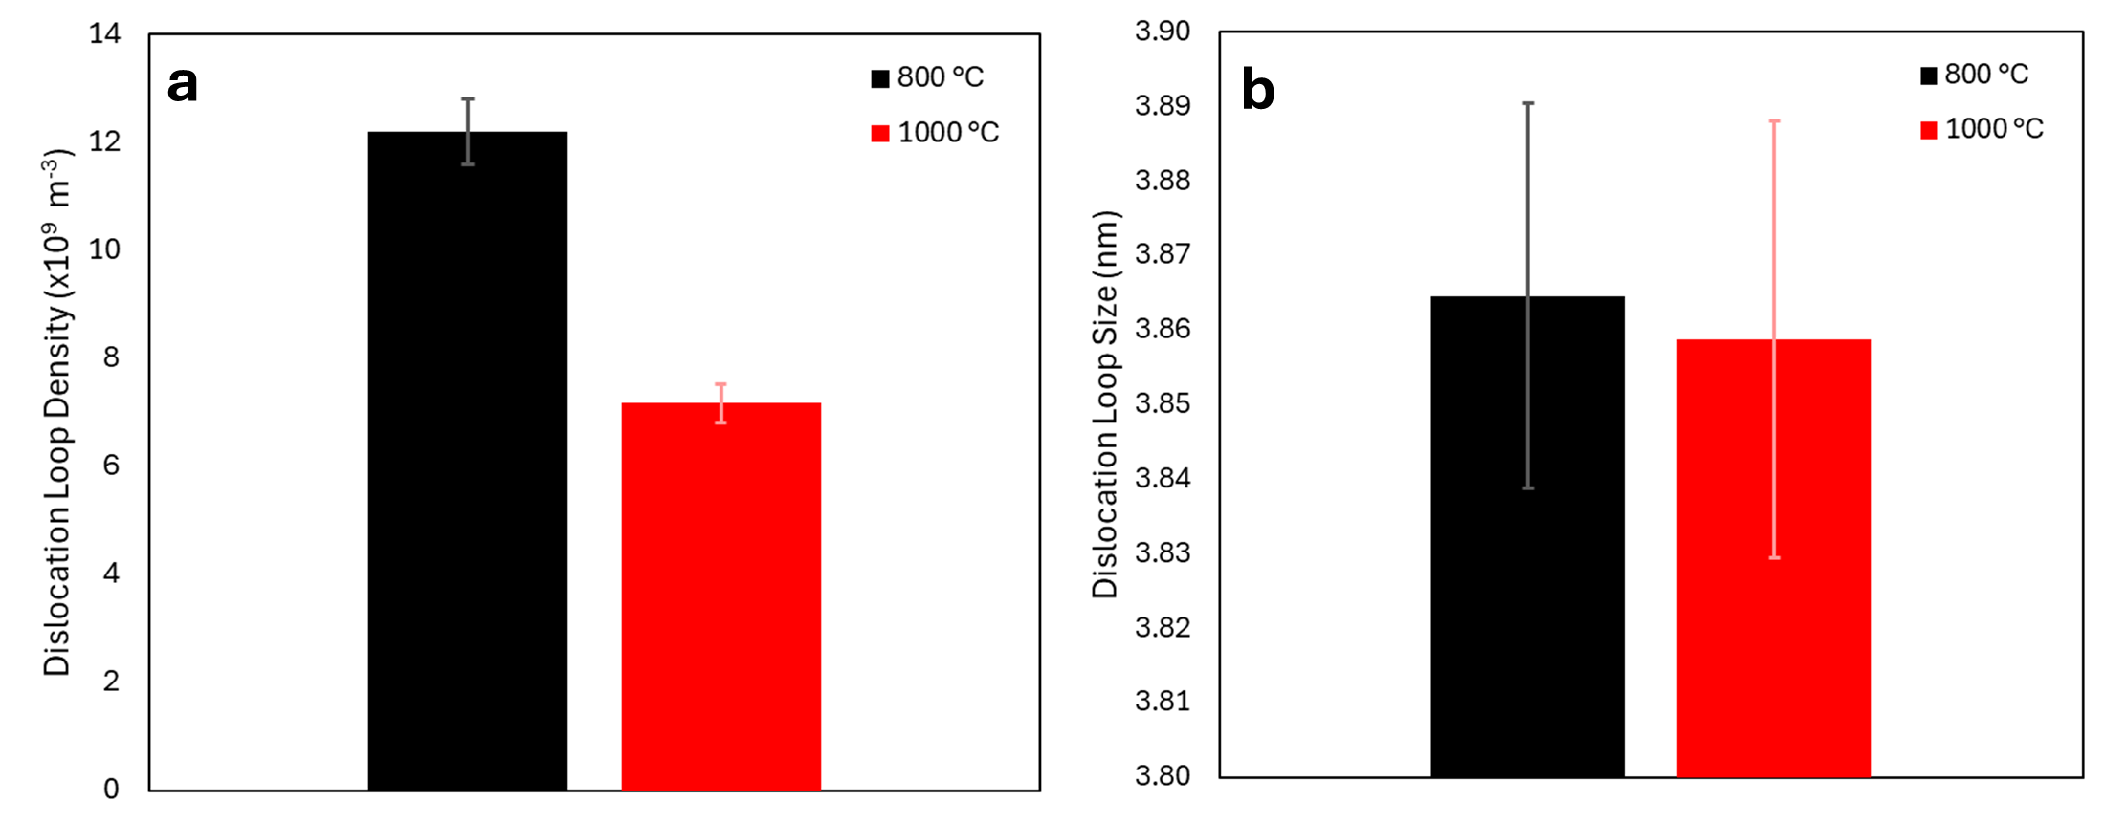
Zirconium Carbide
a) dislocation loop density and b) dislocation loop size analysis for ZrC irradiated up to 1.8 dpa at 800 ºC and 1000 ºC.

Slide 23
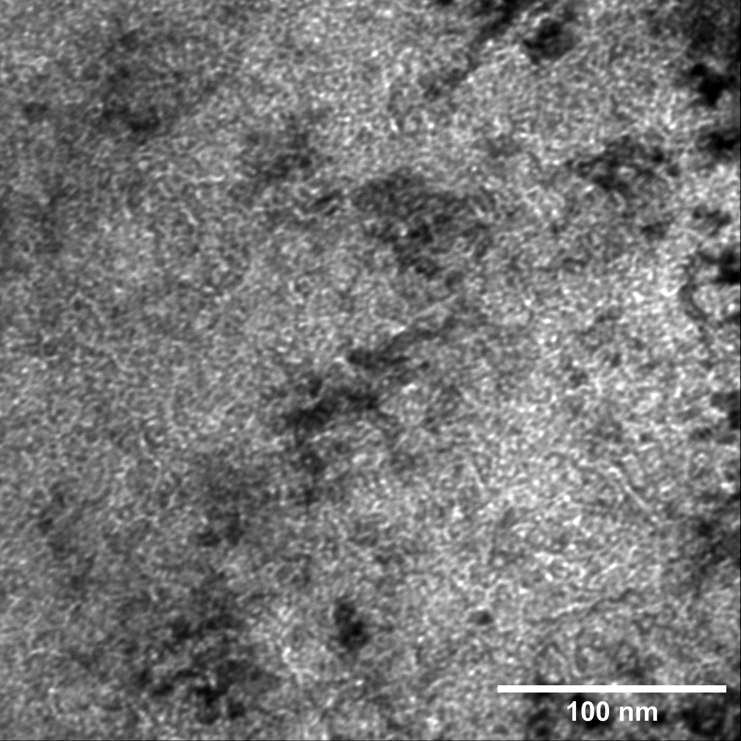
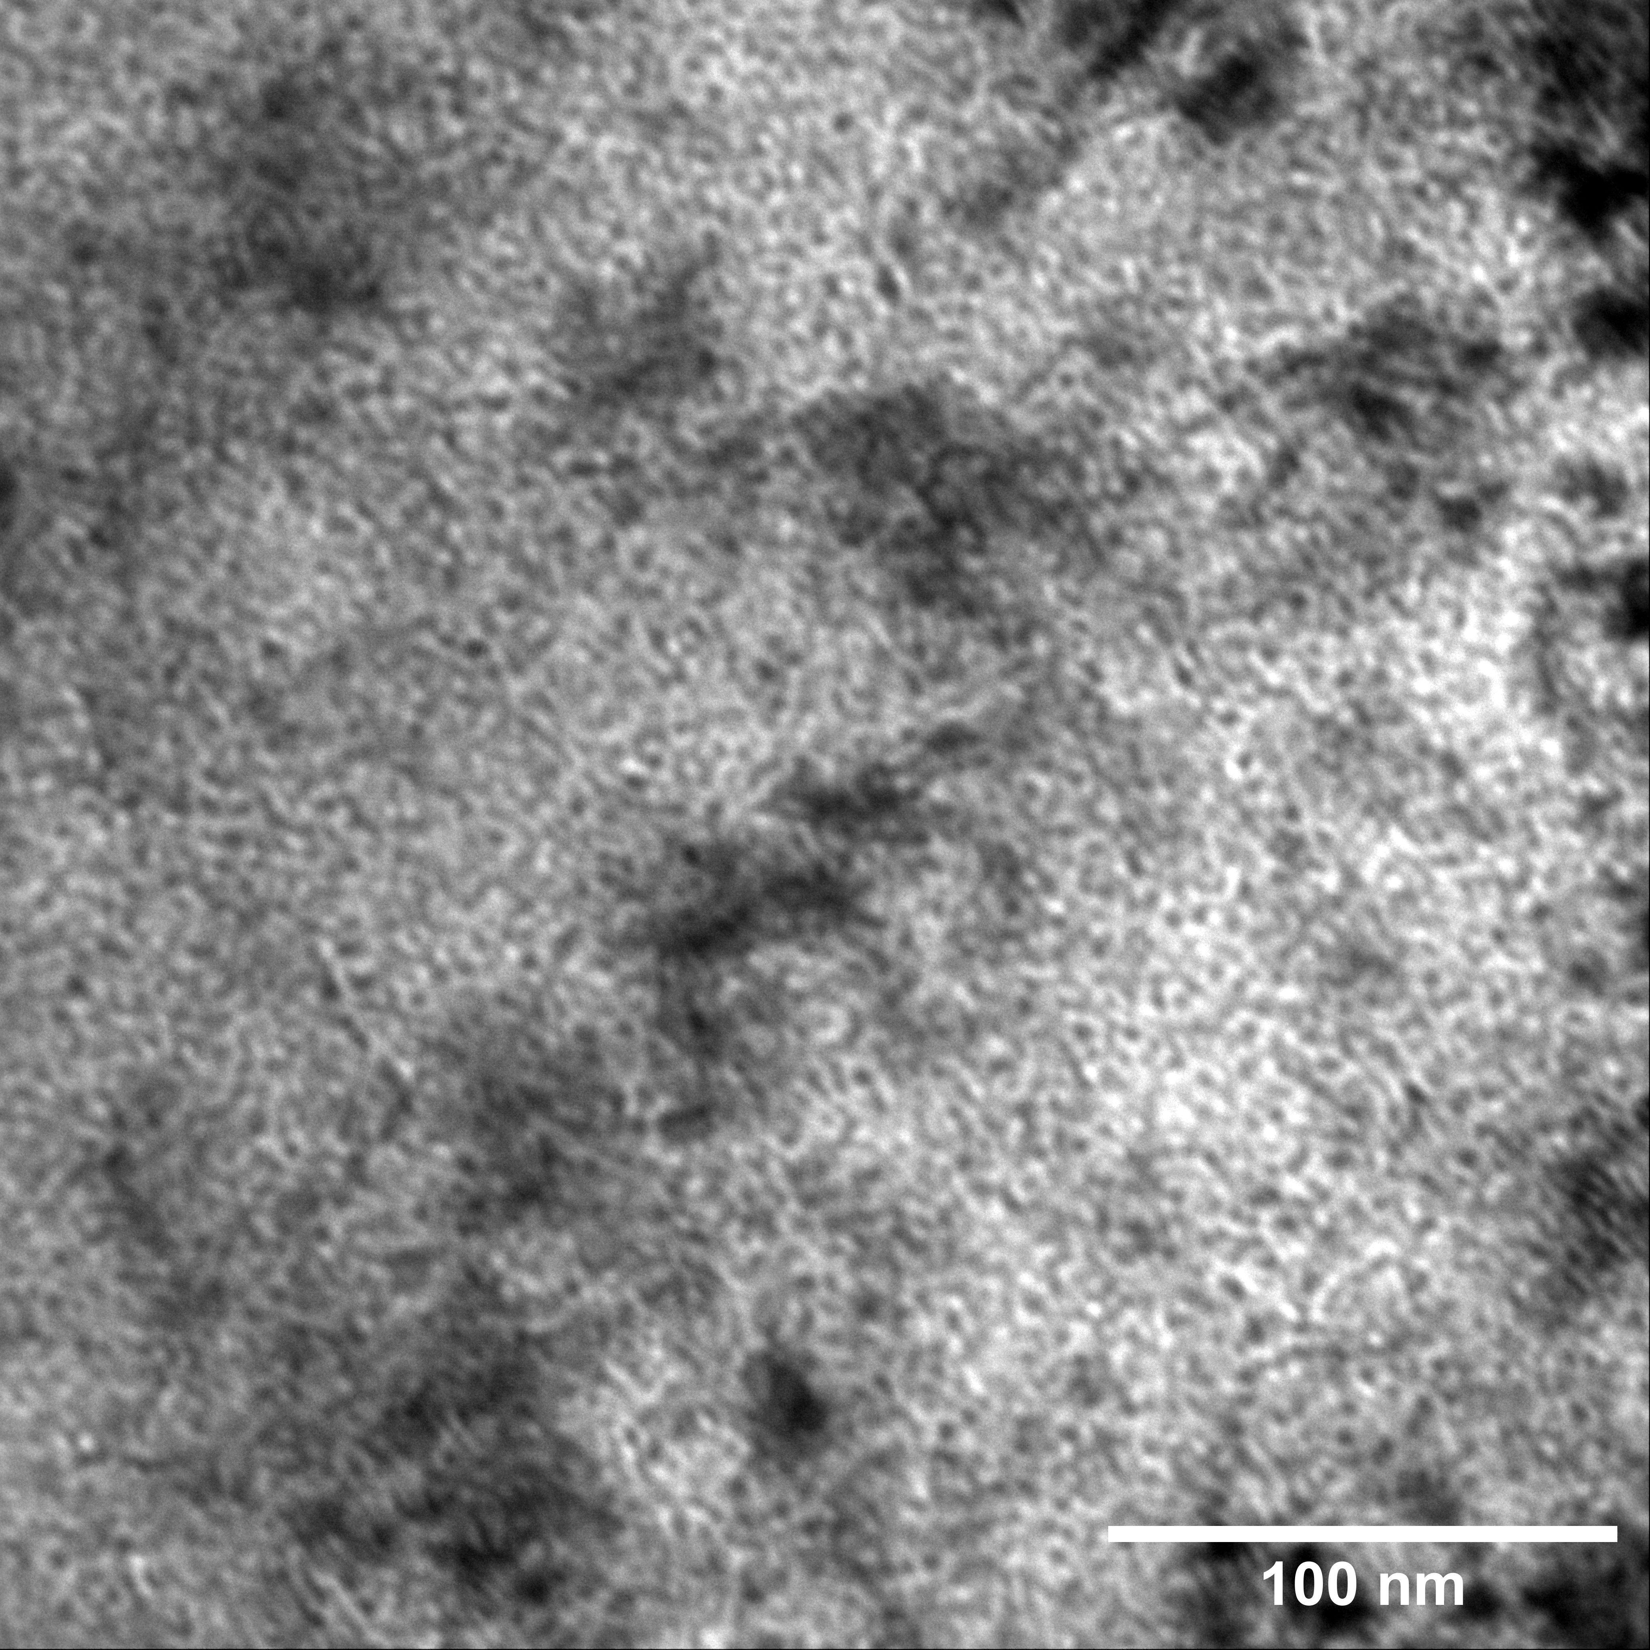
Zirconium Carbide
a
b
Size measurements of bubble and swelling for ZrC at 57 dpa and compared to UC.
 | T (ºC) | Dose (dpa) | Average Size (nm) | Swell (%)
ZrC | 800 | 57 | 3.4 | 0.6
UC | 600 | 9.3 | 1.1 | 0.4
 | 900 | 9.3 | 1.3 | 0.6
Xe bubble formation in a) ZrC under-focus and b) over-focus, with a defocusing of 1 microns.
ZrC showed very similar behavior to UC but at different doses, hinting that carbides might have similar swelling behavior.

Slide 24
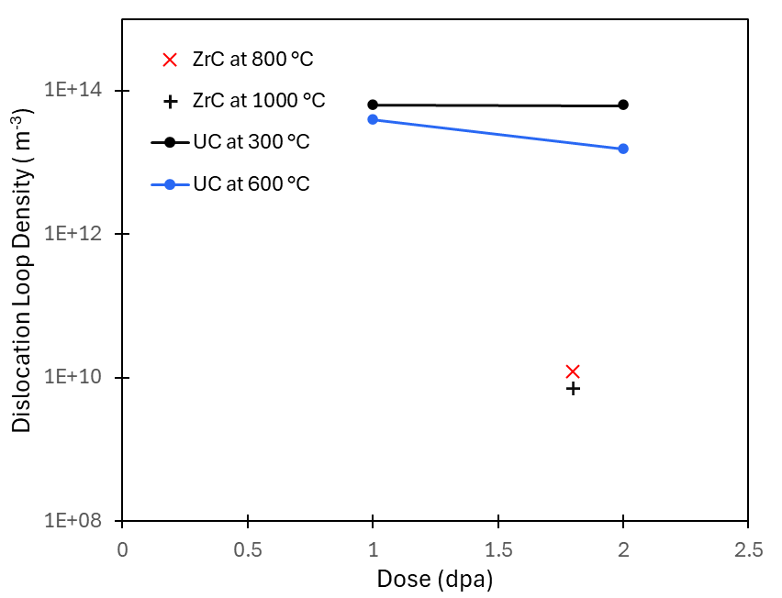
Zirconium Carbide
UC has shown a much higher dislocation loop density compared to ZrC.
This can be due to a difference in stoichiometry or a difference in interstitial diffusivity in the crystal lattice

Slide 25
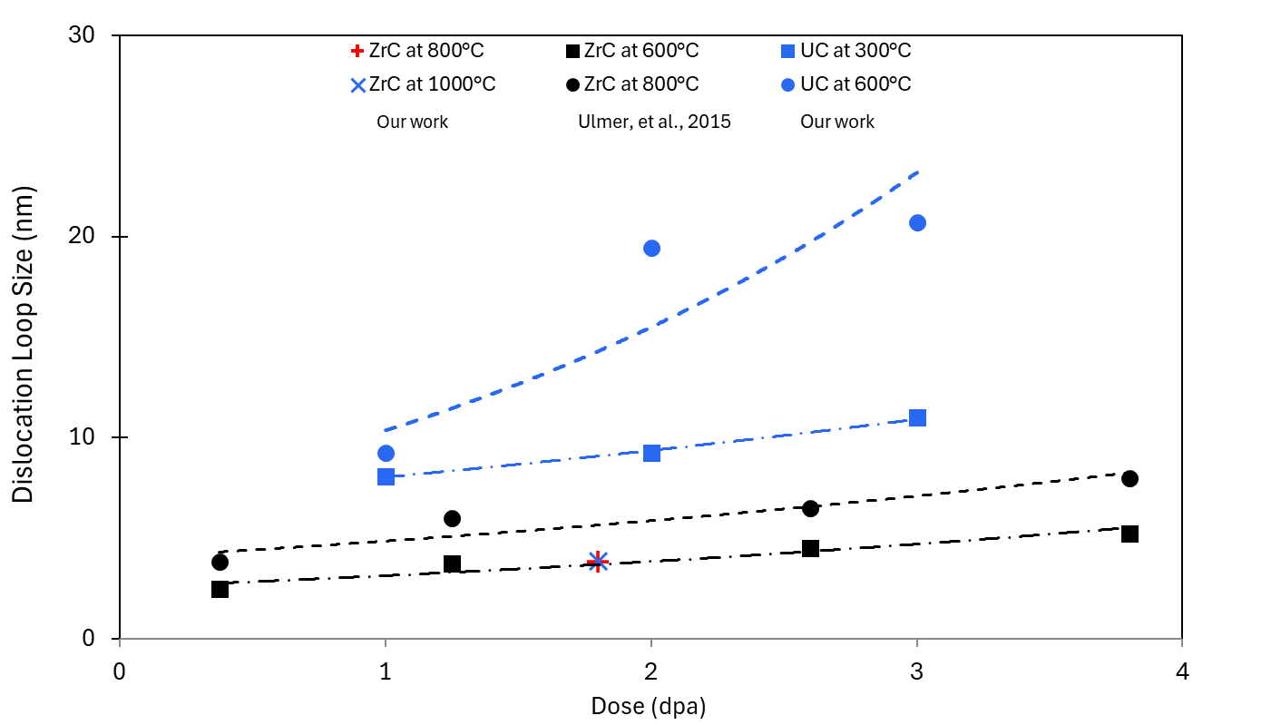
Zirconium Carbide
ZrC shows smaller dislocation loops compared to UC.
ZrC has high energy barriers to both the zirconium and carbon migration.
Additionally, ZrC is stable in single phase at the sub-stoichiometric ZrC_{1-x} which leaves a high concentration of carbon vacancies in the lattice that will combine with interstitials.
Dislocation loop size comparison for ZrC at 800 and 1000 ºC, UC at 300 and 600 ºC and ZrC at 600 and 800 ºC [1].
¹C.J. Ulmer, et al., 2004.

Slide 26
Conclusions
Xe Ion Irradiation (≤900°C)
Kr Ion Irradiation
Nano-grain Structures
Limited Xe bubble growth/mobility observed; temperature is the dominant factor.
Critical swelling temperature likely higher than tested range; future high-temperature experiments needed.
Dislocation loops formed similarly to oxide fuels.
Temperature (vs. dose) dominates loop growth:
  Peak loop density at 3 dpa (300°C) vs. 1 dpa (600°C).
Requires higher dose/temperature studies for mechanistic clarity.
Observed in thin irradiated regions; parallels seen in ZrC (outward deformation) and UO₂ (polygonization).
Formation mechanisms require targeted investigation.
ZrC Irradiation
Dislocation loop evolution in ZrC agreed with literature at lower temperatures.
ZrC exhibited microcracking, suggesting susceptibility to brittle fracture or stress accumulation under irradiation.
Future Work
Expand irradiation studies to higher temperatures/doses.
Probe nano-grain origins and implications for fuel performance

Slide 27




Acknowledgements
This work was supported by the U.S. Department of Energy, Office of Nuclear Energy under DOE Idaho Operations Office Contract DE-AC07-05ID14517 as part of Nuclear Science User Facilities awards #4721 & #4892.
This work was possible with the collaboration and hard work of everyone at NCSU, INL and ANL

Slide 28
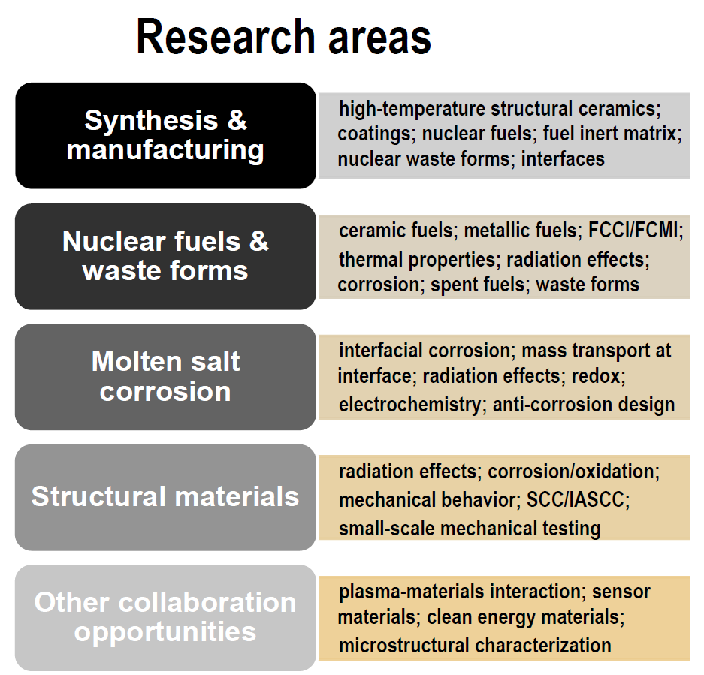
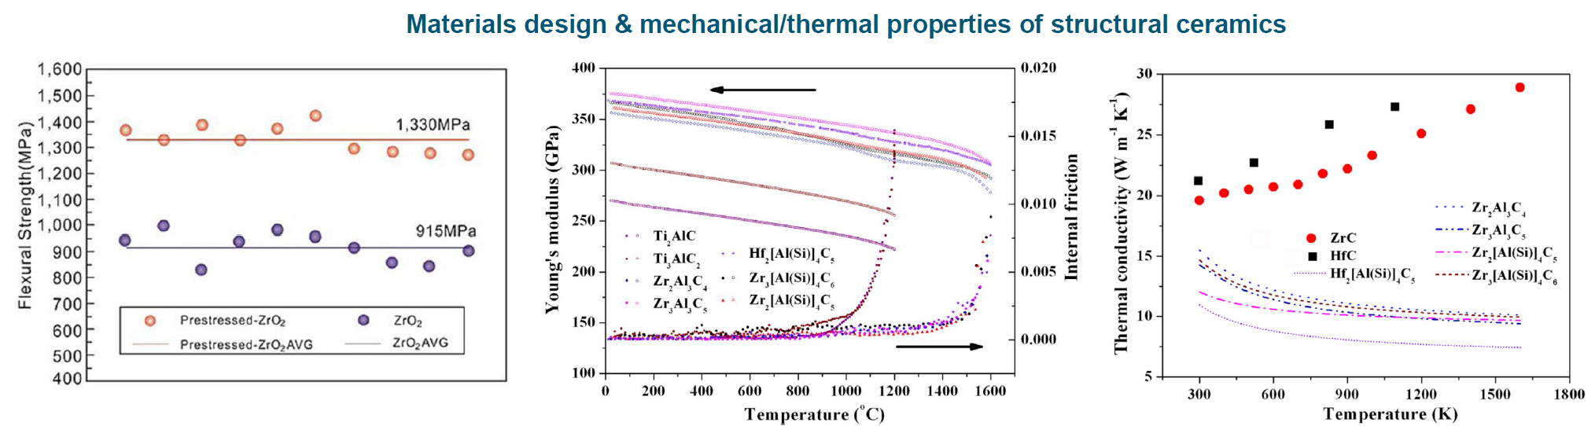
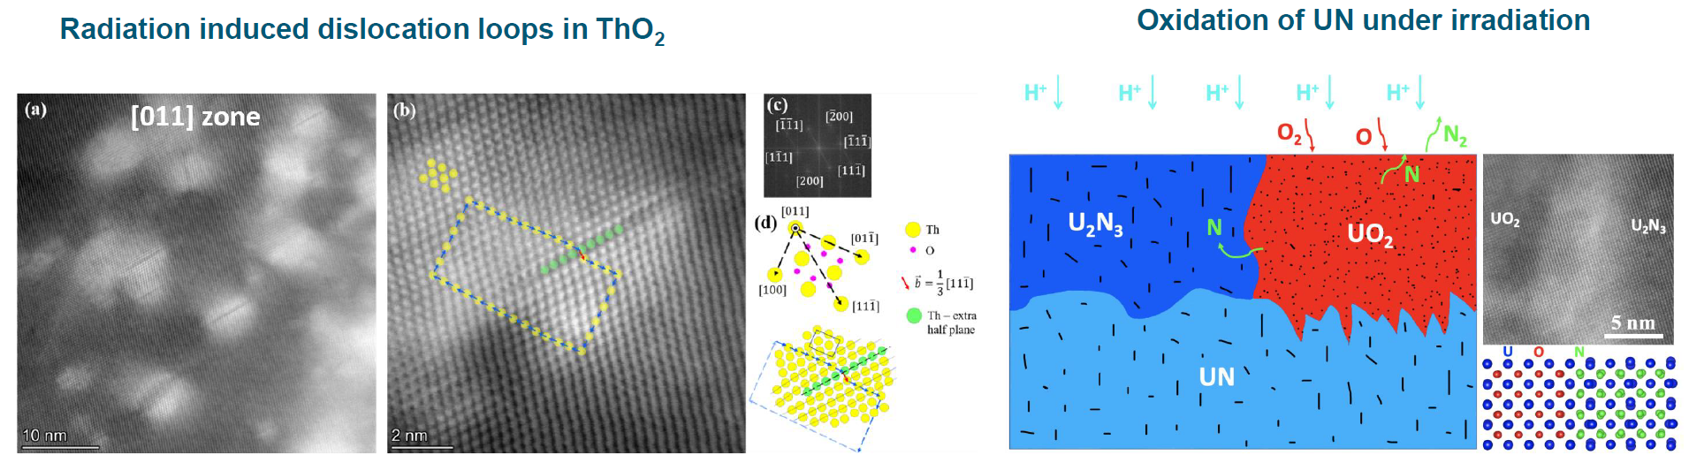
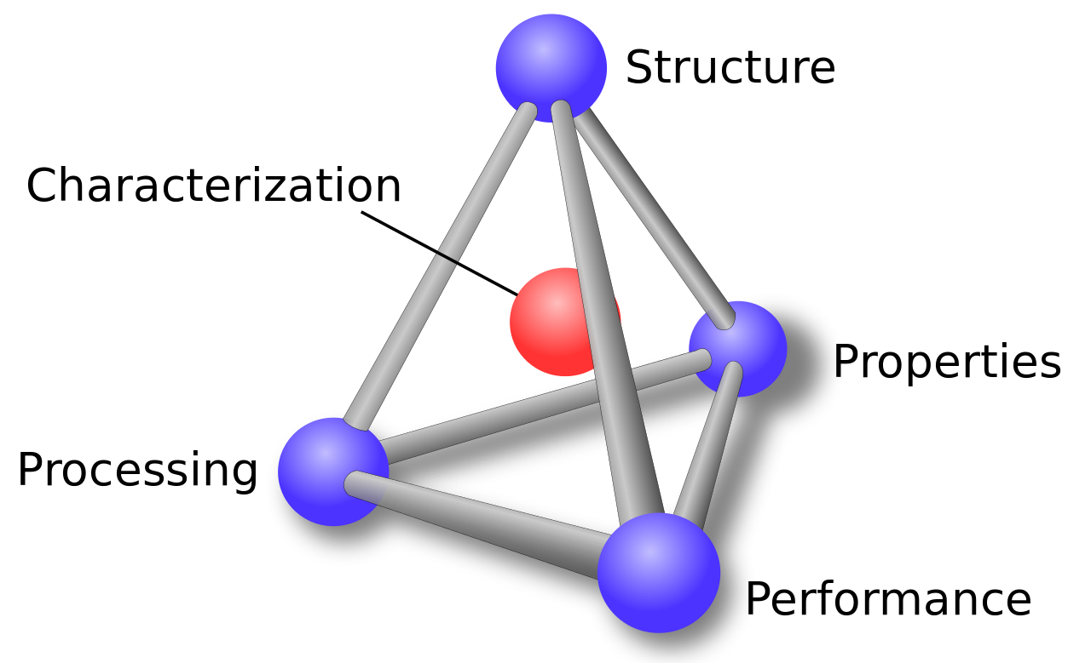
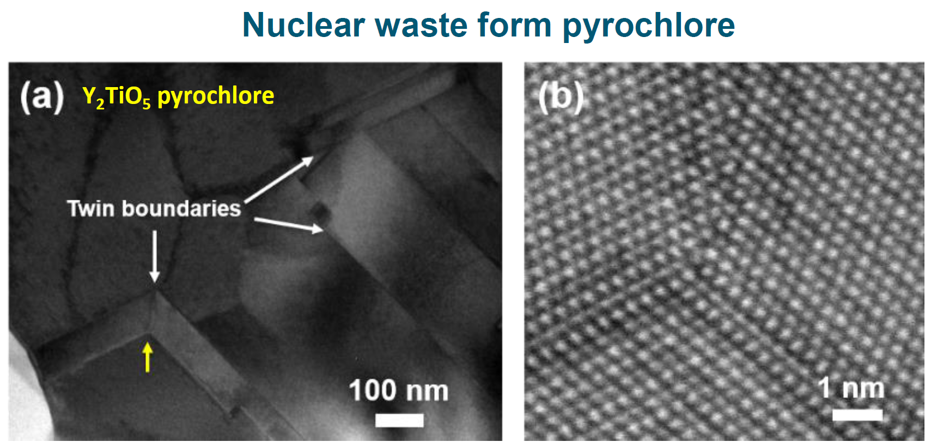
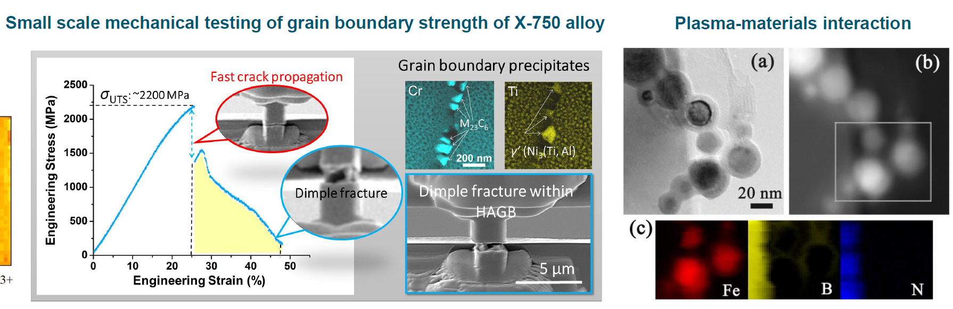
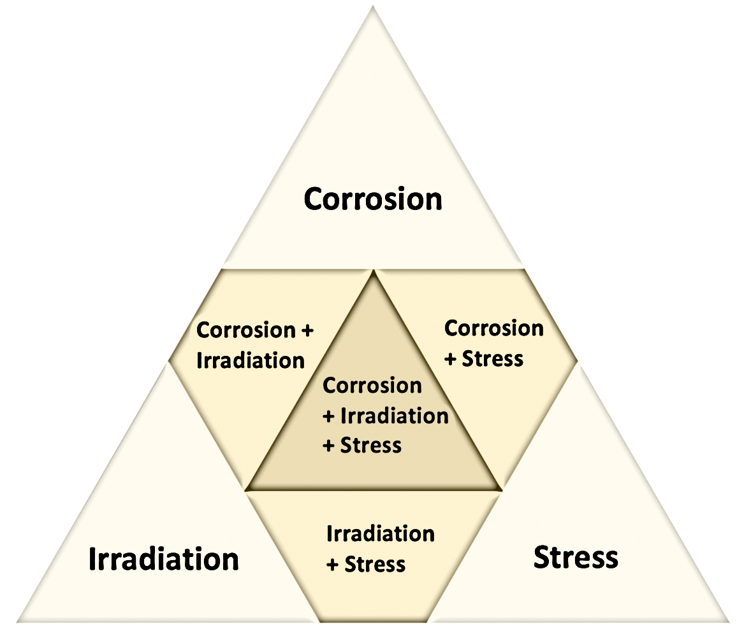
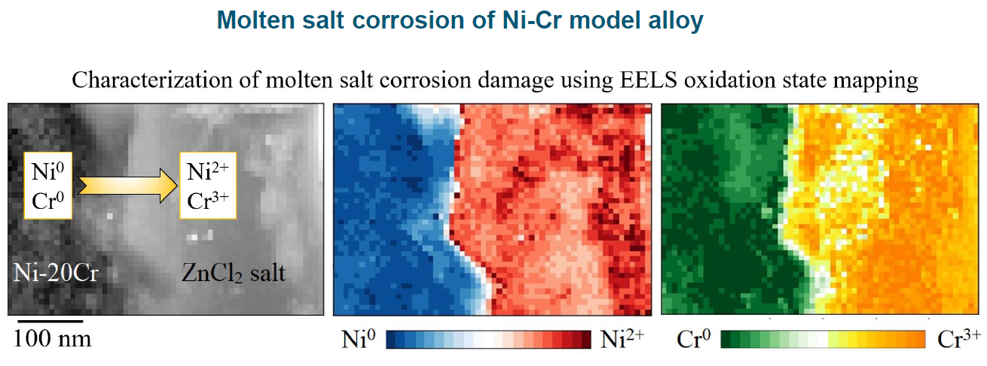
https://www.ne.ncsu.edu/mix/
Materials
In
eXtremes
Y. Bao, L. He et al. J. Materiomics 5(2019) 657-662
Y. Zhou, L. He et al. J. Eur. Ceram. Soc. 33 (2014) 2831-2865
MIX Lab
L. He et al. J. Am. Ceram. Soc. 105 (2022) 5419-5435
L. He et al. Acta Mater. 208 (2021)116778
L. He et al. Mater. Lett.117 (2014) 120-123
Japanese Patent No. 5704640, 2015
K. Bawane, L. He et al. Scripta Mater. 197 (2021) 113790
Y. Wang, L. He et al. Mater. Sci. Eng. A 849 (2022) 143475

Slide 29
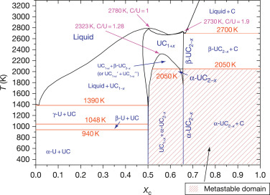
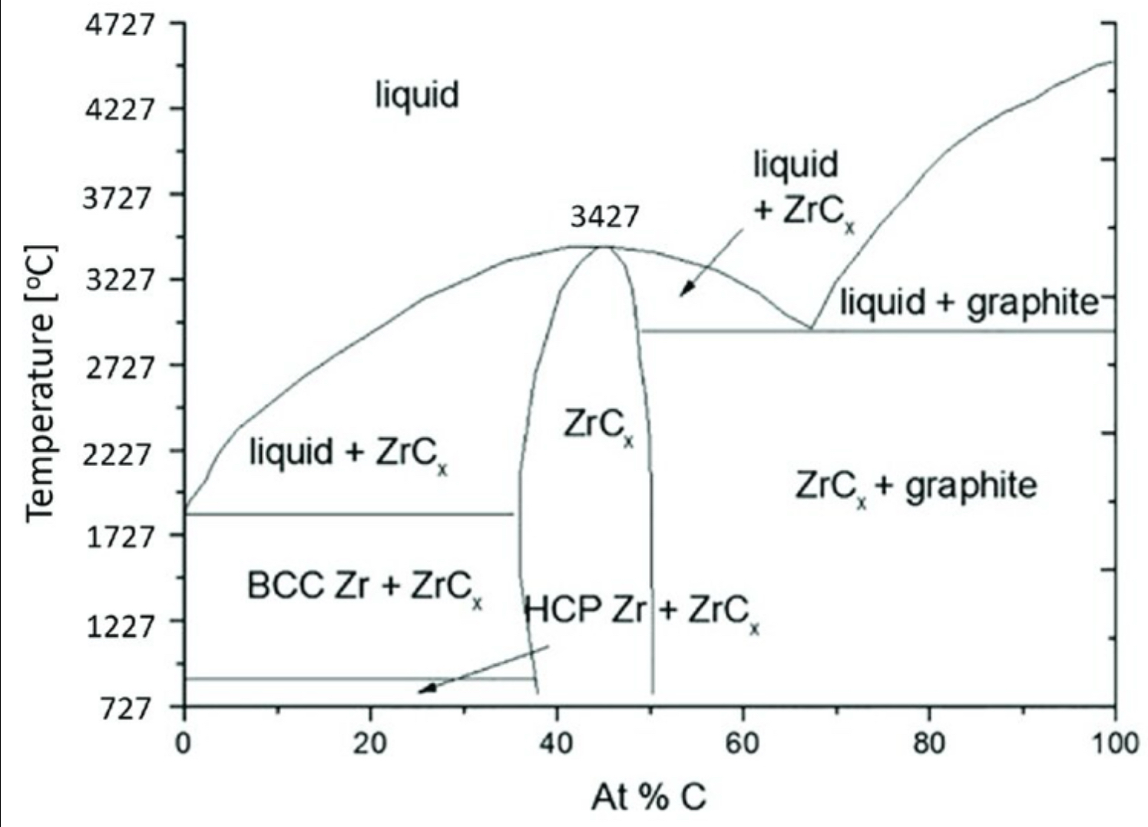
Phase Diagrams

