Slide 1
April 17, 2025
Dr. Kelly McCary
Radiation Measurement Scientist
PI: Dr. Josh Daw
High Fluence Active Irradiation and Combined Effects Testing of Sapphire Optical Fiber Distributed Temperature Sensors
Nuclear Science User Facilities Annual Program Review

Slide 2
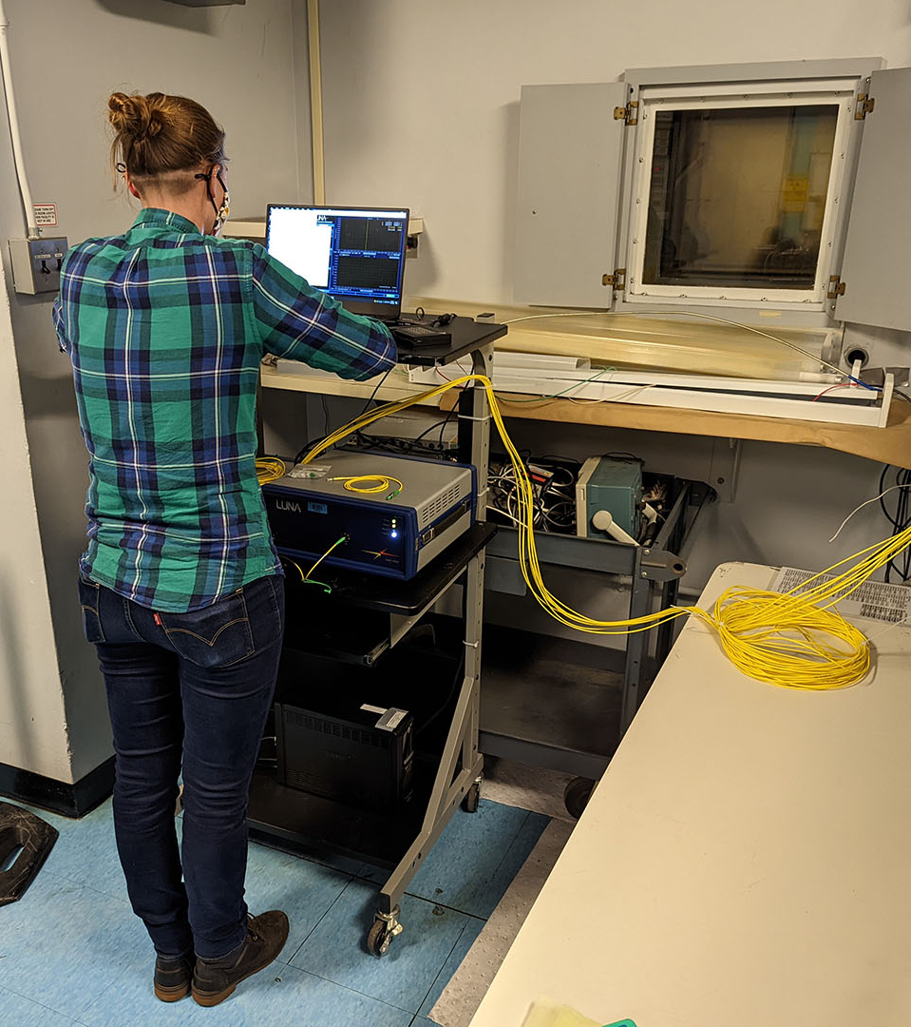
Goals and Objectives
Investigate the in-pile performance of sapphire optical fiber temperature sensors and to develop clad sapphire optical fibers for in-pile instrumentation. Evaluate the distributed sensing performance of the sensors through optical backscatter reflectometry under combined radiation and temperature effects, and high fluence.
    Objective 1: Fabricate sapphire optical fiber sensors.
    Objective 2: Evaluate the clad sapphire fiber.
    Objective 3: Characterize in-pile temperature sensing of sapphire optical fiber and combined temperature and irradiation effects.
    Objective 4: Evaluate the lifetime and sensing performance of the sensor under irradiation to high neutron fluence

Slide 3
Technology Impact
This work is advancing nuclear technology by characterizing and demonstrating a new sensor technology with the potential to make measurements with high spatial and temperature resolution at higher temperatures than prior optical sensors. This technology can also be applied to measurements other than temperature.
This research will deliver modern optical fiber sensing techniques usable in multiple extreme environment applications. In the area of nuclear fuel/material testing, these fibers will enable access to operational data with excellent time and space resolution during irradiation testing.
Commercialization is underway by Luna Innovations. This research represents the opportunity to close technology gaps and demonstrate the potential of sapphire optical fibers.

Slide 4
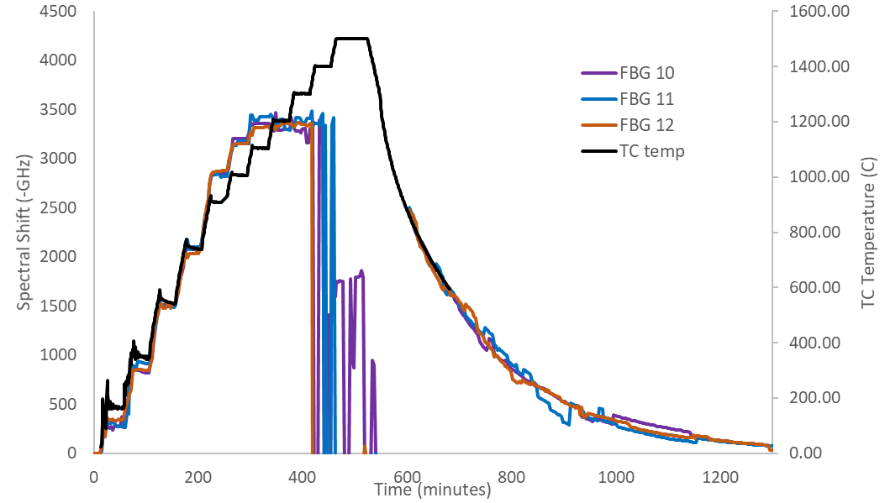
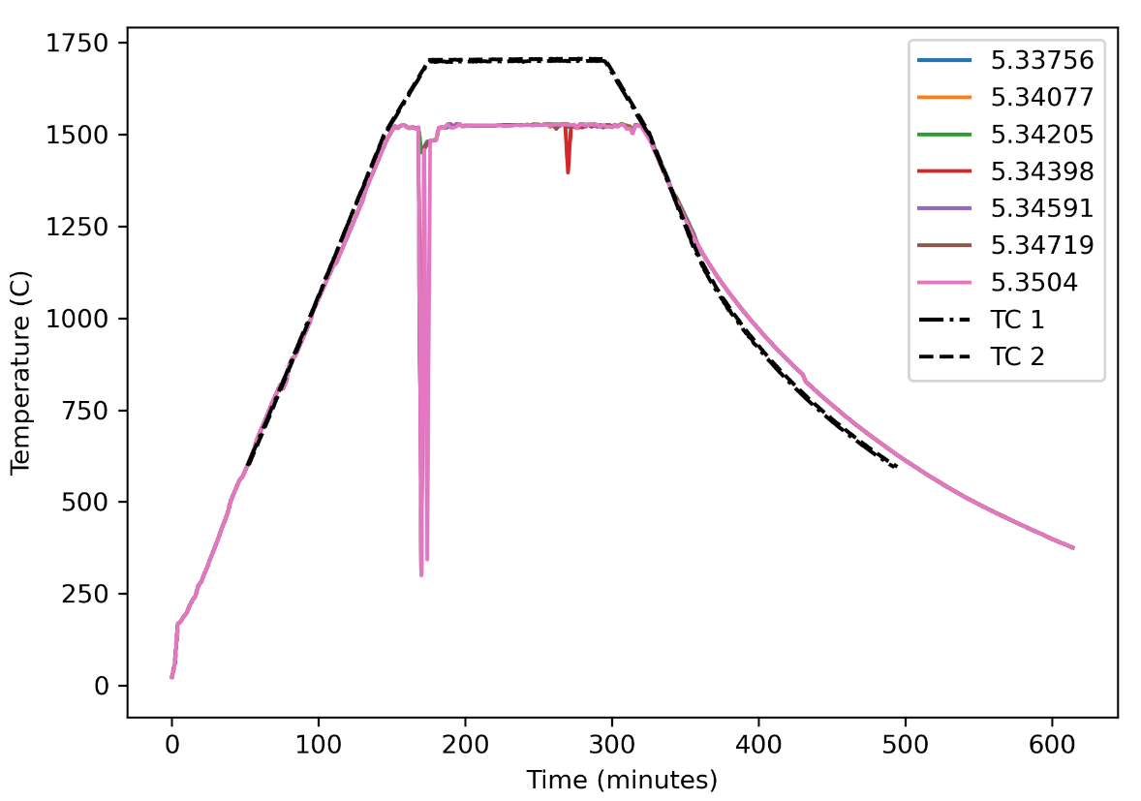
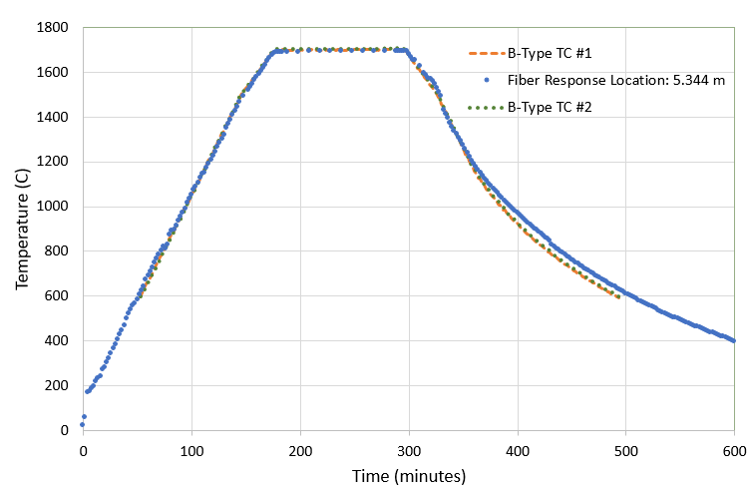
High Temperature Testing: Clad Sapphire
Two thermal tests were completed
with clad sapphire fiber:
8 in. heated region furnace
Interrogated with a Luna Innovations OBR 4600
All the fibers were placed in alumina tubes that were closed on the heated end, then spliced to silica lead-out fibers
Test 1: to 1500℃
When the furnace was heated past 1100℃, the sensing mechanism failed
  Attenuation and exceeded range of OBR
Test 2: to 1700℃ – success with iterative referencing

Slide 5
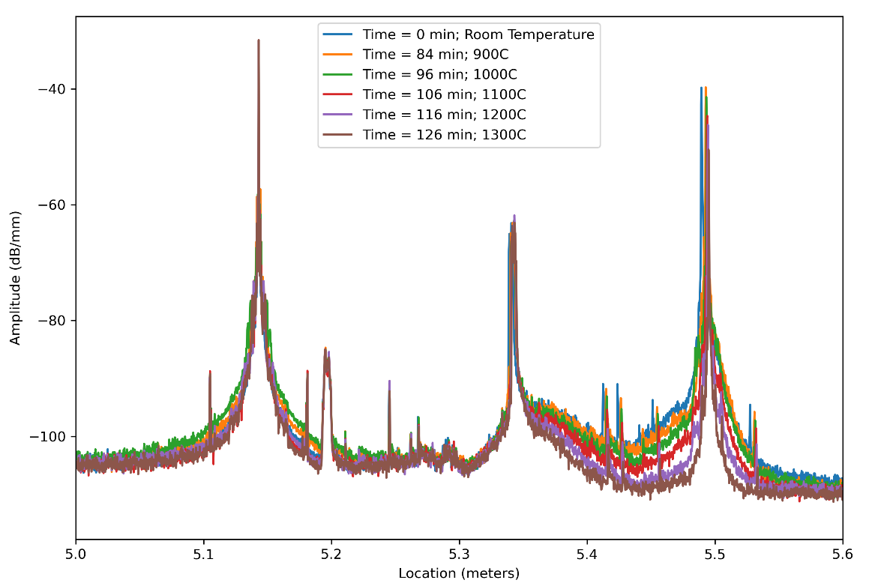
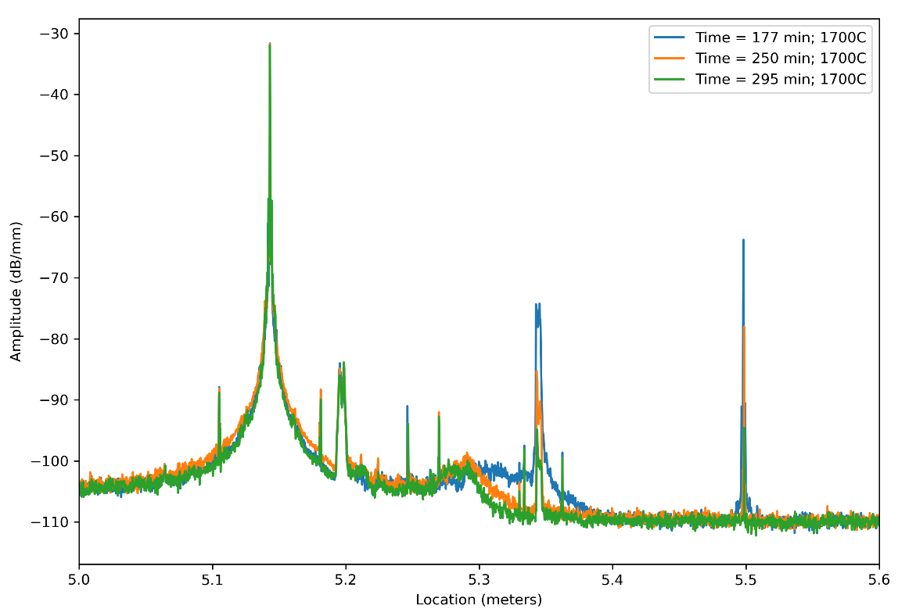
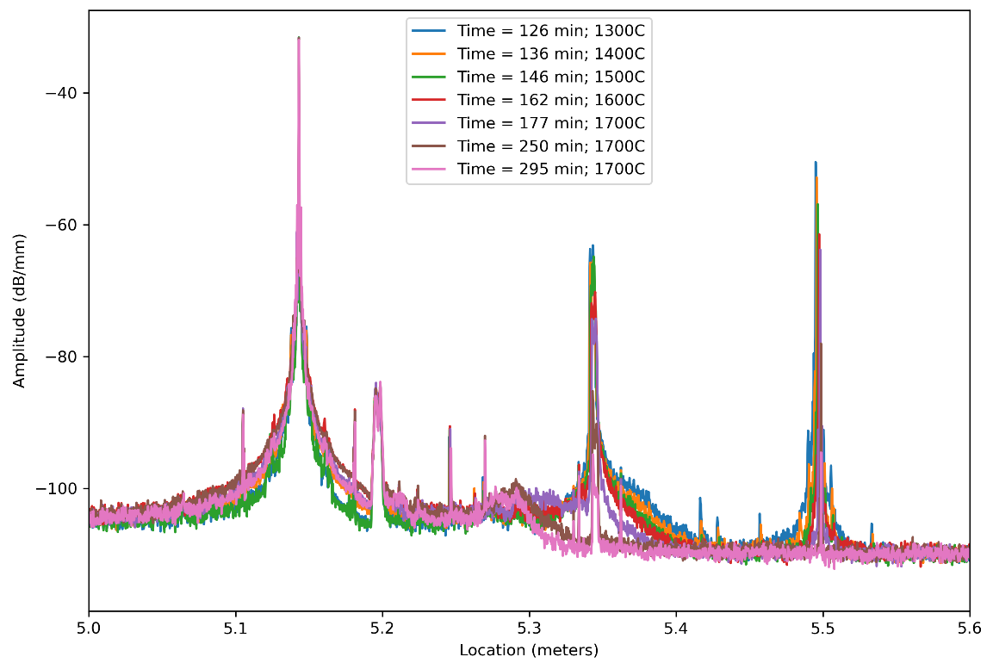
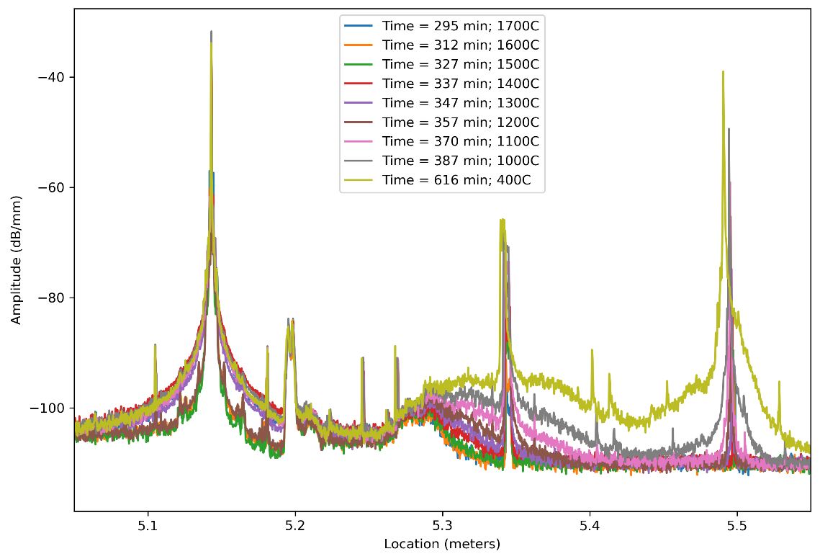
High Temperature Testing: Clad Sapphire
A reduction in amplitude was observed with increasing temperature and time in both tests
This reduction recovers completely when the fibers cool
1
3
2
4

Slide 6
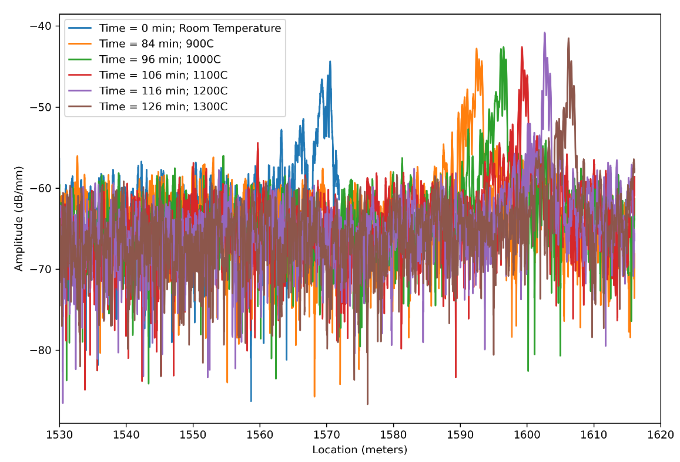
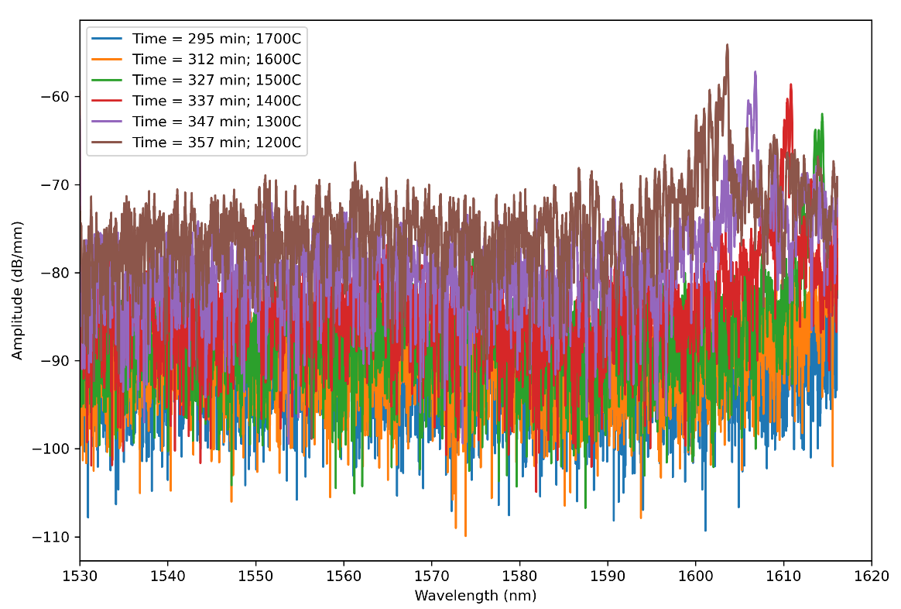

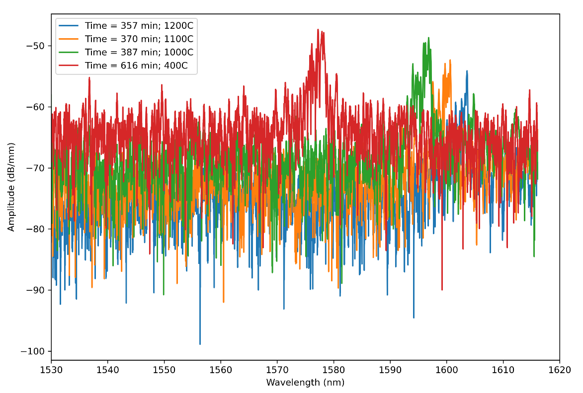
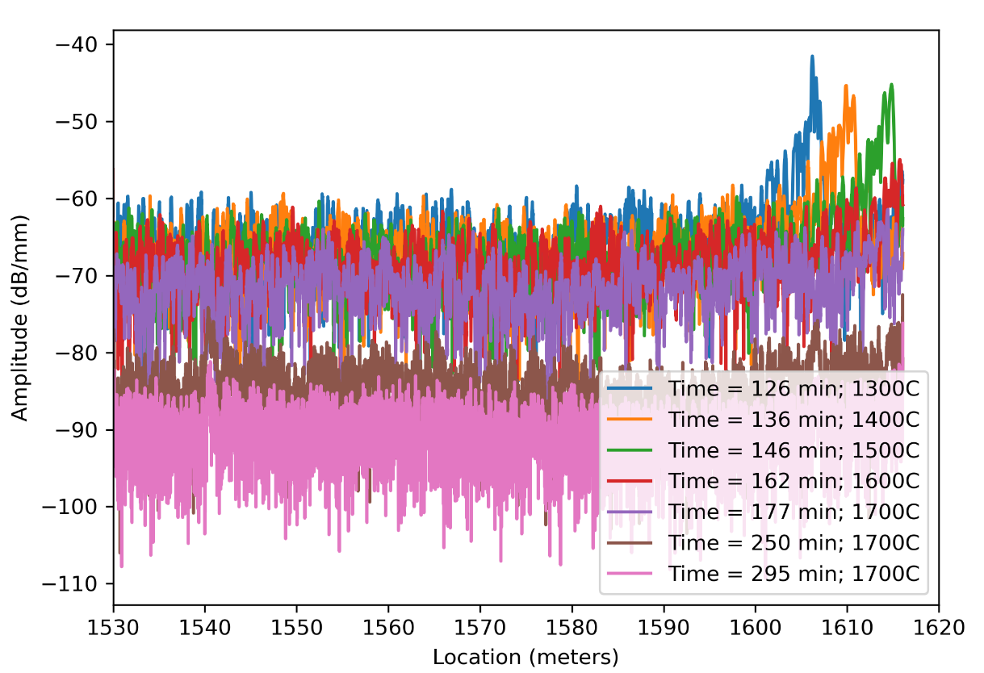
High Temperature Testing: Clad Sapphire
A reduction in amplitude was observed with increasing temperature and time in both tests
This reduction recovers completely when the fibers cool
1
3
2
4

Slide 7
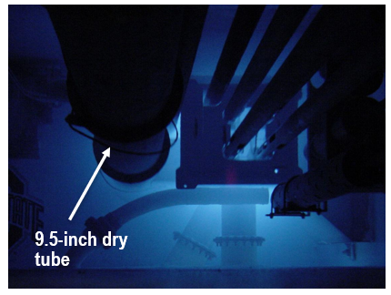
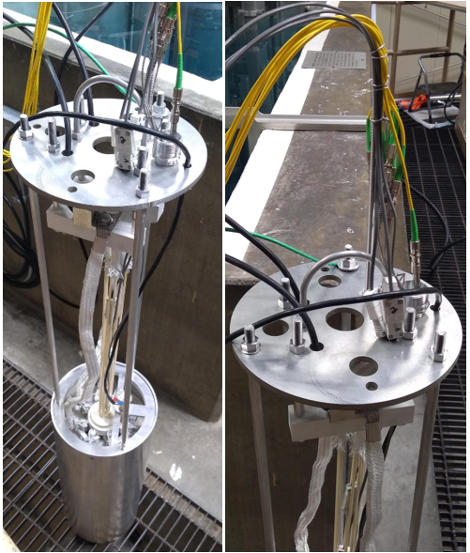
High Temperature Irradiation
The heated irradiation was designed to test the fibers at various temperatures from ambient to 1600ºC
Total fluence: 3.2 x 10¹⁷ n/cm²
  Thermal: 2.3 x 10¹⁷ n/cm²
Sensor 1: 75 um diameter – 13 FBGs inscribed by FemtoFiberTec
Sensor 2: 100 um diameter – 2 FBGs inscribed by UPitt
Sensor 3: 100 um diameter – 1 FBG inscribed by Upitt
Sensor 4: 100 um diameter – No FBGs
Sensor 5: 100 um diameter – 1 FBG inscribed by Upitt
Day | Hours | Power (kW) | Furnace Temp. (Celsius) | Notes
1 | 7 | 450 | off/200
2 | 7 | 450 | 400/600
3 | 7 | 450 | 800
4 | 4 | 450 | 900 | 4 hours, some hours for another customer at 5 kw
5-1 | 0 |  | 1000 | Fuse blow
5-2 | 7 | 450 | 1000
6 | 7 | 450 | 1100
7 | 7 | 450 | 1200
8 | 7 | 450 | 1300
9 | 7 | 450 | 1400
10 | 7 | 450 | 1.5 hrs at 800, 2 hrs at 1000, 2 hrs at 1200
11 | 7 | 450 | 1400 1 hr at 1500 | Fuse blow during heating
12 | 6 | 450 | 1500 1 hr at 1600

Slide 8
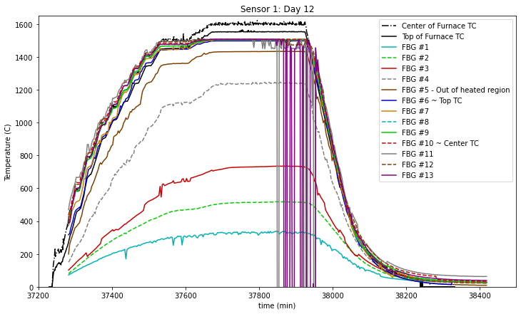
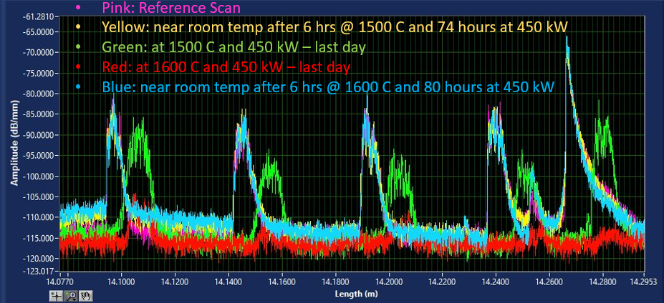
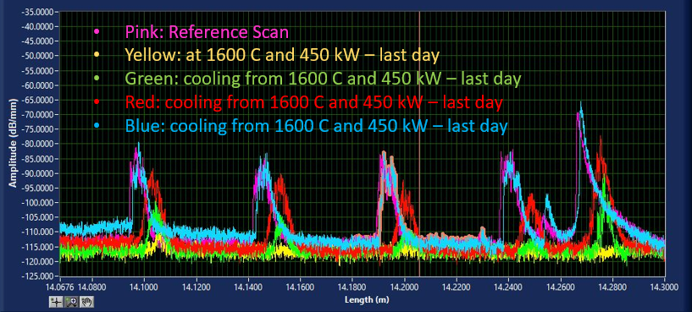
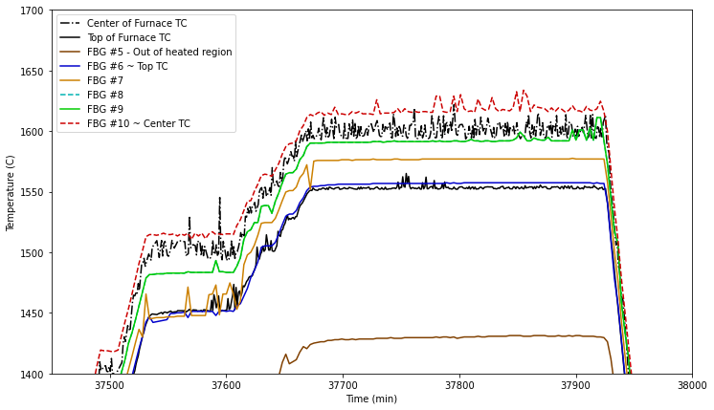
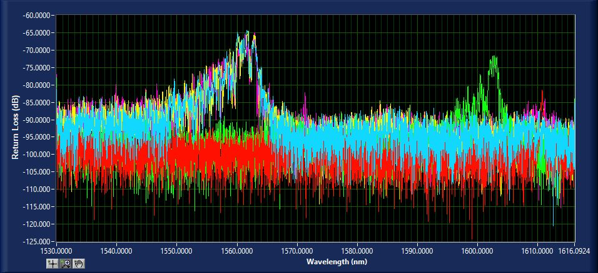
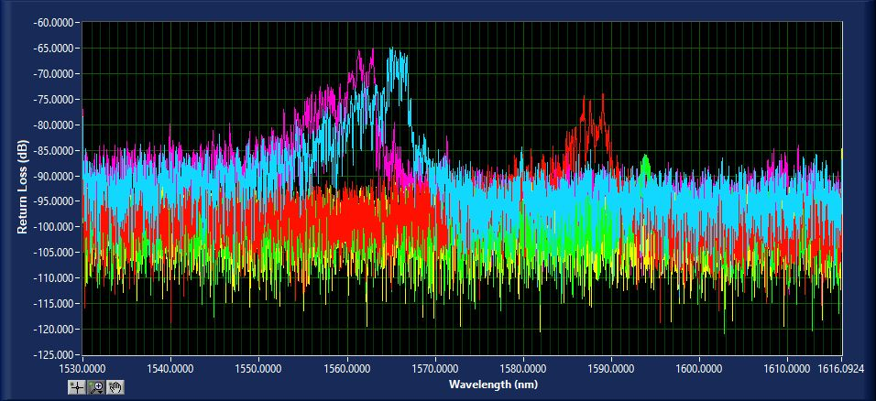
High Temperature Irradiation
Similar failure mechanism was observed at 1600ºC in-pile as was observed in out of pile testing.
After signal loss and amplitude reduction, the FBGs recover as the fiber cools to room temperature
Like the furnace test, iterative referencing helped maintain the measurement
Top: No iterative referencing
Bottom: With iterative referencing
Backscatter profile and wavelength response of FBG #12 for sensor #1 for the last day of irradiation heating.
Backscatter profile and wavelength response of FBG #12 for sensor #1 for the last day of irradiation cooling.

Slide 9
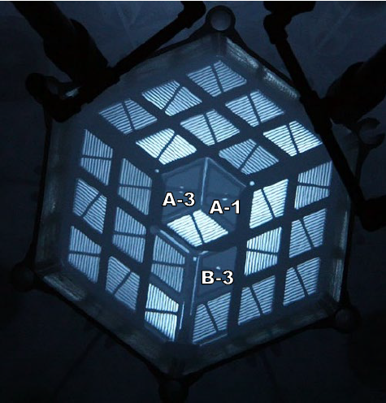
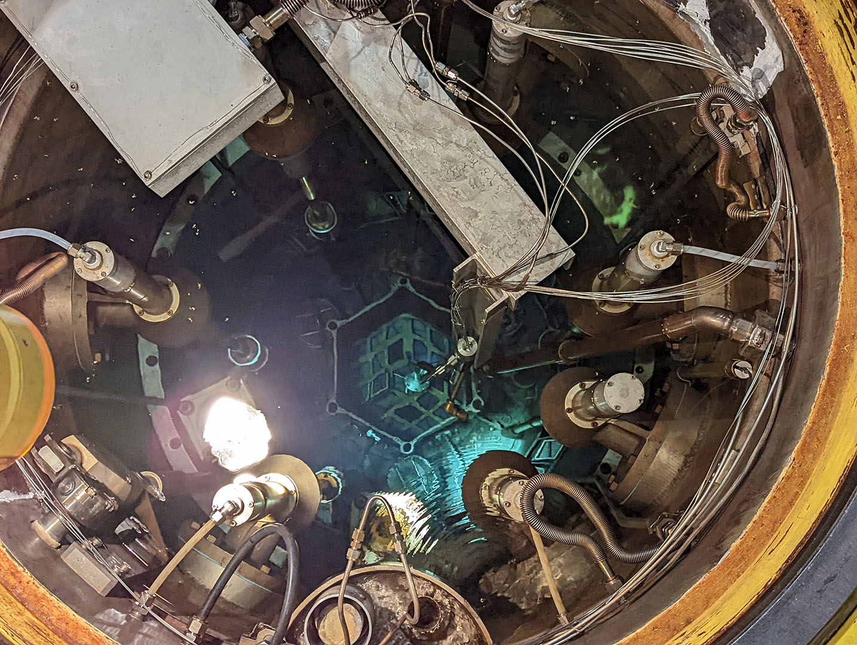
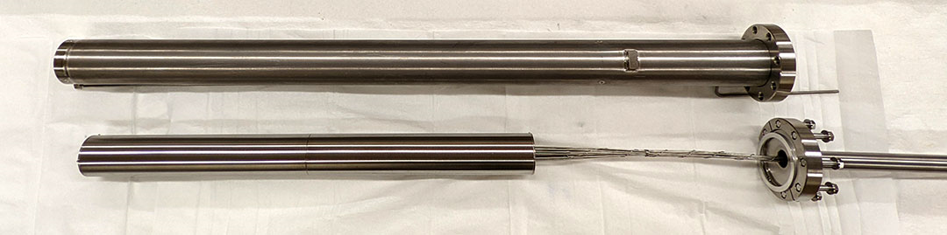
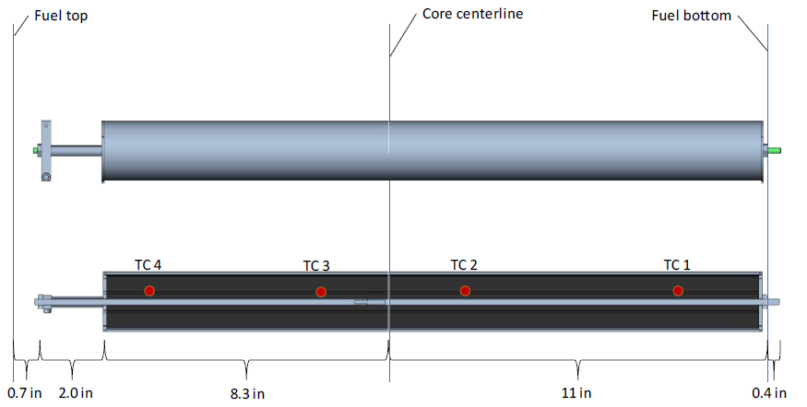
High Fluence Irradiation
MITR Irradiation
2 Cycles
5 Sapphire Sensors
  (1) 75 um diameter fibers
  (2) 100 um diameter fibers
  (2) 125 um diameter fibers
In-Core Sample Assembly in Position A-1
 | Fluence (1/cm²) | Exposure (MGy)
Total Neutron | 1.6E+21
Thermal Neutron (< 1 eV) | 2.3E+20
Fast Neutron (>0.1 MeV) | 7.6E+20
Fast Neutron (>1 MeV) | 3.5E+20
Gamma | 1.6E+21 | 1.9E+04

Slide 10
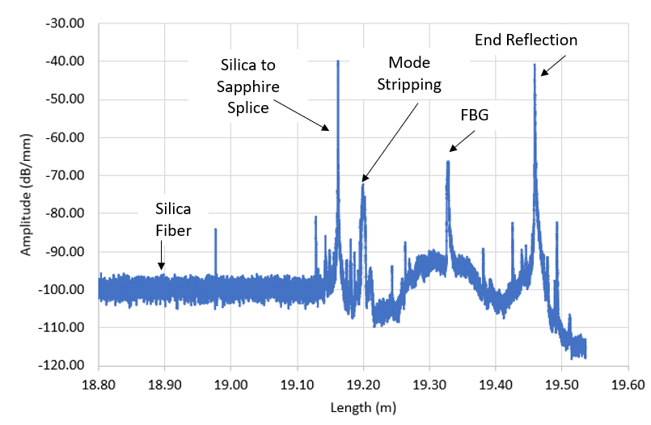
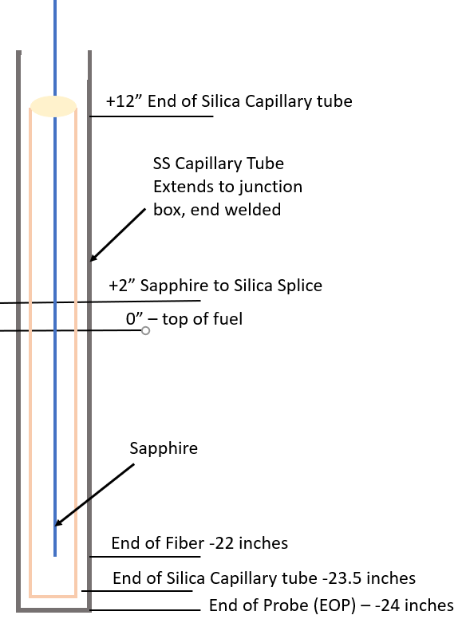
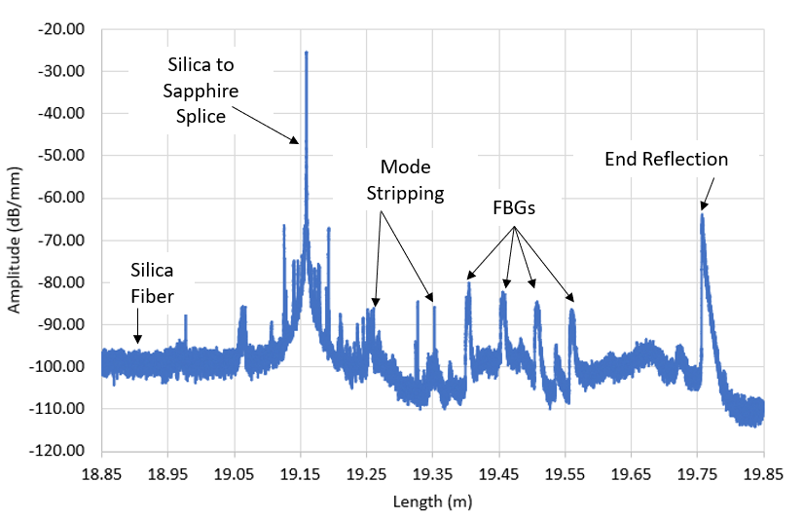
High Fluence Irradiation
Sensors prepared and provided to MITR in preparation for irradiation
5 Sapphire sensors
  125, 100, and 75 um diameter fibers with inscribed FBGS
  Clad, and annealed
  Placed in silica microcapillary tubes to prevent any material interaction
  All treated with a mode-stripping spot treatment
Figure 193: Sensor 3, 100 um diameter with 1 FBG inscribed by U. Pitt, 14 inches long, before installation in the experiment capsule.
Sensor 4, 125 um with 4 FBGs inscribed by FemtoFiber Tec,
22 inches long, before installation in the experiment capsule.

Slide 11
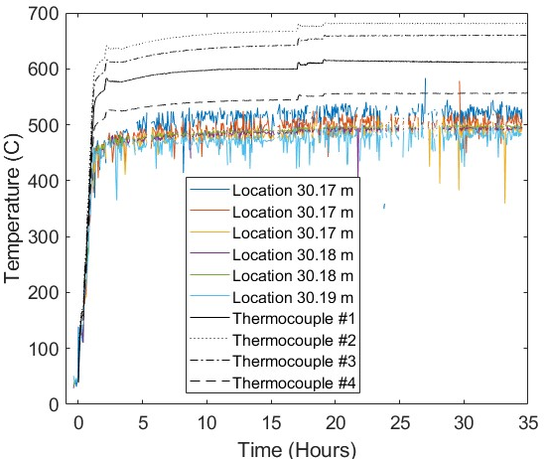
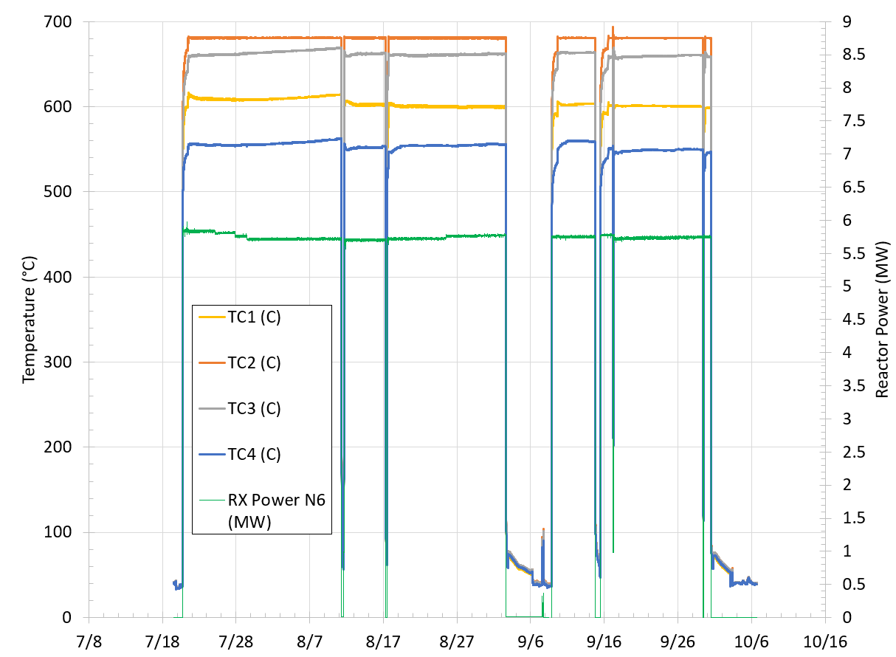
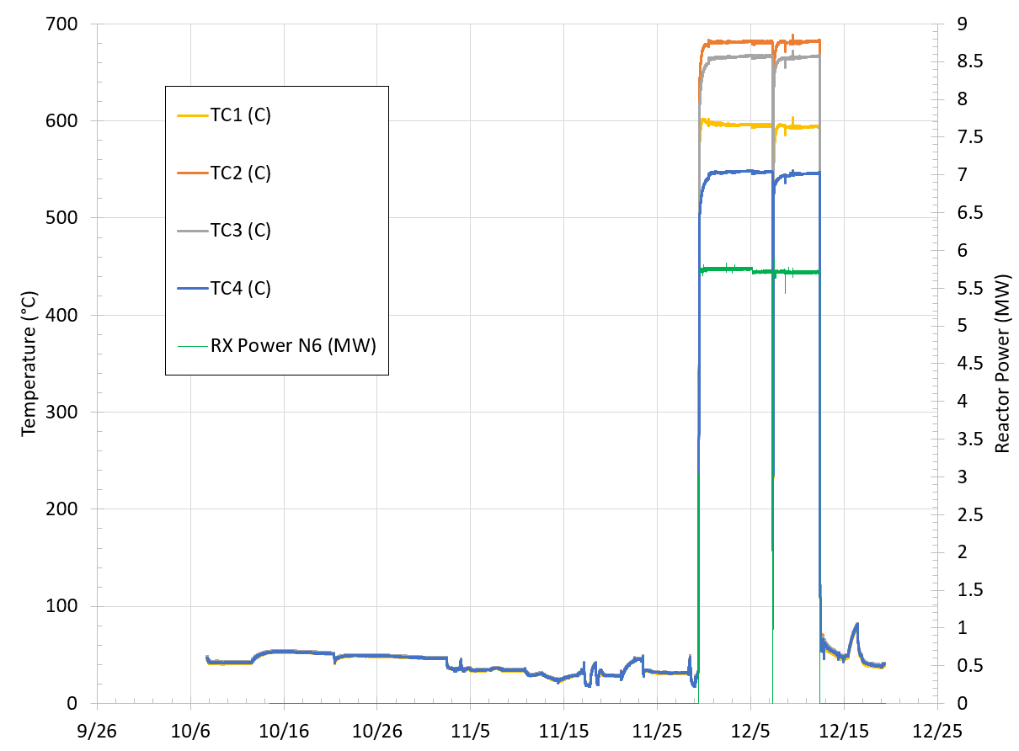
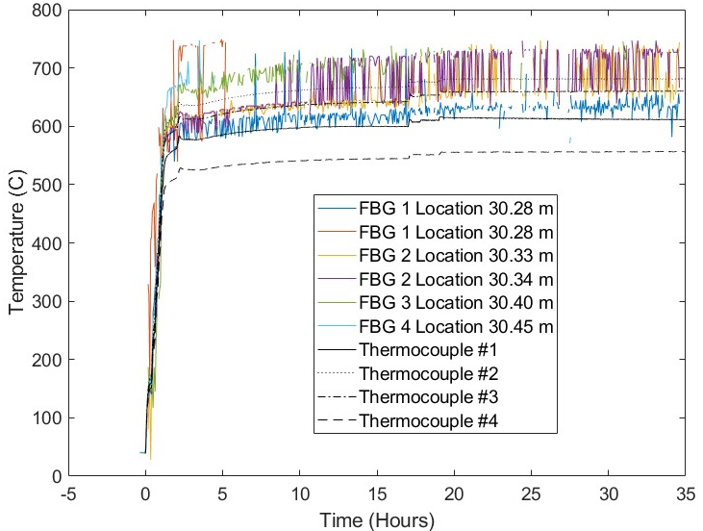
High Fluence Irradiation
Sensor 4, no re-referencing
OFDR referencing was noisy
This consistent with previous observations of larger diameter sapphire fibers
2 Cycles in-core
Temperatures in capsule ranging from approximately 550ºC-680ºC
Sensors 1 and 2 were broken upon installation
Cycle 1
Cycle 2
Sensor 3, with re-referencing

Slide 12
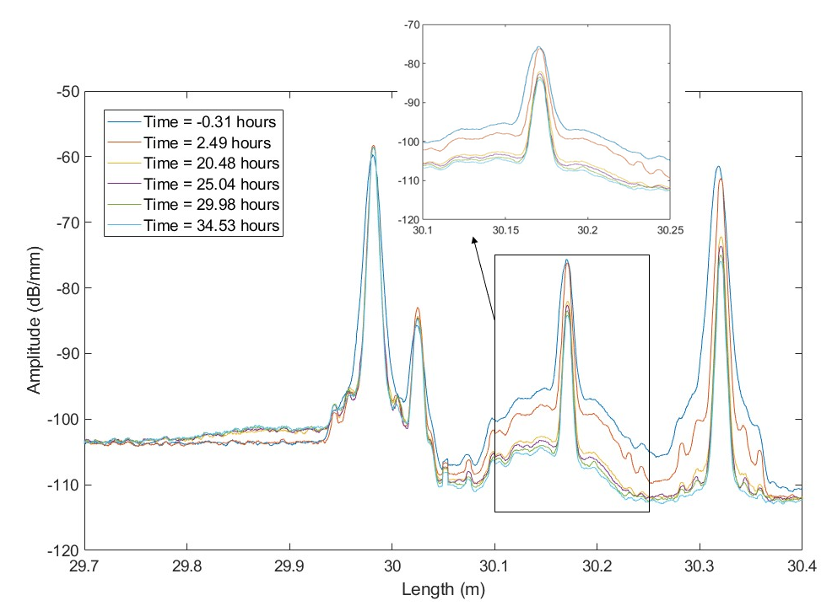
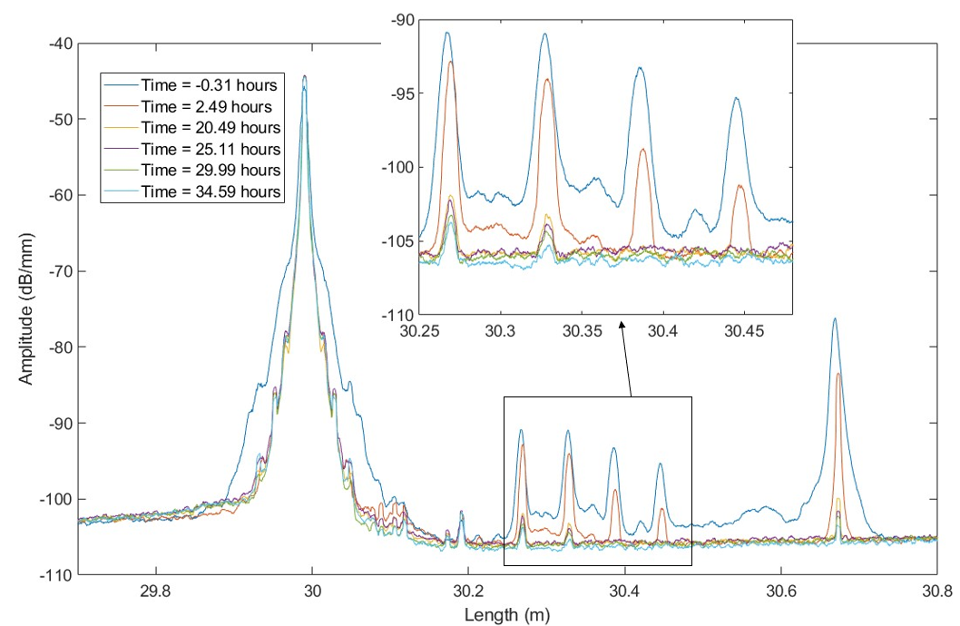
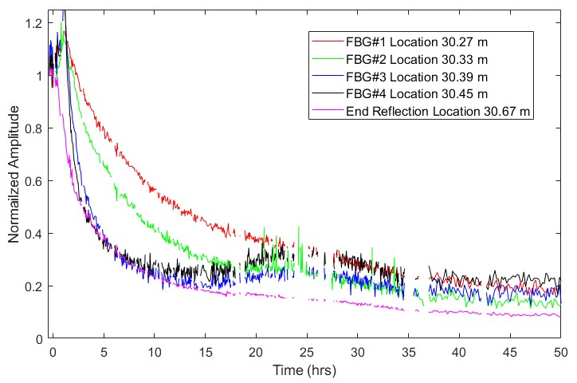
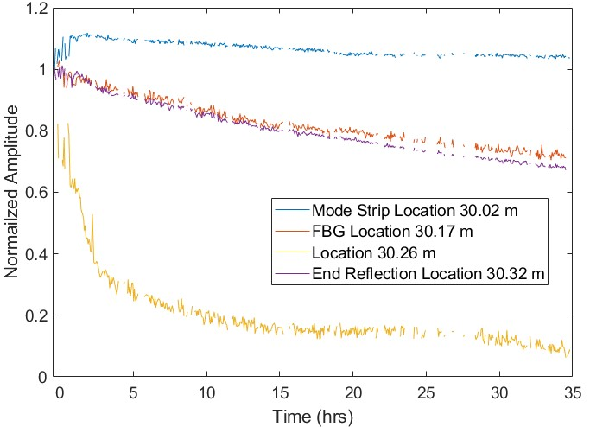
High Fluence Irradiation
Sensor 4
Sensor 3
Significant amplitude reduction during the initial reactor start-up
Reduction in amplitude was larger in the 125 um fibers than 100 um fibers
Normalized amplitude shows a faster reduction in amplitude the further away from the silica splice
  Expected due to increase temperature and flux
Top of fuel at 30.12 m
Top of fuel at 30.15 m

Slide 13
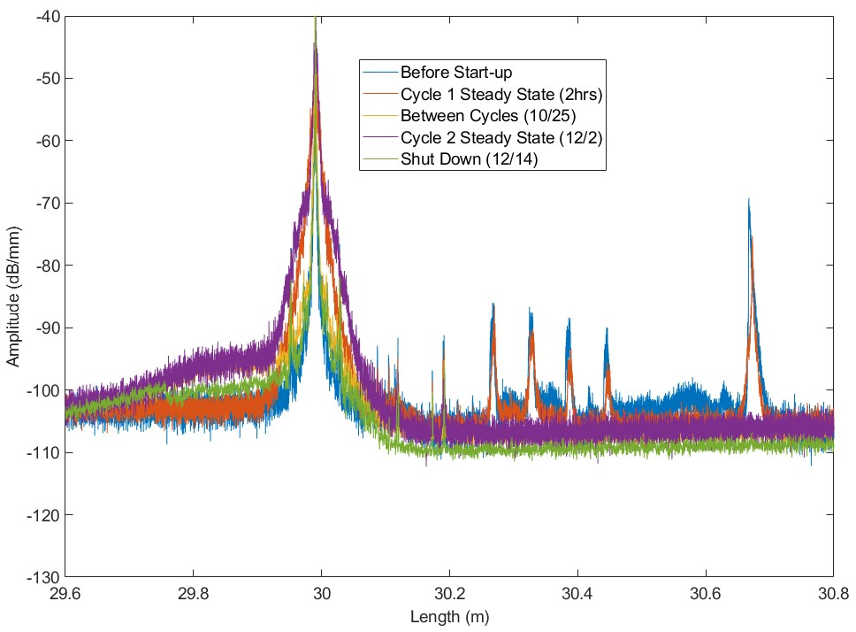
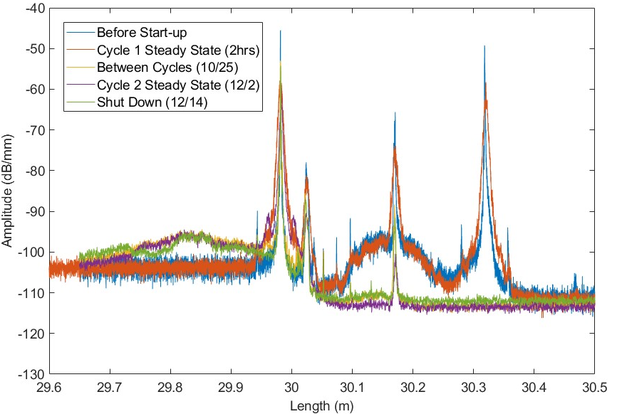
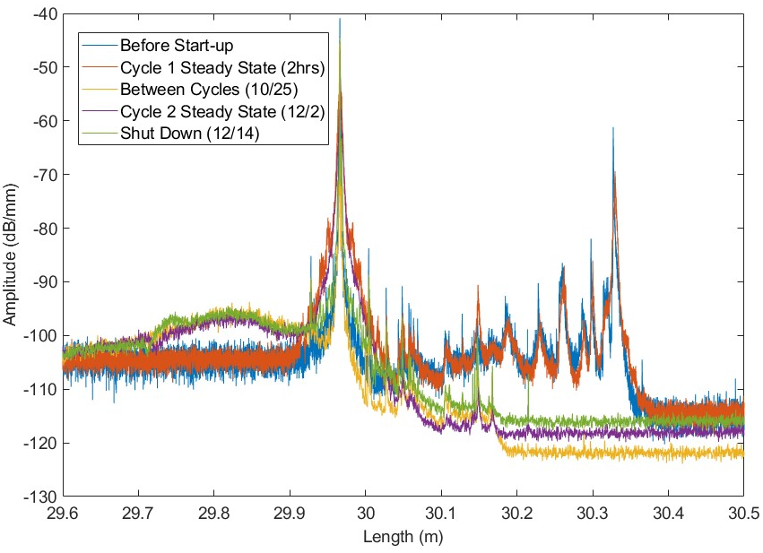
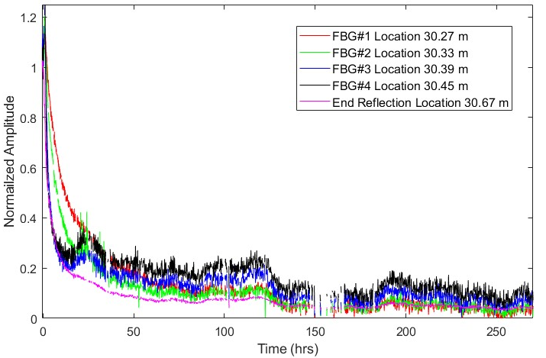
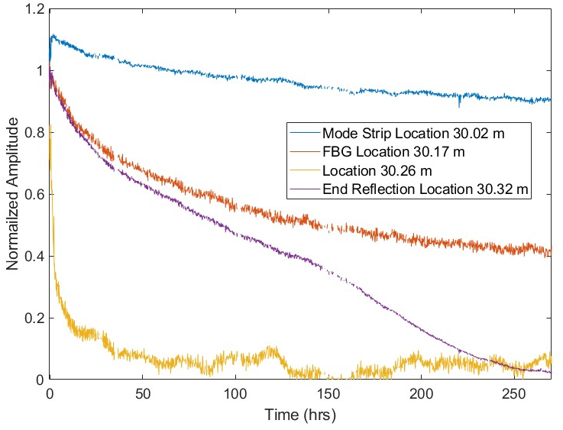
High Fluence Irradiation
Sensor 4
Sensor 3
Signal loss did not recover with reduced temperature
Temperature appears to have a significant impact on attenuation
Top of fuel at 30.12 m
Top of fuel at 30.15 m
Sensor 5
Top of
fuel at 30.09 m
Top of graphite
at 30.17

Slide 14

Conclusions
This work provides a path to deployment for optical fiber-based sensors, including:
The technology of clad sapphire optical fiber sensors was advanced through thermal testing up to 1700℃, where previous work had tested up to 1300℃.
Kelly McCary
Research Scientist, Radiation Measurements
Idaho National Laboratory
Kelly.Mccary@inl.gov
W (208) 533-4885
We would like to acknowledge the support of The Ohio State University Nuclear Reactor Laboratory and the assistance of the reactor staff members, Andrew Kauffman, Dr. Susan White, Kevin Herminghuysen, Matthew Van Zile, and Maria McGraw for the irradiation services provided. As well as David Carpenter and the entire staff at the MITR lab.
Special thanks to Dr. Blue, Dr. Jones, and Dr. Birri for their assistance at Ohio State and Dr. Christian Petrie from ORNL.
The sensing performance of sapphire optical fibers at high temperatures under irradiation was evaluated up to 1600℃
  The results of this work indicate that distributed OFDR sensing in sapphire optical fiber is possible with some conditions.
  The sapphire fibers must be pre-treated appropriately and have well-written defects inscribed to create a stable Rayleigh backscatter signal.
  This work indicates that sapphire optical fiber sensors may be a solution for ultra-high temperature applications where traditional silica optical fibers fail.
  Sapphire sensors are a solution for experiment applications with temperatures above 700℃ for long periods of time, or for experiment applications with any duration above 1000℃. Experiment applications with a low total fluence, such as irradiation in TREAT, would also be a good application of sapphire optical sensors.

