Slide 1
April 15, 2025
  J. Derek Whipple
    NSUF CINR Administrator
CINR NSUF Access Awards & Status
INL/MIS-25-84220

Slide 2
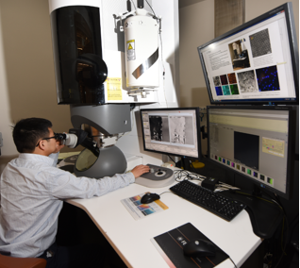
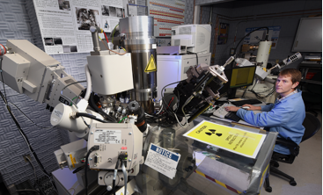
NSUF CINR Overview
Once a year, in close coordination with the Nuclear Energy University Program, Nuclear Science User Facilities (NSUF) seeks proposals that will utilize NSUF irradiation, post-irradiation examination and beamline capabilities through the Consolidated Innovative Nuclear Research (CINR) Notice of Funding Opportunity (NOFO) formerly called the Funding Opportunity Announcement (FOA).
Through the NSUF CINR topic areas, NSUF provides no-cost access to world class capabilities to facilitate the advancement of nuclear science and technology. In addition to access to state-of-the-art facilities, NSUF provides technical assistance including the design and analysis of reactor experiments.
INL/MIS-25-84220

Slide 3
NSUF CINR Schedule
INL/MIS-25-84220

Slide 4
Summary of CINR Work in Various Technical Areas
Technical Areas | Number of Awards | Award Years | Access Funding
Fundamentals for Reactor Materials | 35 | FY15, 16, 17, 18, 19, 20, 21, 22, 23, 24 | $26,976,388
Additive / Advanced Manufacturing | 11 | FY15, 16, 17, 18, 19, 21, 24 | $16,928,001
Advanced Fuel Development | 11 | FY15, 16, 17, 19, 20, 23, 24 | $14,494,994
Sensor Development | 14 | FY15, 17, 18, 19, 20, 21, 24 | $9,030,941
Computational Model Development and Validation | 6 | FY17, 18 | $4,714,455
Welding & Joining Advanced Cladding | 3 | FY16, 17 | $1,656,984
Nuclear Materials Discovery & Qualification Initiative | 2 | FY20, 21 | $995,514
INL/MIS-25-84220

Slide 5
FY24 NSUF CINR Access Awards
INL/MIS-25-84220

Slide 6
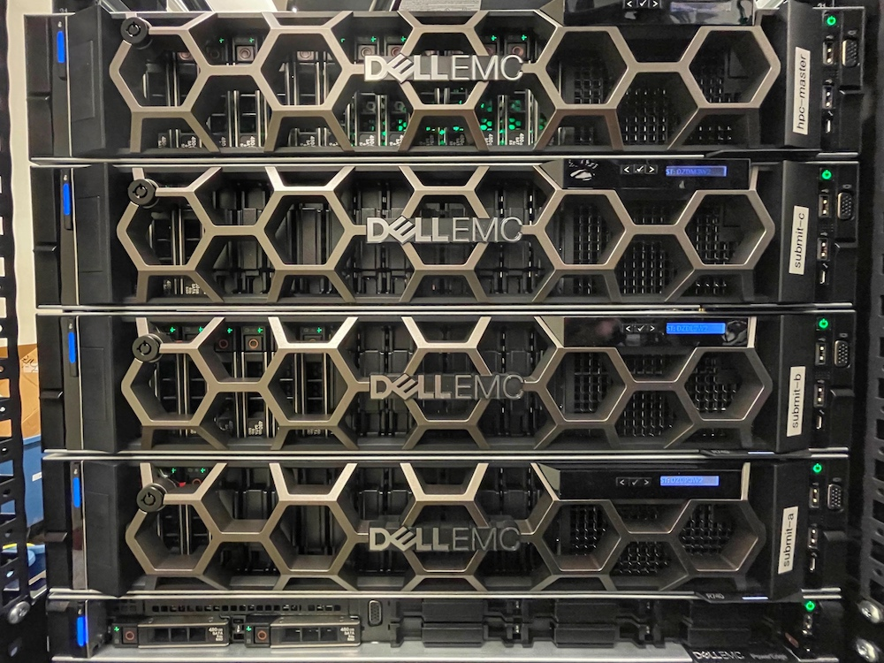

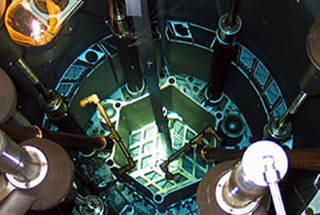
FY24 NSUF CINR Access Awards (Cont.)
INL/MIS-25-84220
Notes:
I added an image of the MIT reactor core. The major cost for this project is the irradiation so the image seemed suitable. Image taken from: https://nrl.mit.edu/facilities/in-core/

Slide 7
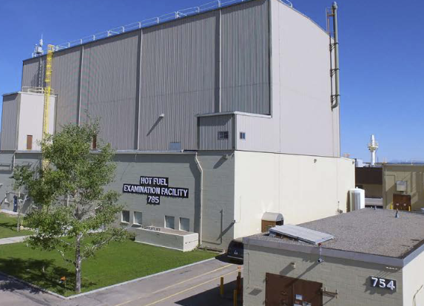
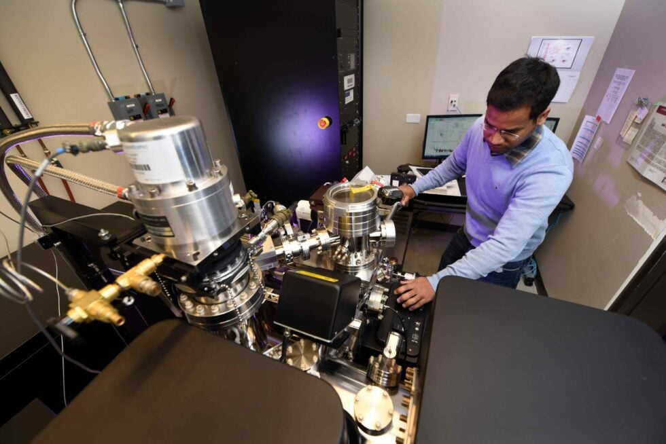
FY24 NSUF CINR Access Awards (Cont.)
INL/MIS-25-84220

Slide 8
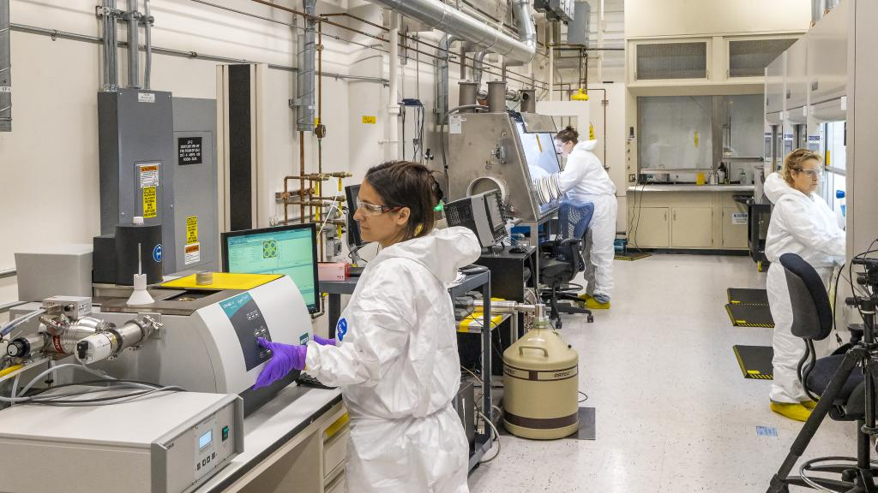
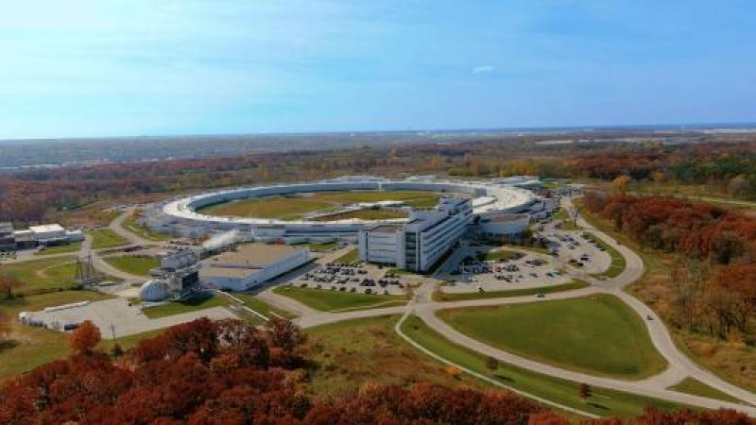
FY24 NSUF CINR Access Awards (Cont.)
INL/MIS-25-84220

Slide 9

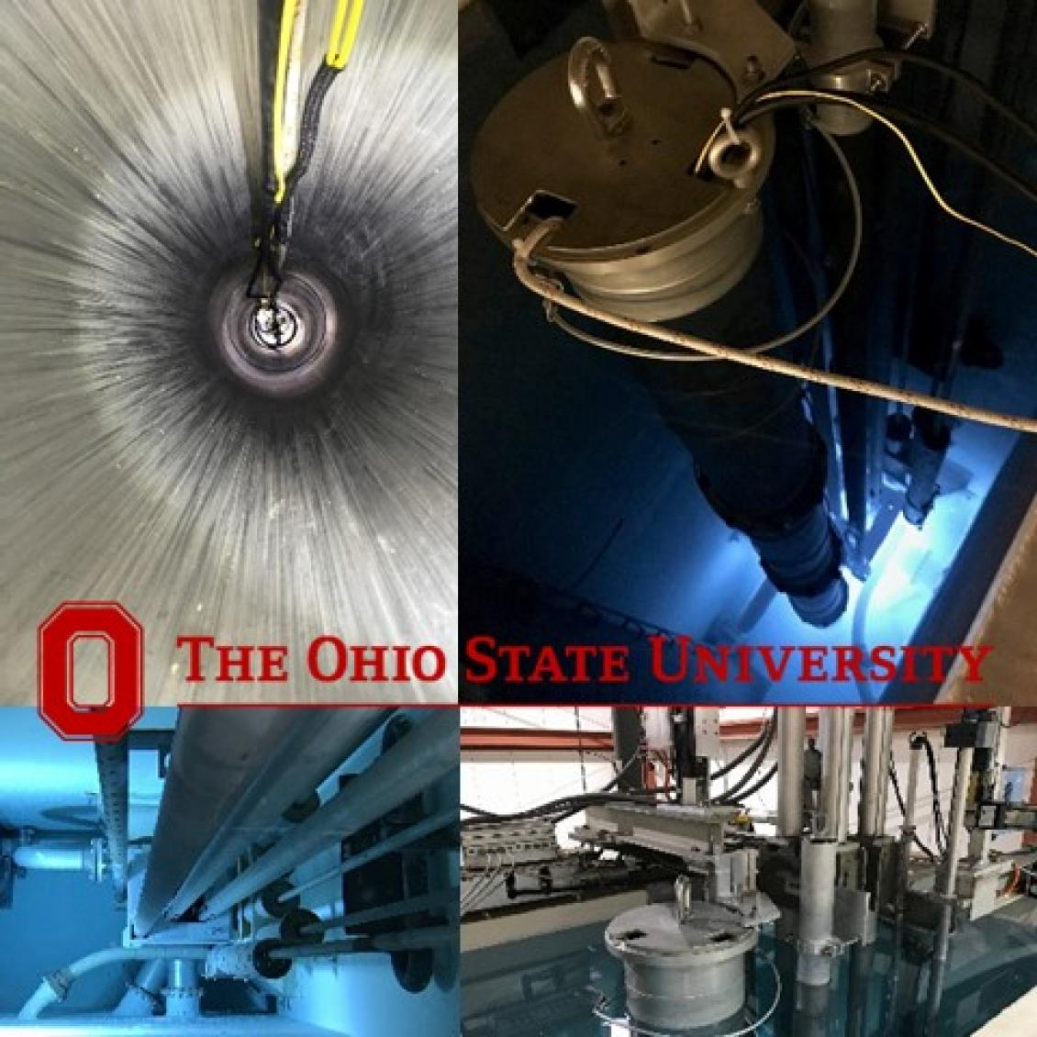
FY24 NSUF CINR Access Awards (Cont.)
INL/MIS-25-84220

Slide 10

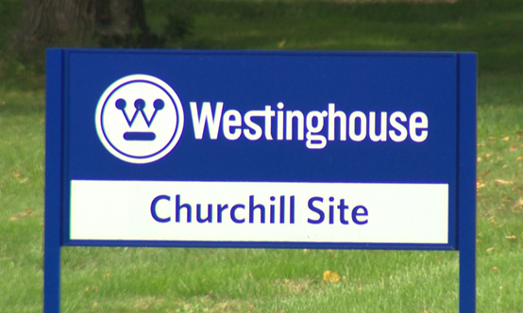
FY24 NSUF CINR Access Awards (Cont.)
INL/MIS-25-84220

Slide 11
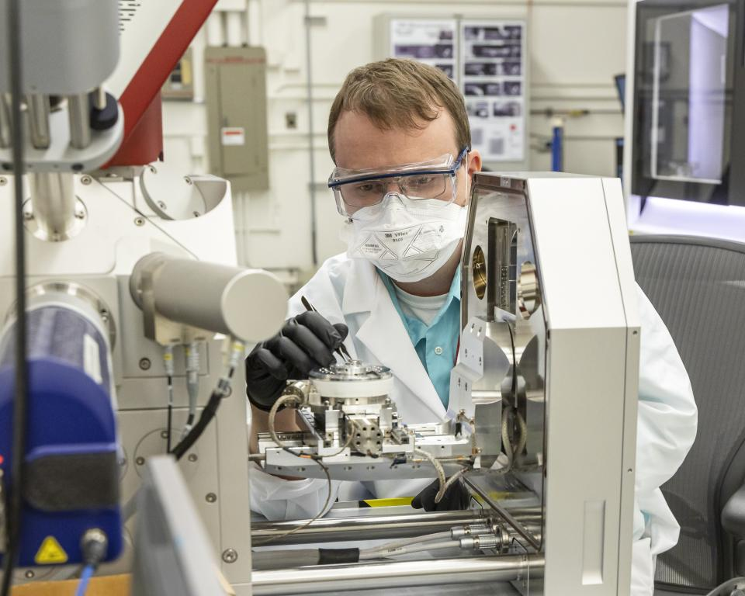
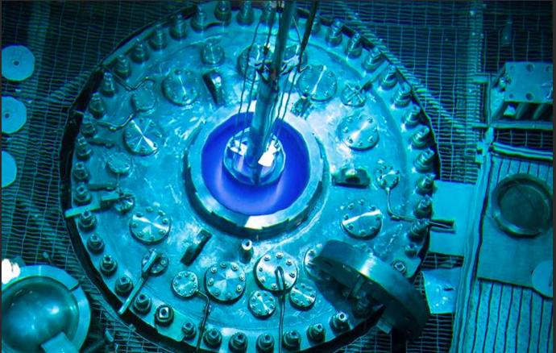
FY24 NSUF CINR Access Awards (Cont.)
INL/MIS-25-84220

Slide 12
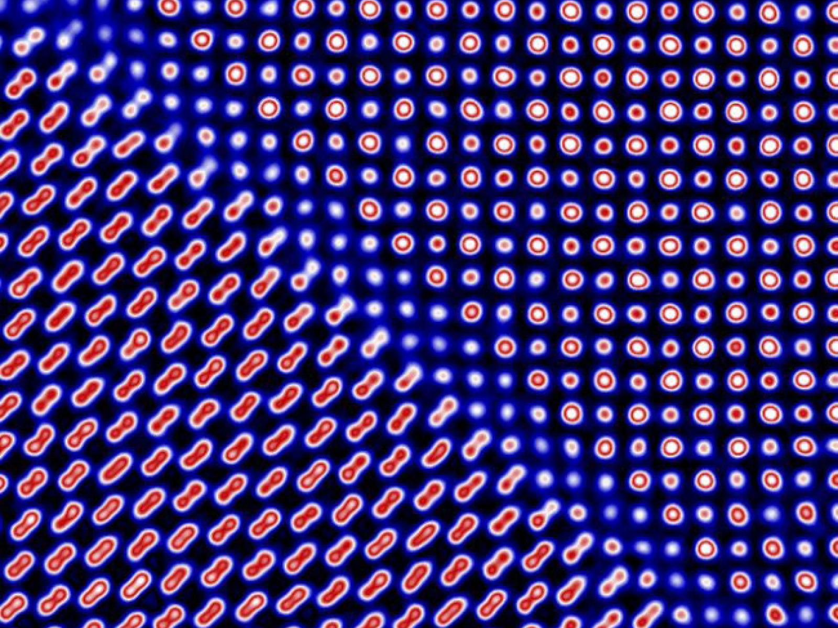
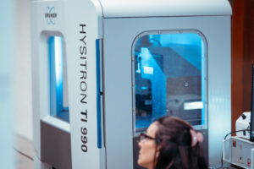
FY24 NSUF CINR Access Awards (Cont.)
INL/MIS-25-84220
Notes:
Berkeley TI 990
Hysitron TI990 TriboIndenter
The TI 990 is an advanced nanomechanical testing system designed to perform specific mechanical tests to obtain
properties such as hardness, modulus, scratch resistance, and wear resistance on nanoscale materials and thin films. The
main part of the system is a proprietary force/displacement transducer that accurately measures forces and
displacements down to uN and nm levels. This transducer is mounted to a piezo nanopositioner that can be used for
accurate placement. The system also includes an optical camera coupled to a 3-axis motorized staging system for
micro-positioning and sample registration. The entire unit is placed on an active vibration dampening system and
is housed in an enclosure to specifically isolate the unit from outside noise.

Slide 13
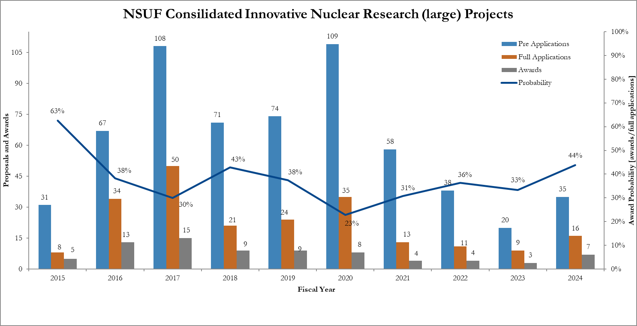
NSUF CINR Applications to Awards
INL/MIS-25-84220

Slide 14
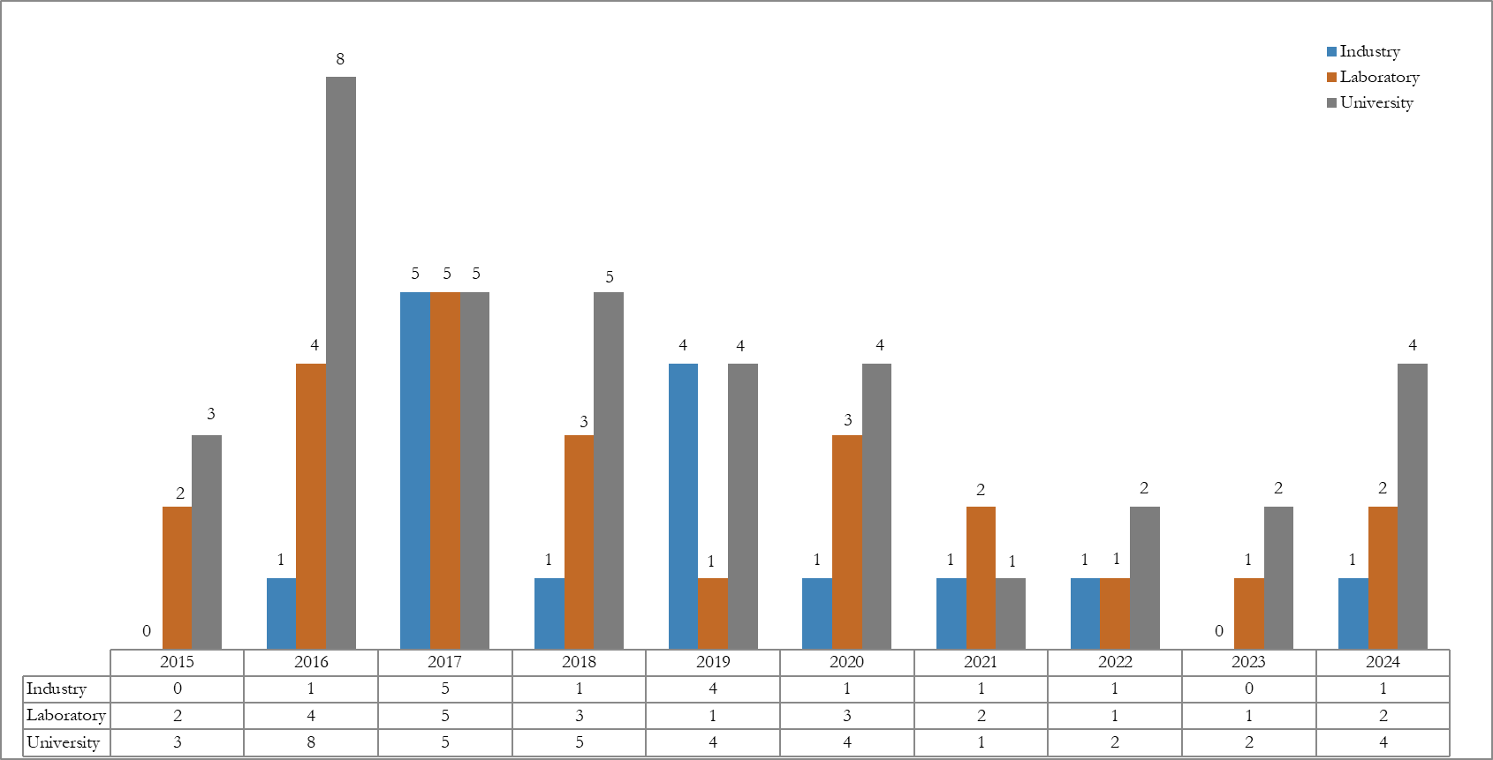
NSUF CINR Awards by Institution Type
INL/MIS-25-84220

Slide 15
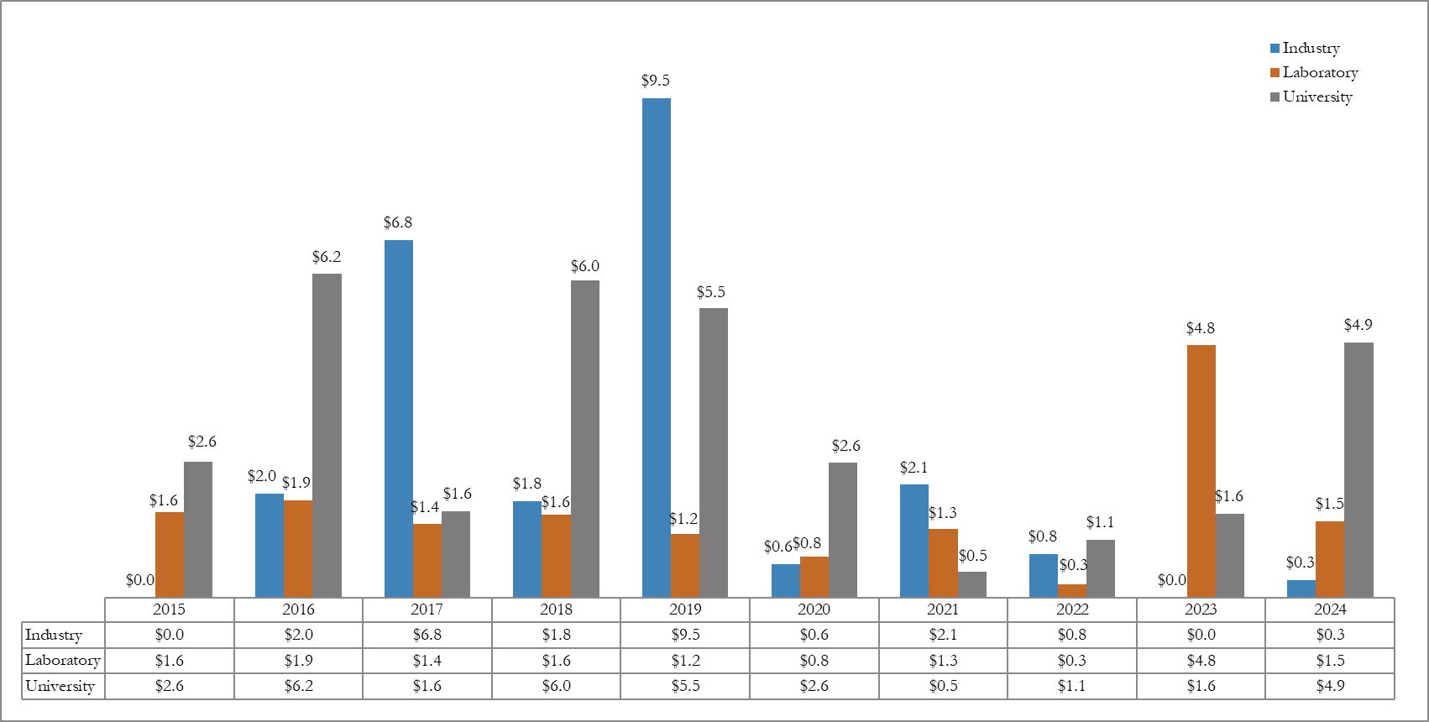
NSUF CINR Award Amounts by Institution
INL/MIS-25-84220

Slide 16
NSUF Access Awards
INL/MIS-25-84220

Slide 17
NSUF Ongoing Access Awards
INL/MIS-25-84220

Slide 18
NSUF Ongoing Access Awards, continued
INL/MIS-25-84220

Slide 19
NSUF Ongoing Access Awards, continued
INL/MIS-25-84220

Slide 20
NSUF Ongoing Access Awards, continued
INL/MIS-25-84220

Slide 21
NSUF Ongoing Access Awards, continued
INL/MIS-25-84220

Slide 22
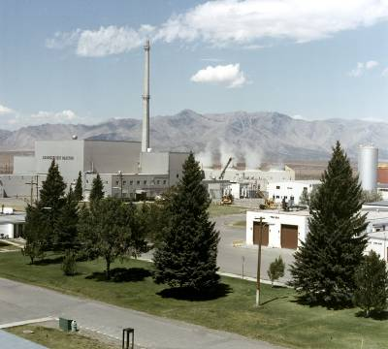
Contact Information
J. Derek Whipple
208-526-4662
j.whipple@inl.gov
INL/MIS-25-84220

