Slide 1

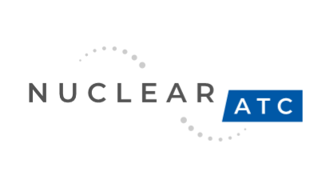
Cost-effective LWR in-pile Testing
Eric Schwarz
NuclearATC
Funding provided by DOE Office of Science SBIR/STTR Phase I Grant FY24

Slide 2
motivation
In-situ LWR materials testing is:
  Useful
  Limited by supply
  Preferred with fission radiation
  Expensive
More tools to enable innovation supports LWR sustainability
  License renewal supports strong workforces, skilled labor and tax base

Slide 3
Factors affecting access
Cost (O&M)
Schedule Availability
  Halden closed in 2018
  ATR, MITR top locations for work
Distance

Slide 4
opportunity
Flux
ATR
Ease of Access
Flexible Scheduling
Lower O&M (reactor and equipment)
  Passive safety
  Optimize operation
  ‘Minimalist design’
LWR proof-of-concept or simple testing needs cost and schedule optimized
MITR
?
Capabilities

Slide 5
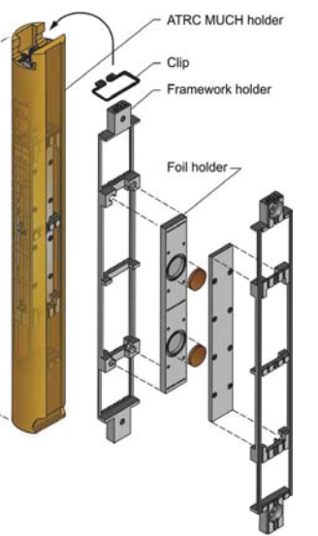
goal
To do In-pile testing BWR, PWR testing for
  Chemistry
  Materials
  Instrumentation
Using Low-cost ‘satisfactory’ sensor design
    Commercial/ Aerospace technology
Using Standard capsules
  2” Diameter tube (~1.75” dia, 6” in length)
  Build from INL/ ATR
From: 2012 Status Report on Efforts to Enhance Instrumentation to Support Advanced Test Reactor Irradiations, INL/EXT-12-27855

Slide 6
Progress
INL Team: Troy Unruh, Malwina Wilding and Austin Fleming
Penn State Radiation Science and Engineering Center (RSEC) key partner
Concept Cost Proposals in progress
  Facility Modifications
Thermal-Hydraulic Concept Modeling in progress
Fundraising
  SBIR/STTR Phase II (~September 2025)
Commercial Operation 1Q2028

Slide 7
Thank you
Eric Schwarz, Founder/ CEO
Eric.schwarz@nuclearatc.com
DOE Grant Award

