Slide 1
April 15-17, 2025
Nuclear Science User Facilities (NSUF) Program Review Meeting:
Agenda

Slide 2
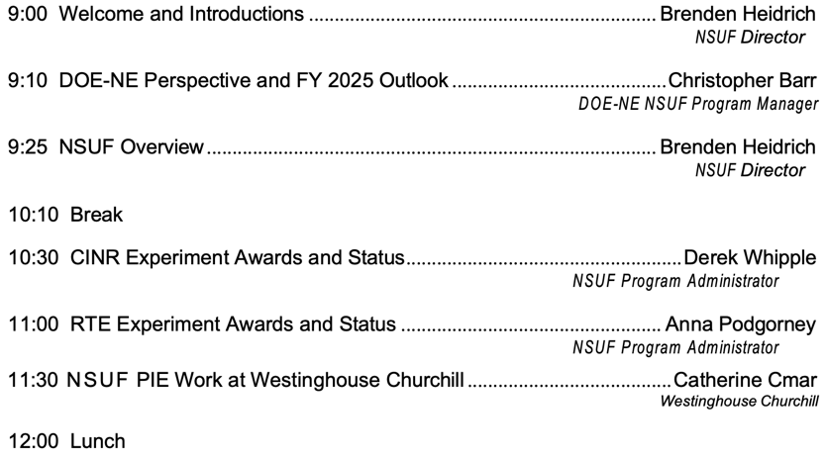
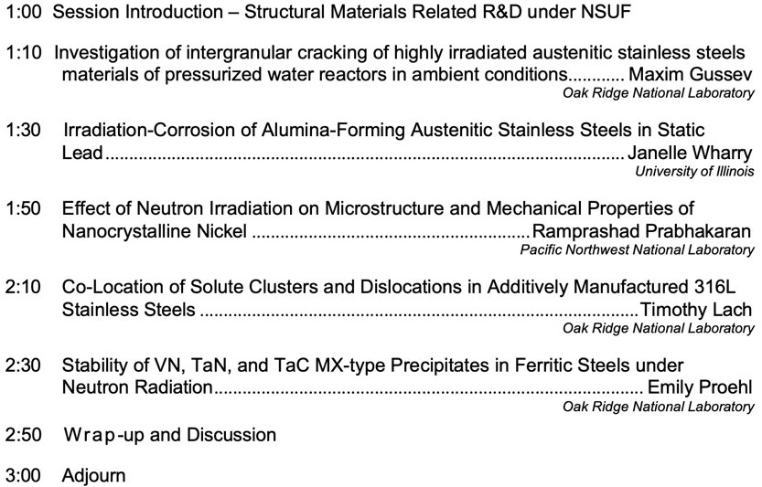
Tuesday – April 15, 2025
Program Overview
NSUF User Access Awards: Structural Materials

Slide 3
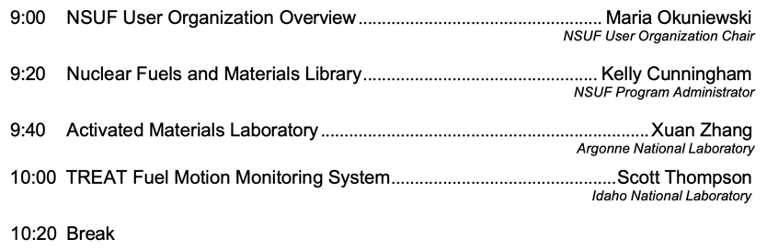
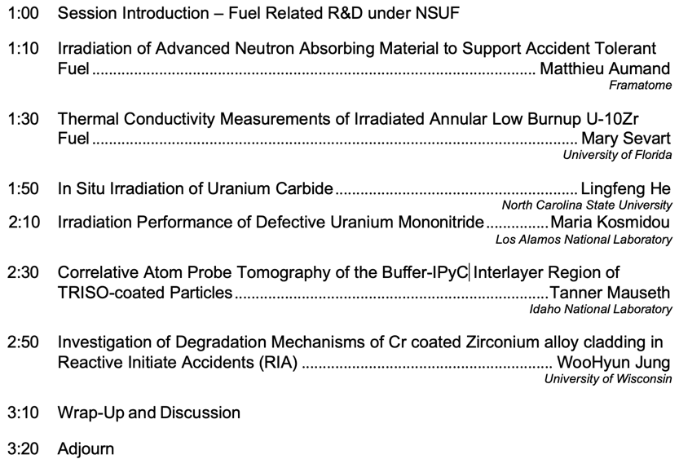
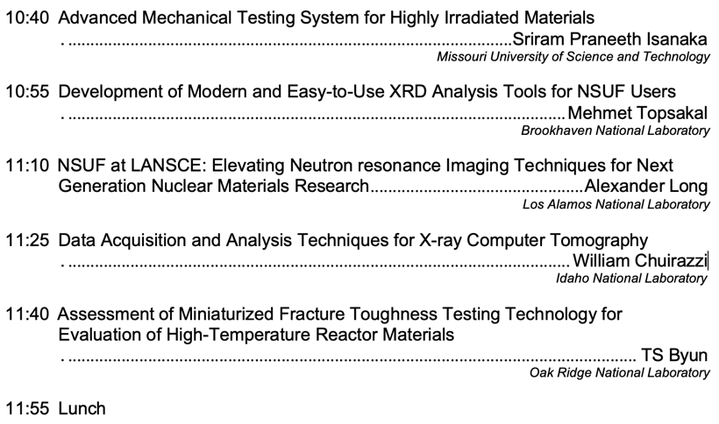
Wednesday – April 16, 2025
Users and Capabilities
NSUF User Access Awards: Fuel and Cladding Materials

Slide 4
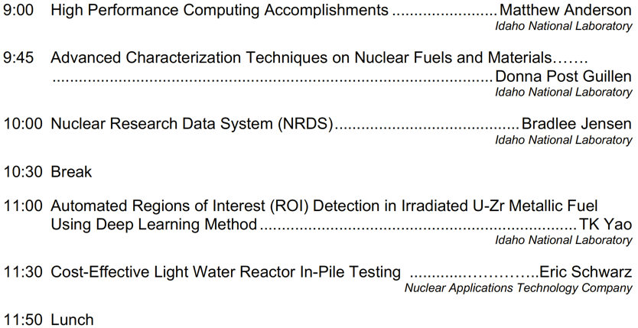
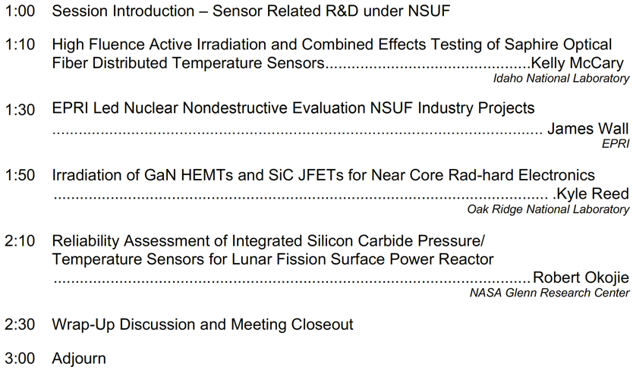
Thursday – April 17, 2025
High Performance Computing
NSUF User Access Awards: Sensor Materials

Slide 5




Slide 6
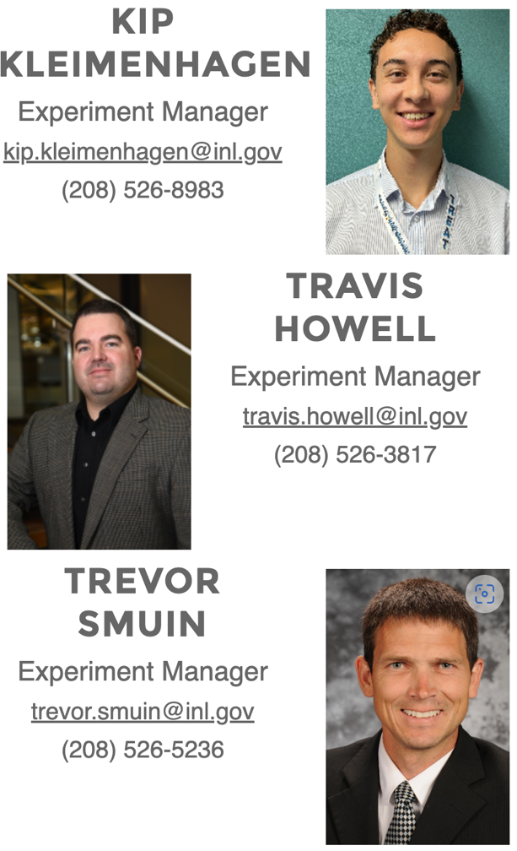

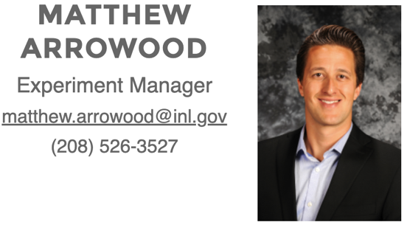


Slide 7

Safety Share:
Common Mental Health Issues in the Workplace
Stress: High workloads, tight deadlines, and difficult colleagues can contribute to stress.
Anxiety: Worry, fear, and excessive nervousness can affect job performance and relationships.
Depression: Symptoms like sadness, hopelessness, and loss of interest can significantly impact work productivity.
Burnout: Chronic stress and exhaustion can lead to burnout, characterized by emotional exhaustion, cynicism, and reduced performance.
This Photo by Unknown Author is licensed under CC BY
Safety share provided by ACUTE Environmental & Safety Services Inc.

Slide 8

Safety Share:
The Impact of Mental Health on the Workplace
Reduced productivity: Mental health issues can decrease employee productivity and efficiency.
Increased absenteeism: Employees struggling with mental health may be more likely to take time off work.
Decreased job satisfaction: Mental health problems can lead to lower job satisfaction and morale.
Negative workplace culture: A toxic work environment can exacerbate mental health issues.
This Photo by Unknown Author is licensed under CC BY
Safety share provided by ACUTE Environmental & Safety Services Inc.

Slide 9

Safety Share:
Promoting Mental Health in the Workplace
Create a supportive culture: Foster a culture of open communication, empathy, and respect.
Offer mental health resources: Provide access to mental health professionals, employee assistance programs (EAPs), and other support services.
Encourage work-life balance: Promote healthy work-life balance and stress management techniques.
Provide training: Educate employees about mental health awareness and how to support colleagues.
This Photo by Unknown Author is licensed under CC BY
By prioritizing mental health in the workplace, organizations can create a healthier, more productive, and more supportive environment for their employees.
Safety share provided by ACUTE Environmental & Safety Services Inc.

