Slide 1
Brenden Heidrich, Director
NSUF Annual Program Review
April 15, 2025
NSUF Program Overview and Update
INL/MIS-25-83964

Slide 2
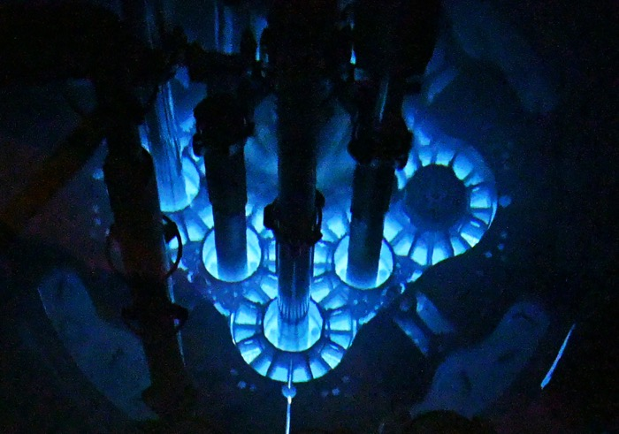
The Nuclear Science User Facilities (NSUF) Program
Established in 2007
  U.S. Department of Energy Office of Nuclear Energy’s first & only user facility
Founded at Idaho National Laboratory (INL)
  INL remains the lead and primary institution
NSUF operates similarly to other user facilities in the United States
  Fundamental Research - basic and applied research in science and engineering, intended to be published and shared broadly with the scientific community
  Competitive proposal processes
  No cost to user for accessing capabilities
  No travel funding to users, etc.

Slide 3
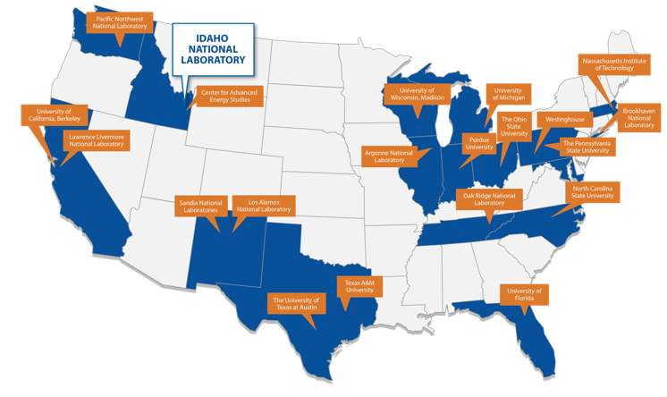
The Nuclear Science User Facilities (NSUF) Program
Unique aspects of NSUF
Consortium of facilities/capabilities
  21 institutions across the United States
  >50 major facilities and laboratories
  NSUF efficiently leverages existing investment in physical capabilities by utilizing excess capacity.
  Funding to partners covers only the costs for the awarded access project
NSUF offers multiple capabilities to a single scientific area
  Fundamental irradiation effects in nuclear fuels and materials important to US nuclear energy development
Projects can last many years
  Major projects can include design, fabrication, transport, irradiation, post-irradiation examination and final disposition.
  All projects are fully forward funded at the start.

Slide 4
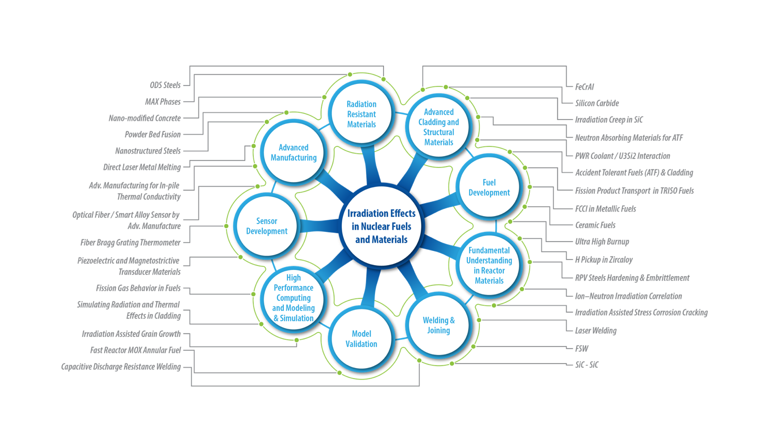
NSUF research areas cover all technical readiness levels

Slide 5
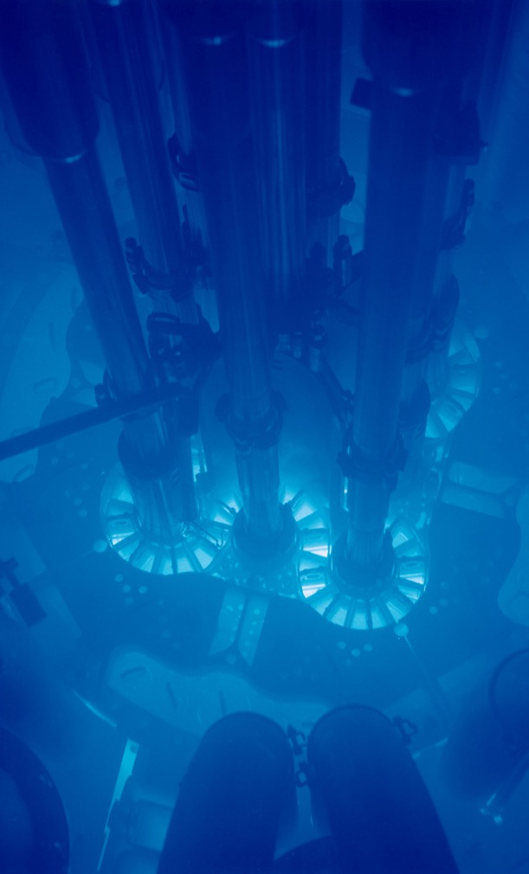
NSUF Capabilities

Slide 6

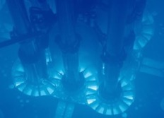

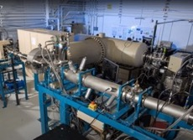

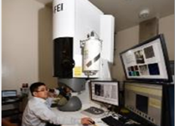

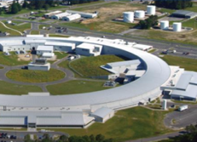


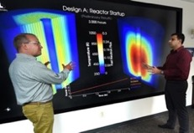
NSUF offers the best capabilities across the nation
Neutron Reactors
12 reactor facilities at national laboratories and universities including the Advanced Test Reactor at INL
Gamma & Ion Irradiation
7 gamma irradiation facilities and 7 ion beam facilities at national laboratories and universities
Cutting-Edge Resources: Access to infrastructure and associated capabilities across 21 partner sites
Open access: Available to industry, academia, and national labs for non-proprietary R&D
Education and training: Workshops, webinars, and hands-on skill development
Impact: Increase understanding to drive innovation across nuclear energy technologies
Post-Irradiation Examination
Multiple hot cell and broad post-irradiation examination facilities including advanced characterization methods
Beamlines
Synchrotron and neutron beamlines for nuclear fuel and materials studies
Computational Resources
Scientific high-performance computing capabilities for advanced modeling and simulation at INL

Slide 7
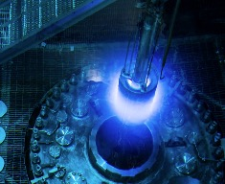
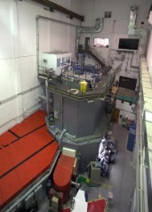
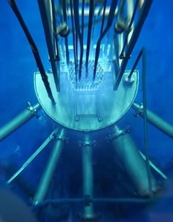
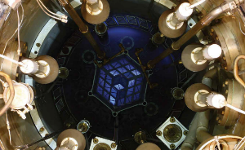
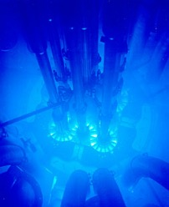
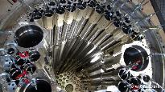
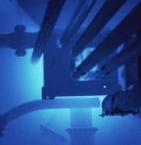
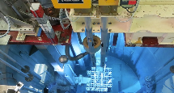
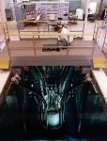
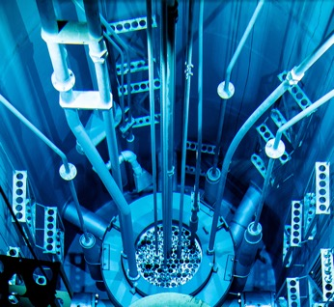
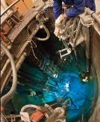
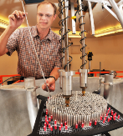
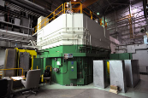
Simulated Reactor Environments: Neutron Irradiation

Slide 8
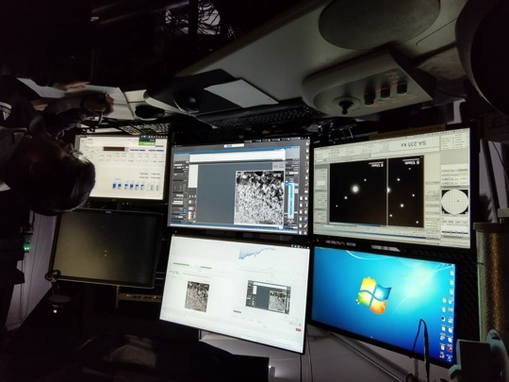
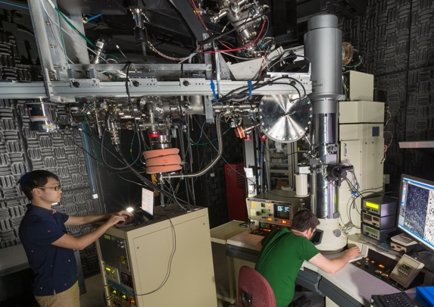
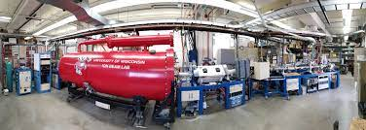
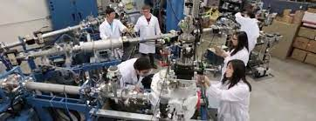
Simulated Reactor Environments: Ion Irradiation
IVEM
I³TEM
MIBL
In Situ TEM
In Situ TEM
In Situ TEM
WISC-IBL
TAMU-AL

Slide 9
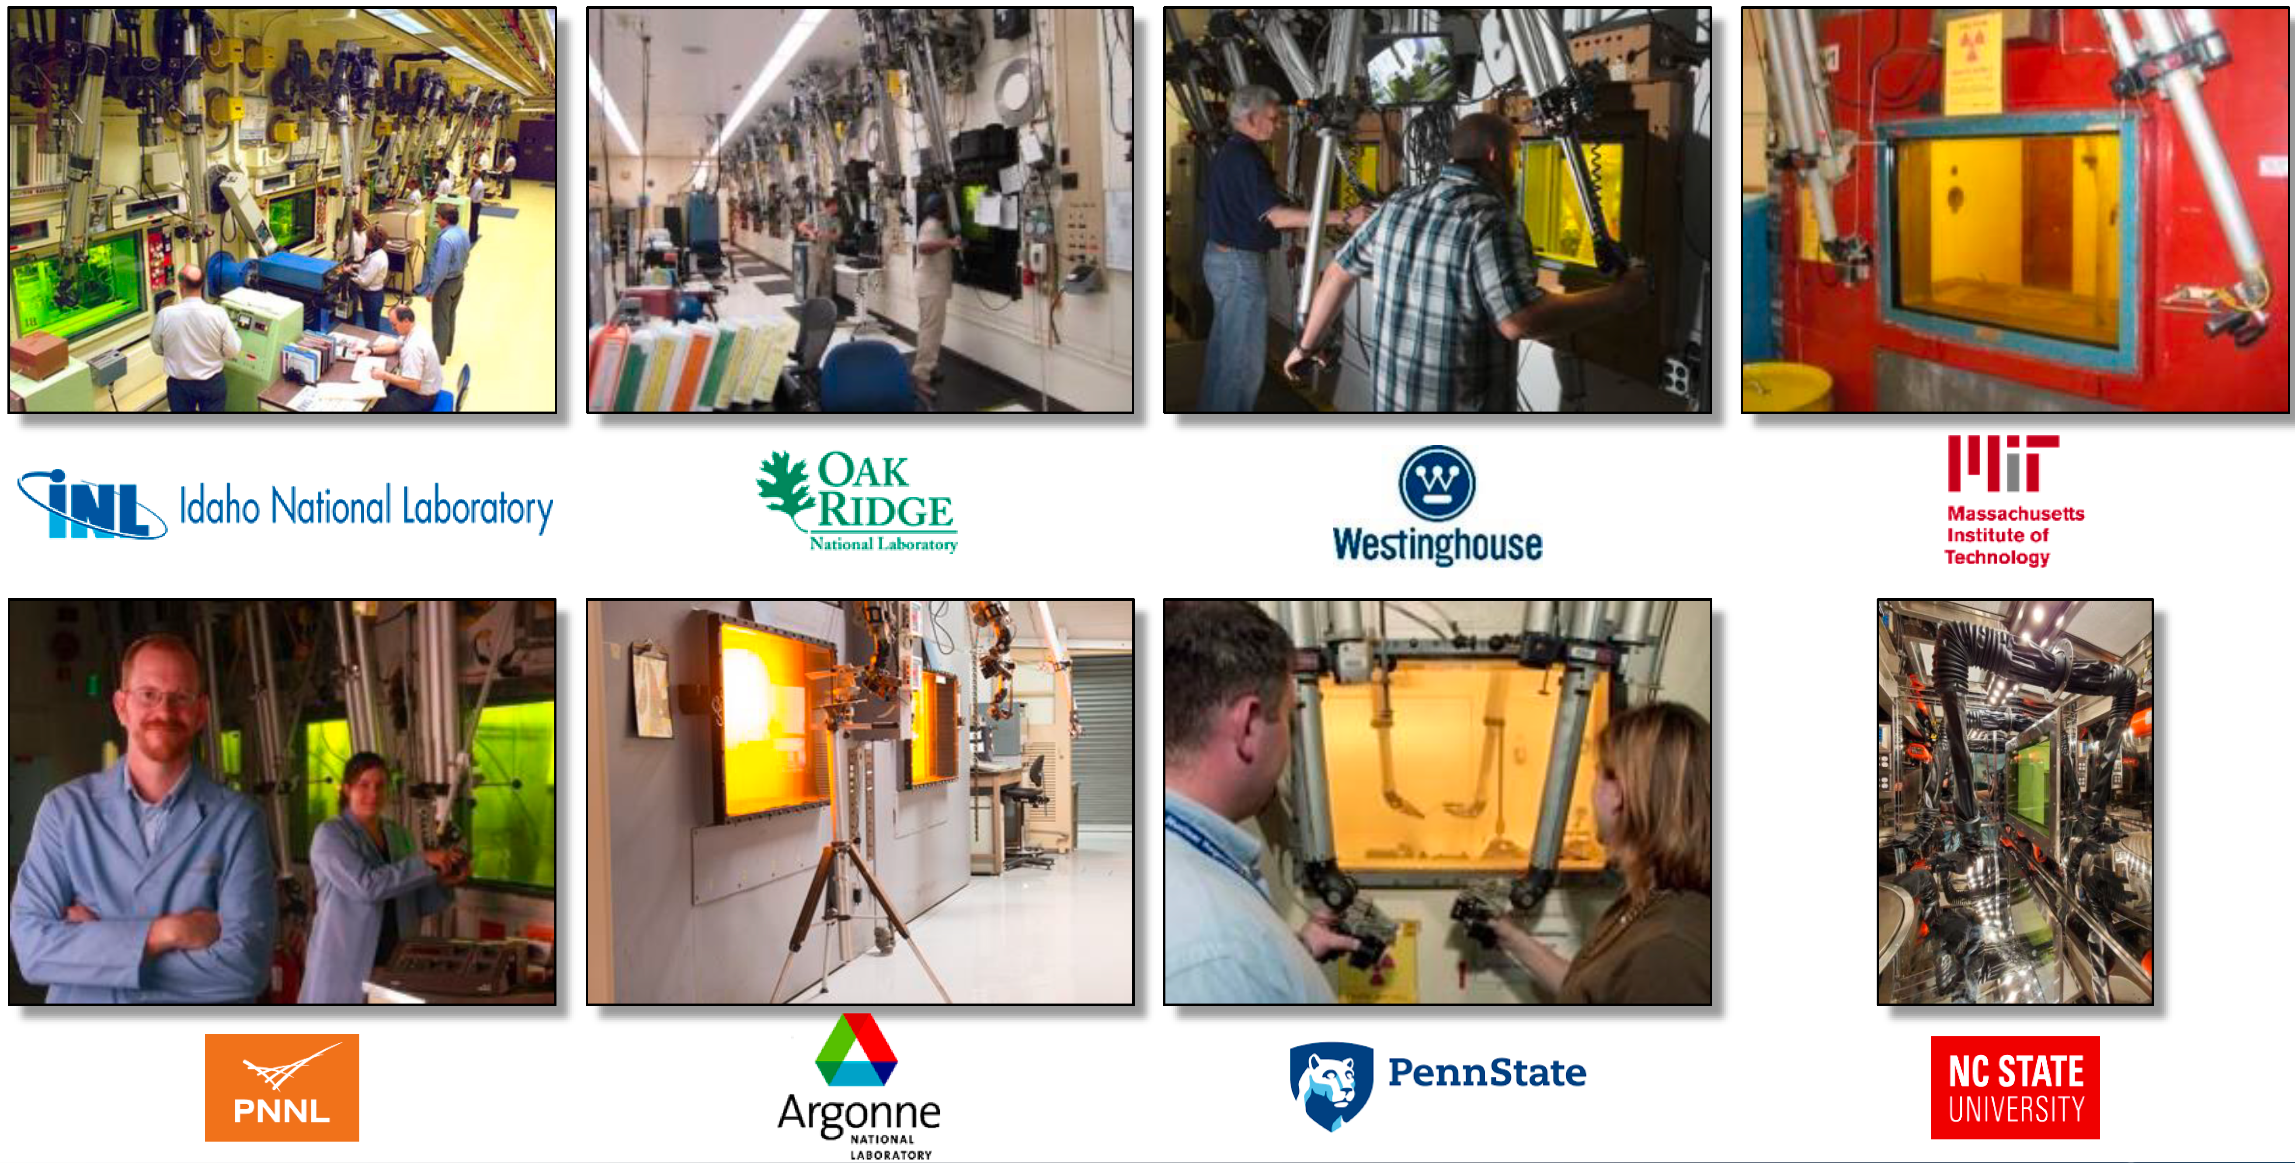
Hot Cells

Slide 10
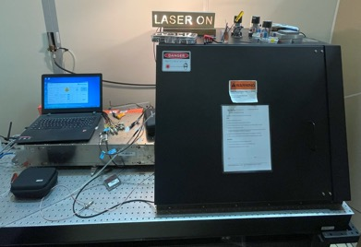
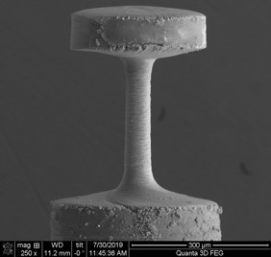
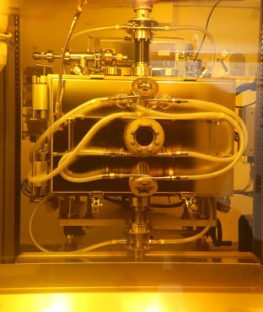
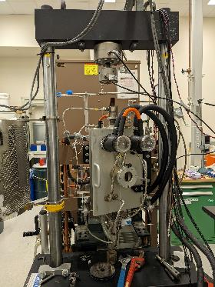
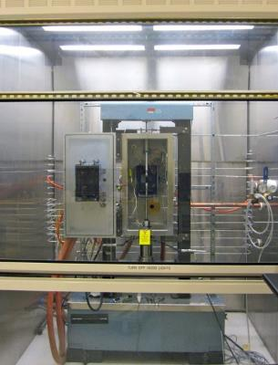
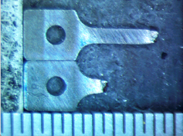
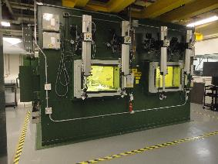
Simulated Reactor Environments: Mechanical Testing
  Hardness/ Bend test/ Tensile/ Creep/ Fatigue/ Compact tension/ Charpy impact (toughness)
High Temp Tensile Testing

Slide 11
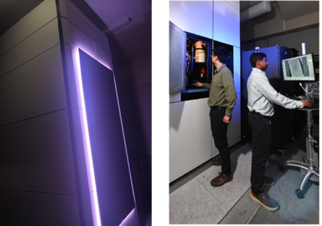
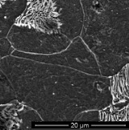
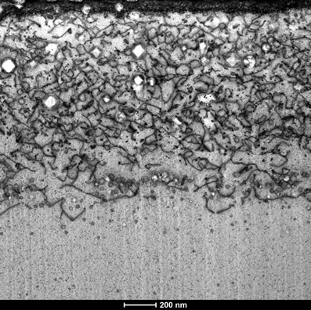
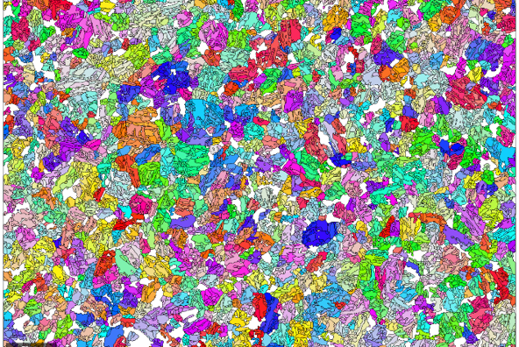
Advanced Microstructure Characterization Capabilities
Optical metallography
Scanning electron microscopy (SEM)
  BSE/EBSD/FIB
Transmission electron microscopy (TEM)
Spectra 300 STEM
STEM resolution 50 pm (125 pm at 30kV)
NF616
Ga₂O₃ Sensor

Slide 12
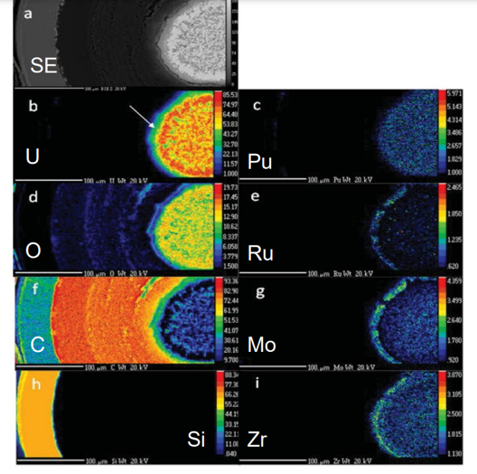


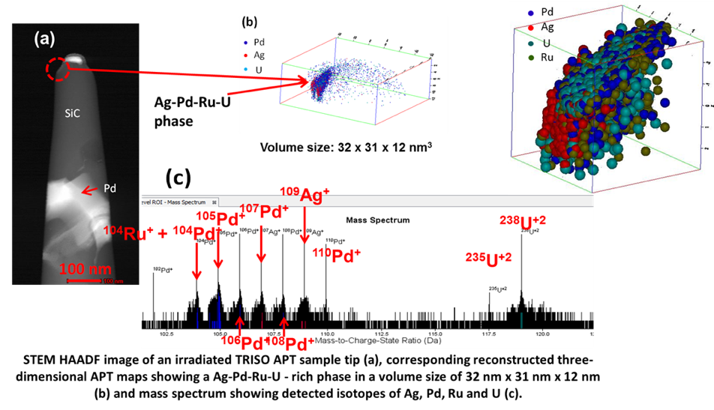
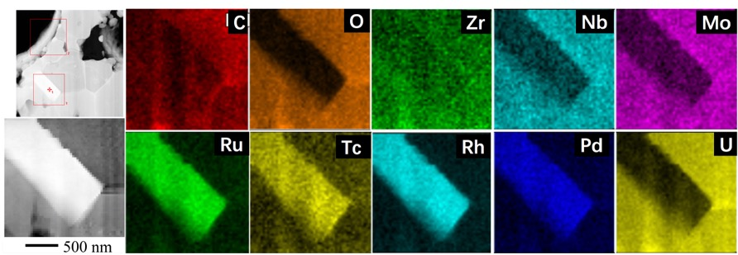
Advanced Microstructure Characterization Capabilities
  Atom probe tomography (APT)
  Electron Probe MicroAnalysis (EPMA)
  Energy Dispersive Spectroscopy (EDS)
  Electron Energy Loss Spectroscopy (EELS)
Combination of TEM + APT
WDS maps of a TRISO fuel particle
TEM images and EDS maps of irradiated fuel particle

Slide 13
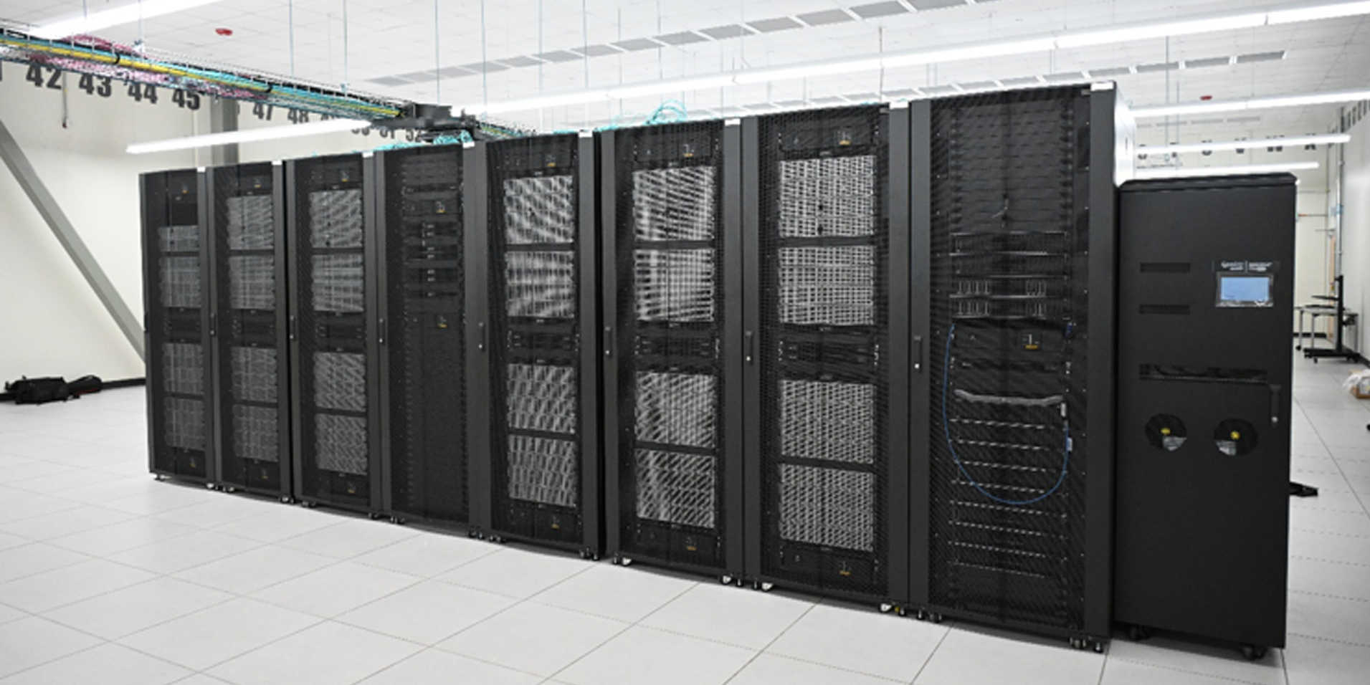
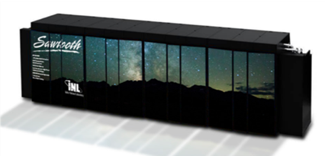
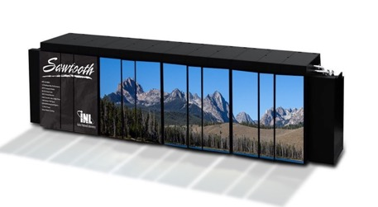
High Performance Computing (HPC) resources
NSUF HPC systems support a wide range of users and programs
Windriver (2025)
  5.4 Petaflops performance (Linpack)
  94,416-core Dell CTS-2 system
  211 TB total memory
Bitterroot (June 2024)
  2 Petaflops performance (Linpack)
  43,008-core Dell CTS-2 system
  90 TB total memory
Hoodoo (2021)
  Machine Learning Cluster
  108 A100 GPUs
Sawtooth (2020)
  5.6 Petaflops performance (was #37 on Top 500 list in 2020)
  99,972 compute cores HPE SGI 8600 system
  395 TB total memory
Bitterroot & Windriver
Sawtooth
Notes:
Lemhi will be transferred to an Idaho university consortium this year, as was done with Falcon four years ago.

Slide 14
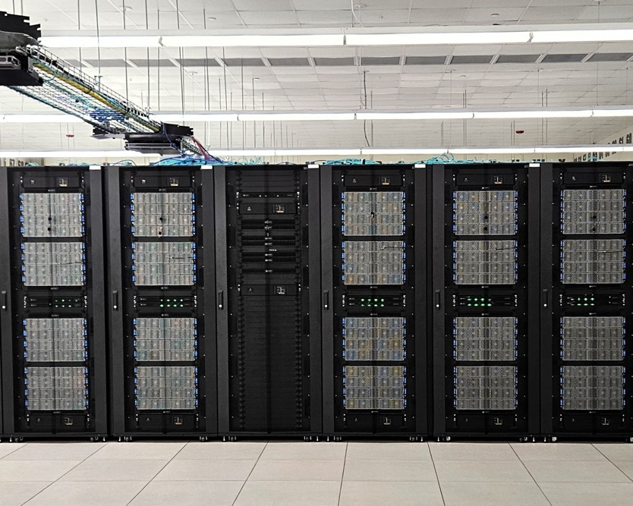
High Performance Computing (HPC)
New supercomputer Bitterroot
  Over 2000 TFlops of performance
  43,008-core Dell Commodity Technology Systems-2 (CTS-2) with each of its 384 nodes having 256 GB of RAM
  90 TB of total memory
Delivered 1,004 million core hours in FY-24 (65 million core hours more than in FY-23)
18 additional nodes added to the Hoodoo system each with four 40 GB A100 GPUs to further support machine learning workloads
Supported 16 trainings relying on HPC resources
Procured two new HPC Systems:
  Wind River (deployed in 2024)
  Teton (to be deployed in 2025)
Image of Bitterroot

Slide 15
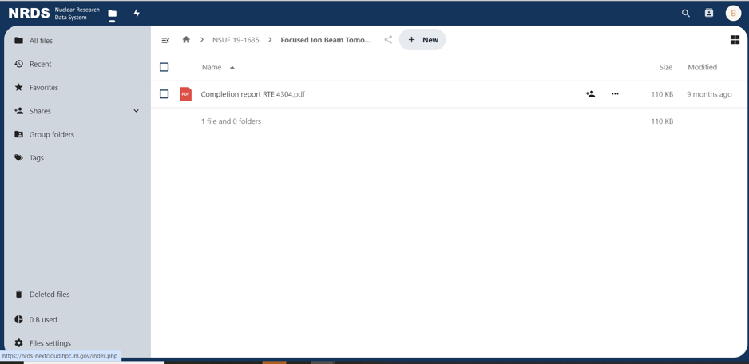
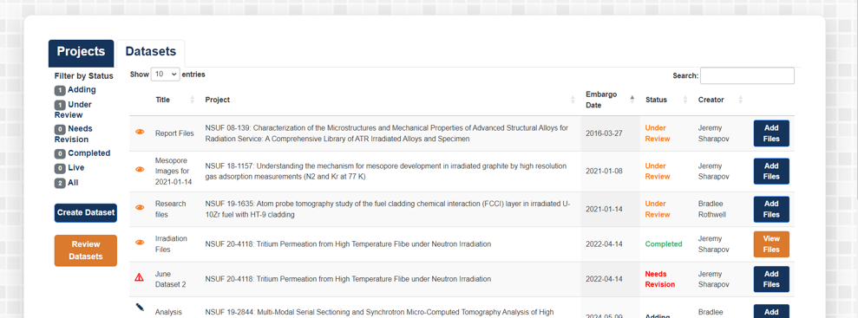
Nuclear Research Data System (NRDS)
Images from NRDS Portal
NRDS Portal released to public
  Site for registered NSUF PIs or co-PI users
  Workspace for data uploads to allow for project user collaboration
  https://nrds-portal.inl.gov/
Added NextCloud connectivity to allow for desktop app automatic uploads to the NRDS Portal
New AI/ML Model added to NRDS
  Predictive Automation of Novel Defect Anomalies (PANDA)

Slide 16
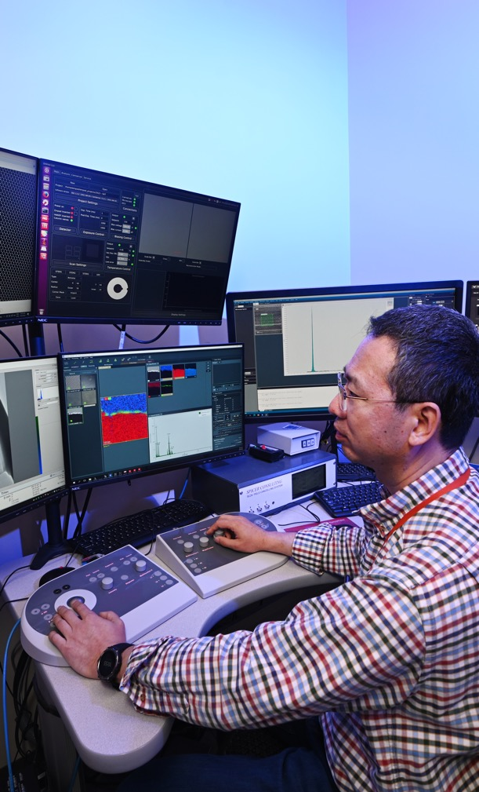
NSUF User Access Opportunities –Prior Year Accomplishments

Slide 17
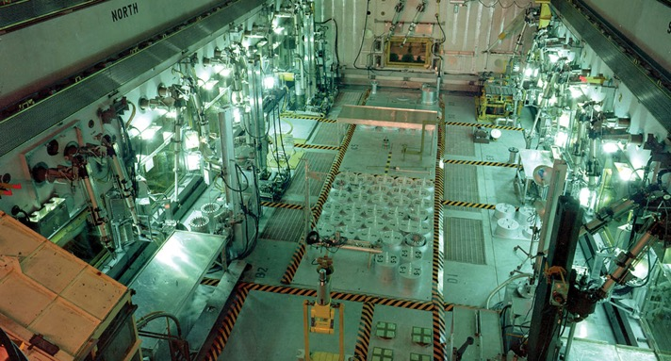
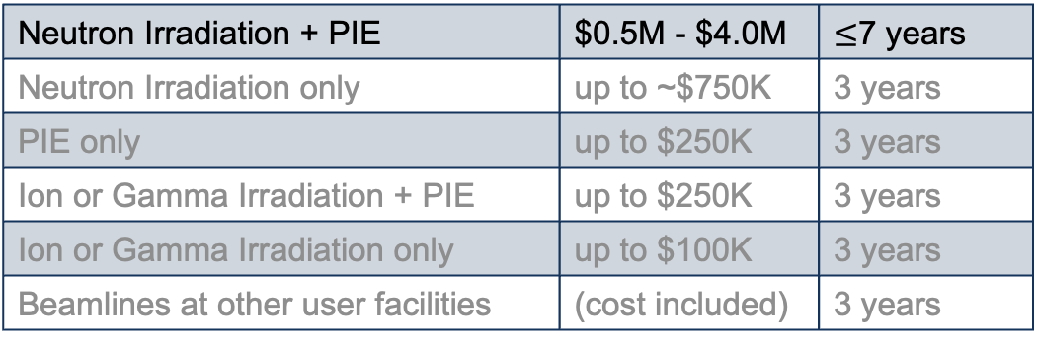
NSUF Funding Calls
Consolidated Innovative Nuclear Research (CINR NOFO)
  One call per year
  Projects include design, analyses, fabrication, transport, irradiation, disassembly, PIE, disposition
  Possibility to also receive user R&D funding on university topic areas
  Guidance on project costs and timelines
Neutron Irradiation + PIE | $0.5M - $4.0M | $≤$7 years
Neutron Irradiation only | up to ~$750K | 3 years
PIE only | up to $250K | 3 years
Ion or Gamma Irradiation + PIE | up to $250K | 3 years
Ion or Gamma Irradiation only | up to $100K | 3 years
Beamlines at other user facilities | (cost included) | 3 years
Notes:
Do not call out or speculate on the timeframe for the 25 or 26 opportunities
Only the 4MM$ is in the current NOFO, the rest are historical guidance

Slide 18

NSUF Access Award Projects Summary: FY07-FY24
Total NSUF Access Award Funding: $137M
816 total projects awarded
  45 CINR type projects executed
  32 CINR type projects currently ongoing
  661 RTEs executed
  78 RTEs ongoing
Awards distribution by institution type
  495 projects to 55 U.S. universities
  253 projects to 10 national laboratories
  35 projects to 13 industrial users*
  * All NSUF access awards support non-proprietary fundamental science and are intended for full public release
Notes:
6 RTE + 1 CINR awards have been cancelled.

Slide 19

NSUF User Access Awards - CINR
Large Projects

Slide 20


CINR awarded projects FY15 – FY24
Number of awards by institution type
Value of awards by institution type

Slide 21
Summary of CINR work in various technical areas
Technical Areas | Number of Awards | Award Years | Access Funding
Fundamentals for Reactor Materials | 33 | FY15, 16, 17, 18, 19, 20, 21, 22, 23, 24 | $26,976,388
Additive / Advanced Manufacturing | 11 | FY15, 16, 17, 18, 19, 21, 24 | $16,928,001
Advanced Fuel Development | 12 | FY15, 16, 17, 19, 20, 23, 24 | $14,494,994
Sensor Development | 15 | FY15, 17, 18, 19, 20, 21, 24 | $9,030,941
Computational Model Development and Validation | 6 | FY17, 18 | $4,714,455
Welding & Joining Advanced Cladding | 3 | FY16, 17 | $1,656,984
Nuclear Materials Discovery & Qualification Initiative | 2 | FY20, 21 | $995,514

Slide 22

CINR awarded projects up to FY24 by research field
Number of awards by field
Value of awards by field

Slide 23

NSUF Funding Calls
Rapid Turnaround Experiments (RTE)
  Three calls per year +1 special call
  Limited funding, executed within 9 months
Projects are selected through open competitive proposal processes
Proposals welcome from university, government laboratory, industry, and small business researchers
  Only non-proprietary projects accepted. All awarded projects are fully forward funded.

Slide 24

NSUF User Access Opportunities:
Rapid Turnaround Experiments
Rapid Turnaround Experiments (RTEs) historically have had up to 3 calls/year and 1 SuperRTE (new in FY 24)
  Limited funding, executed within 9 months (or 12 months for the SuperRTE)
  Projects are selected through open competitive proposal processes
  Proposals welcome from university, government laboratory, industry, and small business researchers
  Only non-proprietary projects accepted. All awarded projects are fully forward funded

Slide 25
NSUF Rapid Turnaround Experiments FY24
1st call: Opened October 2023, 27 awards made February 2024
2nd call: Opened February 2024, 33 awards made June 2024
SuperRTE call: Opened April 2024, 13 awards made August 2024
3rd call: Opened June 2024, 19 awards made September 2024
FY25 Rapid Turnaround Experiments
1st call: Opened October 2024, awards selection is pending

Slide 26
FY24 Rapid Turnaround Experiments Metrics
Standard RTE
SuperRTE
Awarded 79 of the 161 proposals (52%)
Metrics for the three FY24 RTE calls:
  43 awards (out of 94 submitted) to PIs from U.S. universities (46%)
  29 awards (out of 53 submitted) to PIs from U.S. national laboratories and government entities (55%)
  3 awards (out of 7 submitted) to PIs from U.S. industry (43%)
Awarded 13 of the 49 proposals (27%)
  Metrics for the single FY24 SuperRTE :
  7 awards (out of 27 submitted) to PIs from U.S. universities (26%)
  5 awards (out of 17 submitted) to PIs from U.S. national laboratories and government entities (29%)
  1 award (out of 4 submitted) to PIs from U.S. industry (25%)

Slide 27
NSUF SuperRTE FY24
SuperRTEs offer a broader scope than a traditional RTE and allow for more time at NSUF facilities:
  Twice the allowable access time at NSUF partner facilities
  Two NSUF partner institutions for post-irradiation examination
  12-month project duration
  Support for shipping between multiple NSUF partner institutions
  Increased page limit for project narrative
Lessons Learned:
  More interest in SuperRTE than anticipated (49 proposals submitted)
  Subsequent 3rd RTE call received many proposals that did not align with guidelines and were deemed infeasible, irrelevant, or disqualified
  Subsequent 3rd RTE call showed a reduction in overall technical review scores
Notes:
Project narrative for traditional RTE is 2-pages, compared to 3-pages for superRTE.
Less than 15% of the proposals submitted to the 1st, 2nd, and superRTE call were deemed infeasible, irrelevant, or disqualified, compared to 40% in the 3rd RTE call.
51% of superRTEs were scored as 80 or higher for technical reviews, compared to 31% for the 3rd RTE call.

Slide 28
NSUF User Access Awards: Rapid Turnaround Experiments
Small projects

Slide 29

CDF for reviewed RTE proposal costs

Slide 30
RTE and SuperRTE awarded projects through FY24
Institution type

Slide 31
NSUF Rapid Turnaround Experiments FY24

Slide 32

NSUF RTE Proposal Updates
RTE rule clarifications
Material development is outside the scope of an RTE
Proposals requesting irradiation without an NSUF post-irradiation facility must include significant in situ monitoring of the device under irradiation sufficient to result in a measurable scientific outcome
Proposals from non-U.S. institutions must have a U.S.-based collaborator who is not an NSUF partner facility point of contact
CVs limited to 2-pages and suggested format is the NSF Biographical Sketch

Slide 33

NSUF RTE Project Award Updates
Publicizing the Awards
Application items intended for public release (300-word limit):
  Technical Abstract → Project Summary
  Program Relevance Statement
After award announcements are made, some information may be publicly shared:
  Names, institutions, and expertise of principal investigator and team members
  Hypothesis
  Work description

Slide 34
NSUF RTE Project Award Updates
Project Timelines and Expectations
Guidelines provided on RTE page and award announcement letters:
  To achieve the 9-month RTE project timeline:
    Post-irradiation examination (PIE) should be scheduled within 3 months
    Samples should be sent to the PIE facility within 5 months
    Project scope should be completed within 9 months
  To achieve the 12-month SuperRTE project timeline:
    PIE should be scheduled within 4 months
    Samples should be sent to the PIE facility within 7 months
    Project scope should be completed within 12 months

Slide 35
NSUF RTE Completion Reports
New Completion Report template provided at https://nsuf.inl.gov/Page/rte:
  Title and Authors
  Technical Abstract
  Project Description
  Results
  Publications and Presentations
  Program Relevance
  References
Completions reports to be used in NSUF annual reporting
Delayed public release of the report is possible
  Notify nsuf@inl.gov upon submission of completion report
Notes:
The template may be replaced by a web form like HPC.

Slide 36

NSUF Website Updates

Slide 37

Multi-Factor (MFA) Authentication: A New Secure Login Process
Data breaches require additional security
Security features need to be ‘phish proof’
MFA tokens are:
  Time based
  Secure
  Open source
Authenticator apps are free, easy to use, and are widely used
Notes:
To ensure the long-term reliability of our data, and security of our user accounts, we are now requiring multi-factor authentication for login.
Data breaches are very common these days, with some breaches including billions of user accounts. As a result, the hard reality is that nearly no password is safe or secure at this point.
In order to provide a ‘phish proof’ method for authentication, INL now requires MFA through authenticator tokens.
These tokens are time-based, they are only valid for 60 seconds. Tokens are also very secure as they are generated uniquely for your user account.
Because tokens are open source, there are many free, and easy to use authenticator applications available for any user environment and operating system.
We recommend either Google Authenticator or Microsoft Authenticator, but nearly any MFA authenticator app will work to generate the token you need to login.

Slide 38

Proposal Validation: Simplifying the Process of Proposing Research
Validation improvements:
  Intuitive visual cues
  Clear messaging
  Real-time validation
Proposal process is easier
User support has improved
Notes:
Proposals are complex, requiring multiple forms to complete, with validation requirements that change based on the type of proposal, the information being collected, and other factors.
To help our users, we have completely overhauled the way our proposal system validates information and communicates validation issues to the researcher.
We have added intuitive visual cues that use coloration to identify specific sections and fields that need additional attention, and updated validation messages to be clearer and more concise.
Real-time validation has been added to each section of the proposal to improve how we communicate which sections require additional content, and which sections are complete and ready for submission.
These new features have made the process to prepare and submit a proposal more intuitive, easier, and as a result, we have seen a significant reduction in the number of user support requests we receive during a call.

Slide 39

Project Status: Tracking, Scheduling and Reporting
Project status reporting now officially launched
Multi-year pilot program completed
Status reports trigger completion reports
Easy, simple process
Notes:
Awarded projects are given a period of time to complete physical work at facilities, and the new project status system has been developed to simplify, standardize, and support reporting of progress back to NSUF.
This system has had been used by a small pilot group of partners and refined over a multi-year period, we are officially launching this for all NSUF partners this year.
When partners report completion of physical work at the facility, notifications will be sent to help guide researchers to submitting completion reports for their project
The status system is crucial to the business process for completing projects, scheduling and evaluating capability utilization, and reporting.
This new system is extremely easy and simple to use, greatly simplifying and standardizing our previous ad-hoc reporting process for partners.

Slide 40
NRDS Integration: The Future of Research Data
NRDS is now directly integrated with proposals
This integration fully supports single-sign-on (SSO) with NRDS
Research data is directly connected with your awarded proposal
Notes:
NRDS is extremely important to NSUF for the future of research data storage and utilization, and that starts as soon as physical work begins on an awarded project.
To support that work, we have added a direct link to the proposal to access the research data that is generated and collected by the associated partner facilities, instrument scientists, and other sources of research data.
This new feature supports single-sign-on, which means that if you have logged in to the NSUF site, you do not need to login again at the NRDS Portal, if you follow the link in your proposal.
While some researchers may have access to multiple projects in the NRDS portal, this feature provides an easy and convenient way to access the data for a specific project.
This new feature is only available to the PI, facility leads and other authorized staff at requested partner facilities, and NSUF administrators.

Slide 41

NSUF Community Interactions

Slide 42

NSUF Hosts Workshop on Irradiation Testing
Pilot Workshop: May 20-23, 2024 at the Center for Advanced Energy Studies (CAES)
Outreach to non-nuclear energy specific university-affiliated material science researchers.
Hosted undergraduate students and faculty from four institutions and five NSUF university partners
Participants were introduced to nuclear fuels and materials research through:
  Learning from INL staff presentations and tours of the Advanced Test Reactor, Materials and Fuels Complex, Transient Reactor Test Facility
  Performing hands-on work at the CAES Microscopy and Characterization Suite
  Collaborating with faculty and NSUF partner representatives to design proposals suitable for an NSUF Rapid Turnaround Experiment
2024 Irradiation Testing Pilot Workshop participants at the Center for Advanced Energy Studies
Notes:
Objective: Build long-term relationships between the NSUF program office, NSUF partner facilities, and non-nuclear energy specific university-affiliated users to provide better utilization of NSUF resources in addressing United States energy challenges.

Slide 43



2024 User Development Pilot Workshop on Irradiation Testing
Facility Tours:
Experimental Breeder Reactor I (EBR-I)
Advanced Test Reactor (ATR)
Irradiated Materials and Characterization Lab (IMCL)
Sample Preparation Lab (SPL)
Hot Fuel Examination Facility (HFEF)
Transient Reactor Test Facility (TREAT)
Hands On Work:
  CAES Microscopy and Characterization Suite (MaCS)
  Sample preparation
    Jet polish and mounting
  ThermoFisher Spectra 300 STEM
  Cameca Intruments LEAP 4000X HR atom probe
  Quanta 3D FEG Dual focused ion beam
  JEOL JSM-6610LV SEM

Slide 44

NSUF Hosts 2024 Science Review Board
August 6-8, 2024 at the Center for Advanced Energy Studies (CAES)
The NSUF Science Review Board (SRB) consists of 10 members from national laboratories, universities and industry to receive program updates, ask questions and discuss opportunities for growth.
The SRB report provided assessment and feedback to the NSUF program in the areas of:
  Scientific portfolio
  Data management and sharing
  Strategic planning
  Proposal and award policies
  Instrument Scientist and Nuclear Fuels and Materials Library programs
2024 Science Review Board closing day participants gather for a photo at the Center for Advanced Energy Studies.

Slide 45
NSUF Hosts 2024 Science Review Board
10 board members participated from national laboratories, universities and industry to receive program updates, ask questions and discuss opportunities for growth.
The SRB report provided assessment and feedback to the NSUF program in the areas of:
  Scientific portfolio
  Data management and sharing
  Strategic planning
  Proposal and award policies
  Instrument Scientist and Nuclear Fuels and Materials Library programs
2024 Science Review Board closing day participants gather for a photo at the Center for Advanced Energy Studies.

Slide 46

Communications Highlights
Started reconstruction of content website pages
  New format will modernize look and feel, simplify navigation, provide more consistency throughout site
Initiated a new system for communications through GovDelivery
  New templates improve look, feel and brand consistency
  System provides better efficiency, analytics
Increased efforts in brand consistency
  New templates for presentations, reports, event planning
  Brand guide improved to include clearer guidance and best practices

Slide 47

Communications Highlights
LinkedIn page has reached over 900 followers since its inception in April 2024
Increased efforts to collect high quality images and videos of ongoing NSUF experiments at INL for communication materials
High-reaching feature stories, including:
  A smooth ride to the future of nuclear (INL and DOE-NE news)
  U.S. and UK Researchers Fabricate First Capsules for Advanced Reactor Materials Testing (DOE-NE news)

Slide 48

Nuclear Fuels and Materials Library Inventory, Harvesting, and Donations

Slide 49


Nuclear Fuels and Materials Library
The Nuclear Fuels and Materials Library (NFML) is owned by the U.S. Department of Energy’s Office of Nuclear Energy (DOE-NE) and curated by NSUF. It provides public access to over 9,000 samples through NSUF competitive award processes or direct requests approved by the NSUF Program Leadership.
Launched online in 2016, the NFML includes:
Legacy samples from the Experimental Breeder Reactor (EBR-II) shutdown in 1994
Samples and pedigree information from NSUF-awarded irradiations starting in 2008
Donations from varied sources including materials retrieved from decommissioned and operating power reactors

Slide 50
NSUF Nuclear Fuels and Materials Library
NFML Utilization
The NFML was available online for the first time in 2016 for the 3rd RTE Call.
2016 | 75 |  | 13 |  | 17%
2017 | 180 |  | 23 |  | 13%
2018 | 280 |  | 33 |  | 12%
2019 | 185 |  | 22 |  | 12%
Sample requests prior to 2016 3rd call came from PIs familiar with NSUF projects.
2024 had 3 RTE calls and 1 Super RTE call

Slide 51
NSUF Nuclear Fuels and Materials Library
Updated NFML Policy https://nsuf.inl.gov/Page/nfml_request
The majority of the updates involved further clarification of previous policy statements and semantic adjustments
Materials or samples from third parties (industry, foreign entities, other non-DOE federal agencies, etc.) should MUST be transferred to the DOE-NE per a legal Agreement on Transfer of Title and Ownership
NSUF Program Leadership (NSUF Director and Federal Program Manager) will make decisions regarding:
  Direct requests
  Policy changes
  Disputes involving the use of NFML samples, or the admittance of samples into the NFML
Additional sample attributes were added to the list of pedigree information requested for samples offered and accepted into the NFML:
  Material certifications, compositions, and properties
  Irradiation conditions (temperature, dose, flux, fluence, environment, duration)
  Fabrication and/or manufacturing processes
  Sample geometry and dimensions
  Related reports and publications

Slide 52
NSUF Nuclear Fuels and Materials Library
Updated NFML Policy (continued)
Upon completion of the irradiation phase of an awarded experiment the samples are available for post-irradiation examination.
The Principal Investigator (PI) will be given exclusive rights to the samples for a three-year period of post-irradiation examination unless other conditions are agreed upon. This three-year period starts once the materials are at the PIE facility and available for use by the PI.
After the three-year period, the samples will be made available to the general research community for subsequent competitively awarded proposals.
  As a courtesy, subsequent proposers will be provided with the contact information of the original project PI to facilitate potential collaboration opportunities. The original PI may choose to collaborate but cannot deny access to the NFML sample requests included in an awarded proposal. (This statement has been added to the RTE proposal form with the original PI’s contact information.)

Slide 53


NSUF Nuclear Fuels and Materials Library
FY24 Additions: Awarded NSUF Project Samples – GE Hitachi
Irradiation Testing of LWR Additively Manufactured Materials
Direct Metal Laser Melting (DMLM) fabricated using 3D printer technology
Compact Tension and Tensile specimens
Inconel 718 Nickel-base material
316L Stainless Steel
Unirradiated (baseline) specimens
GE-Hitachi capsule internals

Slide 54

NSUF Nuclear Fuels and Materials Library
FY24 Additions: Cooperative Research and Development Agreement
Electric Power Research Institute/NSUF CRADA Pilot Project
Cooperative Research & Development Agreement (CRADA) between DOE NSUF and EPRI made ATR’s capabilities available to universities and the commercial nuclear industry.*
Research on the samples provided a chance to gather data needed for reactor licenses to be extended 40, 60, and 80 years.
The project showed that both materials retain a high level of integrity even at the highest fluence.
Valuable experience was gained in testing protocol and processes, and paved the path for future NSUF experiments on structural materials involving Irradiation Assisted Stress Corrosion Cracking.
Experiment capsules and specimen stack-up
* In 2010 the ATR was primarily used for U.S. Navy and DOE experiments, so opening it up for broader access significantly advanced nuclear research opportunities.

Slide 55

NSUF Nuclear Fuels and Materials Library
FY24 Acquisitions: Continued deliveries from BWXT NOG
Harvested LWR Core Shroud Material
Donor: EPRI/Southern Nuclear/BWXT
304 SS core shroud samples (weld and base metal and Heat Affected Zones (HAZ) from a commercial LWR NPP
Legal transfer of Title and Ownership signed in FY 2022
Samples delivered in batches from BWXT to INL
Last shipment arrived in early March, 2025

Slide 56


NSUF Nuclear Fuels and Materials Library
FY24 Acquisitions: LDRD Donation
Tensile Testing Using the Standard Capsule (TTUSC)
Donor: LDRD-Irradiation/NSUF PIE
ATR-irradiated multi-principal component alloys (MPEA)
SSJ tensile samples of five or more main components irradiated in the SMSC standard capsule
LDRD “Combinatorial and High Throughput Materials Synthesis to Advance Nuclear Materials Discovery”

Slide 57


NSUF Nuclear Fuels and Materials Library
FY24 Acquisitions: Microreactor Program Donation
Yttrium-Hydride Solid Neutron Moderator
Donor: DOE-NE Microreactor Program
ATR-irradiated samples fabricated by LANL
Yttrium-hydride can be used as a moderator for microreactors or space reactors due to its stability at higher temperatures.

Slide 58

Nuclear Fuels and Materials Library
Directed Irradiation Campaigns

Slide 59

NSUF-NNUF Cooperative ATR Project (NIFT-E)
NIFT-E "Neutron Irradiation as a Function of Temperature – Experiment"
Strategic Objectives
Explore sharing of nuclear facilities between US and UK
Further nuclear energy research collaboration
Technical Objectives
Capture effects of neutron irradiation as a function of temperature on dose on nuclear graphite and on alumina-forming austenitic (AFA) steels
Targets microstructure and mechanical property plus corrosion behavior
Stakeholders
US: NSUF plus INL, PNNL, Purdue University, Westinghouse
UK: NNUF plus UK NNL, Univ. of Manchester, Univ. of Oxford, Univ. of Sheffield,
UKAEA
Miscellaneous Material
Oxide-Coated F/M Steels 3µm Al2O3 coated
Oxide-Coated F/M Steels 1.5 µm FeCrAl 1.5 µm Al2O3 coated
Adv Mfg Grade 91
HEAs
Hetero Nano-composites
Alumina-Forming Alloys
GA05 SA
GA05 HT
GA05 20Ni SA
GA05 20Ni HT
AISI Type 304L SS 3 µm Al2O3 coated
AISI Type 304L SS 1.5 µm FeCrAl 1.5 µm Al2O3 coated
Graphite
IG110
2114
PCEA
HOPG
IPyC
Notes:
The objective of the irradiation campaign is to capture the effects of neutron irradiation as a function of temperature on dose on the Alumina-forming austenitic (AFA) material microstructure, mechanical properties, and corrosion behavior. No irradiation data appears to be available for this material.
AFA stainless steels have improved creep strength and oxidation resistance relative to 300-series stainless steels. The ability to form a passive alumina layer on the surface gives AFA excellent oxidation and corrosion resistance. AFA has been investigated for use in supercritical fluid and liquid lead environments and has seen limited commercialization in non-nuclear applications.
This irradiation campaign builds on previous testing campaigns performed on AFA steels in the US as funded by DOE and DOE-NE, and in the UK.
This experiment will also assist in removing the “trial and error” aspect from the design of future nuclear graphite grades.

Slide 60




NIFT-E Capsules & Specimens
Notes:
Graphite capsules being inspected

Slide 61



NIFT-E Capsules & Specimens
Notes:
These pictures are of the “graphite can”, which holds very fragile specimens consisting of two 3mm HOPG disc (0.4mm thickness) and six 6mm PyC disc (0.08mm thickness) specimens. These specimens had to be loaded with vacuum tweezers. The can dimension is roughly 15.25mm in height, with a 9mm diameter.

Slide 62


NIFT-E Project Timeline & Strategy
Activity | Finish Date
Final Design Complete | September 2023
Assembly Complete | September 2024
Commence Irradiation | November 2024
Notes:
Updated information

Slide 63
SAM-3 Collaborative ATR Irradiation Campaign
Objective
  Irradiate various structural/cladding materials important to current and advanced civilian nuclear energy technologies
  Add highly interested/demanded structural/cladding materials from donations and harvesting
    Materials will be characterized to accelerate nuclear structural/ cladding materials development / qualification / deployment.
Approach
  Select high priority nuclear structural/cladding materials for irradiation
  Utilize a standard irradiation capsule design and bounding safety analyses to irradiate structural/cladding material specimens, such as SSJ tensile bars, and 3 & 6 mm disks

Slide 64
Specimen Identification and Prioritization (SIP) Working Group
NSUF has convened a SIP WG of structural/cladding material experts from NSUF stakeholders (DOE-NE, NRC, EPRI, National lab, University) to assist in identifying materials and conditions for the SAM-3 irradiation campaign
The SIP WG will make recommendations to NSUF and leadership of the DOE-NE for the final prioritization and selection of test materials
Determine information on materials of interest for US domestic nuclear energy (fission) applications
Material data needs and priorities
  Materials should be important to the development and deployment of US nuclear reactor technologies
  Materials with limited (or no) irradiation testing data
  Materials identified as critical or desirable over existing alternatives for advanced reactors
  Materials in use, but with an untested manufacturing or treatment process
Irradiation testing conditions
  Specimen geometry needs to fit NSUF Structural Material Standard Capsule (SMSC) (SMSC is limited to 6 mm and 3 mm disks, and SSJ3 tensile specimens)
  Irradiation conditions (temperature, fluence, spectrum, dpa, etc.) need to be provided and be achievable at ATR
  Special conditions (limited capability for special environments while using the SMSC)
Objective of SIP WG

Slide 65

SMSC Capsule Materials and Irradiation Limits
Materials: non-fuel, structural and cladding materials, materials should not be brittle.
Maximum dpa: 6 dpa (in stainless steel)
Temperature range: ~200-700 °C.
Drop In materials experiment
  6 capsules (initial loading)
60 days ATR cycle
B8 position (“small B”)
Concept maximizes the efficiency of the ATR, utilizing all three dimensions available
Experimental Overview
Notes:
This depends entirely on the position and material. For typical stainless steel structural materials, ATR runs a typical 60 day cycle. So a large B position would take 1.5 years for 1 dpa, inner A position would be less than a cycle for 1 dpa. 2 dpa takes twice as long.
ATR's serpentine core

Slide 66


5/8” NSUF Structural Material Standard Capsule (SMSC)
(64) 3 X .5 mm discs
(10) 6 X 1 mm discs
(36) Tensile Specimens 0.75 mm

Slide 67
SIP WG Progress and Timeline
Task | Oct | Nov | Dec | Jan | Feb | Mar | Apr | May | Jun | Jul | Aug | Sep | Oct
Completed material prioritization checklist
Discussed material prioritization checklist
Generated initial recommendations
Select and propose initial set of materials and prioritization
Determine materials and conditions for irradiation
Initiate materials procurement and specimen fabrication
Conduct microstructure characterization
Complete engineering design work
Enter specimen information and pre-characterization data into NFML and NRDS
NFML: Nuclear Fuels and Materials Library
NRDS: Nuclear Research Data System

Slide 68
Expected Impacts of the SAM-3 Campaign
Improved utilization of the NSUF NFML
Increased integration of NSUF with relevant DOE-NE programs
Scientific publications
Talent pipeline (graduate student training, recruitment)
The knowledge gained from the SAM-3 and resultant PIE studies will accelerate structural materials development/qualification/deployment for advanced nuclear reactor technologies in the US

Slide 69
Questions?
  Brenden Heidrich
    Director, NSUF
    Brenden.Heidrich@inl.gov
INL/MIS-25-83964

Slide 70


NSUF Birthday

Slide 71
Backup Slides – CINR Projects

Slide 72


FY23 CINR access awards

Slide 73



FY23 CINR access awards

Slide 74



FY23 CINR access awards

Slide 75
FY24 CINR access awards
Lead Institution | PI | Value, $M | Duration |  | Title
Oregon State University | Julie Tucker | $2.4 | 5 years |  | Neutron/Proton Round Robin: What role does irradiation type play in enhancing ordering in Ni-Cr-based alloys?
Objective: It has been shown that irradiation can enhance ordering in selected Ni-Cr based alloys via proton and neutron irradiation, however heavy ion irradiation to similar doses did not result in ordering. There is a trade-off between ballistic mixing and enhanced diffusion that may produce flux and cascade size dependent microstructures. This innovative project will be dedicated to uncovering the roles of irradiation-type (neutron and proton) in promoting long-range order in Ni-Cr based alloys.
Collaborators: Dr. David Sprouster, State University of New York, Stony Brook Dr. Jia-Hong Ke, INL Technical Lead: Dr. Eric Whiting, INL Dr. Adrien Couet, University of Wisconsin-Madison Dr. Gordon Kohse, Massachusetts Institute of Technology Mr. Frank Gift, Electric Power Research Institute Dr. Eric Focht, U.S. Nuclear Regulatory Commission Dr. Mychailo Toloczko, Pacific Northwest National Laboratory Dr. Matthew Anderson, Idaho National Laboratory |  |  |  | Capabilities: The Oregon State University, College of Engineering's High Performance Computing Cluster (HPCC) STONY BROOK, NY: The Engineered Microstructures and Radiation Effects Laboratory (EMREL), X-ray Powder Diffraction (XPD) and Pair Distribution Function (PDF) beamlines serve a very broad and diverse user community ranging from physics, chemistry, and materials science to earth science INL's simulation codes (e.g., MOOSE, BISON)
NSUF-1.1: CORE AND STRUCTURAL MATERIALS BEHAVIOR AND DEVELOPMENT

Slide 76
FY24 CINR access awards
Lead Institution | PI | Value, $M | Duration |  | Title
North Carolina State University | Lingfeng He | $1.7 | 3 years |  | Radiation Effects of High Entropy Alloys
Objective: To gain a comprehensive understanding of neutron radiation damage at early stage and its impact on the mechanical deformation of high entropy alloys (HEAs) by employing a combination of mechanical testing, state-of-the-art microstructural characterization, and advanced modeling techniques.
Collaborators: Dr. Jason Schulthess, INL Dr. Boopathy Kombaiah, INL Dr. Joseph Newkirk, Missouri University of Science and Technology Dr. Joseph Graham, Missouri University of Science and Technology Dr. Wen Jiang, North Carolina State University Technical Lead: Dr. Yaqiao Wu, Boise State University |  |  |  | Capabilities: NCSU's Materials In eXtremes (MIX) lab Experimental facilities at Missouri S&T Microscopy and Characterization Suite (MaCS) at CAES Materials and Fuels Complex (MFC) at INL
NSUF-1.1: CORE AND STRUCTURAL MATERIALS BEHAVIOR AND DEVELOPMENT

Slide 77
FY24 CINR access awards
Lead Institution | PI | Value, $M | Duration |  | Title
University of Illinois at Urbana-Champaign | James Stubbins | $0.31 | 3 years |  | Characterization of Irradiation-Assisted Stress Corrosion Cracking in 316 Stainless Steel Baffle-Former Bolts Harvested from Commercial Pressurized Water Reactor
Objective: The objective of this project is to assess the mechanisms for initiation and development of irradiation-assisted stress corrosion cracking (IASCC) in austenitic stainless steel internal components, baffle-former bolts, harvested from a commercial pressurized water reactor (PWR). Core internal components of PWRs are subjected to high radiation doses, temperatures and corrosive environments. Advance microstructural characterization techniques are used to explain this degradation process.
Collaborators: Dr. Matthew Kasemer, University of Alabama Dr. Maxim Gussev, ORNL Dr. Peter Kenesei, ANL Dr. Timothy Lach, ORNL Dr. Xiang (Frank) Chen, ORNL Technical Leads: Mr. Kory Linton, ORNL Dr. Xuan Zhang, ANL |  |  |  | Capabilities: ORNL's Low Activation Materials Development and Analysis (LAMDA) facility ANL Advanced Photon Source Experimental Facilities
NSUF-1.1: CORE AND STRUCTURAL MATERIALS BEHAVIOR AND DEVELOPMENT

Slide 78
FY24 CINR access awards
Lead Institution | PI | Value, $M | Duration |  | Title
University of Michigan | Igor Jovanovic | $0.46 | 3 years |  | Measurement of Time-Dependent Transmissivity of Materials for Optical Sensors and Instrumentation
Objective: Optical sensors critically depend on the passage of light through transparent material. Most post-irradiation measurements reported in the literature have been performed with a significant delay after irradiation – from weeks to months. Significantly beyond the scope of prior studies, we will carry out optical transmission measurements in bulk samples during material irradiation with gamma rays and neutrons and concurrent heating and extend the in-situ characterization to shorter wavelengths.
Collaborators: Dr. Piyush Sabharwall, Idaho National Laboratory Dr. Christian Petrie, Oak Ridge National Laboratory Dr. Milos Burger, University of Michigan Dr. Sylvain Girard, Université Jean Monnet Saint-Étienne, France Technical Leads: Dr. Lei Cao, The Ohio State University |  |  |  | Capabilities: University of Michigan College of Engineering and its Center for Ultrafast Optical Science (CUOS) The Ohio State University Nuclear Reactor Laboratory facility
NSUF-1.2: TESTING OF ADVANCED MATERIALS FOR SENSORS

Slide 79
FY24 CINR access awards
Lead Institution | PI | Value, $M | Duration |  | Title
Electric Power Institute, Inc. | James Wall | $0.34 | 4 years |  | Nondestructive Evaluation of Fracture Properties in Irradiated Light Water Reactor Pressure Vessel Steels
Objective: The proposed research will utilize sets of utility owned irradiated RPV surveillance samples with variable fluence levels housed at the Westinghouse Churchill Site in Pittsburgh, PA. These sample sets, which have known fracture properties from prior destructive tests, will be utilized to determine if nonstandard NDE methods can be used to characterize fracture properties of RPV steels nondestructively.
Collaborators: Mr. Elliot J. Long, EPRI Dr. J. Brian Hall, Westinghouse Technical Leads: Ms. Catou Cmar, Westinghouse |  |  |  | Capabilities: Westinghouse Churchill Site, a National Science User Facility (NSUF) EPRI NDE Center in Charlotte, NC
NSUF-2.1: CORE AND STRUCTURAL MATERIALS BEHAVIOR AND DEVELOPMENT

Slide 80
FY24 CINR access awards
Lead Institution | PI | Value, $M | Duration |  | Title
Los Alamos National Laboratory | Caitlin Kohnert | $0.82 | 3 years |  | Advanced hydride moderator irradiations for microreactor and space nuclear reactor deployment
Objective: With the recent signing of Space Policy Directive-6, a US policy goal for micro nuclear reactor and space reactor systems has been designing these systems to utilize low-enriched uranium (<20% U-235) nuclear fuel (2). However, the use of LEU, as opposed to highly enriched uranium (HEU) is accompanied by an increase in fuel mass to achieve criticality (3). One way in which the overall mass of fuel could be reduced is using moderators, which efficiently thermalize neutrons.
Collaborators: Dr. Timothy Lach, ORNL Dr. Nedim Cinbiz, ORNL Technical Leads: Mr. Kory Linton, ORNL |  |  |  | Capabilities: LANL's Hydride Research Laboratory ORNL's Low Activation Materials Development and Analysis (LAMDA) facility High Flux Isotope Reactor (HFIR)
NSUF-2.1: CORE AND STRUCTURAL MATERIALS BEHAVIOR AND DEVELOPMENT

Slide 81
FY24 CINR access awards
Lead Institution | PI | Value, $M | Duration |  | Title
Pacific Northwest National Laboratory | Mychailo Toloczko | $0.64 | 3 years |  | Elemental effects on radiation damage in tempered martensitic steels neutron irradiated to high doses at fast reactor relevant temperatures
Objective: Embrittlement of tempered martensitic (TM) steels is a key issue for their use in several advanced reactor concepts. PNNL has access to multiple TM steels irradiated in FFTF from 370-500°C with variations in C, Si, Mn, Ni, V, Cr, Mo, and N which all affect microstructure during irradiation. We will analyze mechanical properties and microstructure of selected TM steels to quantify the effects of elemental variations on radiation-induced precipitate formation and mechanical properties.
Collaborators: Dr. Dan Edwards, PNNL Dr. Don Brown, National Energy Technology Laboratory, Dr. Kayla Yano, PNNL Dr. Stuart Maloy, PNNL Dr. Tarik Saleh, LANL Dr. Yaqiao Wu, BSU Mr. Peter Hosemann, UC Berkeley Mr. Ramprashad Prabhakaran, PNNL Technical Leads: Dr. Stuart Maloy, PNNL |  |  |  | Capabilities: PNNL: Scanning Electron Microscopy (SEM), Transmission Electron Microscopy (TEM), Focused Ion Beam (FIB) Milling, TEM Liftout Flash Polishing, Hardness Measurement. Atom Probe Tomography (APT): CAES. Tensile Testing of Submillimeter-Size Specimens: UC Berkeley.
NSUF-2.1: CORE AND STRUCTURAL MATERIALS BEHAVIOR AND DEVELOPMENT

Slide 82
FY24 CINR access awards
Lead Institution | PI | Value, $M | Duration |  | Title
Pacific Northwest National Laboratory | Mychailo Toloczko | $0.64 | 3 years |  | Elemental effects on radiation damage in tempered martensitic steels neutron irradiated to high doses at fast reactor relevant temperatures
Objective: Embrittlement of tempered martensitic (TM) steels is a key issue for their use in several advanced reactor concepts. PNNL has access to multiple TM steels irradiated in FFTF from 370-500°C with variations in C, Si, Mn, Ni, V, Cr, Mo, and N which all affect microstructure during irradiation. We will analyze mechanical properties and microstructure of selected TM steels to quantify the effects of elemental variations on radiation-induced precipitate formation and mechanical properties.
Collaborators: Dr. Dan Edwards, PNNL Dr. Don Brown, National Energy Technology Laboratory, Dr. Kayla Yano, PNNL Dr. Stuart Maloy, PNNL Dr. Tarik Saleh, LANL Dr. Yaqiao Wu, BSU Mr. Peter Hosemann, UC Berkeley Mr. Ramprashad Prabhakaran, PNNL Technical Leads: Dr. Stuart Maloy, PNNL |  |  |  | Capabilities: PNNL: Scanning Electron Microscopy (SEM), Transmission Electron Microscopy (TEM), Focused Ion Beam (FIB) Milling, TEM Liftout Flash Polishing, Hardness Measurement. Atom Probe Tomography (APT): CAES. Tensile Testing of Submillimeter-Size Specimens: UC Berkeley.
NSUF-2.1: CORE AND STRUCTURAL MATERIALS BEHAVIOR AND DEVELOPMENT

