Slide 1
Miniaturized Fracture Toughness Testing Technology for Irradiated Materials
2025 NSUF Annual Program Review, April 15-17, Hybrid Meeting
TS Byun (PI), David Collins, Sunday Aduloju, Ben E. Garrison, Annabelle G. Le Coq
Kory D. Linton (NSUF Program Manager at ORNL)
Oak Ridge National Laboratory
Presented at 11:40 AM (MT), Wednesday, April 16
NSUF Program Capabilities and Instrument Scientists
Acknowledgement: This work was supported by the U.S. Department of Energy, Office of Nuclear Energy under DOE Idaho Operations Office Contract DE-AC07- 051D14517 as part of the Nuclear Science User Facilities (NSUF) Program. The research (NFE-24-10168) was performed at Oak Ridge National Laboratory for the NSUF Program, under the contract DE-AC05-00OR22725 with UT-Battelle, LLC.

Slide 2
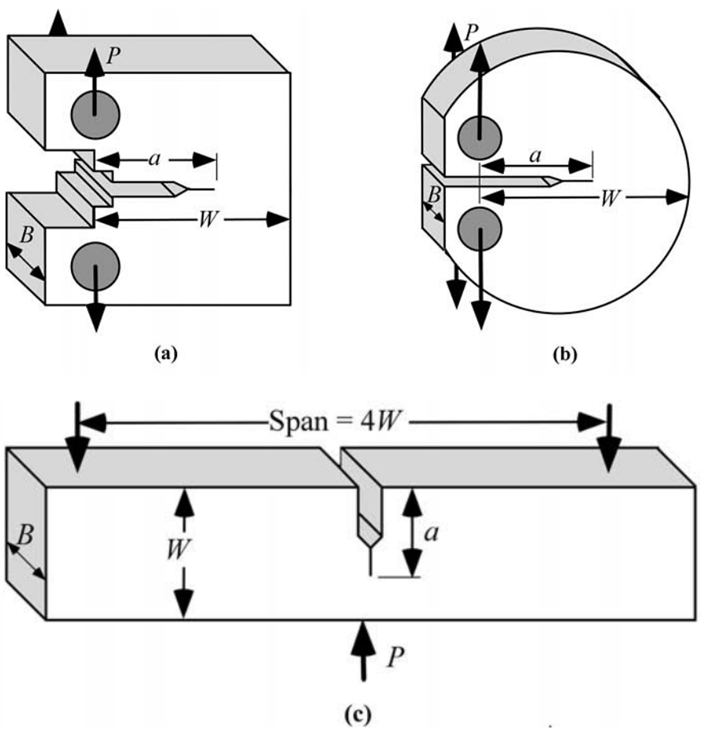
Introduction/Background
Structural materials for advanced reactors, designed for high thermal and economic efficiencies, will be exposed to high temperatures (300–700°C) and high-dose (>10 dpa) neutron radiation damage. This exposure leads to significant degradation of their mechanical, corrosion, and physical properties.
The design of the core structure and selection of materials for a high-performance reactor will require the development of comprehensive evaluation techniques and a robust materials property database.
Ensuring the prevention of failure in critical reactor components during operation is a fundamental requirement for assessing nuclear energy system safety. Therefore, accurately evaluating the fracture resistance of structural materials under service conditions is one of the pivotal steps in the safety assessment process.
While information regarding the high-temperature fracture resistance (J-R) curve of key materials will be essential for successful component design, very limited data on high-temperature fracture toughness have been generated for the new or advanced structural materials.
Aimed to assess the fracture testing and calculation method using 3-mm thick miniature bend bar specimen, the MBS-1 design which was standardized for HFIR irradiation, to characterize the fracture resistance of high-temperature reactor materials before and after irradiation.
CT, DCT, TPB (SEB) Fracture Specimens

Slide 3
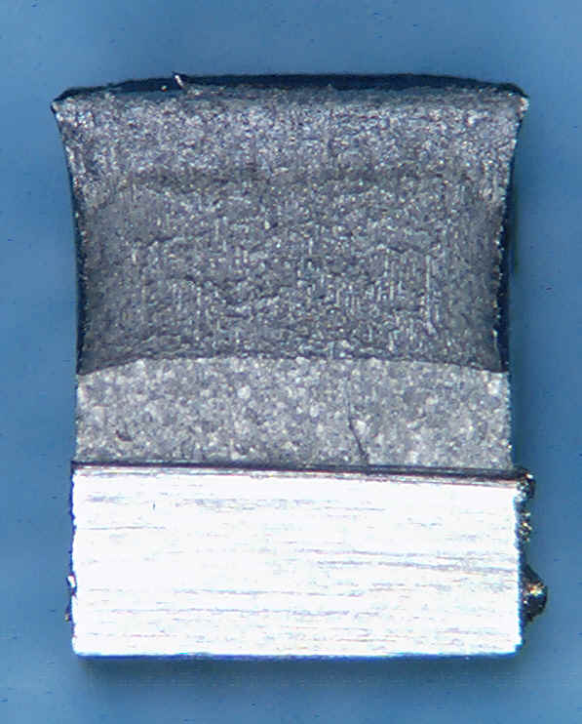
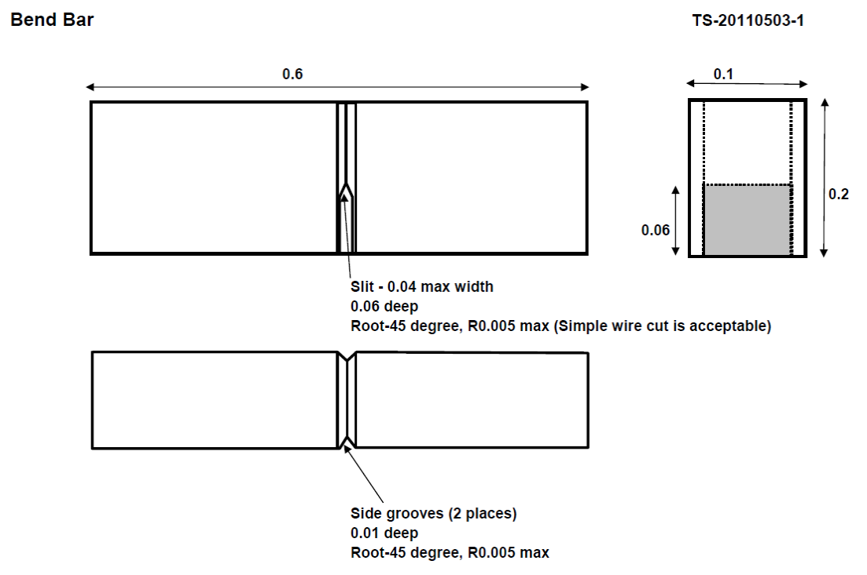
Background: Fracture Toughness from Miniature SEB Specimens
(Byun et al. ASTM-STP 2014, JNM 2016)
Miniature SEB Specimens: 4–5 mm W x 2.5–3 mm B x 12–15 mm L

Slide 4
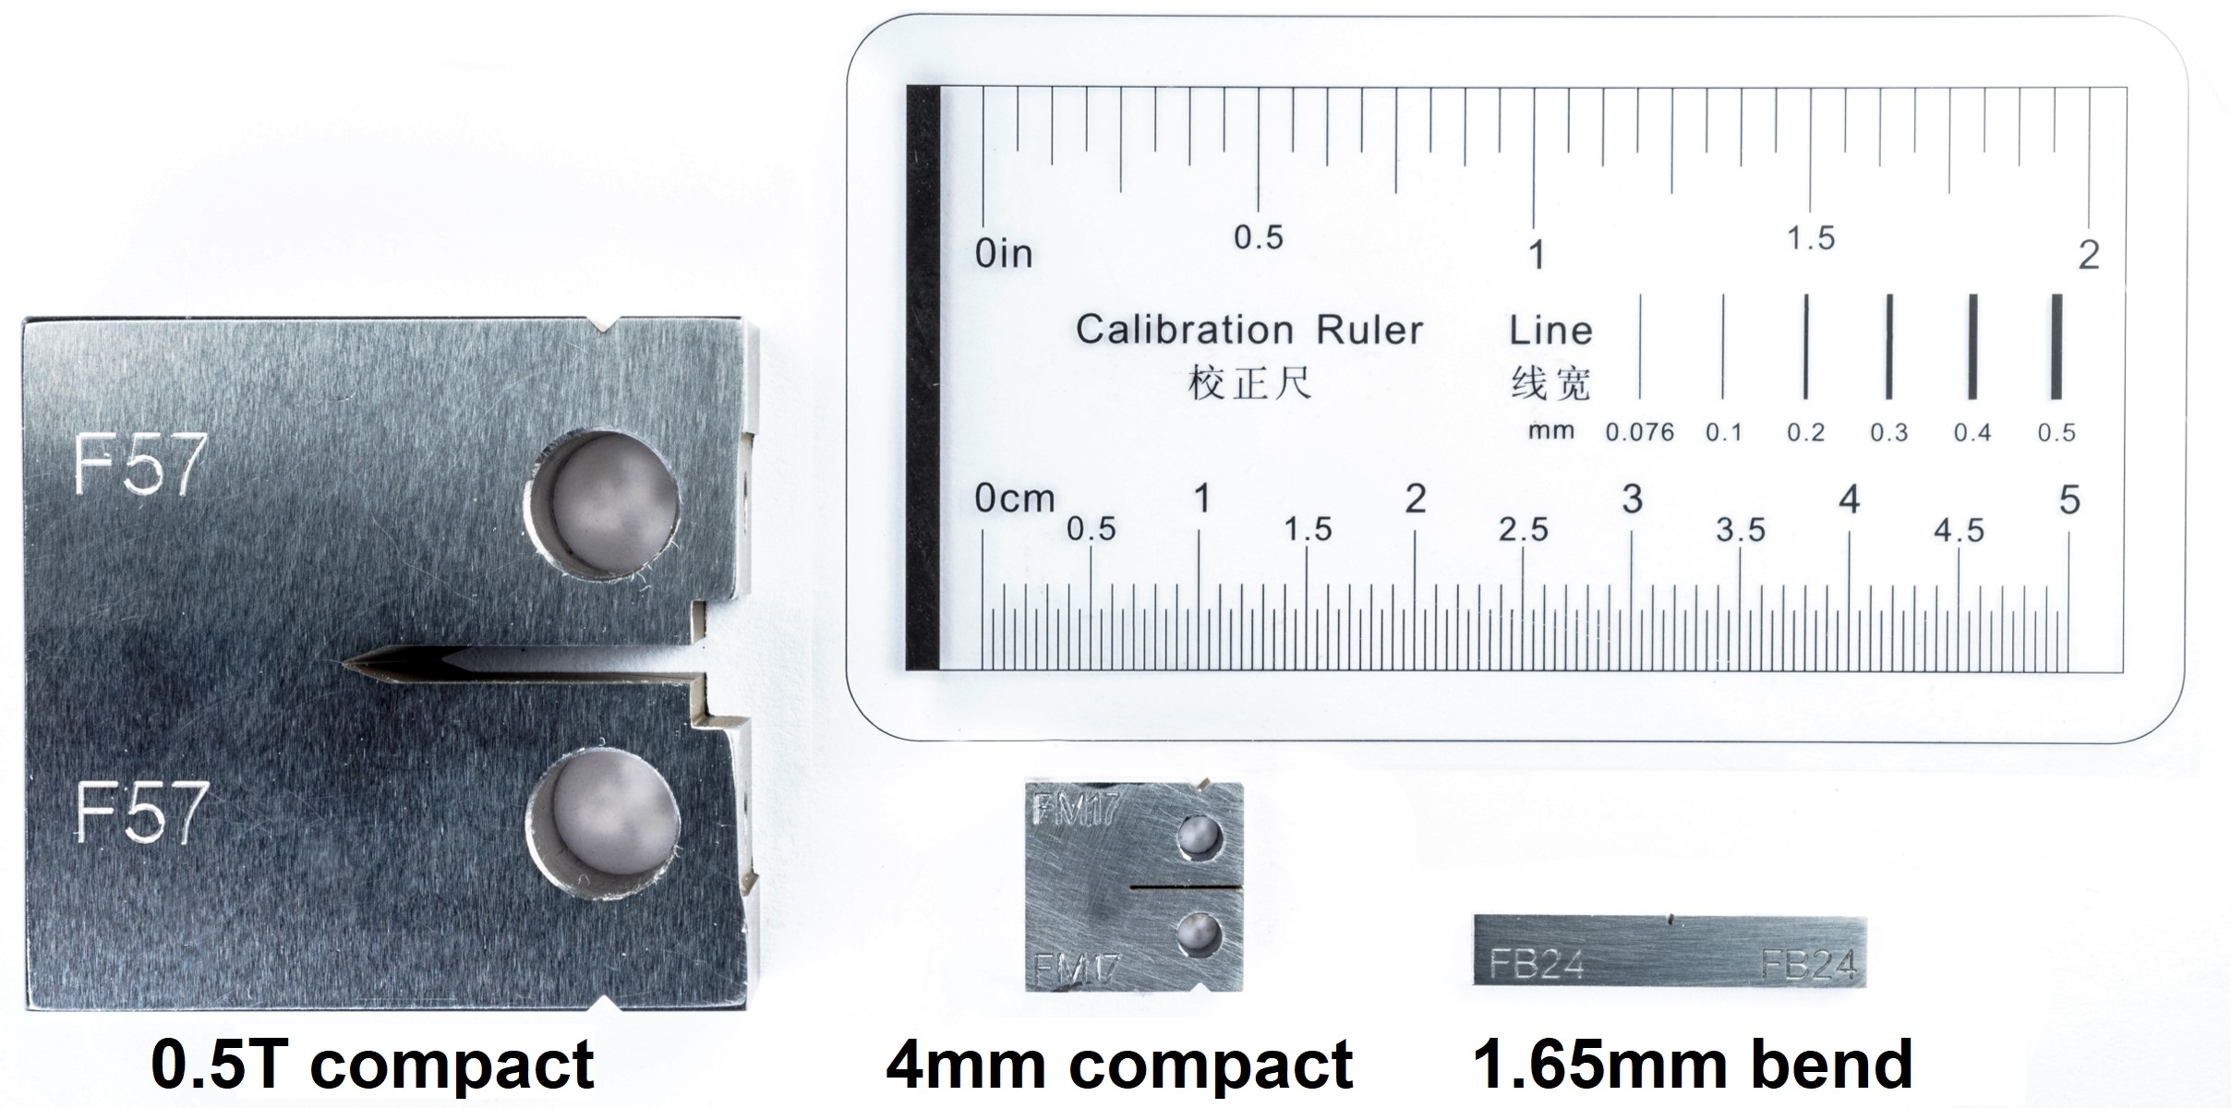
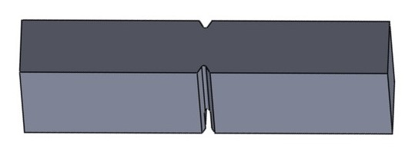
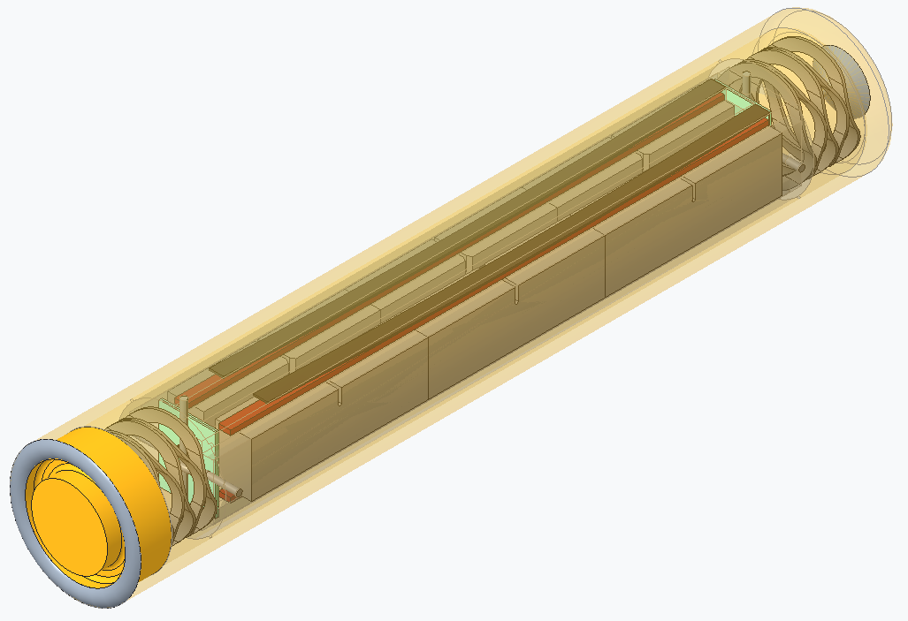
Introduction/Issues & Resolutions
Qualification of advanced (high-temperature) reactor materials requires high-temperature fracture testing after high-dose irradiation.
Fundamental issues: fracture testing in higher-ductility region may be harder to comply with the strain constraint (size) requirement of valid fracture toughness testing, and miniaturization may be limited.
Fracture toughness testing in high-temperature, high-dose condition requires signification simplification in testing practices:
Miniaturization of testing and specimen
Removal of clip (displacement) gage attachment
Testing in monotonic load-displacement mode
Simplest grip design for hotcell manipulator.
Miniature Bend-bar Specimen (14.8 x 4.5 x 3 mm & 2 DGs)
Irradiation capsule design has been standardized for the routine use of miniaturized bend-bar specimens in HFIR irradiation experiments to qualify advanced nuclear materials.
MBS-1 three-point bend fracture specimen design (top) and HFIR Rabbit Capsule GENBEN-2
Champlin et al. ORNL/TM-2023/3037

Slide 5
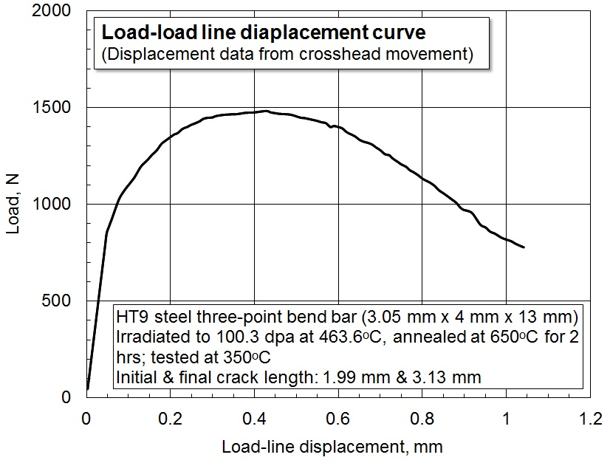
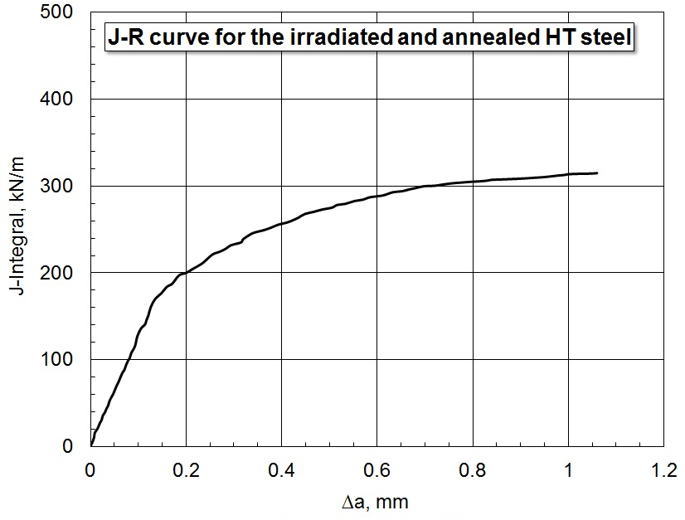
Objective: Fracture Testing & Evaluation Method using MBS Design
With Long History but Lately Simplified for Hotcell and High-T Testing
Method and procedure of fracture testing and analysis have been developed based on:
Specimen reuse technique used in high radiation area
A newly developed simple precracking technique in blinded or inaccessible place like hotcell
Simplification of test procedure (no clip-gage attachment) for testing in high-temperature vacuum furnace and high-radiation area
Modification of data analysis procedure in accordance with the change in data acquisition method (without clip gage).
Experimental Dataset:
Optical measurement of Initial & Final Crack Length Data
Final Output:
Example: HT9 steel irradiated to 100 dpa at 463 °C and annealed at 650 °C for 2h.
Tested at 350 °C.

Slide 6





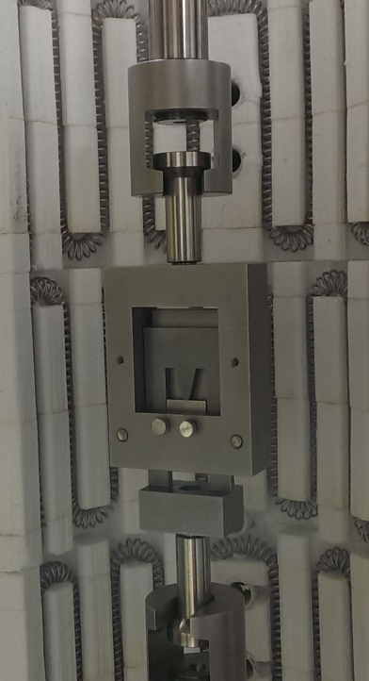

Curve Normalization Method: J&K Calculation Process
The plastic displacement v_{pl(i)} was updated by replacing the crack length of i-th step with that of previous step (i-1): a_{(i)} ← a_{(i-1)}.

Slide 7
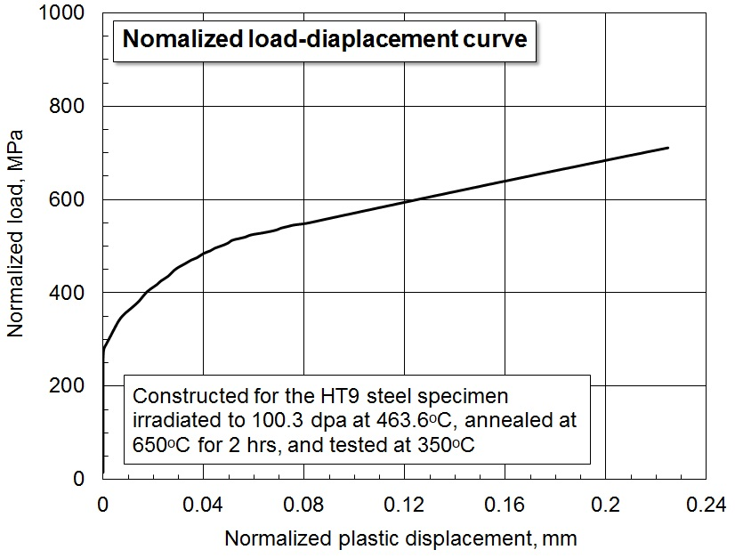





Curve Normalization Method for J-R Curve Construction
  Miniature DCT (10-13 mm dia) or TPB (12-15 mm length, B < 5mm)
  Described in ASTM E1820 Annex
  Requires initial and final crack length measurements and simple P-v record.
  Use theoretical blunting line (J=2s_{Y}Δa) and final J. Crack lengths intermediate are calculated using a normalized curve.
  Useful where high rate of loading, high temperature, aggressive environment, or small specimen are used. (for ductile fracture)
Iterative calculation is preformed for each point between max load point and final crack length using the normalized curve (function) as criteria.

Slide 8
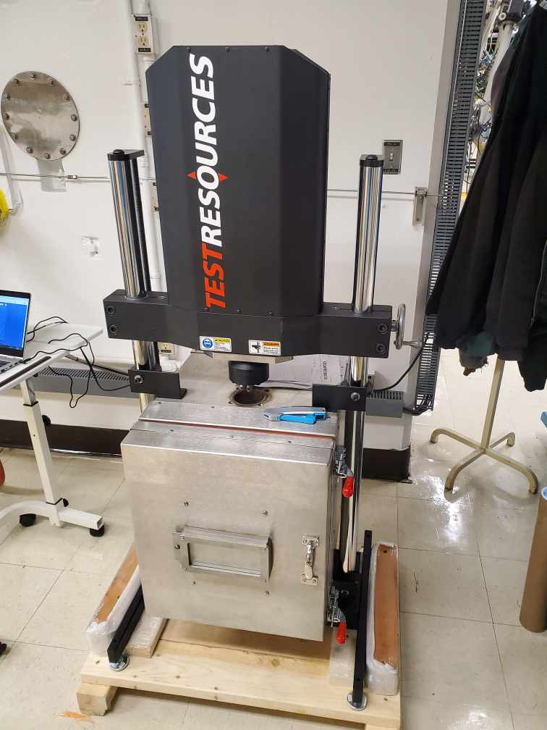

TEST SET UP for MBS-1 Sample & Standardized HFIR Rabbit Capsule GENBEN-2
Three-point or single-edge bend (TPB or SEB) loading mode
14.8 mm L x 4.5 mm W x 3 mm B with 2 x 15%B side groove (MBS-1 design)
6 specimens in a rabbit capsule
Simplified testing method and J-R curve calculation procedure were established.
All specialized for high dose irradiation, handling in hotcell, and testing at high and low temperatures.
Out of cell setup lately done and being used.
HFIR Rabbit Capsule GENBEN-2
System being set for IMET hotcell

Slide 9
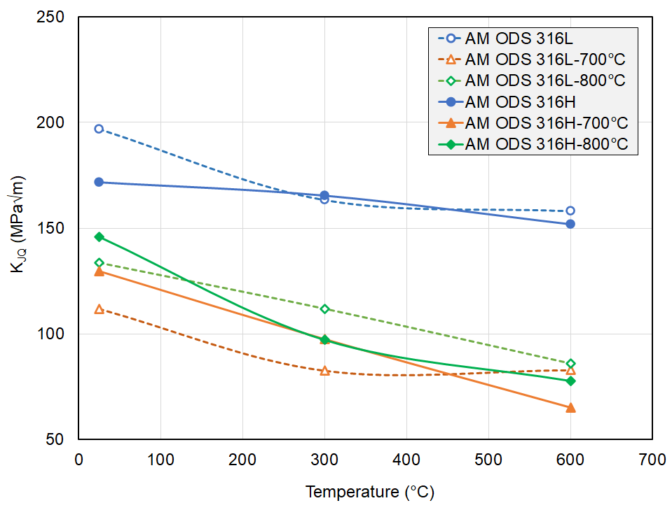
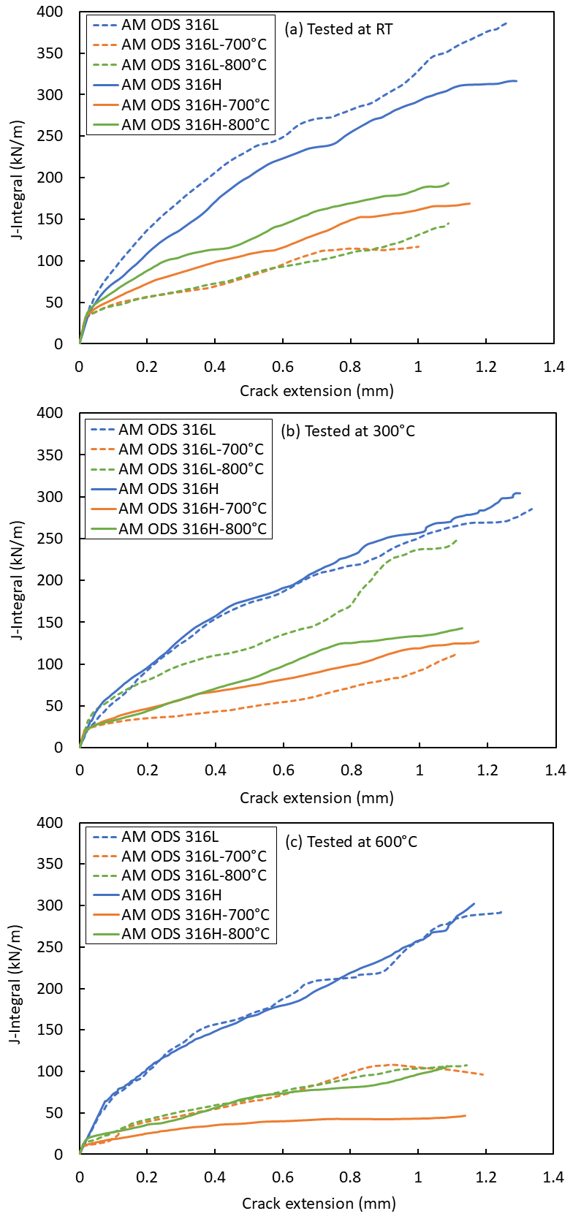
Result of Fracture Toughness Testing using MBS Design
No. | Material | Status
1 | AM 316H | J-R test complete
2 | AM ODS 316H | J-R test complete
3 | AM ODS 316L | J-R test complete
4 | AM ODS 316H+TMT | J-R test complete
5 | AM ODS 316L+TMT | J-R test complete
6 | Fe-9Cr FM Steel (G92 et al.) | J-R test complete
7 | Fe-14Cr ODS FM Steel | J-R test complete
8 | This technology in application stage: Irradiated and nonirradiated materials to be tested.

Slide 10
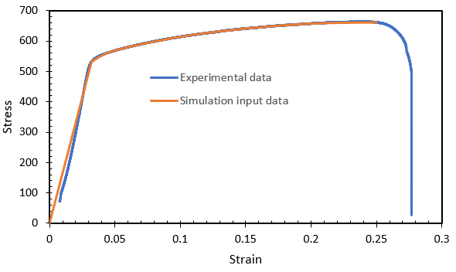
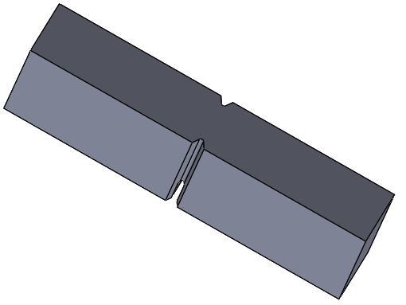
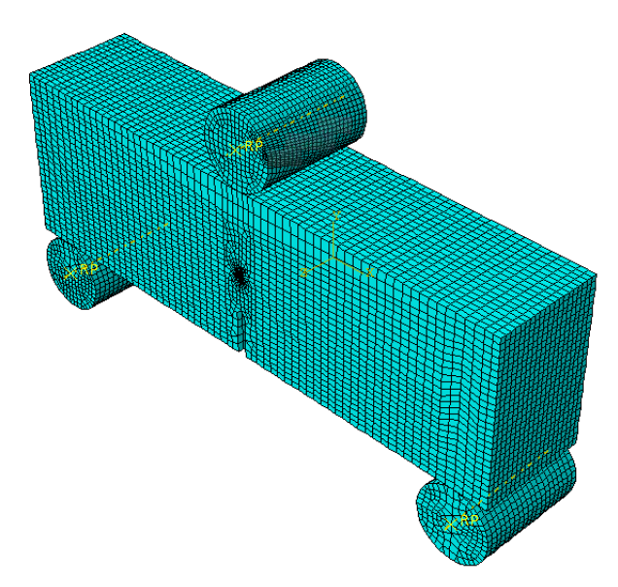
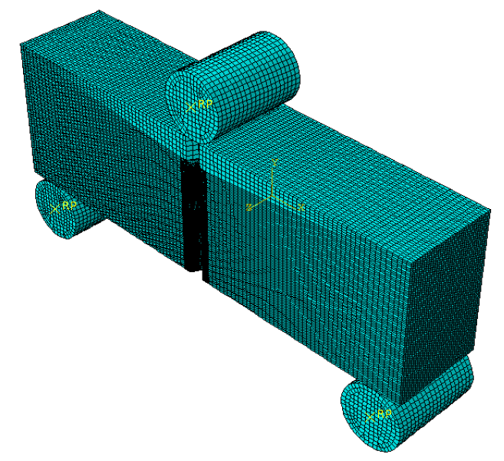
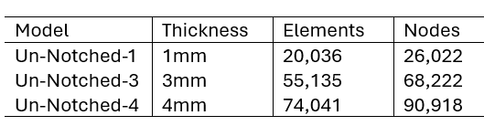
FE Simulation: Fracture specimen model
Material : ODS-AM-316H-RT
Fracture Specimen type: MBS with and without (2 x 15%) side grooves
Subjected to three-point bending (TPB)
Specimen dimension:14.8mm x 4.5mm
Specimen thickness: 1mm, 3mm, 4mm
Employs hexahedral linear dominated finite element mesh
3D solid model was created within SolidWorks 2022 environment
Load-Displacement curves for ODS-AM-316H-RT
High Strain Constraint Is Essential!
Finite Element mesh
MBS without side-groove under TPB
MBS with side-groove under TPB

Slide 11
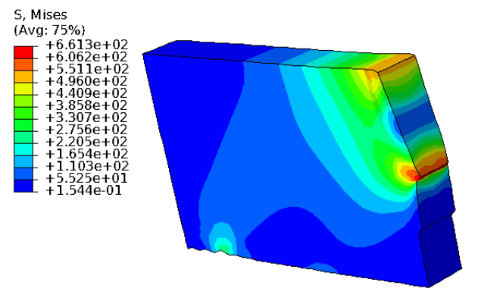
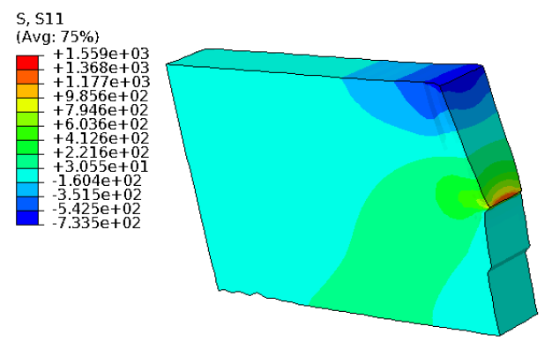
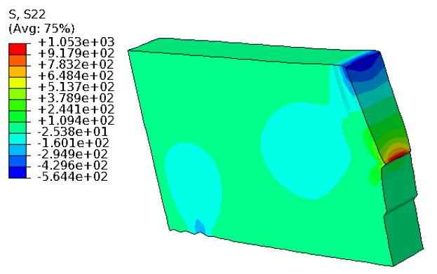
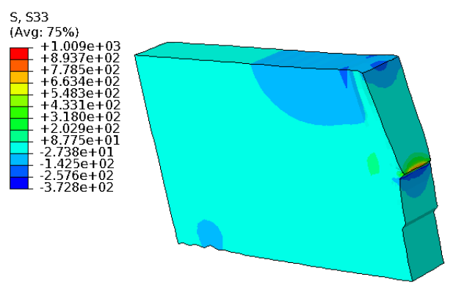
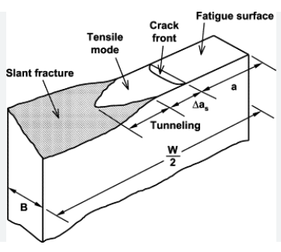
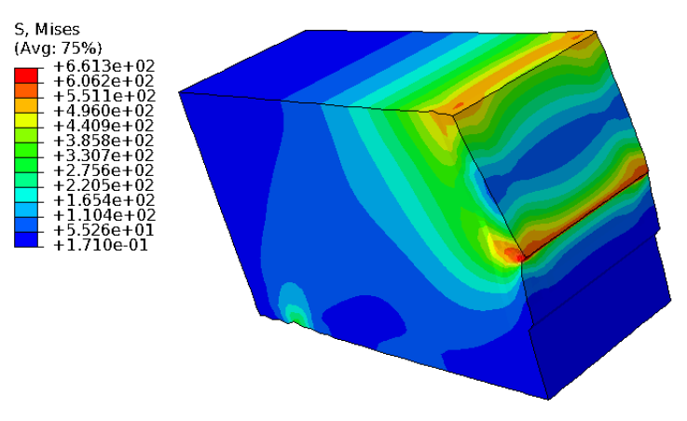
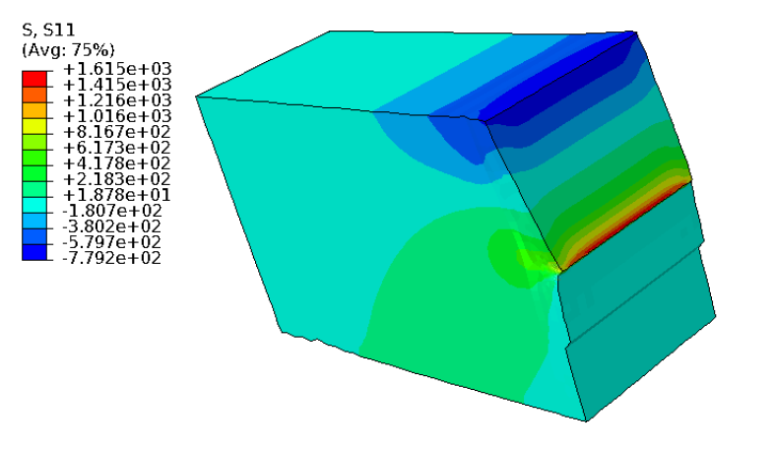
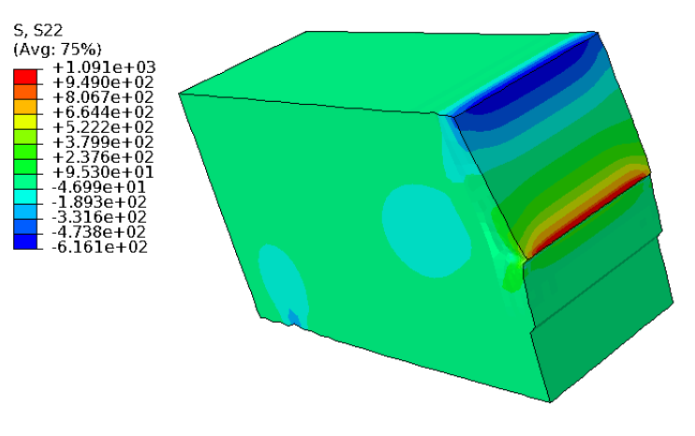
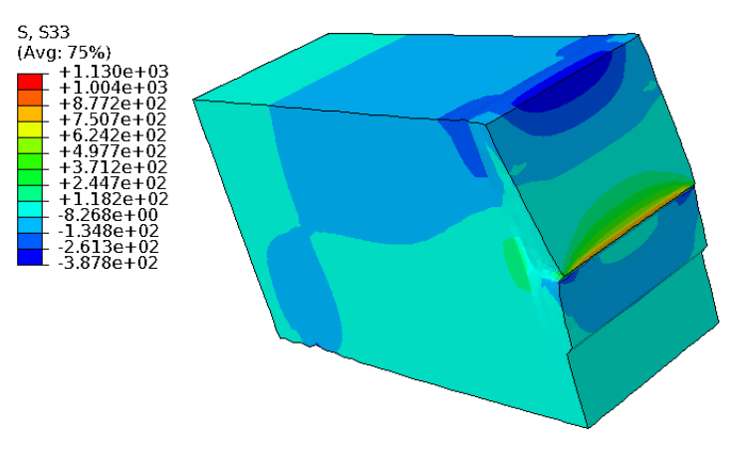
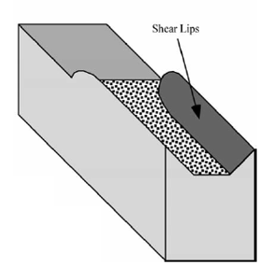
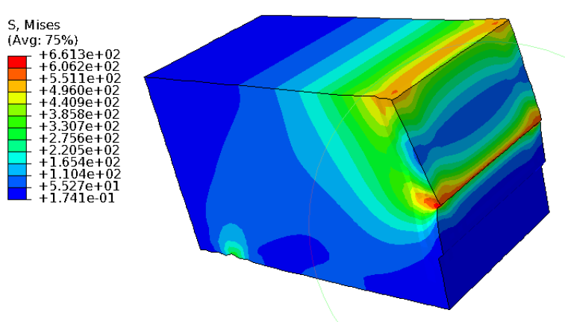
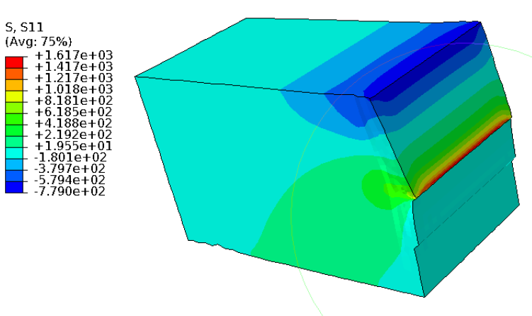
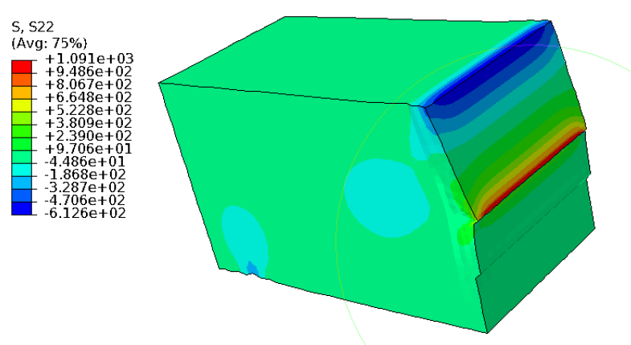
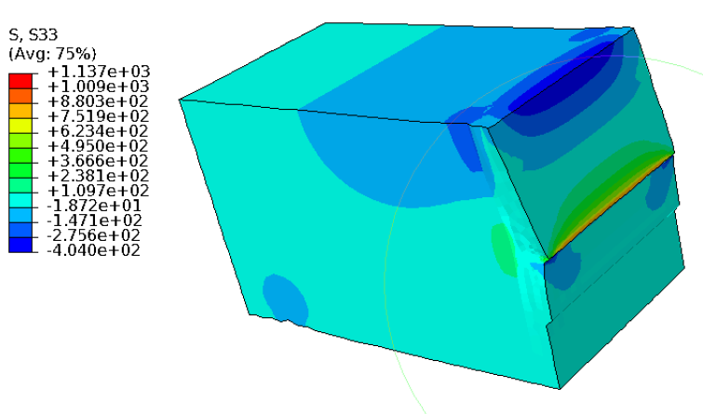
Mode-I Stress Fields at Crack Tip: Thinness Effect
2
1 mm thick
1
3
James, M. A., and J. C. Newman Jr. EFM (2003)
3 mm thick
Anderson T.L. (2005) (3rd edition)
4 mm thick

Slide 12
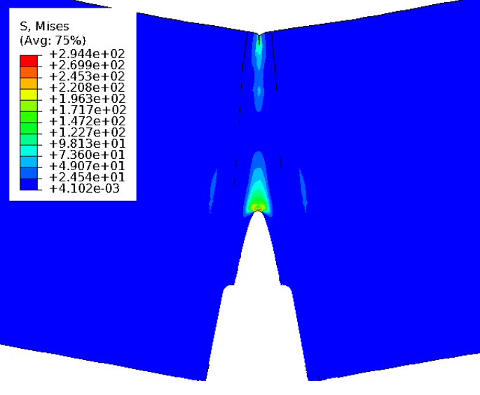
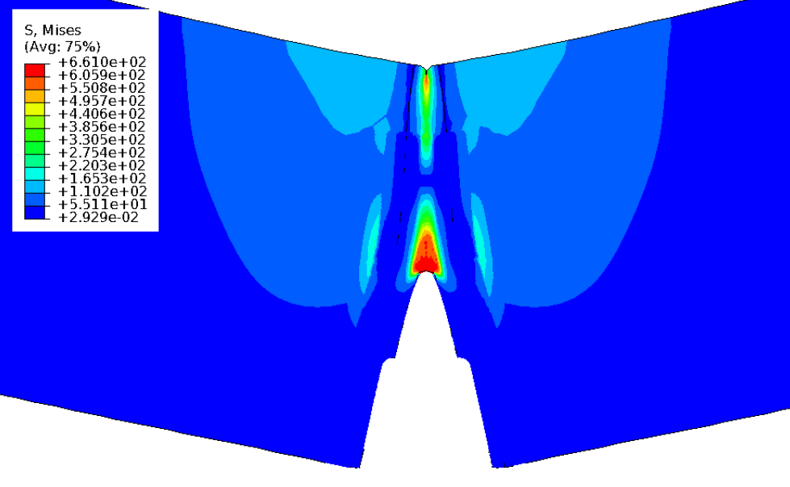
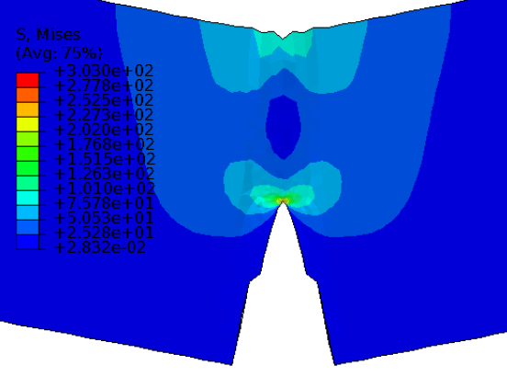
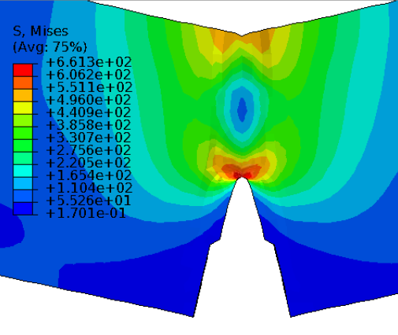
Mode-I Plastic Zone at Crack Tip: Assessment of High Strain/Strain Constraint in MBS
Mode-I high-stress field shape is smaller in the specimen with side grooves than the specimen without.
Side-grooved specimen exhibits additional spear–shaped high-stress zone at edges but with low stress level.
Material inside the plastic zone should be capable of carrying higher stresses and narrower distribution for a high strain constraint.
Assessment-1: MBS specimen with 15% side groove at each side has a well-confined stress/strain zone at crack tip.
Side-grooved specimen
Specimen without side grooves

Slide 13
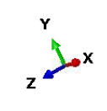
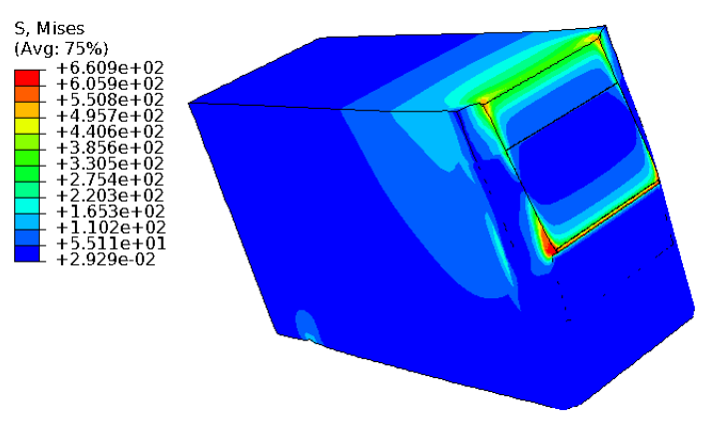
Effect of Side Grooves on Equivalent (Von Mises) Stress
Snapshots taken after yielding and max loads at the crack tip.
Clearly defined and large Mode-I (plane strain) plastic zone shape.
Mode-I plastic zone shape is smaller in the side-grooved specimen.
Specimen without side grooves has varying stress across the crack width near the crack tip (could produce shear lips/tunnelling)
Side-grooved specimen has a constant stress across crack width (B)
Specimen without side grooves
The material inside the plastic zone can carry higher stresses, reducing the need for stress redistribution. James, M. A., and J. C. Newman Jr. EFM (2003)
Specimen with side grooves

Slide 14
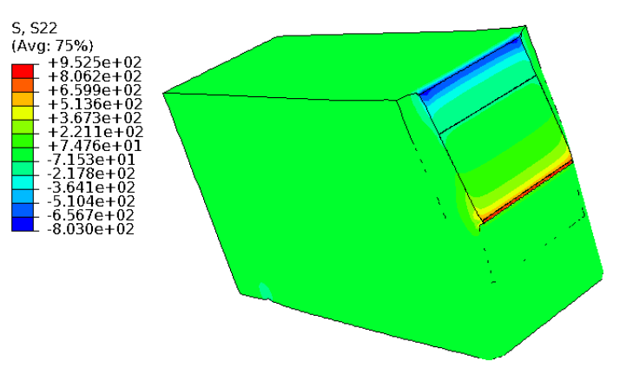
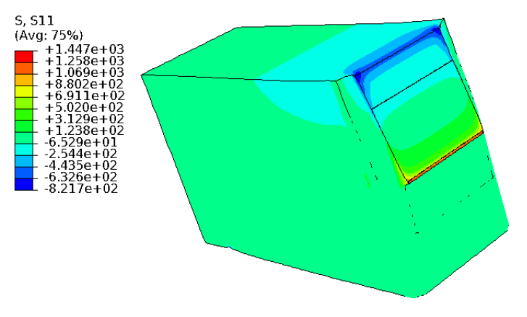
Effect of Side Grooves on Stress Components S11 & S22
Stress contour plot for normal stresses in 11 and 22 are plotted for specimens with and without side grooves.
Stress concentration zone is smaller in the side-grooved specimen than in the flat surface specimen.
S22 plot show a clearly defined tension at the region closer to the crack tip and compression at the load edge of the crack surface over the whole thickness (expected).
Specimen without side grooves
Specimen with side grooves

Slide 15
Discussion: Limitations with MBS-1 Design and Testing Method
Specimen Thickness
Required 1 ≤ W/B ≤ 4 (B = thickness; W = specimen width); MBS-1 W(=4.5mm)/B(=3mm) = 1.5
Satisfied with this requirement but the absolute value of B (3 mm) is small for soft materials.
Resolution: Incorporated deep (total 30%) side grooves (ref. 25%).
Materials with YS > ~ 300 MPa are expected to show no evidence of significant thickness contraction: MBS-1 useful for FM steels, ODS steels, AM austenitic steels, AM ODS steels, irradiated steels etc.
Specimen Length
Required S = 4W±0.2W (S = pin support span; W = specimen width)
MBS-1 S(14.8mm)/W = 2.8
J-integral value is correct in low-∆a region (initial crack intension) but can become overestimated in high-∆a region.
Needs to subtract the energy contribution from the rotation (non-vertical loading) for later part of J-R curve.
W
S

Slide 16
Concluding Remarks
Drawing on extensive experience with subsize specimens and ongoing efforts to integrate advanced testing methodologies, a robust irradiation and fracture testing framework has been developed to qualify advanced nuclear structural materials using miniaturized specimens.
An essential investigation has been conducted to establish a foundational understanding of the deformation and fracture behavior inherent in miniature bend-bar specimens.
Specifically, a comprehensive assessment of the advantages and limitations of using miniature specimens to qualify high-temperature materials is necessary. Achieving consensus through collaboration among research communities and regulatory agencies is essential.
The application of this miniaturized fracture testing and evaluation has commenced in multiple DOE-NE and industry NE programs.
Publications detailing the outcomes of this effort is underway: expect a manuscript on the methodology/procedure for this study in the year and multiple after applications in NE projects.
Available for general use with any specimen type in hotcell/high-T environments (ORNL, PNNL, KIT, UKAEA…).

