Slide 1
April 16th, 2025
William Chuirazzi
X-ray Microscope Instrument Scientist
Diffraction and Imaging Group Lead
Data Acquisition and Analysis Techniques for X-ray Computed Tomography

Slide 2
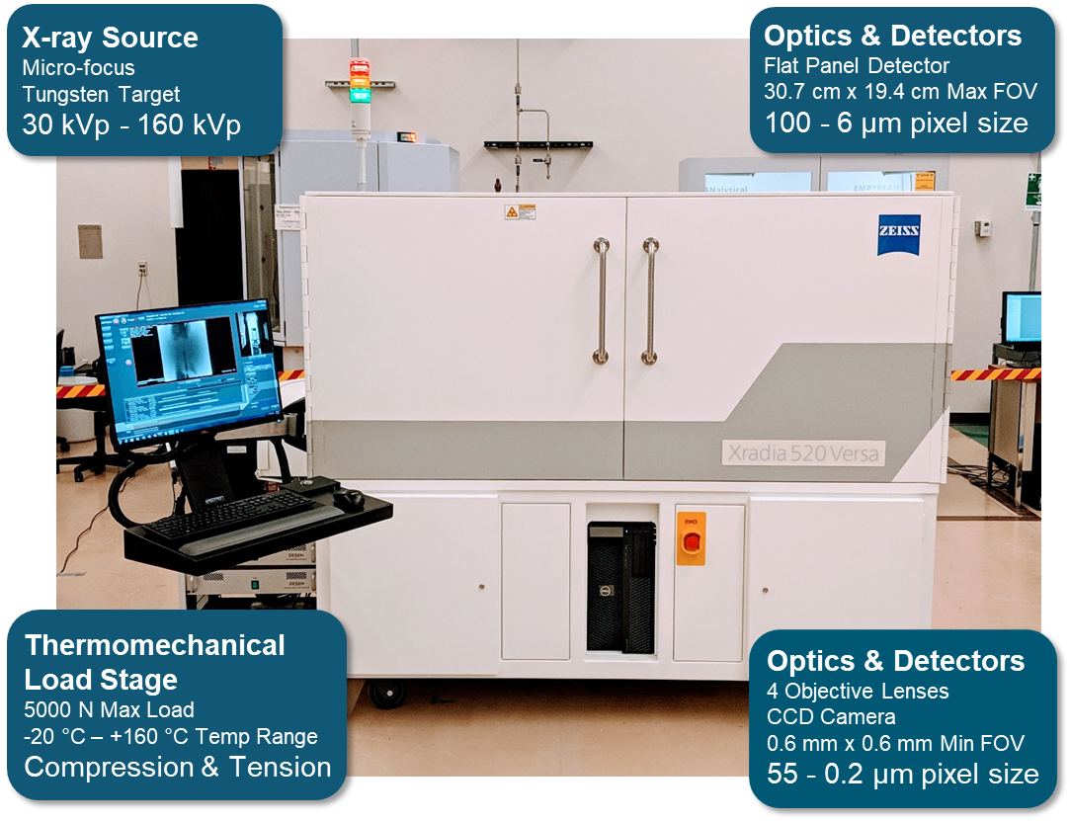
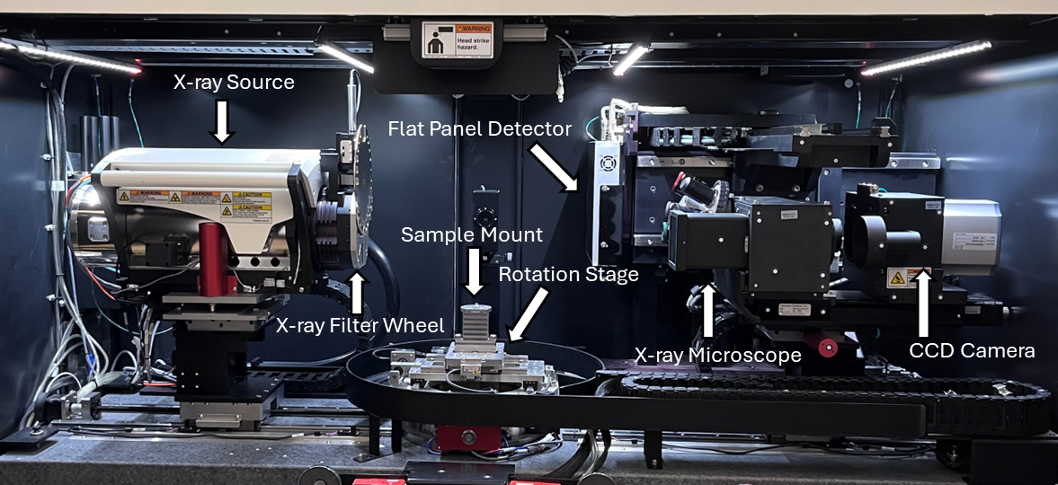
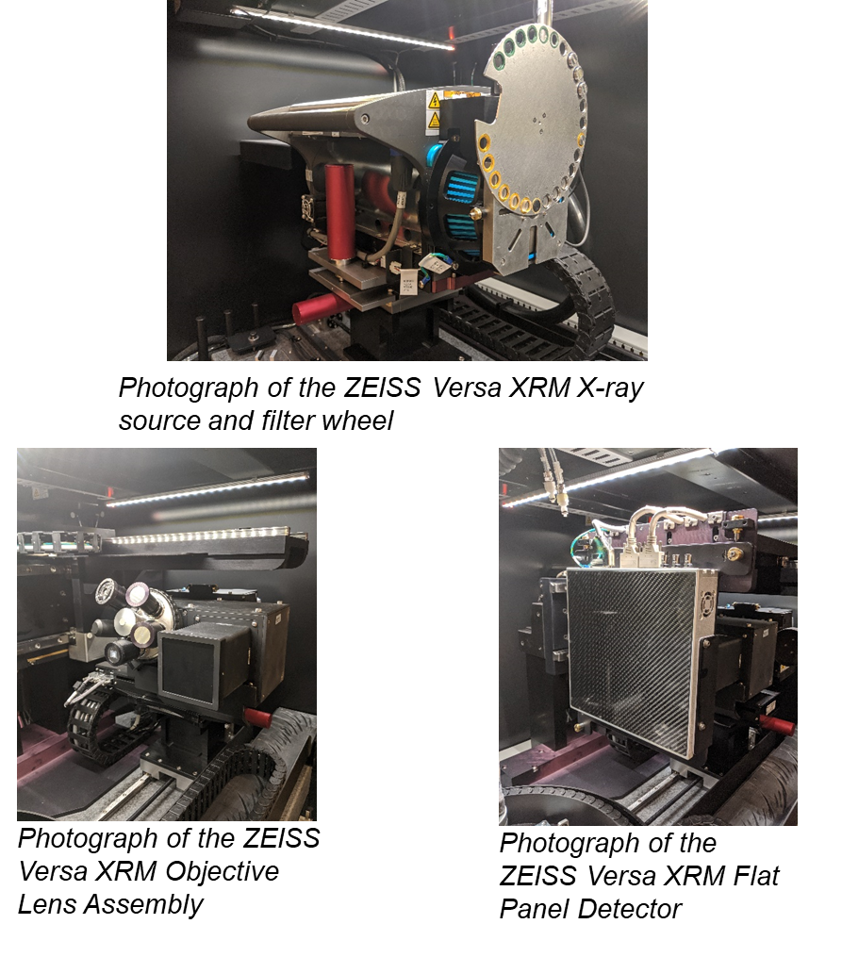
ZEISS Xradia 620 Versa at IMCL
Best spatial resolution to date: 270 nm/voxel
Hottest sample to date: 120 R/hr on contact
Instrument is maintained as radiologically clean

Slide 3
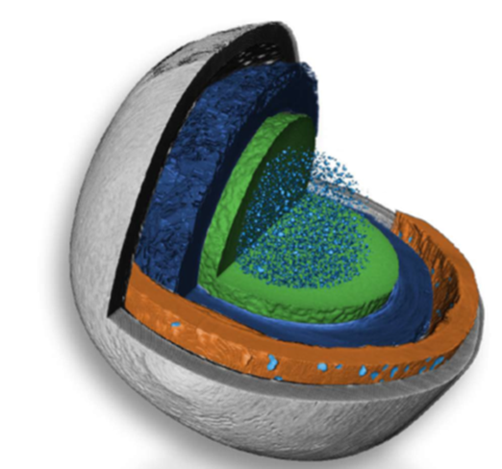
Why the need for X-ray Computed Tomography?
XCT is a nondestructive technique that provides volumetric data
Provides a first look at (irradiated samples)
  Targeted destructive analysis
  Meshing can provide direct inputs for modeling efforts
    Fuel performance, etc.
The ability to perform CT on highly irradiated samples can expedite the PIE process
  Less time spent waiting for decay
  Subsequent experiments/modeling can be planned/conducted

Slide 4
FY24 NSUF Researcher Supported Activities
Pushing the limits of spatial resolution
  Improves quality of the data
    Can see smaller features
    Can more accurately measure larger features
Advanced segmentation and data analysis techniques
  Enables quantitative data extraction
  Quantifying segmentation error
Methodology development for examination of (nuclear) materials
  High Z materials
  Artifacts
  What data can be measured/observed?

Slide 5
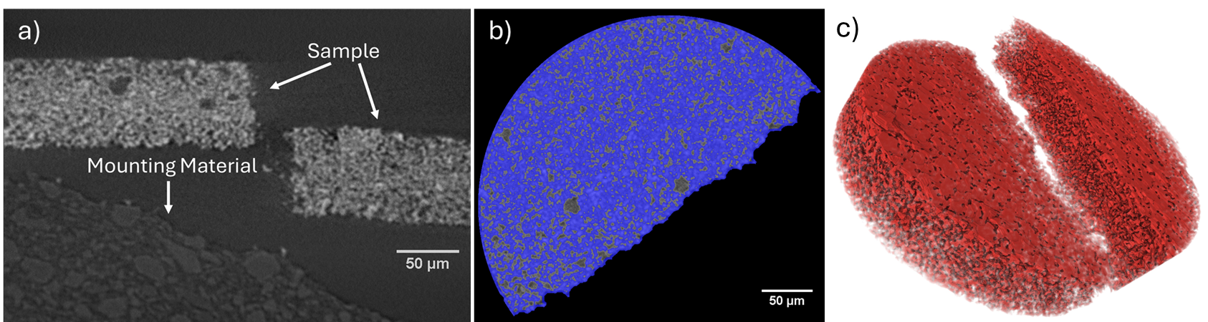
Pushing the Limits of Spatial Resolution
X-ray source upgrade in 2023 produces more photons
Enables higher resolution: 384 nm/voxel
Method development needed to explore the limits of the possible
Battery samples
  Non-radioactive (cheaper)
  Need to resolve fine features
    Informs design and performance evaluation
  High impact science
Method used to support NSUF RTE user data acquisition…
PI: Bor-Rong (Hypo) Chen; borrong.chen@inl.gov
  Bor-Rong Chen, et al., “Digital Light Processing of Porous LLZO Scaffolds for Li-Garnet Solid-State Batteries.” Energy Storage Materials. Submitted.

Slide 6
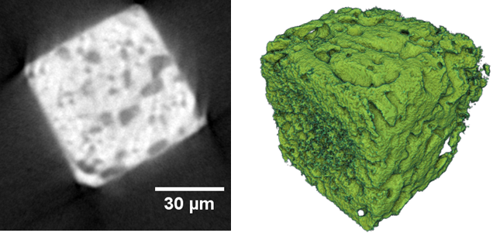
Pushing the Limits of Spatial Resolution/Methodology Development: Characterization of fluff region in an EBR-II metallic fuel pin
FIB lift out of EBR-II fuel pin
  U-19Pu-10Zr
Goal of examining porosity
Record spatial resolution to date:
  270 nm/voxel
Segmentation techniques developed with NSUF IS applied to this sample
  Expedites sample analysis
  Augments analysis for RTE users
PI: Jake Fay; jake.fay@inl.gov

Slide 7
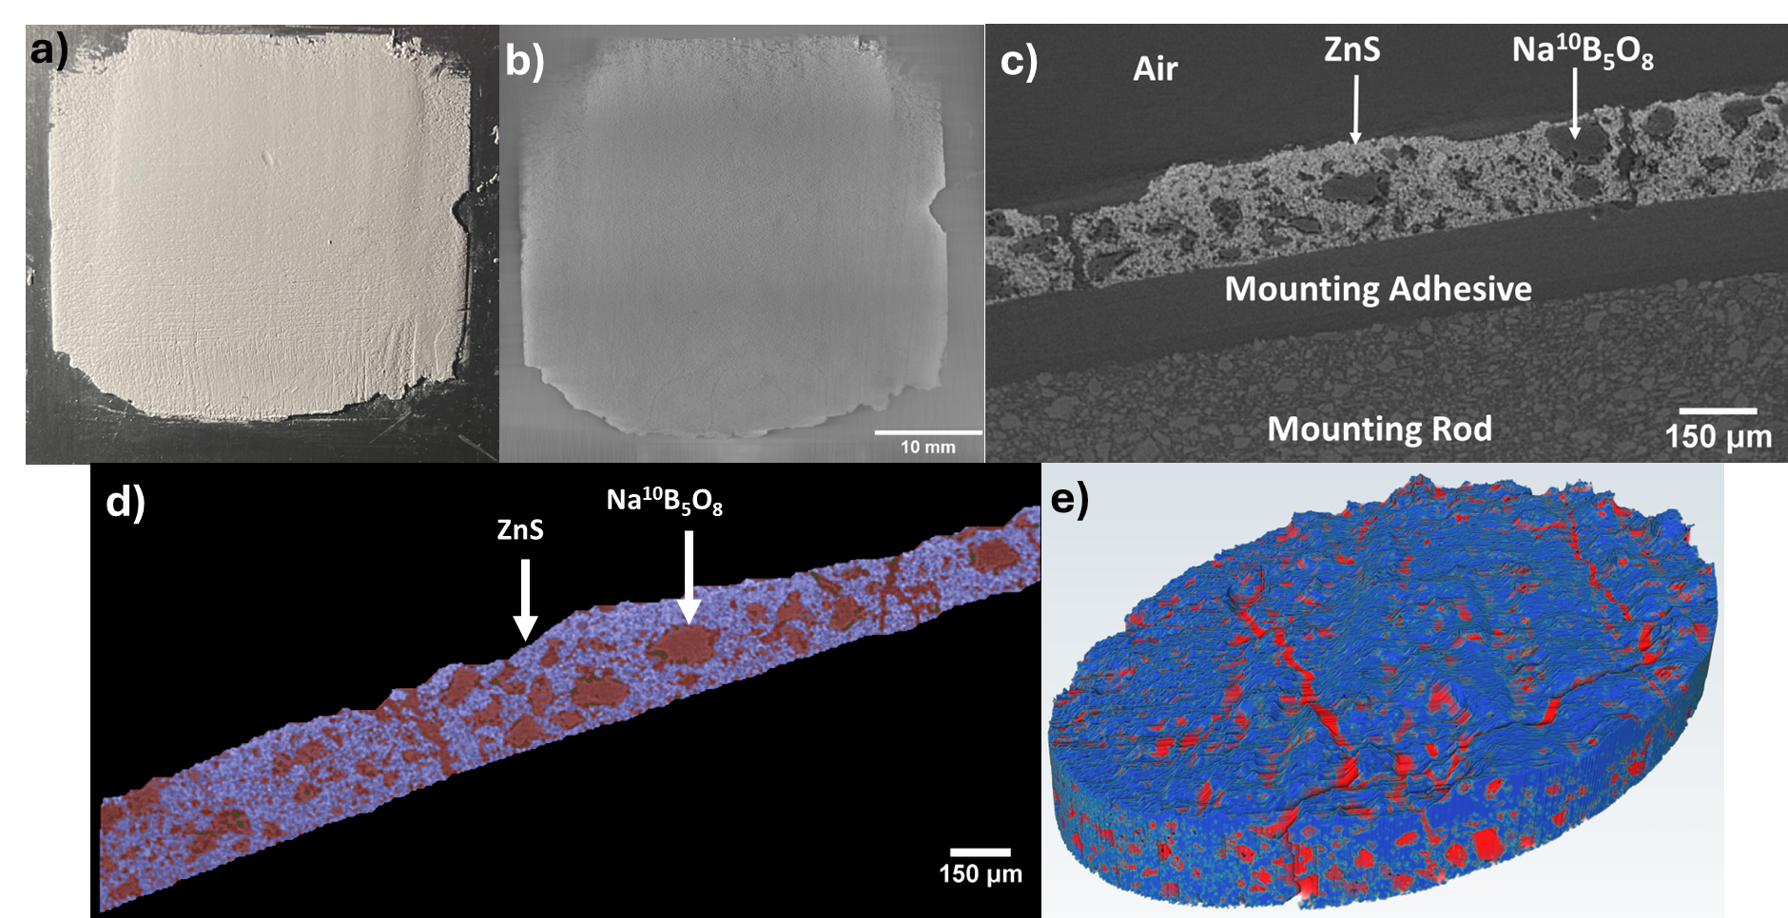
Segmentation Methodology Development
Examination of novel boron-based neutron scintillator screens
  Screen characterization necessary for optimization
  Benefits neutron imaging efforts at INL and beyond
Produced a segmentation script that can be modified for other applications
  Batteries, FIB fuel samples etc.
NSUF Output: Segmentation development
  Low-Z materials
  Low contrast materials
Chuirazzi, William, Steven Cool, and Aaron Craft. "Quantifying neutron scintillator screens with X-ray computed tomography." Nuclear Instruments and Methods in Physics Research Section A: Accelerators, Spectrometers, Detectors and Associated Equipment 1063 (2024): 169248.

Slide 8
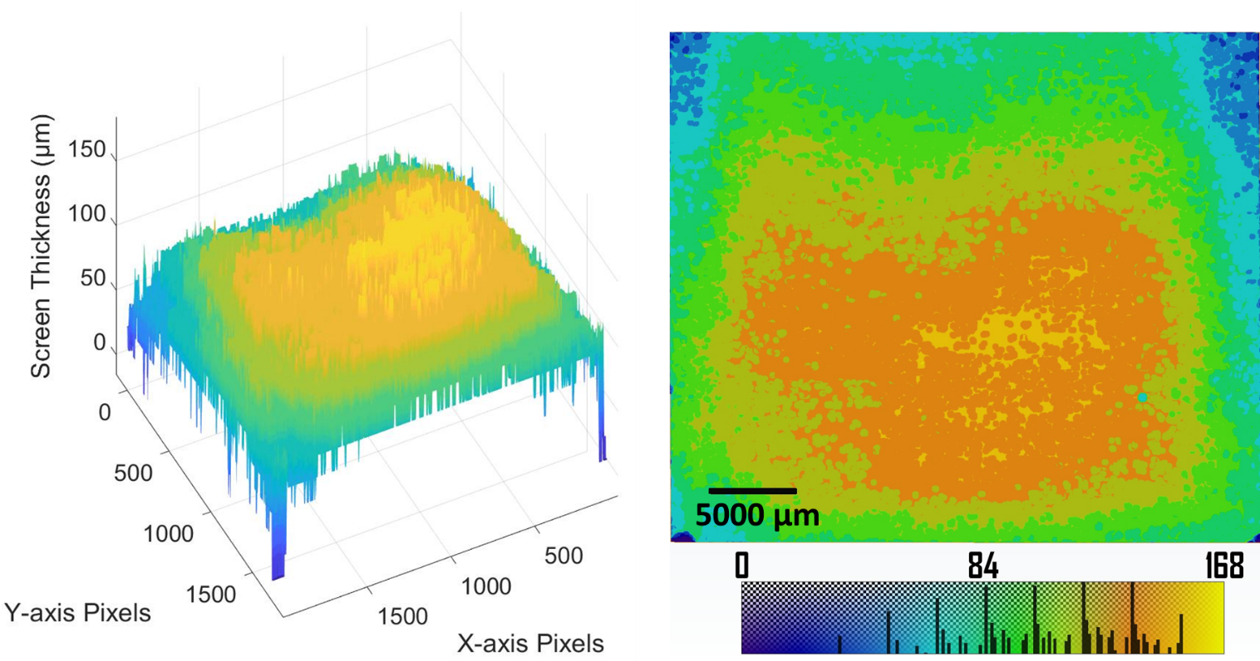
Data Analysis Development
Once the data is segmented, quantitative data can be extracted
Thickness measurement methodology developed
Subsurface defect identification
Visualization scripts developed
Chuirazzi, William, Steven Cool, and Aaron Craft. "Quantifying neutron scintillator screens with X-ray computed tomography." Nuclear Instruments and Methods in Physics Research Section A: Accelerators, Spectrometers, Detectors and Associated Equipment 1063 (2024): 169248.

Slide 9
FY25 NSUF IS Supported Research Activities
  Machine learning based image processing and reconstruction
    Apply ML algorithms to expedite data acquisition for NSUF- relevant samples
    Provide either a reduction in data acquisition time or an improvement in data quality
  In-situ thermal expansion measurements
    Observe thermal expansion of a sample using X-ray radiography (and potentially tomography) in the XRM
    May be possible to calculate the thermal expansion coefficient from the images as well
  Phase-contrast imaging
    Conduct phase contrast imagine
    More clearly distinguish interfaces between different layers of a surrogate
  Additional data analysis, reporting and publication support

Slide 10
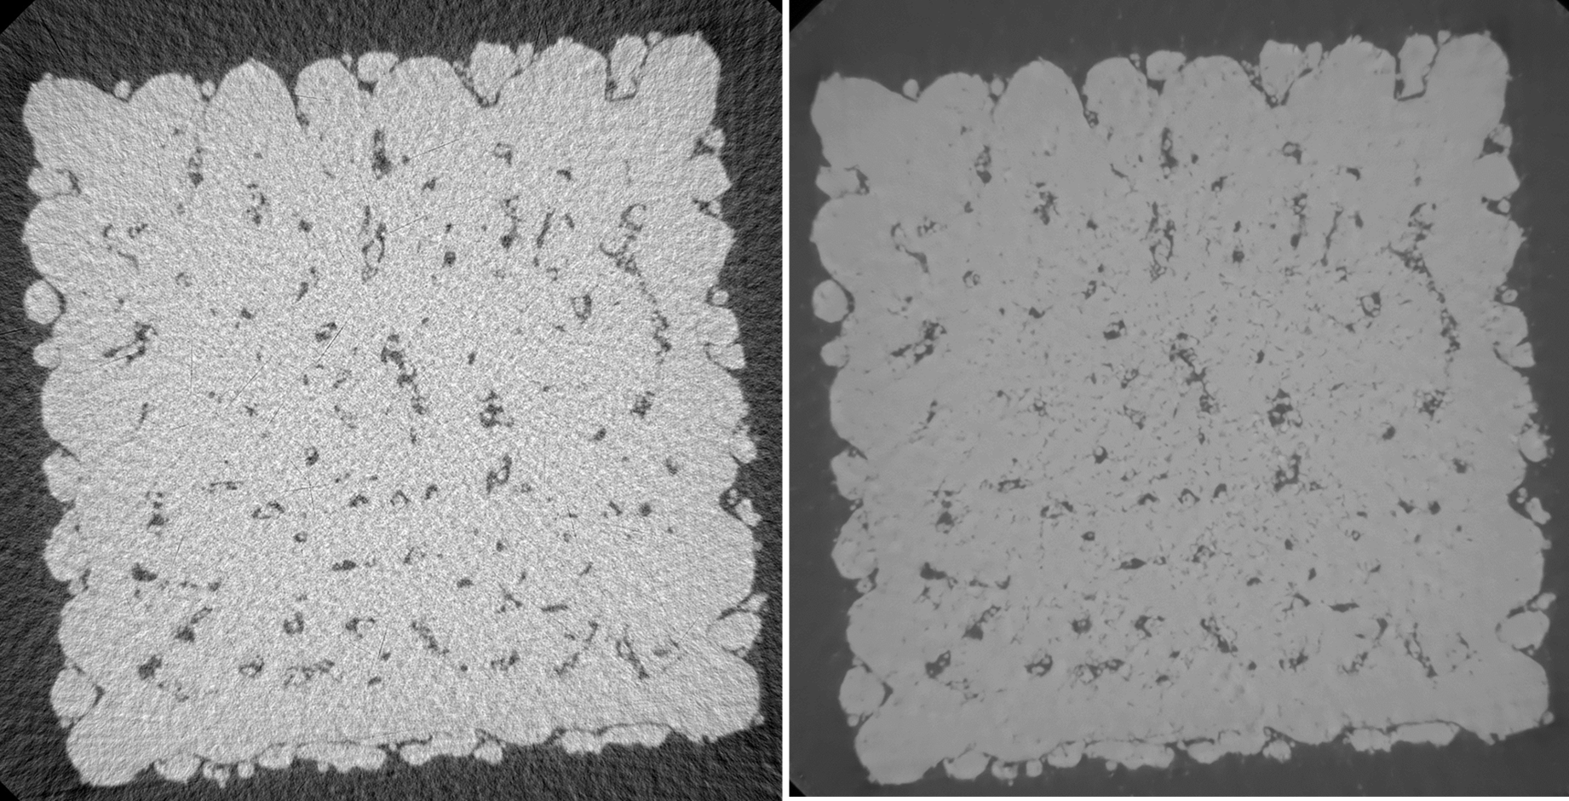
Machine learning based image processing and reconstruction
Collaboration with Oak Ridge National Laboratory (ORNL) to train a machine learning algorithm, which performs data processing and image reconstruction with less 2D projections.
  Data acquisition time has been reduced by ~90%.
  Noise in images is also reduced.
Enables increased imaging throughput.
  Can help NSUF users save time and money (RTEs, etc.)
Reduced scan times of irradiated specimens reduces the radiation dose to personnel and equipment.
  Could image specimens with higher radiation dose rates (fuels, structural materials, etc.)
Will apply this to NSUF-relevant materials in the next few weeks
  TRISO fuels, irradiated samples, etc.
(Left) A 2D cross-sectional slice of a SS316L sample reconstructed with traditional vendor software compared to (Right) the same cross-sectional slice reconstructed with ORNL’s Simurgh algorithm. Noise is reduced and porosity can be more easily distinguished.
ORNL Collaborator: Amir Ziabari (ziabariak@ornl.gov)

Slide 11
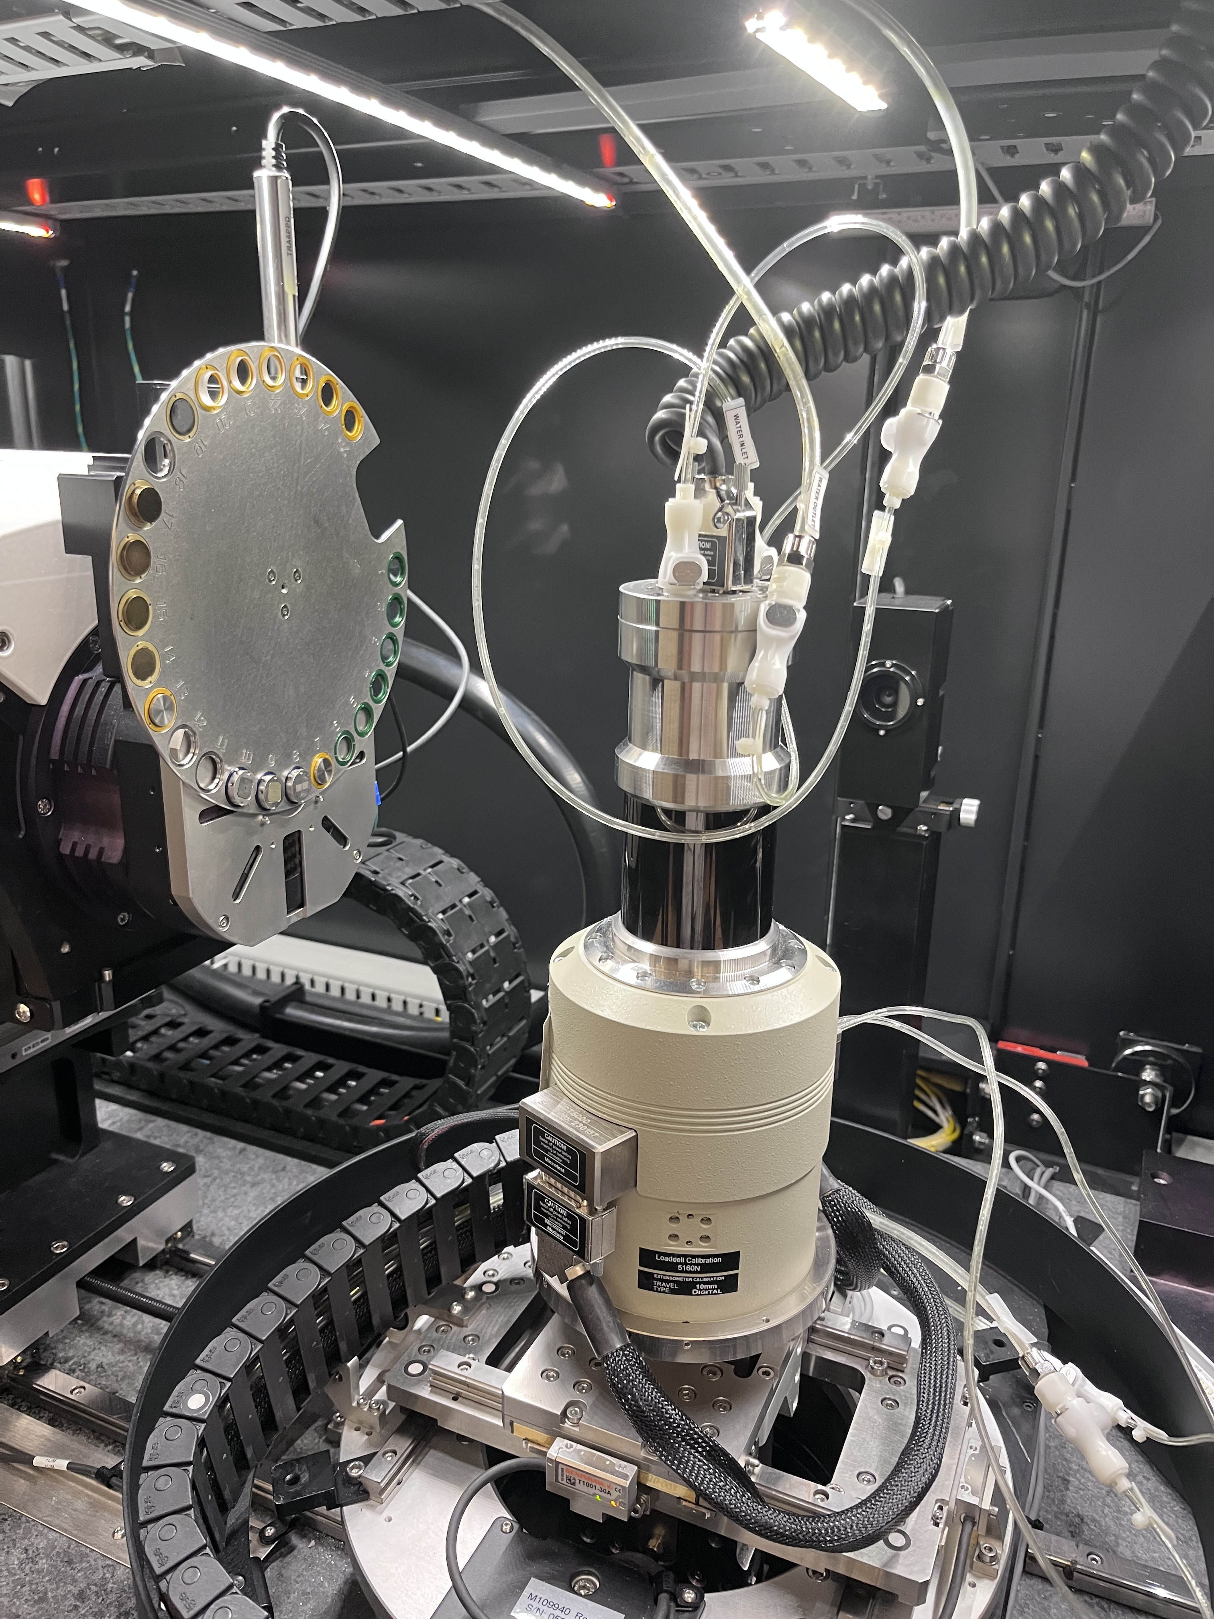
In-situ thermal expansion measurements
Goal is to visually observe thermal expansion
  Could provide noncontact measurement for thermal expansion by analyzing images
  Could simultaneously observe thermal expansion of different materials (layers in a particle, FGM, etc.)
  No commercial equipment currently available to reach temperatures of interest (800˚C -1200˚C)
XRM has a load testing cell that has a heated stage going to 160˚C
  Serves as an available proof of concept
  Can measure thermal expansion through force displacement
FY25 progress has involved writing and approving work control for heating samples within the XRM
Heater has been set-up and tested (up to 100˚C)
Sample identified (aluminum dog bone)
Imaging scheduled for later this summer
The load testing stage configured for heat testing.

Slide 12
NSUF Supported Outputs
FY24 Accomplishments
4 Journal Publications
  William Chuirazzi, Steven Cool, and Aaron Craft. "Quantifying neutron scintillator screens with X-ray computed tomography." Nuclear Instruments and Methods in Physics Research Section A: Accelerators, Spectrometers, Detectors and Associated Equipment 1063 (2024): 169248.
  William Chuirazzi, Rahul Reddy Kancharla, and Swapnil Morankar. "Laboratory-Based Micro-X-ray Computed Tomography of Energy Materials at Idaho National Laboratory." JOM (2024): 1-17.
  William Chuirazzi, Burkhard Schillinger, Steven Cool, Aaron Craft, Zoltan Kis, and Laszlo Szentmiklosi. “Boron-Based Neutron Scintillator Screen Characterization with X-rays and Neutrons.” Springer Nature - Springer Proceedings in Physics. Submitted.
  Bor-Rong Chen, et al., “Digital Light Processing of Porous LLZO Scaffolds for Li-Garnet Solid-State Batteries.” Energy Storage Materials. Submitted.
1 Conference Presentation
  William Chuirazzi, Burkhard Schillinger, Steven Cool, Aaron Craft, Zoltan Kis, and Laszlo Szentmiklosi. “Boron-Based Neutron Scintillator Screen Characterization with X-rays and Neutrons.” 2024. The 12th World Conference on Neutron Radiography. Idaho Falls, ID, USA.
NSUF Presentations
  William Chuirazzi. “X-ray Computed Tomography.” 2024. NSUF Minority Serving Institution Workshop. Idaho Falls, ID, USA.
  William Chuirazzi. “X-ray Computed Tomography in Support of Energy Materials.” 2024. NSUF Science Review Board Meeting. Idaho Falls, ID, USA.

Slide 13
QUESTIONS?
Special thanks:
NSUF
Brenden Heidrich, NSUF Director
Collin Knight, NSUF Deputy Director
Jeff Giglio, NSUF Chief Scientist
XCT
Rahul Reddy Kancharla, Staff Scientist- data analysis support
Swapnil Morankar, Postdoc- instrument development

